Slide 1
Proof-of-Concept Evaluation of Use of Photochemical Grid Model Source Apportionment Techniques for Prevention of Significant Deterioration of Air Quality Analysis Requirements
Bret Anderson, Kirk Baker, Ralph Morris, Chris Emery, Andy Hawkins, Erik Snyder

Slide 2
Acknowledgements to Contributors
Kirk Baker, USEPA OAQPS
Ralph Morris and Chris Emery, ENVIRON
Andy Hawkins, State of Kansas
Erik Snyder, USEPA Region 6

Slide 3
Outline
Introduction to the air quality analysis requirements under the federal major source permitting program
Discuss current methods for conducting Class I air analyses
Compare current methods to possible future methods (Dispersion models v. Photochemical models)
Discuss computational and regulatory barriers to implementation

Slide 4
What is PSD?
The Prevention of Significant Deterioration of Air Quality (PSD) program is the federal major source permitting program.
  National Ambient Air Quality Standards
  Maximum Allowable Increases (“Increments”)
  Air Quality Related Values (AQRV’s) in Federally Protected Class I ares

Slide 5
PSD & Class I Analyses
PSD rules require that a new major source or significant modification to an existing major stationary source must undergo an analysis to determine if the source or modification would have an adverse impact(s) on air quality related values (AQRV’s) determined critical by the Federal Land Managers.
The Federal Land Manager (Federal official charged with direct responsibility for management of such lands) has an affirmative responsibility to protect the AQRV’s (typically visibility and acid deposition) of such lands and to consider, in consultation with the EPA Administrator, whether a proposed source or modification will have an adverse impact on such values.

Slide 6
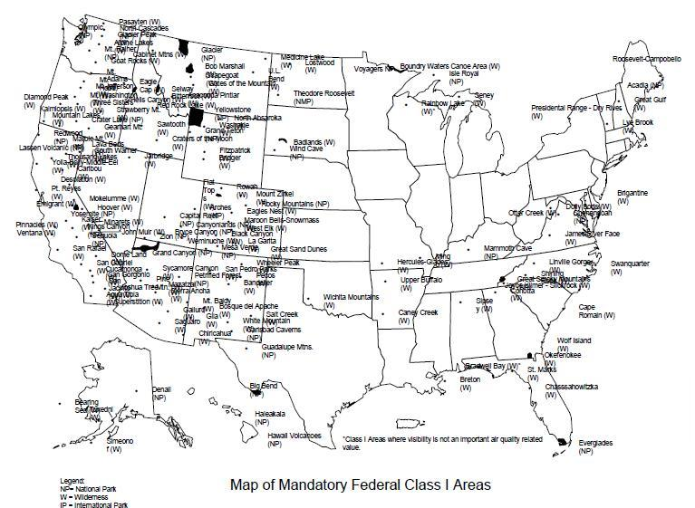
Federal Class I Areas

Slide 7
How Do We Conduct a Class I Air Quality Analysis
Guidance for Class I analyses
  Interagency Workgroup on Air Quality Modeling Phase 2 Recommendations (1998)
  Federal Land Managers’ Air Quality Related Values Workgroup Phase 1 Report (2000/2010)
  40 CFR Part 51, Appendix W (“Guideline on Air Quality Models”)
CALPUFF modeling system used as primary modeling platform for visibility and acid deposition analyses required under PSD
Diagnostic meteorological CALMET used to provide 3D meteorological fields to dispersion model
HNO3/NO3 repartitioning using POSTUTIL
Visibility post-processing using CALPOST

Slide 8
The World According to the Guideline on Air Quality Models
PSD Regulations require adherence to the Guideline on Air Quality Models (“GAQM”)
GAQM requires use of CALPUFF for air quality assessments for source-receptor distances > 50-km
GAQM - 5 years of meteorological data for near-field (e.g. < 50-km) or 3 years of prognostic data for Class I impact analysis (typically distances > 50-km)

Slide 9
Lessons Learned from the Regional Haze Process
Over the past several years, numerous technical issues have been raised concerning the capability of the CALPUFF/CALMET modeling system to properly estimate Prevention of Significant Deterioration (PSD) increments.
  Numerous issues with adequacy of CALMET meteorological fields have been documented by the EPA since 2007.
  Secondary particulate matter (PM; i.e., sulfate and nitrate) is the most important component of air quality related values (AQRVs), and CALPUFF uses a simplified chemical transformation algorithm that was developed over two decades ago.
  Concern exists about the over prediction of impacts, which has led to proposed changes in visibility post-processing to compensate.

Slide 10
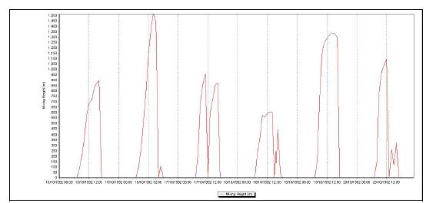
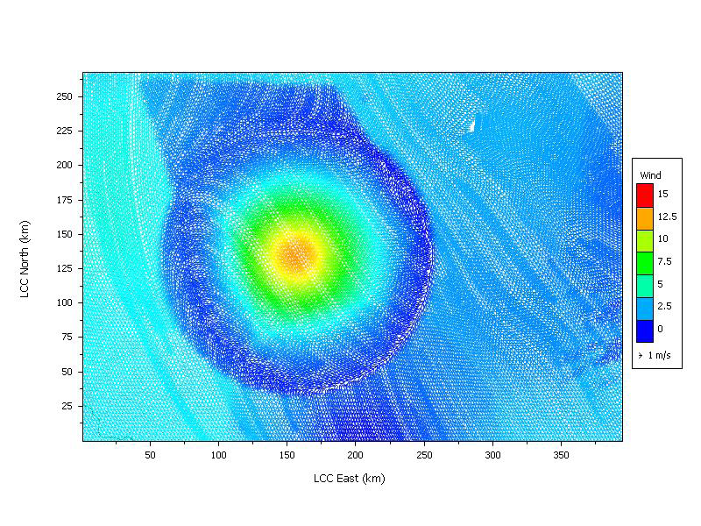
Issues with CALMET Meteorology
Collapsing CBL’s
Objective Analysis Errors

Slide 11
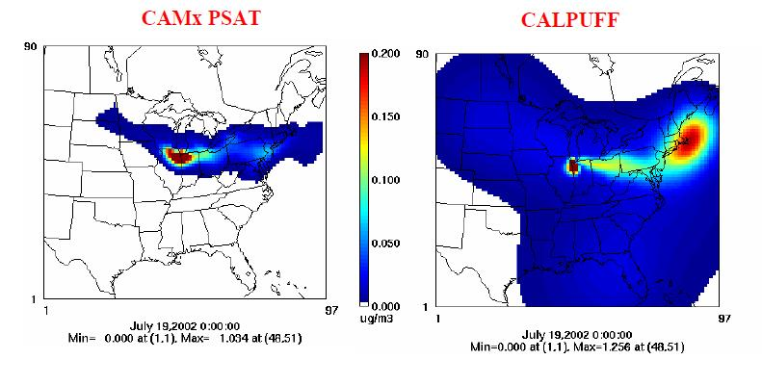
Issues with CALPUFF Chemistry

Slide 12
Need for a New Modeling Paradigm?
The current modeling paradigm for both Class I increment analyses and AQRV analyses remains largely consistent with the original IWAQM Phase 2 recommendations dating to the mid 1990’s. The Phase 2 recommendations are summarized as follows:
  Use of the CALPUFF modeling system
  Use of fully developed time and space varying characterization of the meteorology using CALMET
  Placement of receptors within Class I areas of concern
  Background concentrations of ozone and ammonia are allowed to vary in time and space
  The concentration and AQRV impacts are computed to more directly correspond to the standards, increments, and thresholds of concern.
IWAQM (1992) envisioned a third phase to add more advanced modeling techniques representing the likely emergence of photochemical grid models (PGM’s) for routine. However, additional resources were not forthcoming and the Phase 3 recommendations were ultimately never pursued.
IWAQM reactivated in 2009 to examine current modeling paradigm and determine if Phase 3 goals of use of PGM’s were achievable within the PSD regulatory framework.

Slide 13
Common Concerns Regarding Use of PGM’s for Single Source Analyses
PGM’s can only resolve the dynamics and chemistry of a point source plume to the grid resolution specified and use of a high resolution grid (e.g., 100 m to 1 km) to resolve a plume would require extensive model inputs and model run times.
To assess the impacts of a source two runs have to be performed, a base case with the source and a zeroout case where the emissions of the source are eliminated.
  As PGM runs are already more costly than a source-oriented plume model like CALPUFF, the need to do multiple zero-out runs to assess the individual impacts of multiple sources is quite costly.

Slide 14
Advances in Source Apportionment
PM Source Apportionment Technology (PSAT) that allows the separate tracking of individual source PM impacts so that the individual impacts from many different sources can be obtained cost-effectively in one run; ozone can also be tracked for single sources by dumping reactive tracers for ozone.
Threading of the PSAT PM source apportionment through the full-chemistry PiG module so that the early plume chemistry and plume dynamics can be tracked by the subgrid-scale PiG module until the plume size is commensurate with the grid resolution when the plume can be adequately simulated by the grid model.

Slide 15
EPA/FLM Long Range Transport Modeling Project
In FY 2008, the USEPA initiated a program to reevaluate CALPUFF due to the technical concerns that had come to light during the BART process.
In FY 2009, the USEPA/ENVIRON developed software platform to couple CALPUFF directly to MM5/WRF, eliminating need for CALMET.
In FY 2010, the USEPA initiated a second program with the UNC/ENVIRON team to demonstrate the use of a PGM with source apportionment techniques for estimating the ozone and AQRV impacts due to a single source or group of sources and compare the results with CALPUFF for existing and hypothetical test sources using procedures like those that would be used in a far-field analysis for PSD.

Slide 16
Example Visibility Analysis
CALPUFF Version 5.754
  MESOPUFF II Chemistry
CALMET Version 5.53a
  CALMET configured to best preserve original prognostic met
    Initialized with CENRAP 2002 36-km MM5
    Prognostic upper air (NOOBS=1)
    Prognostic precipitation (NPSTA=-1)
CAMx Version 4.41
  CENRAP Base02f Inventory
  CENRAP 36-km MM5 Meteorology
  Probing Tool: Particulate Source Apportionment (PSAT)
  Plume-in-Grid: GREASD PiG
  Flexinest: Optional 12 km imposed on modeling grid to limit initial dispersion of PiG puffs

Slide 17
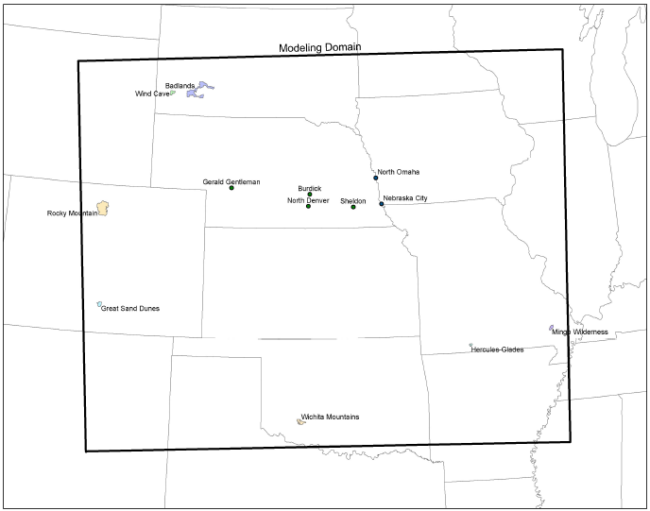
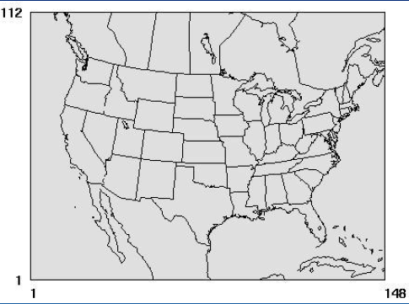
Modeling Domains
CALPUFF Domain:
243 x 195 x 10 (6-km)
CAMx Domain:
148 x 112 x 19 (36-km)

Slide 18
CALPUFF Visibility Impacts

Slide 19
CAMx Visibility Impacts

Slide 20
CALPUFF v. CAMx

Slide 21
Computational Comparison (2007)
Annual CALPUFF run with no spinup
Each annual run on single compute node
  2 x 2.8 GHz XEON CPUs, 2 GB RAM
Single source, entire annual simulation can be completed in less than 6-8 hours
Annual CAMx run with 15 days of spinup per calendar quarter.
Each calendar quarter run on a separate compute node (105 days).
  2 x 2.8 GHz XEON CPUs, 2 GB RAM
With 7 source regions (single sources) and 2 source groups (point and area), average of 3 hours per simulation day or 8 simulation days per CPU day.
105/8 = 13.125 days for calendar quarter to complete.
Run sequentially, it would require 47.5 days to complete.

Slide 22
Barriers to Implementation - Computational
The modeling platforms for the permit modeling community are largely Microsoft Windows based and are engineered for serial applications of models.
The meteorological and photochemical modeling community is largely Unix/Linux based.
Time necessary for annual PGM simulations compared to simplified CALPUFF chemistry.

Slide 23
Computational Considerations
Adaptation of the PGM platforms to operate in a Windows based environment?
  The permit modeling community typically does not have the same level of fluency in either the Unix/Linux operating system or Fortran based programming skills that are essential skill requisites
  IT authorities within State and Local permitting agencies often lack the familiarity and/or resources to dedicate to systems administration and security for Unix/Linux based systems, and thus actively prevent the acquisition of such equipment or, if such hardware is acquired, prevent the presence of such equipment on the State’s internal network.

Slide 24
Barriers to Implementation - Regulatory
The operational construct for the permit modeling community is highly rigid
  Based upon a series of regulations and guidelines which restrict operational flexibility in order to promote more general consistency in the application of models.
The operational construct of the meteorological and photochemical modeling communities is vastly different,
  Based upon a more loosely binding set of EPA recommendations which typically encourage adapting both science and modeling techniques to produce the most scientifically feasible answer given the constraints of the state-of-the-science.

Slide 25
Regulatory Considerations
The differences in the operational paradigms between the two communities will require both the EPA and the FLM’s to develop a more rigid set of operational procedures similar to the current permit modeling paradigm in order to insure both a scientifically sound and consistent set of procedures to prevent an ‘anything goes’ process as would likely develop without such procedures.
Length of meteorological record for PGM’s will likely have to be expanded to be consistent with requirements of GAQM (e.g. 3 years of prognostic data).
Development of significance thresholds for single source (cause or contribute test) required for NAAQS demonstrations.

Slide 26
Conclusion
PGM’s capable of assessing single source impacts for both AQRV and ozone requirements under PSD.
Source apportionment eliminates need for multiple “zero-out” runs
Significant barriers remain to implementation of PGM’s
  Increased computational requirements
  Increased training requirements for permit modeling staff
  Creation of a hybrid regulatory and guidance framework for implementation of PGM’s within a regulatory permit modeling paradigm which is highly rigid and prescriptive

