Slide 1
Evaluation of Mercury Outflow from East Asia using CMAQ-Hg
C. Jerry Lin*^{1,} Li Pan¹, David G. Streets², Suraj Shetty¹, Carey Jang³, Joshua Fu⁴, Thomas C. Ho¹, Hsing-wei Chu¹
¹ College of Engineering, Lamar University, Beaumont, TX
² ANL Decision & Information Sciences Division, Argonne, IL
³ USEPA OAQPS, Research Triangle Park, NC
⁴ Dept. Civil & Environmental Engineering, Univ. of Tennessee, Knoxville, TN
The 2008 CMAS Conference
Research Triangle Park, North Carolina
October 8, 2008

Slide 2
Mercury as a Global Pollutant
A potent neural toxin (LD₅₀ = 10-60 mg/kg, RfD = 0.0001 mg/kg/day for methyl mercury)
An EPA priority air pollutant
Persistent in the environment – causes long range transport
Established contamination episodes globally
Ubiquitous – even at remote regions
Bioaccumulative – enters the food chain

Slide 3

Exposure to MeHg
Notes:
10-1400 ppb

Slide 4
Atmospheric Mercury
All three species are “operationally” defined!!!

Slide 5
Mercury in East Asia…
More than half of global anthropogenic Hg emission is from East Asia, China emission being the most important contributor (Streets et al. 2005; Pacyna et al., 2006)
Although field data are scarce, increasing efforts in measuring air concentration, surface flux and emission have been planned or on-going.
Aircraft campaign and modeling to estimate Hg outflow from the region has been attempted (e.g., Friedli et al., 2004; Pan et al., 2006; 2007)
Long-range and trans-boundary transport of mercury emitted in China has been reported (e.g., Jaffe et al., 2005; 2008)

Slide 6
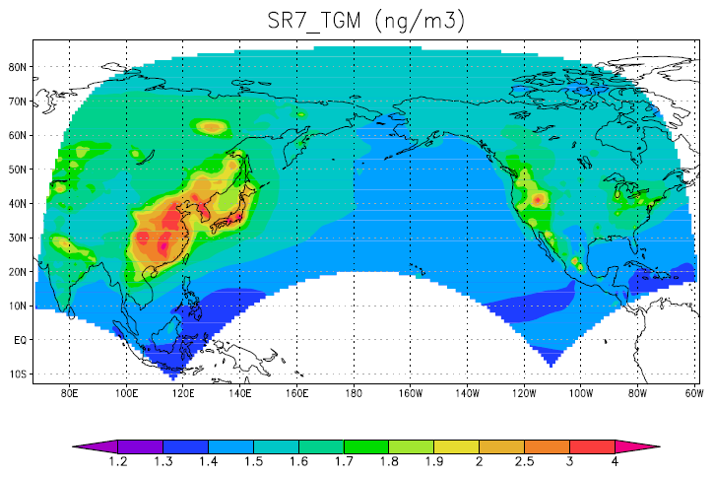
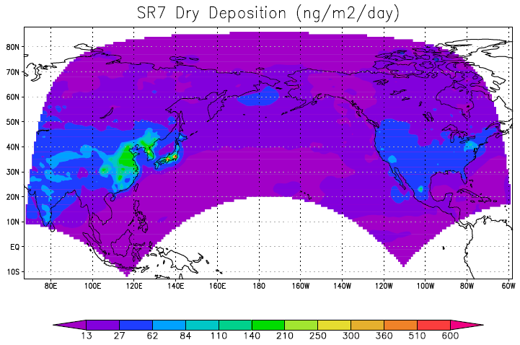
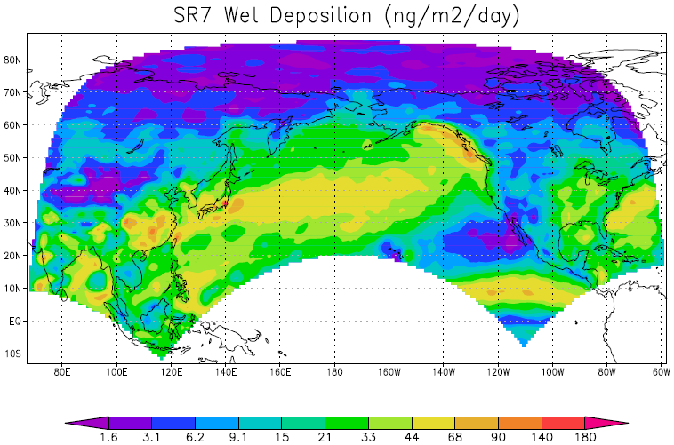
ICAP Trans-Pacific Transport of Hg
TGM
Conc.
Dry
Deposition
ng/m³
ng/m²/day
Comparison
with MDN wet
deposition
Wet
Deposition
ng/m²/day

Slide 7
Import Sensitivity* (ΔHg_{EA} / ΔHg_{NA} ) by 20% Hg emission reduction
TGM Conc.
Dry Dep.
Impact of Asian mercury emission in North America is important because:
the greater Hg emission in EA compared to that of NA
Hg deposition mainly driven by oxidation of background GEM except near the emission sources
Wet Dep

Slide 8
Objectives
To understand the distribution & seasonal variation of mercury concentration and deposition in East Asia
To assess the outflow of mercury from East Asia

Slide 9
Mercury Chemistry Scheme
Gaseous phase
(O3, OH, H2O2,
Halogens)
Hg(0)
GEM
oxidation
Hg(II)
[RGM]
PHg
oxidation
Aqueous phase
(O3, OH, chlorine,
SO3²⁻, HO2)
Hg(0)
Hg(II)
PHg
reduction
Adsorption to solids
in atmospheric water
Hg(p)

Slide 10
Mercury Deposition
Dry Deposition
  Vd estimated by resistance model
  Dominated by RGM and PHg deposition
  Deposition velocity of RGM is about 1 order of magnitude greater than GEM
Wet Deposition
  Affected by Hg gas scavenging and aqueous reactions
  Contributed by aqueous dissolved and sorbed Hg
Notes:
Switch: deposition in the US next slide

Slide 11
Emission Sources
Anthropogenic sources
  Fuel combustion
  Waste incineration
  Industrial metal processing (including Hg mining)
Natural sources
  Volcano emission, weathering, etc
  Emission from vegetation, soils and water bodies
  Fire emission
Re-emission
  Caused by past mercury emission and deposition
  Biotic and abiotic processes cause reduction of deposited Hg(II) back to volatile Hgº

Slide 12
Emission Sources
Anthropogenic sources
  Fuel combustion
  Waste incineration
  Industrial metal processing (including Hg mining)
Natural sources
  Volcano eruption, weathering, etc
  Emission from vegetation, soils and water bodies
  Fire emission
Re-emission
  Caused by past mercury emission and deposition
  Biotic and abiotic processes cause reduction of deposited Hg(II) back to volatile Hgº
  Indistinguishable from surface exchange

Slide 13
Emission Inventory (2001)
In China
(Streets et al., 2005)

Slide 14
Emission Distribution in Domain
Natural/re- emission
834 Mg/yr (China 462 Mg/yr)
Anthropogenic emission
826 Mg/yr (China 575 Mg/yr)
For Year 2001. Shetty et al. (2008)

Slide 15
Regional Hg Emission after Incorporating the Natural/re-emission

Slide 16
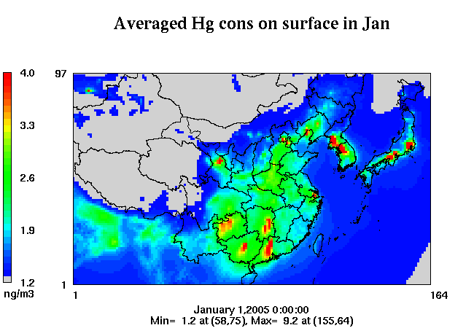
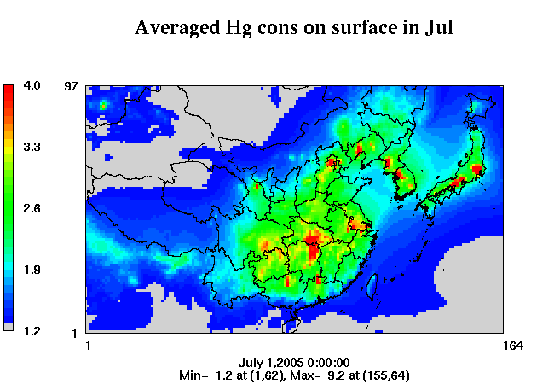
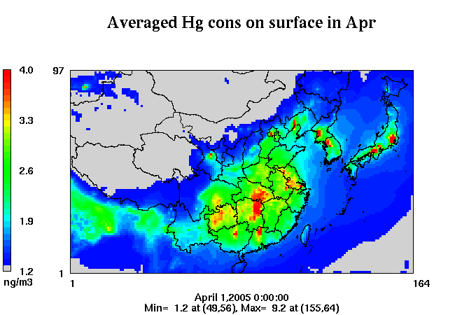
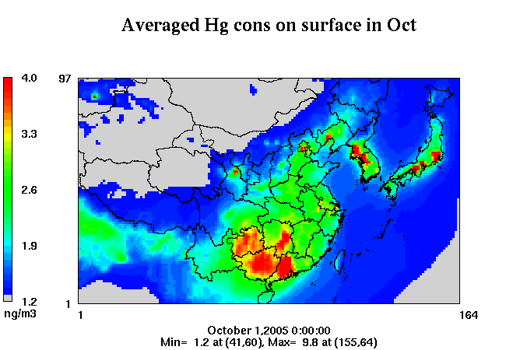
Hg Concentration
JAN
JUL
APR
OCT

Slide 17
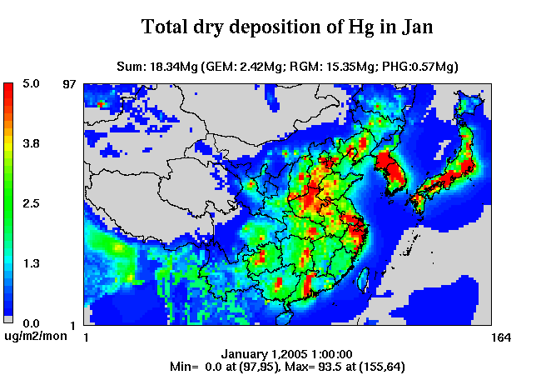
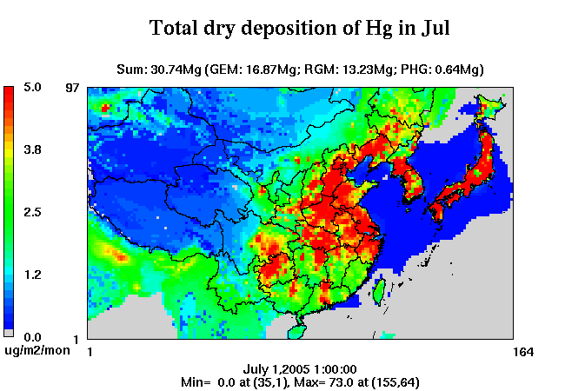
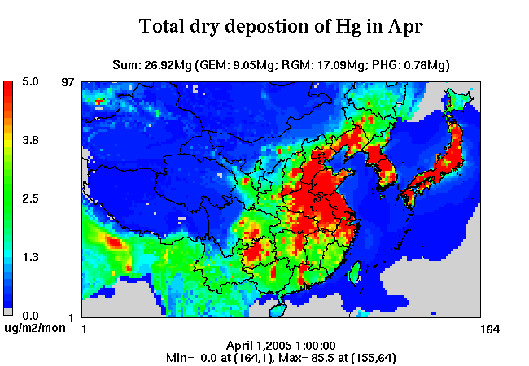
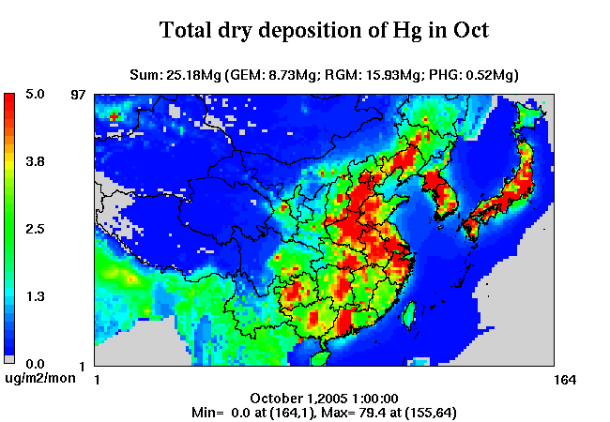
Hg Dry Deposition
JAN
JUL
APR
OCT

Slide 18

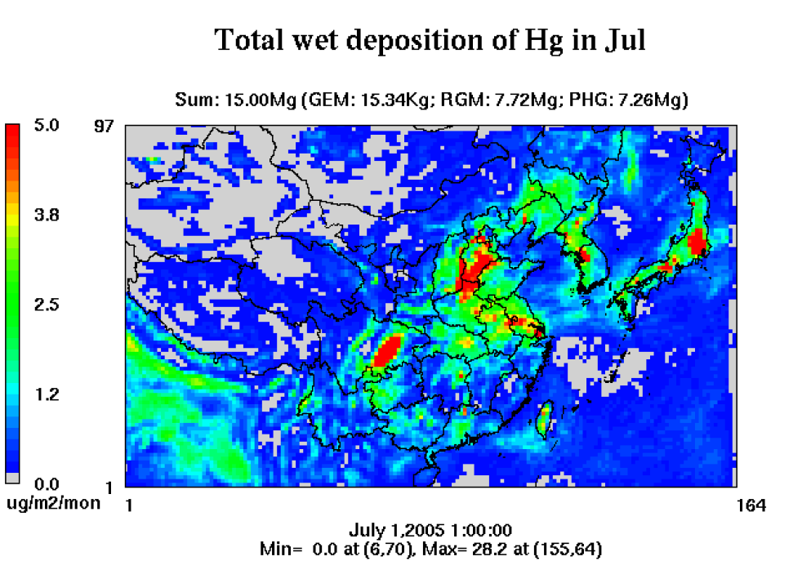
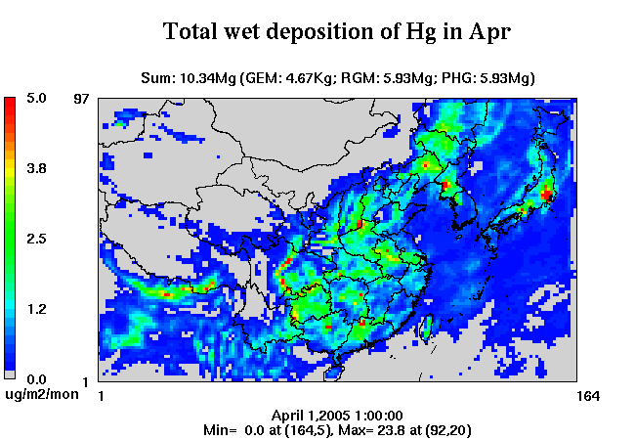
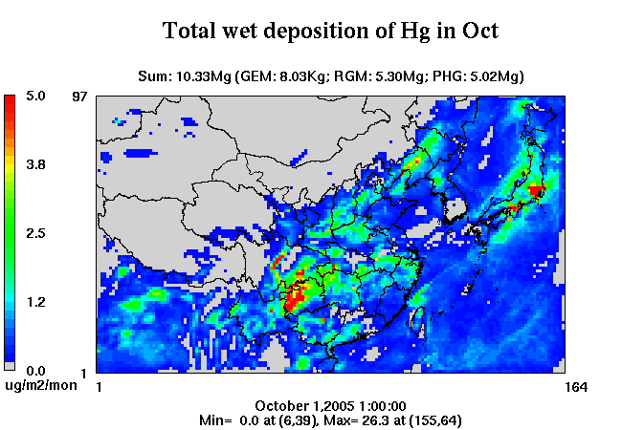
Hg Wet Deposition
JAN
JUL
APR
OCT

Slide 19
Mercury Budget in Domain
Domain Boundary
Atmospheric Mercury
Processes (GEM, RGM, PHg)
Inflow
Outflow
Emission
Deposition
Acc. = F.C. – I.C. = In – Out + Emission – Deposition
Mass Flow (Transport Budget) = In – Out
= F.C. – I.C. – Emission + Deposition

Slide 20
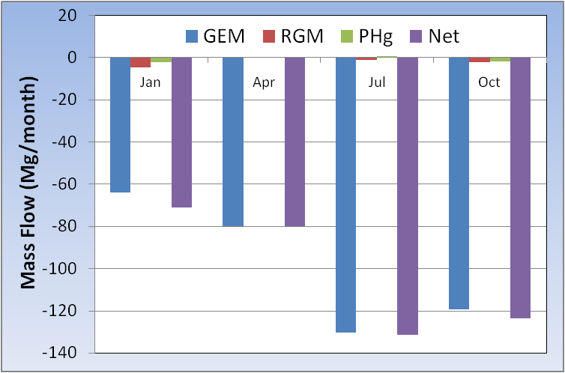
CMAQ-Hg July Simulation
Species | GEM | RGM | PHg
Initial Condition | 389.3 | 3.6 | 1.6
Final Condition | 423.2 | 4.0 | 1.6
Emission | 181.2 | 22.8 | 7.5
Wet Deposition | 0.015 | 7.7 | 7.3
Dry Deposition | 16.9 | 13.2 | 0.6
Mass Flow | -130.4 | -1.4 | 0.4
 | (outflow) | (outflow) | (removed)
Net Mass Budget | 131.4 Outflow
Outflow mainly in the
form of GEM, RGM &
PHg readily removed
in domain
Seasonal variation
in the outflow, largest
outflow in July due to
natural emission

Slide 21
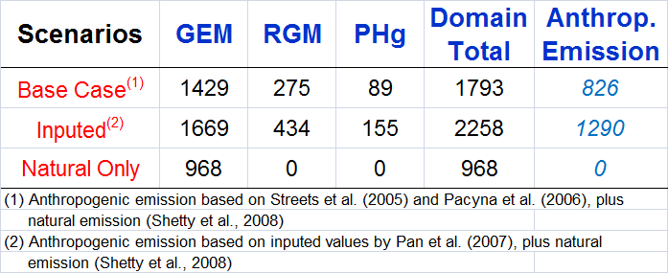
Emission Scenarios (Mg/yr)
Adjusted⁽²⁾

Slide 22
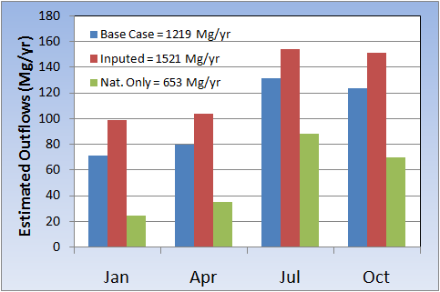
How much net mercury outflow is from East Asia?
Adjusted = 1521 Mg/yr

Slide 23
Conclusions
Incorporation of Hg(0) emission from natural processes helps close the Hg emission gap reported for the region.
Simulated surface air concentration of mercury ranges between 1 to 7 ng m⁻³. High concentrations occur at large anthropogenic sources and emission from natural processes can contribute significantly.
CMAQ-Hg estimates 430 Mg yr⁻¹ total Hg deposition in the domain, dominated by RGM dry deposition and PHg wet deposition.
Annual outflow estimated to be 1200-1500 Mg yr⁻¹ based on CMAQ-Hg model results with some seasonal variation, primarily as GEM.
About 2/3 of the emitted mercury in East Asia leave the domain and is subject to long-range transport.

Slide 24
Acknowledgements
USEPA Office of Air Quality Planning and Standards (ICAP Program)
Texas Commission on Environmental Quality

