Slide 1
Model-Measurement Comparison of Ozone and Precursors Along Land-Water Interfaces during the 2017 LMOS Field Campaign
Liljegren, J; Baker, K.; Valin, L; Szykman, J; Henderson, B.; Judd, L.; Al-Saadi, J; Janz, S.; Sareen, N.; Possiel, N

Slide 2
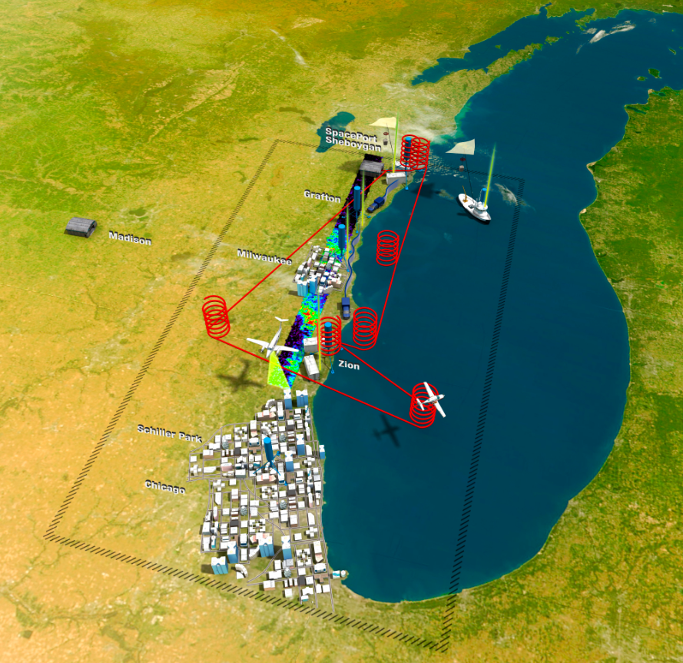
Motivation for the Lake Michigan Ozone Study
Elevated ozone episodes along the shores of Lake Michigan
Several monitors exceed the National Ambient Air Quality Standards (NAAQS)
“lake breeze” airflow can influence ozone production and transport
More info including a white paper can be found at:
https://www-air.larc.nasa.gov/missions/lmos/
https://www.nasa.gov/sites/default/files/thumbnails/image/lmos_2.jpg
Notes:
Study involved aircraft, ground based and ship based measurements of ozone and its precursor compounds

Slide 3
History
No routine measurements over the lake; persistent nonattainment status for ozone
1989 the four Lake Michigan states (IL, IN, WI, MI) formed the Lake Michigan Air Director’s Consortium (LADCO) to coordinate a 3-year Lake Michigan Ozone Study (LMOS 1991)
  later the 1994-2003 LADCO Aircraft Project (LAP)
  Cleary et al. 2015 ferry-based ozone measurements and analysis
Figures from White Paper: Lake Michigan Ozone Study 2017 (LMOS 2017) Peirce et al. 2016
Notes:
Cleary results using measurements from 2008-2010 showed that NAM CMAQ at the time consistently overpredicts [O3] over lake as compared to measurements on the ferry but ferry measurements were on average about 4 ppb higher than O3 measurements along the shoreline
Cleary First study of CMAQ model bias over the water of Lake Michigan (11-16 ppb) greater bias than over the surrounding land (6-9 ppb)
Version of CMAQ??? Paper says National Air Quality Forecast Model (NAQFM) was developed with the collaboration of the National Oceanic and Atmospheric Administration (NOAA) and the Environmental Protection Agency (EPA) (Eder, 2009). The NAQFM is made up of two components: the National Center for Environmental Prediction’s (NCEP) North American Mesoscale (NAM) meteorological model and the EPA’s Community Multiscale Air Quality (CMAQ) modeling system

Slide 4
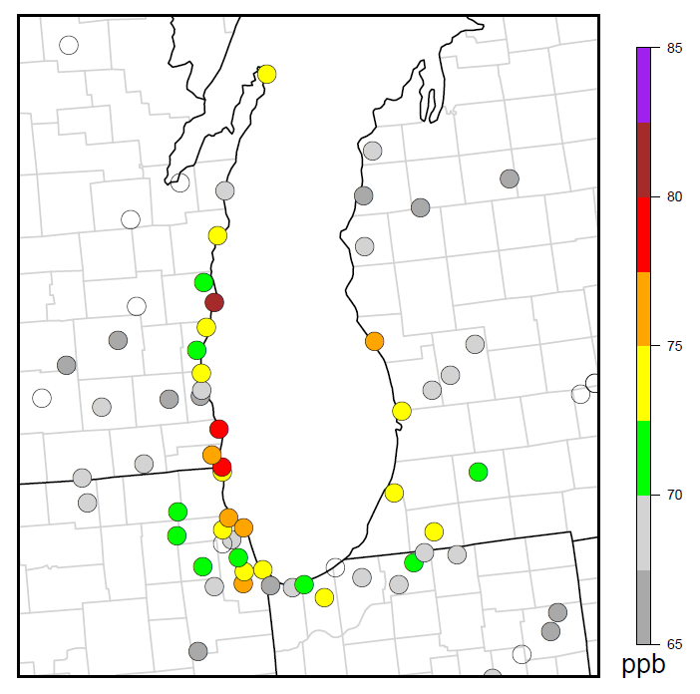
LMOS 2017
May 22‐June 22, 2017
Ozone Area Design Values (2016-2018)
3 high ozone episodes during LMOS
June 2
June 10-12
June 14-16
Sheboygan
1 high ozone episode prior to the start of the LMOS study
Chicago area
May 16-17
Notes:
High ozone episodes with hourly ozone values >70 ppb
Figure is a map of the routine ozone monitoring locations, the Sheboygan shoreline monitor and the Kenosha Wisconsin monitor north of Chicago are typically the nonattainment monitors for the study area

Slide 5
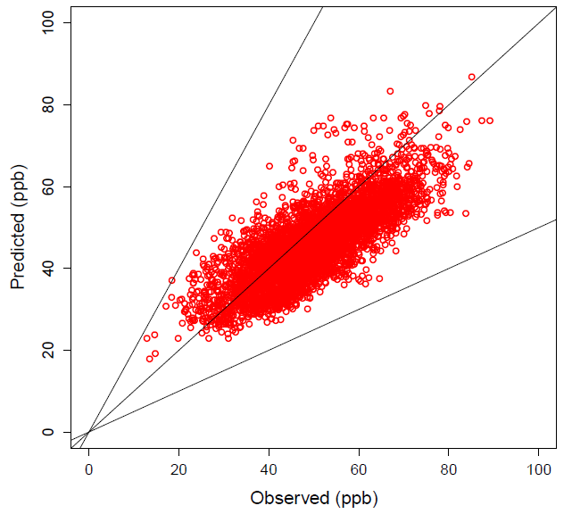
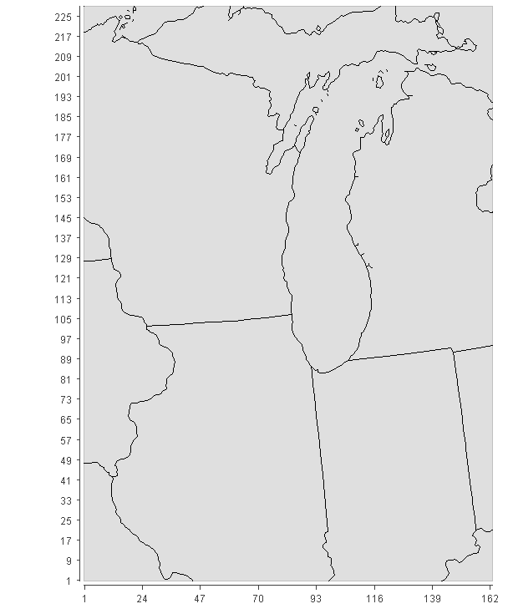
Model: CMAQv5.3 as released via GitHub
Emissions: EPA’s 2016 beta platform w/ 2017-specific
Mechanism: cb6r3_ae7_aq
Meteorology: WRF v3.8
Domain: Lake Michigan 4km 35 layers
Maximum daily 8-hour averaged ozone (MDA8)
May 12 – June 23, 2017
Notes:
We also ran 4km CMAQv5.3

Slide 6
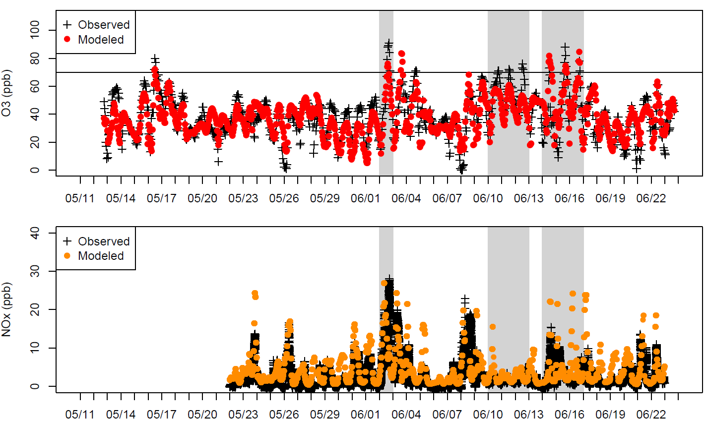
Ozone Zion IL
NOx Zion IL

Slide 7
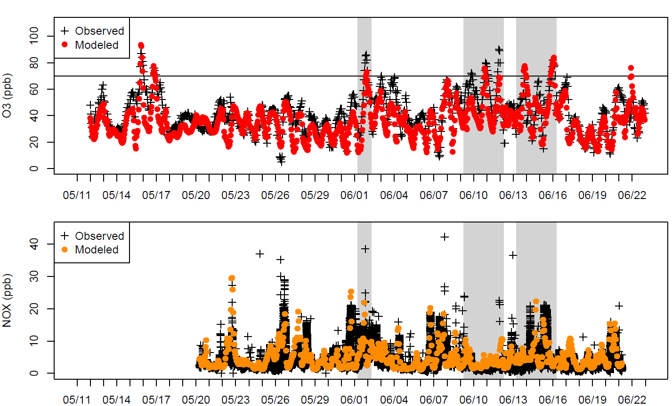
Ozone Sheboygan WI
NOx Sheboygan WI

Slide 8
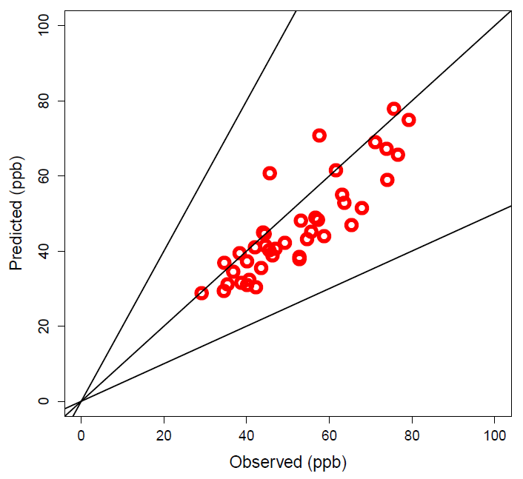
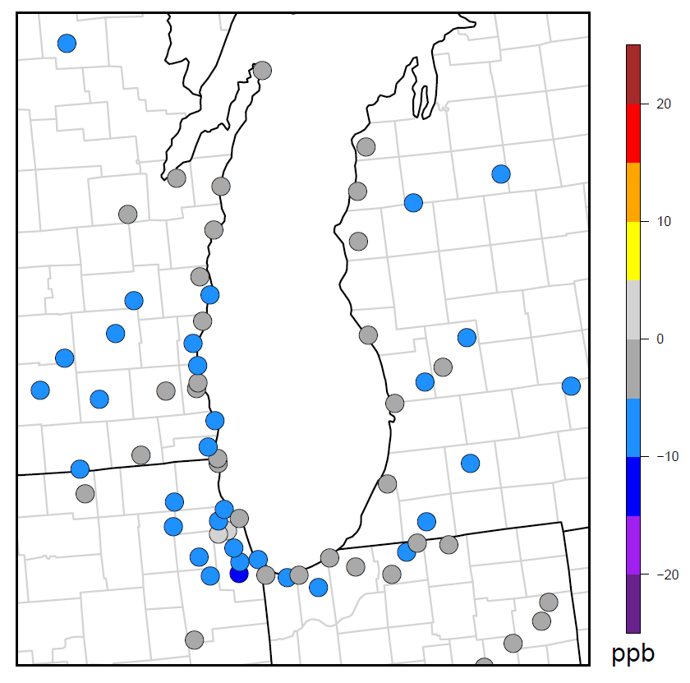
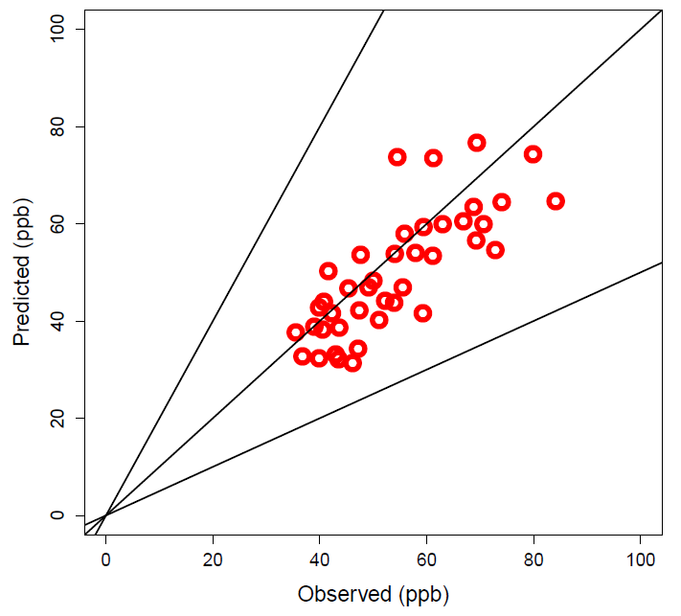
Ozone Performance
May 12- June 23
Mean Bias of Average MDA8
Sheboygan
May 12- June 23
Sheboygan
Chicago area
May 12- June 23
Chicago area

Slide 9
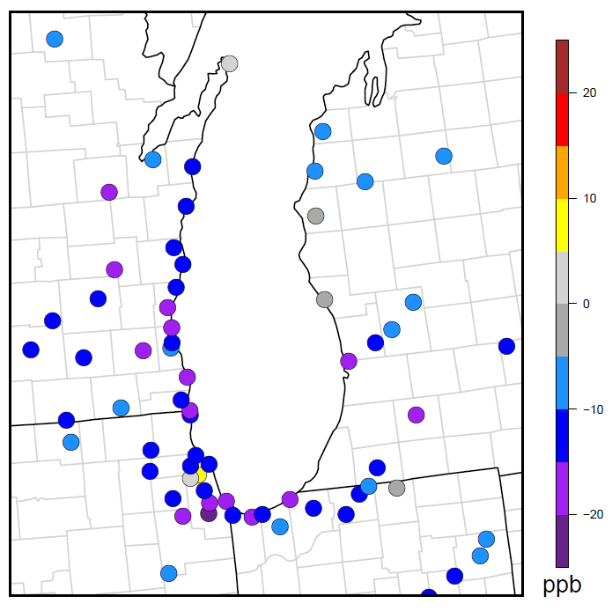
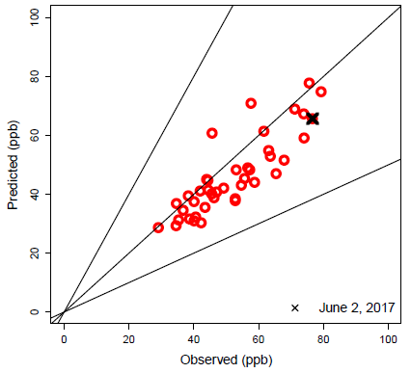
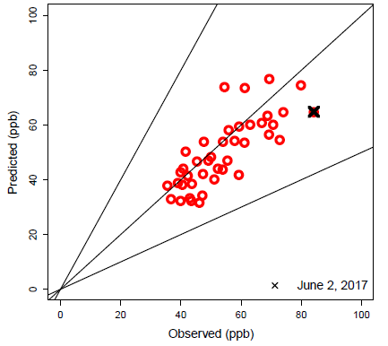
Ozone Performance—June 2
MDA8 Mean Bias June 2, 2017
Sheboygan
May 12- June 23
Sheboygan
Chicago
area
Chicago area
May 12- June 23
Monitor Location | Observed (ppb) | Modeled (ppb) | Obs/Mod Time
Sheboygan | 76 | 65 | 11am/1pm
Chicago Area (Kenosha WI) | 84 | 64 | 2pm/1pm

Slide 10
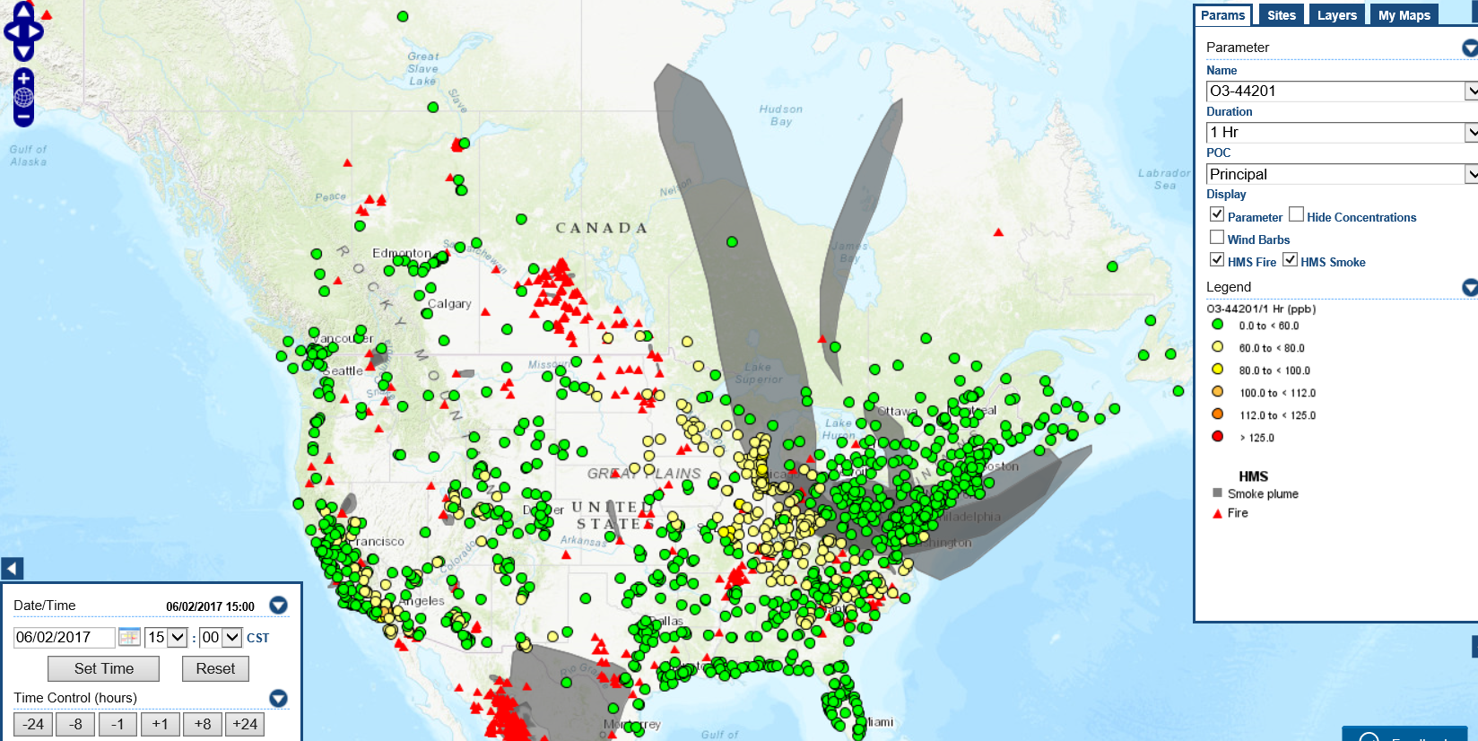
June 2, 2017, ozone, fires, and smoke
https://www.airnowtech.org/navigator/

Slide 11
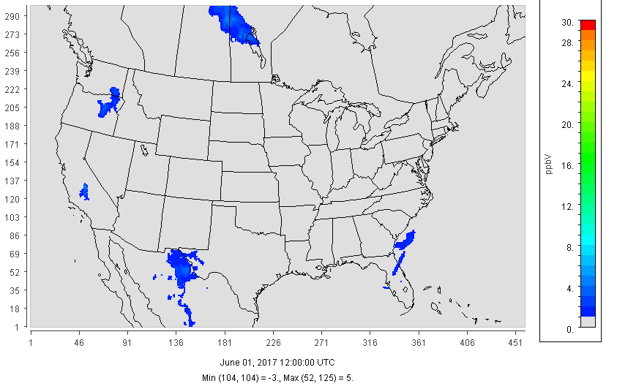
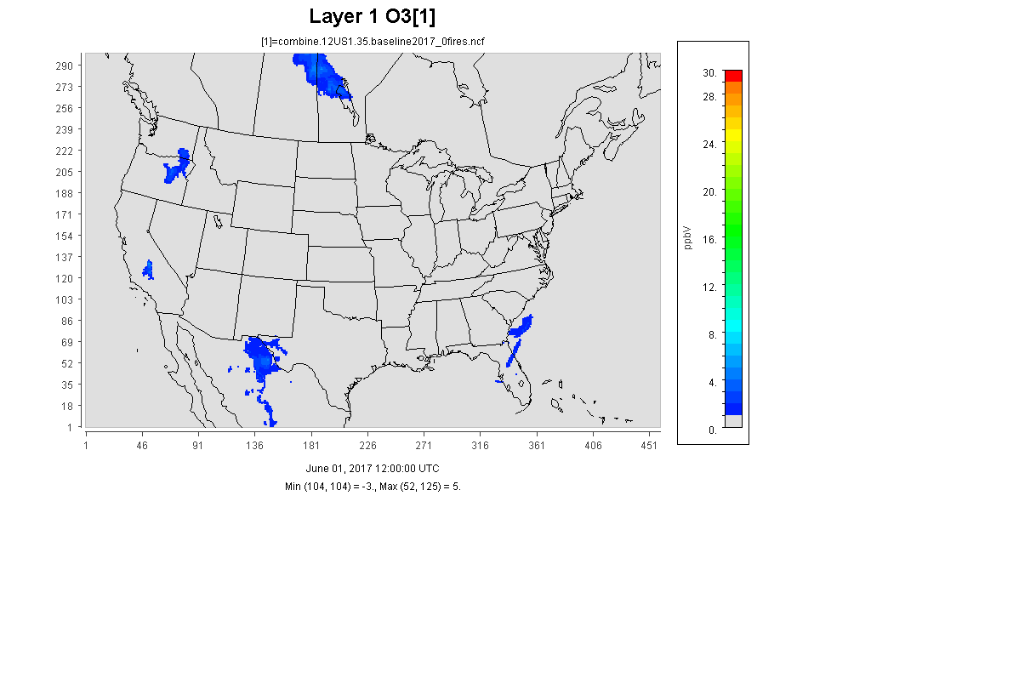
Zero-out (fires only contribution) on June 2, 2017
12km CMAQv5.2.1 CONUS

Slide 12
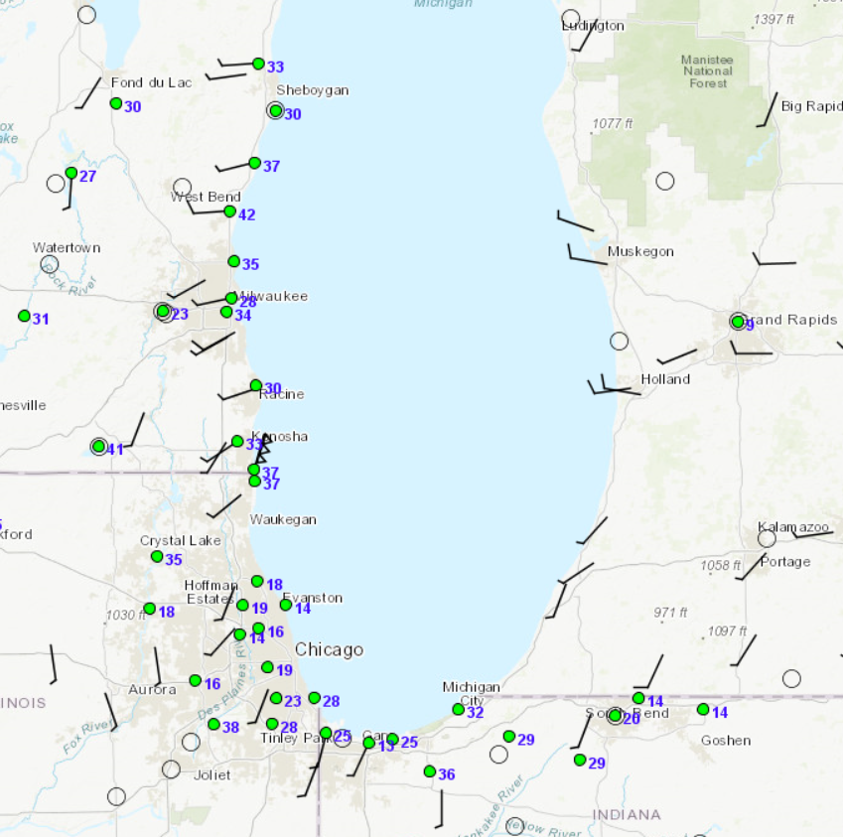
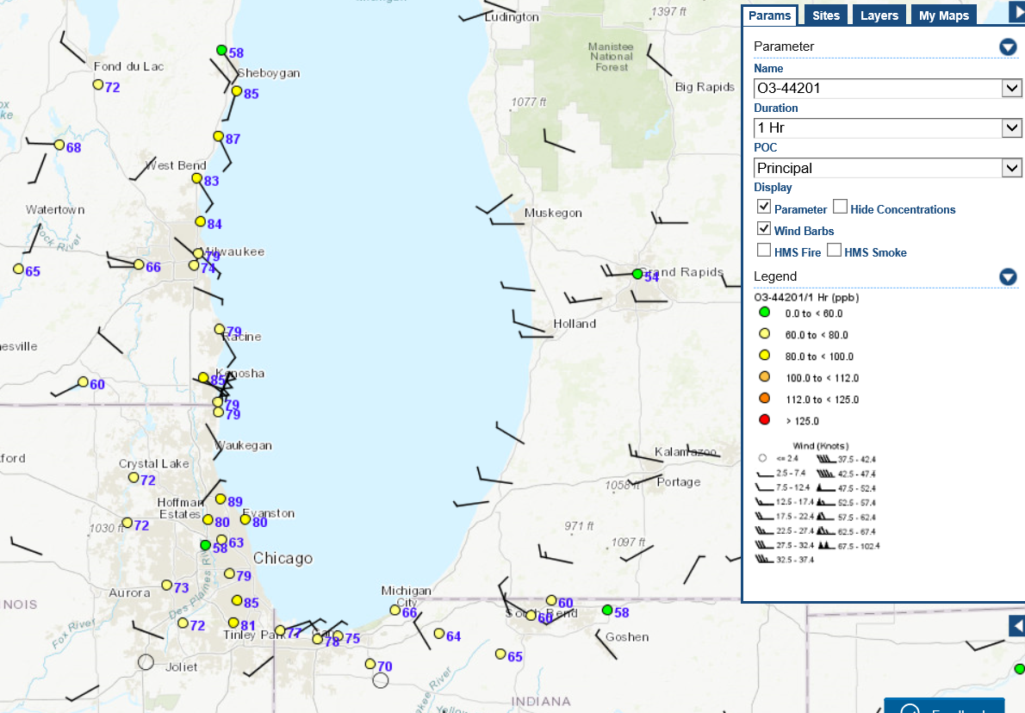
Focus on June 2, 2017 episode
6:00 CST
14:00 CST
shift in wind direction indicative of lake breeze
https://www.airnowtech.org/navigator/
Notes:
Hourly ozone and wind barbs 6 AM and 2 PM on June 2

Slide 13
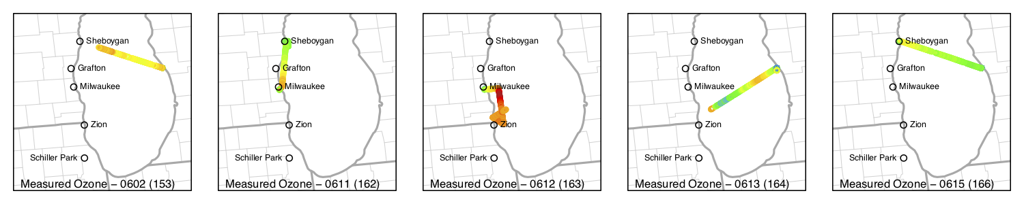
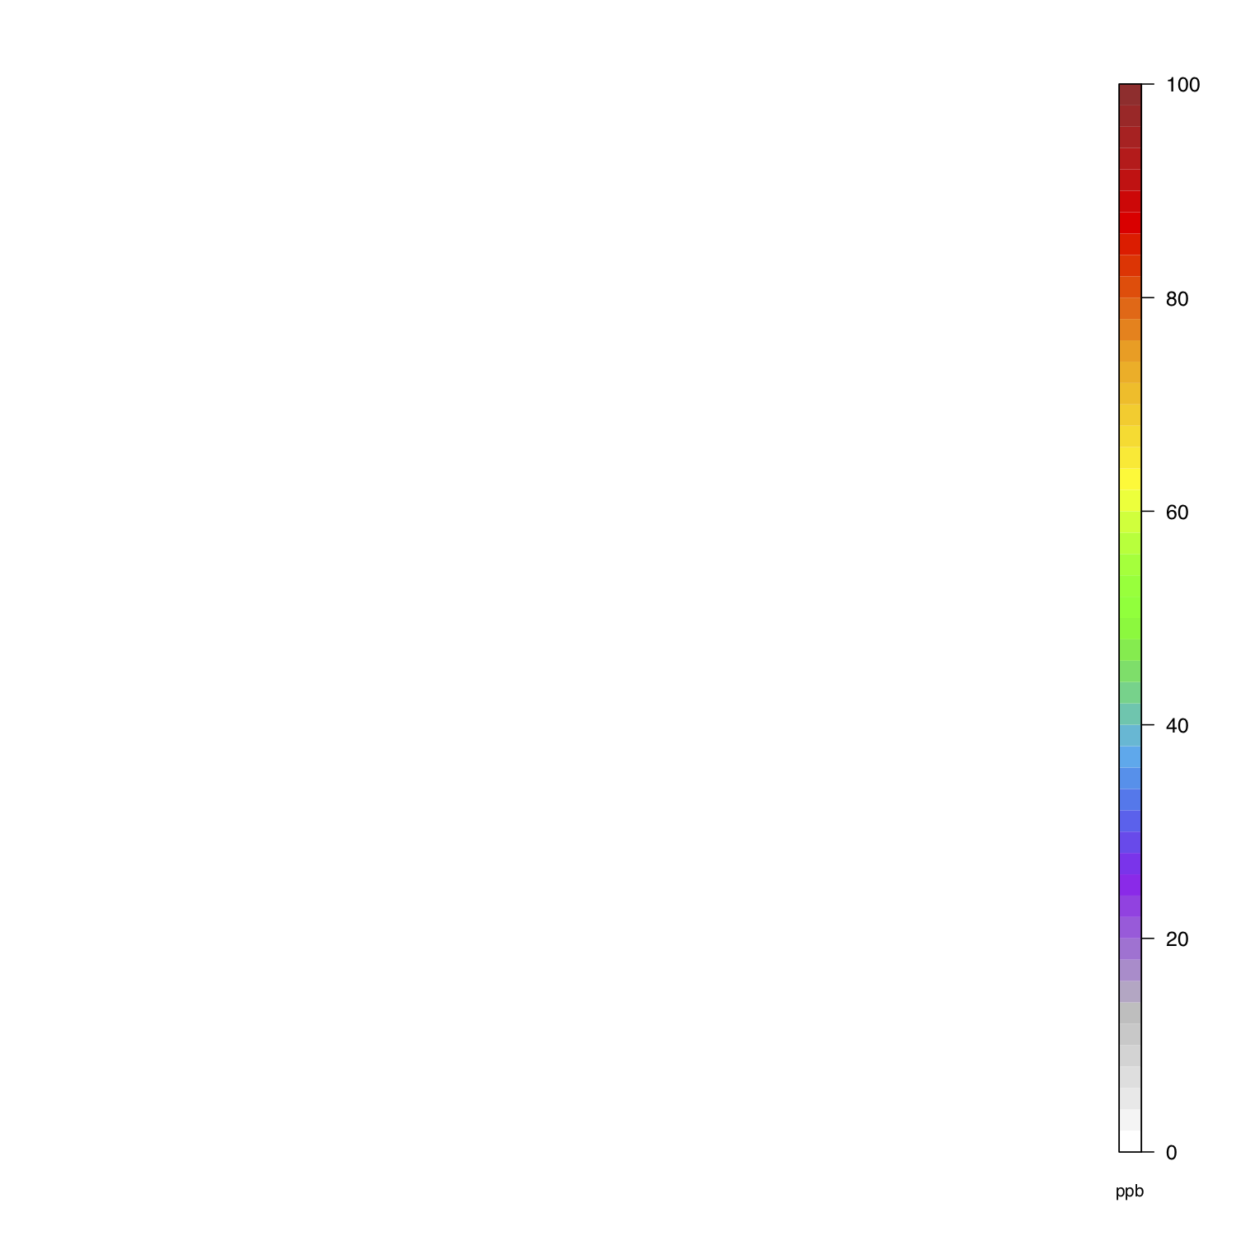
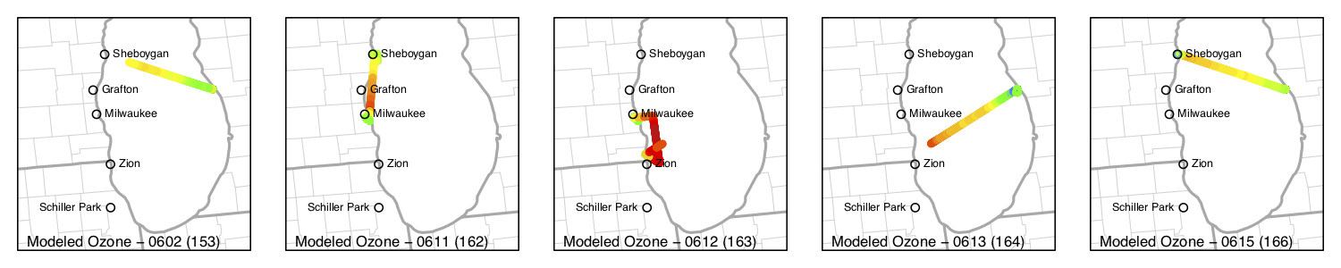
Observed (top) and Predicted (bottom) Ozone over Lake Michigan
June 2
June 11
June 12
June 13
June 15
EPA ORD/NOAA Research Vessel LMOS Data Repository

Slide 14
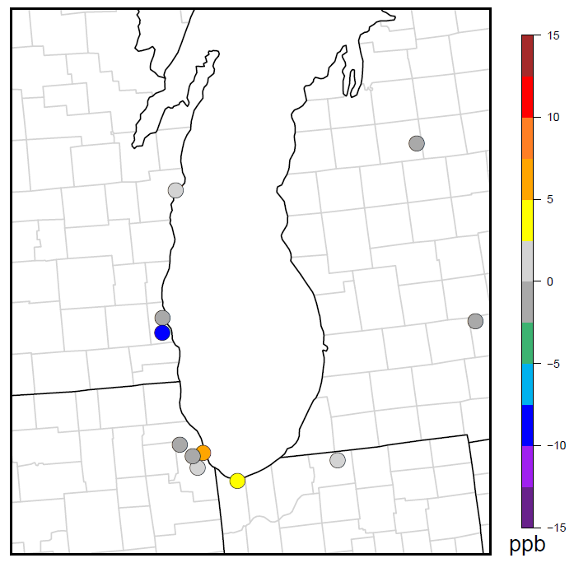
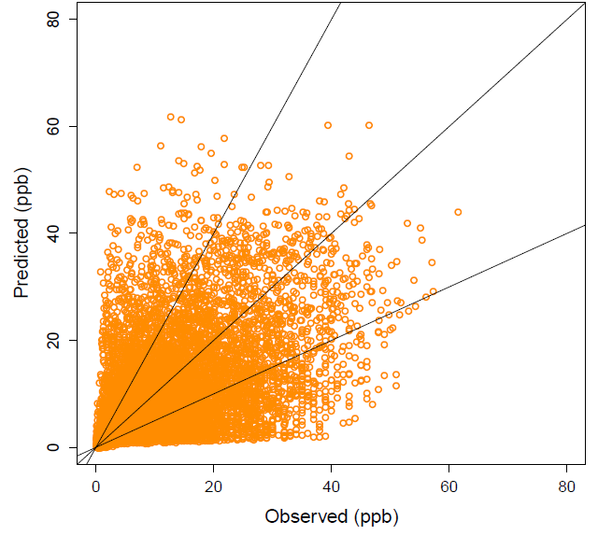
NO₂ Performance
May 12 – June 23, 2017
Mean Bias of Average Hourly NO₂
May 12 – June 23, 2017
Hourly Nitrogen Dioxide (NO₂)

Slide 15
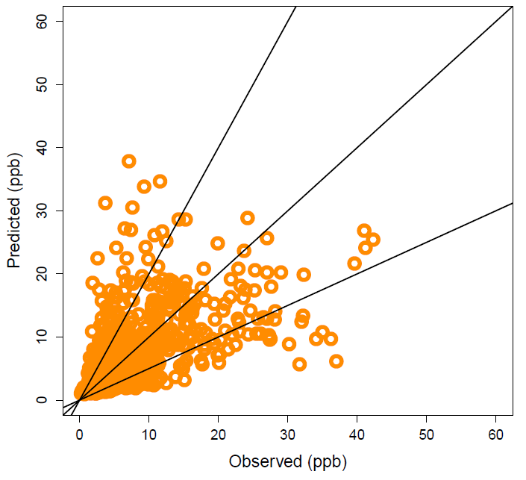
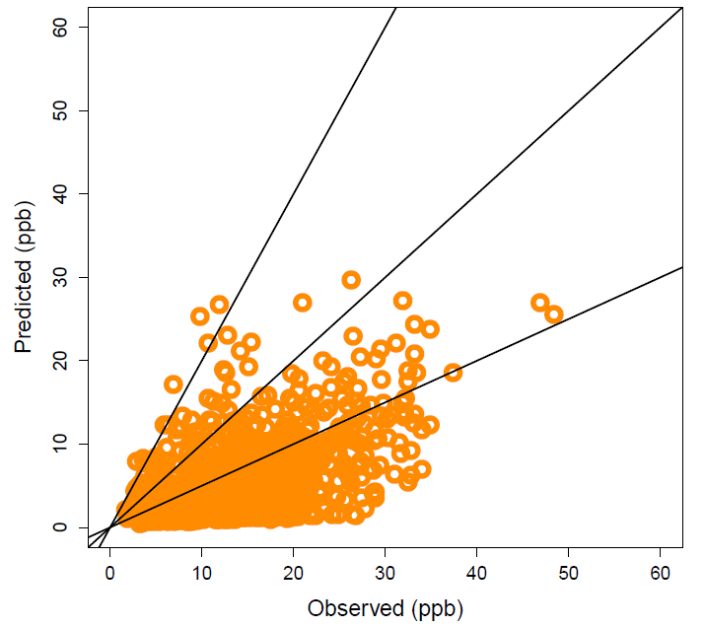
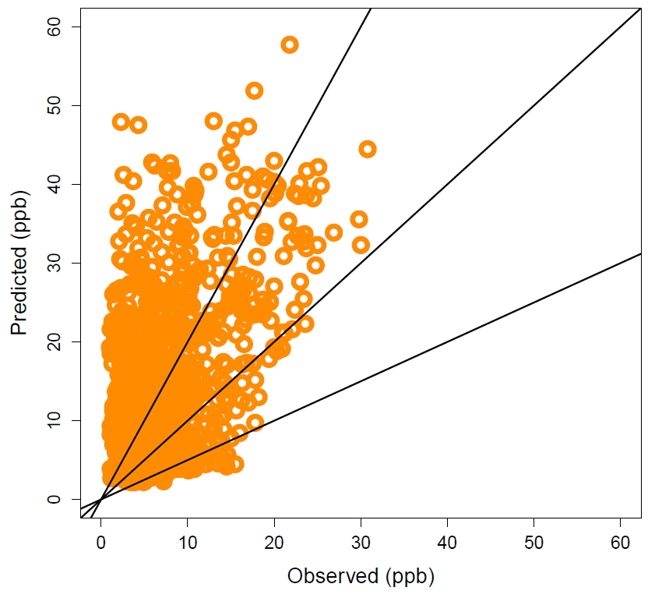
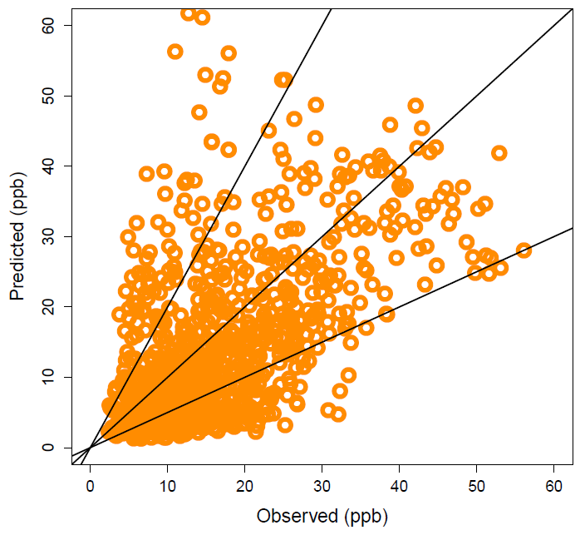
NO₂ Performance
Mean Bias of Average Hourly NO₂
May 12 – June 23, 2017
Milwaukee1
Milwaukee2
Milwaukee1
Milwaukee2
Chicago2
Chicago1
Chicago1
Chicago2

Slide 16
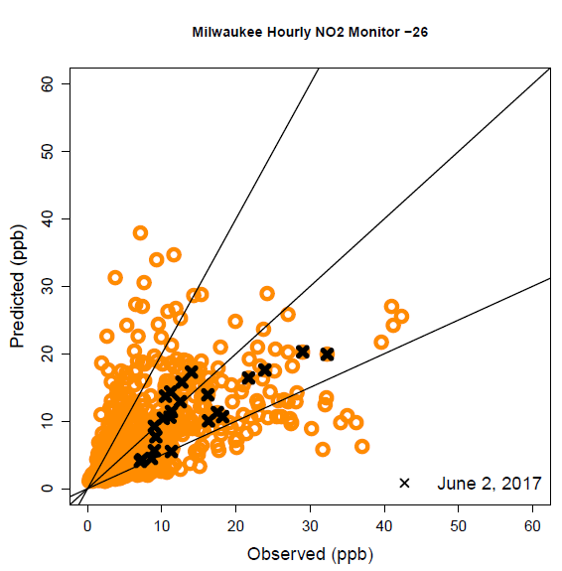
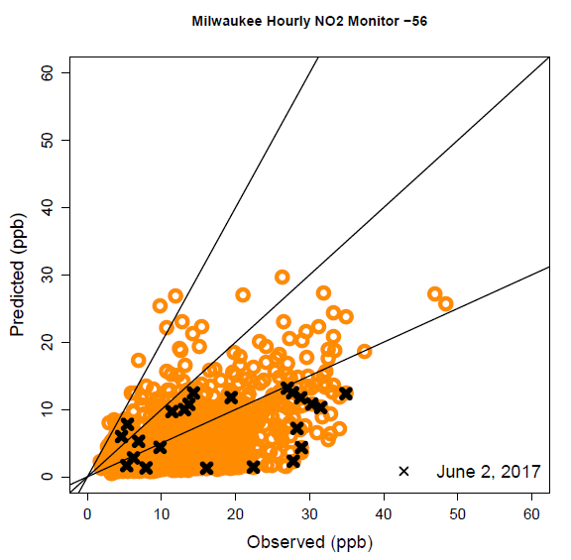
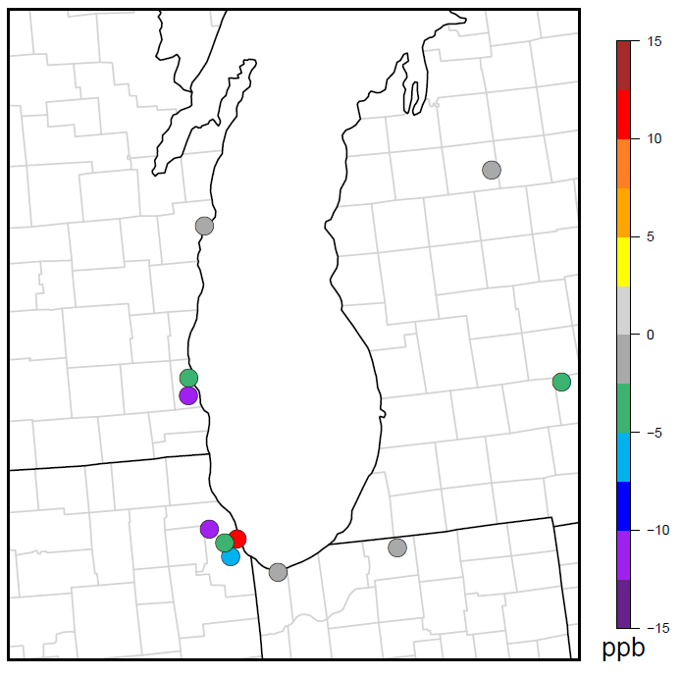
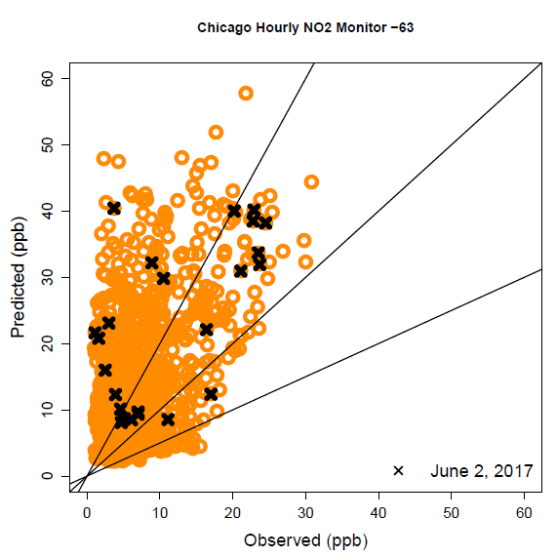
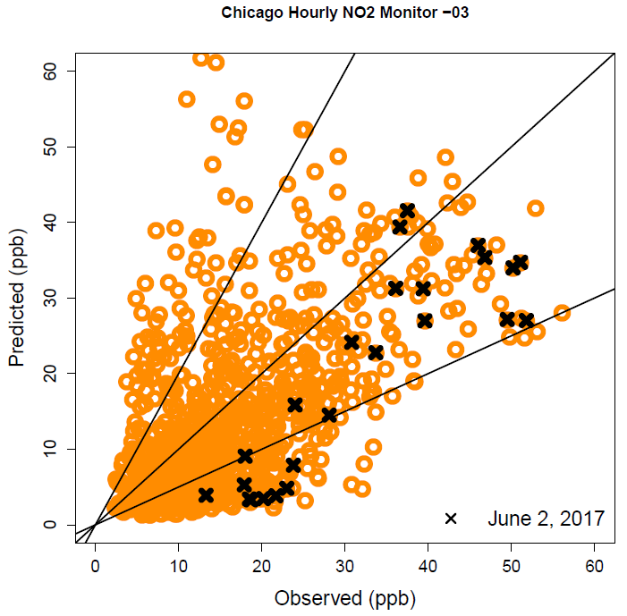
May 12 – June 23, 2017 (x = June 2 only)
NO₂ Performance
Mean Bias of Average Hourly NO₂
for June 2, 2017 ONLY
Milwaukee1
Milwaukee2
Milwaukee1
Milwaukee2
Chicago2
Chicago1
Chicago1
Chicago2

Slide 17

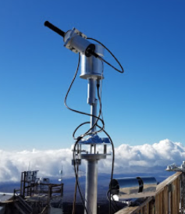
GeoTASO & Pandora Spectrometer System
GeoTASO = Geostationary Trace Gas and Aerosol Sensor Optimization
GeoTASO high res column NO₂ measurements from sub-orbital flights
  aggregated to hourly, and
  projected to the 4 km CMAQ model domain
GeoTASO hourly flight segments were then aggregated to a multi-hour composite for comparison with CMAQ total column NO₂
Pandora ground-based total column NO₂ measurements are also depicted
https://twitter.com/nasa_langley/status/462244232732762112
https://pandora.gsfc.nasa.gov//index.html

Slide 18
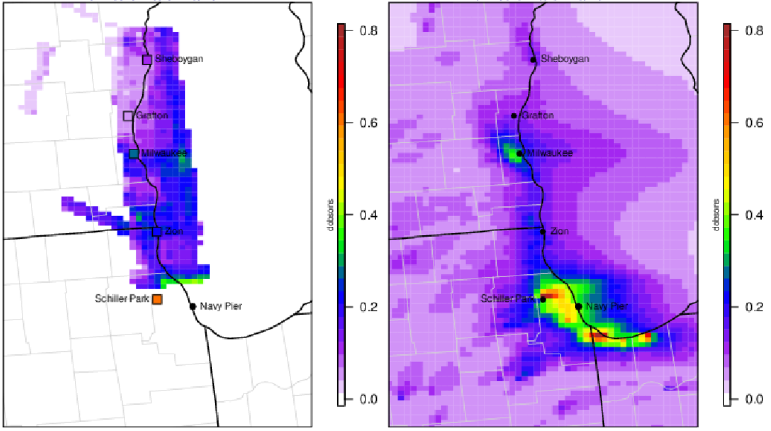
GeoTASO-Pandora & CMAQ NO₂ column
June 2
2pm – 6pm
Observed
Modeled

Slide 19
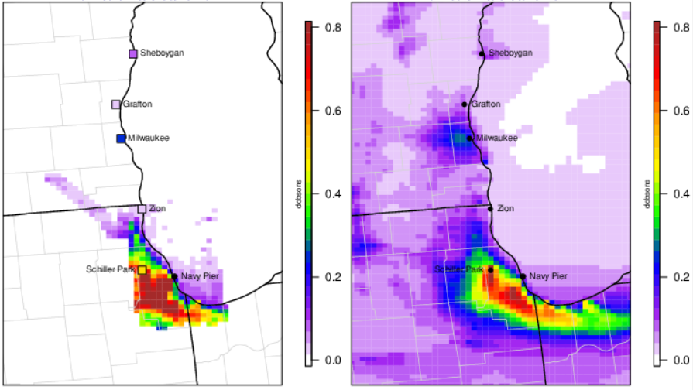
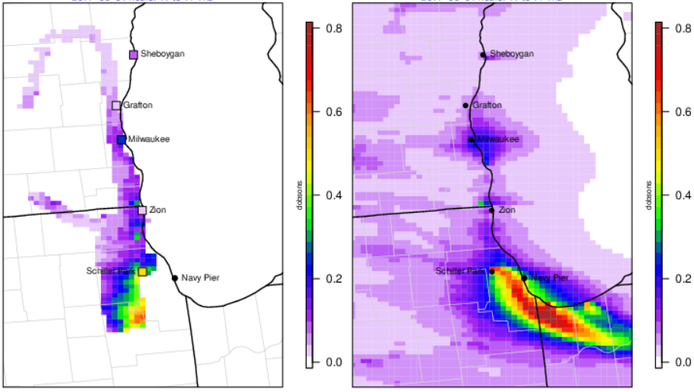
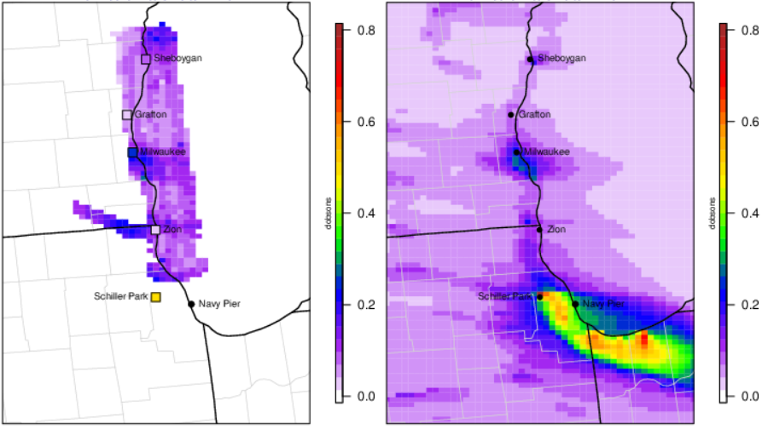
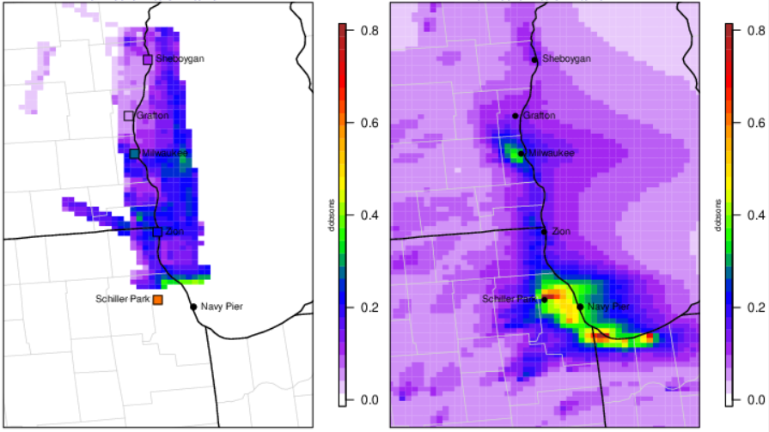
GeoTASO-Pandora & CMAQ NO₂ column
June 1 to June 2
Observed
8-10am
Predicted
8-10am
Observed
11-2pm
Predicted
11-2pm
Observed
3-5pm
Predicted
3-5pm
Observed
2-6pm
Predicted
2-6pm

Slide 20
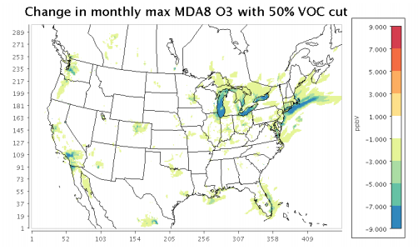
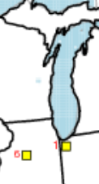
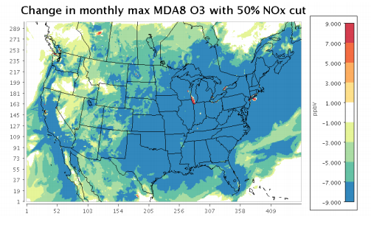
Modeling-Based Evidence of Regional NOx Sensitivity
Modeling of individual hypothetical sources in the Lake Michigan region shows NOx emissions generally have a greater ozone impact than VOC emissions
CAMx modeling based on 2011 platform
Hypothetical Source 1 Emissions and O3 Impact
Precursor | Emissions (tons per year) | Stack release height (low or high) | Maximum downwind ozone impact (ppb)
NOx | 500 | H | 1.15
NOx | 500 | L | 1.18
NOx | 1000 | H | 2.04
NOx | 3000 | H | 2.81
VOC | 500 | L | 0.42
VOC | 1000 | H | 0.78
VOC | 1000 | L | 0.81
VOC | 3000 | H | 2.00
https://www3.epa.gov/ttn/scram/guidance/guide/EPA454_R_16_006.pdf
https://www.epa.gov/sites/production/files/2017-05/documents/national_modeling.advance.may_2017.pdf

Slide 21
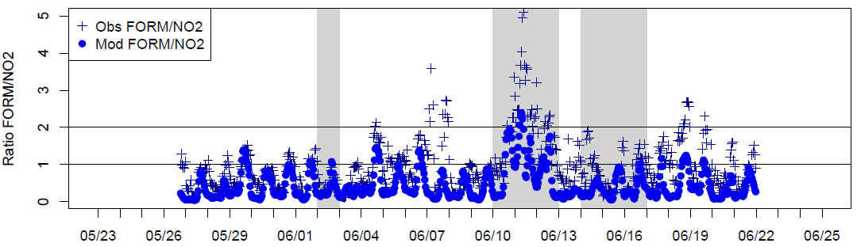
Indicator Ratios of Ozone Sensitivity — Sheboygan
Ratio of Hourly Averaged Formaldehyde (FORM) to NO₂ at Sheboygan
NOx- sensitive
transitional
VOC- sensitive
Measurements at Spaceport Sheboygan EPA ORD LMOS Data Repository

Slide 22
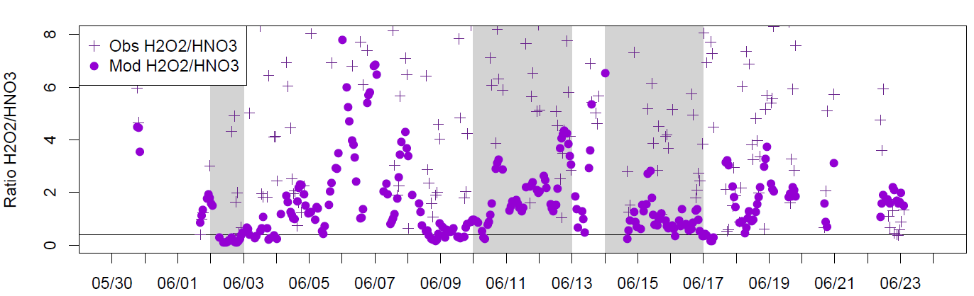
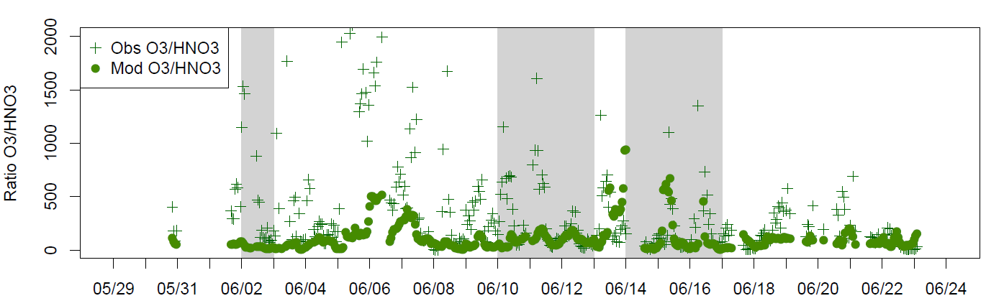
Indicator Ratios of Ozone Sensitivity — Zion
Sillman 1995
H2O2/HNO3
> 0.4 NOx sensitive
0.3 - 0.5 transitional
< 0.4 VOC sensitive
In general,
higher values for the O3/HNO3 ratio indicate NOx-sensitivity
lower values VOC-sensitivity
12-16 transitional
CIMS measurements
Tim Bertram et al.
LMOS Data
Repository

Slide 23
Ongoing Analyses
Model again with 2016v1 platform (current modeling was done with the 2016 beta) updated any 2017-specific emissions where available
Analyze the other high ozone episodes that occurred in 2017
Look at other key data from LMOS 2017

Slide 24

Questions
&
Thank You
Liljegren, J; Baker, K.; Valin, L; Szykman, J; Henderson, B.; Judd, L.; Al-Saadi, J; Janz, S.; Sareen, N.; Possiel, N

Slide 25
Additional Slides

Slide 26
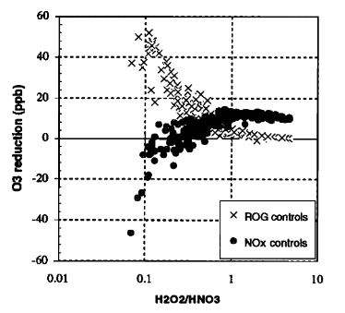
Indicator Ratios of ozone sensitivity
Sillman 1995 indicator approach to ozone sensitivity has drawbacks
Relationship btwn sensitivity and indicator species may shift with changes in initial emission rates (i.e. depend on model assumptions)
Based on assumption of accuracy in model-based indicator species correlation
Figure 5 from Sillman 1995 Predicted reductions in peak O3 from 35% reduction in emis rate for anthro VOC (crosses) and NOx (circles) plotted against H2O2/HNO3 coincident with the ozone peak in the simulation for Lake Michigan base case.
Sillman 1995
H2O2/HNO3
< 0.4 VOC sensitive
> 0.4 NOx sensitive
0.3 - 0.5 transitional

Slide 27
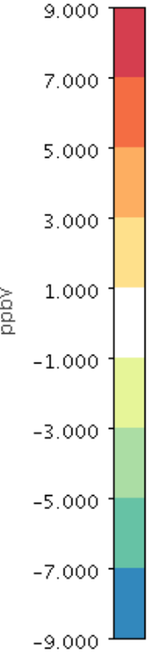
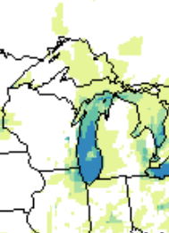
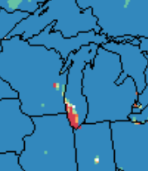
Change in monthly max MDA8 with 50% VOC cut
Change in monthly max MDA8 with 50% NOx cut

Slide 28
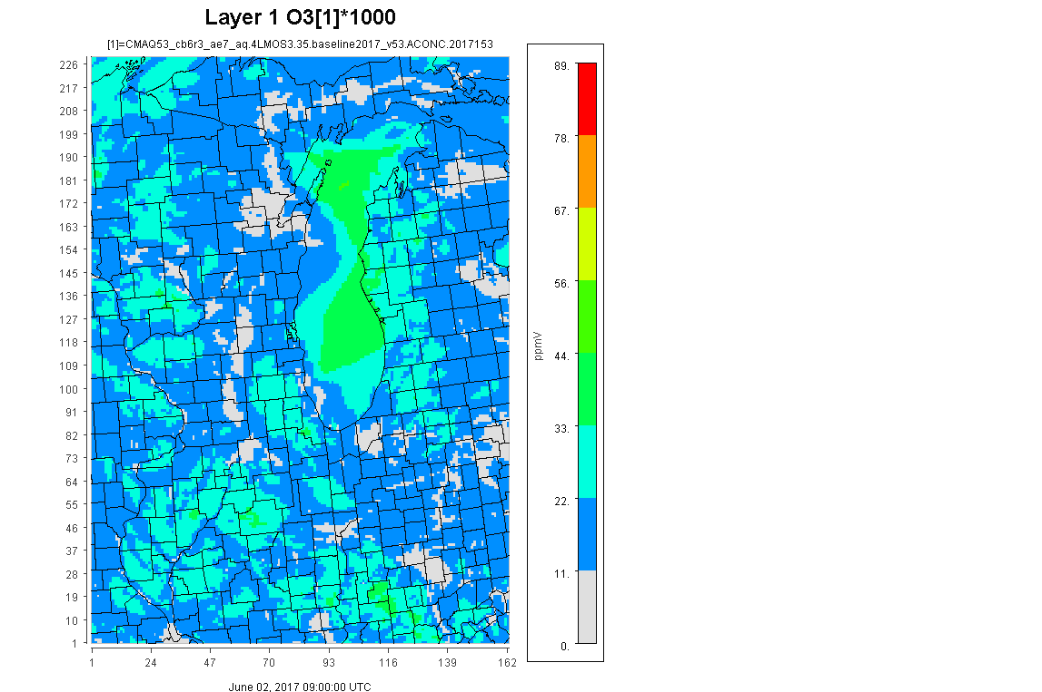

Hourly Ozone June 2nd
ppb
10 am – midnight

Slide 29
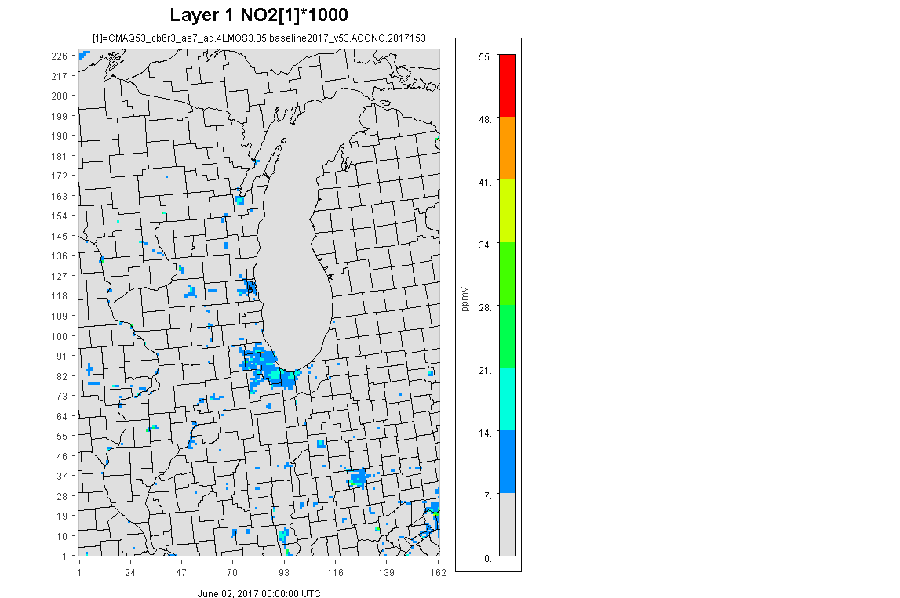

Hourly NO₂ June 2nd
ppb
1 am – midnight

Slide 30
Emissions information for 2017 model runs
Platform Sector abbreviation | Notes about the sector
ptegu | 2016 beta except replace with 2017 CEMS where applicable and apply known shutdowns. Derive and apply temporal profiles based on 2017 CEMS data using methods consistent with 2016 beta. Process all EGUs as elevated sources.
pt_oilgas | 2016 beta.
ptnonipm | 2016 beta.
ag | 2016 beta for livestock and fertilizer. Use 2017 met-based temporalization for both livestock and fertilizer.
ptagfire | 2017 Pouliot data (convert to FF10)
afdust_adj | 2016 beta with 2017 met-based adjustments.
beis | 2017 BEIS with water corrections
cmv_c1c2 | 2016 beta (projected from 2014)
cmv_c3 | 2016 beta (projected from 2014) as 12km points
rail | 2016 beta (from ERTAC)
nonpt | 2016 beta (portions projected from 2014)
np_oilgas | 2016 beta (ERG+state) with 2016 temporal profiles and spatial surrogates.
rwc | 2016 beta projected from 2014 with temporal allocation based on 2017 met
nonroad | 2016 beta adjusted to 2017 using national factors from OTAQ
onroad | 2016 beta adjusted to 2017 using national factors from OTAQ
onroad_ca_adj | 2017 CARB
ptfire | 2017 NEI draft fires – confirm Flint Hills looks appropriate
ptfire_othna | 2017 FINN fires
othafdust | 2016 beta (2015 Canada) adjusted with 2017 met data
othpt | 2016 beta
othar | 2016 beta
onroad_can | 2016 beta
onroad_mex | 2017 MOVES-Mexico

Slide 31
EPA’s WRF configuration
typically used for regulatory modeling e.g. CONUS transport
Version | WRF ARW v3.8
Meteorological initial and boundary fields retrieved from | 12km North American Mesoscale Forecast system (NAM)
Horizontal resolution | 4 km
Vertical resolution | 35 layers between the surface and 50 mb with thinner layers closer to the surface
Cumulus Parametrization | Kain-Fritsch (new Eta)
Shallow Convection | no shallow convection
Microphysics | Morrison 2-moment
Longwave radiation | RRTMg
Shortwave radiation | RRTMg
PBL Scheme | ACM2 (Pleim)
Surface Layer Scheme | Pleim
Land-Surface Scheme | Pleim-Xiu Land-Surface Model
Urban Model | No urban physics
Land Use Classification | NLCD40
3D analysis nudging | grid
SFC analysis nudging | off
obs nudging | off
sea surface temperature (SST) | default

Slide 32
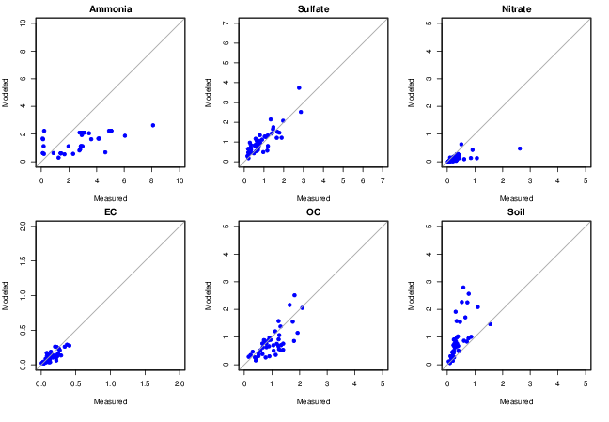
Speciated PM2.5 and NH3
Model tends to underestimate regional ammonia compared to AMON
Good agreement for sulfate, EC, and OC compared with IMPROVE/CSN monitors
Nitrate a little underpredicted and soil components were systematically overestimated

Slide 33

Ozone Area Design Values (2016-2018)
Preliminary 2017-2019 DV Sheboygan and Chicago
both 75 ppb
Sheboygan
81 ppb
Chicago
79 ppb

Slide 34

Region 5
2008 Ozone Nonattainment Areas
Have come into attainment and been redesignated
Cleveland
Columbus
Cincinnati
St. Louis
Did not reach attainment by attainment date and were bumped up to classification of “moderate” nonattainment
Chicago
Sheboygan
Did not reach attainment by attainment date and bumped up to “serious” nonattainment
  Chicago
Sheboygan qualified for and requested a 1-year extension, but Sheboygan did not attain by the 1-year extension date and would need to be bumped up to serious if not redesignated based on 2019 clean data
2008 ozone NAAQS = 0.075 ppm (75 ppb)
Notes:
Attainment date for Moderate areas: July 20, 2018
Statutory deadline for issuing final determinations: January 20, 2019
NPRM published November 14, 2018
EPA proposed determinations of attainment/failure to attain (and reclassification to Serious), and 1-year attainment date extensions based on 2015-17 DV for 11 areas
Proposal also included due dates for attainment plans and RACT implementation
Final notice anticipated in late spring 2019

Slide 35

Region 5
2015 Ozone Nonattainment Areas
14 areas in Region 5 are “marginal” nonattainment
Chicago IL/IN/WI
Northwest Milwaukee/Ozaukee County Shoreline WI
Sheboygan County (partial) WI
Manitowoc County (partial) WI
Door County (partial; Rural Transport Area) WI
St. Louis IL/MO
Berrien County MI
Allegan County (partial) MI
Muskegon County (partial) MI
Detroit MI
Cleveland OH
Columbus OH
Cincinnati OH
Louisville IN/KY
Bold areas still violating based on prelim 2019 data
Non-bolded areas clean and/or redesignated

Slide 36

NO2

Slide 37


Slide 38


Slide 39


Slide 40


Slide 41
GeoTASO-Pandora & CMAQ NO₂ column
June 1 to June 2
Observed
8-10am
Predicted
8-10am
Observed
11-2pm
Predicted
11-2pm
Observed
3-5pm
Predicted
3-5pm
Observed
2-6pm
Predicted
2-6pm

Slide 42
Observed (top) and Predicted (bottom) Ozone over Lake Michigan
June 2
June 11
June 12
June 13
June 15
EPA ORD/NOAA Research Vessel LMOS Data Repository

