Slide 1

Improvements to EPA’s SPECIATE Database:
SPECIATE5.0
Madeleine Strum EPA/OAQPS,
Others on the EPA SPECIATE WORKGROUP, and
Frank Divita and Ying Hsu, Abt Associates
Marc Menetrez, ORD; Casey Bray, OAQPS, Venkatesh Rao, OAQPS,
Souad Benromdhane, OAQPS; Heather Simon, OAQPS; Ben Murphy, ORD;
George Pouliot, ORD, Havala Pye, ORD, Amara Holder, ORD; Mike Hays, ORD;
Ingrid George, ORD; Libby Nessley, ORD; Justine Geidosch, OTAQ
Momei Qin, formerly EPA ORD, now with Nanjing University for Information Science & Technology, Nanjing, China

Slide 2

What Is SPECIATE
Repository of source-based speciation profiles that provide the chemical composition of organic gas such as volatile organic compounds (VOC), and particulate matter (PM)
propane
ethylene
VOC
formaldehyde
acetaldehyde
ethanol
etc.
elemental carbon
organic carbon
nitrate
PM_{2.5}
sulfate
aluminum
silicon
iron
etc.
Notes:
Speciation is the process of disaggregating an inventory species representing a group of pollutants, and disaggregating it into the detailed species in that group. The detailed species depend on the type of source emitting the inventory species. For example, for a combustion source, once would expect that formaldehyde be a component of the VOC, but if the source is evaporation resulting from the application of a solvent-borne coating, then formaldehyde might not be a component of the VOC

Slide 3
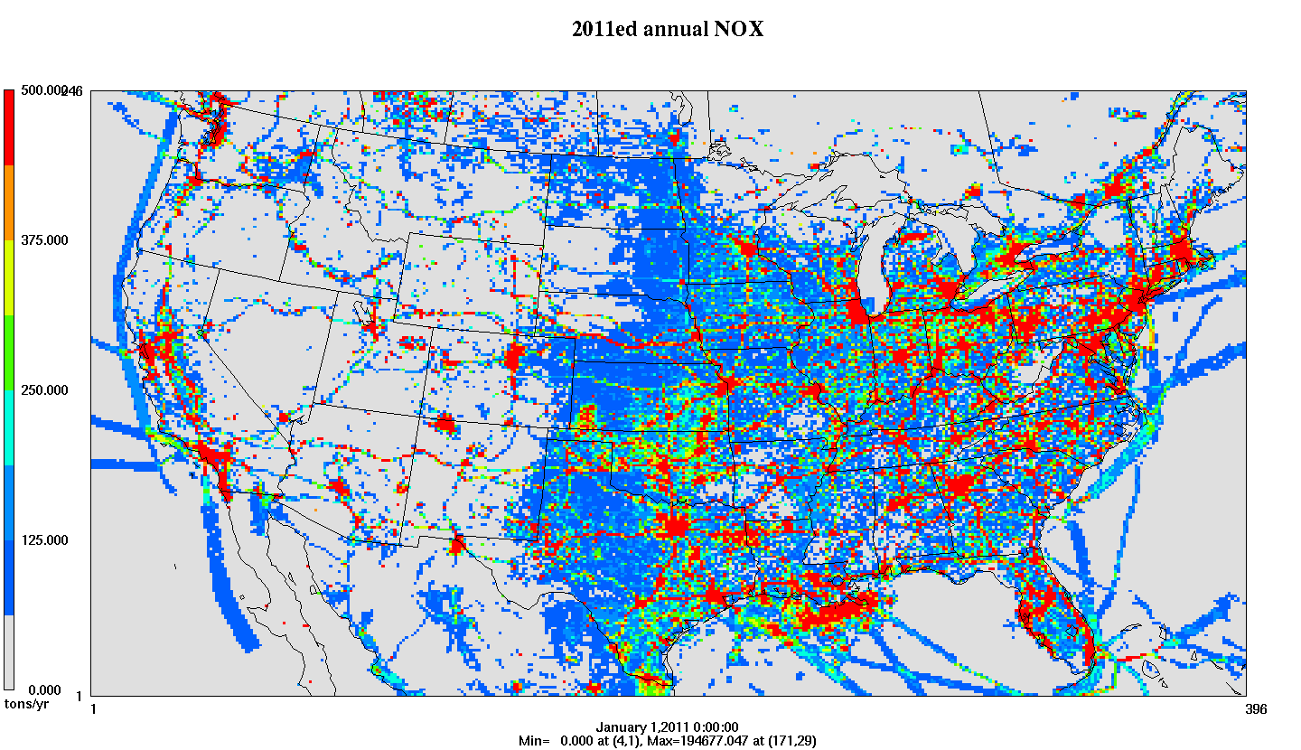

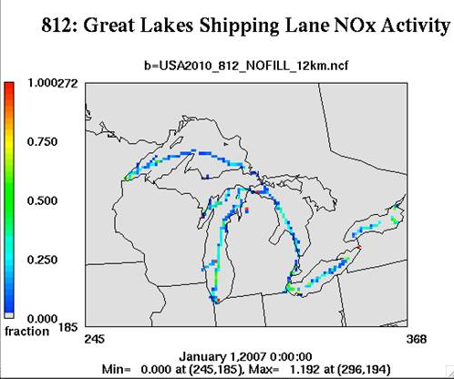
SPECIATE As Part of Emissions Preparation for Photochemical Air Quality Modeling
SMOKE software system performs
temporal allocation, speciation and spatial allocation
VOC and PM_{2.5} need to be speciated into chemical components for photochemical modeling
Each speciation profile is cross-referenced to an inventory source by source classification code (SCC), pollutant, and potentially by region
Thousands of SCCs in the NEI are mapped to a few hundred profiles
Temporal Profiles
Emission
Inventory
Speciation Profiles
Final product: hourly, speciated gridded, emissions in a format for an air quality model
Spatial Surrogates
Notes:
NEI emissions need to be processed before they can be applied in air quality models and this processing is done through the SMOKE software system.
-In the figure above, we are focused on the step in the center (speciation) not on the spatial or temporal allocation. (top and bottom panels fade with click)
-The NEI generally provides annual county level emissions totals for total PM2.5 and VOC while models need hourly gridded and speciated emissions.
An emissions modeling platform is the full set of emissions inventories, other data files, software tools, and scripts that process the emissions into the form needed for air quality modeling. Each emissions modeling platforms supports air quality modeling of an historic year and one or more later years. Each platform relies on a version of the National Emissions Inventory (NEI) for most of its data, although some adjustments are made to support air quality modeling. All data and scripts needed to prepare emissions for air quality modeling are provided with each emissions modeling platform.

Slide 4
Other Key Uses
Estimate black carbon and organic carbon for use in carbon emission assessments and inventories
  Black Carbon Report to Congress
  Arctic deposition study
Source apportionment
Estimate air toxics emissions

Slide 5
Types of Profiles in SPECIATE
GAS – Organic gas, based on VOC or total organic gases (TOG)
GAS-VBS – Used for volatility basis set (VBS) treatment in air quality models (contains intermediate volatility explicit and lumped species based on saturation vapor pressure)
PM-Simplified – Model-ready for AE5 aerosol mechanism
PM-AE6 – Model-ready for AE6/AE7 aerosol mechanism
PM-VBS – Model-ready for VBS treatment in chemical transport models (contains organic carbon and non-carbon organic matter lumped species broken out by saturation vapor pressure; includes SVOCs)
PM – Any other PM (i.e., not model-ready)
OTHER – Mercury, NOX, semi-volatile VOC (SVOC)
Notes:
For the latest version of SPECIATE we added a field called profile type to distinguish between the different types of proifiles.
Gas profiles are gaseous organic compound profiles that provide the composition of total organic gas (TOG) or volatile organic compound (VOC) emissions from sources.
There are 3 types of PM profiles PM which is any PM profile that is not AE6 or VBS.

Slide 6
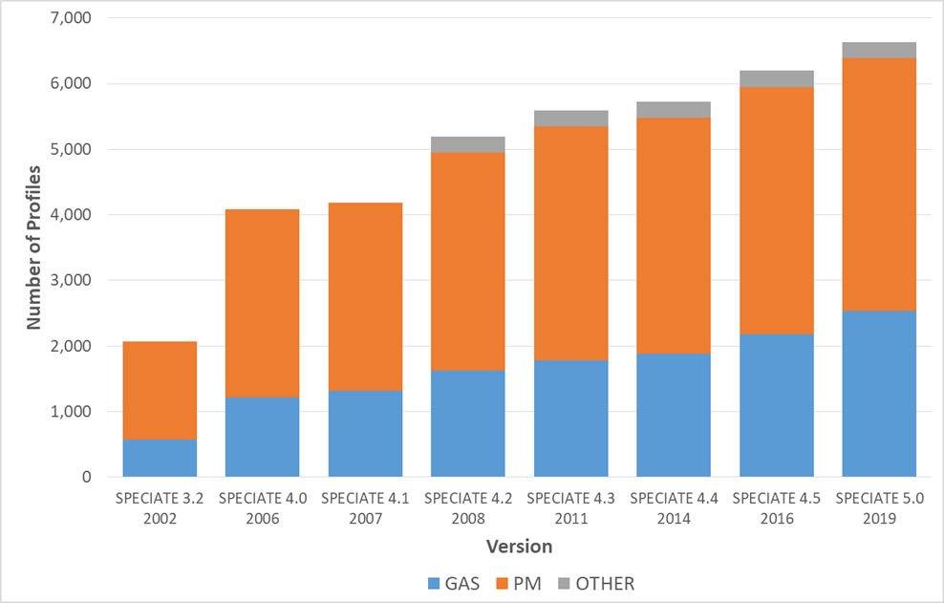
Expansion of the SPECIATE Database
SPECIATE5.0:
6,654 profiles
First
Introduce VBS
First
Introduce AE6
More Region Specific Oil & Gas

Slide 7
How Profiles are Added
Notes:
Madeleine Strum is in the emission inventory group in the Office of Air Quality Planning and Standards and is a very active member on EPA’s SPECIATE work group and is co-work assignment manager along with Marc Menetrez who is the lead for the SPECIATE database and work assignment manager. Marc is with National Risk Management Research Laboratory in EPA’s Office of Research and Development, located here at Research Triangle Park NC.
Casey Bray has been working on various aspects of SPECIATE as a student intern with ORD and is now with EPA’s, Sector Policies and Programs Division (SPPD), Measurement Policy Group. We are the group that is in charge of AP 42, we actually stole it from Madeleines group.

Slide 8
Updates to SPECIATE 5.0
Database design (improved Microsoft Access® structure)
Additional metadata fields
Corrected nonVOC fields (SPECIES_PROPERTIES)
  Siloxanes fixed - resulting from EPA research on organic aerosol formation from volatile chemical products
Added profiles
Improved online browser
Overall improvements to the SPECIATE program
  Needs Analysis (Bray, et al., Atmospheric Environment, June 2019)
  Guidelines for data developers

Slide 9
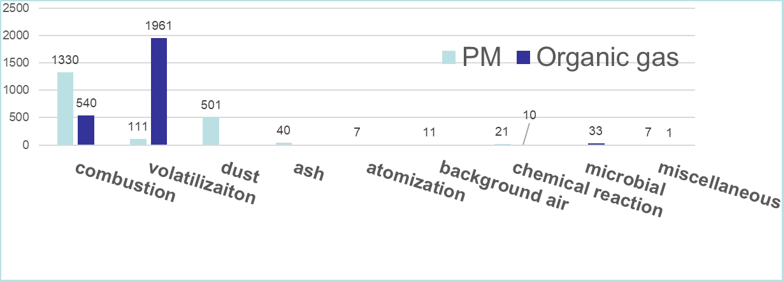
Profile Categorization Fields
CATEGORY_LEVEL_1_Generation Mechanism
  9 distinct values, most are “combustion” or “volatilization”
CATEGORY_LEVEL_2_Sector_Equipment
  ~ 200 distinct values, e.g., “biomass burning; prescribed fire” or “biomass burning; fireplace”
CATEGORY_LEVEL_3_Fuel_Product
  ~500 distinct values, e.g., “wheat straw” or “rice straw” or “juniper”

Slide 10
Other Metadata Fields Added
QSCORE
Master_Pollutant emission rate
Species emission rates
Mass Overage Percent
Organic loading
Particulate loading
Species vapor pressure
Species oxygen to carbon ratio

Slide 11
Additional Quality Review Process “QSCORE”
Evaluation criteria focused on
  Reference
  Relevance of data (emission source reflects current technology)
  Quality test program
  Documentation on sampling/analytical method
  Profile Completeness
  Data reduction/statistics
Our Cross-Office SPECIATE Workgroup develops the QSCORE for every profile via team discussions
Notes:
Detailled QSCORE criteria are in SPECIATE 5.0 Documentation and Guidelines for Data developers

Slide 12
Improved Documentation
Now providing Excel® workbooks showing calculations from the raw data (e.g., journal article) to SPECIATE profiles
Improved access to references
  Digital Object Identifiers (DOIs) for literature references
  Web links to reports where available on internet
  Documents that are not readily available via web link are posted on our ftp site

Slide 13
New Profiles – SPECIATE 5.0
Added Profiles
  375 new GAS profiles for a total of 2,550
  80 new PM profiles for a total of 3,854 (PM, PM-AE6, PM-SIMPLIFIED)
  6 PM-VBS and 4 GAS-VBS profiles
Considering at least the following SPECIATE5.0 profiles for our air quality modeling platform:
Gas (TOG):
  Sugar cane burning
  Consumer products (multiple)
  Corrected heavy duty diesel
  Wyoming oil and gas (multiple)
  Livestock (multiple)
PM (PM2.5):
  Marine Vessel AE6
  Corrected wildfire/prescribed fire
  Natural gas combustion
  Aircraft
Notes:
Hundreds of new profiles were added to SPECIATE, including 375 new gas profiles and 80 new PM profiles. We also added 6 new PM VBS profiles. Some of the new gas profiles added include profiles for sugar cane burning, consumer product, oil and gas and heavy duty diesel vehicle and some of the new PM profiles include an AE6 ready marine vessel profile, a correct emission source profile for wildfire/prescribed fires, natural gas combustion and aircraft.

Slide 14
New SPECIATE Browser
Provides database access for the non-Access® user
Ability to search, view and download profiles and/or metadata, species, and export them into Excel®
Filter by any metadata field; sort any field
Construct your own table with fields of interest
LINK: https://www.epa.gov/air-emissions-modeling/speciate
Tip: don’t use internet explorer – google chrome is fine
Notes:
In addition to the access database, there is also a SPECIATE data browser. One of the key strengths of the browser is that it lets you easily search for profile and compare them against one another. The SPECIATE data browser can be accessed from the SPECIATE home page or directly from this link. So now we are going to look at a few examples using the data browser:
LINKS:
https://www.epa.gov/air-emissions-modeling/speciate
https://edap.epa.gov/public/single/?appid=fc3f186a-f39c-46d9-afa6-d4c3556b99c1&sheet=62a951b9-2689-46fb-b08b-1a6fa5814edb&opt=currsel&select=clearall
https://edap.epa.gov/public/single/?appid=fc3f186a-f39c-46d9-afa6-d4c3556b99c1&sheet=62a951b9-2689-46fb-b08b-1a6fa5814edb&opt=currsel&select=clearall

Slide 15

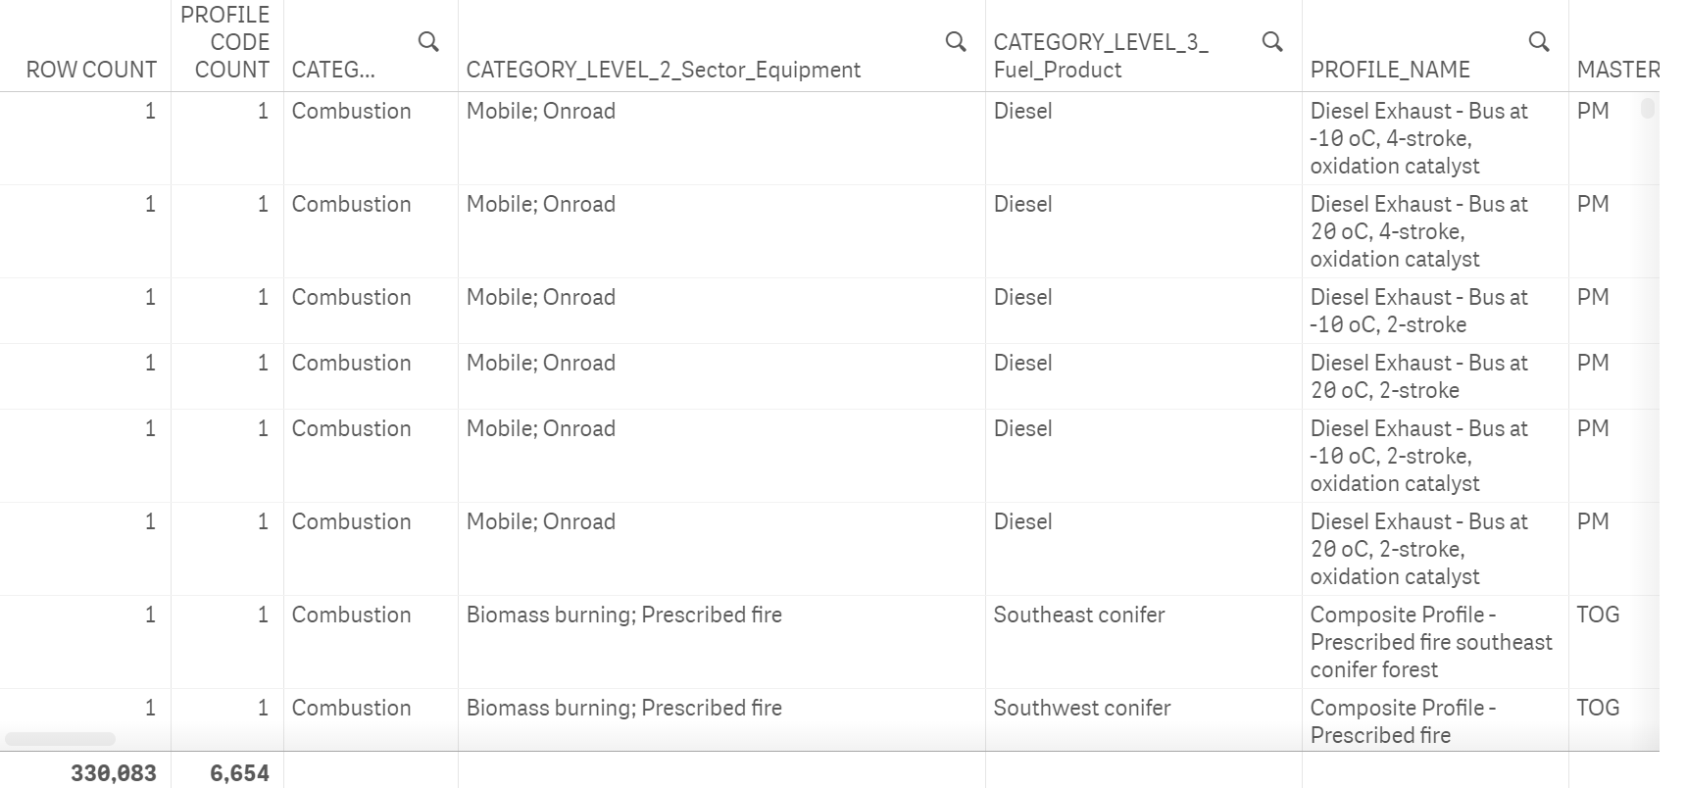
Browser – Profile Info view gives you ALL fields
Search on any field

Slide 16
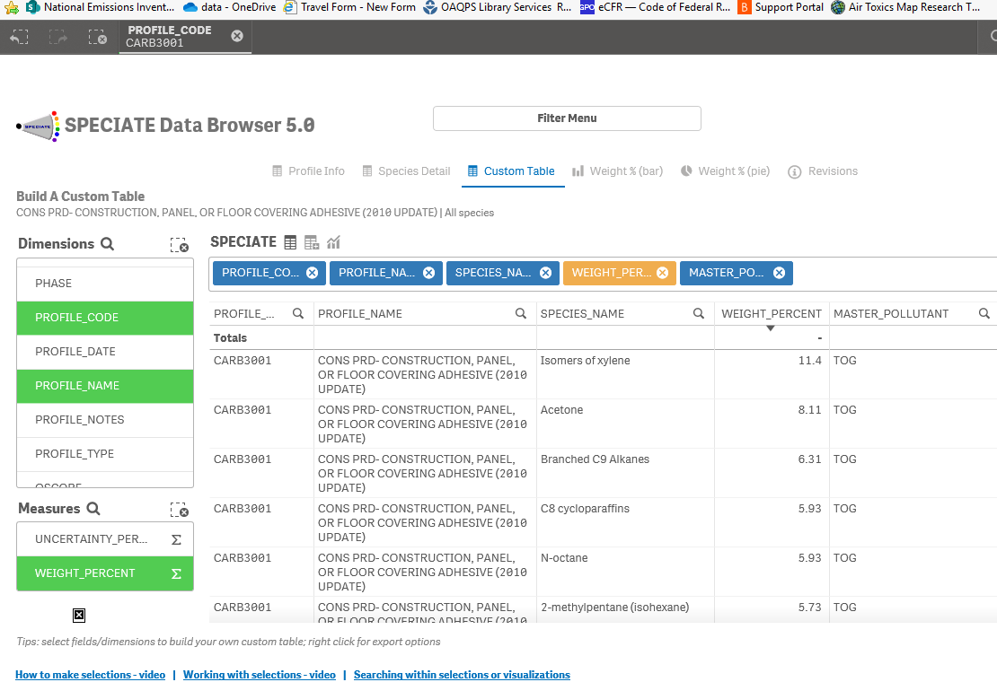
Browser – Custom Table
Selected one profile
Sorted
descending
Helpful tips

Slide 17
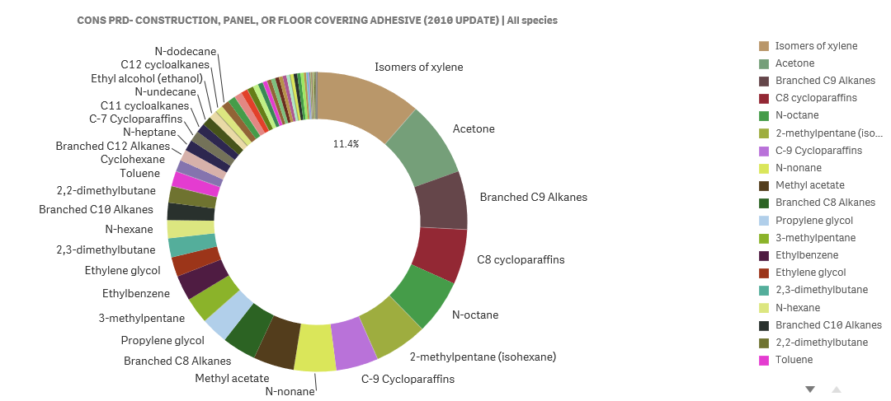
Browser – View a Profile
View/Compare profiles

Slide 18
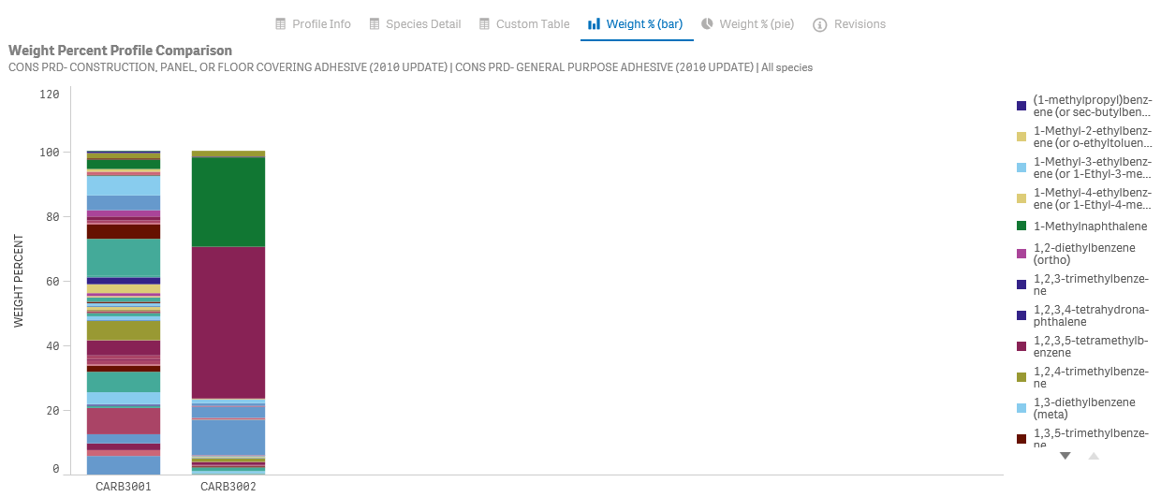
Browser – Compare 2 Profiles
Select 2 or more profiles to get a comparison
17

Slide 19
Guidelines for Data Developers
Discusses completeness, quality and documentation
Data should fully characterize the source emissions (an entire suite of species)
For PM emission source profiles, the size fraction of the PM should always be included
Template with examples and further explanation of metadata fields provided as part of the guidelines document
Data may be voluntarily emailed to SPECIATE_WG@epa.gov

Slide 20
Future Work
Provide updates to SPECIATE more frequently
Additional outreach to researchers on our data needs
Continue to improve the database

Slide 21
Additional acknowledgements:
Reviews: Jeff Vukovich, Marc Houyoux (OAQPS), Rich Cook (OTAQ), Will Yelverton (ORD)
Qlik Browser - Arthur Zuco (OAQPS),
Website - Caroline Farkas (OAQPS)
MS Access FORMS - Barron Henderson (OAQPS)
For more information
www.epa.gov/air-emissions-modeling/speciate

