Slide 1
2019 CMAS Conference
The Fast Air Quality Responses from the
Fine Particle Reduction Measures of South Korea
Jinseok Kim¹, Younha Kim¹, Jung-Hun Woo^{1*}, B.H Baek², Jinsu Kim¹, Youjung Jang¹, Minwoo Park¹
1 Konkuk University, Seoul, Korea
2 University of North Carolina, Chapel Hill, USA
* Correspondence : jwoo@konkuk.ac.kr
Notes:
- Hi, I'm Jinseok Kim from KunkukUniversity in South Korea.
- In this presentation, I would like to present an assessment of Korea's fine particle reduction policy using the fast air quality response model called RSM.

Slide 2
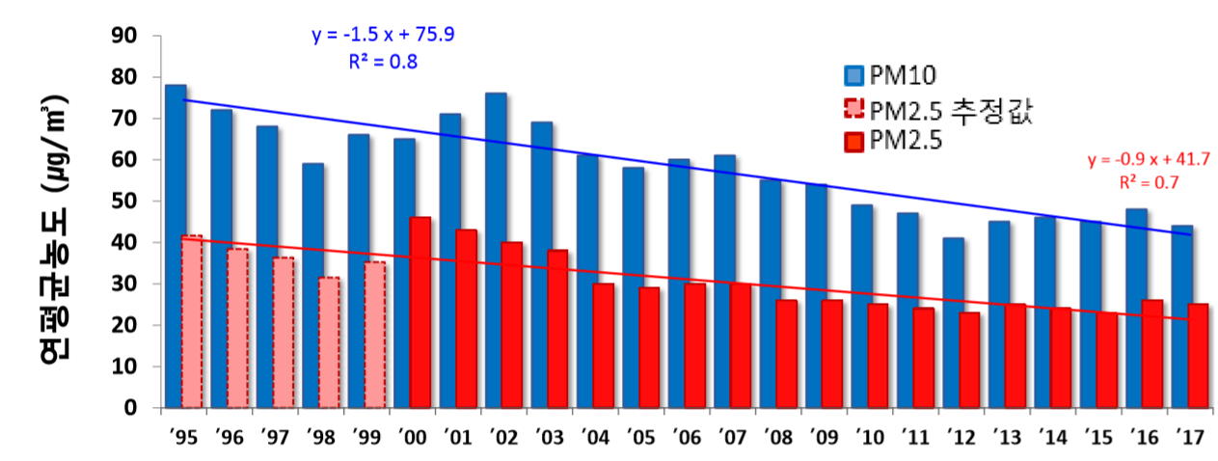
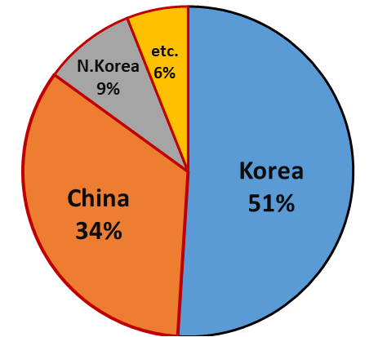
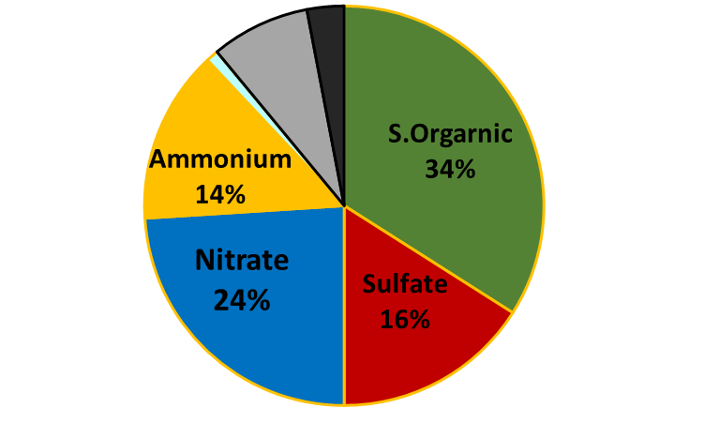
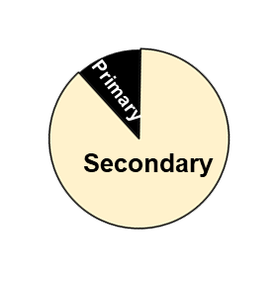
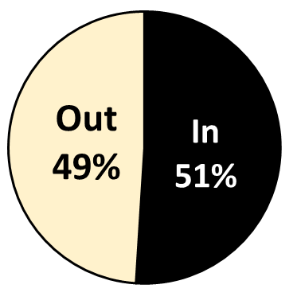
Background
Recent Air Pollution issue in Korea(Seoul Metropolitan Area)
PM2.5 annual Average (ug/m³)
fine particulate matter
(NASA KORUS-AQ Campaign)
Local vs.
Transboundary
Contribution
Black
Carbon
8%
Primary vs. Secondary
Composition
P. Orgarnic 8%
Chloride 1%
NIER/NASA, 2017
2
Notes:
Seoul, the capital of Korea, has recently faced atmospheric environmental problems. As you see the pictures in this slide, local air quality issues like PM2.5 has been causing many concerns on human health impacts.
- Although PM10 and PM2.5 concentrations have been on a decreasing trend, but we can see the increase again from 2012 to 2016.
- We have been facing the air quality impacts from our neighbor countries like China, North Korea, and other countries.
- To understand these regional air quality issues, last 2017, Korea government had completed the collaborative research air quality field campaign with NASA, it is called “KORUS”.
- Based on this campaign study with NASA, we have found out that almost 34% of high PM2.5 episode are caused by China and 9% by North Korea.
- And also this secondary organic aerosol among PM2.5 is about 34%, sulfate, nitrate and ammounium are 16%, 24% and 14%, respectively.
(So, to understand this complex air quality issues and come up witha better control strategies, we have been working on developing this integrated, assessment model, GUIDE modeling system.)

Slide 3
Objective of GUIDE System
Fine Particle Policy in Korea (2019)
Domestic Emission Reduction
(Industrial, Mobile, Power, Residential, etc.)
Health Protection
(High concentration season management system, Indoor Air Quality Management)
Fine Particle Management Plan
(20’~24’)
40% reduction in domestic emissions
30% improvement in PM_{2.5} annual avg. concentration
Accelerate domestic emission reduction
Strengthening the performance of countermeasures
strengthen action to seasonal high concentrations
International Cooperation
(Korea-China Environmental Cooperation, LTP, NEACAP)
Scientific Policy Support
(Science-based policy
Public participation-communication)
3
Notes:
3
This slide is a diagram of fine particle reduction policy in Korea.
This plan aims to reduce Korea's particle emissions by 40% and improvement of the annual average PM2.5 concentration by 30%.
As shown in the red box, emission reduction policies for industrial, mobile, power and residential sources are applied.
The purpose of this study is to analyze whether Seoul's target PM2.5 concentration can be achieved by applying these policies.

Slide 4
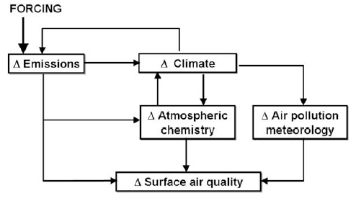
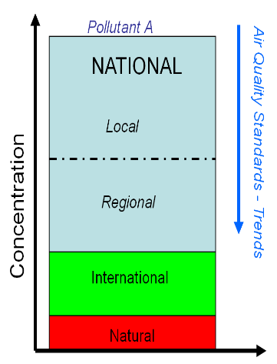
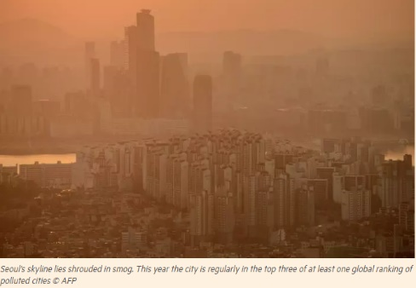
Objective of GUIDE System
Integrated Assessment of Air Quality
Socio-economy
Energy-Emissions
Pollution Process
Jacob et al.,(2007)
Pollution Level
Health Impact
Health Impact
= Concentration x Intake
4
Notes:
4
This slide is a schematic of the cause and process of fine particle.
Socioeconomic and energy causes emissions of pollutants, and these pollutants determine air quality through meteorology and chemical reactions.
These changes in air quality affect health and, as a result, socioeconomic factors.
Therefore, to make a policy decision, it is important to consider this process in order to establish an accurate policy.
chemical transport model is required to determine the policy, but it takes a long time to operate the chemical transport model.
Therefore, a fast air quality response model such as RSM is needed.

Slide 5
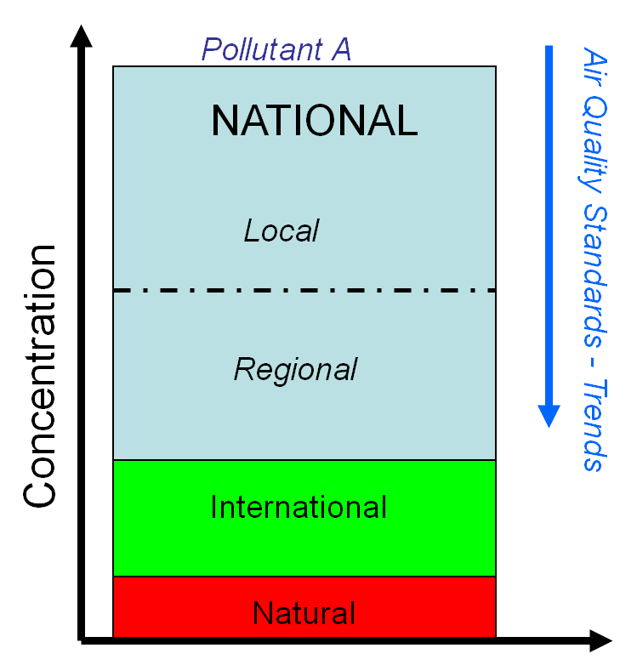











Objective of GUIDE System
The GHGs and Air pollutants Unified Information Design System for Environment
(*GUIDE)
Socio-economy and Energy
Socio-economy and Energy
Emissions and Air Quality
Emissions and Air Quality
Cost-Benefit Analysis
Cost-Benefit Analysis
Health Impact
Health Impact
*GUIDE : GHGs and air pollutants Unified Information Design system for Environment
5
Notes:
5
- This figure shows the GUIDE model development framework.
This model is consisted of four major parts. The first one is the Socio-economy and Energy part, the second one is the air quality modeling system , the third one is cost-benefit decision making system, and then last one is Health Impact.
This presentation I am going to focus on showing the air quality modeling system outcomes we recently completed.

Slide 6
Objective: Policy Supporting Air Quality Model
Policy Supporting Air Quality Model
Response Surface Model (RSM)
——a meta-model built upon multi-“Brute Force” model simulations, to explore the response relationship between emission changes and air quality responses
Ambient Concentration
Sensitivity (e.g., DDM)
“real atmosphere”
RSM
Source Apportionment (e.g., ISAM)
0
1
Emission ratio
(Jia Xing et al., 2018, CMAS conference)
base
6
Notes:
6
Here is a brief description of RSM taken from a slide presented by Jia at last year's CMAS conference.
RSM is a meta-model built upon multi-“Brute Force” model simulations, to explore the response relationship between emission changes and air quality responses

Slide 7
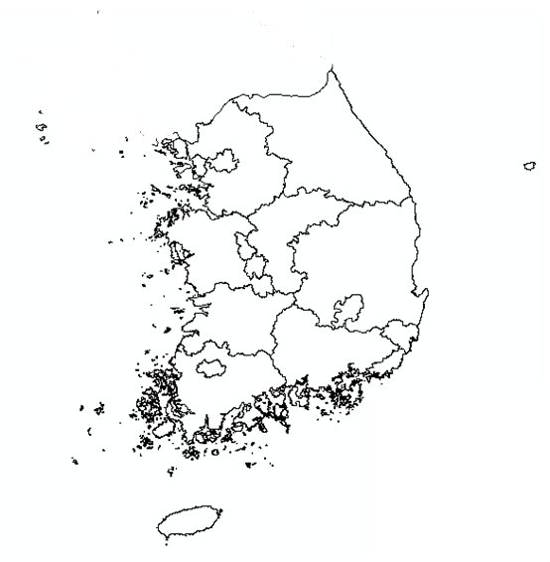
Objective: Policy Supporting Air Quality Model
RSM* Design for “GUIDE”
Region | Pollutant | Sector
Seoul | CO | Power(POW)
Busan | CO₂ | Industry(IND)
Daegu | NH₃ | Mobile(MOB)
Incheon | NO_{X} | Residential/commercial(RES)
Gwangju | SO₂ | Agriculture(AGR)
Daejeon | PM₁₀ | Other(OTH)
Ulsan | PM_{2.5} | Solvent(VOC)
Sejong | VOC | Boundary condition(BC)
Gyunggi-do
Gangwon-do
Chungcheongbuk-do
Chungcheongnam-do
Jeollanam-do
Jeollabuk-do
Gyeongsangbuk-do
Gyeongsangnam-do
Jeju
  Region, pollutants, and sector
  17 Regions
  8 Pollutants
  7 Sectors
Reduction policy is applied by region when applying the policy.
In addition, the reduction policy is generally implemented for each source, so it is divided into 17 regions and 7 sources.
Region-Sector Control Factors : ~119 Factors + Boundary Condition
= 120 Factors
*Response Surface Modeling
7
Notes:
7
- The RSM design for the GUIDE model is as follows.
- Korea is divided into 17 regions, and There are a total of 8 pollutants (CO, CO2, NOx, Ammonia and so on) with a total of 7 sectors like power, industry, mobile, residential, agriculture and the Solvent VOC sector.
- SMOKE processing is drivedby utilizing the sectors classified as above.
- So, we have created a total of 119 factors by region and sector with boundary conditions to consider the impacts from our neighbor countries like China and North Korea.

Slide 8
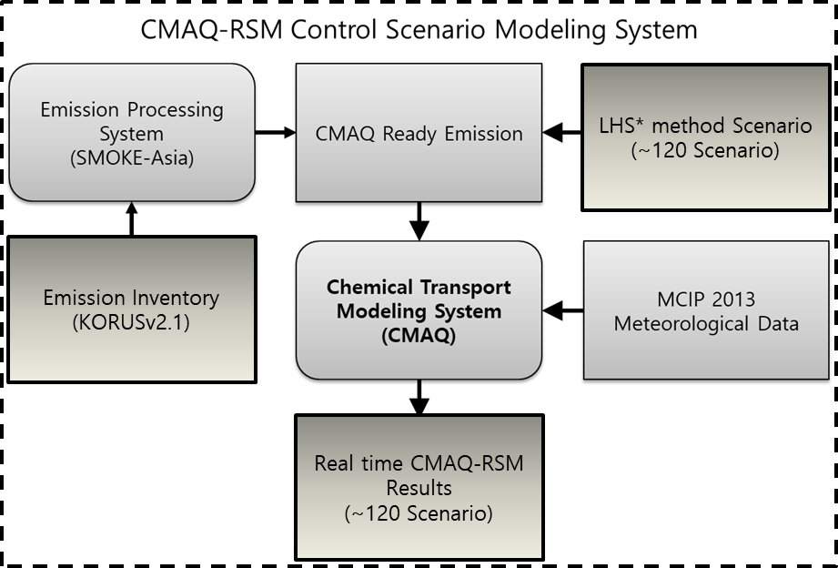
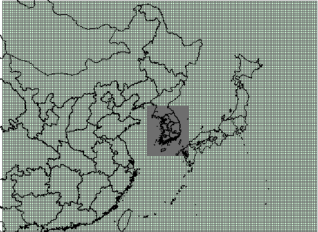
Objective: Policy Supporting Air Quality Model
Chemical Transport Modeling System(CMAQ-RSM) Modeling Framework
Domain
Chemical Transport Model | CCTM in CMAQ v4.7 (U.S. CMAS)
Emissions
• anthropogenic emission model | SMOKE-Asia (Woo et al., 2009)
• emissions inventory | CREATEv3.0 (Woo et al., 2018), KORUSv5, SAPRC-99 aero3
Meteorological Model | WRF (U.S. NCAR)
Period | January, April, July, October, 2013
Domain | • Extent : Domain 1 (East Asia). Domain 2 (South Korea)
 | • Grid resolution (domain): 27 ⅹ27km²(174 x 128), 9 ⅹ9km²(67 x 82))
 | • N. of vertical layer: 30
*Response Surface Modeling
8
Notes:
8
- For our ChmicalTransport Modeling system, we used the CMAQ v4.7 with Chemical Mechanism SAPRC99.
- Emissions were processed using SMOKE-Asia with KORUS v5 inventory which is based on the latest East Asia region emissions inventory called CREATE v3.0.
- The meteorological model was WRF. To represent the seasonality of air quality, we modeled January, April, July, October.
- The one in the redboxis the 27km by 27km modeling domain and the smaller black box around South Korea is 9km * 9km modeling domain.

Slide 9
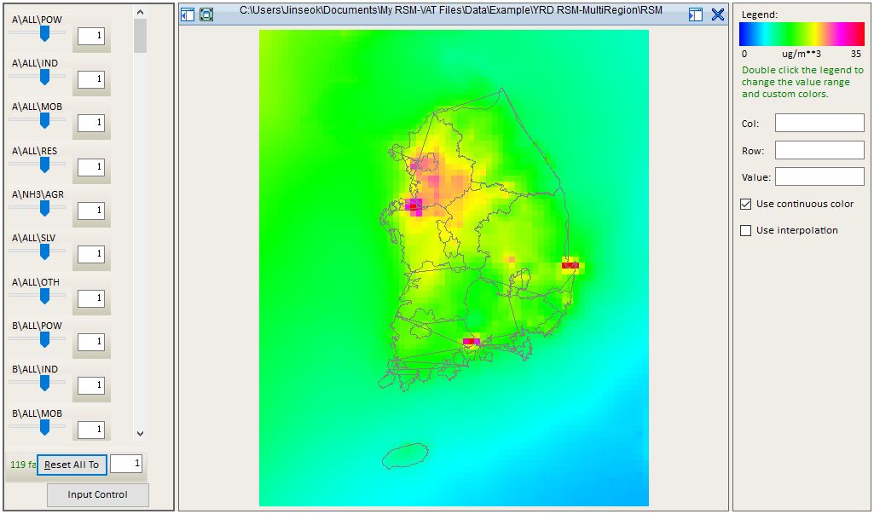
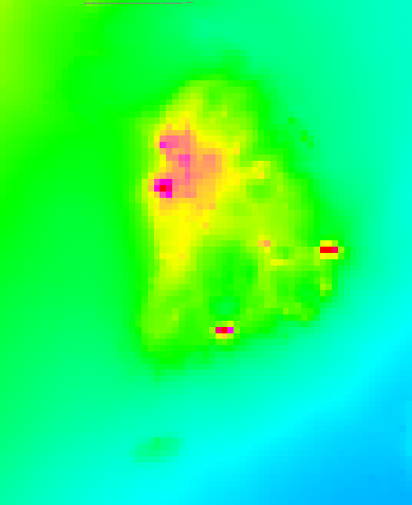
Result
RSM Base Scenario [PM2.5]
9
Notes:
9
- The results of the RSM are shown as follows.
- This figure is the result of RSM for PM2.5, which shows the Base Scenario.
- The red box area is where the industrial complex and power plant are located.
As you can see it is showing a high concentration.

Slide 10
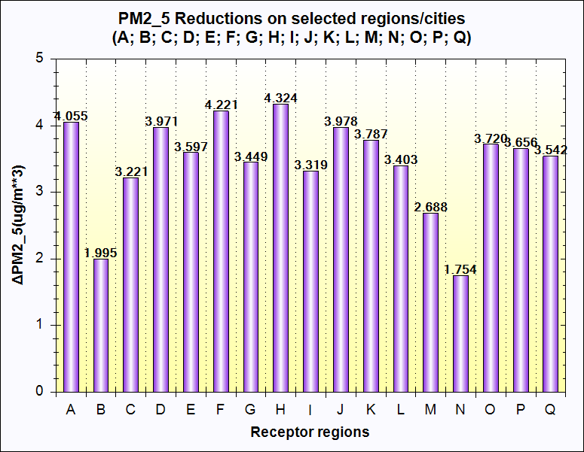
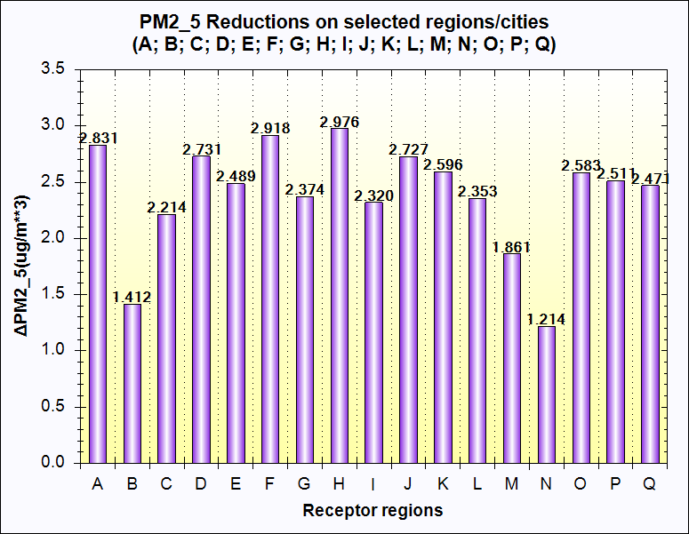
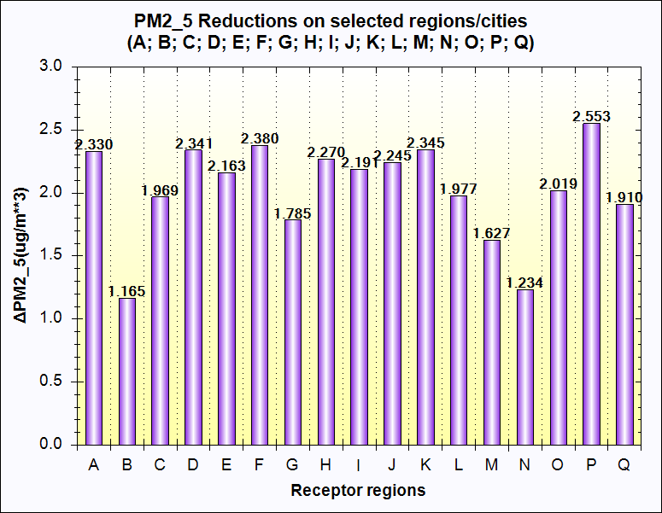
Result
RSM Results (△PM2.5) [Base-Scenario] : △Reduction(+)
Seoul | Incheon | Busan | Daegu | Gwangju | Gyeonggi | Gangwon | Chung -Buk | Chung -Nam | Gyeong -Buk | Gyeong -Nam | Jeon -Buk | Jeon -Nam | Jeju | Daejeon | Ulsan | Sejong
A | B | C | D | E | F | G | H | I | J | K | L | M | N | O | P | Q
(A)
(B)
(C)
A : All sector 30% reduction;
B : All sector 20% reduction;
C : Power 25%, Industry 43%, Mobile 32%, Residential 15% reduce
(Recommend policy in Korea);
Notes:
10
- The following are the results of testing base scenarios and reduction scenarios using RSM.
- The meaning of each graph is shown below.
- Graphs A and B are scenarios that reduce all emissions by 30% and 20%.
It can be seen that the fine particle reduction concentration is larger when 30% reduction than 20% reduction.
- Even if korea reduce the amount of emissions uniformly across all regions, we can see that the responses from each region are different.
- Graph C shows the result of applying the desired PM2.5 reduction policy from 2017 to 2022 planned in Korea.
- I'll tell you about more detail about this in the next slide.

Slide 11
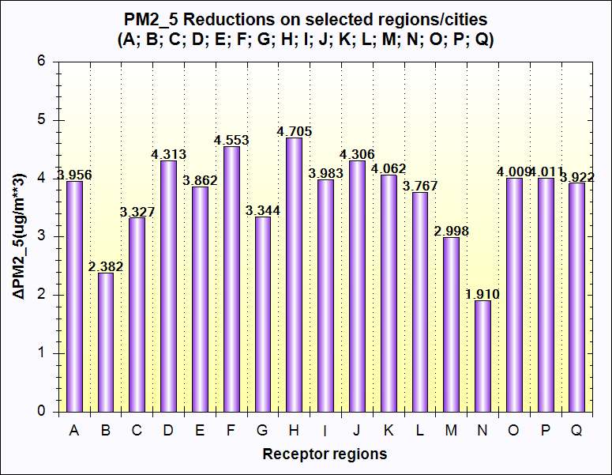
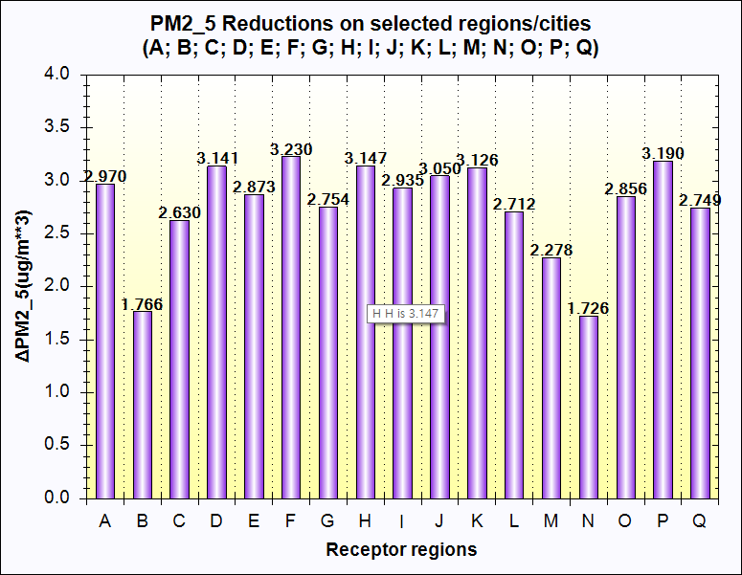
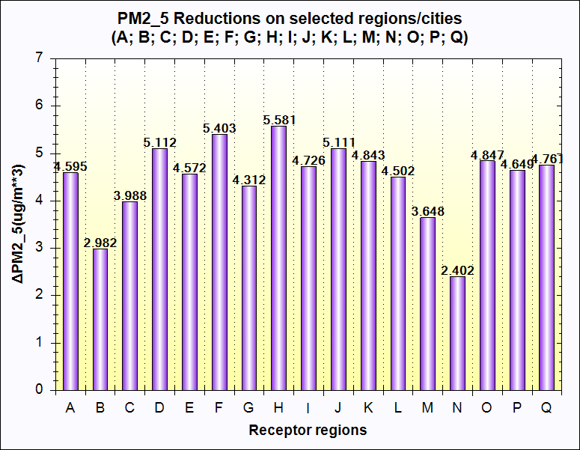
Result
Recommended policy in Korea for PM_{2.5} : △Reduction(+)
Seoul | Incheon | Busan | Daegu | Gwangju | Gyeonggi | Gangwon | Chung -Buk | Chung -Nam | Gyeong -Buk | Gyeong -Nam | Jeon -Buk | Jeon -Nam | Jeju | Daejeon | Ulsan | Sejong
A | B | C | D | E | F | G | H | I | J | K | L | M | N | O | P | Q
(A)
(B)
2.33ug/m³
3.956ug/m³
Targeted PM_{2.5} in A region(Seoul):
5ug/m³ Reduction
(A) : Power 25%, Industry 43%, Mobile 32%, Residential 15% Reduction
(B) : (A) + Solvent VOC 30% Reduction
(C) : (A) + Agriculture Sector 30% Reduction
(D) : (A) + Solvent VOC & Agriculture Sector 30% Reduction
(C)
(D)
2.97ug/m³
4.595ug/m³
11
Notes:
11
- We also analyzed the current policy using RSM.
- Graph A is the one from the previous slide and the concentration of PM2.5 that is reduced base on the Korea’s PM2.5 policy.
- The goal of this policy is to reduce Seoul's PM2.5 concentration by 5 ug / m3.
- However, we have derived the RSM result that it is difficult to achivethe target with the current policy alone.
- So, we have reduced the VOC emission from Solvent sector by 30% in Graph B, and Agriculture 30% reduction in Graph C, and finally recudedthe Solvent VOC and Agriculture source 30% in Graph D.
- While Graph B and C did not meet the goal in region A, Graph D showed that reducing the solvent VOC sector and Agriculture sector by 30%, it is closer to requirement of current policy goal.
- Using RSM in this way allows decision makers to consider what policies need to be implemented to achieve their goals.

Slide 12

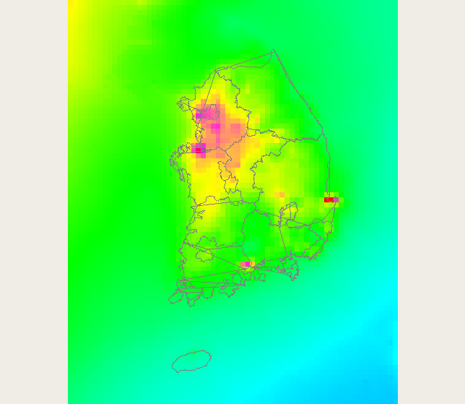
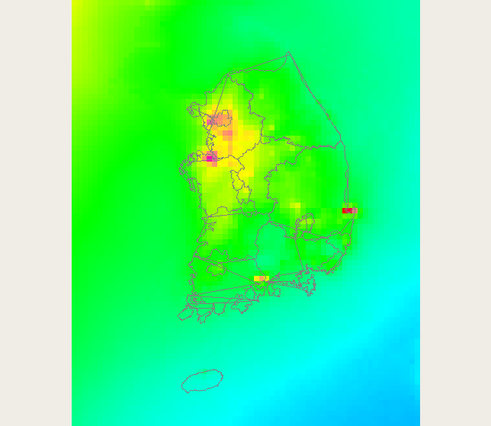
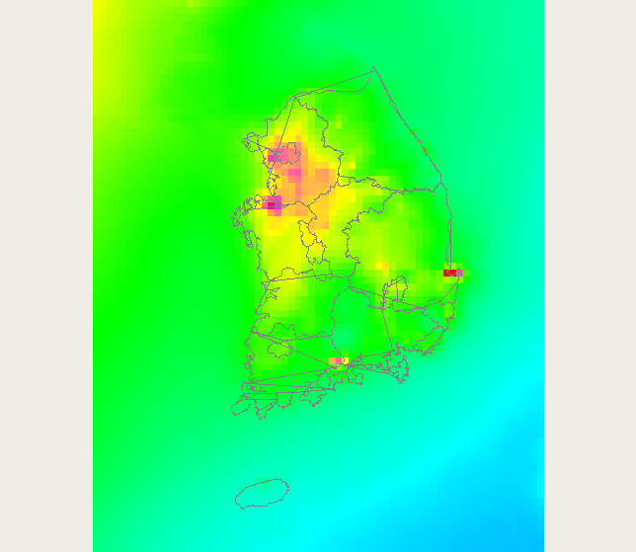
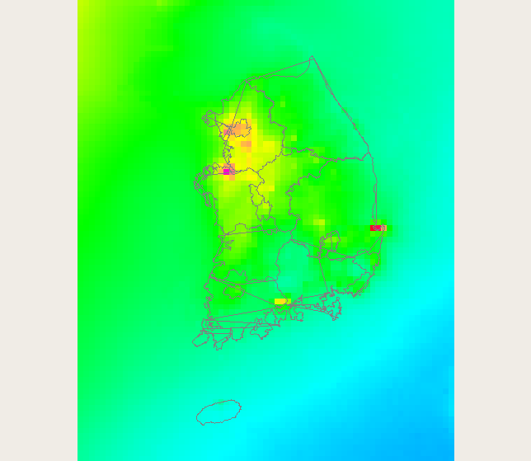
Result
Recommended policy in Korea for PM_{2.5}
(A)
(B)
Targeted PM_{2.5} in A region(Seoul):
5ug/m³ Reduction
(A) : Power 25%, Industry 43%, Mobile 32%, Residential 15% Reduction
(B) : (A) + Solvent VOC 30% Reduction
(C) : (A) + Agriculture Sector 30% Reduction
(D) : (A) + Solvent VOC & Agriculture Sector 30% Reduction
(C)
(D)
12
Notes:
This area is Seoul, and this area is SMA.
As shown in the graph above, you can see that D shows the highest reduction.

Slide 13
Summary & Future Work
Summary
To improve the fine particle pollution in Korea, it is necessary to consider the secondary formation.
In order to support Korea's fine particle reduction policy, a fast air quality responses modeling method that can simulate secondary formation is needed.
Based on the evaluation of Korea's current fine dust reduction policy by running RSM, we believe that the target will not be met.
As a result of reducing VOC and NH3, we can see that we are nearing the target.
As mentioned earlier, Korea has a large amount of secondary particulate matter, so a policy to reduce VOC and NH₃ is needed.
Ongoing Work
Development of GUIDE Model using Polynomial Function RSM(pf-RSM) and Evaluation of Reduction Policy in Korea.
Development of Policy Supporting Air Quality Model using Neural Network System.
13
Notes:
12
- finally, it is summary.
In this study, we assessed Korea's fine particle reduction policy using RSM and showed that it is important to reduce the pollutants that form secondary fine dust such as VOC and NH3.
Work in progress includes developing models using ABaCAS's pf-RSM and developing models using the Artificial Neural Network.

Slide 14
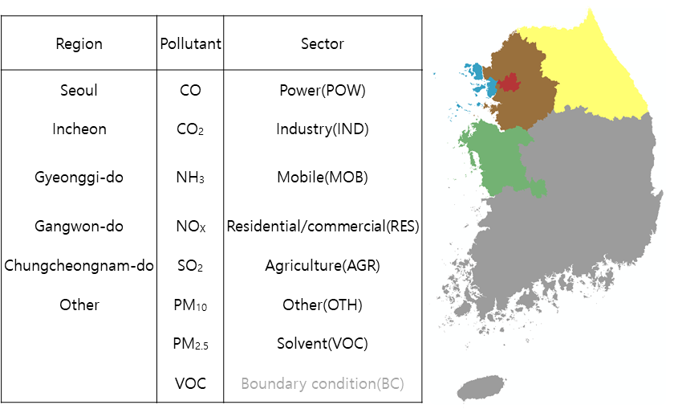
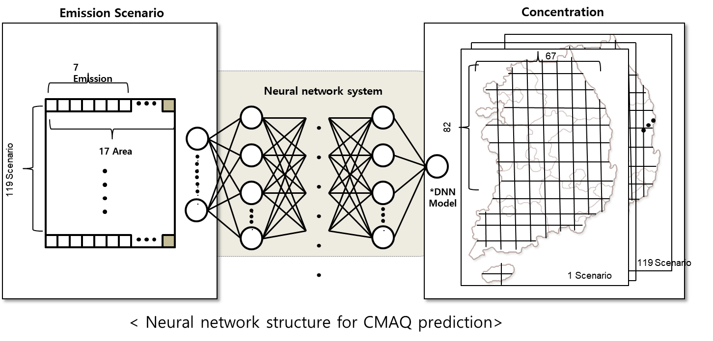
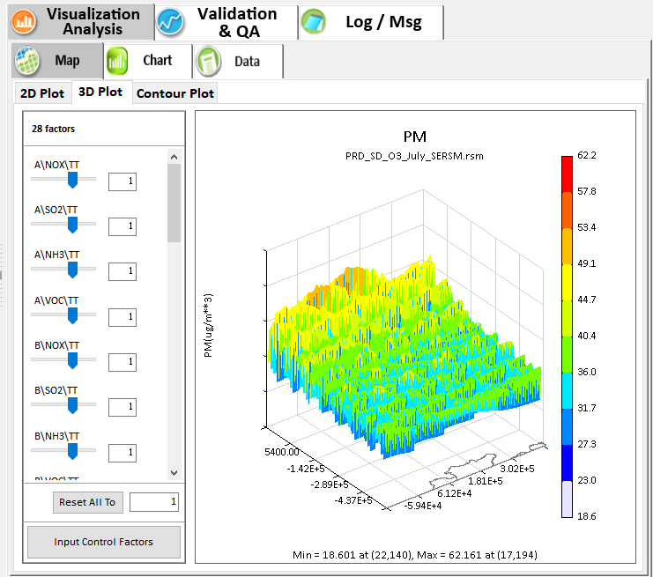
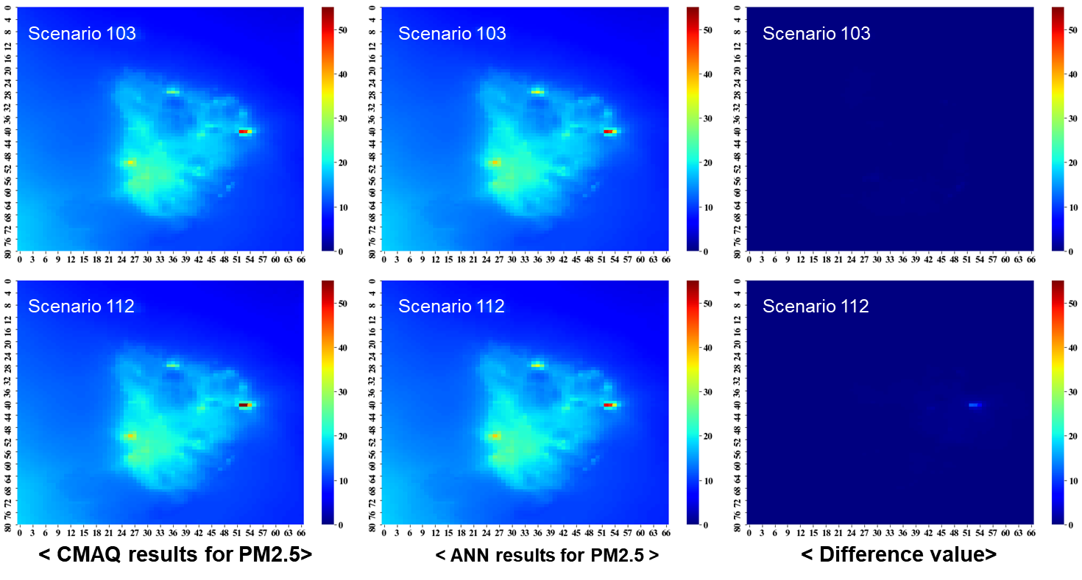
Ongoing Work
Polynomial Function (pf-RSM)
Artificial Neural Networks [ANN]
(DNN : Deep Neural Network)
(EH R&C, Donggeun Park)
14
Notes:
13
On the left is a simple initial result for pf-RSM, and on the right is a figure of the Artificial Neural Network Model.
- For more accurate and faster air quality simulation, we will build machine learning to replace RSM.
- The machine learning technique to be used is Artificial Neural Network.

Slide 15
Thank you

Slide 16
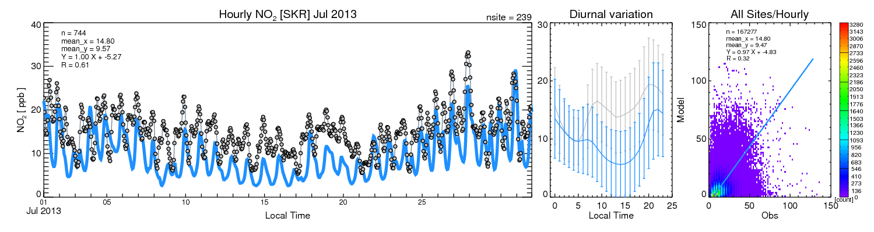
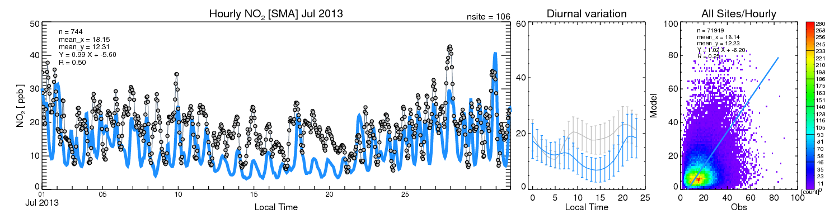
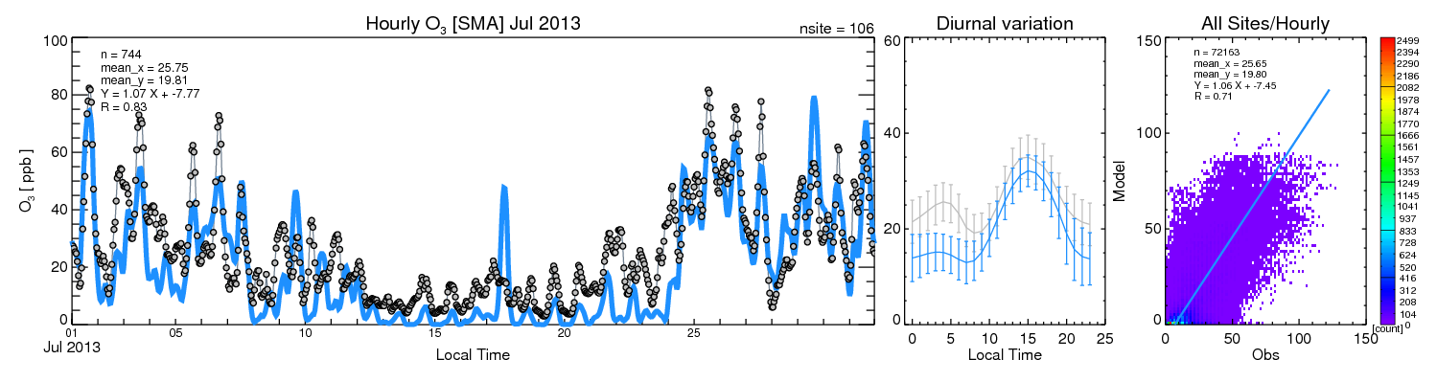
Objective: Policy Supporting Air Quality Model
Comparison between CMAQ simulation results and actual data for the High Ozone Season (July)
(a: Rural Area NO₂, b: Metropolitan Area NO₂,
c: Metropolitan Area O₃)
CMAQ Base Modeling Evaluation
Comparison of the simulated concentration of ozone and the measured concentration of atmospheric measurement network
a)
b)
c)
Notes:
Before we start the CMAS-RMS control scenario simulations, we peformed the complete CMAQ based modeling evaluations. These plots are showing the NOx and ozone simulation results in July.
The R square of NOx is about 0.6, but the R square of ozone is more than 0.7.
Based on these evaluations, I concluded that the performance of CMAQ was reasonable.

Slide 17
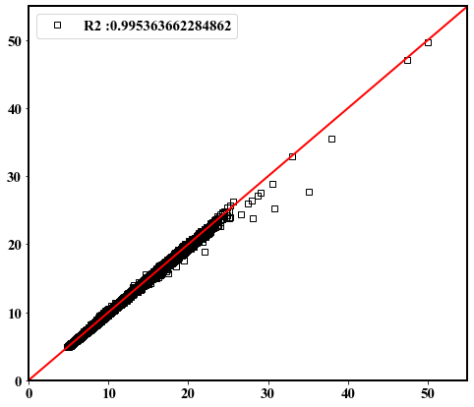
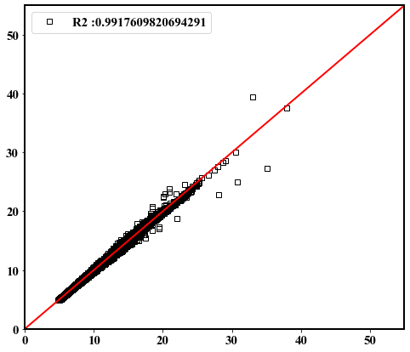

Ongoing Work
Artificial Neural Networks [ANN]
< X-Y scatter plot for PM2.5 simulated by CMAQ (x) and predicted by ANN (y) >
$$R^{2} for PM2.5$$
Test set 1:
Test set 2:
Test set 3:
Test set 4:
Test set 5:
Test set 6:
Test set 7:
Test set 8:
Test set 9:
Test set 10:
Test set 11:
Test set 12:
Test set 13:
Test set 14:
Test set 15:
Test set 16:
Test set 17:
Test set 18:
0.9900388352406807
0.9875725168431644
0.995363662284862
0.9902496015204016
0.9796365859943141
0.9922605937312811
0.992465383834284
0.9908581651211383
0.9935778893271817
0.991587651427032
0.9903208132541785
0.9917609820694291
0.9879447840246753
0.9961424054129685
0.9854696365856964
0.9922297245644464
0.9799730840919849
0.9922534028219463
(EH R&C, Donggeun Park)
17
Notes:
14
- A correlation analysis of the results for the 18 scenarios of ANN is presented.
- It can be seen that thecorrelation coefficient is higher than 0.98, which is highly correlated with the result of CMAQ.

