Slide 1
National Air Quality Forecast Capability
prediction updates:
bias correction for ozone
Ivanka Stajner¹, Jeff McQueen^{2,} Pius Lee³, Jianping Huang^{2,5},
Ho-Chun Huang^{2,5}, Li Pan^{3,6}, Youhua Tang^{3,6}, Daniel Tong^{3,6}, Ariel Stein³, James Wilzak⁴, Irina Djalalova^{4,8}, Dave Allured^{4,8}, Phil Dickerson⁷, Jose Tirado^{1,9}
  (1) NOAA NWS/STI
  (2) NOAA NWS/NCEP
  (3) NOAA ARL
  (4) NOAA ESRL
  (5) IMSG
  (6) CICS, University of Maryland
  (7) EPA
  (8) CIRES, University of Colorado
  (9) ERG
      with contributions from the entire NAQFC Implementation Team
CMAS Conference, Chapel Hill, NC October 24, 2018

Slide 2
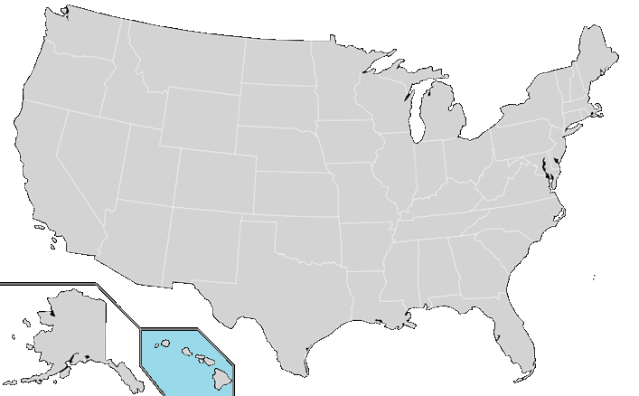
National Air Quality Forecast Capability status in October 2018
Improving the basis for air quality alerts
Providing air quality information for people at risk
Prediction Capabilities:
Operations:
Ozone nationwide
Smoke nationwide
Dust over CONUS
Fine particulate matter (PM2.5) nationwide
Testing of improvements:
Ozone
Smoke
PM2.5
2004: ozone
2007: ozone and smoke
2012: dust
2016: PM2.5
2005: ozone
2009: smoke
2010: ozone
2016: PM2.5
2010: ozone & smoke
2016: PM2.5

Slide 3
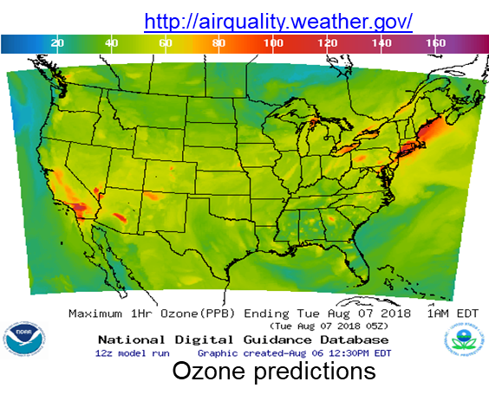
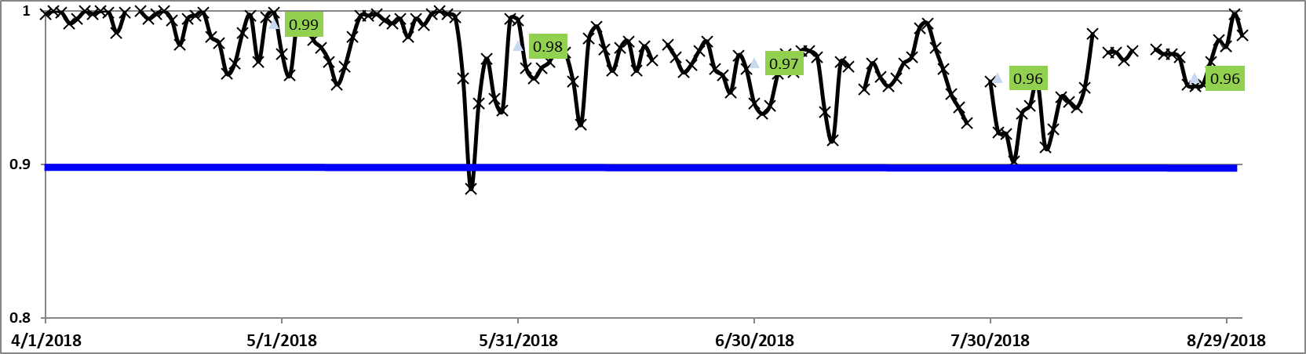
Ozone predictions
Model: Linked numerical prediction system
Operationally integrated on NCEP’s supercomputer
NOAA/EPA Community Multiscale Air Quality (CMAQ) model version 5.0.2
NOAA/NCEP North American Mesoscale (NAM) numerical weather prediction
Observational Input:
NWS compilation weather observations
EPA emissions inventory
Gridded forecast guidance products
On NWS servers: airquality.weather.gov, ftp-servers and web service (12km resolution, hourly for 48 hours)
Updated 2x daily
Verification basis, near-real time: Ground-level AIRNow observations of surface ozone and PM2.5
Customer outreach/feedback
State & Local AQ forecasters coordinated with EPA
Public and Private Sector AQ constituents
CONUS, wrt 70 ppb Threshold
Operational
Maintaining prediction accuracy as the warning threshold was lowered and emissions of pollutants are changing
Operational daily maximum of 8h ozone predictions wrt 70 ppb threshold over CONUS

Slide 4
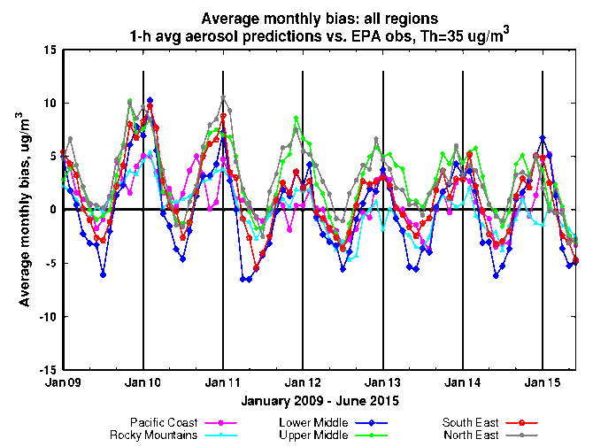
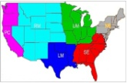
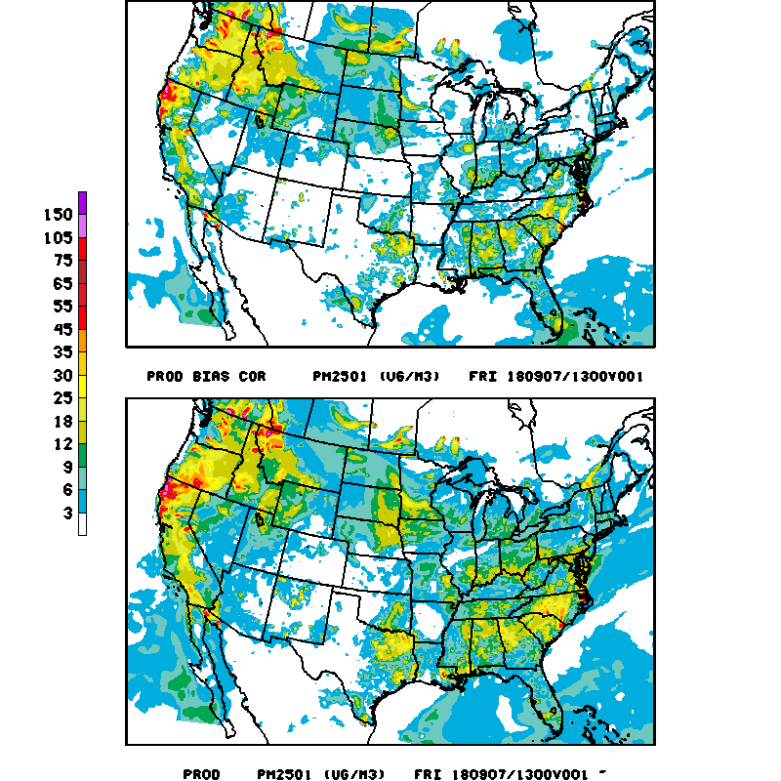
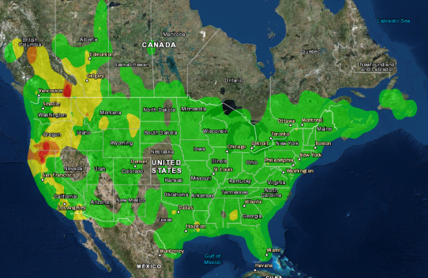
PM2.5 predictions from the same CMAQ system
  Predictions for 48h at 12km resolution over CONUS
  CMAQ 5.0.2: CB05 gases, AERO-6 aerosols since June 2017; CMAQ 4.7, CB05 with AERO-4 prior
  Sea salt emissions, wildfire and dust emissions and suppression of soil emissions from snow/ice covered terrain included since summer 2014 (Lee et al., Weather and Forecasting 2016); only NEI sources prior
  Model predictions exhibit seasonal prediction biases: overestimate in the winter; underestimate in summer.
  Additional observational input: AIRNow PM2.5 observations for bias correction and verification
Forecast challenges
Improving sources for wildfire smoke and dust
Chemical mechanisms eg. SOA
Meteorology eg. PBL height
Chemical boundary conditions/trans-boundary inputs
NAQFC PM2.5 predictions

Slide 5
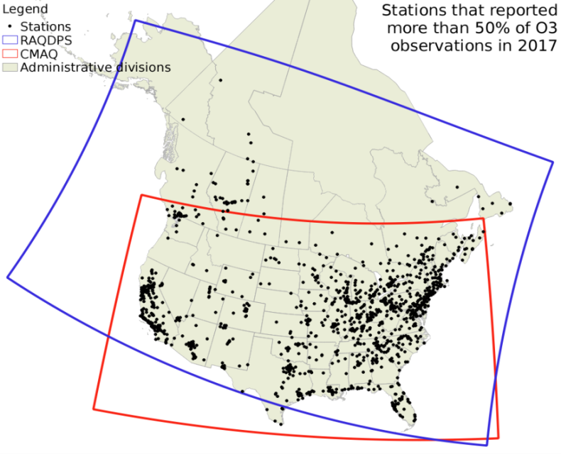
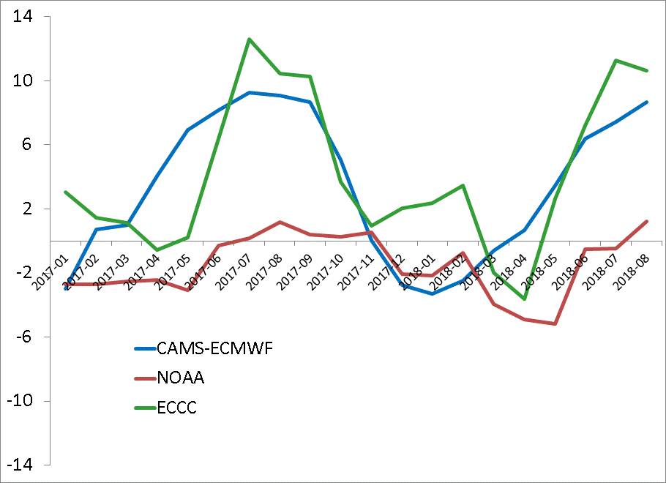
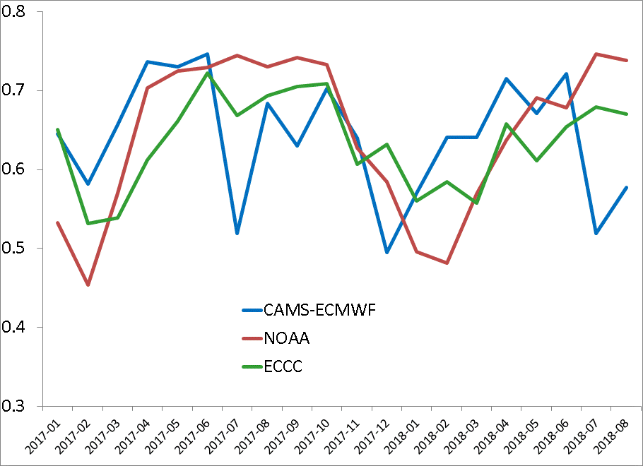
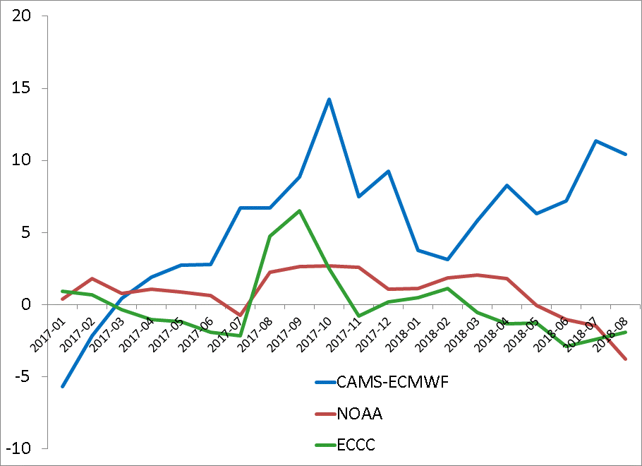
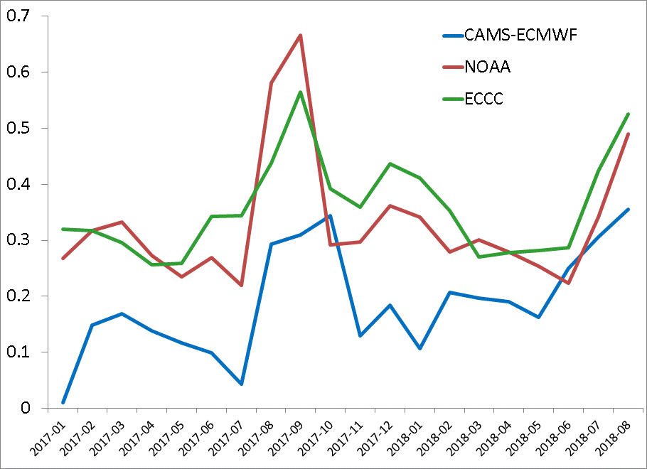
Monthly statistics for
ECCC, NOAA and ECMWF systems (2017/01 – 2018/08)
O₃
Number of stations that reported at least 50% of all the hourly observations:
O₃ | 1196
PM_{2.5} | 789
NOAA has the best performance for both MB and R in summertime.
O₃
MEAN BIAS (MB)
ECCC and NOAA have comparable MB and R values. ECMWF is over-predicting PM_{2.5}.
PM_{2.5}
CORRELATION (R)
Pavlovic et al. Statistics are calculated using daily MAX observed and forecasted concentrations

Slide 6
Updates to air quality predictions for the next implementation
Update fine particulate matter (PM2.5) bias correction system to use:
  Consistent model predictions for training of the unified KFAN bias correction system
  Increased number of observation sites for model bias correction to over 900 monitors
  Improvements to forecast extreme events by adding the difference between the current raw model forecast and historical analogs’ mean to the KFAN bias-corrected predictions
New ozone bias correction with the same unified codes and configuration
  Uses ozone, wind direction, wind speed, temperature, solar radiation, NOx, NOy and PBL height as parameters to identify analogs
Updated anthropogenic emissions (NEI2014)
Updated fire emissions processing
  To accommodate NESDIS operational procedure changes
New fire emissions diurnal profile
Update Alaska and Hawaii domain CMAQ code to the same version used for CONUS :
  CB05 gas-phase and aero6 aerosol chemistry (155 species)
  Improved heterogeneous, aqueous, winter-time reactions
  Improved SOA and coarse mode PM
Wildfire smoke emissions and bias correction are not used on O-CONUS domains at this time.
Tentative implementation schedule is in mid-December

Slide 7
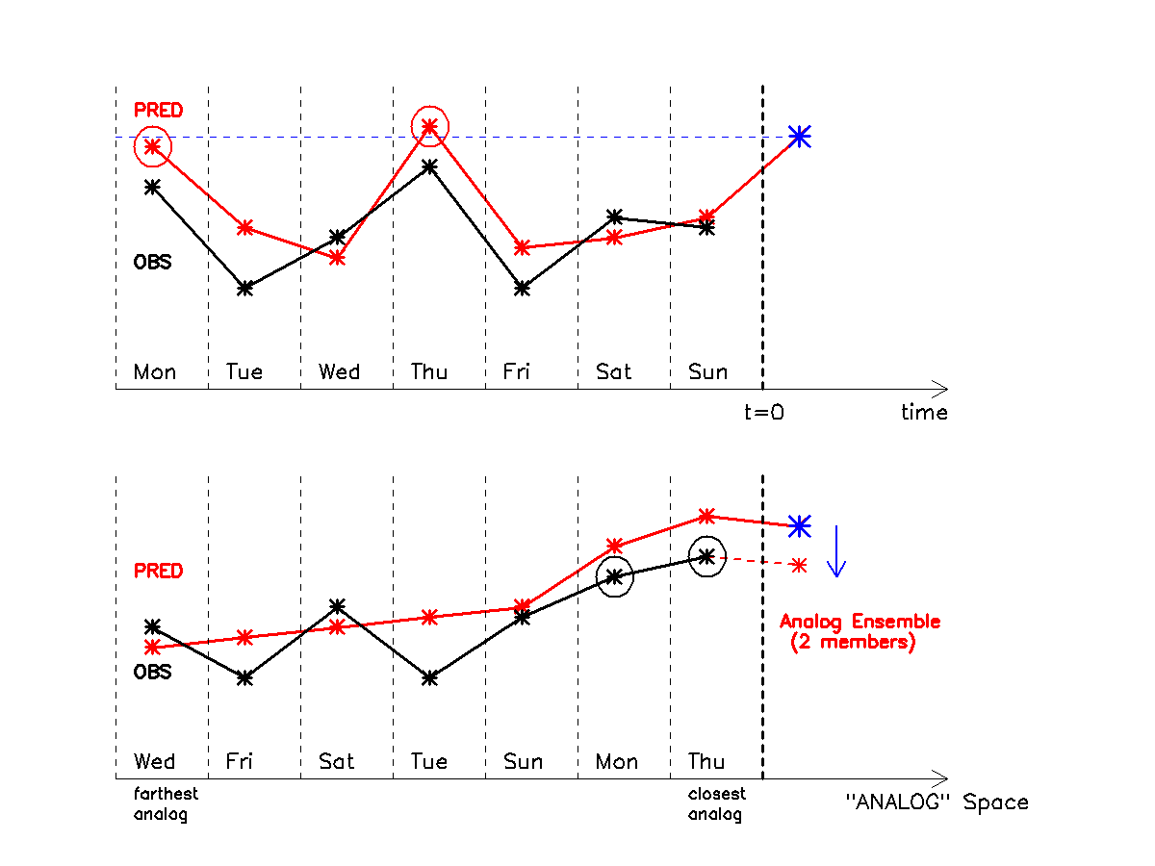

Bias correction scheme
Schematic of the standard analog post-processing scheme.
The analog technique searches for previous forecasts similar to the current forecast (blue star) – where the similar forecasts are circled in black, and re-orders the time series with the first closest analog directly preceding the new forecast, and the second closest forecast next (bottom panel)
The observations (in black) corresponding to the two-best analog forecasts are then weighted by how closely they resemble the current forecast, and their weighted sum (the ensemble mean) provides the corrected forecast estimate (new green star on day eight)
Once the bias correction is calculated at a given forecast hour for each AIRNow observation site, the bias is interpolated across the CMAQ grid, and then added to the CMAQ gridded forecast.
Red curve: time series predicted by a model
Black curve: observations
Data to the right of the dashed line at t=0: the new forecast

Slide 8
KFAN modification for extreme event correction
PM2.5 from wildfires
Ozone exceedances in the Eastern US
CMAQ
KFAN-New
Analogs
CMAQ
Ozone, PM2.5
Analogs
Ozone, PM2.5
Obs
KFAN
Obs
KFAN
Time
Time
Standard KFAN bias correction
with good analogs
New KFAN bias correction with
very poor analogs
The left panel is the typical case of having analogs that are similar to the current forecast, but the observations have a bias relative to those analogs, which is then corrected.
If an extreme event occurs (right panel) that previously has not occurred in the training data set, the best analogs will have a different value than the current forecast (indicated by the dashed red line).
The modification made to the KFAN technique is simply to add this difference (the dashed red line) to the standard KFAN value, resulting in the KFAN-new forecast.

Slide 9
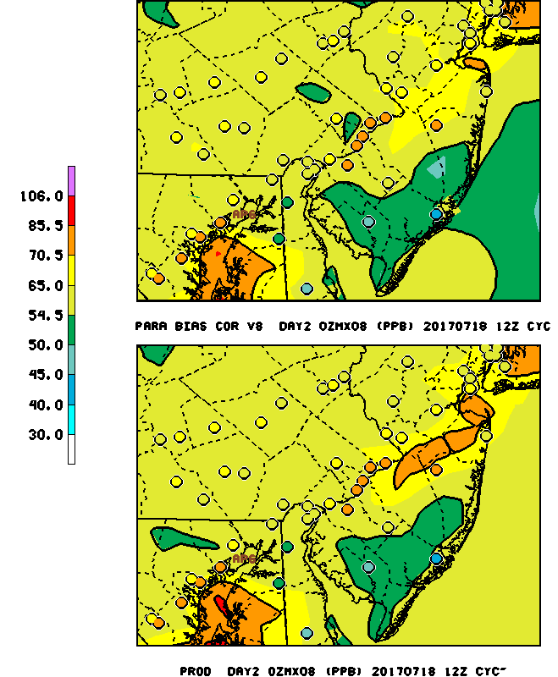
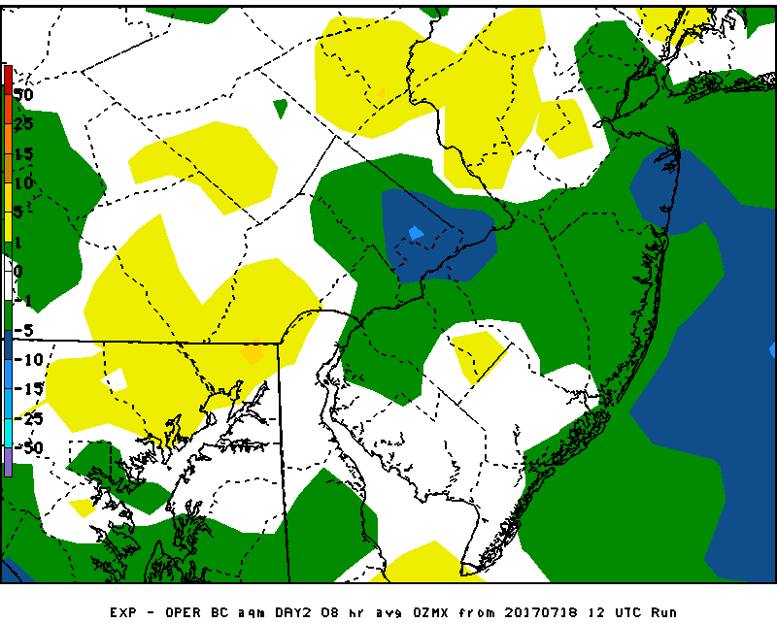
Day 2 8hr daily max O₃
Valid July 19,2017
EXP BC - Production
Philadelphia experimental bias-corrected
O₃ predictions degraded from Raw production
predictions by 5-10 ppb
OBS: 77 ppb
Prod: 67
Exp BC: 61
9
Notes:
Ozone bias correction degrades forecast

Slide 10
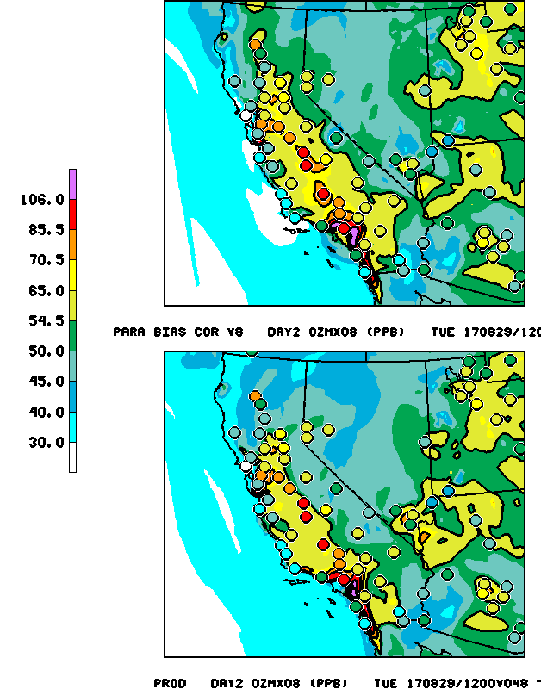
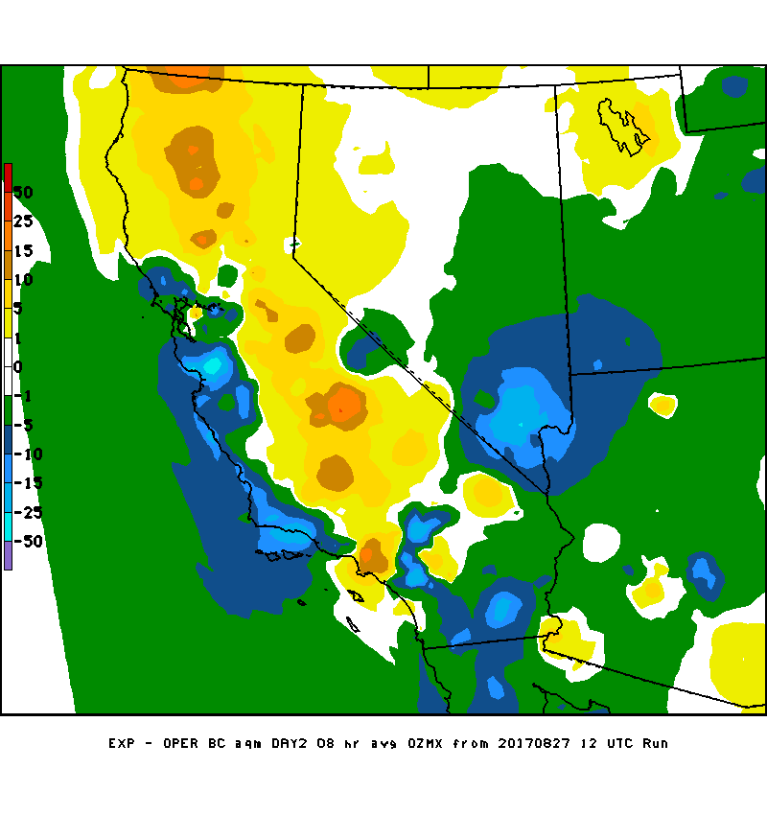
8 hr max O₃ for day 2
Valid Aug 28, 2017
EXP BC
EXP BC - Production
PROD
BC: Helps correct underprediction over California valleys
from fire influenced O₃ production

Slide 11
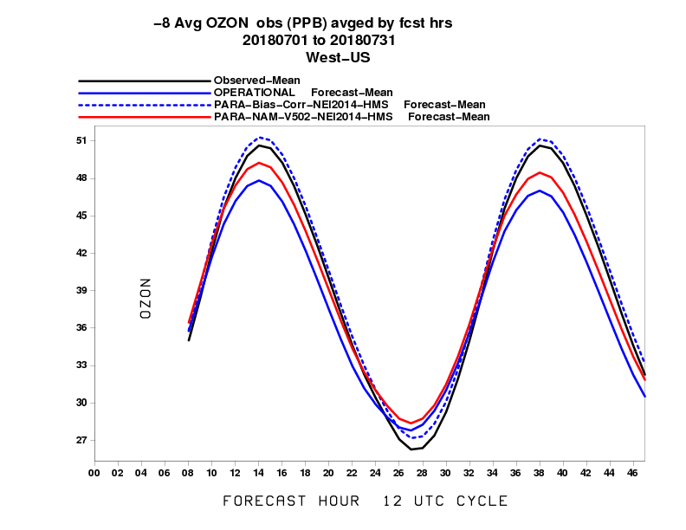
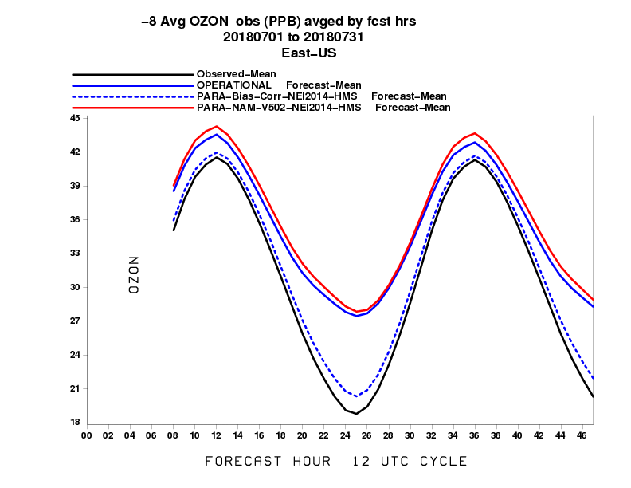
Performance of ozone predictions: diurnal variability in July 2018
Western U.S.
Eastern U.S.
Bias correction:
Improves agreement for daily maximum of 8h average ozone
Improves diurnal cycle amplitude

Slide 12
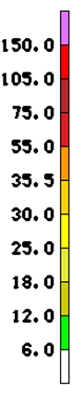
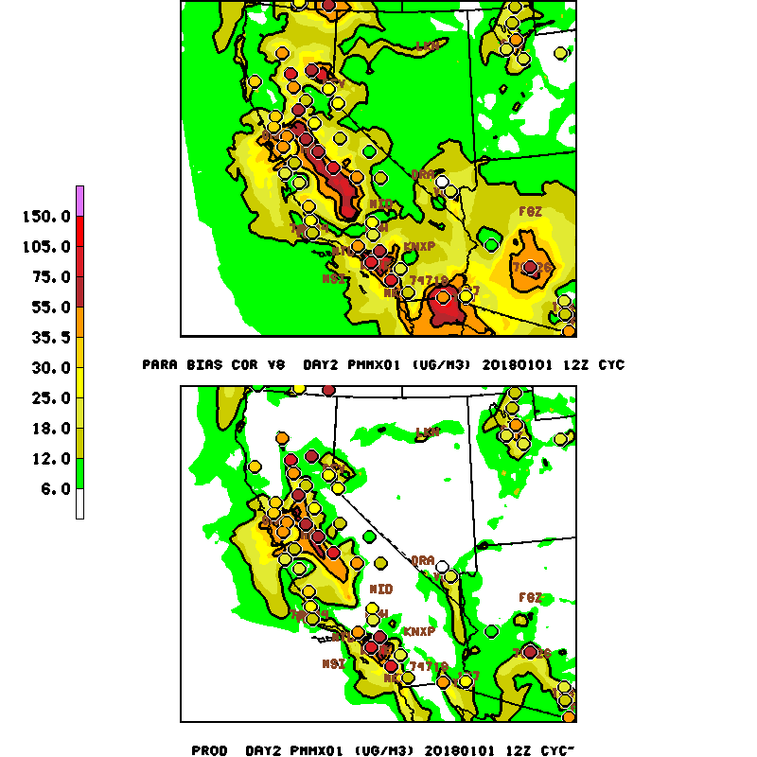
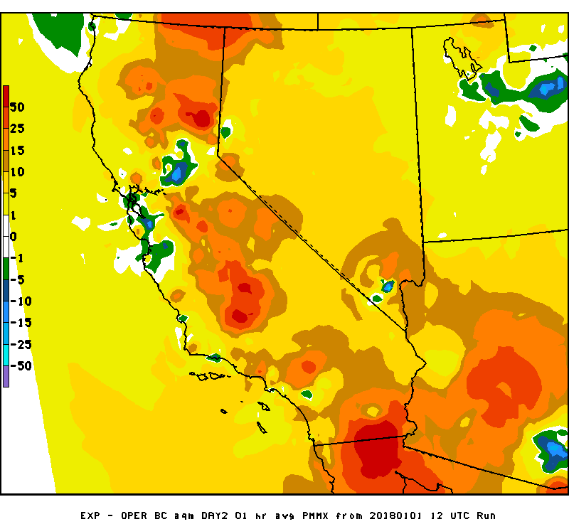
Day 2 daily 1hr Max PM2.5
Valid Jan. 2, 2018
PROD
“Raw”
EXP
BC V8
Bias correction better captures stagnation
episode in Central Valley
EXP BC - PROD

Slide 13
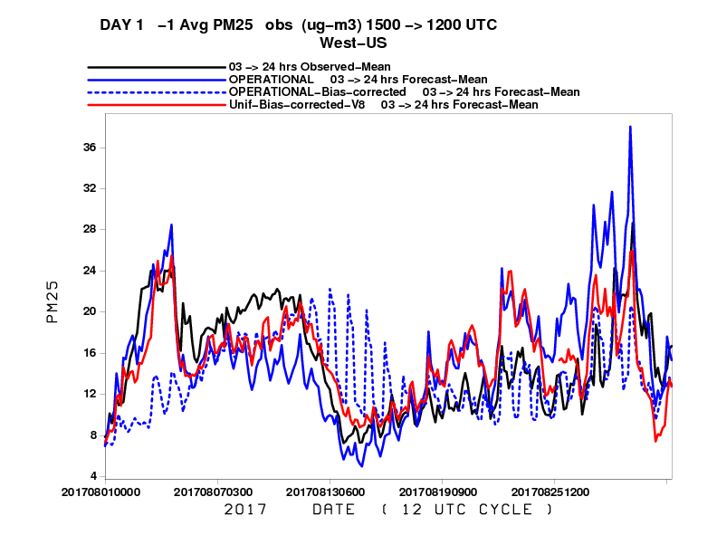
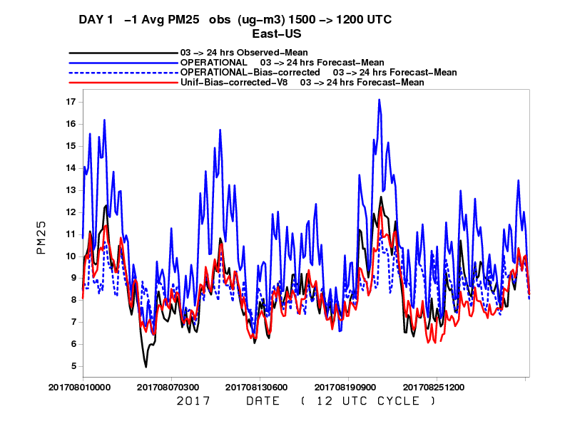
Prod, Prod BC, Exp BC PM2.5
Daily Time Series
August, 2017
WEST
EAST
Exp Bias correction
West: - Removes post wild-fire event noise
  - Captures wild-fire events esp. early Aug
East: Similar to prod BC, some improvement around 8/21-8/25

Slide 14
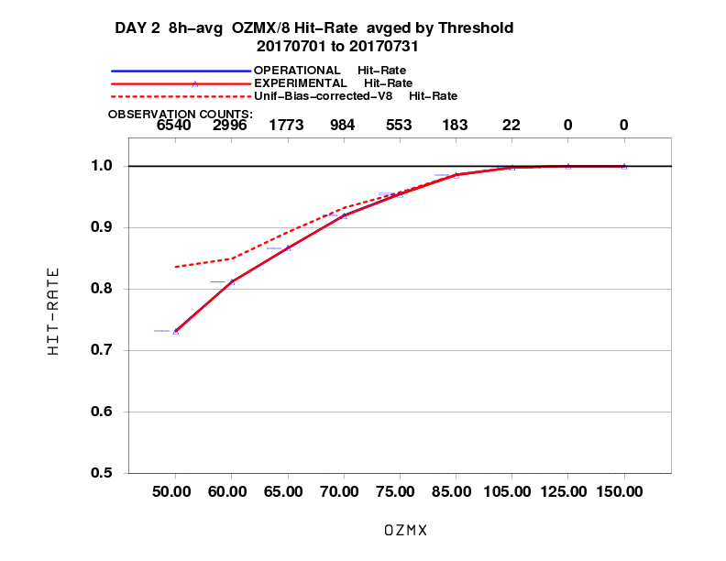
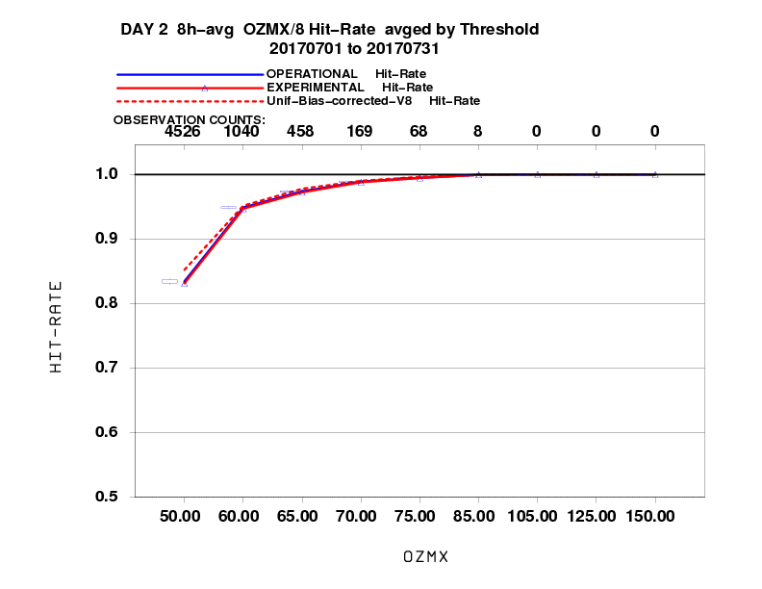
Performance of ozone predictions
Fraction correct for 8h ozone maximum (day 2)
Western US
Eastern US
July
July
BC compared to Raw | Exper. ozone 8h max BC
Day 2 | West | East
July | ++ | +
August | ++ | +
Experimental bias correction for ozone is better than raw model, especially in the Western US

Slide 15
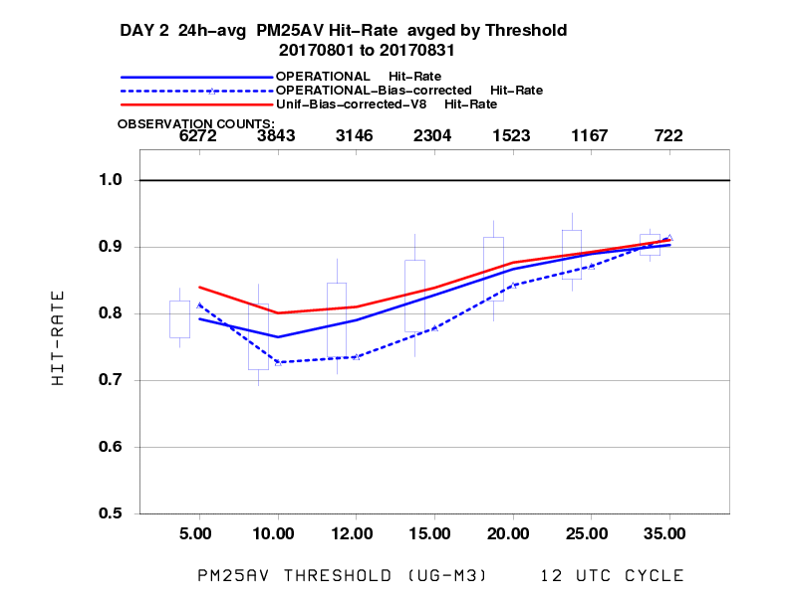
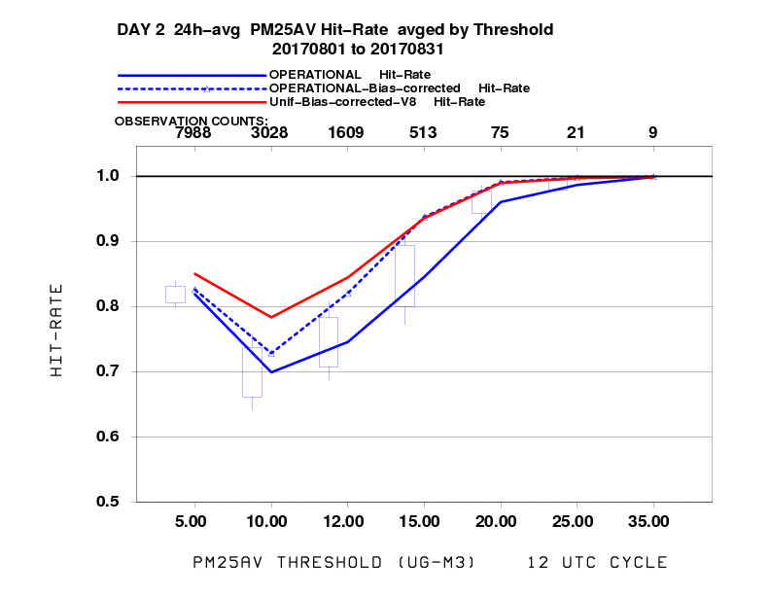
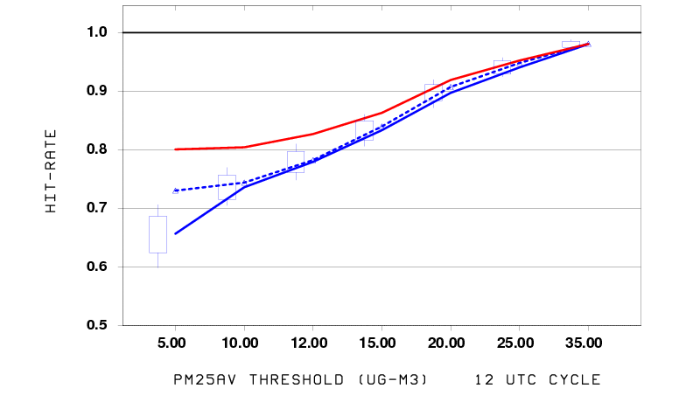
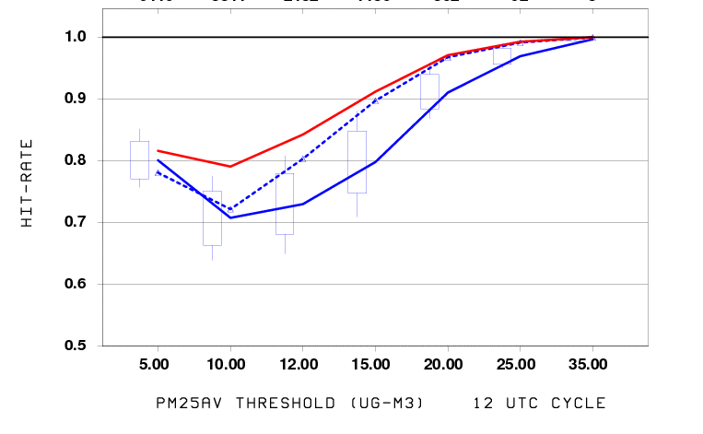
Performance of PM2.5 predictions
(Aug 2017 and Jan 2018)
BC compared to Raw | Operational PM2.5 24h avg BC |  | Exper. PM2.5 24h avg BC
Day 2 | West | East | West | East
August | -- | + | + | ++
January | + | + | ++ | ++
Fraction correct for 24-hour average PM2.5 (day 2)
Western US
Eastern US
Experimental bias correction is better than operational one
Experimental bias correction is much better than raw model in January and for Eastern US in August
August
August
January
January
January

Slide 16
Summary evaluation of bias corrected predictions
BC compared to Raw | Operational PM2.5 24h avg BC |  | Experimental PM2.5 24h avg BC |  | Experimental ozone 8h max BC
Day 2 | West | East | West | East | West | East
July | + | + | ++ | ++ | ++ | +
August | -- | + | + | ++ | ++ | +
September | -/+ | + | + | ++ | ++ | +
January | + | + | ++ | ++
Fraction Correct for day 2 predictions indicates:
New ozone bias corrected prediction is better than raw model prediction
Updated PM2.5 bias correction is better than both raw model predictions and operational bias corrected predictions

Slide 17
Emissions

Slide 18
Emissions in the operational model
Point sources: upgrade based on 2017 CEM and 2018 DoE Energy Outlook, Canada 2011 Environment Canada Emission Inventory (ECEI), Mexico inventory (MI) 2012 version2.2
Area sources: NEI2011 with O_n_G adjustment for 2016 + FORM/NOx upgrade
Non-road: for U.S. used NEI2011, ECEI 2006 for Canada; MI 2012 for Mexico
Mobile sources: Cross State Air Pollution Rule (CSAPR) 2011 Emission Data
Intermittent emissions: windblown dust – FENGSHA Model (Tong et al., 2016)
Wild fires -- NESDIS Hazard Mapping System (HMS) & fuel from New USFS BlueSky v3.5.1
Natural source: Biogenic with BEIS3 Version 3.14; Sea-salt based on 10m wind

Slide 19
Next emissions update
NEI2014v2 from EPA – significant activity data changes
Some of the differences from NEI2011:
Oil and gas has point and area components
Area Agriculture: NH₃ expanded with all related species
MOVES2014v2: 2014 Activities modulated by 2017 NAM

Slide 20
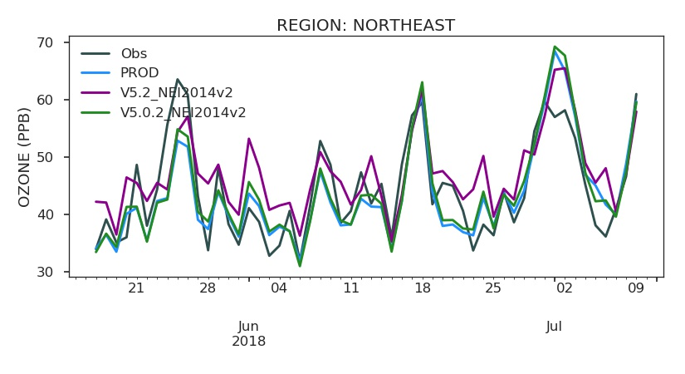
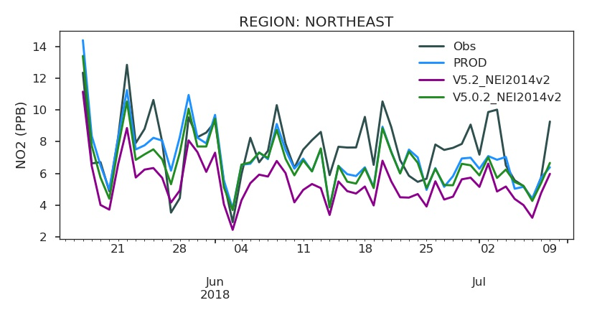
Emissions testing Summer 2018
NE US
Larger impacts from CMAQ versions than from emissions
NEI2014V2 testing for Summer 2018

Slide 21
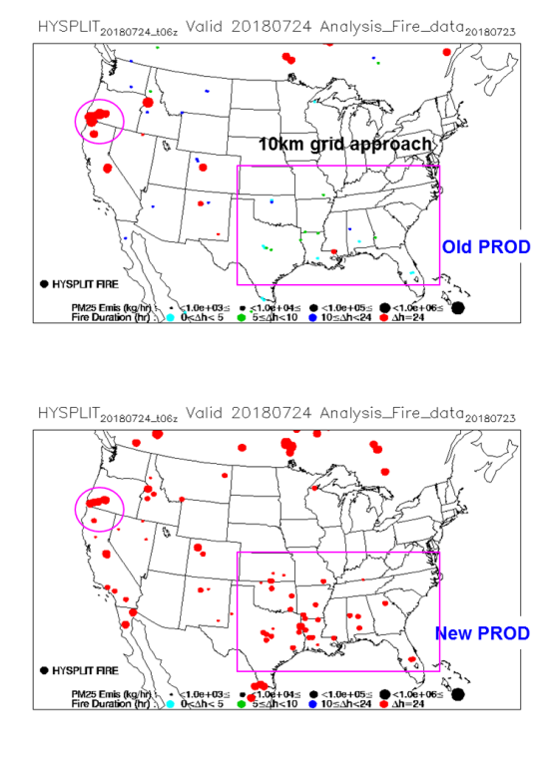
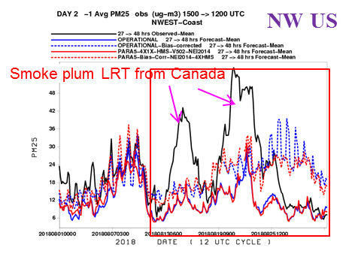
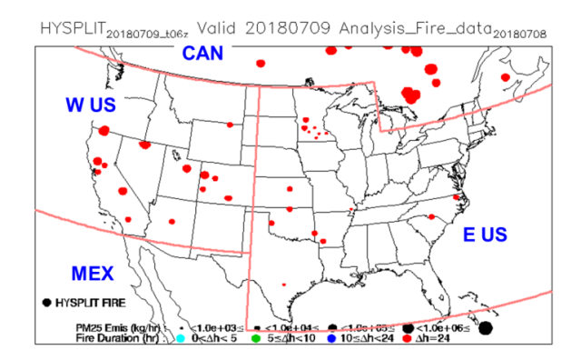
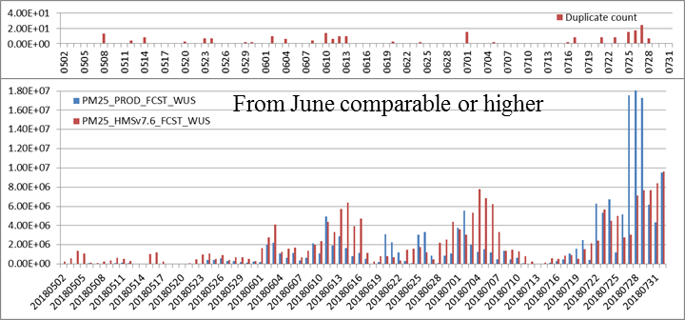
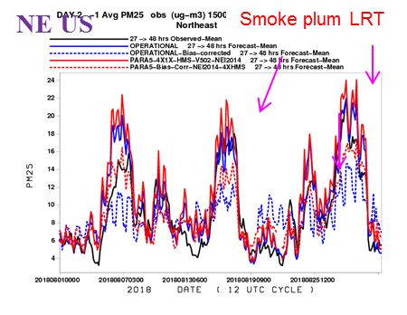
Updated wildfire emissions
Interim NESDIS HMS processed fire information system (w/ GOES-16)
  NESDIS HMS group discontinues the manual inspection of HMS fire because of the increase number of fire detection from GOES-16 data.
  All fires in a 10 km² gridded area are represented by one HMS fires information.
  Interim solution only has manual inspection to remove false positive and add false negative west of 102W in the CONUS domain.
  Used operationally from April 11-July 31, 2018.
New HYSPLIT/BlueSky fire processing based on HMS fire detections (w/ GOES-16)
  New automated system is used operationally since August 01 2018.
  Aggregate all satellite fire detections, both geostationary and orbital, into a 0.01°x0.01° grid.
  Identify HMS fire and starting time of each grid with more than one detection.
  Assume all fires continue through forecast period
Impact of 24 hour fire duration assumption
Without the Canadian smoke plume included in the LBC, CMAQ greatly underestimates the NW US PM₂₅.
The comparison of the western US fire PM₂₅ emission between using HMS provided fire information (w/ manual inspection; blue bar) and from automated system (red bar). Results from automated system lead to overestimate of small fires but underestimate of large fires with comparable results of medium fire.
Missing manual increase of HMS fire strength
CMAQ captures the impact of LRT smoke plume on the NE US.
HMS Fire duplication
W US - Fire PM25 emission in forecast days

Slide 22
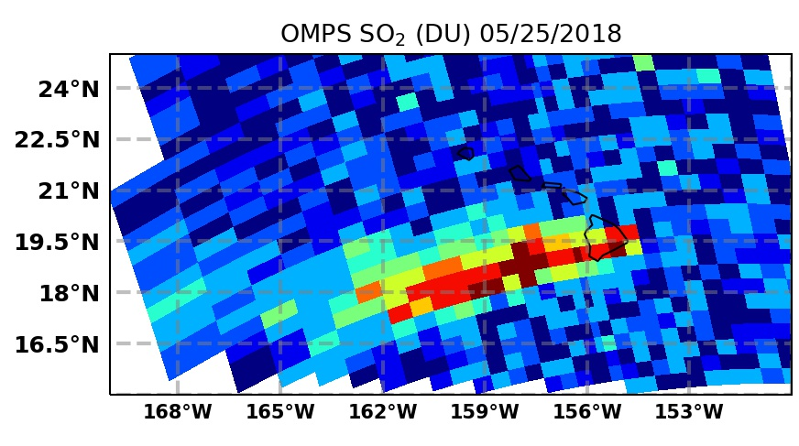
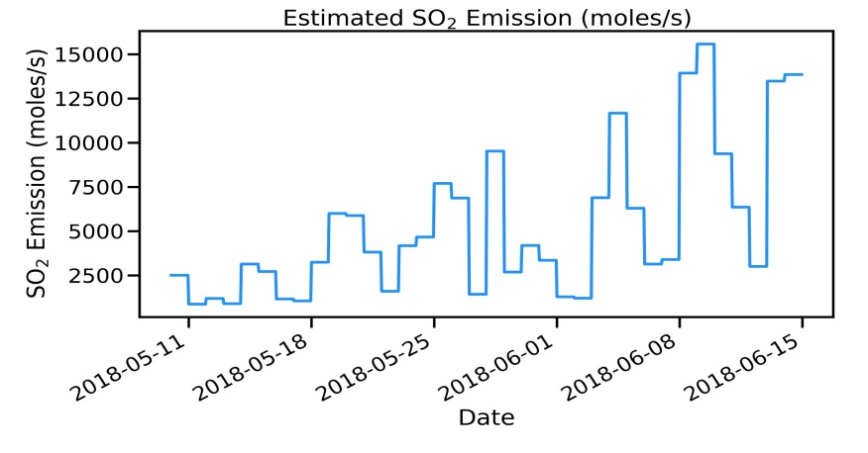
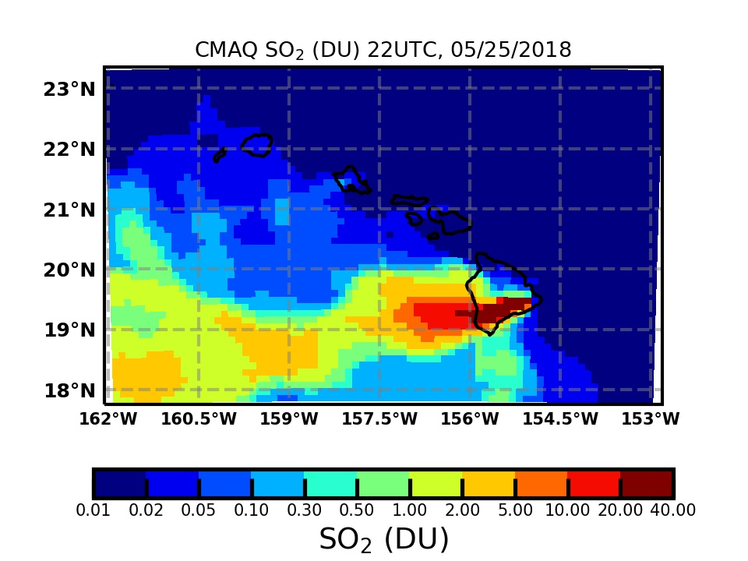
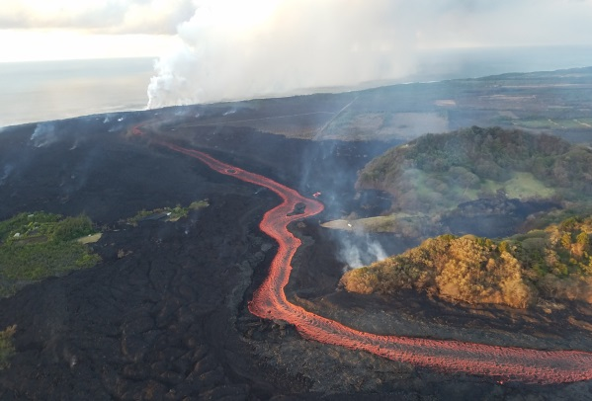
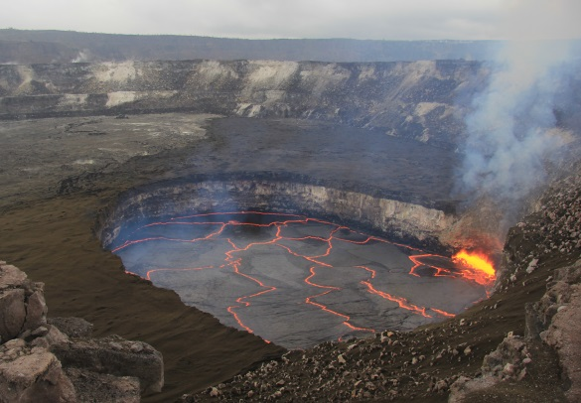
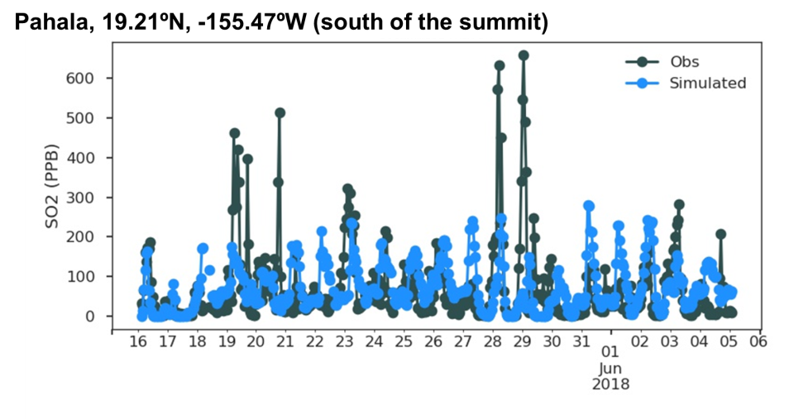
Initial retrospective testing: volcanic emissions - Kilauea example
The Kilauea volcano in the big island of Hawaii erupted since May 2018. The major eruption occurred in two locations: the east rift zone (lava outflow region) and the summit (lava lake). The volcano activities emitted significant amount of SO₂ and created the unhealthy VOG plumes. We estimated the SO₂ emission and plume rise distribution using OMPS satellite data, and CMAQ model results agreed well with the observation.

Slide 23
Testing of predictions with FV3GFS and for day 3

Slide 24
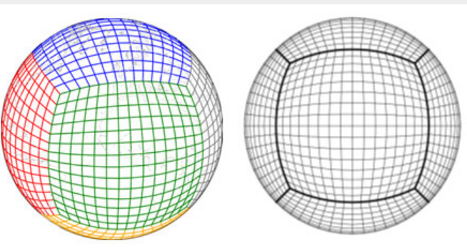
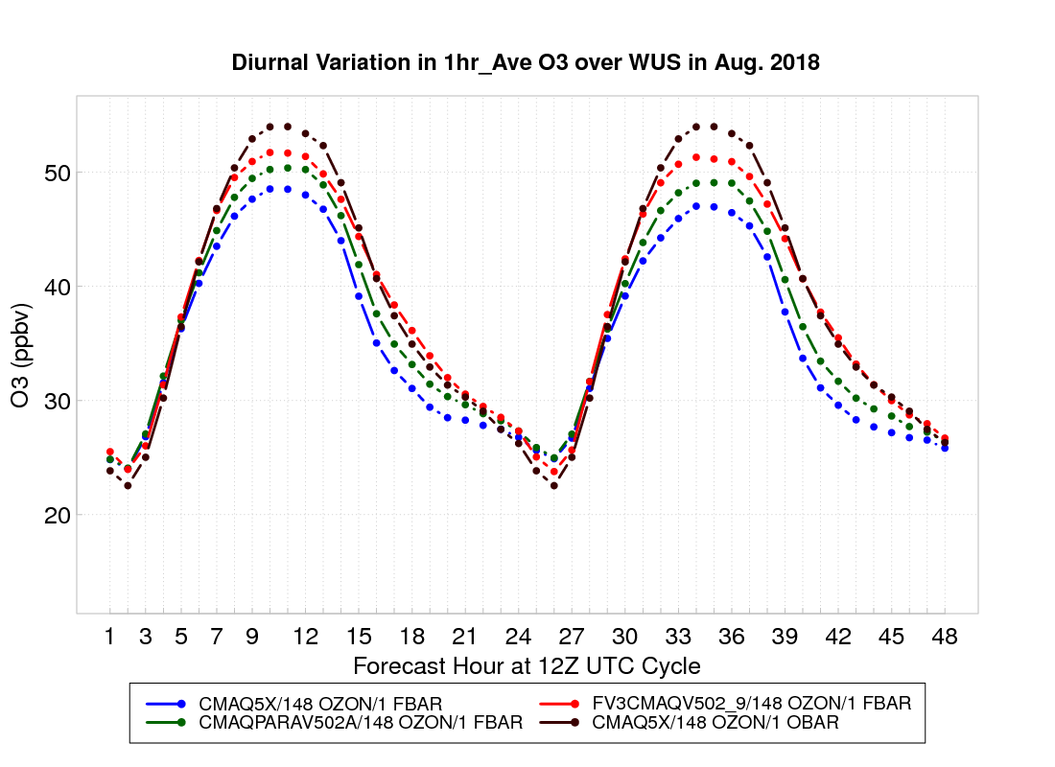
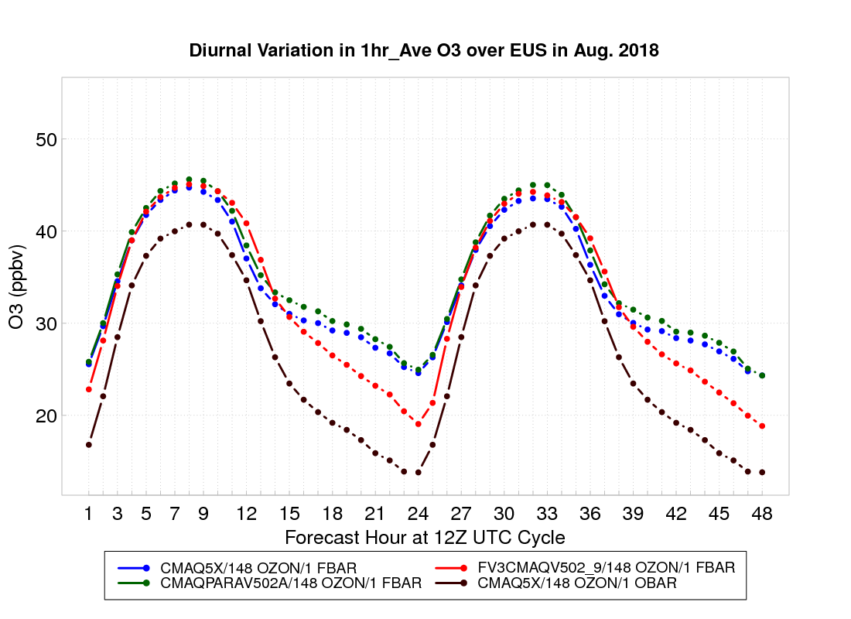
FV3GFS
PM_{2.5} under-predicted, especially during daytime
Average ozone shows some improvement
WUS
EUS
Observations
Operational (NAM + NEI2011)
NAM + NEI2014
FV3GFS + NEI2014
FCST HR 12 UTC Cycle
FCST HR 12 UTC Cycle

Slide 25
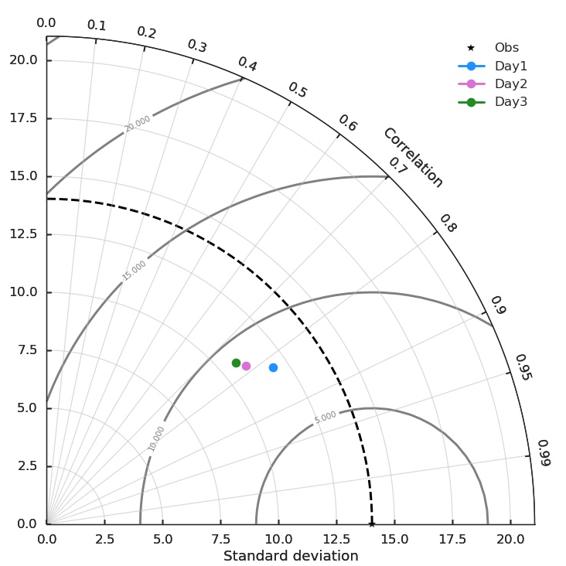
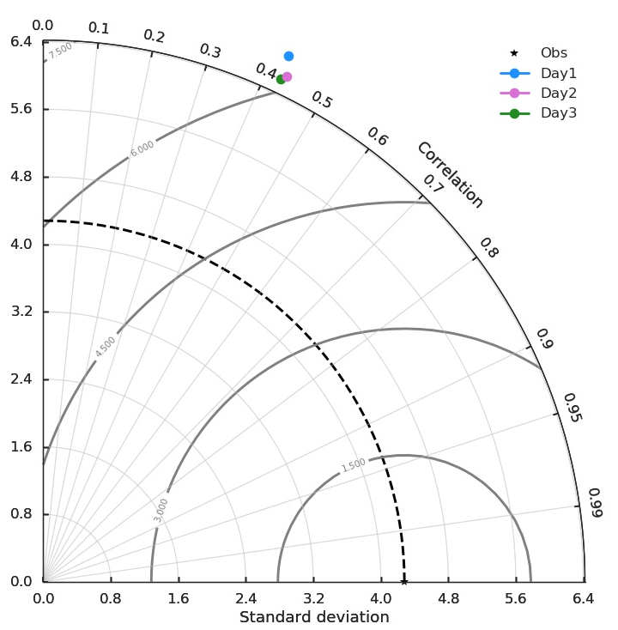
Performance for Day 1, 2 and 3 predictions from
FV3-CMAQ5.0.2 (20180913-20180924)
MDA8 O₃
24 h PM_{2.5}
Performance for Day 2 and Day 3 predictions is comparable

Slide 26
Summary
Next implementation planned for December:
New bias-corrected ozone predictions
Updated fine particulate matter (PM2.5) bias correction
Updated anthropogenic emissions from NEI2014v2
Updated wildfire smoke emissions diurnal profile
Updated Alaska and Hawaii domain CMAQ code to the same version used for CONUS
Work in progress:
Transition to using Unified Forecast System based on FV3GFS to provide meteorology for off-line and in-line coupling with CMAQ
Extension of predictions to 72 hours
Emissions improvements
Testing of updated CMAQ versions

Slide 27
Acknowledgments:
AQF implementation team members
Special thanks to previous NOAA and EPA team members who contributed to the system development
NOAA/NWS/STI Ivanka Stajner NAQFC Manager
NWS/OD Cynthia Jones Data Communications
NWS/OSTI/MDL David Miller, Dave Ruth Dev. Verification, NDGD Product Development
NWS/STI Jose Tirado-Delgado Program Support
NESDIS/NCDC Alan Hall Product Archiving
NWS/NCEP
  Jeff McQueen, Jianping Huang, Ho-Chun Huang AQF model interface development, testing, & integration
  Jun Wang, Li Pan, *Sarah Lu Global dust aerosol and feedback testing
  *Brad Ferrier, *Eric Rogers, NAM coordination
  *Hui-Ya Chuang, Perry Shafran, Boi Voung
  Geoff Manikin Smoke and dust product testing and integration
  Rebecca Cosgrove, Steven Earle, Chris Magee NCO transition and systems testing
  Mike Bodner, Andrew Orrison HPC coordination and AQF webdrawer
ESRL/PSD
Jim Wilczak, Irina, Djalalova, Dave Allerud, bias correction development
NOAA/OAR/ARL
  Pius Lee, Daniel Tong, Youhua Tang CMAQ development, adaptation of AQ simulations for AQF
  Barry Baker
  Ariel Stein HYSPLIT adaptations
NESDIS/STAR Shobha Kondragunta Smoke and dust verification product development
NESDIS/OSDPD Liqun Ma Production of smoke and dust verification products
EPA/OAQPS partners:
Chet Wayland, Phil Dickerson, Brad Johns, John White AIRNow development, coordination with NAQFC
  * Guest Contributors

