Slide 1
Development of 2016 Hemispheric Emissions for CMAQ
October 24, 2018
Presented by: Jeff Vukovich
A. Eyth, B. Henderson, C. Jang (US EPA OAQPS)
C. Allen, J. Beidler, K. Talgo (CSRA-GDIT)

Slide 2
Project Overview
Goal: Support a northern hemispheric CMAQ run for year 2016 using the latest available emissions data to better understand hemispheric transport of biogenic and anthropogenic pollutants
  Implement N. American emissions inventories using latest 2016 modeling platform
  Integrate a recently acquired year 2015 China inventory
  Project year 2010 Hemispheric Transport of Air Pollutants (HTAP) v2 gridded inventories to more current year

Slide 3
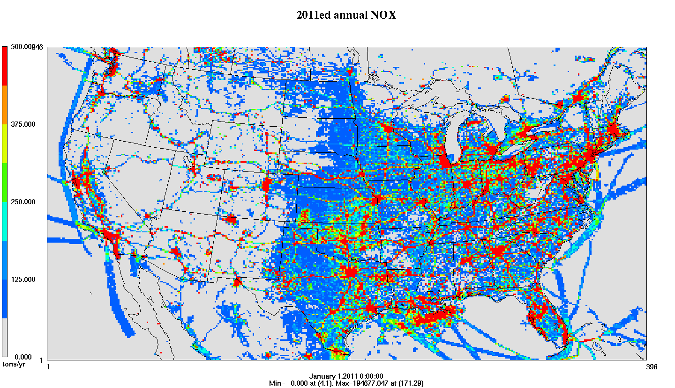

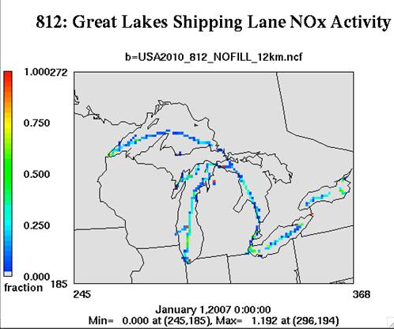
Emissions Modeling Process
Ancillary Data: profiles and cross references
SMOKE
SMOKE software performs
temporal allocation,
spatial allocation, speciation, and plume rise to create:
Temporal Profiles
Inventories
(annual, monthly, daily, hourly)
Met. Data
Speciation Profiles
Gridded, hourly, speciated emissions in a format for an air quality model
Spatial Surrogates
Notes:
Go quickly: Ancillary data = temporal profiles, speciation profiles, spatial surrogates

Slide 4
Challenges
Achieving consistency throughout the hemisphere in speciation, spatial allocation, temporal allocation, and vertical allocation
Preparing emissions for the rest of the northern hemisphere based on gridded inventories
Implementing new China inventory
Obtaining hemispheric inventories for fires and biogenics
Projecting HTAP gridded inventory to a more current year
Zeroing out HTAP inventory over North America
Notes:
Give a quick introduction to emissions modeling
Specifics about 2011v6.2 platform

Slide 5
Use of HTAP inventories
Resolution: 0.1 degrees latitude by 0.1 degrees longitude for year 2010
Pollutants: CO, NMVOC, NO_{x}, SO₂, NH₃, PM₁₀, PM_{2.5}, black carbon (BC) and organic carbon (OC)
Emissions sectors: agriculture, aircraft, industry, power industry (i.e., energy), ground transport, residential, and shipping
  Some sectors have monthly inventories, others annual
SMOKE 4.0 and later: read gridded inventories and regrid them onto a desired modeling grid
Layering: uses constant layer fractions (J. Xing) since there are no stack parameters

Slide 6
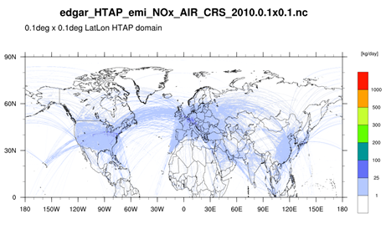
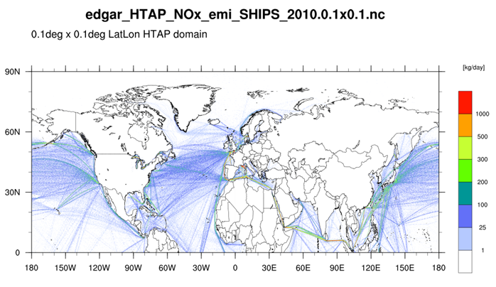
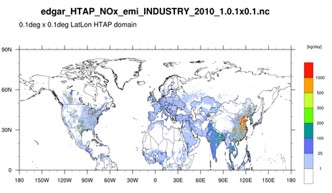
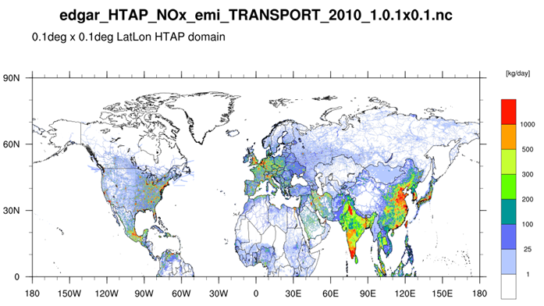
NOx from Selected HTAP Sectors
Aircraft Cruising
Shipping
kg NO_{x}/day
Industry
Ground transport

Slide 7
Community Emissions Data System (CEDS) for Historical Emissions
Global emissions datasets that include current years (through 2014) and by country
http://www.globalchange.umd.edu/ceds/
Hoesly et al, Historical (1750–2014) anthropogenic emissions of reactive gases and aerosols from the Community Emissions Data System (CEDS), Geoscientific Model Development, 2018, Vol. 11, p 369-408 https://www.geosci-model-dev.net/11/369/2018/gmd-11-369-2018.pdf

Slide 8
Using CEDS to project HTAPv2 from 2010 to 2014
HTAPv2 2010 sector | CEDS sector
g_ag | "Agriculture" or "AGRICULTURE"
g_energy | "Energy production" or "POWER"
g_industry | "Industrial" or "INDUSTRY" + "Solvents production and application" or "SOLVENTS"
g_transport | "Transportation" or "TRANSPORT",
g_residential | "Residential, Commercial, Other" or "RESIDENTIAL" + "Waste" or "WASTE"
g_ships | "International Shipping" or "SHIP"
* Note factors not available for aircraft projections

Slide 9
Using CEDS to project HTAPv2 from 2010 to 2014(2)
Use emissions trends from 2010 to 2014 in the CEDS data to generate a projection factor for each HTAPv2 sector
The CEDS-derived projection factors were applied by HTAPv2 sector and by country and by pollutant
Example:

Slide 10
2015 China inventory
School of Environment, Tsinghua University, Beijing
16 different emissions sectors
Gridded emissions for a 27km Lambert Conformal grid
    Included Hong Kong and Macau; not Taiwan
CAPS emissions provided except CO
  Used HTAPv2 CO emissions
CB6 speciation provided
Monthly, weekly, diurnal profiles provided
Used same vertical layering allocation as used with HTAP gridded inventories

Slide 11
2015 China inventory (2)
16 different sectors and the pollutants provided in each sector
* Note open burning not used; FINN fires used

Slide 12
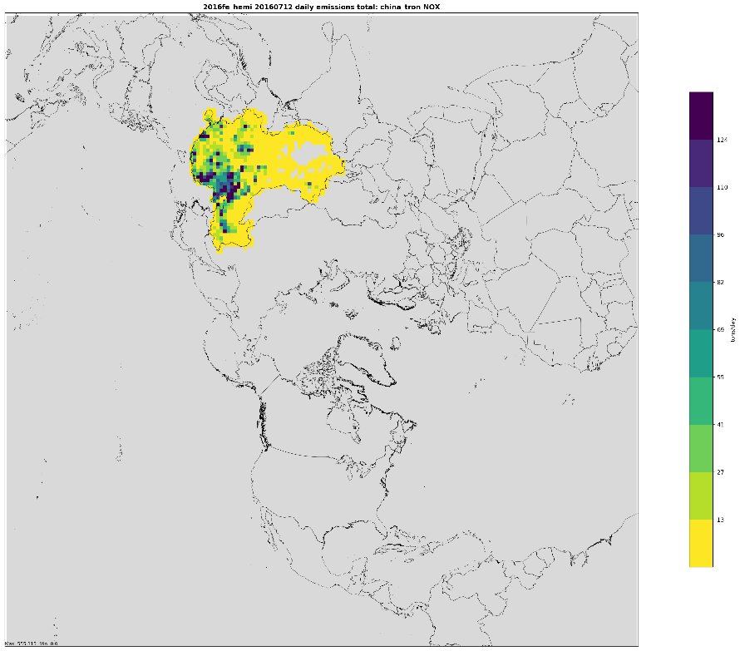

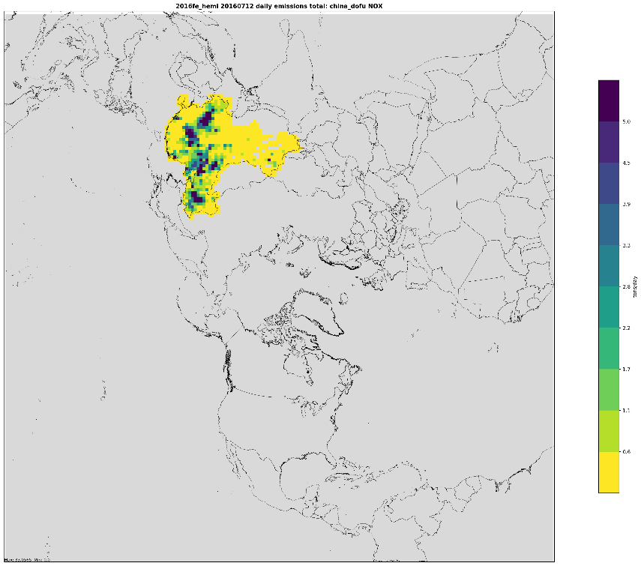
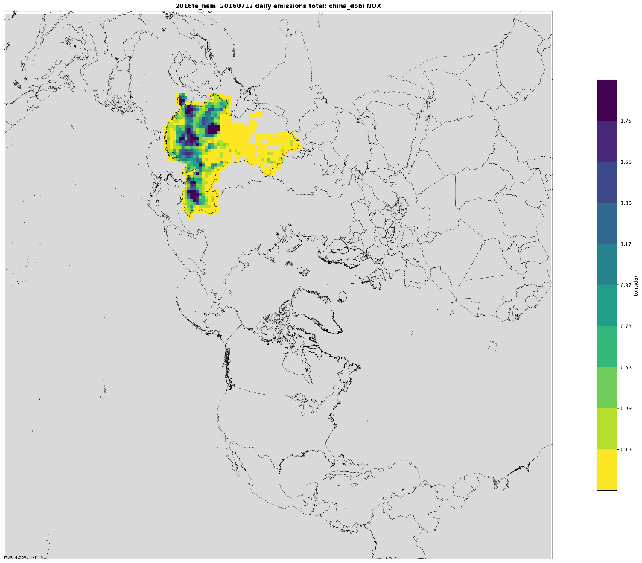
NOX Road transport
NOX Power plant
165
75
NOX Domestic bio-fuels
NOX Domestic fossil fuels
6
2

Slide 13
Other Inventories
U.S. anthropogenic inventories based on 2016 emissions modeling platform which includes 2014NEIv2
  Including the inventories for Alaska, Hawaii, Puerto Rico, and Virgin Islands
  U.S. fires from 2016 emissions modeling platform
  Biogenic from BEISv3.61 for USA
Canada 2016 (interpolated), Mexico 2016 (interpolated)
Fire INventory from NCAR (FINN) used outside U.S.
  FINN includes “croplands” fires (did not use HTAPv2 ag fires)
MEGAN v2.1 for outside of USA
Monthly GEIA Lightning NOx inventory used
  Spatially vary diurnal profiles generated
Ocean chlorine consistent with modeling platform

Slide 14
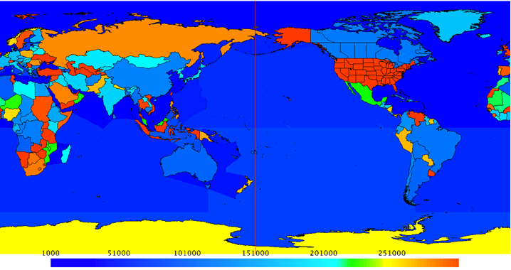
Supporting SMOKE Input Files
GEOCODE contains all country, state, county and district definitions (replaces COSTCY)
GRIDMASK file (for 0.1x0.1 grid) assigns GEOCODEs and time zones to each grid cell

Slide 15
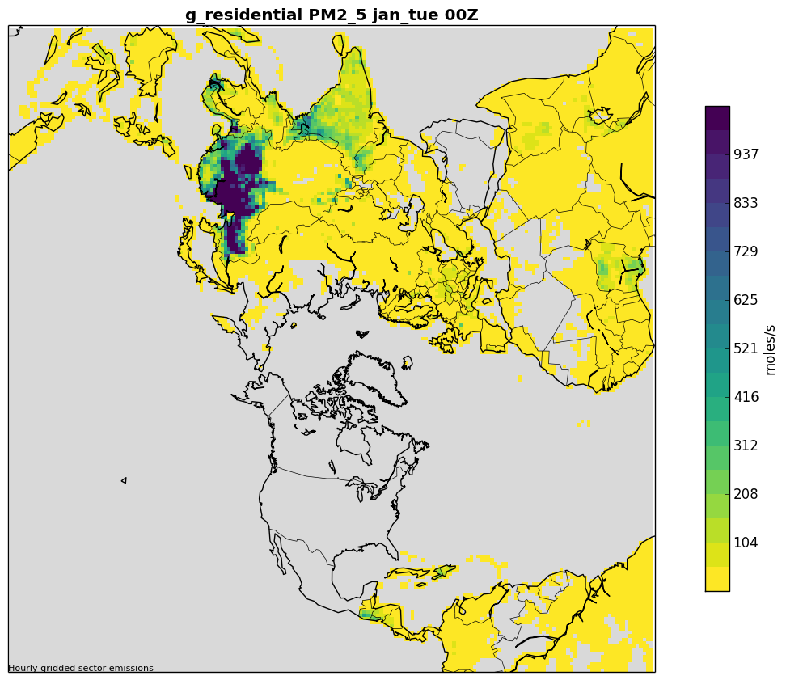
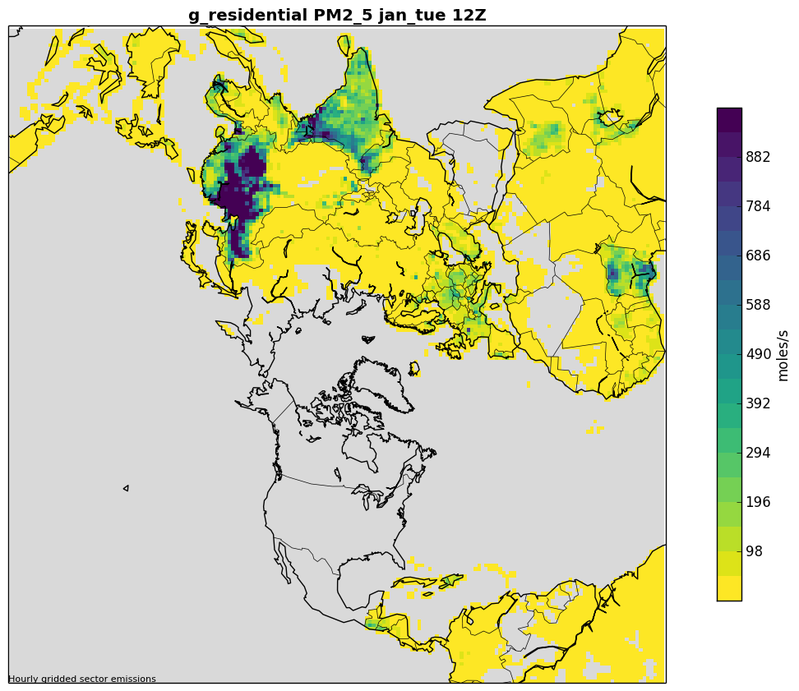
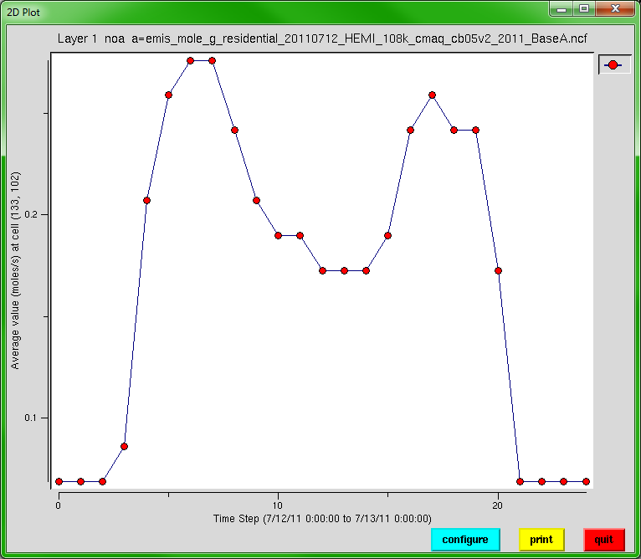
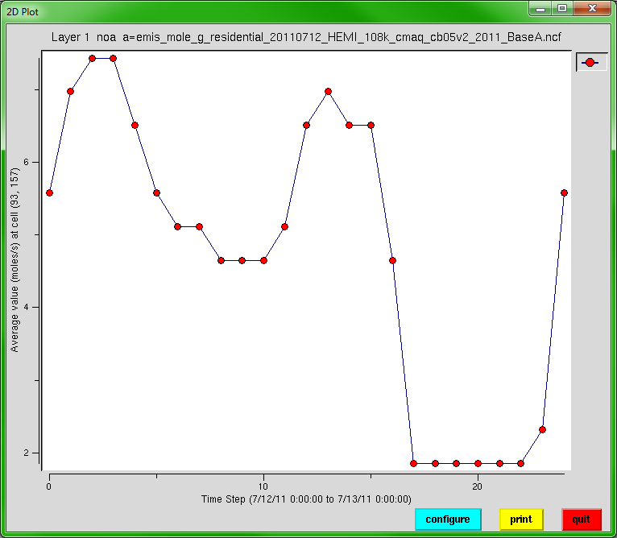
January Residential PM2.5
Residential emissions have two peaks: morning and evening local time
00Z
12Z
All times in GMT
France
India

Slide 16
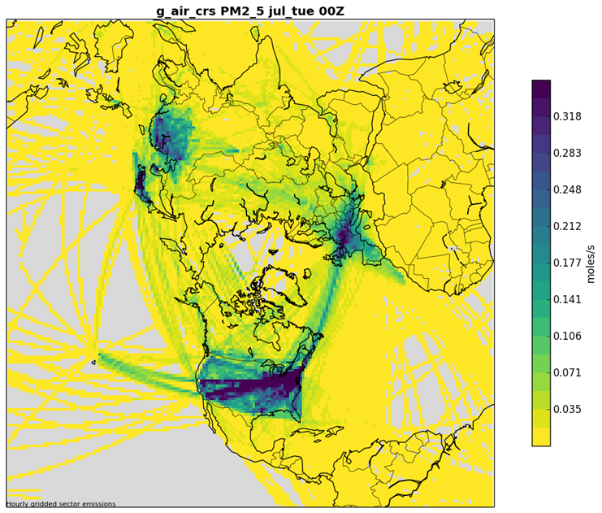

Spatial Allocation
Spatial Surrogates for U.S., Canada, and Mexico developed for the hemispheric grid
  187x187 polar stereographic 108km x 108km
  Covered outlying areas: AK/HI/PR/VI
  Spatial cross-reference had to be updated
No surrogates needed outside of North America because inventories are regridded

Slide 17
Vertical Distribution
Emissions created for 44 layers
  Layer 1 median at 10m, and layer 44 at 18,200m
SMOKE plume rise used in North America
  Based on stack parameters
  Fires have a special treatment
HTAP emissions
  Use SMOKE program Layalloc to put emissions at specific height ranges
  Aircraft emissions split into landing and takeoff (layers 1-15), climbing and descent (16-33), and cruising (34-38)
  Improved allocation of shipping and industry sources implemented
FINN: fires assigned to specific height ranges

Slide 18
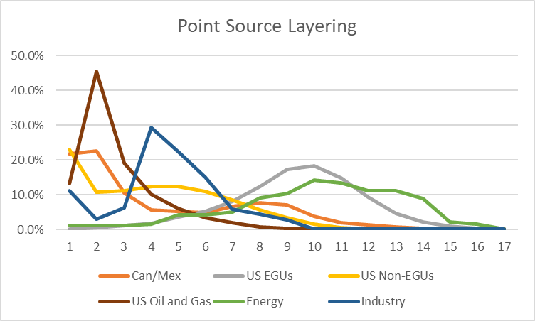
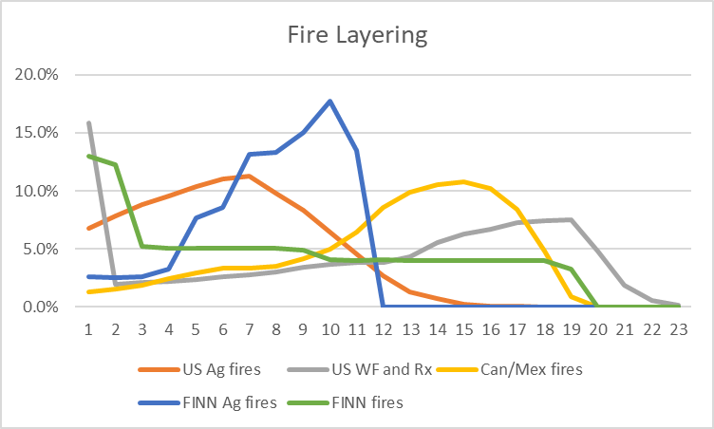
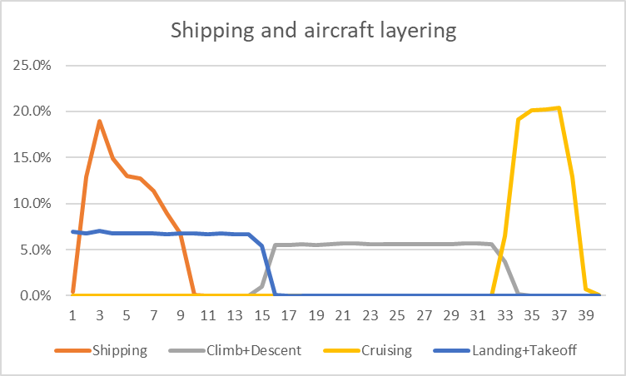
Vertical Distributions by Sector
L | Km | L | Km
1 | .01 | 25 | 4.2
5 | 0.1 | 30 | 6.8
10 | 0.4 | 35 | 10
15 | 0.9 | 40 | 14
20 | 2.1 | 44 | 18

Slide 19
Speciation
Carbon Bond 6 (CB06)-based speciation
Used 2016 platform within North America
Set of speciation profiles for HTAP based on the previous (e.g. 2011) platform averages
For HTAP, only a single speciation profile can be used per sector, country and pollutant
HTAP BC and OC inventory pollutants were used directly
  Rest of PM2.5 speciated into CMAQ’s AE6

Slide 20
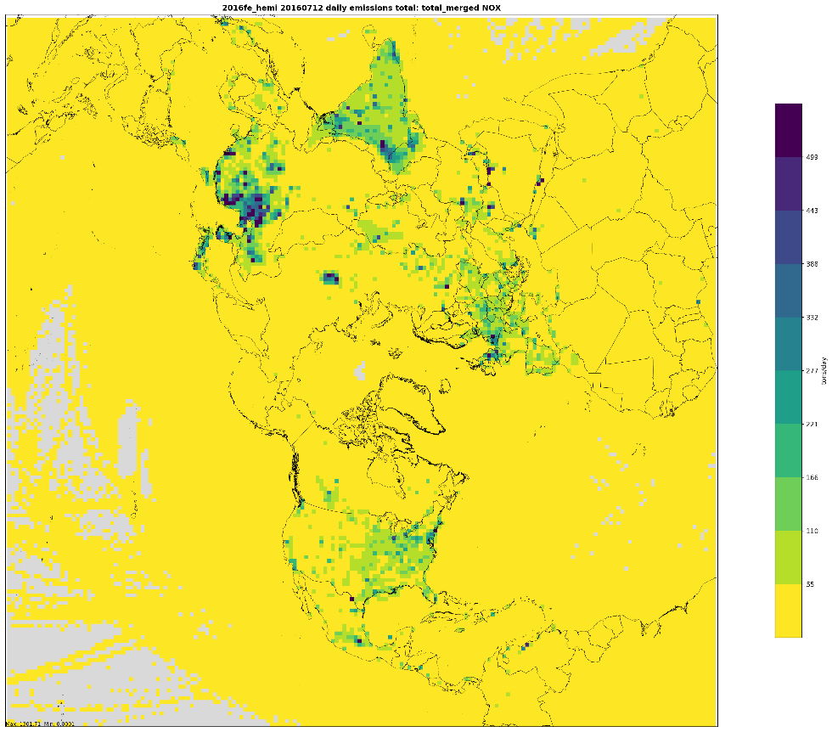
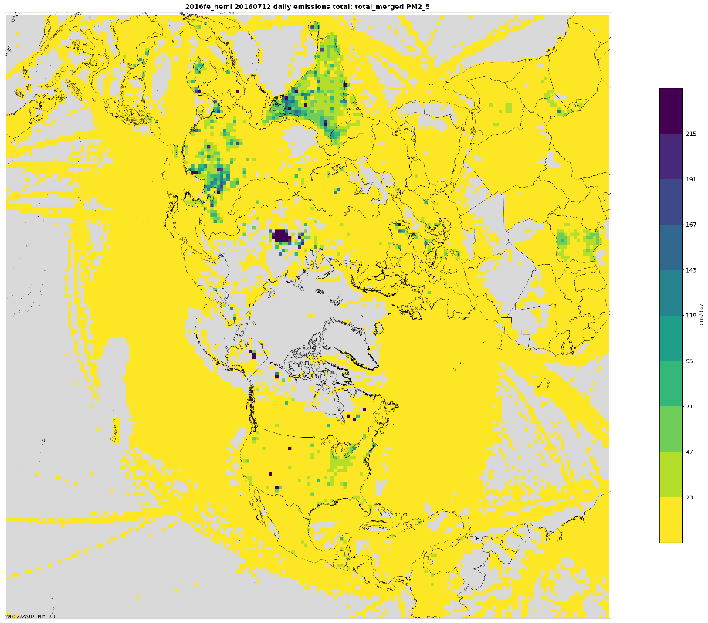
Examples of merged emissions
July weekday NOX
July weekday PM2.5

Slide 21
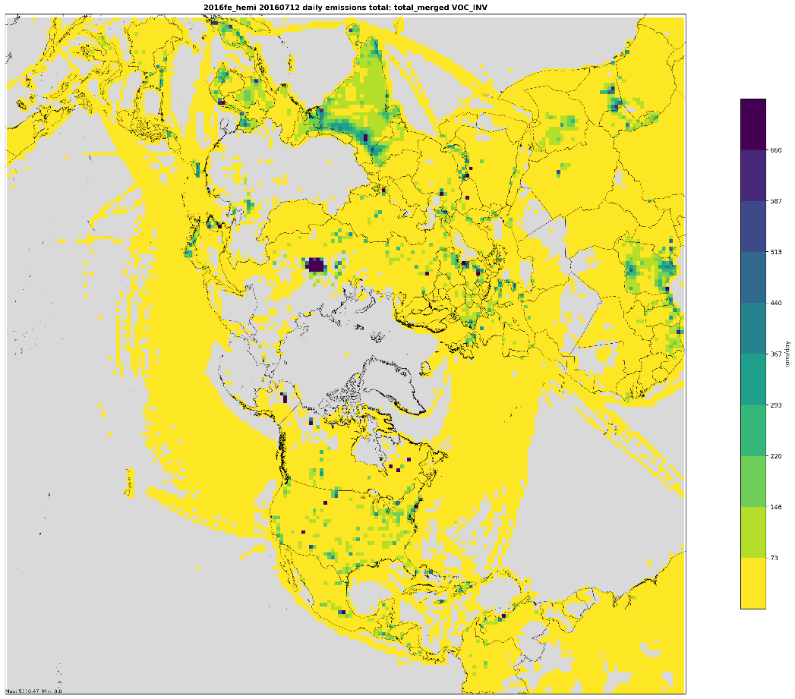
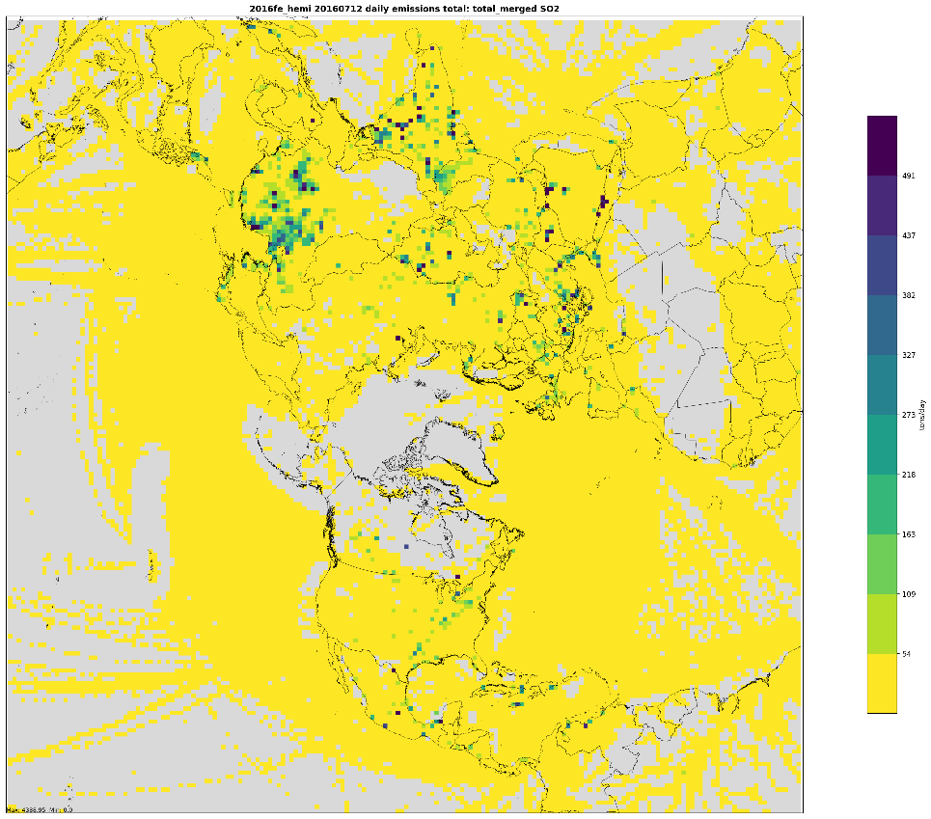
Examples of merged emissions (2)
July weekday VOC
July weekday SO2

Slide 22
Future Work
More emissions sensitivity studies where we evaluate the impact of changing emissions in other parts of the world
Consider other methods to obtain future-year projections for non-U.S. emissions using alternative sources (e.g. trends from satellite data)
Improvements to biogenic emissions
Improvements to layering
Possible release of hemispheric emissions modeling platform later
Questions can be directed to vukovich.Jeffrey@epa.gov or eyth.alison@epa.gov

Slide 23
References
Xing, J., R. Mathur, J. Pleim, C. Hogrefe, C.-M. Gan, D. Wong, C. Wei, R. Gilliam, and G. Pouliot (2015), Observations and modeling of air quality trends over 1990–2010 across the Northern Hemisphere: China, the United States and Europe, Atmospheric Chemistry and Physics, 15(5), 2723-2747
Xing, J., J. Pleim, R. Mathur, G. Pouliot, C. Hogrefe, C. M. Gan, and C. Wei (2013), Historical gaseous and primary aerosol emissions in the United States from 1990 to 2010, Atmos. Chem. Phys., 13(15), 7531-7549, doi:10.5194/acp-13-7531-2013
Janssens-Maenhout, G., M. Crippa, D. Guizzardi, F. Dentener, M. Muntean, G. Pouliot, T. Keating, Q. Zhang, J. Kurokawa, and R. Wankmüller (2015), HTAP_v2. 2: a mosaic of regional and global emission grid maps for 2008 and 2010 to study hemispheric transport of air pollution, Atmospheric Chemistry and Physics, 15(19), 11411-11432
Pouliot, G., T. Keating, G. Maenhout, C. Chang, J. Beidler, and R. Cleary (2014), The Incorporation of the US National Emission Inventory into Version 2 of the Hemispheric Transport of Air Pollutants Inventory, in Air Pollution Modeling and its Application XXIII, edited, pp. 265-268, Springer International Publishing.

