Slide 1
Model inter-comparison study for urban scale secondary atmospheric pollutants in Japan
~ PM2.5 and its major components ~
Yamaji, K.¹, Chatani, S.², Kitayama, K.², Itahashi, S.³, Saito, M.⁴, Takigawa, M.⁵, Morikawa, T.⁶, Kanda, I.⁷, Miya, Y.⁸, Komatsu, H.⁹, Sakurai, T.¹⁰, Morino, Y.²,
Shimadera, H.¹¹, Uranishi, K.¹¹, Fujiwara, Y.¹², Hayami, H.³
¹Kobe University, Kobe, Hyogo 658-0022, Japan
²National Institute for Environmental Studies, Tsukuba, Ibaraki 305-8506, Japan
³Central Research Institute of Electric Power Industry, Abiko, Chiba 270-1194, Japan
⁴Ehime University, Matsuyama, Ehime 790-8566, Japan
⁵Japan Agency for Marine-Earth Science and Technology, Yokohama, Kanagawa 236-0001, Japan
⁶Japan Automobile Research Institute, Tsukuba, Ibaraki 305-0822, Japan
⁷Japan Meteorological Corporation, Osaka, Osaka 556-0021, Japan
⁸Japan Weather Association, Toshima, Tokyo 170-6055, Japan
⁹Kanagawa Environmental Research Center, Hiratsuka, Kanagawa 254-0014, Japan
¹⁰Meisei University, Hino, Tokyo 191-8506, Japan
¹¹Osaka University, Suita, Osaka 565-0871, Japan
¹²Suuri-Keikaku, Chiyoda, Tokyo 101-0003, Japan
the 17th Annual CMAS Conference
22-24, Oct 2018, the Friday Center, UNC-Chapel Hill
Notes:
A title of my talk today is “Inter-comparison of model performance for PM_{2.5} and its components over Japan in J-STREAM”.

Slide 2
Acknowledge
This research was supported by the Environment Research and Technology Development Fund (5-1601) of the Environmental Restoration and Conservation Agency.
Collaborators are
Li, J.(IAP/CAS), Sudo, K.(Nagoya Univ.), Yumimoto K.(Kyusyu Univ.), Kajino, M.(MRI), Sugata, S.(NIES), Nagashima, T.(NIES), Inoue, K.(AIST), Hara, M.(Saitama pref.), Okumura, T.(Osaka pref.), Sasaki, K.(JWA), Watanabe, S. (JWA), Nishizawa, T.(SURI), Yoshida, F.(SURI), Ogata, K.(SURI), Koike, K.(Idea), Satake, S.(JNUS)

Slide 3
J-STREAM
An inter-comparison study of regional AQ models for O₃ and PM2.5, J-STREAM (Japan’s study for reference air quality modeling) has been started from 2016
Targets of this study
phase I
O₃, PM2.5 and components of PM2.5 in each season
Every two weeks of each season from 2013win to 2014win
*observed ambient concentrations of PM2.5 components are available
phase II
High concentrations of O₃, PM2.5 and components of PM2.5
2016win, 2017spr, 2017sum
phase III
Sensitivity analysis for source apportionments
Goals of this study
Suggesting better model settings with high performance
Showing the uncertainty level of these model settings
Notes:
An inter-comparison study of regional air quality models for O3 and PM2.5, J-STREAM (Japan’s study for reference air quality modeling) has been started from 2016. This project is 3 years project.
Targets of J-stream are,
O3, PM2.5 and components of PM2.5
firstly, to evaluate model performances(reproducibility) of O3, PM2.5 and components of PM2.5, and in second(secondary), these high concentrations, and finally, sensitivity analysis for source apportionments by all participant models.

Slide 4
Base case model setting (WRF/CMAQ)
MODEL | WRF –ARW v3.7.1
reanalysis | NCEP FNL(1deg., 6hr)
SST | RTG_SST_HR(1/12deg., daily)
p_top | 100hpa
grid_fdda | guv, gt, gq = 0.0001(D1), 0.00005(D2), 0.0(D3), 0.0(D4)
mp_physics | WSM5
ra_lw_physics | RRTM
ra_sw_physics | Dudhia
bl_pbl_physics | MYNN3
cu_physics | Kain-Fritsch
MODEL | CMAQv5.0.2
Emission | Chatani et al., Atmosphere, 2018
Boundary （D1） | CHASER (global model) with HTAP emission
Initial （D1） | CMAQ default (one month spin-up)
Gas Chemistry | saprc07tc
Aerosol Chemistry | aero6
Aqueous chemistry | cloud_acm_ae6
Photolysis | phot_inline
Horizontal advection | yamo
Vertical advection | wrf
Horizontal diffusion | hdiff/multiscale
Vertical diffusion | vdiff/acm2
dry deposition | m3dry

Slide 5
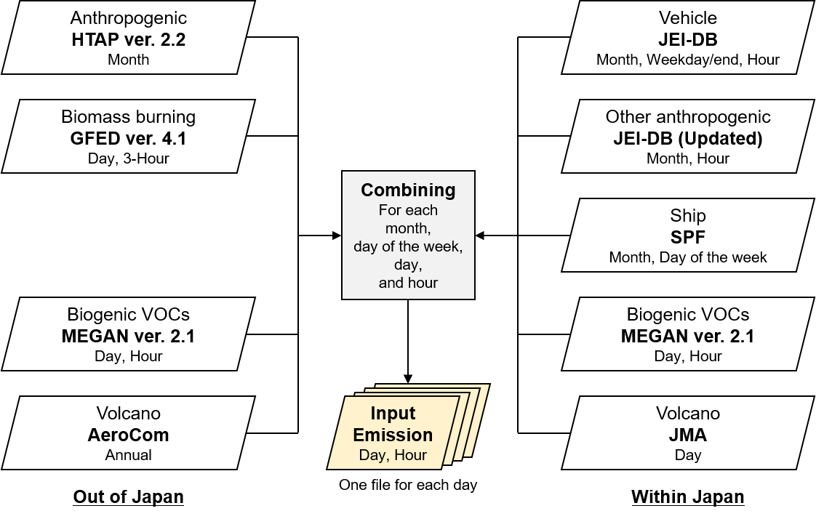
Base case emissions
Asian Emission
Japanese Emission
Input emissions were provided for all participants.
Most participants used this emissions.
from Chatani et al., Atmosphere, 2018

Slide 6
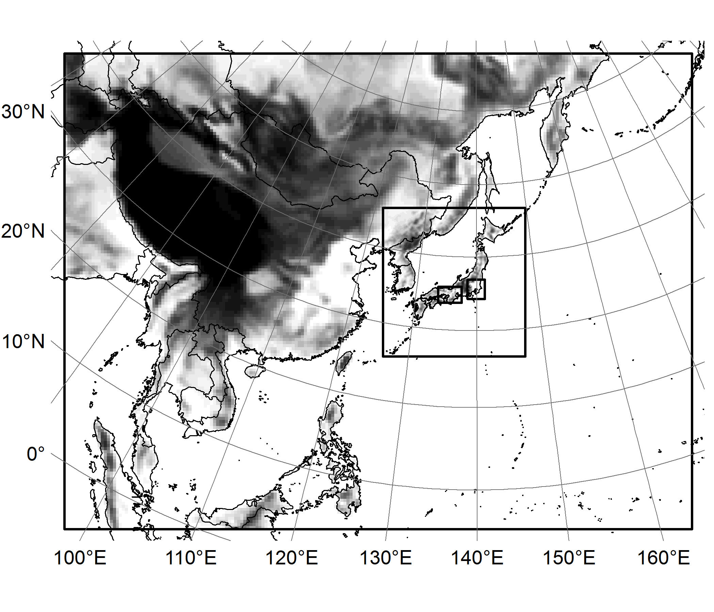
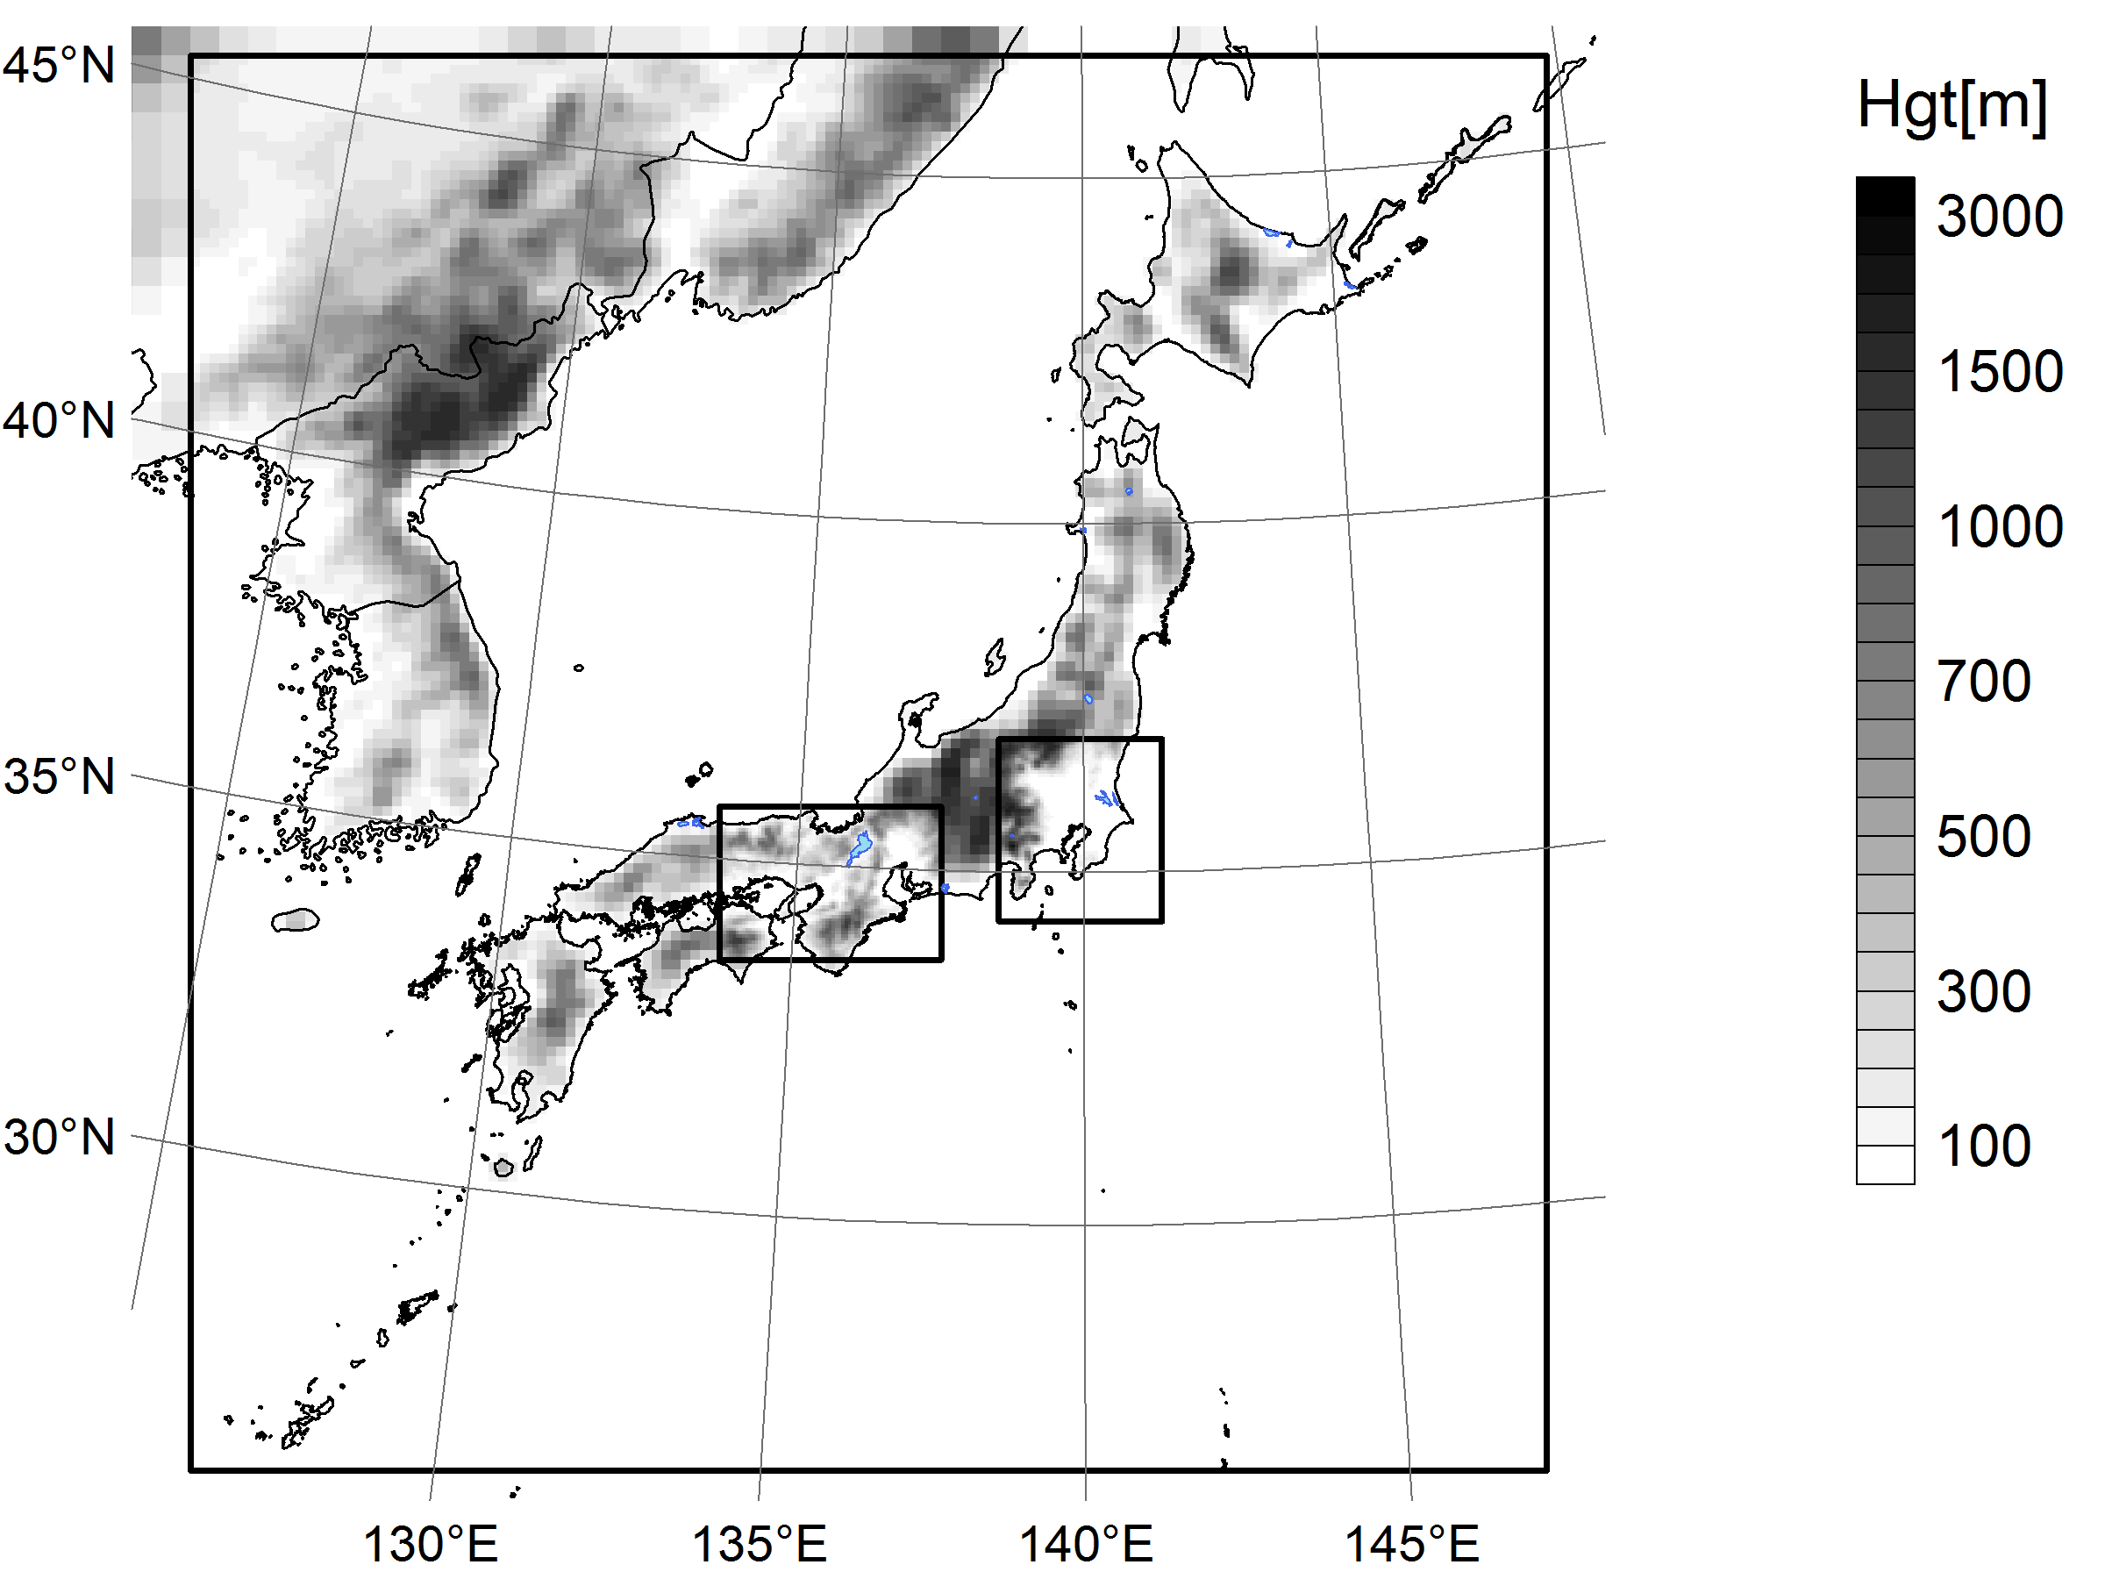
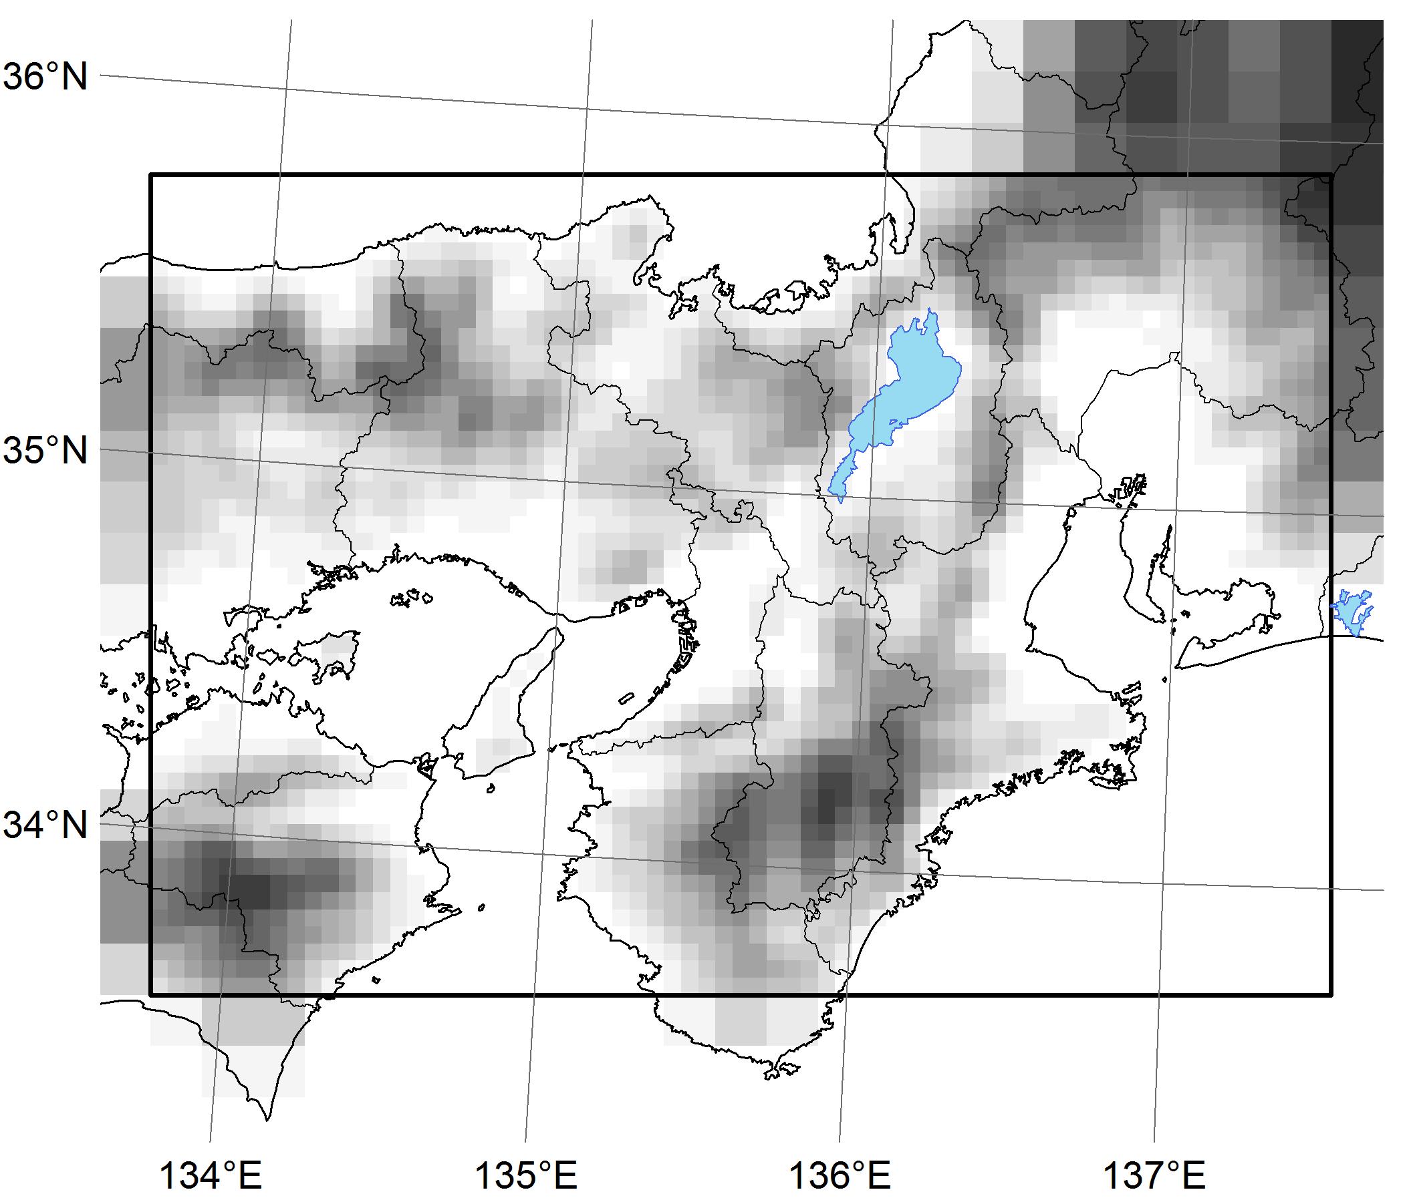
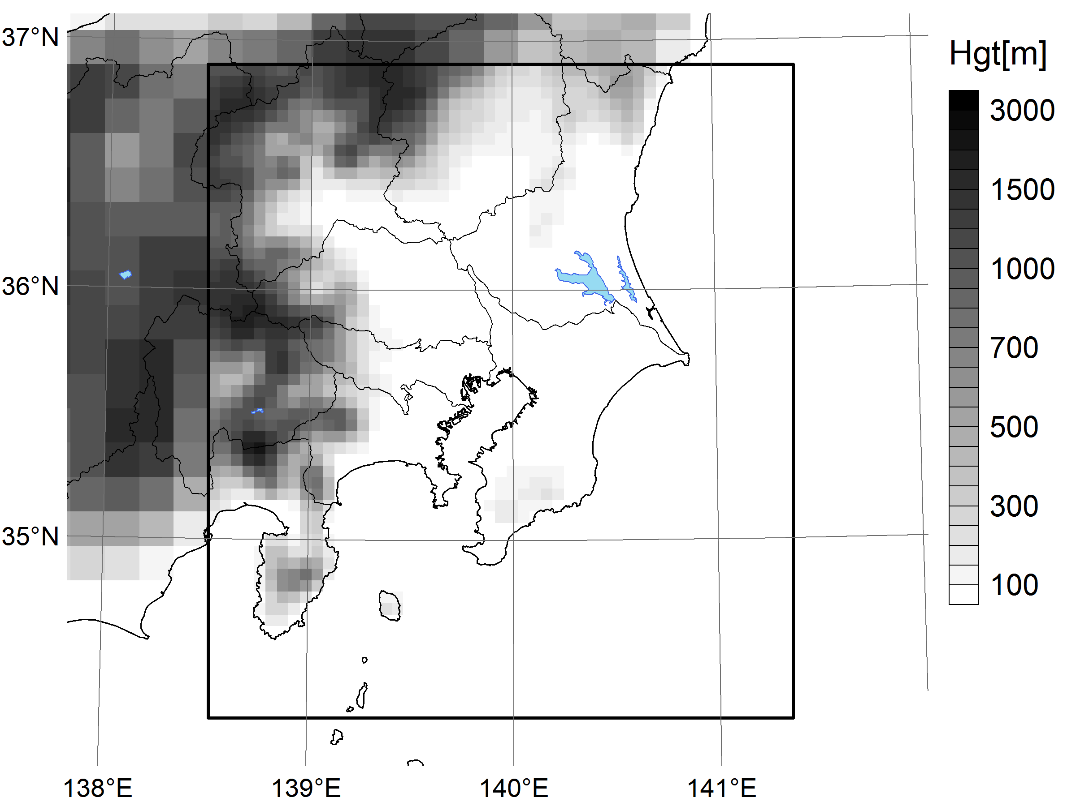
Common model domains for J-stream
D1
D2
D2
D3
D4
Δ=45km
207x157x30 grids
Δ=15km
141x147x30 grids
Target domains to evaluate, D3 and D4 with 5km resolution
D3
D4
Δ=5km
Δ=5km
69x48x30 grids
51x57x30 grids
OSAKA-NAGOYA
TOKYO
Notes:
These panels show common model domains in J-stream

Slide 7
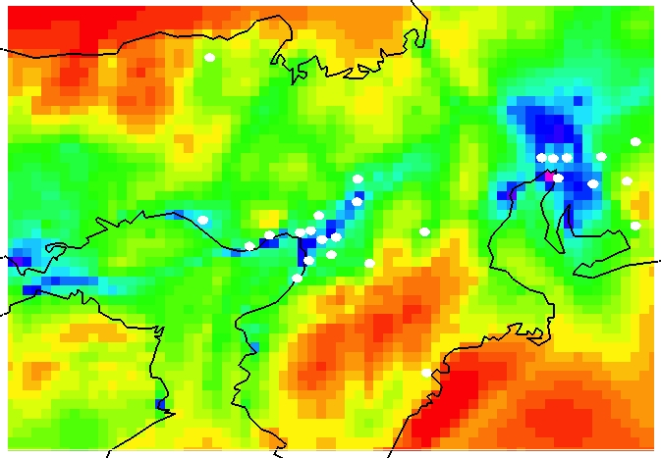
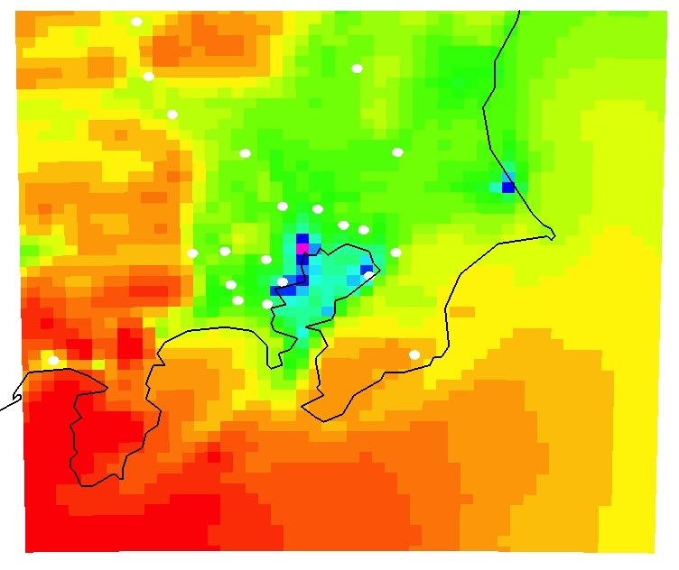
Observation sites for evaluating
D2
D3
D4
Model results were compered with observations at the Japan ambient air pollution monitoring stations for every 2 week in each season.
Δ=15km
141x147x30 grids
OSAKA-NAGOYA Area
TOKYO Area
D3
D4
Japan ambient air pollution monitoring stations(○) in D3(24 stations), and D4(26 stations)

Slide 8
Participant model list (Phase I)
ID | Model | Version | Chemical mechanism | Aerosol Module | Emission | Meteorology | Boundary | Domains
 |  |  |  |  |  |  | (d01) | d01 | d02 | d03 | d04
CQ01 | CMAQ | 4.7.1 | SAPRC99 | aero5 | Own | Provided | (Provided) |  |  |  | x
CQ02 | CMAQ | 4.7.1 | SAPRC99 | aero5 | Provided | Provided | (Provided) |  |  |  | x
CQ03 | CMAQ | 4.7.1 | SAPRC99 | aero5 | Provided | Provided | (Provided) |  |  |  | x
CQ05 | CMAQ | 5.0.1 | CB05 | aero6 | Provided | Provided | (Provided) |  |  | x | x
CQ06 | CMAQ | 5.0.1 | SAPRC07 | aero6 | Provided | Provided | (Provided) |  |  | x | x
CQ07 | CMAQ | 5.0.1 | SAPRC07 | aero6 | Provided | Provided | (Provided) |  |  | x | x
CQ08 | CMAQ | 5.0.1 | SAPRC07 | aero6 | Provided | Provided | (Provided) |  |  | x | x
CQ09 | CMAQ | 5.0.1 | SAPRC99 | aero5 | Own | Own | (Provided) |  |  | x
CQ10 | CMAQ | 5.0.1 | SAPRC99 | aero5 | Provided | Provided | (Provided) |  |  | x | x
CQ11 | CMAQ | 5.0.1 | SAPRC99 | aero5 | Provided | Provided | no |  |  |  | x
CQ12 | CMAQ | 5.0.2 | CB05 | aero6 | Provided | Provided | Provided | x | x | x | x
CQ13 | CMAQ | 5.0.2 | CB05 | aero6vbs | Provided | Provided | Provided | x | x | x | x
CQ14 | CMAQ | 5.0.2 | CB05 | aero6 | Provided | Provided | Provided | x | x | x | x
CQ15 | CMAQ | 5.0.2 | CB05 | aero6 | Provided | Provided | Provided | x | x | x | x
CQ16 | CMAQ | 5.0.2 | RACM2 | aero6 | Provided | Provided | Provided | x | x | x | x
CQ17 | CMAQ | 5.0.2 | RACM2 | aero6 | Provided | Provided | (Provided) |  |  | x | x
CQ18 | CMAQ | 5.0.2 | SAPRC07 | aero6 | Own | Own | Own | x | x | x | x
CQ19 | CMAQ | 5.0.2 | SAPRC07 | aero6 | Provided | Provided | Provided | x | x | x | x
CQ20 | CMAQ | 5.0.2 | SAPRC07 | aero6 | Provided | Provided | Provided | x | x | x | x
CMAQ(29)
Notes:
Most participant models are CMAQ. But each mechanism and setting of CMAQ is different each other.

Slide 9
Participant model list (Phase I)
ID | Model | Version | Chemical mechanism | Aerosol Module | Emission | Meteorology | Boundary | Domains
 |  |  |  |  |  |  | (d01) | d1 | d2 | d3 | d4
CQ21 | CMAQ | 5.0.2 | SAPRC07 | aero6 | Provided | Provided | Provided | x | x | x | x
CQ22 | CMAQ | 5.0.2 | SAPRC07 | aero6 | Provided | Own | MOZART | x | x | x | x
CQ23 | CMAQ | 5.0.2 | SAPRC99 | aero5 | Provided | Provided | Provided | x | x | x | x
CQ24 | CMAQ | 5.0.2 | SAPRC99 | aero5 | Provided | Provided | (Provided) |  |  | x | x
CQ25 | CMAQ | 5.1 | SAPRC07 | aero6 | Own | Provided | Provided | x | x | x | x
CQ26 | CMAQ | 5.1 | SAPRC07 | aero6 | Provided | Provided | (Provided) |  |  | x | x
CQ27 | CMAQ | 5.1 | SAPRC07 | aero6 | Provided | Provided | (Provided) |  |  | x | x
CQ28 | CMAQ | 5.1 | SAPRC07 | aero6 | Provided | Provided | (Provided) |  |  | x | x
CQ29 | CMAQ | 5.1 | SAPRC07 | aero6 | Provided | Provided | Provided | x | x | x | x
CQ30 | CMAQ | 5.2.0 | CB05 | aero6 | Provided | Provided | (Provided) |  |  | x | x
CX | CAMx | 6.4 | SAPRC07 | CF | Provided | Provided | (Provided) |  |  | x | x
WC01 | WRF-Chem | 3.7.1 | RADM2 | MADE/SORGAM | Provided | Own | MOZART | x | x | x | x
WC02 | WRF-Chem | 3.7.1 | RADM2 | MADE/SORGAM | Provided | Own | MOZART | x | x | x | x
WC03 | WRF-Chem | 3.8.1 | RADM2 | MADE/SORGAM | Provided | Own | MOZART | x | x | x | x
CMAQ(29)
CAMx
WRF-Chem
29 CMAQ, 1 CAMx, 3 WRF-cham joined in J-stream Phase I.
Several kinds of different model versions and settings were used in some model, ex. CMAQ.
A few model did not use provided Emis., Met, and Boundary.
Notes:
Most participant models are CMAQ. But each mechanism and setting of CMAQ is different each other.

Slide 10
From phase I results
Model performances of PM2.5 and components of PM2.5
in every two weeks of each season
*observed ambient concentrations of PM2.5 components are available

Slide 11
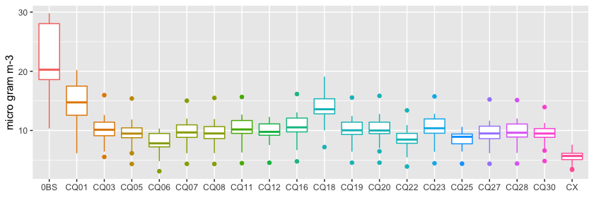
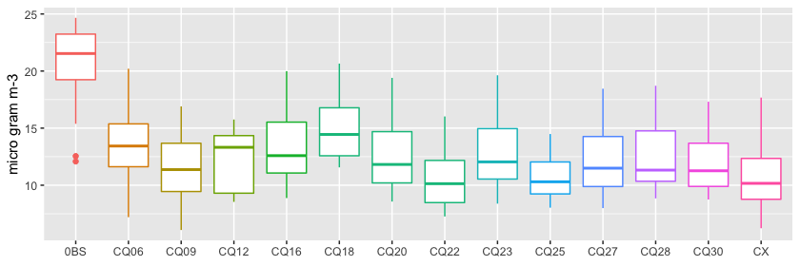
Results
2 weeks averaged PM2.5 in winter 2014
OBS
CQ471
CQ501
CQ502
CQ510
CQ520
CX
D4(TOKYO Area)
Total PM2.5
OBS
D3(OSAKA-NAGOYA Area)
Total PM2.5
OBS
CQ501
CQ502
CQ510
CQ520
CX
Notes:
These panels show 2 weeks averaged concentrations of total PM2.5, sulfate, Nitrate, OA by model and participant model at Kansai in summer .
WRF-chem produced more PM2.5 compering to CMAQ and CAMx,
but, WRF-chem tended to overestimate observed PM2.5.

Slide 12
Results
2 weeks averaged PM2.5 in winter 2014
OBS
CQ471
CQ501
CQ502
CQ510
CQ520
CX
D4(TOKYO Area)
As for 2 weeks averaged PM2.5, all model underestimated PM2.5 in winter with a little difference between models. One half of obs.
D3(OSAKA area) showed better performance than D4(Tokyo area).
These tendencies found in the other seasons.
Total PM2.5
CAMx
D3(OSAKA-NAGOYA Area)
Total PM2.5
Notes:
These panels show 2 weeks averaged concentrations of total PM2.5, sulfate, Nitrate, OA by model and participant model at Kansai in summer .
WRF-chem produced more PM2.5 compering to CMAQ and CAMx,
but, WRF-chem tended to overestimate observed PM2.5.

Slide 13
Results
2 weeks averaged PM2.5 in winter 2014
OBS
CQ471
CQ501
CQ502
CQ510
CQ520
CX
D4(TOKYO Area)
The other Emis. and Boundary, or Met. were used in CMAQ
These results showed large difference from base setting.
Magnitude of this difference was lager than differences in aerosol mechanism or/and version of CMAQ.
Total PM2.5
D3(OSAKA-NAGOYA Area)
Total PM2.5
*No total PM2.5 of WRF-chem was submitted for winter.
Notes:
These panels show 2 weeks averaged concentrations of total PM2.5, sulfate, Nitrate, OA by model and participant model at Kansai in summer .
WRF-chem produced more PM2.5 compering to CMAQ and CAMx,
but, WRF-chem tended to overestimate observed PM2.5.

Slide 14
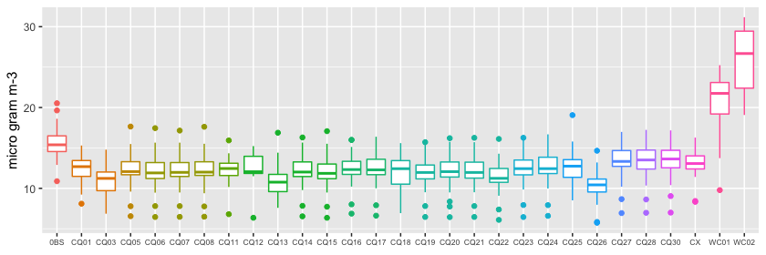
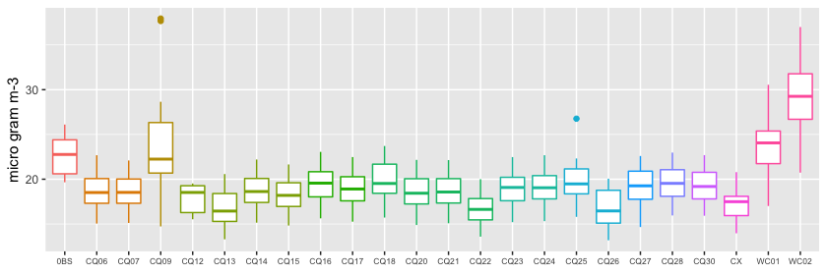
Results
2 weeks averaged PM2.5 in summer 2013
OBS
CQ471
CQ501
CQ502
CQ510
CQ520
CX
WC
D4(TOKYO Area)
WRF-chem were much larger than obs. and the other models
Total PM2.5
D3(OSAKA-NAGOYA Area)
Total PM2.5
Notes:
This show summer time PM2.5
These panels show 2 weeks averaged concentrations of total PM2.5, sulfate, Nitrate, OA by model and participant model at Kansai in summer .
WRF-chem produced more PM2.5 compering to CMAQ and CAMx,
but, WRF-chem tended to overestimate observed PM2.5.

Slide 15
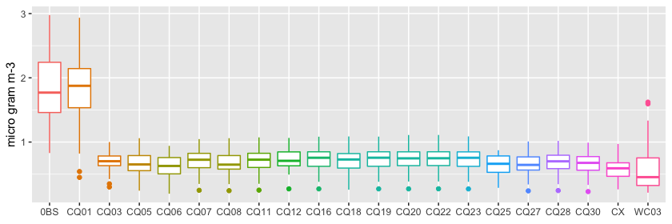
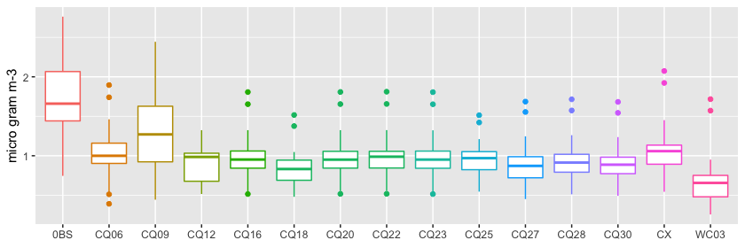
Results
2 weeks averaged PM2.5(EC) in winter 2014
OBS
CQ471
CQ501
CQ502
CQ510
CQ520
CX
WC
D4(TOKYO Area)
Most models are much lower than obs.
Less than one half of obs.
These tendencies found in the other seasons.
WRF-chem
PM2.5(EC)
D3(OSAKA-NAGOYA Area)
PM2.5(EC)
Notes:
These panels show 2 weeks averaged concentrations of total PM2.5, sulfate, Nitrate, OA by model and participant model at Kansai in summer .
WRF-chem produced more PM2.5 compering to CMAQ and CAMx,
but, WRF-chem tended to overestimate observed PM2.5.

Slide 16
Results
2 weeks averaged PM2.5(EC) in winter 2014
OBS
CQ471
CQ501
CQ502
CQ510
CQ520
CX
WC
D4(TOKYO Area)
PM2.5(EC)
One model* can capture EC concentration.
* with different emissions, higher emission
D3(OSAKA-NAGOYA Area)
One model with different Emis.(higher emission) and Met., showed better.
PM2.5(EC)
Notes:
These panels show 2 weeks averaged concentrations of total PM2.5, sulfate, Nitrate, OA by model and participant model at Kansai in summer .
WRF-chem produced more PM2.5 compering to CMAQ and CAMx,
but, WRF-chem tended to overestimate observed PM2.5.

Slide 17
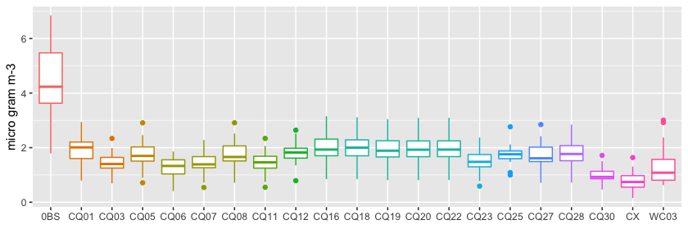
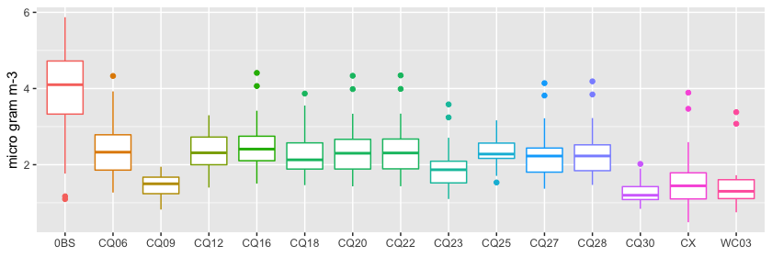
Results
2 weeks averaged PM2.5(OC) in winter 2014
OBS
CQ471
CQ501
CQ502
CQ510
CQ520
CX
WC
D4(TOKYO Area)
Most models were much lower than obs. Less than one half of obs.
PM2.5(OC)
D3(OSAKA-NAGOYA Area)
One model (better performance for EC) showed lower OC.
PM2.5(OC)
Notes:
These panels show 2 weeks averaged concentrations of total PM2.5, sulfate, Nitrate, OA by model and participant model at Kansai in summer .
WRF-chem produced more PM2.5 compering to CMAQ and CAMx,
but, WRF-chem tended to overestimate observed PM2.5.

Slide 18
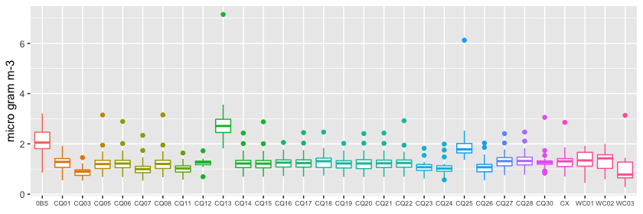
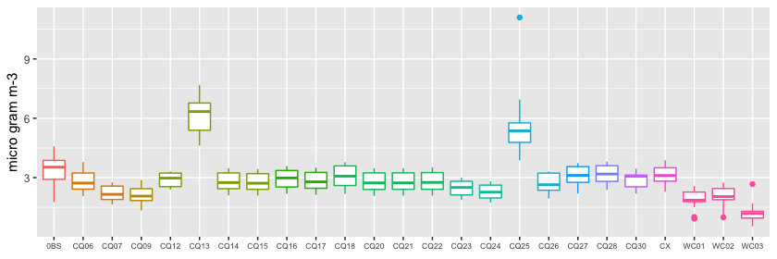
Results
2 weeks averaged PM2.5(OC) in summer 2013
OBS
CQ471
CQ501
CQ502
CQ510
CQ520
CX
WC
D4(TOKYO Area)
CMAQ with VBS showed good performance for summer time OC.
PM2.5(OC)
Emis
D3(OSAKA-NAGOYA Area)
Emis
PM2.5(OC)
Notes:
As for summertime organic carbon,
These panels show 2 weeks averaged concentrations of total PM2.5, sulfate, Nitrate, OA by model and participant model at Kansai in summer .
WRF-chem produced more PM2.5 compering to CMAQ and CAMx,
but, WRF-chem tended to overestimate observed PM2.5.

Slide 19
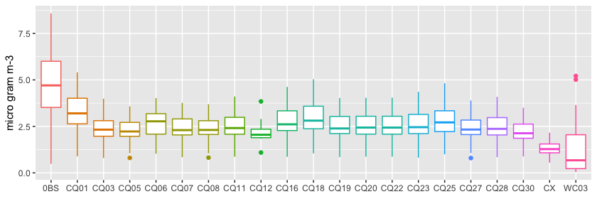
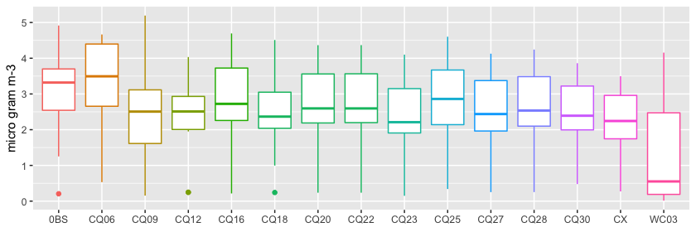
Results
2 weeks averaged PM2.5(NO3) in winter 2014
OBS
CQ471
CQ501
CQ502
CQ510
CQ520
CX
WC
D4(TOKYO Area)
Most models are much lower than obs. at Tokyo area.
In Osaka area, models showed better performance.
WRF-chem
PM2.5(NO3)
D3(OSAKA-NAGOYA Area)
PM2.5(NO3)
Notes:
These panels show 2 weeks averaged concentrations of total PM2.5, sulfate, Nitrate, OA by model and participant model at Kansai in summer .
WRF-chem produced more PM2.5 compering to CMAQ and CAMx,
but, WRF-chem tended to overestimate observed PM2.5.

Slide 20
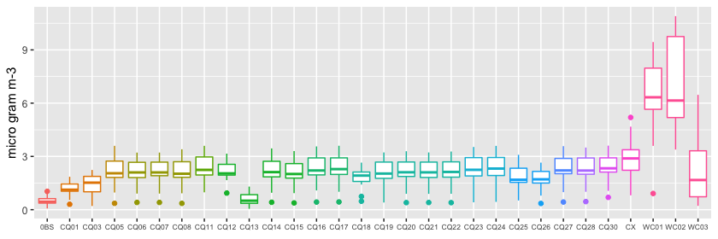
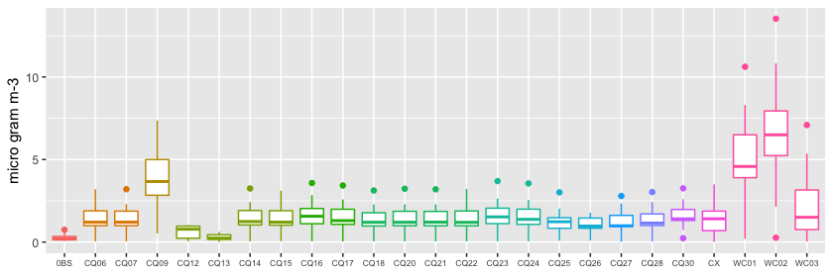
Results
2 weeks averaged PM2.5(NO3) in summer 2013
OBS
CQ471
CQ501
CQ502
CQ510
CQ520
CX
WC
D4(TOKYO Area)
Most models are much larger than obs in warmer seasons, although underestimate in winter
PM2.5(NO3)
D3(OSAKA-NAGOYA Area)
As for WRF-chem, large differences were found in different model settings.
PM2.5(NO3)
Notes:
These panels show 2 weeks averaged concentrations of total PM2.5, sulfate, Nitrate, OA by model and participant model at Kansai in summer .
WRF-chem produced more PM2.5 compering to CMAQ and CAMx,
but, WRF-chem tended to overestimate observed PM2.5.

Slide 21
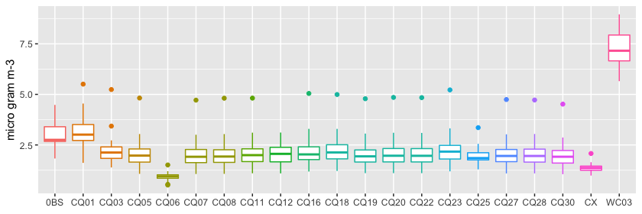
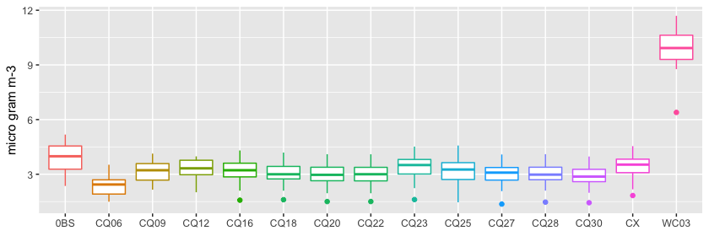
Results
2 weeks averaged PM2.5(SO4) in winter 2014
OBS
CQ471
CQ501
CQ502
CQ510
CQ520
CX
WC
D4(TOKYO Area)
CMAQ and CAMx showed a little underestimations.
WRF-chem were much larger (three times) than obs.
WRW-chem
PM2.5(SO4)
CAMx
One model* captured SO4 concentration.
* with different emissions, higher emission
D3(OSAKA-NAGOYA Area)
PM2.5(SO4)
Notes:
These panels show 2 weeks averaged concentrations of total PM2.5, sulfate, Nitrate, OA by model and participant model at Kansai in summer .
WRF-chem produced more PM2.5 compering to CMAQ and CAMx,
but, WRF-chem tended to overestimate observed PM2.5.

Slide 22
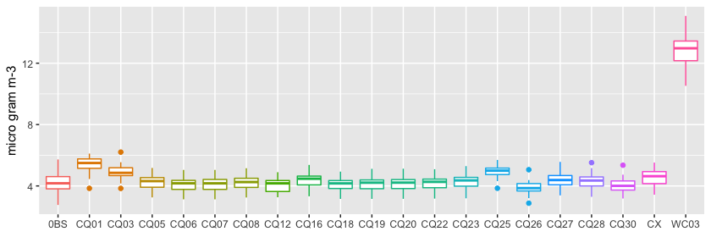
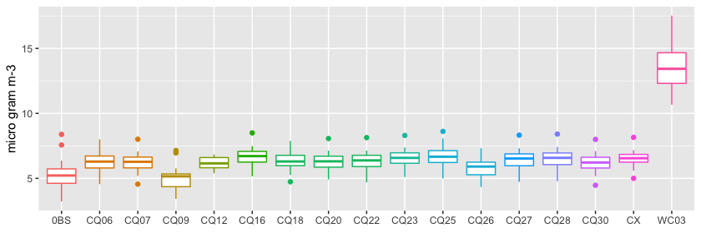
Results
2 weeks averaged PM2.5(SO4) in spring 2013
OBS
CQ471
CQ501
CQ502
CQ510
CQ520
CX
WC
D4(TOKYO Area)
CMAQ and CAMx were same level(D4, Tokyo) or larger (D4, Osaka)than obs. in spring
PM2.5(SO4)
D3(OSAKA-NAGOYA Area)
PM2.5(SO4)
Notes:
These panels show 2 weeks averaged concentrations of total PM2.5, sulfate, Nitrate, OA by model and participant model at Kansai in summer .
WRF-chem produced more PM2.5 compering to CMAQ and CAMx,
but, WRF-chem tended to overestimate observed PM2.5.

Slide 23
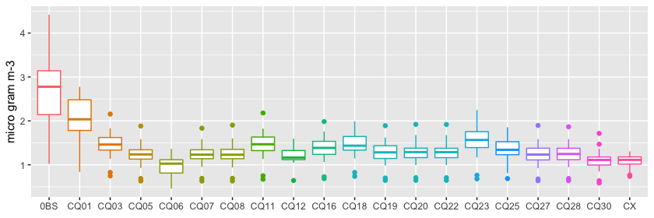
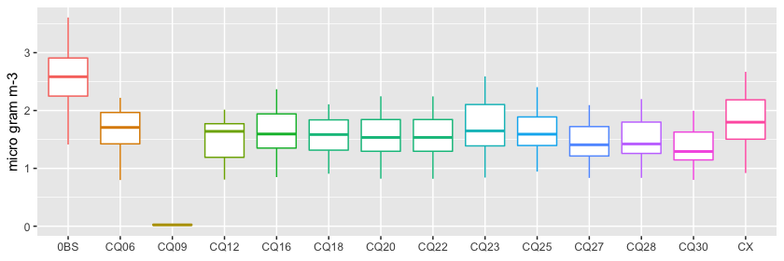
Results
2 weeks averaged PM2.5(NH4) in winter 2014
OBS
CQ471
CQ501
CQ502
CQ510
CQ520
CX
D4(TOKYO Area)
Most models are much lower than obs. Less than one half of observation.
These tendencies found in the other seasons.
PM2.5(NH4)
D3(OSAKA-NAGOYA Area)
PM2.5(NH4)
Notes:
These panels show 2 weeks averaged concentrations of total PM2.5, sulfate, Nitrate, OA by model and participant model at Kansai in summer .
WRF-chem produced more PM2.5 compering to CMAQ and CAMx,
but, WRF-chem tended to overestimate observed PM2.5.

Slide 24
Summary
Winter | CMAQ | CAMx | WRF-chem | OTHERS | Spring | CMAQ | CAMx | WRF-chem | OTHERS
Total | -- | -- |  | E,B(+) | Total | - | -
EC | -- | -- | -- | E,B(+) | EC | -- | -- | -- | E,B(+)
OC | -- | -- | -- |  | OC | --- | --- | ---
NO3 | --/+- | ---/+- | - |  | NO3 | ++ | + | +-
SO4 | -/+- | -/+- | +++ | E,B(+) | SO4 | +- | +- | +++
NH3 | - | - |  | E,B(+) | NH3 | +-/+ | +-/+
Summer | CMAQ | CAMx | WRF-chem | OTHERS | Autumn | CMAQ | CAMx | WRF-chem | OTHERS
Total | - | - | +++ | E,B(+) | Total | - | - |  | E,B(+)
EC | -- | -- | - | E,B(+) | EC | - | - | -- | E,B(+)
OC | -/-- | -/+- | -- | E,B, VBS(+) | OC | -- | -- | --
NO3 | ++ | ++ | +++ |  | NO3 | + | + | +-
SO4 | - | - | +++ |  | SO4 | +- | +- | +++
NH3 | +- | +- | +++ |  | NH3 | +- | +- | +-
CMAQ and CAMx tended to underestimate observed PM2.5
Differences in particulate concentrations due to differences in the CMAQ mechanisms(version) was a little for 2 weeks averaged values compared to differences due to differences in input data for CCTM
WRF-chem tended to overestimate

Slide 26
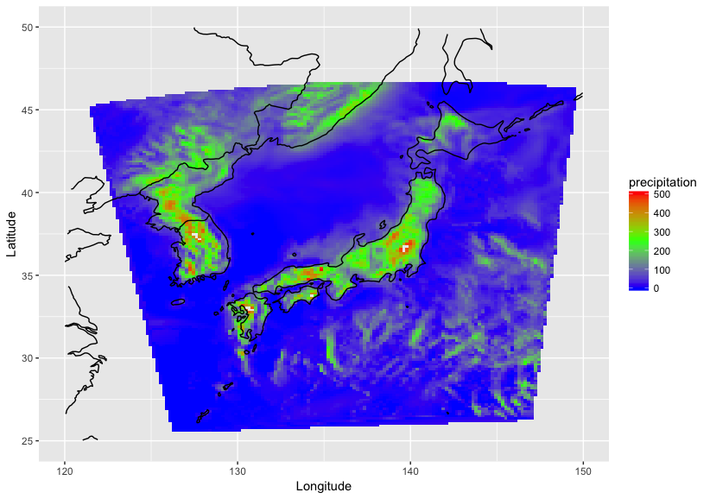
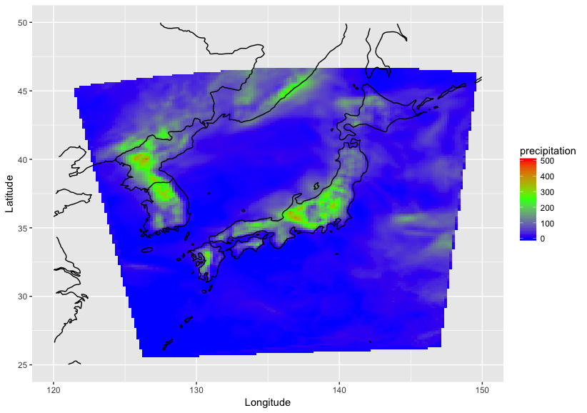
Discussion
CMAQ vs WRF-chem
Comparison of meteorology between WRF/CMAQ(common data) and WRF-chem
①Common data for J-stream
②WRF-chem
mp_physics: WSM5（4）
cu_physics:Kain-Fritsch（1）
mp_physics:Lin （2）
cu_physics:Grell-3（5）
> WSM5+KF
> Lin+Grell3
Precipitations（summer）
Precipitation（summer）
WSM5+KF
D2
Lin+Grell3
D2
Notes:
Here show the difference between WRF/CMAQ and WRF-chem.
We can find that both model settings for meteorology made a big differences in meteorology especially precipitations

Slide 27
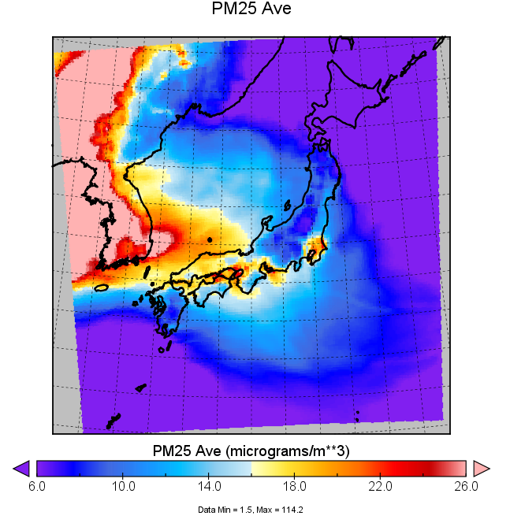
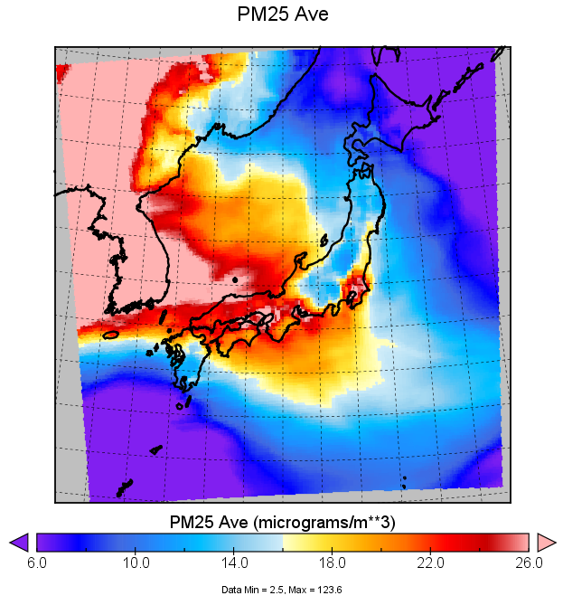
Results
PM2.5 by CMAQ using WRF calculations
①CMAQ PM2.5 using WRF
with WSM5+KF
②CMAQ PM2.5 using WRF
with Lin and Grell-3
D2
D2
Notes:
These panels show summer time surface PM2.5 concentrations based on these two types of WRF simulations.
① is using J-stream common setting and ② is using a WRF-chem setting in J-stream

