Slide 1
Searching for missing carbonaceous aerosols sources in Bogotá: Sensitivity analysis using WRF-Chem
Maria Paula Pérez-Peña, MSc. ¹
Ricardo Morales Betancourt, PhD. ¹
1 – Universidad de los Andes, Bogotá, Colombia.
Chapel Hill, NC
2018

Slide 2
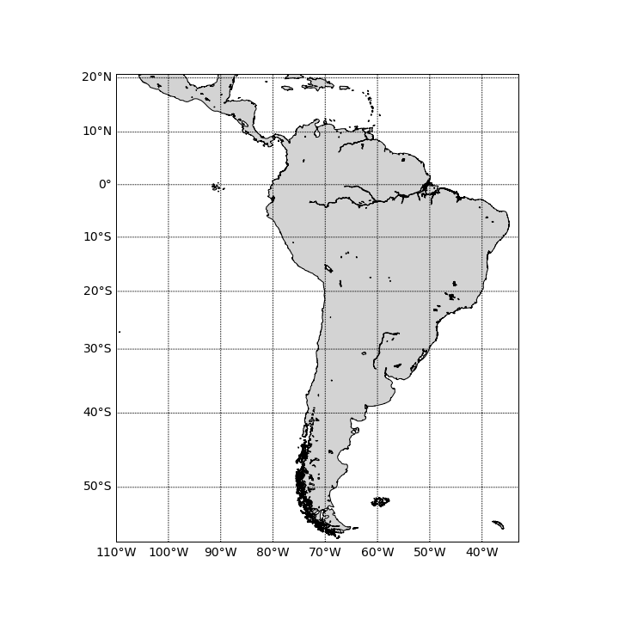
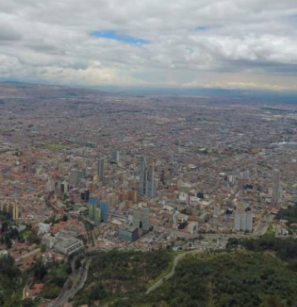




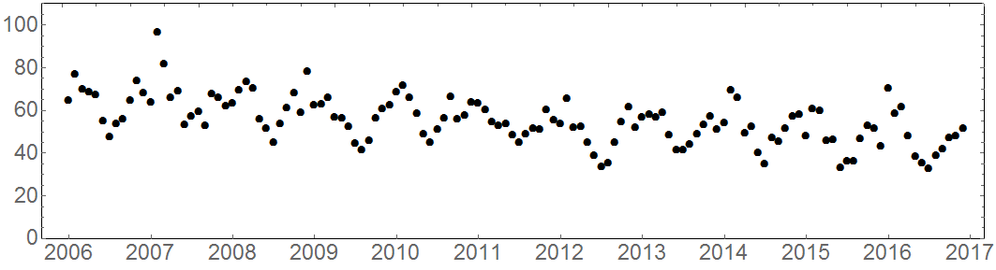
Our study area: Bogotá, Colombia
Introduction
CONTEXT
Bogotá is a fast-growing megacity.
~8M inhabitants
~2M vehicles (73% privately owned)
MAIN CONCERN
Particulate matter
PM₁₀ [µg m⁻³]
Annual average concentrations
PM₁₀ : 49.1 [µg m⁻³]
PM_{2.5} : 29.1 [µg m⁻³]
AQ monitoring network data in Bogotá
Notes:
Annual average pm10 c=49.1
Annual average p¿m2.5 c= 29.1
UNCERTAINTIES
Composition of particulate and gaseous species in the atmosphere

Slide 3

Introduction
PM₁₀ composition in Bogotá
A
B
C
(Vargas & Rojas, 2007)
D
E
A
D
(Ramírez et al., 2018)
Conference (Pachón et al., 2017)
B
PM Species
C
 | Organic Matter |  | Sulfate (SO₄²⁻)
 | Elemental Carbon |  | Nitrate (NO₃⁻)
 | Crustal/Mineral/Soil |  | Trace
 | Ionic |  | Others (un-speciated)
 | Secondary Inorg. Aer.
Bogotá
Notes:
Remove name of places, set them as a side note
Suba, caervajal, tunal, inmisión, u.libre

Slide 4
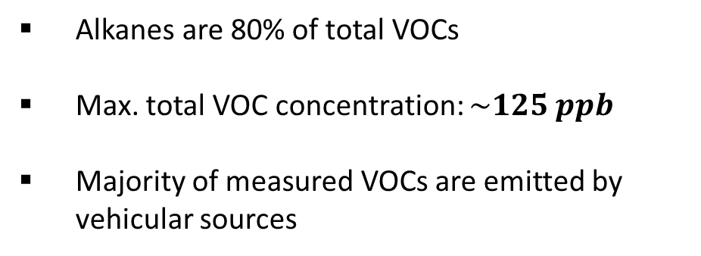
Gas phase measurements in Bogotá
Introduction
11 Air Quality monitoring stations (∆) in Bogotá
CO, NOx, SO₂ and O₃ are measured
VOC Characterization
Alkanes are 80% of total VOCs
Max. total VOC concentration: $\sim 125 ppb$
Majority of measured VOCs are emitted by vehicular sources
(Franco, Pacheco, Belalcázar & Behrentz, 2015)
Bogotá AQMN
Notes:
Bogotá has measurements of O3, CO, NOx and SO2
While PM10 has been measured in more occasion, only one peer reviewed work has been published where the gaseous phase has been characterized

Slide 5
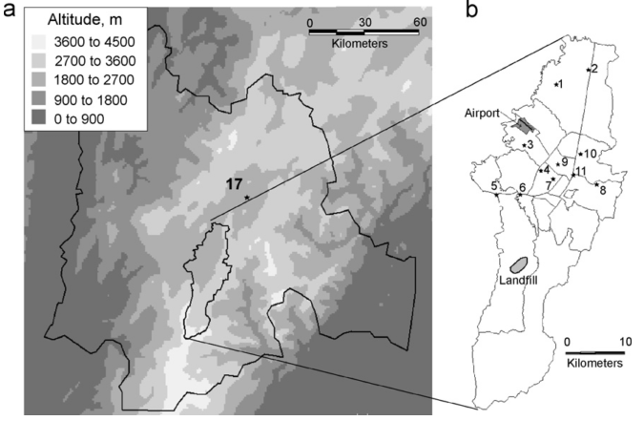
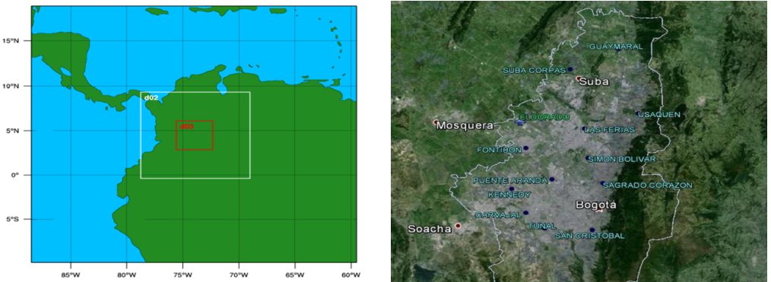
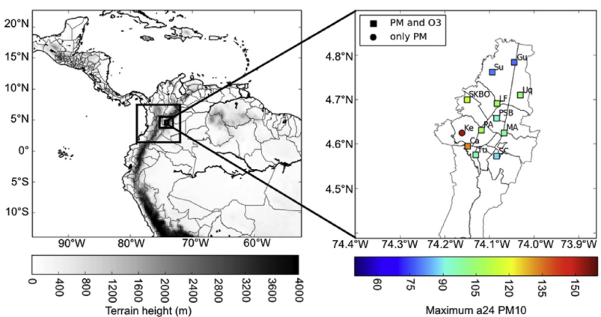
Previous AQ modelling studies in Bogotá
Introduction
TAPOM/FVM
On-road traffic sources represent a significant contribution of the EI
(Zárate et al., 2007)
WRF-Chem
Sensitivity analysis show the best gas-phase chemical mechanism to use (RADM2)
(Kumar et al., 2016)
CMAQ
Resuspended dust from paved and unpaved roads is a significant source of PM in the city.
(Nedbor-Gross et al., 2018)

Slide 6
Our goal
Introduction
To be able to explain the observed levels of carbonaceous airborne species in the city by means of chemical transport modelling
Our methods
Determine optimal model configuration (i.e., static fields, physics, gas-phase chemistry, aerosol schemes…)
Test out different emissions inventories: Sensitivity analysis
Identify potential weaknesses in emission sources and emissions speciation
Notes:
Our goal: To be able to reproduce the observed levels of carbonaceous airborne species observed in the city by means of chemical transport modelling, and further assess its impact on a regional level.
Select inventories
Select configuration (physc chem)
Find missing sources
Select our goals

Slide 7
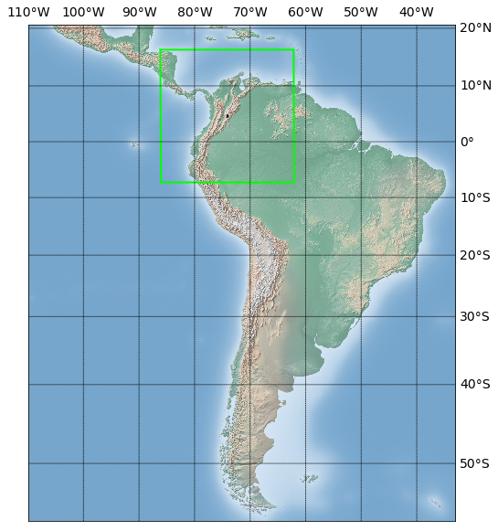
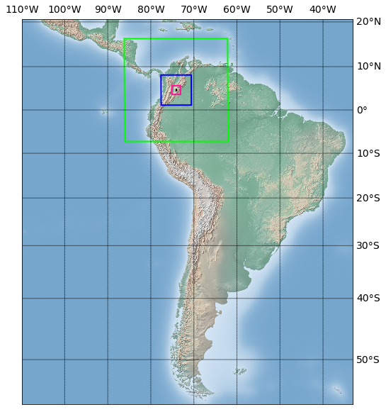
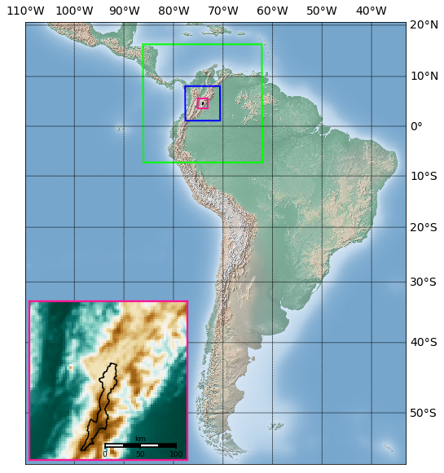
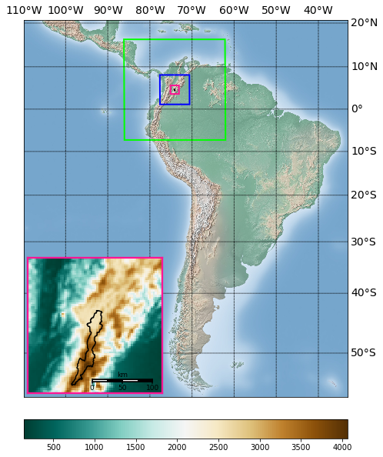
Simulation and challenges
WRF-Chem V3.9.1
3 Nested domains
D01: 27 x 27km
D02: 9 x 9km
D03: 3 x 3km
500 m
4000 m
D03
Complex Topography
Notes:
Our modelling domain:
Our challenges
Geographic location of our domain
What is our downscaling

Slide 8
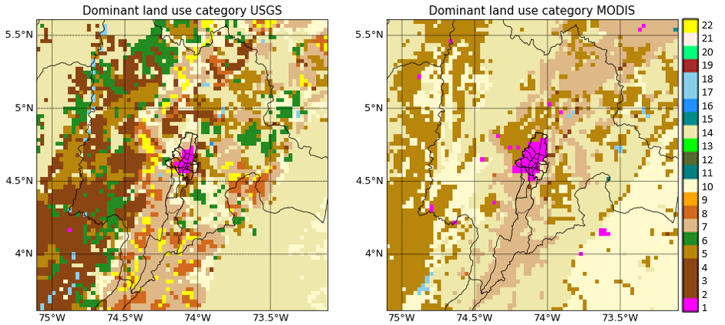
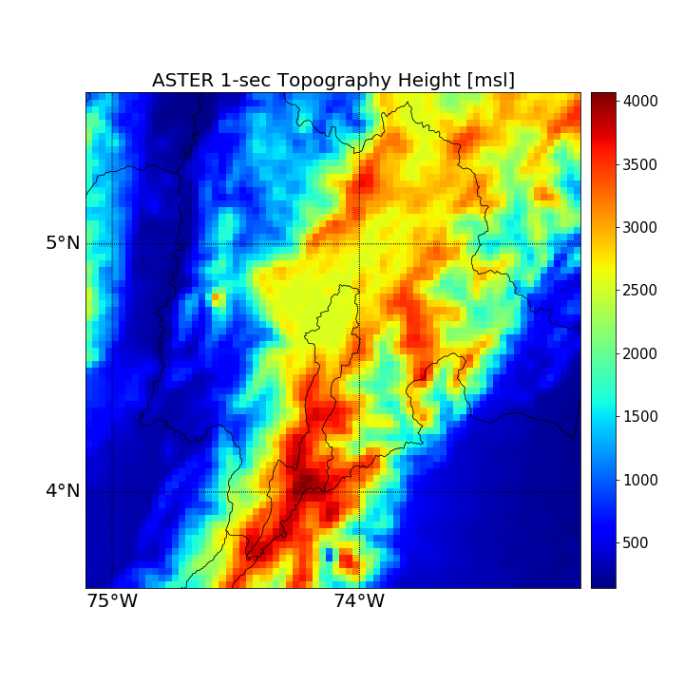
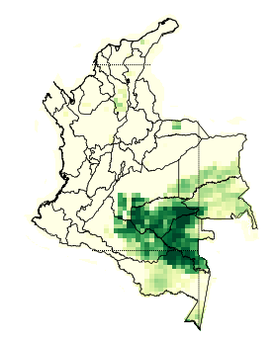
Building a base case Bsc
Methods
STATIC FIELDS
Land use: MODIS
Topography: ASTER
(Nedbor-Gross, 2018)
Urban areas
CHEMISTRY RELATED
Biogenic emissions:
MEGAN
online
Anthropogenic EI
BC and IC:
MOZART4-GEOS5 for d01
Local EI for cities
  Bogotá (RPM estimates)
Global EI
  EDGAR V4.3.1
  EDGAR-HTAP
Chem. options:
RACM and
MADE/VBS
Notes:
There have been developments of EI for some cities in Colombia

Slide 9
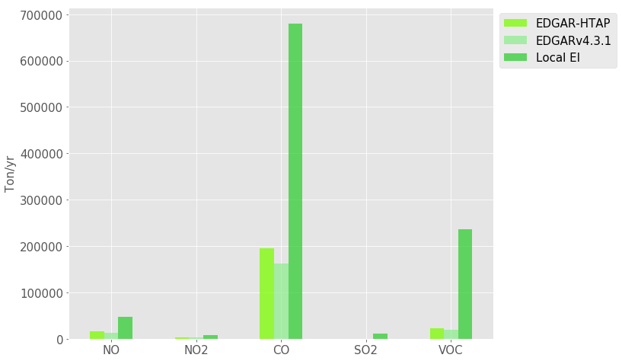
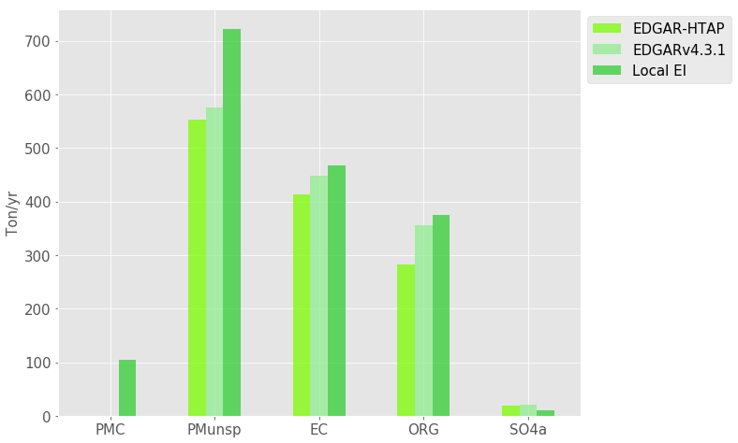
Methods
Global emissions Vs. Local emissions
Mobile emissions inventory
Particle Emissions
Gas Phase Emissions
Notes:
Considering such discrepancies, we decided to test out first the global emissions inventories

Slide 10
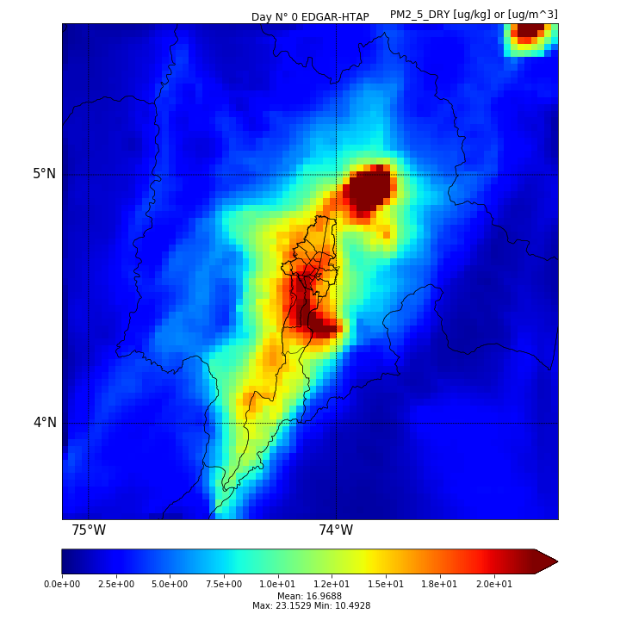
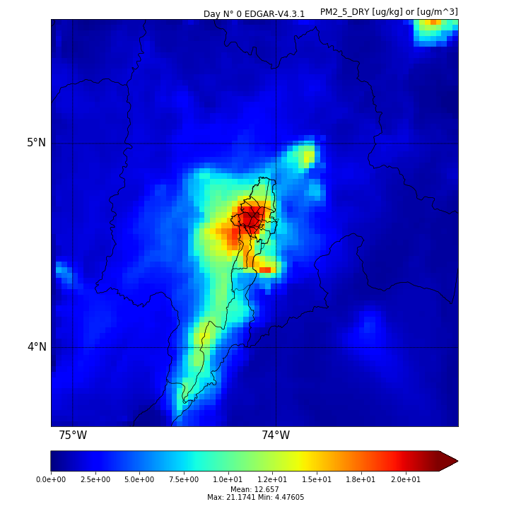
Choosing the global inventory for our base case
Methods
PM_{2.5}
[µg/m³]
EDGAR-HTAP
EDGARv4.3.1
Power plant 2
Power plant 1
Overestimation of energy sector emissions by EDGAR-HTAP

Slide 11
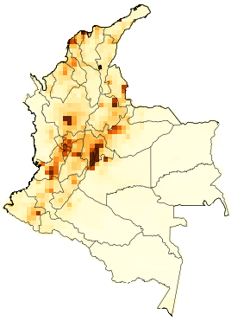
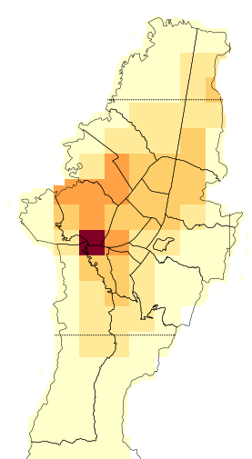
Building a base case Bsc
Methods
STATIC FIELDS
Land use: MODIS
Topography: ASTER
(Nedbor-Gross, 2018)
CHEMISTRY RELATED
Biogenic emissions:
MEGAN
online
Anthropogenic EI
BC and IC:
MOZART4-GEOS5 for d01
Chem. options:
RACM and
MADE/VBS
We choose EDGARv4.3.1 adding local RPM

Slide 12
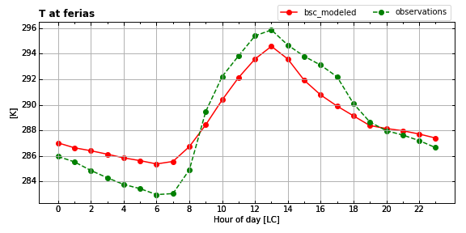
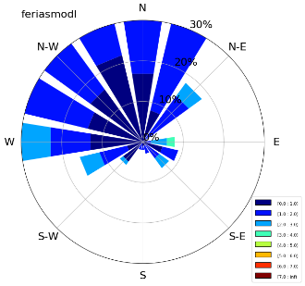
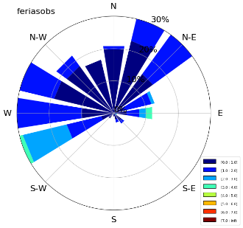
Meteorology evaluation
Results
Attainance of benchmarks
AQ monitoring network (RMCAB)
Model
Observations
TEMPERATURE

Slide 13
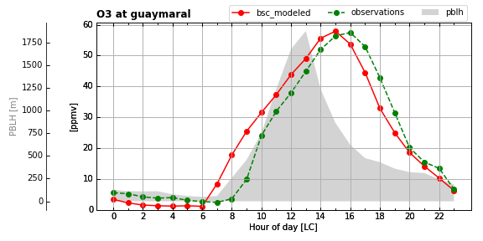
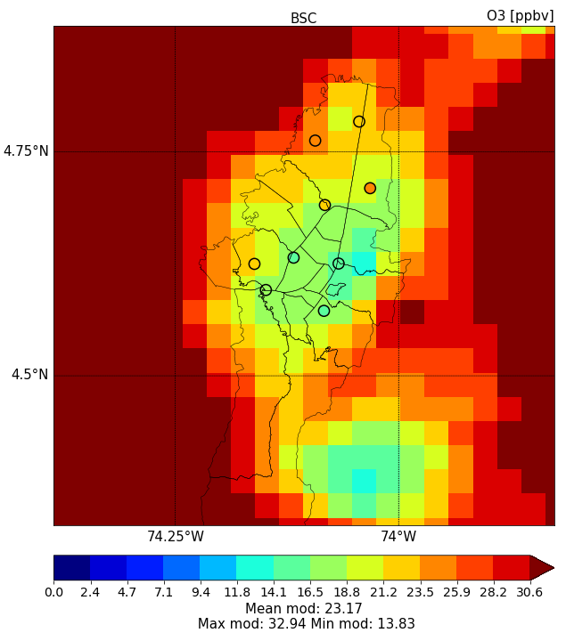
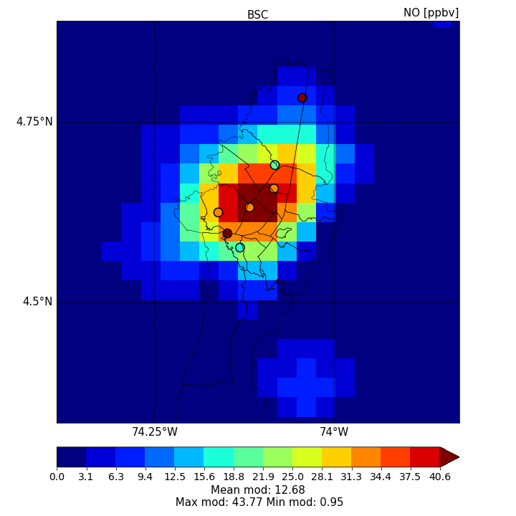
Chemistry performance
Results
Mod
Obs
PBLH
O₃ [ppb]
[ppb]
NO [ppb]

Slide 14
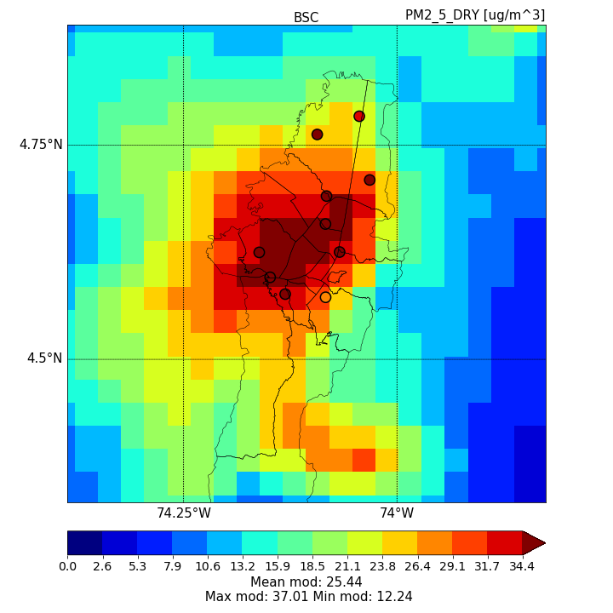
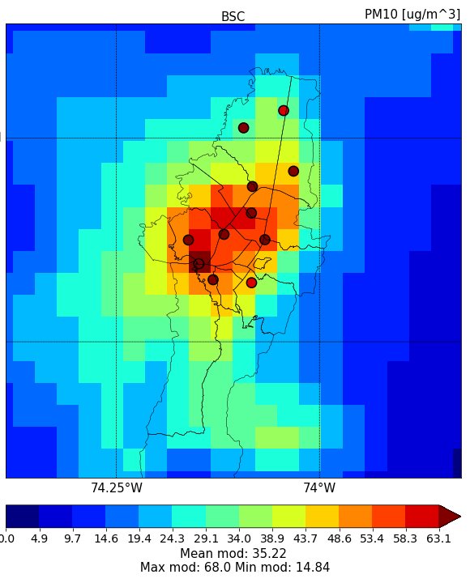
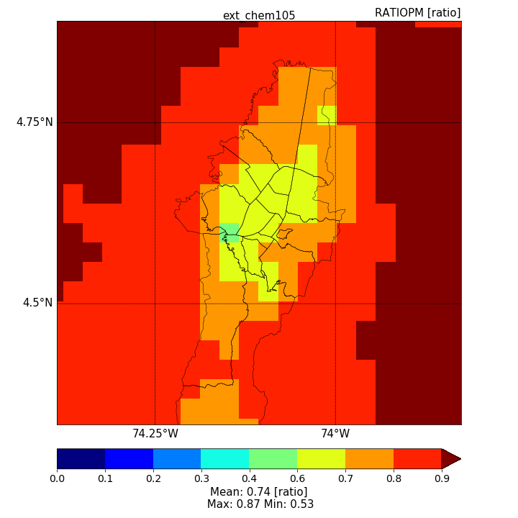
Chemistry performance
Results
PM_{2.5}
PM₁₀
PM_{2.5}
/ PM₁₀
[µg/m³]
[µg/m³]
Fine particles underestimated in north of the city (misplaced emissions?)
Coarse mode particles are underestimated all over Bogotá

Slide 15
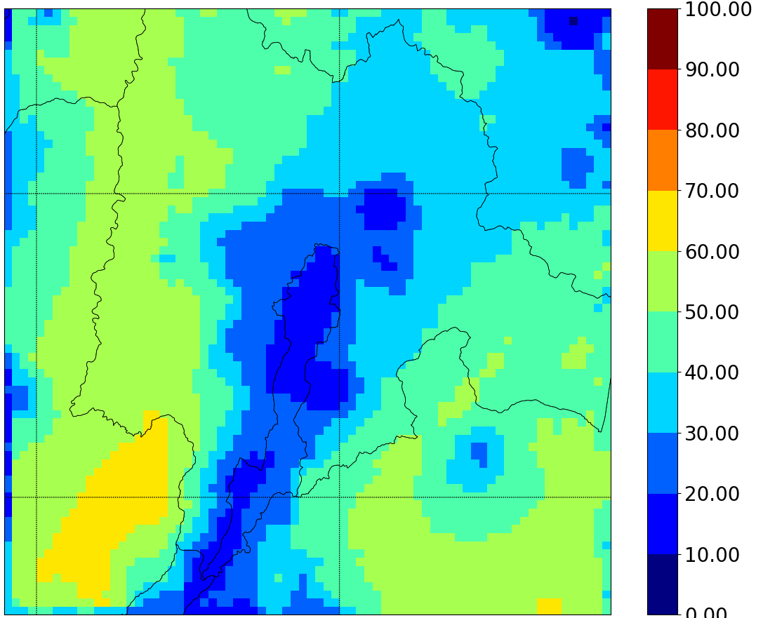
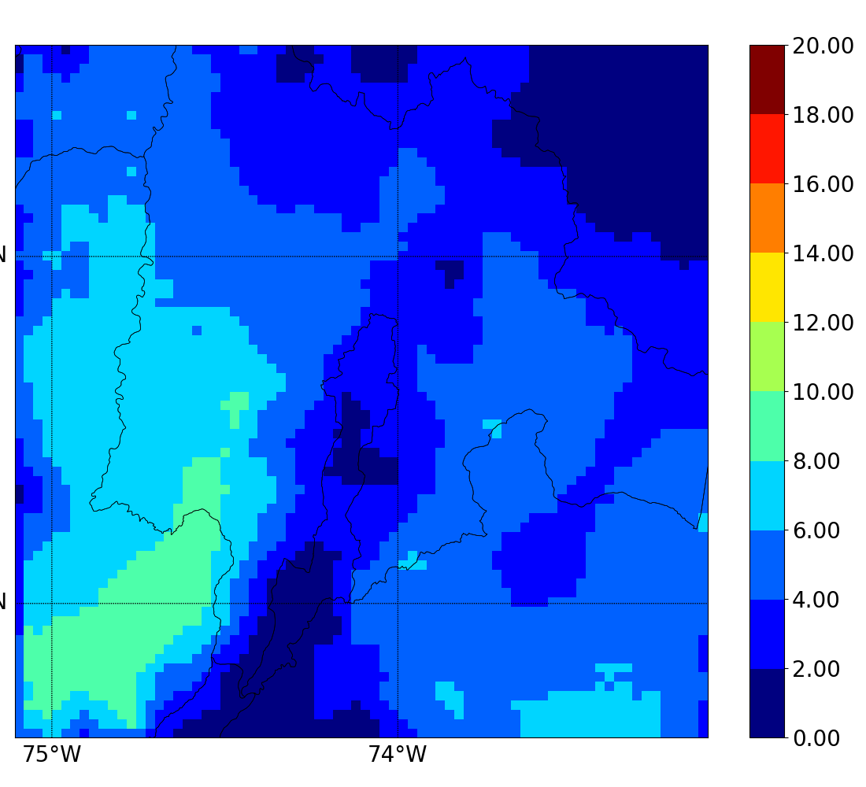
OA contribution to PM₁₀
Results
Organic fraction in PM₁₀
Observed composition PM₁₀
18% Organic/PM₁₀ within Bogotá
ASOA fraction in PM₁₀
2.7% ASOA/PM₁₀ within Bogotá
(Ramírez et al., 2018)
Notes:
We know our simulations are good, but what about the composition and the contribution of organic species to the simulated PM? Well …

Slide 16
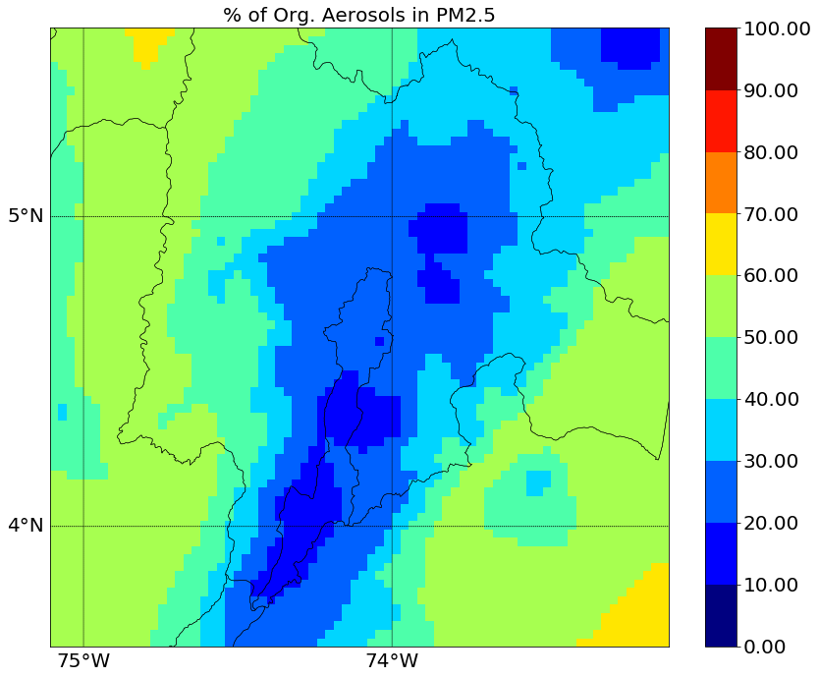
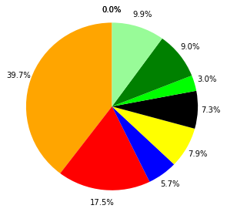
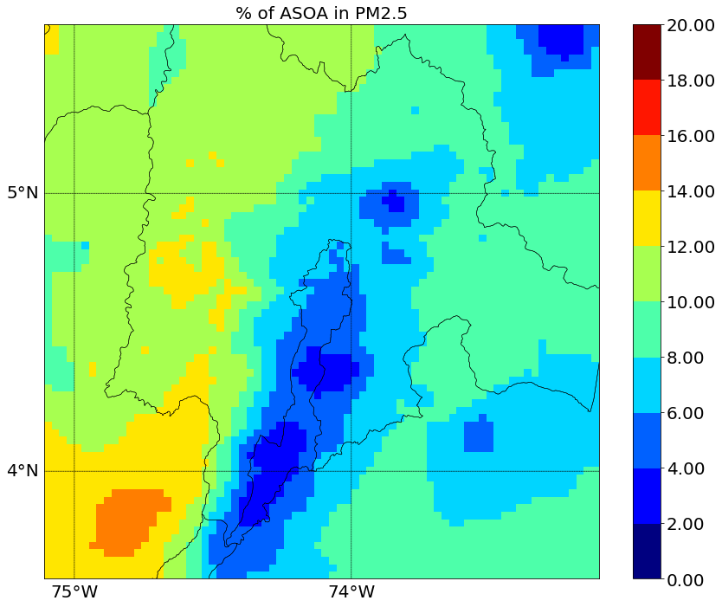
OA contribution to fine PM
Results
Organic fraction in PM_{2.5}
Modeled composition PM_{2.5}
22% OM/PM_{2.5} within Bogotá
ASOA fraction in PM_{2.5}
3% ASOA/PM_{2.5} within Bogotá
Notes:
We know are simulations are good, but what about the composition and the contribution of organic species to the simulated PM? Well …

Slide 17
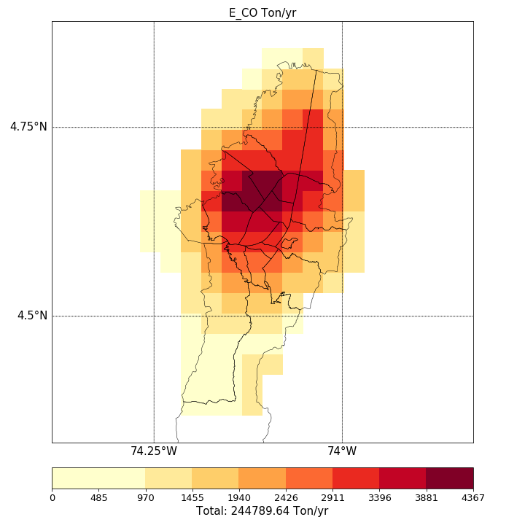
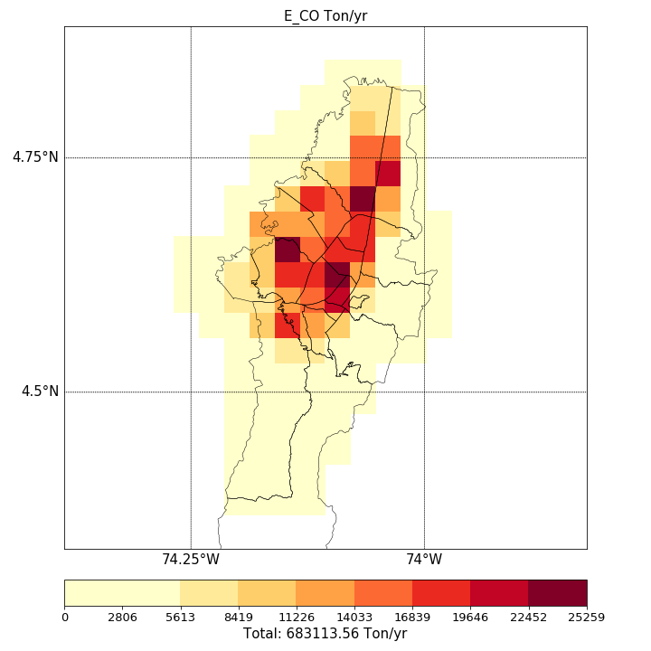
Results
Using the local mobile emissions
CO (Ton/yr)
EDGARv4.3.1
Local emissions 2012
Vs.
> 10X VOC
4X CO
5X NOx
1X PM
Notes:
So what if we now tested the local emissions inventory, which though having higher magnitudes, spatially show a more accurate pattern of emissions

Slide 18
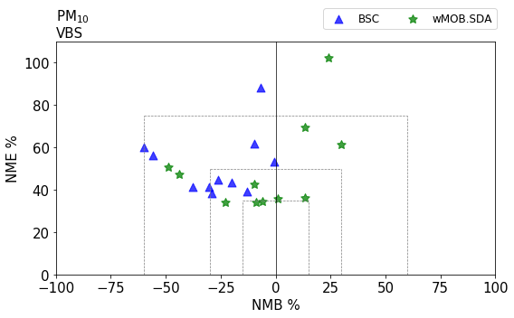
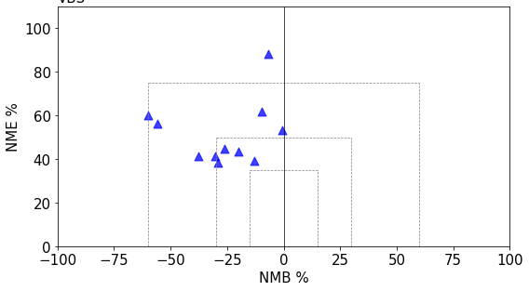
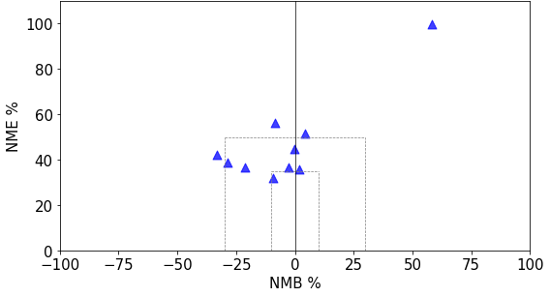
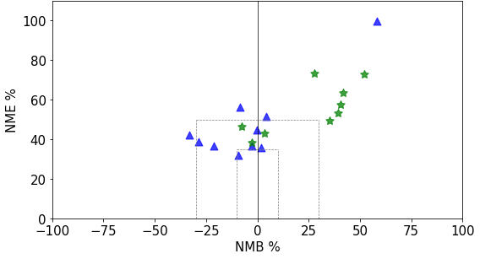
Modeled PM performance
Results
PM₁₀
Results
PM₁₀
Base case
Using mob loc EI
Local mobile emissions inventory produces a significant change on particle estimates
PM_{2.5}
PM_{2.5}
Overestimation of fine particles
|18

Slide 19
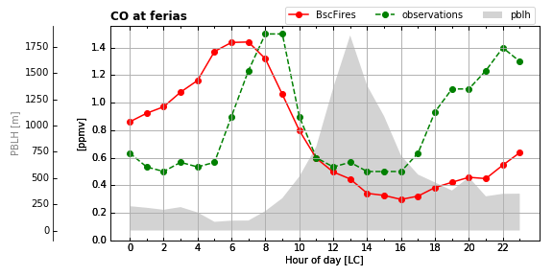
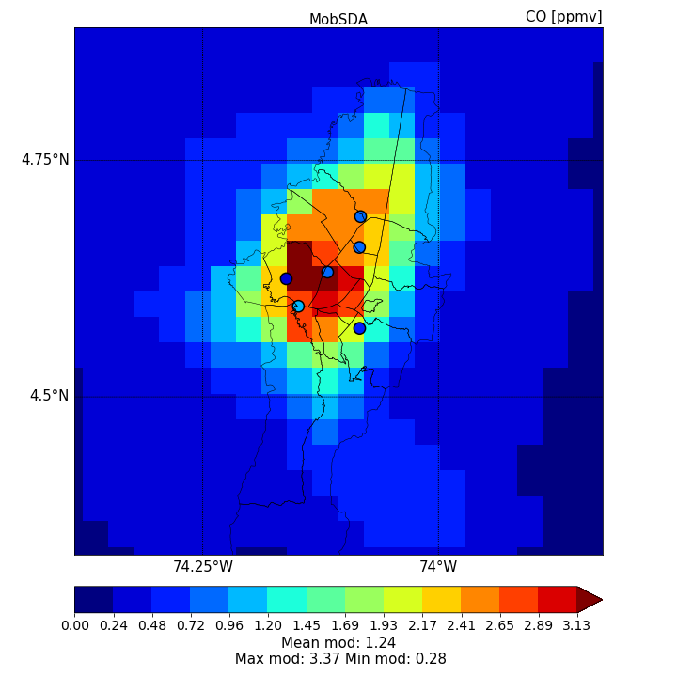
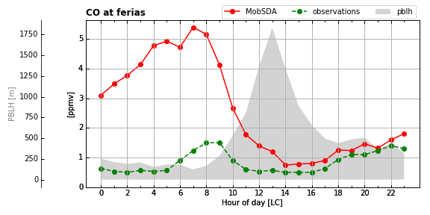
Using the local emissions: What happens with the gaseous phase?
Results
Base case
Mod
Obs
PBLH
CO [ppb]
With local mobile emissions

Slide 20
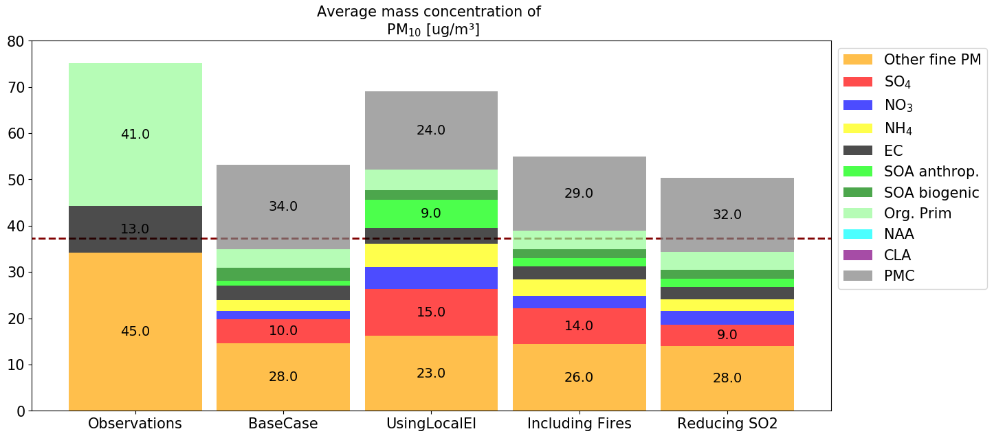
Particle composition
Results
Average Observed PM_{2.5}
PM₁₀
With MADE/VBS regional sources don’t explain the OM
But gas phase pollutants are overestimated!

Slide 21
Concluding remarks
Take home message
Even with high concentration of SOA precursors, OM is not well represented
EC is underrepresented in all simulations, irrespective of emission inventory used
Our results suggest that missing OM and EC could be caused by:
  Too little POM and EC in the local/global emissions inventory
  Need of speciation of re-suspended particles emitted in the city (Work developed by Jorge Pachón’s group)
  Do we have a misrepresentation of regional sources? Biomass burning aerosols from wildfires?

Slide 22
Speciation of PM_{2.5}
Ongoing work
Measurements campaigns of fine PM
PM_{2.5} 27.9 [µg m⁻³]

Slide 23
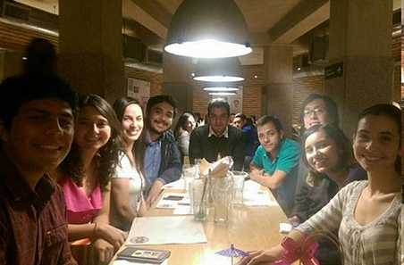

Acknowledgements
This work was funded by the FAPA program from the Office of the vice-dean for Research from Universidad de los Andes, Bogotá, Colombia.
We thank the local authority Secretaría Distrital de Ambiente SDA for providing the local emissions inventory for 2012.
We acknowledge use of the WRF-Chem preprocessor tools anthro_emiss, bio_emiss and mozbc provided by the Atmospheric Chemistry Observations and Modelling Lab (ACOM) of NCAR.
To the air quality group from CIIA . . .

Slide 24
Thank you!!!
Questions ?
Maria Paula Pérez-Peña, MSc. ¹
Ricardo Morales Betancourt, PhD. ²
1 – mp.perez@uniandes.edu.co
2 – r.moralesb@uniandes.edu.co

Slide 25
Back-up slides
Maria Paula Pérez-Peña, MSc. ¹
Ricardo Morales Betancourt, PhD. ²
1 – mp.perez@uniandes.edu.co
2 – r.moralesb@uniandes.edu.co

Slide 26
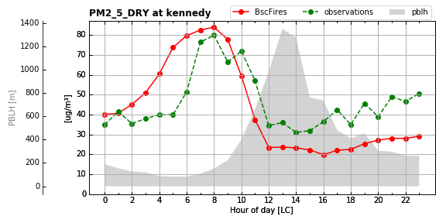
Pollutant dependency to PBLH estimates
Results
…. Too low night-time PBLH

Slide 27
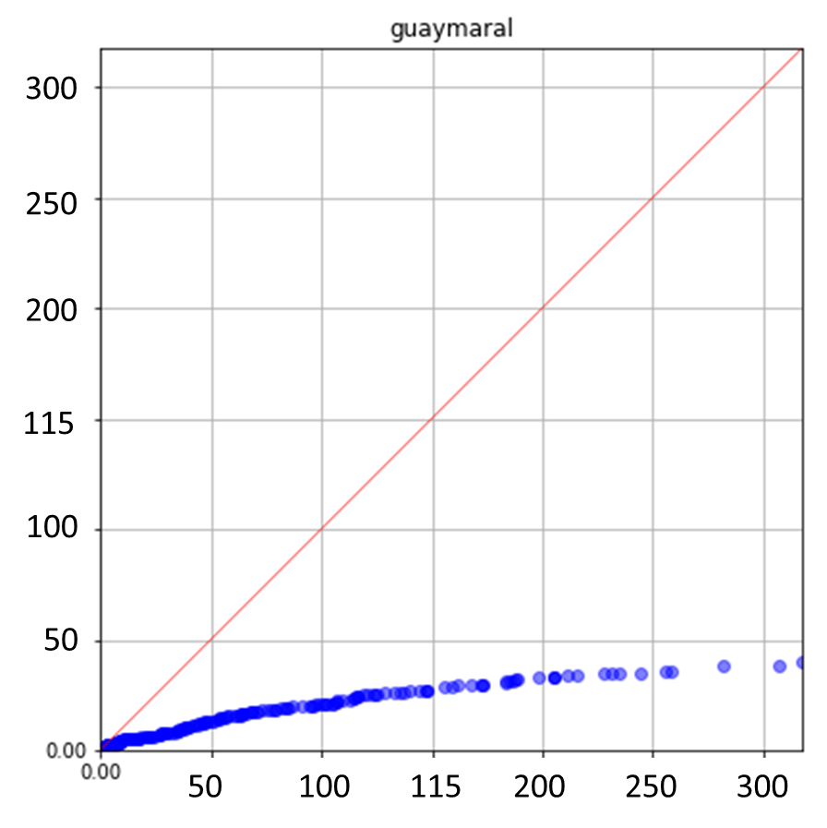
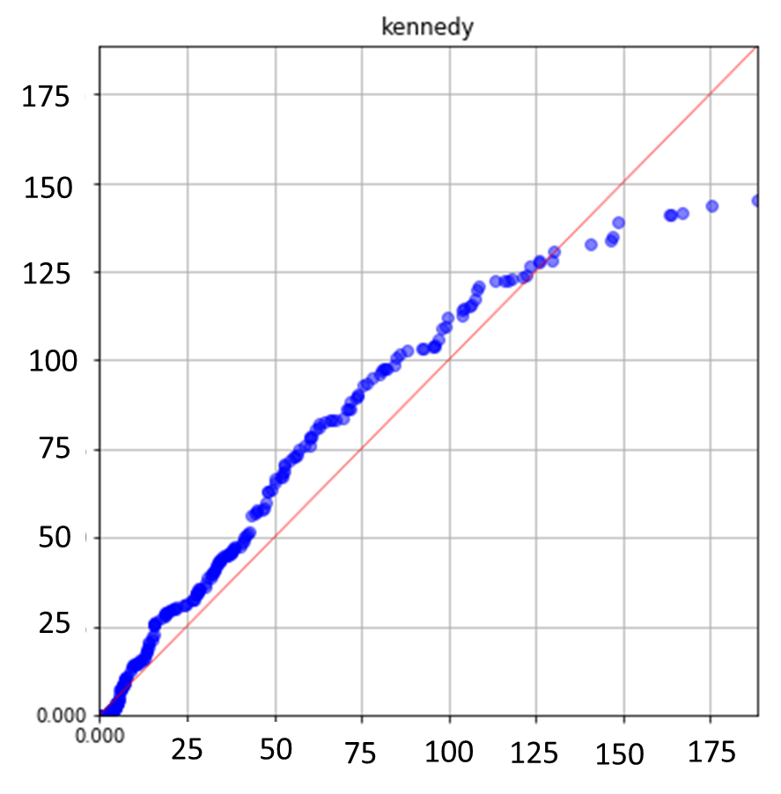
Base case modelling results: chemistry performance
NO [ppb]
PREDICTIONS
PREDICTIONS
OBSERVATIONS

Slide 28
Concluding remarks
The results of our simulations indicate that PM2.5 and PM10 levels can be represented well with the emission inventories explored in the study.
The contribution of both, Elemental Carbon and Organic Aerosols is highly underestimated.
Secondary inorganic aerosol contribution is overestimated by all model simulations.
Organic aerosol contribution is only well represented when using the local inventories, which grossly overestimates other species such as CO and VOC.
Secondary inorganic aerosol contribution is overestimated by all model simulations

