Slide 1
Introducing the Surface Tiled Aerosol and Gaseous Exchange (STAGE) Dry Deposition Option for CMAQ V5.3
Jesse O. Bash¹, John Walker¹, Donna Schwede¹, Patrick Campbell², Tanya Spero¹,
Wyat Appel¹, Mark Shephard³, Karen Cady-Pereira⁴, Rob Pinder⁵, Havala Pye¹,
Ben Murphy¹, Kathleen Fahey¹
1. EPA National Exposure Research Laboratory, RTP, NC, US
2. University of Maryland, College Park, MD
3. Environment and Climate Change Canada, Toronto, ON
4. AER Inc., Lexington, MA
5. EPA Office of Air Quality Policy and Standards, RTP, NC, US
17th Annual CMAS Conference, Chapel Hill, NC
October 22-24, 2018
Office of Research and Development
National Exposure Research Laboratory, Computational Exposure Division
Notes:
(1) While “arial” is used in this example, other fonts may be used. Please strive for consistency in font type and size.
(2) While a blue background is shown here, other colors noted on the EPA/ORD intranet site may be used.
(3) A picture may be added if desired.
--- The goal is to promote our CED “brand” and maintain some degree of consistency among CED presentations.

Slide 2
Disclaimer: The views expressed in this presentation are those of the authors and do not necessarily reflect the views or policies of the U.S. EPA.
Office of Research and Development
National Exposure Research Laboratory , Computational Exposure Division
Office of Research and Development
National Exposure Research Laboratory, Computational Exposure Division
Notes:
Disclaimer may be placed elsewhere in the presentation (such as the title slide or the “final” slide); however, it should be clearly legible.

Slide 3
Motivation and Scope
What is STAGE?
Field scale evaluation
Regional scale evaluation
Summary and future directions
Motivation

Slide 4
Dry Deposition Development Motivation
Data needs for critical loads and total maximum daily load assessments
Linked models need higher resolution or land use specific input
Environmental impact of pollutant deposition is important for ecological impacts, e.g. soil vs vegetative uptake
Tiled and mosaic schemes are becoming more common in meteorological models, e.g. Noah, ECMWF, etc
Tiled = land use specific deposition, e.g. lumps land use types
Mosaic = finer resolution surface layer, e.g. retains spatial information
Newly available multispecies deposition datasets
Generalize model processes
Unify the resistance schemes for bidirectional and dry deposition and simplify the process of adding new deposition species

Slide 5
CMAQ v5.2.1 Resistance Parameterization
Bidirectional Exchange
Dry Deposition
R_{inc}
R_{soil}
Pleim et al. 2013
Pleim and Ran 2011

Slide 6
What is STAGE?
Resistance Parameterization
Surface Tiled Aerosol and Gaseous Exchange (STAGE) model
Sub-grid land use specific gaseous and aerosol deposition
Fluxes area weighted to grid cell
Allows the output of land use specific fluxes
Models fluxes as gradient based processes
Using Kirschhoff’s current law
Estimates in-canopy fluxes and concentrations
Bidirectional and unidirectional schemes use the same resistance model
Easy to add bidirectional exchange for modeled species
Χ_{w}>0
Adapted from Nemitz et al. 2001

Slide 7
Resistance Parameterizations
Soil, water, and vegetation specific quasi laminar boundary layer resistance
Updated in-canopy aerodynamic resistance
Based on integrated in-canopy eddy diffusivity
Revised resistance to wet surfaces modeled following parameterization in aqueous chemistry Kinetic Mass Transport (KMT) model in CMAQ aqueous chemistry
Added diffusive and bulk accommodation coefficient restrictions
Resistance to vegetation and soil for non-polar organics estimated from physical and chemical processes
Similar to organic aerosol processes and field scale models for persistent organic pollutants
Ozone deposition to soil revised using parameterizations from in-canopy flux measurements
Plant functional type and smooth surface specific Stokes number for aerosol deposition

Slide 8
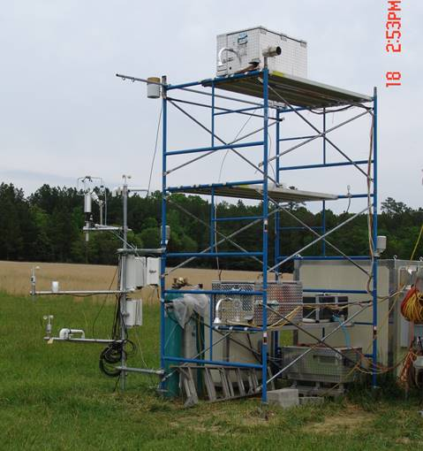
Duke Forest Flux Measurements
Continuous measurements of NH₃, SO₂, and HNO₃ using a Monitor for AeRosols and Gases (MARGA) instrument with two inlets (Rumsey and Walker 2017)
Run in a gradient mode
Measurements taken at a grass field in the Blackwood Division of Duke Forest from July through November 2012
Grassland was cut at the onset of measurements
Dynamic test of in-canopy and leaf quasi-laminar boundary layer resistances

Slide 9
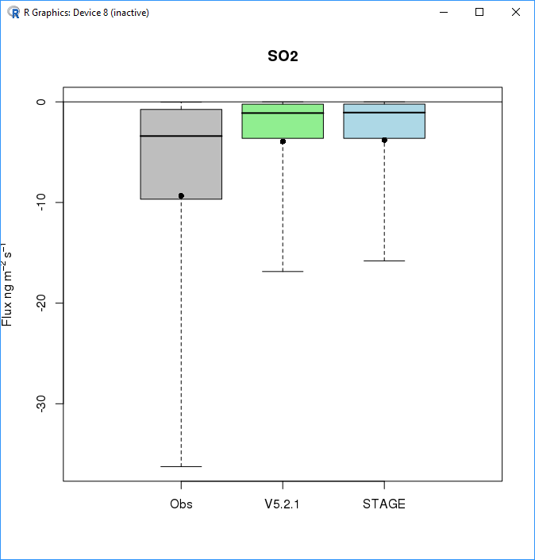
Duke Forest Flux Measurements: SO₂
Small changes in overall evaluation
Increase in bias and correlation
Decrease in error
Changes in error and bias are due to a reduction of large deposition events to wet surfaces
Increasing the SO₂ apparent reactivity improves model performance
 | V5.2.1 | STAGE
NMB | -57.7% | -59.3%
NME | 72.7% | 71.0%
r | 0.508 | 0.551
July through November 2012

Slide 10
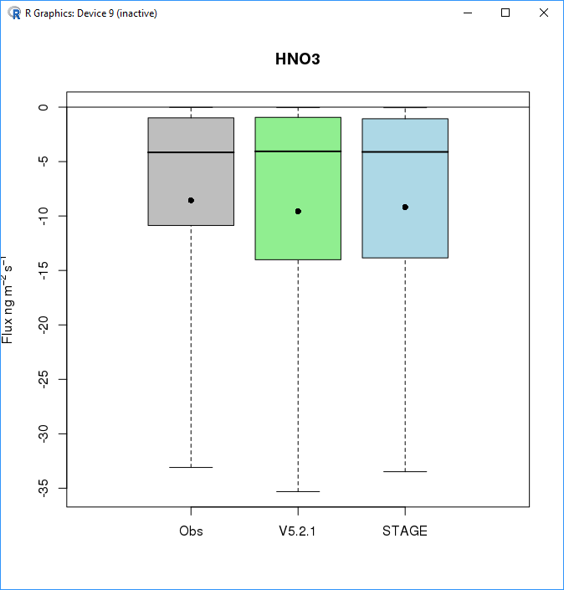
Duke Forest Flux Measurements: HNO₃
HNO₃ deposition governed by aerodynamic resistances
In STAGE the in-canopy aerodynamic and quasi-laminar boundary layer resistances changed
Observed improvements indicate better representation of R_{inc} and R_{b}
 | V5.2.1 | STAGE
NMB | 11.9% | 7.3%
NME | 55.7% | 53.2%
r | 0.719 | 0.724
July through November 2012

Slide 11
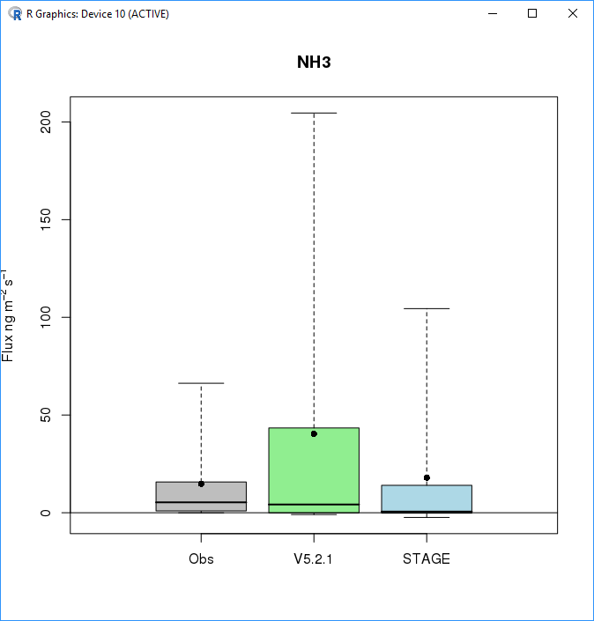
Duke Forest Flux Measurements: NH₃
Improvement over v5.2.1 parameterization
V5.2.1 higher correlation driven by outliers
Rank correlation coefficients 0.491 for both models
 | V5.2.1 | STAGE
NMB | 172.8% | 21.8%
NME | 235.0% | 144.0%
r | 0.348 | 0.254
July through November 2012

Slide 12
Regional Scale Evaluation
 | 2011 | 2016
Emissions | 2011 NEI V2 | 2014 NEI V2
Chemical Mechanism | CB6r3 | CB6r3
Aerosol Model | Aero6 | Aero7
Meteorology | WRF 3.8.1 | WRF 3.8.1
Boundary Conditions | Hemispheric CMAQ v5.2.1 | Hemispheric CMAQ v5.2.1

Slide 13
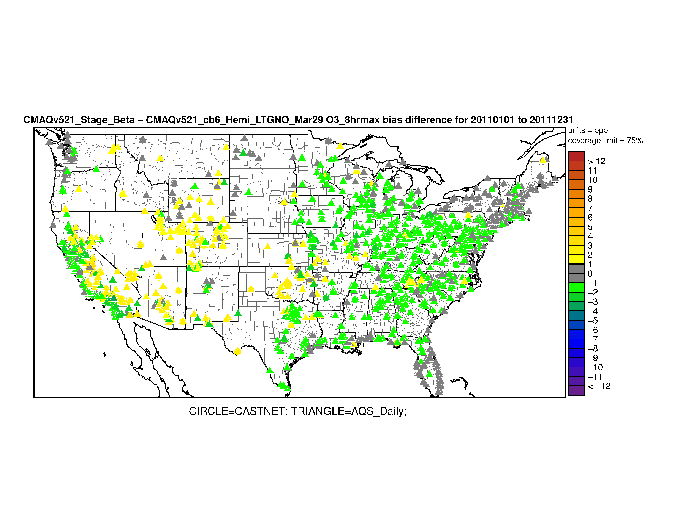
Regional Scale Evaluation: O₃
Reduced biases at 70.7% of sites
Winter biases reduced due to snow deposition parameterization
Eastern US biases due to soil deposition parameterization
Coastal biases reduced due to feedback between organic deposition and PAN formation
Western summertime biases increase due to WRF v3.8.1-PX overestimate of vegetation coverage
Should be corrected in WRF v4.0
Annual 2011 STAGE-V5.2.1 Bias Difference
Max 8 hour O₃
 | V5.2.1 | STAGE
NMB | 5.9% | 2.4%
NME | 15.6% | 15.0%
r | 0.79 | 0.79

Slide 14
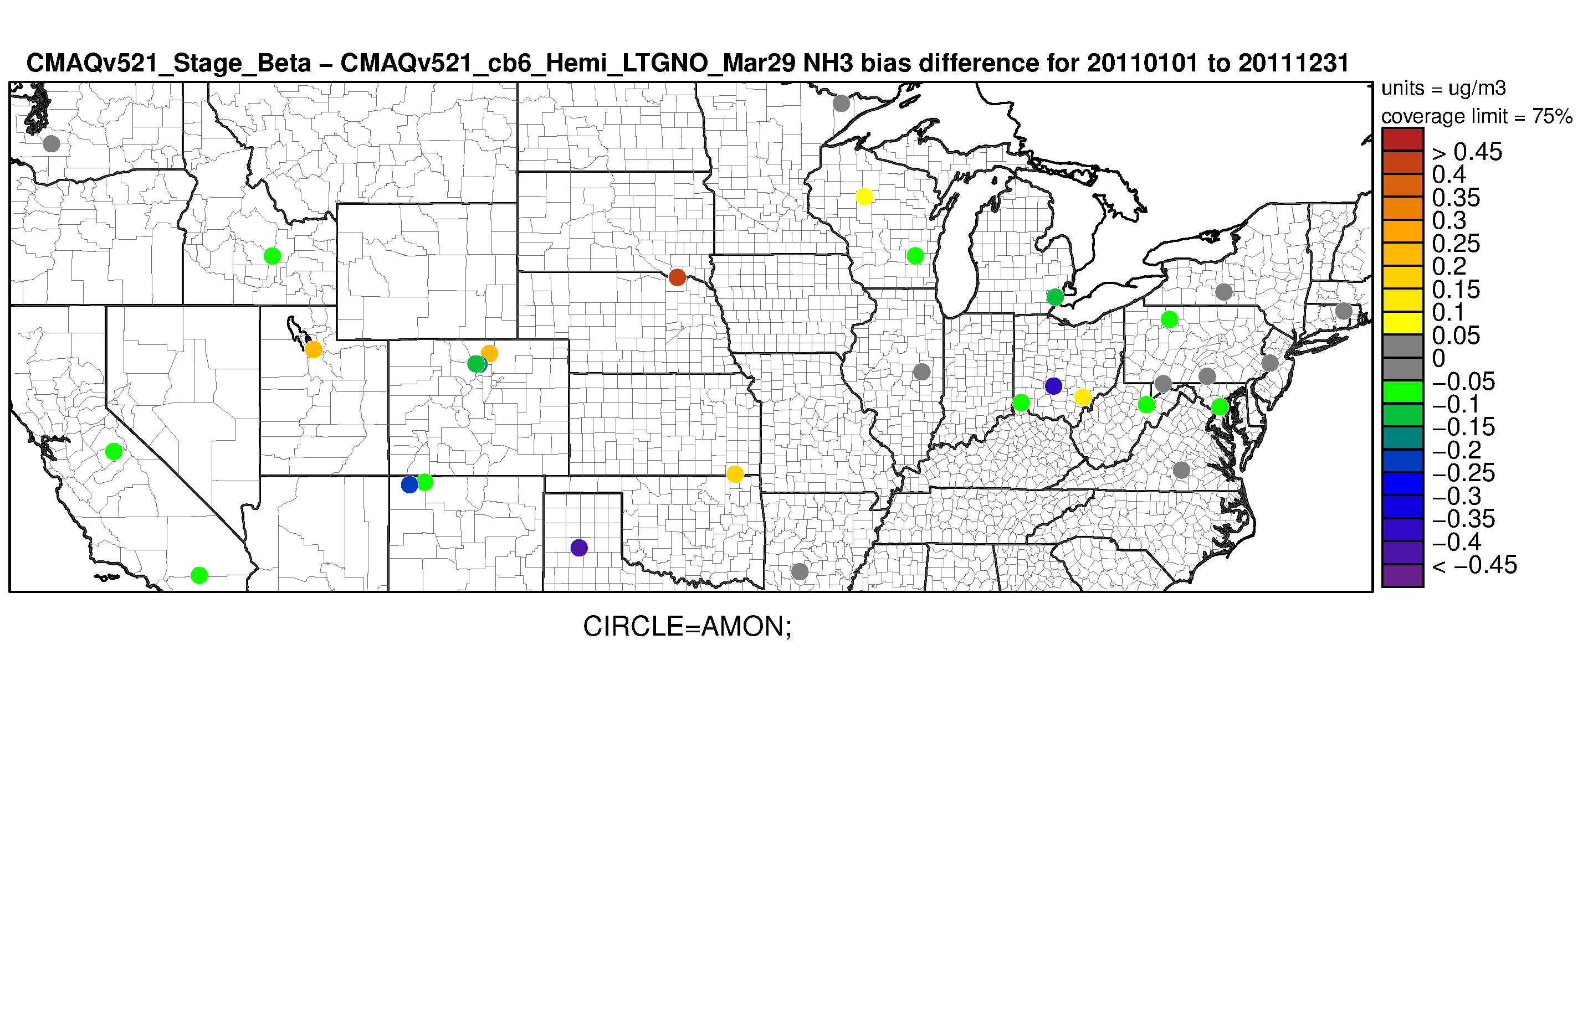
Regional Scale Evaluation: NH₃
Annual 2011 STAGE-V5.2.1 Bias Difference
Two Week Mean NH₃
Reduced biases at 72.1% of sites
Winter biases reduced due to snow and soil parameterization
Still biased low
Eliminated overprediction in the summer and Southeast in v5.0.2 and v5.2.1
Largely responsible for low bias of those model versions
Biased high in the upper Midwest
Lower bias in the Mountain West
Still biased low
 | V5.2.1 | V5.0.2 Bidi | STAGE
NMB | -14.4% | -7.1% | -9.8%
NME | 76.8% | 73.4% | 74.4%
r | 0.36 | 0.33 | 0.40

Slide 15
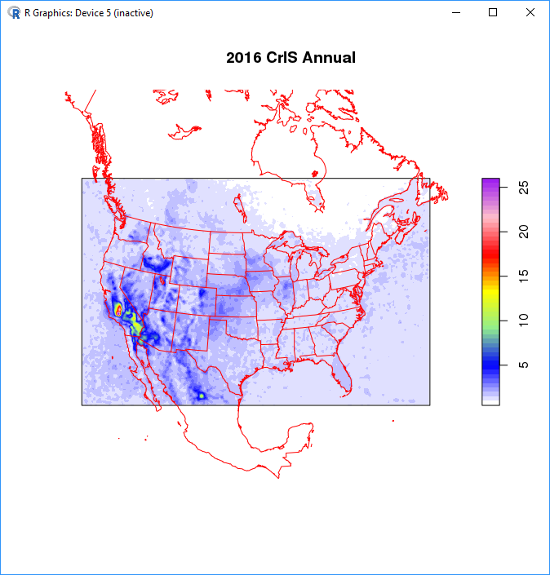
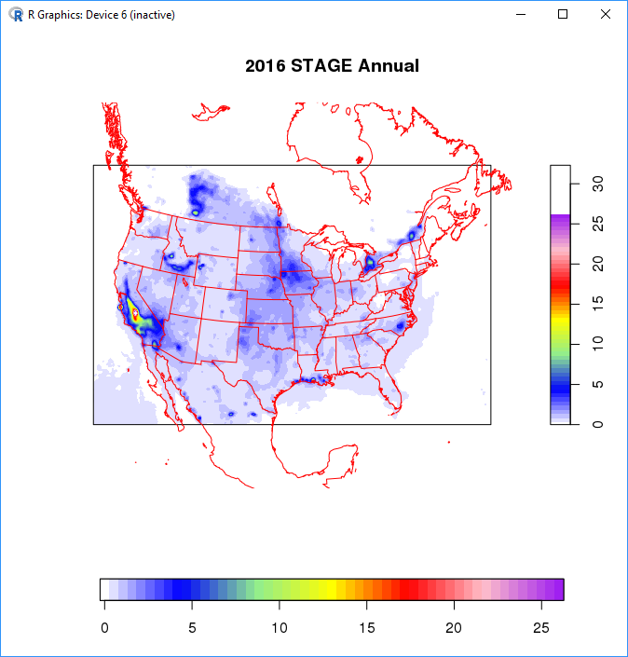
Regional Scale Evaluation: CrIS NH₃
Cross-track Infrared Sounder (CrIS) onboard the Joint Polar Satellite System

Slide 16
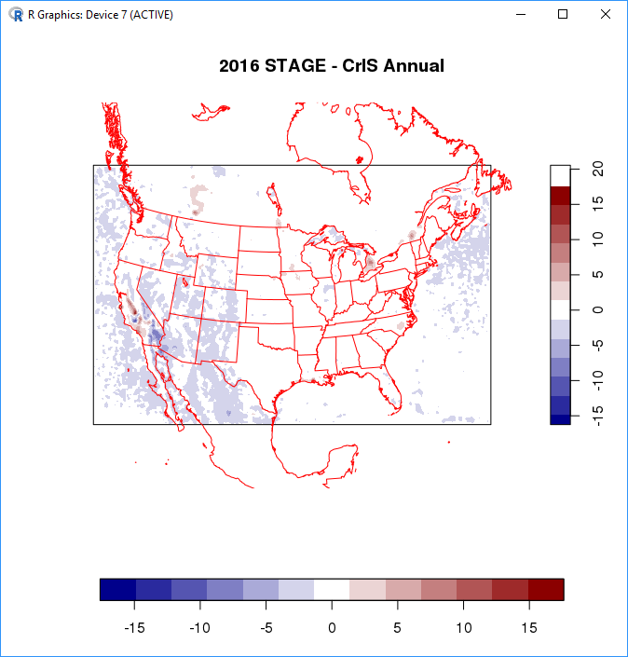
Regional Scale Evaluation: NH₃
CrIS data paired in space and time
Lower biases in the Eastern US
Persistent biases in NC and Iowa
Swine producing areas
CMAQ is missing variability in NH₃ concentrations in the Mountain west
2016 simulations underestimate NH₃ when compared to AMoN and CrIS
2014 NEI v2 ammonia emissions and temporal allocation may contribute to biases
EPIC underestimates fertilizer application

Slide 17
Evaluation Summary
A unified bidirectional/dry deposition scheme was developed for CMAQ v5.3
Evaluates well against field scale and monitoring network observations
Reduced biases in O₃ for coastal areas and in the Southeast
NH₃ and O₃ underpredicted in 2016
Due to 2011 NEI versus 2016 NEI?
Missing variability in NH₃ concentrations in the Mountain west
May be missing emissions
PM biases increased but error decreased and correlation increased
Capturing NO₃ and SO₄ aerosols better
Wet deposition is generally improved in STAGE and M3dry v2
Due to updates to coarse mode aerosol deposition

Slide 18
Application Summary
Land use specific deposition will better facilitate critical loads and TMDL applications
Ecological impact of deposition differs by land use
Different land uses have different critical loads
Managerial decision are often land use specific, e.g. zoning, riparian buffers, etc.
Bidirectional and dry deposition schemes have been unified
Model structure allows for easy representation of bidirectional species
Simply need to provide an estimate of a concentration in the soil, stomata or vegetation surface

