Slide 1
Advanced Land Surface Processes in the Coupled WRF/CMAQ with MODIS Input
Limei Ran¹, Robert Gilliam¹, David Wong¹, Hosein Foroutan², Jonathan Pleim¹, George Pouliot¹, Wyat Appel¹, Matthew Woody³, Benjamin Murphy¹, Kirk R. Baker³, Daiwen Kang¹, Shawn Roselle¹, Brian Eder¹, Ellen Cooter¹
¹Computational Exposure Division, USEPA/ORD/NERL, Research Triangle Park, NC, USA
²Department of Biomedical Engineering and Mechanics, Virginia Tech, Blacksburg, VA, USA
³Office of Air Quality Planning and Standards, USEPA, Research Triangle Park, NC, USA

Slide 2
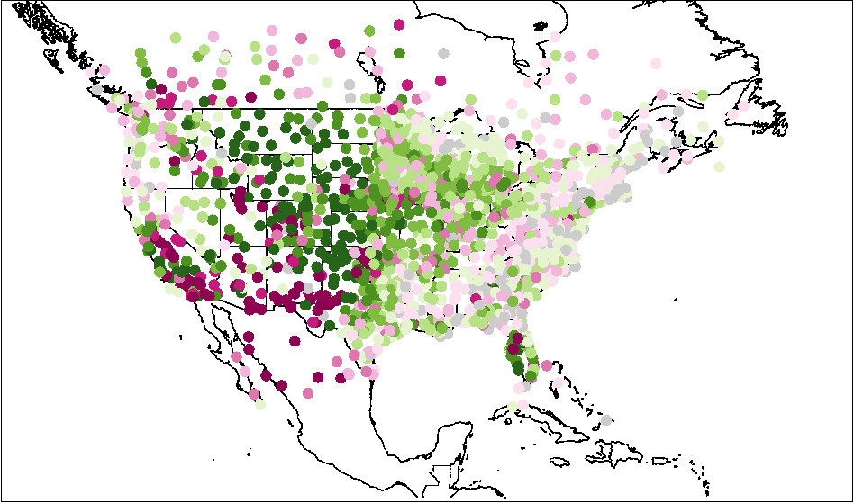
1. Background and Objective
LSM: important for WRF/CMAQ
Meteorology: heat, moisture and momentum (e.g. LH, soil water, 2-m T and Q, PBLH)
Air quality: dry deposition and dust emissions
Efforts on improving land surface processes
Evaluated and updated WRF v3.4 with MODIS vegetation product for offline CMAQ v5.0.1 (Ran et al., 2015 and 2016, JGR-Atmos.)
Implemented a photosynthesis approach in the PX LSM box model (Ran et al., 2017, JGR-Atmos.)
Monthly average mean bias (MB) and error (MAE)
Updated: WRF3.4 bias difference: MODIS – Base
Better:
63.85% sites
2-m Q
200608
2006
MODIS input helps reduce 2-m Q bias during growing season from April to September
MODIS improves 2-m Q in the north-central states

Slide 3
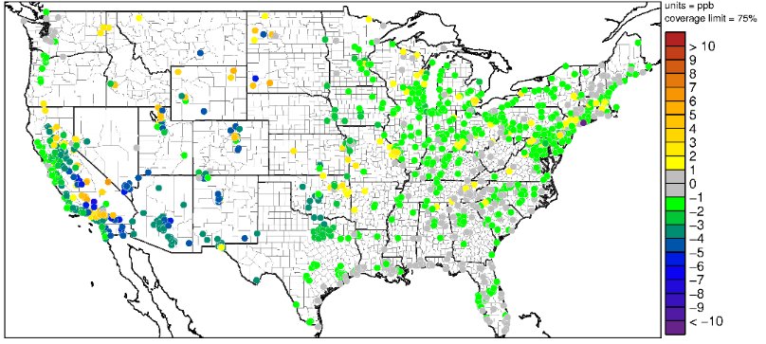
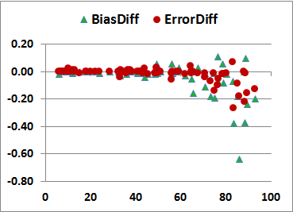
1. Background and Objective
Efforts on improving land surface processes
Updated CMAQ v5.0.1 for O₃ dry deposition soil resistance and developed a simple irrigation scheme in updated WRF v3.4 (Ran et al., CMAS 2016)
CIMIS Site Metrics vs. Grid Irrigated Land Percent
Bias Difference: Updated CMAQ – Base CMAQ
MODIS: Irrigation – Base
2-m T
2010 05-06
O₃
200608
Bias reduction across domain, particularly southwest - > sparsely vegetated land (average 2.1 ppb)
Sites in > 50% irrigated grid cells show bigger improvements
Coupled WRF v3.8/CMAQ v5.2 with the previous updates and new changes
MODIS vegetation input
Soil treatment
Goal: evaluate the updated coupled model - WRF/CMAQ
CMAQ 12km (April and August 2016)
CA 4km with the simple irrigation scheme (May - June, 2010)

Slide 4
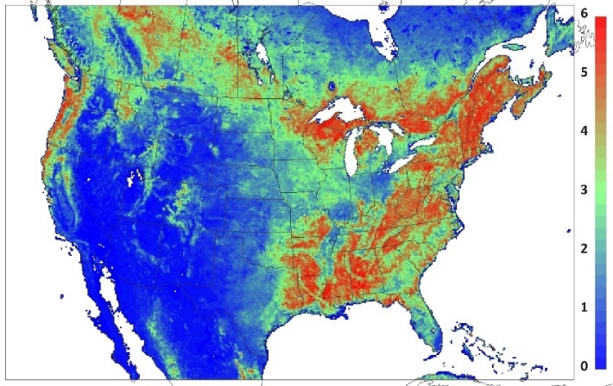
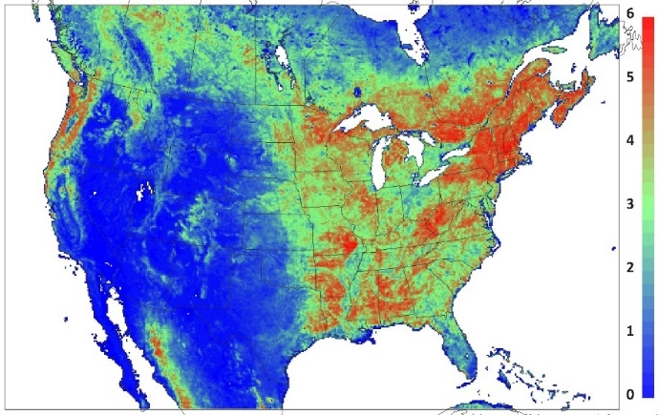
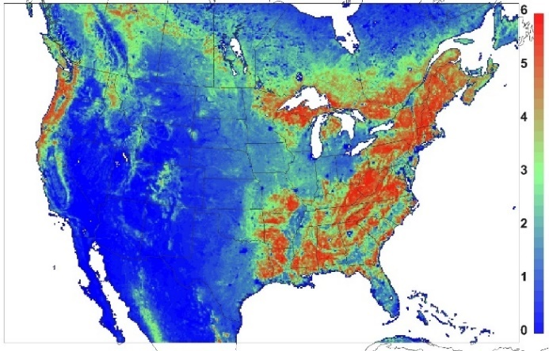
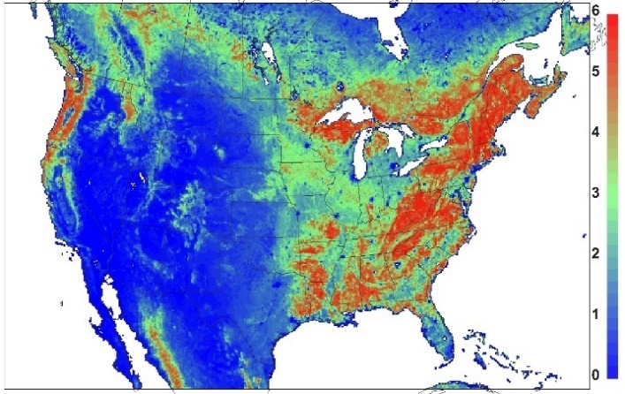
2. MODIS Data and Soil Treatment
MCD15A2H V6 LAI: 2016-06-25
MCD15A2H V6 LAI: 2016-08-04
Real-time LAI
MODIS LAI/FPAR V6 products at 500m:
Inconsistent values – jumping due to contaminations in image acquisition
LAI is lower in the peak growing day in August than that in June
MOD15A2GFS V5 LAI: 06-25
MOD15A2GFS V5 LAI: 08-04
4 year averaged LAI (2004-2007)
North American Carbon Program (NACP) MODIS gap-filled and smoothed products at 1km (Gao et al., 2008, IEEE):
LAI is consistent, but different from real-time product
WRF and CMAQ dust model

Slide 5
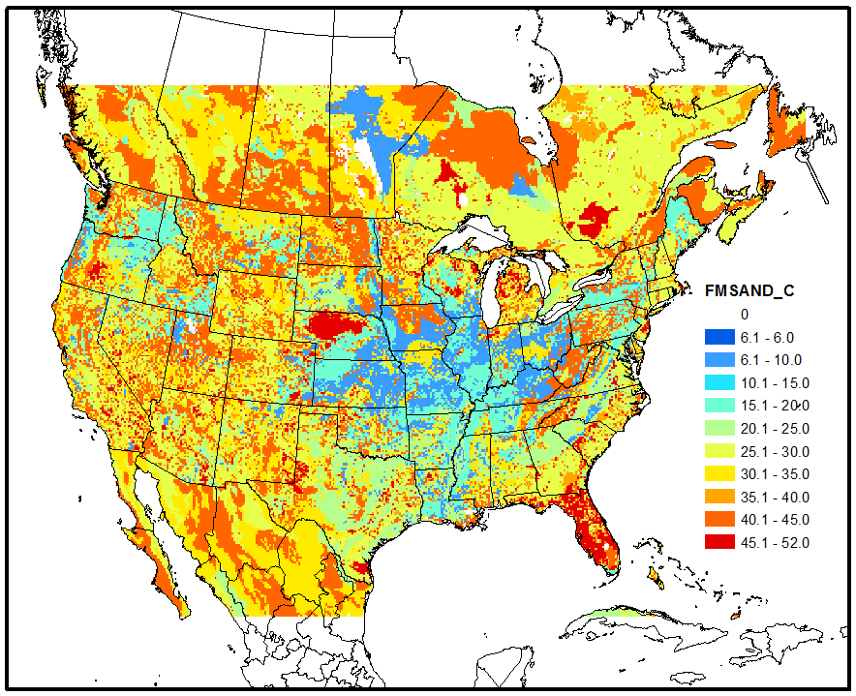
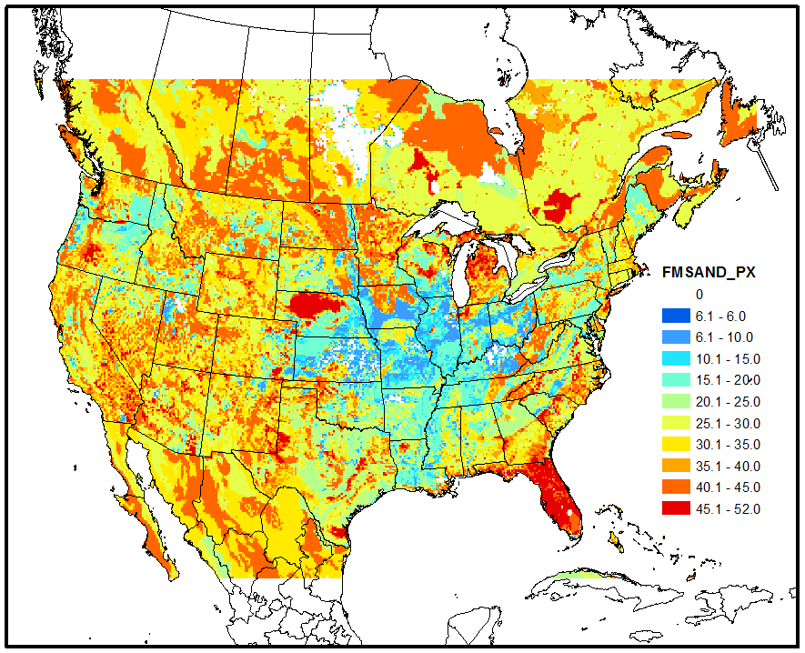
2. MODIS Data and Soil Treatment
Consistent soil and vegF treatment for:
WRF PX LSM (Pleim and Xiu, 1995, JAM)
CMAQ dust model (Foroutan et al., 2017, JAMES)
Residual soil water for 11 soil types
1 : 1
WRF PX LSM updated on:
Soil texture: Menut et al., 2013, JGR-Atmos
Soil parameters: Noilhan & Mahfouf et al., 1996, GPC, ECMWF TESSEL
Soil residual water: fitted function using soil texture based on Rawls et al., 1982, Trans. ASAE
Fine and medium sand percent at 12km grid cells
CMAQ dust model updated on:
WRF vegetation fraction (MODIS FPAR)
WRF Soil texture:
Very similar – PX LSM soil categories do well
More fine and medium sand in the east and less in the west from WRF
Base CMAQ: soil categories
Modified CMAQ: WRF

Slide 6
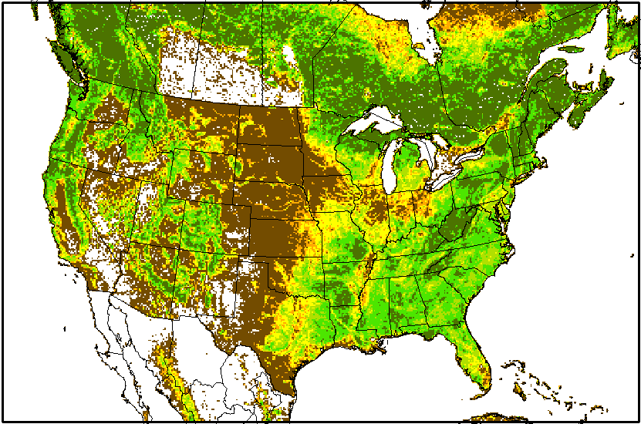
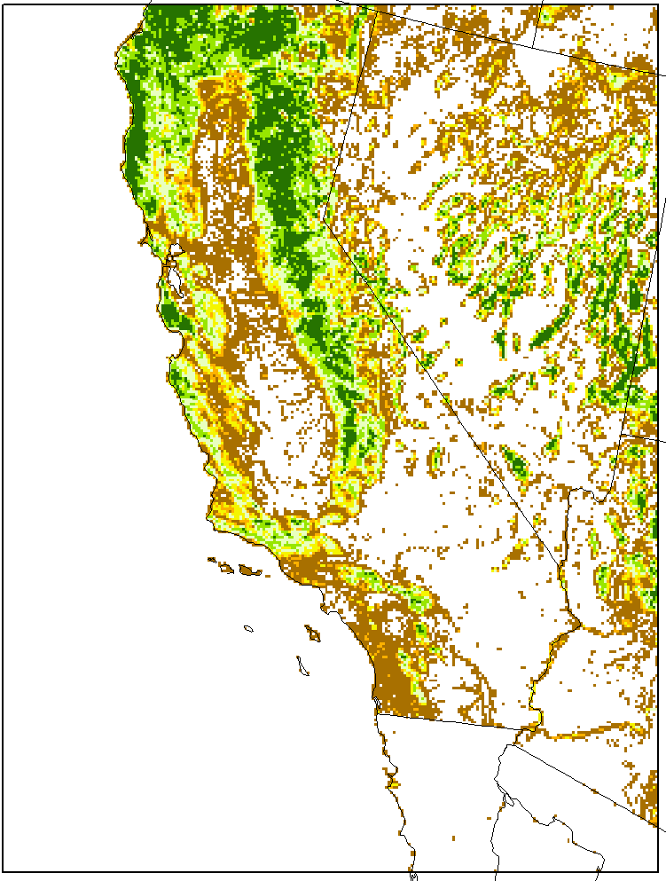
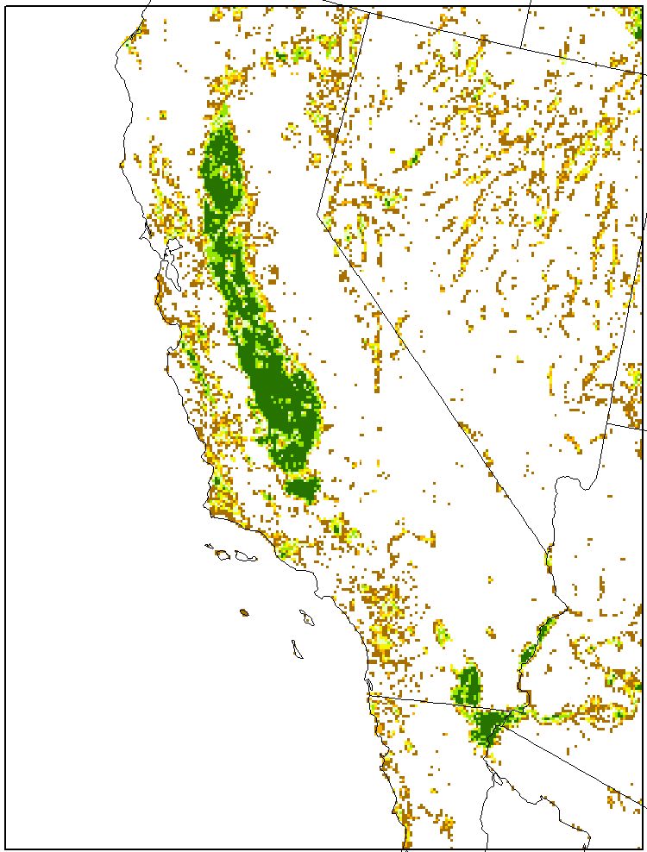
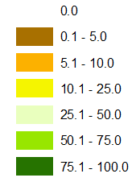
3. WRF/CMAQ Evaluation – Model Configuration
Forest Percent for CONUS 12km NLCD(2011)/MODIS(2016)
Updated coupled WRF-ARW v3.8/CMAQ v5.2
Two domains
CONUS 12km April and August 2016: two scenarios
BASE: standard released WRF and CMAQ with PX LSM table
MODIS: updated system with averaged LAI/FPAR
Emissions: NRT emissions from projected USEPA NEI
CA 4km May to June 2010: two scenarios
MODIS: updated system with averaged LAI/FPAR
MODIS IRR: with a simple irrigation scheme
Emissions: same as what is used by Woody et al., 2016, ACP
Forest and Agricultural Percent for CA 4km NLCD(2011)/MODIS(2010)
Configuration
No feedback
NCEP 12km NAM analysis and reanalyzed with OBS data using OBSGRID
Indirect soil nudging from 2-m T and Q (SFDDA) in the PX LSM
2010 and April 2016: standard NCEP NAM 12km every 3 hours
August 2016: hourly UnRestricted Mesoscale Analysis (URMA) 2.5km
CB05e51 gas-phase chemistry, AE6 modal aerosols
In-line biogenic and dust emissions
Others: standard EPA options (Ran et al., 2016, JGR-Atmos.)

Slide 7
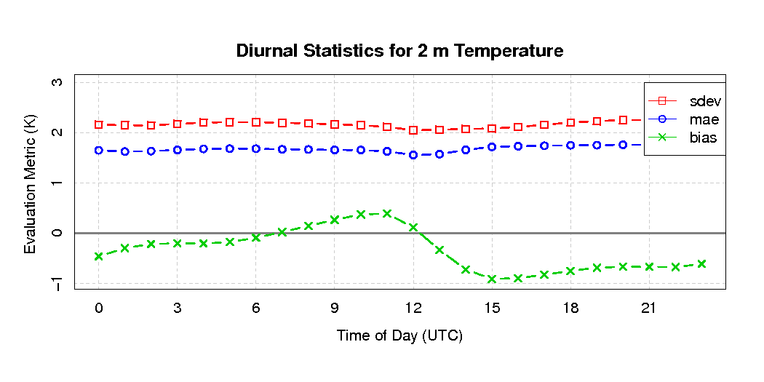
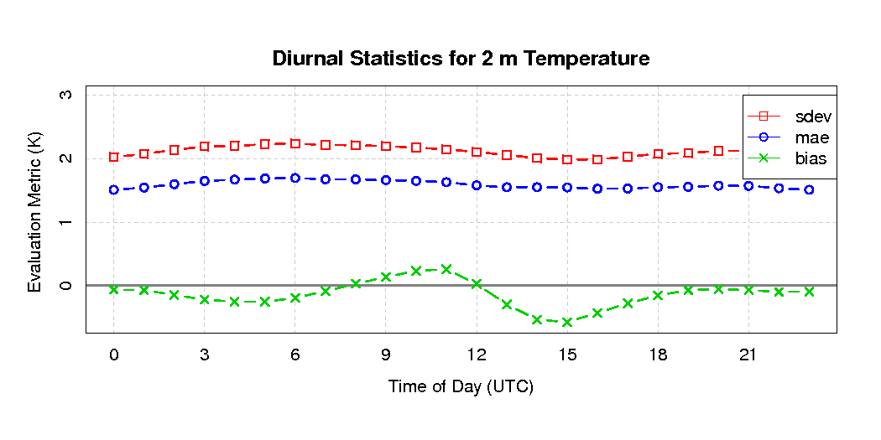
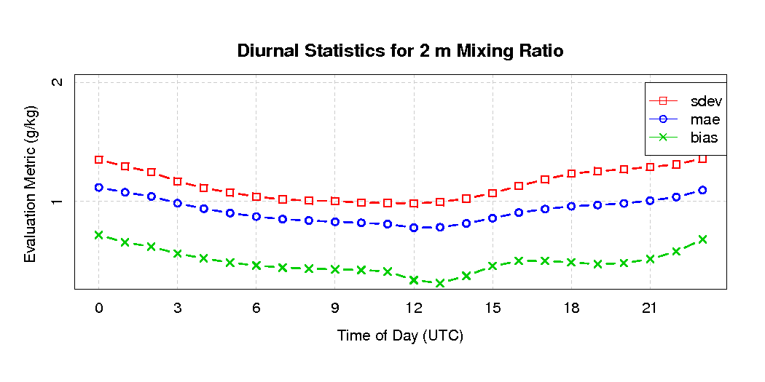
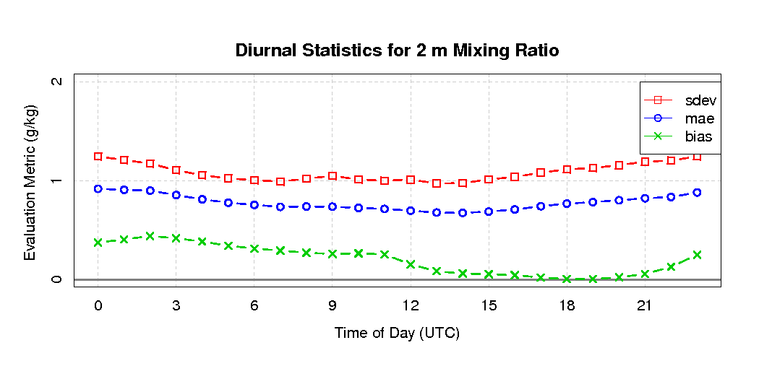
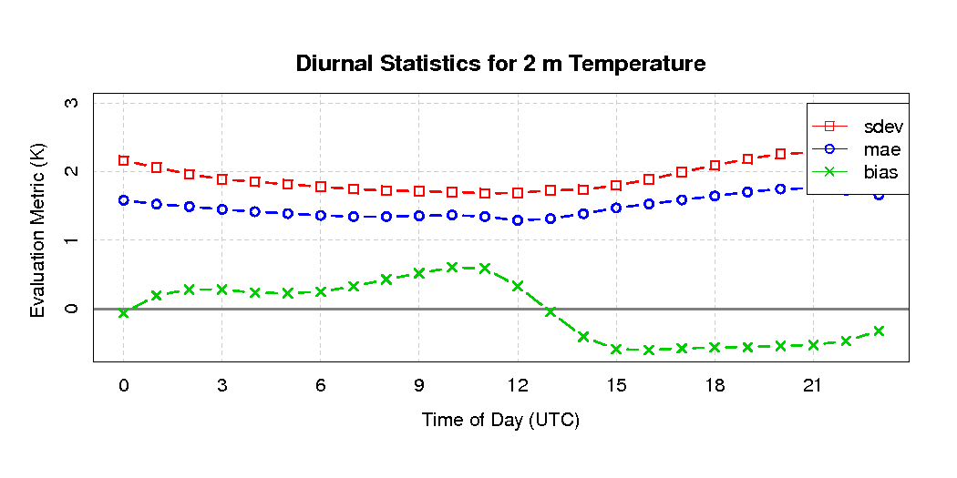
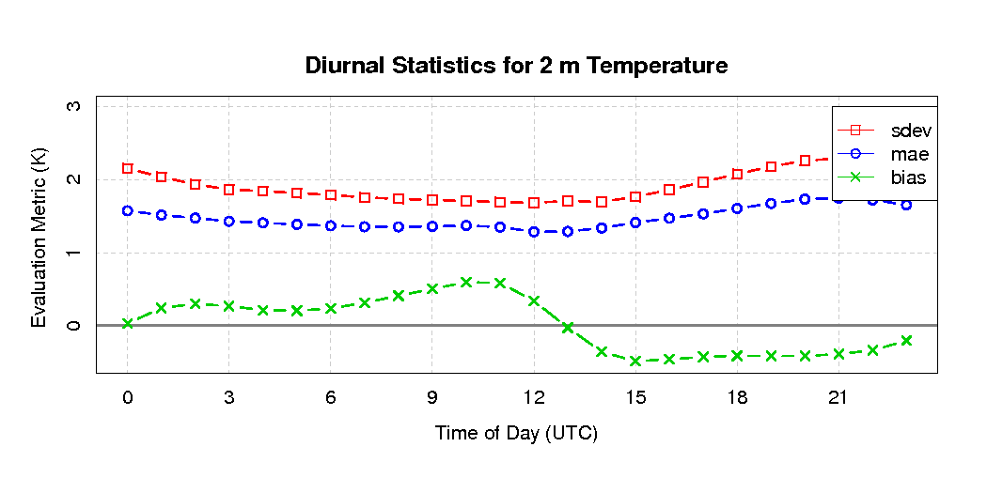
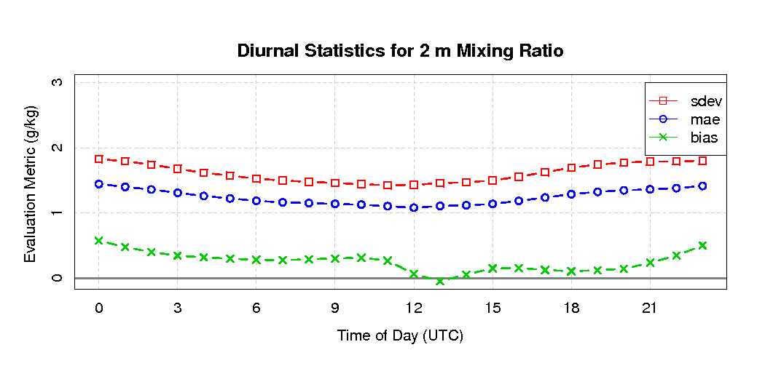
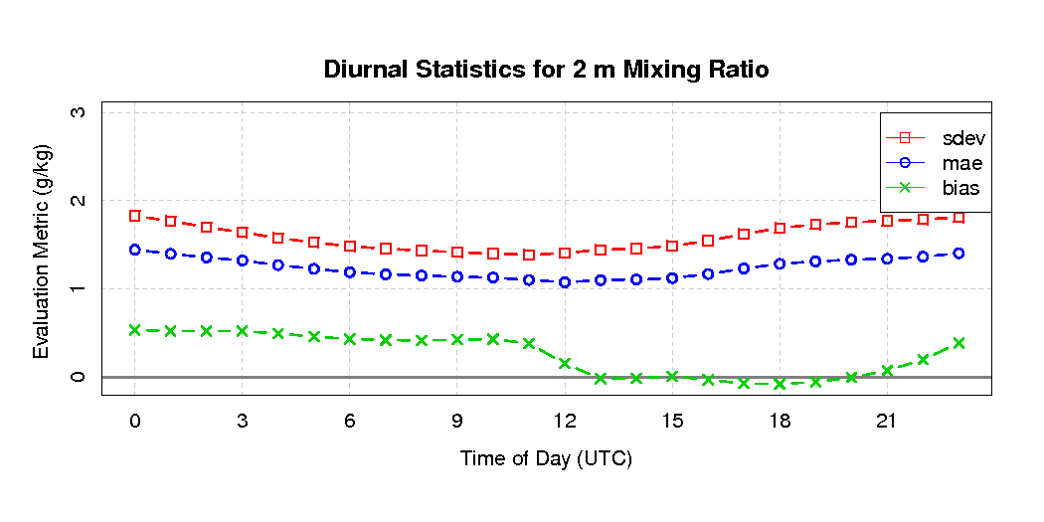
3. WRF/CMAQ Evaluation – CONUS 12km
Diurnal Comparison against MADIS Observations
Base
MODIS
2016-04
Every 3 hours - NCEP NAM 12km PX LSM soil nudging input
Cold and wet bias reduction during the day, particularly late afternoon
2-m T (K)
2-m Q (g/kg)
2016-08
Base
MODIS
Every 1 hour - URMA 2.5km PX LSM soil nudging input
2-m T and Q perform really well for both cases
MODIS improves daytime cold and wet bias slightly
2-m T (K)
2-m Q (g/kg)
Diffusion soil resistance used in the MODIS case (Sakaguchi and Zeng, 2009 JGR; Pleim et al., 2013 JGR-Atmos.) : tends to make night wetter (Swenson and Lawrence, et al., 2014, JGR) than the β soil approach (Lee and Pielke, 1992 JAM) in the base

Slide 8
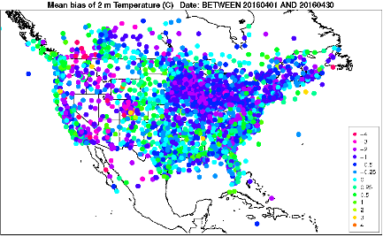
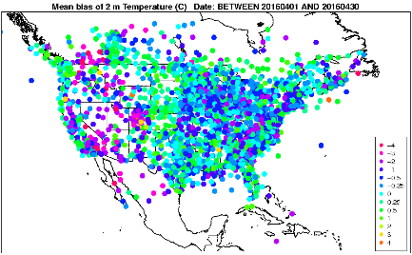
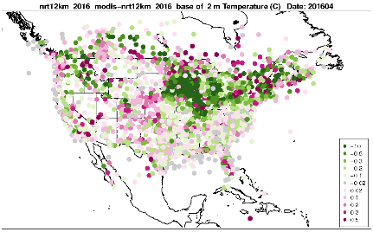

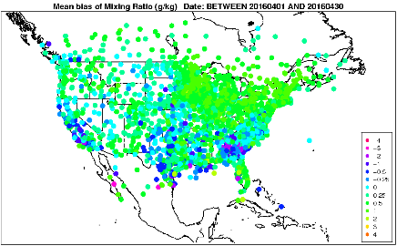
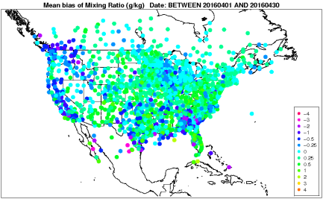
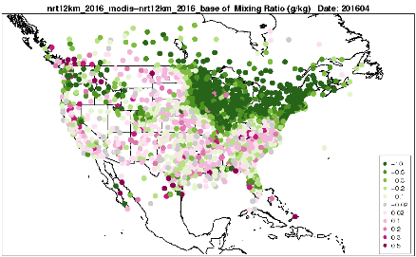
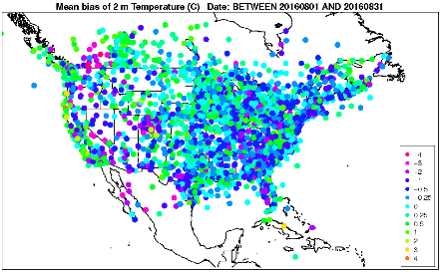
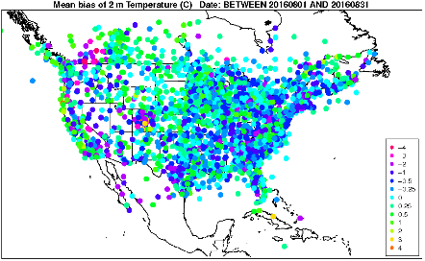
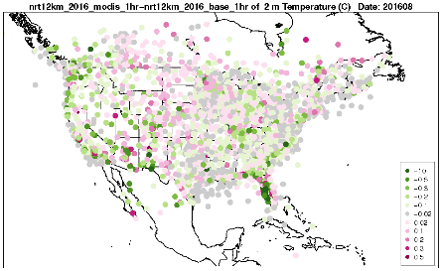
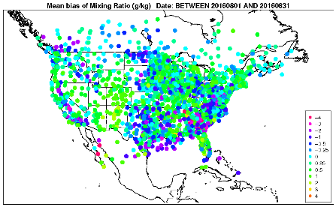
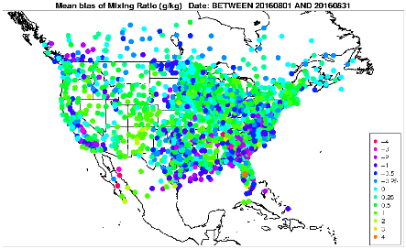
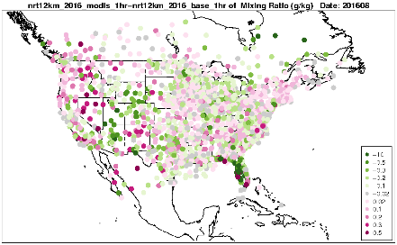
3. WRF/CMAQ Evaluation – CONUS 12km
Bias Spatial Comparison against MADIS Observations
Base
MODIS
MODIS - Base
2016-04
2-m T (K)
Better:
57% sites
Every 3 hours – NCEP NAM 12km PX LSM soil nudging input
MODIS reduced cold and wet bias in the northern east
2-m Q (g/kg)
Better:
66% sites
Base
MODIS
MODIS - Base
2016-08
Every 1 hour – URMA 2.5km PX LSM soil nudging input
2-m T: similar with slightly reduced cold bias in the west and FL in MODIS
MODIS reduced wet bias in central Plains and FL, but worse for many in the west
2-m T (K)
Better:
53% sites
Hourly URMA nudging input: dominant influence
MODIS impacts different from 3 hour nudging in August from Ran et al., 2016, JGR-Atmos.
Better:
47% sites
2-m Q (g/ka)

Slide 9
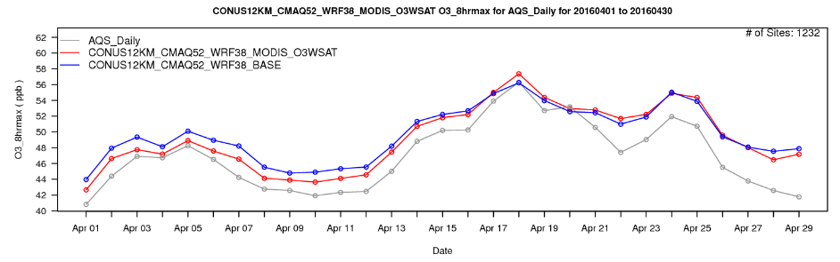
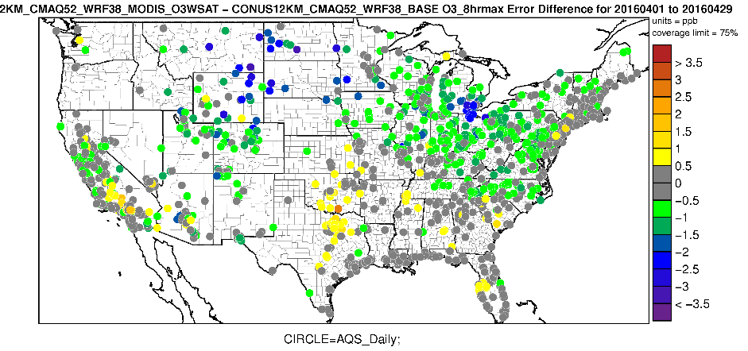
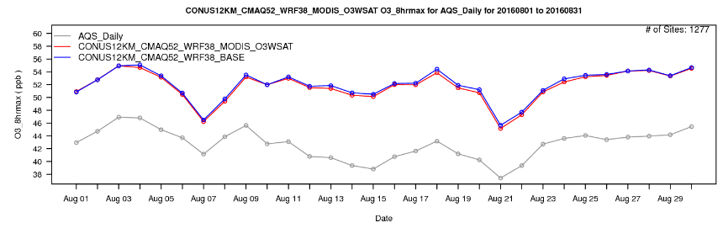
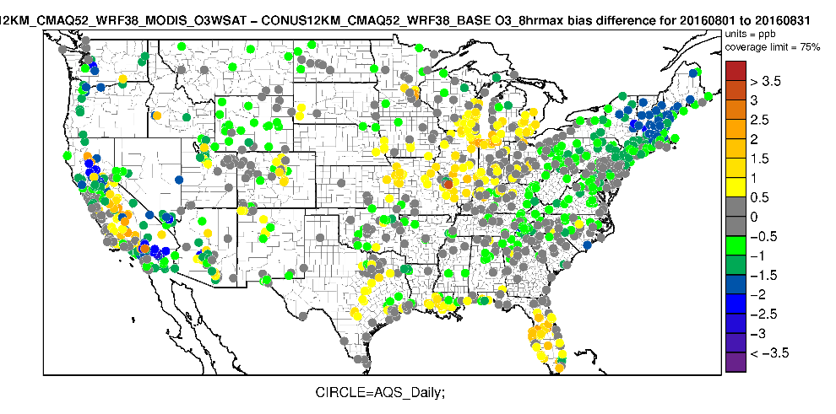
3. WRF/CMAQ Evaluation – CONUS 12km
Daily Maximum 8-h Average O₃ (ppb) against AQS sites
2016-04
Error: MODIS - Base
MODIS case slightly better in early days of April
MODIS case reduces errors for sites in the north
2016-08
Bias: MODIS - Base
MODIS and Base perform similarly on daily average domain-wide
Better most of the east, northwest, southwest for MODIS
Worse in FL, around IL, around the Central Valley for MODIS

Slide 10
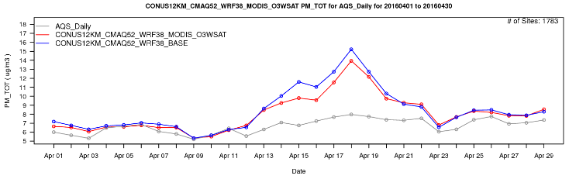
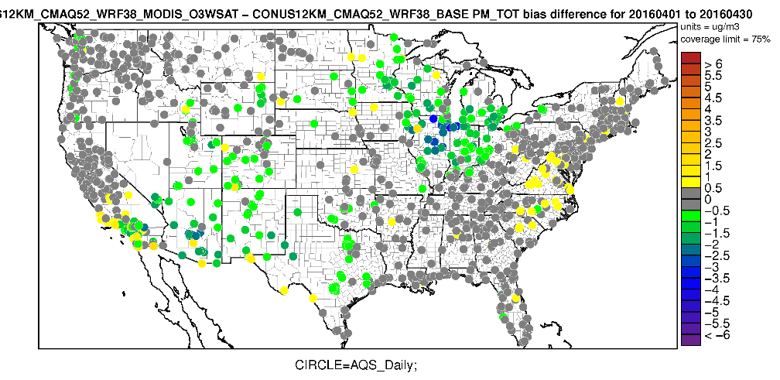
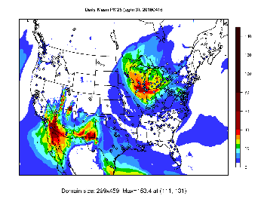
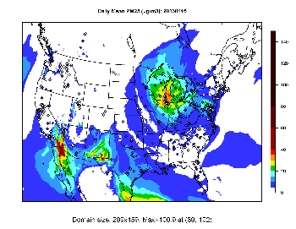
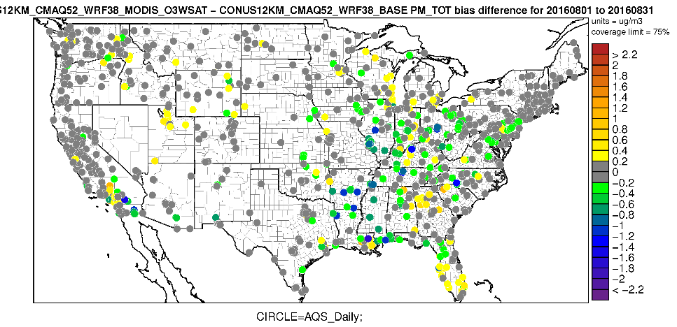
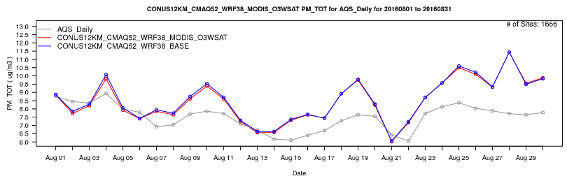
3. WRF/CMAQ Evaluation – CONUS 12km
Daily PM_{2.5} (ug/m³) evaluation against AQS sites
2016-04
Bias: MODIS - Base
2016-04-16: Base
2016-04-16: MODIS
MODIS case tends to reduce dust emissions further during the dust events
Reduced dust emissions helps PM_{2.5} from the SW to Great Lakes states
2016-08
Bias: MODIS - Base
MODIS and Base perform similarly on daily average domain-wide
Many sites in the east tend to be better with reduced high bias

Slide 11
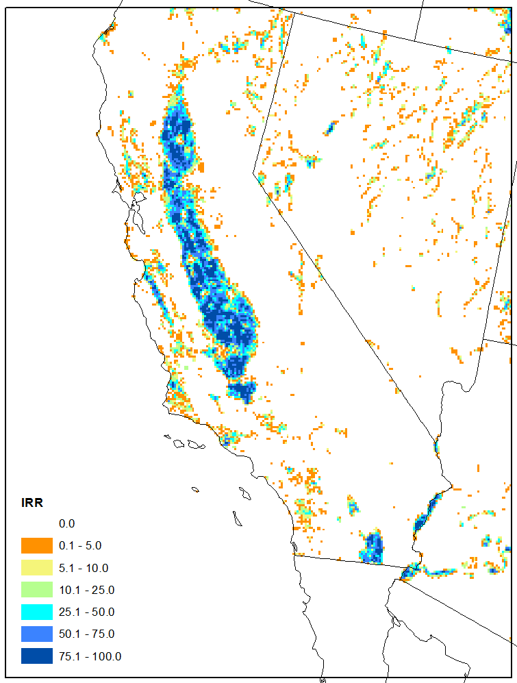
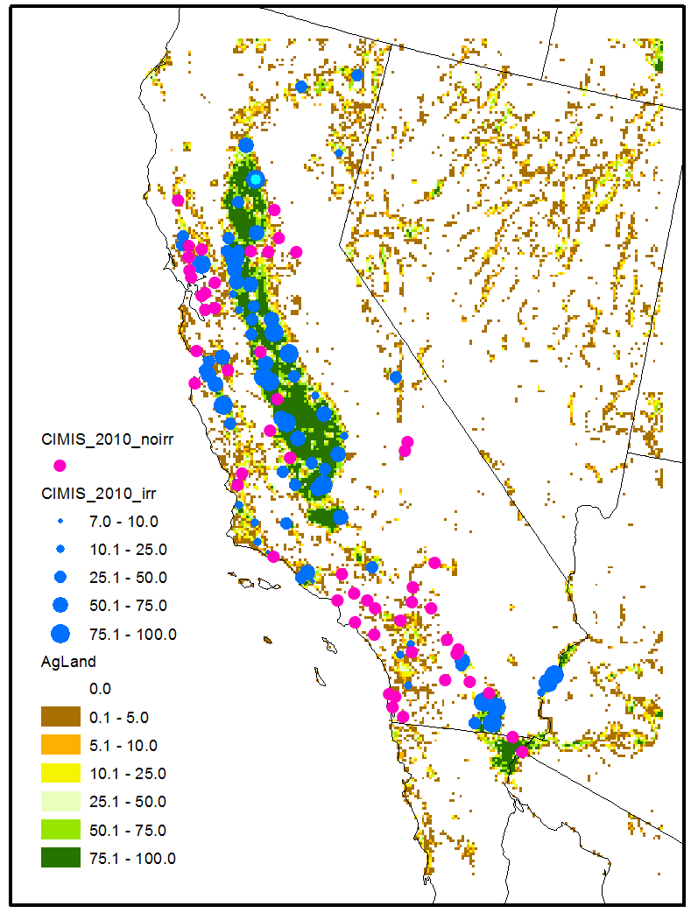
3. WRF/CMAQ Evaluation – CA 4km
Comparison against CIMIS
Irrigated agricultural land (%)
at 4km grid cells
Agricultural land (%) and CIMIS stations at 4km grid cells
California Irrigation Management Information System (CIMIS) Stations (http://www.cimis.water.ca.gov/)
Irrigation data for crop and pasture: MIrAD-US at 250m (http://earlywarning.usgs.gov/USirrigation)
Irrigation scheme: PX LSM deep soil water content is modified based on:
Max. allowable water depletion (Hanson et al., 2004; Sorooshian et al., 2011, JGR; Ozdogan et al., 2010, AMS)
MADIS site evaluations: similar results
CIMIS sites (May 10 to June 30, 2010) : MODIS IRR - MODIS vs. grid irrigated land Percent
CIMIS sites in > 50% irrigated grid cells (34 sites) show some improvements

Slide 12
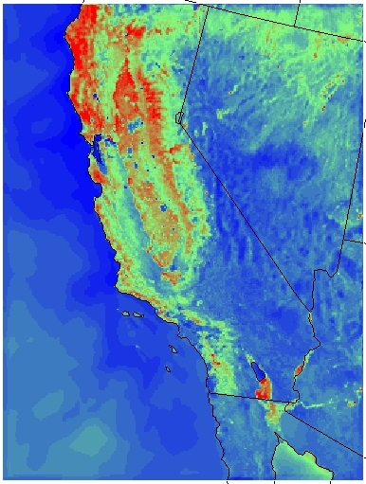

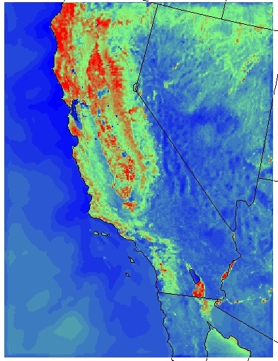
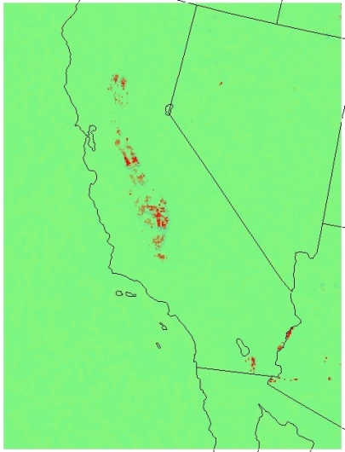

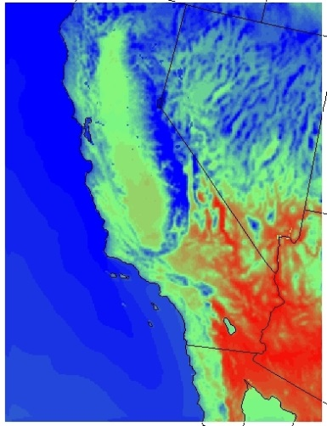

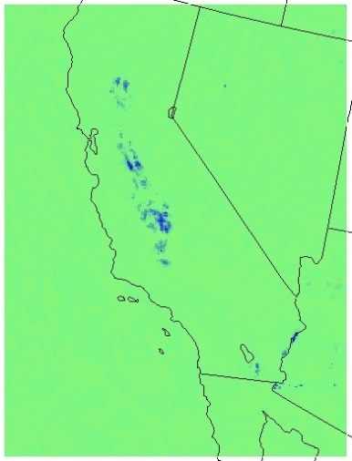




3. WRF/CMAQ Evaluation – CA 4km
20-Z average and average difference from May 10 to June 30, 2010
LH (W/m²): MODIS
LH: MODIS IRR
LH: MODIS IRR - MODIS
LH increases in the Central Valley
2-m T and PBLH decrease accordingly
2-m T (K): MODIS
2-m T: MODIS IRR - MODIS
PBLH (m): MODIS
PBLH: MODIS IRR - MODIS

Slide 13




3. WRF/CMAQ Evaluation – CA 4km
Daily Maximum 8-h Average O₃ (ppb) against AQS sites
2010-05-10 to 06-31
MAError: MODIS IRR - MODIS
Irrigation treatment reduces errors for the Central Valley and southeastern area
During the ozone event, irrigation reduces the daily averaged mean bias and error in the Central Valley slightly
Ozone event: 2010-06-01 to 06-07
Bias: MODIS IRR
Bias: MODIS IRR - MODIS
MAError: MODIS IRR - MODIS

Slide 14






3. WRF/CMAQ Evaluation – CA 4km
Daily PM (ug/m³) evaluation against AQS sites
2010-05-10 to 06-31
Bias: MODIS IRR
Bias: MODIS IRR - MODIS
MAError: MODIS IRR - MODIS
PM_{2.5}
PM₁₀
Irrigation reduces bias and error of PM_{2.5} and PM₁₀ slightly

Slide 15
Conclusions and Future Work
Conclusions
Updated coupled WRF/CMAQ performs reasonably well with averaged MODIS vegetation
Reduces cold and wet bias during the daytime; but tends to make the model wetter late at night
Surface ozone is slightly better and PM is improved particularly during the dust events
The simple irrigation scheme helps improve the system in general
Reduces hot and dry bias for CIMIS sites which are dominated by irrigated agricultural land
Influences LH, 2-m T, and PBLH in the Central Valley
Improves ozone and PM in the Central Valley
Future Work
Complete two manuscripts with detailed description and analysis
Implement the photosynthesis approach in the updated system
Help implement the updates in the WRF and CMAQ releases

Slide 16
Disclaimer
While this work has been reviewed and cleared for presentation by the U.S. EPA, the views expressed here are those of the authors and do not necessarily represent the official views or policies of the Agency.

