Slide 1

Quantifying PM2.5 Health Benefits of Coal Power Plant
Phase-out in Ontario and Alberta
Burak Oztaner, Marjan Soltanzadeh, Shunliu Zhao, AMIR HAKAMI (Carleton); Amanda Pappin, Lauren Pinault, Rick Burnett (Health CANADA); Matt Turner, Daven Henze (CU Boulder); Shannon Capps (Drexel); Peter Percell (Houston); Jaroslav Resler (ICS Prague); Jesse Bash, Sergey Napelenok, Kathleen Fahey (EPA); Rob Pinder; Ted Russell, Athanasios Nenes (Georgia Tech); Jaemeen Baek, Gregory Carmichael, Charles Stanier (IOWA); Adrian Sandu (Virginia Tech); Tianfeng Chai (Maryland).
16th Annual CMAS Conference
October 23-25, 2017

Slide 2
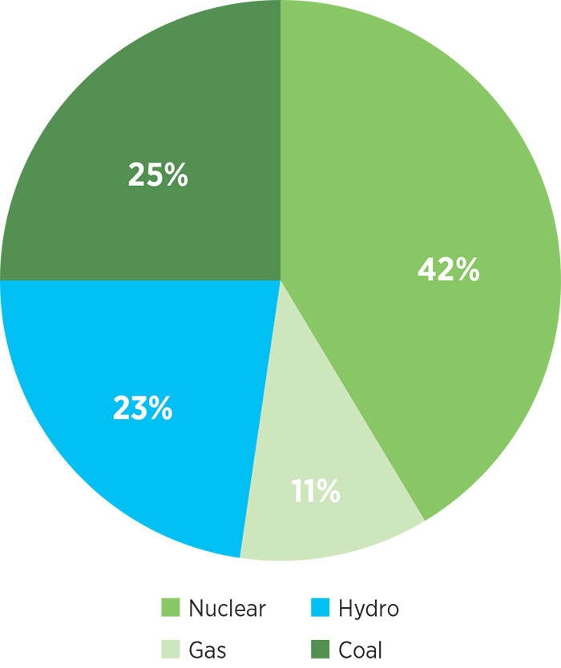
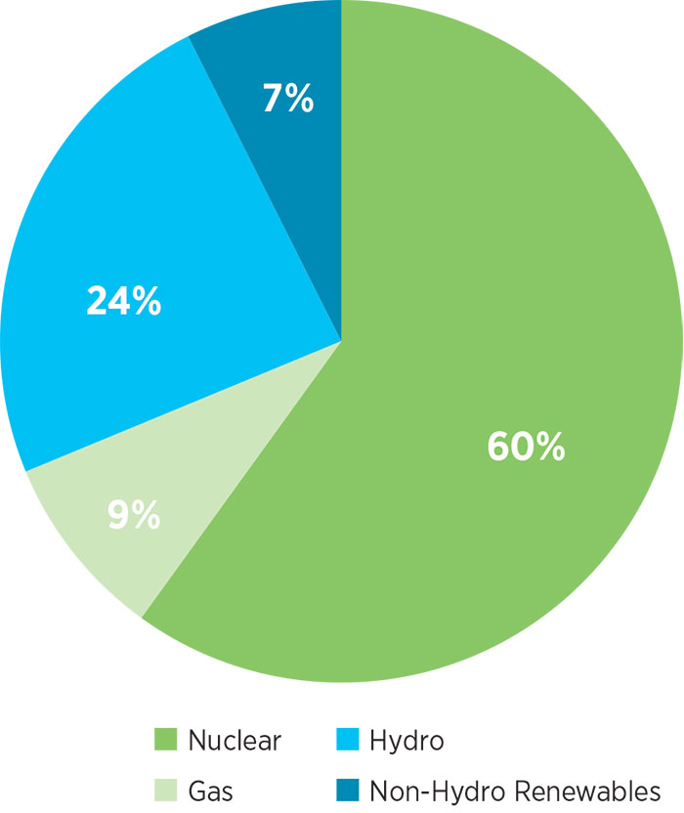
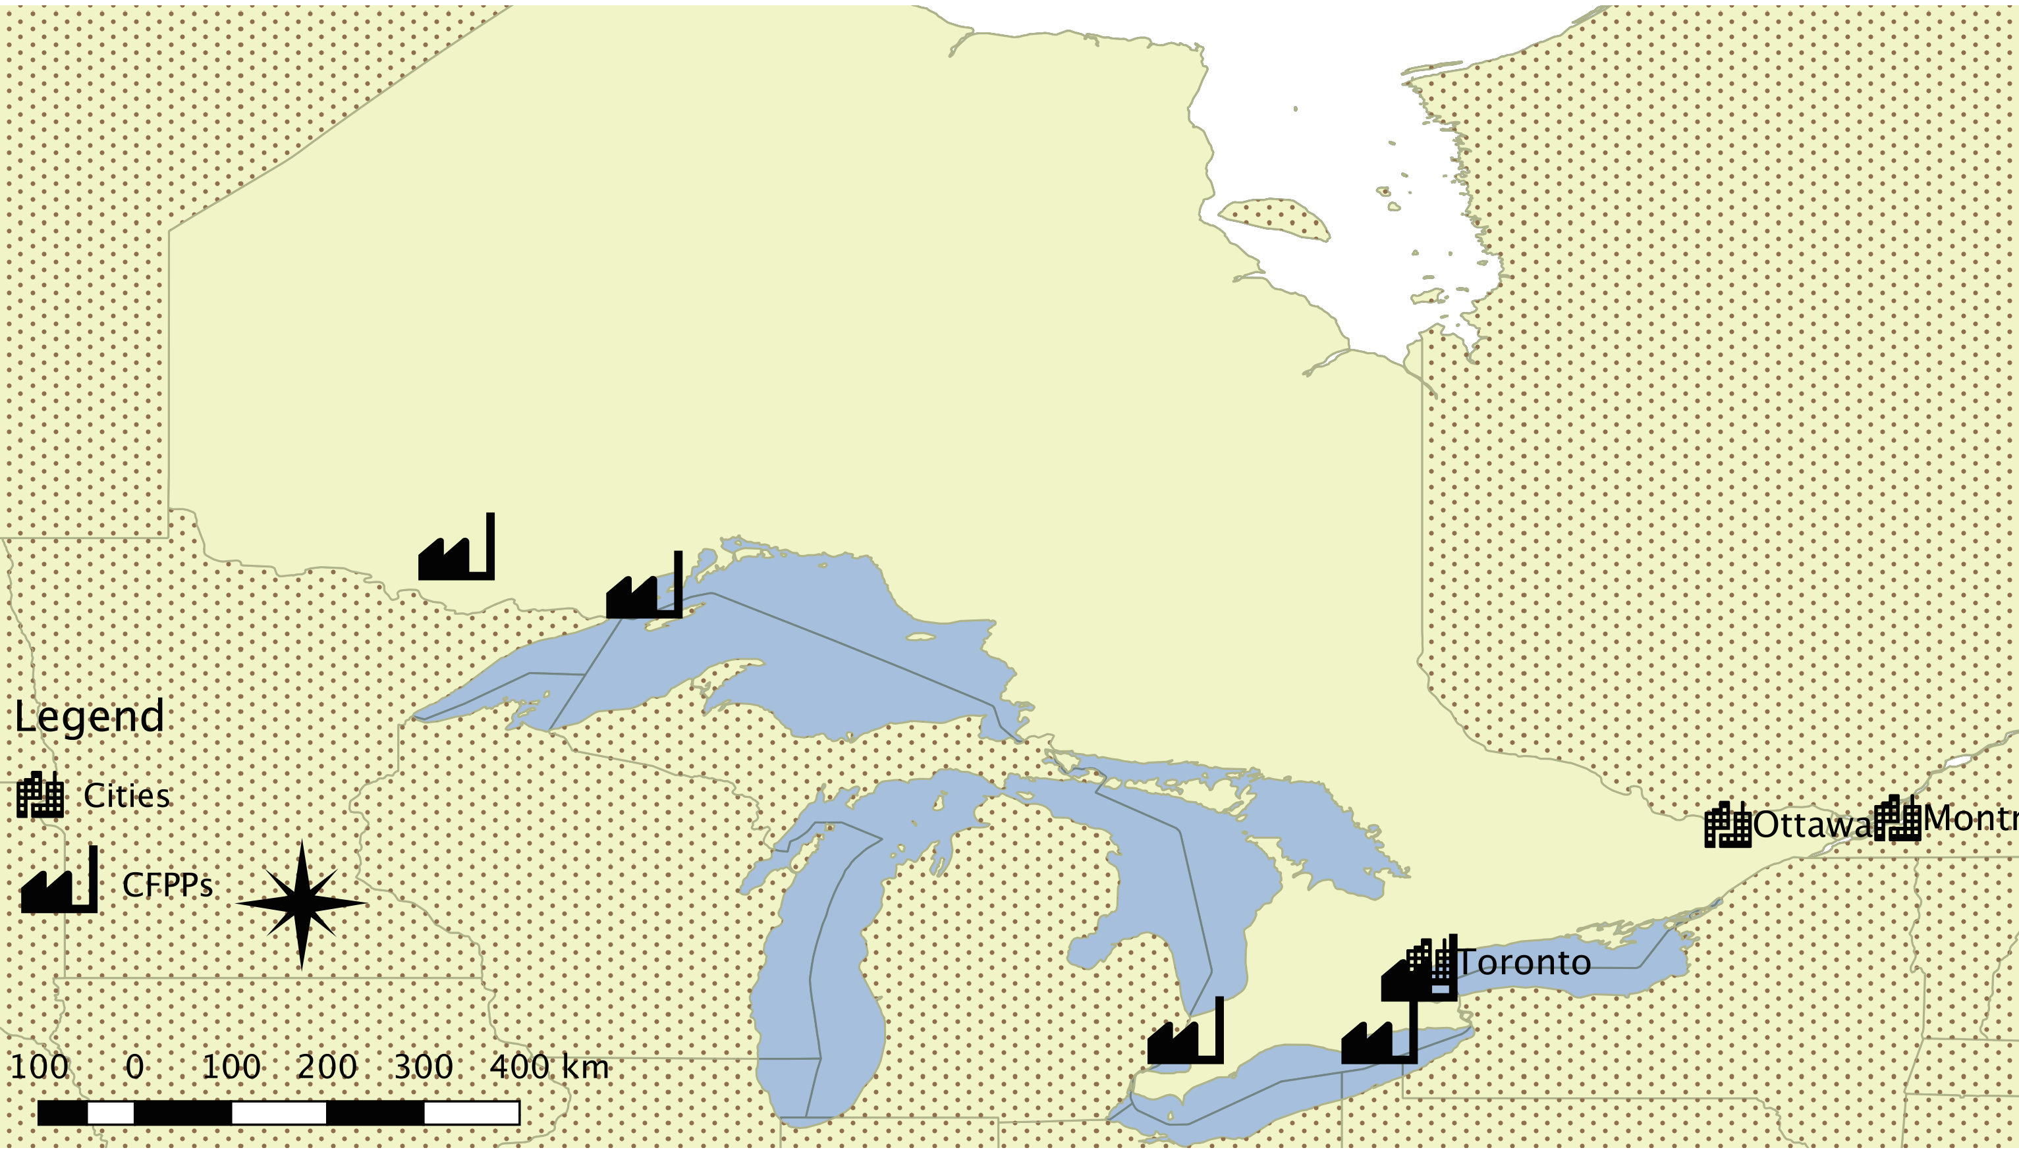
Eliminating Coal in Ontario
Coal capacity was reduced in a staged approach from 2003 – 2014 to maintain system reliability and operational efficiency
2003
2014
Ontario Ministry of Environment (2005) estimated C$3 billion benefits due to avoided mortality from coal phase-out.
16th Annual CMAS Conference
October 2017

Slide 3
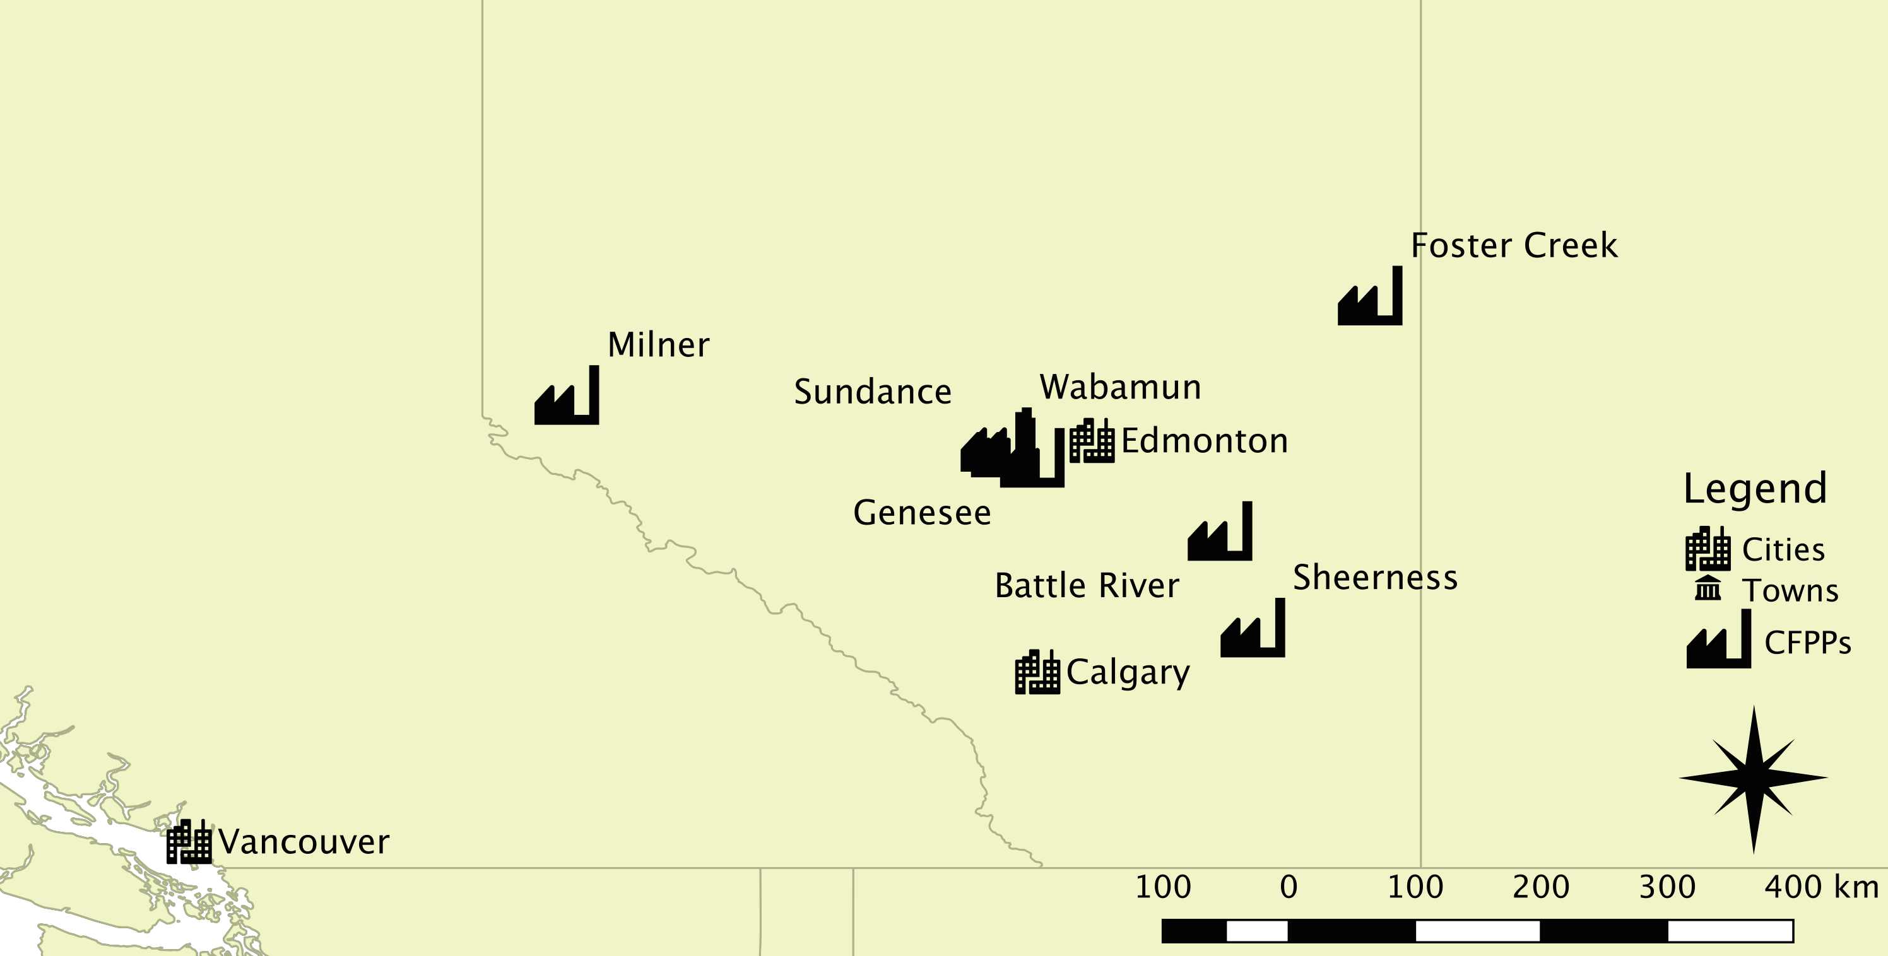
Coal Phase-Out in Alberta
12 of Alberta’s 18 coal-fired generating units will be done by the year of 2030.
The plan also sets a "30 by '30" renewable energy target, in which 30% of electricity used by Albertans will come from renewable sources like solar, wind and hydro by 2030.
The Canadian Association of Physicians for the Environment (CAPE) estimate that the phase-out plan will result in ~ C$3 billion monetized health benefits by preventing 1000 premature deaths.
https://www.alberta.ca/climate-coal-electricity.aspx
16th Annual CMAS Conference
October 2017

Slide 4
Adjoint sensitivity analysis: where influences come from
E
C
Inputs/emissions
Mortality
16th Annual CMAS Conference
October 2017

Slide 5
Health Impact Valuation
Economics
Epidemiology
Air quality modeling
16th Annual CMAS Conference
October 2017

Slide 6
Mortality as the Adjoint Objective Function
An adjoint application requires definition of an objective (or cost) function:
  A scalar → Chronic exposure mortality
    Within the province
    out-of-province
  Function of concentrations → Concentration-response functions
    Single-pollutant model (PM_{2.5})
    Joint 3-pollutant model (PM_{2.5}, O₃, NO₂)
16th Annual CMAS Conference
October 2017

Slide 7
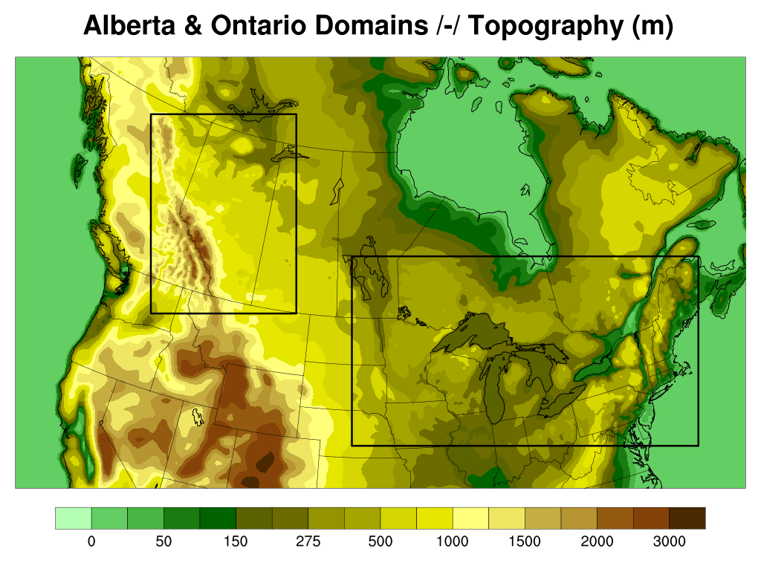
Methodology
Meteorology | WRF v3.8.1
Emissions | SMOKE v3.7 – NEI/NPRI 2010
Resolution | 36 km Canada, nested 12 km Alberta and Ontario
IC/BC | Hemispheric CMAQ v5.2 with Edgar/HTAPv2
CTM | CMAQ v5.0 and its adjoint
Objective function | Monetized mortality (Pappin et al., 2016)
Backward BC | 36 km nested nationwide mortality
16th Annual CMAS Conference
October 2017

Slide 8
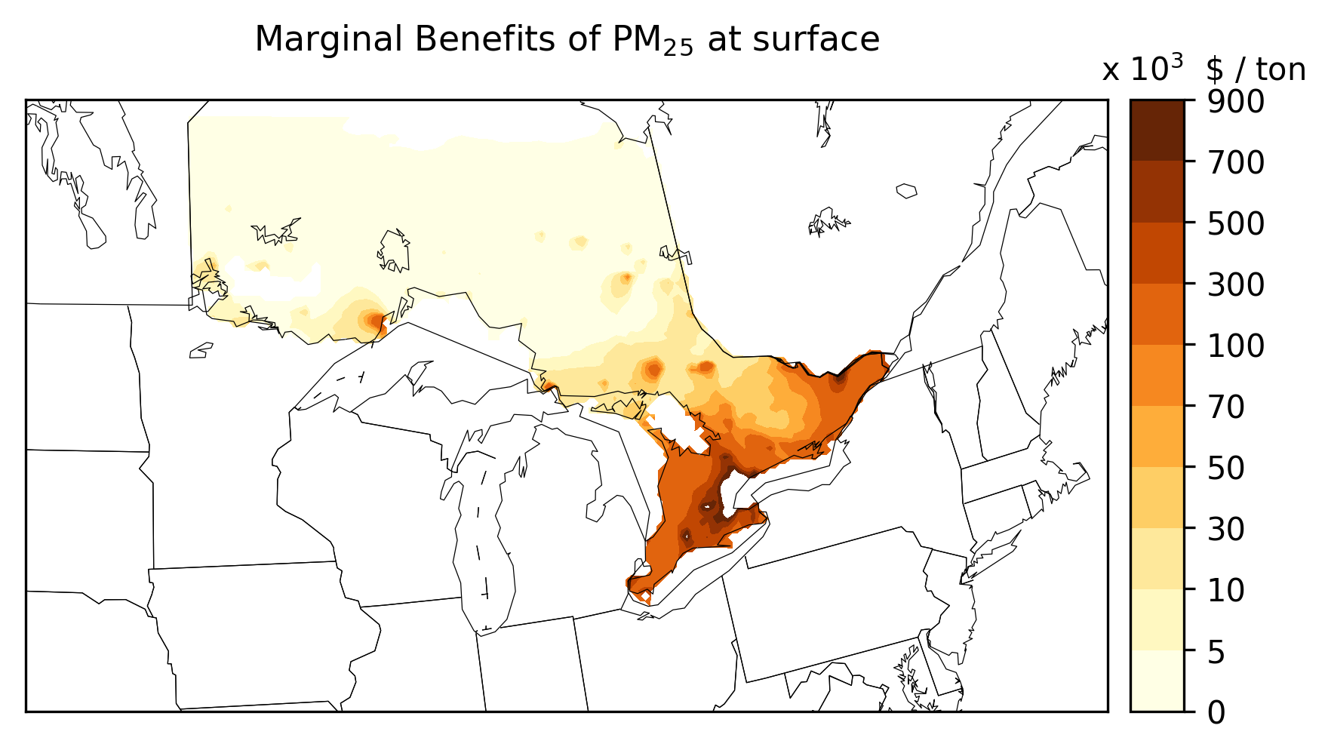
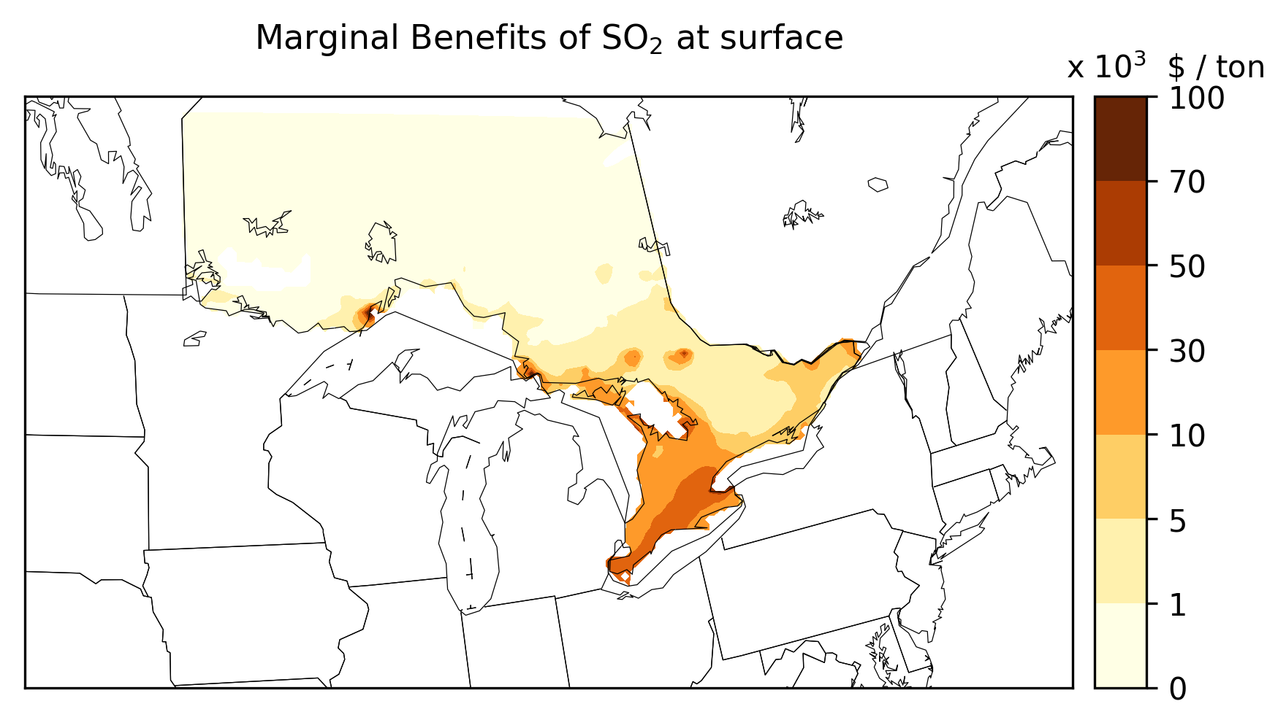
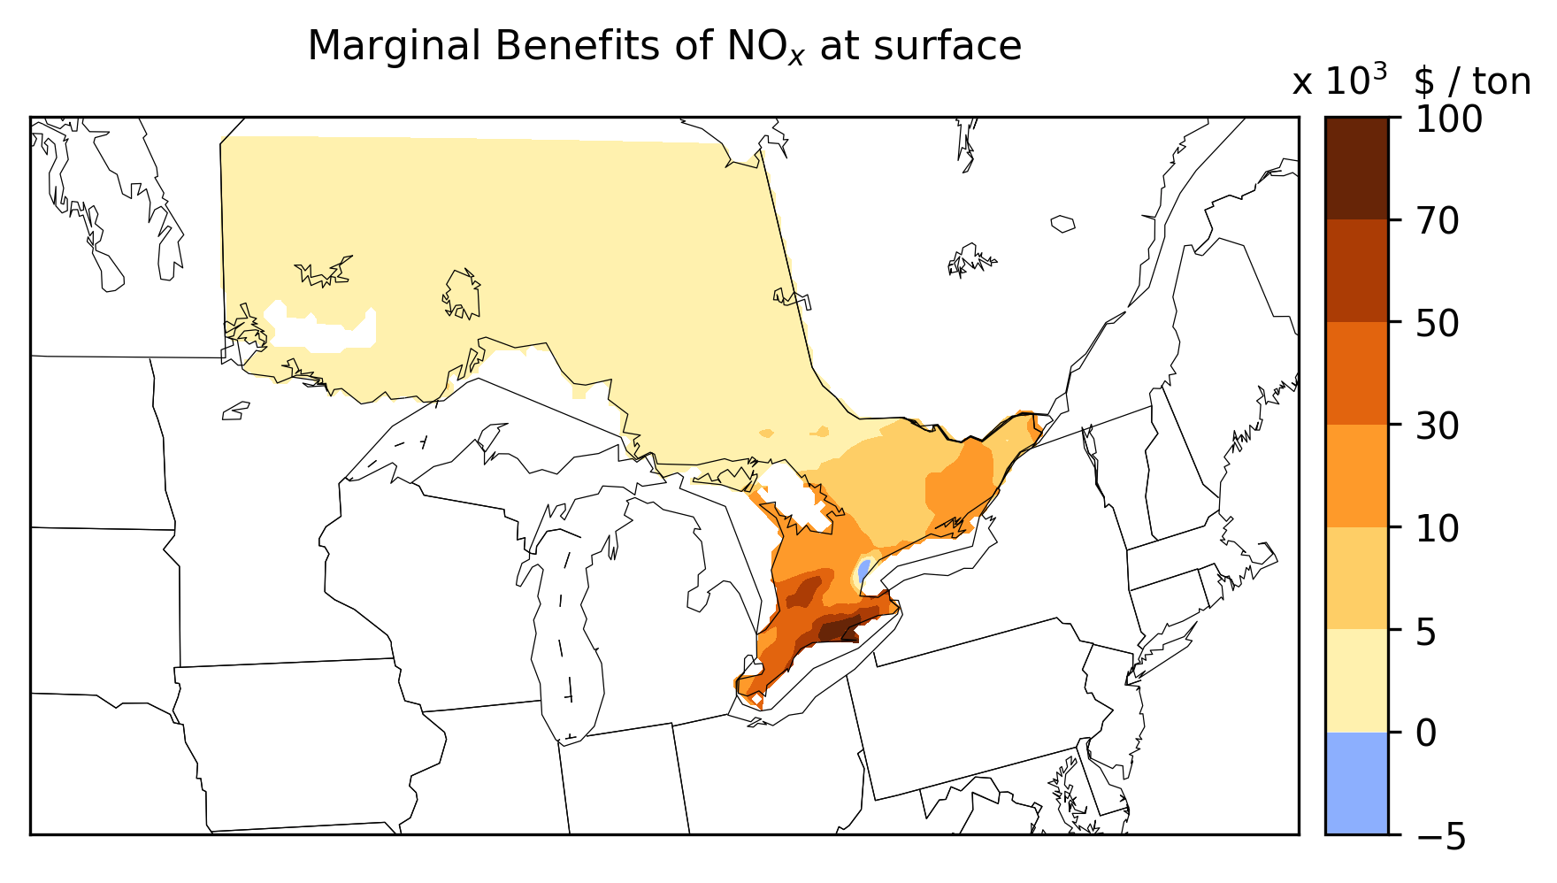
Results : Marginal Benefits (Ontario – single pollutant model)
16th Annual CMAS Conference
October 2017

Slide 9
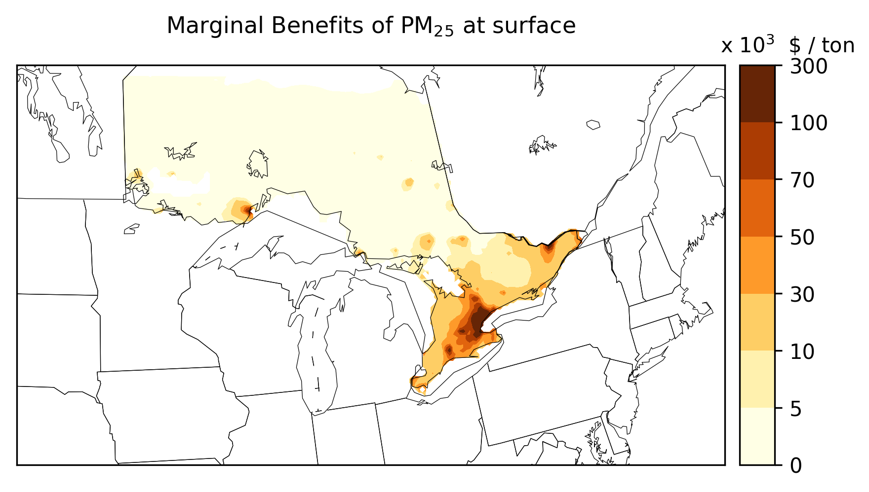
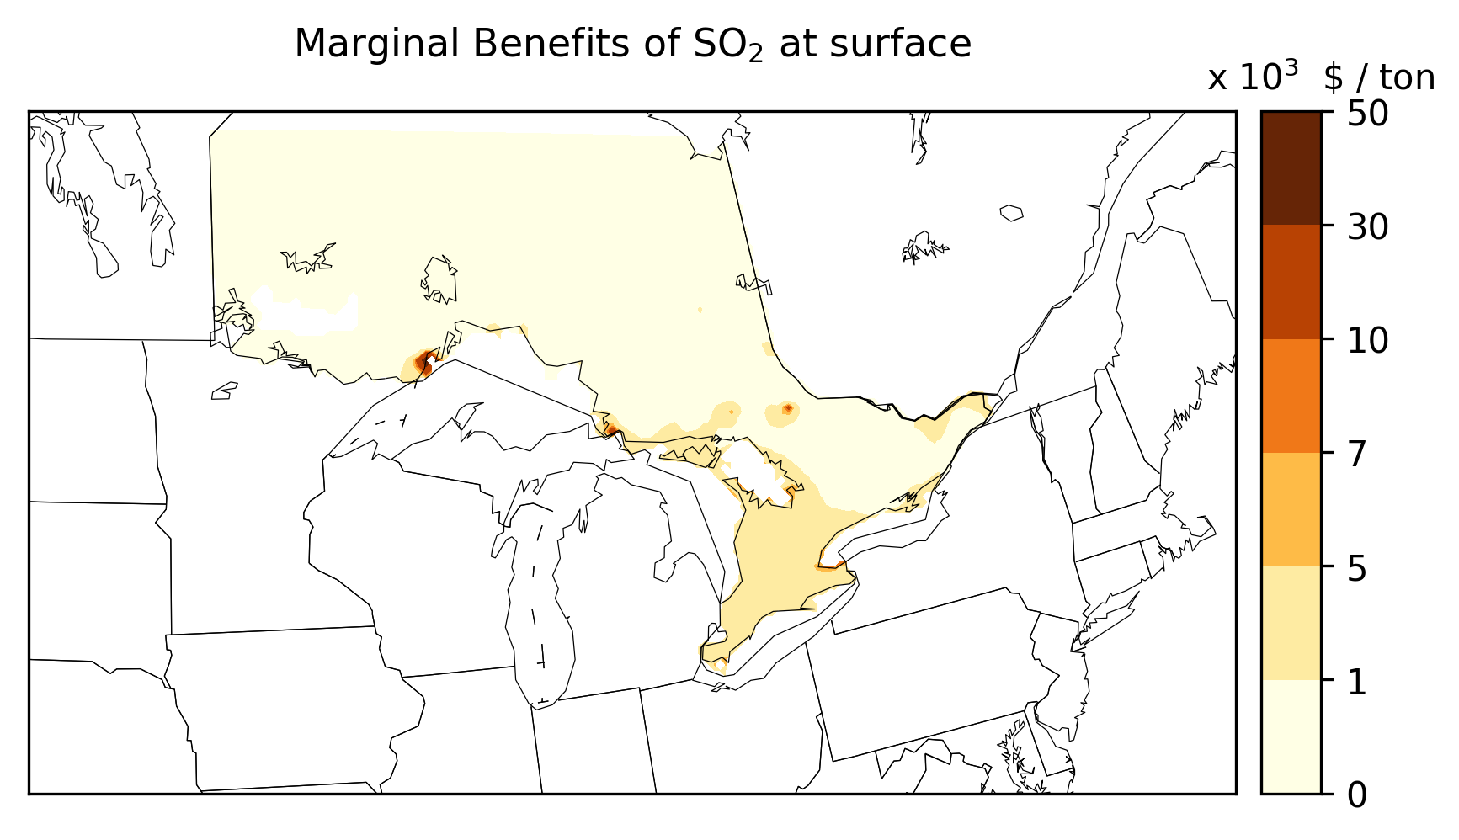

Marginal Benefits (Ontario – 3-pol. model)

Slide 10
Total Benefits (Ontario)
ONTARIO 3-Pollutant Forcing Model (C$ Million)
Plant | PM_{2.5} | NO_{X} | SO₂ | Plant Total | Plant Total (36 km)
Lambton PG | 7 | 135 | 85 | 227 | 251
Nanticoke PG | 15 | 374 | 141 | 530 | 501
Lakeview PG | 3 | 195 | 23 | 221 | 192
Thunder Bay PG | 2 | 54 | 4 | 60 | 23
Atikokan PG | 1 | 18 | 2 | 21 | 12
Province Total |  |  |  | 1059 | 979
16th Annual CMAS Conference
October 2017

Slide 11
Total Benefits (Ontario) (cont.)
ONTARIO Single-Pollutant Forcing Model (C$ Million)
Plant | PM_{2.5} | NO_{X} | SO₂ | Plant Total | Plant Total (36 km)
Lambton PG | 60 | 163 | 717 | 940 | 998
Nanticoke PG | 141 | 379 | 1162 | 1682 | 1583
Lakeview PG | 28 | -36 | 200 | 192 | 154
Thunder Bay PG | 5 | 3 | 13 | 21 | 24
Atikokan PG | 1 | 38 | 90 | 129 | 14
Province Total |  |  |  | 2964 | 2773
16th Annual CMAS Conference
October 2017

Slide 12
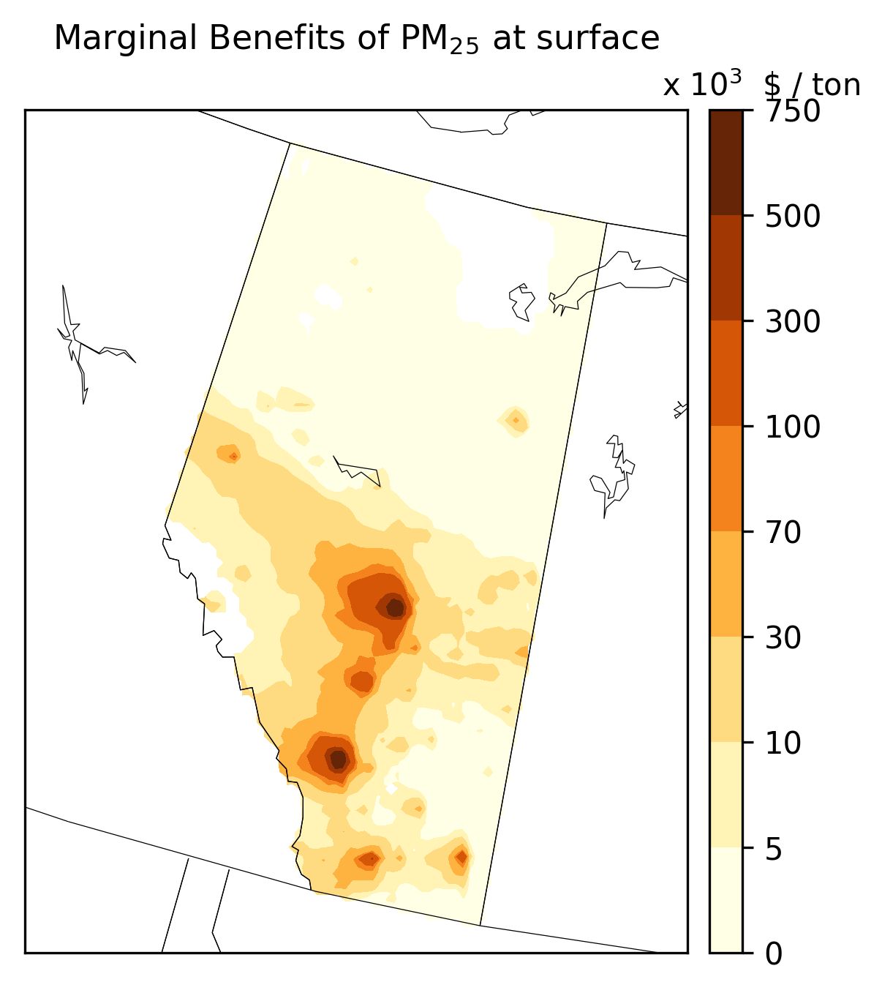
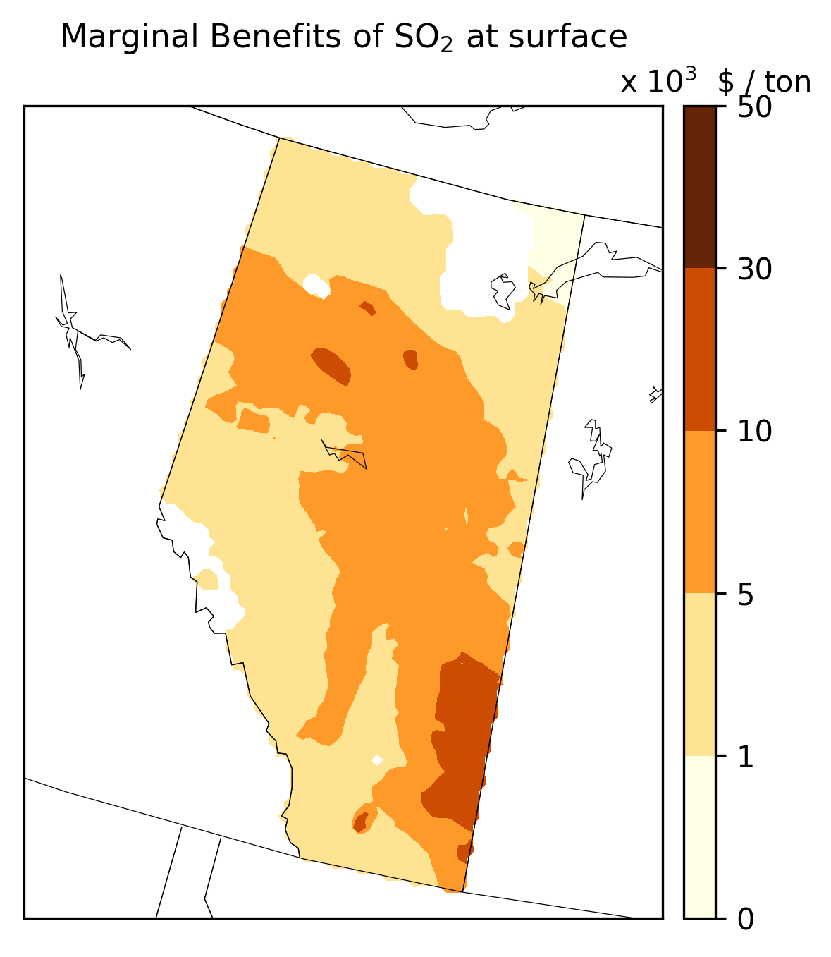
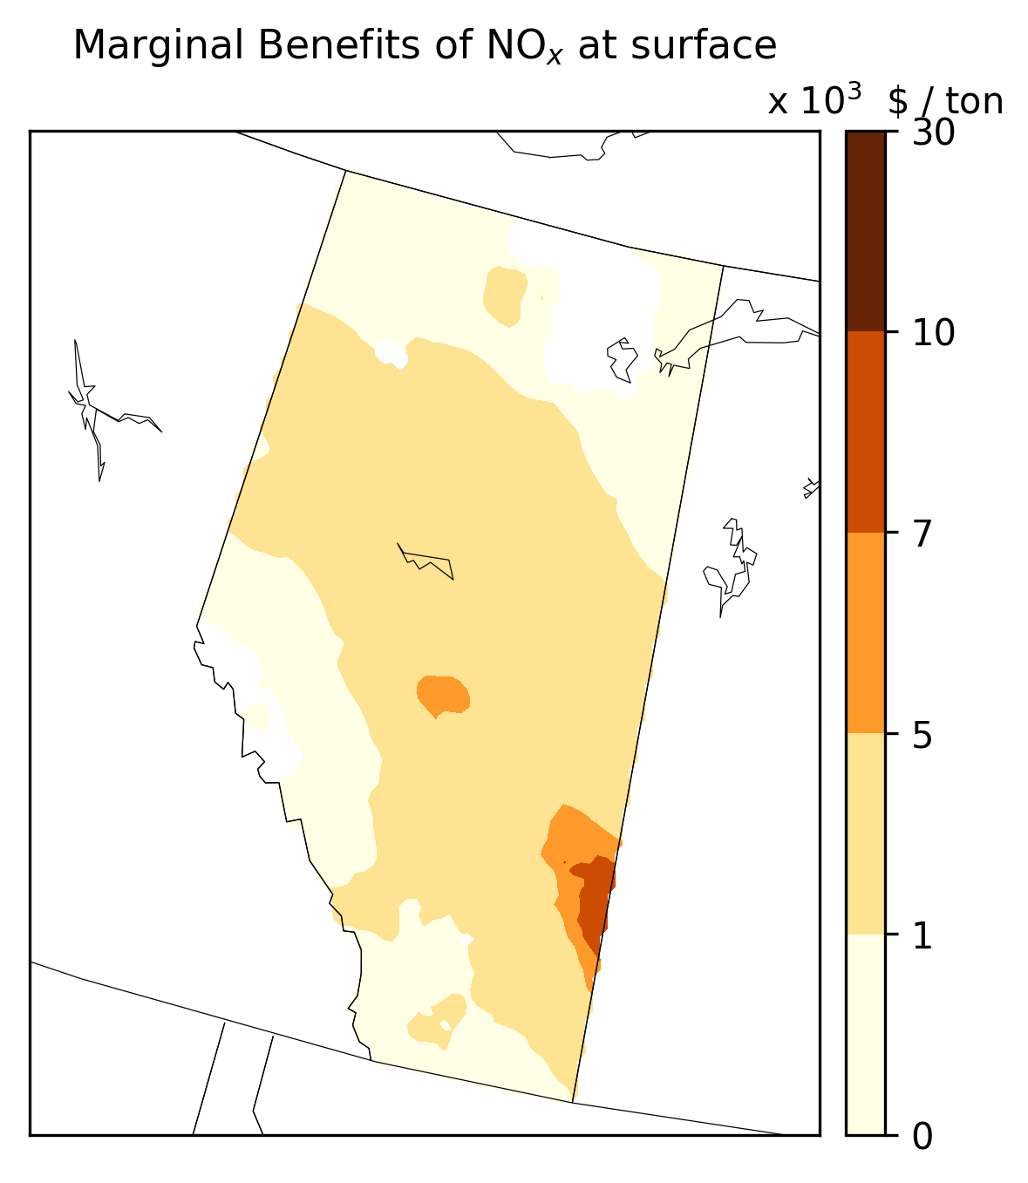
Marginal Benefits (Alberta – single pollutant model)
16th Annual CMAS Conference
October 2017

Slide 13
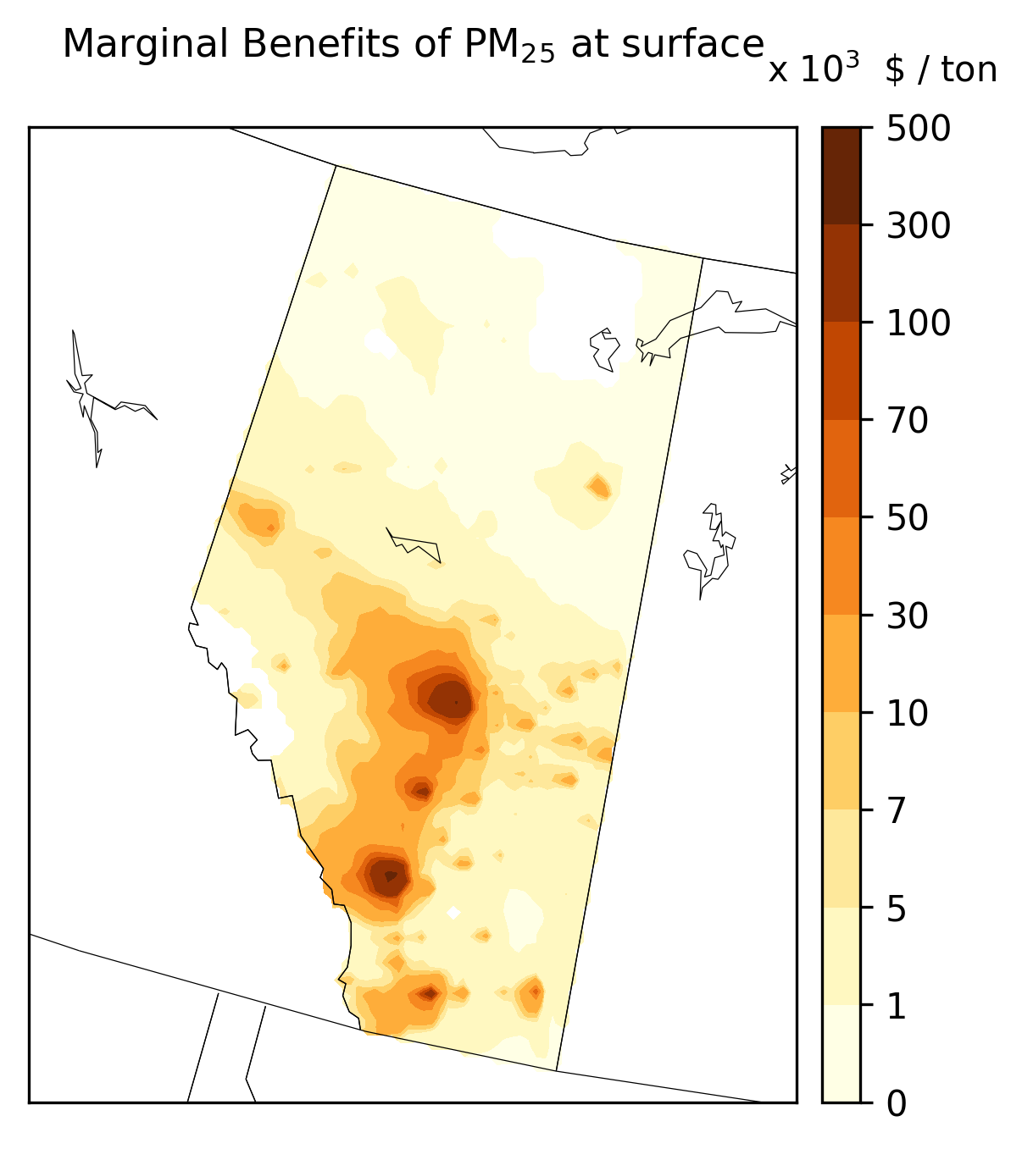
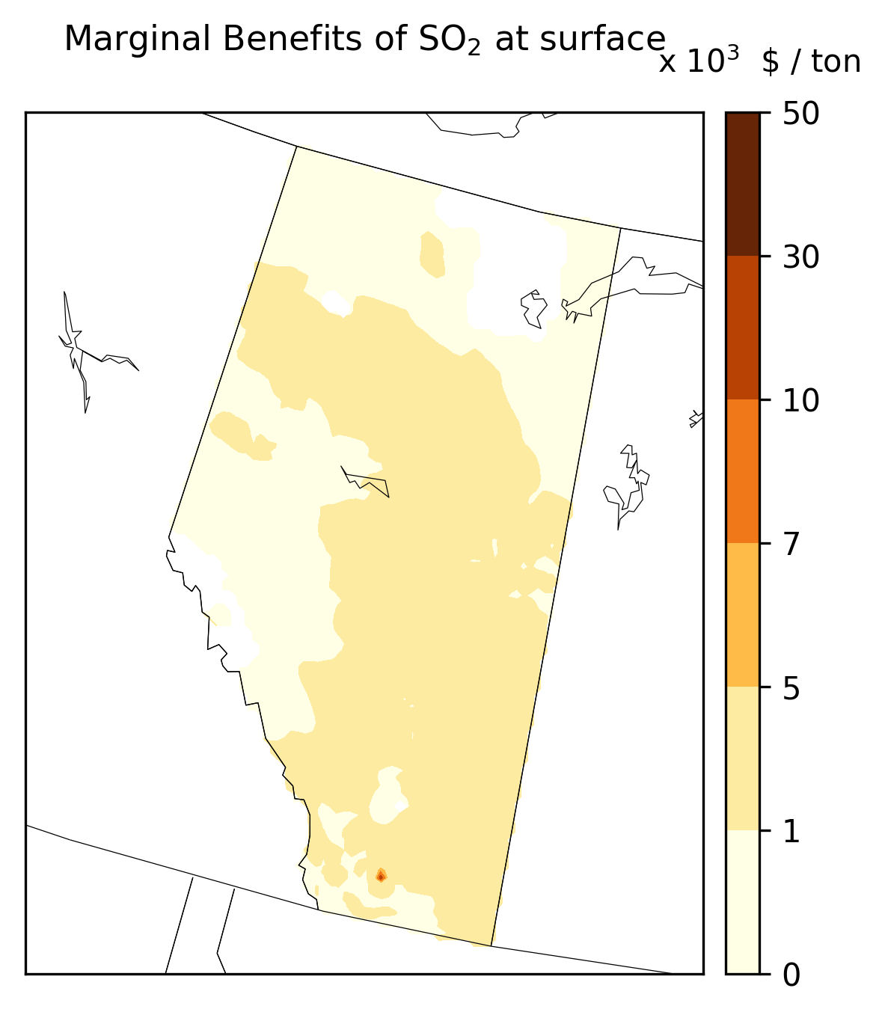
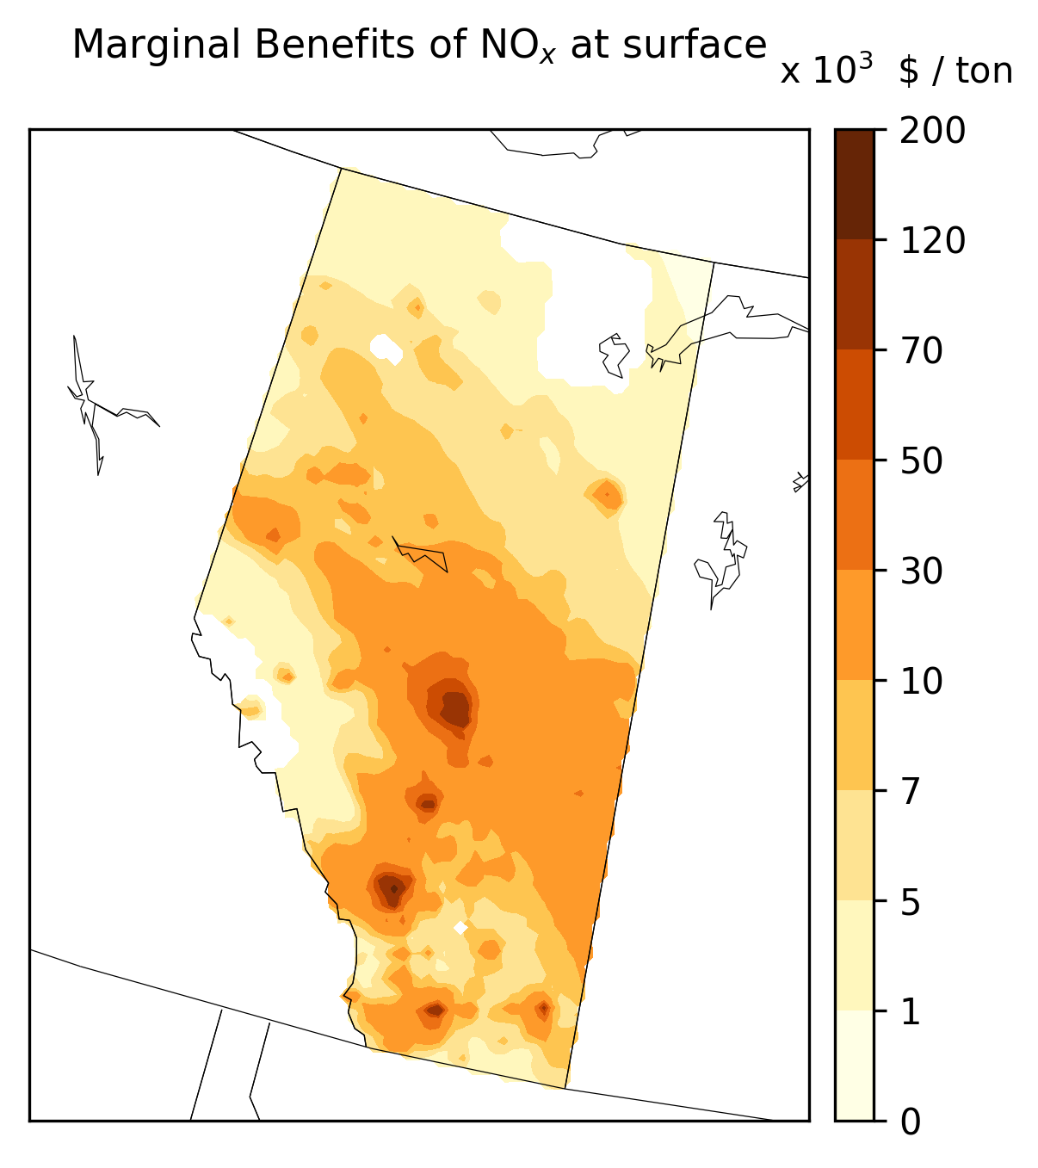
Marginal Benefits (Alberta – 3-pol. model)

Slide 14
Total Benefits (Alberta)
ALBERTA 3-Pollutant Forcing Model (C$ Million)
Plant | PM_{2.5} | NO_{X} | SO₂ | Plant Total
Milner PG | <1 | 6 | 1 | 7
Foster Creek PG | <1 | 2 | 1 | 3
Sheerness PG | <1 | 68 | 105 | 173
Battle River PG | 1 | 110 | 62 | 173
Genesee PG | 1 | 40 | 46 | 87
Keephills PG | 2 | 96 | 32 | 130
Wabamun PG | 1 | 47 | 15 | 63
Sundance PG | 6 | 186 | 72 | 264
Province Total |  |  |  | 900
16th Annual CMAS Conference
October 2017

Slide 15
Total Benefits (Alberta) (cont.)
ALBERTA Single-Pollutant Forcing Model (C$ Million)
Plant | PM_{2.5} | NO_{X} | SO₂ | Plant Total
Milner PG | <1 | 1 | 3 | 4
Foster Creek PG | <1 | <1 | 3 | 4
Sheerness PG | <1 | 34 | 592 | 626
Battle River PG | 1 | 49 | 386 | 436
Genesee PG | 3 | 89 | 189 | 281
Keephills PG | 5 | 32 | 140 | 177
Wabamun PG | 3 | 15 | 70 | 88
Sundance PG | 13 | 63 | 301 | 377
Province Total |  |  |  | 1993
16th Annual CMAS Conference
October 2017

Slide 16
Estimated Benefits (C$ Millions)
Provinces | 3-pol. Model | Single-pollutant | Previous estimates
Ontario | 1059 | 2965 | 3020
Alberta | 900 | 1993 | (~3000)
16th Annual CMAS Conference
October 2017

Slide 17
Conclusions
Previous studies appear to have overestimated the benefits of coal phase-out in Ontario. However, larger epidemiological effect estimates result in comparable benefits.
The choice of epidemiological model has a significant impact on estimated benefits.
For Ontario most of health benefits are in-province, while Alberta coal phase-out entails larger out-of-province benefits.
16th Annual CMAS Conference
October 2017

Slide 18
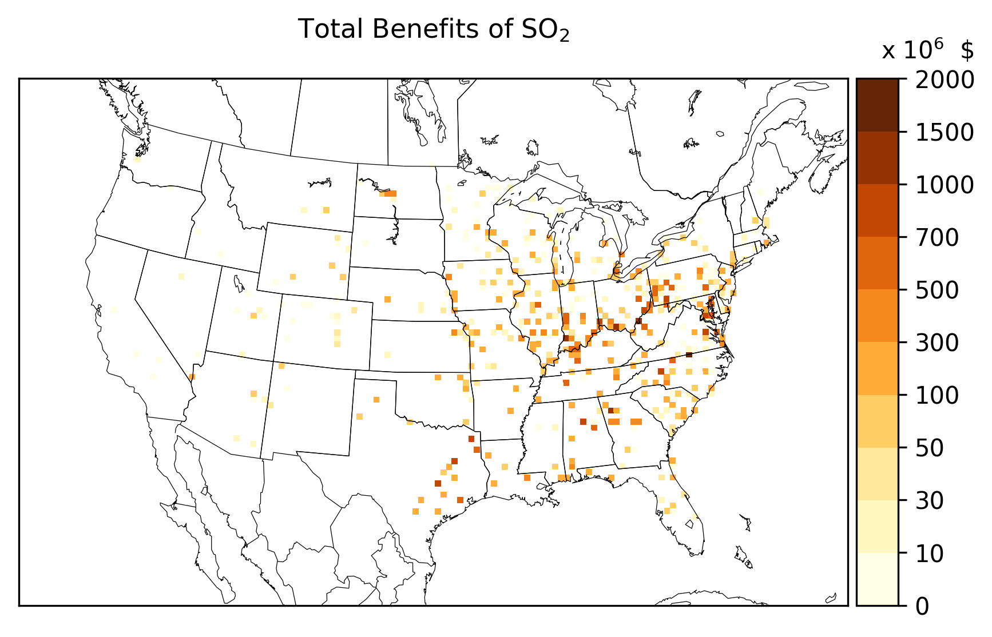
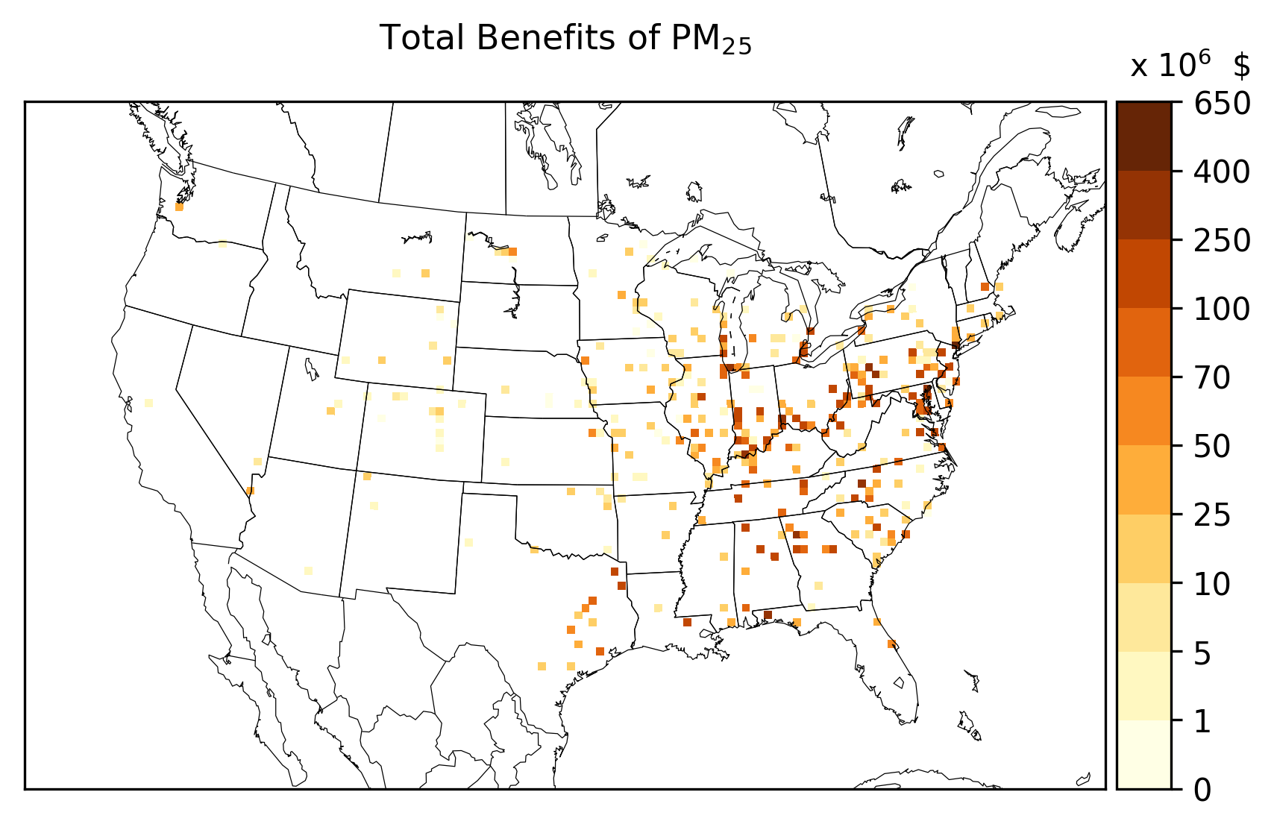
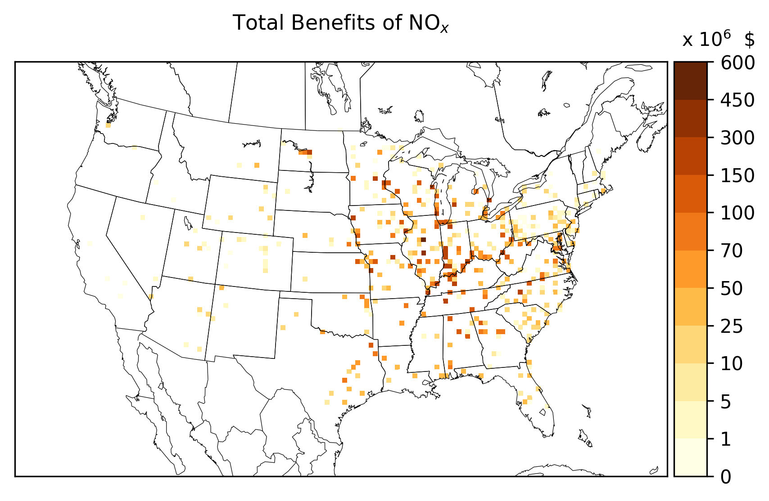
Coal in the U.S. (Total Benefits)
SO₂: $55 Billion
PM_{2.5} : $17 Billion
NO_{X}: $10 Billion
16th Annual CMAS Conference
October 2017

Slide 19
Thank you!
Ontario Ministry of Energy (retrieved March, 2017), “The End of Coal”. http://www.energy.gov.on.ca/en/archive/the-end-of-coal/
DSS Management Consultants Inc. (2005). Cost-Benefit Analysis: Replacing Ontario’s Coal-Fired Electricity Generation. Closing the Coal- Fired Power Plants. Mimeo: Condential Final Report to the Ontario Ministry of Energy.
The Government of Alberta (retrieved March, 2017), “Phasing out coal pollution”. https://www.alberta.ca/climate-coal-electricity.aspx
Pappin, AJ, et al. (2016) "Health benefits of reducing NOx emissions in the presence of epidemiological and atmospheric nonlinearities." Environmental Research Letters 11: 064015.
Crouse et al. (2015) Ambient PM2.5, O3, and NO2 exposures and associations with mortality over 16 years of follow-up in the Canadian Census Health and Environment Cohort (CanCHEC). Environmental Health Perspectives, 11.
Nasari, M. M. et al. (2016). A class of non-linear exposure-response models suitable for health impact assessment applicable to large cohort studies of ambient air pollution. Air Quality, Atmosphere, & Health, 9(8), 961–972. http://doi.org/10.1007/s11869-016-0398-z
16th Annual CMAS Conference
October 2017

