Slide 1

Improving BCs to address over-prediction of o₃ influx from the Gulf of Mexico
Ou Nopmongcol, Maria Zatko, Jaegun Jung, and Greg Yarwood
Ramboll Environ
Shantha Daniel, Barry Exum, and Jim Smith
Texas Commission on Environmental Quality
CMAS
Oct 25, 2017

Slide 2
motivation
Regional models over-predict O₃ transported onshore
Adding halogen chemistry improved model performance, yet over-prediction is still present
Boundary conditions (BC) extracted from global models such as GEOS-Chem and MOZART
Further reduce bias by updating GEOS-Chem to include halogen chemistry
Notes:
Smith et al., 215 CMAS presentation
Addressing model overprediction of ozone influx from the Gulf of Mexico
2-4 ppb reduction of MDA8 bias

Slide 3
Iodine chemistry
IO + HO₂ cycle | IO + IO cycle | IO + NO₂ cycle
I + O₃ → IO + O₂ IO + HO₂ → HOI + O₂ HOI + hν → I + OH Net: O₃ + HO₂ → OH + 2 O₂ | (I + O₃ → IO + O₂) x 2 IO + IO → I + OIO OIO + hν → I + O₂ 2 O₃ → 3 O₂ | I + O₃ → IO + O₂ IO + NO₂ → IONO₂ IONO₂ + hν → I + NO₃ NO₃ + hν → NO + O₂ NO + O₃→ NO₂ + O₂ 2 O₃ → 3 O₂
These cycles are referred to as catalytic cycles because the halogen atoms are regenerated in the reactions and therefore one I atom can potentially destroy many O₃ molecules.
Notes:
Three main ozone destruction pathways by iodine. These cycles are referred to as catalytic cycles because the halogen atoms are regenerated in the reactions and therefore one I atom (and similarly for Br and Cl) can potentially destroy many O₃ molecules.

Slide 4
Approach
Modeling Database
Model:
  GEOS-Chem v10-01 (June, 2015)
  Benchmark chemical mechanism (UCX + SOA)
    UCX includes full ozone chemistry of NOx, ClOx, BrOx, HOx) – no iodine
Approach
  Modifying GEOS-Chem source code to include iodine chemistry and emissions

Slide 5
Approach: Iodine chemistry
Br-Chemistry is already available in GEOS-Chem
I-chemistry : consider 2 mechanisms
Both mechanisms include the largest contributors to ozone depletion, i.e., IO + HO2 = HOI, OIO photolysis, and IO + NO₂ = IONO₂
Mechanism | Full | Compact
Source | Sherwin et al. (2016) | CAMx compact I-chemistry (Yarwood et al., 2015)
# gas rxn | 29 | 12
# photolysis rxn | 14 | 8
Heterogeneous rxn | Yes | No
Br/I interaction | Yes | No
Notes:
The compact mechanism in CAMx was modified from the full mechanism with Br to improve computational efficiency. Used sensitivity analysis to determine limiting reactions. Three reactions that counteract or limit O₃-depletion by iodine are OIO + OIO = IXOY, IO + IO = 0.4I + 0.4OIO + 0.6I2O2, and I2O2 + O3 = IXOY, all of which ultimately lead to the conversion of iodine radicals into I_{X}O_{Y} in the aerosol phase. The reaction OIO + OIO = IXOY is the least important of the three.

Slide 6
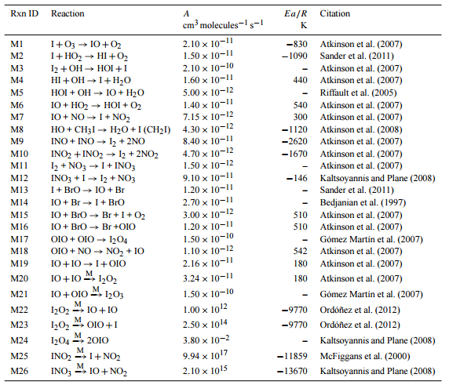
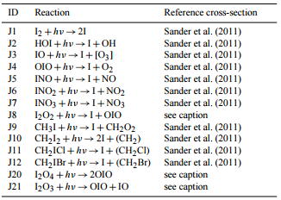
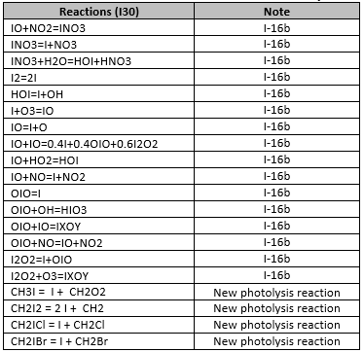
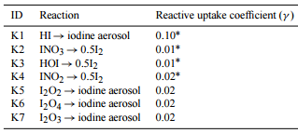

Iodine chemistry implemented in geos-chem
Full I-chemistry
Compact I-chemistry
Notes:
These tables show a lot of detail. The main story is that it’s complicated to add photochemical, bimolecular, termolecular, and heterogeneous reactions into GC.
The compact I-chemistry scheme is much less complicated than the full-I chemistry presented in Sherwen et al. (2016).
Main differences: Full includes Br and I interactions, explicit treatment of IxOy, and heterogenous uptake of iodine species (the last is the biggest difference)
Both include largest contributors to ozone depletion: IO+HO2 = HOI, OIO photolysis, IO+NO2 = IONO2
We excluded heterogeneous reactions that allow iodine cycling back to the atmosphere (reactions K2-K4 in Sherwen et al.) due to their small contributions to ozone burden (less than 1%).

Slide 7
GEOS-Chem modification
Adding new tracers and chemical reactions:
Assign specific tracer identification number and molecular weight for new I-species and increased total number of tracers in GEOS-Chem.
Update the restart file to include new I-species.
Incorporate new photochemical, bimolecular, termolecular, and heterogeneous reactions, which required updating the master chemical mechanism and updating the Kinetic PreProcessor (KPP) chemistry solver files.
Define absorption cross-section and quantum yield values for each photochemical reaction.
Define reactive uptake coefficients for heterogeneous reactions.
Define Henry’s constant and molar heat of formation required for wet and dry deposition for I-species.
Add new I-species as diagnostics in order to store concentrations and fluxes to an output file.
Notes:
Not an easy chore. Requires testing and QA/QC

Slide 8
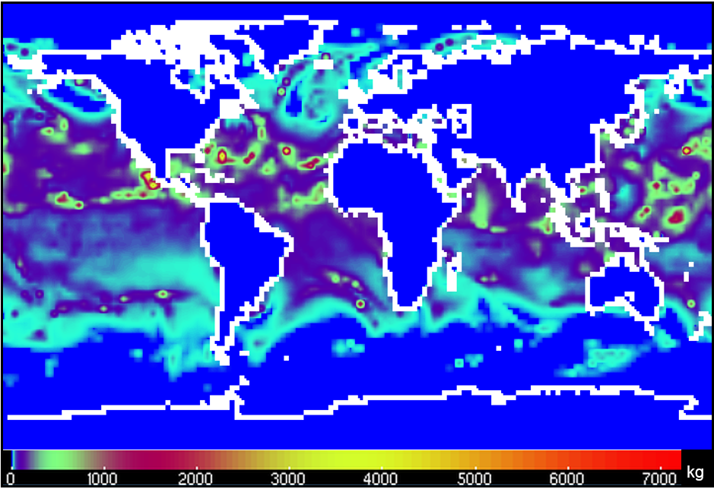
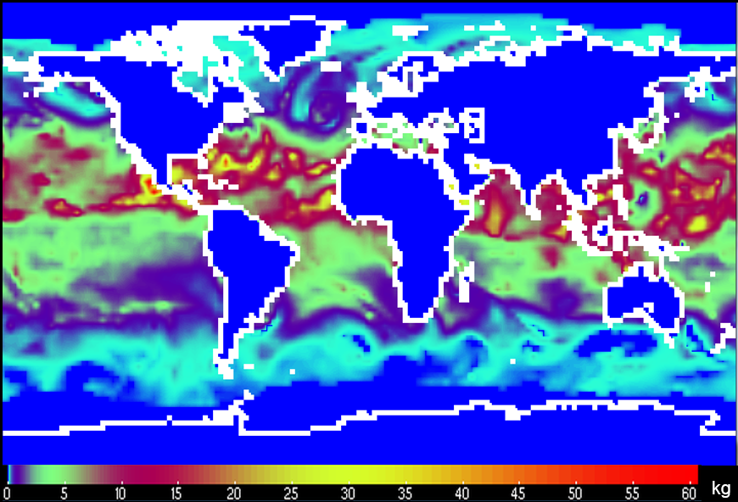
Approach
Halogen emissions
I Emissions
  HOI and I₂ from inorganic sources dependent on O₃, wind speed, SST
  Iodomethanes from seawater proportional to chlorophyll-a
Br emissions (CH₃Br, CH₂Br₂ and CHBr₃) available in GEOS-Chem
Notes:
Oct 1 hourly emissions at 3 am UTC
Halomethanes are generated by organic sources and allocated spatially according to monthly average chlorophyll-a observations (satellite) and calibrated to reproduce global annual emission budgets

Slide 9
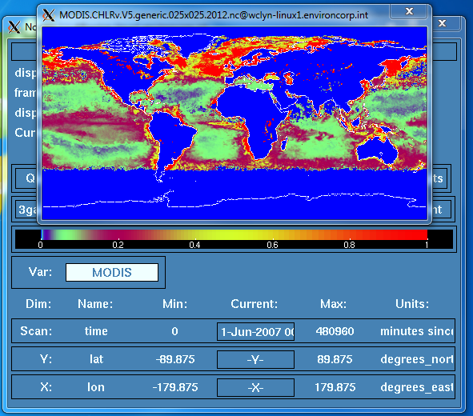
GEOS-Chem modification
Adding oceanic emissions of I-species:
Modified HEMCO emissions interface to calculate in-line organic and inorganic iodine emissions as a function of ozone, wind speed, and SST.
Downloaded and integrated MODIS chlorophyll-a concentrations data
Modified HEMCO source codes to read-in and store chlorophyll-a data
Added emitted I-species as diagnostics, which required code modifications at the GEOS-Chem/HEMCO interface level.
Customized HEMCO diagnostic file to store I-species emissions in an output file
Global sea water concentration of chlorophyll-a (mg/m³)
June 2012, MODIS Satellite data

Slide 10
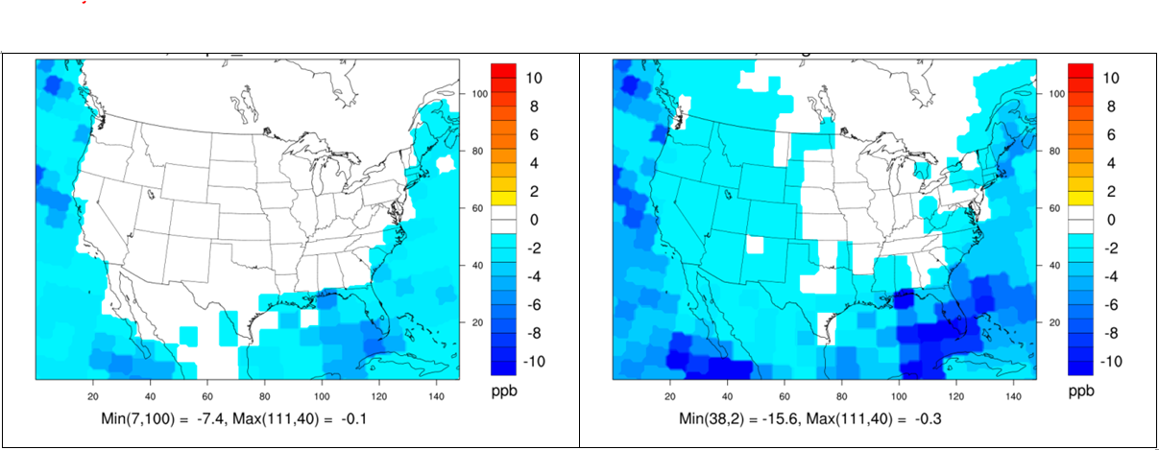
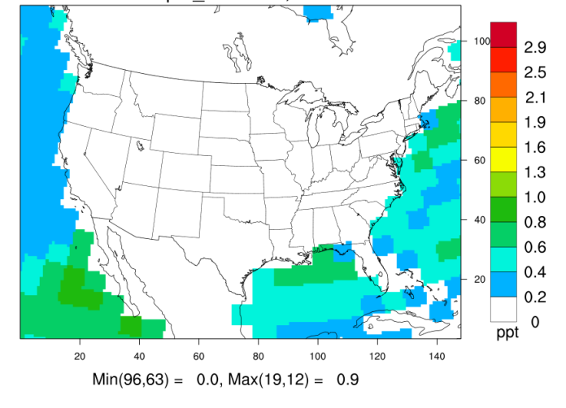
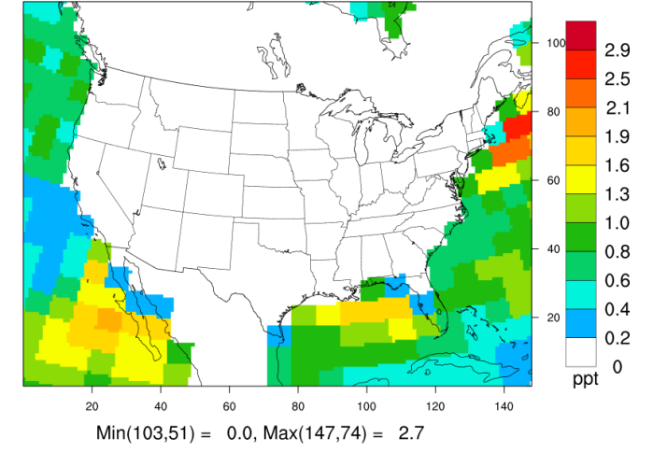
2012: Full VS Compact
Aug, 2012
Delta MDA8
(ppb)
Base – Compact
Base – Full
Compact Full
Average monthly IO (ppt)
Notes:
Reductions are larger over oceans and tending to be larger at lower latitudes where stronger sunlight enhances photochemistry and warmer water emits more HOI. The full I-chemistry reduces peak daily maximum 8-hour average (MDA8) ozone in August by up to15 ppb, while the condensed mechanism indicates decrements of up to 7 ppb (similar spatial patterns).

Slide 11
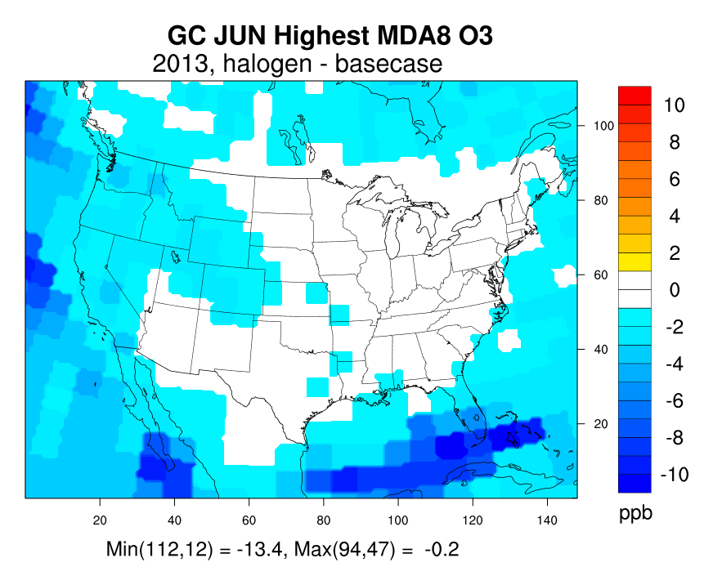
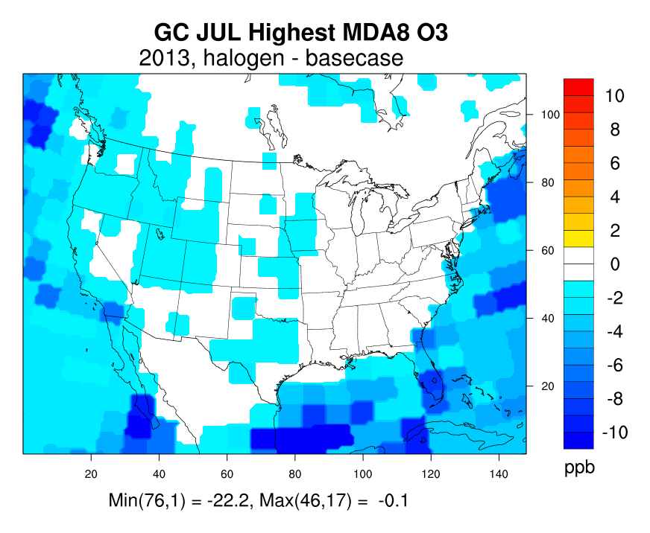
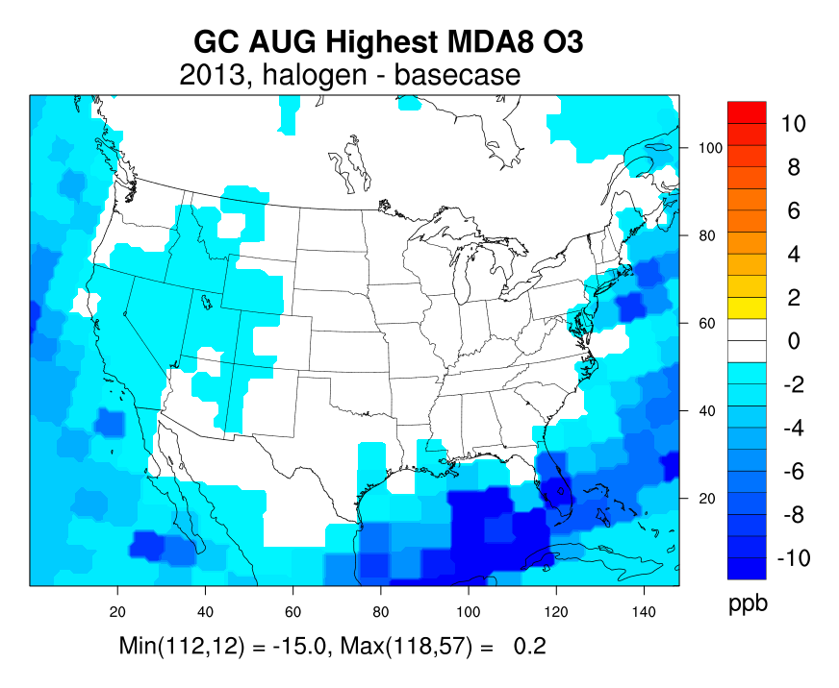
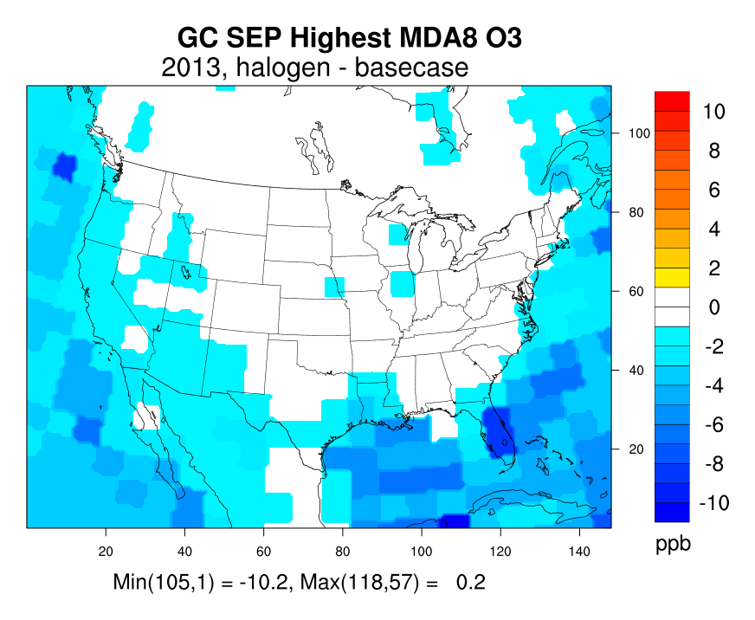
2013 June-Sep: Base - Full
Jun Jul Aug
Sep
Similar spatial distribution across summer months
Up to 22 ppb over ocean in July.
Up to 4 ppb inland in the west
Notes:
2013 simulation uses HTAP2, updated LNOx, and GEOS-FP meteorology
More prominent decreases are seen in the west because HOI is almost depleted by the time it arrives at the southern and eastern coastlines.
22 ppb reduction of peak MDA8 is large. This process is important in GEOS-Chem – and not only important for Texas or coastal cities. The reduction penetrates inland in the WUS

Slide 12
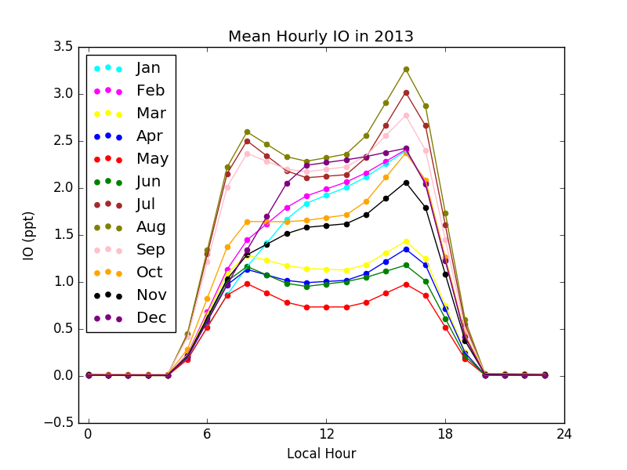
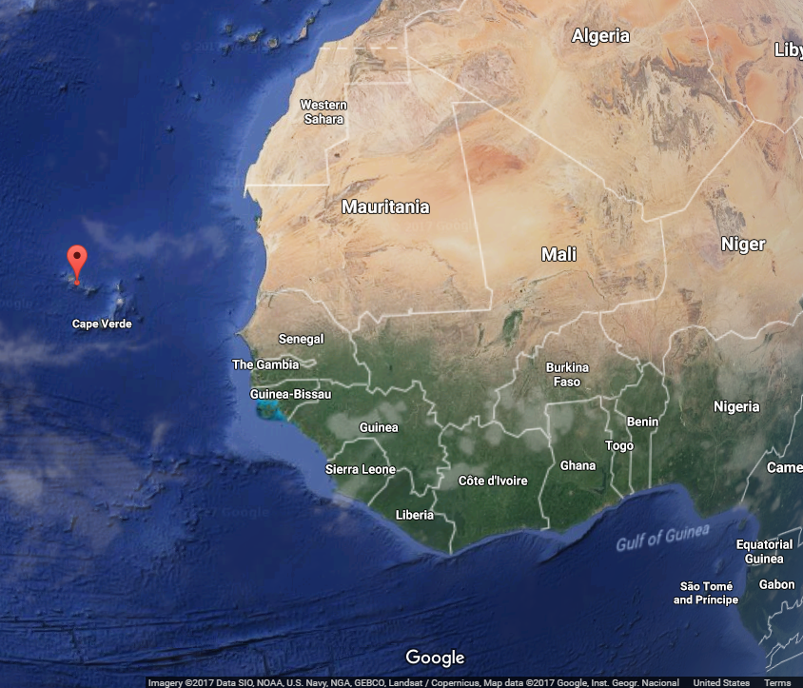
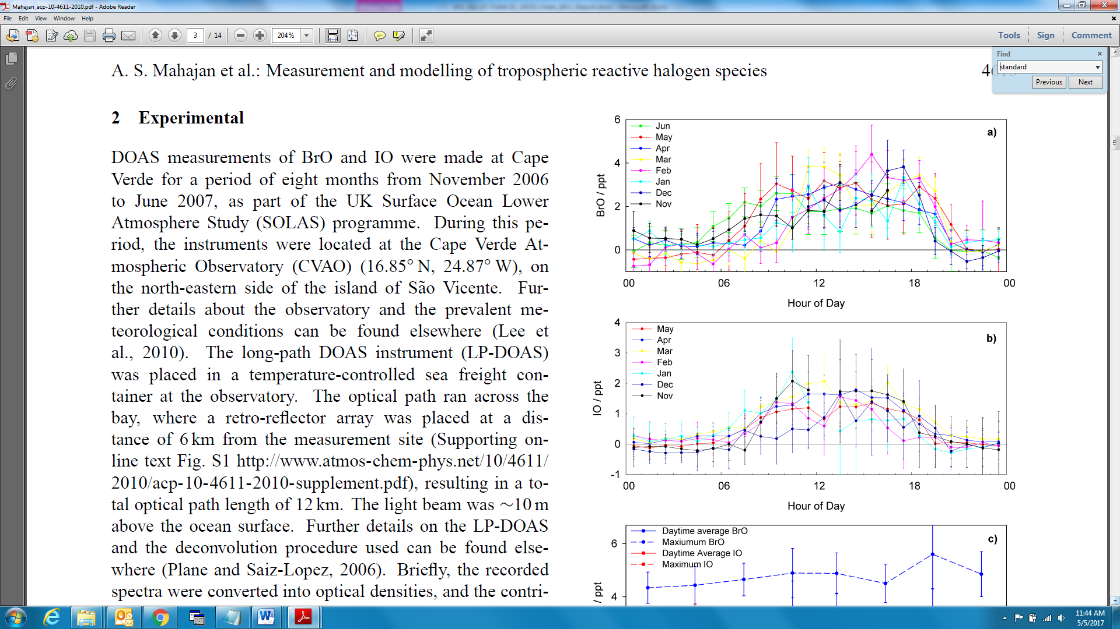
IO comparison
Model
Observation
Agreement with IO measurements at CVAO
  mean IO within 1-2 ppt range
CVAO
Cape Verde Atmospheric Observatory (CVAO)
Notes:
top-hat distribution with highest concentrations between 9:00-15:00 and zero at night

Slide 13
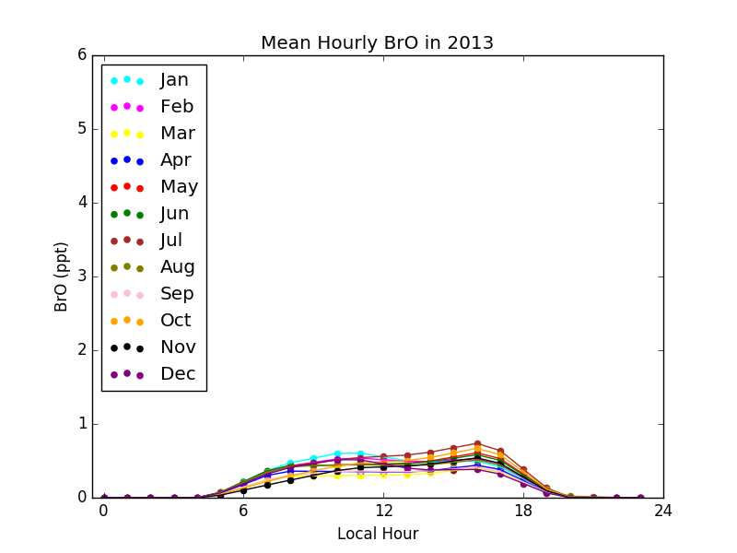
BrO comparison
CVAO
Modeled BrO ~ a factor of five lower than the observations
  Predicted range 0.3-0.6 ppt
Model Observations
Notes:
top-hat distribution with highest concentrations between 9:00-15:00 and zero at night

Slide 14
Conclusion
Important that GEOS-Chem applications are run with halogen chemistry to reduce ozone bias
  peak MDA8 ozone reduced by up to 22 ppb
  GEOS-Chem V11-02 (in development) will include halogen chemistry
Agreement of IO concentration at CVAO may suggest that iodine emissions are reasonable
Underprediction bias of BrO may suggest missing emission sources or unknown Br chemistry
Notes:
Important to use halogen not only in Texas or coastal cities but also in the western US

Slide 15
Recommendations
Evaluate impacts from BCs with and without halogen in the regional models
Need more measurement comparisons at other locations to validate models and iodine chemistry
  Halogen measurements at the Galveston coast during summer 2016
Recently proposed reaction HOI + NO₃--> IO + HNO₃ is shown to improve diurnal profiles for NOx and O₃.
  Maybe important in the Gulf of Mexico given presence of NOx emissions that promote NO₃ formation at night.
Notes:
This reaction consumed HOI at night and therefore reduced a spike in IO at sunrise due to HOI photolysis, which is not observed by measurements

Slide 16
Thank You
Any questions?
This study was sponsored by the Texas Commission on Environmental Quality

Slide 17
references
Mahajan, A.S., J.M.C. Plane, H. Oetjen, L. Mendes, R.W. Saunders, A. Saiz-Lopez, C.E. Jones, L.J. Carpenter, G.B. McFiggans. 2010. Measurement and modelling of tropospheric reactive halogen species over the tropical Atlantic Ocean. Atmos. Chem. Phys., 10, 4611-4624, 2010 doi:10.5194/acp-10-4611-2010.
Prados-Roman, C., C.A. Cuevas, R.P. Fernandez, D.E. Kinnison, J.F. Lamarque, A. Saiz-Lopez. 2015. A negative feedback between anthropogenic ozone pollution and enhanced ocean emissions of iodine. Atmospheric Chemistry and Physics, 15(4), 2215-2224.
Sherwen, T., M.J., Evans, L.J., Carpenter, S.J., Andrews, R.T., Lidster, B., Dix, T.K., Koenig, R., Sinreich, I., Ortega, R., Volkamer, A., Saiz-Lopez. 2016. Iodine's impact on tropospheric oxidants: a global model study in GEOS-Chem. Atmospheric Chemistry and Physics, 16(2), pp.1161-1186.
Travis, K., Jacob, D.J., Fisher, J.A., Kim, P. S., Marais, E.A., Zhu, L., Yu, K., Miller, C.C., Yantosca, R.M., Sulprizio, M.P., Thompson, A.M., Wennberg, P.O., Crounse, J.D., St. Clair, J.M., Cohen, R.C., Laughner, J.L., Dibb, J.E., Hall, S.R., Ullmann, K., Wolfe, G.M., Pollack, I.B., Peischl, J., Neuman, J.A, Zhou, X. 2016. Why do models overestimate surface ozone in the Southeast United States? Atmos. Chem. Phys., 16, 13561-13577, doi:10.5194/acp-16-13561-2016.
Saiz-Lopez, A., Plane, J., Cuevas, C.A., Mahajan, A.S., Lamarque, J.F. Kinnison, D.E., 2016. Nighttime atmospheric chemistry of iodine. Atmospheric Chemistry and Physics, 16(24), pp.15593-15604.
Reed, C., Evans, M.J., Crilley, L.R., Bloss, W.J., Sherwen, T., Read, K.A., Lee, J.D., Carpenter, L.J., 2017. Evidence for renoxification in the tropical marine boundary layer. Atmospheric Chemistry and Physics, 17(6), pp.4081-4092.
Smith, J. H., M. Estes, J. Mellberg, O. Nopmongcol, G. Yarwood. 2015. Addressing model over-prediction of ozone influx from the Gulf of Mexico. Presented at CMAS 2015.

Slide 18
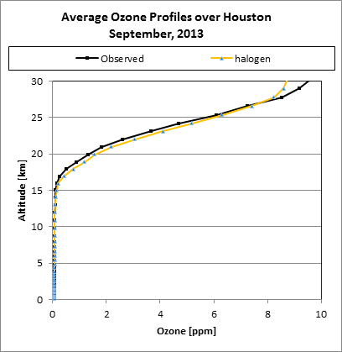
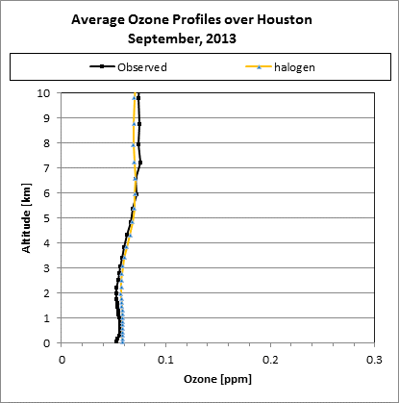
Ozone MPE
The model replicates September ozone vertical profile at Houston very well
Notes:
Good performing ozone is not likely because of halogen – just how GC performs.

Slide 19
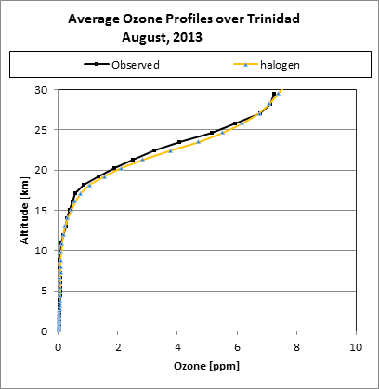
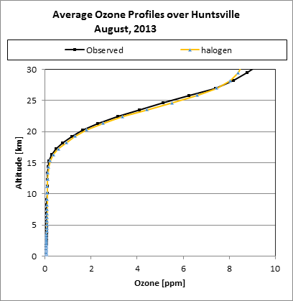
Ozone mpe
Ozonesonde at Trinidad Head (CA) and Huntsville (AL)

Slide 20
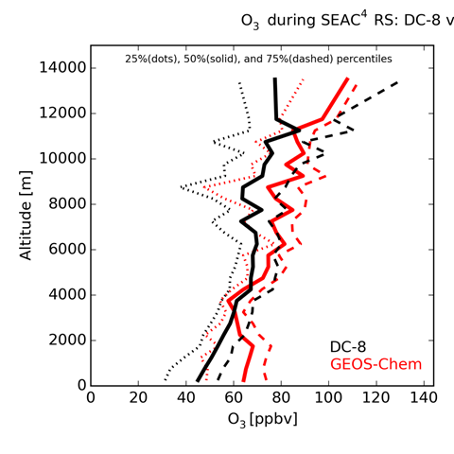
Ozone MPE
Reasonable overall compared to CASTNET and SEAC⁴RS aircraft observations.
Tends to underpredict in spring
Overestimate the highest ozone in summer in the Central and Eastern US
Possible reasons: excessive NOx emissions and excessive boundary layer vertical mixing (Travis et al., 2016)
The SEAC⁴RS aircraft campaign in Aug-Sep 2013
Notes:
The SEAC⁴RS aircraft campaign in August-September 2013

