Slide 1



Investigation of the Atmospheric Conditions Governing the Relationship between Aerosol Optical Depth and Surface PM_{2.5} Concentrations in the Western U.S.
S. Marcela Loría-Salazar¹, W. Patrick Arnott¹, Anna Panorska², James C. Barnard¹, Jayne M. Boehmler¹, and Heather A. Holmes¹,
¹Atmospheric Sciences Program, Department of Physics, University of Nevada, Reno
²Department of Mathematics and Statistics, University of Nevada, Reno
October 25th, 2017
16th Annual CMAS Conference
Chapel Hill, North Carolina, USA

Slide 2
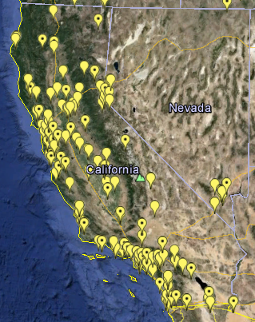
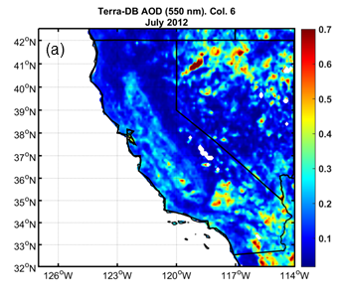


Motivation
EPA PM_{2.5}
MODIS AOD
http://www.epa.gov/airdata/ad_maps.html
Loria-Salazar et al., 2016
(Atmos. Environ)
Point-level
measurement
Grid AQ data
Data fusion model
$${{PM}_{2.5}}_{obs}\left(s,t\right)=α_{0}\left(s,t\right)+α_{1}\left(s,t\right) {AOD}_{MODIS}+ ε\left(s,t\right)$$
Additive bias:
$α_{0}\left(s,t\right)$ =${ β}_{0}\left(s\right)$ +${ β}_{0}\left(t\right)$ +${ γ}_{0}Z_{0}$
Multiplicative bias:
$α_{1}\left(s,t\right)$ =${ β}_{1}\left(s\right)$ +${ β}_{1}\left(t\right)$ +${ γ}_{1}Z_{1}$
Chang et al., 2013
Chang et al. 2013
Notes:
However, the semi-arid western U.S. continues to be an unproven and infrequently explored area for remotely sensed atmospheric aerosol pollution retrievals. The study of aerosol transport and optical properties in this area is a challenge due to the complex terrain, bright surfaces, presence of anthropogenic and biogenic emissions, secondary organic aerosol formation, smoke from wildfires, and low aerosol concentrations during non-fire conditions.
Previous studies have shown that MODIS retrievals failed to estimate column-integrated aerosol pollution levels and particle size over Nevada and California in the summer months of 2012 and 2013 due to high surface albedo, heterogeneous vertical profile of aerosol concentrations, and incorrect parameterizations for surface reflectance. MODIS algorithms overestimated AOD by more than a factor of 3 in Reno, NV and more than a factor of 2 over Fresno, CA.

Slide 3
Motivation
EPA PM_{2.5}
MODIS AOD
http://www.epa.gov/airdata/ad_maps.html
Loria-Salazar et al., 2016
(Atmos. Environ)
Point-level
measurement
Grid AQ data
Data fusion model
$${{PM}_{2.5}}_{obs}\left(s,t\right)=α_{0}\left(s,t\right)+α_{1}\left(s,t\right) {AOD}_{MODIS}+ ε\left(s,t\right)$$
Additive bias:
$α_{0}\left(s,t\right)$ =${ β}_{0}\left(s\right)$ +${ β}_{0}\left(t\right)$ +${ γ}_{0}Z_{0}$
Land use and meteorological variables
Multiplicative bias:
$α_{1}\left(s,t\right)$ =${ β}_{1}\left(s\right)$ +${ β}_{1}\left(t\right)$ +${ γ}_{1}Z_{1}$
Chang et al., 2013
Chang et al. 2013
Notes:
However, the semi-arid western U.S. continues to be an unproven and infrequently explored area for remotely sensed atmospheric aerosol pollution retrievals. The study of aerosol transport and optical properties in this area is a challenge due to the complex terrain, bright surfaces, presence of anthropogenic and biogenic emissions, secondary organic aerosol formation, smoke from wildfires, and low aerosol concentrations during non-fire conditions.
Previous studies have shown that MODIS retrievals failed to estimate column-integrated aerosol pollution levels and particle size over Nevada and California in the summer months of 2012 and 2013 due to high surface albedo, heterogeneous vertical profile of aerosol concentrations, and incorrect parameterizations for surface reflectance. MODIS algorithms overestimated AOD by more than a factor of 3 in Reno, NV and more than a factor of 2 over Fresno, CA.

Slide 4
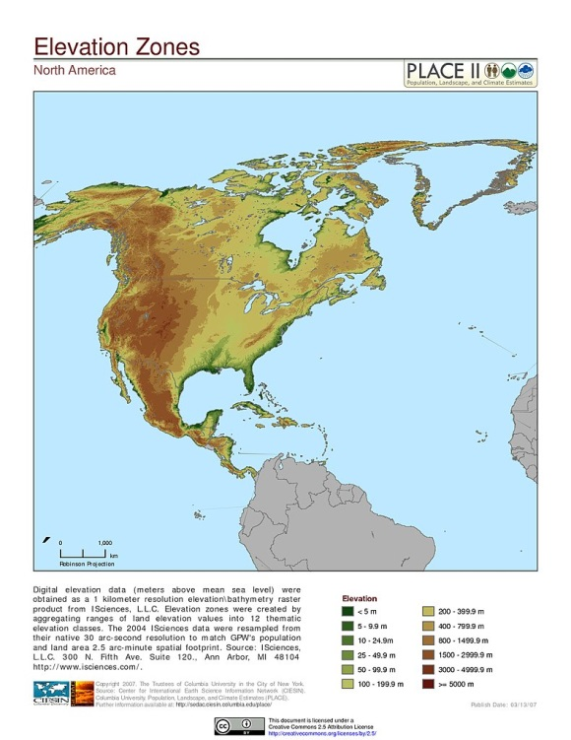
Challenges in the western U.S.
  Diverse aerosol chemical and physical compositions
  Transboundary aerosol pollution from Eurasia
  Irregular topography
    Are most aerosols contained within the boundary layer?
  Heterogeneous surface reflectance:
    Impact satellite algorithms
http://sedac.ciesin.columbia.edu/downloads/maps/nagdc/nagdc-population-landscape-climate-estimates-v2/Continent_North_America_ElevationZone.jpg
Notes:
However, the semi-arid western U.S. continues to be an unproven and infrequently explored area for remotely sensed atmospheric aerosol pollution retrievals. The study of aerosol transport and optical properties in this area is a challenge due to the complex terrain, bright surfaces, presence of anthropogenic and biogenic emissions, secondary organic aerosol formation, smoke from wildfires, and low aerosol concentrations during non-fire conditions.
Previous studies have shown that MODIS retrievals failed to estimate column-integrated aerosol pollution levels and particle size over Nevada and California in the summer months of 2012 and 2013 due to high surface albedo, heterogeneous vertical profile of aerosol concentrations, and incorrect parameterizations for surface reflectance. MODIS algorithms overestimated AOD by more than a factor of 3 in Reno, NV and more than a factor of 2 over Fresno, CA.

Slide 5
Challenges in the western U.S.
  Diverse aerosol chemical and physical compositions
  Transboundary aerosol pollution from Eurasia
  Irregular topography
    Are most aerosols contained within the boundary layer?
  Heterogeneous surface reflectance:
    Impact satellite algorithms
http://sedac.ciesin.columbia.edu/downloads/maps/nagdc/nagdc-population-landscape-climate-estimates-v2/Continent_North_America_ElevationZone.jpg
Notes:
However, the semi-arid western U.S. continues to be an unproven and infrequently explored area for remotely sensed atmospheric aerosol pollution retrievals. The study of aerosol transport and optical properties in this area is a challenge due to the complex terrain, bright surfaces, presence of anthropogenic and biogenic emissions, secondary organic aerosol formation, smoke from wildfires, and low aerosol concentrations during non-fire conditions.
Previous studies have shown that MODIS retrievals failed to estimate column-integrated aerosol pollution levels and particle size over Nevada and California in the summer months of 2012 and 2013 due to high surface albedo, heterogeneous vertical profile of aerosol concentrations, and incorrect parameterizations for surface reflectance. MODIS algorithms overestimated AOD by more than a factor of 3 in Reno, NV and more than a factor of 2 over Fresno, CA.

Slide 6
Planetary boundary layer
CBLH
5PM
Vertical potential temperature gradient method [Stull, 1988]
The height at which the potential temperature exceeds the surface potential temperature by 1.5 K [Holzworth, 1964; Seibert et al., 2000]
The bulk Richardson number (RB~0.2) [Stull, 1988]
Notes:
The transport physics of wildfire smoke plumes complicate the MODIS retrievals because the smoke plumes can travel at ground level or aloft with limited downward mixing to the surface. This transport is investigated using the planetary boundary layer height and the apparent optical height to characterize the extent of vertical mixing of the aerosol

Slide 7
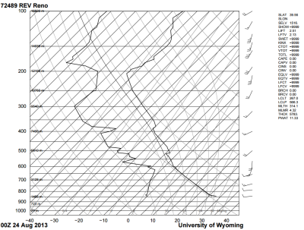
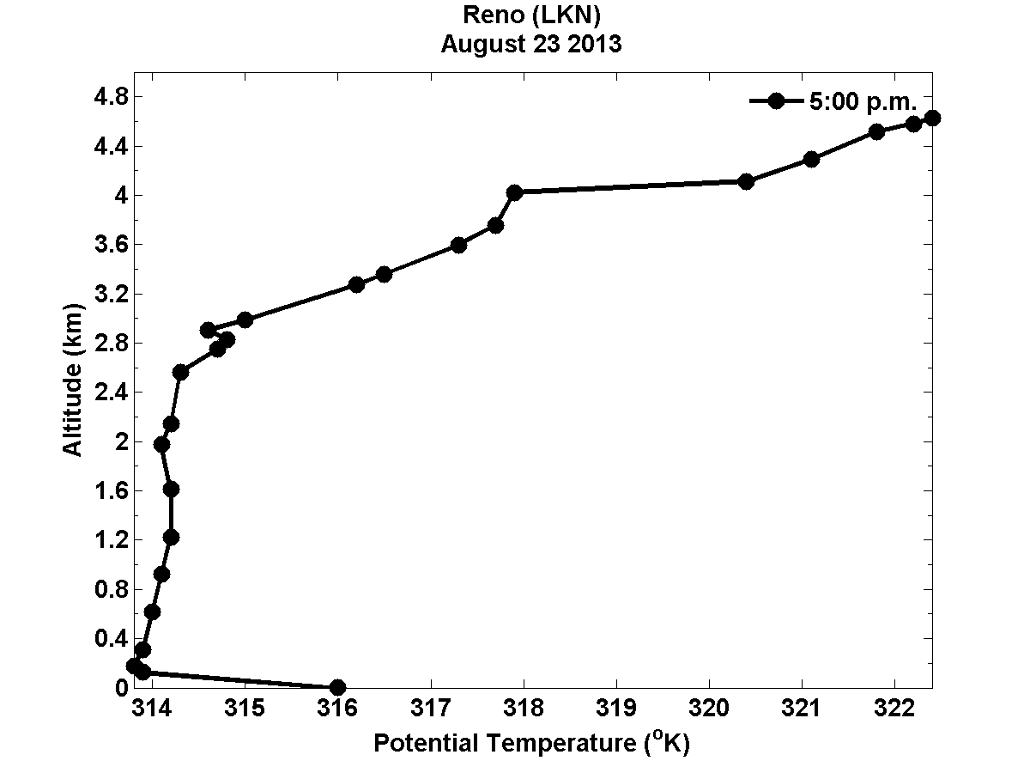
Planetary boundary layer
CBLH
5PM
Notes:
The transport physics of wildfire smoke plumes complicate the MODIS retrievals because the smoke plumes can travel at ground level or aloft with limited downward mixing to the surface. This transport is investigated using the planetary boundary layer height and the apparent optical height to characterize the extent of vertical mixing of the aerosol

Slide 8

Apparent Optical Height (AOH)
Estimates the height that aerosols can reach in the atmosphere
In-situ photoacoustic and reciprocal nephelometer: Surface β_{ext}
Ground-based sunphotometry: Columnar AOD
$$AOH\left(λ\right)= AOD\left(λ\right)/β_{ext}\left(λ\right)$$
Loria-Salazar (JGR, 2014)

Slide 9
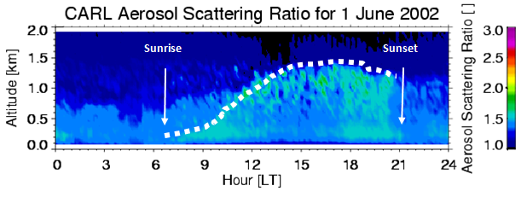
Apparent Optical Height (AOH)
Estimates the height that aerosols can reach in the atmosphere
In-situ photoacoustic and reciprocal nephelometer: Surface β_{ext}
Ground-based sunphotometry: Columnar AOD
$$AOH\left(λ\right)= AOD\left(λ\right)/β_{ext}\left(λ\right)$$
Loria-Salazar (JGR, 2014)
Raman Lidar Picture of the Convective Mixed Layer at the DOE ARM site in North Central Oklahoma. (Courtesy of Dr. David Turner)

Slide 10

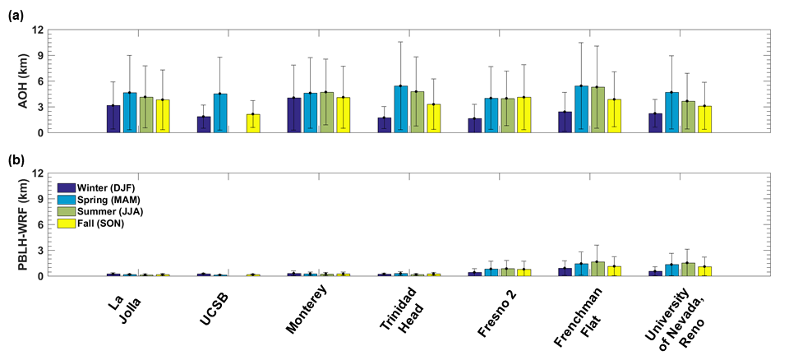
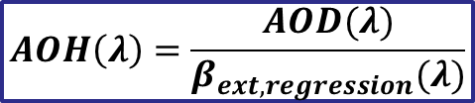
Apparent Optical Height (AOH)
California and Nevada, 2013
  Aerosols are not contained within the boundary layer
$$AOH\left(λ\right)=\frac{AOD(λ)}{β_{ext, regression}(λ)}$$
Loria-Salazar (Accepted Atmos. Environ, 2017)

Slide 11
Objectives and Hypotheses
Goal
Find covariates for the data fusion model that can improve the relationship between AOD & PM_{2.5} in the western U.S.
Objectives
Investigate the relationship between columnar AOD & PM_{2.5}
Hypotheses
Columnar AOD and surface PM_{2.5} will not be linearly correlated
Physical processes in the atmosphere can explain the behavior of AOD and PM_{2.5} in the western U.S.

Slide 12
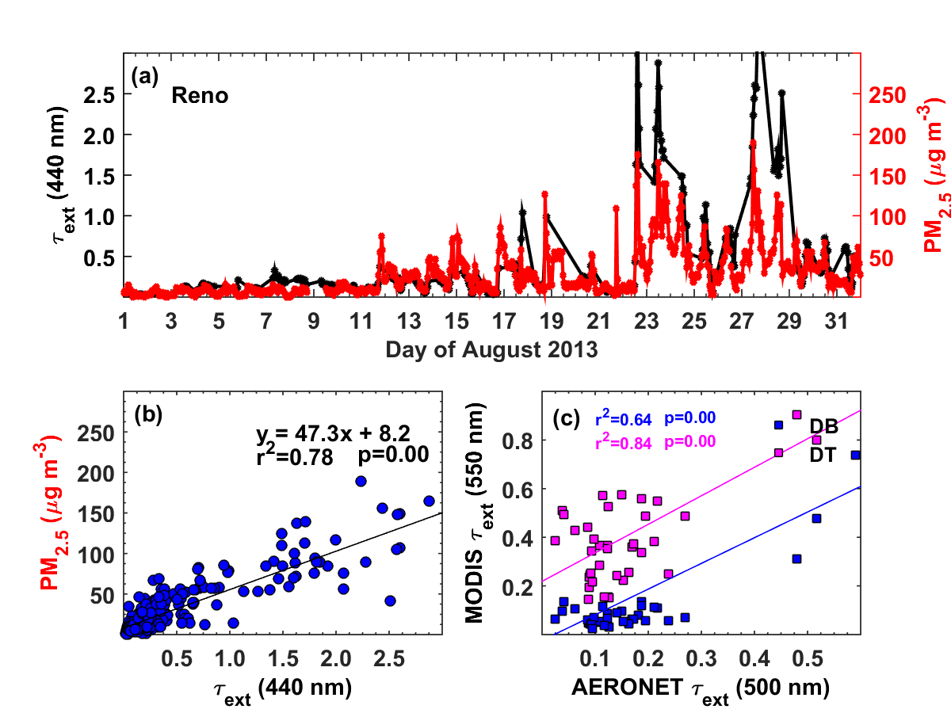
PM_{2.5}, AERONET and MODIS C6 AOD
Reno, NV, August 2013
AERONET AOD (440 nm)
MODIS AOD (500 nm)
AERONET AOD (440 nm)
AERONET AOD (500 nm)
Loria-Salazar et al., 2015 (CMAS 2015)

Slide 13
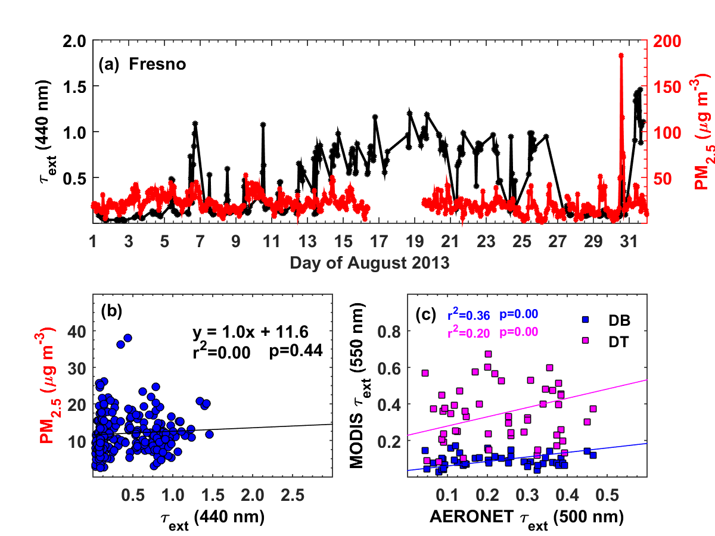
PM_{2.5}, AERONET and MODIS C6 AOD
Fresno, CA, August 2013
AERONET AOD (440 nm)
MODIS AOD (500 nm)
AERONET AOD (440 nm)
AERONET AOD (500 nm)
Loria-Salazar et al., 2015 (CMAS 2015)

Slide 14
HYSPLIT Back Trajectories: 31 Aug 2013
24 hour, NAM 12-km
Reno
Reno:
100m & 2000m near plume
Fresno:
4000m & 5000m near plume
100m & 500m west of plume, clean air
Fresno
Loria-Salazar et al., 2015 (CMAS 2015)
Notes:
The boundary layer physics and smoke transport can be investigated using backward air mass trajectories from the Hybrid Single Particle Lagrangian Trajectory (HySplit) model. In Figure 4 (right), the HySplit model trajectories are overlaid on the visible satellite image from MODIS. The visible image shows a smoke plume over Fresno on Aug. 31st 2013, however based on the data sown in the time series plot of AOD and PM2.5 it is evident that the plume does not reach ground level (i.e., AOD increases while surface PM2.5 is not elevated). The plume transport physics can be further investigated by looking at the heights of the HySplit trajectories.
The two trajectories from Fresno that pass over the smoke plume are at 4km and 5km, above the PBL height therefore the smoke plume is not mixed down to surface level. It is important to investigate both the complex smoke plume physics and emissions inventory uncertainties to improve the modeling for smoke plume transport and surface air quality prediction related to wildfire smoke emissions.

Slide 15
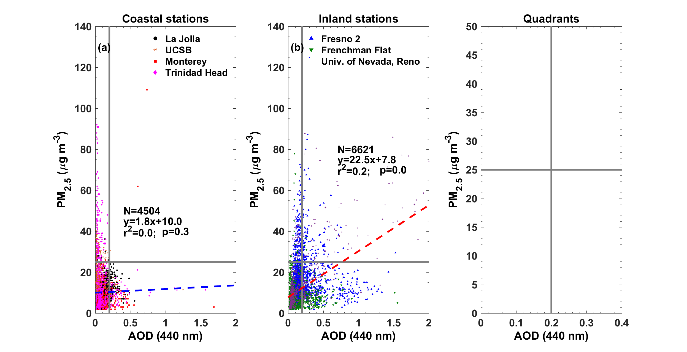
Columnar AERONET AOD vs surface PM_{2.5}
California and Nevada, 2013
AERONET AOD (440 nm)
AERONET AOD (440 nm)
Loria-Salazar (Accepted Atmos. Environ, 2017)

Slide 16
Columnar AERONET AOD vs surface PM_{2.5}
California and Nevada, 2013
AERONET AOD (440 nm)
AERONET AOD (440 nm)
AERONET AOD (440 nm)
Loria-Salazar (Accepted Atmos. Environ, 2017)

Slide 17
Columnar AERONET AOD vs surface PM_{2.5}
California and Nevada, 2013
Q-1
Low surface
Low column
AERONET AOD (440 nm)
AERONET AOD (440 nm)
AERONET AOD (440 nm)
Loria-Salazar (Accepted Atmos. Environ, 2017)

Slide 18
Columnar AERONET AOD vs surface PM_{2.5}
California and Nevada, 2013
Q-2
High
surface
Low
column
Q-1
Low surface
Low column
AERONET AOD (440 nm)
AERONET AOD (440 nm)
AERONET AOD (440 nm)
Loria-Salazar (Accepted Atmos. Environ, 2017)

Slide 19
Columnar AERONET AOD vs surface PM_{2.5}
California and Nevada, 2013
Q-2
Q-3
High
surface
Low
column
High
surface
High column
Q-1
Low surface
Low column
AERONET AOD (440 nm)
AERONET AOD (440 nm)
AERONET AOD (440 nm)
Loria-Salazar (Accepted Atmos. Environ, 2017)

Slide 20
Columnar AERONET AOD vs surface PM_{2.5}
California and Nevada, 2013
Q-2
Q-3
High
surface
Low
column
High
surface
High column
Q-1
Q-4
Low surface
Low column
Low
surface
High column
AERONET AOD (440 nm)
AERONET AOD (440 nm)
AERONET AOD (440 nm)
Loria-Salazar (Accepted Atmos. Environ, 2017)

Slide 21
Quadrant method
California and Nevada, 2013
AOD-PM_{2.5}
Physical variables
Q-1
Q-2
Q-3
Q-4

Slide 22
Quadrant method
California and Nevada, 2013
AOD-PM_{2.5}
Physical variables
Q-1
Q-2
Q-3
Q-4
Relationship

Slide 23
Quadrant method
California and Nevada, 2013
AOD-PM_{2.5}
Physical variables
Q-1
Q-2
Q-3
Q-4
Relationship
Associate

Slide 24
Quadrant method
California and Nevada, 2013
Categorize
AOD-PM_{2.5}
Physical variables
Q-1
Q-2
Q-3
Q-4
Relationship
Associate

Slide 25
Quadrant method
California and Nevada, 2013
Categorize
AOD-PM_{2.5}
Physical variables
Q-1
Q-2
Q-3
Q-4
Relationship
Associate
Is there any physical phenomenon that can explain the behavior of AOD and PM_{2.5} in the quadrants?

Slide 26
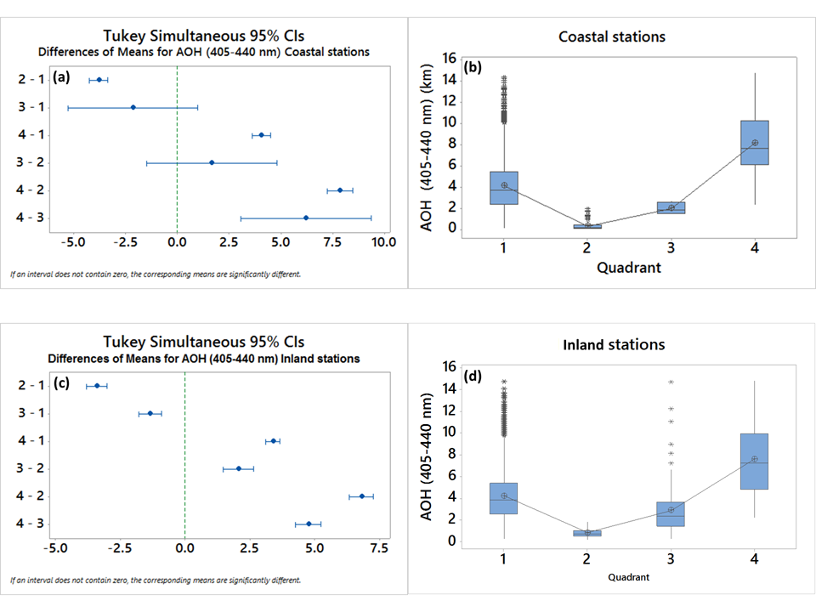
Quadrant method
California and Nevada, 2013
  Statistical approach
Find significant differences
between quadrants
1-way ANOVA
Loria-Salazar (Accepted Atmos. Environ, 2017)

Slide 27
Quadrant method
California and Nevada, 2013
  Statistical approach
Find significant differences
between quadrants
Variability in the quadrants
1-way ANOVA
Box and whisker plots
Loria-Salazar (Accepted Atmos. Environ, 2017)

Slide 28
Quadrant method
California and Nevada, 2013
  Statistical approach
Find significant differences
between quadrants
Variability in the quadrants
Variables
AEE (AERONET)
Fine and coarse fraction (AERONET)
PBLH (WRF)
AOH (model)
Temperature (weather station)
Relative humidity (weather station)
Wind speed (weather station)
1-way ANOVA
Box and whisker plots
Loria-Salazar (Accepted Atmos. Environ, 2017)

Slide 29
Columnar AERONET AOD vs surface PM_{2.5}
California and Nevada, 2013
Q-2
Q-3
(+) association
AOD
PM_{2.5}
increase together
No association
AOD
PM_{2.5}
Q-1
Q-4
(+) association
AOD
PM_{2.5}
increase together
No association
AOD
PM_{2.5}
AERONET AOD (440 nm)
Loria-Salazar (Accepted Atmos. Environ, 2017)

Slide 30
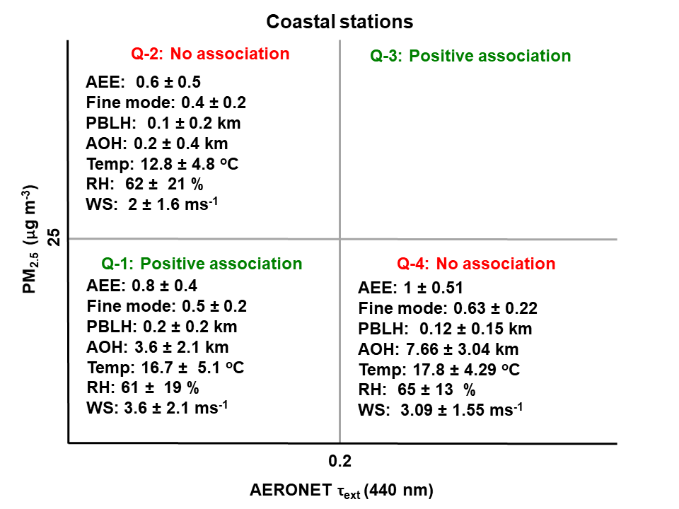


Quadrant method: Coastal stations
California and Nevada, 2013
Temperature inversion
Local sources of aerosol pollution
Long-range transport
AERONET AOD (440 nm)
Loria-Salazar (Accepted Atmos. Environ, 2017)

Slide 31
Quadrant method: Coastal stations
California and Nevada, 2013
AERONET AOD (440 nm)
Loria-Salazar (Accepted Atmos. Environ, 2017)

Slide 32
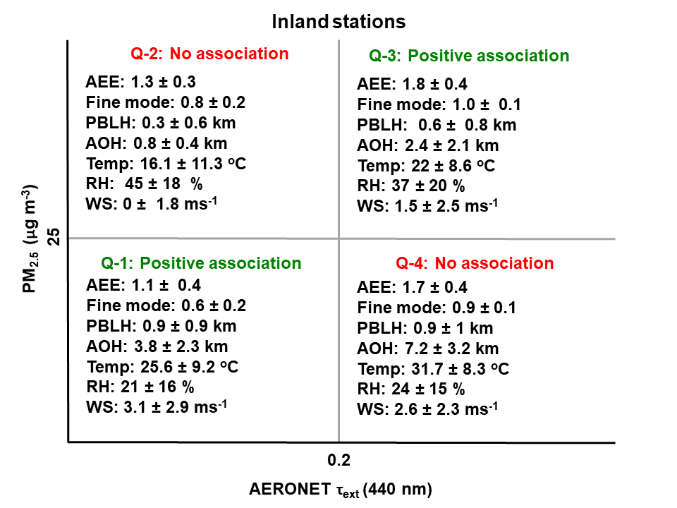
Quadrant method: Inland stations
California and Nevada, 2013
Temperature inversion
Fine particles
Local sources of aerosol pollution
Long-range transport and/or entrainment
AERONET AOD (440 nm)
Loria-Salazar (Under review Atmos. Environ, 2017)

Slide 33
Quadrant method: Inland stations
California and Nevada, 2013
AERONET AOD (440 nm)
Loria-Salazar (Accepted Atmos. Environ, 2017)

Slide 34
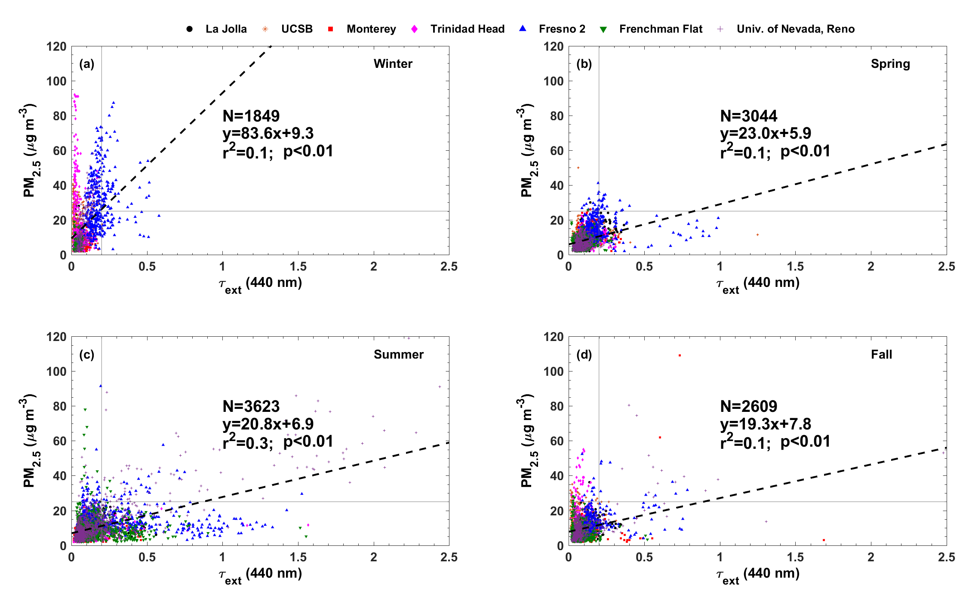
Quadrant method: Seasonal
California and Nevada, 2013
AERONET AOD (440 nm)
AERONET AOD (440 nm)
AERONET AOD (440 nm)
AERONET AOD (440 nm)
Loria-Salazar (Accepted Atmos. Environ, 2017)

Slide 35
Conclusions
Summary
Surface PM_{2.5} is not linearly correlated with columnar AOD
Multiple relationships between AOD and PM_{2.5} in California and Nevada
Atmospheric processes affect the relationship between AOD and PM_{2.5}
Quadrant method diagnoses atmospheric processes impacting AOD and PM_{2.5}
Local pollution sources in a well-mixed PBL leads to positive association
Stable PBL and long-range transport results in no association

Slide 36

Acknowledgments
Yellowstone/UCAR
We would like to acknowledge high-performance computing support from Yellowstone (ark:/85065/d7wd3xhc) provided by NCAR's Computational and Information Systems Laboratory, sponsored by the National Science Foundation.
NASA
This material is based upon work supported by NASA NESSF (NASA Earth and Science Student Fellowship) program under Cooperative Agreement No. NNX16AN94H.
Skylar Smith
Undergrad student

Slide 37
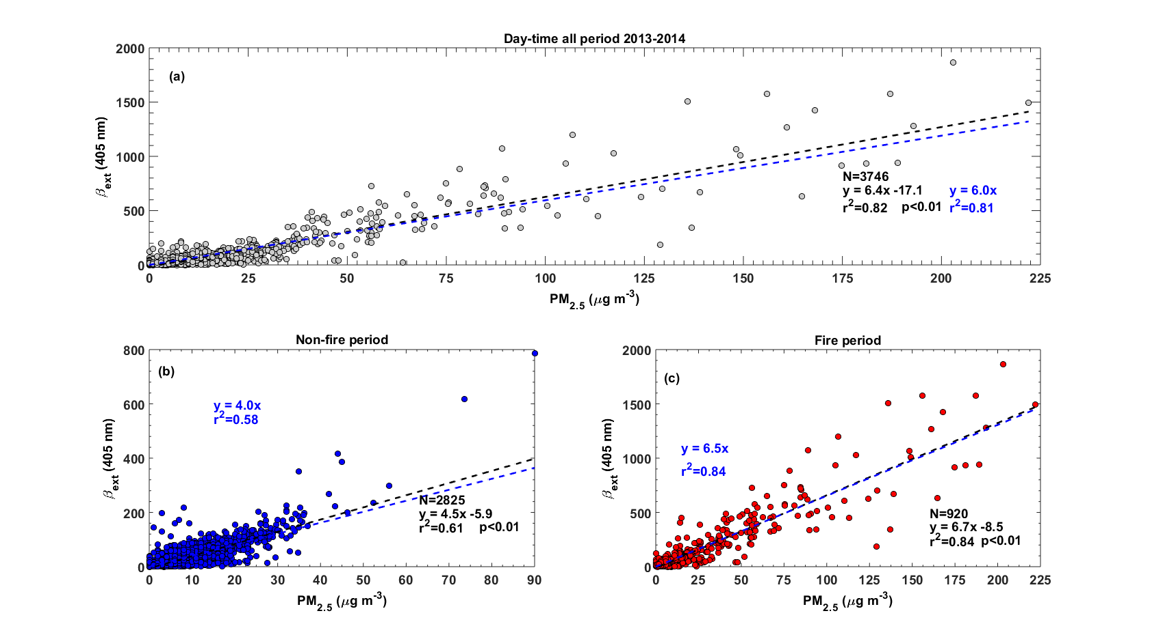
β_{ext} model from surface PM_{2.5}
Notes:
Health effects of ambient air quality
Georgia Birth Cohort
Geo-coded patient information
Atlanta - epidemiologic results using central monitor data suggest associations of acute health effects and mobile source emissions
Spatially resolved health study needs spatial air quality metrics

Slide 38
β_{ext} model from surface PM_{2.5}
Non-fire periods:
$$β_{ext}={\left(−{0.000408{ PM}_{2.5}}^{2}+0.07919 {PM}_{2.5}+1.6358\right)}^{1/{0.264033}}$$
Fire periods:
$$β_{ext}={\left(−{0.000205{ PM}_{2.5}}^{2}+0.06543 {PM}_{2.5}+2.1819\right)}^{1/{0.283988}}$$
Notes:
Health effects of ambient air quality
Georgia Birth Cohort
Geo-coded patient information
Atlanta - epidemiologic results using central monitor data suggest associations of acute health effects and mobile source emissions
Spatially resolved health study needs spatial air quality metrics

Slide 39
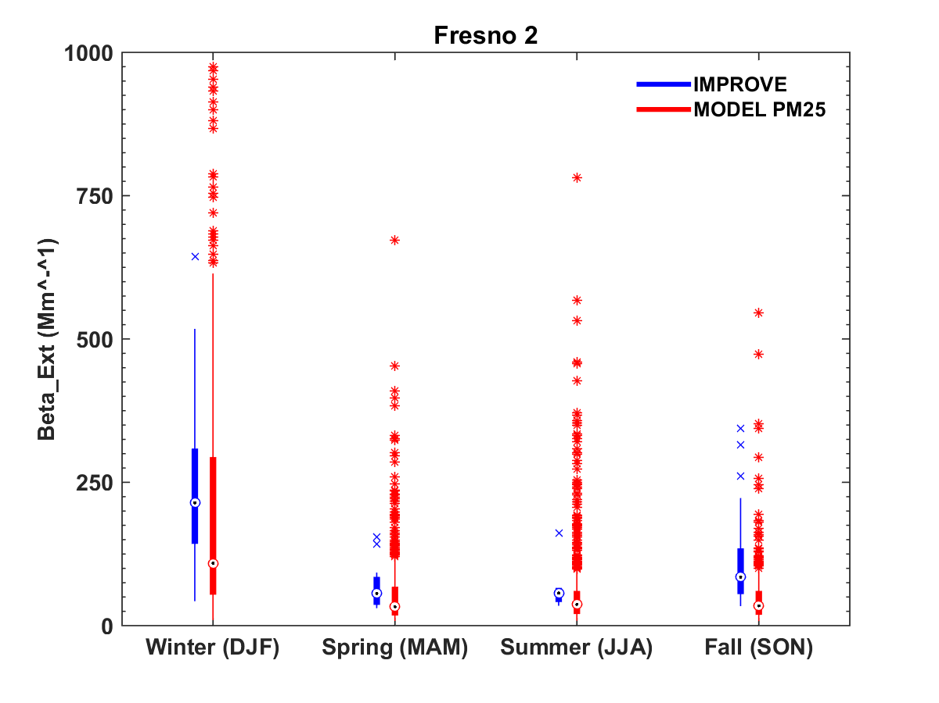
β_{ext} model from surface PM_{2.5}
Notes:
Health effects of ambient air quality
Georgia Birth Cohort
Geo-coded patient information
Atlanta - epidemiologic results using central monitor data suggest associations of acute health effects and mobile source emissions
Spatially resolved health study needs spatial air quality metrics

Slide 40
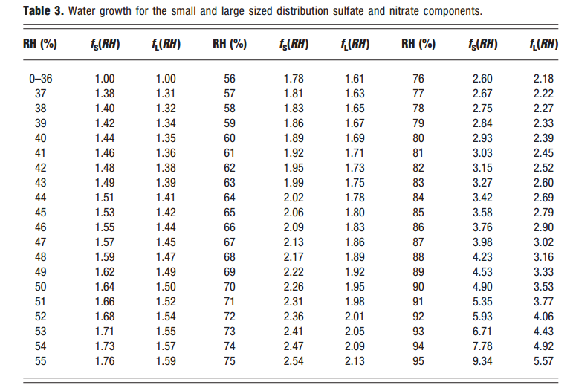
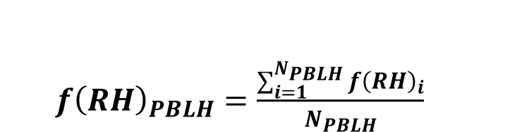
Potential hygroscopic growth
${f\left(RH\right)}_{PBLH}=\frac{\sum_{i=1}^{N_{PBLH}}{{f\left(RH\right)}_{i}}}{N_{PBLH}}$
Pitchford et al., 2012 (Research in progress)

Slide 41
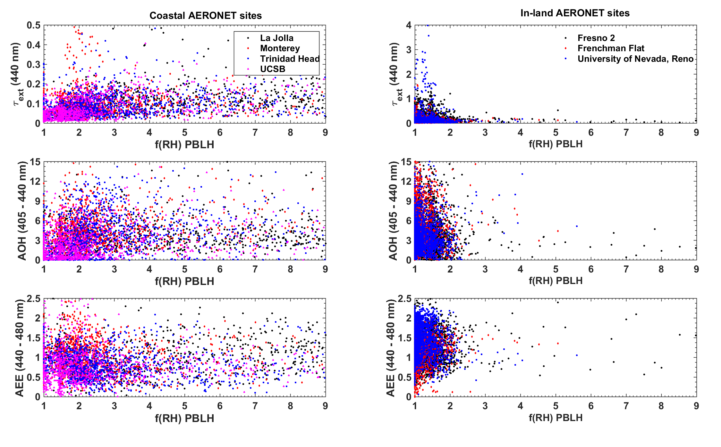
Potential hygroscopic growth
r²~0.17
r²<0.01

