Slide 1
Impact of Flare Emissions at Variable Operating Conditions on Air Quality in the Houston Region
Wenxian Zhang, Erin E. Tullos, Yongtao Hu,
Athanasios Nenes, Armistead G. Russell
CMAS Annual Meeting
Oct 29, 2014

Slide 2
Acknowledgements
Funding Support:
Phillips 66
U.S. EPA
Southern Company/
Georgia Power
Data Support:
Barry Exum with TCEQ
RD83479901

Slide 3
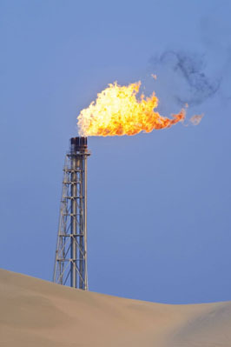
Flare Emissions in the HGB Area
Flares – widely used safety and control devices in the petrochemical industry
Flare emissions are assumed to be constant in current national emissions inventory.
Flare VOC emissions are highly variable with time and were found to be associated with rapid ozone buildup in the HGB area.
- e.g. Murphy and Allen, 2005, Webster et al., 2007

Slide 4
Factors Impacting Flare VOC Emissions
Total flare VOC emissions, including unburned and partially-burned vent gas, is calculated as
Two factors affecting flare VOC emissions:
Vent gas flow rate (VG)
Combustion efficiency (CE), which is not always higher than 98% (Torres et al., 2012; Allen and Torres 2011), and can be affected by factors such as
- Vent gas flow rate
- Assist steam flow rate
- Assist air flow rate

Slide 5
Air Quality Impact of Flare VOC Emissions
Previous studies focused on addressing the impact of temporally variable vent gas flow rate on ozone concentrations (e.g. Pavlovic et al., 2012; Webster et al., 2007; Nam et al., 2006)
- Flare VOC emissions were generated by stochastic models.
- The add-on ozone can be up to ~50 ppb, but the increase in daily maximum ozone is less than 10 ppb.
Recent flare test results indicated that combustion efficiency is the key parameter to determine flare VOC emissions.
This study focused assessing flare combustion efficiency variation and flare emissions impact under various operating conditions using CMAQ and its sensitivity techniques.

Slide 6
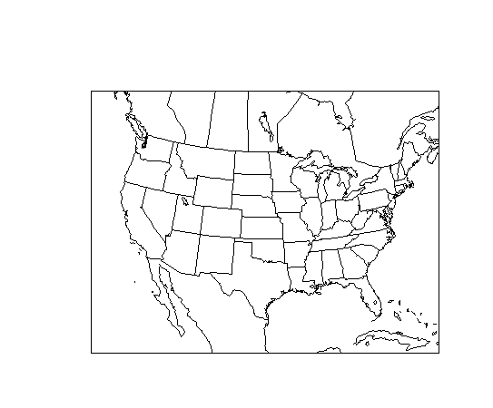
CMAQ Modeling in the HGB Area
Modeling domain
- Nested 4x4km grids
- Southeastern Texas
Episode
- Aug 10 – Sep 14, 2006
Modeling system
- SMOKE v2.6
- WRF v3.0
- CMAQ v4.7.1 with HDDM
Emissions Inventories
- 2005 NEI
- Designed emissions scenarios for the model flare
12x12 km
36x36 km
4x4 km

Slide 7
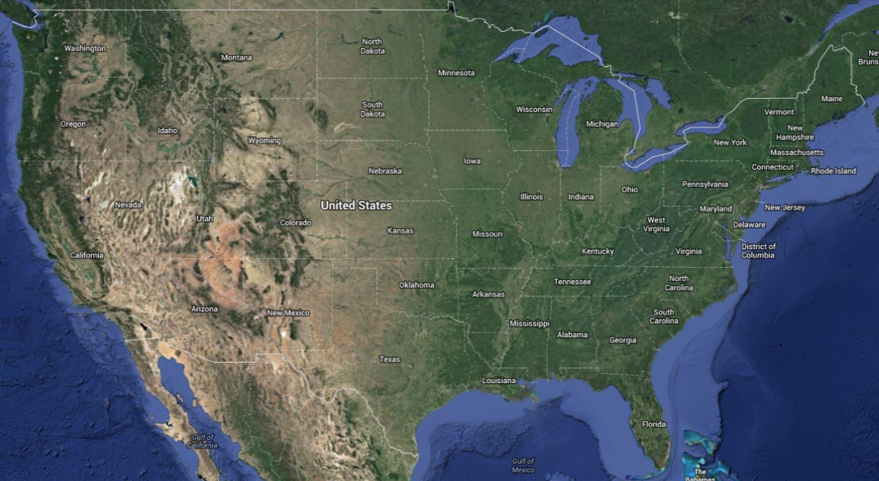
CMAQ-HDDM3D
HDDM – high-order decoupled direct method
Gives first- and second-order sensitivities of pollutant concentrations to parameters, e.g., emissions rate, at the same time simulating concentrations and in the same dimensions of concentrations (Yang et al., 1997; Hakami et al., 2003; Napelenok et al., 2006; Zhang et al., 2012).
C*
ΔC
ΔC
ΔC
ΔC
ΔC
ΔC
ΔC
ΔC
ΔC
ΔC
ΔC
ΔC
ΔC
ΔC
C₀
ΔC
ΔC
ΔC
ΔC
ΔC
ΔC
ΔC
ΔC
ΔC
ΔC
ΔC
ΔC
ΔC
ΔC
ΔC
ΔC
ΔC
ΔC
ΔE
ΔC
ΔC
ΔC
δE
ΔC
ΔC
ΔC
ΔC
ΔC
ΔC
ΔC
E₀
E
Forward Sensitivity

Slide 8
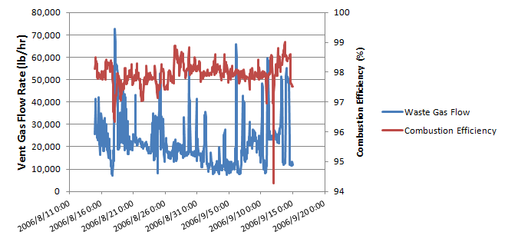
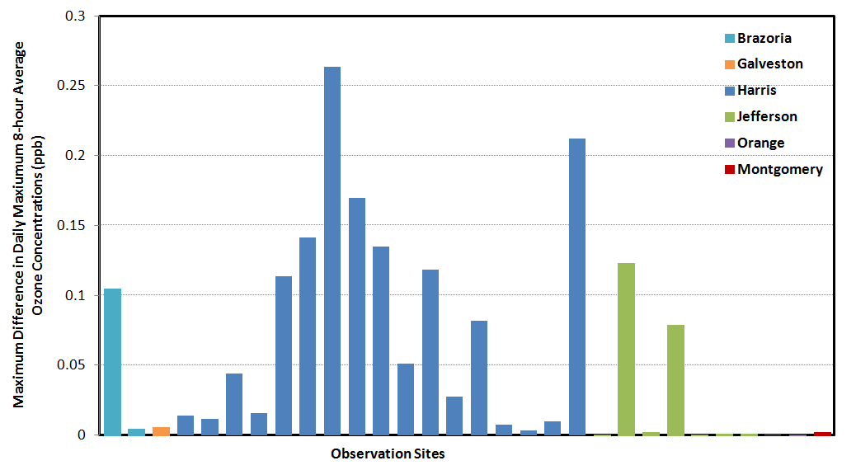
Flare Emission Impact under Three Common Operating Modes
Continuous Flow
Vent Gas Flow Rate
Use the VOC emissions based on the hypothetical vent gas flow and combustion efficiency for the model flare
CE = 98%
CE(t)
Base VOC Emissions
Control VOC Emissions
ΔE_{VOC}
DDM
Maximum Difference in
Daily Maximum 8hO3 at 30 monitoring sites
ΔC_{ozone}

Slide 9
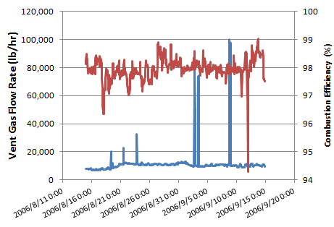
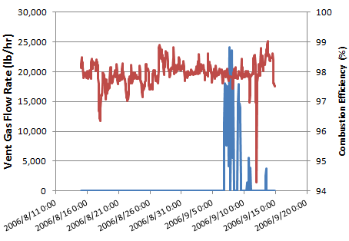
Continuous Flow with Partial Flare Gas Recovery
Intermittent Use Flow

Slide 10
Changes in Flare Emissions Impact with Assist Steam
Use the reported VOC emissions in 2006 Texas special inventory (TCEQ 2010; Pavlovic et al., 2009) for the model flare
Run CMAQ-HDDM3D with 12 sensitivity parameters, and use each parameter to represent flare VOC emissions at a two-hour block
Construct a reduced form model (RFM) that is dependent on the changes in VOC emissions at each hour in the past 24 hours
The changes in VOC emissions at each hour is determined by the flow rate of assist steam
Reduced Form Model
Changes in flare VOC emissions at hour j
O₃(t)
t₁
t₂
……
……
t_{i}
E(t)

Slide 11
How to Determine Δε?
Vent Gas
Flow Rate (VG)
E_{VOC,base}
Assist Steam
Flow Rate (S)
CZNHV
CE
E_{VOC,control}
∆ε
Vent Gas
Flow Rate (VG)
Combustion Zone Net Heating Value
VG – flare vent gas flow rate of the model flare, obtained from 2006 Texas Special Inventory (TCEQ 2010; Pavlovic et al., 2009)
S – assist steam flow rate, obtained from TCEQ 2011-2012 HRVOC Flare Survey
NHV_{VG} – flare vent gas net heating value, obtained from TCEQ 2011-2012 HRVOC Flare Survey
Combustion Efficiency
Fitted curve based on TCEQ 2011-2012 HRVOC Flare Survey, obtained from presentation “Modeling Flare Destruction and Removal Efficiency” by Jim Smith on Oct 23, 2012.

Slide 12
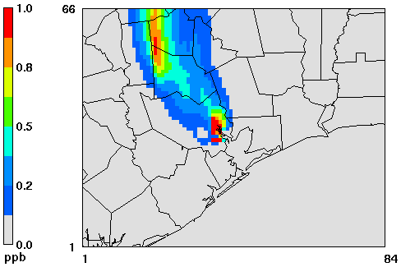
Maximum Add-On Ozone
The add-on 8-hour average ozone concentration at a grid can be as high as 10 ppb, but the maximum add-on ozone does not necessarily occur at the grid with the daily maximum ozone concentration.
Maximum add-on ozone = 10 ppb
Base ozone concentration = 29 ppb

Slide 13
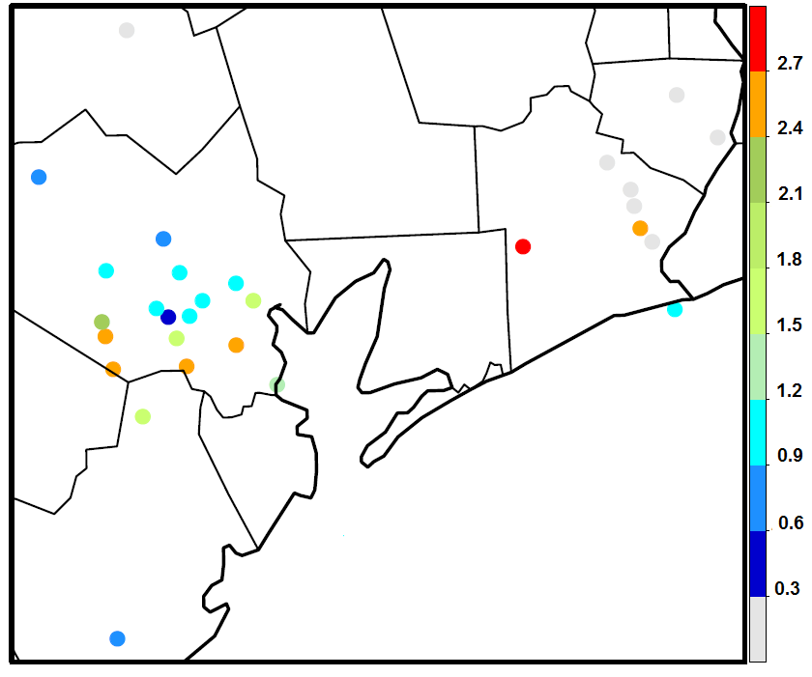
Impact on Daily Maximum 8hrO3
Maximum Increase in DM8hO3 at 30 monitoring sites
- Maximum increase = 3 ppb
- Mostly affected monitors in Harris County; can affect monitors in Jefferson County if meteorological condition favors
◆
ppb

Slide 14
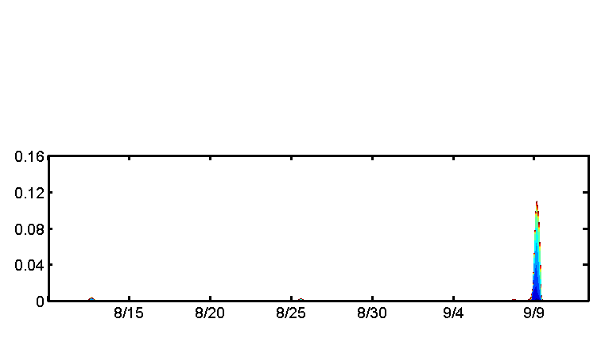
Time Series of Flare Emissions Impact at Different Hours
Houston Croquet
Max = 0.16 ppb
Source Contributions to 8-h Ozone (ppb)
8/19
8/24
8/29
9/3
9/8
9/13
Port Arthur West
Max = 0.10 ppb
8/19
8/24
8/29
9/3
9/8
9/13
Date

Slide 15
Conclusions
Emissions impact of a single flare has been estimated using CMAQ-HDDM3D.
Three common flare operating modes: continuous use flares without or with partial flare gas recovery lead to larger increases in ozone concentrations than intermittent use flares.
Impact of assist steam: the amount of steam addition had a discernible effect on the simulated ozone concentration, with the largest modeled increase in daily maximum 8-hour average ozone at any monitoring site found to be ~3 ppb, which occurred at a monitor in Jefferson County.
Flare VOC emissions during morning hours have the most significant impact on monitors near the source, while flare VOC emissions during night hours have the most significant impact on remote monitors.

Slide 16
Thanks for your attention!
Questions?

