Slide 1
Understanding sources of organic aerosol during CalNex 2010 using the CMAQ-VBS
Matthew Woody¹, Kirk Baker¹, Patrick Hayes², Jose Jimenez³, and Havala Pye¹
¹U.S. EPA
²Université de Montréal
³University of Colorado
13th Annual CMAS Conference
October 27-29, 2014

Slide 2
Motivation
41% of the measured submicron aerosol mass at Pasadena was organic during CalNex
> 70% of midday OA is estimated to be secondary in Pasadena, CA (Hayes et al., JGR, 2013)
CMAQ traditionally underpredicts SOA (Foley et al., GMD, 2010; de Gouw et al., JGR, 2008; Volkamer et al., GRL, 2006)
OA measurements collected during CalNex (AMS, ¹⁴C) provide unique opportunity to evaluate CMAQ with the volatility basis set (CMAQ-VBS) (Koo et al., AE, 2014)

Slide 3
CMAQ-VBS
Organic aerosols lumped based on volatility
  4 basis sets in CMAQ-VBS
    Primary anthropogenic and biogenic [biomass burning (BBOA)]; secondary anthropogenic and biogenic
    5 bins for each basis set (C* values of 10⁰ to 10³ µg m⁻³ plus 1 non-volatile bin)
Primary organic aerosols (POA) treated as semi-volatile (SVOCs) and aged
Anthropogenic secondary organic aerosols (SOA) aged
Includes SOA formation pathway from intermediate volatility organic compounds (IVOCs)
  IVOC emissions = 1.5 x SVOC emissions

Slide 4
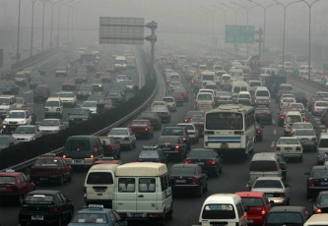
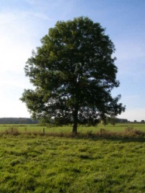
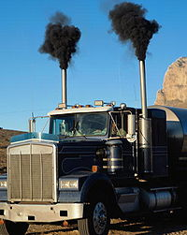
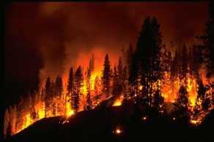
Schematic of CMAQ-VBS OA Module
Oxidation
IVOCs
Oxidation
Aromatics
SV_ASOA1
SV_ASOA2
SV_ASOA3
SV_ASOA4
Alkanes
ASOA0
ASOA1
ASOA2
ASOA3
ASOA4
POA0
POA1
POA2
POA3
POA4
SV_POA1
SV_POA2
SV_POA3
SV_POA4
Aging
Aging
SV_BSOA1
SV_BSOA2
SV_BSOA3
SV_BSOA4
Aging
BBOA0
BBOA1
BBOA2
BBOA3
BBOA4
BSOA0
BSOA1
BSOA2
BSOA3
BSOA4
VOC Emissions
Oxidation
Isoprene
Terpenes
SV_BBOA1 SV_BBOA2
SV_BBOA3 SV_BBOA4
Biomass Burning POA Emissions
POA Emissions
VOC Emissions

Slide 5
CMAQ-AE6 vs. CMAQ-VBS
 | AE6 | VBS
POA | Non-volatile Aged | Semi-volatile Aged Distinct volatility splits for POA emissions from gas, diesel, non-volatile, and “other”
SOA | Precursor specific products (e.g. ATRP1, ATRP2) Oligomerized (biogenic and anthropogenic) | Products (biogenic and anthropogenic) lumped based on volatility (e.g. A_AVB0 – A_AVB4, A_BVB0 – BVB4) Aged (anthropogenic only) IVOC formation pathway
BBOA | Lumped with POA | Tracked separately from POA Aged

Slide 6
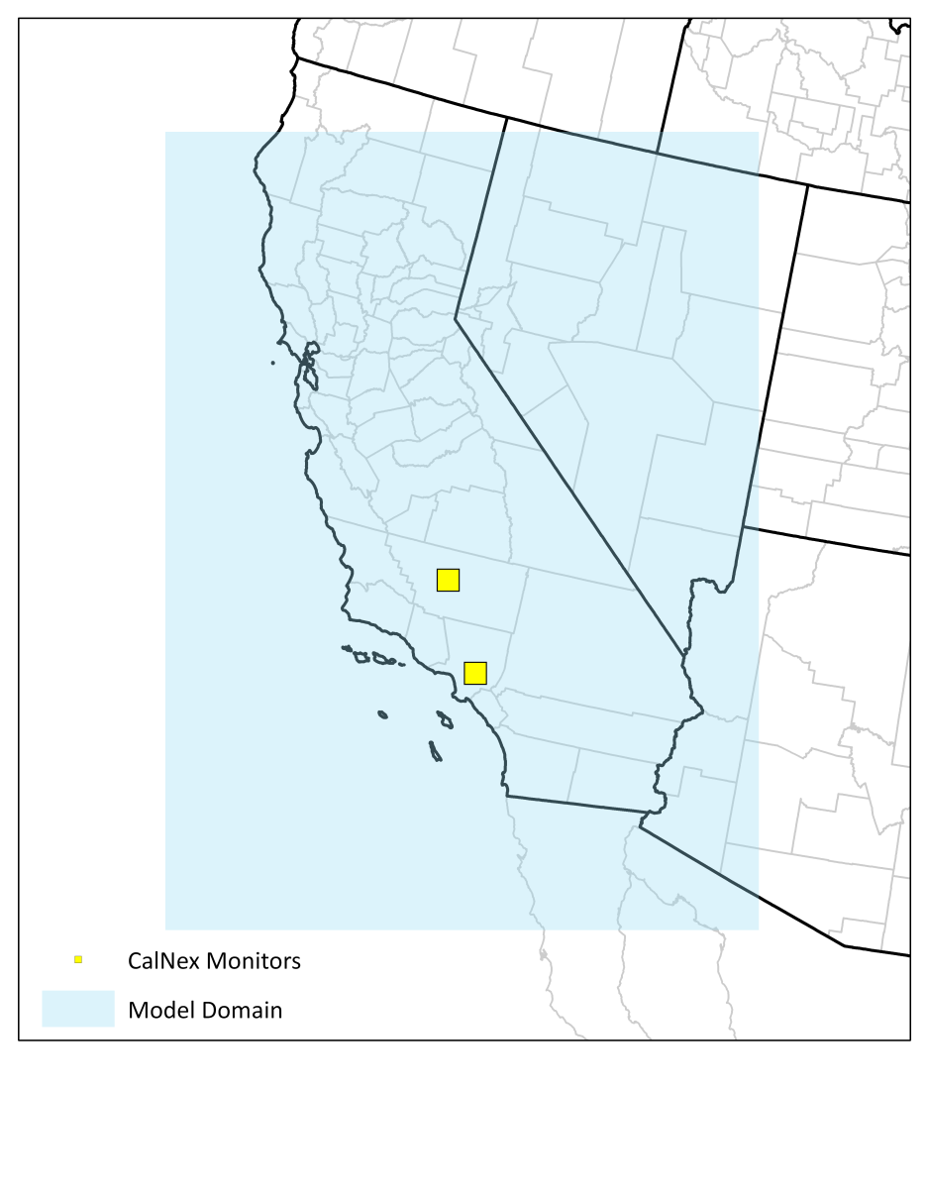
Model Setup
CMAQ v5.0.2
  CB05
  AERO6 + VBS
4 km grid resolution
May and June, 2010
2011 NEI v1
POA + SVOC emissions = NEI POA (no scaling), IVOC = 1.5 x POA
Added basis set for meat cooking + ability to track POA from gas, diesel, meat cooking, and “other” sources separately
Bakersfield
Pasadena

Slide 7
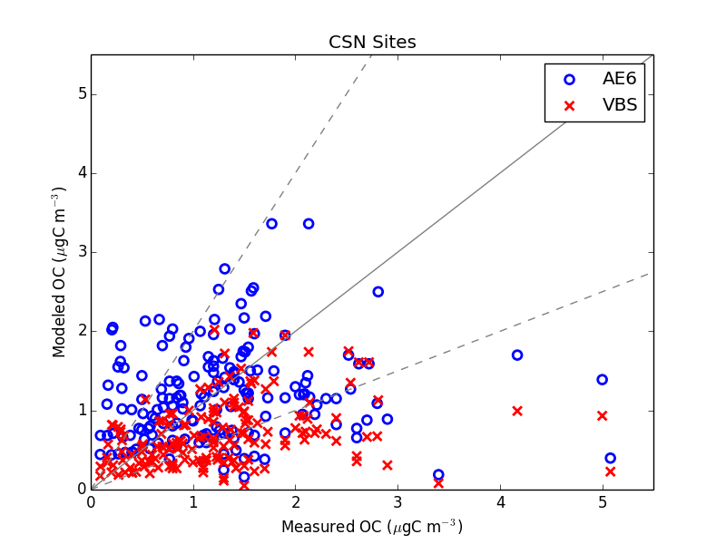
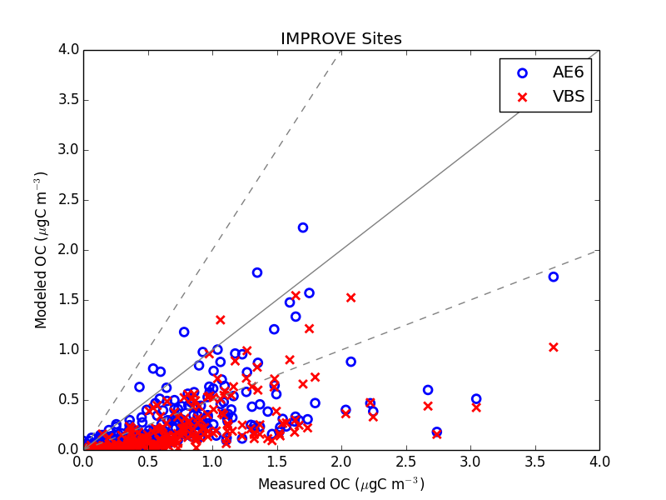
CMAQ-AE6 and CMAQ-VBS OC Model Performance
 |  | NMdnB (%) | NMdnE (%)
CSN | AE6 | 9.9 | 43.9
 | VBS | -25.5 | 36.5
IMPROVE | AE6 | -55.7 | 57.6
 | VBS | -63.9 | 64.6
CMAQ-AE6 OC performance better at CSN and IMPROVE sites

Slide 8
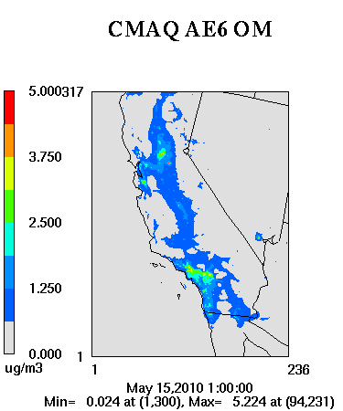
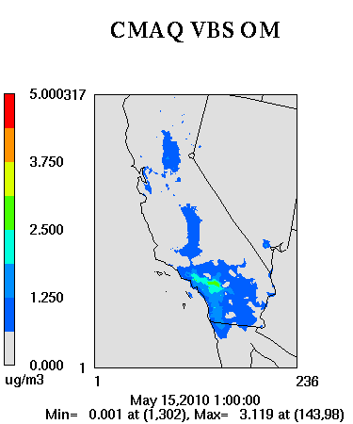
Organic Matter (OM)
Lower OM concentrations with CMAQ-VBS

Slide 9
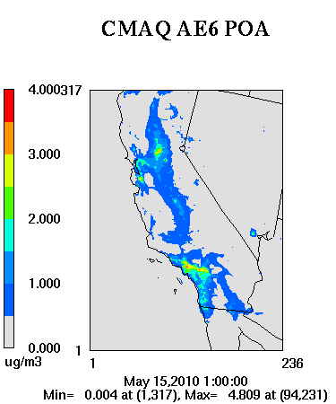
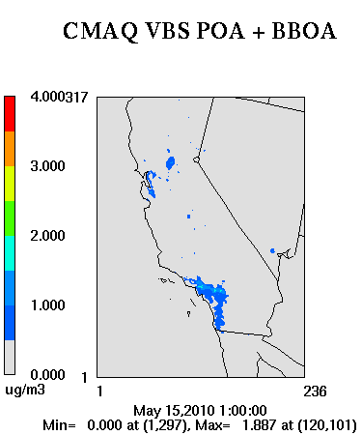
POA (VBS POA + BBOA)
CMAQ-VBS semi-volatile POA treatment lowers POA concentrations considerably

Slide 10
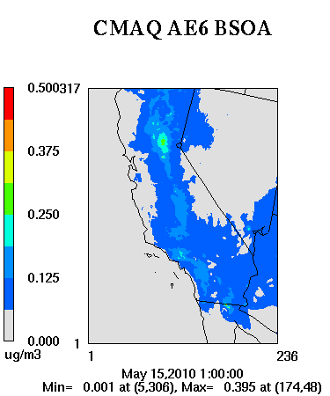
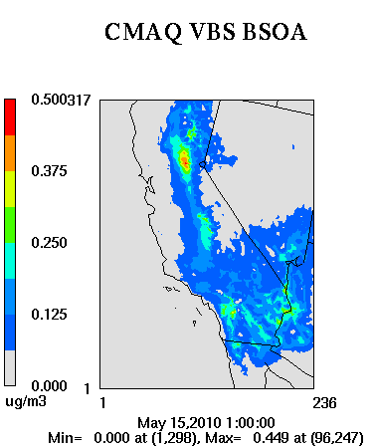
Biogenic SOA
Biogenic SOA comparable between two OA schemes
Notes:
CMAQ-VBS includes Nox dependent yields for TERP and ISOP (plus OH, O3, NO3)

Slide 11
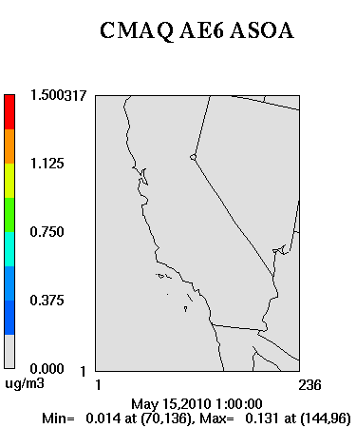
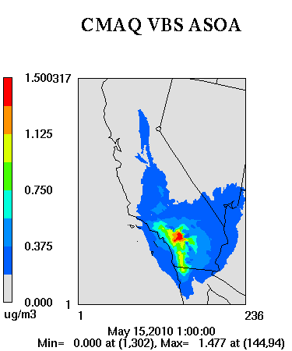
Anthropogenic SOA
CMAQ-VBS produces considerably more anthropogenic SOA (~10x)

Slide 12
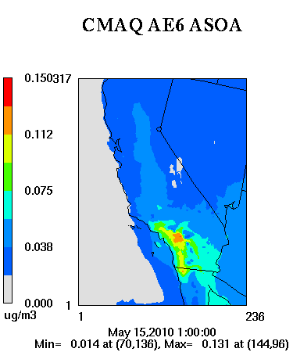
Anthropogenic SOA
x10
CMAQ-VBS produces considerably more anthropogenic SOA (~10x)

Slide 13
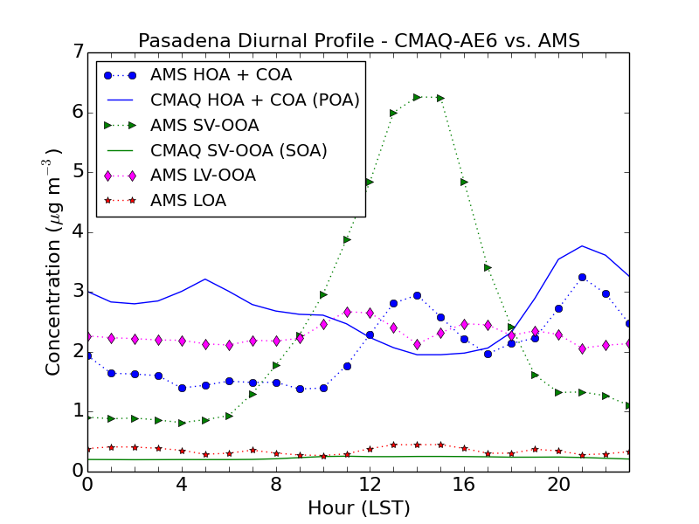
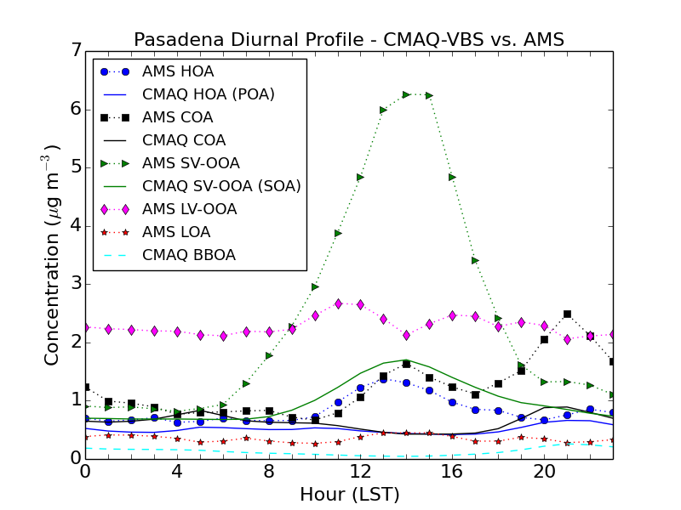
Comparison with AMS Measurements (Pasadena)
CMAQ-AE6
CMAQ-VBS
CMAQ-AE6 overpredicts POA (AMS HOA) and underpredicts SOA
CMAQ-VBS better represents SOA diurnal profile [but peak still 4.6x lower than measured peak SOA (LV-OOA + SV-OOA)]
Notes:
Dual peak of meat cooking consistent across multiple measurement studies
CMAQ captures evening meat cooking peak (collapse of PBL)
CMAQ-VBS misses afternoon peak of COA and POA and evening peak of HOA

Slide 14
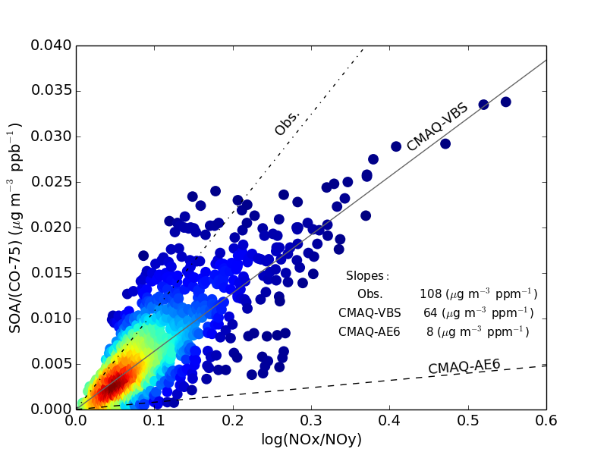
CMAQ-VBS SOA/ΔCO vs. Photochemical Age (log NOx/NOy) (Pasadena)
CMAQ-VBS SOA/ΔCO vs. photochemical age (fairest comparison of model vs. observations) ~1.7x lower than observations (108 μg m⁻³ ppm⁻¹);
CMAQ-AE6 ~13.5x lower

Slide 15
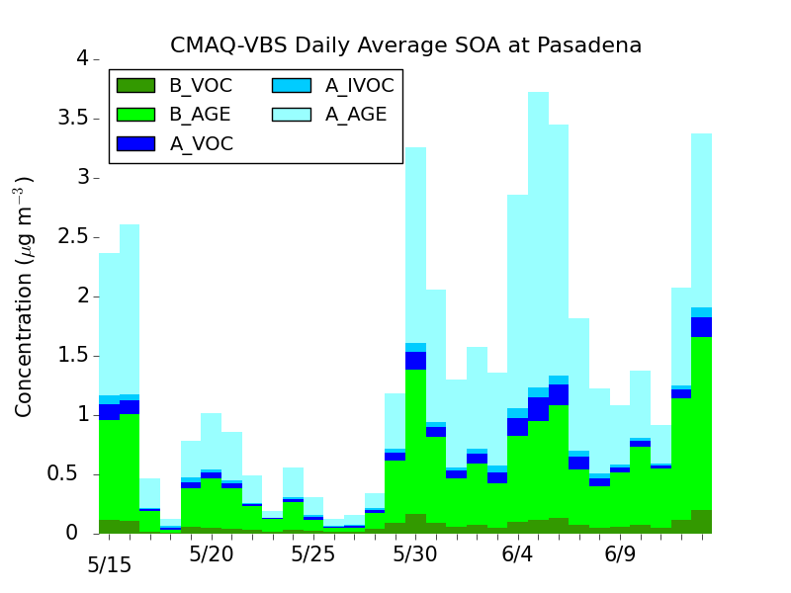
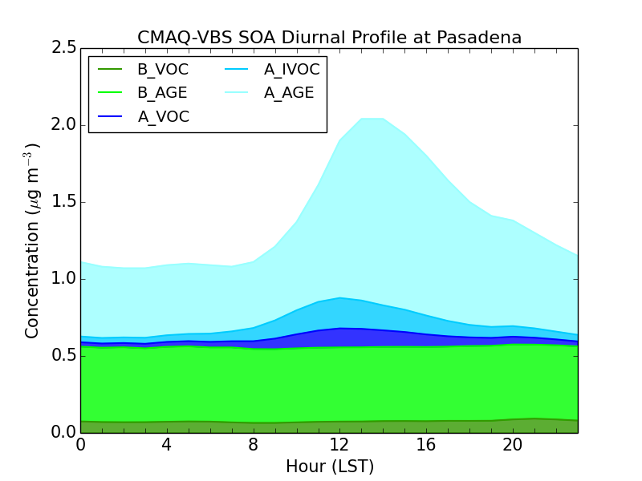
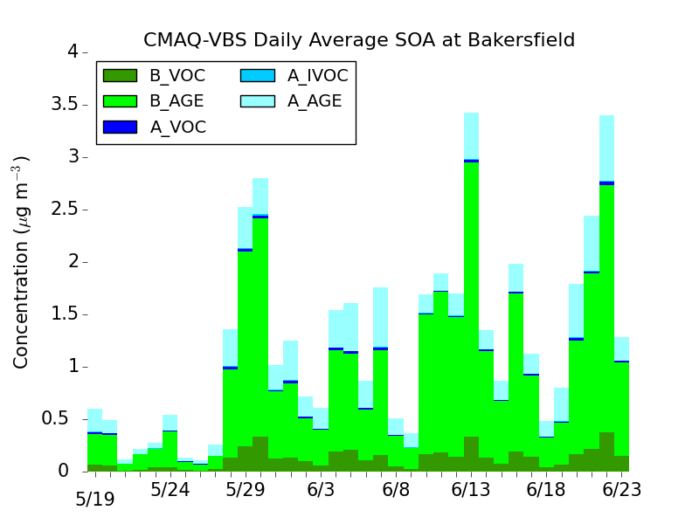
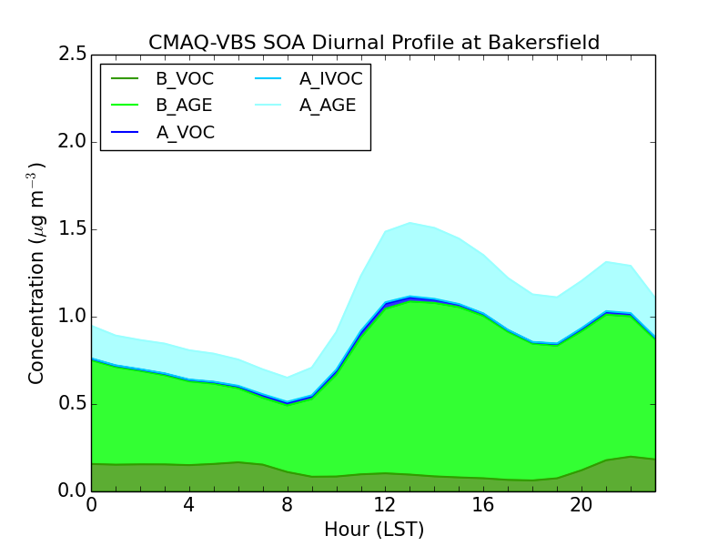
CMAQ-VBS SOA Contributions (Pasadena)
Daily Average
Diurnal Profile
Anthropogenic Aging
Pasadena
Anthropogenic
Aging
Biogenic Aging
Biogenic
Aging
Anthropogenic Aging
Bakersfield
Biogenic Aging
CMAQ-VBS SOA formed from VOCs (A_VOC and B_VOC) comparable to CMAQ-AE6. Most CMAQ-VBS SOA formed from aging [A_AGE and B_AGE (sensitivity test)]

Slide 16
CMAQ-VBS POA Source Apportionment
Diesel x 10
Gas
1.20
0.120
0.105
1.05
0.090
0.90
0.075
0.75
0.060
0.60
0.045
0.45
0.030
0.30
0.015
0.15
0.000
0.00
μg m⁻³
μg m⁻³
Meat Cooking
1.20
Other
1.20
1.05
1.05
0.90
0.90
0.75
0.75
0.60
0.60
0.45
0.45
0.30
0.30
0.15
0.15
0.00
0.00
μg m⁻³
μg m⁻³
Majority of POA in LA attributed to meat cooking (at Pasadena: ~55% meat cooking, 21% gas, 15% other, and 9% diesel)

Slide 17
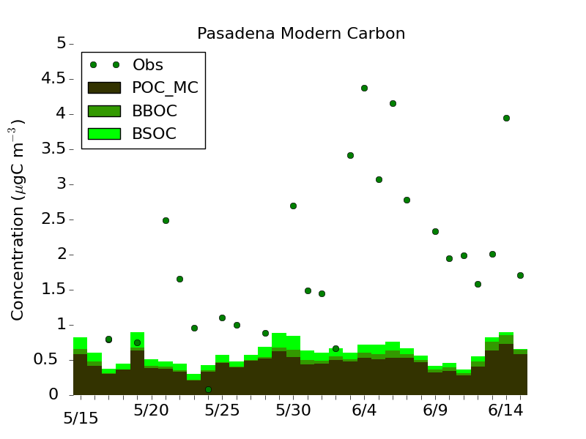
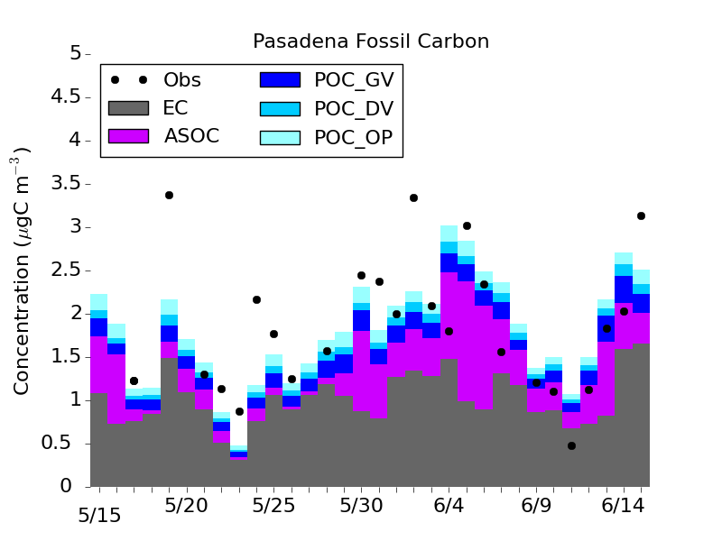
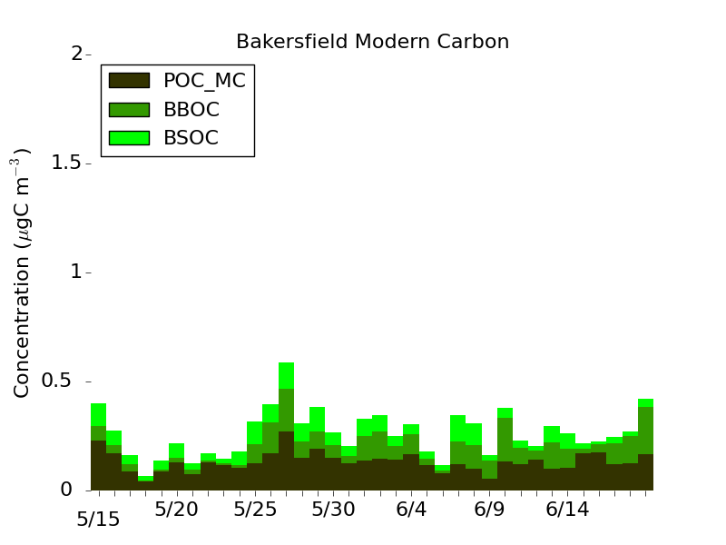
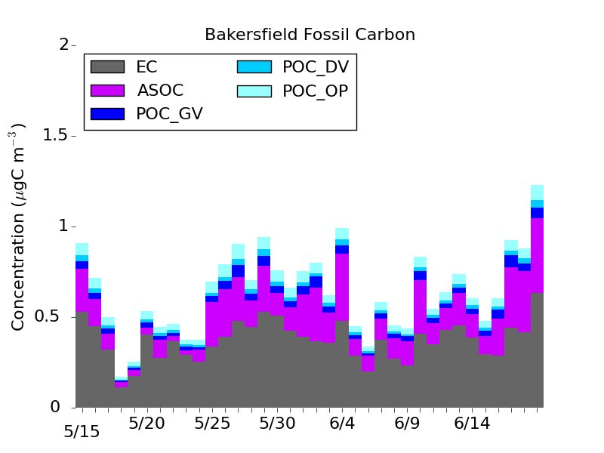
Non-Fossil vs. Fossil Carbon
Non-Fossil
Fossil
Pasadena
Bakersfield
CMAQ-VBS overpredicts (underpredicts) fossil (non-fossil) fraction (obs ~50/50 split); however likely positive bias in non-fossil measurements
Notes:
Days with non-fossil fraction > 1 removed (thought to be days when medical incinerator plume passed by measurement site). Suggests other days likely had a positive non-fossil bias as plume didn’t hit site directly but may still have impacted measurements

Slide 18
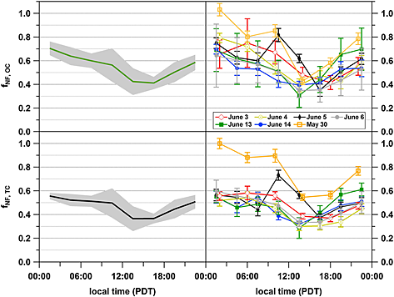
Non-Fossil Fraction (Pasadena)
CMAQ-VBS
Obs.
CMAQ-VBS captures diurnal profile of non-fossil fraction well but biased low
Non-Fossil Fraction (OC)
Non-Fossil Fraction (TC)
(Zotter et al., JGR, 2014)

Slide 19
Conclusions
CMAQ-AE6 OC performance better at routine networks (CSN, IMPROVE)
  CMAQ-VBS underpredicts OC due to semi-volatile treatment of POA
CMAQ-VBS better represents SOA/POA split at Pasadena
  CMAQ-VBS semi-volatile POA compares favorably to AMS HOA
  Majority of SOA mass formed from aging
  SOA still underpredicted (~4.6x compared to AMS peak)
    VOCs generally well represented (Baker et al., ACP, in prep.)
    Photochemical age ~1.7x too low
    Yields ~2.7x too low, within 4x uncertainty reported by Zhang et al. (PNAS, 2014)
Majority of POA at Pasadena attributed to meat cooking
CMAQ-VBS overpredicts fossil C and underpredicts non-fossil C
Notes:
Which model to use when. Ae6 for total OA mass, VBS for SOA and SOA/POA split
Future work to examine contributions of SOA formed from unspeciated VOCs from gas and diesel vehicles

Slide 20
Acknowledgements
John Offenberg, U.S. EPA
This project was supported in part by an appointment to the Internship/Research Participation Program at the Office of Research and Development, U.S. Environmental Protection Agency, administered by the Oak Ridge Institute for Science and Education through an interagency agreement between the U.S. Department of Energy and EPA.

Slide 21
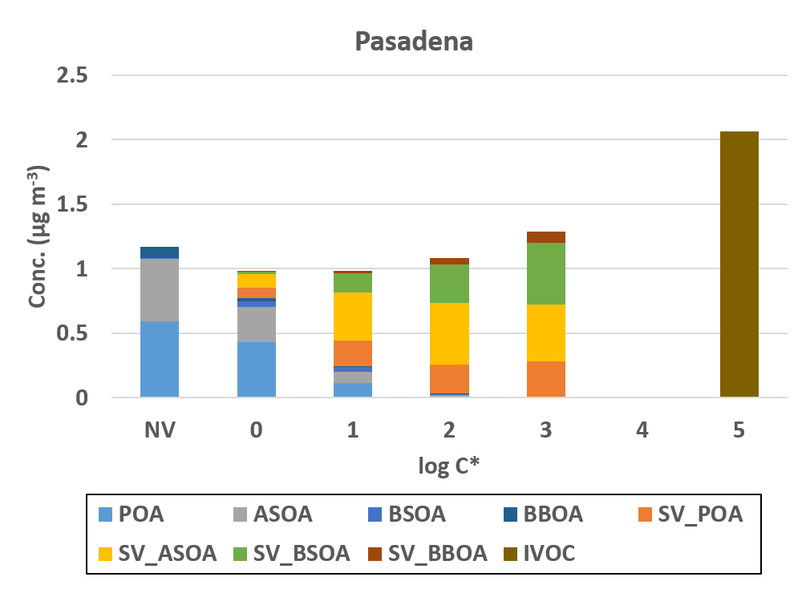
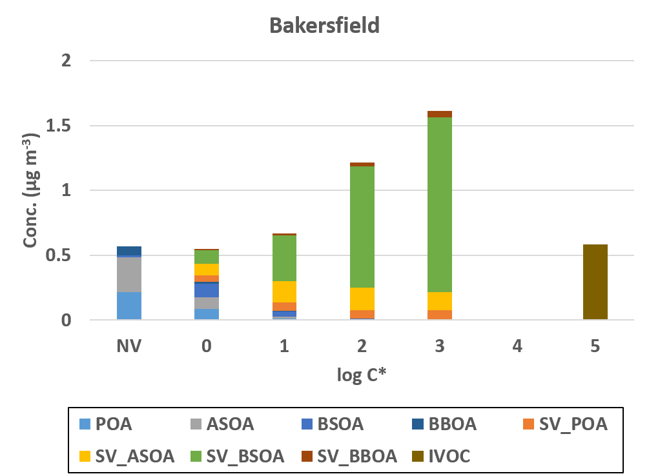
CMAQ-VBS Volatility Distribution
Wider range of volatilities represented in CMAQ-VBS.
Majority of CMAQ-AE6 OA mass (not shown) in 2-3 bins (NV, 10¹, 10²) (Baker et al., ACP, in prep.)

