Slide 1
Application and Evaluation of MODIS LAI, fPAR, and Albedo Products in the WRF/CMAQ System: Meteorology Simulations
Limei Ran^{1,2}, Robert Gilliam³, Frank Binkowski², Aijun Xiu², Larry Band², Jonathan Pleim³
¹Ph.D. Candidate, Curriculum for the Environment and Ecology, UNC-Chapel Hill, NC
²Institute for the Environment, UNC-Chapel Hill, NC
³Atmospheric Modeling and Analysis Division, ORD NERL/USEPA, Research Triangle Park, NC

Slide 2
Outline
Background
Objective
WRF Simulations and Analysis
CMAQ Simulations and Analysis
Conclusions and Ongoing Work

Slide 3
Background
LAI, vegetation fraction, albedo - important parameters in WRF/CMAQ
LAI and VegF -> surface LH/H partitioning and deposition
Albedo -> surface energy budget and photolysis rates
Stored in LSM lookup tables with some seasonal adjustments
PX LSM is commonly used in retrospective WRF/CMAQ:
Simple vegetation scheme (ISBA; Noilhan and Planton 1989)
Soil scheme: force restore approach for 2-layers with indirect on-line soil:
Q nudging (Pleim & Xiu 2003)
- Mainly for daytime deep soil layer in vegetated areas
T nudging (Pleim and Gilliam 2009)
- Mainly for daytime deep soil layer in vegetated areas
For nighttime deep soil layer, most effective in less-vegetated areas and winter
Strength: Continuously and effectively adjust soil T, Q to reduce errors in 2m T, Q
Drawback: May compensate and mask errors in model physics
Key to correctly use: Configure PXLSM WRF with soil Q and T nudging from surface FDDA (accurate 2m T and Q analyses or re-analyses)

Slide 4
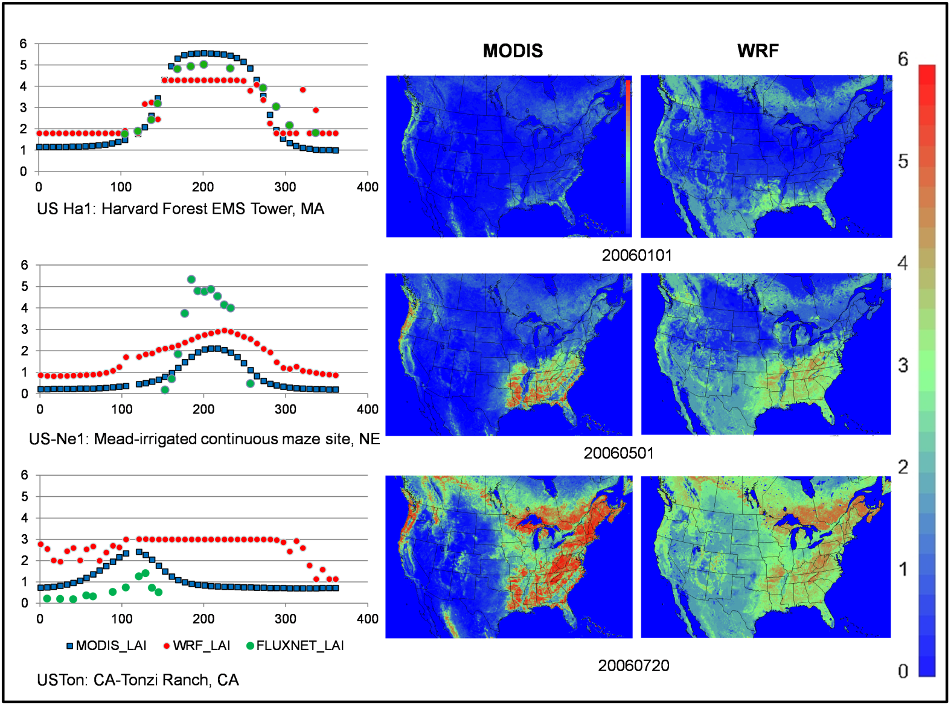
PX WRF LAI: 1. Difficulties to correctly estimate individual crop LAI 2. Failed to capture the Spring peak greenness of the West woody dryland 3. Relatively high during the cold seasons and low during the peak green summer Average minimum and maximum LAI values for broad land cover vegetation categories in the LSM tend to dampen the extremes of LAI values.
Background – 2006 LAI
LAI Comparisons:
FLUXNET
PX-LSM WRF
MODIS-MOD15A2GFS (8days and 1km)

Slide 5
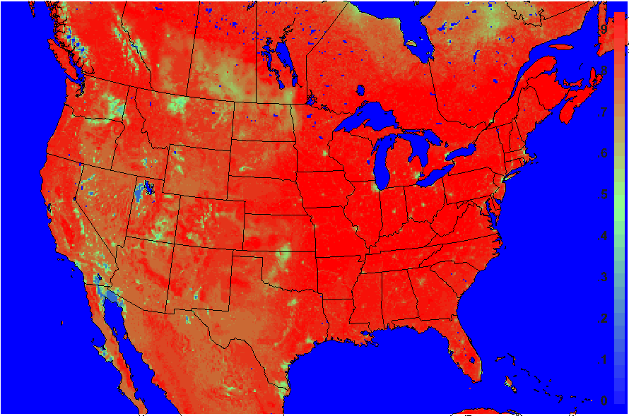
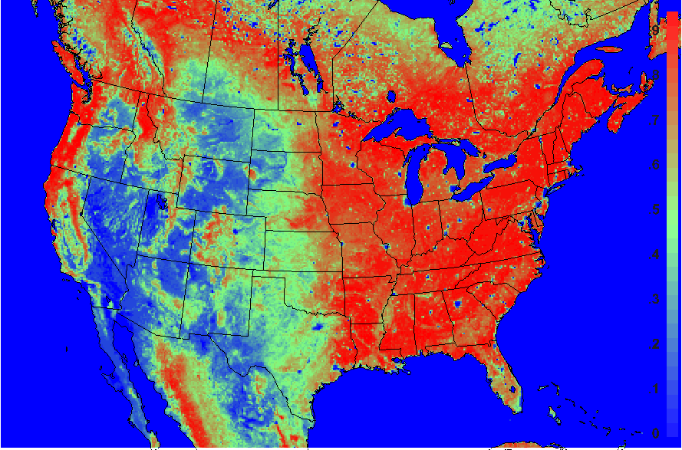
Background: Vegetation Cover 12km CONUS domain, 2006-08-10
PX LSM WRF with NLCD/MODIS land cover
MODIS at 12km
In the West, PX veg fraction is clearly over-estimated which allows soil moisture nudging scheme to be more effective.
fPAR - portion of PAR used by plants, often used as the surrogate of vegetation cover fraction (Los et al. 2000, Mu et al. 2011)

Slide 6
Research Objective
Objective:
Reduce overall uncertainty in retrospective WRF/CMAQ simulations by improving LSM processes through:
Using MODIS LAI, fPAR and surface albedo products to better describe spatial and temporal variations in vegetation and land surface
Method:
WRF/CMAQ simulations with modified WRF (particularly PX LSM and RRTMG) for gridded temporal MODIS LAI, fPAR and MODIS BRDF/Albedo Model parameter data

Slide 7
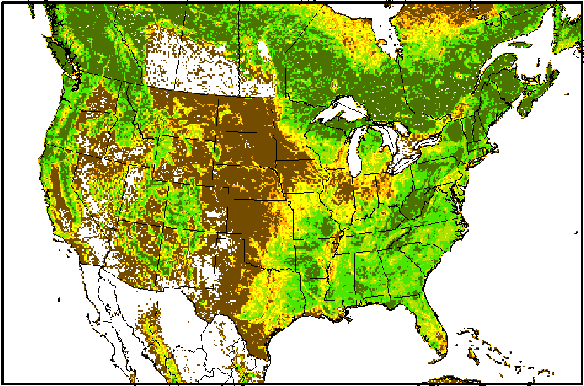
Modeling Domain, Scenarios, Configuration
CONUS 12km, 2006 NLCD/MODIS
08/01/2006 – 09/09/2006
Four WRF scenarios:
Base case: standard WRF with PX LSM tables
LAI and fPAR case: NACP MOD15A2GFS (Gap-Filled, smoothed 8-day 1km)
Albedo case: MCD43A1 BRDF/Albedo SW 3DParameters (8-day files from 16 day product, 500m)
LAI, fPAR, albedo case: MOD15A2GFS and MCD43A1
Two CMAQ scenarios:
Base case: Base case WRF Met
LAI, fPAR, albedo case: LAI, fPAR, albedo case WRF Met
Observation data:
NOAA’s Meteorological Assimilation Data Ingest System (MADIS)
AQS and other air quality network data
WRF:
Modified WRF–ARW V3.4 for inputs of MODIS LAI, fPAR and albedo parameters
NCEP 12km NAM analysis and reanalyzed with OBS data using OBSGRID
Regular nudging scheme for analysis nudging (U/V, T, Q) above the PBL and indirect soil moisture and T nudging from 2-m T and Q in the PX LSM
Other physics options: ACM2 PBL scheme, the RRTMG radiation model for SW and LW radiation, the Morison cloud microphysics scheme, and the Kain-Fritsch cumulus scheme
CMAQ (2006 AQMEII-2 CONUS emission input and configuration):
CMAQ v5.0.2 with CB05 gas-phase chemistry, AE6 modal aerosols
In-line biogenic and dust emissions

Slide 8
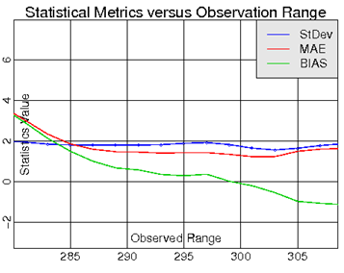
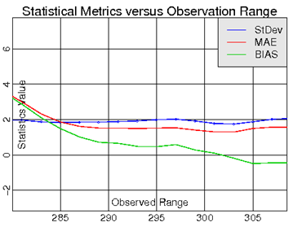
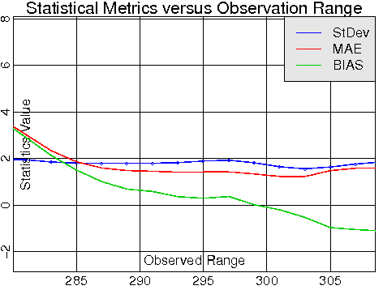
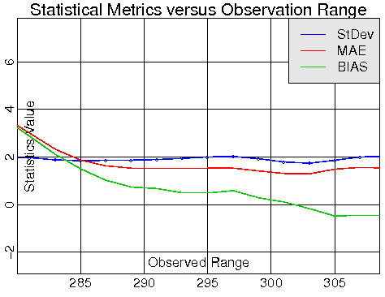
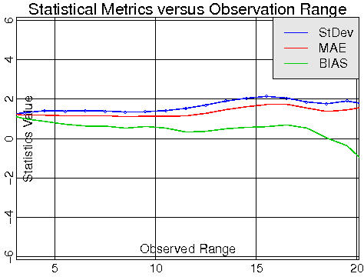
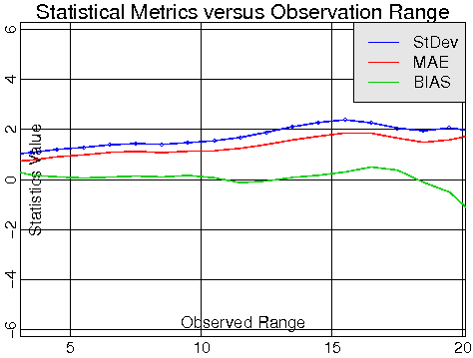
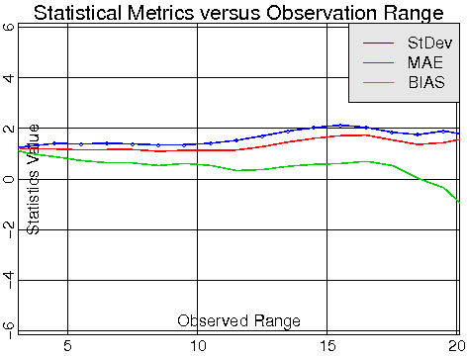
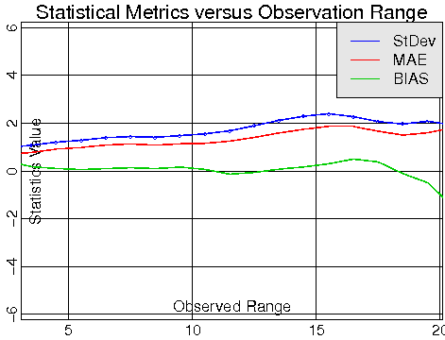
Meteorology Results: Aug 10 – Sept 9, 2006 Statistical Metrics vs. OBS Range
2-m T
2-m Q
Bias reduced
Base Case
LAI/fPAR Case
Albedo Case
LAI, fPAR, Albedo Case
MODIS LAI/fPAR run increases overall 2m T bias but reduces cold bias at high end
Wet bias below 14 g/kg is practically eliminated

Slide 9
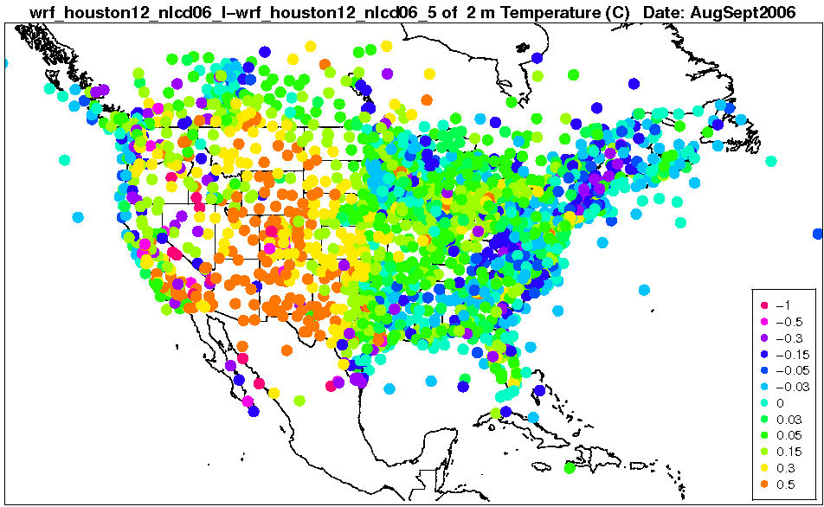
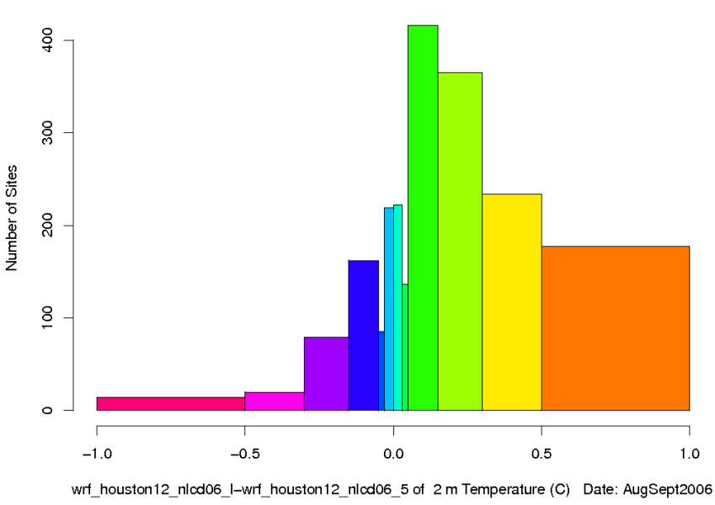
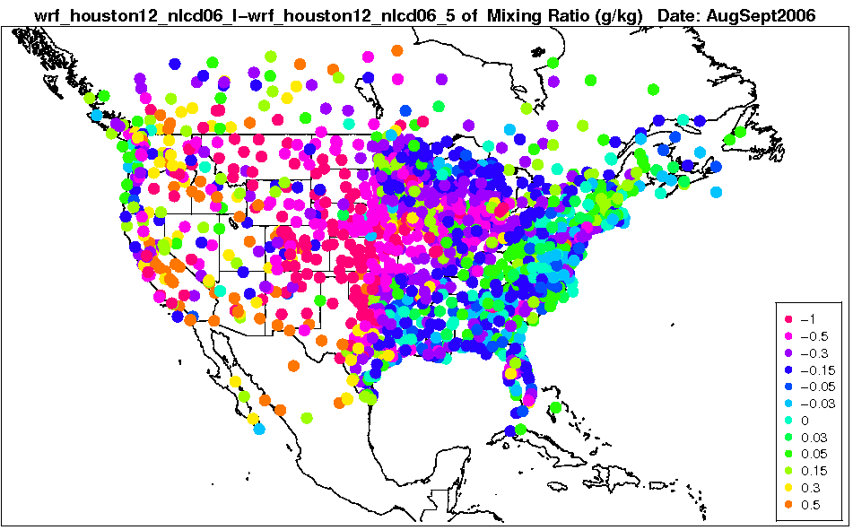
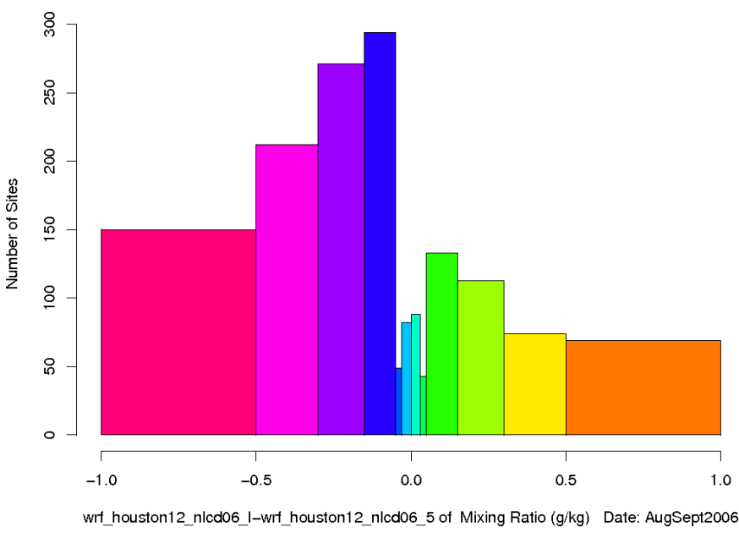
Meteorology Results: Aug 10 – Sept 9, 2006 Mean Bias Difference: LAI/fPAR Case – Base Case
2m T
2m Q
More realistic LAI and vegF in West from MODIS increases 2m T bias, decreases 2m Q bias
Exception: Southern AZ, NM where MODIS veg run is too hot and dry

Slide 10
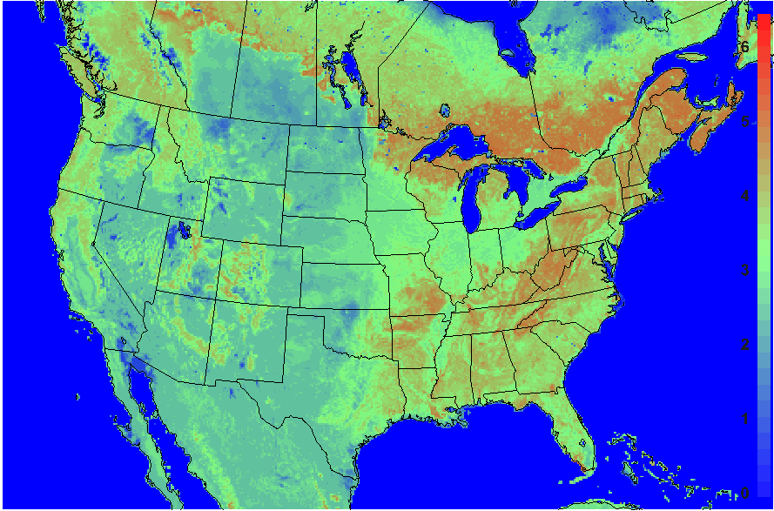
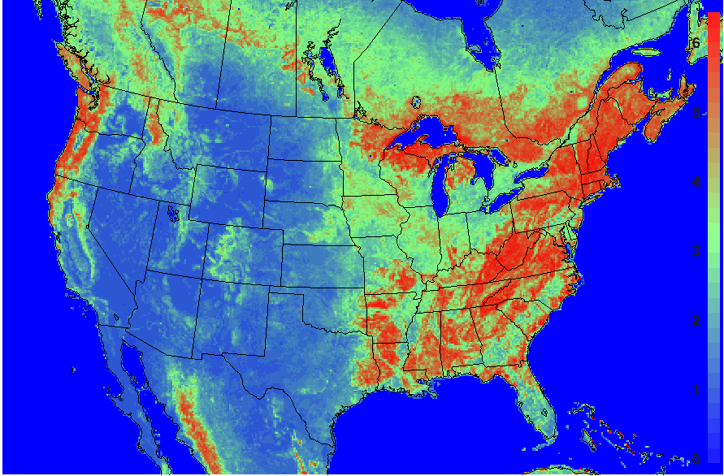
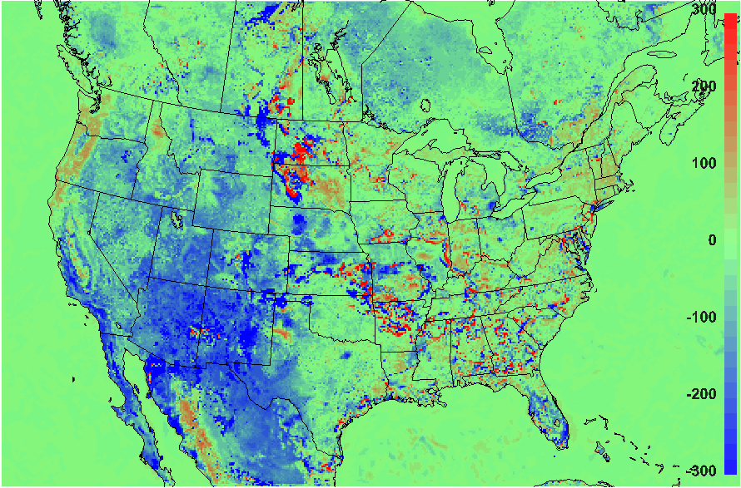
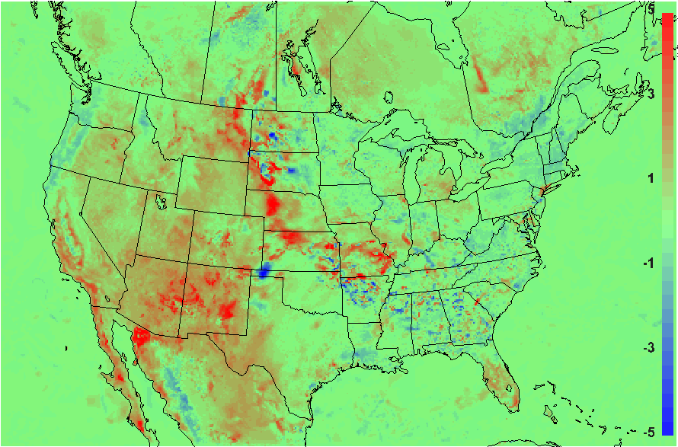
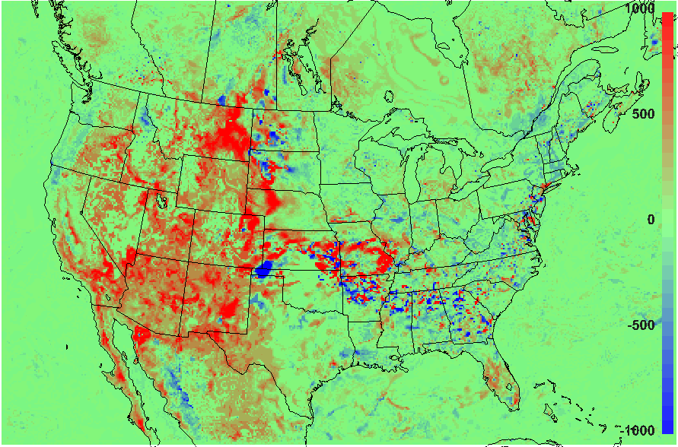
Meteorology Result Comparison: Aug 10, 2006, 20Z
Base Case
LAI/fPAR Case
LAI
Difference: LAI/fPAR Case – Base case
LE
2mT
PBLH
Lower LAI and veg frac in West from MODIS reduces LE and increases 2mT, PBLH

Slide 11
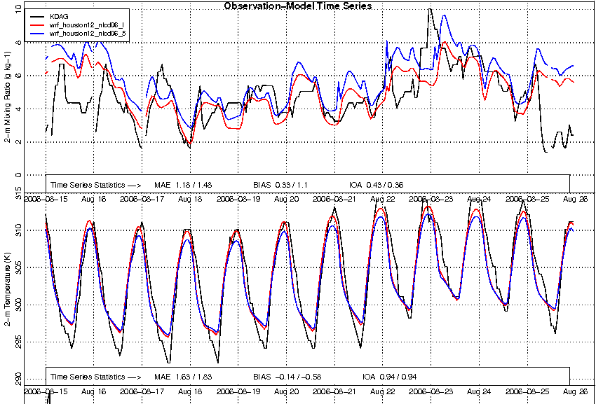
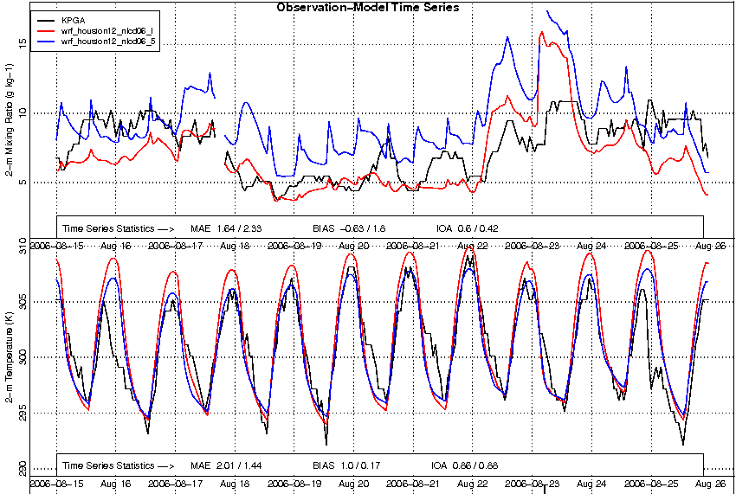
Measurement Site Comparison, Aug 15-25, 2006 ASOS site, Base Case and LAI/fPAR Case
KDAG, CA Northern Death Valley
KPGA, Northern AZ
LAI/fPAR run reduces wet bias in base
Hotter peak 2mT agrees better w/ obs
LAI/fPAR run greatly reduces wet bias in base
Hotter peak 2mT too hot compared w/ obs

Slide 12
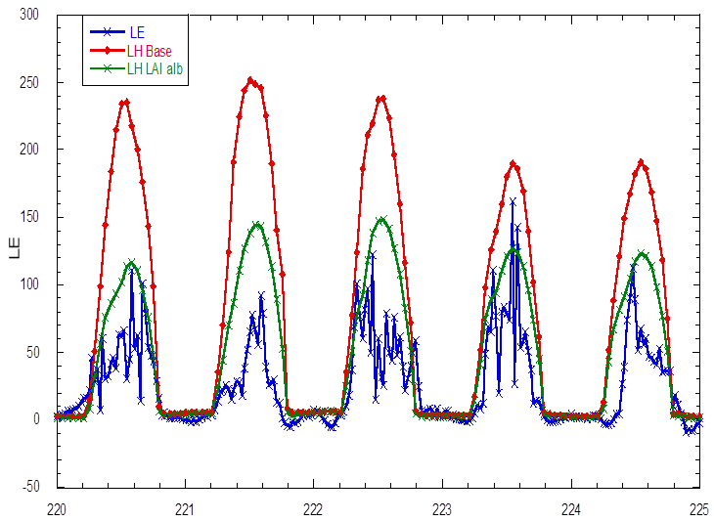
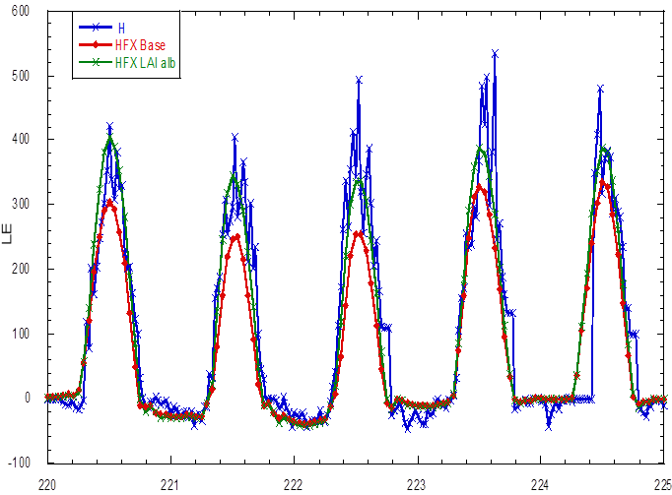
FLUXNET Measurement Comparison: Latent and Sensible Heat Tonzi, CA, Aug 8-13, 2006
LE
H
Base run overcompensates for high T bias by increasing soil moisture → LE too high, H too low
MODIS LAI/fPAR run LE and H agree better with FLUXNET

Slide 13
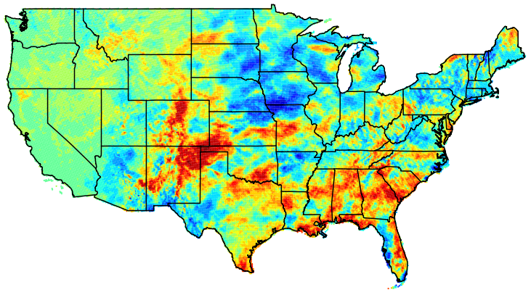
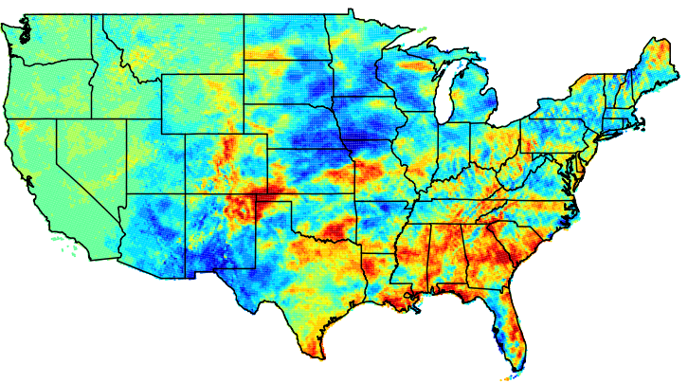
Meteorology Results: Precipitation Difference (in) for Aug 2006
Base Case - PRISM
LAI/fPAR Case - PRISM
Wet bias reduced
Wet bias in the western Central Plain is reduced in MODIS LAI/fPAR run
Increased dry bias in the SW and Northern Plain regions

Slide 14
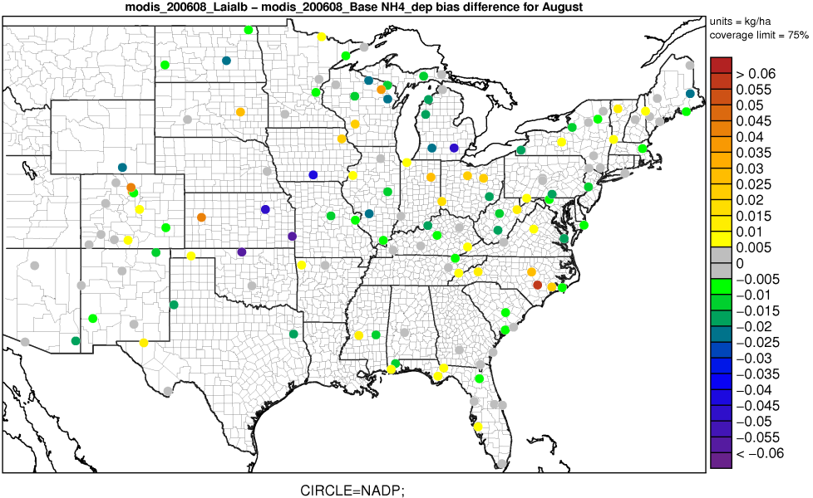
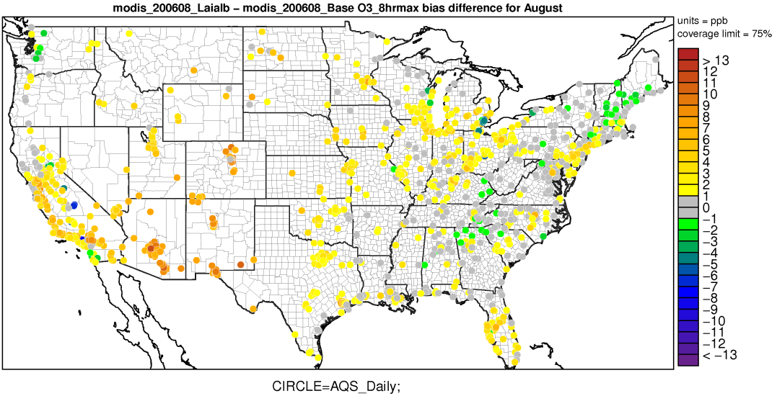
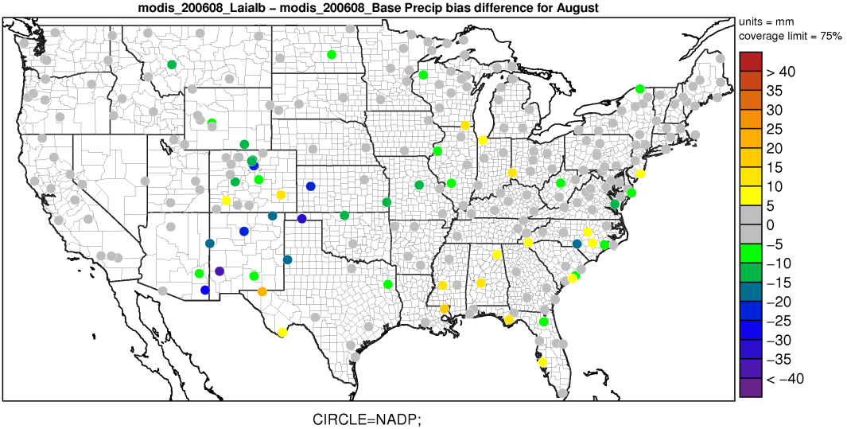
Air Quality Site Comparison: Aug 10 – 30, 2006 Mean Bias Difference LAI,fPAR,albedo Case – Base Case
NH₄ Wet Deposition
8hMax O₃
Precipitation
Greater high bias for 8hmax O₃ in CMAQ run with MODIS input MET due to hotter T, particularly in the SW
Reduced bias for NH₄ wet deposition at many sites likely due to the improved P

Slide 15
Conclusions and Ongoing Work
Conclusions
MODIS LAI/fPAR have much bigger impacts on met-simulations than MODIS albedo, particularly in the West, Central
The West, Central become hotter and dryer, but with peak T matching OBS better for many sites and with much reduced Q bias
High P bias in the western Central Plain is reduced
8hmax O3 bias is increased and NH₄ wet deposition bias is reduced
Improvement needs (e.g. soil T and Q) for high T bias
Ongoing Work
In-depth CMAQ evaluations
2006 full year WRF/CMAQ simulation with MODIS inputs
A coupled photosynthesis-conductance vegetation model in PX LSM WRF/CMAQ with MODIS inputs (coupled impact assessment of CO₂ on MET/AQ and AQ on vegetation)

Slide 16
Acknowledgements
Christian Hogrefe and K. Wyat Appel at USEPA AMAD for providing 2006 AQMEII-2 CONUS emission input/configuration and AMET AQ analysis scripts
Conghe Song, Jason West, Adel Hanna at UNC-Chapel Hill for supporting the Ph.D. research

Slide 17
Extra

Slide 18
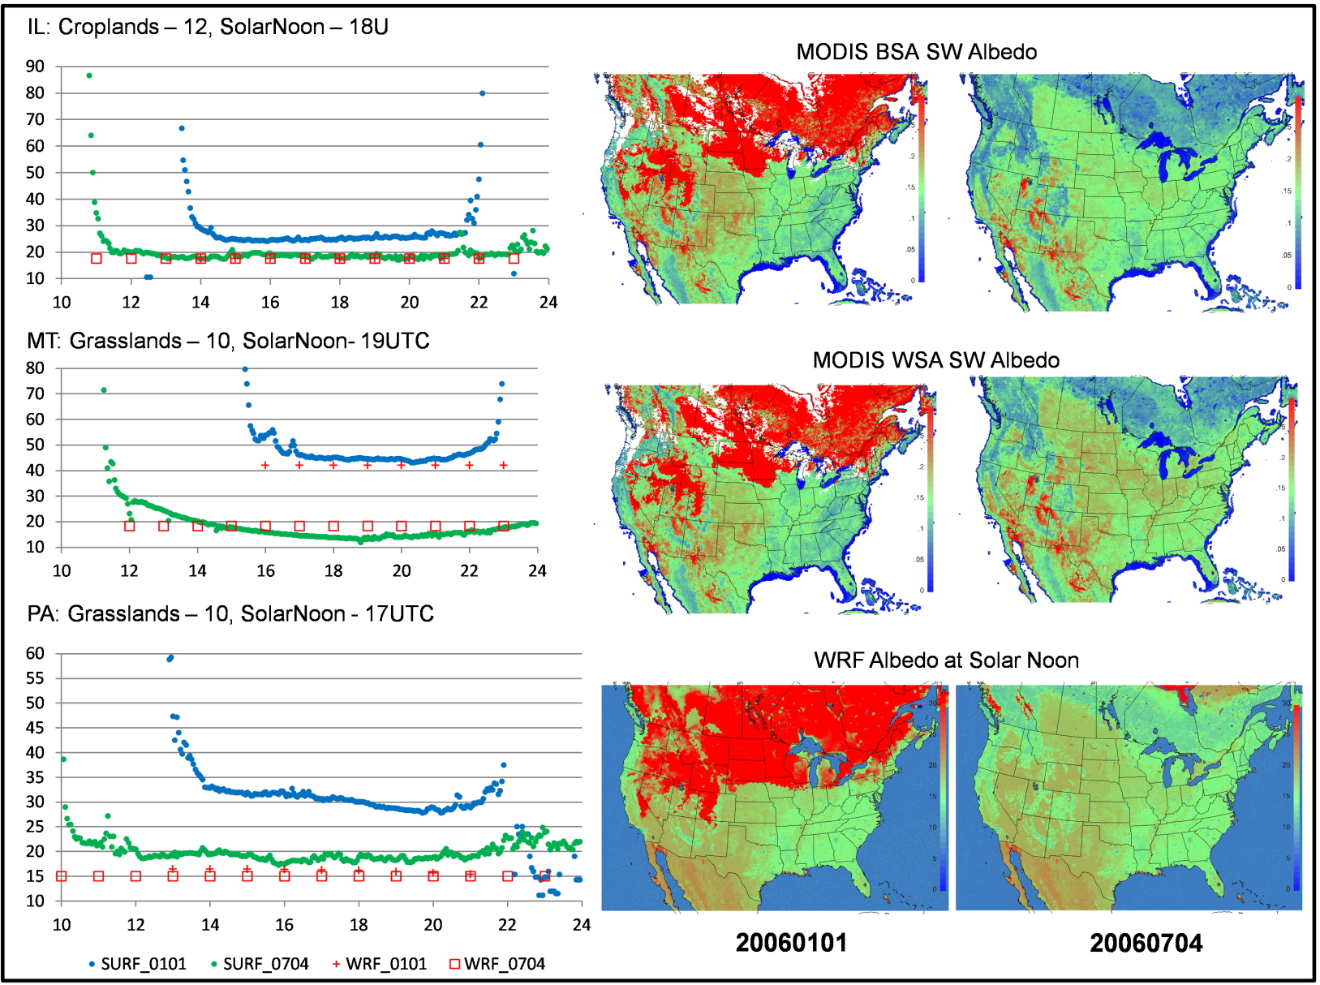
1. PXLSM WRF albedo is missing the diurnal, seasonal, and spatial patterns. 2. More appropriate to use daily snow analyses to define snow coverage and albedo. 3. MODIS albedo excluding the snow coverage areas does capture the heterogeneous surface.
Albedo comparison:
SURFRAD
PXLSM WRF
MODIS MCD43A3 (solar noon)
Site MODIS albedo:
BSA WSA
IL(01/01): 12.75 11.94
IL(07/04): 17.14 19.43
MT(01/01): 20.52 17.68
MT(07/04): 16.05 18.62
PA(01/01): 13.11 12.28
PA(07/04): 15.06 16.85

Slide 19
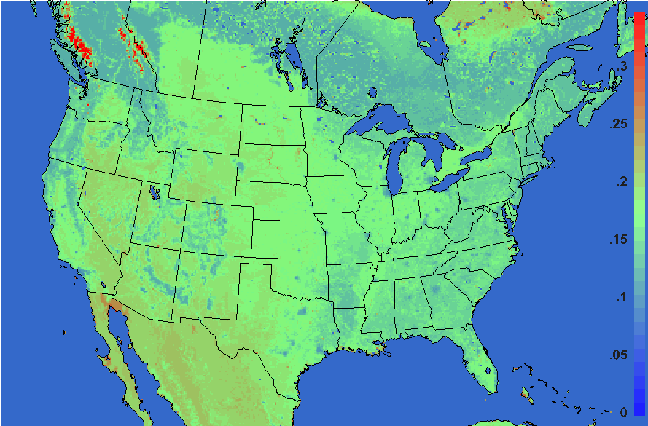
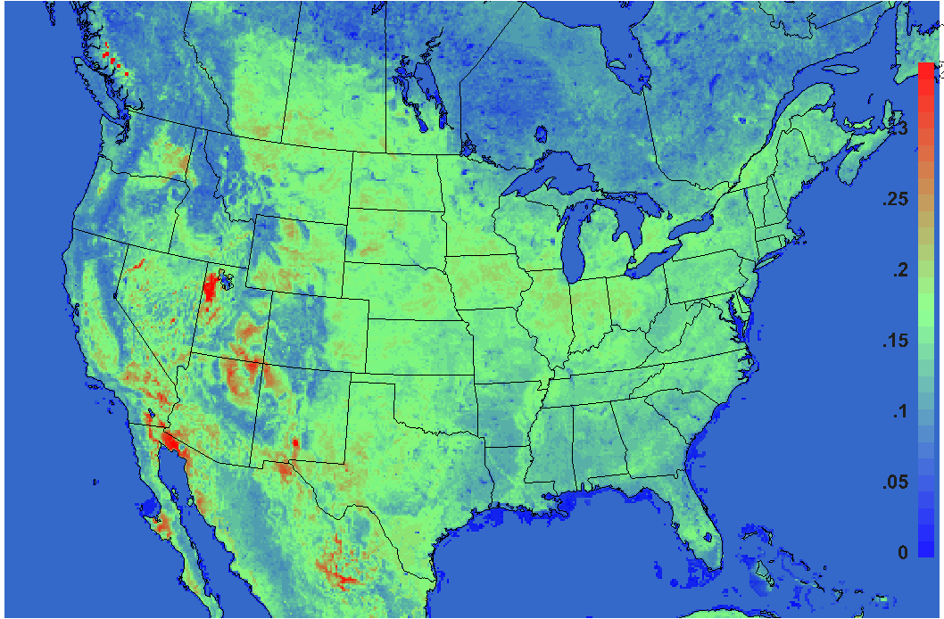
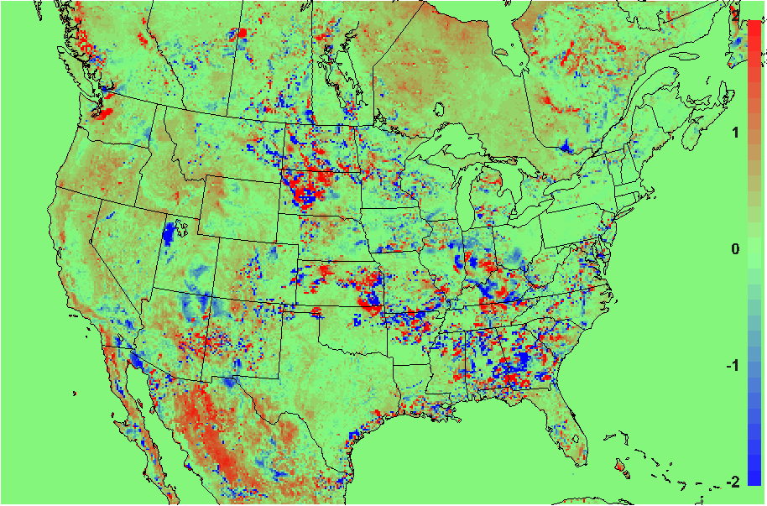
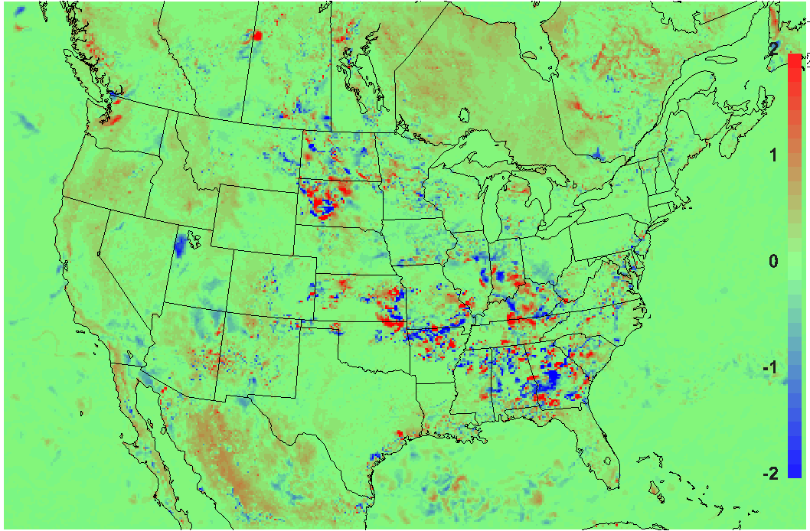
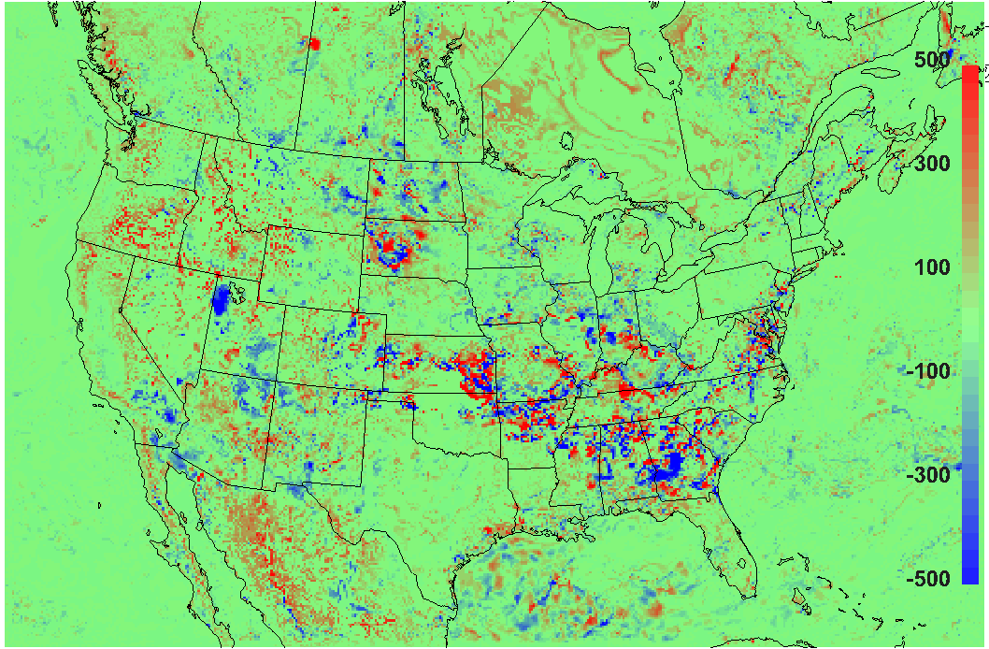
Meteorology Result Comparison: Aug 10, 2006, 20Z
Base Case
Albedo Case - 20Z
Albedo
Difference: Albedo Case – Base case
TSK
2mT:
PBLH
MODIS albedo generally lower in veg areas, particularly coniferous forest
Higher in barren areas (e.g. Utah salt flats)

