Slide 1
The role of future scenarios to understand deep uncertainty for air quality management
Julia Gamas, Rebecca Dodder, Dan Loughlin, Cynthia Gage
Energy and Climate Session, CMAS Conference
October 29, 2014

Slide 2
Outline
Scenario Planning Process
  What is it and why is it relevant to air quality management?
  Four scenarios for air quality
Modeling Future Scenarios in MARKAL
  Incorporation of the scenarios into MARKAL
  Illustrative Results
Next Steps

Slide 3
Part I. Scenario Planning Process for Air Quality Management

Slide 4
Scenario Planning for Air Quality Management
There is complexity in the way the environment interacts with human systems (economic, social and political).
Key drivers may disrupt system dynamics in unforeseen ways, making it difficult to predict future conditions precisely.
This kind of deep uncertainty presents a challenge to organizations faced with making decisions about the future, including those involved in air quality management.
  Which driving forces do we consider?
  How will they behave?
  How will they interact with other driving forces?
  What will the end result be for air quality?

Slide 5
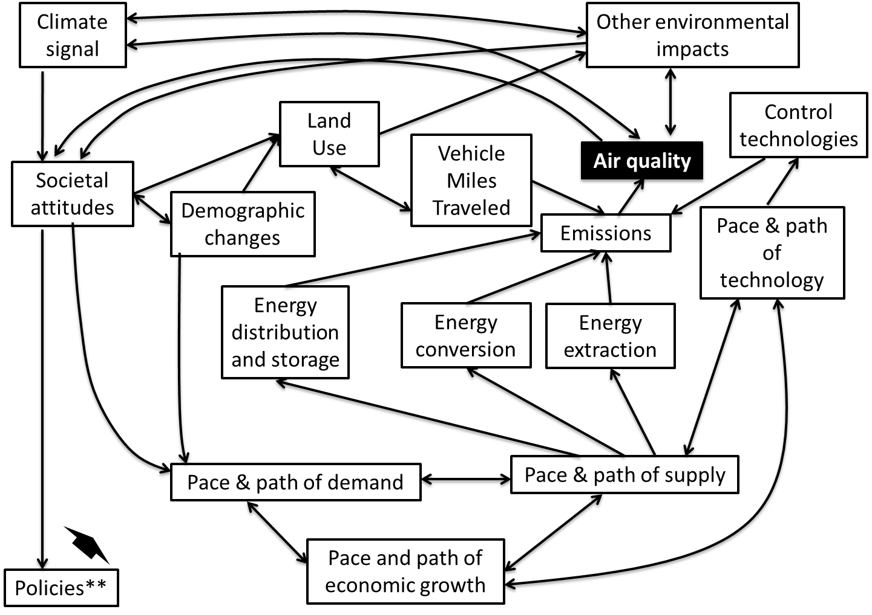
Notes:
Explain drivers up front. Walk through an example. VMT and land use. Oil prices and geopolitics.

Slide 6
Scenario Planning (Schwartz 1997; Schoemaker 1991) allows us to:
  Identify relevant driving forces.
  Rank them by how uncertain and critical they are to our problem
  Identify critical futures of interest from those driving forces
  Understand and be prepared for critical futures (rehearse the future)
Scenario Planning has been previously applied in both the private and public sectors, including environmental applications, but has not been previously applied to air quality (Ghanadan and Koomey 2005; NPS 2013; GBN 2007).
  For example, the national parks service used scenarios to understand potential impacts of climate change on the parks and future management needs under each scenario.

Slide 7
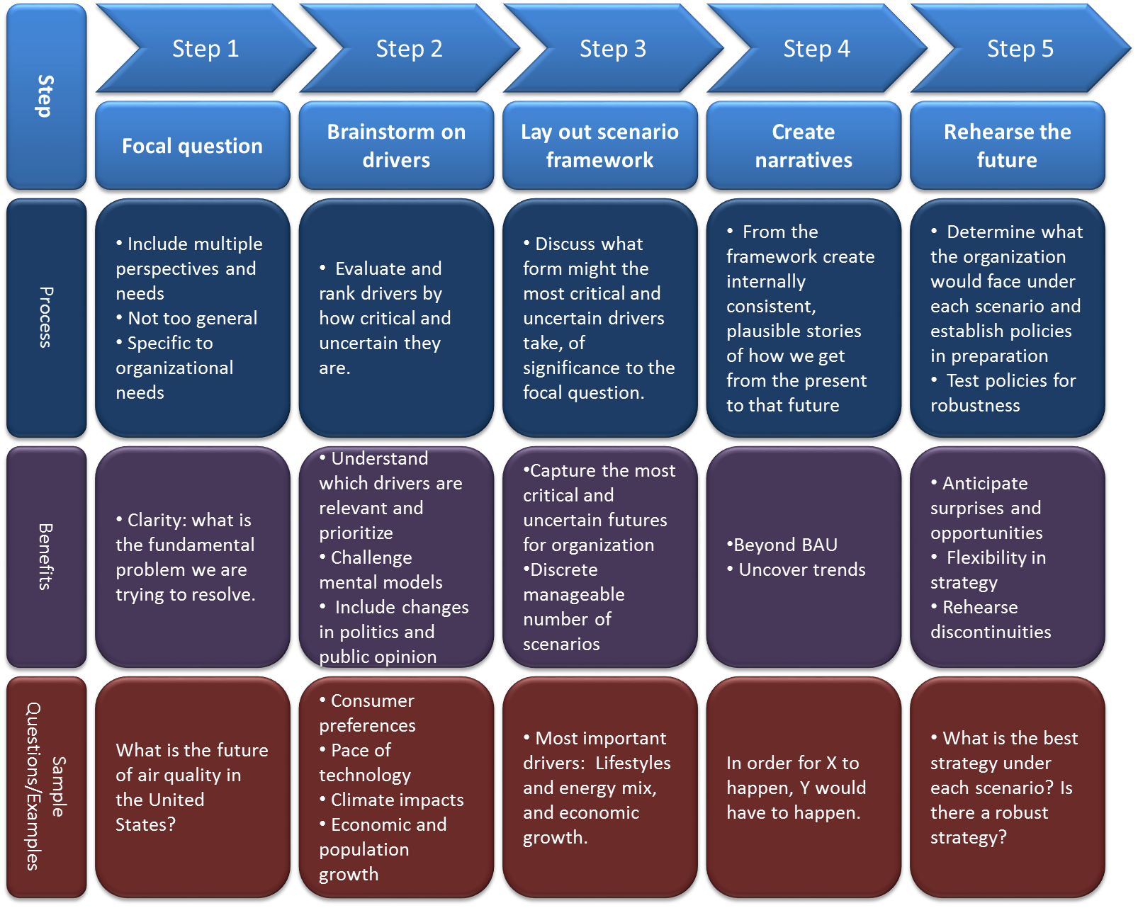
Overview of our process

Slide 8
Four Scenarios for Air Quality
EPA held two workshops that included EPA and external experts (Gamas 2012).
Step 1. Specify a focal question
What is the future of air quality in the United States?

Slide 9
Step 2. Identify key driving forces
Key Driving Forces:
Energy (extraction, conversion, distribution and storage, efficiency, international energy trends)
Land Use and transportation patterns (type of human settlements, vehicle-miles travelled)
Economy (rate and direction of growth)
Policies (other than EPA policies: e.g. energy efficiency, energy security, direction of research and development)
Climate change signal (strength, temperature and precipitation, damages from storms and flooding)
Environmental indicators other than climate change (ecosystem health, persistence of pollutants, water resource quantity and quality)

Slide 10
From the key drivers, identify those most critical and uncertain:
Technology (emissions reductions technologies, other technological developments)
Societal attitudes (consumption choices based on support for environmental protection)
These became the backbone of our scenarios framework.

Slide 11
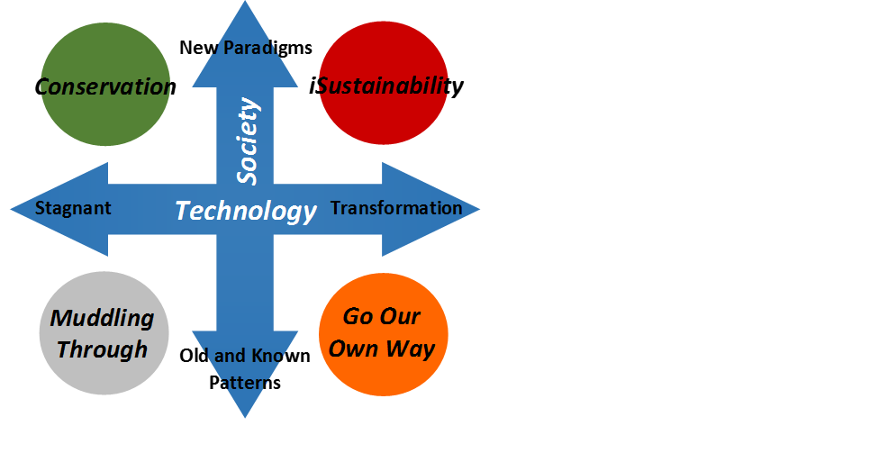
Step 3. Construct the scenario framework
What values of interest to our focal question could these two drivers take?
Technology (high tech vs. low tech)
Societal attitudes (support for environmental protection vs. indifference).

Slide 12

Step 4. Develop narratives
Conservation is motivated by environmental considerations. Assumptions include decreased travel, greater utilization of existing renewable energy resources, energy efficiency and conservation measures adopted in buildings, and reduced home size for new construction.
iSustainability is powered by technology advancements, and assumes aggressive adoption of solar power, battery storage, and electric vehicles, accompanied by decreased travel as a result of greater telework opportunities.
Muddling Through has limited technological advancements and stagnant behaviors, meaning electric vehicle use would be highly limited and trends such as urban sprawl and increasing per-capita home and vehicle size would continue.
Go Our Own Way includes assumptions motivated by energy security concerns. These assumptions include increased use of domestic fuels, particularly coal and gas for electricity production and biofuels, coal-to-liquids, and compressed natural gas in vehicles.

Slide 13
Step 5. Rehearsing the future
In Conservation current technologies as well as conservation measures are moving society towards lower emissions. Emissions in general could decrease substantially. Air quality management would likely focus less on end-of-pipe type controls and more on supporting the development of renewable energy sources, energy efficiency, fuel switching and clean fossil fuels.
In Muddling Through emissions would increase. Air quality management would likely focus more on end-of-pipe controls.
Notes:
Could go over only two examples but leave all four for discussion if needed.

Slide 14
In iSustainability many advanced technologies are available. The need for end-of-pipe controls would be lower, and air quality managers could focus on making sure society reaps the benefits of new technologies coming online (e.g. smart grid).
In Go Our Own Way society, and therefore government, are concerned with energy security. All fuels are being developed. Air quality managers could take advantage of this trend by promoting energy efficiency that would maximize the use of domestic energy sources and decrease emissions in the process.

Slide 15
II. Modeling Future Scenarios In MARKAL

Slide 16
Incorporation of Scenarios into MARKAL
  Illustrate the scenarios quantitatively
  Run sensitivities on the scenarios and gain insights about the roles of different drivers:
    How different do fossil fuel prices have to be from renewable fuel prices to see a significant shift in their use?
    What might unintended consequences of shifts in the use of one technology be on the use of another?
  In scenarios it isn’t just values of variables that might change, but also parameters:
    Elasticities of supply and substitution amongst inputs represent technological change
    Elasticities of demand represent consumer preferences
  Exploring the efficacy of candidate management strategies over very different realizations of the future
  Use the scenarios to develop management strategies that are inherently robust (are effective under any scenario)

Slide 17
MARKAL is uniquely suited to the task because of its:
  Detailed representation of the full energy system (from extraction of fuels to their use in meeting end-use energy demands)
  Relatively fast runtime and ease with which alternative assumptions and sensitivities can be examined
  Ability to uncover internal inconsistencies in the storylines (for example, in Conservation, increased nuclear power was needed to replace baseload electricity production formerly provided by coal plants).

Slide 18
We translated big picture concepts in the narratives to fairly detailed numbers and parameters into the model:
Example levers included:
Bounding out advanced technologies in Conservation and Muddling Through
Decreasing advanced technology costs in iSustainability and Go Our Own Way
Adjusting market share constraints in Conservation, resulting in a decrease in vehicles size
In iSustainability, reflecting more telework by reducing travel demand and new commercial space, while increasing new home size for home offices

Slide 19
We present results for system-wide NO_{x} and SO₂ emissions to illustrate relative changes in emissions for the four scenarios, to highlight the relevance to air quality management.
We then show results for three major aspects of the energy system:
Changes in primary energy consumption
Changes in electricity generation mix
Changes in light duty vehicle mix
These examples are key sectors that drive emissions changes for air quality, but also could provide information for decision-makers for other pollutants and environmental impacts of interest.

Slide 20
Illustrative Results
Notes:
In the figure, red trajectories indicate low technology development, while blue indicate high technology development. Solid lines represent adoption of new societal paradigms, where dashed lines represent stagnant behaviors. Note that these results do not incorporate the recent Tier III onroad vehicle emission standards or the proposed New Source Performance Standards for new and existing coal-fired power plants.

Slide 21
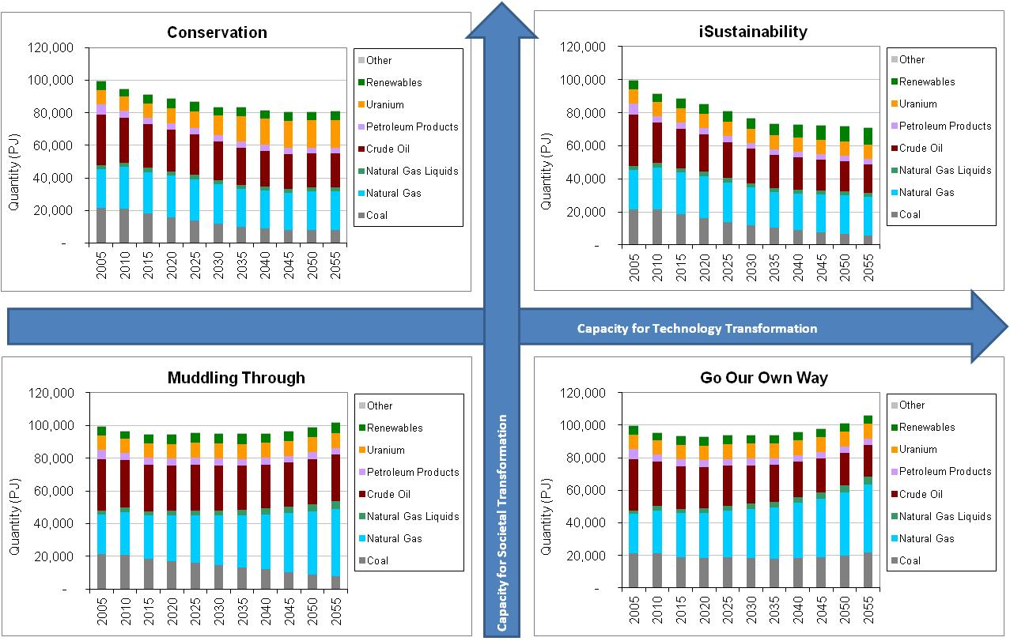
Primary Energy Consumption

Slide 22
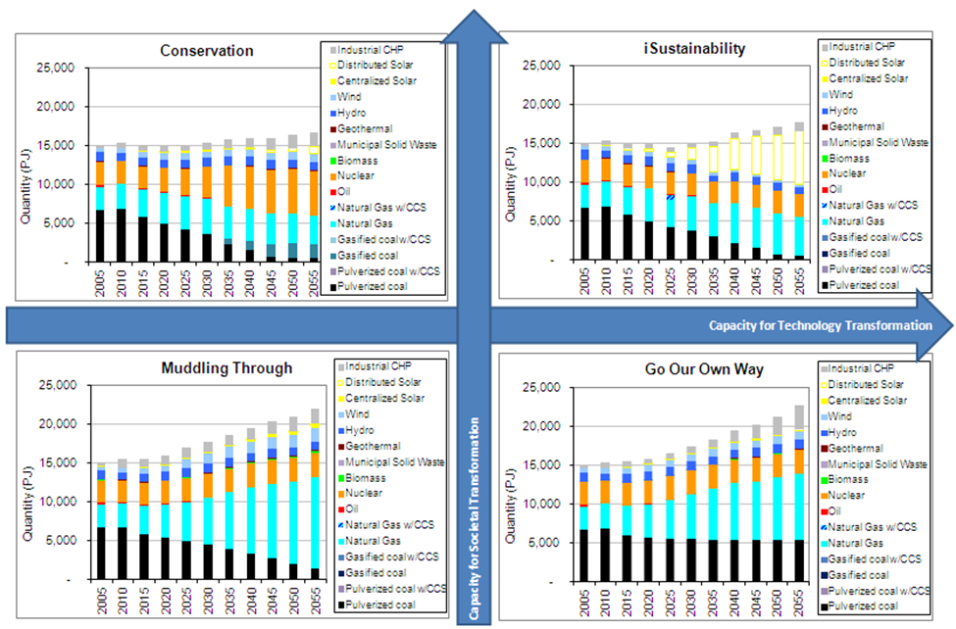
Electricity Generation

Slide 23
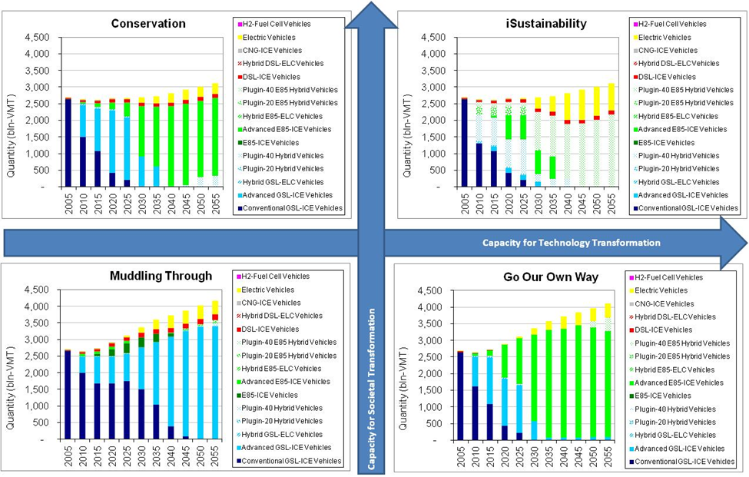
Light Duty Vehicles

Slide 24
Observations
On process:
  Implementing detailed scenario assumptions into MARKAL in some instances proved challenging or tedious. For example, assuming new buildings are net-zero required considerable research into the turnover of the building stock. Forcing in other assumptions limited the flexibility of the model in responding to additional stimuli. Scenario assumptions had to be re-implemented when the underlying MARKAL model changed.
Results
  Despite the wide-ranging differences in assumptions regarding technology development and behavior, all four scenarios indicate that the trend of decreasing NOx and SO2 emissions will continue, largely driven by air quality regulations.
  By 2040, NOx emissions across the scenarios are approximately 20% to 40% lower than in 2015. There is considerably more uncertainty related to future SO₂ emissions. Emissions in 2040 range from approximately 6% greater to 35% less than in 2015.

Slide 25
Next Steps
MARKAL 2014 released in September, 2014, we are incorporating the scenarios to the new database.
Based upon our preliminary results, we are exploring how the scenarios can be refined to yield broader coverage of air quality outcomes.
We can further explore our analysis from Step 5 within the context of MARKAL by testing how specific controls and policy options behave in each scenario.

Slide 26
Next Steps
  We are also exploring alternative ways to implement the scenarios into MARKAL so that updated scenarios can be incorporated faster:
    Instead of forcing technological and behavioral changes to match the detailed scenario narratives, in the next implementation, we plan to integrate the broader scenario drivers (technological change and changing societal paradigms) in a manner that gives the model more flexibility to respond to changes in model inputs.
  From the application standpoint, we will begin to explore how the scenarios can be used in a long-term planning context, identifying robust, multi-pollutant management strategies.

Slide 27
Thank you.

