Slide 1
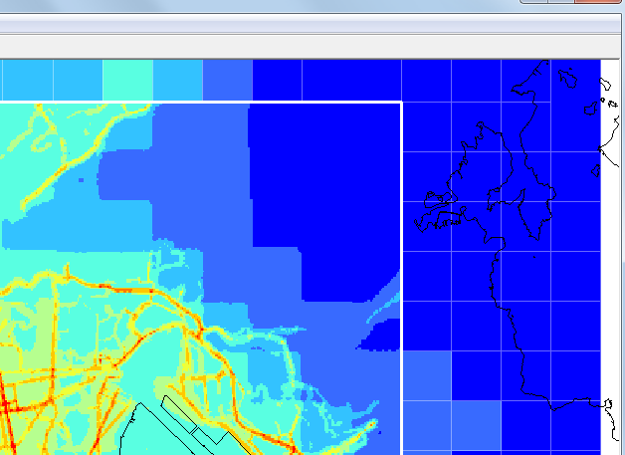

The Development and Evaluation of an Automated System for Nesting ADMS-Urban in Regional Photochemical Models
Jenny Stocker, Christina Hood, David Carruthers, Martin Seaton, Kate Johnson, Jimmy Fung
13th Annual CMAS Conference
Chapel Hill, NC
October 27-29, 2014

Slide 2
Contents
Introduction
Nesting concept
System implementation
Example use of system:
  Input data
  System configuration
  Run times
  Validation methodology
  Results
Conclusions

Slide 3
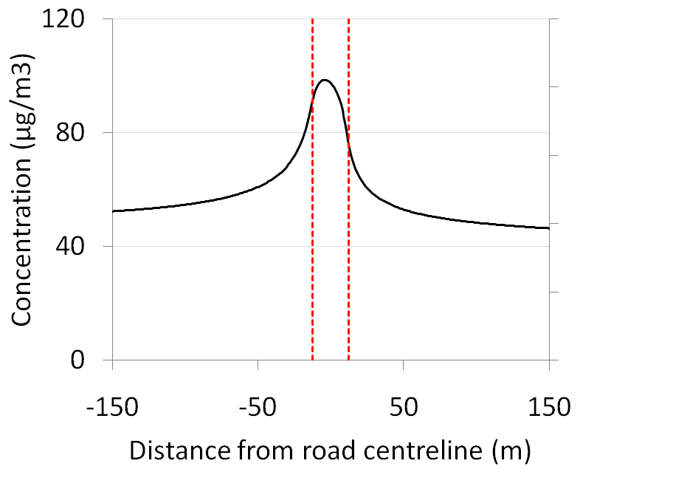
Introduction
Regional meteorological models represent complex flow variations over large spatial scales
Regional photochemical models represent complex chemistry and dispersion processes over large spatial scales
Regional models are increasingly being required to run at high resolution to perform, e.g. pollutant exposure assessments
Concentrations close to roads within urban areas vary significantly over tens of metres
Variation:
Over 30 µg/m³ NO₂ within 50 m
NO₂
Heavily trafficked road, no canyon
Road width 25 m

Slide 4
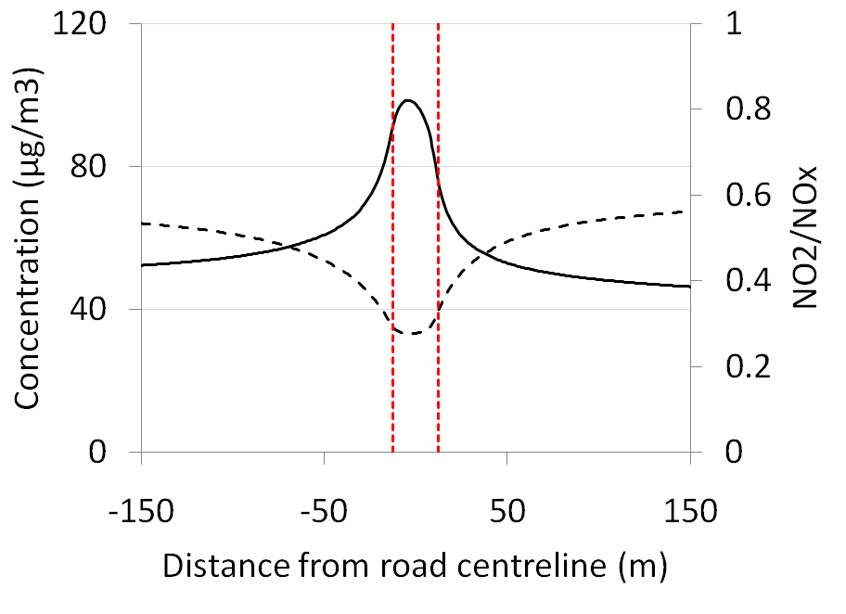
Introduction
Regional meteorological models represent complex flow variations over large spatial scales
Regional photochemical models represent complex chemistry and dispersion processes over large spatial scales
Regional models are increasingly being required to run at high resolution to perform, e.g. pollutant exposure assessments
Concentrations close to roads within urban areas vary significantly over tens of metres
Variation:
Over 30 µg/m³ NO₂ within 50 m
Variation due to dispersion and chemistry
NO₂/ NO_{x}
NO₂
Heavily trafficked road, no canyon
Road width 25 m

Slide 5
Introduction
Regional meteorological models represent complex flow variations over large spatial scales
Regional photochemical models represent complex chemistry and dispersion processes over large spatial scales
Regional models are increasingly being required to run at high resolution to perform, e.g. pollutant exposure assessments
Concentrations close to roads within urban areas vary significantly over tens of metres
Issues with running regional models at high resolution include:
  Difficult to include explicit modelling of roads and near-source features, e.g. street canyons
  Run times and data storage requirements become prohibitive
  Some parameterisations within the model become invalid, in particular cloud parameterisations in WRF
Notes:
No advanced modelling of specific source types can be included when all emissions are represented as grid cells. For example, in order to include the effects of street canyons and traffic-induced turbulence on the dispersion of pollutants from road sources, source-specific parameters such as canyon geometry and traffic flows are required.

Slide 6
Introduction
What are the advantages of a nested system of models?
Model feature | Model
 | Regional (eg grid based) | Local (eg Gaussian plume)
Domain extent | Country (few 1000 km) | City (50km)
Meteorology | Spatially and temporally varying from meso-scale models | Usually spatially homogeneous
Dispersion in low wind speed conditions | Models stagnated flows correctly | Limited modelling of stagnated flows
Deposition and chemical processes | Reactions over large spatial and temporal scales | Simplified reactions over short-time scales
Source resolution | Low | High
Validity | Background receptors | Background, roadside and kerbside receptors

Slide 7
Nesting concept
The nesting concept introduced in Stocker et al. (2012):
  Exploits the advantages of each model type
  Avoids double counting emissions
Briefly:
  At short time scales, the local model resolves the high concentration gradients close to roads, and performs fast NO_{x} chemistry
  For longer time scales, the regional model accurately represents pollutant transport and complex chemical processes
  Distinguish between the models using a ‘mixing time’, ΔT, defined as the time required for the pollutants to become uniformly mixed over the scale of the regional model grid
Concentration within nested domain | = | Regional modelling of emissions | - | Gridded locally modelled emissions (ΔT) | + | Explicit locally modelled emissions (ΔT)
Notes:
ΔT varies with the size of the regional model grid, the meteorological conditions and the details of the local emissions, although a uniform value of one or two hours forms an adequate approximation

Slide 8
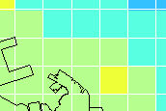
Nesting concept
Theoretically, ΔT depends on grid scale and meteorology; in practice, ΔT fixed at 1 to 2 hours
Regional model calculations performed off-line i.e. nesting is a post-processing system
Regional meteorology drives local model
Concentration within nested domain | = | Regional modelling of emissions | - | Gridded locally modelled emissions (ΔT) | + | Explicit locally modelled emissions (ΔT)
Consistent emissions used in both models
Nesting calculations performed separately for each regional model grid cell
Notes:
ΔT varies with the size of the regional model grid, the meteorological conditions and the details of the local emissions, although a uniform value of one or two hours forms an adequate approximation

Slide 9
System implementation
Meso-scale meteorological data (WRF)
Regional model concentration output
Key
Utility
Data
Model run
Emissions data

Slide 10
System implementation
Meso-scale meteorological data (WRF)
Regional model concentration output
Key
Utility
Data
Model run
Meteorological data for use in local model
Emissions data

Slide 11
System implementation
Meso-scale meteorological data (WRF)
Regional model concentration output
Key
Utility
Data
Model run
Meteorological data for use in local model
Local upwind background
Local model
Gridded run for background (0.5 hr)
Emissions data
Nesting background

Slide 12
System implementation
Meso-scale meteorological data (WRF)
Regional model concentration output
Key
Utility
Data
Model run
Meteorological data for use in local model
Local upwind background
Local model
Gridded run for background (0.5 hr)
Emissions data
Nesting background
Local model
Main gridded run (ΔT)
Local model
Main explicit run (ΔT)

Slide 13
System implementation
Meso-scale meteorological data (WRF)
Regional model concentration output
Key
Utility
Data
Model run
Meteorological data for use in local model
Local upwind background
Local model
Gridded run for background (0.5 hr)
Emissions data
Nesting background
Local model
Main gridded run (ΔT)
Local model
Main explicit run (ΔT)
Concentration within nested domain | = | Regional modelling of emissions | - | Gridded locally modelled emissions | + | Explicit locally modelled emissions

Slide 14
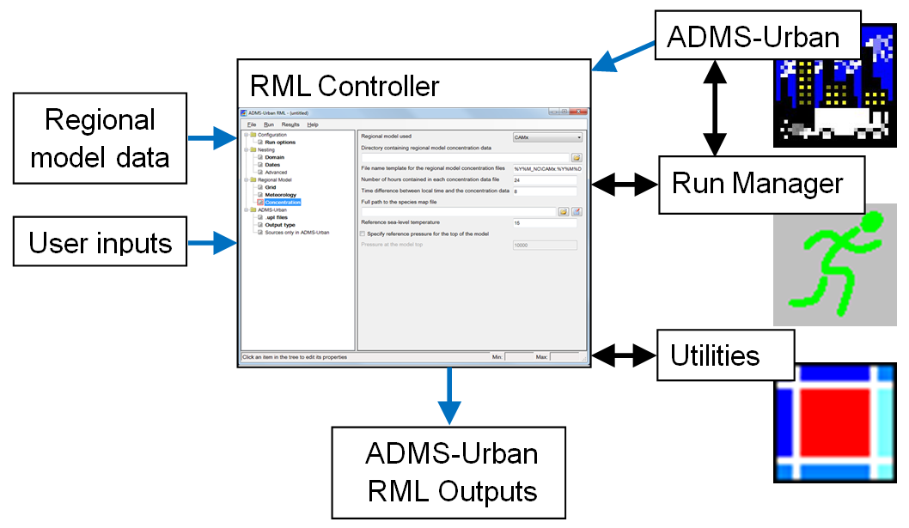
System implementation: components
Regional model data: WRF, CAMx, CMAQ, EMEP4UK
Local model: ADMS-Urban
Notes:
In order to run the system, you need 3 pieces of software. ADMS-Urban dispersion model, Run Manager software, which distributes ADMS-Urban runs over a network of computers, and the RML controller
In terms of inputs to the system, the regional model data is required in terms of WRF meteorological data files for the whole nesting domain; regional model data requires data for the domain plus a buffer or one cell in all directions.
3 ADMS-Urban model files are required as input: one run with gridded emissions used in the calculation of the urban background concentrations for each grid cell, a run with the explicit emissions where all road sources have representative geometry and associated information eg road widths and canyon heights, and a gridded run which is the same as the explicit run, but with no explicit sources.
Other user inputs are required: eg Spatial domain specifications, time period of interest, Run Manager configuration details, details of new development sources, not included in the regional model
First run Model verification to check that the model inputs and system configurations are set up correctly. Runs the system for a single hour. Check output. Then run Model.
Output is calculated at single receptors when the model is run in verification model or over a grid of receptors when contour output is required, eg for exposure calculations. Output is in netcdf format, but one of the ADMS-Urban utilities converts this format to standard ADMS-Urban text files, which can be inspected and/or contoured using ADMS utilities and links to 3rd party software eg ArcGIS.

Slide 15
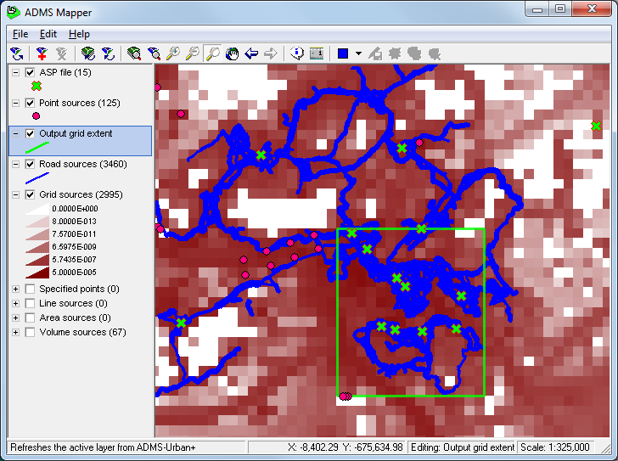
Example use of system
Domain: Hong Kong Special Administrative Region (HK SAR)
Period: 2010
Regional models: WRF (v 3.2) and CAMx (v 5.4)
Input data:
  1 km regional model data (Yao et al., 2014)
  Gridded emissions data as used in CAMx
  For major roads, traffic flow, speed and location data
  Point source information
Emission sources & output locations
Contouring domain
Monitors

Slide 16
Example use of system
System configuration:
  Larger nesting domain to cover all monitor locations (72km x 49 km)
  Smaller nesting domain for contour runs covering Hong Kong urban areas (17 km x 17 km)
  ΔT = 1 hour
  7 desktop computers, one for RML Controller, 6 for ADMS-Urban runs
Run times for 1 year:
  Validation run at monitors – 6 hours
  Contour output – 1 to 2 weeks (processor availability dependent)
Validation methodology:
  14 continuous monitors:
    3 roadside
    10 urban background
    1 rural

Slide 17
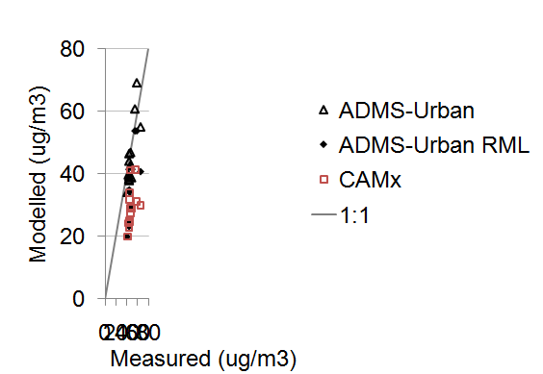
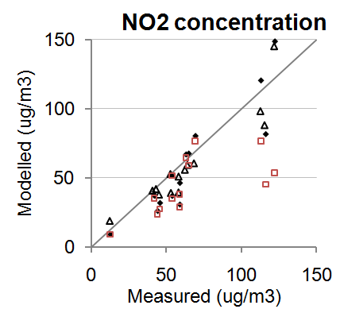
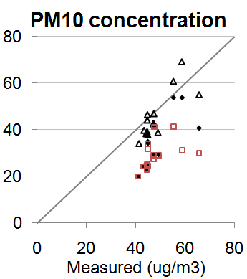
Example use of system
Results: validation at monitors
  ADMS-Urban (uses measured background concentrations & meteorology)
  ADMS-Urban RML
  CAMx
Notes:
3 processors on runs machines.

Slide 18
Example use of system
Results: validation at monitors
  ADMS-Urban (uses measured background concentrations & meteorology)
  ADMS-Urban RML
  CAMx
NO₂ statistics
Site type | Sites | Model | Observed (µg/m³) | Modelled (µg/m³) | R | Fac2
Roadside | 3 | ADMS-Urban | 116.6 | 110.6 | 0.60 | 0.88
 |  | ADMS-Urban RML | 117.2 | 117.1 | 0.57 | 0.88
 |  | CAMx | 117.2 | 58.5 | 0.49 | 0.45
Background | 10 | ADMS-Urban | 54.7 | 48.0 | 0.58 | 0.81
 |  | ADMS-Urban RML | 55.6 | 47.7 | 0.56 | 0.73
 |  | CAMx | 55.6 | 44.1 | 0.54 | 0.68
Rural | 1 | ADMS-Urban | 12.5 | 19.0 | 0.57 | 0.86
 |  | ADMS-Urban RML | 12.7 | 9.0 | 0.30 | 0.52
 |  | CAMx | 12.7 | 9.0 | 0.30 | 0.52
Notes:
3 processors on runs machines.

Slide 19
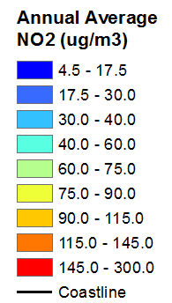
Example use of system
Results: contour plot of annual average NO₂
17 km
CAMx outer domain
Kowloon
ADMS-Urban RML domain
Consistency of background concentrations
Hong Kong Island
Notes:
3 processors on runs machines.

Slide 20
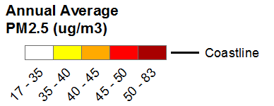
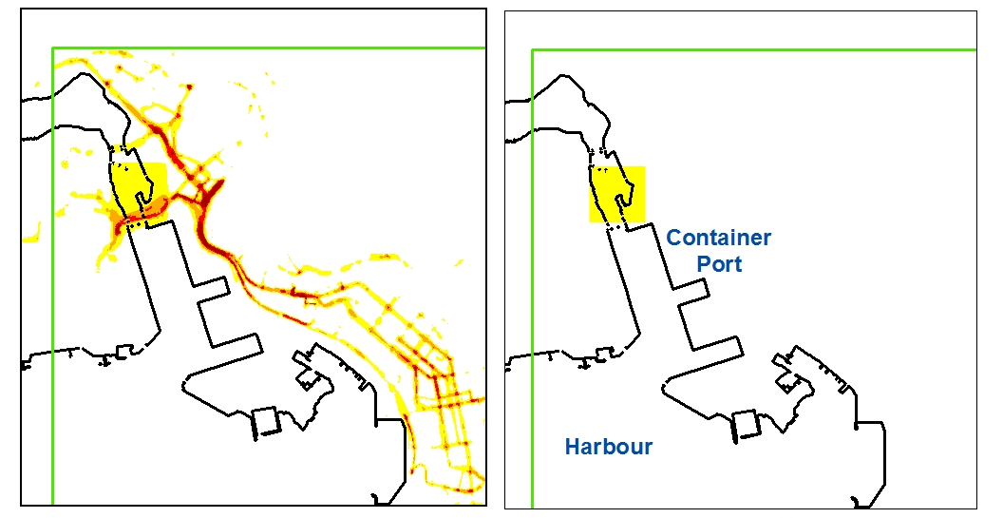
Example use of system
Results:
  Contour plot for PM_{2.5}
  Exceedences of the annual average air quality objective, 35 µg/m³
8 km
ADMS-Urban RML output
CAMx
Notes:
3 processors on runs machines.

Slide 21
Conclusions
Fully automated system based on Stocker et al. (2012) that nests the local dispersion model ADMS-Urban in a regional model (RM)
Full range of gaseous and particulate pollutant species modelled
Meteorology and background from each RM grid cell used in local modelling
In rural locations, ADMS-Urban RML results are the same as RM results, as there are no local sources
In urban locations, ADMS-Urban RML results differ from RM results, particularly for NO_{x} species where the effects of local sources and street canyon morphology dominate the concentrations
The example demonstrates that the ADMS-Urban RML performs better than CAMx at roadside sites

Slide 22

Acknowledgements
The ADMS-Urban RML system has been developed in collaboration with researchers from the Hong Kong University of Science and Technology, supported by the Hong Kong Environmental Protection Department.

Slide 23
System implementation
Running the system: meteorology
CERC utility used to extract ADMS-format .met files from WRF data for the nesting domain cell
Notes:
ΔT varies with the size of the regional model grid, the meteorological conditions and the details of the local emissions, although a uniform value of one or two hours forms an adequate approximation

Slide 24
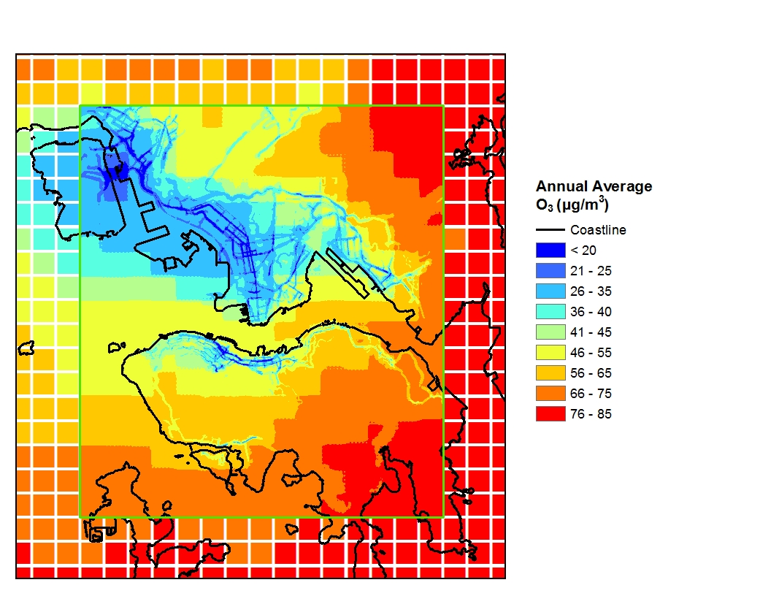
Example use of system
Results: contour plot of annual average O₃
15 km
CAMx outer domain
Kowloon
ADMS-Urban RML domain
Consistency of background concentrations
Hong Kong Island
Notes:
3 processors on runs machines.

Slide 25
System implementation
Installation

Slide 26
System implementation
System inputs
Notes:
In terms of inputs to the system, the regional model data is required in terms of WRF meteorological data files for the whole nesting domain; regional model data requires data for the domain plus a buffer or one cell in all directions.
3 ADMS-Urban model files are required as input: one run with gridded emissions used in the calculation of the urban background concentrations for each grid cell, a run with the explicit emissions where all road sources have representative geometry and associated information eg road widths and canyon heights, and a gridded run which is the same as the explicit run, but with no explicit sources.
Other user inputs are required: eg Spatial domain specifications, time period of interest, Run Manager configuration details, details of new development sources, not included in the regional model

Slide 27
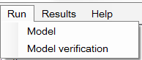
System implementation
Running the system
Notes:
First run Model verification to check that the model inputs and system configurations are set up correctly. Runs the system for a single hour. Check output. Then run Model.

Slide 28
System implementation
System outputs
Notes:
Output is calculated at single receptors when the model is run in verification model or over a grid of receptors when contour output is required, eg for exposure calculations. Output is in netcdf format, but one of the ADMS-Urban utilities converts this format to standard ADMS-Urban text files, which can be inspected and/or contoured using ADMS utilities and links to 3rd party software eg ArcGIS.

