Slide 1
Improvements to the characterization of organic nitrogen chemistry and deposition in CMAQ
Donna B. Schwede¹, Deborah Luecken¹, John Walker²,
George Pouliot¹, Wyat Appel¹, James Kelly³, Kirk Baker³
¹National Exposure Research Lab, US EPA, RTP, NC
²National Risk Management Laboratory, US EPA, RTP, NC
³Office of Air Quality Planning and Standards, US EPA, RTP, NC

Slide 2
Acknowledgements
Chris Lehman (National Atmospheric Deposition Program
DISCOVER AQ Team
CALNEX Team
Ron Cohen (Lawrence Berkeley National Laboratory)
Melinda Beaver (EPA)
Daiwen Kang (Computer Sciences Corporation)

Slide 3
Background & Motivation
Characterizing nitrogen deposition is important
  Excess nitrogen deposition can lead to acidification and eutrophication
    Decreases in forest growth
    Loss of species diversity and shifts in species distributions
    Harmful algal blooms
  Needed as input for critical loads assessments
    Critical load – threshold above which harmful effects occur
Studies estimate that organic N contributes 10-30% of total N budget
Current version of CMAQ provides only a basic treatment and greatly underestimates organic N deposition
Nitrogen species (except for NH3, NOx) are NOT included in the National Emission Inventory; emissions inventories are focused on ozone and PM which limits what we can model

Slide 4
Sources of Organic Nitrogen
Focus is here for now
(from Cape et al, 2011)

Slide 5
Organic N Speciation
Measurement techniques are improving and more speciated data are becoming available, but we still don’t know the complete picture
Many more organic N compounds are being measured than we have chemistry and emissions for
  Rocky Mountains study (Benedict et al, 2012) – 404 different nitrogen-containing organic compounds identified in air samples
  NJ study (Altieri et al, 2009) – 402 N-containing organic compounds determined in rainwater
Modeling 400+ species is not practical for air quality modeling

Slide 6
Current Treatment in CMAQ
Some organic N species such as PAN, PPN, and MPAN are explicitly modeled
Many N species are not explicitly tracked … the chem mechanism is targeted for ozone and lumps species by # of carbons
  Organic nitrates are lumped into NTR (CB05), RNO3 (SAPRC)
  e.g. dimethyl amine – ALK5 in SAPRC07 and ALD2 in CB05
Species are lumped for wet deposition and deposition velocity calculations

Slide 7
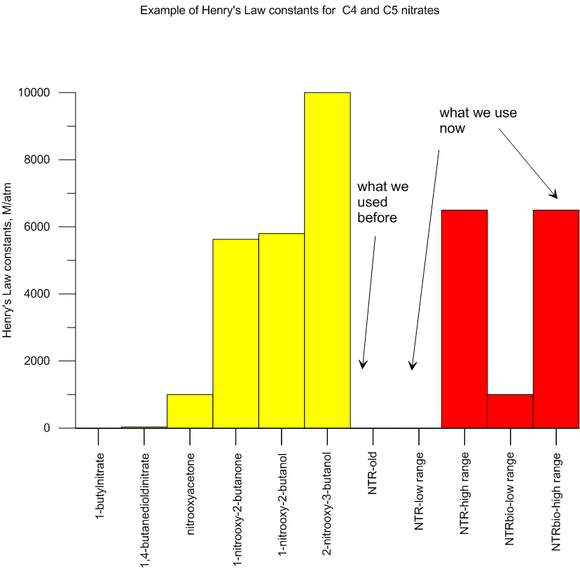
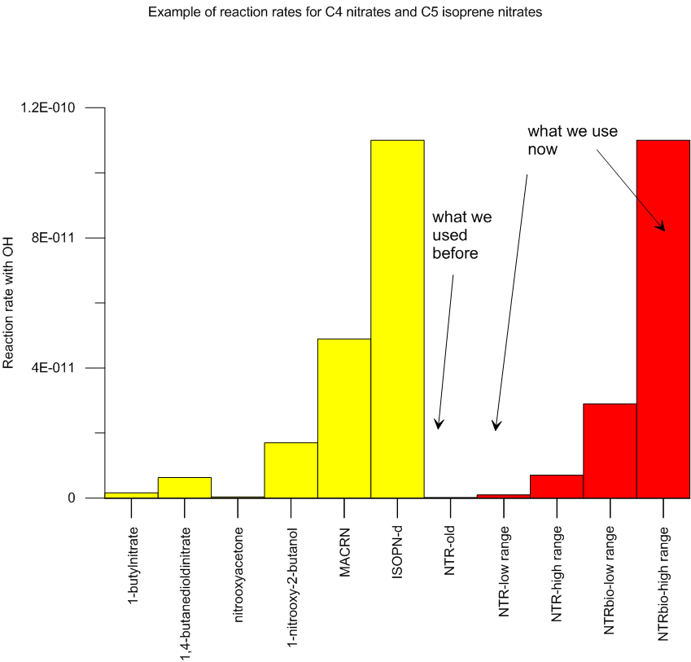
Differences Between Species
Henry’s Law (affects dry and wet deposition)
Reactivity (affects chemical lifetime)

Slide 8
New Approach in CMAQ
Species | Functional groups | Reaction rate with OH | Photolysis rate | Solubility | Represents
NTRALK | -ONO2 | low | low | low | First generation nitrates from alkanes
NTROH | -ONO2, -OH | low | low | high | First generation nitrates from alkene
NTRCN | -ONO2, =O | Med-high | high | Low-med | Second+ generation carbonyl and aldehyde nitrates
NTRCNOH | -ONO2, =O, -OH | Med-high | high | high | Second+ generation hydroxycarbonyl nitrates
NTRPX | -ONO2, -OOH, | med | high | high | Anthropogenic nitrates formed from reaction with HO2
NTRM | C=C, -OH, -ONO2 | high | low | high | First generation nitrates from biogenics
NTRI | -ONO2, -OH, =O | high | high | high | Second+ generation nitrates from biogenics
*** See Deborah Luecken’s poster for details

Slide 9
CMAQ Run summary
CMAQ model Configuration
  CMAQ v5.0.2
    New BEIS algorithm
    Bidirectional NH3
    CB05 (base and new (E7))
    Enhanced O3 dep due to ocean iodide
    GEOS-Chem boundary conditions
  Met
    WRF v3.4
    KF Trigger
    PX LSM
    ACM2

Slide 10
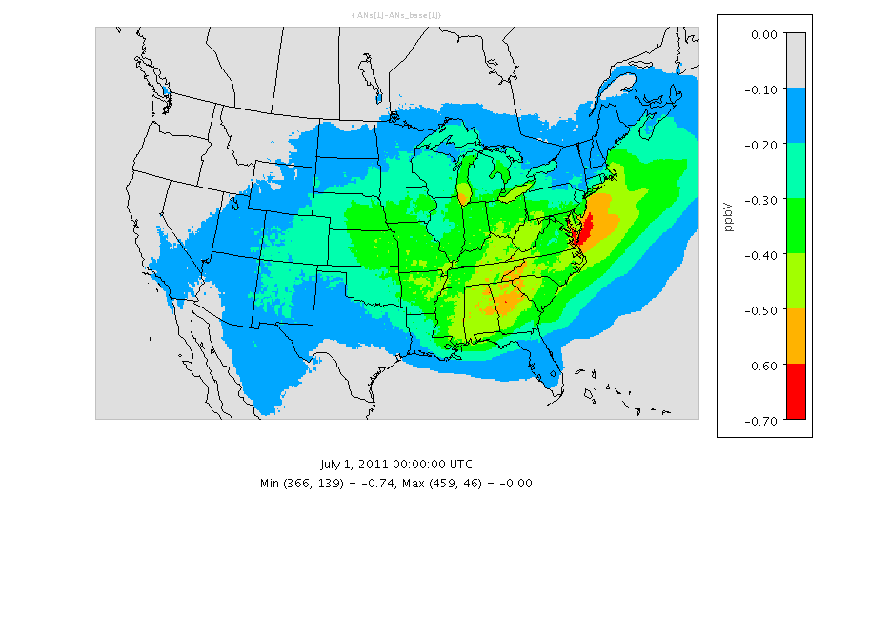
Difference in Concentration
Difference (new - base) in monthly average concentration of total organic alkyl nitrates in the atmosphere between new scheme and base scheme.

Slide 11
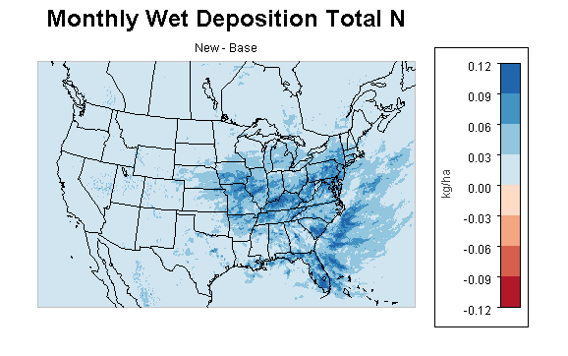
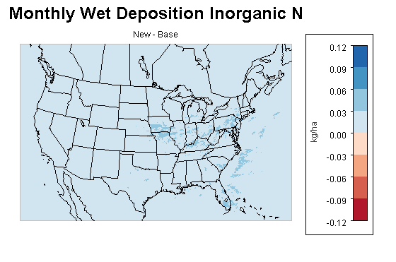
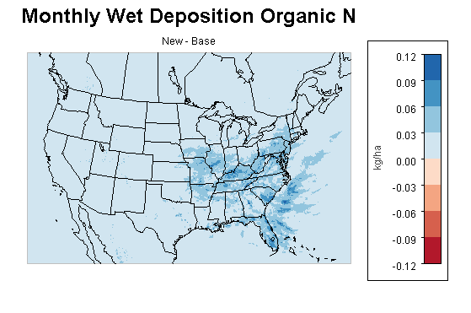
Difference in Wet Deposition
New - Base

Slide 12
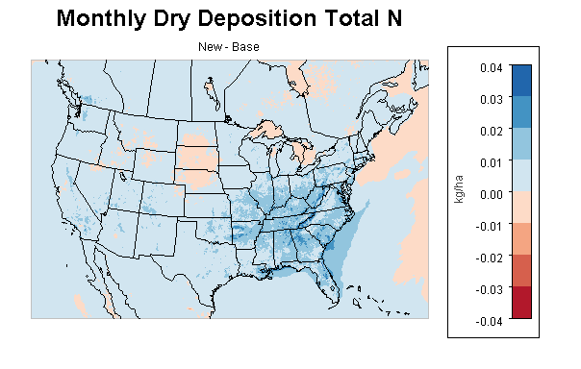
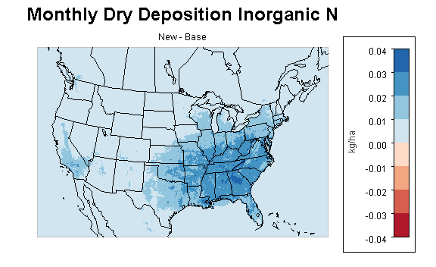
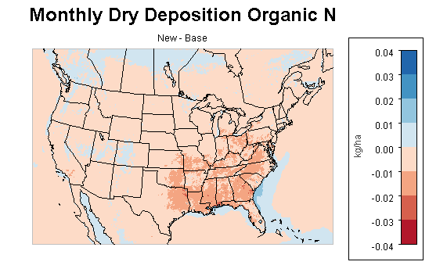
Difference in Dry Deposition
New - Base

Slide 13
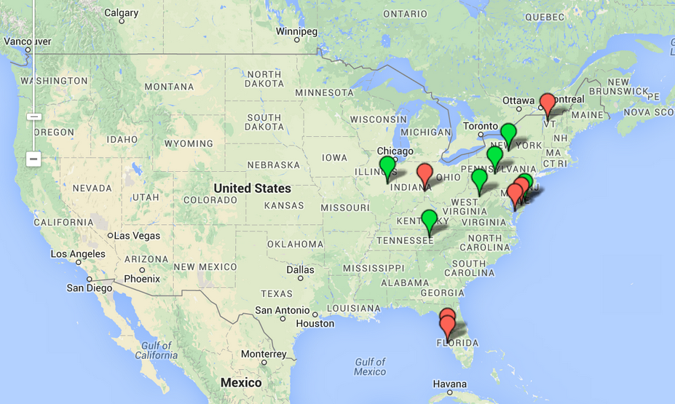
Comparisons w/ Measurements
Field studies
  Bondville, IL wet deposition study
    2010 study designed to explore feasibility of measuring wet deposition of bulk Organic N concentrations at NTN and AIRMoN sites
    Wet only collector (no dry dep interference); not filtered (filter can introduce organics); refrigerated samples
    Organic N by difference

Slide 14
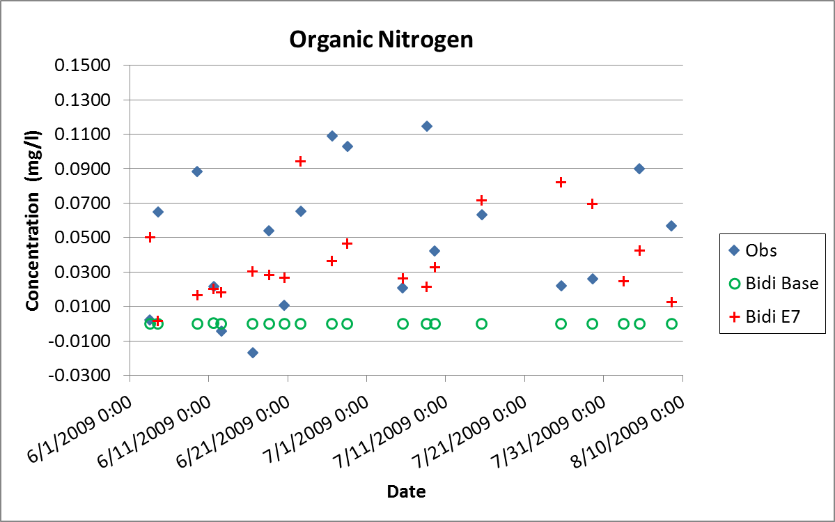
Bondville – Precipitation Chemistry

Slide 15
Comparisons w/ Measurements
Air Quality System (AQS) Sites
  Ambient air quality monitoring information from EPA, state, local, and tribal agencies
  5000 current monitors

Slide 16
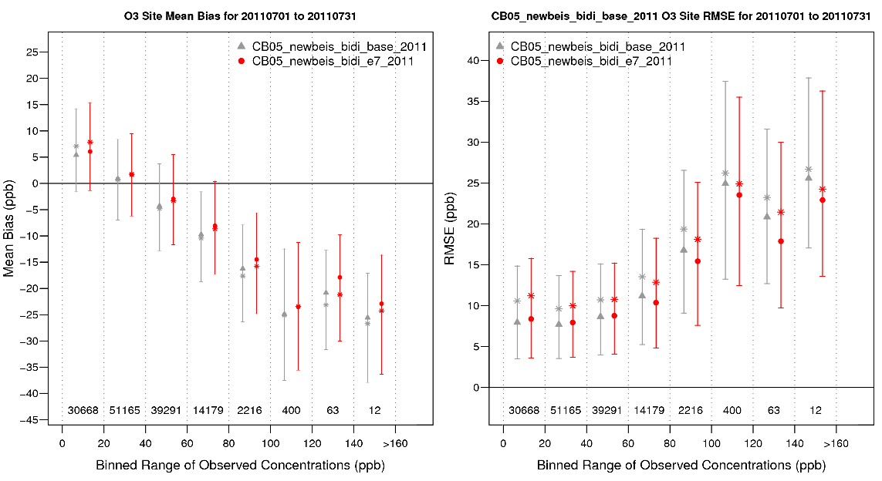
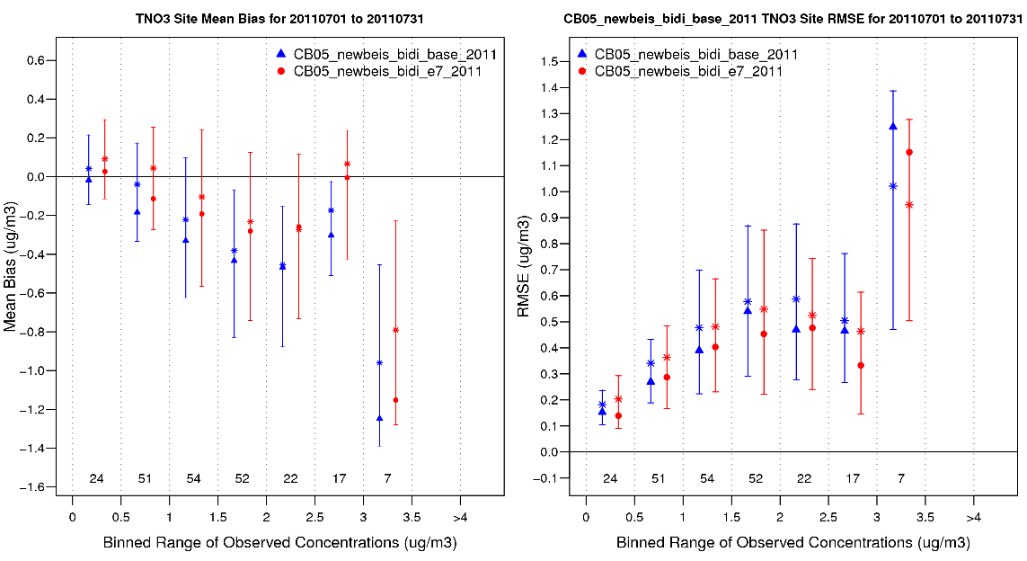
AQS Concentrations - 2011
O₃
Total Nitrate

Slide 17
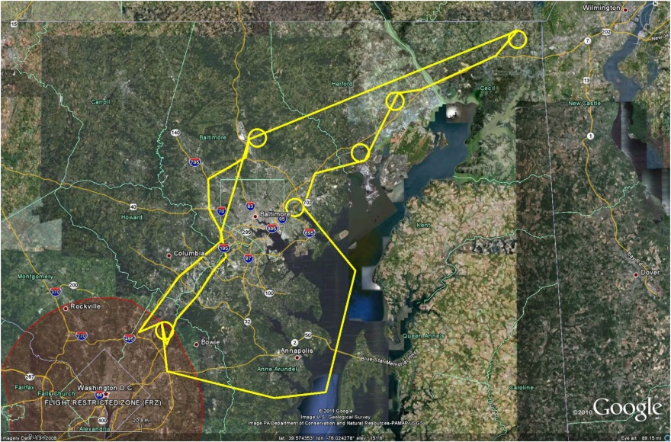
Comparisons w/ Measurements
Field studies
  Deriving Information on Surface Conditions from Column and Vertically Resolved Observations Relevant to Air Quality. (DISCOVER-AQ) Baltimore, MD
    2011 study combining satellite, airborne, and ground-based observations to study urban air pollution

Slide 18
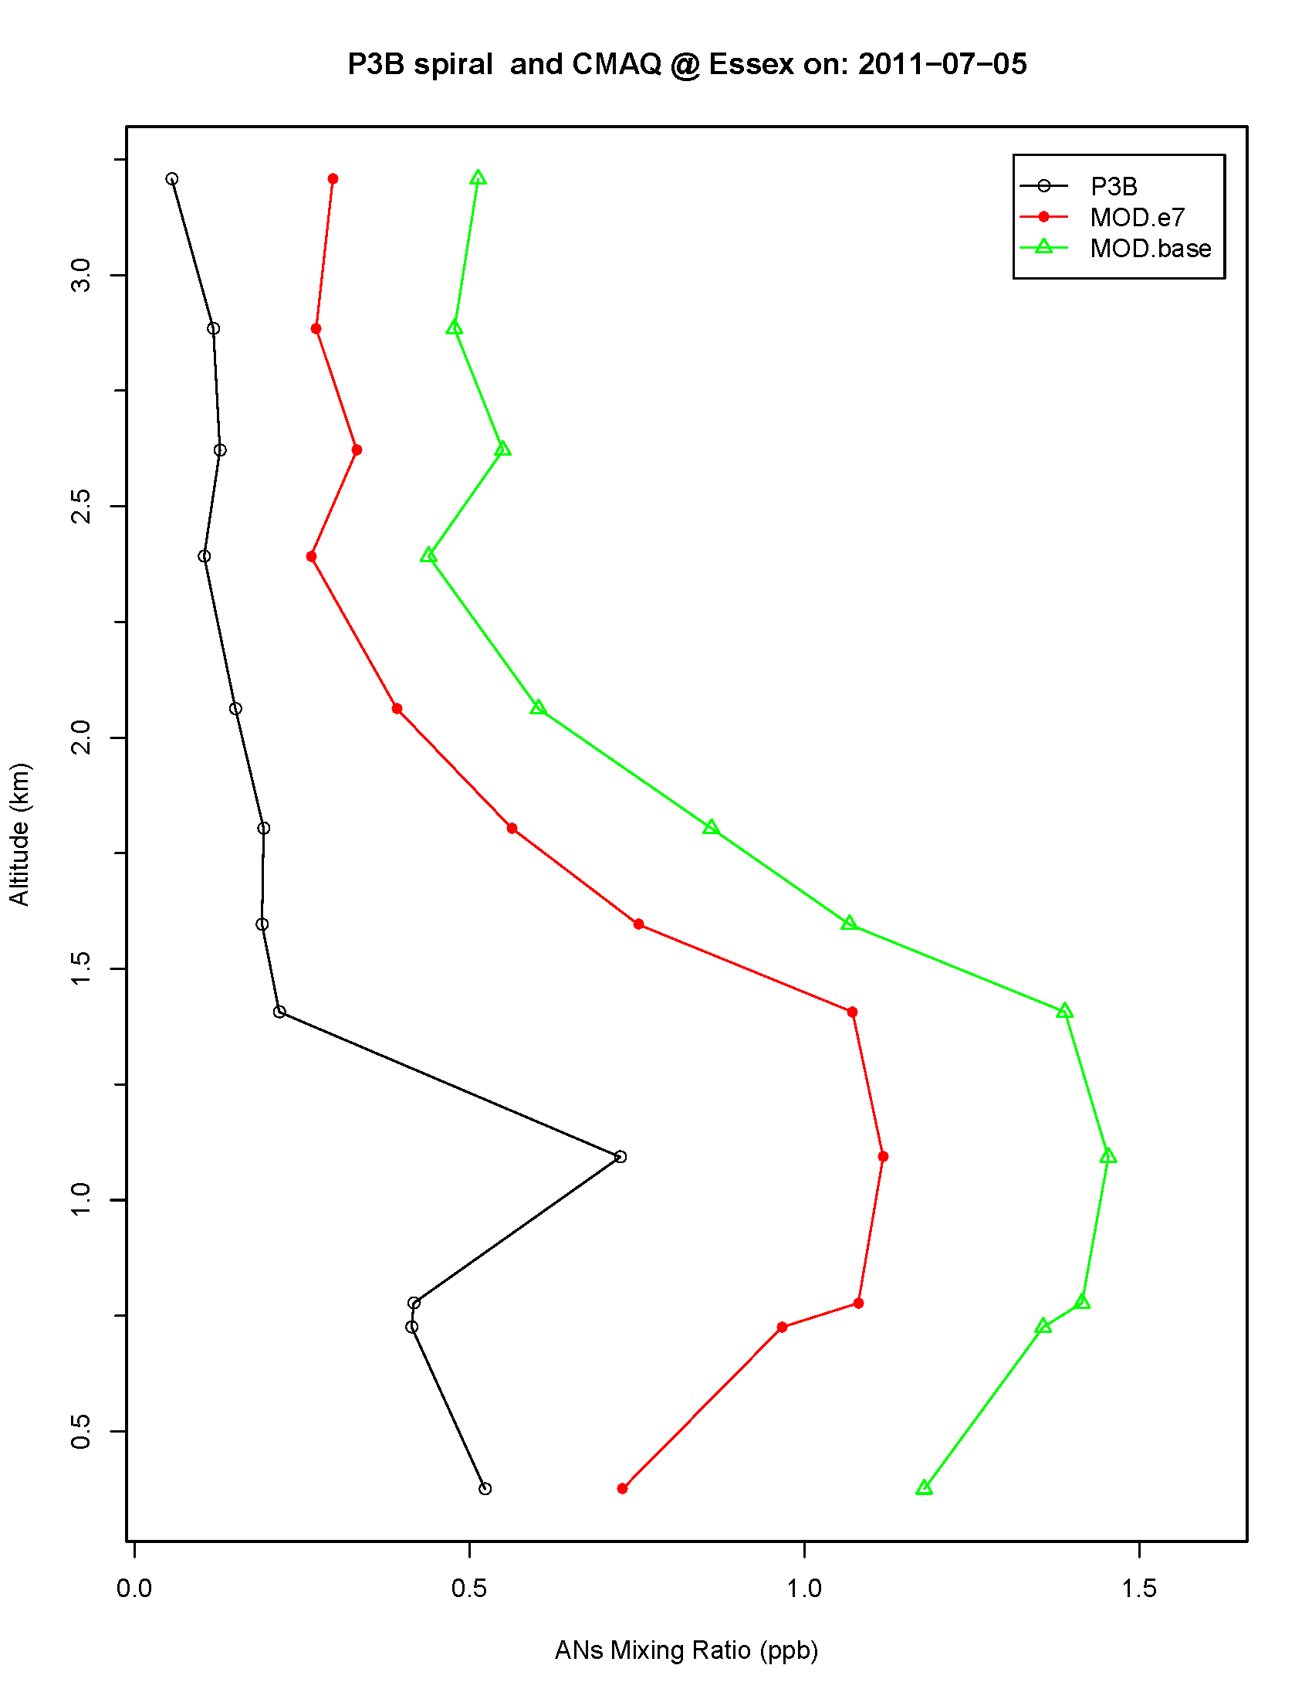
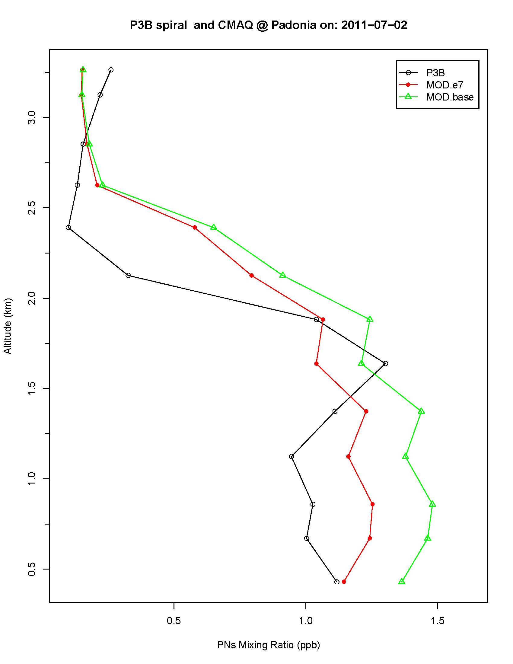
DISCOVER - AQ
ANs – Alkyl Nitrates
(NTRx)
Essex Site
PNs – Peroxyacyl Nitrates
(PAN, PANx,OPAN, MPAN)
Padonia Site

Slide 19
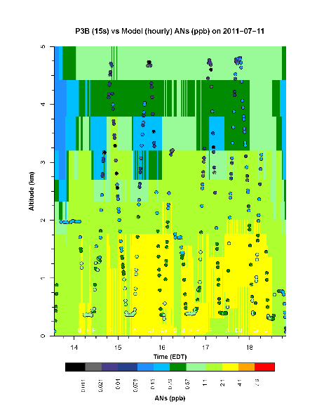
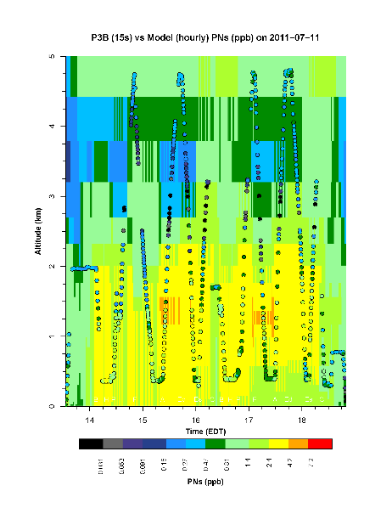
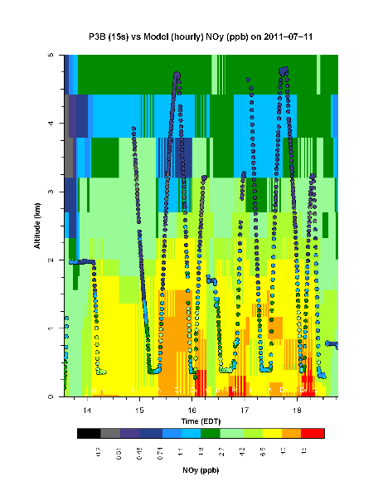
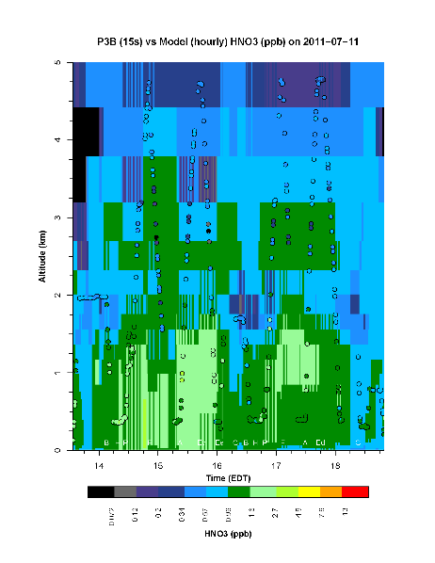
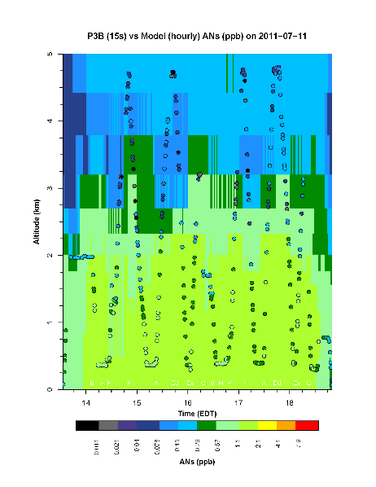
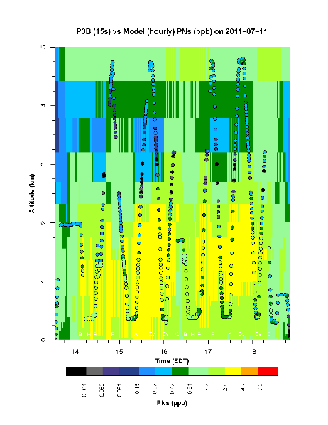
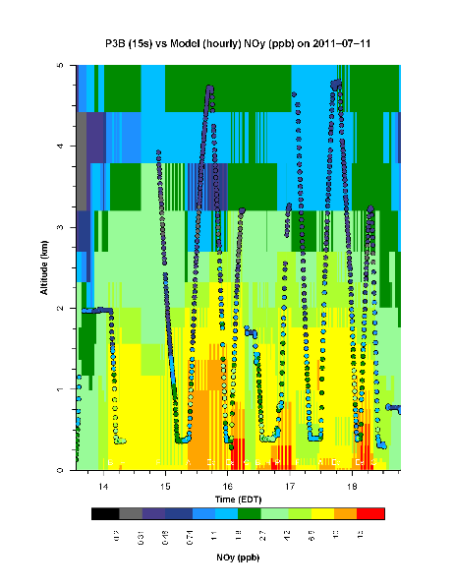
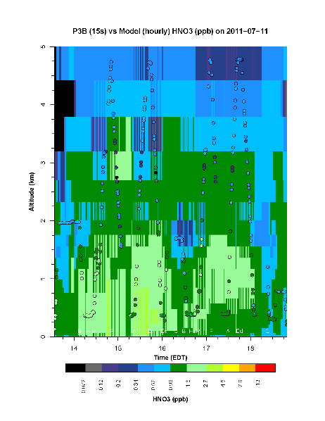
DISCOVER-AQ
ANs
PNs
NOy
HNO₃
Base
New (E7)

Slide 20
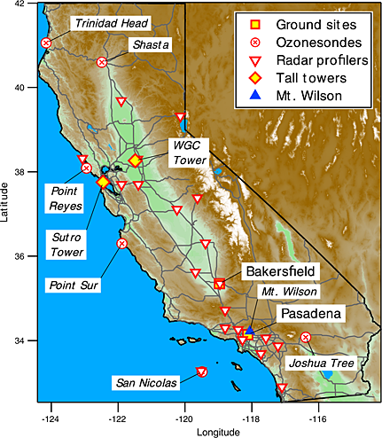
Comparisons w/ Measurements
Field studies
  California Research at the Nexus of Air Quality and Climate Change (CALNEX) – Bakersfield, CA
    2010 study combining satellite, aircraft, and ground-based observations to study atmospheric transport and chemistry and emissions inventories

Slide 21
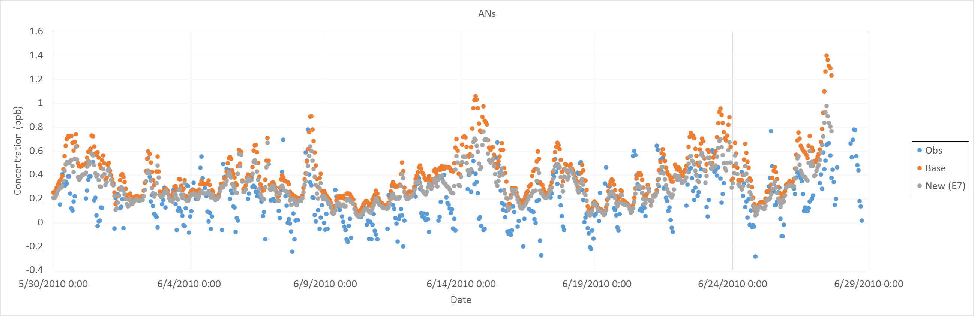
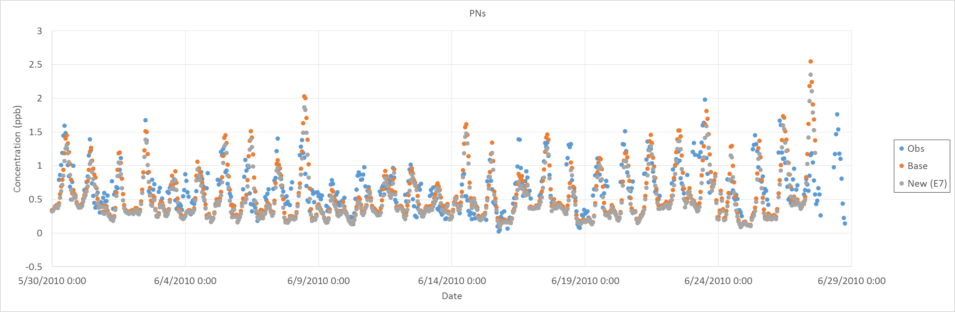
CALNEX
ANs
PNs

Slide 22
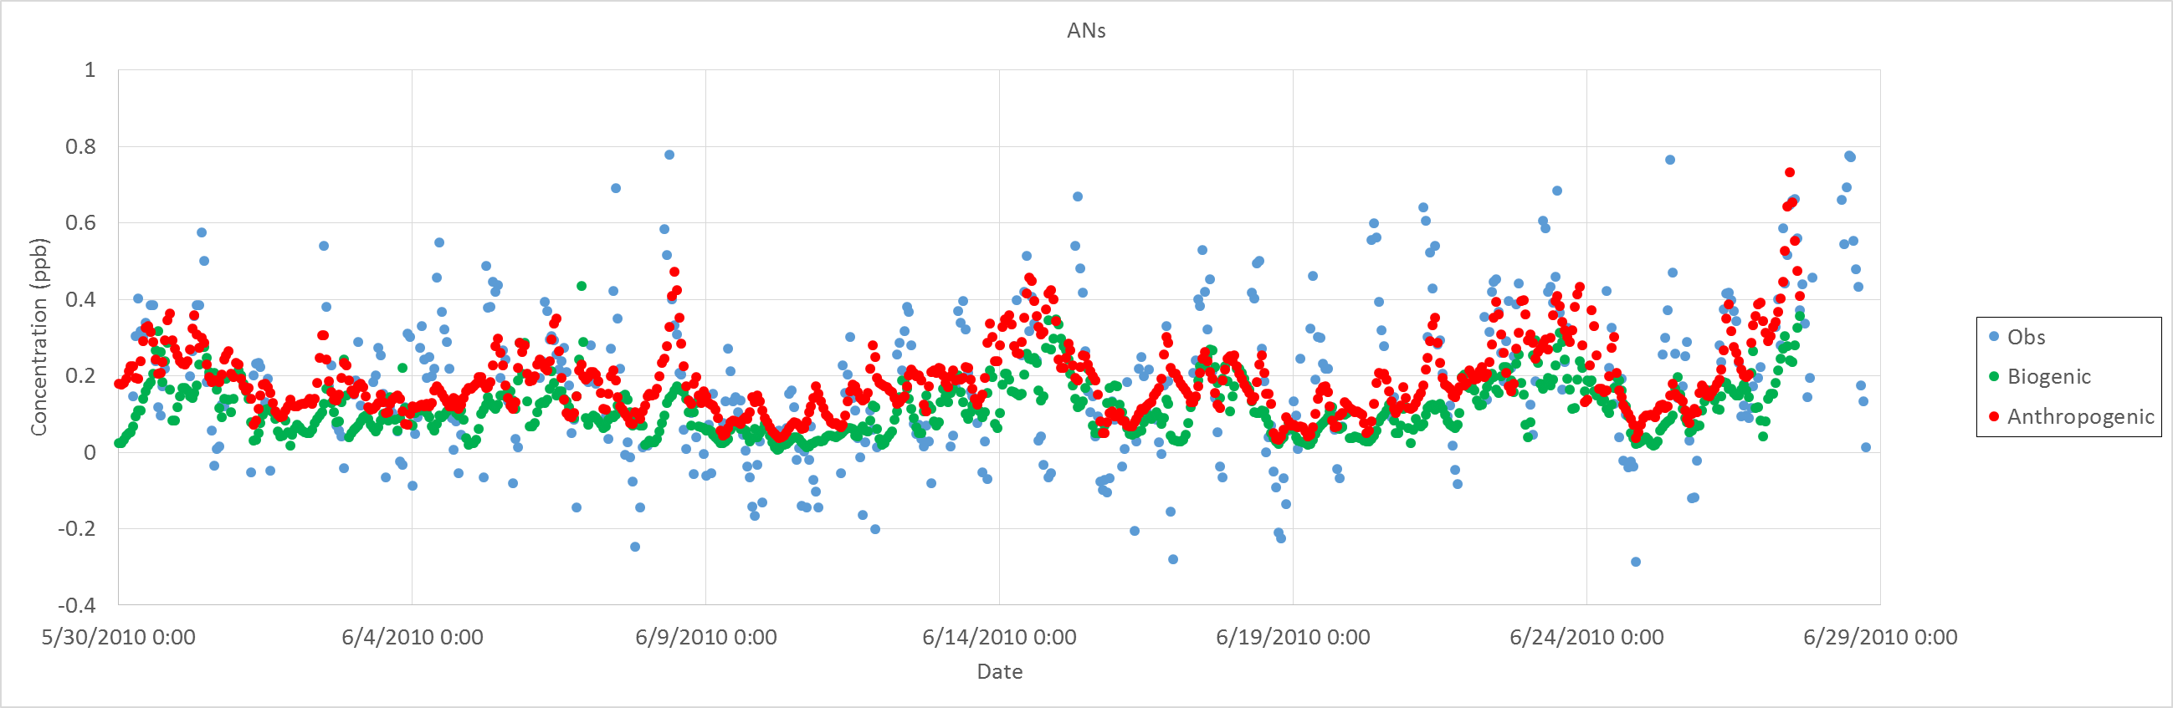
CALNEX
ANs

Slide 23
Summary
Understanding of chemistry and emissions of organic N is a rapidly growing field, but there is still much to learn and improve in the modeling
Organic N is an important component of the nitrogen budget, but has been historically underpredicted
Recent changes to the organic N treatment in CMAQ have resulted in improved model performance
Additional comparisons with measurements are needed

Slide 24
Future Work
Expand evaluation using other data sets
Begin working on model improvements for other organic N species
  Amines – importance in OH reactivity
Chemical mechanism work
  Expand the focus of chemical mechanisms beyond ozone/PM
  Track more of the nitrogen species explicitly
Improve emissions characterizations to include nitrogen species other than HNO3 and NOx

