Slide 1
Updates to EPA’s 2011 Emissions Modeling Platform
October 29, 2014
Alison Eyth, Alexis Zubrow, Rich Mason
EPA Office of Air Quality Planning and Standards
Emission Inventory and Analysis Group

Slide 2
Background: Purpose and Contents of a Modeling Platform
Modeling platforms are used to support EPA regulations and other analyses, e.g.
Regulatory Impact Assessments and Designations for NAAQS, Transport Rules, National Air Toxics Assessment
Purpose:
Provides comprehensive air quality modeling system that uses the most recent technically sound data and state-of-the-science tools available.
Major components:
Air quality models (CMAQ, CAMx)
Meteorological models (WRF) and met. data
Boundary conditions (GEOS-Chem)
Emissions: base year (NEI), projected to future years
Other: ancillary data for emissions modeling, projections data, emissions modeling tools (SMOKE, etc) and scripts

Slide 3
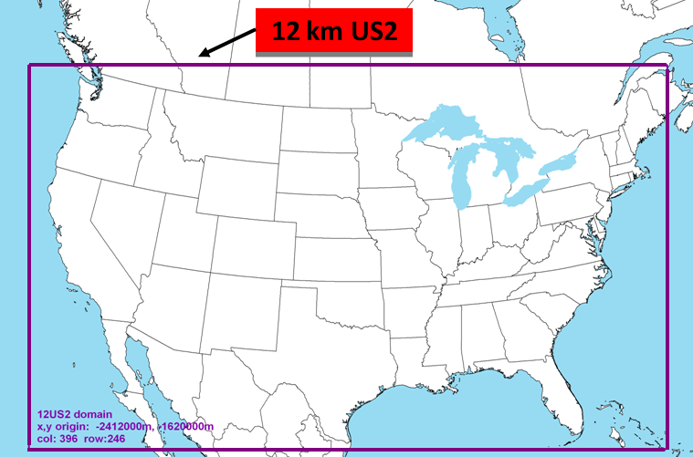
2011 Platform Modeling Domain

Slide 4
Base Year Emissions: 2011 National Emissions Inventory
Data is submitted by states, locals, tribes (S/L/T) and EPA into the Emissions Inventory System
Five categories
Point/Facility Inventory (point locations)
Nonpoint (county-based)
Onroad mobile sources
Nonroad mobile sources
Events (e.g., Fires)
EPA and S/L/T data is interleaved to create the NEI
http://www.epa.gov/ttn/chief/net/2011inventory.html
2011 NEI Version 2 to be released soon!

Slide 5
Emission Inventory Updates to 2011 Modeling Platform
U.S. emissions based on 2011 NEI Version 2
Revisions submitted during comment period (3/31/14)
Oil and gas updates both from EPA and states
Residential wood combustion updates
Agricultural burning reductions in the Midwest
Redistribution of Commercial Marine Vessel emissions
Gulf of Mexico emissions updated to 2011
Updated biogenic emissions based on BEIS v3.6
MOVES 2014 for onroad emissions
Non-US emissions included in the platform
Canada 2010 emissions & spatial surrogates (courtesy Environment Canada)
Mexico 2008 emissions – compiled from the Inventario Nacional de Emisiones de Mexico, 2008

Slide 6
2011v2 Platform Non-Continental U.S. Point Source NOx

Slide 7
2011v2 Platform Non-U.S. Nonpoint Source NOx

Slide 8
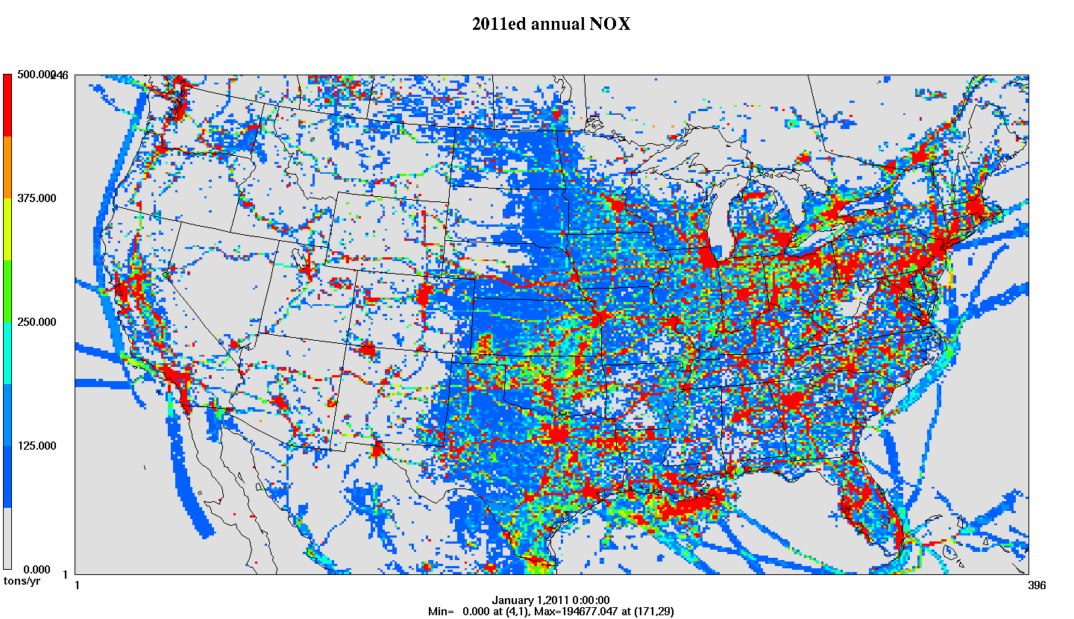
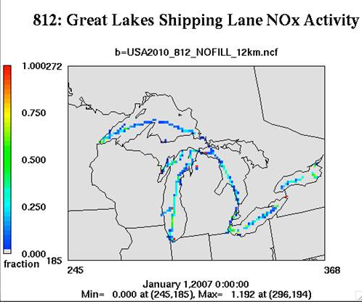
Emissions Modeling Process
Steps needed to convert emissions inventories into the resolution and formats needed by air quality models.
Temporal Profiles
Inventories (annual/ monthly/daily)
Speciation Profiles
Gridded, hourly, speciated emissions for air quality modeling
Spatial Surrogates

Slide 9
Major Changes to Onroad
New Source Category Codes map closely to MOVES
Speciation now done in MOVES (see Sontag/Zubrow for more information)
More representative counties for Con. US (284 vs 163)
Improved spatial surrogates
extended idling locations (truck stops)
urban/rural unrestricted roads
off-network short/long haul trucks
bus stops
Improved temporal profiles
2012 Vehicle Travel Information System (VTRIS)
Reported traffic count data to the Federal Highway Administration (FHWA)
Varies by state, HPMS vehicle (10, 20, 30, …) and road type
Distinct hourly / diurnal profiles for weekdays/Sat/Sunday
Day of the week profiles (i.e. Monday vs Tuesday vs …)

Slide 10
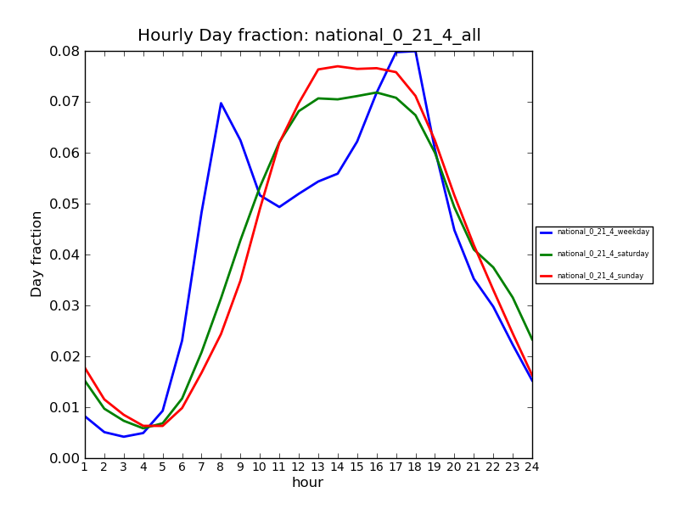
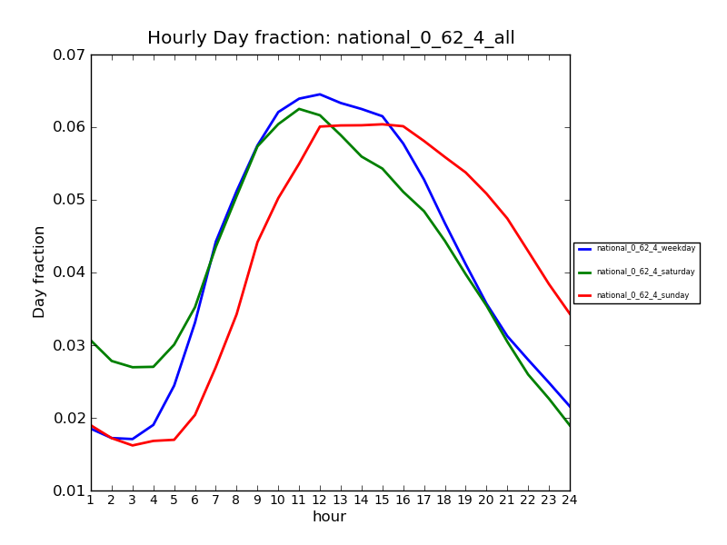
National Diurnal Temporal Profiles
Days of week: Blue weekday, Green Sat, Red Sun
Passenger cars
Urban restricted
Combination truck long-haul
Urban restricted

Slide 11
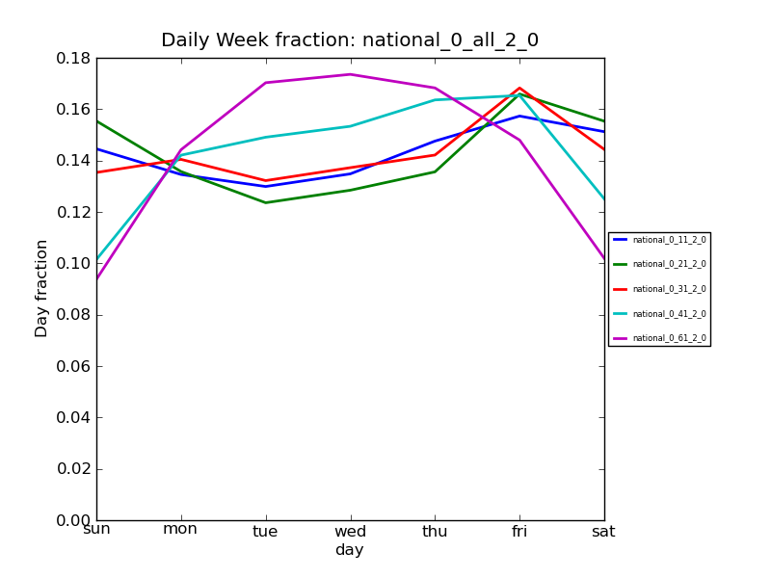
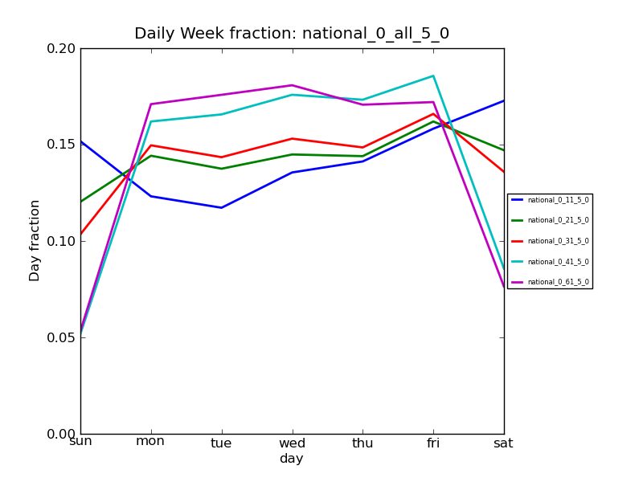
National Day of Week Temporal Profiles
Rural restricted:
light-duty have Friday peak
Urban unrestricted: more traffic weekdays
Notes:
Note range is smaller on rural restricted, i.e less variation by day

Slide 12
Other profile updates
Speciation profiles consistent with SPECIATE 4.4
Industry wide composite profiles for Pulp & Paper and Chemical manufacturing reduce references to 0000 profile
Reassignments of temporal profiles based on comments
Adjusted assignments of sources with zero Sunday emissions
Adjusted oil and gas temporal profiles based on new month-specific data and default temporalization for more categories assigned to 7 days x 24 hour profiles
Adjustments to Electric Generating Unit profiles
Smoothed CEMS data before developing profiles to remove spikes from non-measured data points
Assigned profiles for partial-year reporters so that emissions are allocated to the non-reporting period based on regional averages

Slide 13
Outputs from UNC’s CEMS Data Correction Tool
Emissions spikes adjusted to average values when they are not flagged as measured in CEMS data flags

Slide 14
BEIS 3.6: Updated Biogenic Emissions
Updated leaf temperature algorithm
Leaf temperature calculated using canopy model rather than 2 meter temperature
Land use based on:
U.S. National Land Cover Database (NLCD) 2006
Moderate Resolution Imaging Spectroradiometer (MODIS) for Canada and Mexico
Forest areas constrained by canopy coverage
Tree species from USFS Forest Inventory and Analysis (FIA) data v5.1
Selected surveys from 2002 to 2012 to get a complete decadal US survey that bounds the years being modeled

Slide 15
July Biogenic Isoprene from BEIS 3.6

Slide 16
July ISOP Difference BEIS 3.6 – BEIS 3.14

Slide 17
SMOKE 3.6 Updates
MOVES 2014 support
Speciation done within MOVES
Computational speed-ups support handling more reference counties in the same time as before
New rate-per-hour mode for extended idling of trucks
Control factors can be input to Movesmrg by representative county and pollutant
Better support for source apportionment
Includes BEIS 3.6
New temporal profile and cross reference format
Database-friendly .csv format with more flexibility
V3.6 Coming soon! See http://smoke-model.org

Slide 18
2011 Emissions Modeling Platform Development: Steps and Timing
Item | Timeframe
2011 runs based with new platform | November-December 2014
Release 2025 O3 NAAQS data (2011v1) | December, 2014
Develop Future Year Projections | November-December 2014
Future Year Runs | Starting January 2015
EPA posts emissions modeling platform inventories and other data on the CHIEF Emissions Modeling Clearinghouse: http://www.epa.gov/ttn/chief/emch

Slide 19
Thank you to all the contributors to our tools, runs, and data…
EPA OAQPS NEI Team and Data Analysis Team
EPA OAQPS Air Quality Modeling Group
EPA Office of Research and Development
UNC Institute for the Environment
CSC
ERG
ENVIRON
Environment Canada
Regional Planning Organizations
States
Industry
Researchers

Slide 20
Please join us at the 2015 International Emission Inventory Conference!
Doubletree Hotel in San Diego, California
April 13-16, 2015
Abstracts due November 28, 2014 Training offered April 13-14, 2015
For more information, see:
http://www.epa.gov/ttn/chief/conferences/ei21/index_papers.html
Photo courtesy pdphoto.org: http://pdphoto.org/PictureDetail.php?mat=pdef&pg=8864

