Slide 1
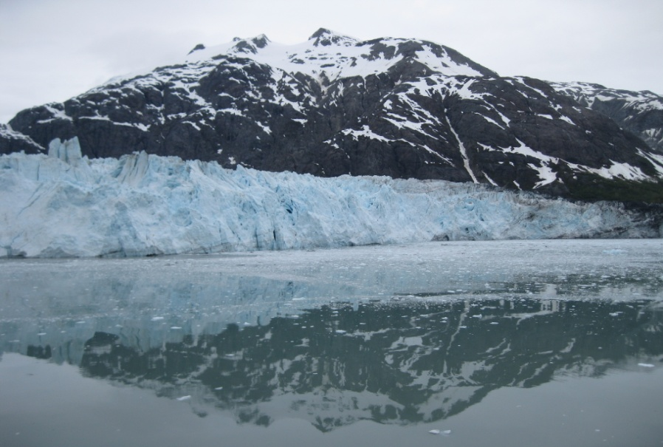
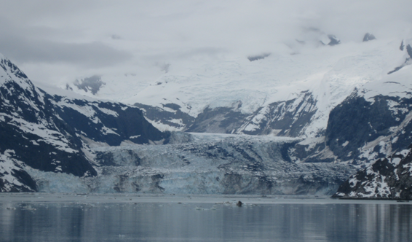
Development and Status of EPA’s 2011 Modeling Platform
October 29, 2013
Alison Eyth, Rich Mason, Alexis Zubrow
Glacier Bay, Alaska, June 2013

Slide 2
Purpose and Contents of a
Modeling Platform
Modeling platforms are used to support EPA regulations and policy-related analyses
Purpose:
  To provide a comprehensive air quality modeling system using the most recent technically sound data and state-of-the-science tools available.
Major components:
  Modeling domain
  Air quality models, meteorological models and data, boundary and initial concentrations
  Base year emissions data, projected future year emissions projections data, emissions modeling ancillary data and emissions modeling tools and scripts

Slide 3
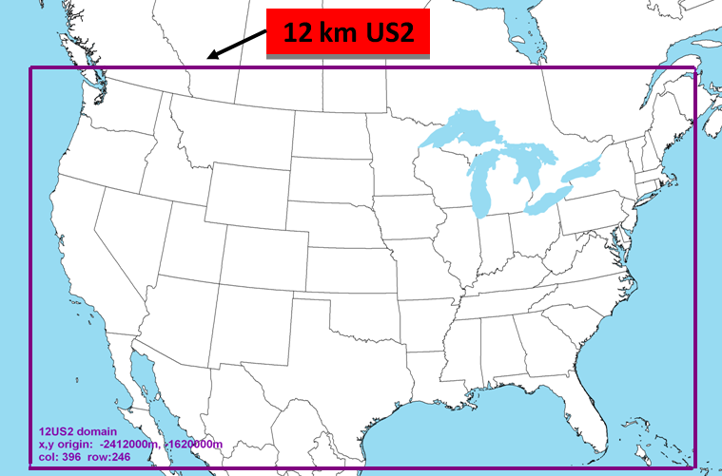
2011 Platform Modeling Domain

Slide 4
2011 Modeling Platform
Used for Transport Rule, O3 NAAQS RIA, 2011 National Air Toxics Assessment, …
Supports both CMAQ and CAMx
WRF for meteorology
GEOSChem for initial and boundary conditions
Emissions based on 2011 NEI Version 1
Non-US emissions included in the platform are:
  Mexico 2012 (projected from 1999)
  Canada 2006

Slide 5
2011 National Emissions Inventory
Released September 30, 2013 (fastest ever)
  http://www.epa.gov/ttn/chief/net/2011inventory.html
Data is submitted by states, locals, tribes and EPA into the Emissions Inventory System
Five categories
  Point/Facility Inventory (point locations)
  Nonpoint (county-based)
  Onroad mobile sources
  Nonroad mobile sources
  Events (e.g., Fires)
EPA and S/L/T data is interleaved to create the NEI

Slide 6
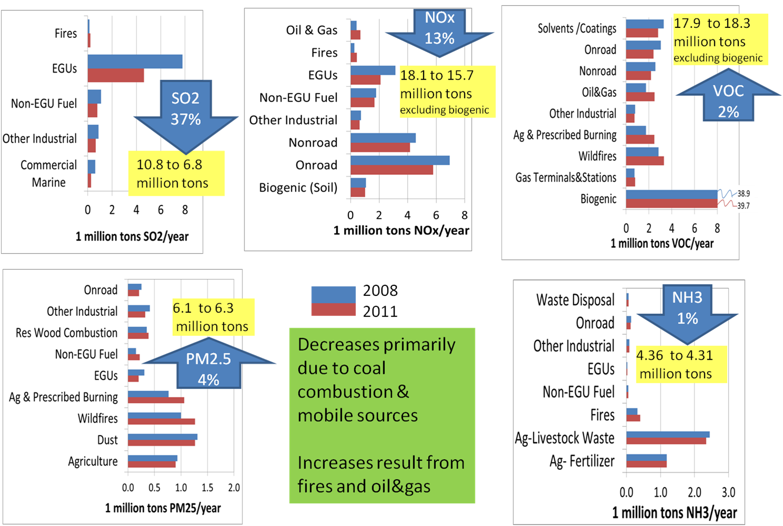
Changes from 2008 to 2011 NEI (see poster by Madeleine Strum)

Slide 7
Emissions Modeling -
High-level Overview
Emissions modeling converts annual (or monthly) point- or county-based inventories into hourly emissions for each model grid cell, in a format the air quality model can use
SMOKE is the emissions model used by EPA:
http://smoke-model.org
Emissions Modeling Framework is used to manage data and model runs
EPA posts emissions platform data, once available, on the CHIEF Emissions Modeling Clearinghouse
  http://www.epa.gov/ttn/chief/emch
  Inventory and some activity data
  Ancillary data for speciation and spatial and temporal allocation
  Watch for 2011 platform to be posted soon!
  Projected data for future years to be posted once available

Slide 8
Deriving Platform Inventories from the NEI
NEI data is output from EIS as ‘flat files’ for each category except fires
  Point fire data developed for NEI and modeling platform
Point and nonpoint data is divided into modeling sectors according to how they are processed through SMOKE
  Point -> ptegu*, ptegu_pk*, ptnonipm, pt_oilgas*
  Nonpoint -> afdust, ag, c1c2rail, np_oilgas*, nonpt, rwc*
  * indicates a new sector for 2011 platform
  Great Lakes CMV emissions replaced with LADCO inventory
  Missing ethanol plants added
NEI onroad and nonroad data are developed by running MOVES and NMIM, respectively, and then entering summarized data into EIS
  Modeling sectors: onroad, onroad_rfl, nonroad
  Special adjustments made for CA and TX to state-provided values
C3marine is point data in platform and shapes in NEI and has some differences in emission values

Slide 9
2011 Platform Onroad Emissions
2011 NEI: MOVES activity data/inputs obtained directly from states for the first time
  Using state inputs for VMT and VPOP but not fuels
  Temporal profiles developed based on state inputs (Zubrow talk)
  State inputs include inspection / maintenance programs, age distributions, etc.
MOVES county databases (CDBs) received from more than 30 agencies
EMFAC-based emissions for California (per their submittal)
SMOKE-MOVES used to generate NEI for most states
  Provides hourly, speciated, gridded emissions for the AQM
  Use of representative counties offers computational advantages and works with cloud computing
  Representative counties updated for v1 based on input
  from states

Slide 10
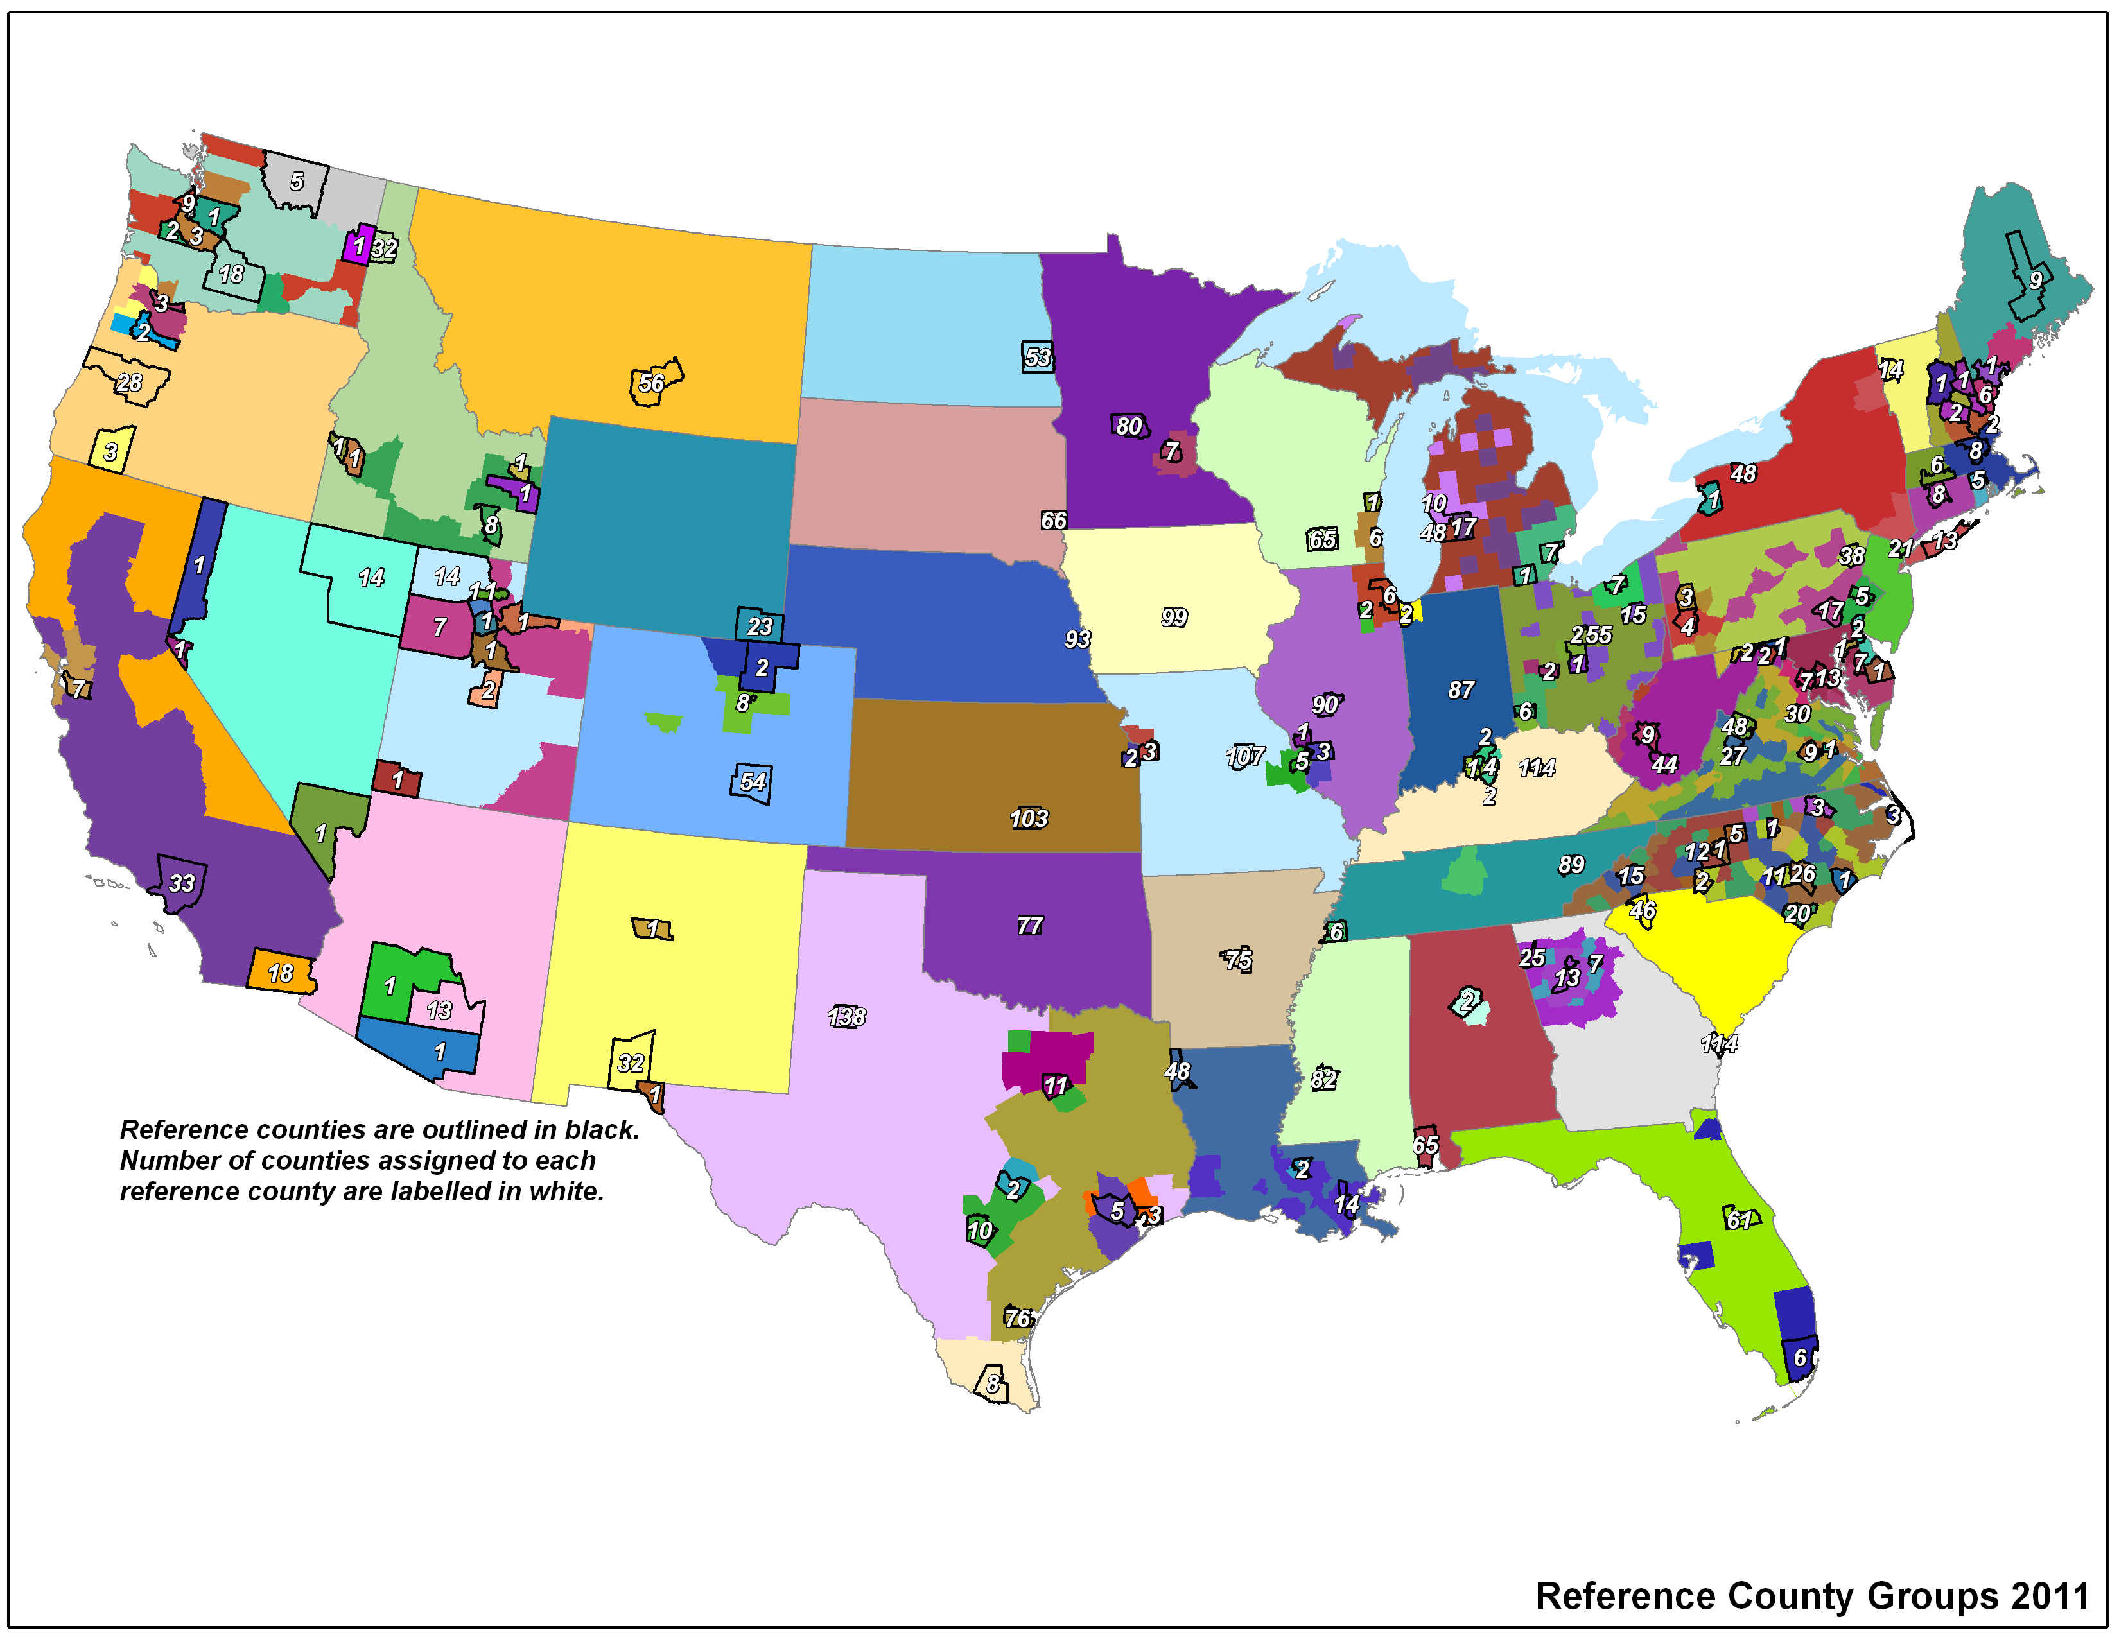
SMOKE-MOVES Representative County Groups
Notes:
Updated rep counties from 2007 platform. Now have at least 1 county per state which allows state inputs to be directly used for that state.

Slide 11
EGU Temporal Profiles
Continuous Emissions Monitoring System (CEMS) data for NO_{x}, SO₂, and heat input is used to temporalize emissions when it is available
For sources without CEMS data, temporal profiles are derived from sources that do have data
  Profiles take emissions from annual->month,
  month->day, and day->hour
  Peaking units removed from the average profiles
  Profiles developed for each IPM region and fuel
    Fuel types used are coal, gas, and other
  New for 2011: Year-specific temporalization to be preserved as much as possible into future years
New units in the future year are temporalized using the region and fuel-specific profiles

Slide 12
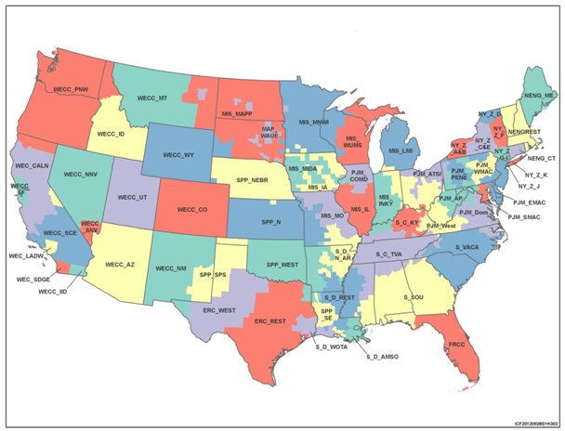
64 IPM Regions Used in v5.13

Slide 13
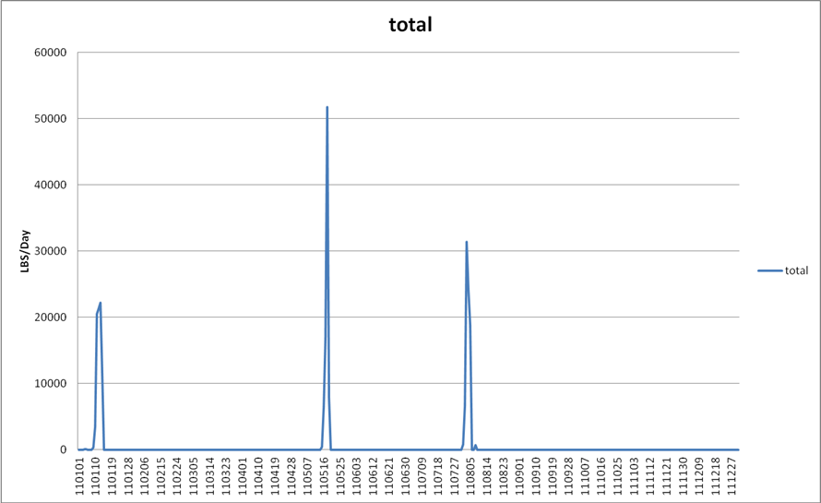
Example of a Peaking Unit
Emissions each day of the year

Slide 14
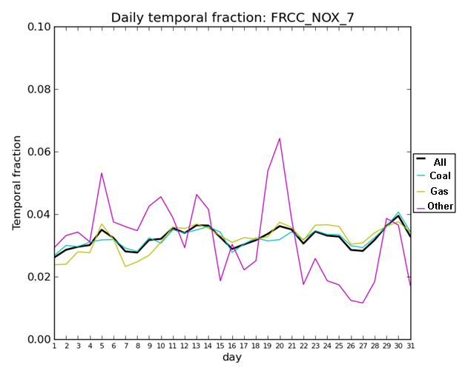
Example of Non-Peaking Units in July in Florida
Notes:
Left plot shows example of peaking unit. Notice the emissions are restricted to just a few days. Right plot looks at non-peaking units for a FL region for month->day temporalization. These have been averaged by fuel and then averaged over all fuels (black).

Slide 15
Spatial Surrogates
Use circa 2010 data (census, FEMA, National Transportation Atlas Database 2011)
Oil and gas surrogate updates for Northeast and WRAP
Commercial Marine Vessel improvements in Great Lakes and Gulf

Slide 16
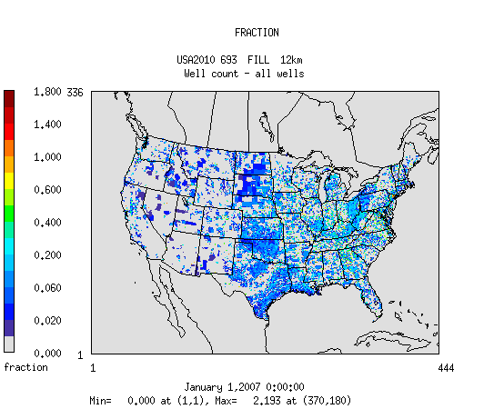
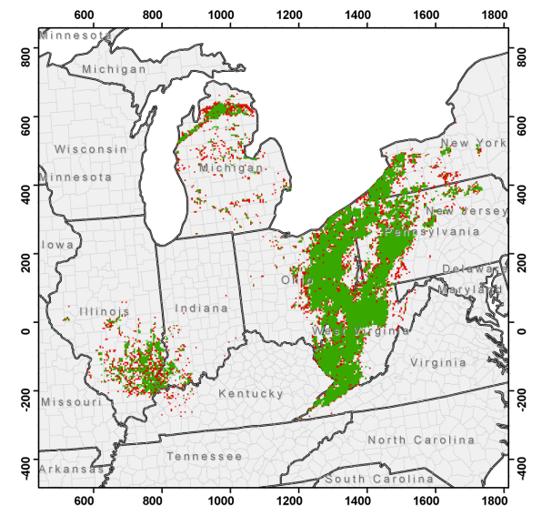
Updated Oil and Gas Surrogates
New Surrogate includes Marcellus shale region in the Northeast (has new emissions in 2011)
WRAP States Updated

Slide 17
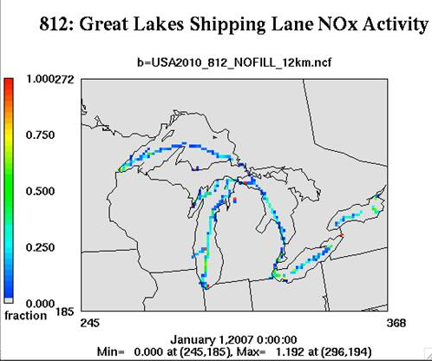
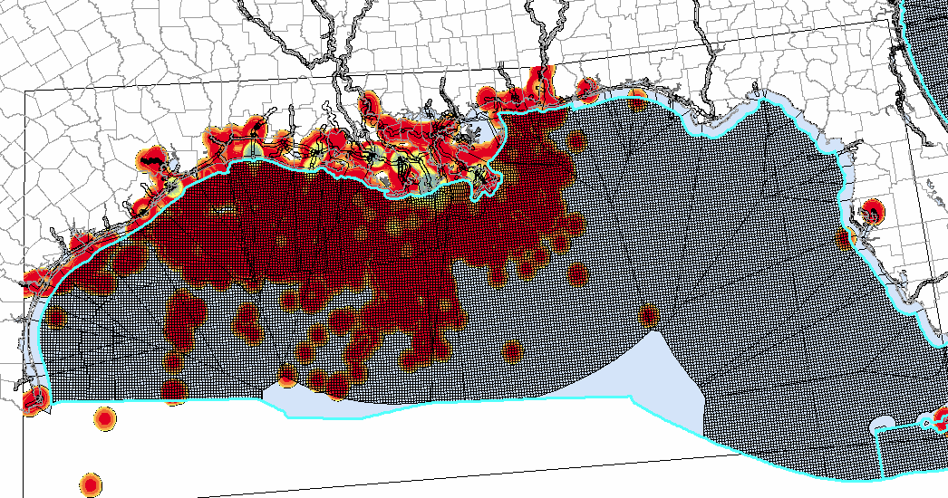
Commercial Marine Surrogates
Gulf surrogate needed due to C1C2 emissions now placed in Gulf
Older Great Lakes surrogates
smeared emissions across the lakes

Slide 18
Recent SMOKE Updates
Support for source apportionment
Improved support for daily and hourly inventories (e.g., HAP integration)
Updates to SMOKE-MOVES
  Optimization for faster run-time
  Better use of gridded met data for off-network
  Use of binned RH for on and off-network
  Adjustment factors can be used in Movesmrg
  NCEP data can be used as input for non CONUS areas
Improved error checking
Incorporated Bash approach for ag NH3 temporalization

Slide 19
2011 Emissions Modeling Platform Development: Steps and Timing
Item | Timeframe
Preliminary 2011 Runs | May-August, 2013
Finalize 2011 Base Year Platform | September, 2013
Develop Future Year Projections | October-November, 2013
Provide 2011 Modeling Platform | November, 2013
2011 National Air Toxics Assessment | Began August, 2013
Transport Rule Proposal Modeling | Began October, 2013
Provide 2018 Projection from 2011 | December, 2013
Ozone NAAQA RIA Proposal | TBD
Comments on 2011 and 2018 Data | Winter (2011), Spring (2018)

Slide 20
Evolution of Modeling Platform
Components of modeling platform are “evolutionary” and not static
  Emissions, meteorological, and air quality models are updated by developers on a semi-regular basis; though not necessarily in sync with the timing of our rules.
  Emissions inventories are subject to updates and project-specific adjustments and refinements
Updated data and tools will be integrated into the platform over time
Updated versions of the 2011 platform will be used for modeling in 2014-2015
20
Notes:
This slide was MOVED from near beginning. perhaps delete this slide –very general

Slide 21
Ongoing work
Improving methods for RWC emissions estimates
Improving oil and gas emissions estimates, spatial allocation, and speciation
Refining c1c2 CMV emissions distribution / estimates
Improving base year (NEI) controls information & industrial non-EGU projections
Updating biogenic land use and emissions factors (ORD)
Continue to integrate Fire Emissions Tracking System (FETS) data into SmartFire (SF2) to improve ID & classification of fires
Reviewing stack parameters for reasonableness
Obtaining updated Canada/Mexico (base and future year)

Slide 22
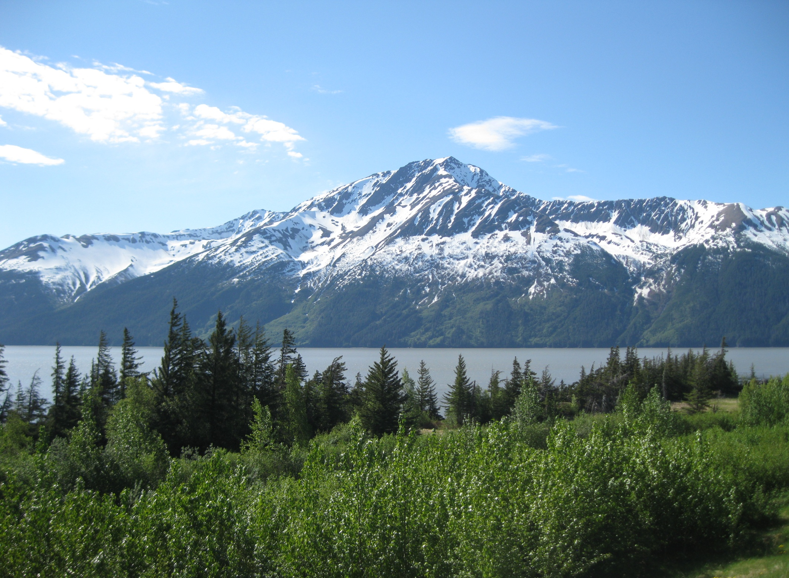
Acknowledgements
UNC IE CEMPD: Zac Adelman, Limei Ran, Catherine Seppanen
ENVIRON: Michele Jiminez, Tejas Shah,
Amnon Bar-Ilan, Greg Yarwood
National Air Data Group: Jon Miller, Martin Husk
EIAG Data Analysis Team: Venkatesh Rao,
Lee Tooly, Josh Drukenbrod, Rhonda Thompson
NEI Team: Ron Ryan, Laurel Driver, Roy Huntley, Jennifer Snyder, Sally Dombrowski, Michael Heath
EIAG Group Leader: Marc Houyoux
AQMG: Norm Possiel, Brian Timin, Kirk Baker
ORD: George Pouliot, Jesse Bash

