Slide 1
Lagrangian Photochemical Modeling of Ozone Formation and Aerosol Evolution in Biomass Burning Plumes: Toward a Sub-grid Scale Parameterization
M.J. Alvarado¹ (malvarad@aer.com), R.J. Yokelson², S.K. Akagi², I.R. Burling², E. Fischer³, G.R. McMeeking³, K. Travis⁴, J.S. Craven⁵, J.H. Seinfeld⁵, J.W. Taylor⁶, H. Coe⁶, S.P. Urbanski⁷, C.E. Wold⁷, and D.R. Weise⁷
¹Atmospheric and Environmental Research (AER) ²University of Montana
³Colorado State University ⁴Harvard University ⁵California Institute of Technology ⁶University of Manchester ⁷USDA Forest Service
2013 CMAS Conference
October 30, 2013
Copyright 2013, Government sponsorship acknowledged.
Notes:
I’d like to thank the chairs for the opportunity to talk to you today about the work we are doing at AER to investigate the chemical transformations that take place within biomass burning smoke plumes in the first few hours after emission, and how to include these processes in atmospheric chemistry models.

Slide 2
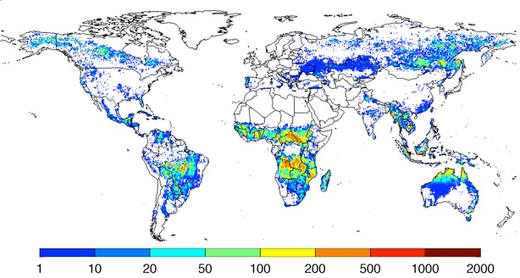
Biomass Burning Impacts Air Quality and Climate
Annual carbon emissions (as g C m⁻² year⁻¹), averaged over 1997-2009, derived using MODIS fire counts and burned area.
Large global source of trace gases and particles
Emissions highly variable between fires
About half of organic compounds in smoke are unidentified (e.g., SVOCs)
Rapid near-source chemistry creates O₃, PAN, SOA, etc.
Understanding this chemistry is critical to assessing air quality and climate impacts.
Species | % of Atm. Source (Andreae & Merlet, 1999 and IPCC, 2001)
CO | ~17%
CH₄ | ~3.5%
NO_{x} | ~16%
OC | 12% - 45%
BC | 12% - 28%
Notes:
Why is biomass burning important? Biomass burning is a large, global source of trace gases and particles. The map shows the global extent of biomass burning, while the table shows how much of the total atmospheric source of various pollutants is from biomass burning. However, the impacts of biomass burning on air quality and climate are not well understood. First, the emissions are highly variable between fires, and half of the organic compounds by mass in the smoke are unidentified, mostly a mixture of various semi-volatile organic compounds (SVOCs). In addition, rapid chemical changes take place within the smoke plume, creating ozone, PAN, and secondary organic aerosol. So understanding this chemistry is critical to assessing the air quality and climate impacts of biomass burning.

Slide 3
Aerosol Simulation Program (ASP v2.0)
ASP (Alvarado and Prinn, 2009) models the formation of O₃ and SOA in smoke plumes.
Gas-phase chemistry
≤C₄ gases follow MCM v3.2 (Saunders et al., 2003).
Other organic gases follow RACM2 (Goliff et al., 2013).
Inorganic aerosol thermodynamics
OA thermodynamics using the Volatility Basis Set (VBS) (Robinson et al., 2007).
Evolution of the aerosol size distribution and optical properties.
ASP can be run as a box model, or as a subroutine within 3D models (Alvarado et al., 2009).
Notes:
The model I use to study the chemistry of biomass burning smoke plumes is the Aerosol Simulation Program, or ASP. For organic gases with four or fewer carbons, the chemistry is unlumped and follows the Leeds Master Chemical Mechanism, while for larger organic gases we follow RACM2. The model simulates inorganic aerosol thermodynamics and uses the Volatility Basis Set to simulate the organic aerosol thermodynamics. The model also calculates the evolution of the aerosol size distribution and the aerosol optical properties. In this talk, I’ll mainly be running ASP within a simple Lagrangian parcel model, but it can be run as a subroutine in larger, 3D models. The figures on the right show the centerline results for 3D simulations of O3 and OH within a South African savannah fire plume

Slide 4
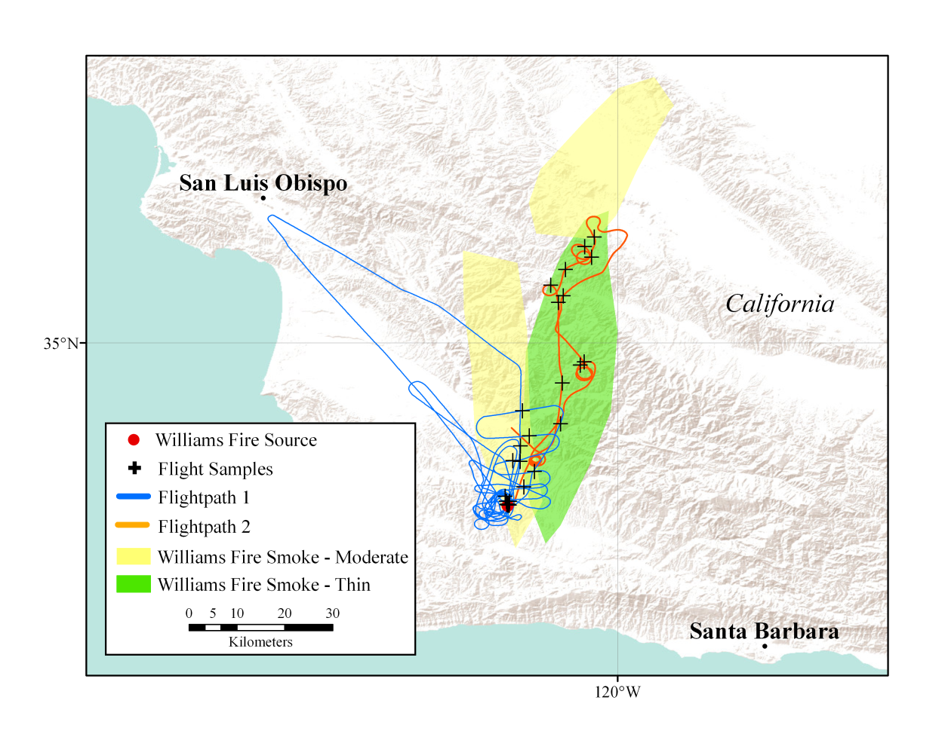
Williams fire sampling (Akagi et al., 2012)
The Williams fire (burning scrublands) was sampled from 10:50-15:20 LT on November 17, 2009. Skies were clear all day and RH was low (11-26%) with variable winds (2-5 m/s).
Measurements included U. Montana airborne FTIR (CO, O₃, NO_{x}, PAN, C₂H₄, etc.), compact ToF-AMS (aerosol mass conc.), SP2 (BC), nephelometer, and meteorological data.
Notes:
In this talk, I’ll be using ASP to study the chemistry of the smoke plume from the Williams fire near San Luis Obispo which was sampled with the US Forest Service Twin Otter aircraft. This experiment is nice because the skies were clear all day with low RH, and the plume was reasonably isolated from other pollution sources. The top figure shows a picture of the smoke plume, showing low altitude and high altitude smoke going in different directions. The aircraft sampling followed the high-altitude plume along the flight tracks shown in the map below. Several gas-phase species were measured with the University of Montana airborne FTIR, while an AMS and SP2 provided aerosol composition data.

Slide 5
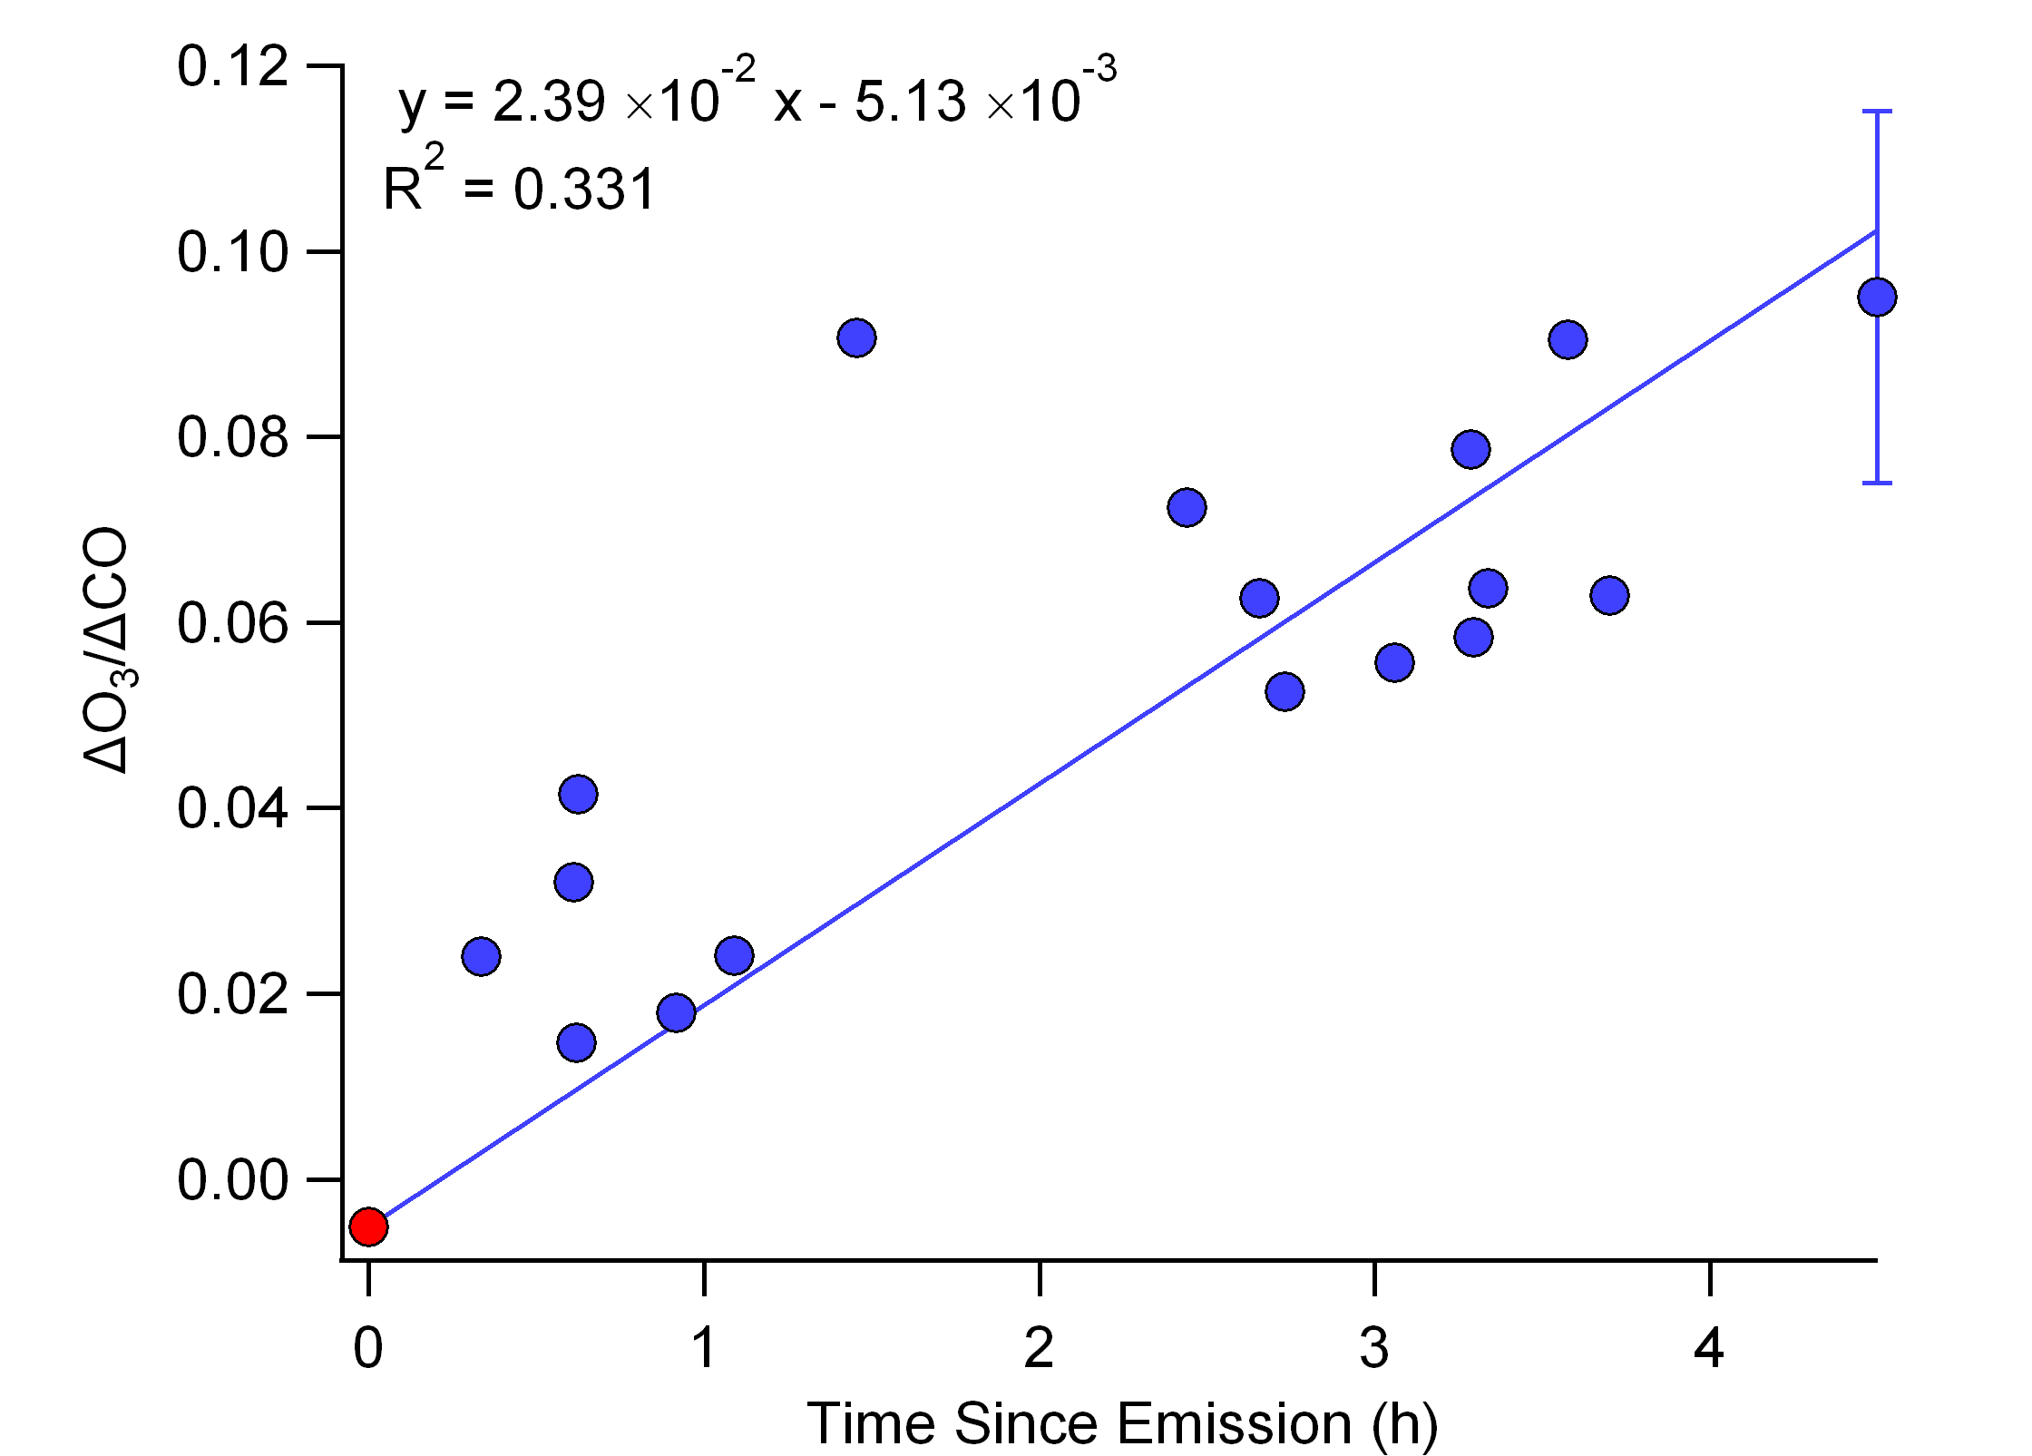
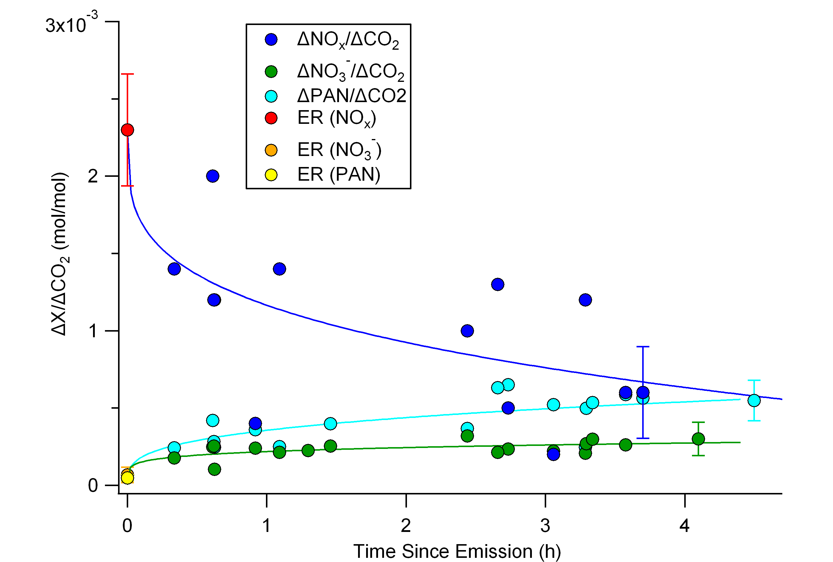
Key Observations of Williams fire
ΔO₃/ΔCO increased to 10% in 4.5 hr.
Significant PAN formation.
ΔO₃ = O₃ in plume – background O₃
Significant formation of HCOOH and CH₃COOH
ΔOA/ΔCO₂ slightly decreases in 4.5 hr (from 3.6±0.9x10⁻³ to 2.8±0.9x10⁻³)
Notes:
Here I’m showing the key results from the Williams fire. The x axis in both plots is time after emission. We can see rapid chemical formation of both ozone and PAN within the smoke plume. Although it’s not shown here, there was also secondary formation of formic and acetic acids within the smoke plumes. However, organic aerosol (normalized to CO2) actually decreased slightly during plume aging. This is consistent with observations from other studies by Bob Yokelson’s group, which have seen little net increase in OA in smoke that has a large production of acetic acid.

Slide 6
Without SVOC Chemistry, ASP performs well for O₃ and PAN, as well as NO_{x}, C₂H₄ and OH.
O₃ (ppb)
ΔPAN/ΔCO₂
Smoke Age (hr)
Smoke Age (hr)
Fast, Medium, and Slow Dilution Rates
Solid = In Plume Photo, Dashed = Above Plume Photo
Notes:
So how well does ASP do in simulating this plume? Here I’m showing the model results for O3 and PAN for the case where we assume the unidentified SVOCs are unreactive. Again the x axis is time after plume emission, and the horizontal error bars are due to the uncertainty in the average wind speed within the plume. The different line colors correspond to three different estimates of the plume dilution rate, while the solid lines are for the reduced photolysis rate in the plume and the dashed lines are for the enhanced photolysis at the top of the plume. We can see that the model does a good job of simulating the O3 and PAN formation within the smoke plumes, and although I’m not showing it it also performs well for NOx, ethylene, and OH.

Slide 7
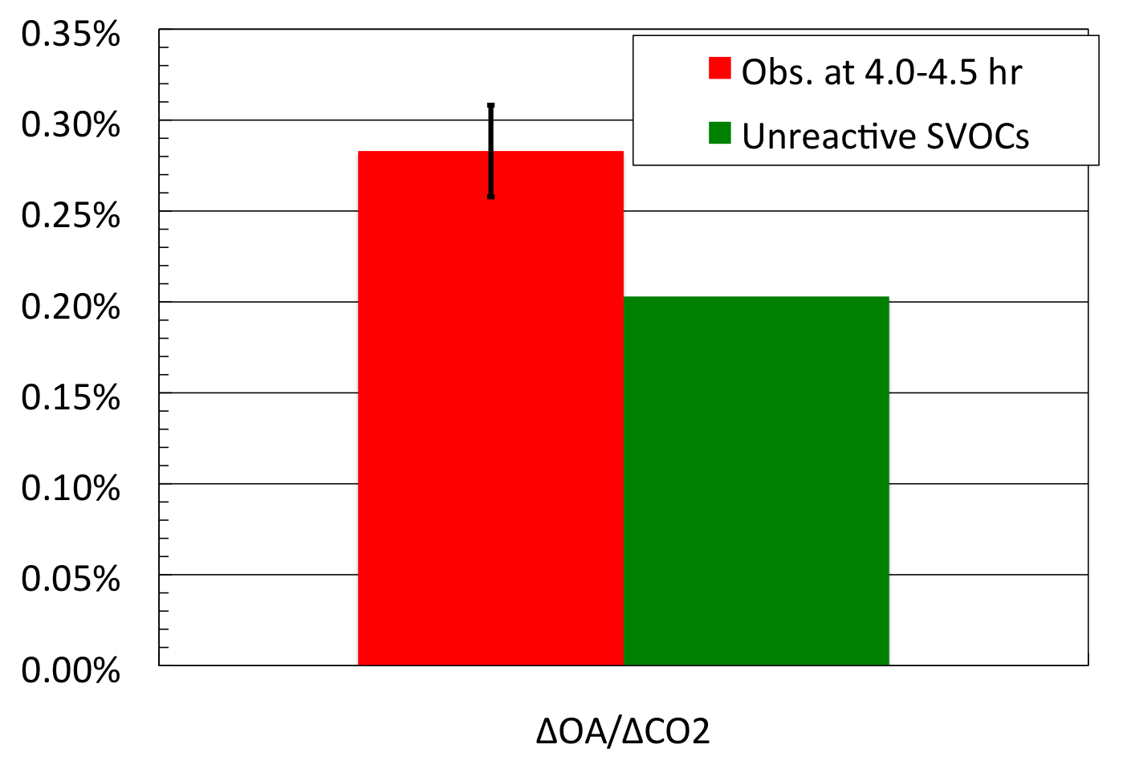
But OA and organic acids are underestimated.
Organic Aerosol (OA)
Enhancement Ratios at 4-4.5 hr
ΔCH₃COOH/ΔCO
ΔOA/ΔCO₂ (g/g)
Smoke Age (hr)
Can adding reasonable SVOC chemistry help?
Notes:
However, as you might expect, ignoring the SVOC chemistry leads to an underestimate of OA downwind, as shown on the left where red is the observations and green is the model. The model also underestimates the formation of acetic acid when SVOC chemistry is ignored. So the question is, can adding reasonable SVOC chemistry help remove these underestimates?

Slide 8
Adding SVOC Chemistry
In the 1D-VBS framework, SVOCs react with OH to produce only less volatile SVOCs:
In reality, SVOCs form RO₂ radicals, which can fragment into higher volatility products, form O₃, and regenerate HO_{x}:
Notes:
We tried two ways of adding in the chemistry of the SVOCs. The first is used in most implementations of the volatility basis set, where an SVOC reacts with OH to produce a lower volatility SVOC, and nothing else. Our second method is a little more rigorous, recognizing that in reality SVOCs react with OH to make peroxy radicals. The reaction of these peroxy radicals with NOx can make lower volatility SVOCs as above, but can also fragment to make higher volatility SVOCs, form O3 by producing NO2 and HO2, and can regenerate HOx radicals thereby continuing the chemistry.

Slide 9
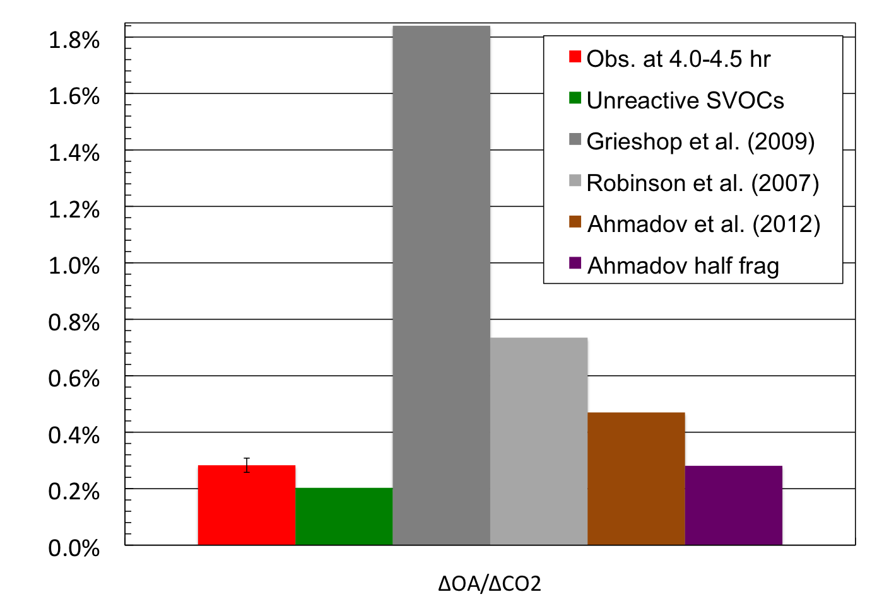
Need slow OH reaction rate and/or fragmentation to explain low OA downwind
Organic Aerosol (OA)
Enhancement Ratios at 4-4.5 hr
k_{OH} = 10⁻¹¹ cm³/s
HC8 in RACM2: 1.1x10⁻¹¹ cm³/s
k_{OH} = 10⁻¹¹ cm³/s + 50% RO₂ frag
Formation of Acetic Acid?
ΔOA/ΔCO₂ (g/g)
Notes:
So what happens when we add SVOC chemistry? Again, the red is the observation and the green is for unreactive SVOCs. The two grey bars and the brown bar are for the simple SVOC chemistry, where organic reacts with OH to produce another organic, but with different reaction rates from the literature. The brown bar, with a reaction rate of 10⁻¹¹ cm³/s, gives the closest match, and this reaction rate is similar to the reaction rate of large-chain alkanes in RACM2. However, this still overestimates OA downwind. The purple bar is like the brown bar, but assumes that 50% of the RO2 radicals fragment on reaction with NO, and is much more consistent with the observations. But if the RO2 radicals fragment, what happens to the other half? One possibility is that the fragmentation reaction slices two carbons off of the SVOC, producing acetic acid.

Slide 10
Acetic acid formation consistent with formation by RO₂ fragmentation
k_{OH} = 10⁻¹¹ cm³/s + 50% RO₂ frag
ΔCH₃COOH/ΔCO
Smoke Age (hr)
Notes:
And here’s I’m showing the results for acetic acid if we assume that every time an SVOC RO2 radical fragments it produces acetic acid and a higher volatility SVOC. The model is now a little high, but the observation seem consistent with formation of acetic acid by SVOC fragmentation. This might explain why plumes with high acetic acid formation have relatively low OA formation and vice versa – I the RO2 radicals fragment, you get acetic acid, and if they don’t, you get large SOA production.

Slide 11
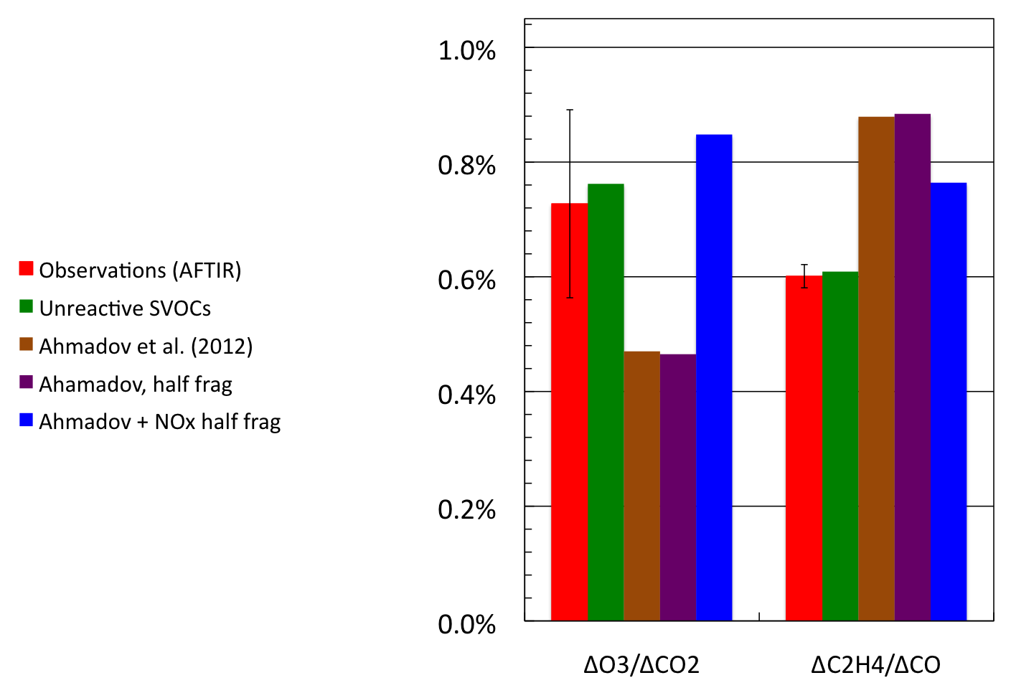
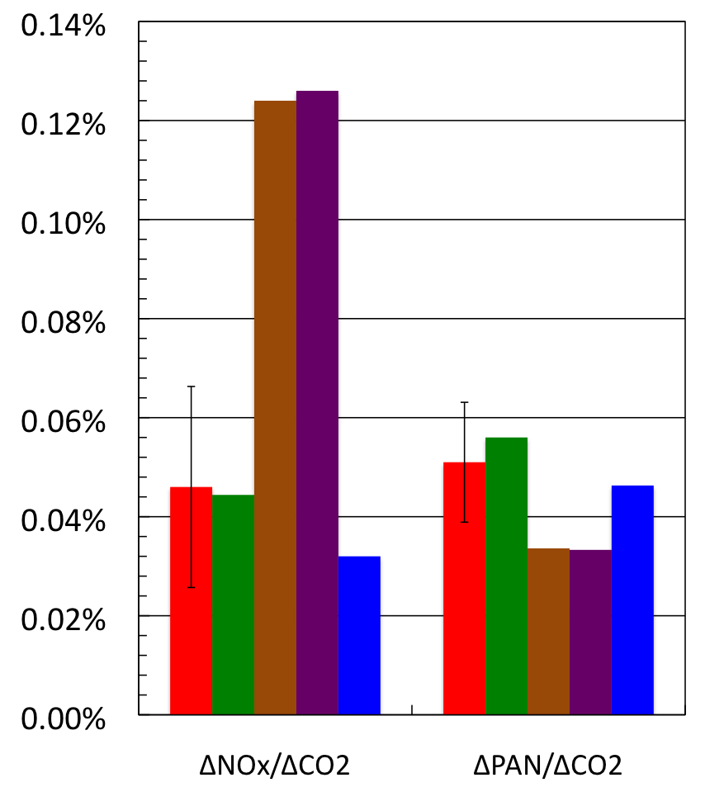
Need to include SVOC NO_{x} and HO_{x} chemistry for O₃, NO_{x}, and PAN
Enhancement Ratios at 4-4.5 hr
ΔOA/ΔCO₂ (g/g)
ΔO₃/ΔCO₂
ΔC₂H₄/ΔCO
ΔNO_{x}/ΔCO₂
ΔPAN/ΔCO₂
k_{OH} = 10⁻¹¹ cm³/s, 50% of RO₂ fragment, AND
1.25 O₃ per rxn (vs. 1.44 for HC8) and 60% HO_{x} recycled (vs. 58%)
Notes:
So the purple bar case looks pretty good for organic aerosol and acetic acid. But what’s happened with our ozone and PAN match? Well, as you can see in these bar plots, the match with O3 and PAN has been destroyed by adding SVOC chemistry. This is because in the brown and purple cases, the SVOCs are a sink for OH but do not produce O3 or regenerate HOx, which reduces the secondary production of ozone and PAN. However, this give us an opportunity to see how much O3 and HOx the SVOC chemistry has to produce to match the gas-phase observations. The blue bar shows the case where the SVOCs produce 1.25 ozones per reaction with OH and recycle 60% of the OH as HO2. In this case, we do a reasonable job of matching organic aerosol, ozone, NOx, and PAN, but OH is still underestimated, as we can see by the overestimate of ethylene. These assumed chemical parameters for the SVOCs are not unreasonable – in fact, they are pretty close to the chemistry of long-chain alkanes in RACM2.

Slide 12
Using ASP to Build a Sub-grid Scale Parameterization for GEOS-Chem
Follow approach used by Vinken et al. (2011) for ship plumes
We use ASP to build look-up tables of ΔO₃/ΔCO, ΔNO_{x}/ΔCO, ΔPAN/ΔCO, etc. versus smoke age
Look-up table will include dependence on biome, temperature, solar zenith angle (SZA), and other fire and meteorological parameters
Notes:
So studies like the Williams fire study I’ve been presenting can give us confidence in the ability of the ASP model to be used to develop a sub-grid scale parameterization of the chemistry of biomass burning plumes for larger chemical models. We’re currently building such a parameterization for GEOS-Chem, following the approach Vinken et al. used for ship plumes. We’ll use the ASP model to develop lookup tables of the enhancement ratios of ozone, NOx, PAN, and other nitrogen containing species versus smoke age. The lookup table will include the dependence of these enhancement ratios on the biome, temperature, solar zenith angle, and other fire and environmental parameters.

Slide 13
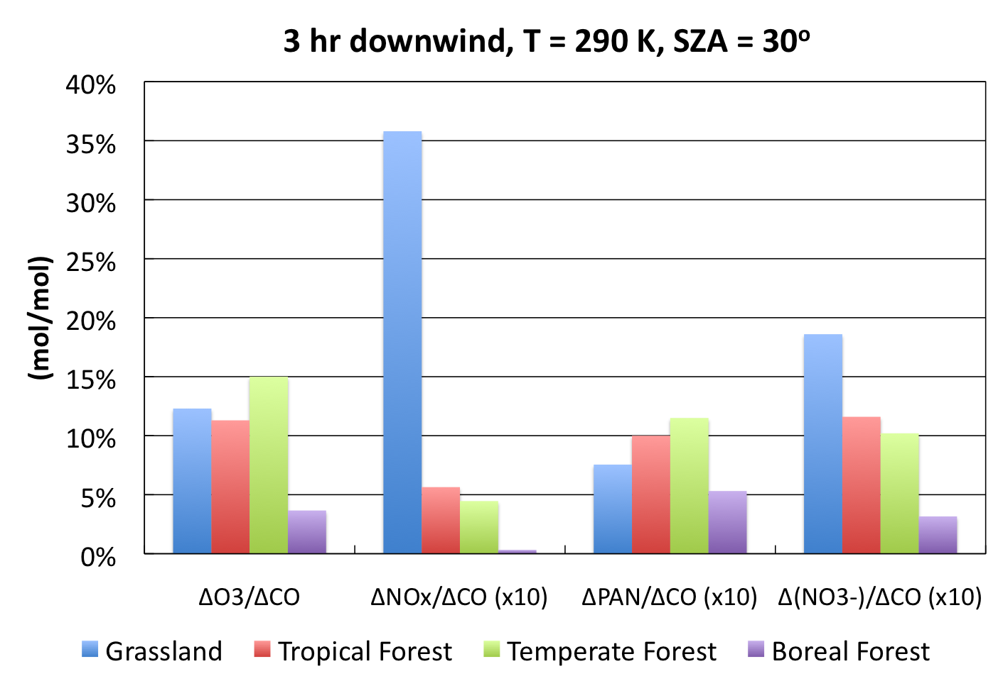
Variation with biome
Notes:
Here are some preliminary results showing the dependence of these enhancement ratios on biome, all for the same smoke age, temperature, and solar zenith angle. Grasslands have largest initial NOx/CO ratio, and even after 3 hours a large amount of NOx remains, suggesting further O3 formation after 3 hrs. Tropical and temperate forests are similar to each other, and produce roughly equal amounts of PAN and inorganic nitrate. But Boreal forests, with their low NOx, have very little O3 formation and convert twice as much NOx to PAN as to inorganic nitrate.

Slide 14
Conclusions
SVOC chemistry can have a large impact on O₃, PAN, and OA in the smoke plume.
Reasonable SVOC chemistry can simulate O₃, PAN, and OA observations from the Williams Fire.
k_{OH} ~10⁻¹¹ cm³/s with ~50% of RO₂ radicals fragmenting to produce higher volatility SVOC + CH₃COOH
1.25 O₃ for each SVOC + OH reaction (vs 1.44 for alkanes)
60% of OH regenerated as HO₂ (vs ~58% for alkanes)
Provides a model-based constraint on the chemistry of the SVOCs
Preliminary work using ASP to develop a sub-grid parameterization for GEOS-Chem is promising.

Slide 15
Future Work
Using ASP to simulate smog chamber studies
Studies of additional plumes from Yucatan, Brazil, Western US, etc.
Is SVOC chemistry similar between plumes?
Integration of ASP into HYSPLIT Lagrangian dispersion model driven with WRF meteorology.

Slide 16
Acknowledgements
This modeling work funded by NSF grant AGS-1144165.
Sampling of the Williams fire was funded by NSF grants ATM-0513055 and ATM-0936321, and by SERDP projects SI-1648 and SI-1649.
Improvements to ASP aerosol optical properties funded by NASA ACMAP grant NNX11AN72G.

Slide 17
Backup Slides

Slide 18
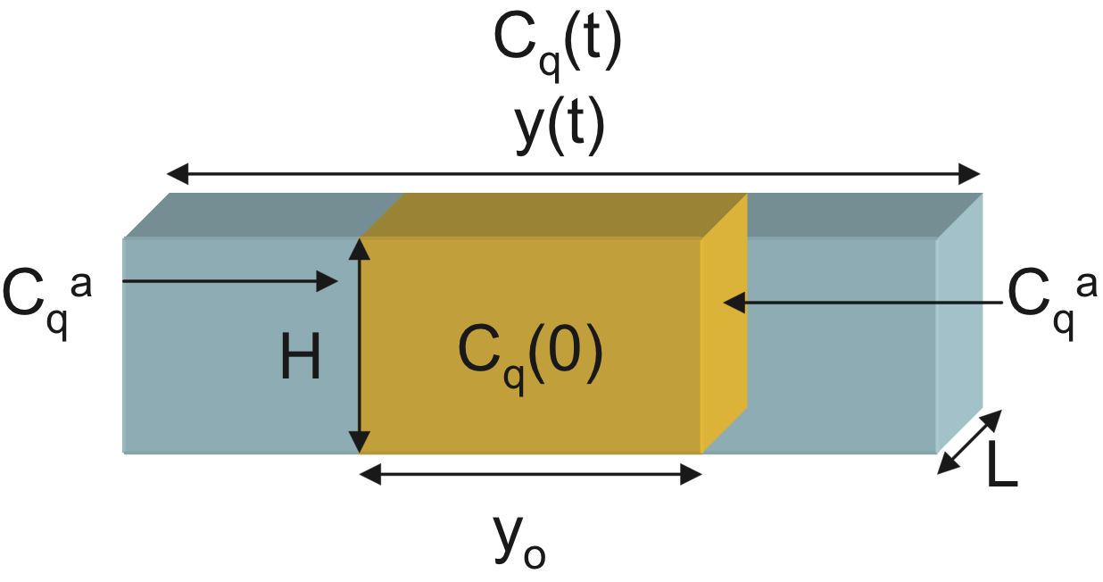
Aerosol Simulation Program (ASP v2.0)
ASP (Alvarado and Prinn, 2009) simulates the formation of ozone and secondary OA within smoke plumes. ASP calculates:
Gas-phase, heterogeneous, and aerosol-phase chemistry,
Secondary inorganic and organic aerosol,
Evolution of the (sectional) aerosol size distribution, and
Aerosol optical properties.
ASP can be run as a box model, as a subroutine within 3D models (e.g., Alvarado et al., 2009).
Plume modeled as a Lagrangian parcel of fixed height and down-trajectory length but variable width y(t)
(Mason et al., 2001).

Slide 19
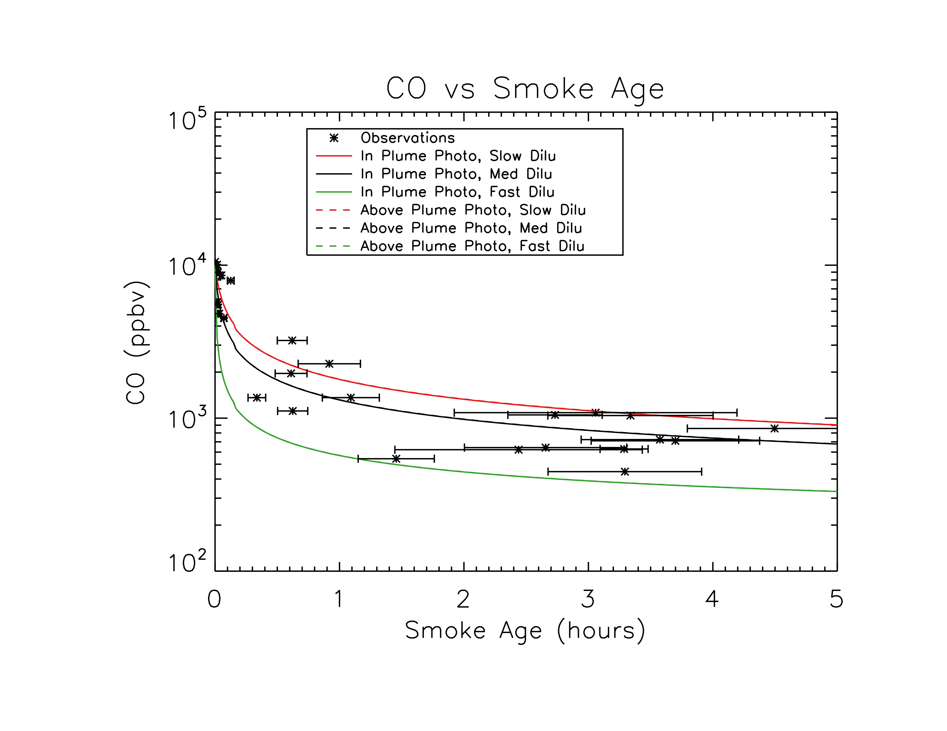
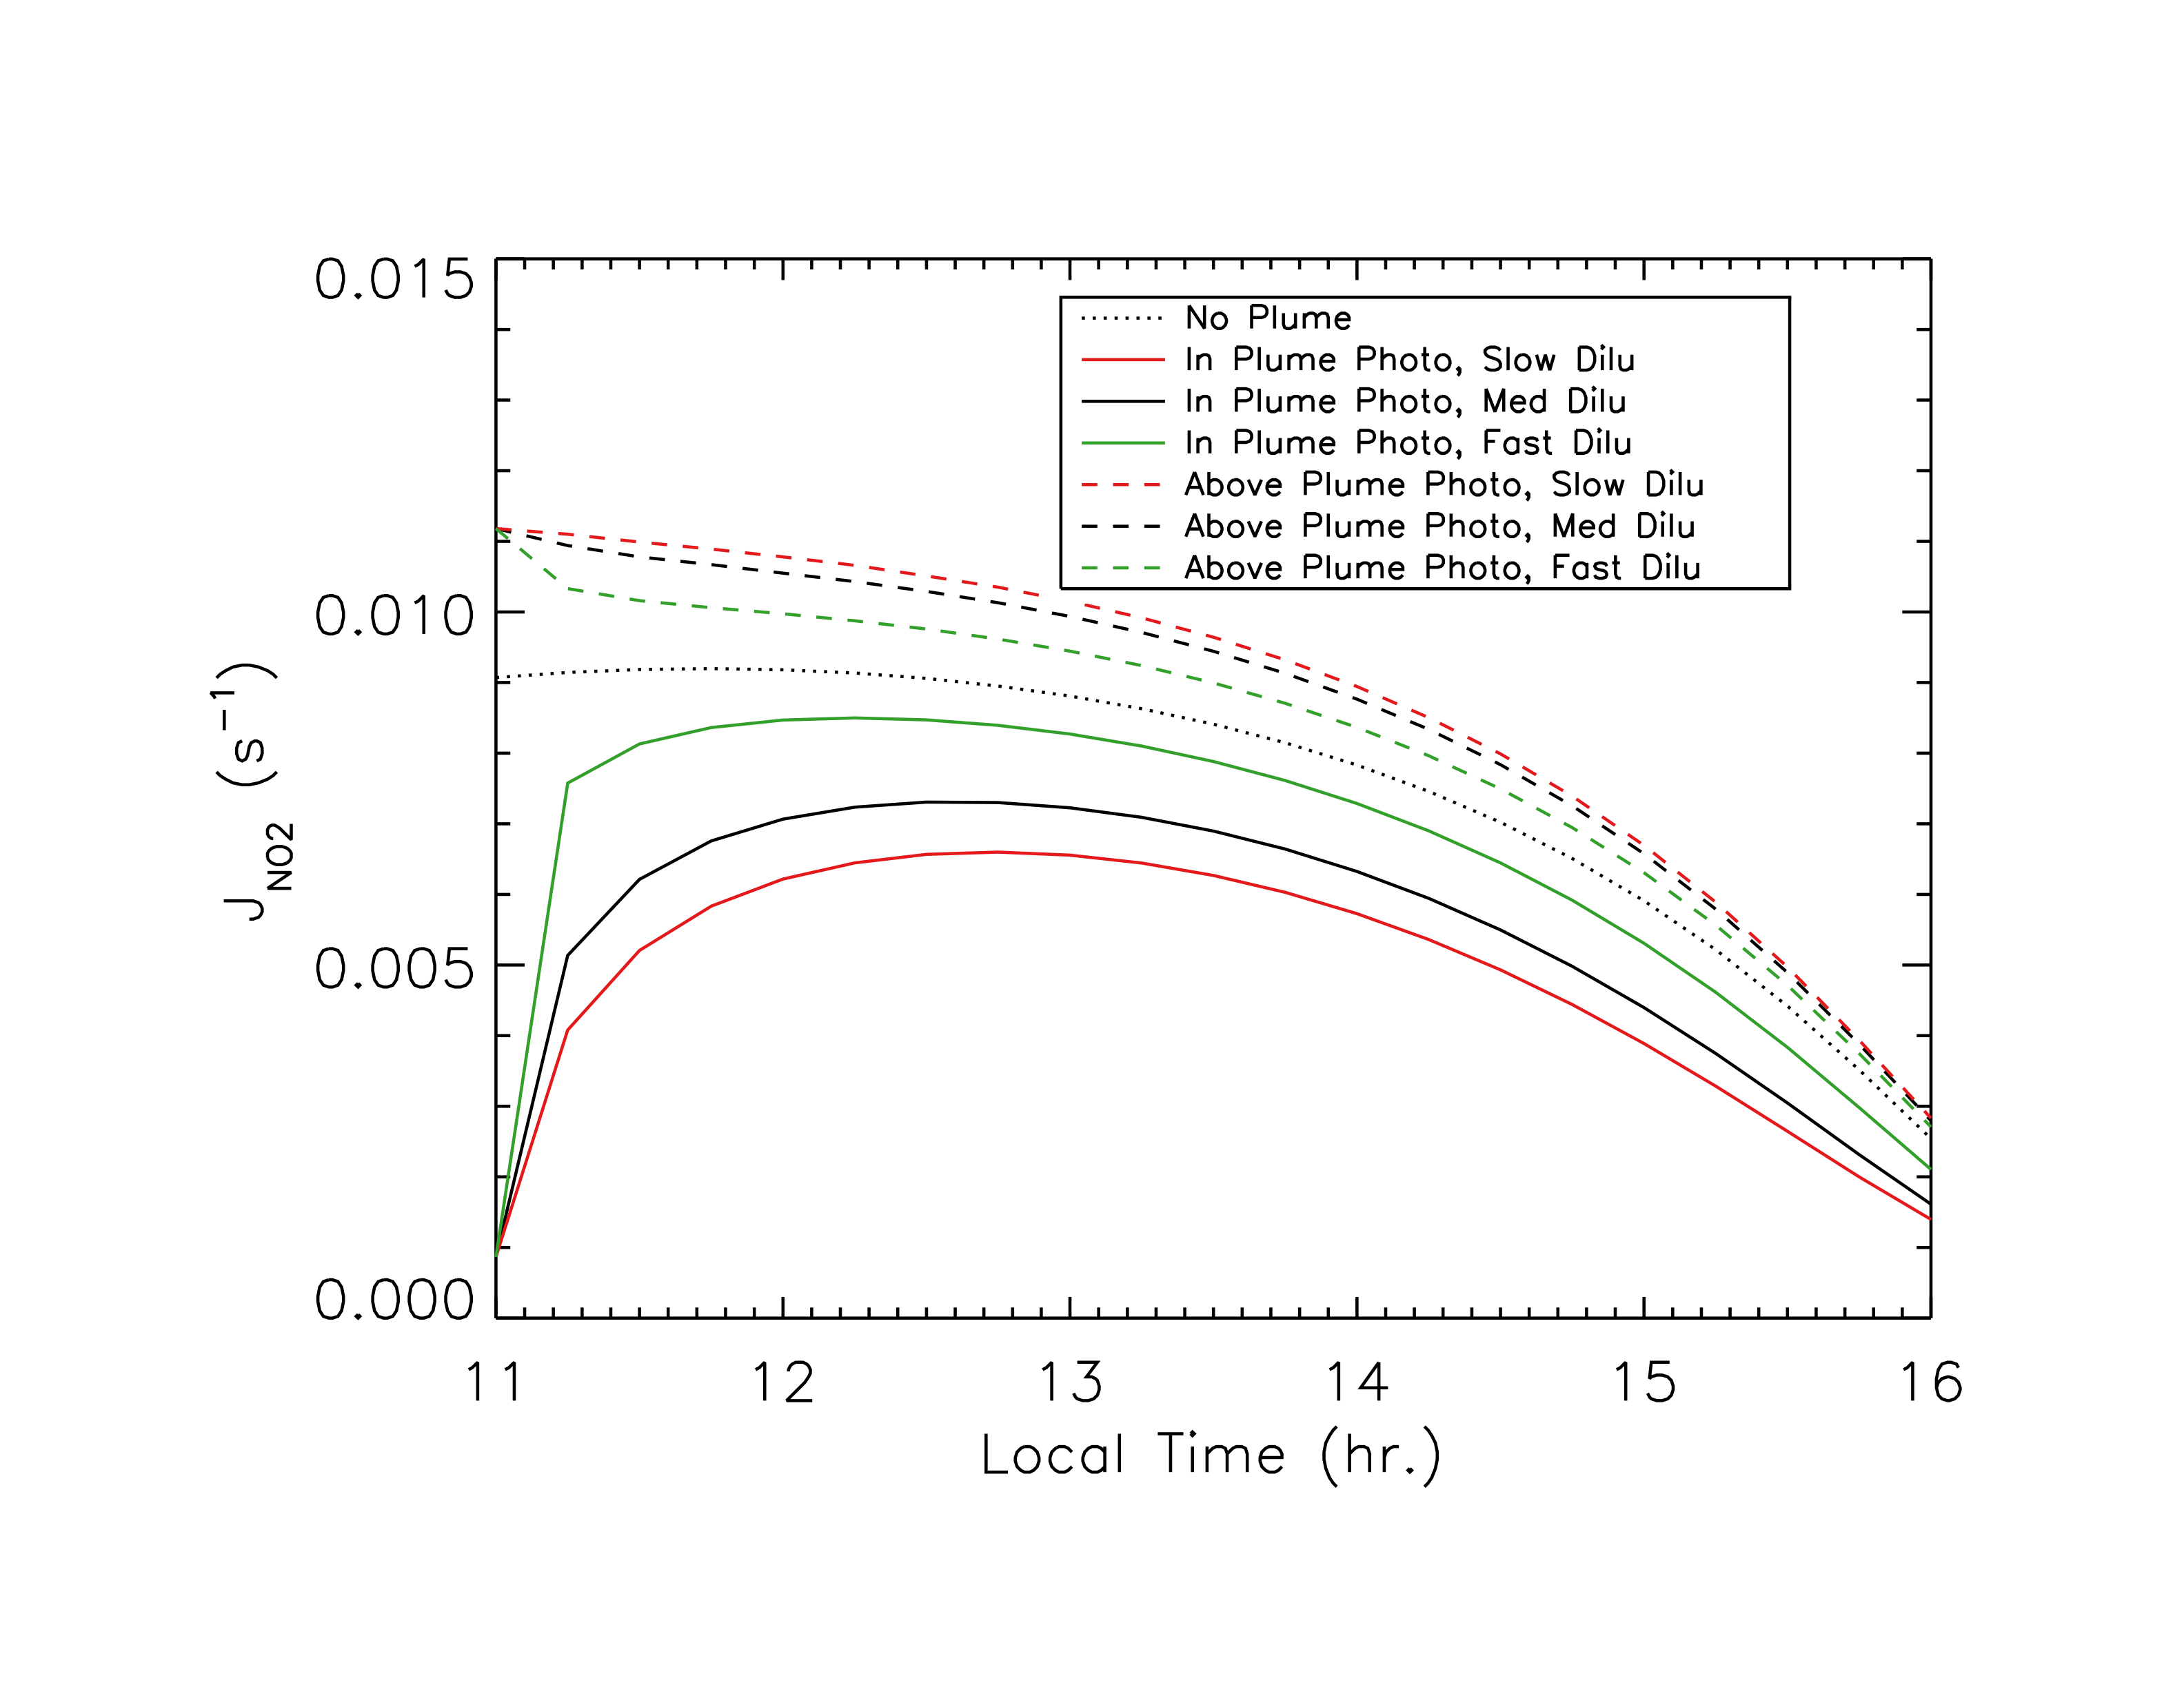
ASP v2.0 Setup for the Williams Fire
Initial and background concentrations from observations, literature, or GEOS-Chem.
Observed CO used to determine best fit and upper/lower limits for model dilution rate.
Photolysis rates calculated offline with TUV v5.0 (Madronich and Flocke, 1998) with smoke diluting with time.
POA volatility distribution based on Grieshop et al., 2009.

Slide 20
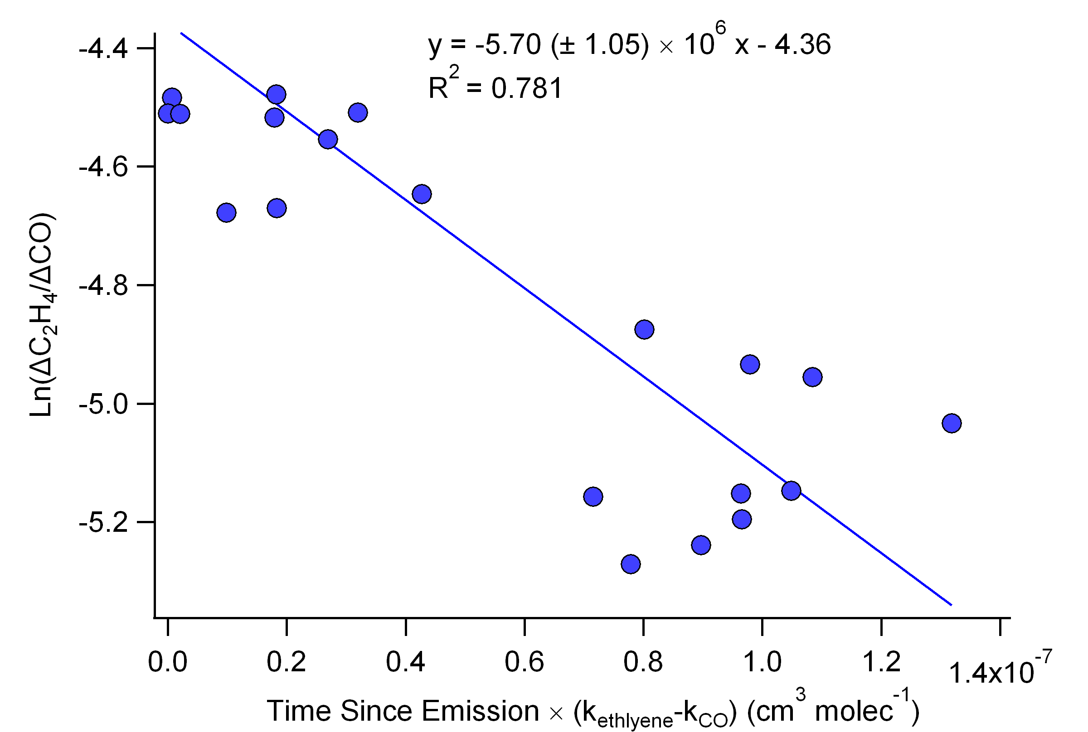
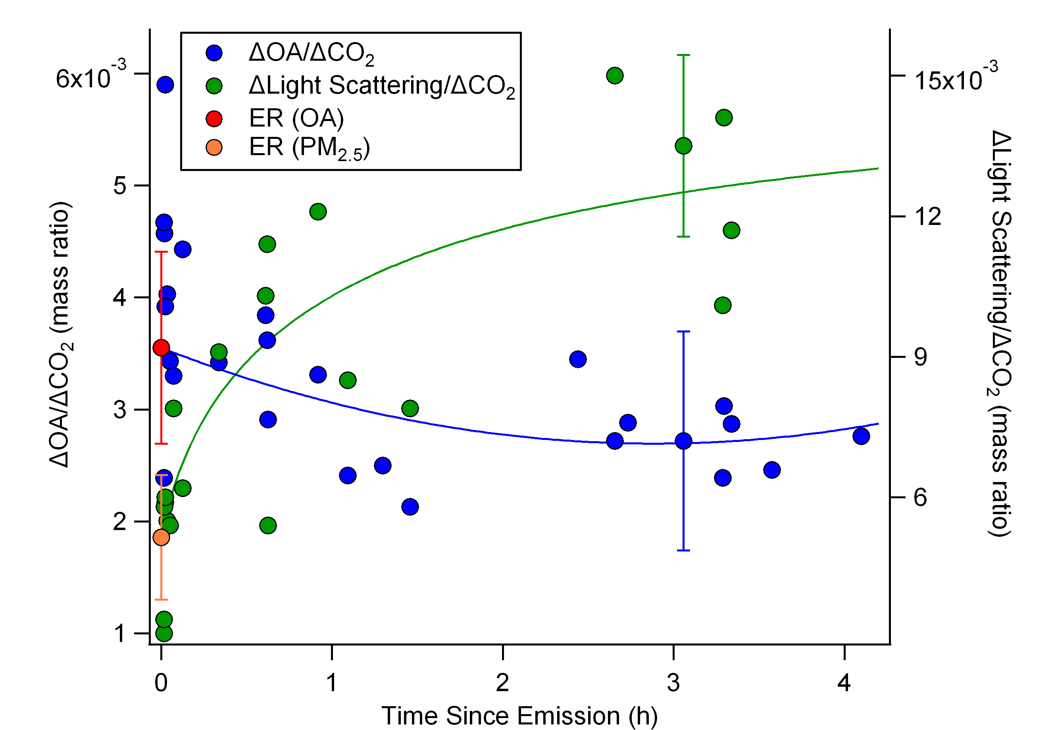
Key Observations of Williams Fire
ΔO₃/ΔCO increased to 10% in 4.5 hr.
OH conc. of 5-6 × 10⁶ cm⁻³.
No increase in OA
Significant PAN formation.

Slide 21
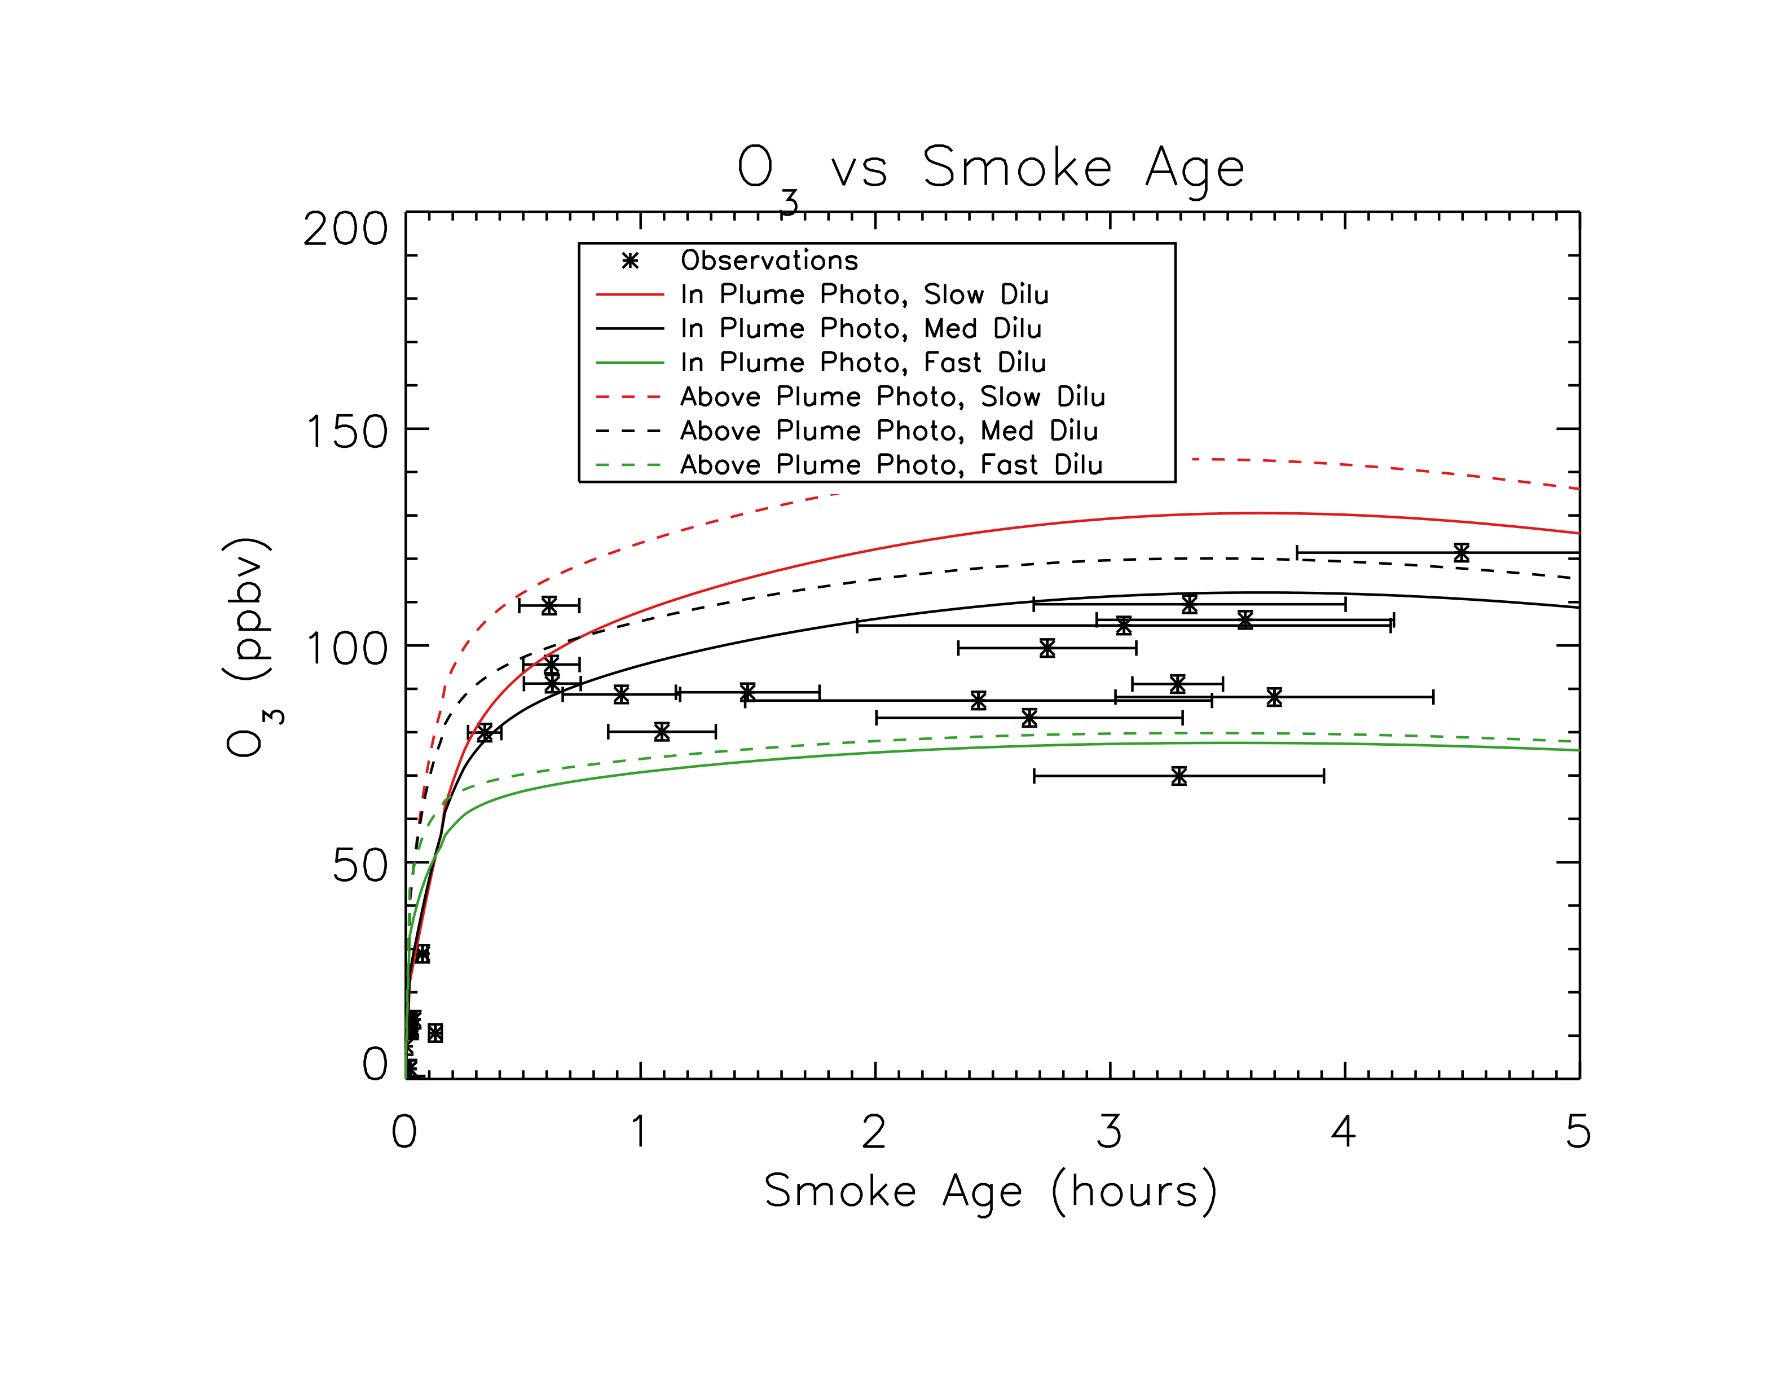
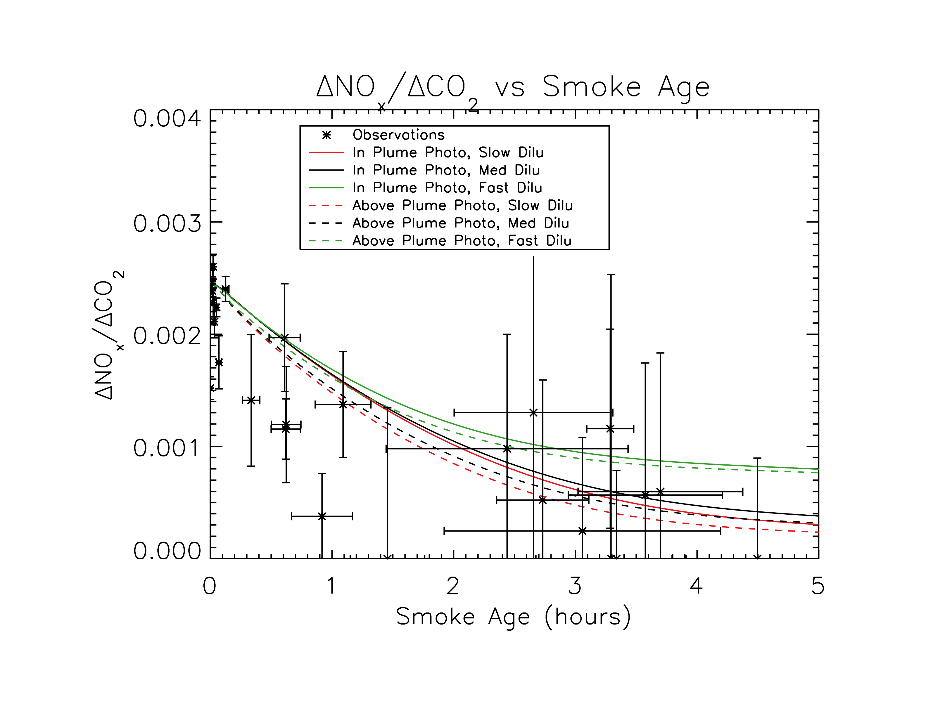
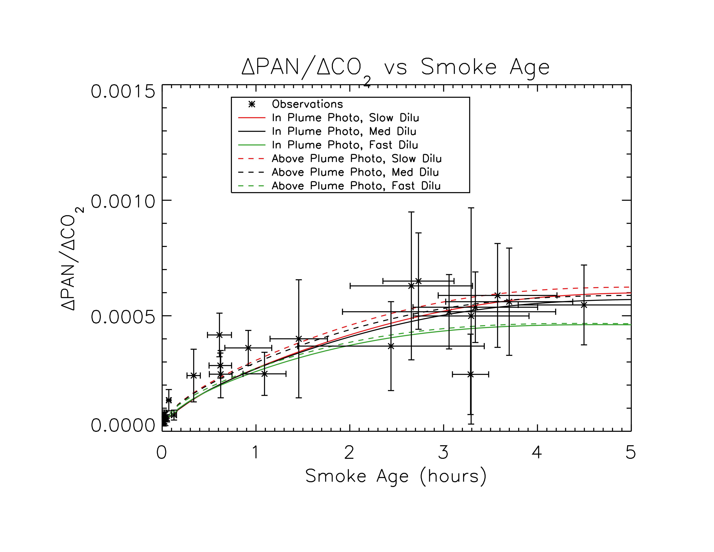
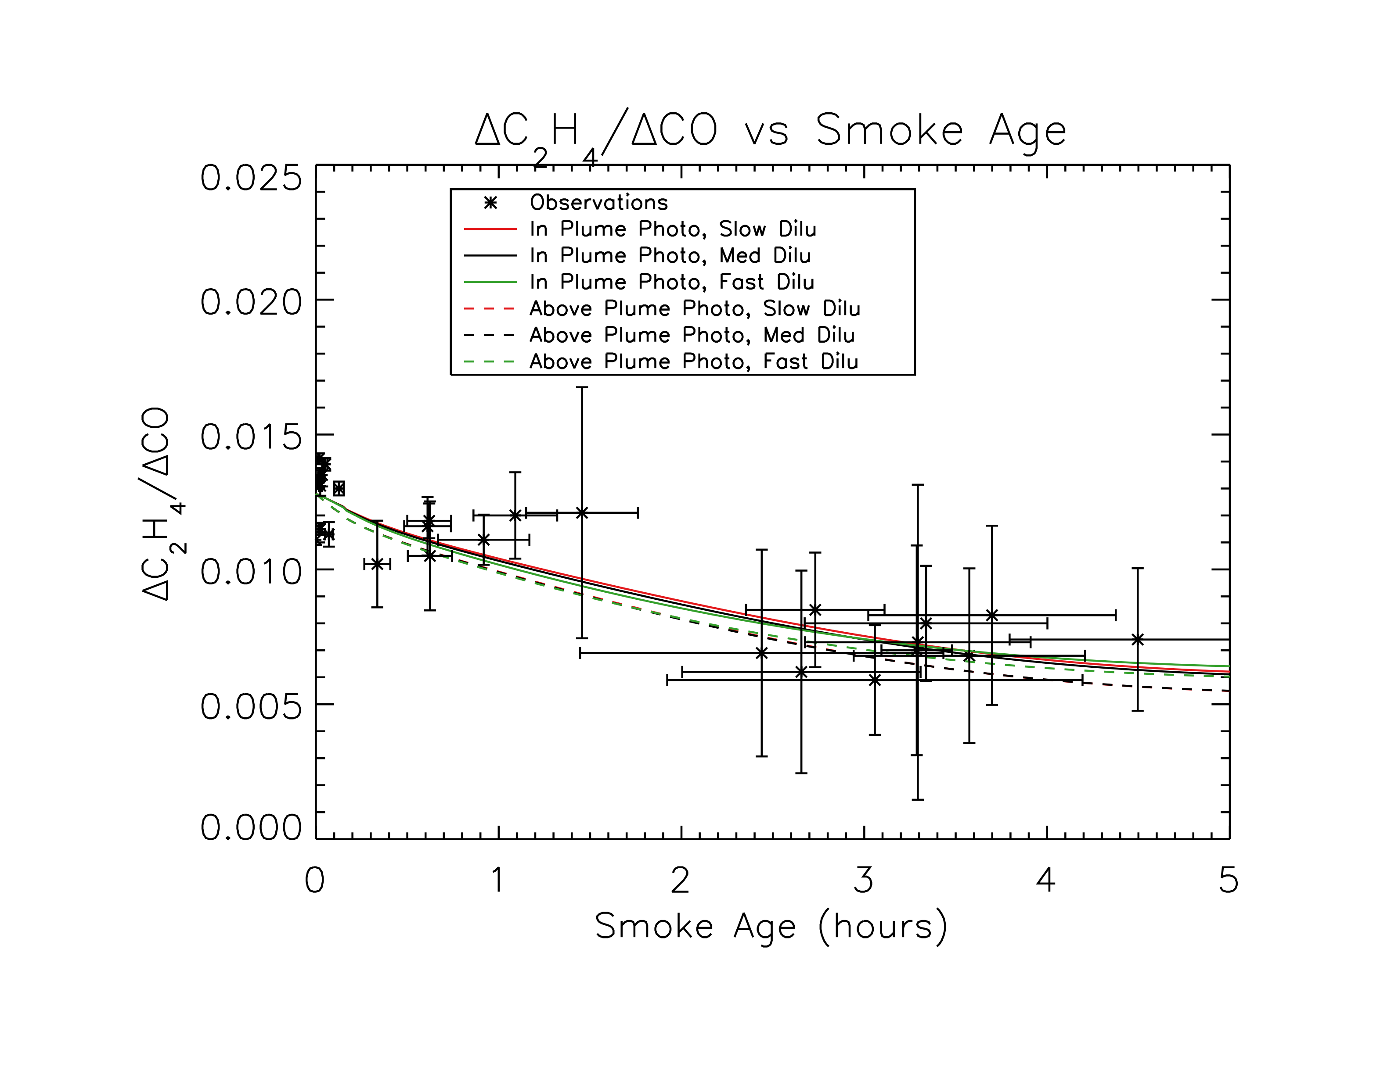
Without SVOC Chemistry, ASP performs well for O₃, NO_{x}, PAN, C₂H₄ and OH.
O₃ (ppb)
ΔNO_{x}/ΔCO₂
ΔPAN/ΔCO₂
ΔC₂H₄/ΔCO

Slide 22
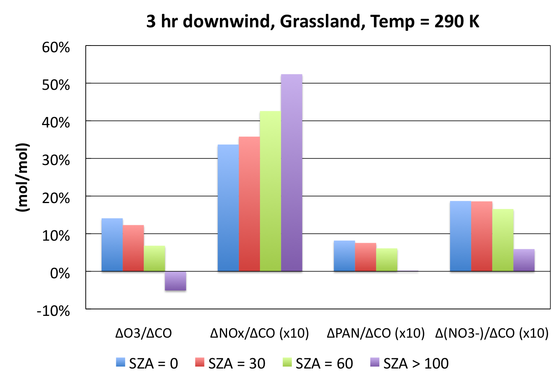
Variation with Solar Zenith Angle
Notes:
Changes with SZA are large, as expected at higher SZA chemistry is slower.

Slide 23
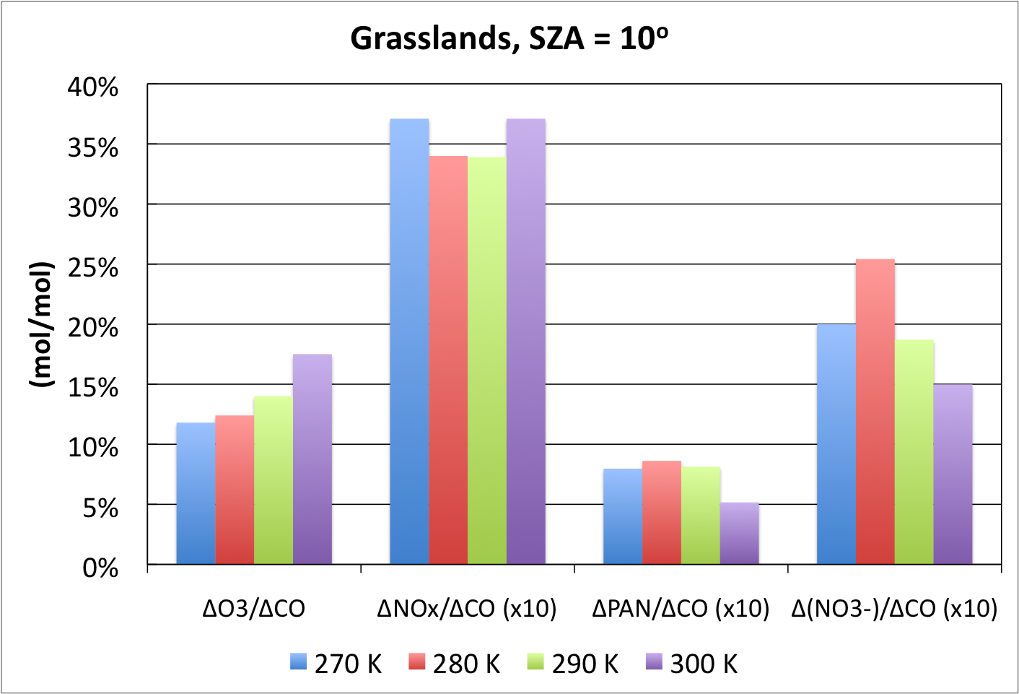
Variation with Temperature
Notes:
Temperature effects are relatively small, O3 is a constant increase, PAN and NO3- max out at moderate temps.

