Slide 1
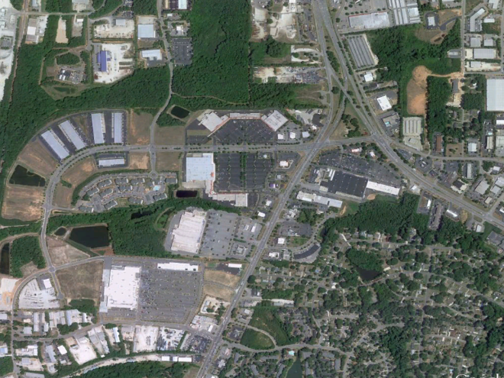
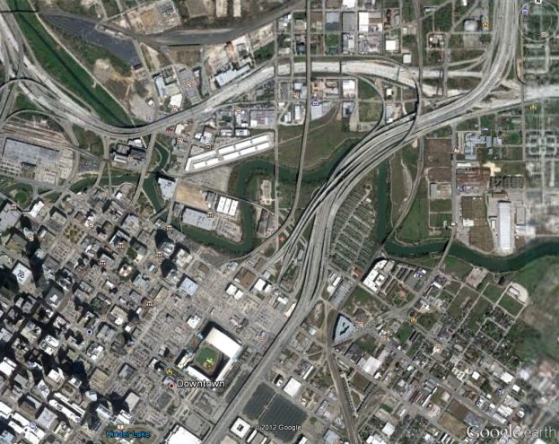
Simple urban parameterization for WRF-CMAQ.
Jonathan Pleim and Robert Gilliam
USEPA

Slide 2
Motivation
Urban/suburban areas are generally warmer and more turbulent than surroundings
Less stable boundary layers at night and during morning and evening transitions mix surface emissions more quickly
Rate of morning PBL growth and entrainment from residual layers are critical for photochemisty in urban areas
Effects of built environments disproportionately important for AQ because of high emissions in these areas

Slide 3
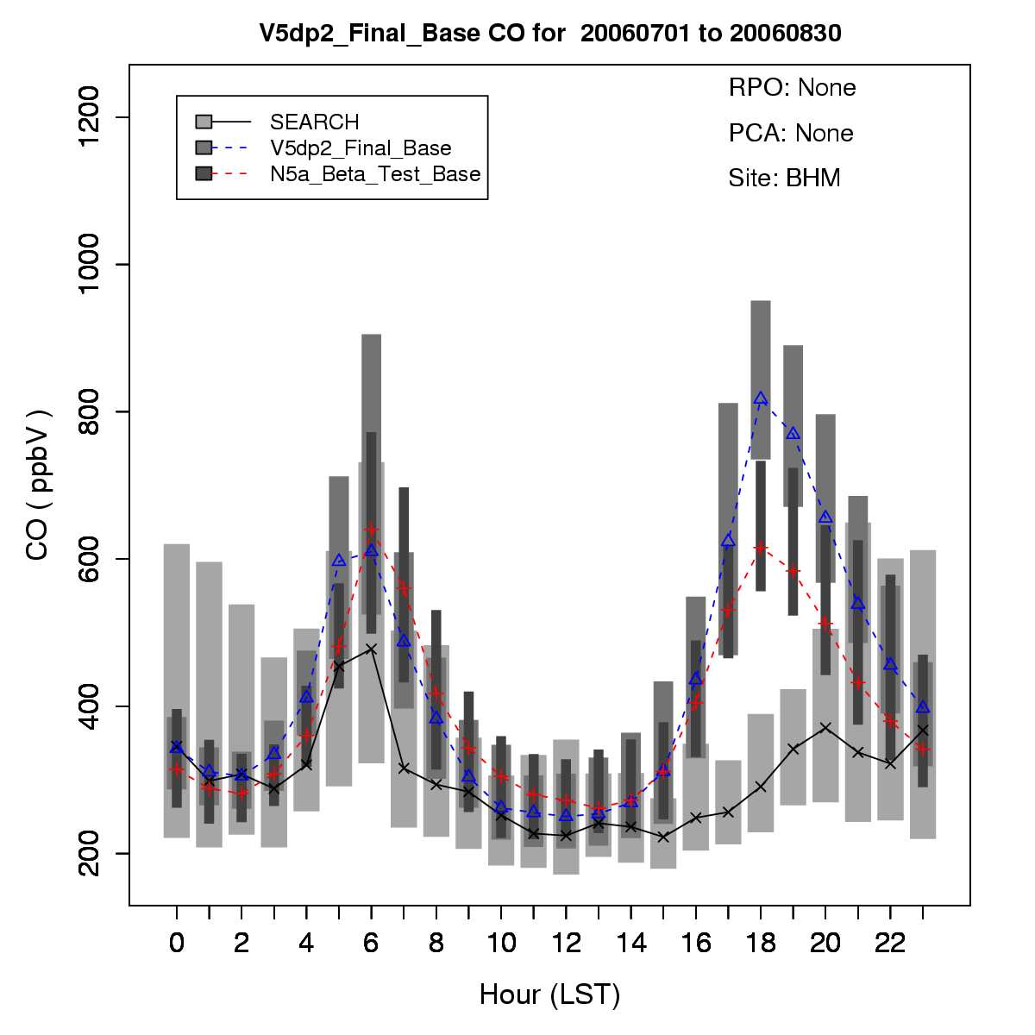
Problem
Birmingham (SEARCH)
Without realistic treatment of urban effects:
  PBL too stable during morning and evening transitions and overnight
  Overprediction of ground emitted primary species (e.g. CO, NOx, Primary PM)
July 2006 – CMAQ 12 km CO

Slide 4
Potential Solutions
Meteorological models and parameterizations for urban areas vary greatly in complexity and data requirements.
Currently WRF has several urban parameterizations: Bulk, single-layer, and multi-level BEP-BEM NUDAPT all tied to the NOAH LSM
Need for a simple scheme considers the effects of development at the local (1-4 km) and regional (12 km) grid scales that works with the PX LSM that we use for WRF-CMAQ.

Slide 5
A New Bulk Approach for PX LSM
Leverage very high resolution National Land Cover Database (NLCD) with multi-level urban classifications
  PX LSM considers subgrid LU fractions
Utilize NLCD-based Impervious surface data directly in land-surface model to scale surface heat capacity
Increase surface roughness for urban LU classes to better represent developed areas
Decrease albedo in urbanized areas to account for sky-view and radiation trapping effects
Reduce deep soil temperature nudging strength

Slide 6
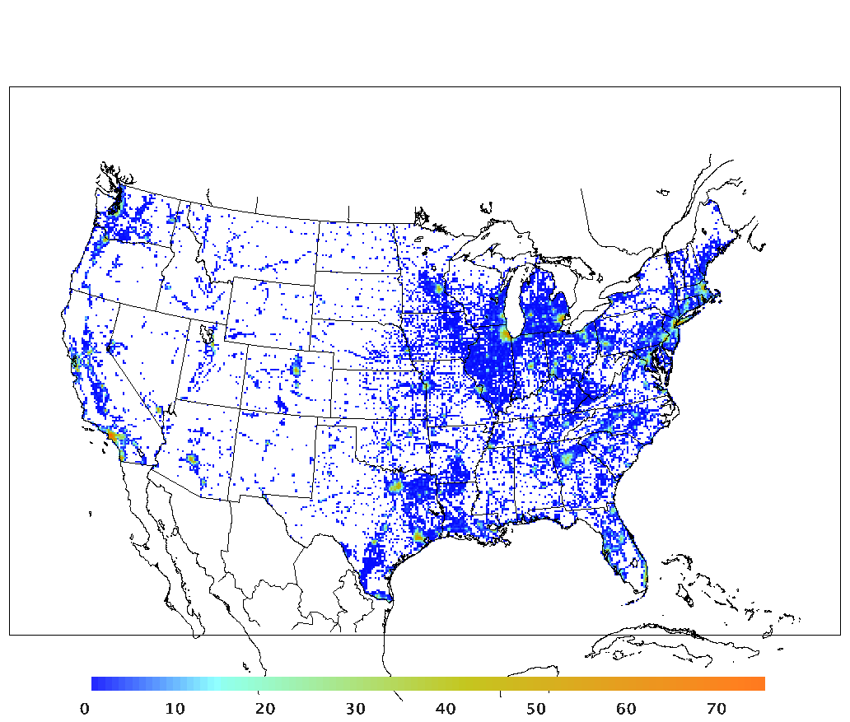
Impervious Fraction (%) for 12 km Grid

Slide 7
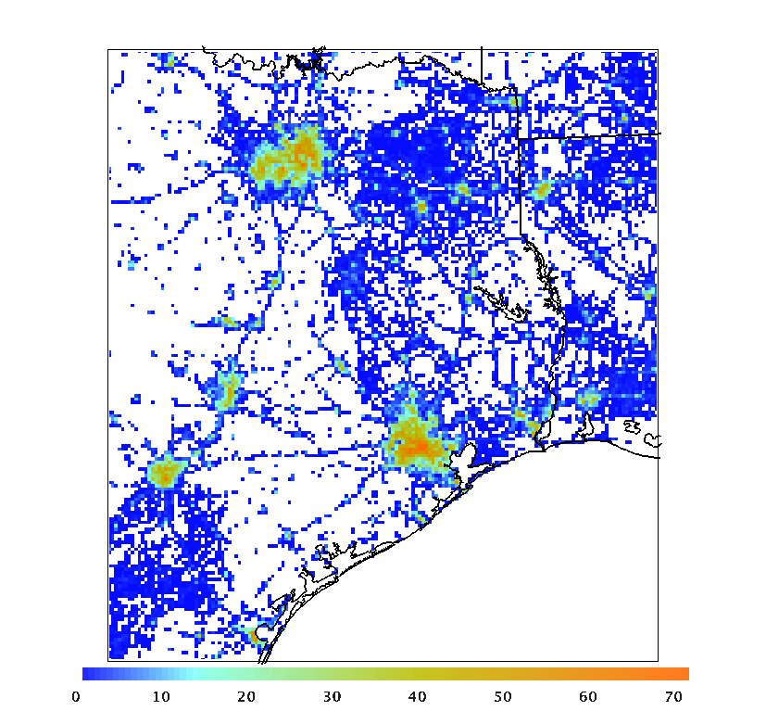
Impervious Fraction (%) for 4km Grid

Slide 8
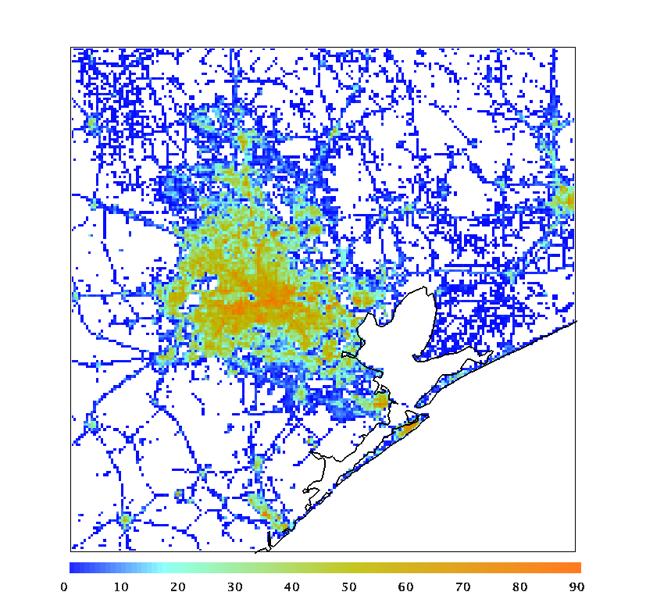
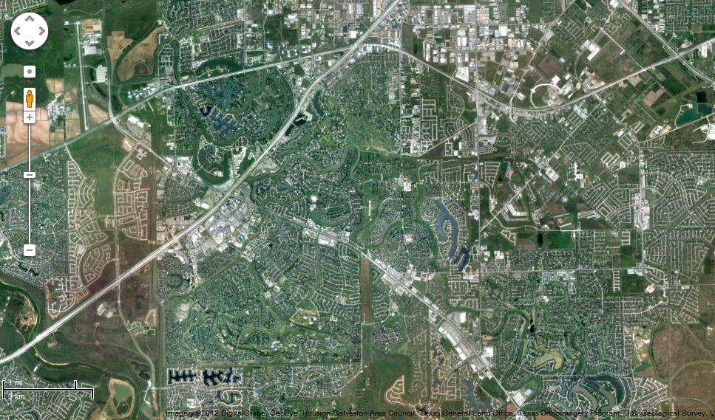
Impervious Fraction (%) for 1 km Grid
Shopping malls in Sugarland

Slide 9
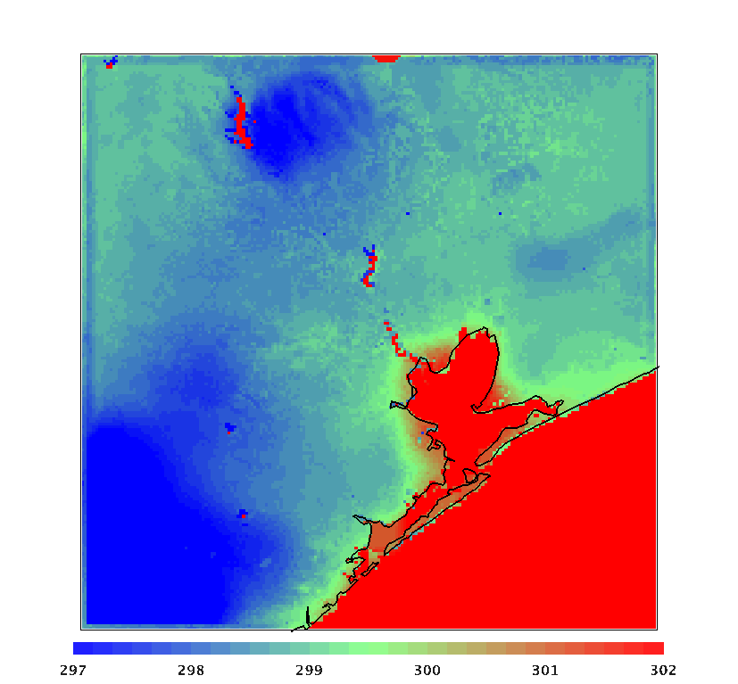
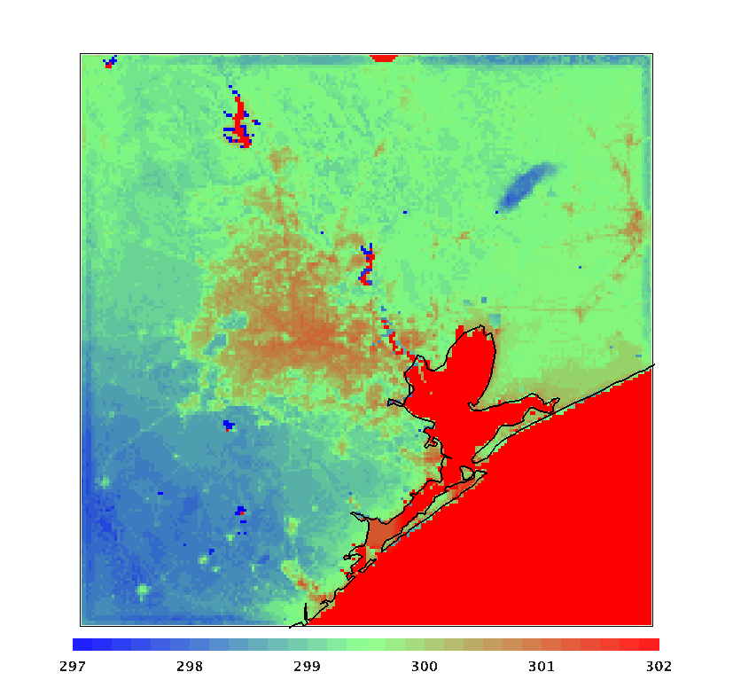
Skin Temperature on Aug 24,2006 at 10Z
Base – NLCD 2006
Urban

Slide 10
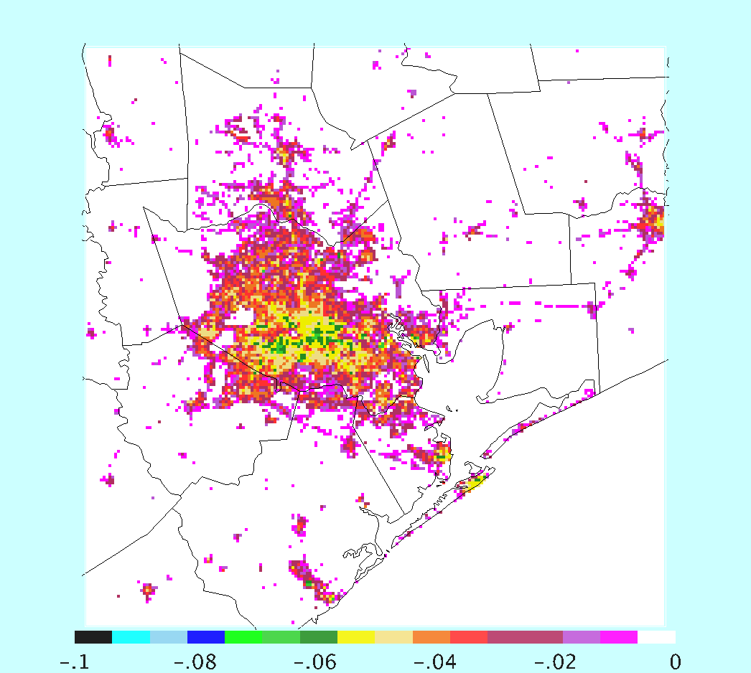
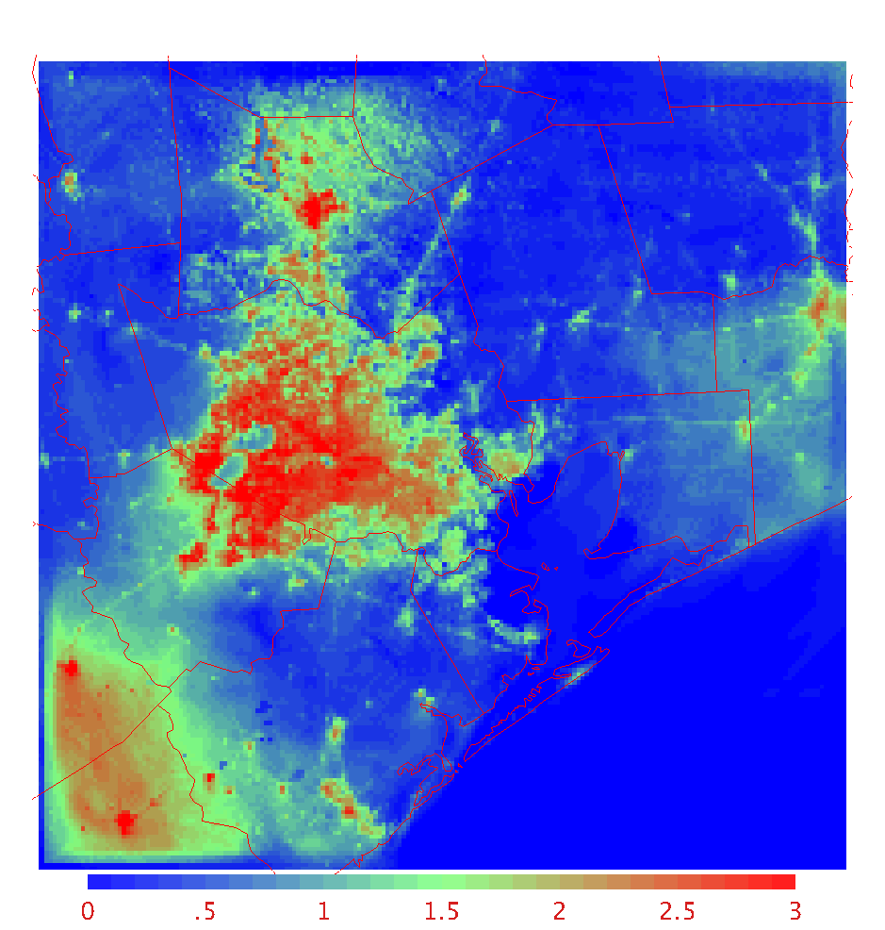
1 km WRF August 2006: Urban - Base
Albedo
T2m (Aug 31, 6AM LT)

Slide 11
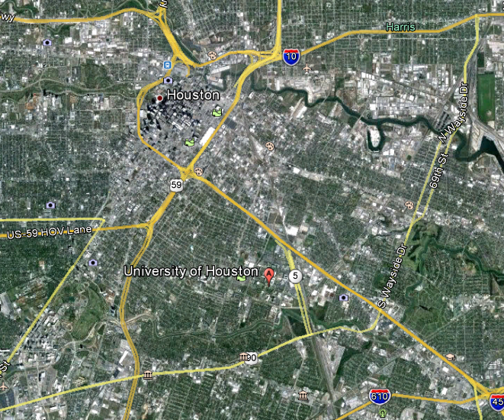
Evaluation Using Tethersonde Profiles
Tethersondes were launched on selected evening and nights in September through November at U of Houston
Profiles from 2 model runs :
Base (NoImp) --- no impervious, NLCD 2006
Urban (Imp2) – Impervious, increased roughness, decreased albedo and weaker deep soil temp nudging
Tethersonde data provided by Bernhard Rappenglueck (UH)

Slide 12
September 7, 20 LT (1Z)
WS
θ_{v}

Slide 13
September 7, 23LT (4Z)

Slide 14
September 7, Midnight LT (5Z)

Slide 15
September 8, 2LT (7Z)

Slide 16
September 8, 3LT (8Z)

Slide 17
September 8, 4LT (9Z)

Slide 18
September 8, 6LT (11Z)

Slide 19
September 8, 8LT (13Z)

Slide 20
CMAQ urban treatment
To compensate for inadequate treatment of enhanced turbulent mixing in urban areas CMAQ sets the minimum eddy diffusivity according to fraction of urban LU:
  In CMAQv4.7.1 and earlier: K_{zurb} = 2.0 and K_{zrur} = 0.5 m²/s
  In CMAQv5.0 and later: K_{zurb} = 1.0 and K_{zrur} = 0.01 m²/s
We hope to eliminate the need for this arbitrarily large K_{zmin} in urban areas by improving urban model in WRF

Slide 21
CMAQ Runs
Four runs for 4 km Texas domain – Aug 23 – September 9
Unmodified CMAQ 5.0.1
  Base run using WRF-NLCD2006
  Urban run using impervious data and other urban mods
Modified CMAQ 5.0.1 with minimum Kz set to 0.01 m2/s everywhere
  Base run
  Urban run

Slide 22
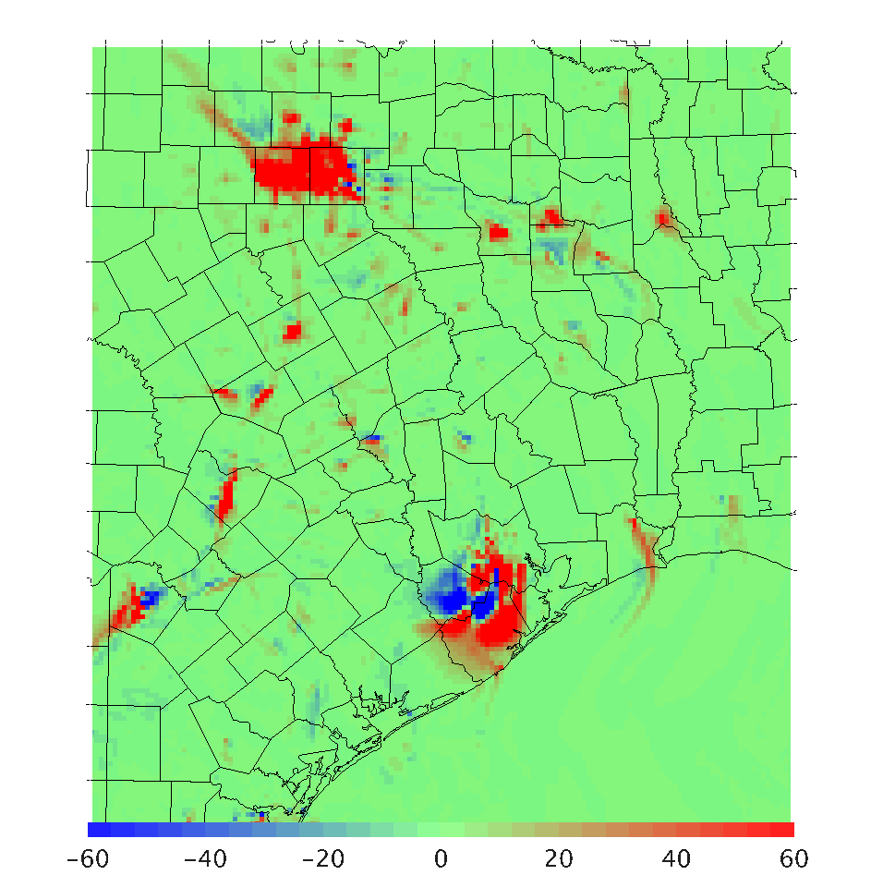
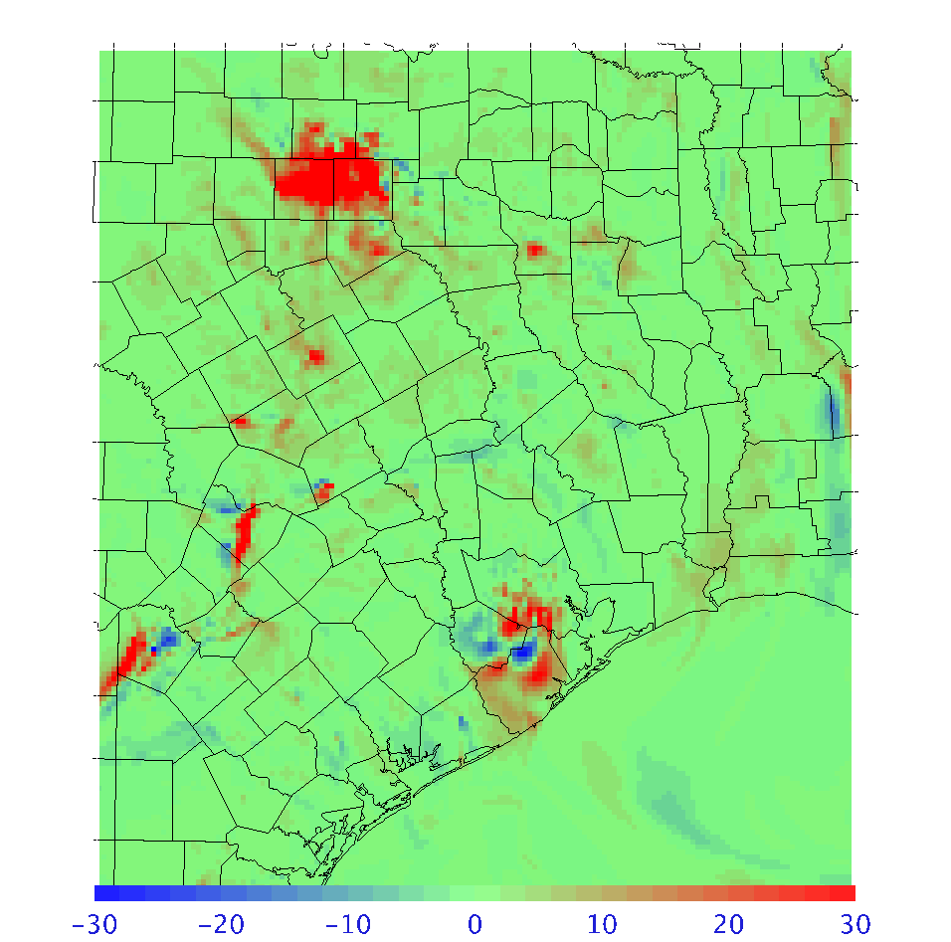
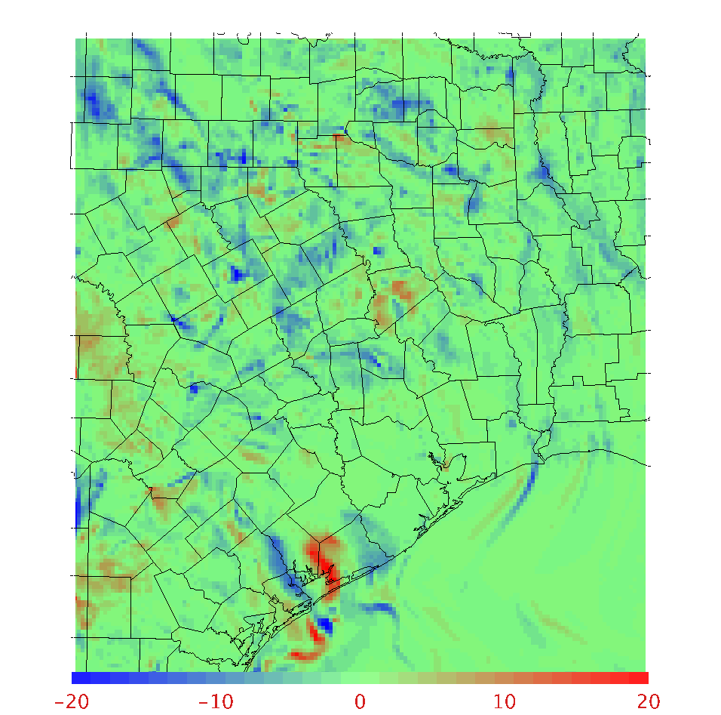
Base – Urban at 13Z (8AM LT) Aug 31, 2006
No urban minimum K_{z} (K_{zmin} = 0.01)
NOx
PM
O₃
Large differences in primary pollutants at night and morning
Substantial differences in O₃ but at a time when concentrations are low

Slide 23
NOx: August 24 – September 8, 2006
3 AQS sites
6 AQS sites
12 AQS sites
Way too high at night in Houston for all runs
Both the Urban mods and the high minimum Kz reduce over prediction of NOx

Slide 24
PM2.5: August 24 – September 8, 2006
Urban mods effective for Dallas in lowering nocturnal PM2.5
High minimum Kz more effective for Houston
Model too low at San Antonio except for morning Rush

Slide 25
Conclusions
New bulk urban scheme for the PX-LSM shows much improved PBL structure in evening, overnight, and morning compared to Houston tethersonde measurements
4 km CMAQ runs show reduced high bias for primary pollutants but still too high
Removing urban K_{zmin} makes over-prediction worse
Further improvements should be evaluated meteorologically since nocturnal emissions may have significant errors

Slide 26
Next steps
Enhancements to the Urban parameterization:
  Add anthropogenic heating based on population and housing unit density
  Add NLCD canopy fraction data for accurate accounting of tree cover in all areas including urban.
Comprehensive evaluation of meteorology and AQ at all scales

Slide 27
Extras

Slide 28
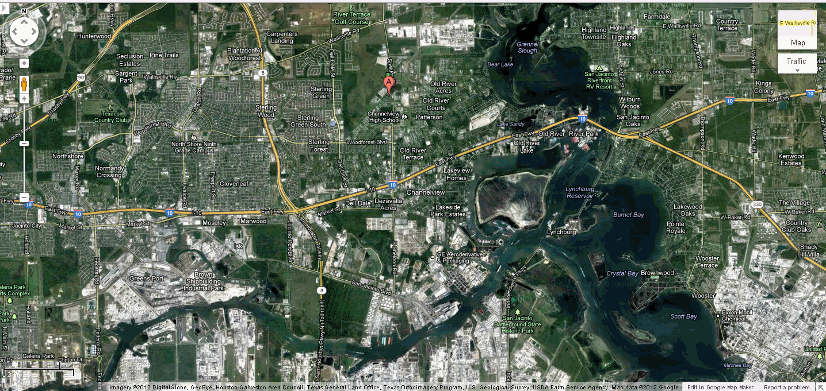
Why AQ model at 4 km resolution grossly overpredicts NOx in Houston
AQS site near Houston ship channel
2 km

Slide 29
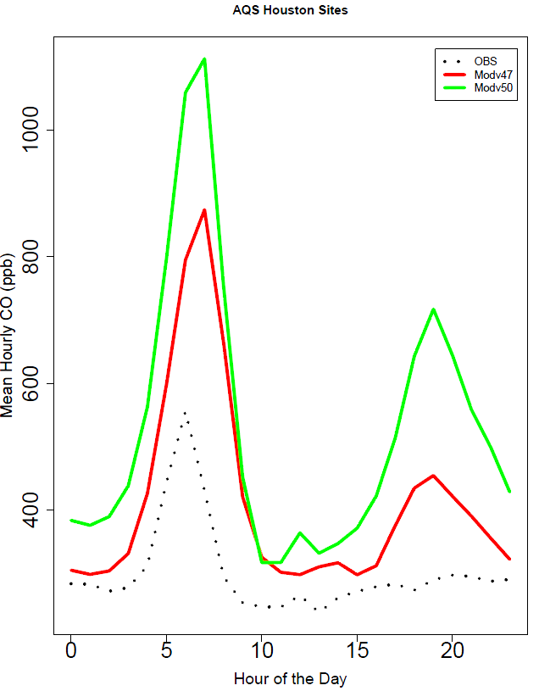
4 km modeling for Houston – August 2006
CMAQ v4.7 and 5.0 overpredict CO especially during morning and evening rush hours
WRF Potential temperature (blue) in Houston at 7 PM shows premature surface inversion

Slide 30
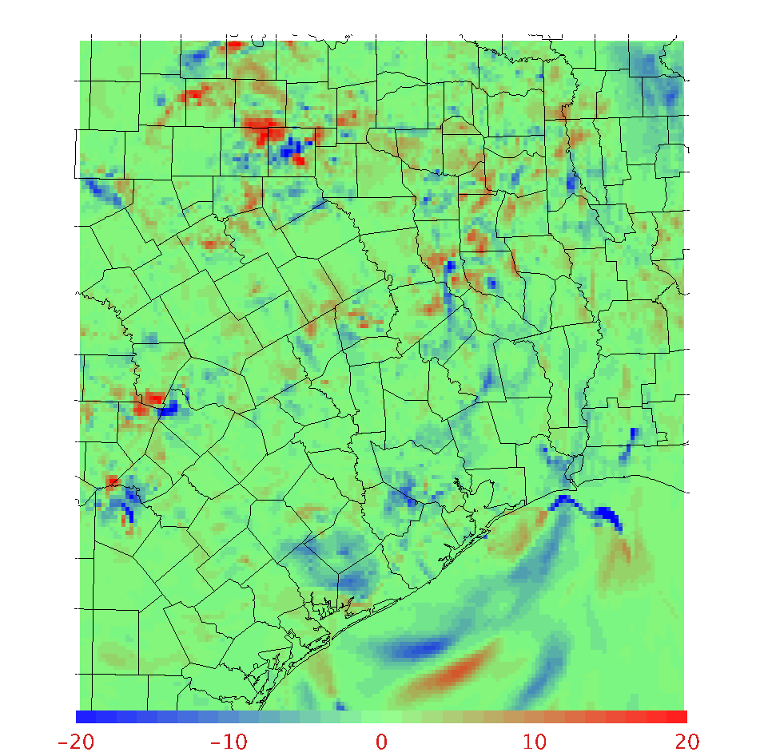
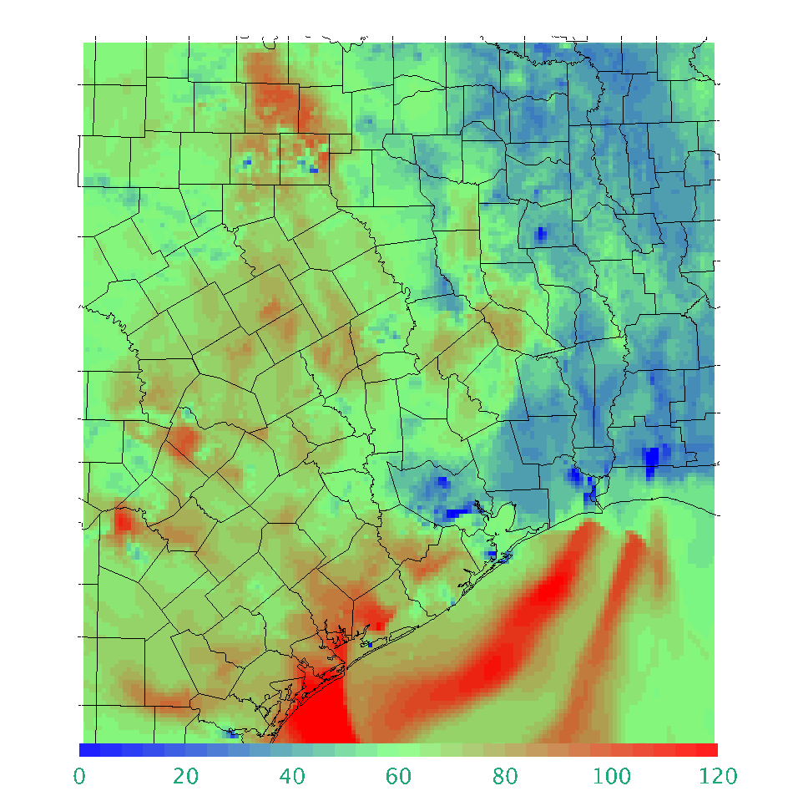
Ozone at 00Z (7PM LT) Sept 1, 2006
Base - Urban
Urban
Substantial ozone differences in evening when concentrations are high

Slide 31
Ozone: August 24 – September 8, 2006
Difference among the 4 runs are less for Ozone than for NOx
Run with least nocturnal mixing (highest over-prediction of NOx) is closest to Obs for Dallas and San Antonio.
All runs too low for Houston.

Slide 32
NOx: August 24 – September 8, 2006
3 AQS sites
2 AQS sites
Daytime modeled NOx compares well for San Antonio
Urban effects are small for Austin

