Slide 1
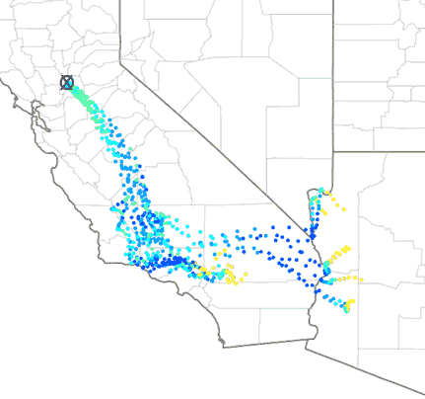
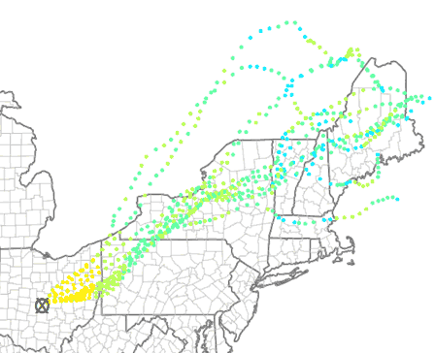
Ensemble Air Quality Modeling Using the Coupled WRF-CMAQ Model
Robert Gilliam*, Christian Hogrefe*, James Godowitch*, Rohit Mathur*, Jun Du** *US EPA, **NOAA/NCEP
October 16, 2012

Slide 2
Outline
Background of ensemble approach
Model configuration
Variability of meteorological ensembles
Response of CMAQ to ensemble meteorology inputs
Conclusions and future research goals

Slide 3
Background of Ensemble Approach
Grid nudging, or four dimensional data assimilation (FDDA), is used to drive our retrospective meteorological simulations for CMAQ.
FDDA analyses (U/V, T and Q) are generally obtained from national forecast model initial conditions archives.
FDDA analyses are computed using 3-D variational (3DVAR) data assimilation systems or objective analyses hybrid (Obsgrid), which produce a single best-fit of all observations collectively to a background field (typically short-term forecast).
In recent years, 3DVAR systems like NCEP’s GSI have adopted ensemble generation methods like breeding or ensemble transform (EnKF), which produce a range of initial conditions that represent statistically possible states of the atmosphere.

Slide 4
Background of Ensemble Approach: Main Research Questions
If an ensembles set of initial conditions are truly a representation of the uncertainty of the state of the atmosphere, can they be used to estimate the CMAQ uncertainty that results from variations in its meteorological inputs?
Can this CMAQ ensemble variability add value to our general understanding of inherent variability of single CMAQ simulations, like the expected error ranges or variability? i.e.; 8-hr max O3 of 78 ppb +/- 8 ppb

Slide 5
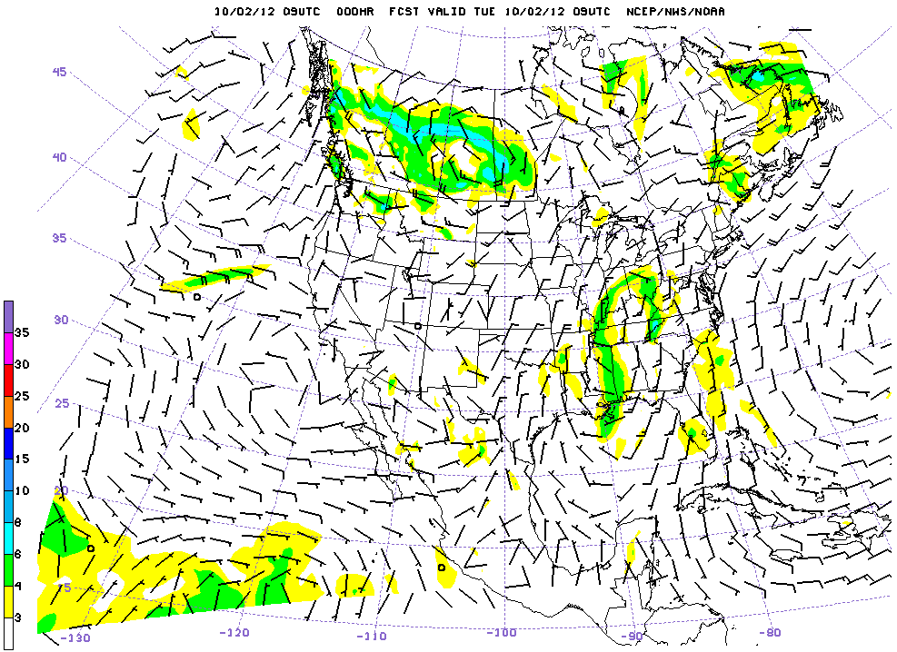
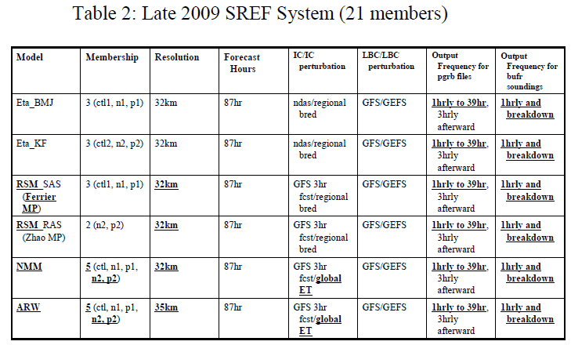
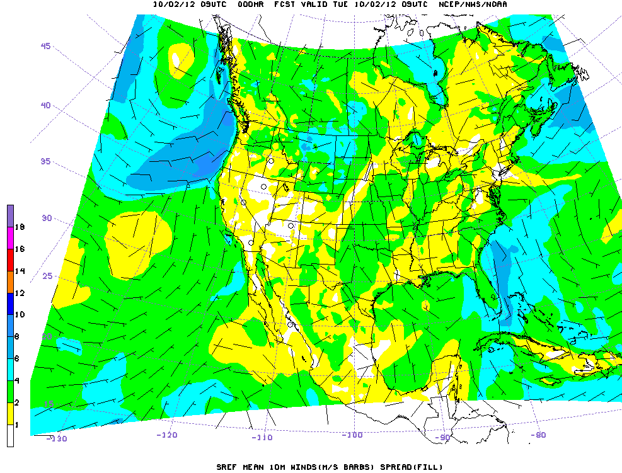
Short-Range Ensemble Forecast System (SREF)
*
NCEP Short Range Ensemble Forecast (SREF) System Upgrade in 2009
Jun Du, Geoff DiMego, Zoltan Toth, Dusan Jovic, Binbin Zhou, Julia Zhu, Hui-Ya Chuang, Jun Wang, Henry Juang , Eric Rogers and Ying Lin (Environmental Modeling Center, NCEP/NOAA, Camp Springs, Maryland)
*

Slide 6
General Ensemble Configuration
Used Short-Range Ensemble Forecast (SREF) system’s initial conditions each 6 hours for FDDA.
Used the two-way WRF-CMAQ model (no feedback) on the 12 km CONUS grid.
Ran single WRF-CMAQ for a 10 day spin-up period (May 27-June 5) prior to the ensemble modeling period using 2006 emissions.
Generated separate wrffdda_d01 files for 15 SREF members using WRF’s real.exe.
Ran 15 member ensemble for a 4-day high ozone case where the only difference was the ensembles FDDA fields above the PBL.
Examined the variability of WRF, WRF model performance, transport trajectories and CMAQ performance from a probabilistic perspective.

Slide 7
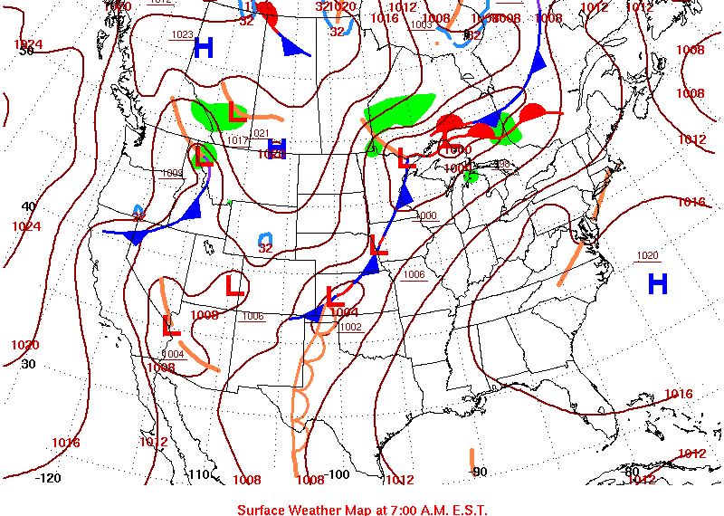
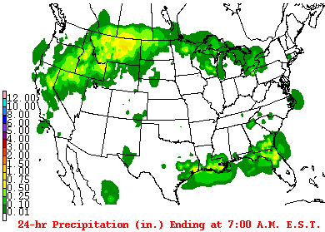
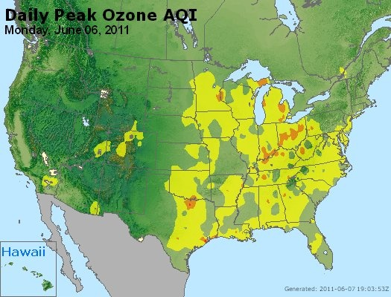
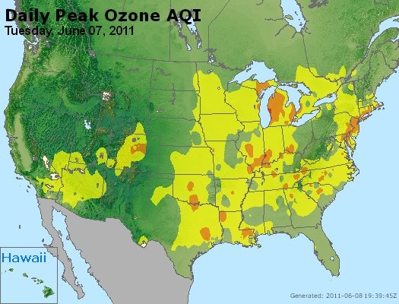
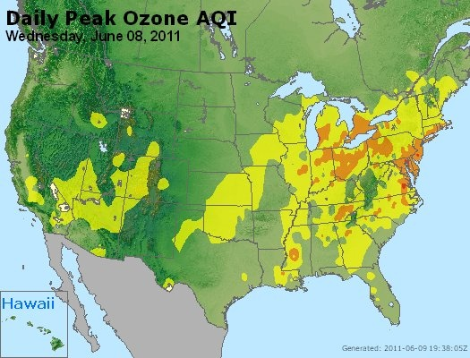
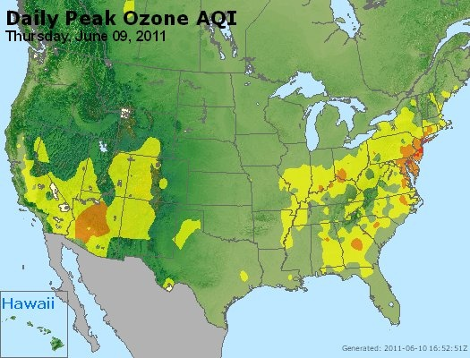
June 8, 2011
June 8
Note: Maps were developed by NOAA/NCEP/HPC http://www.hpc.ncep.noaa.gov/dailywxmap/
Four-day case (Jun 6-9, 2011) study represents a classic eastern US elevated ozone regime.
Bermuda high pressure expands influence to entire eastern US (above).
Warm temperatures, clear skies and low precipitation (top-right) are reflection of subtropical high’s influence.
Southerly flow becomes conveyor belt of ozone and precursors to the highly populated northeast US. (AirNow maps)

Slide 8
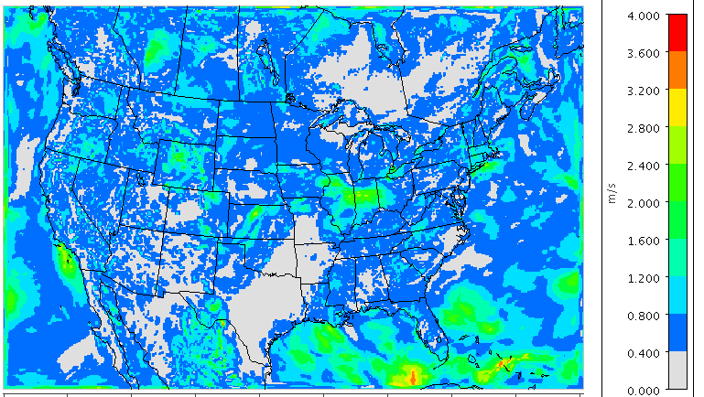
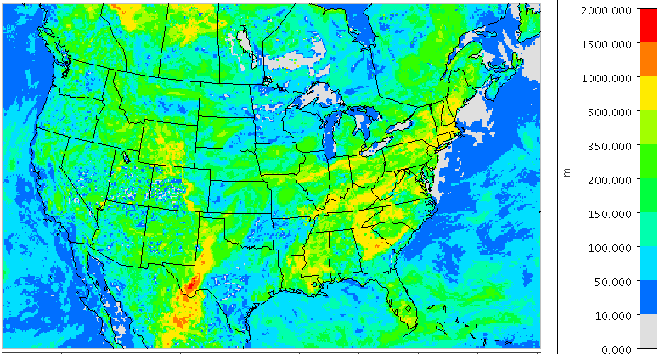
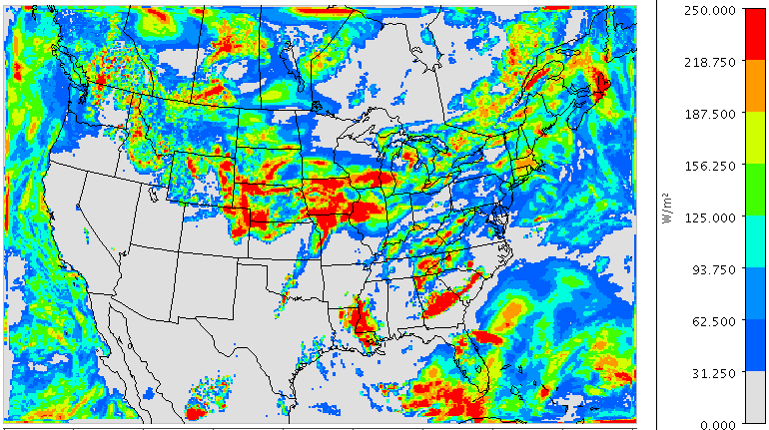
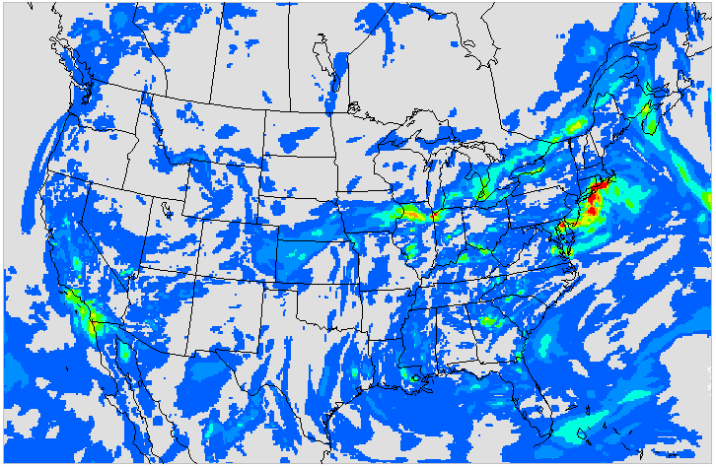
WRF-CMAQ Ensemble Std. Dev.
10 m Wind Speed (m/s)
PBL Height (m)
Shortwave Rad(W/m^2)
500 m Ozone (ppb)

Slide 9
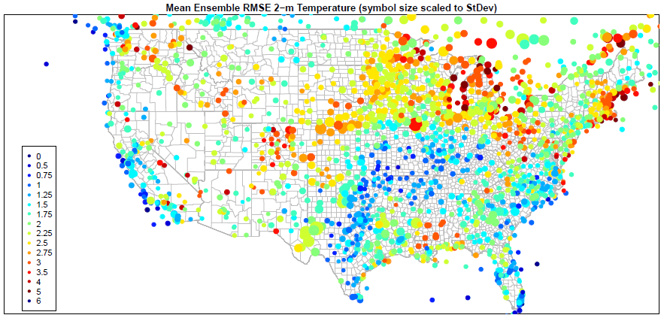
Variability of Ensemble RMSE (T_{2m})
Std. Dev. of Ensemble RMSE is generally below 0.20 K when ensemble RMSE is low (< 2.0K)
Higher ensemble error and variability of error exists in the Midwest, Northeast where more active weather persisted over the study period
Variability in temperature RMSE shows ensemble does have a significant spread along frontal boundaries and during active weather regimes.

Slide 10
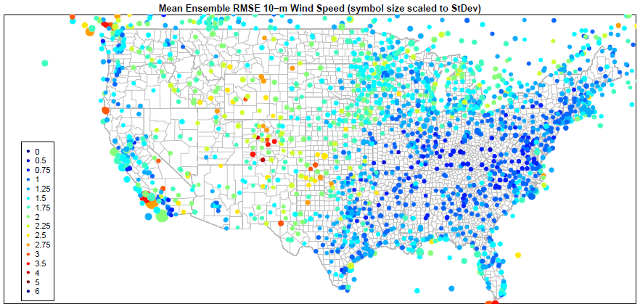
Variability of Ensemble RMSE (WS_{10m})
Mean ensemble RMSE generally low across most of the US (< 2 m/s).
Variability of Ensemble RMSE is mostly less than 0.2 m/s with some larger values along land water boundaries (i.e.; West Coast).

Slide 11
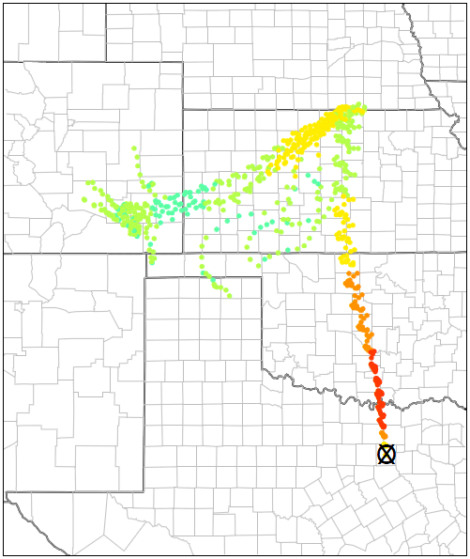
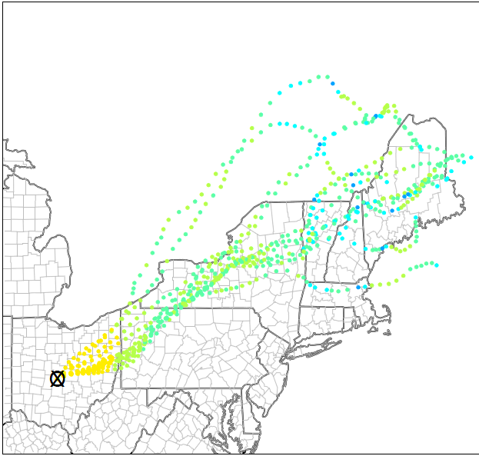
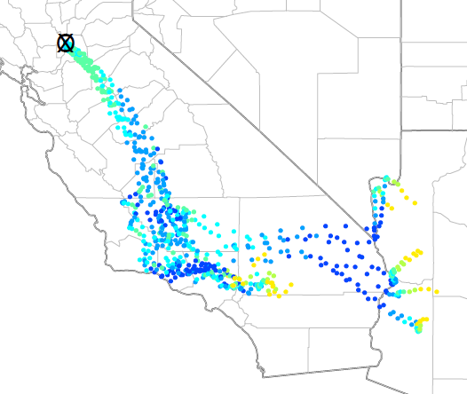
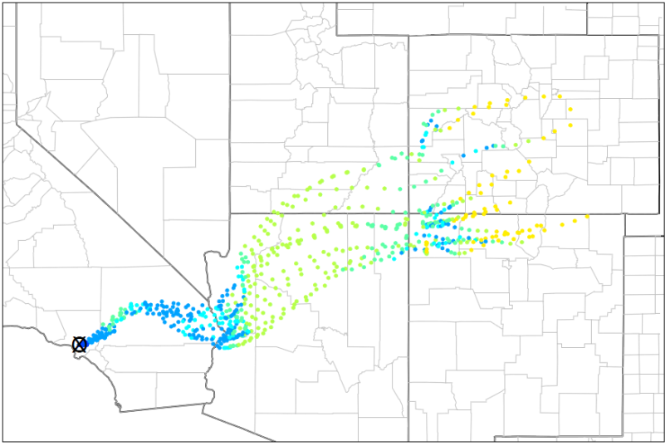
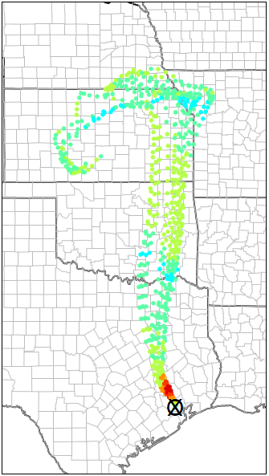
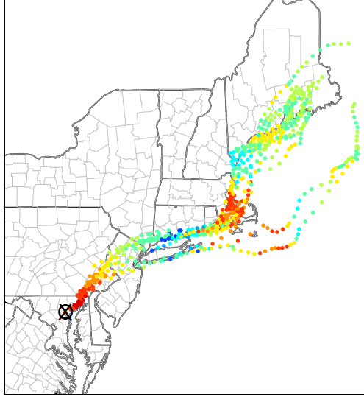
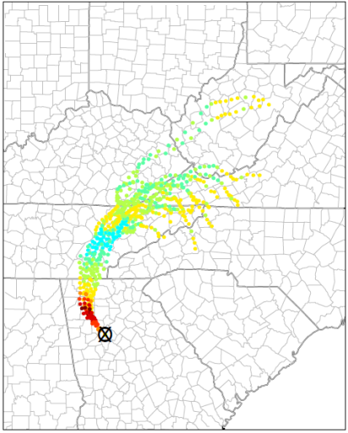
Single Level Ensemble Trajectories
Sacramento
Dallas
Columbus
Los Angeles
Baltimore
Trajectories are around 130 m agl with colors representing O₃ concentrations (ppb) along the traj. June 7, 18 UTC to June 10, 00 UTC
Houston
Atlanta

Slide 12
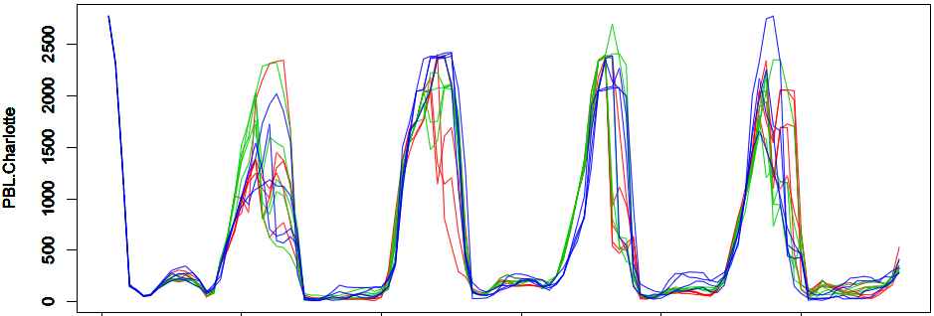
Charlotte, NC
06/05/11
06/07/11
06/09/11

Slide 13
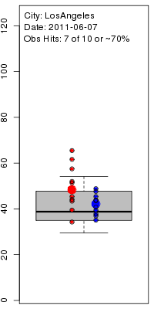
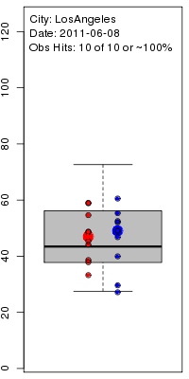
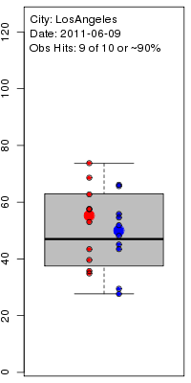
Ensemble O₃ Predictions for US Cities Los Angeles
June 7
June 8
June 9
8-hr max O3 obs
Ensemble Distribution
Baseline WRF-CMAQ

Slide 14
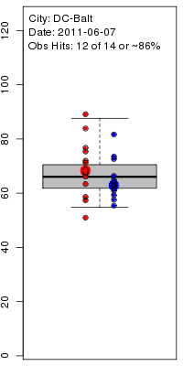
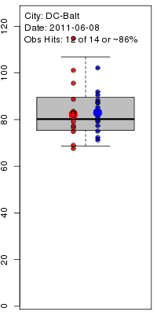
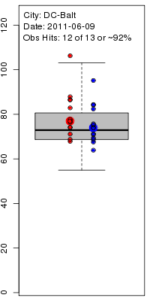
Ensemble O₃ Predictions for US Cities Baltimore
June 7
June 8
June 9

Slide 15
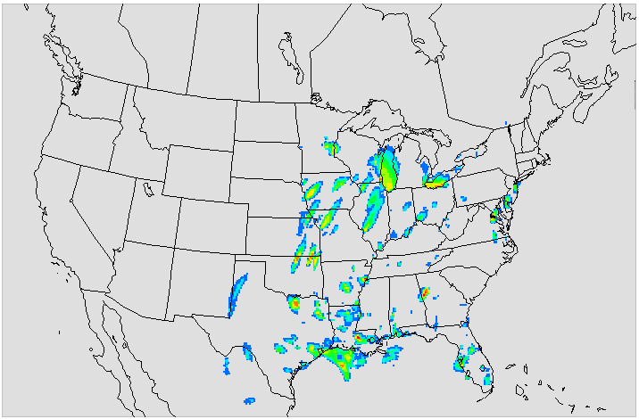
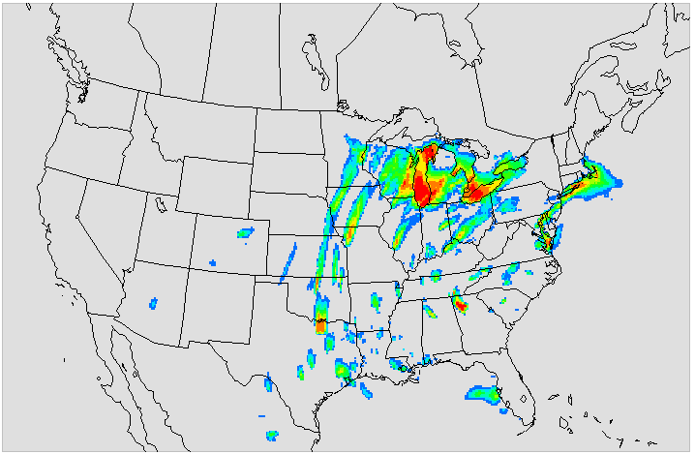
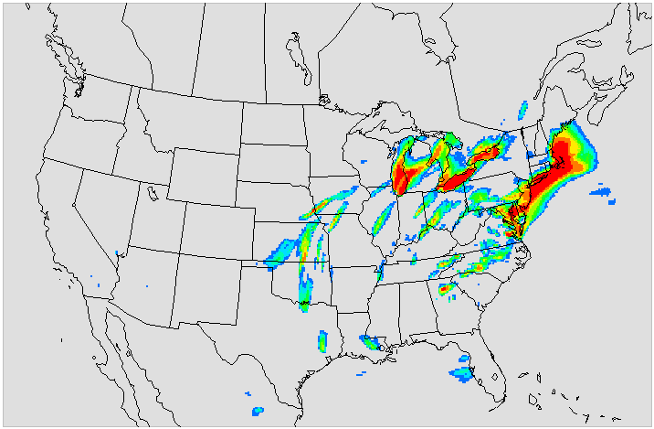
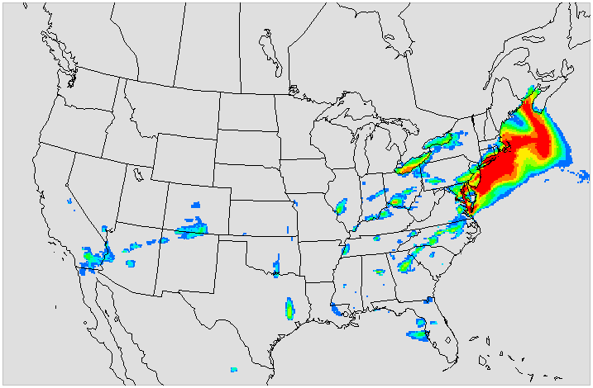
Probability (%) of 8-hr Ozone > 75 ppb
June 6, 2012
June 7, 2012
June 8, 2012
June 9, 2012

Slide 16
Conclusions
Ensemble FDDA using SREF does produce significant variability in key meteorological parameter like clouds, radiation, PBL depth, lower tropospheric winds and temperature
This meteorological variability has in many instances, a large impact on CMAQ’s Ozone and CO concentrations.
This preliminary case study showed that in and around urban areas, max 8-hr Ozone can vary as much as 5-15 ppb because of meteorological input uncertainty passed to CMAQ.

Slide 17
Future ensemble research
Test longer term ensemble runs for the summer of 2012 with longer spin-up and up-to-date emissions with parallel baseline run using our standard WRF FDDA.
Perform ensemble simulations with reduced emissions to investigate the impact of inherent meteorological uncertainties on the modeling system response to emission controls and source/receptor relationships.
Explore other ensembles like the GFS, which is a single model 20 member ensemble, or the new SREF which will be reduced to 16 km grid scale, or possible our own ensemble through the GSI system on our model domain.
Develop more exact uncertainty levels of major pollutants
Use Ensemble FDDA to explore wintertime PM_{2.5} CONUS-wide, but also for specific problem areas like stable cold pools in areas of the Rockies (SLC).

Slide 18
Acknowledgements
NOAA-NCEP: SREF ensemble initial conditions for case study
NOAA/ESRL: MADIS observations used for WRF evaluation
US EPA’s AirNow program: AirNow ozone maps and observational AQ measurements
David Wong: WRF-CMAQ code and run scripts

Slide 19
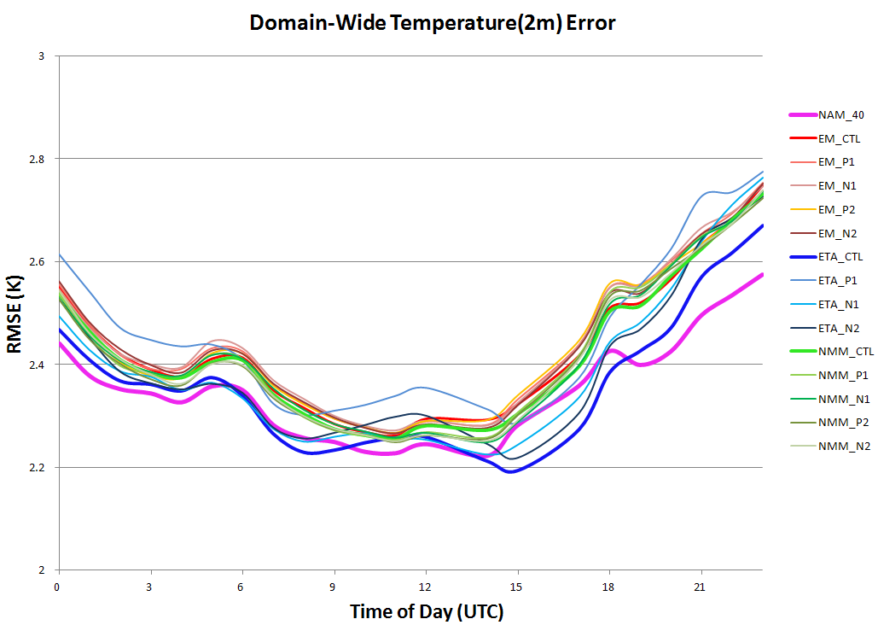
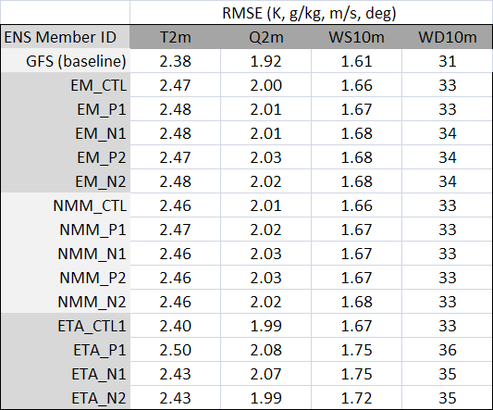
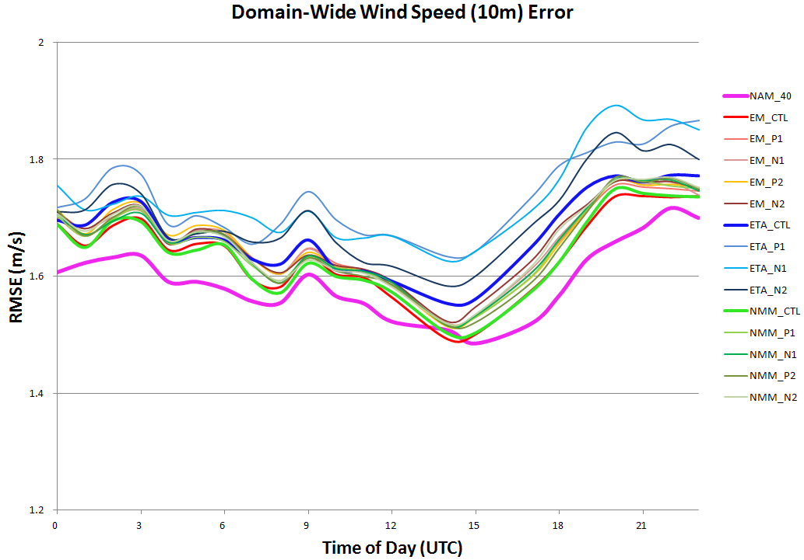
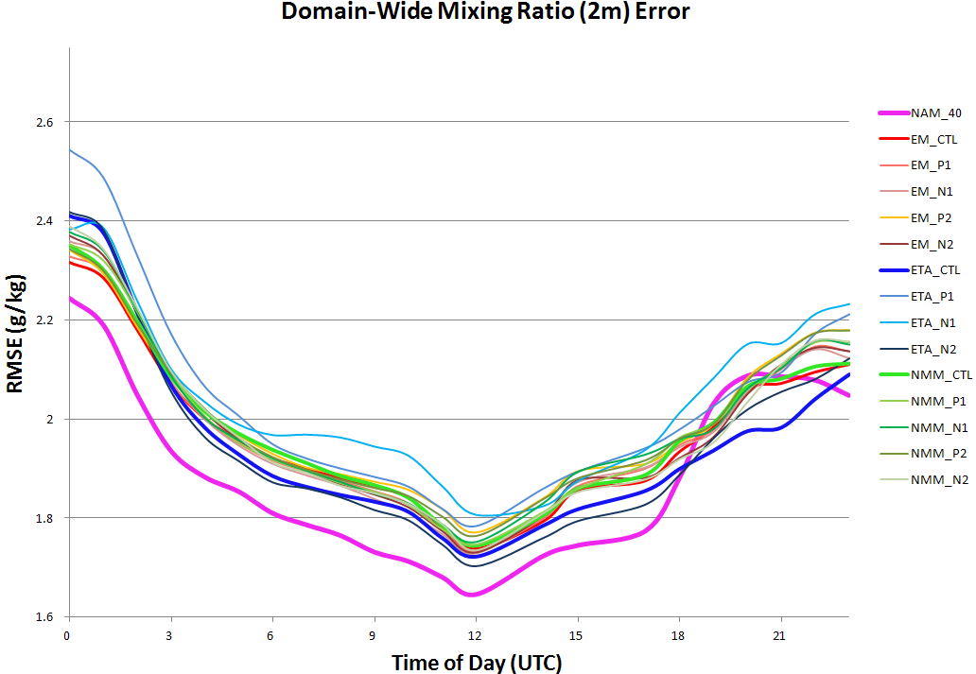
WRF Ensemble Error (RMSE)
Baseline
Baseline
Baseline

Slide 20
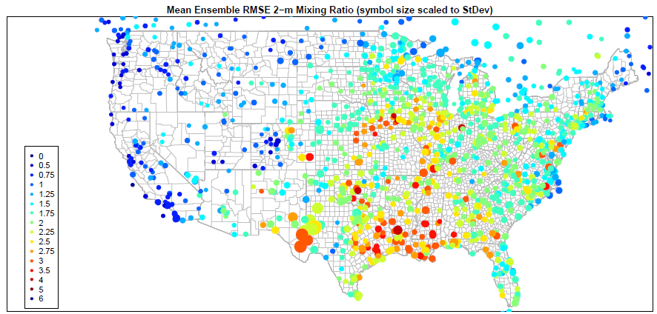
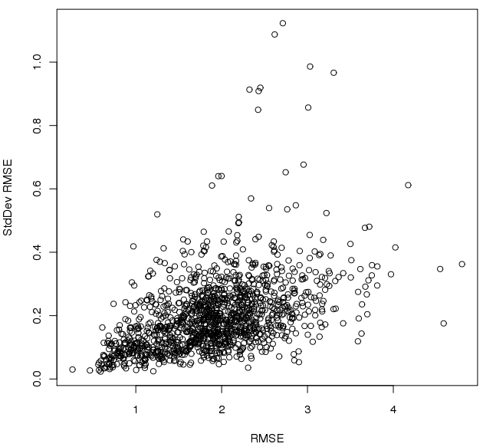
Variability of Ensemble RMSE

Slide 21
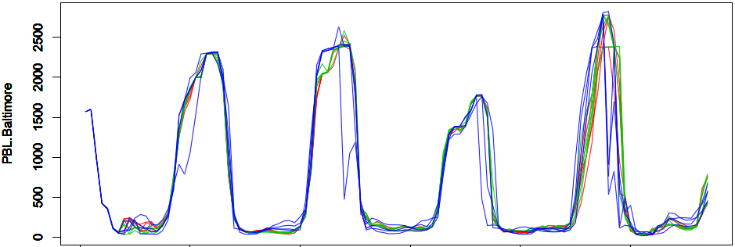
Baltimore, MD
06/05/11
06/07/11
06/09/11

Slide 22
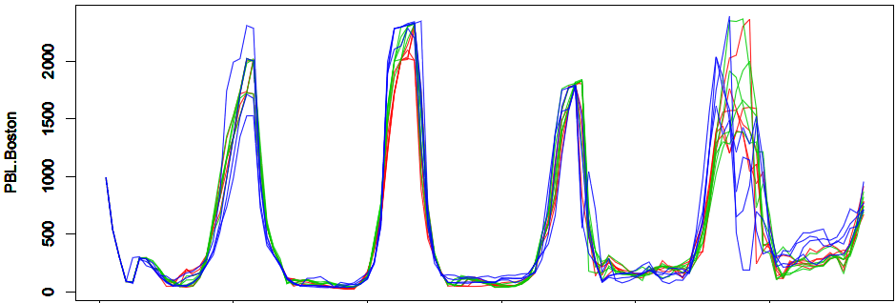
Time Series of WRF and CMAQ
Boston, MA
06/05/11
06/07/11
06/09/11

Slide 23
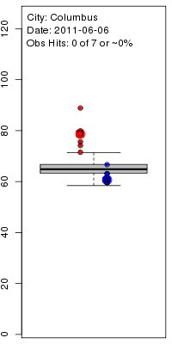
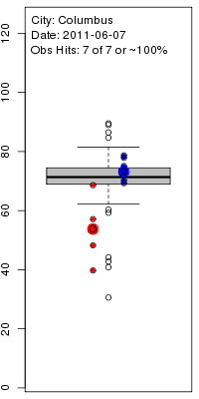
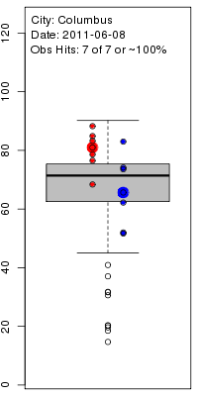
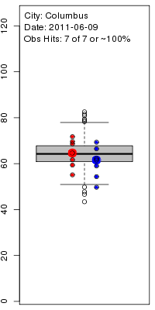
Ensemble O₃ Predictions for US Cities Columbus
June 6
June 7
June 8
June 9

Slide 24
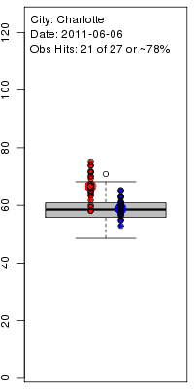
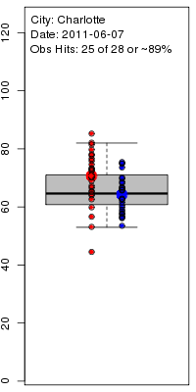
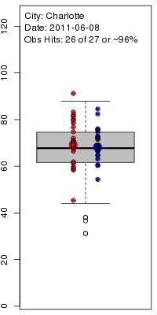
Ensemble O₃ Predictions for US Cities Charlotte
June 6
June 7
June 8
June 9

Slide 25
Ensemble O₃ Predictions for US Cities Dallas
June 6
June 7
June 8
June 9

Slide 26
Ensemble O₃ Predictions for US Cities Houston
June 6
June 7
June 8
June 9

Slide 27
Probability (%) of 8-hr Ozone > 65 ppb
June 6, 2012
June 7, 2012
June 8, 2012
June 9, 2012

Slide 28
Probability (%) of 8-hr Ozone > 90 ppb
June 8, 2012
June 9, 2012

Slide 29
Single-observation increments
GSI
EnKF
hybrid
Single 850 hPa T_{v} observation (1K O-F, 1K error)

Slide 30
Why use EnKF for ensemble data assimilation and ensemble forecast initialization instead of operational ETR?
ETR (Ensemble transform with rescaling)
Not designed to represent 6-h forecast error covariances - viable for hybrid paradigm?
Update of breeding method to include orthogonalization of perturbations in analysis variance norm.
Virtually no additional computational cost beyond forward integration
Perturbations based on resizing to analysis-error mask derived for 500 hPa streamfunction
Tuned for medium range forecast spread and “fast error growth”
T190L28 version of the GFS model
EnKF
Perturbations specifically designed to represent analysis and background errors (parameters tuned by running DA stand-alone)
T254L64 version of the GFS
Extra computational costs worth it for hybrid?

