Slide 1
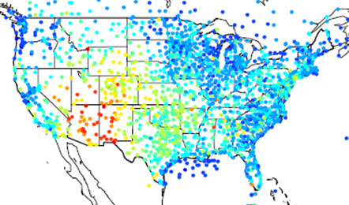
Overview of the Atmospheric Model Evaluation Tool (AMET) version 1.4
K. Wyat Appel and Robert C. Gilliam
US EPA/UNC-CMAS Webinar November 12, 2019

Slide 2
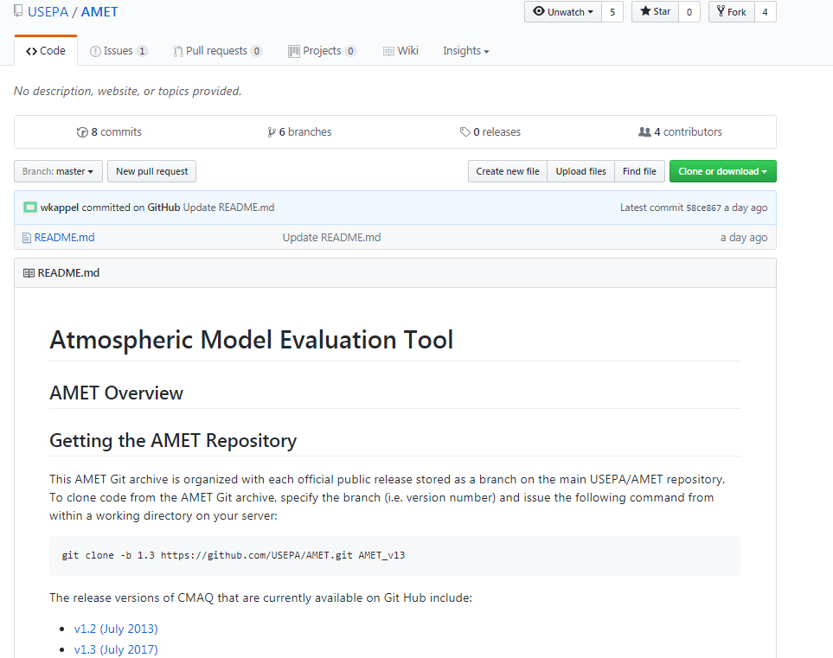
Brief History of AMET
AMET v1.0
Early AMET
AMETv1.2
AMETv1.3
Appel et al. (2011) Environ. Modell. Softw., 26, 434-443.
Bug fixes, new scripts
Significant updates over previous version
Available through GitHub for the first time
First developed by Rob Gilliam for MM5 meteorological applications (early 2000s)
First public release through CMAS Center
AMETv1.1
Extended to AQ applications by Wyat Appel (mid-2000s)
Feb 2008
May 2008
July 2013
July 2017
Minor update
AMETv1.4
August 2019
New interactive analysis plots
Ability to use AMET-AQ without MySQL database
https://github.com/USEPA/AMET

Slide 3
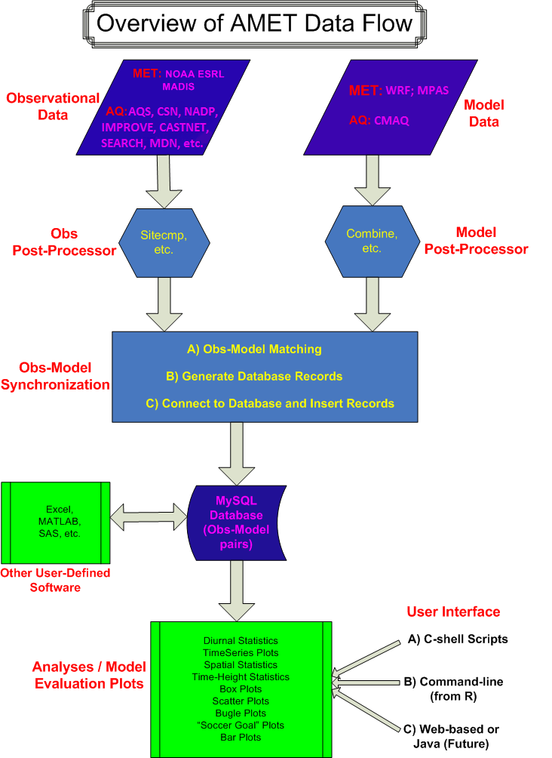
General Overview of AMET
Model evaluation tool for both AQ and MET models
WRF, MPAS (MM5 no longer supported)
CMAQ, CAMx (requires some pre-processing)
Utilizes open source software
MySQL database software: Data storage and access
Fortran (post-processing tools)
R statistical software: Database interface and analysis
Advantages of AMET
capable of managing large datasets efficiently
partially automated system, therefore easy to use
relational database allows for unique querying of data
pre-defined analysis scripts for common analysis across groups
users can easily develop their own custom analyses in R
or leverage output files to do their own analyses
(AQ only)
(AQ only)

Slide 4
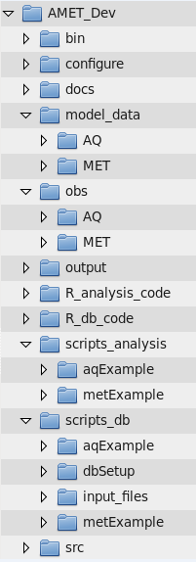
General Overview of AMET: GitHub Code Structure
- External AQ binaries
- R configuration file
- Documentation
- Model output
- Downloaded Met and AQ observations
- Output files for both AQ and MET
- R analysis code
- R model-observation matching code
- Analysis C-Shell scripts
- Model-observation matching and database management C-shell scripts
- Source code for AQ required executables

Slide 5
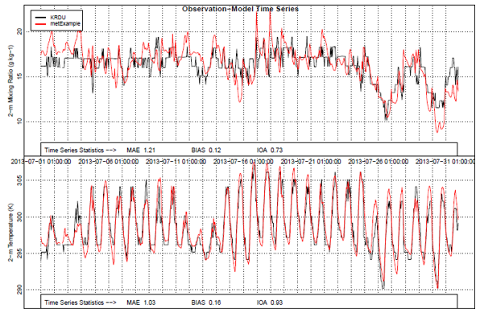
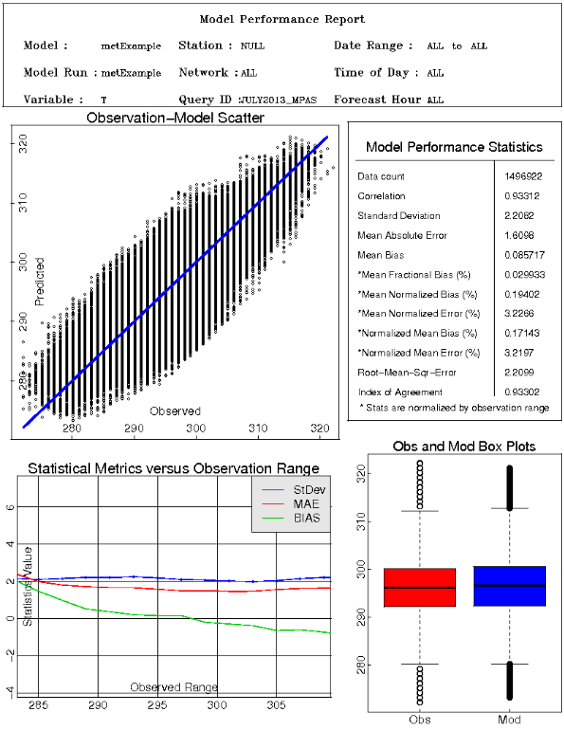
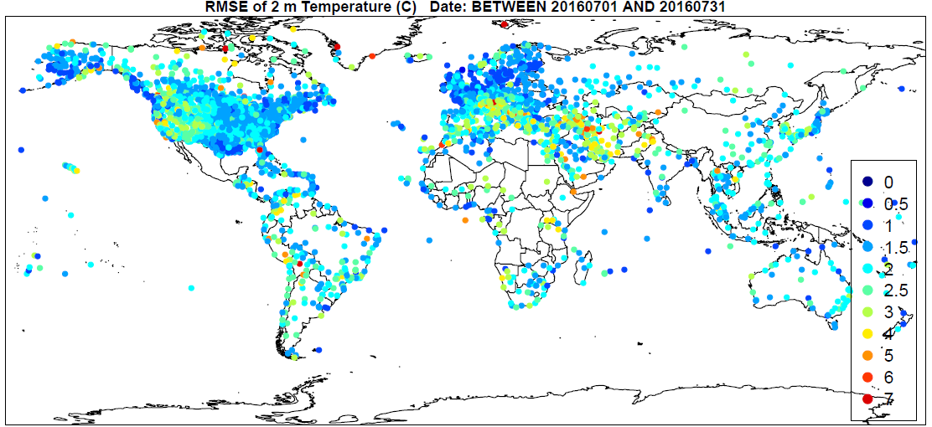
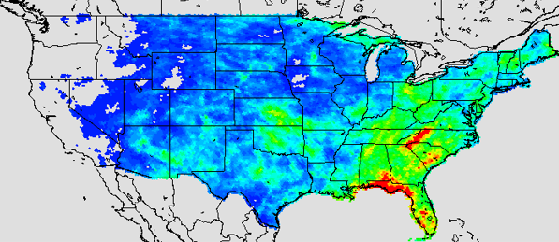
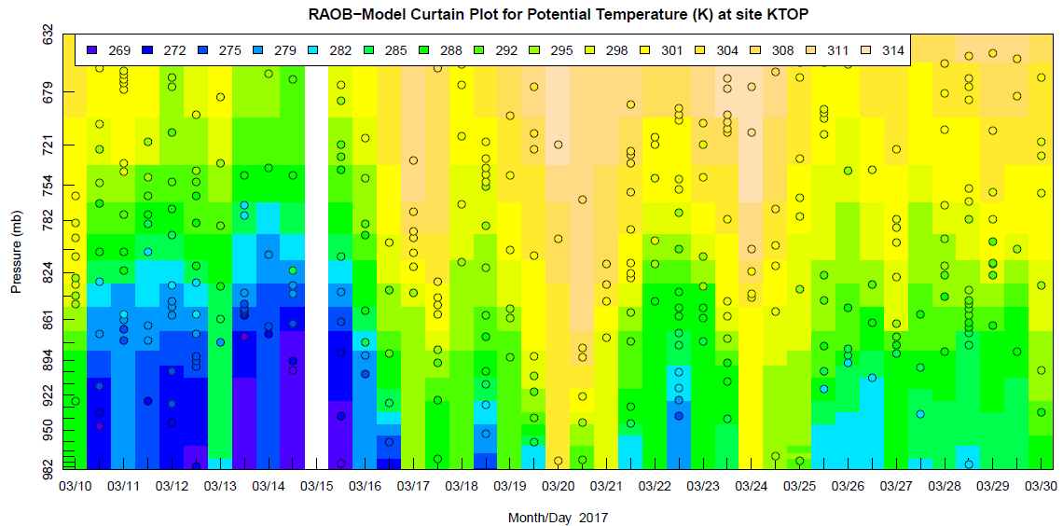
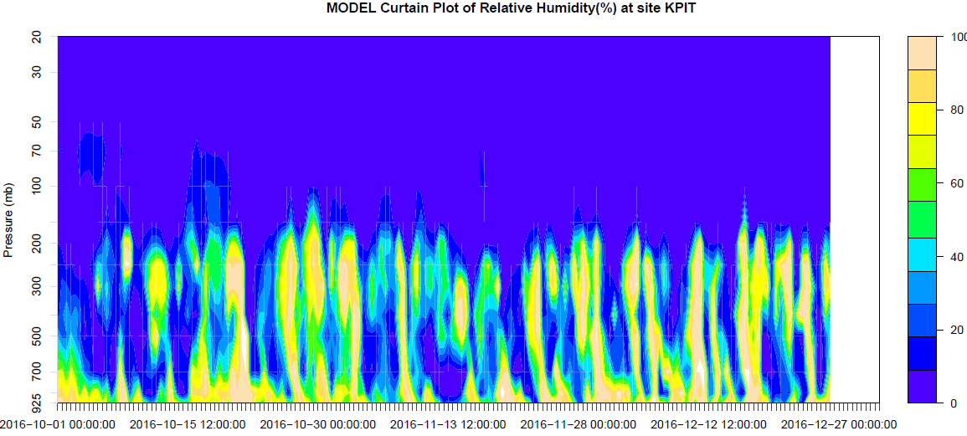
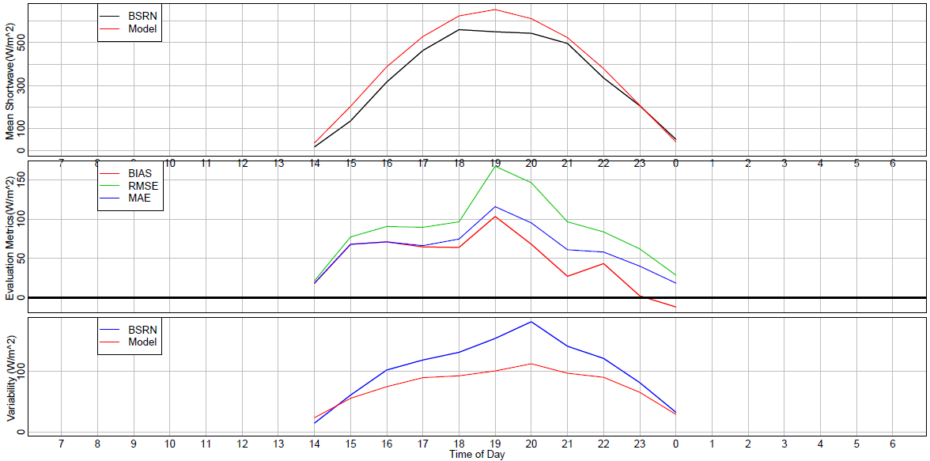
Examples of AMET-MET Module Plots

Slide 6
Key Updates to the AMETv1.4 MET Module
Upper-air evaluation using MADIS sounding dataset (RAOB)
Surface shortwave radiation evaluation using global Baseline Surface Radiation Network (BSRN) dataset
Precipitation evaluation using PRISM daily and monthly observations
Compatibility with all WRF map projections including Lambert Conformal, Polar Stereographic, Mercator and Lat-Lon (interim update Nov 2019)
Evaluation of surface moisture timeseries at specific locations or an averaged groups of sites
Faster database population

Slide 7
AMETv1.4 MET Module (A Review)
All R-based scripting with Cshell control wrappers
Direct reading of NetCDF MADIS obs files
Compatibility with the global Model for Prediction Across Scales (MPAS) model
Simplified project table and database management
separate database and project creation scripts have been eliminated
automatically generated (database and project tables) at run-time
AutoFTP option for acquiring MADIS and surface radiation data
Dynamic MET site accounting
master site list is updated each observation file read with only new sites
interpolation weights are only computed for new sites which improved speed
existing sites and those outside of the model domain are automatically skipped
option to auto-update “stations” meta-data table

Slide 8
Workflow (MET): Matching Model with Observations
Go to project ID directory ($AMETBASE/scripts_db/) and update the observation-model matching run script(s) to reflect new project: matching_surface.csh, matching_raob.csh, matching_bsrn.csh

Slide 9
Workflow (MET): Matching Model with Observations
Execute the run script(s): matching_surface.csh, matching_raob.csh, matching_bsrn.csh
It’s suggested that VERBOSE = T for initial cases until users feel comfortable everything is running as it should
It’s necessary to set UPDATE_SITES = T for the first project or metExample project to populate the stations table (for spatial statistics plots)
Note: AutoFTP will automatically get all observations each time increment and skip if file already exists

Slide 10
Workflow: Statistical Analysis of WRF and/or MPAS
Analyze the WRF/MPAS-Observation paired data using analysis scripts
cp –r $AMETBASE/scripts_analysis/metExample $AMETBASE/scripts_analysis/myNewProject
Eight canned scripts are provided: run_spatial_surface.csh, run_timeseries.csh, run_timeseries_rh.csh, run_summary.csh, run_daily_barplot.csh, run_plot_srad.csh, run_raob.csh and run_prism_comp.csh
Settings common across all analysis scripts
or png

Slide 11
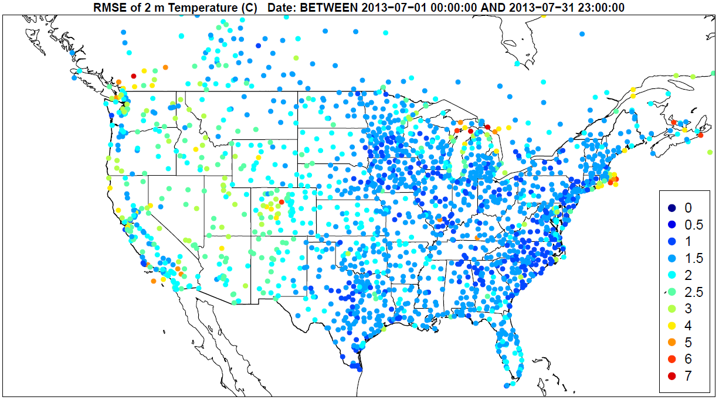
Workflow: Statistical Analysis of WRF and MPAS
Settings
run_spatial_surface.csh
./input_files/spatial_surface.input
Outputs: - 2-m temperature, mixing ratio, 10-m wind speed and direction
- Index of agreement, RMSE, MAE and bias of each variable
- Text csv of site specific stats and R data file

Slide 12
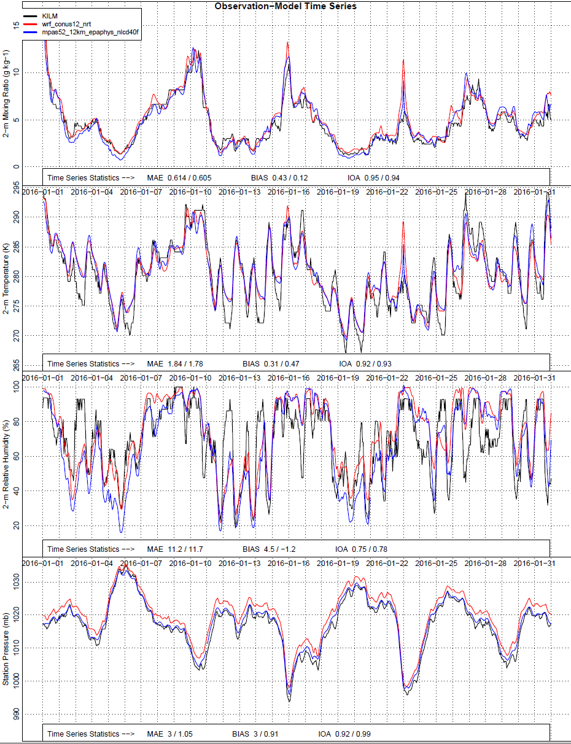
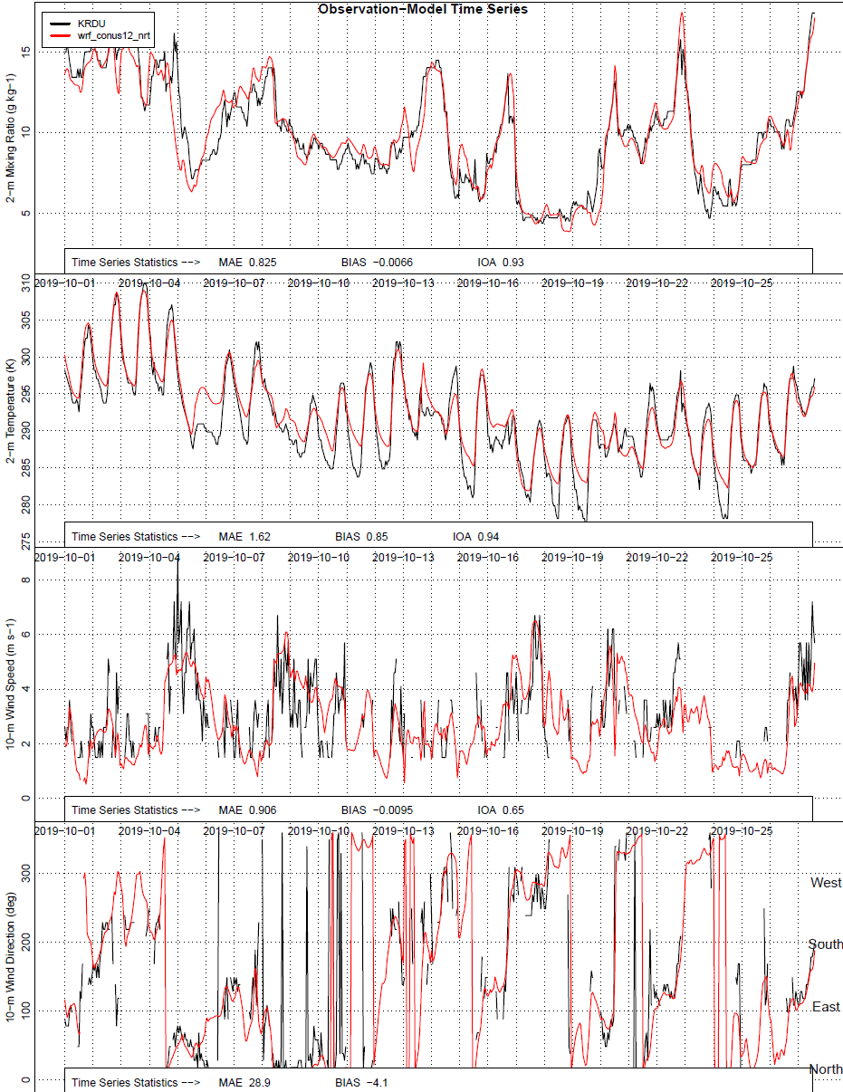
NEW: Updated Timeseries
run_timeseries.csh run_timeseries_rh.csh
./input_files/timeseries.input and ./input_files/timeseries_rh.input
Outputs: - 2-m temperature, mixing ratio, 10-m wind speed/direction, relative humidity and surface pressure in 4 panel plot
- Index of agreement, MAE and bias
- Text (csv) of site timeseries and R data file
Settings

Slide 13
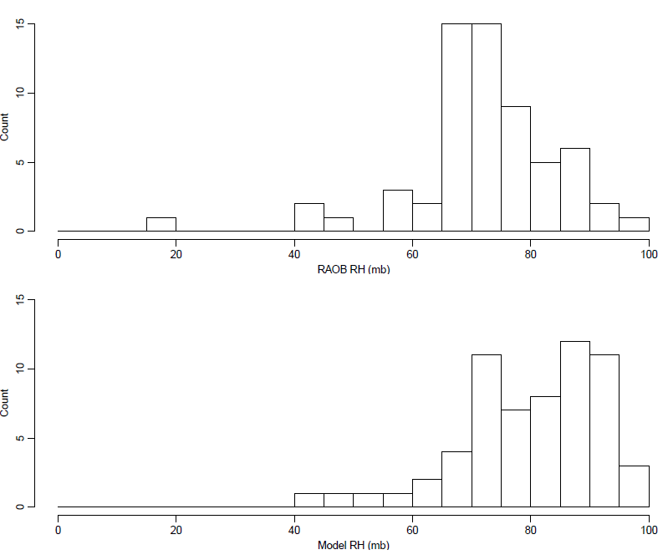
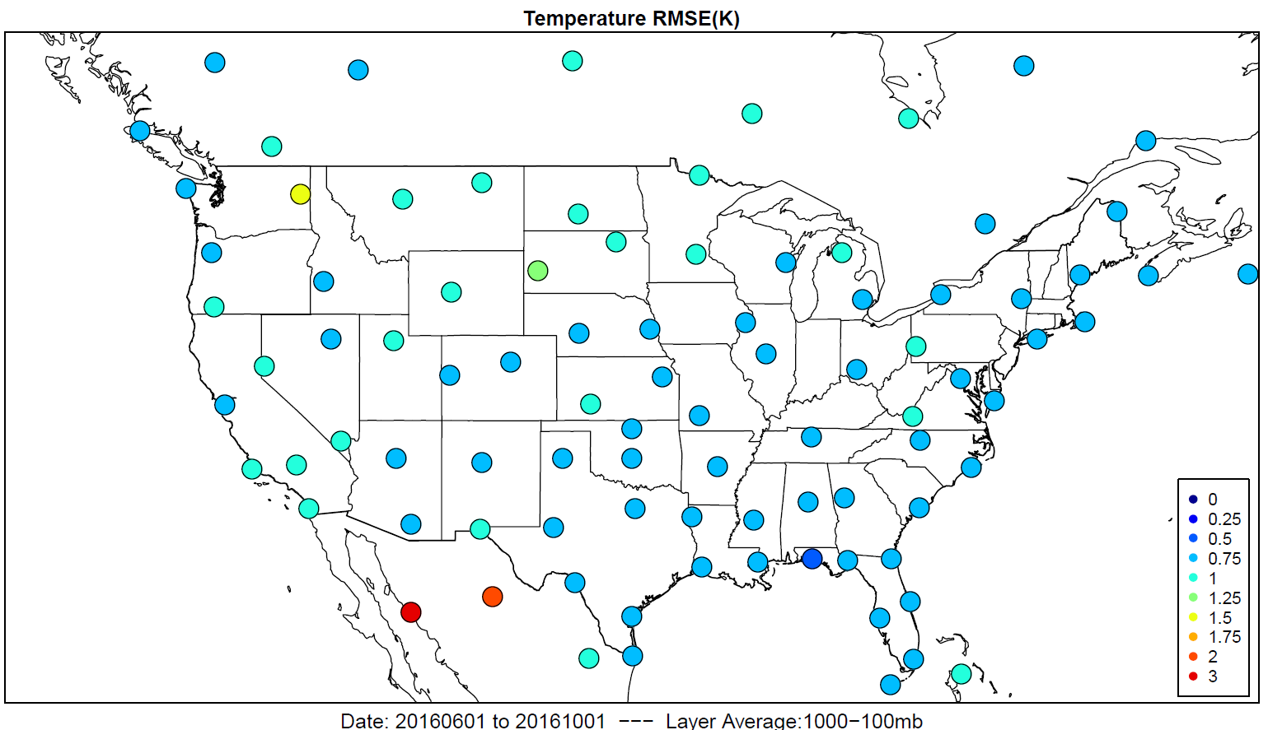
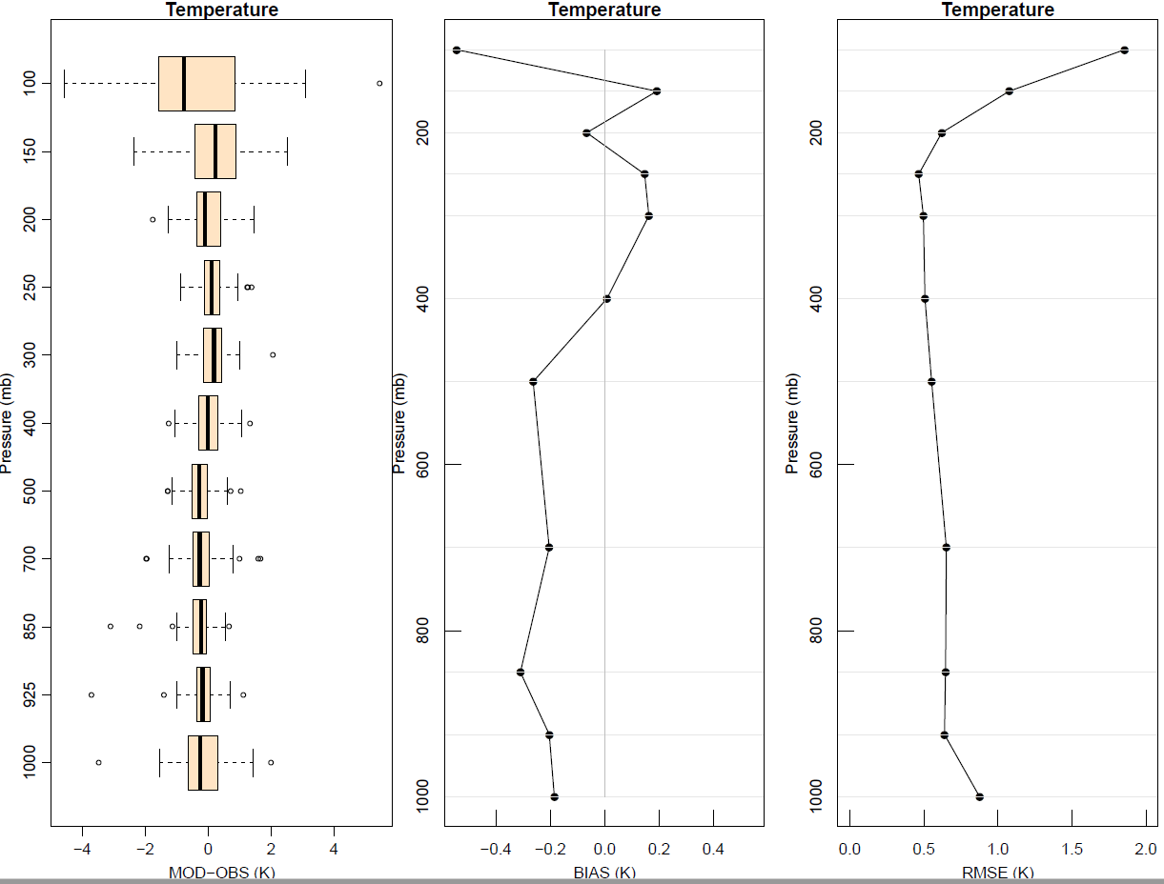
NEW: Evaluation of Upper-Air Meteorology
Outputs:
Temperature, Theta, RH and Winds
Spatial, profile, curtain, histogram, timeseries
Text (csv) of spatial and profile timeseries statistics
run_raob.csh
./input_files/raob.input
RH Histograms
Profile
Spatial
Curtain
Timeseries
Curtain

Slide 14
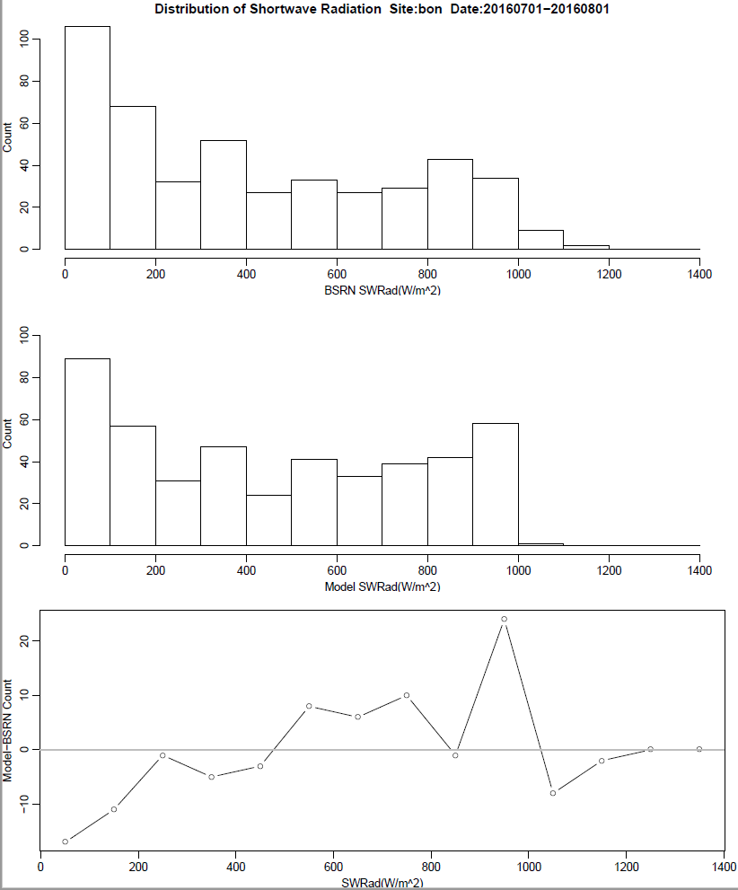
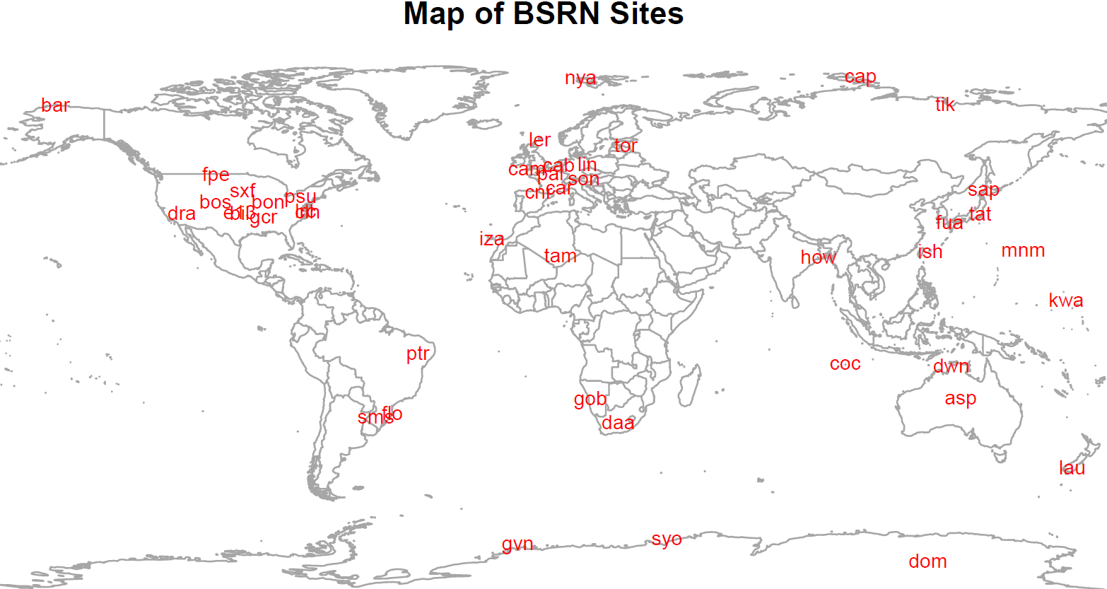
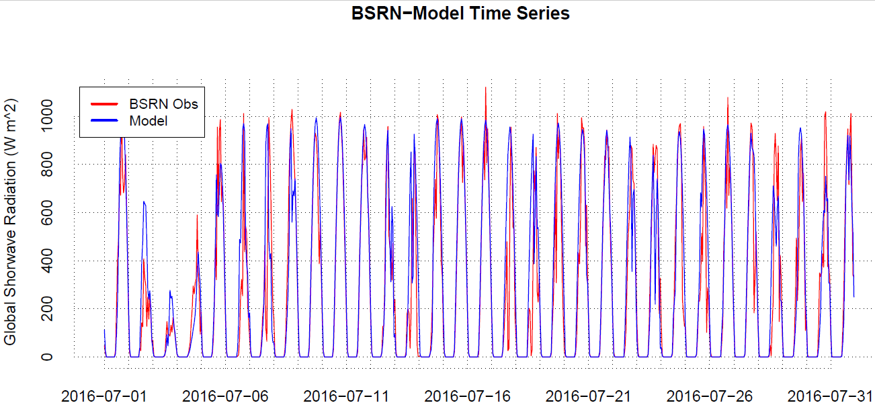
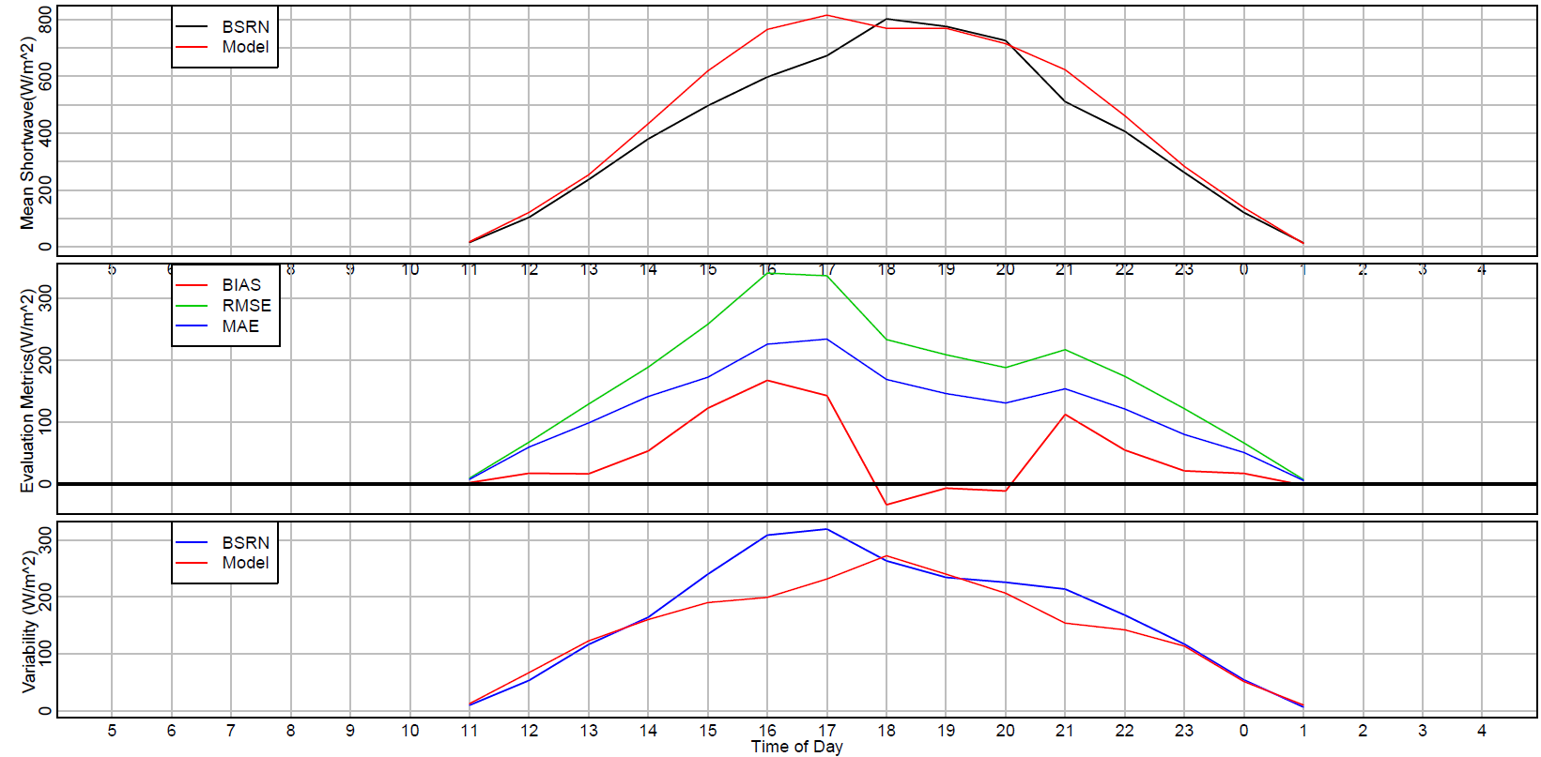
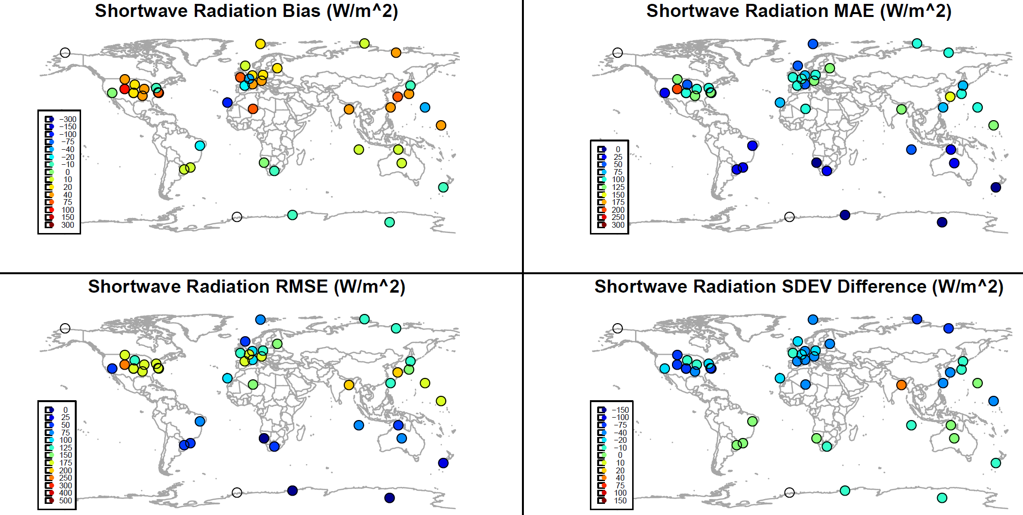
NEW: Evaluation of Shortwave Radiation
Outputs:
Shortwave radiation for the evaluation of clouds
Spatial, diurnal, histogram, timeseries
Text (csv) of spatial and profile timeseries statistics
Histograms
run_plot_srad.csh
./input_files/plot_srad.input
Timeseries
Diurnal
Spatial

Slide 15
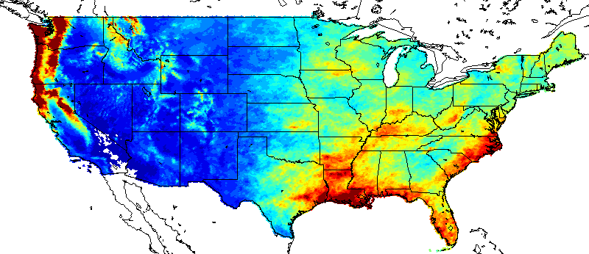
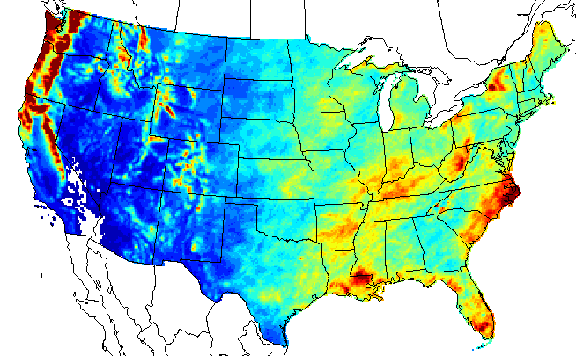
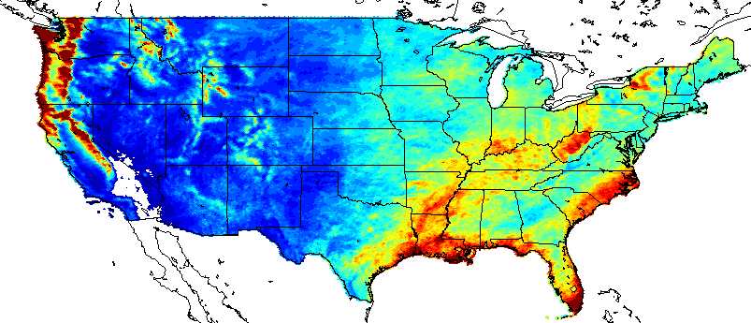
NEW: Evaluation of Precipitation
Outputs:
WRF or MPAS format NetCDF file with gridded model and PRISM precipitation totals
Daily or monthly files
Use Verdi, Vis5D, Ncview or other tools for visualization
Can post process files for grid statistics and explore time periods outside of the daily and monthly provided
run_prism_comp.csh
./input_files/prism_comp.input
PRISM
WRF
MPAS
Jan-Dec 2016

Slide 16
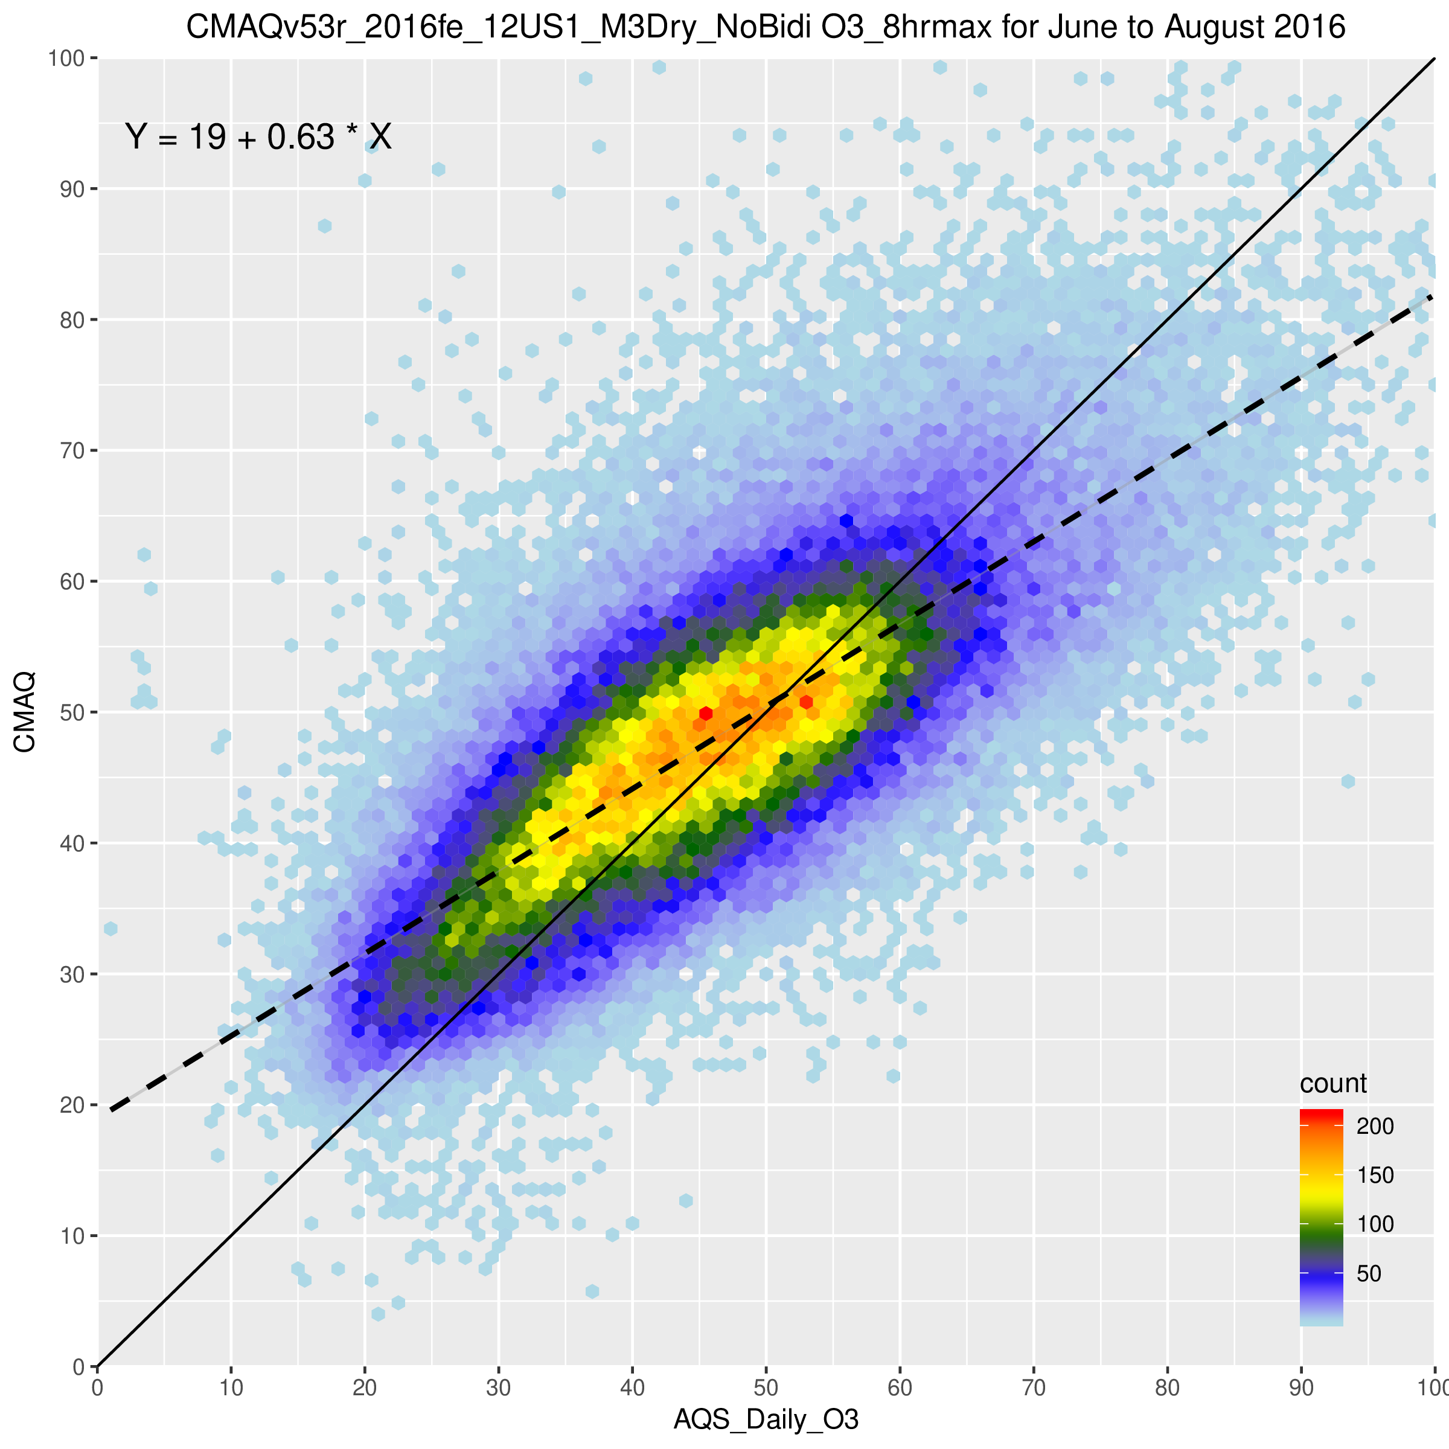
Overview of the AMET-AQ Module
Designed to work directly with CMAQ output
could be modified to work with any data though (e.g. water measurements)
Directly supports data from a number of routine networks
North America: AQS, IMPROVE, CSN, CASTNET, NADP, MDN, SEARCH, AMON, AIRMON, FLUXNET
Europe: AIRBASE, AURN, EMEP, AGANET, ADMN, NAMN
global: TOAR, NOAA ESRL
Stores each network separately for more robust analysis
Utilizes Site Compare to do the model/observation matching
Fortran based utility that is provided with CMAQ and AMET
requires properly formatted observation files
These files are available for download (see next slide)

Slide 17
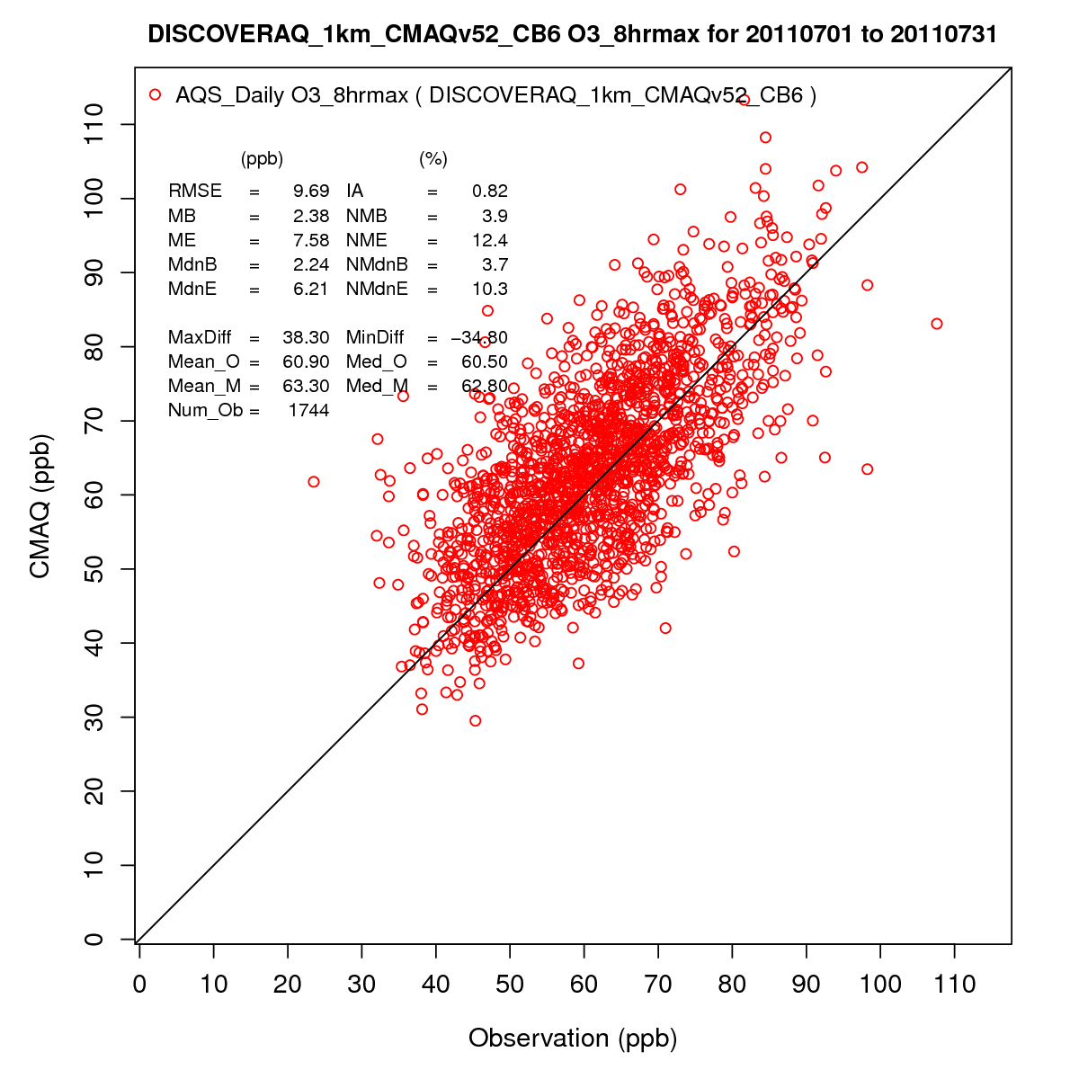
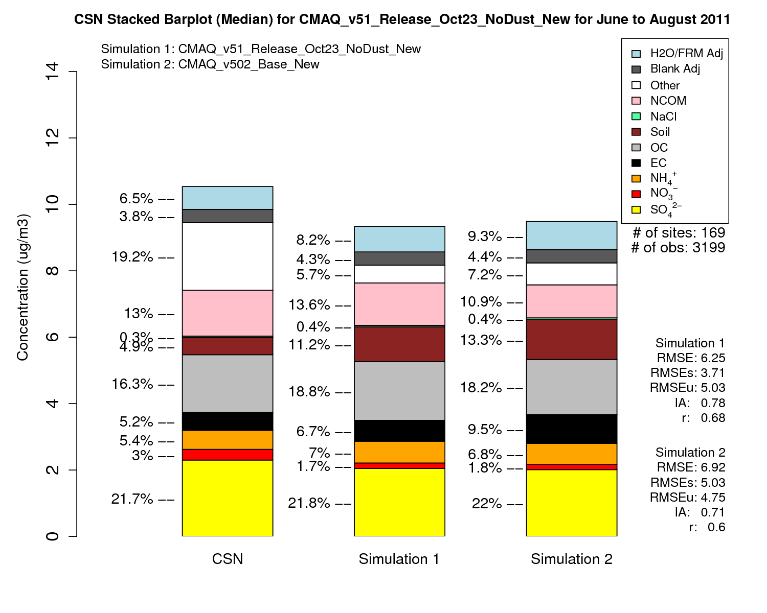
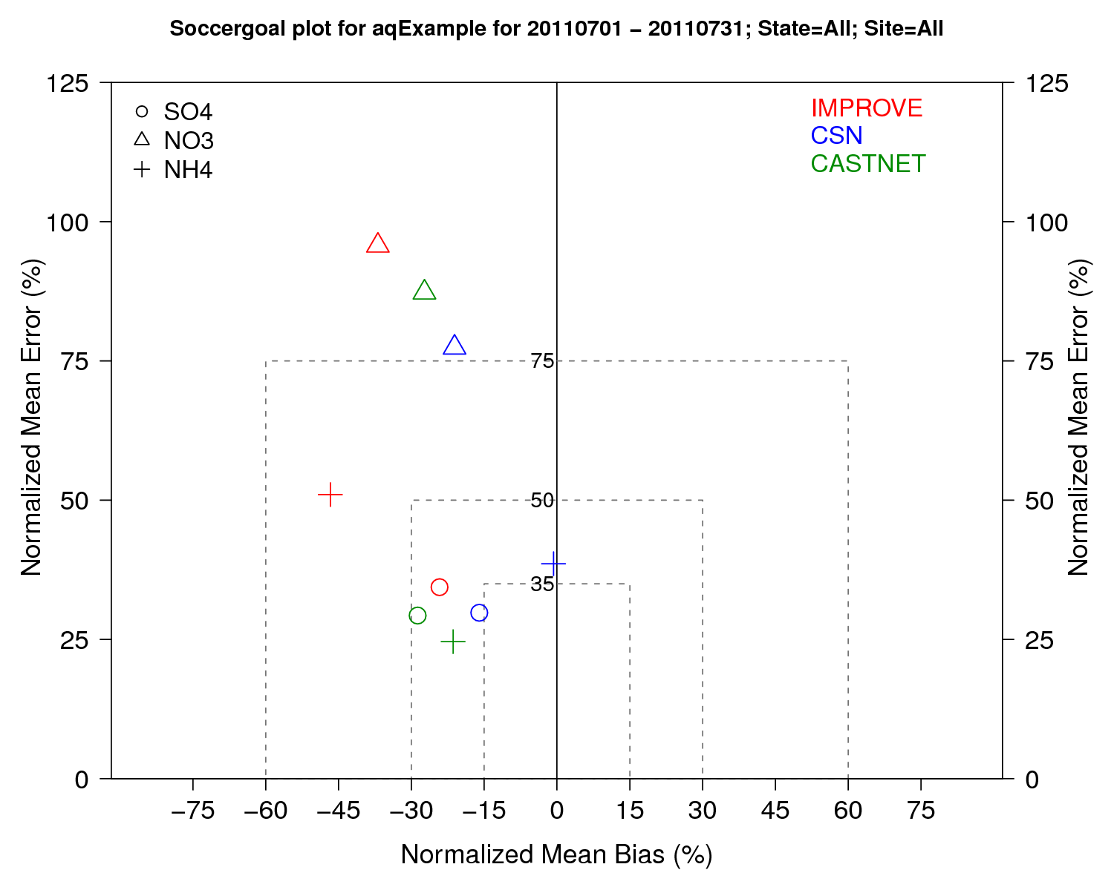
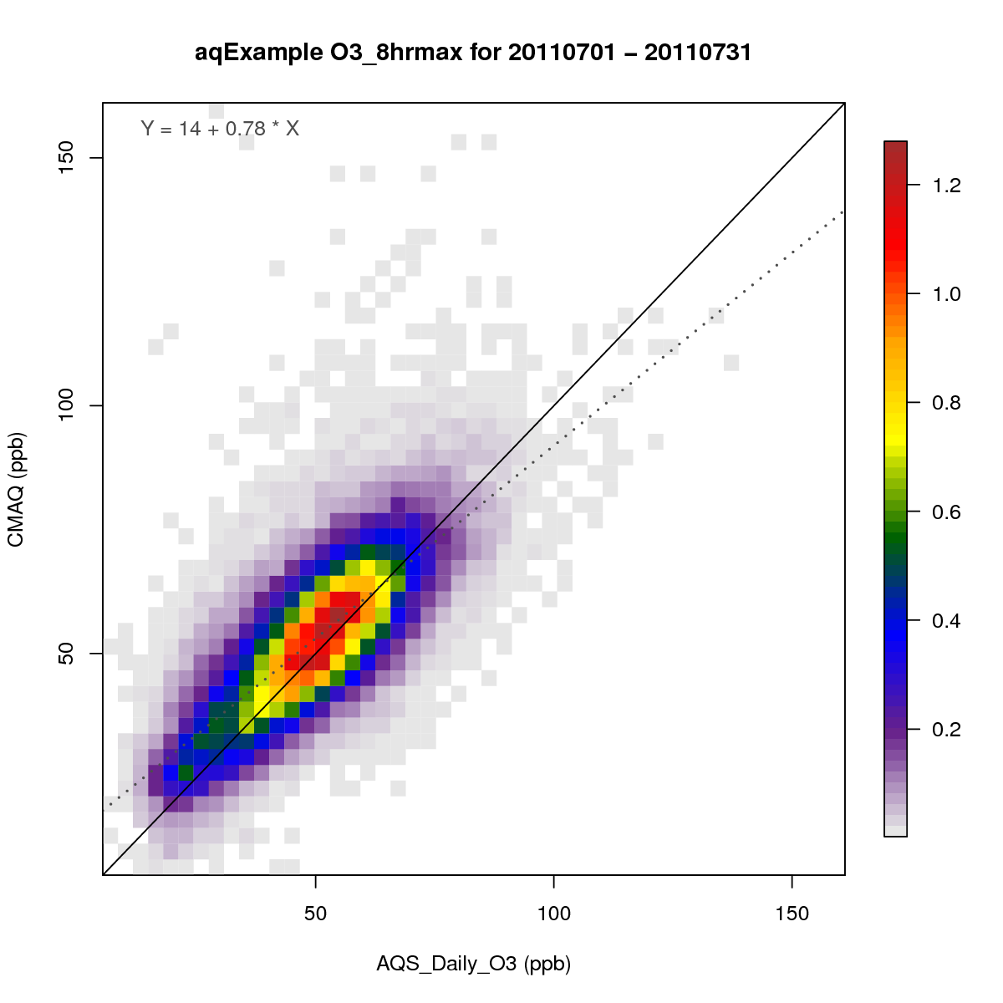
Examples of AMET-AQ Module Plots

Slide 18
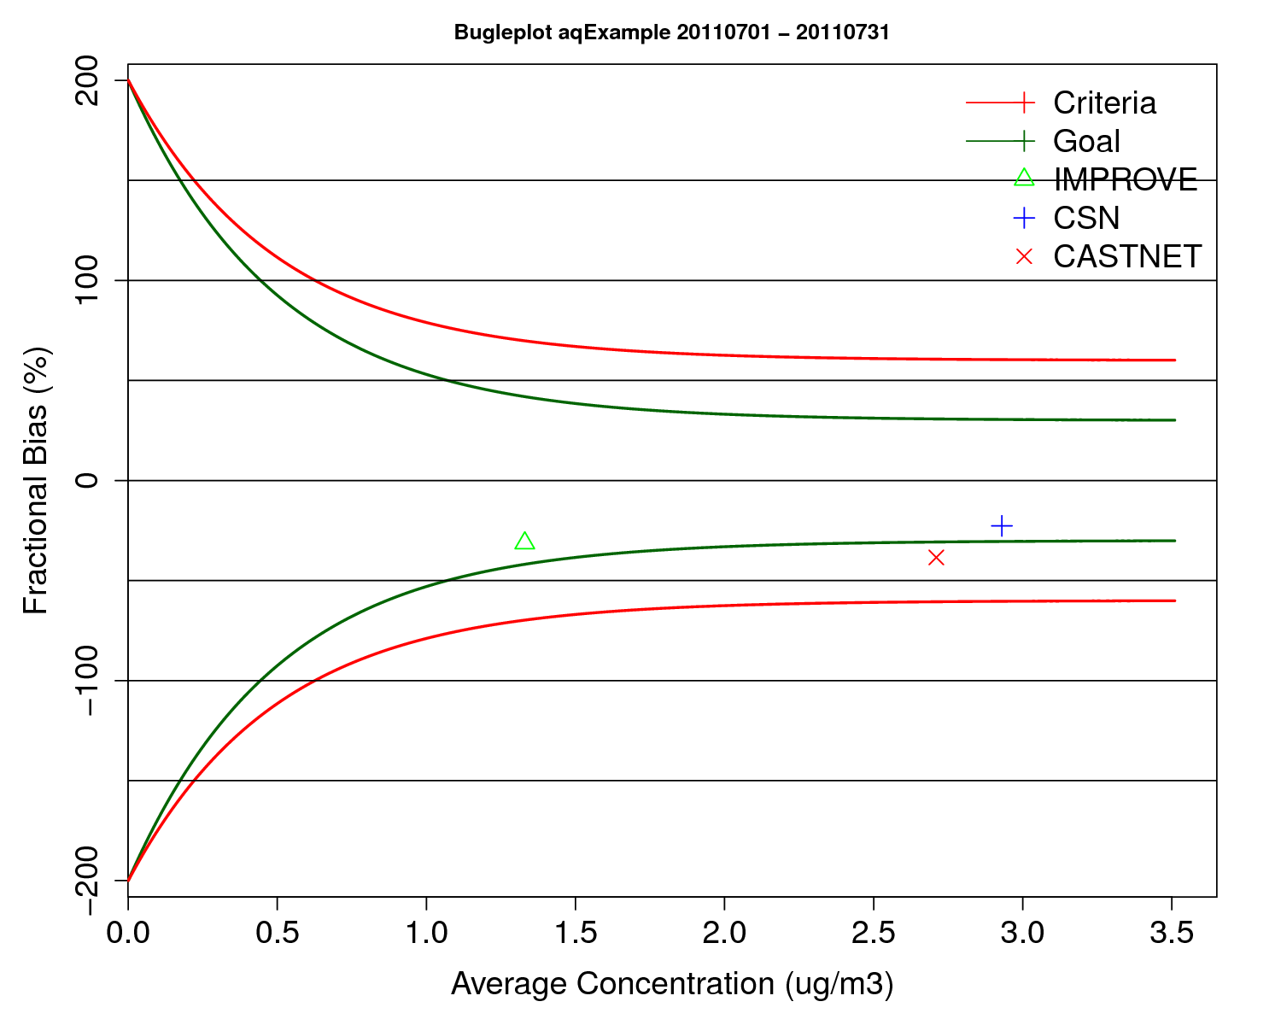
Key Updates to the AMETv1.4 AQ Module
Added support for the TOAR and NOAA ESRL networks
Added support for MPAS output (beta)
Streamlined database querying function
makes creating new AMET-AQ analysis scripts easier
Project table species are now dynamically generated from header
removed hard-coded species names
makes adding new networks/species much easier
Added ability to read Site Compare files directly
allows for analysis without the MySQL database
as such, can use AMET-AQ without the database installed
Many new interactive analysis scripts added
use the R leaflet and dyGraphs libraries
Updated versions of many other analysis scripts using R ggplot library
Added ability to use AMET-MET data with many AMET-AQ analysis scripts

Slide 19
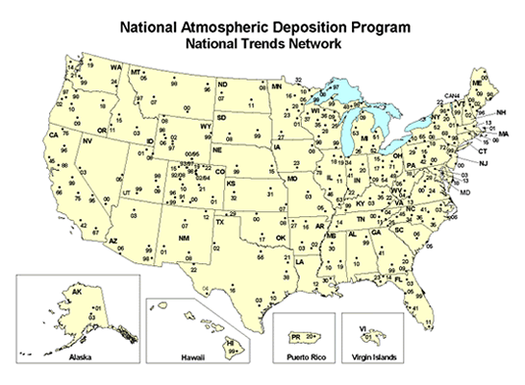
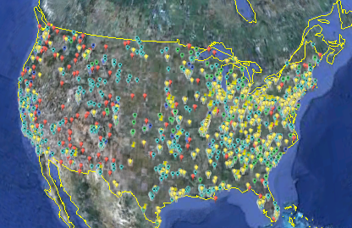
AMET-AQ Observation Data Files
Observations are paired with model data using Site Compare
Site Compare requires properly formatted data files
Unlike the AMET-MET module, AMET-AQ requires pre-generated observation files
the AMET-AQ ready files for NA are available for download directly
data currently available for 2000-2017
most data for EU need to be obtained from the source
The CMAS Center has posted these data files on a Google drive
see the CMAS website for instructions on accessing these files
https://www.cmascenter.org/download/data.cfm (2000 - 2017 North American Air Quality Observation Data)
https://drive.google.com/drive/folders/0B2kjxCwKICxUZ3ZyNEVld2F6bHc
note that while these data files are updated periodically, user’s should to refer to the data source for latest data

Slide 20
AMET-AQ Analysis
Various AQ analysis scripts
Required input files:
Each analysis script has
its own input file
CMAQ model data (combine files)
AMET-AQ Initialization (database setup)
create_amet_user.csh
delete_db.csh
Required input files:
None
AMET-AQ Project
(project creation and database population)
aqProject.csh
Required input files:
AQ_species_list.input
sites_meta.input
AMET-AQ Batch Analysis
Single AQ analysis script
Required input files:
Single input file
AMET Web Interface (Beta)
PHP based webpage interface for AMET-MET and AMET-AQ
May be provided as beta code via GitHub for testing at some point
Observation data (CMAS center website)

Slide 21
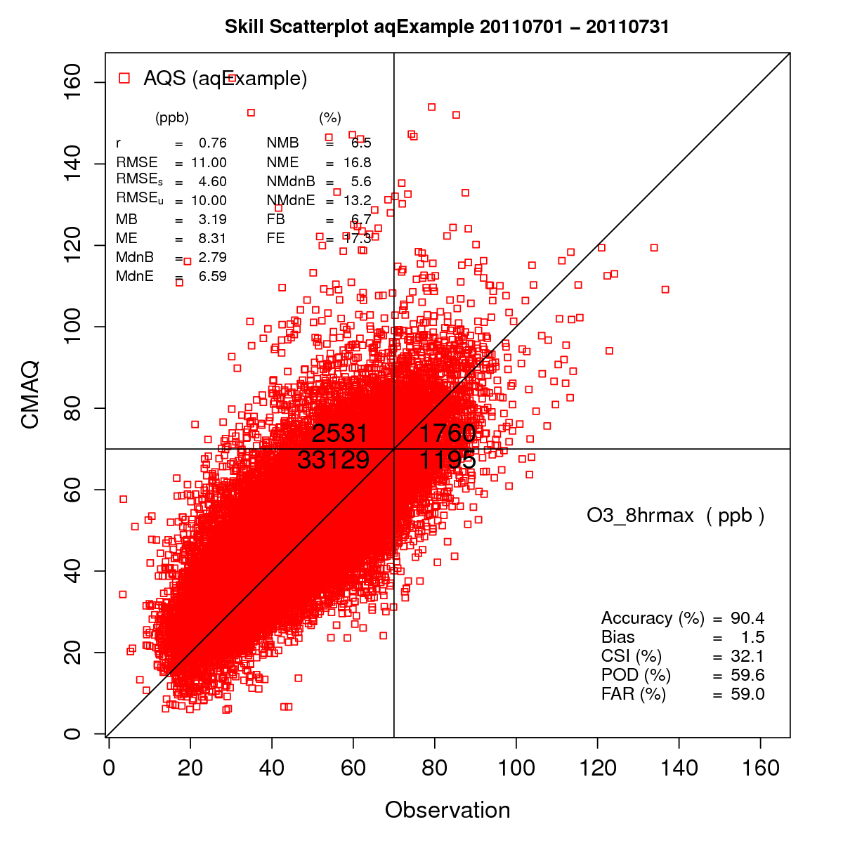
AMET-AQ Module Query/Plot Options
Temporal specific queries
Date range; specific year, month or day; day of week; hour of day; etc.
Spatial specific queries
State(s); MJOs; pre-defined regions; lat/lon box
Data specific queries
Query based on model/ob value
Cross query with other data
Custom queries can also be created
Can create queries based on any data in the database
Many plots are customizable
Control data ranges, colors, symbols, titles, etc.

Slide 22
Analysis Scripts in the AMET-AQ Module
Boxplots
Hourly
Day of Week
MDA8
Roselle
Solar Radiation
Bugle Plot
Histogram
Overlay File
Spatial Plots
Difference
Model to Model
Ratio
Monthly Stat Plot
Raw Data
Scatter Plots
Binned
Density
Model to Model
Percentiles
Single Network
Forecast Skill
Soil
“Soccergoal” Plot
Spectral Analysis
Stacked Bar Plots
AERO6
Panel
AERO6 Panel
Soil
Stats and Plots
Temporal
Time Series
Model to Model
Multi-Network

Slide 23
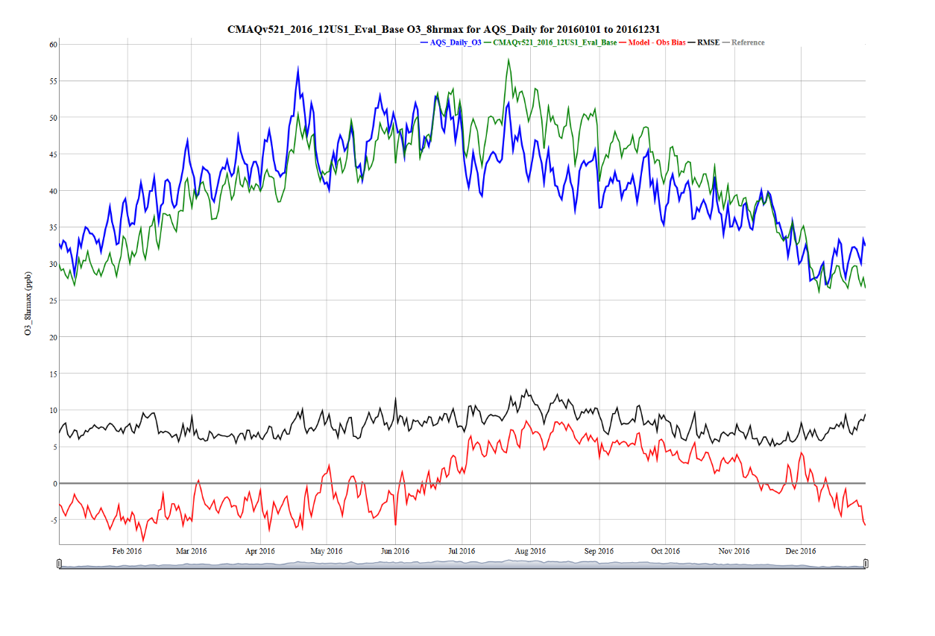
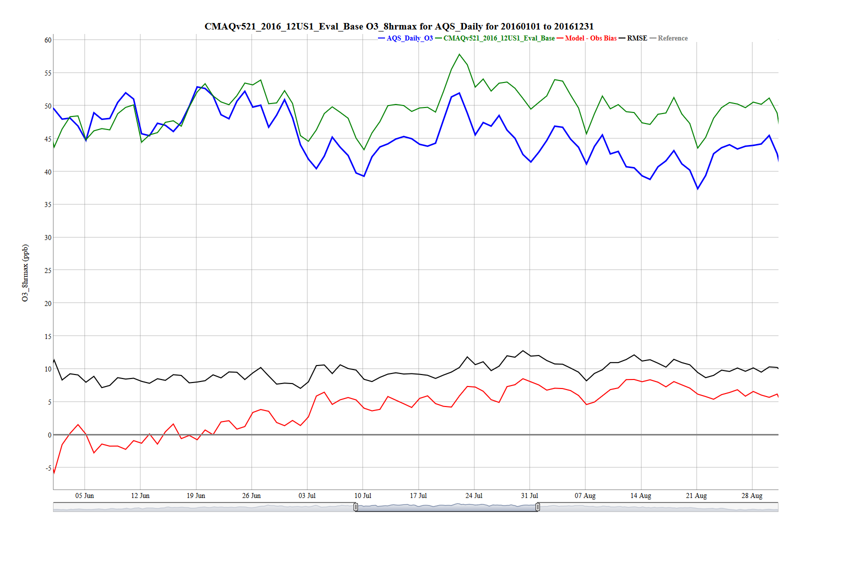
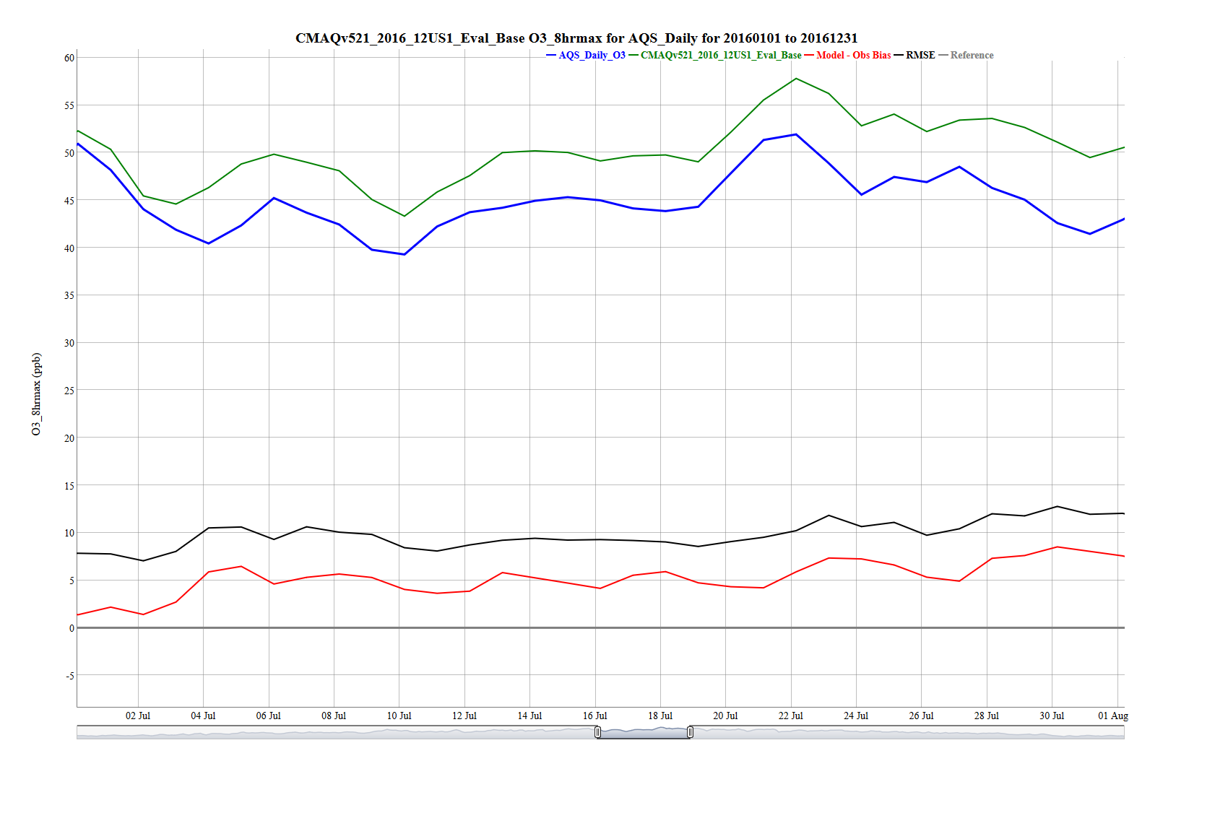
New: Interactive Time-series Plot
Concentration
Bias, error, RMSE, correlation
Add/remove traces
Zoom
Mouse-over values
Exportable to static image

Slide 24
New: Interactive Spatial Plots
Zoom
Mouse-over values
Multi-network
Toggle networks on/off
Change base map (on-the-fly)

Slide 25
Improved Stacked Bar Plot for PM Species

Slide 26
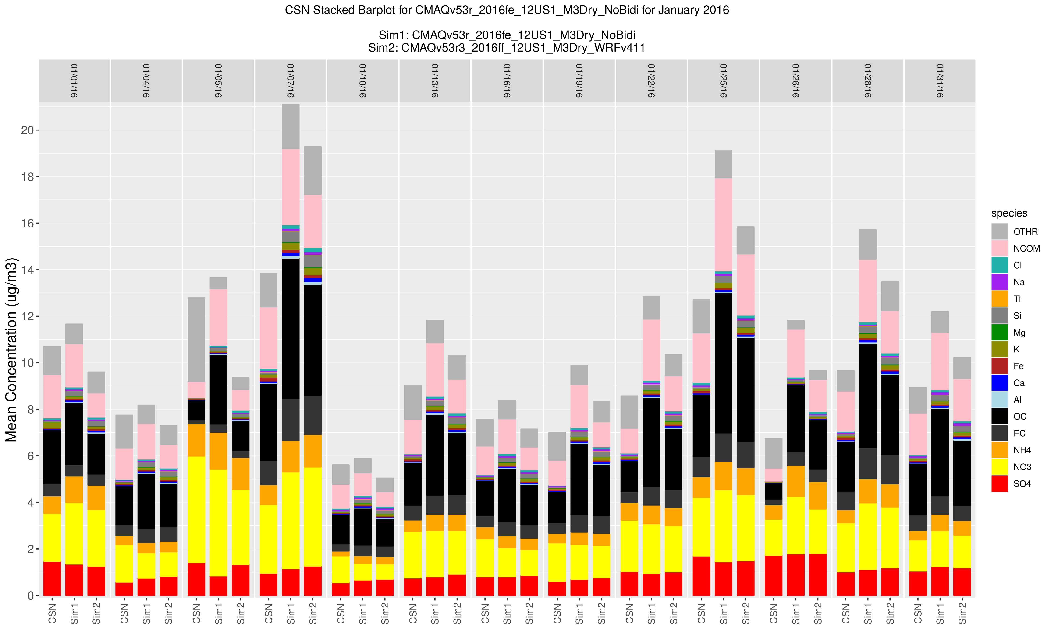
New: Stacked Bar Time-series

Slide 27
New: Interactive Boxplot Using R plot_ly Library

Slide 28
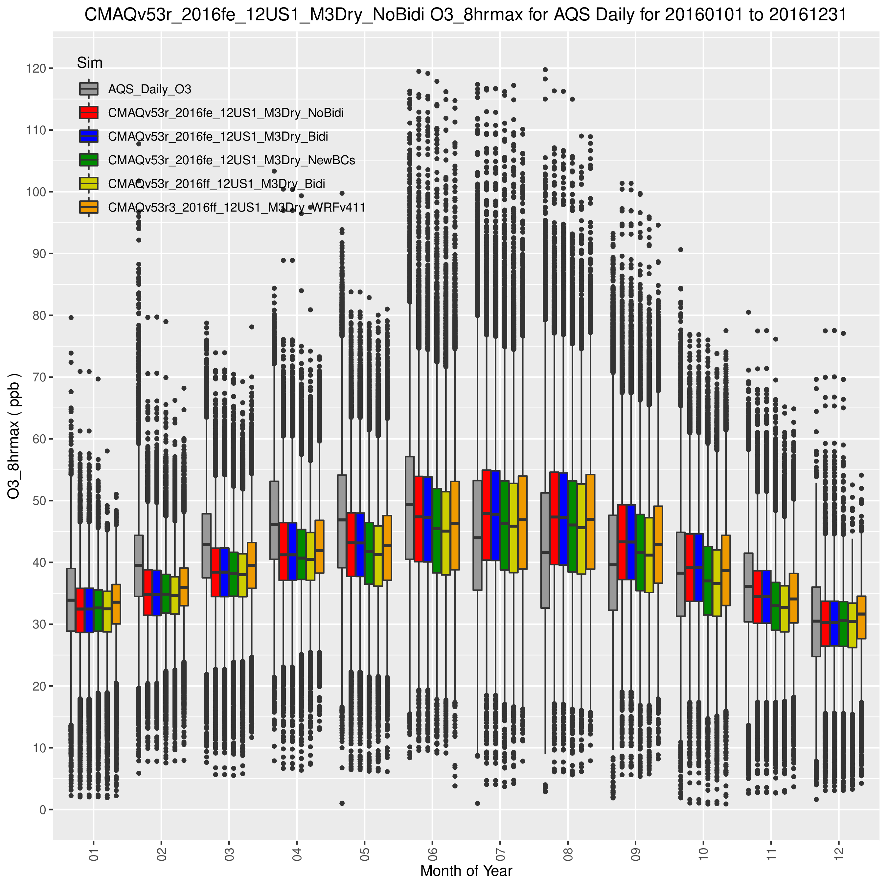
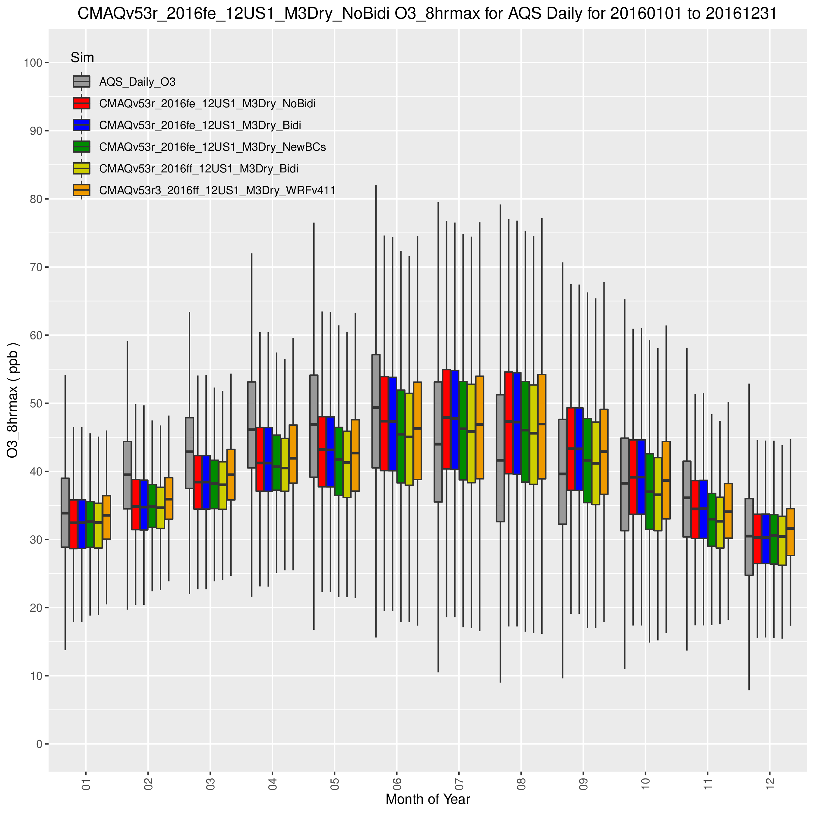
Enhanced Boxplot Using R GGplot Library

Slide 29
Interactive Binned-Bias Boxplot Using R plot_ly Library

Slide 30
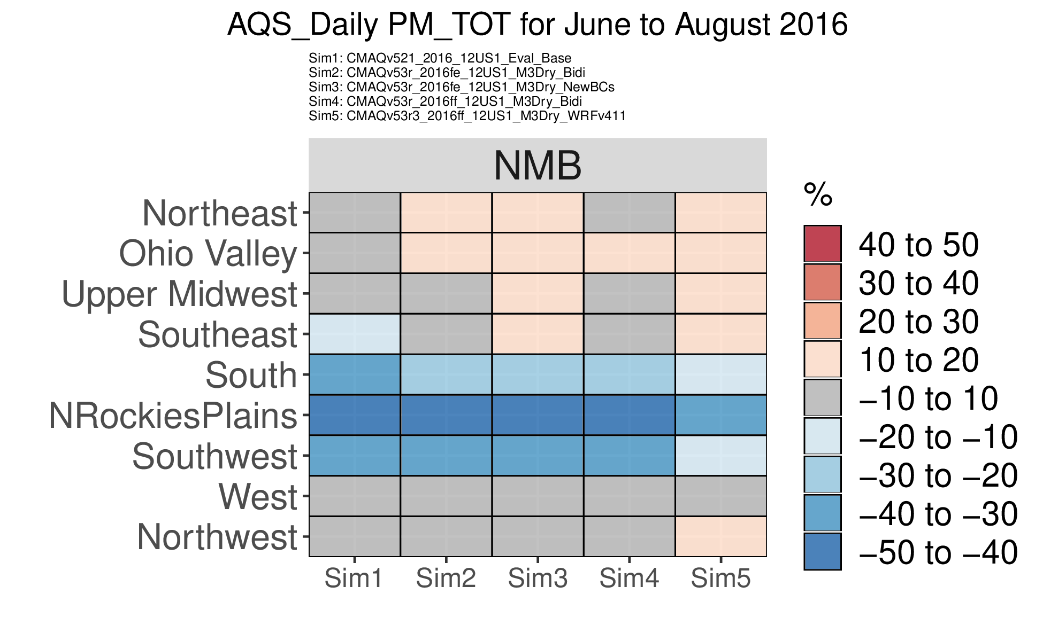
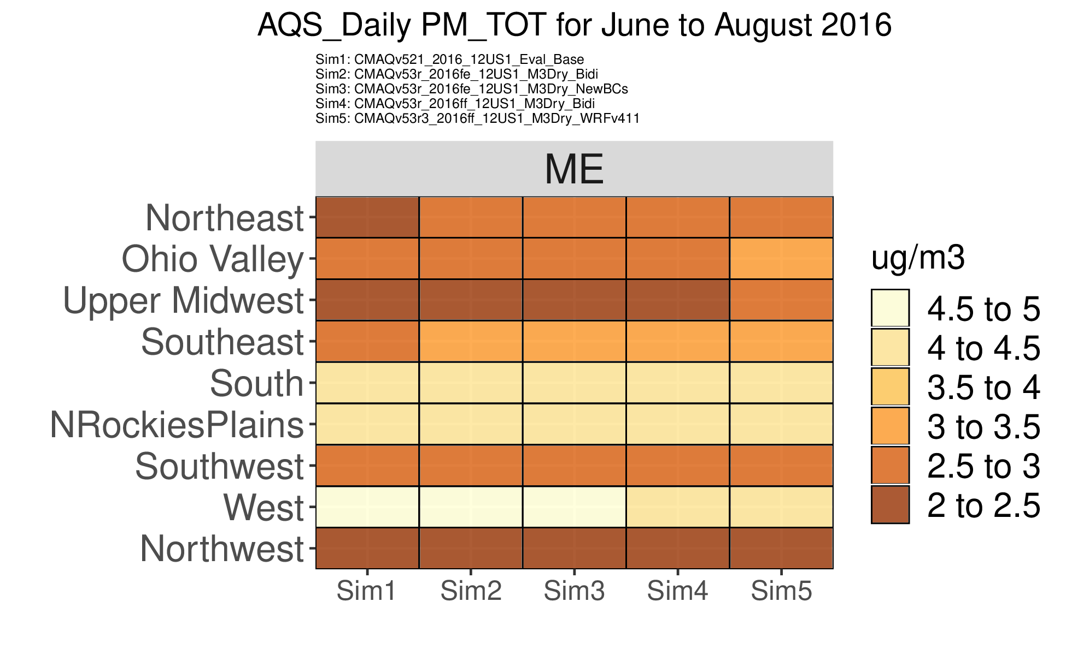
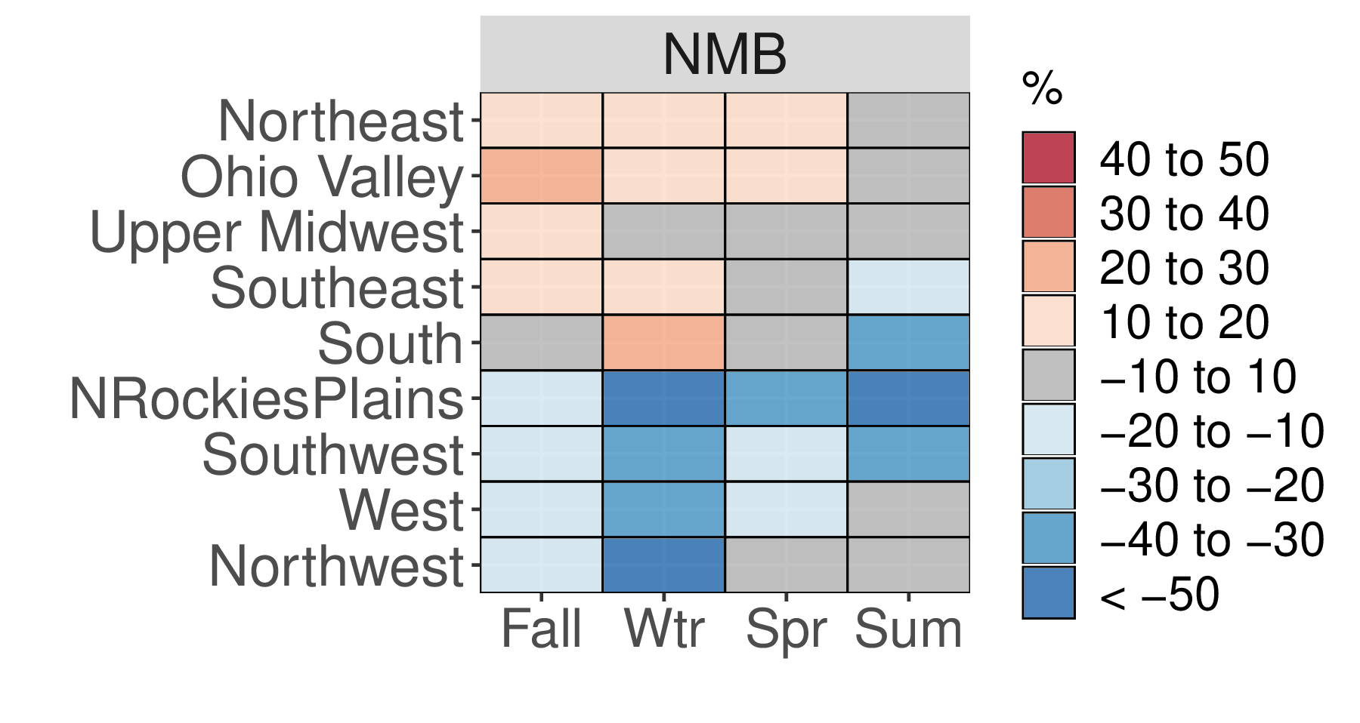
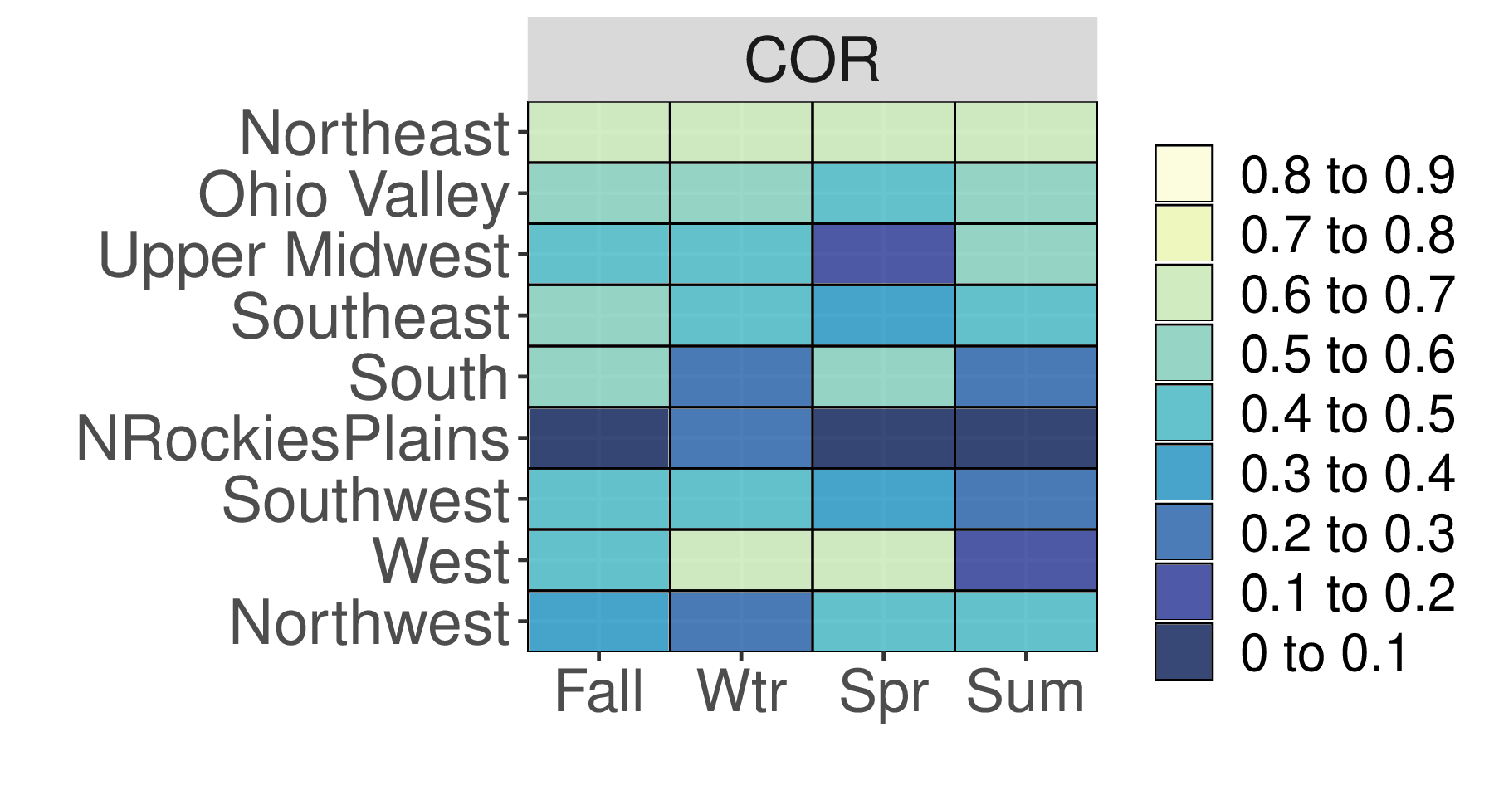
New: “Kelly” Plot

Slide 31
Using Met Data with AMET-AQ Plotting Scripts

Slide 32
Using Met Data with AMET-AQ Plotting Scripts

Slide 33
Batch Processing Analysis in the AMET-AQ Module
“batch processing” analysis script available in AMET-AQ (since AMETv1.3)
Allows for “mass production” of plots using a single script
user can select which plots to create
utilizes a single namelist file
Can produce all available AQ analysis plots
neatly organized directory tree is created
removes the need for configuring and running individual analysis script
Batch script is part of a unified post-processing script for CMAQ
“master” CMAQ post-processing script available with AMET and CMAQ
single script to run combine, site compare and create batch plots
does require AMET code, but does not require MySQL database

Slide 34
Critical Error Found Affecting AMETv1.4 AQ Code
Critical error found in AMET-AQ code on 11/6/2019
Error caused the site metadata in the database to populate correctly
result of a missing column definition in the site_metadata table setup
Results in AQ analysis scripts utilizing the MySQL database to fail
cannot match site information between tables
Error does not affect when using AMET-AQ without the database
Simply fix has already been pushed and merged into master code
If you download AMET prior to 11/6/2019, there are instructions for how to fix the error
https://github.com/USEPA/AMET/issues/78

Slide 35
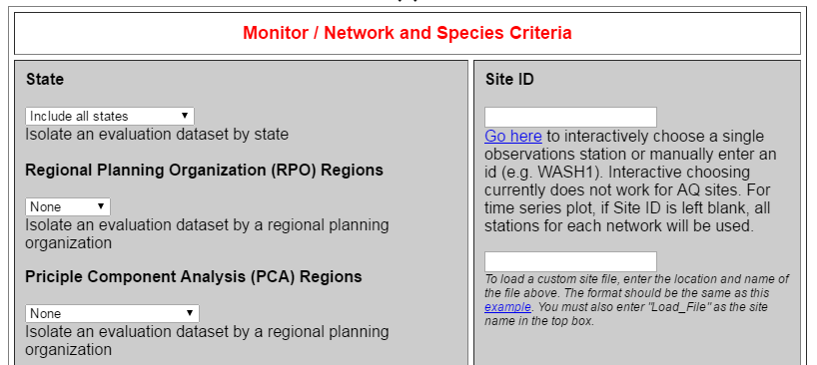
Web-based Graphical User Interface for AMET
Web based (PHP) GUI for AMET
project selection through a drop-down menu
easy selection of plotting options
sub-setting of sites/locations
Overlays on top of existing AMET release code
requires two additional configuration files
no other AMET code modifications required
Does require user to run Apache web-server
Beta version will be made available on Git-Hub
limited support available
Web-based GUI has been used at EPA for years with good success

Slide 36
Obtaining AMET and Documentation
AMET now resides in a GitHub repository
https://github.com/USEPA/AMET/tree/master
Latest version available under master
Previous AMET versions 1.2 and 1.3 are also available
Release notes available on AMET GitHub main page
AMET code is also linked from the CMAS Center website
Installation, Quick Start, and User’s guides available
https://github.com/USEPA/AMET/blob/master/docs/AMET_Users_Guide_v14.md
https://github.com/USEPA/AMET/blob/master/docs/AMET_Install_Guide_v14.md
https://github.com/USEPA/AMET/blob/master/docs/AMET_QuickStart_Guide_v14.md
A development space will added to the AMET GitHub repository
Space where user contributed code can be shared
AMET web interface code (beta version) will initially reside here

Slide 37
Obtaining AMET and Documentation

Slide 38
Future MET Evaluation Components
AutoFTP for PRISM precipitation evaluation
requires reading GIS-based shapefiles rather than ASCII text files
more re-scripting required before implementation
Modernize some of the older plots
Ability to filter sites that have a different elevation than the model
Point precipitation analysis and statistics
Utilize ACARS profiles in MADIS
provides for more temporally resolved boundary layer comparisons

Slide 39
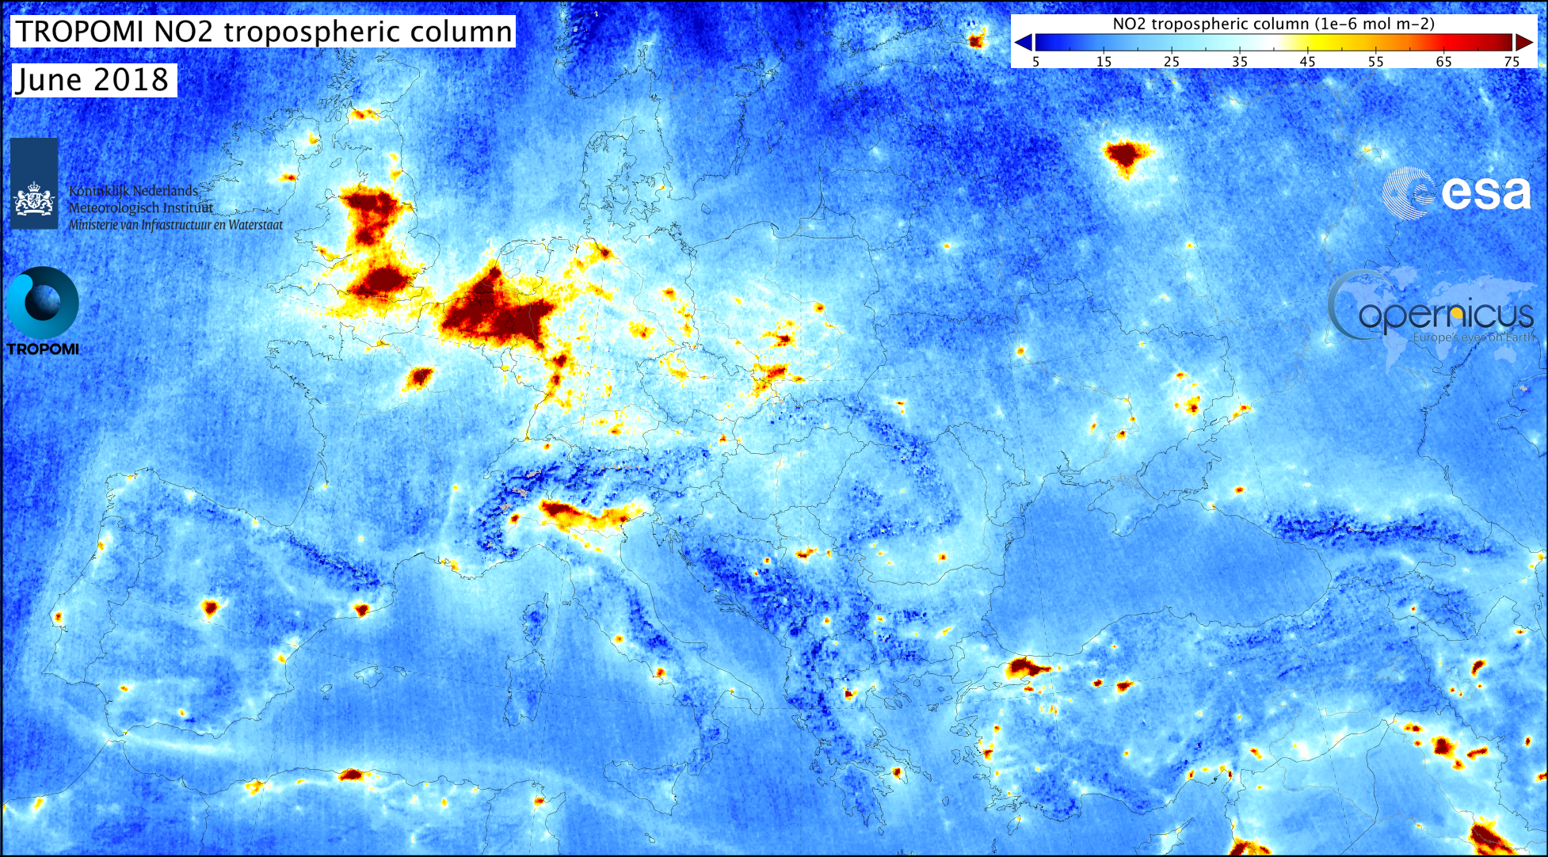
Future AQ Evaluation Improvements
Add additional querying capability to database-less AQ analyses
Improve several of the new AMET-AQ plots
configurable colors scales, improve text size across plots, etc.
Explore adding more interactive plots
Improve query speed for large data queries
incorporate more database indexing
Add satellite data to routine AQ analysis
Add ozonesonde and other upper-air AQ analyses
Source: http://www.tropomi.eu/data-products/nitrogen-dioxide

Slide 40
Thanks to:
Liz Adams (UNC)
Code testing and documentation
Kristen Foley (EPA)
Endless help with GitHub
Ben Murphy (EPA)
Also helped with GitHub
Christian Hogrefe (EPA)
Support for AMET-AQ tools

