Slide 1
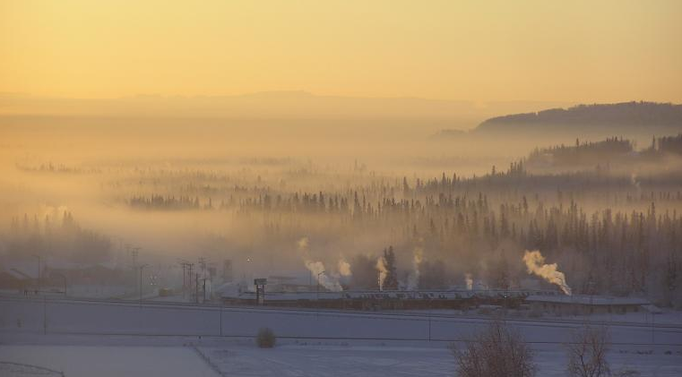
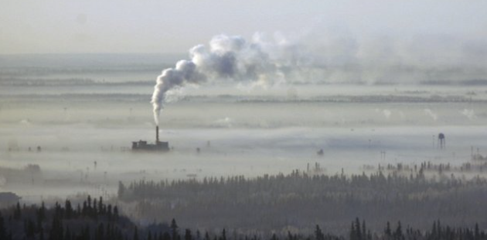
Modeling the wintertime meteorology for the 2022 Alaskan Layered Pollution and Chemical Analysis (ALPACA) campaign
Robert Gilliam, Kathleen Fahey, George Pouliot, Havala Pye, Nicole Briggs, Sara Farrell and Deanna Huff
Eric Engman/Fairbanks Daily News-Miner via AP
UAF, Geophysical Institute
Disclaimer: The views expressed in this presentation are those of the authors and do not necessarily reflect the views or policies of the U.S. EPA.
Center for Environmental Measurements and Modeling, AESMD, ADMB
United States Environmental Protection Agency

Slide 2
Outline
Overview
Model configuration(s)
Evaluation of the Initial ALPACA simulation
Sensitivity tests & evaluation using independent observations
Conclusions and Next Steps
Acknowledgement: Roman Pohorsky, Andrea Baccarini & Julia Schmale for Helikite Profile measurements (École polytechnique fédérale de Lausanne) Alaska Dept. of Environ. Conservation (AK DEC) for Hurst, Ncore and AStreet measurements Meeta Cesler-Maloney, William Simpson & Univ. Alaska - Fairbanks for CTC measurements ADEC & Rambol Group (Bart Brashers) for consulting on Fairbanks WRF configurations

Slide 3
Overview
ALPACA
Observational and modeling campaign (Jan-Feb 2022) to investigate the emissions and chemical and meteorological influences on pollution in Fairbanks.
Motivation
To support AK DEC (Dept, Environmental Conservation) by providing an effective modeling tool to characterize Fairbanks PM episodes for the development of efficient approaches to reduce high PM concentrations
Goal
Generate WRF/SMOKE/CMAQ dataset for the ALPACA intensive measurement period that will leverage extensive observation data for model evaluation and development
US EPA Roadmap
WRF
Use WRF configuration based on 2008 case study
Run Near-real time WRF as support modeling during ALPACA
Post-campaign sensitivity testing to refine WRF meteorology
Finalize modeling for SMOKE & CMAQ
SMOKE
Emissions data from AK DEC and 2017 NEI
Source sector separated emissions files to leverage DESID module
Updated emissions from lab-based woodstove and fuel analysis
Meteorology-base emissions updates based on 2022 winter modeling
CMAQ
Run CMAQv5.3.2+ with heterogeneous sulfate chemistry updates (See Sara Farrell talk tomorrow afternoon)
Use mass of field campaign measurements to comprehensively evaluate chemistry modeling
Run instrumented/tracking versions for further diagnostic evaluation (e.g., STM, ISAM)

Slide 4
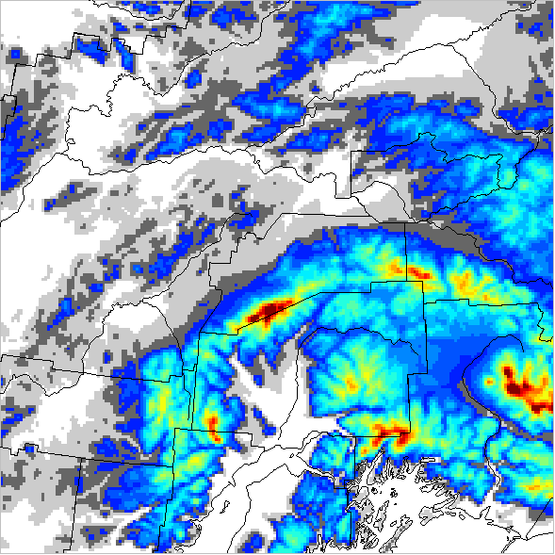
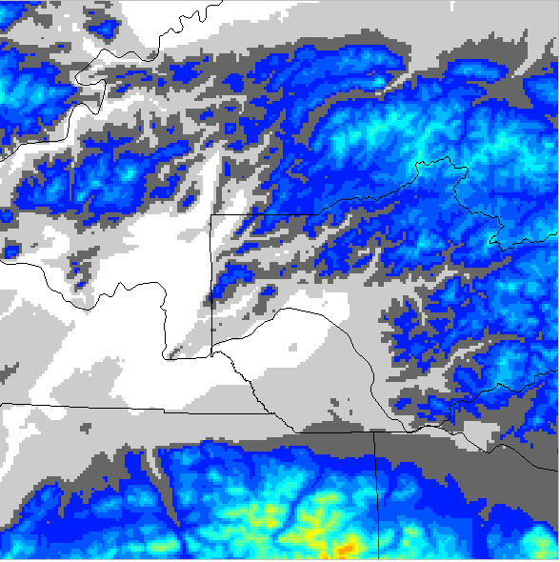
WRF Configuration
4 km Domain (elev.)
WRF Physics (WRFv4.3)
RUC LSM
MYNN TKE PBL
Morrison Mp
RRTMG SW/LW
No subgrid Cp scheme
1.33 km Domain
1.33 km Domain (elev.)
Fairbanks
BC & Data Assimilation (DA)
NCEP GFS boundaries
GFS FDDA (4 km)
Obs nudging (1.33 km): METAR and Mesonet
Obs nudging (1.33 km): RAOB (PAFA)
Anchorage
Simulations
Daily DA simulations with 72 hr forecast during ALPACA
Continuous Obs Nudging run post-ALPACA
1.33 km Sensitivities
No DA
FDDA Only
FDDA + ON
DA with ALPACA Obs (pending)
Fairbanks
WRF/CMAQ modeling domain - 4 km outer domain with nested 1.33 km centered over Fairbanks
- Nov 15-Dec 31 spin-up → Jan 1-Feb 28 ALPACA - 38 total vertical levels with extra fine spacing below 500 m - 11 lowest layers @ approx. 2, 5, 9, 17, 32, 52, 82, 132, 207, 311, 433, 555 meters

Slide 5
WRF Domain Zoom

Slide 6
Evaluation of the post-ALPACA Continuous 1.33 km WRF that used Observation Nudging (ON*)
* Based on a Feb 2008 case study and multiple WRF sensitivities

Slide 7
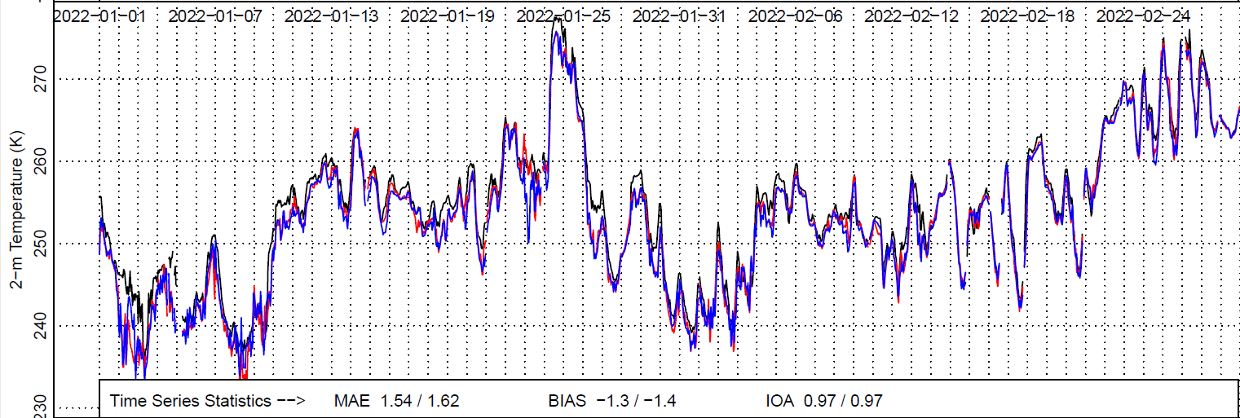
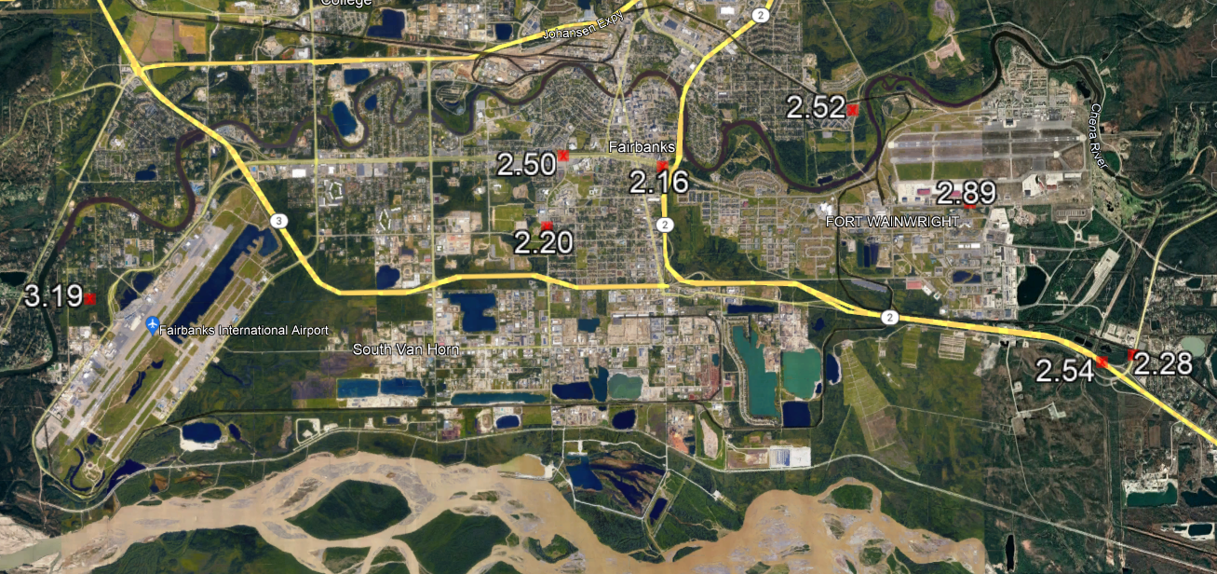
2-m Temperature RMSE (Jan 1-Feb 28, 2022)
Obs (FAEA2)
ON1
ON2
Best WRF performance
@FAEA2
PAFB
RMSE = 2.16 K MAE = 1.54 K
BIAS = -1.3 K IOA = 0.97
PAFA
F3318

Slide 8
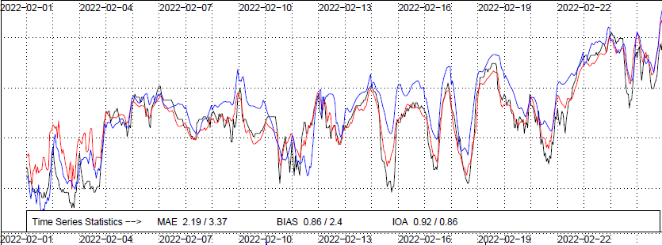
Profile Comparisons at Fairbanks Int. Airport (PAFA)
Cold pool dates for comparisons
Obs (PAFA)
ON1
ON2
Feb 2022

Slide 9
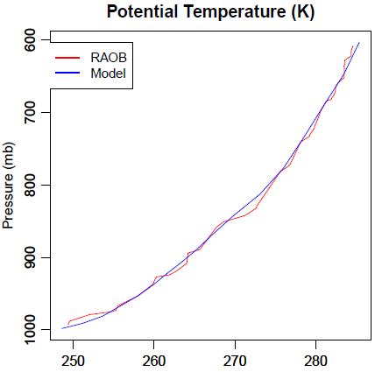
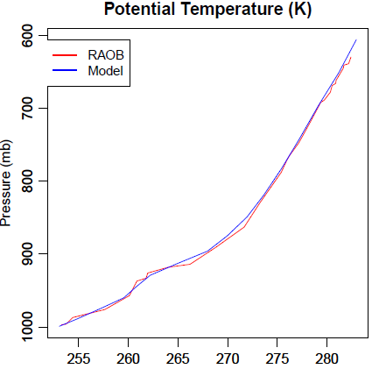
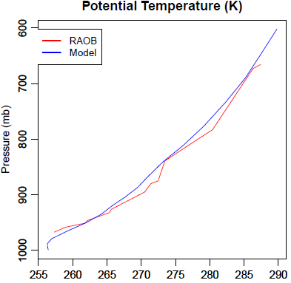
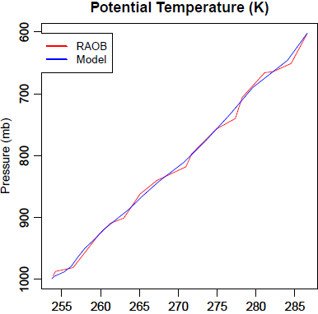
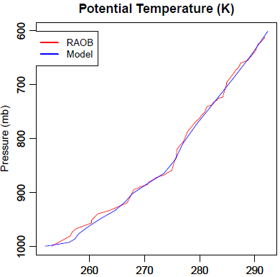
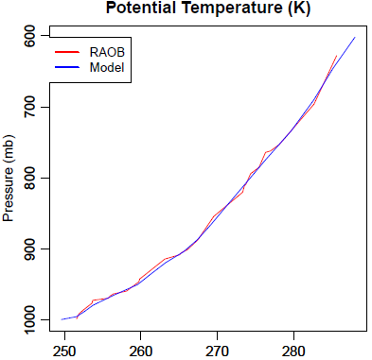
WRF 1.33 km comparisons with PAFA RAOB
Jan 31, 2022 -- 00 UTC
Feb 01, 2022 -- 00 UTC
Feb 02, 2022 -- 00 UTC
Feb 03, 2022 -- 00 UTC
Feb 16, 2022 -- 12 UTC
Feb 17, 2022 -- 12 UTC

Slide 10
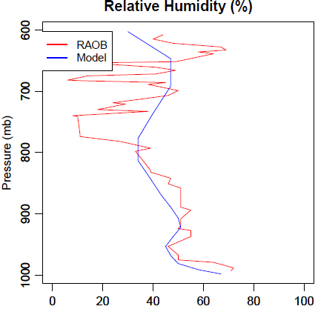
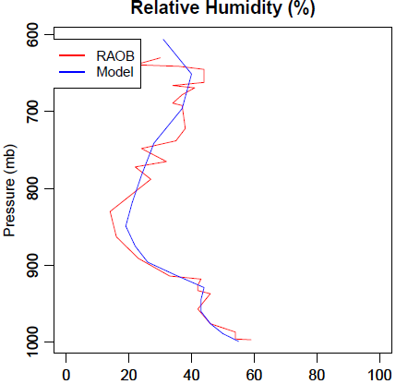
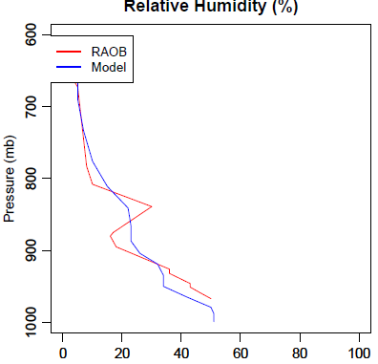
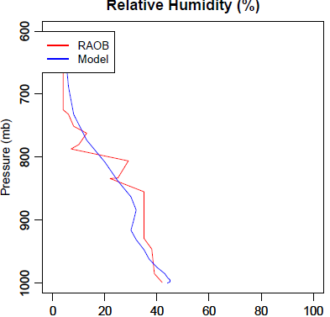
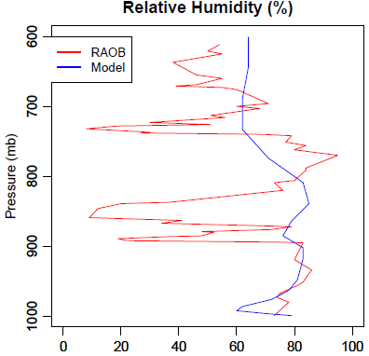
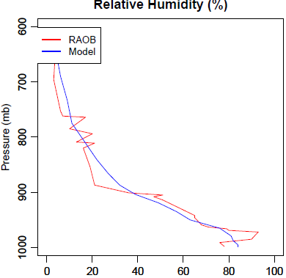
WRF 1.33 km comparisons with PAFA RAOB
Jan 31, 2022 -- 00 UTC
Feb 01, 2022 -- 00 UTC
Feb 02, 2022 -- 00 UTC
Feb 03, 2022 -- 00 UTC
Feb 16, 2022 -- 12 UTC
Feb 17, 2022 -- 12 UTC

Slide 11
Evaluation of WRF sensitivities using independent ALPACA field data CTC Site Alaska DEC Sites Helikite Profiles

Slide 12
1.33 km WRF Sensitivity Experiments
No data assimilation on the nested 1.33 km grid. FDDA was used on the 4 km parent grid (NODA)
Observation nudging on the 1.33 km grid using standard NOAA observations and local mesonet measurements + PAFA sounding twice daily (ON)
Grid nudging on the 1.33 km grid similar as the parent 4 km grid. Grid nudging or four-dimensional data assimilation is done using global GFS analyses every 3 hours and applied only above the planetary boundary layer on both domains (FDDA)
FDDA like above with observation nudging (FDDA+ON)

Slide 13
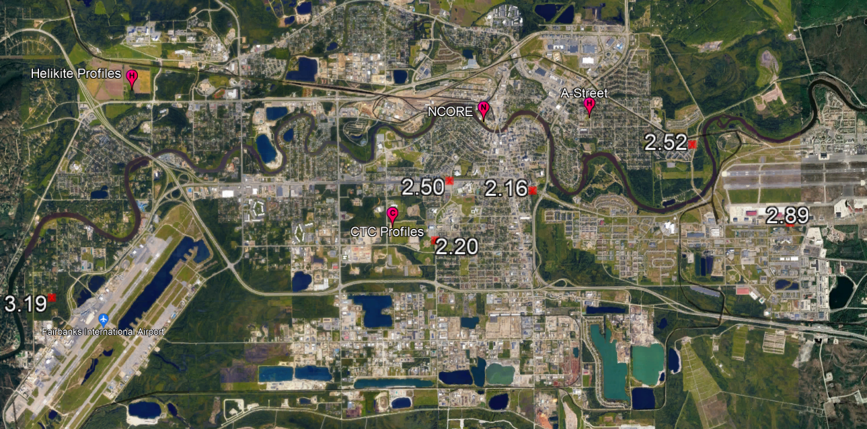
Model Evaluation Using CTC Observations
Hourly
3 m temp
6 m temp
11 m temp
23 m temp
Observations are independent of DA/Observation nudging

Slide 14
CTC 3-m Temperature (K)
CTC obs not used in DA
No data assimilation (NODA)
Obs Nudging (ON)
Grid nudging above PBL (FDDA)
Grid and obs nudging (FDDA+ON)
Jan 2022

Slide 15
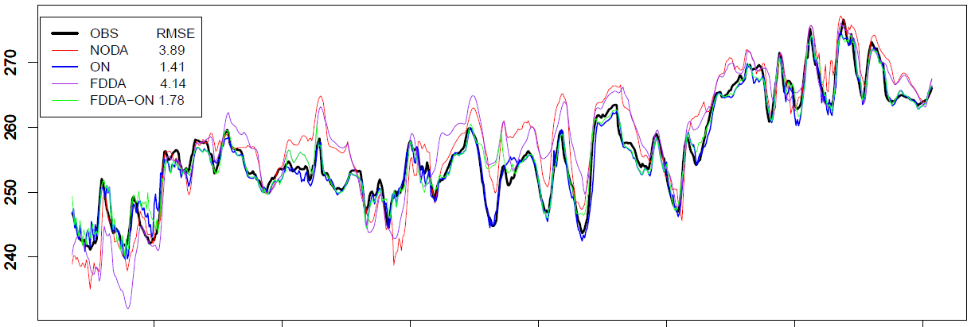
CTC 3-m Temperature (K)
CTC obs not used in DA
No data assimilation (NODA)
Obs Nudging (ON)
Grid nudging above PBL (FDDA)
Grid and obs nudging (FDDA+ON)
Feb 2022

Slide 16
CTC 23-m Temperature (K)
CTC obs not used in DA
No data assimilation (NODA)
Obs Nudging (ON)
Grid nudging above PBL (FDDA)
Grid and obs nudging (FDDA+ON)
Jan 2022

Slide 17
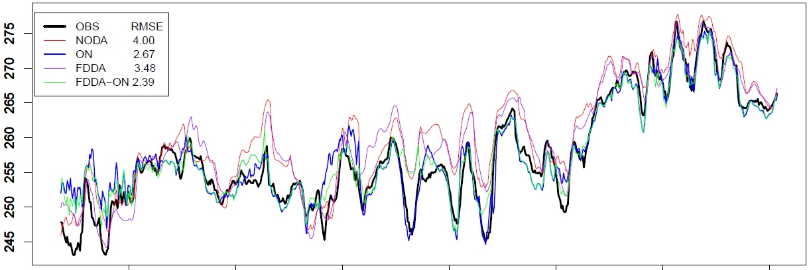
CTC 23-m Temperature (K)
CTC obs not used in DA
No data assimilation (NODA)
Obs Nudging (ON)
Grid nudging above PBL (FDDA)
Grid and obs nudging (FDDA+ON)
Feb 2022

Slide 18
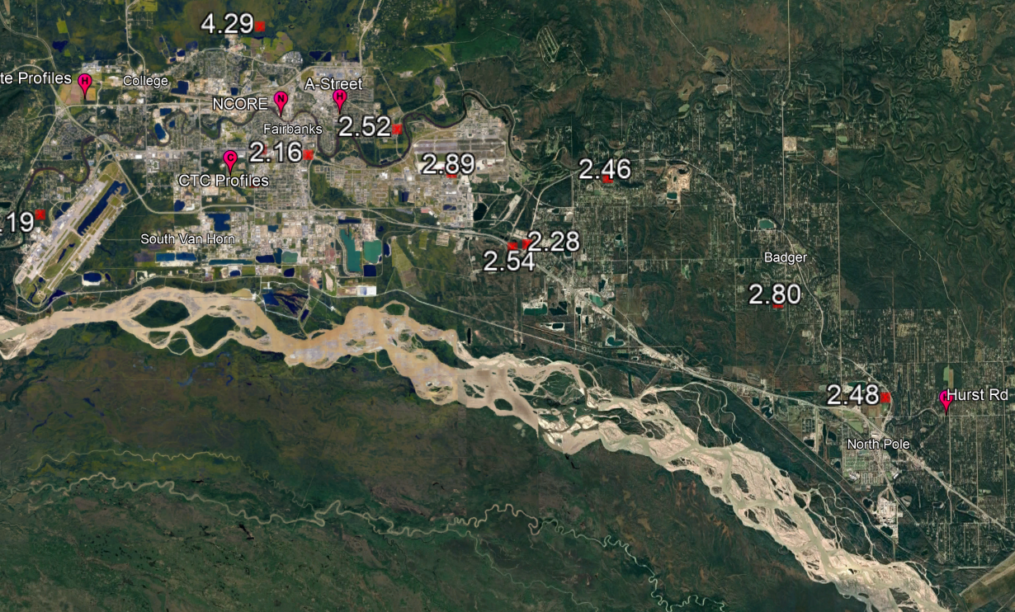
Model Evaluation Using Alaska DEC Observations
s
s
Hourly
3 m temp
10 m temp
23 m temp (Hurst)
Observations are independent of DA/Observation nudging
s

Slide 19
A-Street Jan 2022
3-m Temperature
ADEC obs not used in DA
10-m Temperature
No data assimilation (NODA)
Obs Nudging (ON)
Grid nudging above PBL (FDDA)
Grid and obs nudging (FDDA+ON)

Slide 20
NCORE Feb 2022
3-m Temperature
ADEC obs not used in DA
10-m Temperature
No data assimilation (NODA)
Obs Nudging (ON)
Grid nudging above PBL (FDDA)
Grid and obs nudging (FDDA+ON)

Slide 21
Hurst Jan 2022
3-m Temperature
10-m Temperature
ADEC obs not used in DA
No data assimilation (NODA)
Obs Nudging (ON)
Grid nudging above PBL (FDDA)
Grid and obs nudging (FDDA+ON)
23-m Temperature

Slide 22
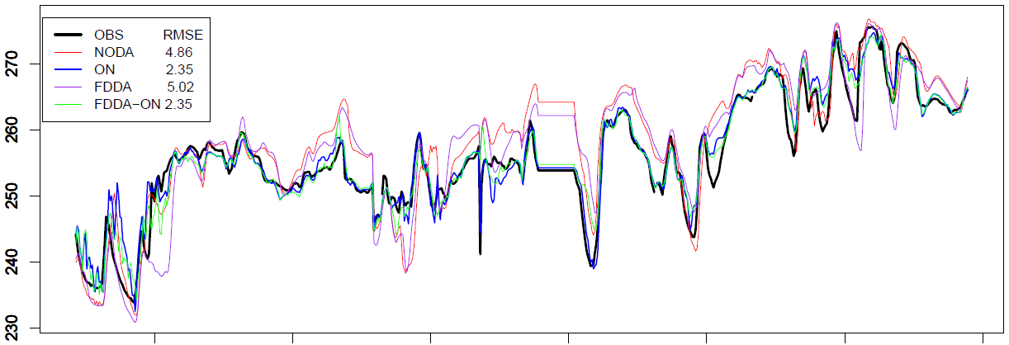
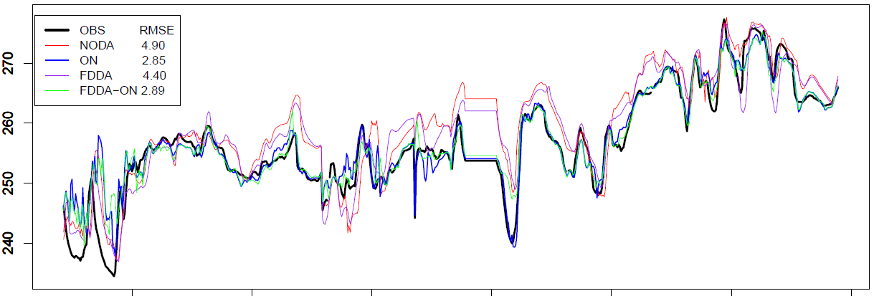
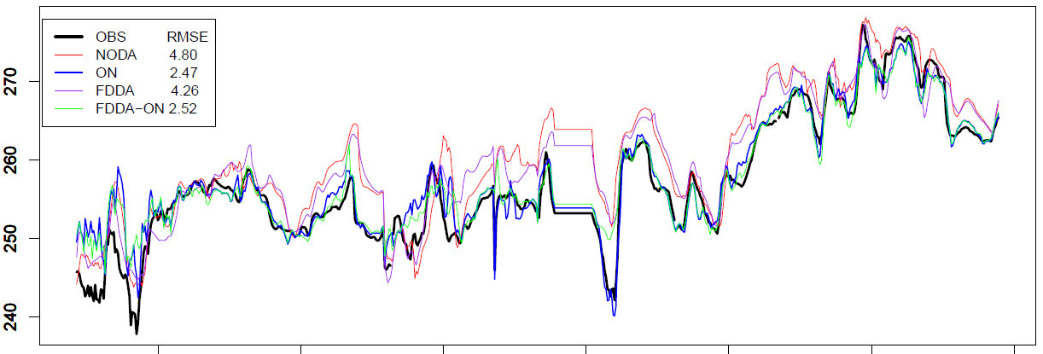
Hurst Feb 2022
3-m Temperature
10-m Temperature
ADEC obs not used in DA
No data assimilation (NODA)
Obs Nudging (ON)
Grid nudging above PBL (FDDA)
Grid and obs nudging (FDDA+ON)
23-m Temperature

Slide 23
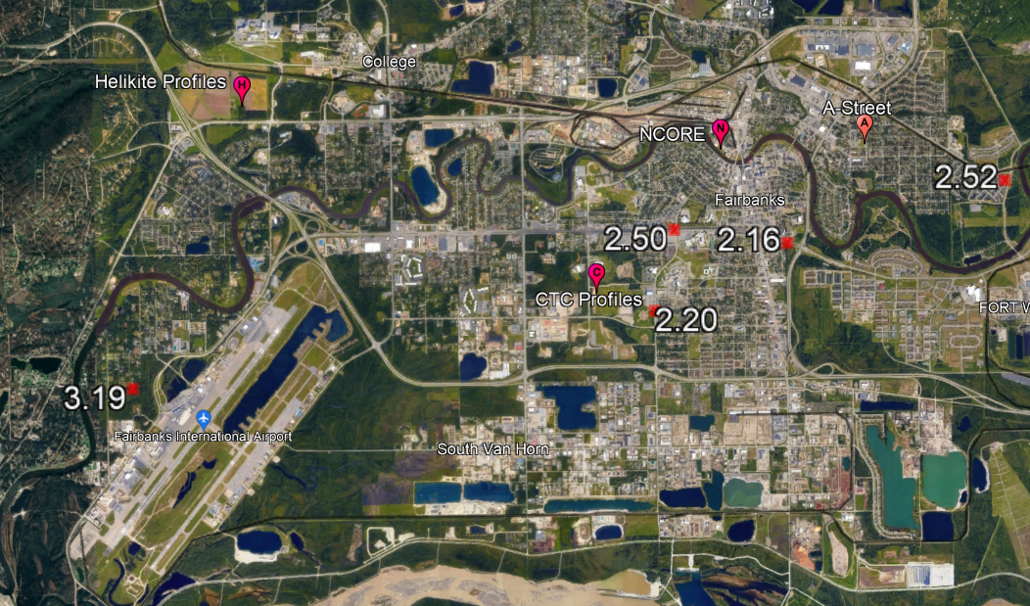
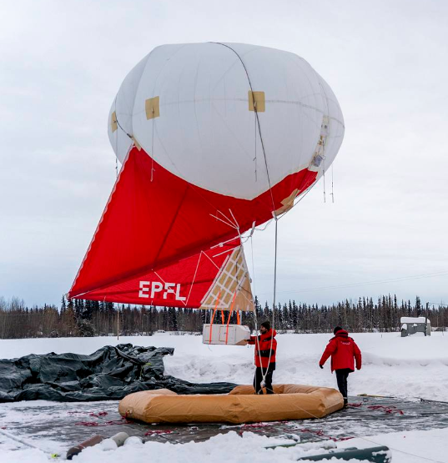
Model Evaluation Using Helikite Profiles
Strategic Launches
Jan 30, 31
Feb 3, 4, 6, 7, 9, 10, 19, 20, 21, 22, 23, 25
Theta, RH profiles
< 1 m ∆z
> 1000 samples per profile
Independent of DA/Observation nudging

Slide 24
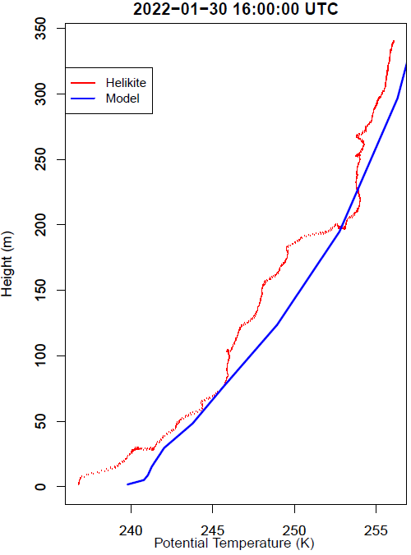
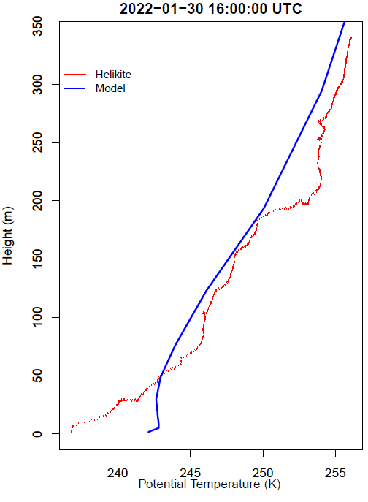
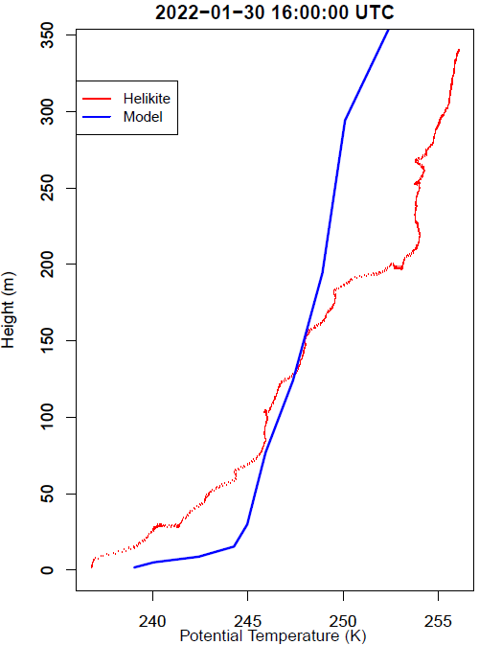
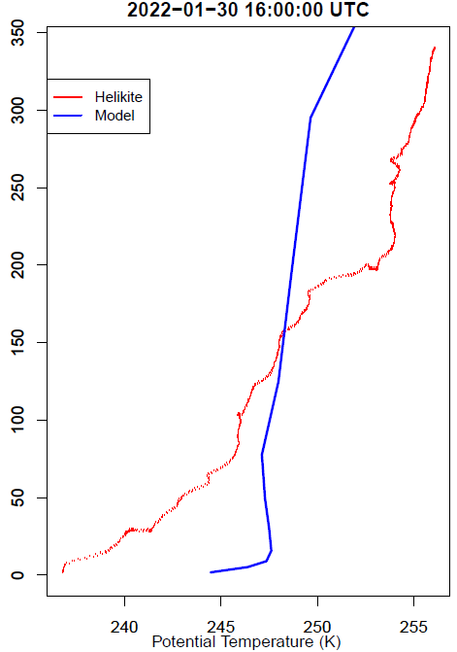
Morning Jan 30, 2022
Note: Preliminary -- Helikite not used in DA
No DA
Obs Nudging (ON)
FDDA
FDDA+ON

Slide 25
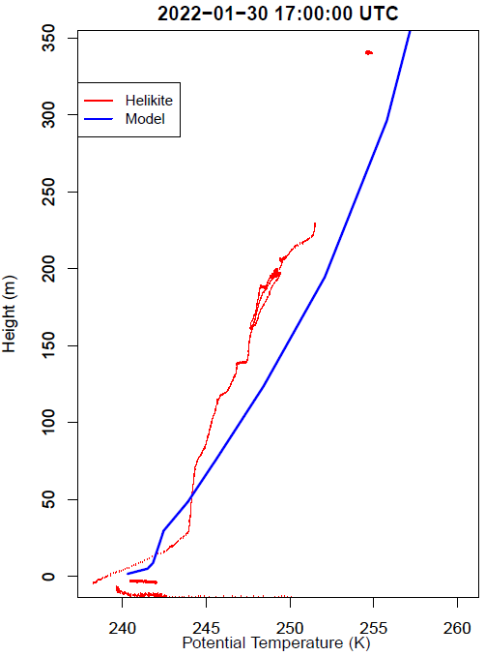
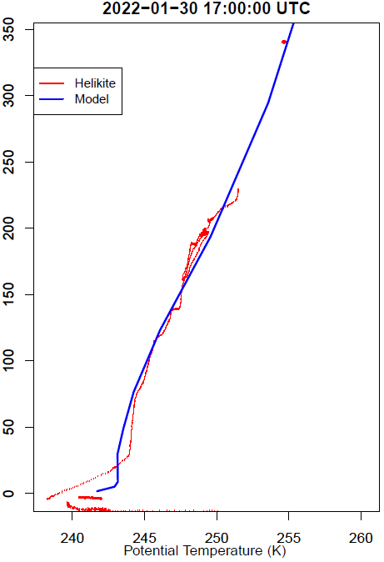
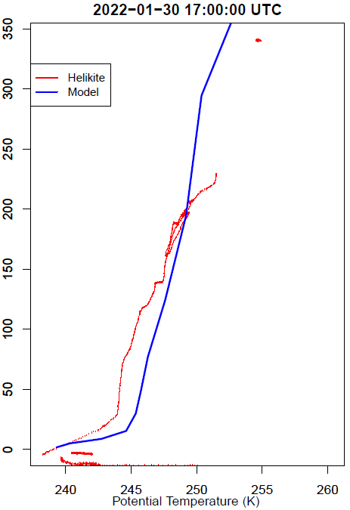
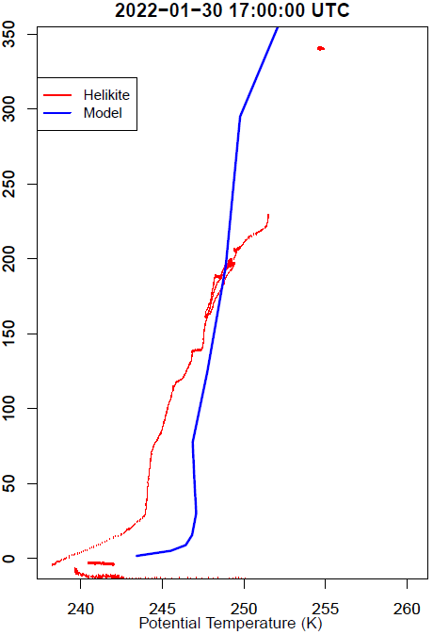
Morning Jan 30, 2022
Note: Preliminary -- Helikite not used in DA
No DA
Obs Nudging (ON)
FDDA
FDDA+ON

Slide 26
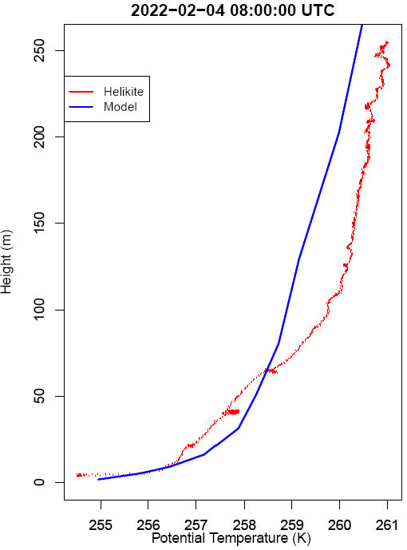
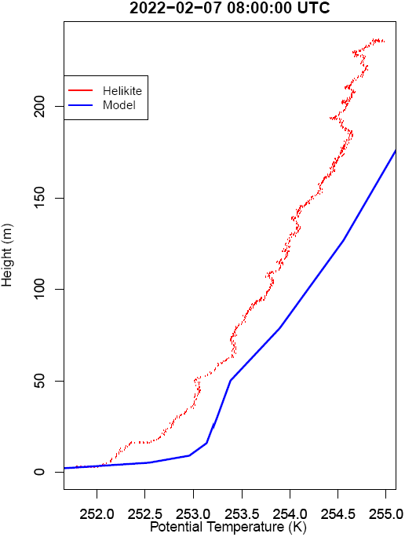
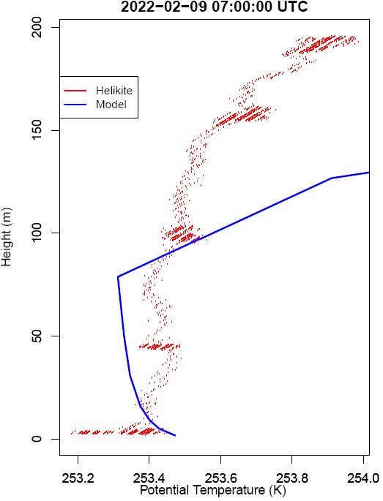
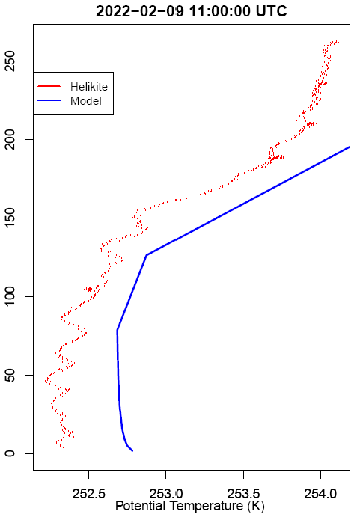
Other Profiles in Feb (The Good)
Note: Preliminary -- Helikite not used in DA
Obs Nudging (ON)

Slide 27
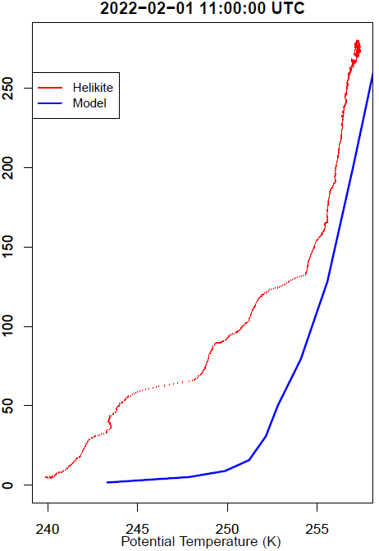
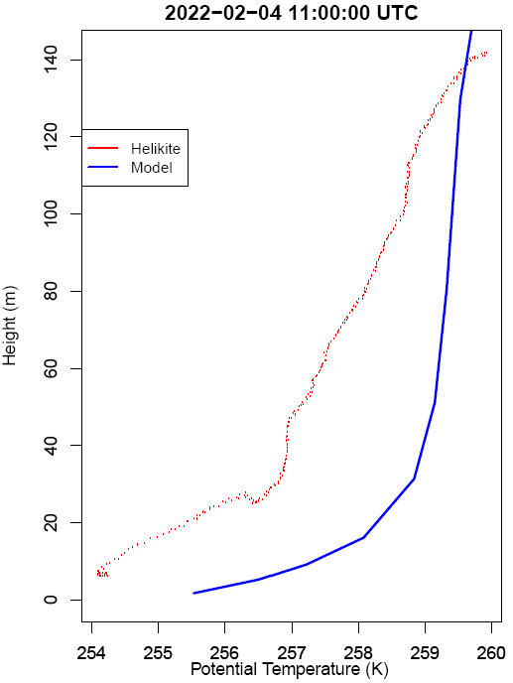
Other Profiles in Feb (The Bad)
Note: Preliminary -- Helikite not used in DA
Obs Nudging (ON)

Slide 28
Conclusions
Observation nudging (ON) works locally in-and-around Fairbanks as assessed by independent near-surface measurement
FDDA alone is not sufficient to model near surface temperature/met in complex winter cases in subarctic regions like Fairbanks – likely an issue with vertical resolution of weather analyses that may only have 1-2 samples below 250 m and extreme surface inversions
FDDA + ON does perform well below 23 m per CTC and ADEC multilevel observations.
While the No Data Assimilation run does simulate colder temps at the ground at Helikite launch site for a few profiles, other 2-23 m temperature observations show very poor performance otherwise

Slide 29
Next Steps
Utilize CTC four-level (3, 6, 11, 23 m), hourly temperature and potentially 23 m wind measurements in ON to improve near-surface temperature inversion
Utilize Alaska DEC two/three-level temperature and wind at Ncore, Astreet and Hurst Rd sites in ON to improve simulated inversion
Test HHHR analysis dataset as FDDA driver (better vertical and horizontal res.)
Chemistry simulations using CMAQ!

