Slide 1
Spatiotemporal Trends in PM_{2.5} Chemical Composition in the Continental U.S. during 2006-2021
Bin Cheng¹, Saravanan Arunachalam¹ and Kiran Alapaty²
¹Institute for the Environment, The University of North Carolina at Chapel Hill, NC, USA
²U.S. Environmental Protection Agency, Research Triangle Park, NC, USA
Presented at
The 21st Annual CMAS Conference, Chapel Hill, NC
October 17-19, 2022
Disclaimer: The views expressed in this presentation are those of the authors and do not necessarily reflect the views or policies of the U.S. EPA.

Slide 2
Introduction: PM_{2.5} chemical compositions in the U.S.
Fine particulate matter (PM_{2.5}):
One of the six criteria pollutants
Adverse health and environmental impacts
National monitoring network since late 1990’s
Air Quality System (AQS)
Chemical Speciation Network (CSN)
Interagency Monitoring of Protected Visual Environments (IMPROVE)
Major chemical compositions of PM_{2.5}
Sulfate (SO₄²⁻), ammonium (NH₄⁺), nitrate (NO₃⁻), organic carbon (OC), elemental carbon (EC), and a spectrum of elements and ions (Bell et al., 2007)
Attributed to a variety of emissions sources and atmospheric processes
Toxicity of PM_{2.5} chemical components
The PM_{2.5} components may not have the same toxicity (Levy et al., 2012; Krall et al., 2013)
EC and organic compounds associated with higher risks of emergency hospitalization
Visibility degradation of PM_{2.5}
PM_{2.5} related ammonium sulfate [(NH₄)₂SO₄] and organic compounds are the main contributors to the light extinction in the SE U.S.
Other components (EC, NH₄NO₃, crustal materials) also responsible for visibility impairment

Slide 3
Introduction: PM_{2.5} chemical compositions in the U.S.
Spatial and temporal variations of PM_{2.5} chemical compositions
PM_{2.5} conc. have been significantly reduced in the U.S. (Cheng et al., 2019)
Stringent state and local control measures lead to emission reduction
Dynamic changes of PM_{2.5}
Fate and transport of various primary and secondary pollutants
Spatial heterogeneity of various emission sources & local meteorological conditions
Emissions control strategies implemented along the time
Comprehensive explanation of adverse impacts of PM_{2.5}
Detailed analysis of spatiotemporal trends of PM_{2.5} chemical compositions
Aid in tracking progress of regulatory actions
Understanding the relationship between changes in emissions & ambient conc.
Research objectives
Investigate the dynamic contributions of various chemical compositions to the PM_{2.5} mass conc. in spatial and temporal scales in the continental U.S.
Provide basic information of atmospheric chemical condition
Implicate the potential development of PM_{2.5} control strategies

Slide 4
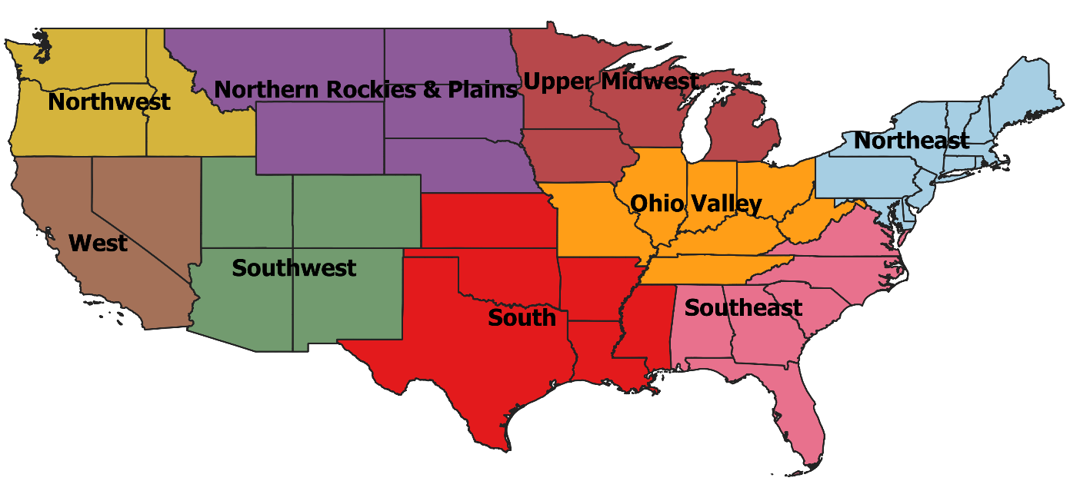
Methodology
PM_{2.5} and chemical composition monitoring network
PM_{2.5} mass conc. and chemical speciation data were downloaded from U.S. EPA Air Quality System database (USEPA, 2021)
Regions within the contiguous United States
Nine climatically consistent regions were identified within the continental U.S.: Northeast, Upper Midwest, Ohio Valley, Southeast, Northern Rockies and Plains, South, Southwest, Northwest, and West
Atmospheric chemical condition analysis
The ammonium availability index, J = $\frac{\left[{NH}_{4}^{+}\right]}{2 × \left[{SO}_{4}^{2−}\right] + \left[{NO}_{3}^{−}\right] }$ (Chu et al., 2004)
J < 1, NH₄⁺ deficit; J = 1, neutralization; J > 1, NH₄⁺ surplus
Data adjustment
Organic matter (OM) = 1.4 × (OC_{M} – OC_{FB})
OC_{M} = measured organic carbon; OC_{FB} = field blank organic carbon
Statistical analysis
Tukey’s honest significant difference (HSD) test
Theil Sen regression
Kendall’s tau statistics

Slide 5
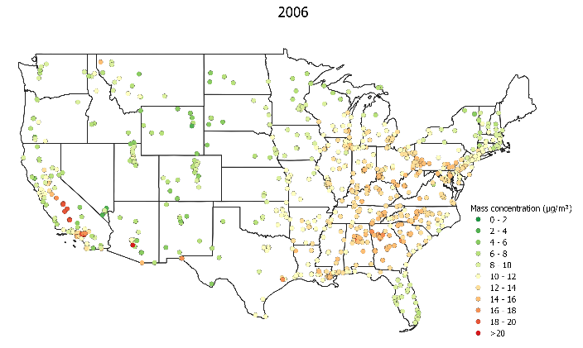
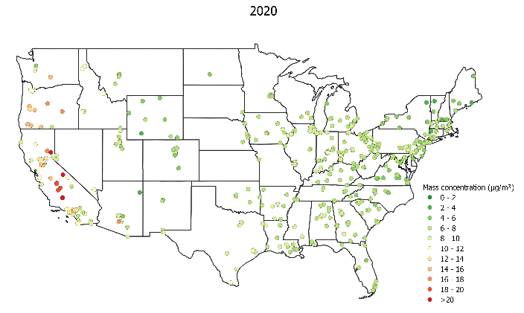
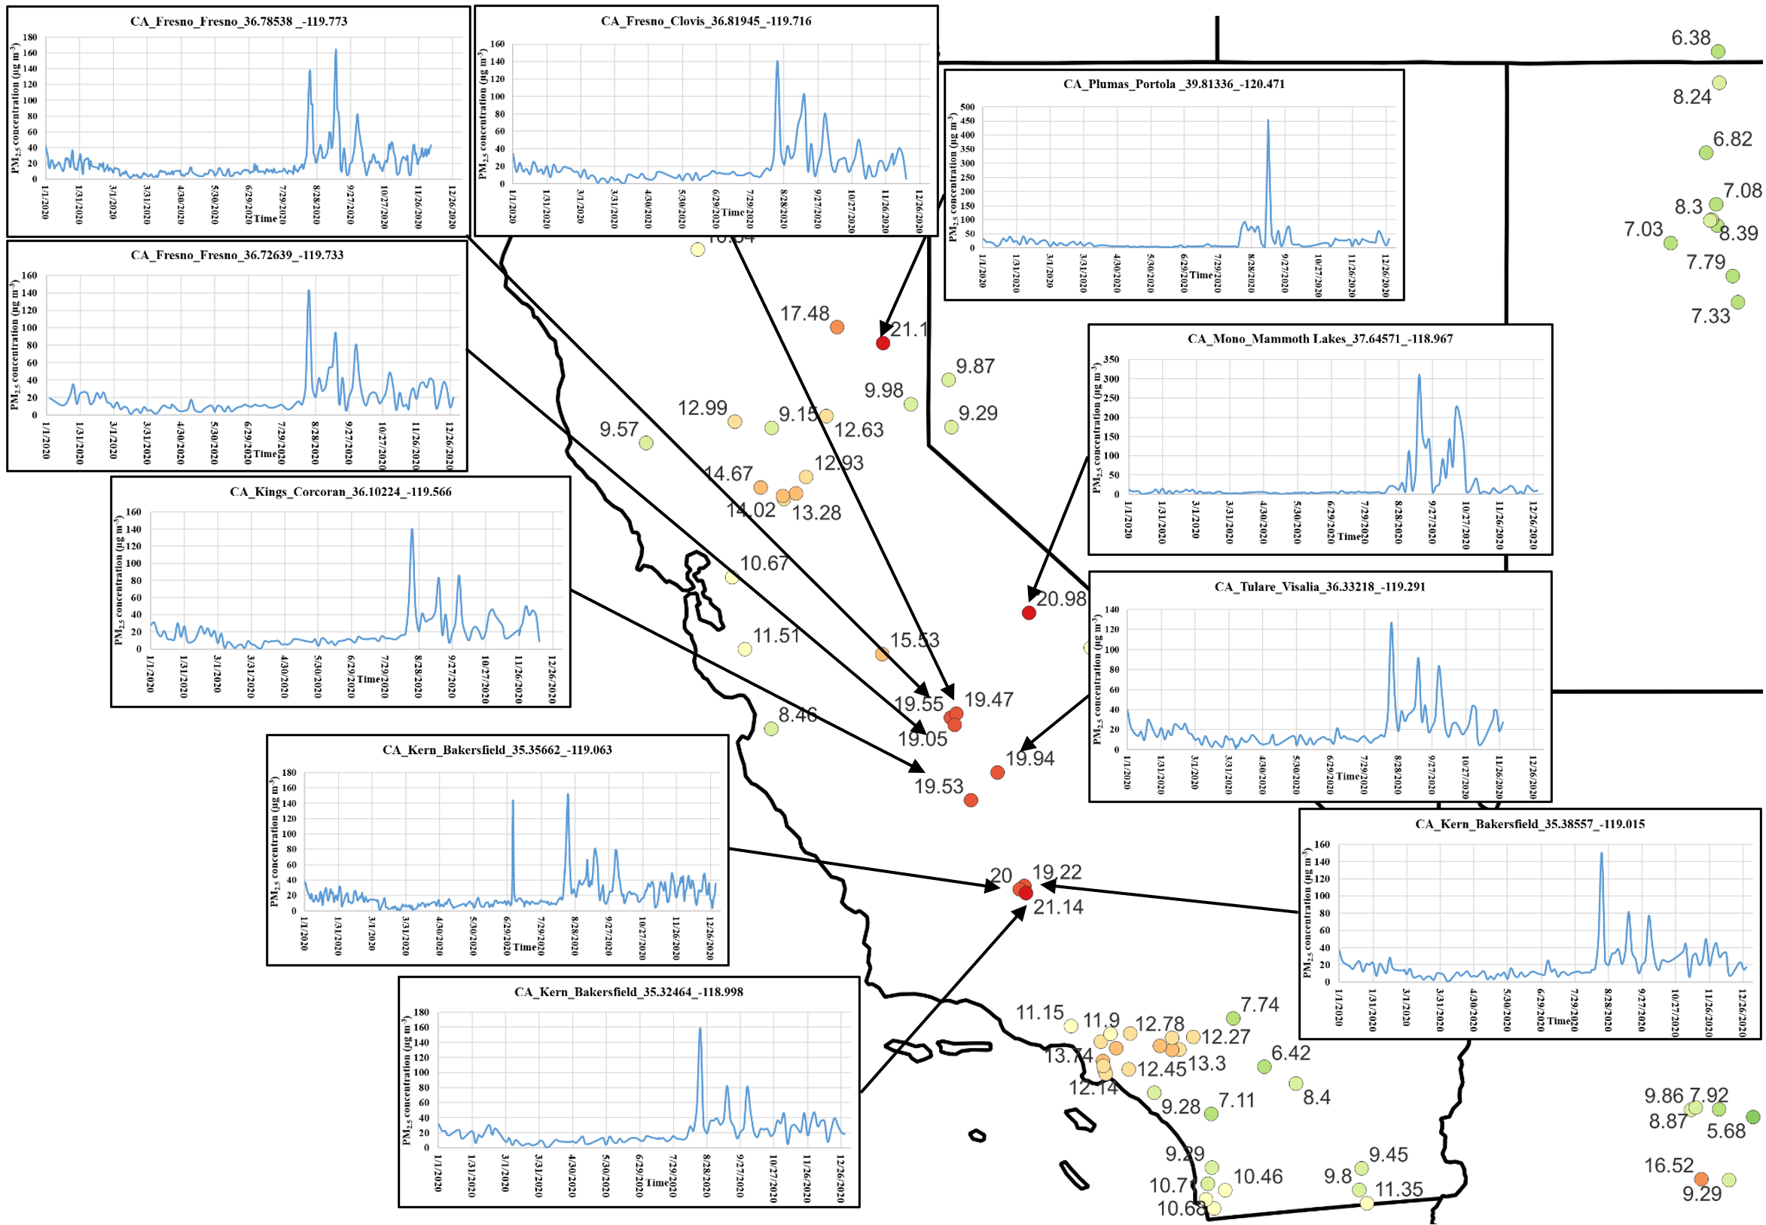
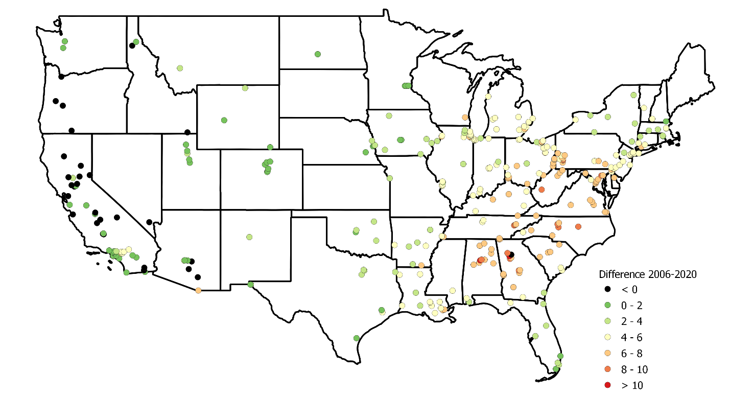
Annual average PM_{2.5} concentrations
Higher in CA, Eastern U.S.
Spikes in CA, reduction in Eastern U.S.
ΔPM_{2.5} (2006 minus 2020)
2020 CA wildfires
Greater reductions in areas with higher PM_{2.5} conc. in 2006; increase in CA

Slide 6
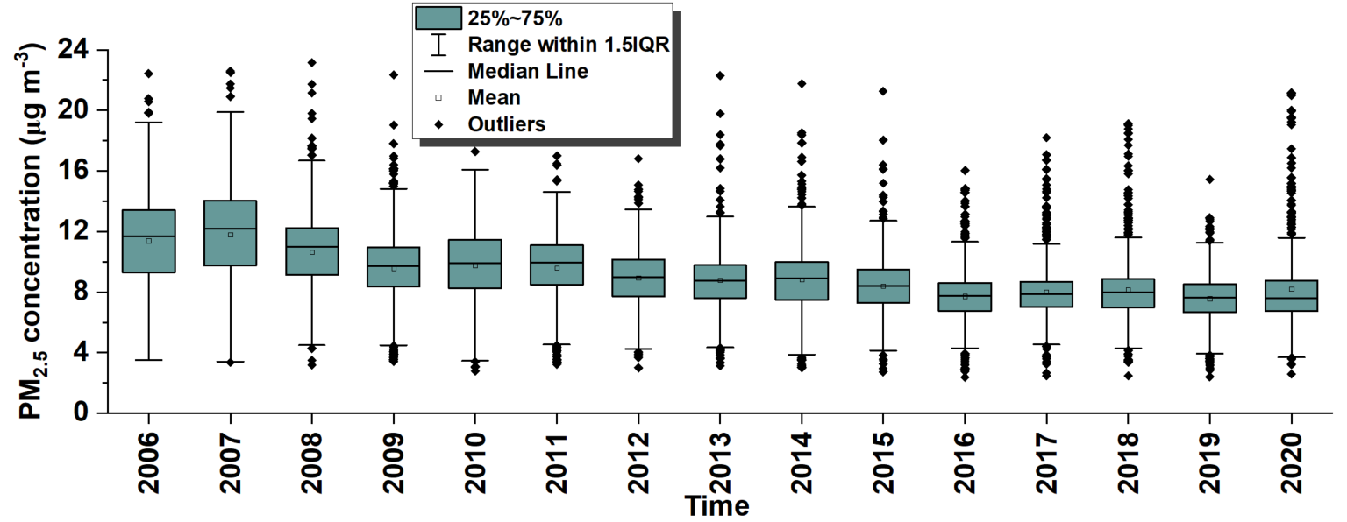
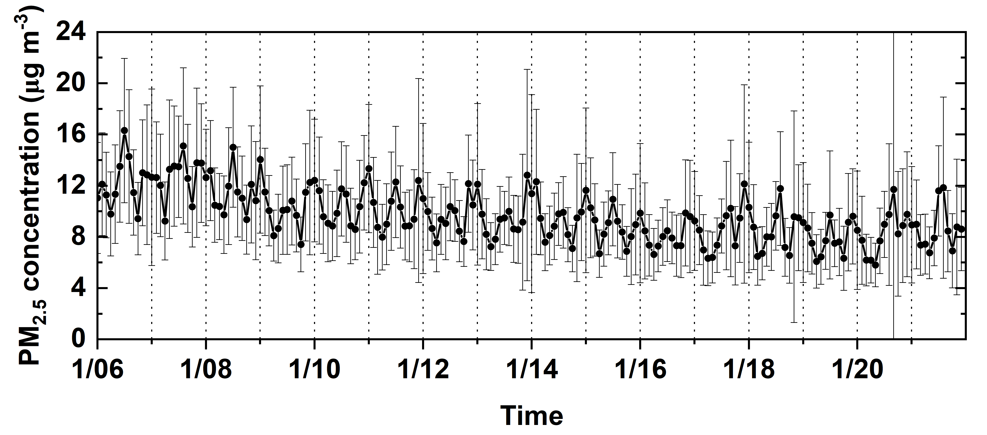
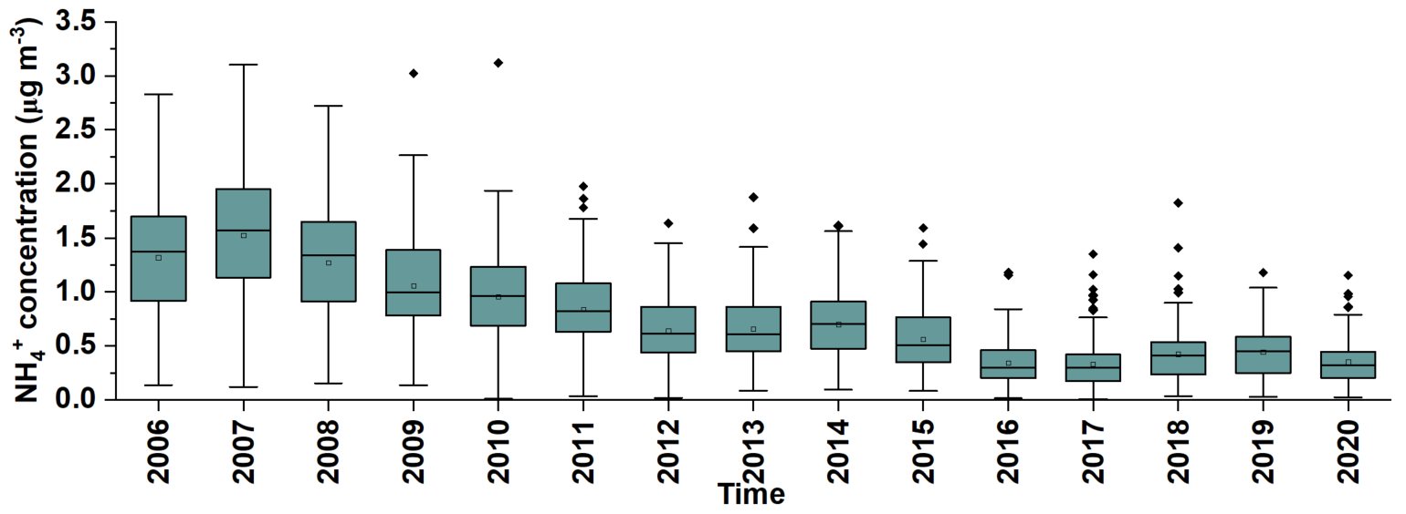
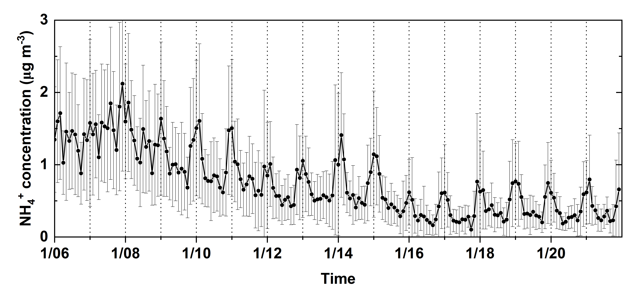
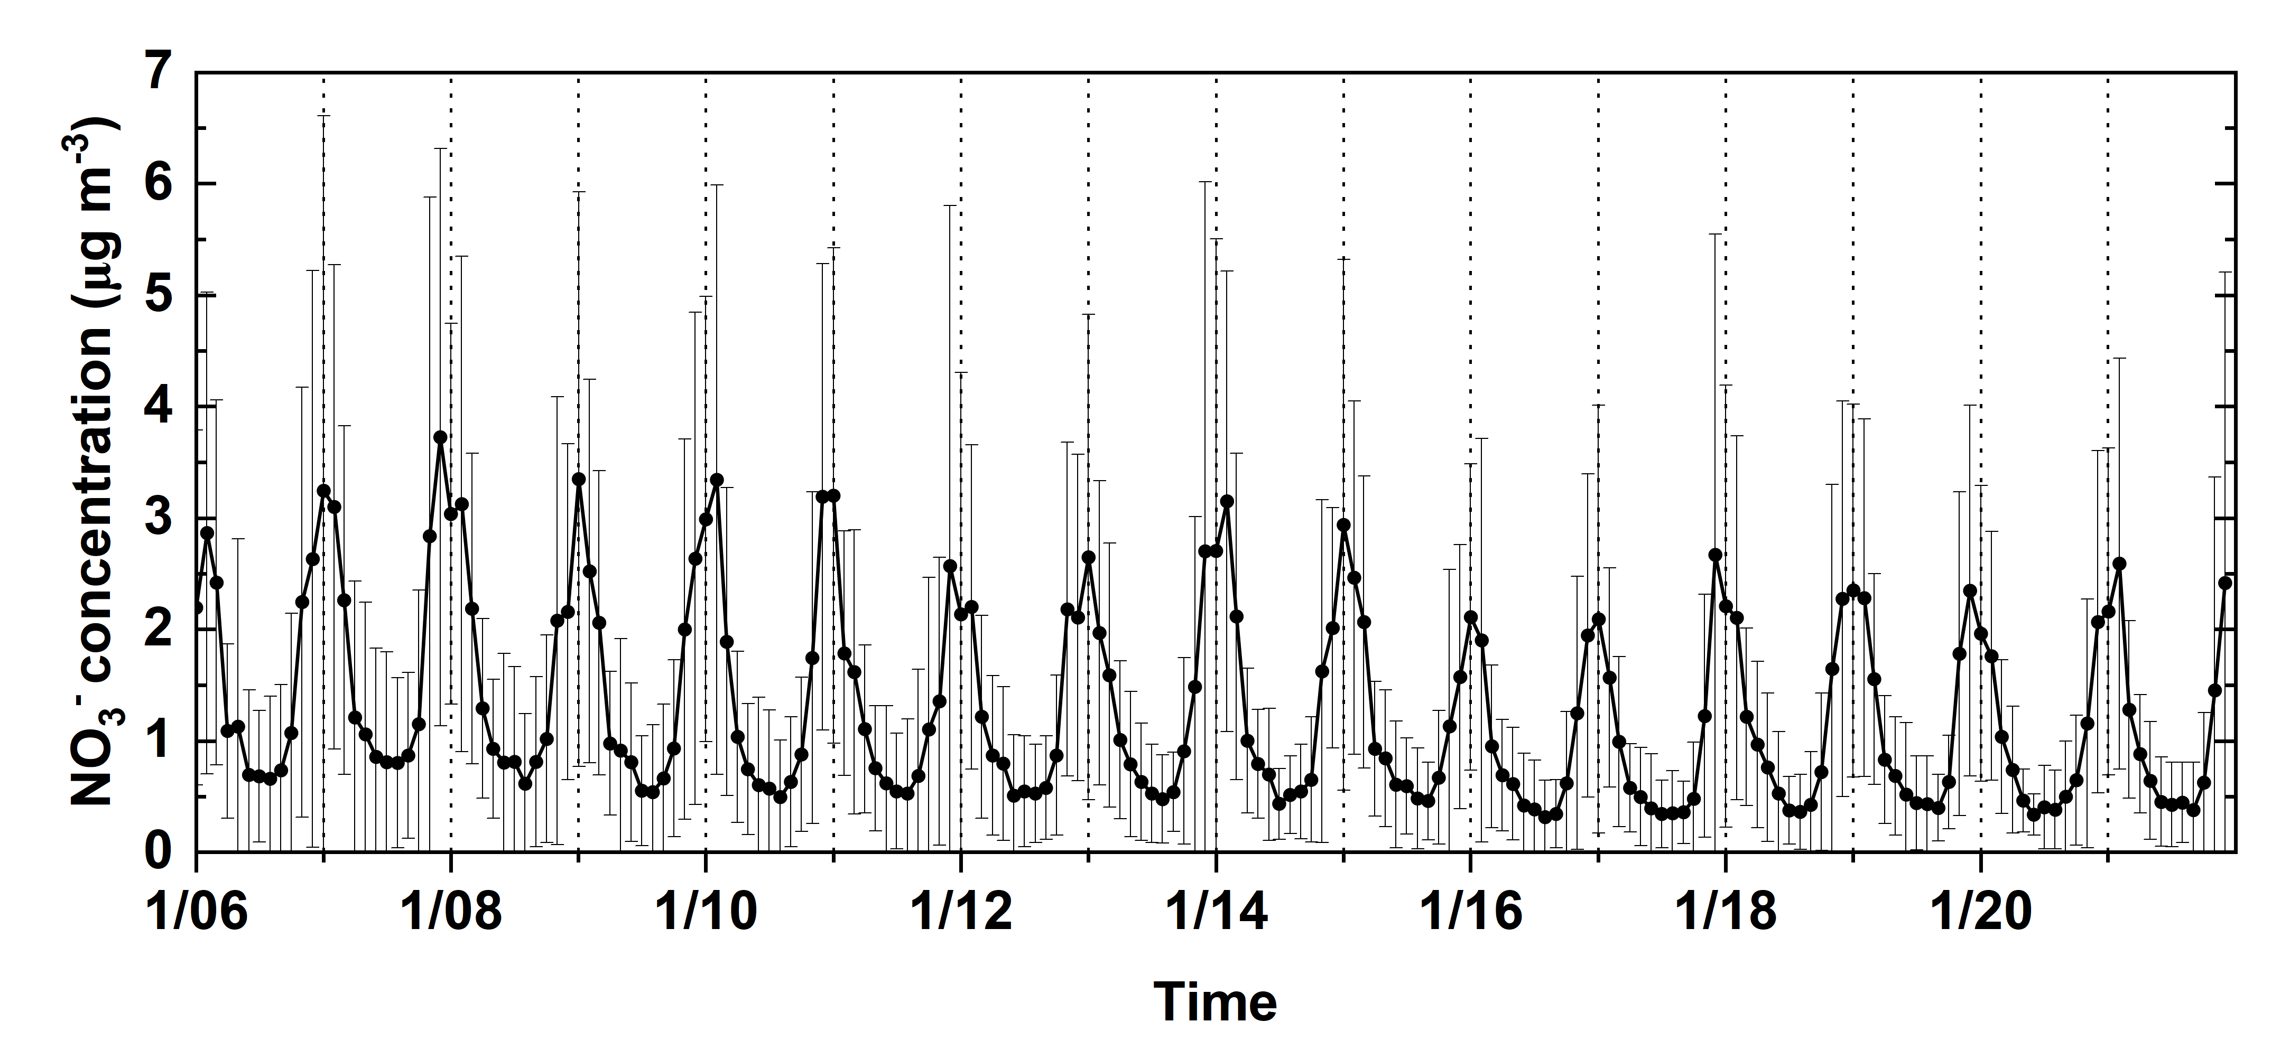
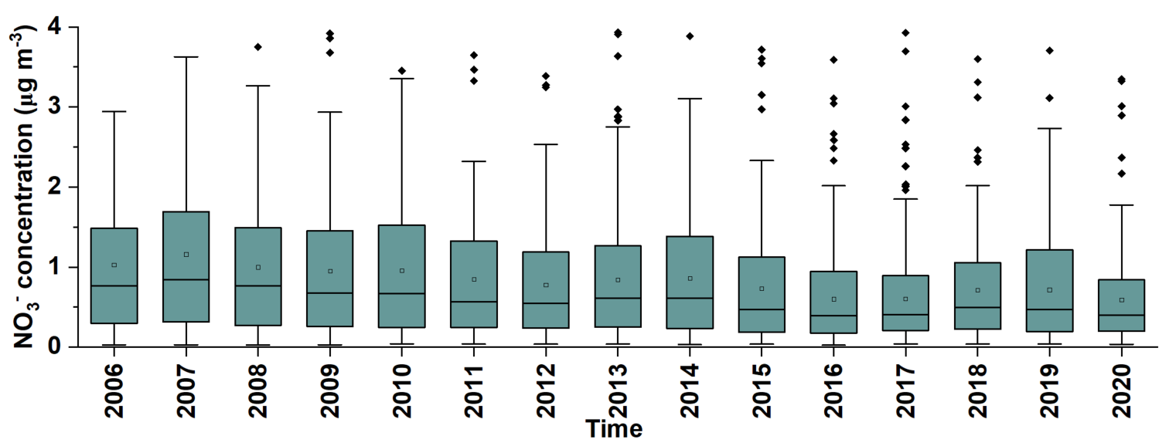
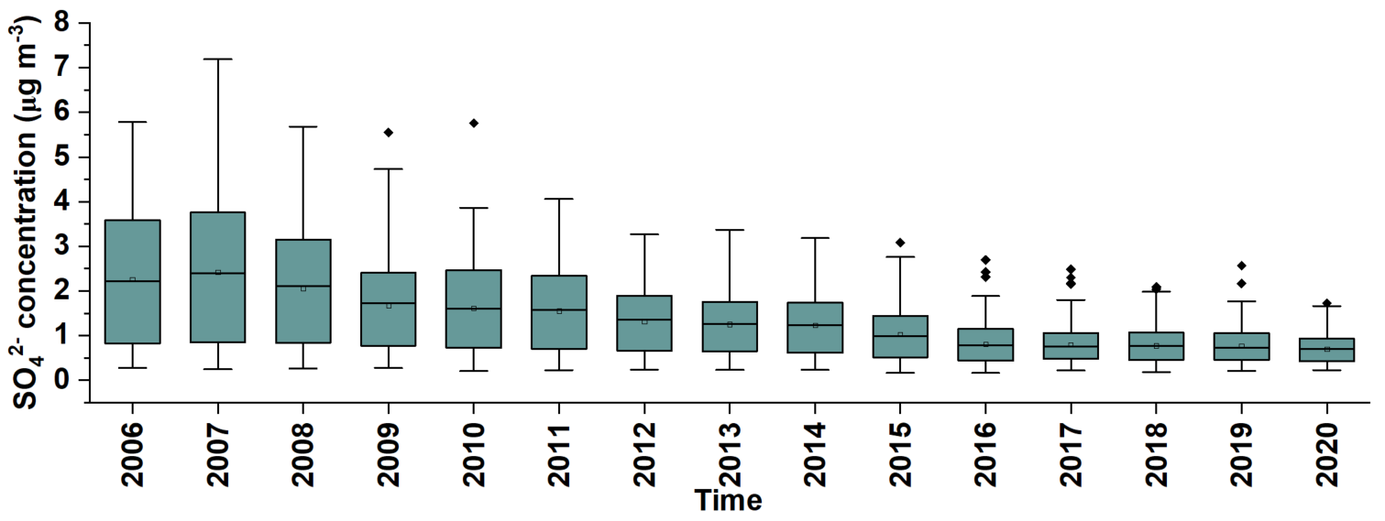
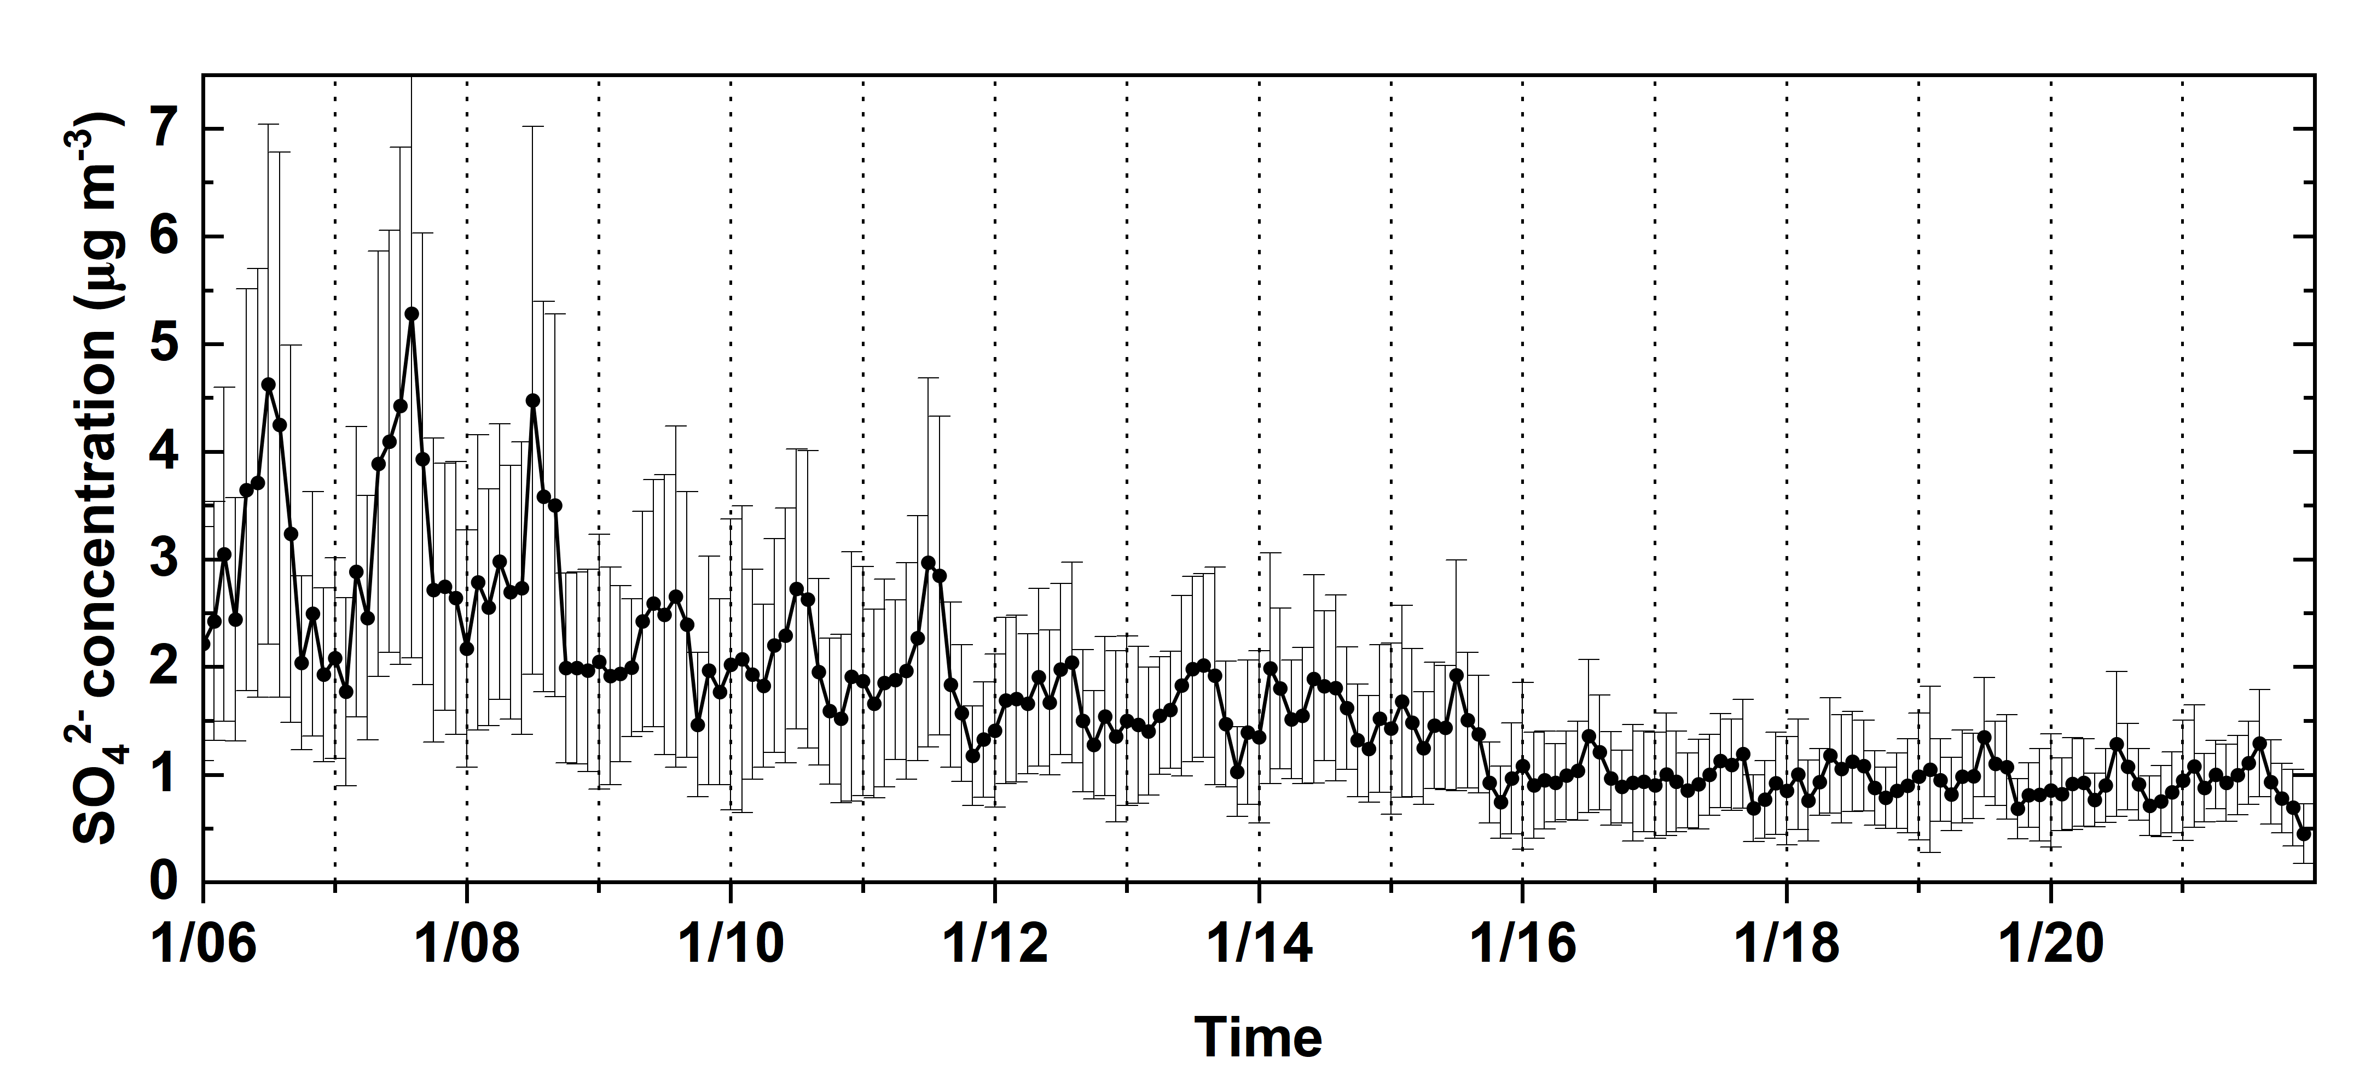
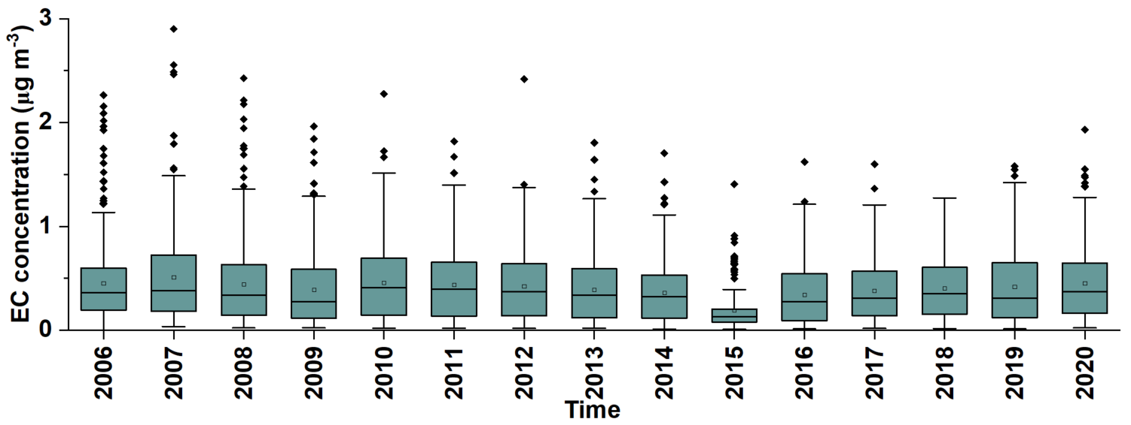
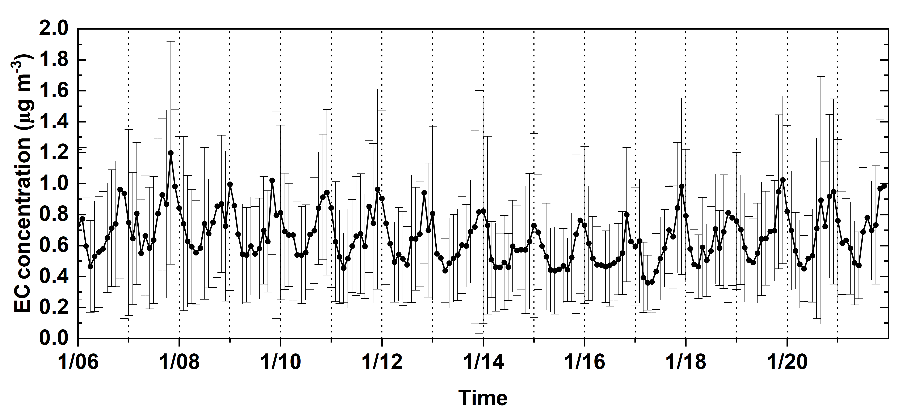
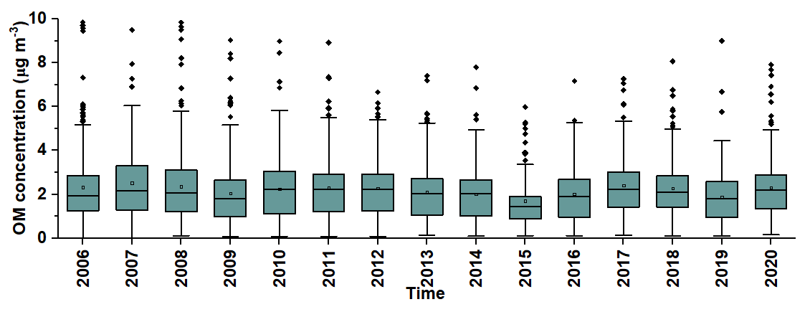
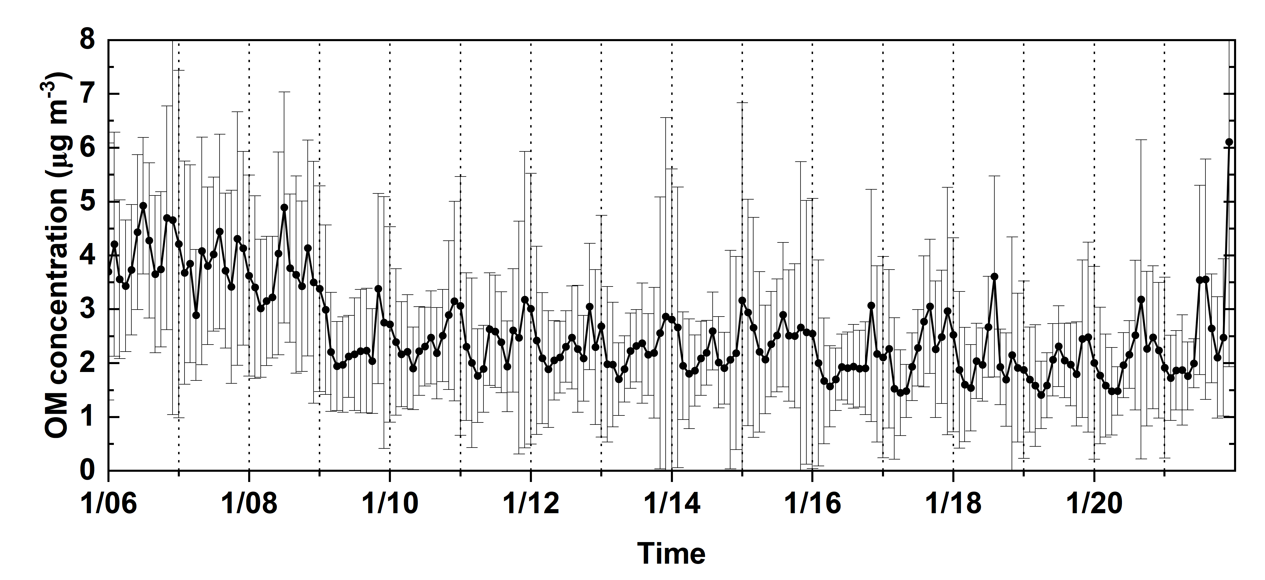
Temporal trend of PM_{2.5} and PM_{2.5} chemical compositions concentrations
PM_{2.5}
1. PM_{2.5} significant reduction, 11.38 ± 2.94 µg m⁻³ (2006) to 8.20 ± 2.76 µg m⁻³ (2020)
2. The reductions in inorganic PM_{2.5} (i.e., NH₄⁺, NO₃⁻, and SO₄²⁻) are the major contributors
3. PM_{2.5} peak in summer before 2008 and peak in winter after 2008
4. NO₃⁻ and EC tended to peak in winter, while SO₄²⁻ tended to peak in summer
5. Less seasonal variation of SO₄²⁻ in recent years
NH₄⁺
NO₃-
↑ winter, ↓ summer
SO₄²⁻
↑ summer, ↓winter
EC
↑ winter, ↓ summer
OM

Slide 7
Emission trend of NH₃, NO_{x}, SO₂, primary PM_{2.5}, and VOC
NO_{x}
Significant & spatially consistent reductions in the emissions of NO_{x} & SO₂
National SO₂ emissions decreased by 85.6% & national NO_{x} emissions decreased by 59.6% (2006-2021)
The Tier 2 & 3 emission standards
The Clean Air Interstate Rule (CAIR) implemented in 2005
Financial crisis during around 2008-2009
The Cross-State Air Pollution Rule (CSAPR) replaced CAIR in 2015
Improved vehicle technology
Transition of gasoline/diesel vehicles to electric vehicles
SO₂
NH₃
Pri-PM_{2.5}
VOC

Slide 8
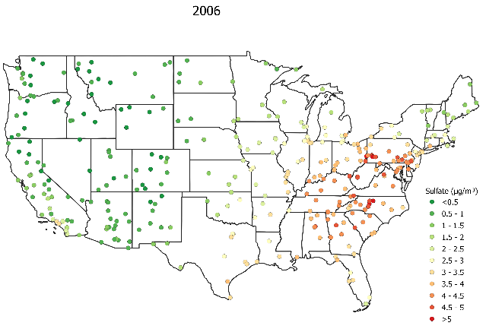
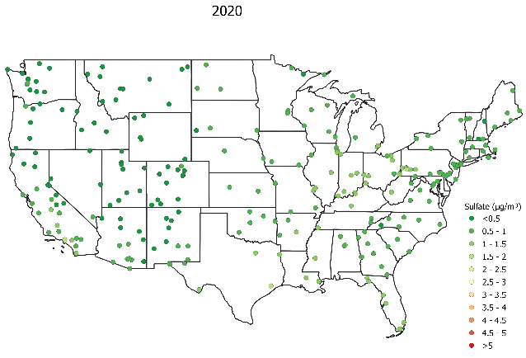
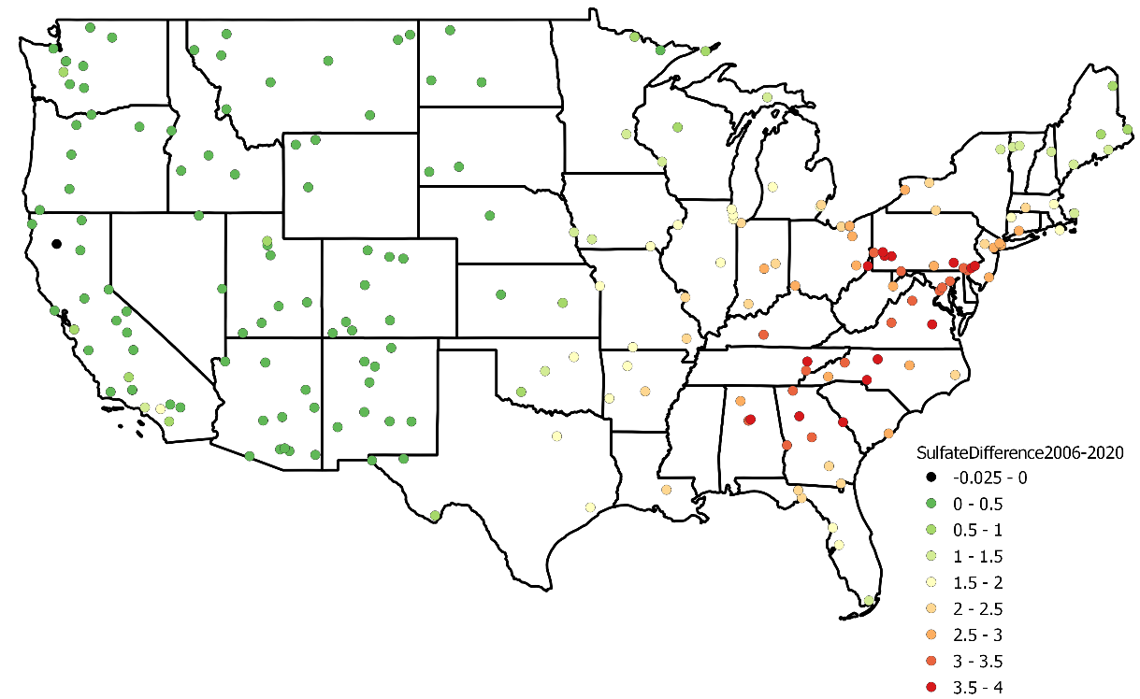
Spatiotemporal trend of SO₄²⁻
Higher in Eastern U.S.
Reduction across U.S.
1. SO₄²⁻ conc. were higher in Ohio River Valley region, Great Lake Basin, and southeastern U.S. in 2006
2. Significant reduction of SO₄²⁻ during 2006-2020 and greater reductions occurred in eastern U.S. (3.5-4.0 µg m⁻³)
3. Less spatial heterogeneity in 2020
ΔSO₄²⁻ (2006 minus 2020)

Slide 9
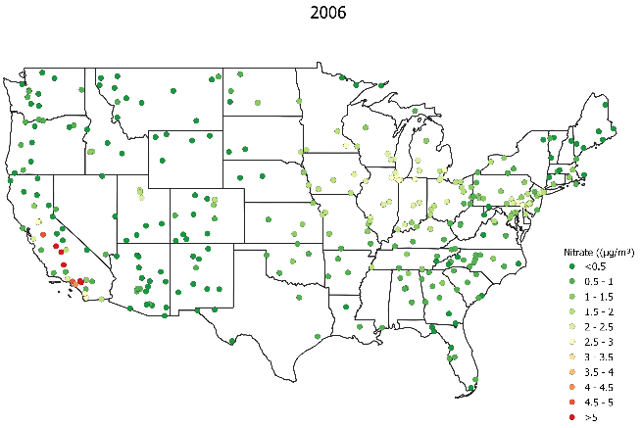
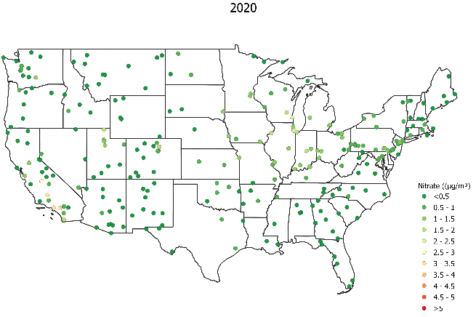
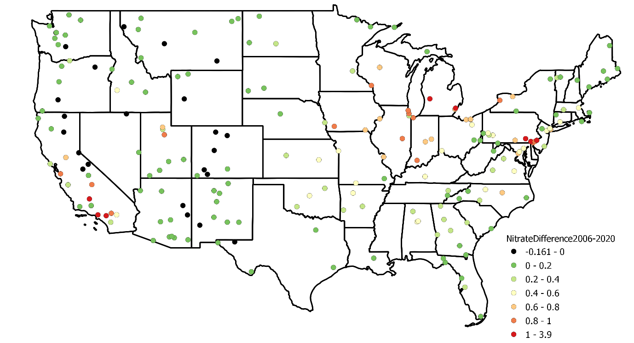
Spatiotemporal trend of NO₃⁻
Higher in CA & Great Lake Basin
Reduction across U.S.
1. NO₃⁻ conc. were higher in California & Great Lake Basin in 2006
2. NO₃⁻ conc. were significantly reduced during 2006-2020
3. Larger reduction in area with higher NO₃⁻ in 2006, the highest reduction was 1-3.9 µg m⁻³
3. Less spatial heterogeneity in 2020
ΔNO₃⁻ (2006 minus 2020)

Slide 10
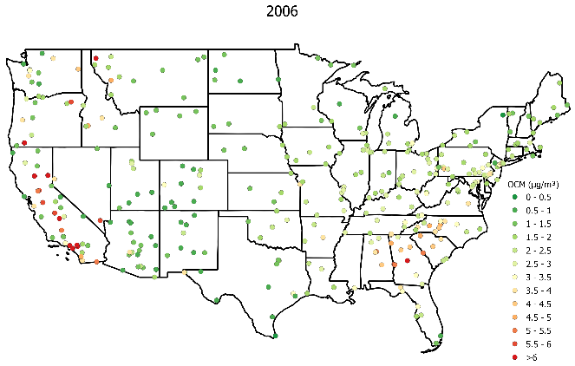
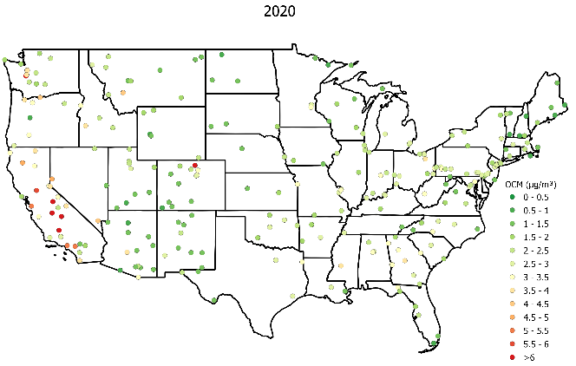
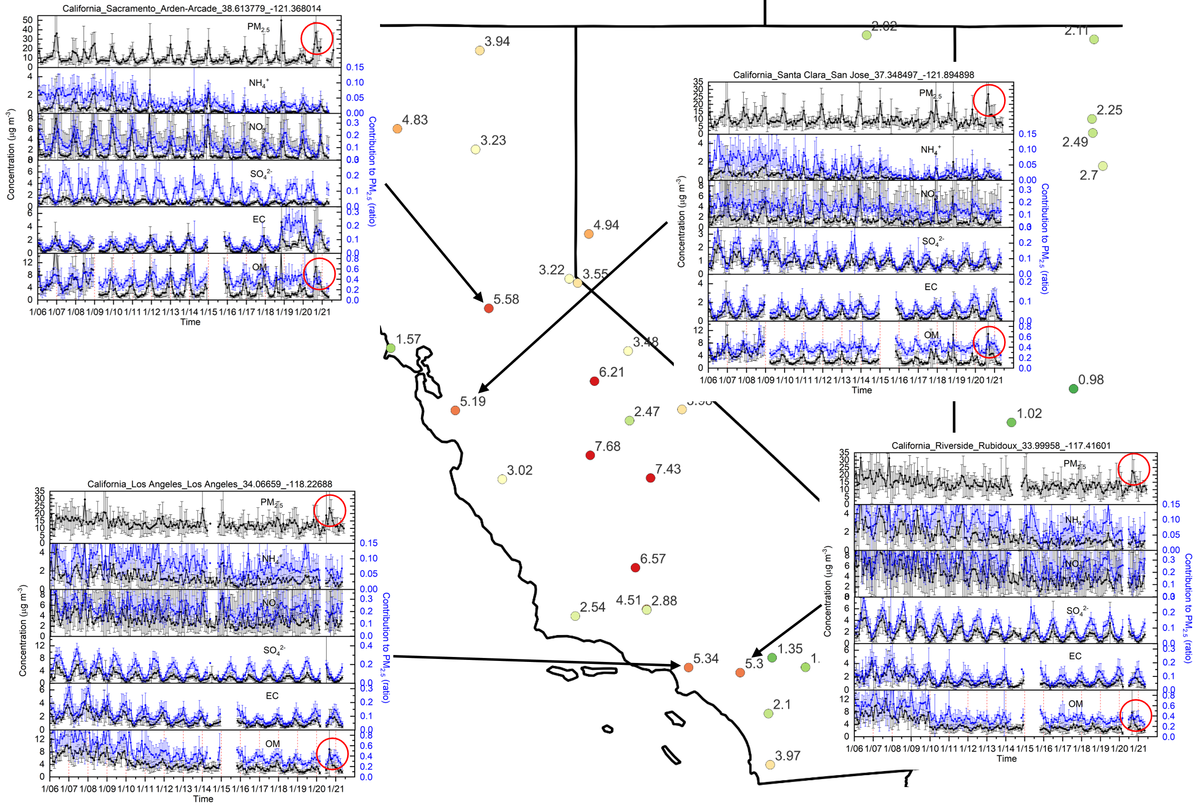
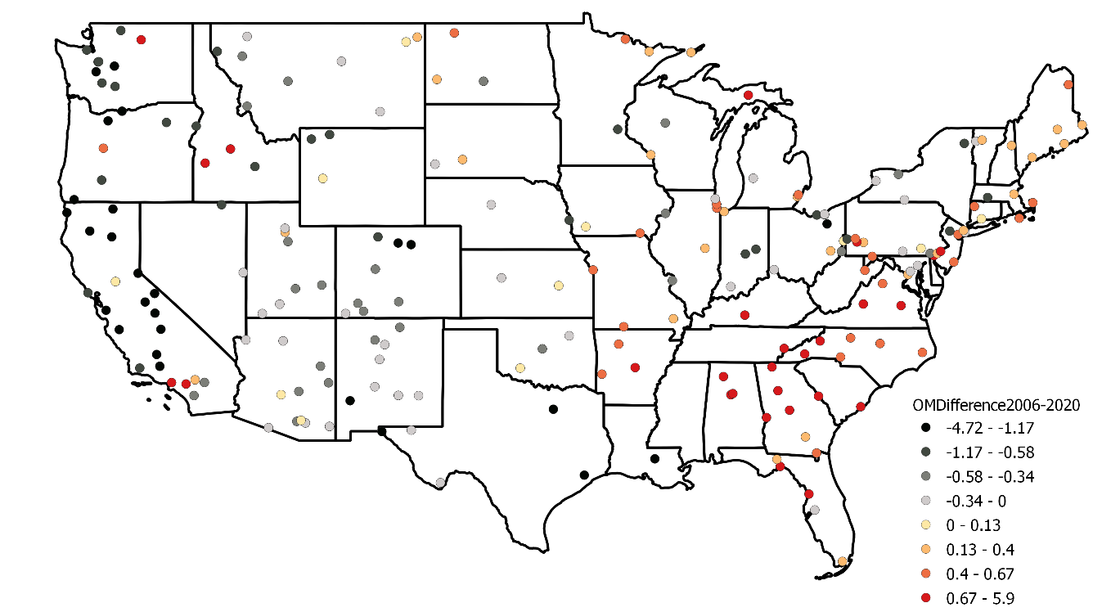
Spatiotemporal trend of OM
↑
↓
Higher in CA & SE U.S
Increase or decrease in certain areas
2020 CA wildfires
ΔOM (2006 minus 2020)
1. Increase in CA, 4.72 µg m⁻³
2. Decrease in SEUS, 5.9 µg m⁻³

Slide 11
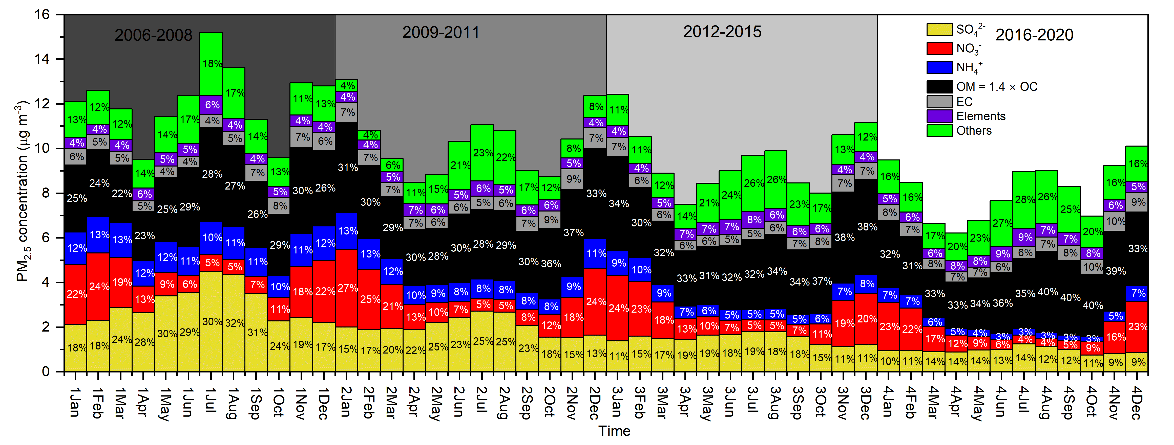
Monthly PM_{2.5} mass closure profile
1. The declining trend of PM_{2.5} in four periods (Tukey test) mainly attributed to the reductions in 3 inorganic components, SO₄²⁻, NO₃⁻, and NH₄⁺
2. The carbonaceous fraction (OM + EC) amounted to ~ 38–50% of PM_{2.5} during 2016-2020, the major contributors to PM_{2.5}
3. Since SO₄²⁻, NO₃⁻, and NH₄⁺ have almost levelled off in recent years, further air quality improvements may require targeting carbonaceous species
4. Before 2008, PM_{2.5} tended to peak in summer, while after 2008, PM_{2.5} tended to peak in winter; the considerable reduction of SO₂ emissions led to the weaker seasonal variation of SO₄²⁻ in recent years

Slide 12
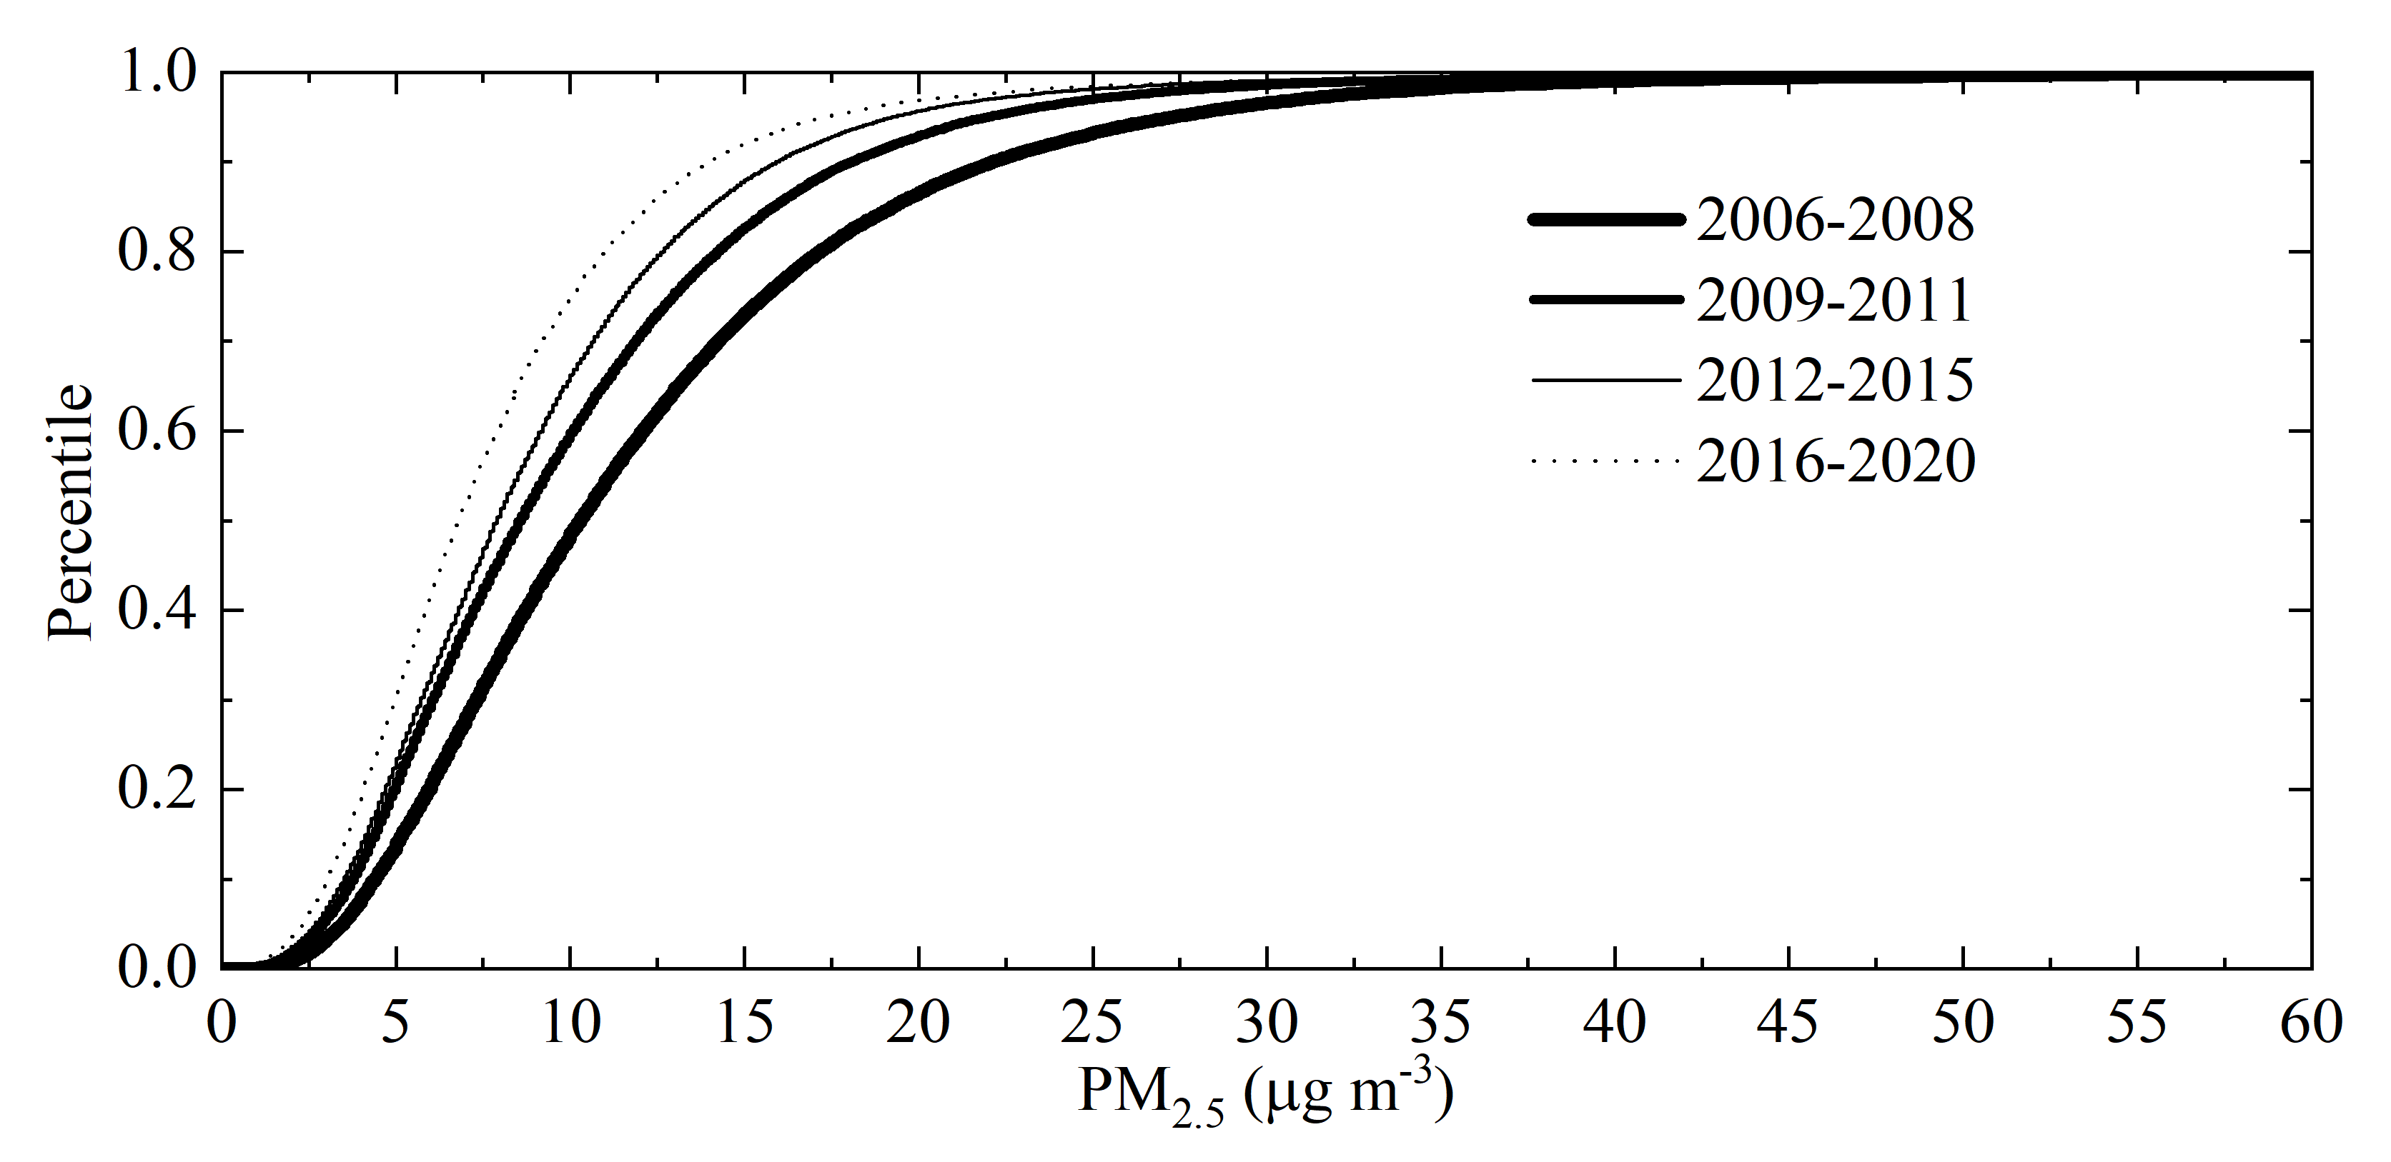
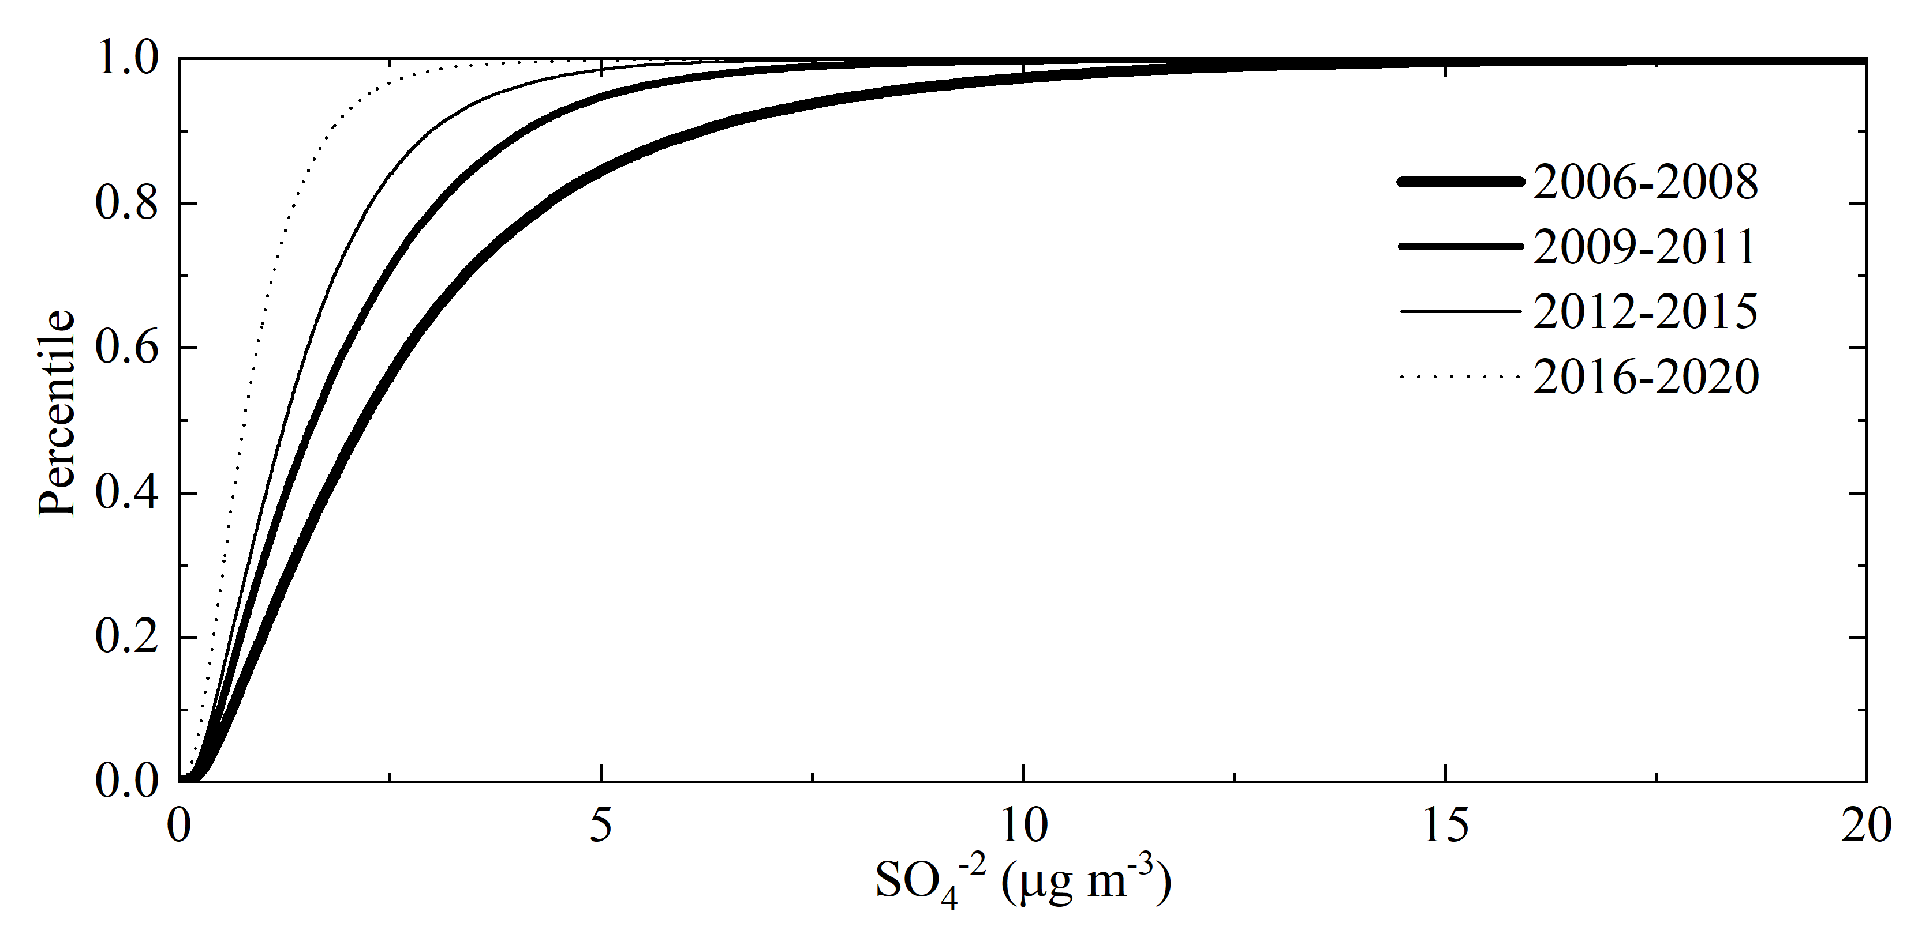
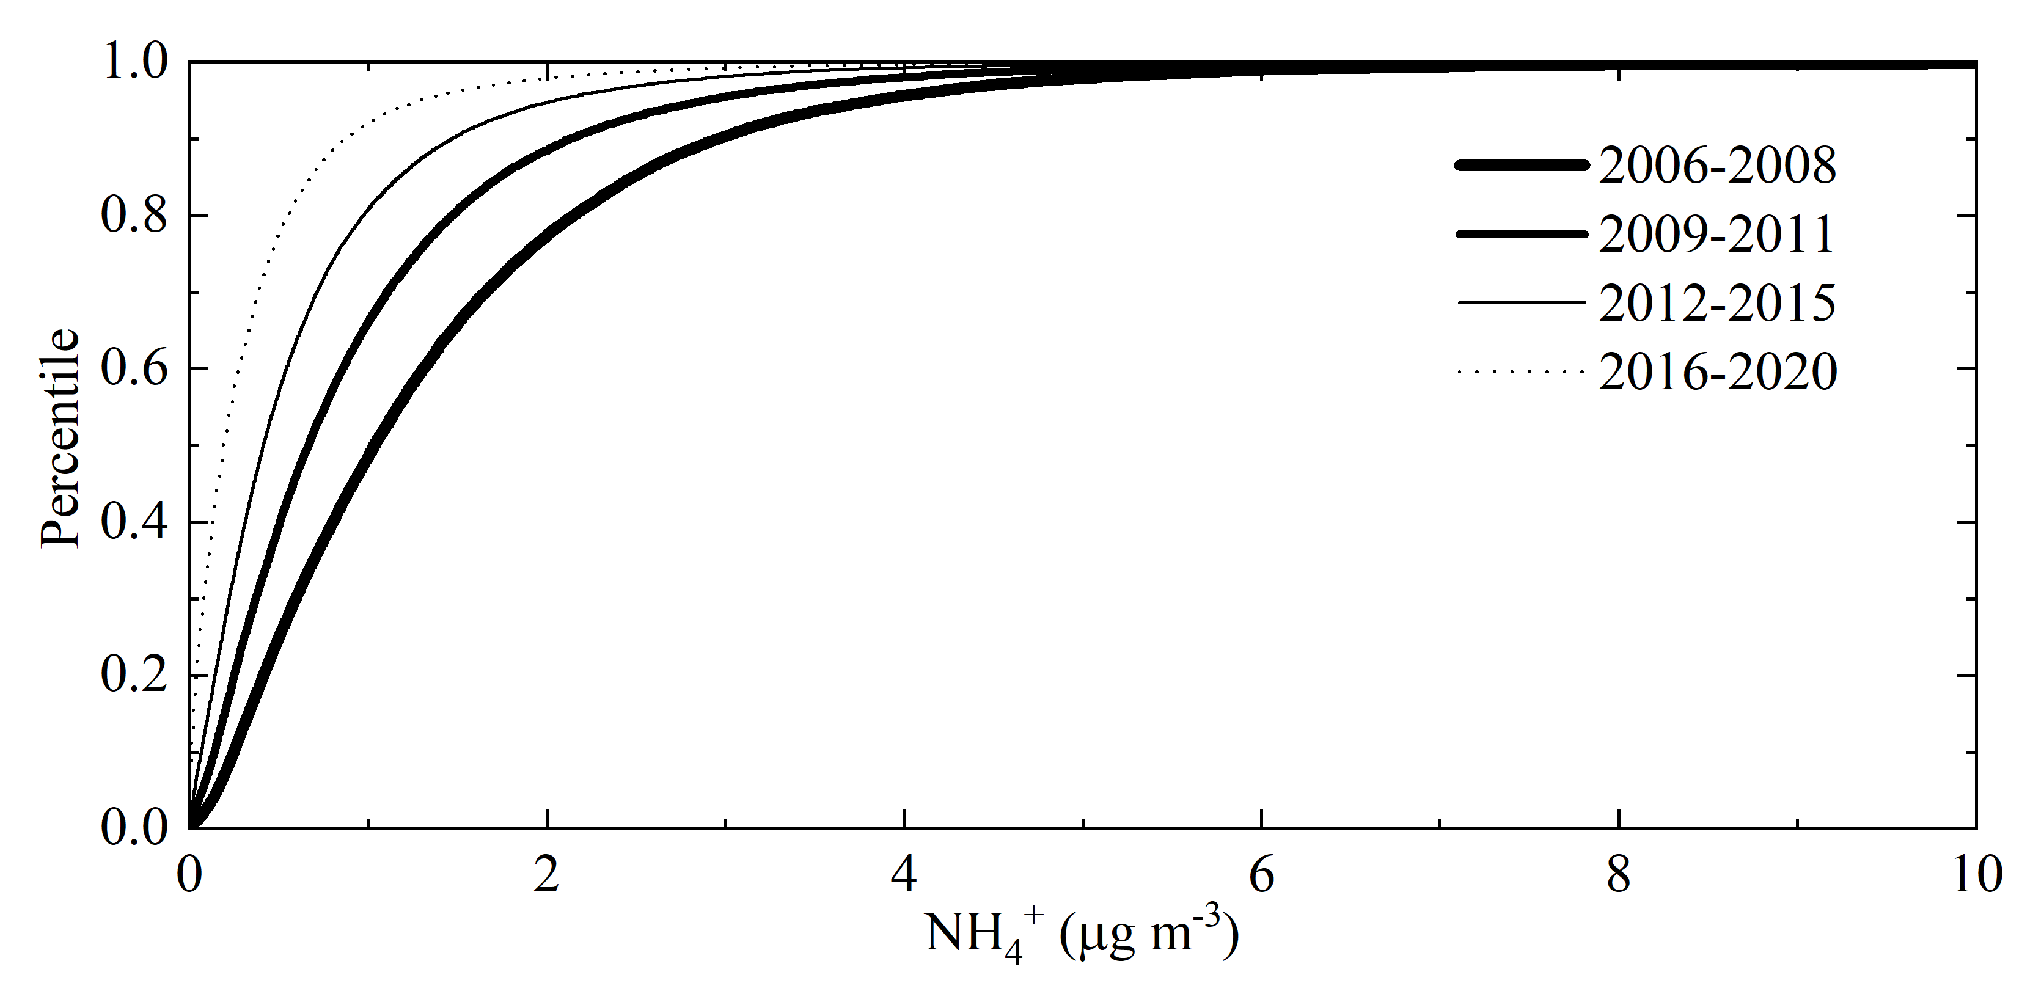
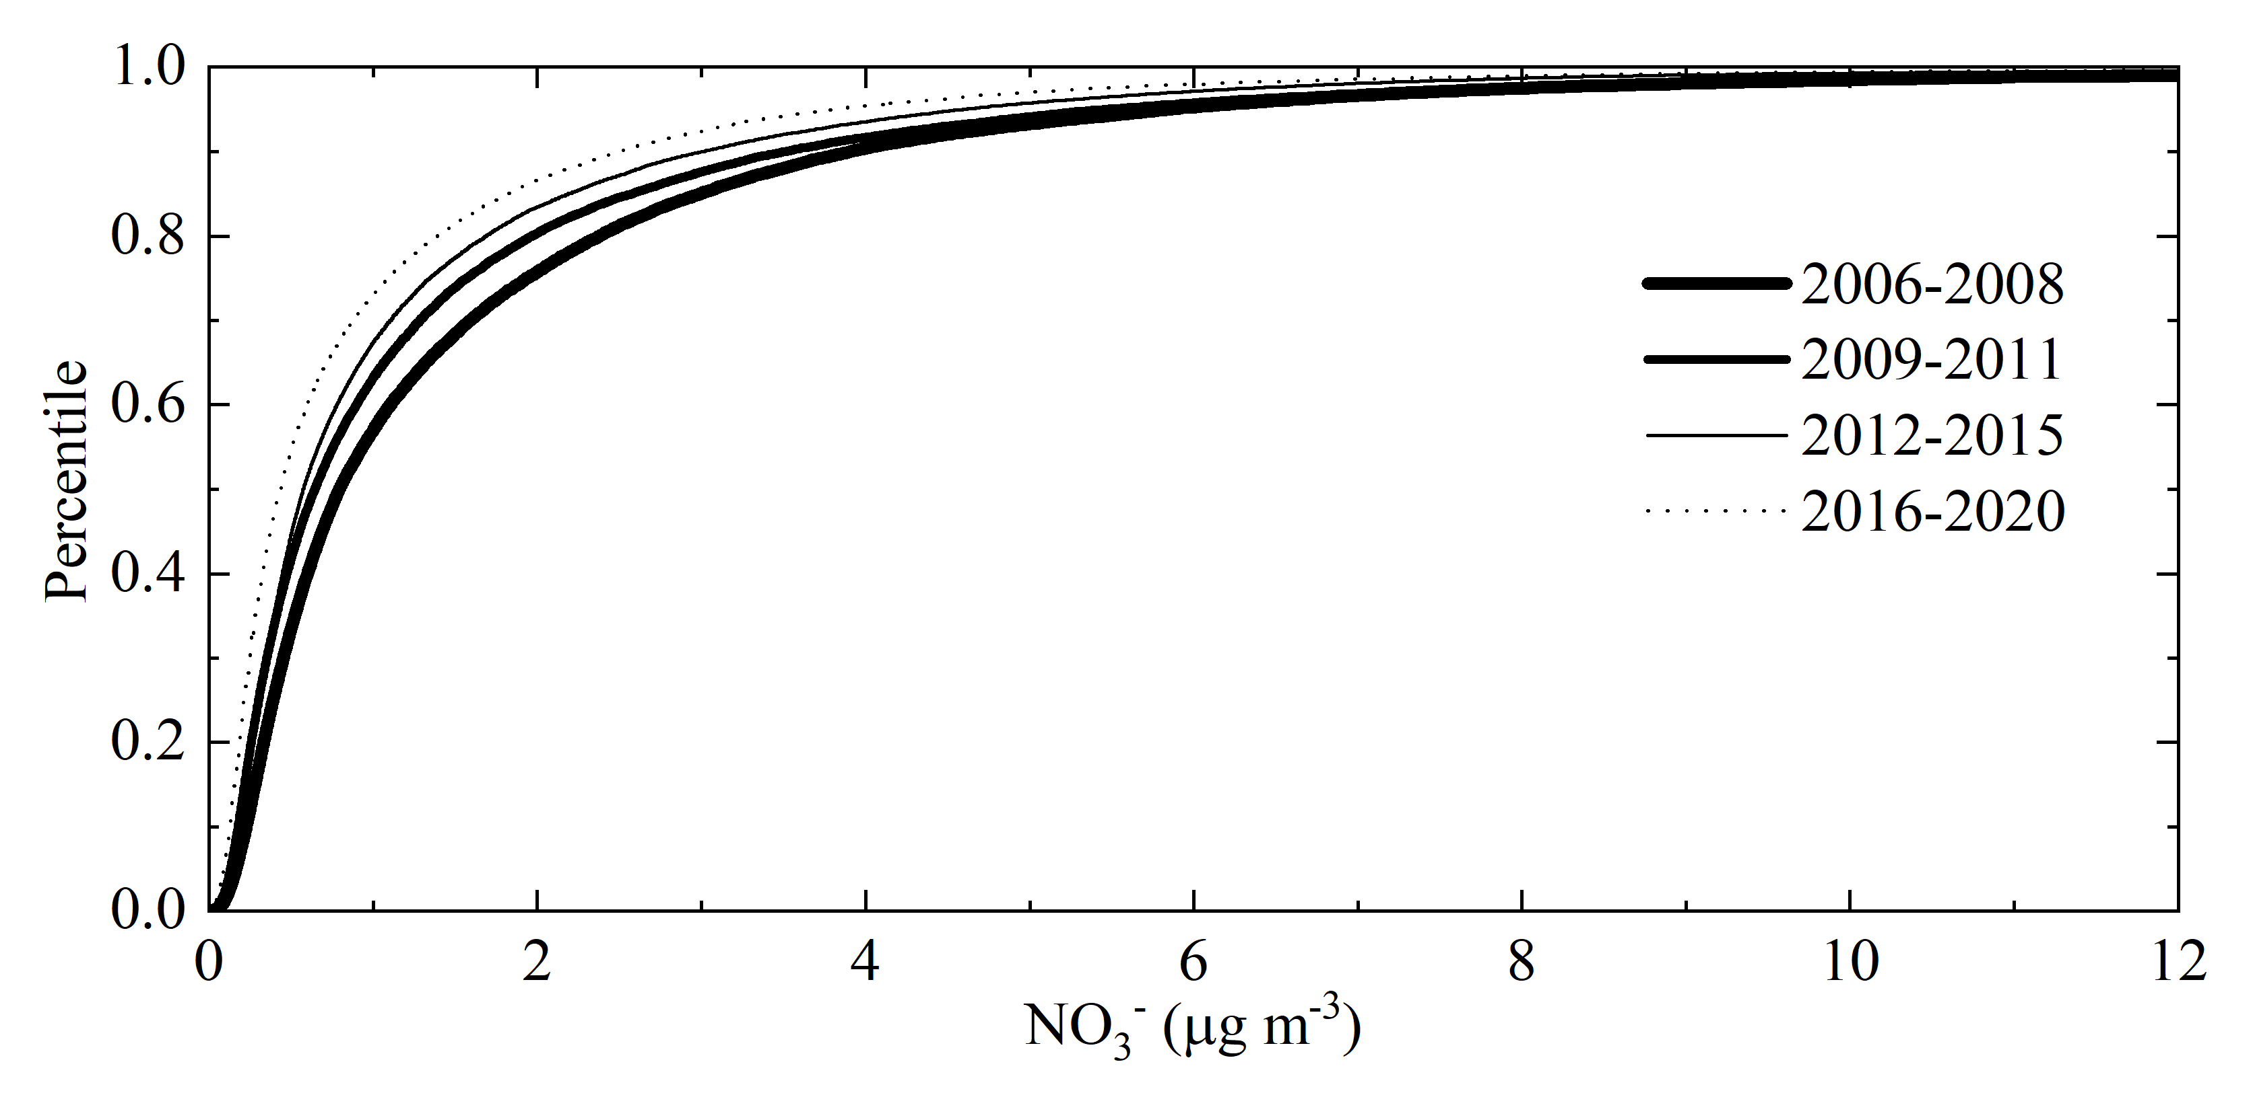
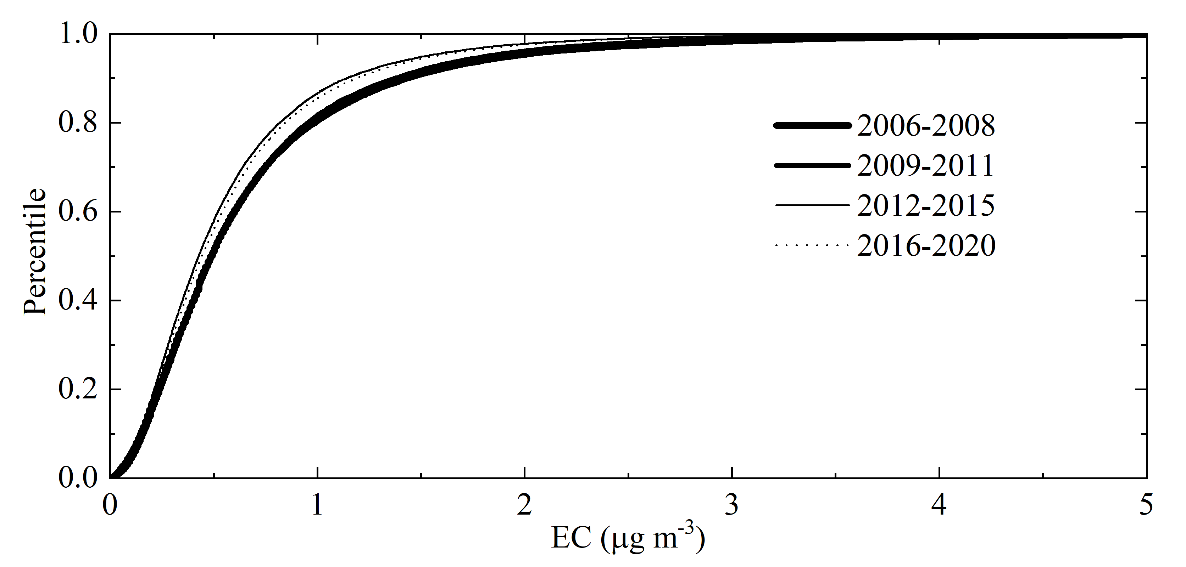
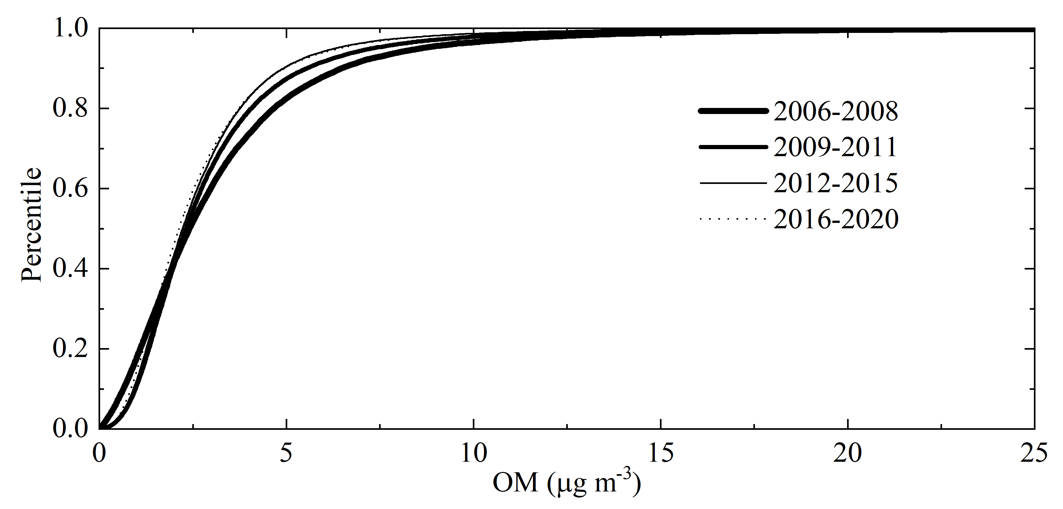
Trend in extrema
PM_{2.5}
SO₄²⁻
NH₄⁺
NO₃-
EC
OM
1. Fewer high PM_{2.5} conc. occurred during 2006-2020, which indicated that the heavily polluted days (heavy hitters) occurred less in recent years
2. The 98th percentile of PM_{2.5} conc. in each period are: 34.1 μg m^{–3} during 2006-2008; 27.7 μg m^{–3} during 2009-2011; 24.6 μg m^{–3} during 2012-2015; 23.2 μg m^{–3} during 2016-2020, which were all below the primary and secondary 24-hr PM_{2.5} NAAQS (35 μg m⁻³)
3. Reduction in the occurrence of extrema PM_{2.5} conc. can be mainly attributed to the reductions of SO₄²⁻, NH₄⁺, and NO₃⁻ rather than OM and EC

Slide 13
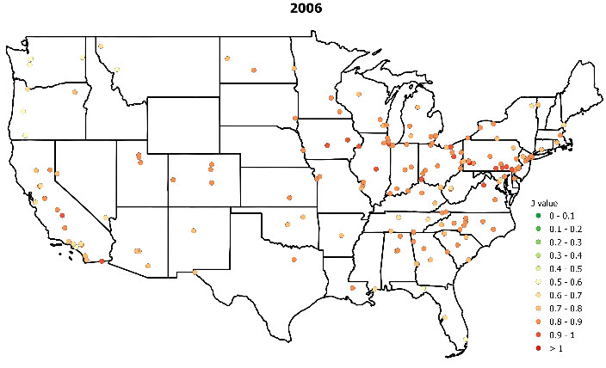
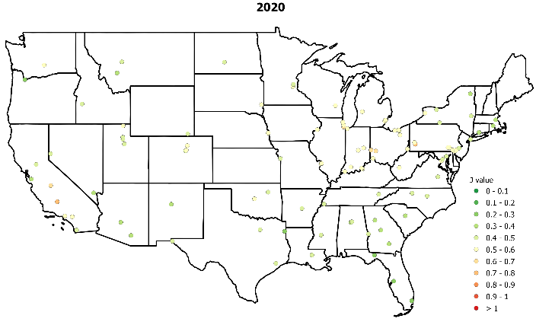
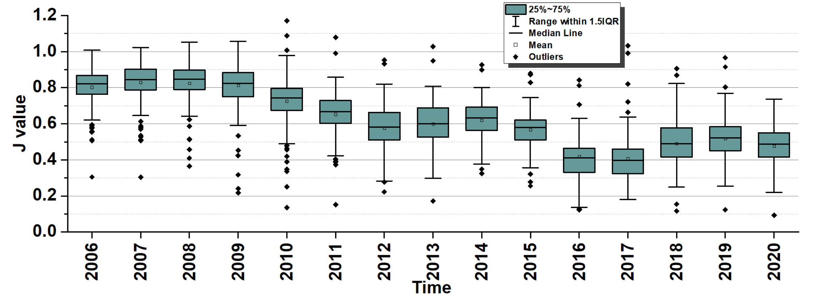
Ammonium availability index-J
J = $\frac{\left[{NH}_{4}^{+}\right]}{2 × \left[{SO}_{4}^{2−}\right] + \left[{NO}_{3}^{−}\right] }$
1. J values (0.80 ± 0.10 to 0.48 ± 0.10) exhibited a reduction trend during 2006-2020, acidic particles
2. The reduction trend in J was inconsistent with the temporal changes of ↑NH₃, ↓NO_{x}, and ↓SO₂ emissions

Slide 14
Summary
PM_{2.5} was significantly reduced, 11.38 ± 2.94 µg m⁻³ (2006) to 8.20 ± 2.76 µg m⁻³ (2020) mainly attributed to the reductions in inorganic PM_{2.5} (i.e., NH₄+, NO₃⁻, and SO₄²⁻)
The largest air quality improvements occurred in areas with the worst baseline air quality (Ohio Valley & SE U.S.)
Spikes in PM_{2.5} in CA were due to higher EC & OM from 2020 wildfires
Control strategies on SO₂ and NO_{x} led to significant emissions reductions
SO₄²⁻, NO₃⁻, and NH₄⁺ almost levelled off in recent years, further air quality improvements may require targeting carbonaceous species
The heavily polluted days (heavy hitters) occurred less in recent years
Particles are acidic
This analysis provided insights to target specific precursors to aid in the development of PM_{2.5} control strategies in the future

Slide 15
Selected References
Bell, ML, Dominici, F, Ebisu, K, Zeger, SL, Samet, JM. Spatial and temporal variation in PM_{2.5} chemical composition in the United States for health effects studies. Environmental Health Perspectives. 2007;115(7):989-995.
Cheng, B., Wang-Li, L., Meskhidze, N., Classen, J., Bloomfield, P. Spatial and temporal variations of PM_{2.5} mass closure and inorganic PM_{2.5} in the Southeastern U.S. Environ. Sci. Pollut. Res. 2019, 26, 33181–33319.
United States Environmental Protection Agency (USEPA). 2021. Air Data: Air Quality Data Collected at Outdoor Monitors Across the US.. https://aqs.epa.gov/aqsweb/airdata/download_files.html
Krall, JR, Anderson GB, Dominici F, Bell ML, Peng RD. 2013. Short-term exposure to particulate matter constituents and mortality in a national study of U.S. urban communities. Environ Health Perspect. 121(10):1148-53.
Acknowledgments
This project was funded by New York State Energy Research and Development Authority (NYSERDA)
Great thanks to Dr. Brett Gantt and Liz Naess for helpful discussions
Great thanks to Dr. Wyat for providing the useful information for the EC and OC data correction

Slide 16
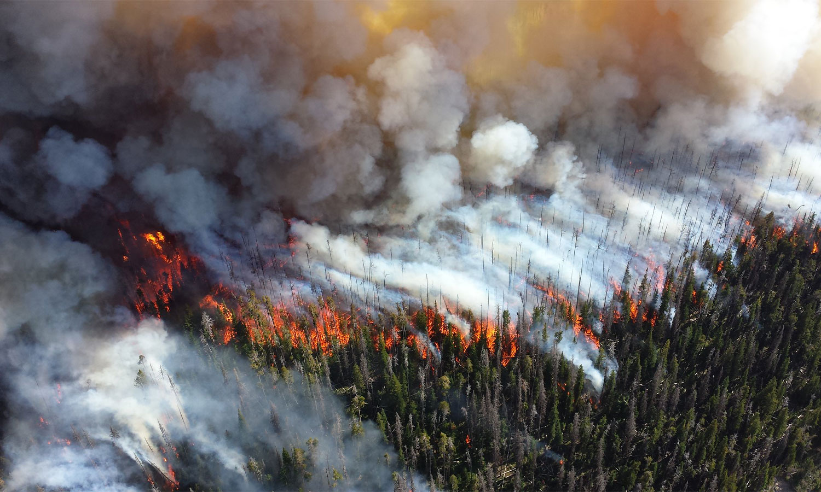
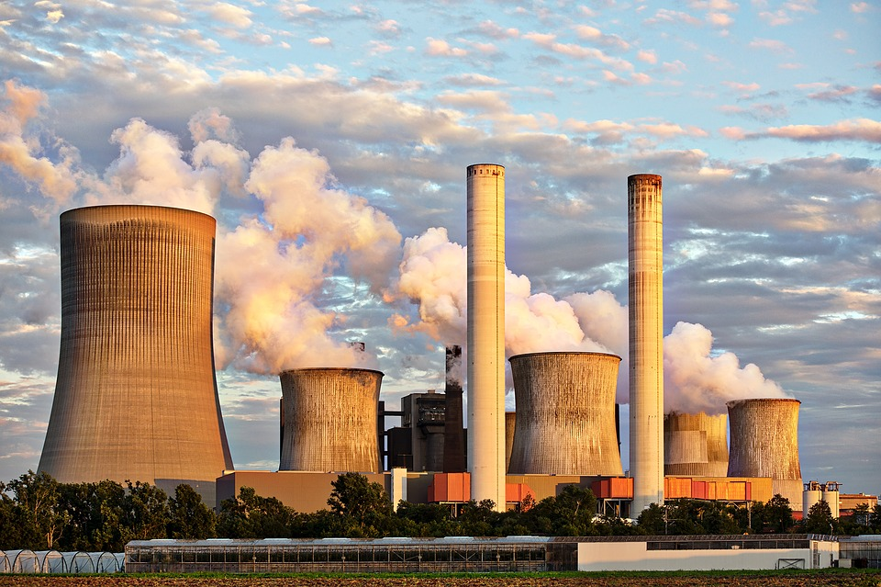
Mike Lewelling/National Park Service
Thank you!
Any questions?
Jessica Wentz and Romany Webb

Slide 17
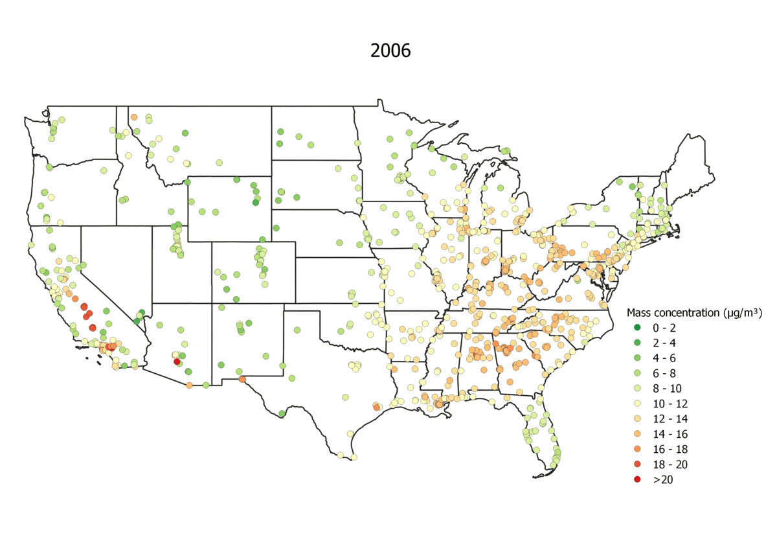
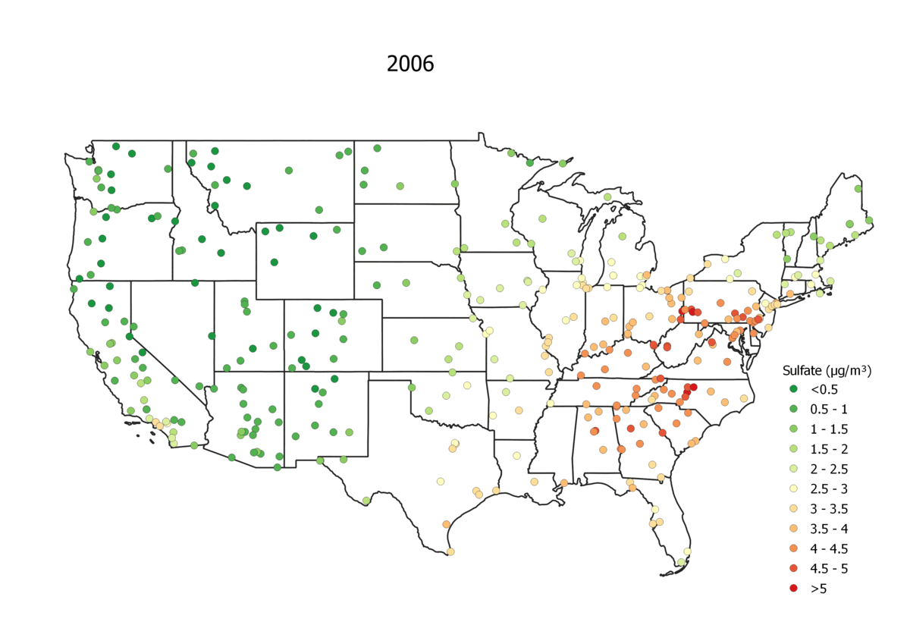
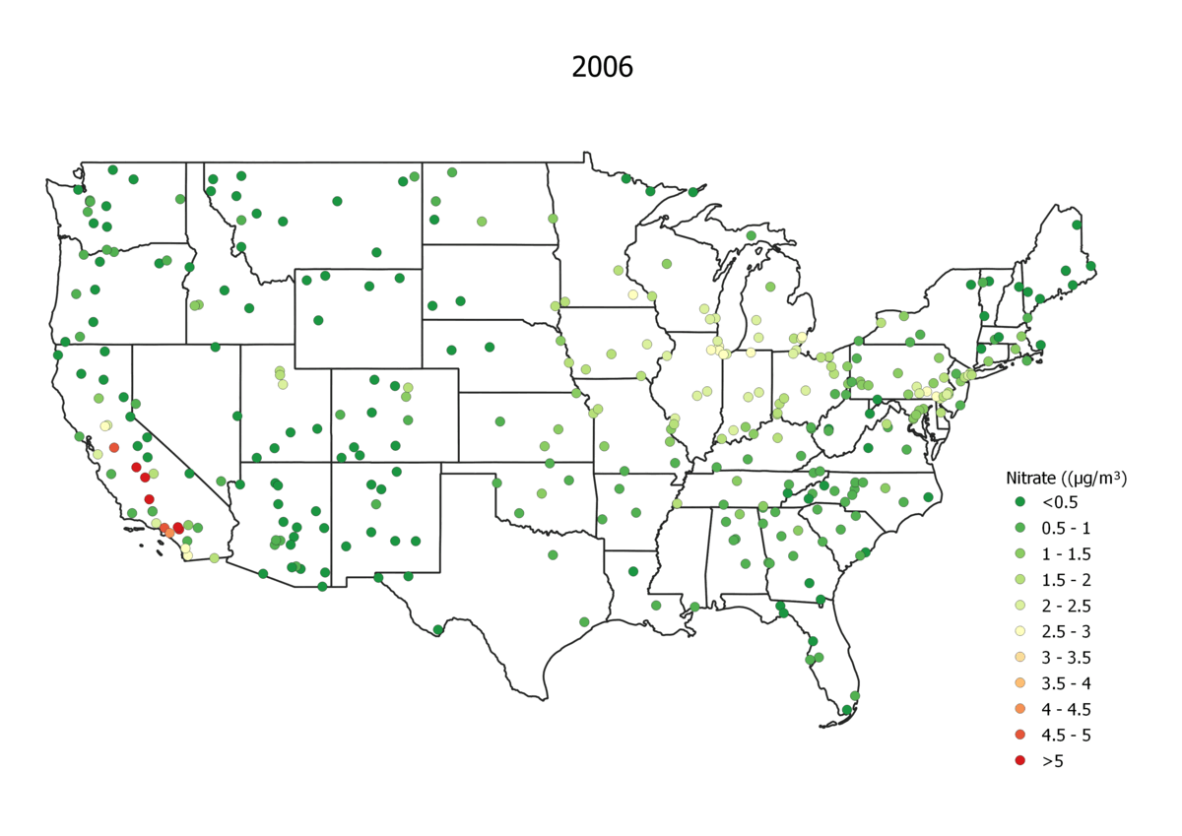
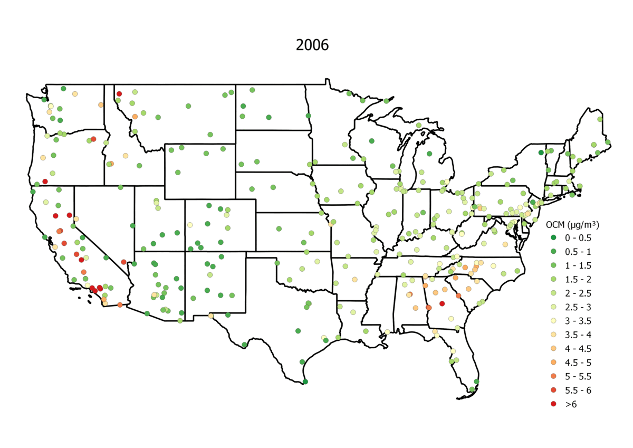
Extra Results (animation)
PM_{2.5} mass concentration (2006-2020)
SO₄²⁻ (2006-2020)
NO₃⁻ (2006-2020)
OM (2006-2020)

Slide 18
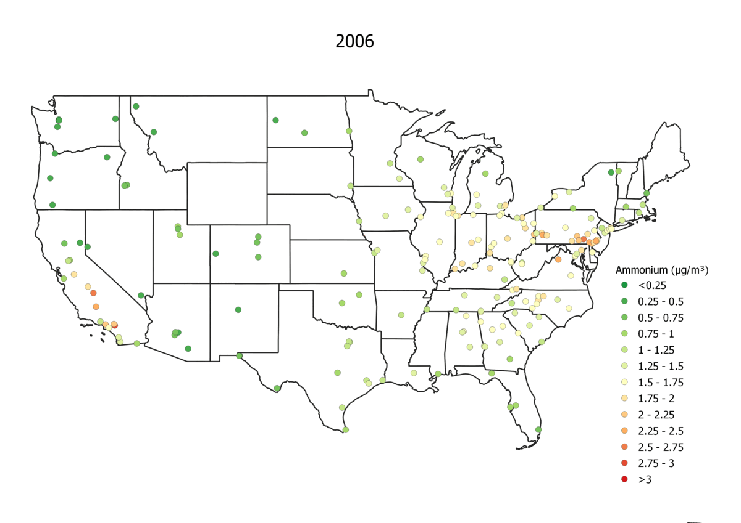
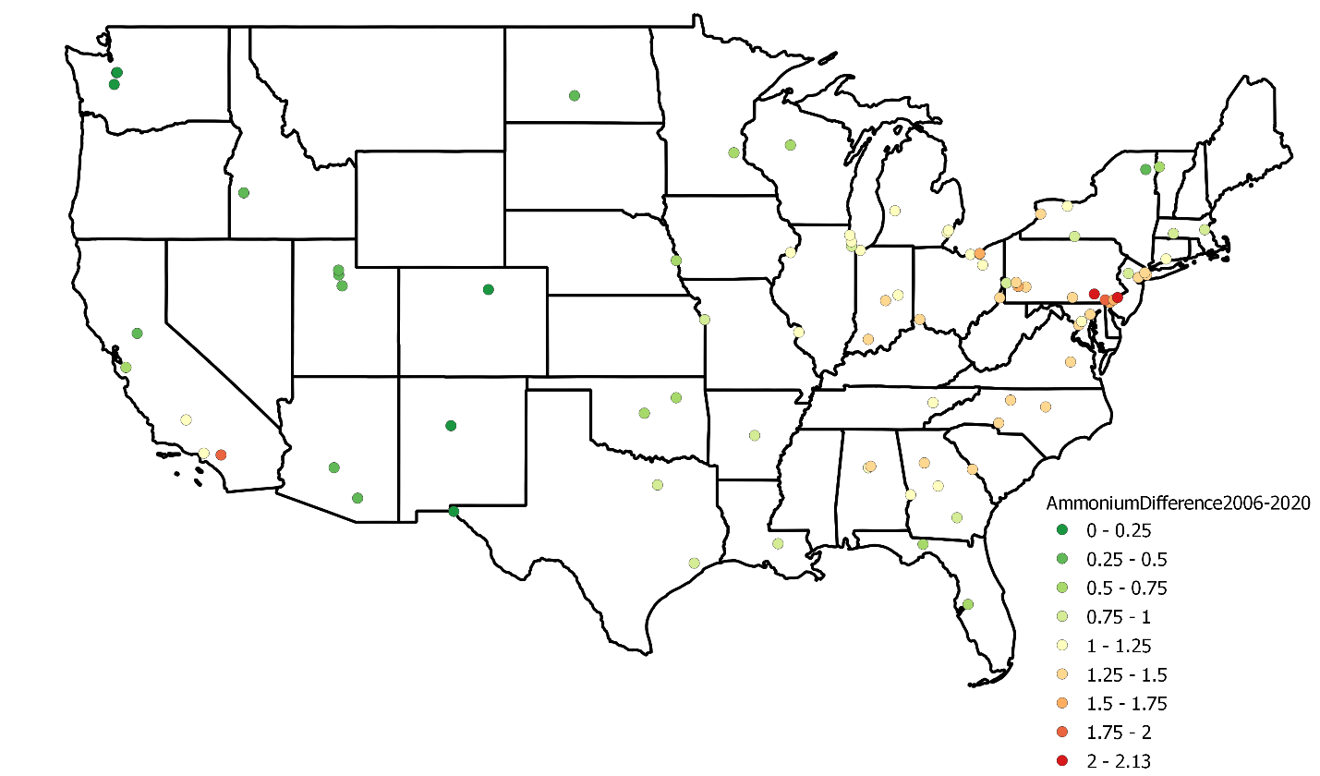
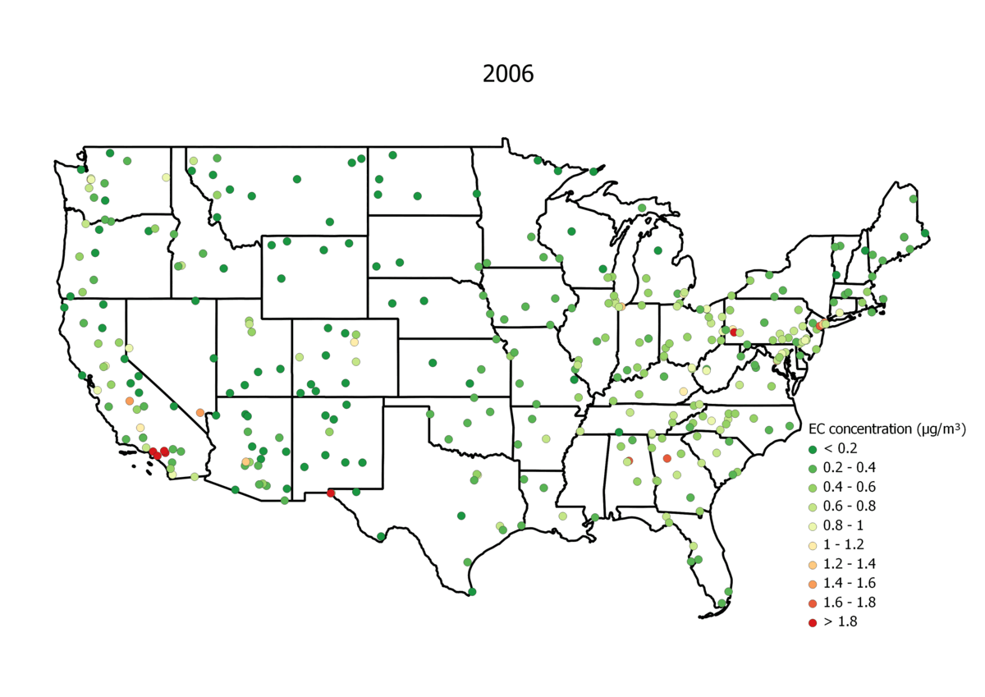
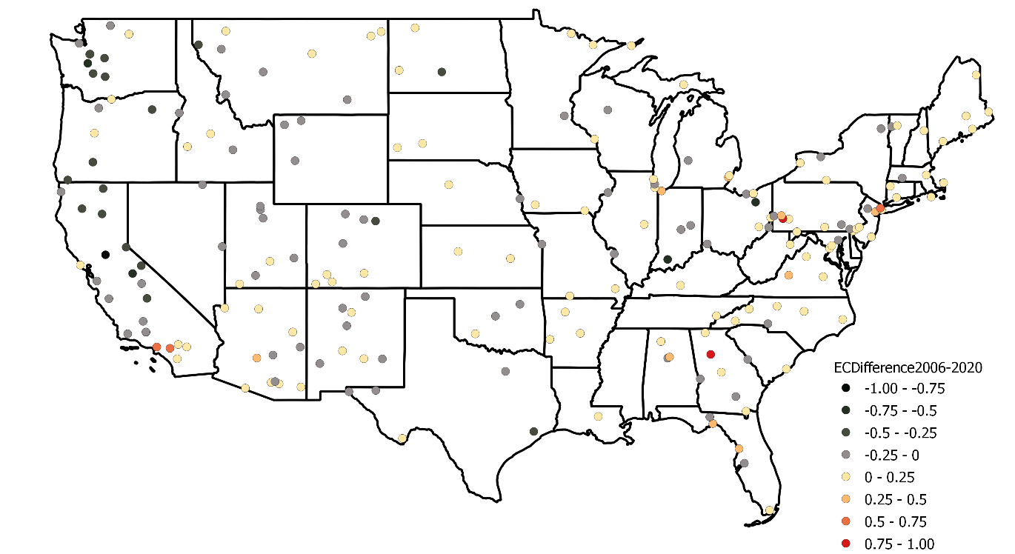
Spatiotemporal trend of NH₄⁺ & EC
ΔNH₄⁺ (2006 minus 2020)
NH₄⁺ (2006 to 2020)
ΔEC (2006 minus 2020)
EC (2006 to 2020)

Slide 19
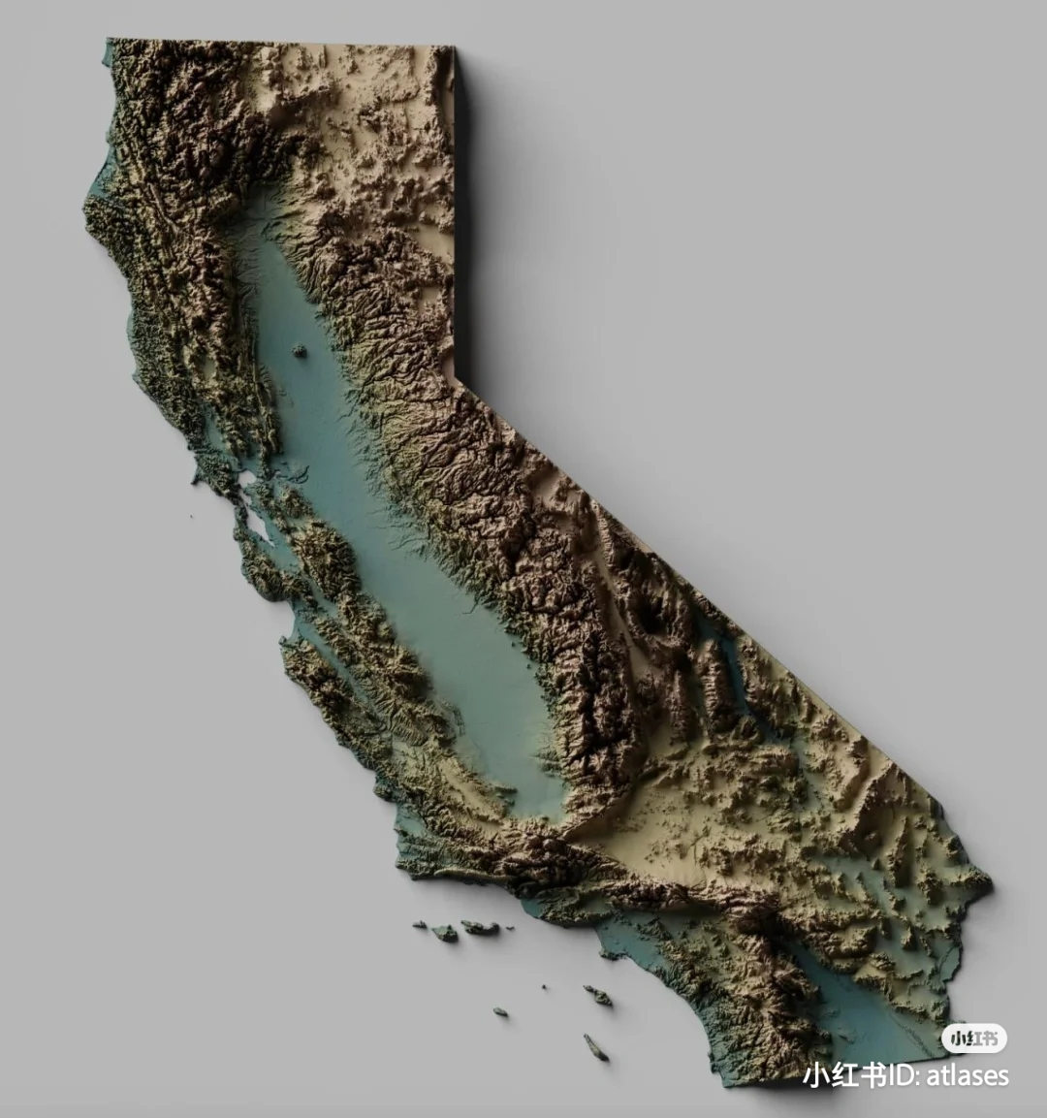
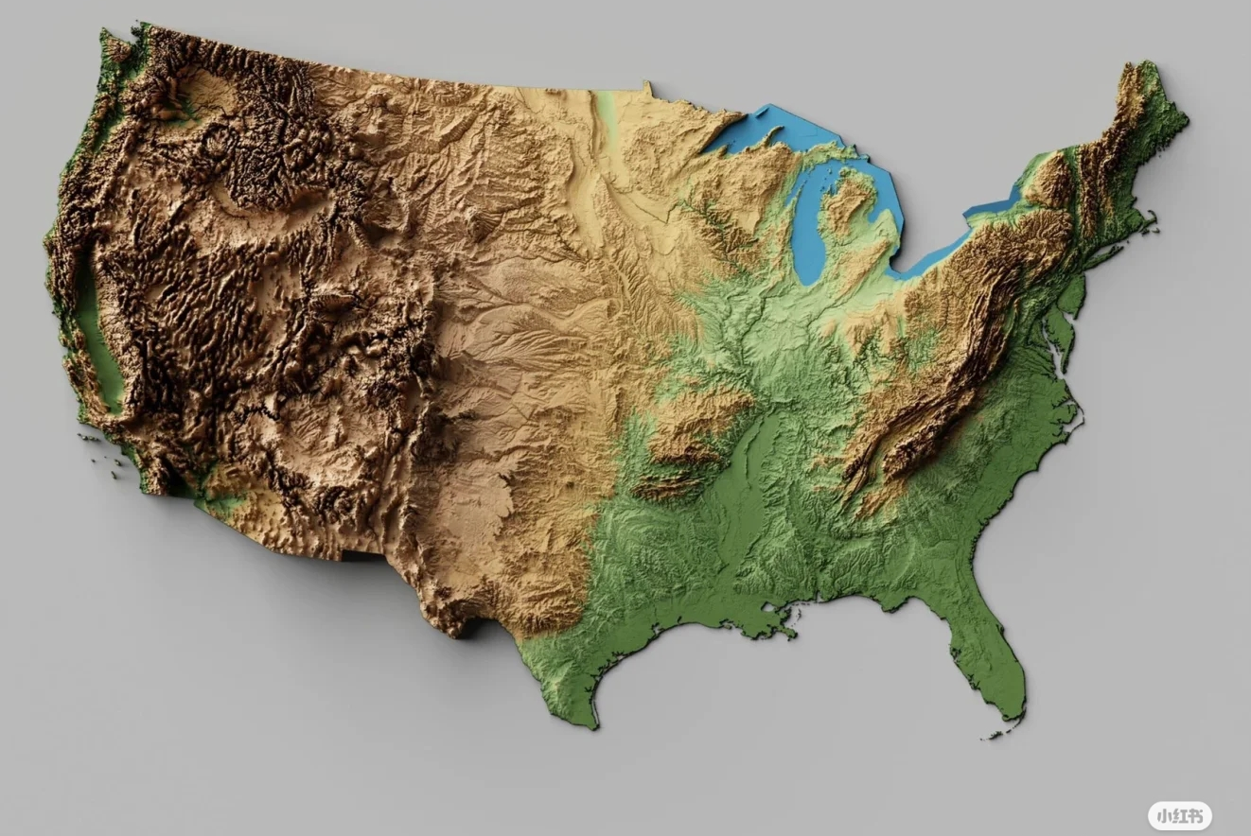
Topography
San Joaquin Valley
USA topography
CA topography

