Slide 1
Comparisons of Air Quality Models for Prescribed Burning Simulations at a Military Base in Southeastern United States
Zongrun Li, M. Talat Odman, Yongtao Hu,
Armistead G. Russell
School of Civil and Environmental Engineering,
Georgia Institute of Technology
A project funded by

Slide 2
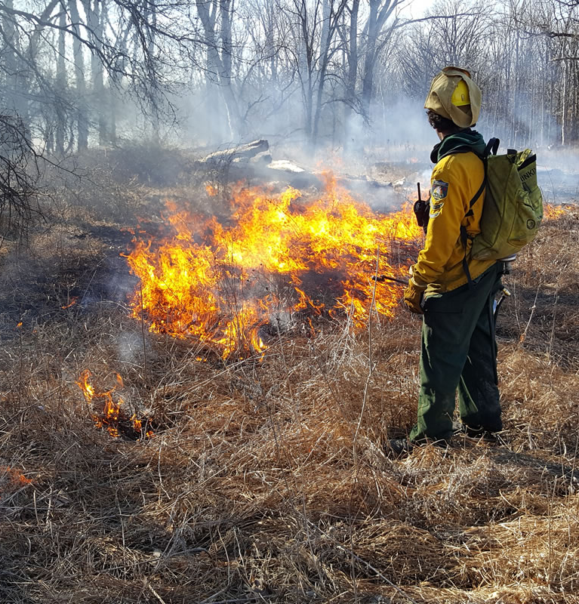
Background
Wildland fire:
Wildfire
Prescribed burning
Agricultural burning
Why investigate?
Increasing trend due to global warming.
As anthropogenic sources are controlled increasingly, contributions of burning to air pollution becomes more important.
Improve PM_{2.5} prediction and modeling.
Health and equity concerns
Notes:
What is prescribed burning:
Wildfires are hard to control and hazardous to human health and wealth.
So, people used prescribed burning to prevent wildfires and prescribed burning is expected has less hazardous than wildfires.

Slide 3
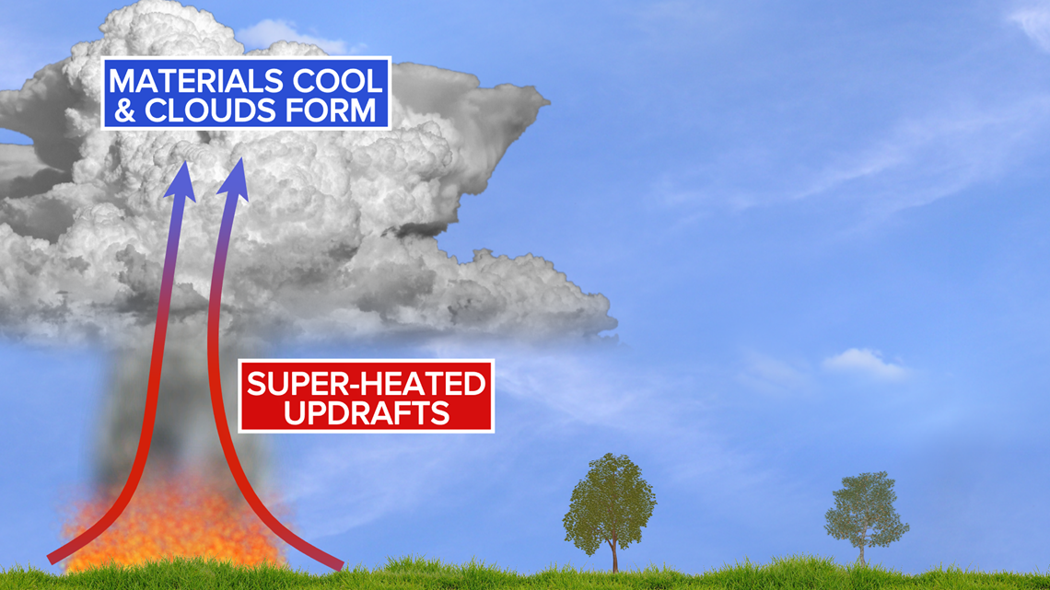
Challenges
Atmosphere
Wind (smoke transport), radiation (smoke composition)
Nuclei (superfog) affects latent heat release due to condensation. BC, BrC absorb radiation
Smoke
Wind, moisture
(fire spread, fire ignition)
Emits smoke (PM,
water vapor, etc.)
Heat flux (buoyancy) affects plume height
Water vapor,
heat flux, fire dominated local wind
Fire
Notes:
Although prescribed burning is worth to simulate, there are still many challenges behind prescribed burning simulations.

Slide 4
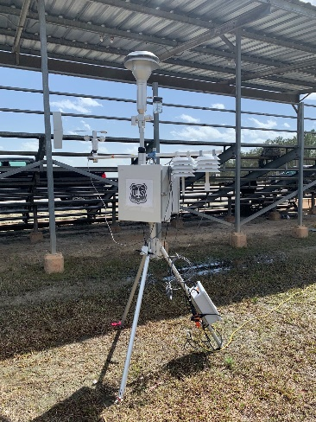
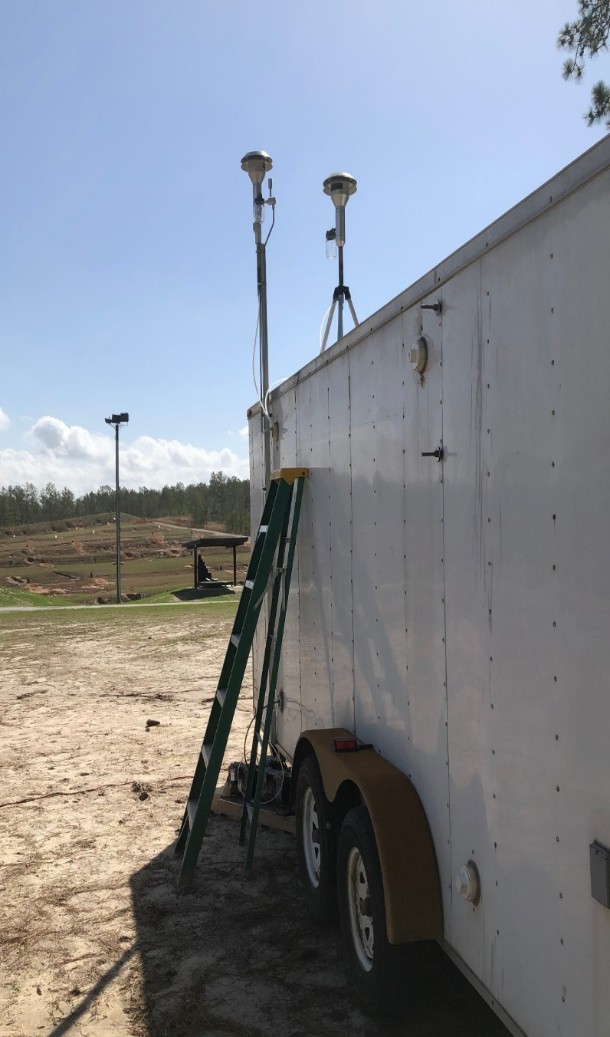
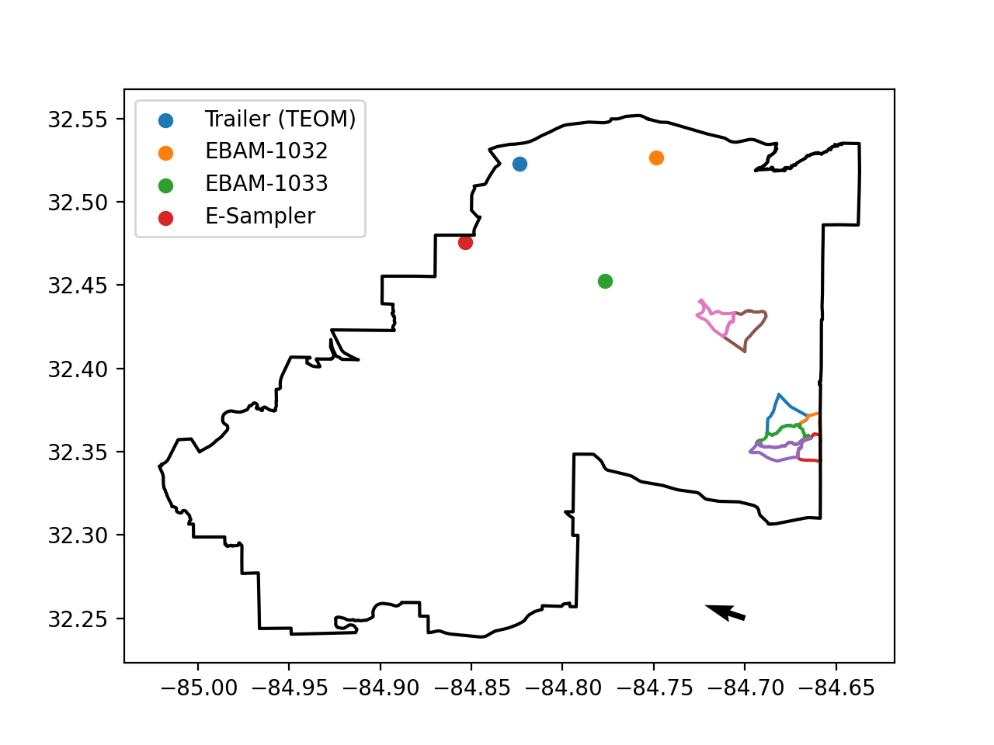
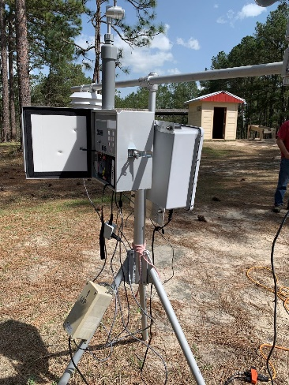
Method: Observations at Ft. Benning
Deployed one instrumented trailer and 2 E-BAMs, and 1 E-Sampler
E-BAMs and E-Sampler measure PM_{2.5} mass
March 23, 2021
E-BAM
Wind Direction
Trailer at Ft. Benning (Spring 2021)
E-Sampler
Notes:
Southeastern wind

Slide 5
Model | WRF-Fire (v4.2) | BlueSky-CMAQ (v5.3)
Type of Model | Eulerian coupled fire-atmosphere model | Eulerian chemical transport model
Ignition Method | Line ignition (drip torch) | -----
Start Time of Fires | GOES-16 | GOES-16
End Time of Fires | Bounded by burn unit boundary | GOES-16
Meteorology | 2D-Deformation (Mesoscale) | 2D-Deformation (Mesoscale)
 | 3D- adaptive TKE (higher resolution fire model domain)
Anthropogenic Emissions | -- | EPA 2016v1 platform
Biogenic Emissions | -- | Online BEIS (v3.14)
Fire Emissions | Online calculated based on LANDFIRE fuel type, Rothermel formula. Inert tracer for PM_{2.5}, CO, etc. | Hourly BlueSky (v4.3) Prichard-O’Neill emissions
Plume Rise | Plume is elevated by buoyancy. | FEPS plume rise model (Briggs plume top behavior)
 |  | SEV plume rise model
Chemistry | -- | CB6
Notes:
We are using 3D-Adaptive TKE in the higher-resolution fire model domain.

Slide 6
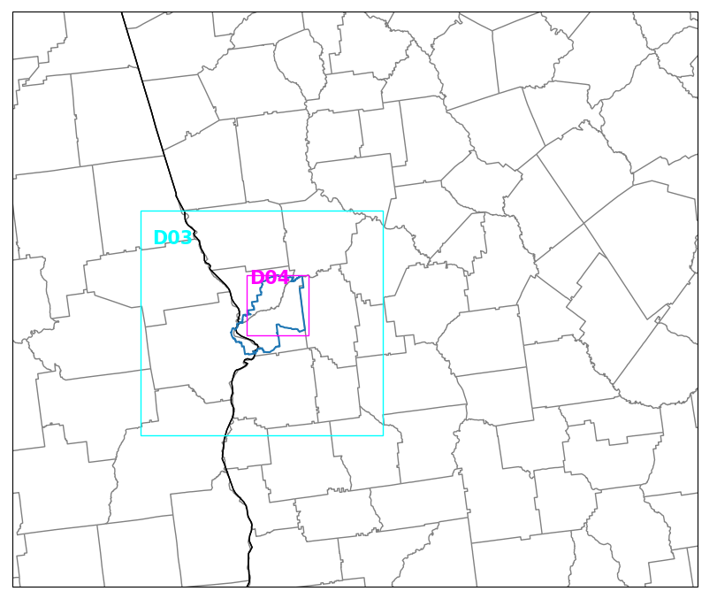
Model Setups
12km-4km-1km-200m
BlueSky-CMAQ uses 1km meteorology
WRF-Fire simulates fires at 200m domain

Slide 7
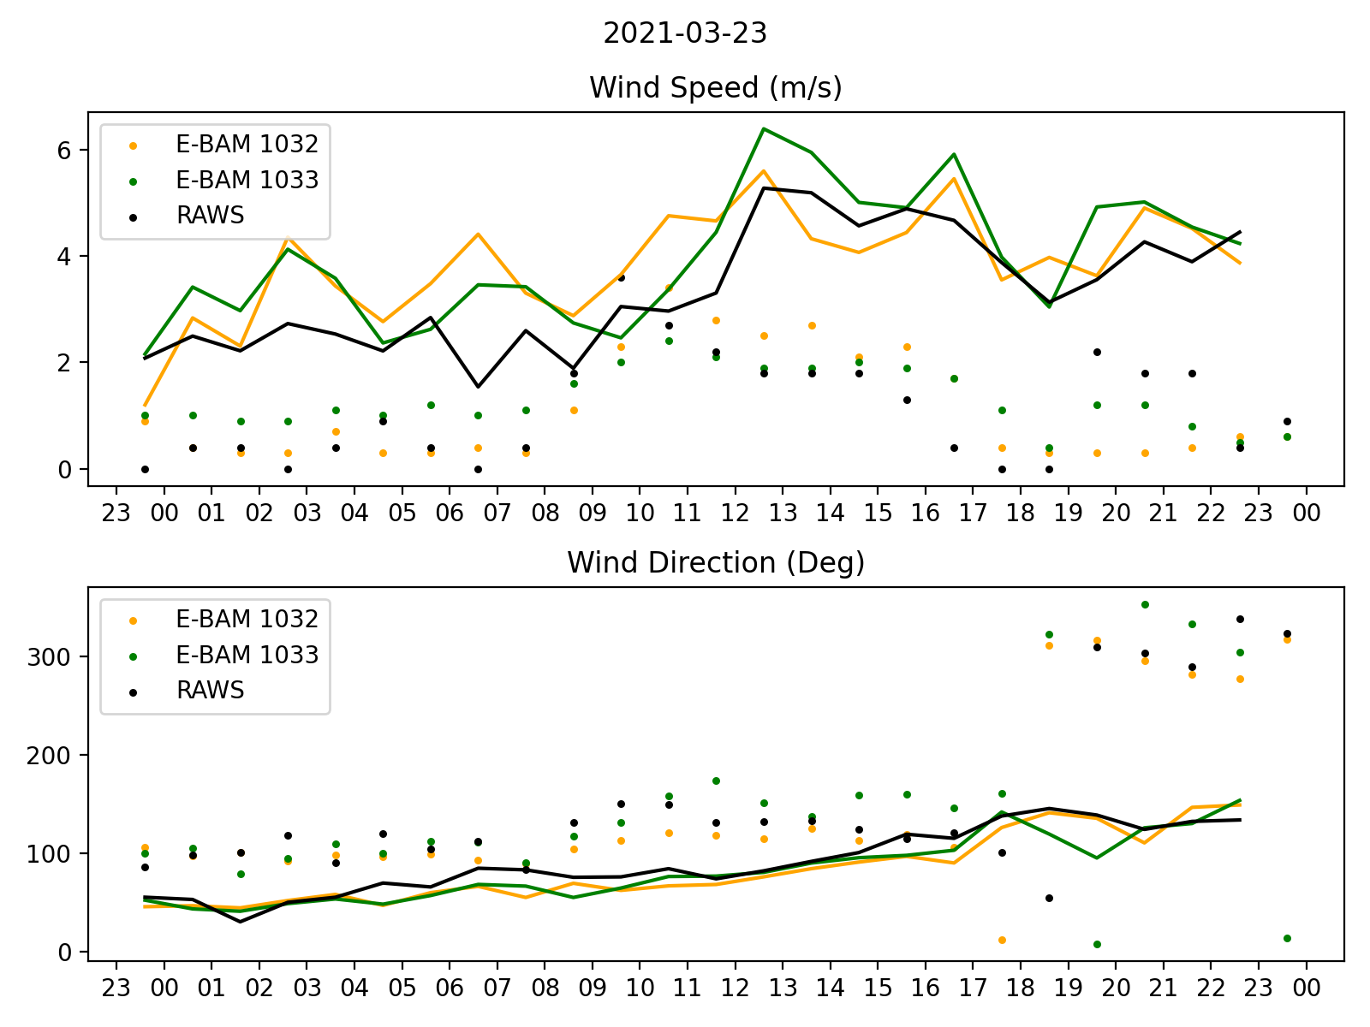
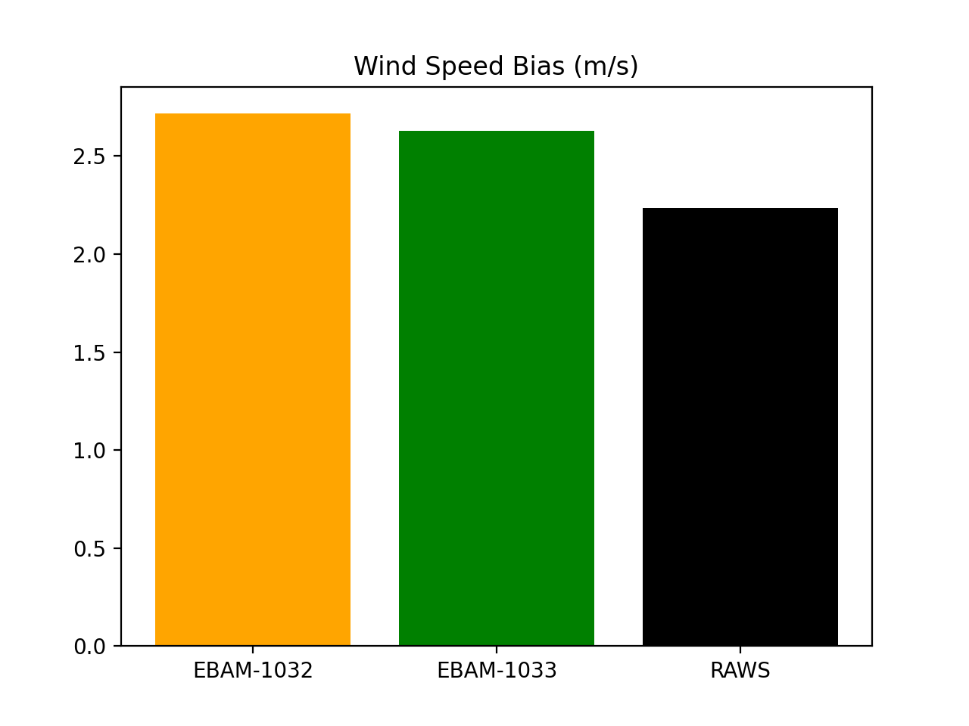
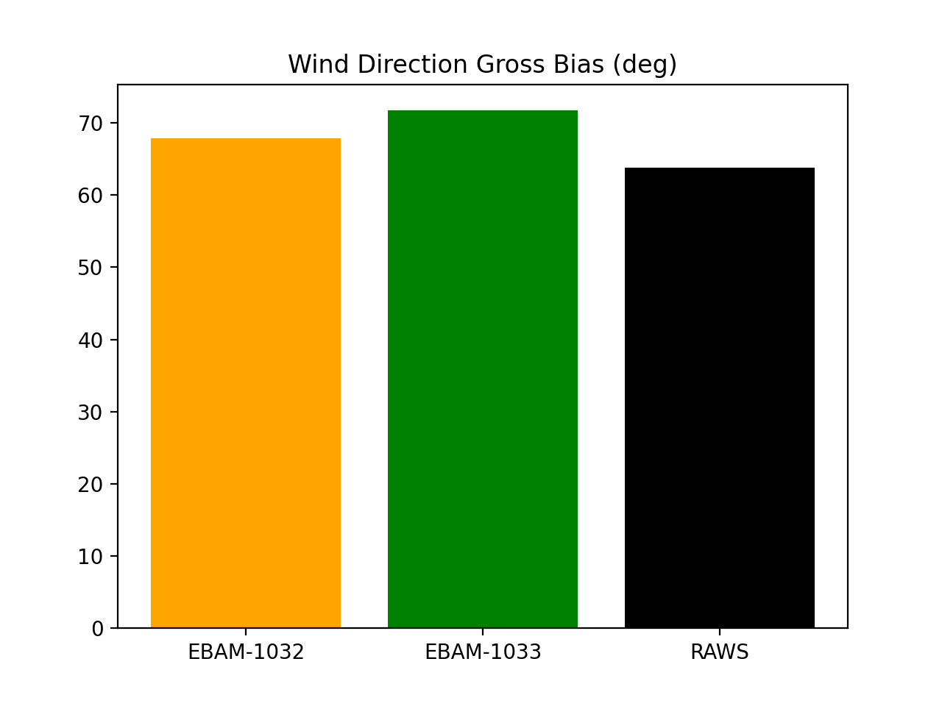
Results: Meteorological Modeling with WRF
WRF 1km Domain Wind
Bias = WRF-OBS
Dots: observations Lines: WRF results
Notes:
Firstly, we evaluate our meteorological result by comparing wind from WRF with observations.

Slide 8
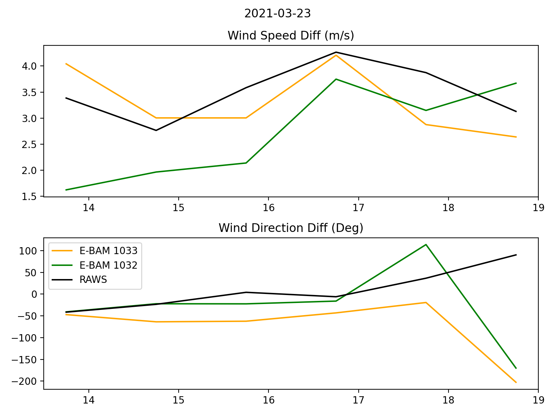
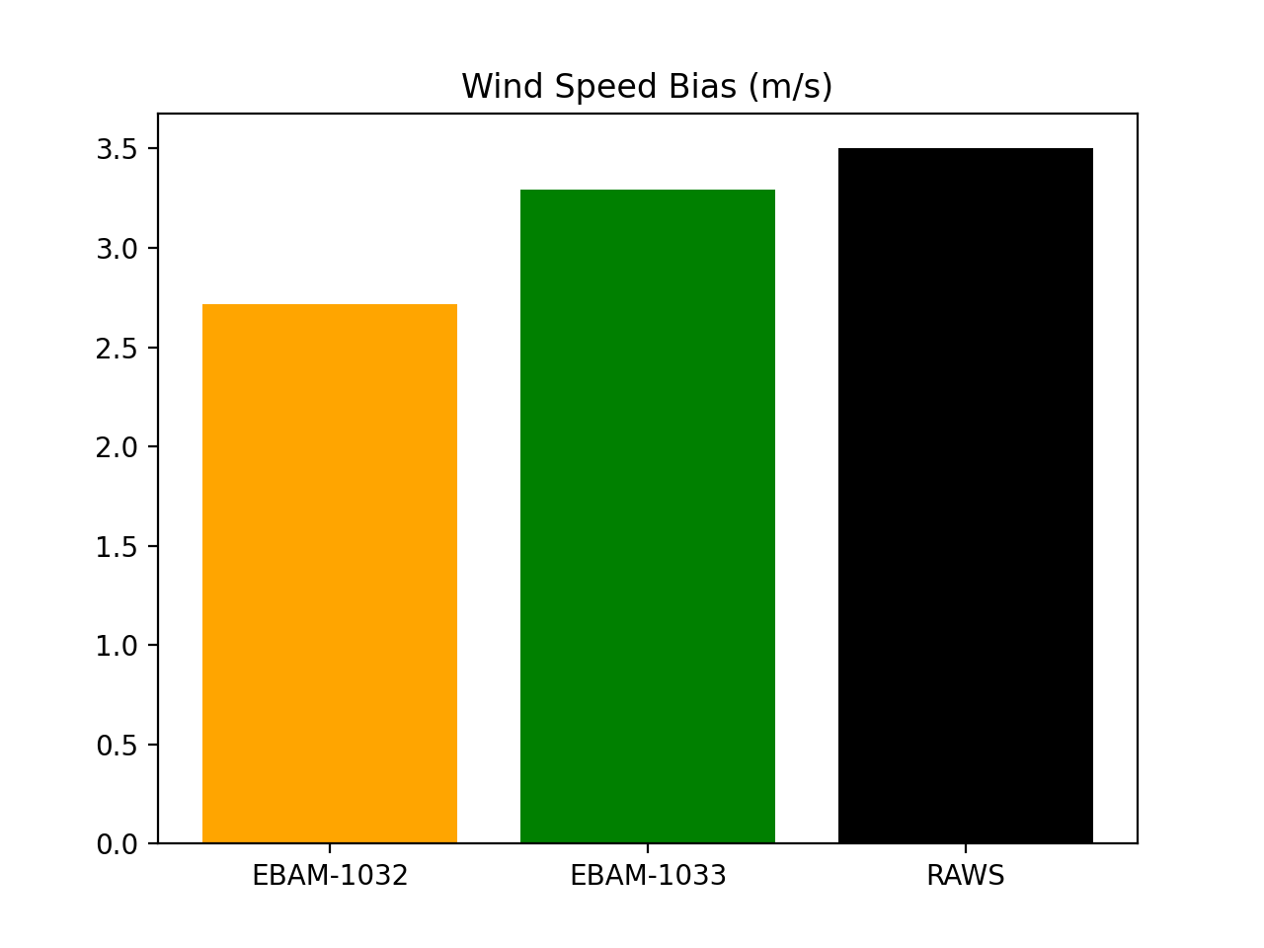
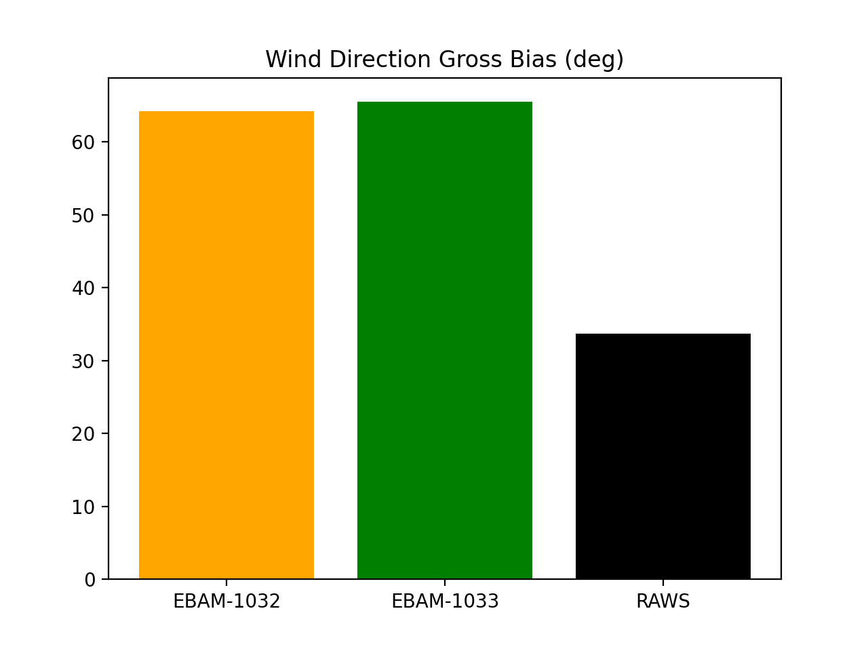
Results: Meteorological Modeling with WRF
Wind Bias (during burning from GOES-16) = WRF – OBS (14:00-19:00 UTC)
Bias = WRF-OBS
Notes:
Since we more care about the time period during the prescribed burning, we windowed the meteorology during prescribed burning and do the evaluation. We have 2-3 m/s wind speed bias and 30–60 degrees wind direction bias. While the main bias from wind direction is after 18 UTC.

Slide 9
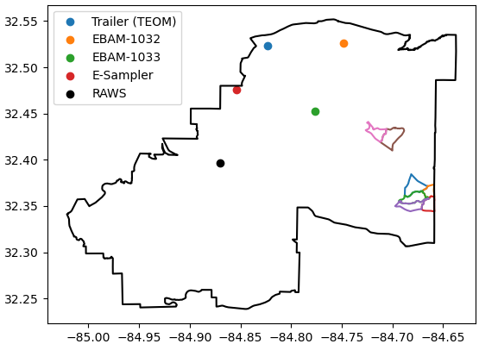
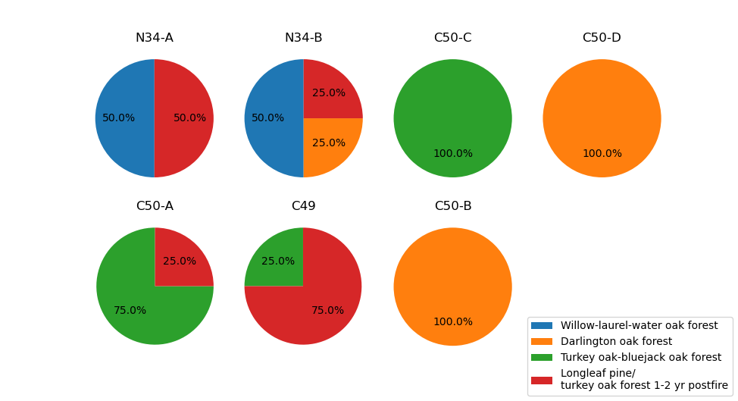
Modeling 23 March 2021 Burns
BlueSky Fuels (FCCS)
N34-A
N34-B
C49
C50-A
C50-B
C50-C
C50-D
WRF-Fire Fuels (LANDFIRE)
Notes:
For the comparisons of different fire models, I will start with the differences on emissions, plume height and then go to the 3d structure of simulated plume and concentrations of PM2.5 at monitors.
BlueSky uses FCCS (fuel characteristic classification system) 1km resolution. The system has more detailed fuel type classification in whole US. It includes hundreds of fuel types, and the system classifies them by ecosystem, fuel behavior, etc.
WRF-Fire uses LANDFIRE products which has 30m resolution. It has high spatial resolution while it does not have detailed classification of fuel type. It uses 13 Anderson Fire Behavior Fuel Models to classify the all fuels in US.

Slide 10
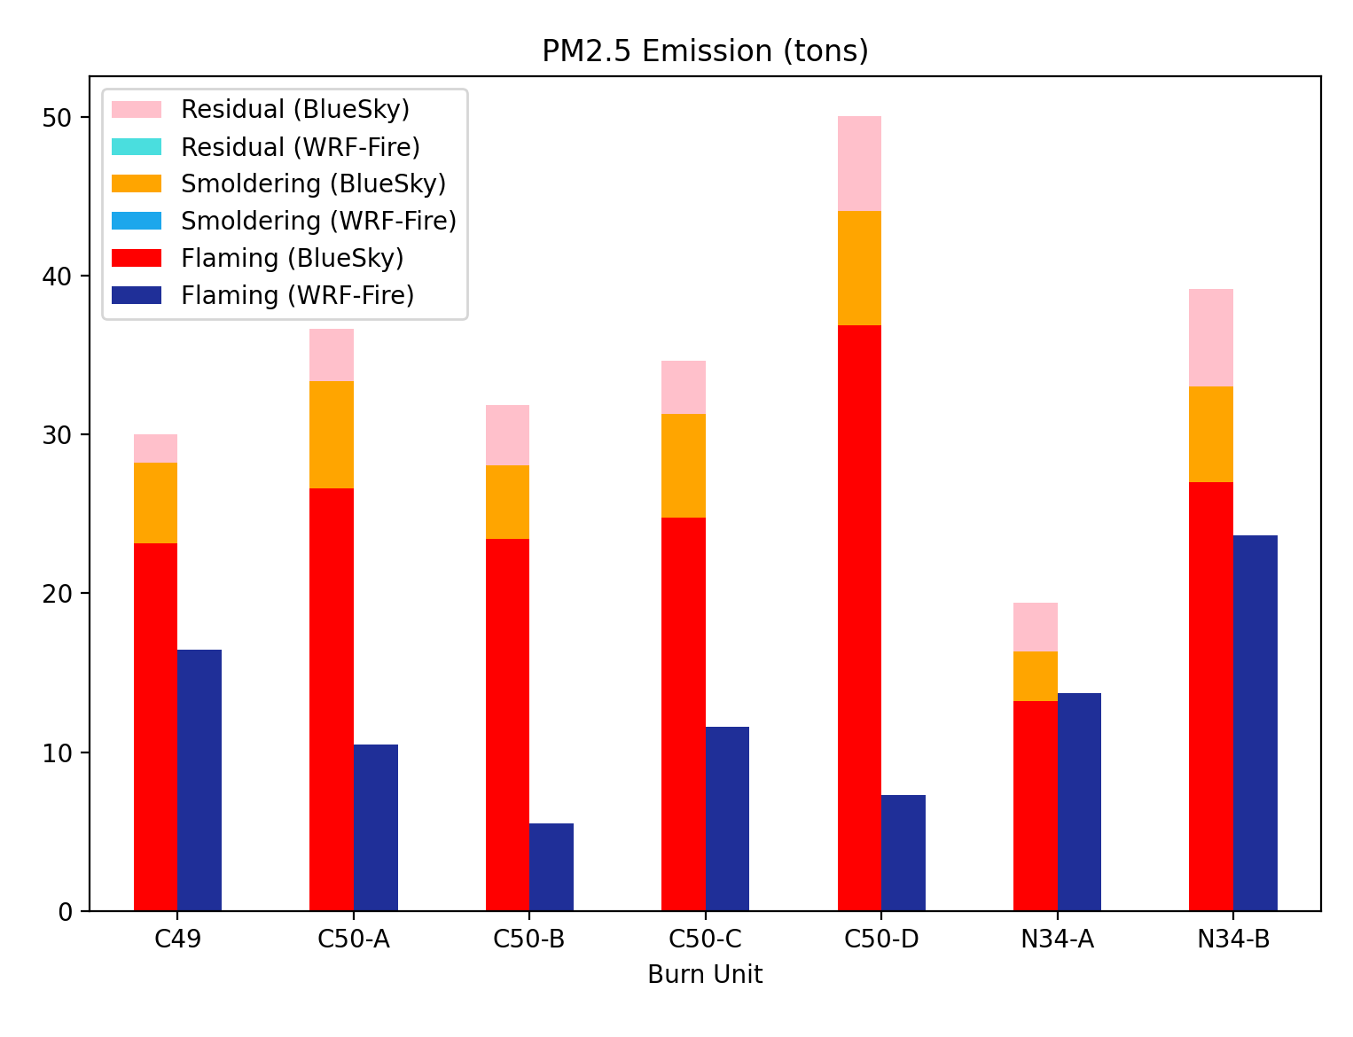
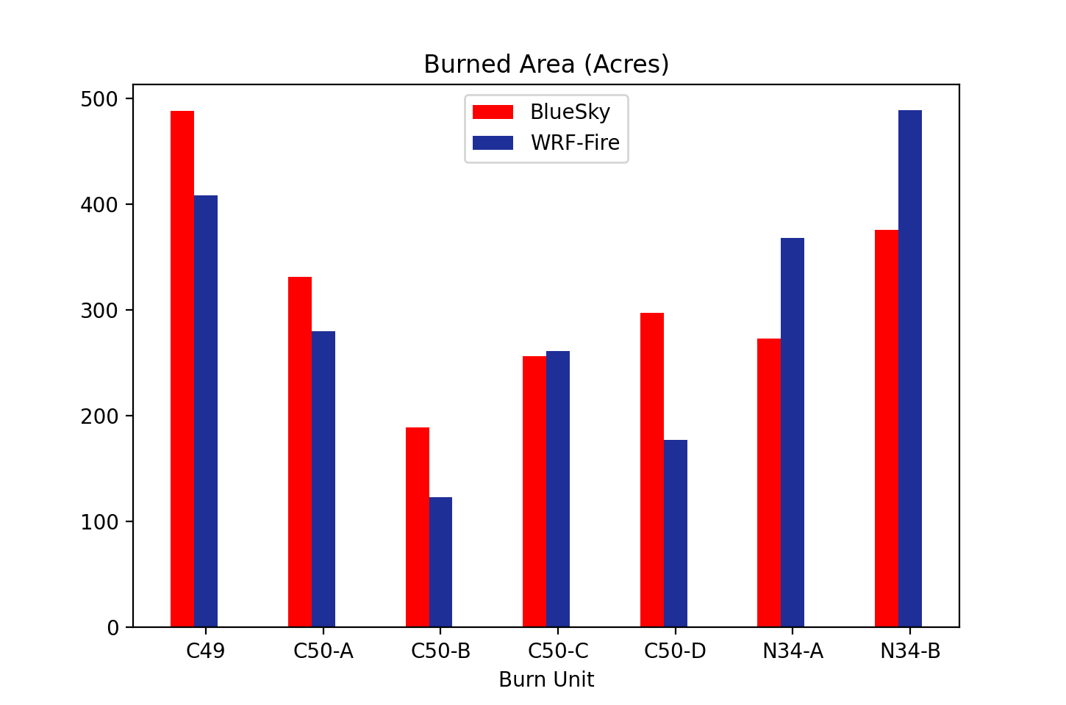
Results: Emissions Comparison
BlueSky
WRF-Fire only has flaming phase
WRF-Fire emission factors range from 5.4 to 13.0 g/kg for different fuel types
BlueSky emissions are based on SERA (Smoke Emissions Reference Application). PM_{2.5} emission factor has mean value of 26.0 g/kg (standard deviation 39.3 g/kg).
WRF-Fire
BlueSky
WRF-Fire
WRF-Fire burned region is bounded by the fuel.
BlueSky can directly intake the burned area from burning records.
Notes:
We compared the emissions and burned area by each burned unit. As we can see, WRF-Fire has lower PM2.5 emissions than BlueSky. The differences can be explained by several aspects:
1. phase
2. emission factor
3. Burned area

Slide 11
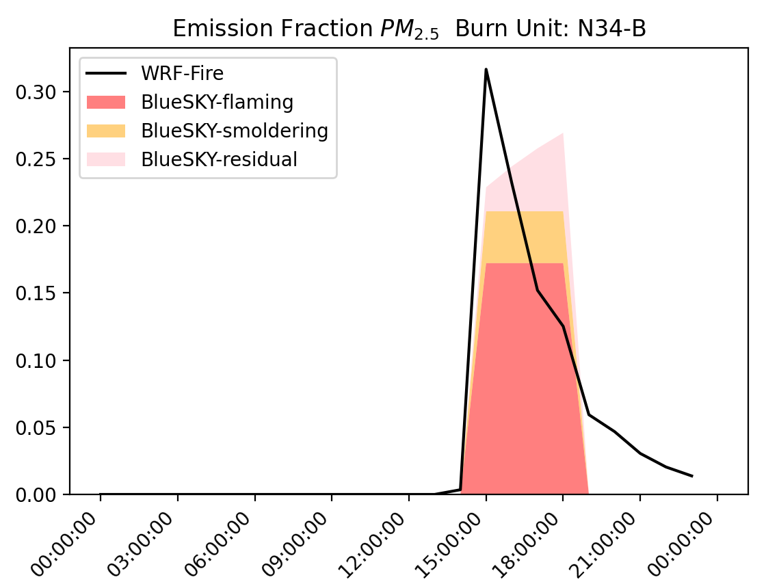
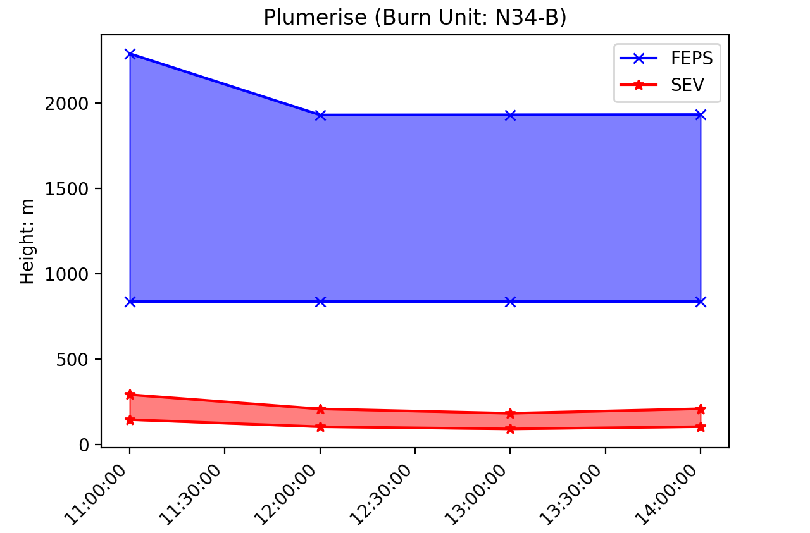
Time Profile and Vertical Profile
WRF-Fire time profile and smoke height are related to fire spread rate and emitted heat flux.
BlueSky time profile and vertical distribution are uniform.
FEPS plume height is highest, followed by WRF-Fire and SEV.

Slide 12
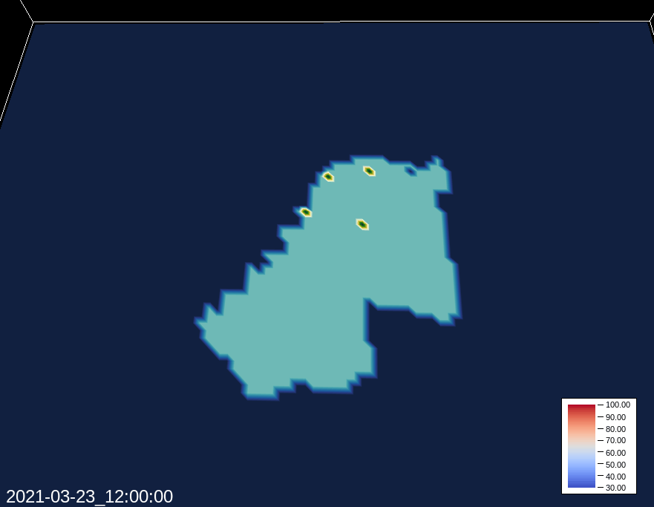
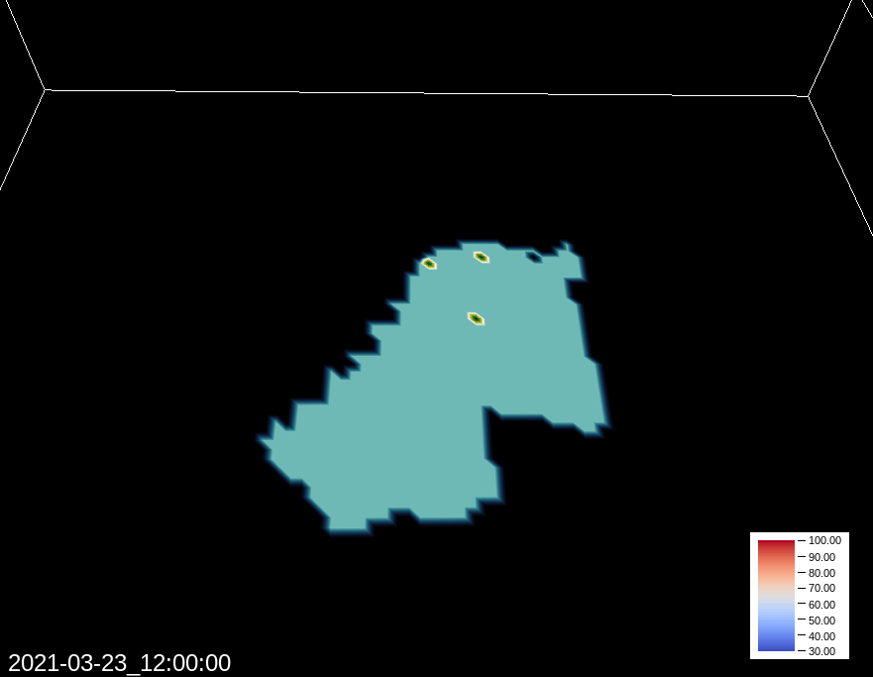
3D Structure of PM_{2.5}
CMAQ FEPS PM_{2.5} TOT
CMAQ SEV PM_{2.5} TOT
Notes:
We visualize the 3D structure of PM2.5 by Vapor software. As we can see, although we use the same meteorology condition, the smoke direction is still different since they have differences in vertical structure. The wind direction can be different in different vertical layers.

Slide 13
3D Structure of PM_{2.5}
Notes:
Here is the WRF-Fire simulation results. We have more sub plumes structures in each burned region since we conduct a more complex ignition method which is line ignition. While BlueSky CMAQ framework uses a point source assumption.

Slide 14
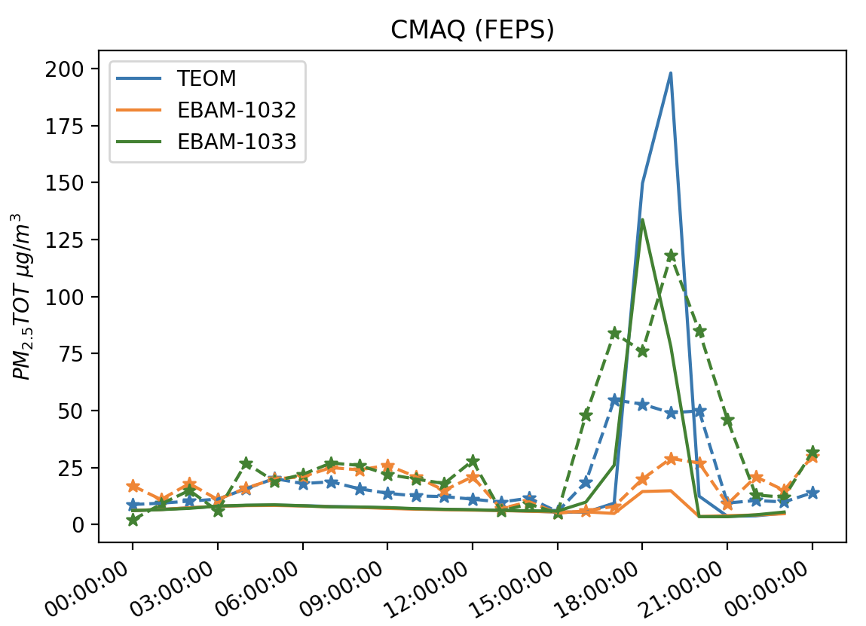
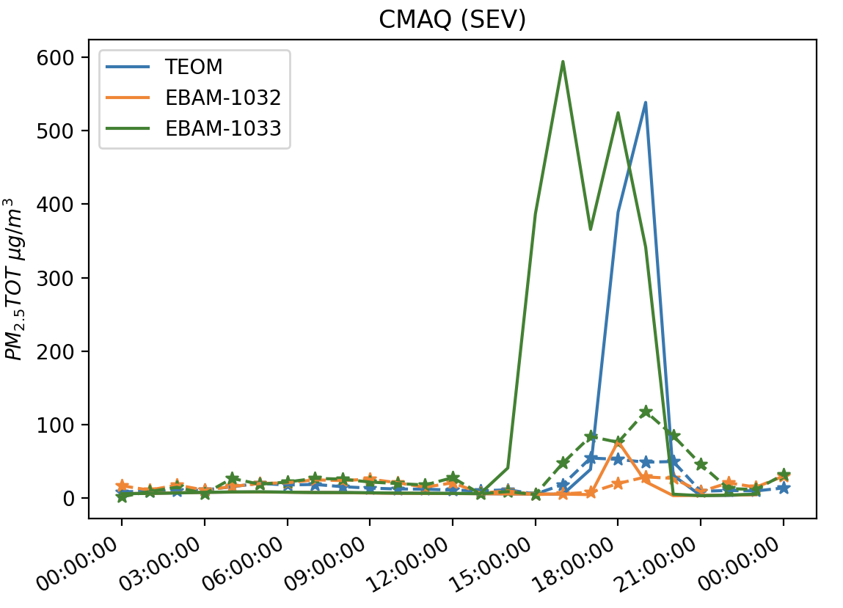
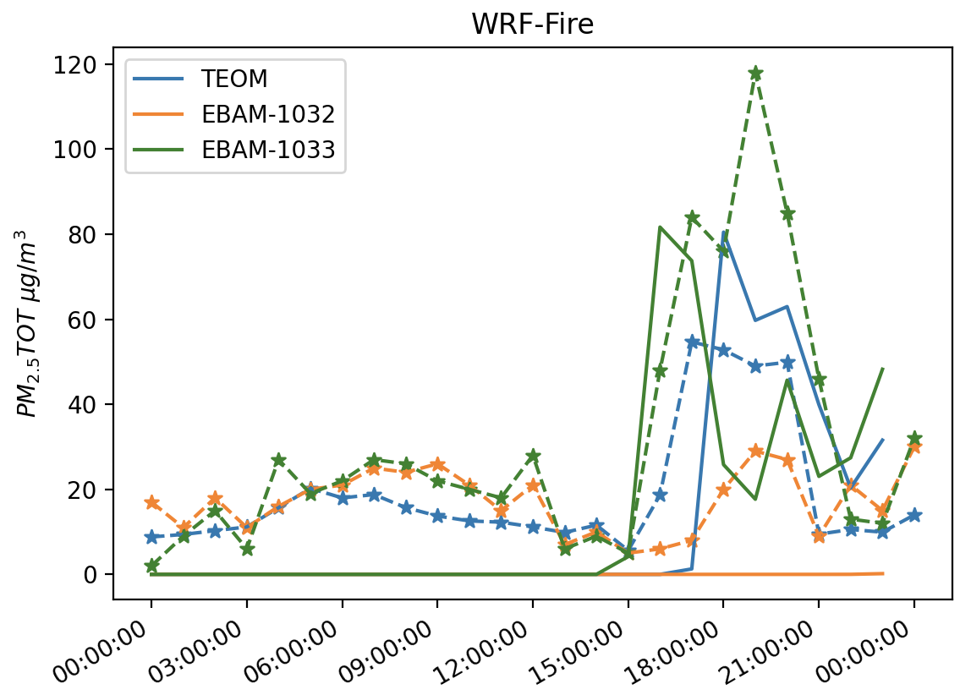
Results: Comparisons with Measurements
200
PM_{2.5}
600
120
Notes:
CMAQ-FEPS captures the PM2.5 peaks at three monitors. The peak start time is later than observations. It because that smoke needs more time to diffuse to the ground in FEPS due to high plume height. The highest PM2.5 concentration is higher than observations. Maybe because of emission is overestimate or the uniform emission profile is not realistic, and it overestimates the fire emissions after ignition.
SEV PM2.5 concentration peaks at all three monitors but the performance is worse than FEPS. The peak start time is earlier than observations. It because CMAQ does a linear interpolation of emissions. If we input hourly emissions, it starts 1 hour earlier than our input due to interpolation. The model has highest PM2.5 concentration at peak. It can be partly explained that the plume is near ground. Also, it has lower differences between plume bottom and plume top which makes the smoke emission more condensed than FEPS.
WRF-Fire successfully simulate two peaks at TEOM and EBAM-1033. Comparing to FEPS, the start time of peak at EBAM-1033 is closer to observation. But we miss a PM2.5 peak at EBAM-1032. Also, EBAM-1033 second peaks is not as high as observation. Notice that we have high differences at wind direction at late afternoon. It can partly explain the differences between WRF-Fire and observations.

Slide 15
Conclusion
BlueSky-CMAQ and WRF-Fire for prescribed burning simulation have discrepancies on time profile, vertical profile and intensity of emissions.
Wind direction and wind speed are important for both prescribed burning simulation frameworks. We need to pay more attention to the winds besides ground wind.
We are considering to use observation nudging
Both frameworks have advantages / disadvantages for advising fire managers.
WRF-Fire is more accurate but computationally expensive.
BlueSky-CMAQ considers different phases of fire emissions but cannot simulate complex ignition methods.
Notes:
BlueSky-CMAQ plume rise model are too simple for applying different ignition methods. It cannot help fire manager to know which method could be mitigate the air pollution impact related to prescribed burning. WRF-Fire is computational consuming (32 times than CMAQ), and the emission estimation is unrealistic (lack of smoldering phase); emission factor for each fuel type needs field experiments to measure. There is no general emission factor for these 13 Anderson fuel model. As we know, the emission factor can be different even for the same fuel at different latitude.
So, there is still enough work need to do for the prescribed burning simulations.

Slide 16
Thanks for Listening!

Slide 17
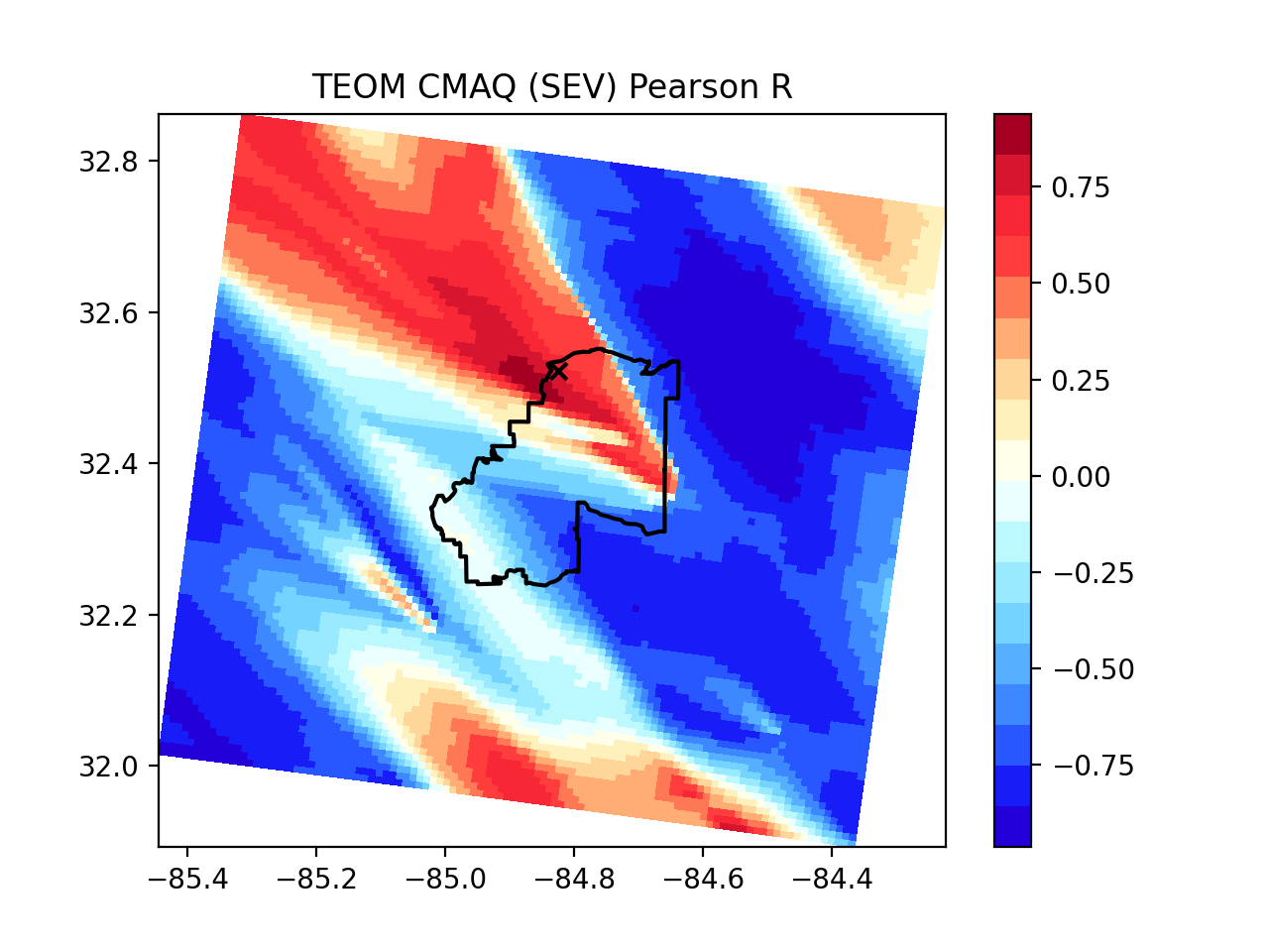
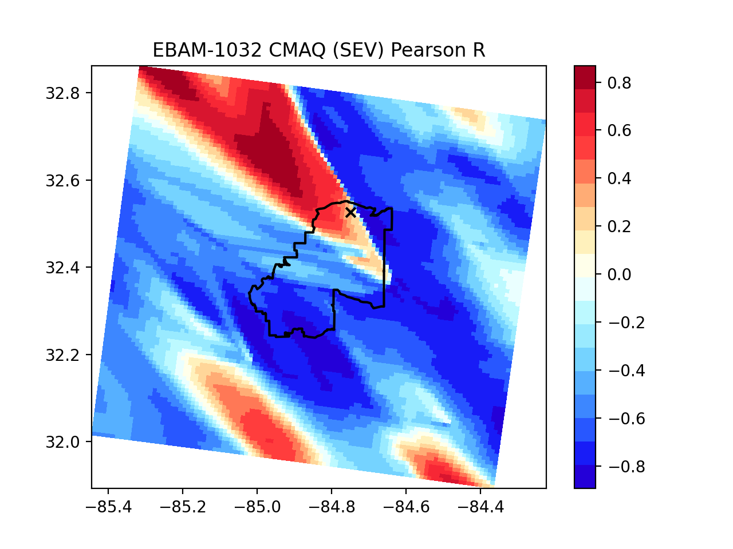
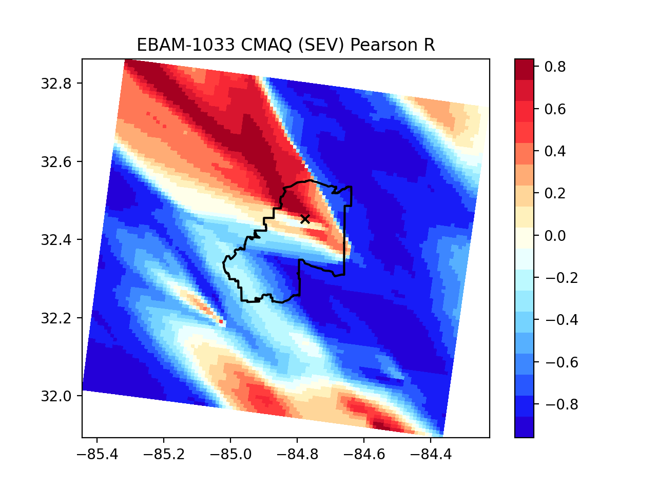
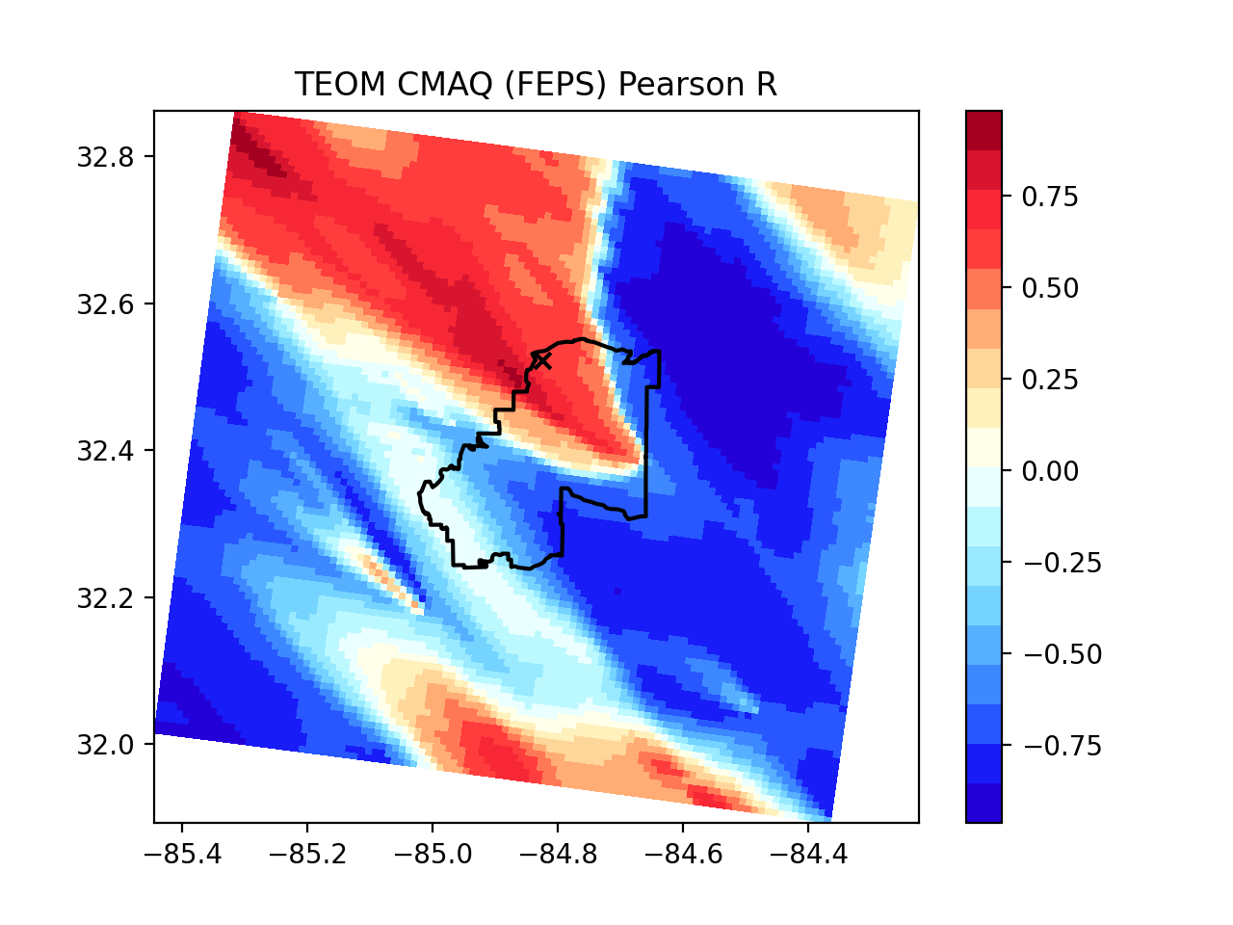
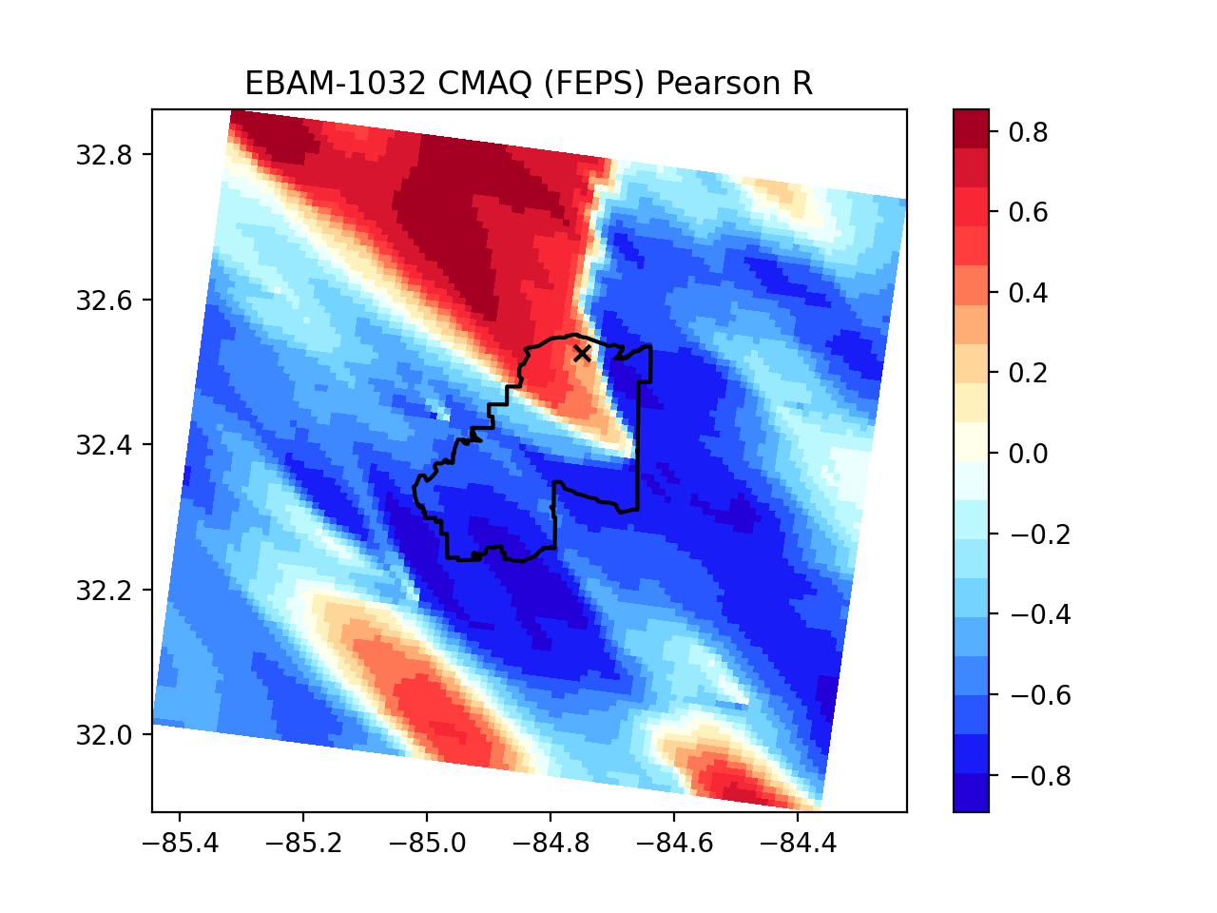
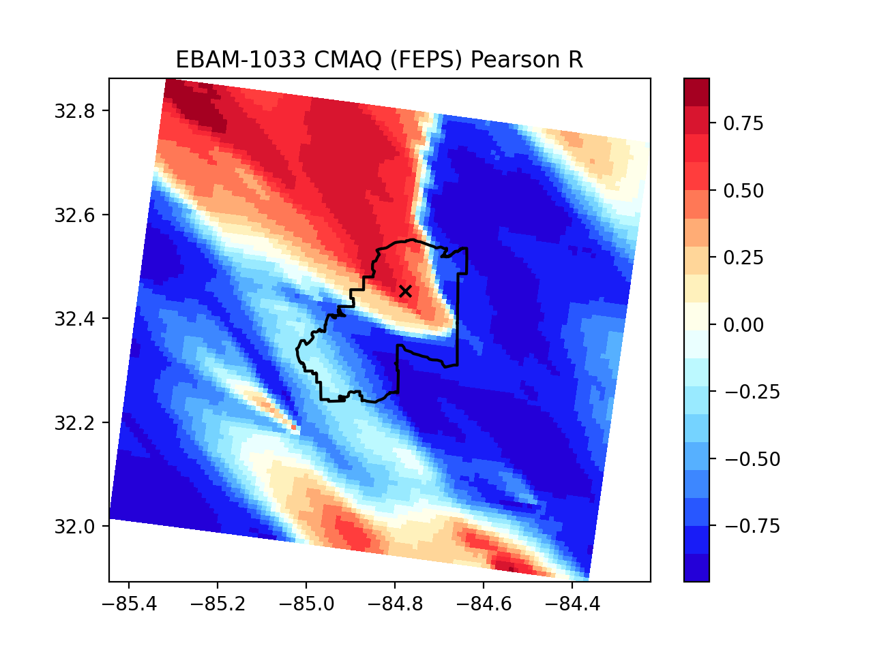
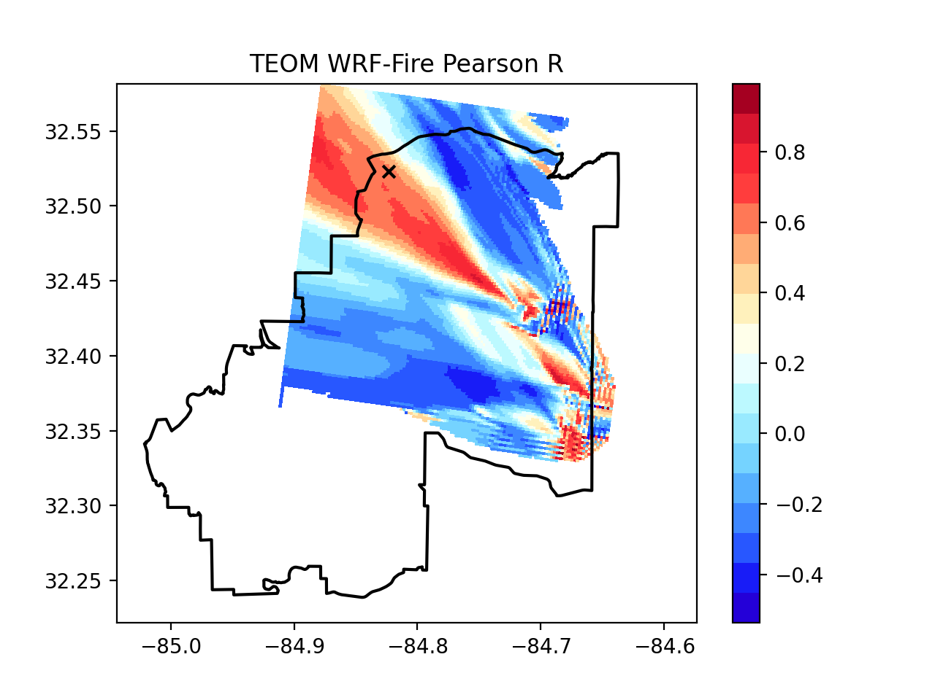
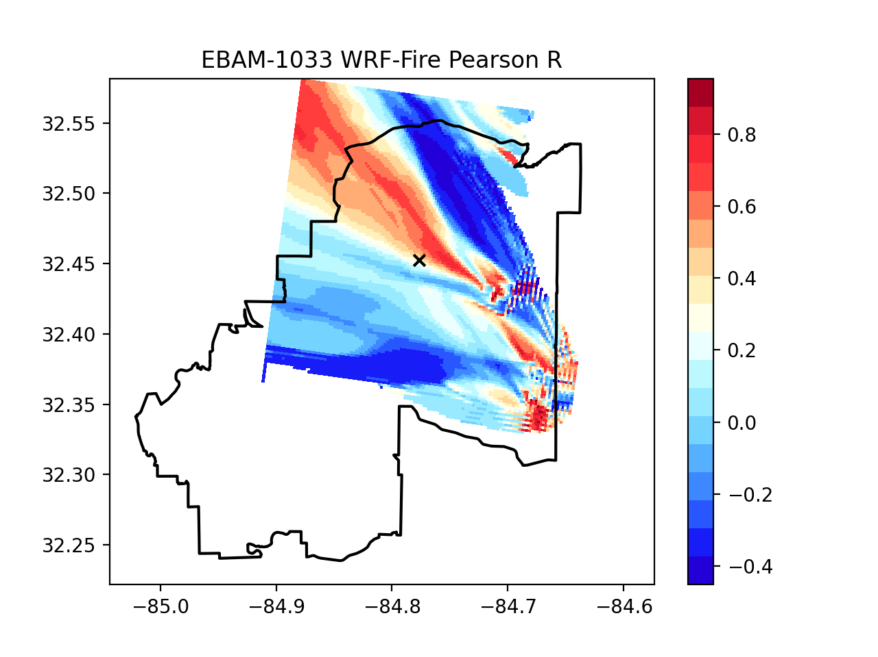
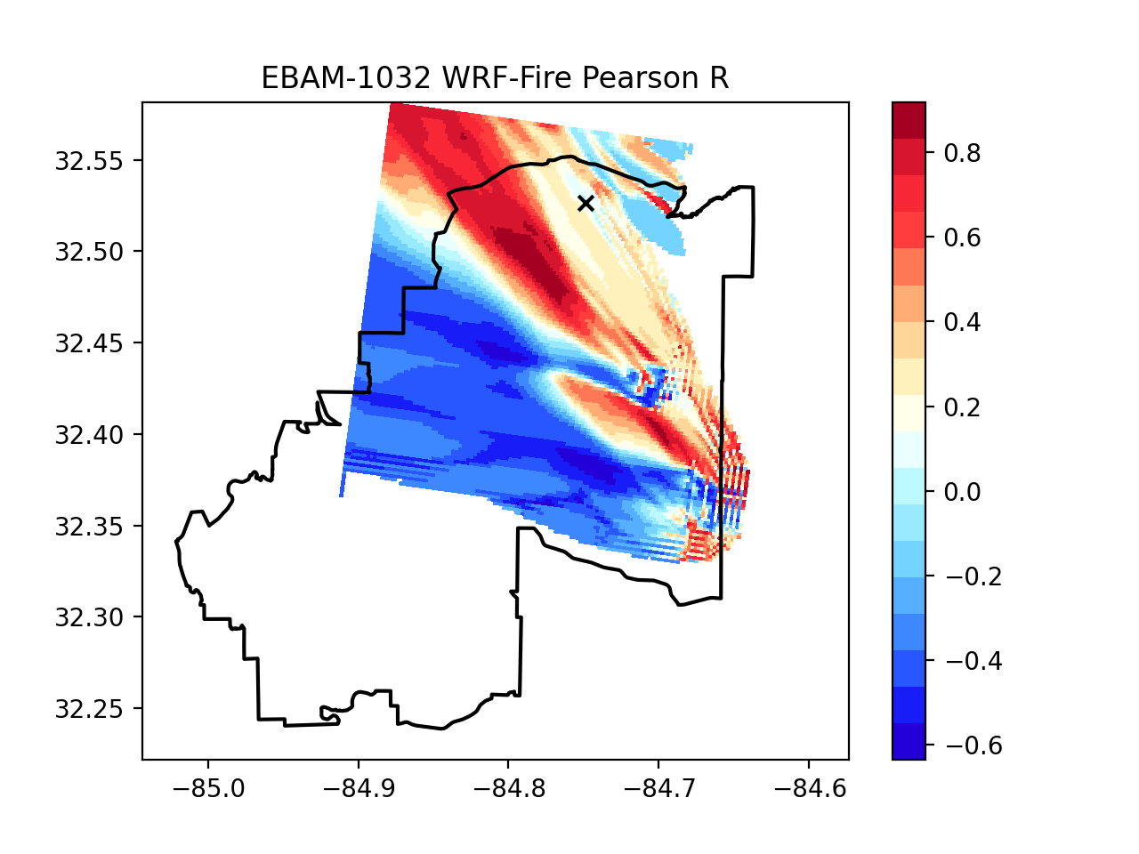
How wind important?
Notes:
Perturb the monitor location
Simply rotate the monitor location does not consistently improve the result
1. Wind direction bias changed hour by hour.
2. Upper layers’ wind could affect the result.
3. Rotation of monitor could change the original relative location between monitor and sources when we have multiple sources. If the resolution is coarse and sources are close to each other, different sources impact could be considered as one source. When the resolution is fine and the site close to the sources, it could have problems.

Slide 18
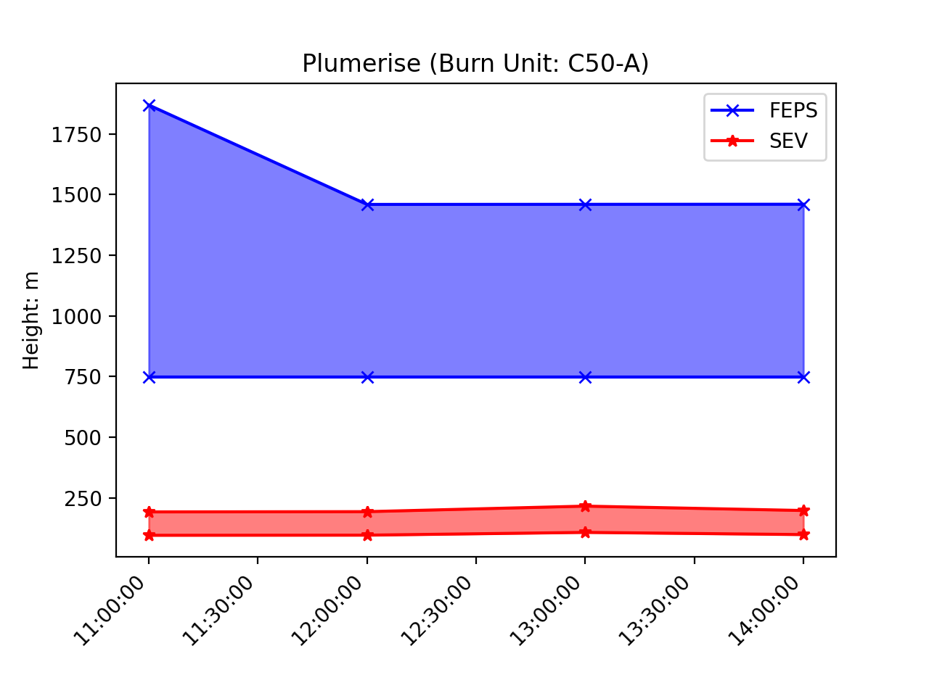
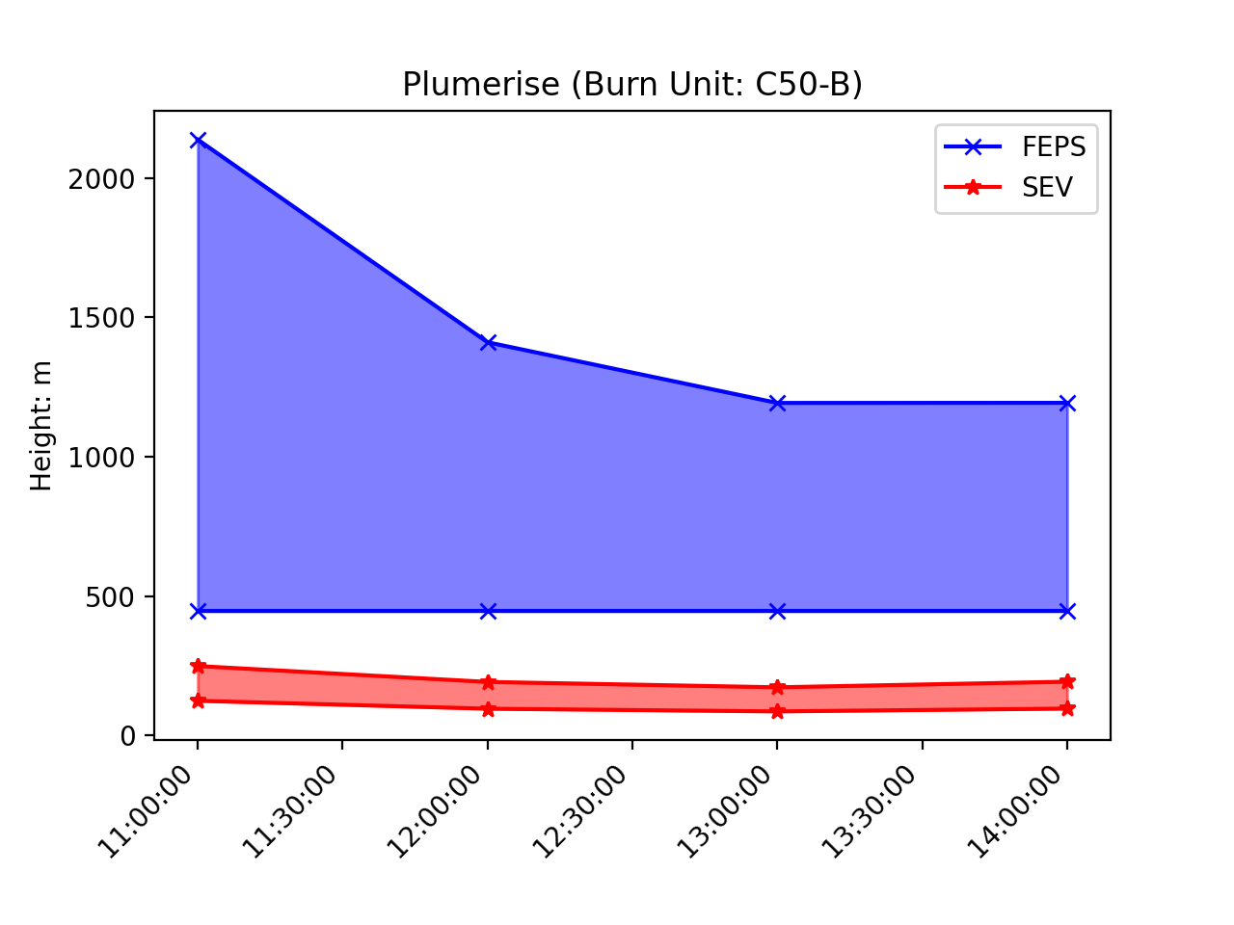
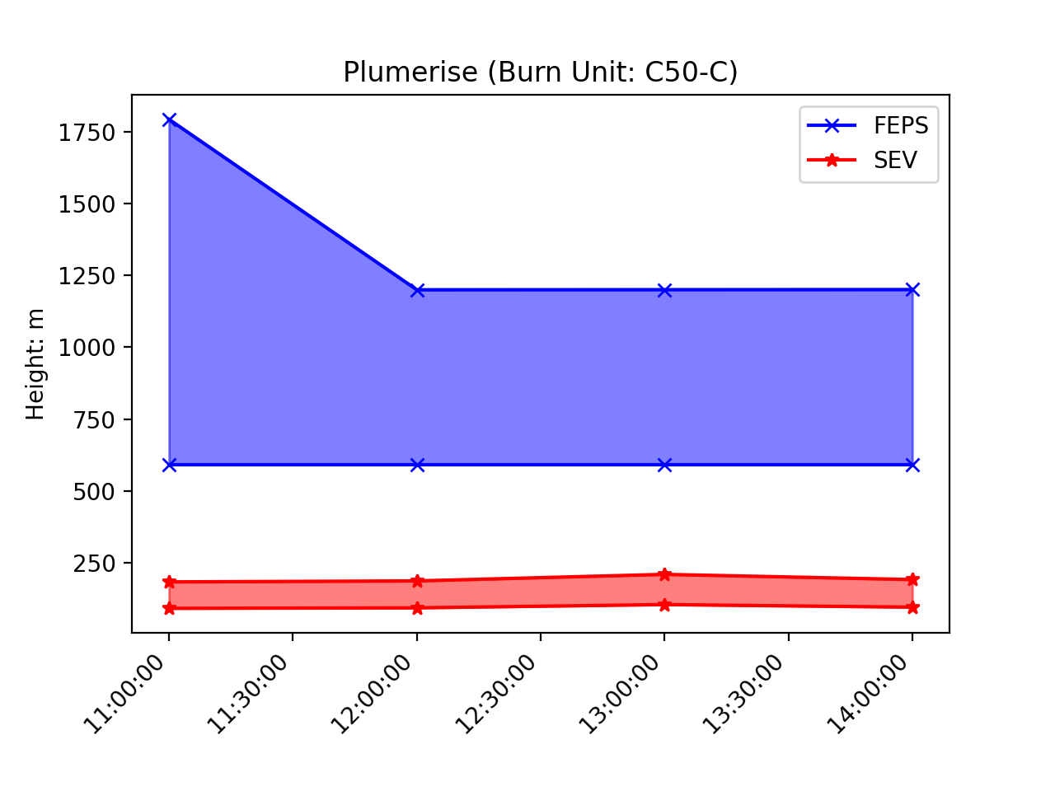
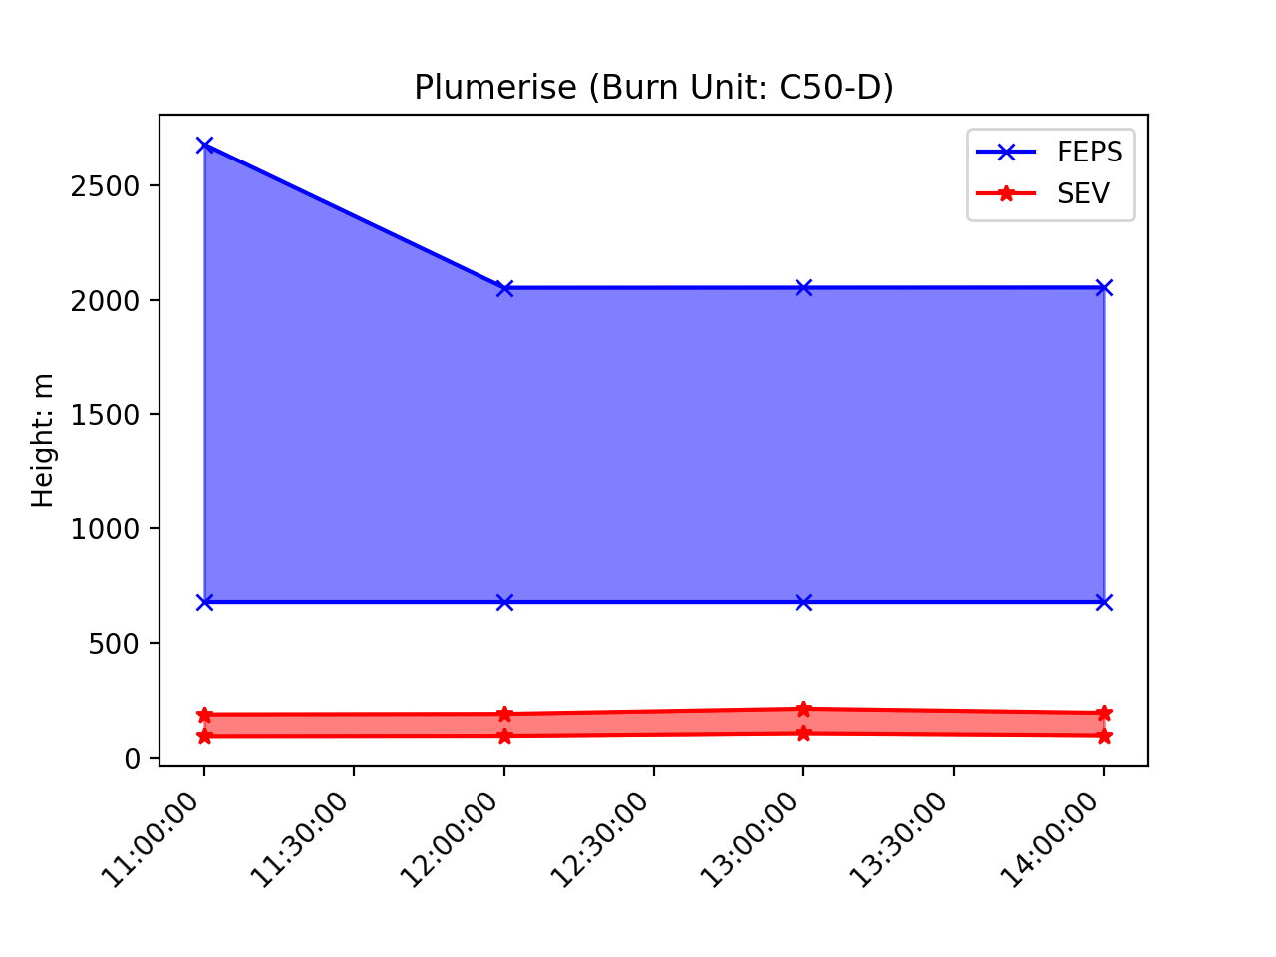
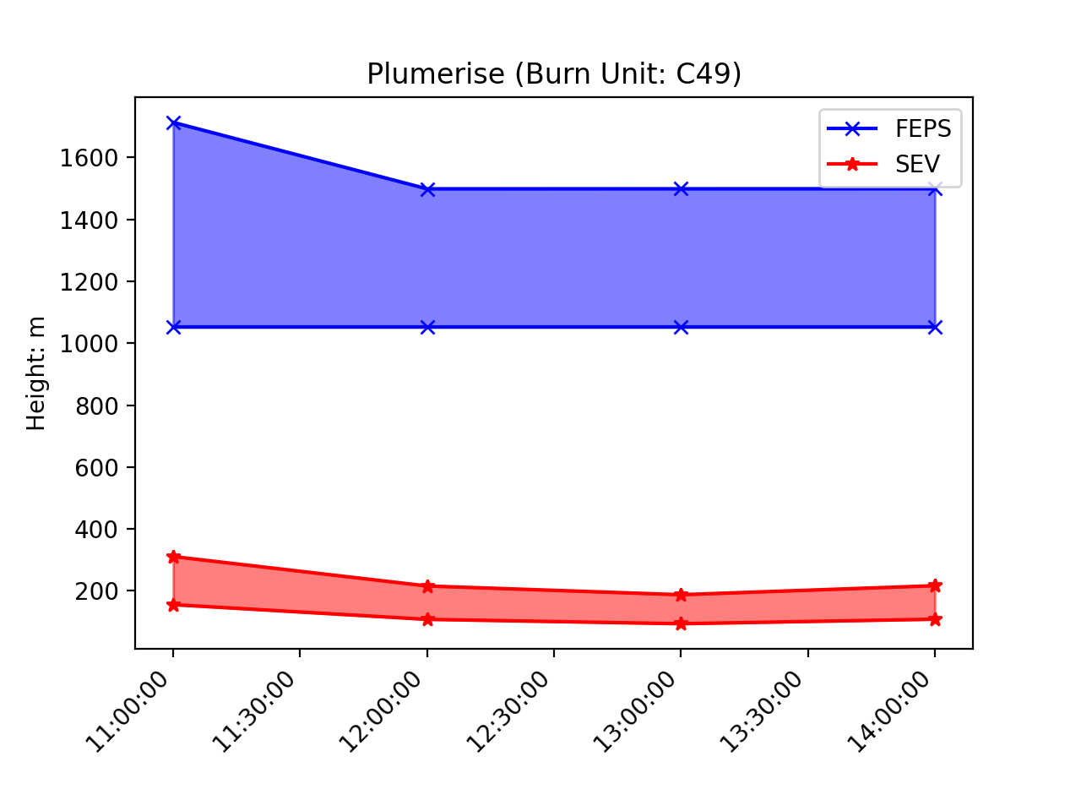
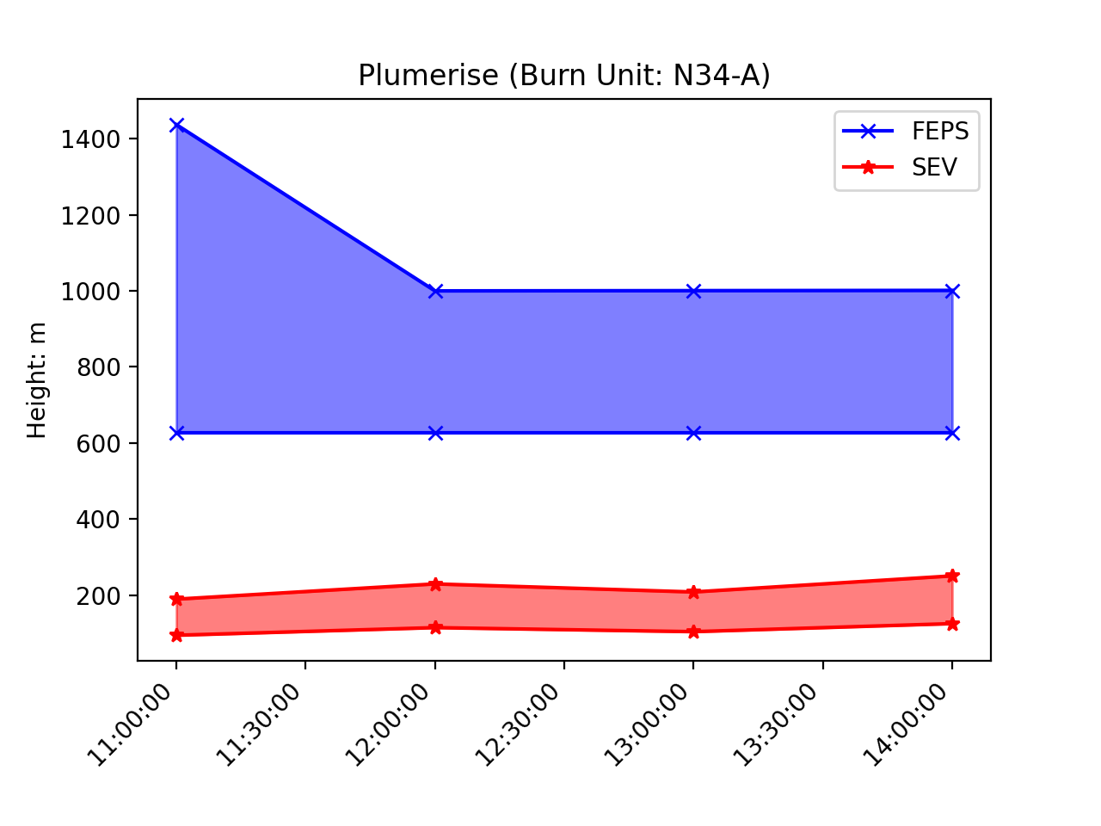
Supplementary Information
Plume height for other burn units

Slide 19
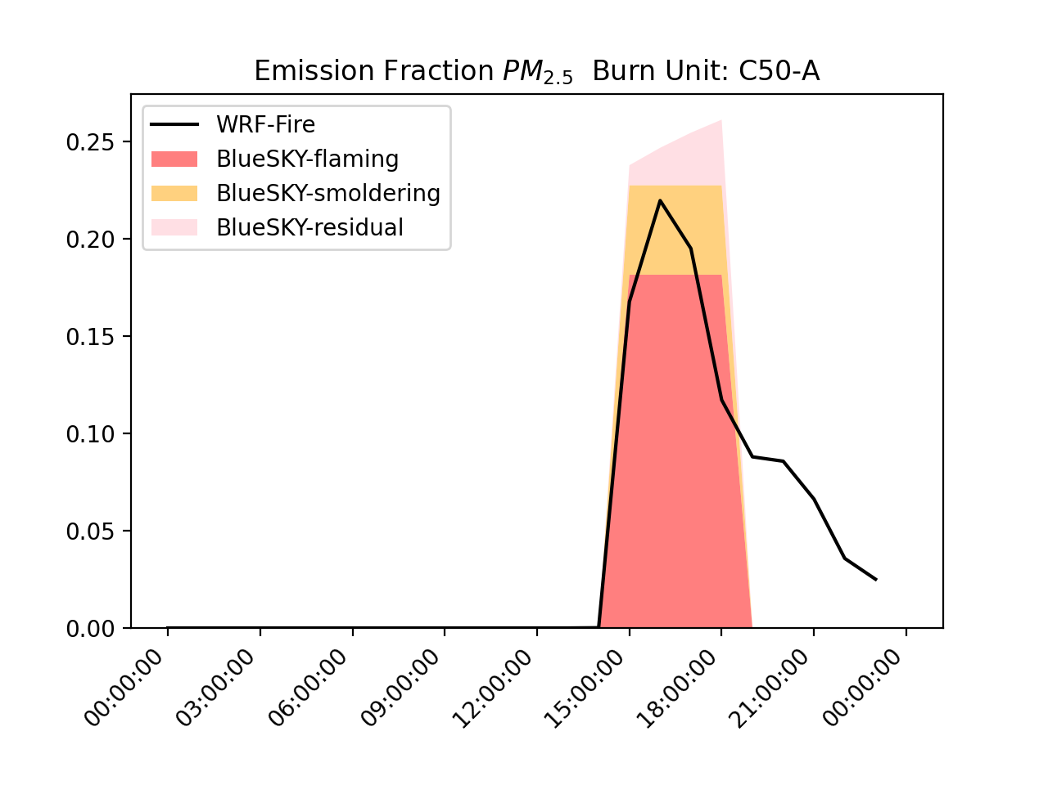
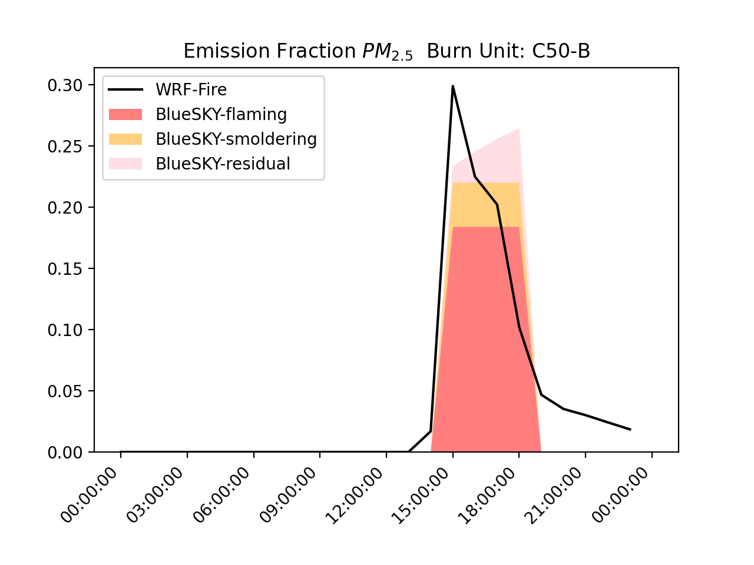
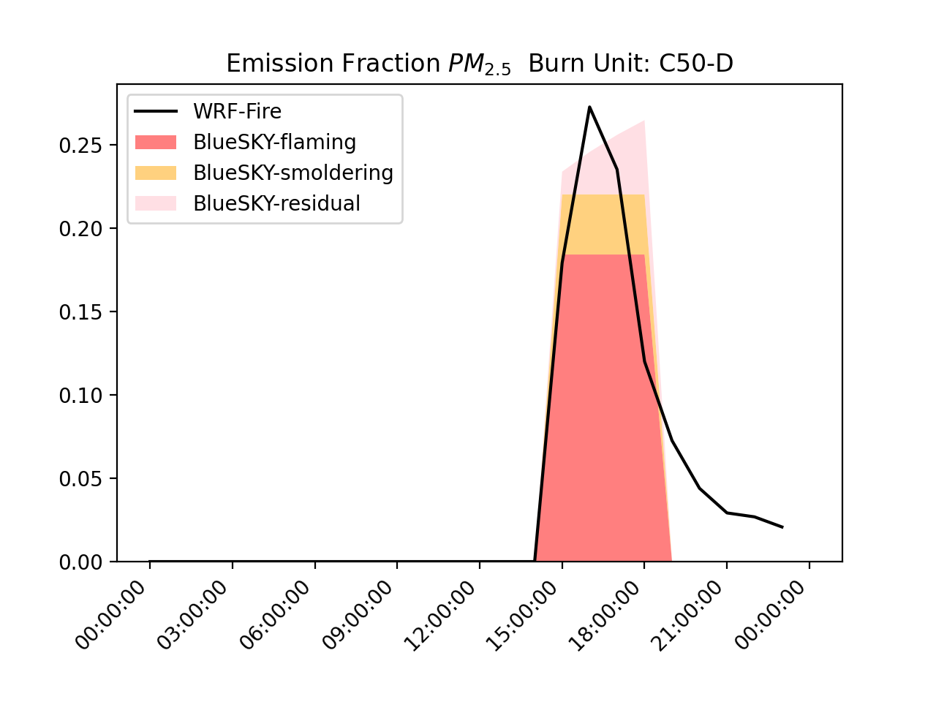
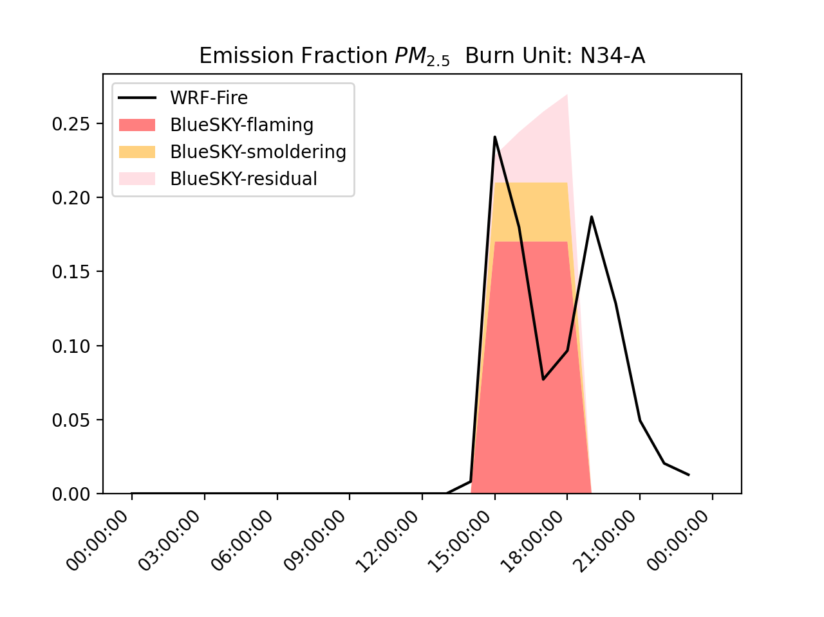
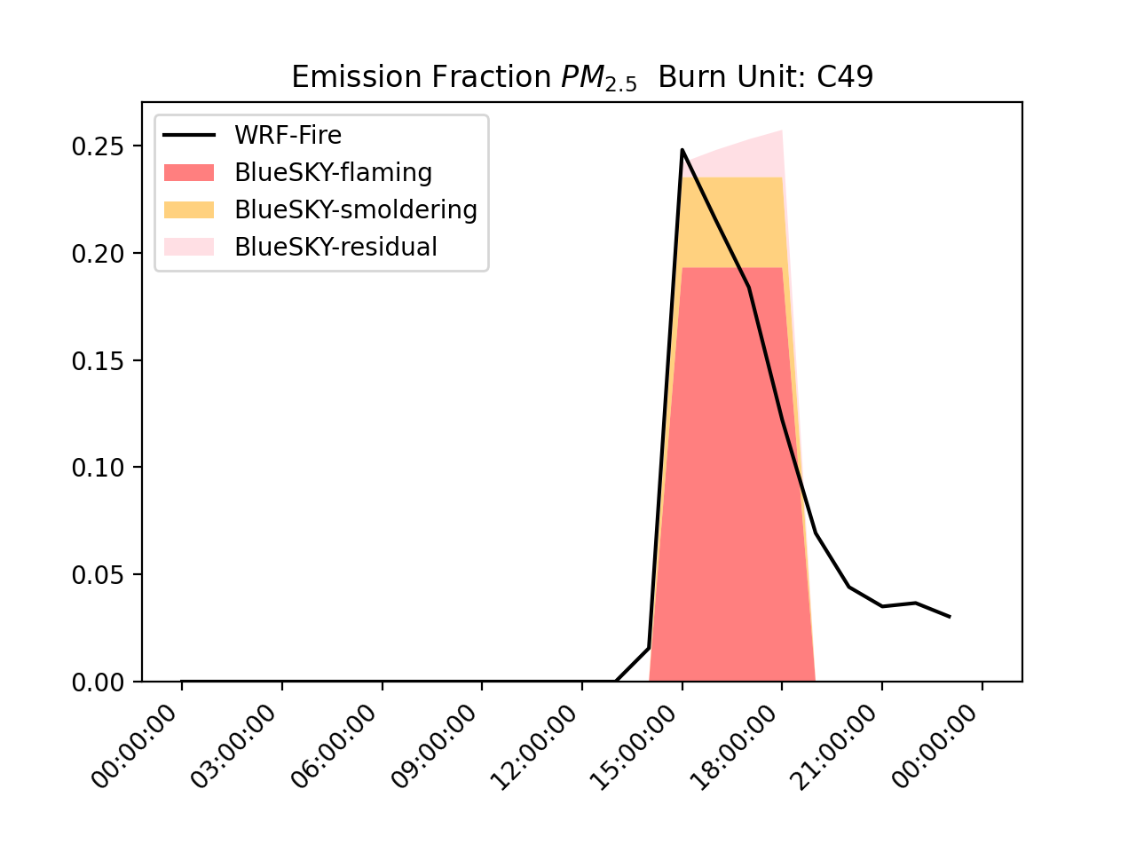
Emission time profile

Slide 20
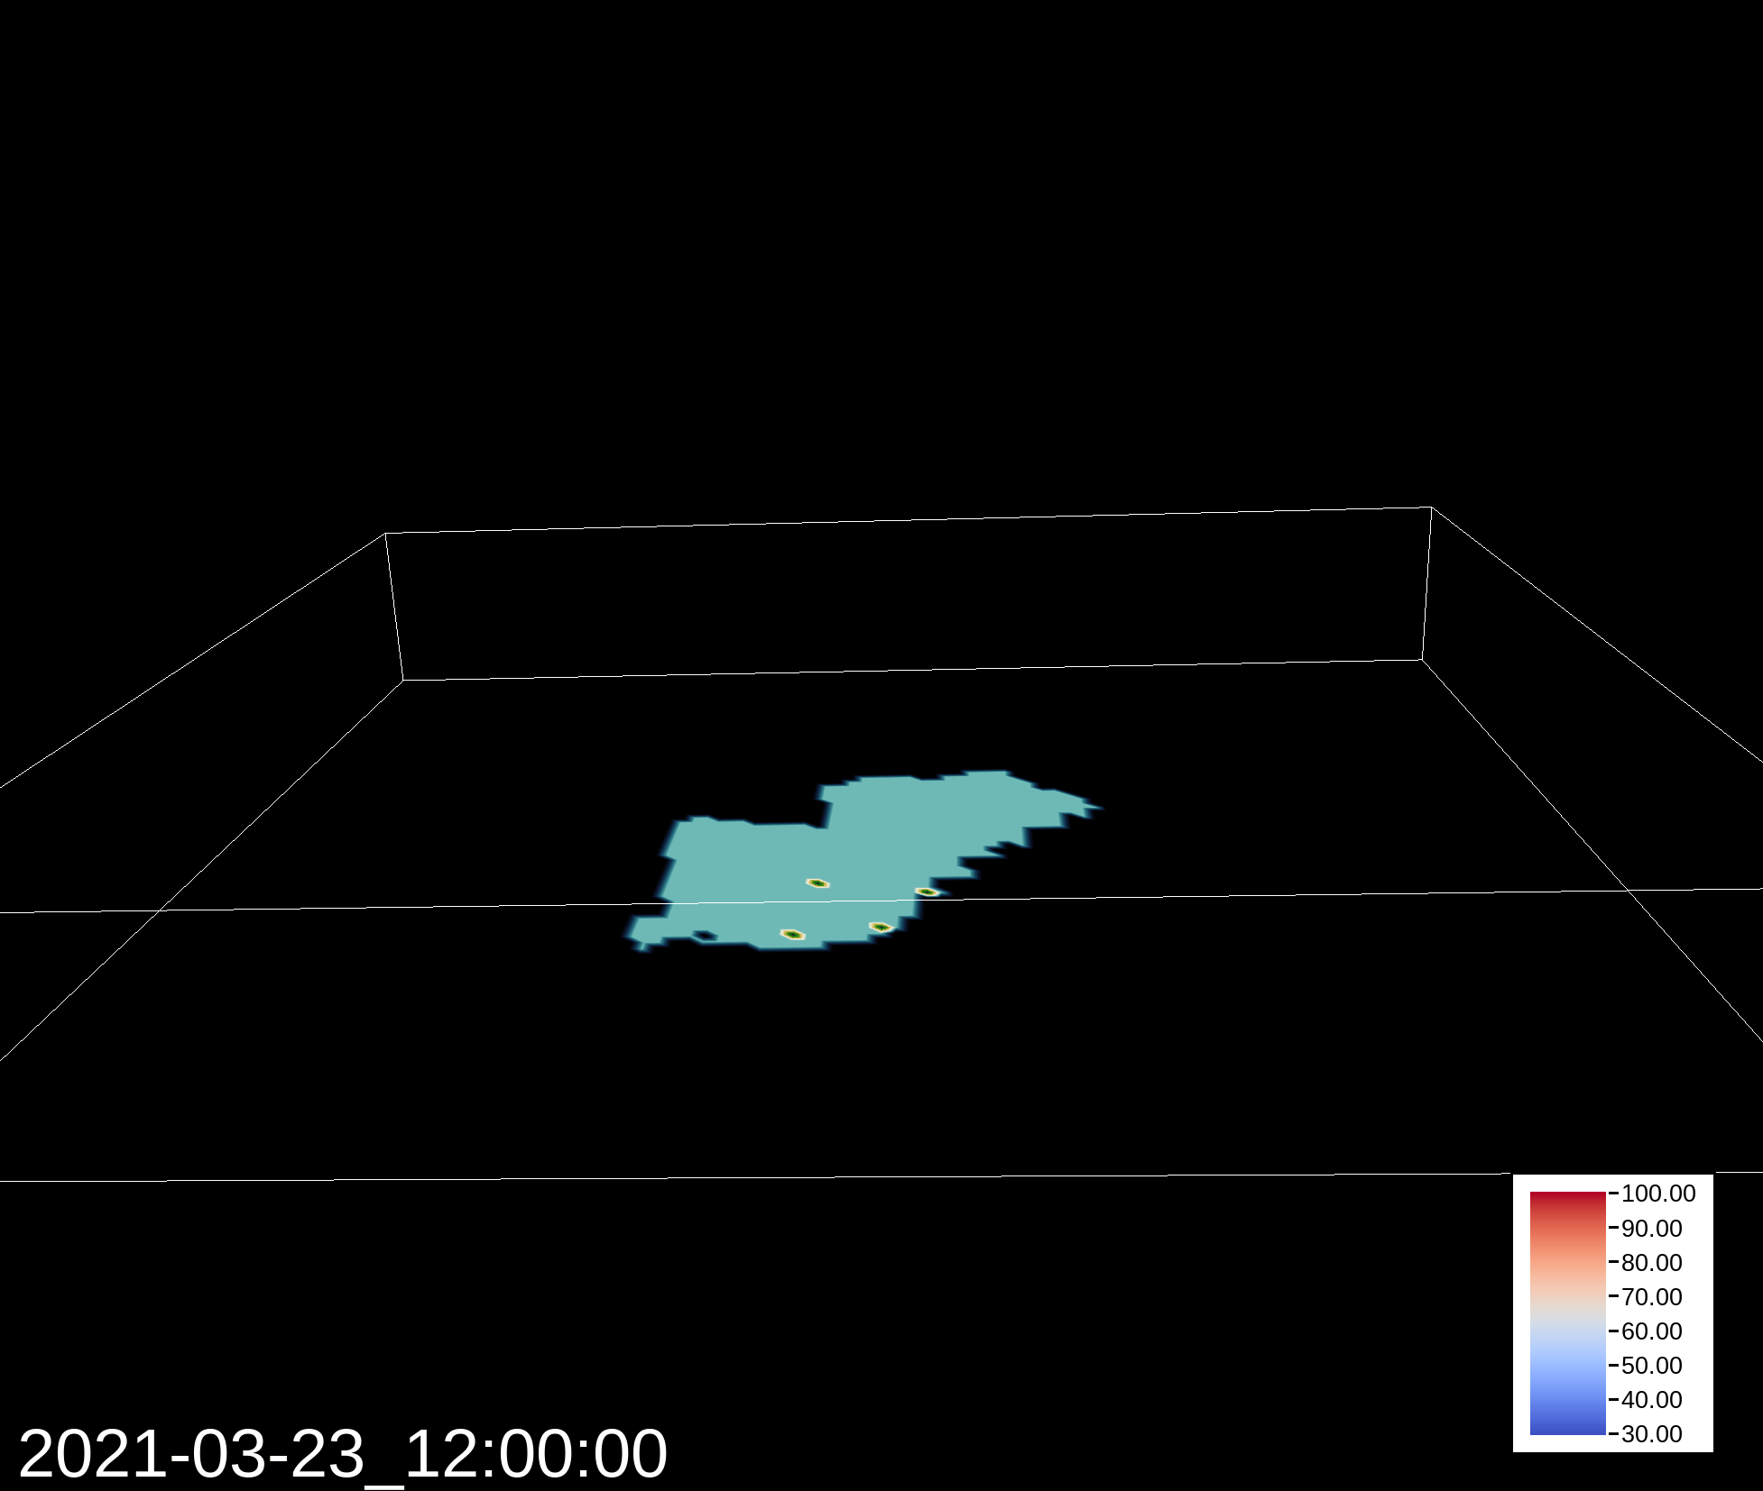
Smoke Structure Side View
FEPS
FEPS

Slide 21
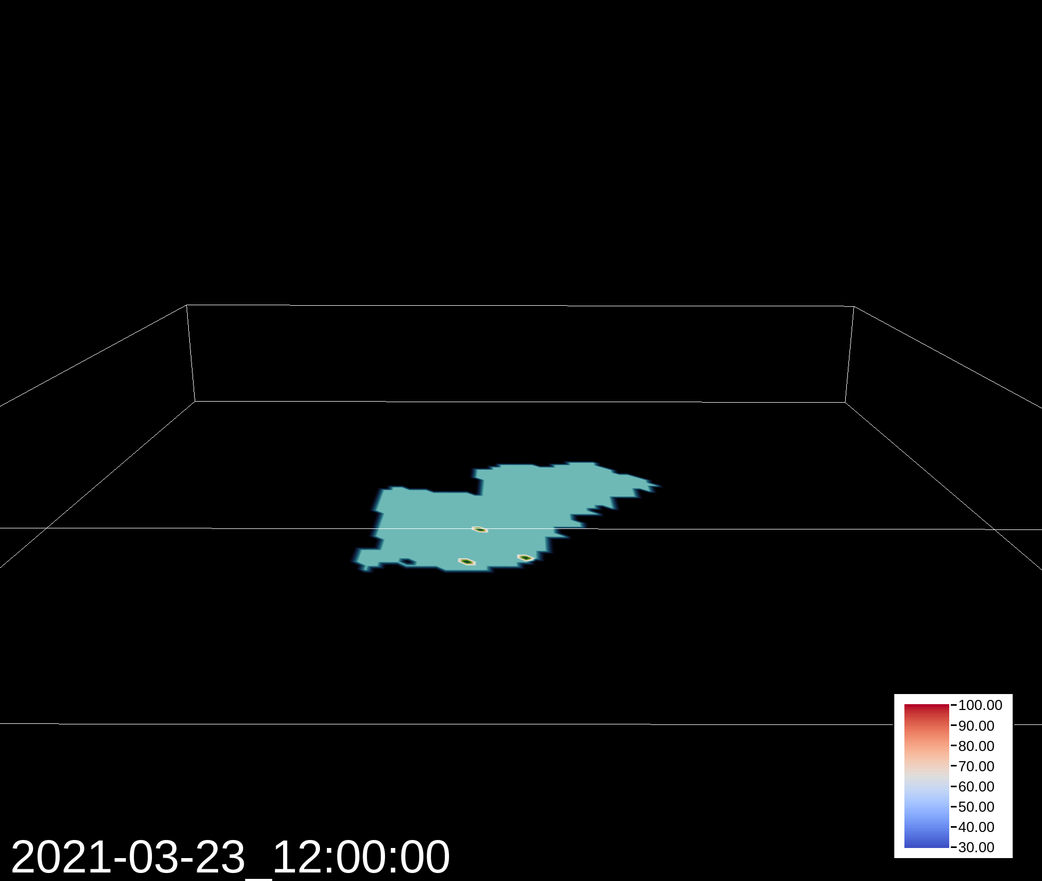
Smoke Structure Side View
SEV

Slide 22
Smoke Structure Side View
WRF-Fire

Slide 23
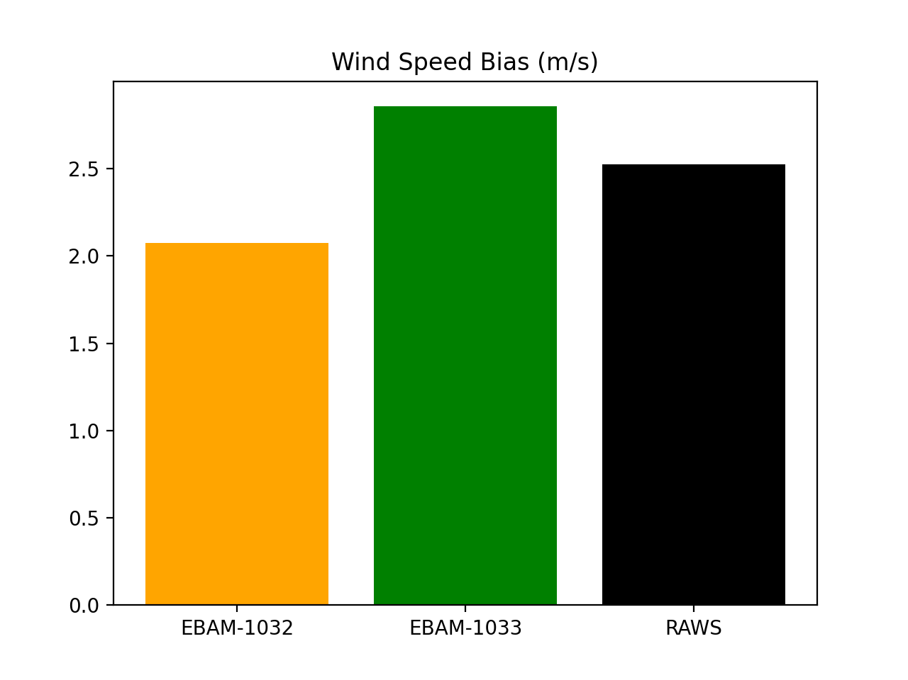
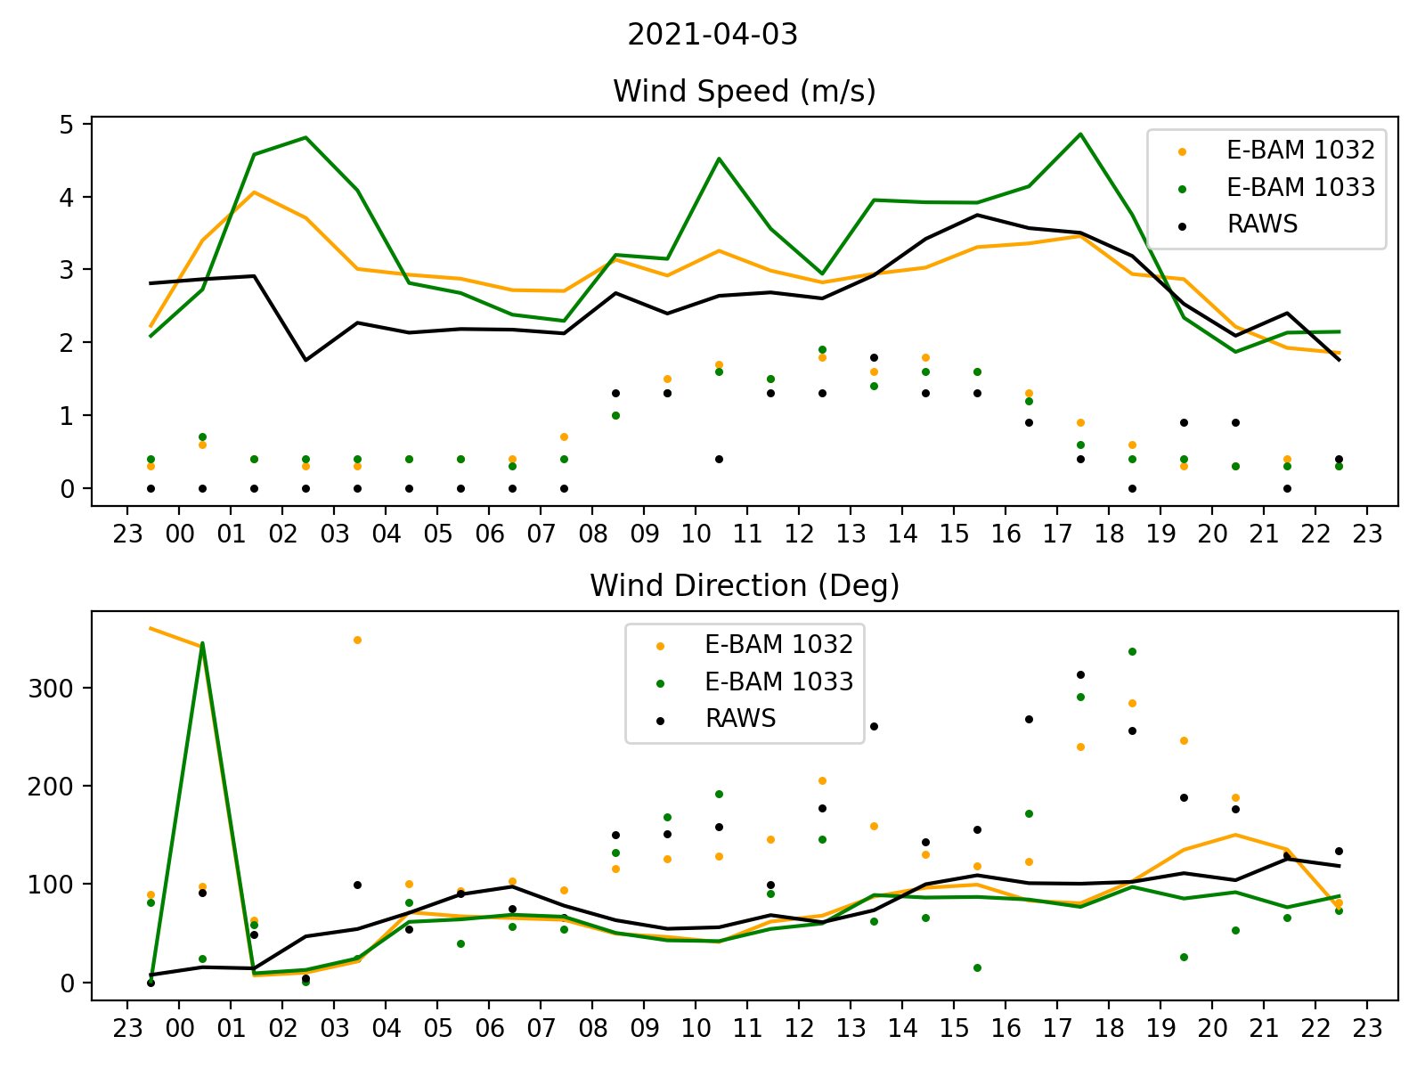
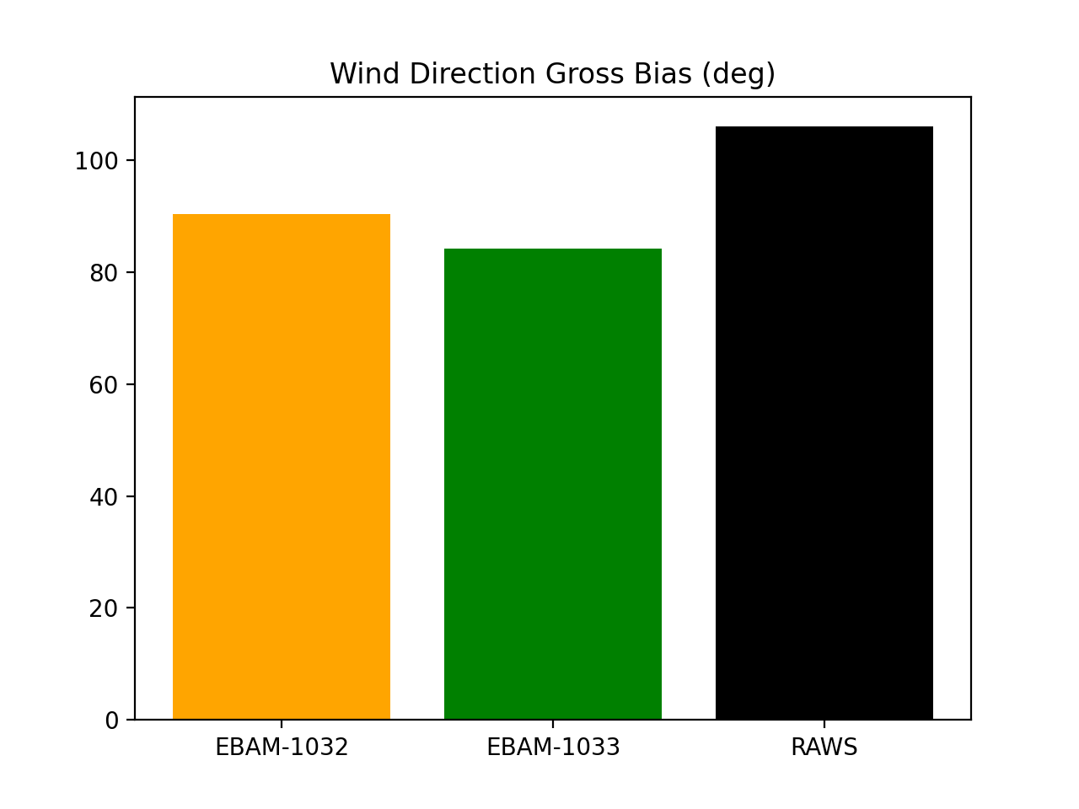
Meteorological Modeling with WRF: April 3
WRF 1km Domain Wind
Bias = WRF-OBS (15:00-20:00)
Notes:
Have high difference at late afternoon

Slide 24
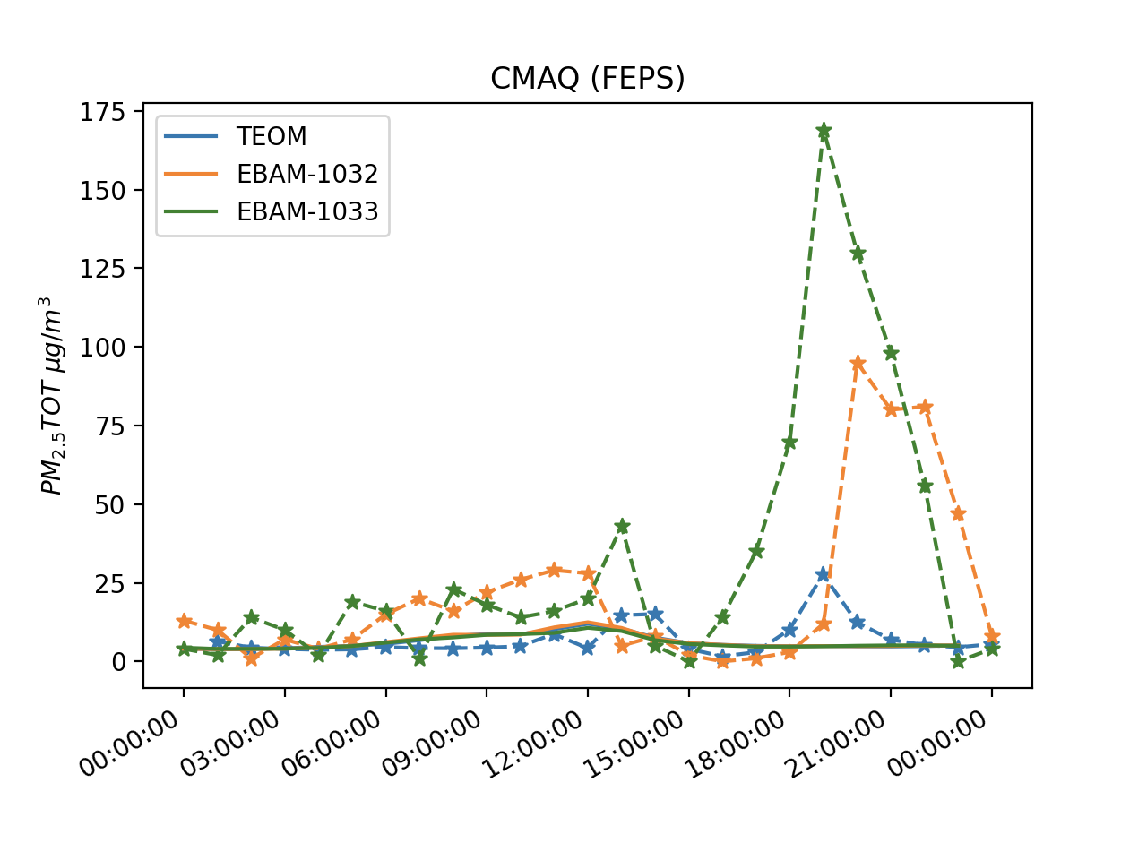
Results: Comparisons with Measurements
GOES-16: Start at 15:11. End at 19:36 UTC

Slide 25
Meteorological Modeling with WRF: April 6
WRF 1km Domain Wind
Bias = WRF-OBS (15:00-21:00)
Notes:
Have high difference at late afternoon

Slide 26
Results: Comparisons with Measurements
GOES-16: Start at 15:36. End at 20:41 UTC

