Slide 1
Performance of an Electrified U.S. Passenger Car Fleet in 2050 Under Future Climate Scenarios on Air Quality
Abiola S. Lawal, T. Nash Skipper, Jooyong Lee, Huizhong Shen, Yilin Chen, Cesunica E. Ivey, Anu Ramaswami, Kara M. Kockelman, Armistead G. Russell.
CMAS 2022
October 17th 2022
Sustainable Healthy Cities Network

Slide 2
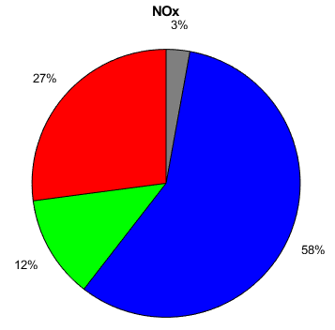
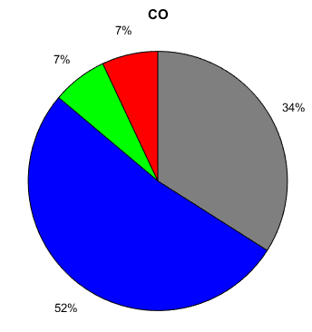
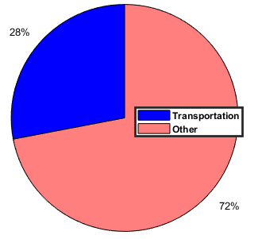
Transportation: Significant component of the US energy economy Largest contributor to urban pollution.
Energy
Emissions
Source: 2018 US EPA Emissions trends
Source: Energy Information Administration (2018)

Slide 3
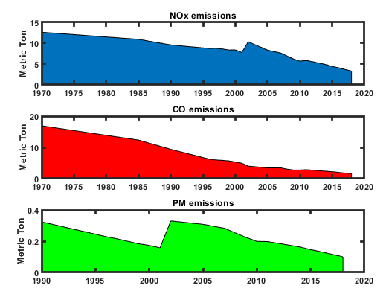
Impact of Environmental Regulations?
Despite an increase in the number of vehicles and increased VMTs, regulations over the past few decades have helped to improve air quality in the US.
Since the passage of the Clean Air Act (CAA) and further amendments, the following have occurred
Passenger cars are over 80% cleaner than there were in the 60s
Fuels are cleaner
Technological advancements
Source: US EPA
Transportation Emission Reductions
74% Reduction in NOx
90% Reduction in CO
70% Reduction in PM_{2.5}

Slide 4
Impact of Environmental Regulations
Pollutant | 2011 | 2050
Volatile Organic Compounds | 0.11 g/mile | 0.0057 g/mile
Carbon Monoxide | 3.97 g/mile | 0.92 g/mile
Nitrous Oxides | 0.48 g/mile | 0.02 g/mile
PM_{2.5} | 0.01 g/mile | 0.002 g/mile
Obtained using EPAs Motor Vehicle Emissions Simulator (2014)
Takes into account the Corporate Average Fuel Economy (CARE) standards enacted by the last administration.
Passenger cars are becoming quite ‘clean’.

Slide 5
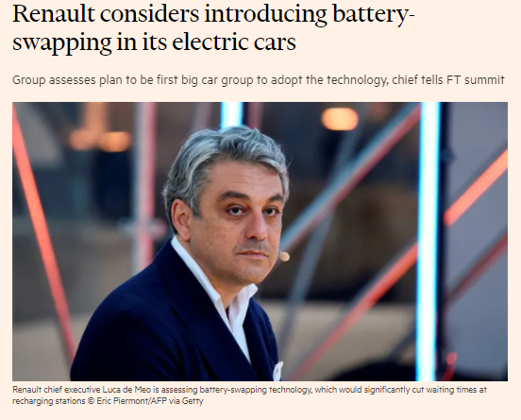
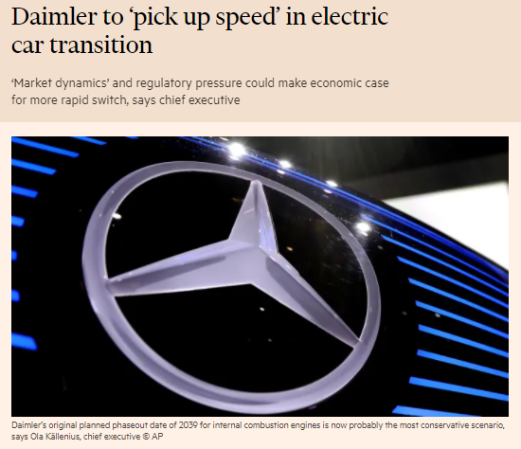
Trends show EVs on the way to replace gasoline cars

Slide 6
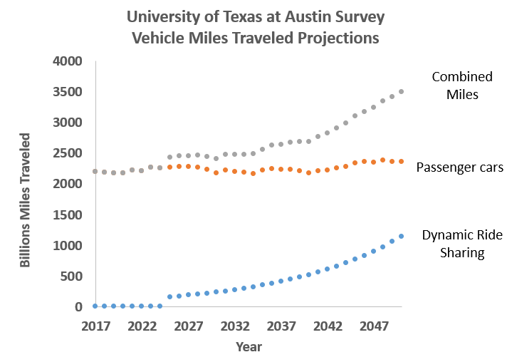
Combination of Automation and Electric Vehicles is affecting consumer choices
Automation
Increasing access with shared rider fleets

Slide 7
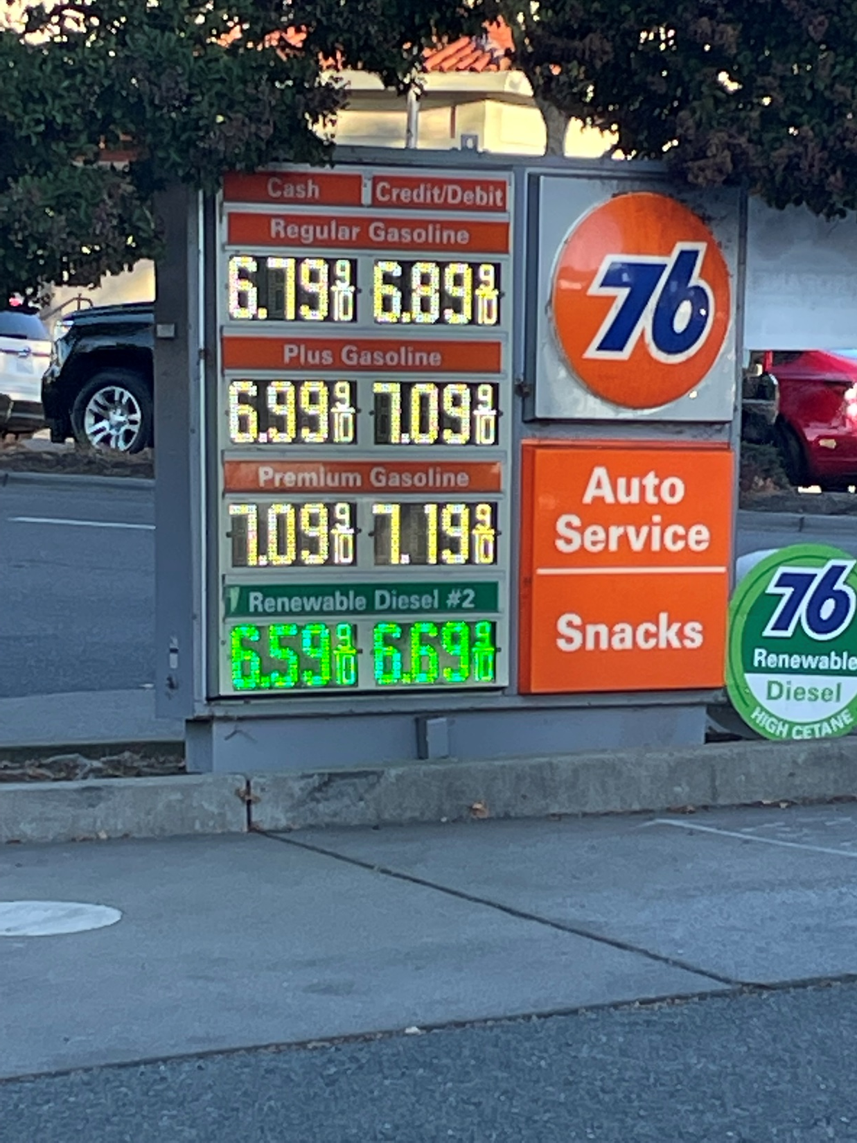
Economic & Energy Nexus
Bay area gas prices: October 2022
With gas prices like these……,
who wouldn’t want an EV?
Electric vehicles becoming affordable

Slide 8
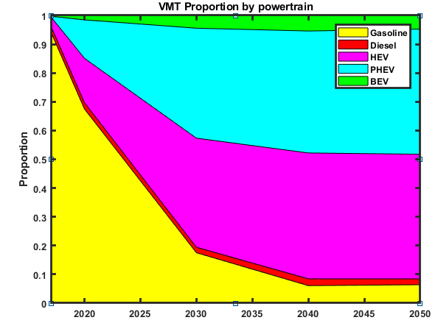
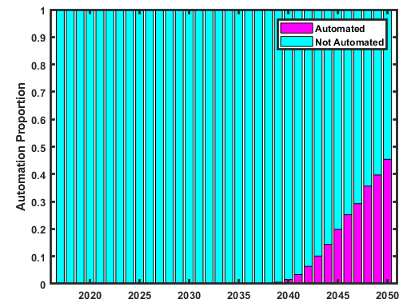
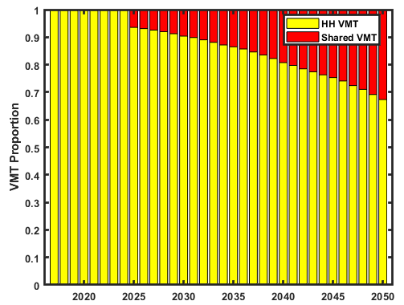
All of this means what?
Electrification options of passenger car fleet
Battery (BEVs)
Plug in Hybrid Electric Vehicles (PHEVs)
Hybrid Electric Vehicles (HEVs).
Automation Mode
Automated 2. Not Automated
Driving Mode
Personal vehicle within households
Ride Sharing (e.g. Uber)
Vehicle automation up to 40%
VMT proportion from shared ride
services is about 30%.
VMTs largely from a combination of electric vehicles
Given these trends (clean gasoline cars, electric cars, increased VMTs)
Notes:
Some variables might affect adoption: price point and affordability (economic nexus)
Technology (Charging stations and battery life)
Additional grid use: infrastructure
Life cycle: end use (creating another problem) - sustainability
But the benefits:
Access
Cleaner cities
Lower energy use: charging and use efficiency
Will this solve our problems with environmental pollution

Slide 9
Questions
What impact will the combination of the following have on air quality in 2050?
Increased VMTs
Automation
Electric vehicles
Will changes in air quality from electrification of passenger car fleet, be substantial, when compared with cleaner gasoline powered cars by 2050?
What impact will climate have on air quality under an electrified fleet scenario?

Slide 10
Objective: Evaluate the effect of electric cars on 2050 air quality
Chemical Transport Model (CTM)
Ozone, NOx, SO₂ and particulate matter
Account for increased travel demand (vehicle miles traveled) on emissions
Include an analysis of different Representative Concentration Pathways (RCPs)
Evaluate EV efficacy in context of other sectors and future control technologies.
Quantify differences of EV efficacy to 2050 clean gasoline powered vehicles
Health benefits

Slide 11
Overall approach
Survey of Car Owners
Project adoption of autonomous vehicles
Scale up from Survey
2016 NEI
SMOKE/Platform
Use 2050 projected emissions for other sectors and MOVES output to modify emission inventory
CMAQ
Simulate dispersion and generation of secondary pollutants (ozone, SOA, etc.)
Concentration Profile
Resulting car fleet power train make up
MOVES
Generate emissions for simulated vehicle population and VMT
Statista Projection Tables for populations and households
2016/2050
Use 2050 predicted meteorology.
VMT
UT-Austin
University Collective
Predicted Car
Demographic
Emission Rates
Emission Report
CMAQ Output
Notes:
SOA = secondary organic aerosol

Slide 12
Input into MOVES Mobile Emissions Scale up 2016 - 2050
Annual, Monthly, Daily, and hourly VMT distribution (2011 NEI)
Fleet Age Distribution (Fleet Turnover)
UT-Austin Survey Passenger Cars
MOVES default for others
VMT Road Type distribution (2011 NEI)
Vehicle Type VMT: UT-Austin
Fuel data (MOVES default)
VMT Speed Distribution (MOVES default)
Fleet Power Train Makeup
UT-Austin Survey Passenger Cars
MOVES default for others
This is set up to run on pace to speed up the runs

Slide 13
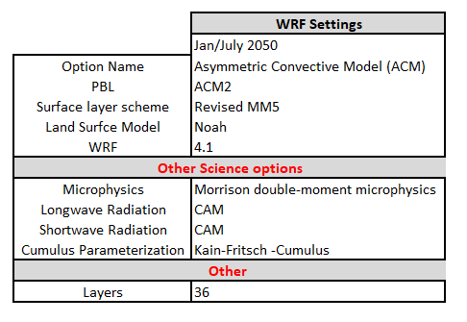
MOVES-SMOKE-WRF-CMAQ
MOVES - Motor Vehicle Emissions Simulator (2014b)
Used to estimate mobile emissions
SMOKE-2016 NEI platform GT NEMS
2016 National Emissions Inventory (NEI) was used as base case and to scale future emissions.
Sparse Matrix Operator Kerner Emissions (SMOKE) modeling system
Meteorology
Community Earth System Model Version 1 (CEMSI)
Global model developed by the National Center for Atmospheric Research (NCAR)
Weather Research Forecasting (WRF) Model v4.1
Used to downscale the global model
Two climate scenarios: RCP4.5/RCP8.5
Air Quality Modeling
The Community Multiscale Air Quality (CMAQ) system
CMAQv 5.3.2
12km by 12km grid size: 12US2
BEIS done inline

Slide 14
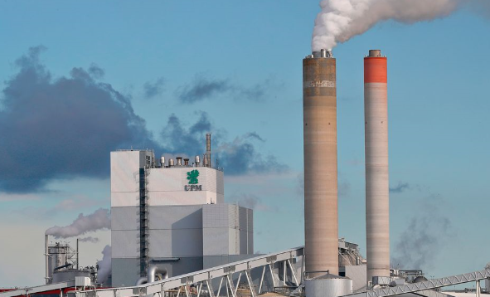
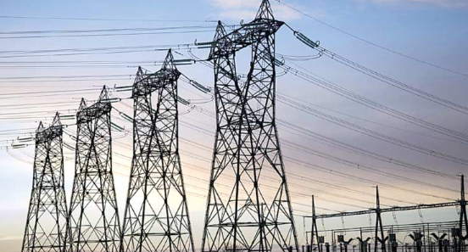
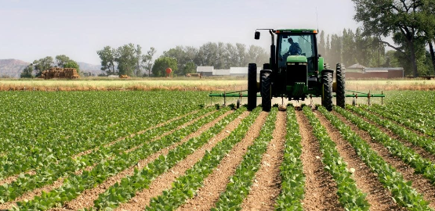
Emissions Other Sectors
2050 emissions for other sectors were estimated using the GT-NEMS forecast model which assesses energy distribution, with demand in combination with technology changes and regulations.
Electricity Power Generation Power Units
Area Source and Non Point (Residential, Commercial, Agriculture and Industrial sectors)
Biogenic emissions: Biogenic Emissions Inventory System (BEIS) version 3.61
Details of the methods can be found in recently published article by Shen et al.
Relaxed Energy Policies Coupled with Climate Change Will Significantly Undermine Efforts to Attain US Ozone Standards (2019). Published in One Earth. DOI:https://doi.org/10.1016/j.oneear.2019.09.006

Slide 15
Scenario runs
Simulation Case | 1 | 2 | 3
Scenario Year | 2016 | 2050 | 2050
Season (month) | July/Jan | July/Jan | July/Jan
Base Case to compare | NA | 1 | 1/2
Future Energy policy (REP) | N/A | REP | REP
Emissions | 2016 NEI | 2050 Projected | 2050 Projected
Marginal Energy Adjusted for EV Charging on the grid | NA | No | Yes
EV adoption | NA | NA | None Aggressive Moderate
EGU Energy Mix | NA | REP Renewable | REP Renewable
Meteorology Climate: Representative Concentration Pathway | 2050/2016 4.5/8.5 | 2050 4.5/8.5 | 2050 4.5/8.5
Biogenic emission file | BEIS 2016 | BEIS 2050 | BEIS 2050
Electrification Scenario | None | None | Fleet Electrification

Slide 16
Results I: Climate
CMAQ

Slide 17
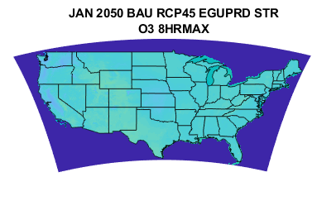
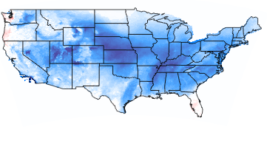
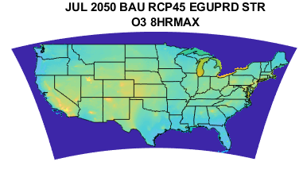
2050 O₃ 8HR MAX: Effect of meteorology/climate
EV BAU Scenario:
Moderate electrified fleet
No automation
No dynamic ride sharing
Stringent Energy Policy
Energy use from EV charging
Winter(Jan)/Summer(July)
RCP4.5- RCP8.5
[12.8, 40.76]
[-15.6, 5.5]
[Min, Max]
RCP4.5- RCP8.5
Unexpected climate trend seen in July, given that RCP8.5 is warmer
[21.6, 85.5]
[-10.4, 16.0]
More O₃, projected with RCP45 in the Southeast

Slide 18
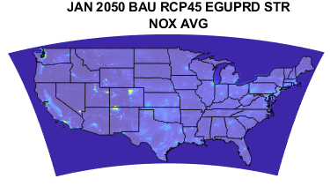
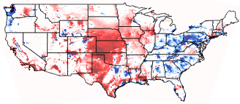
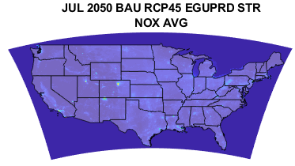
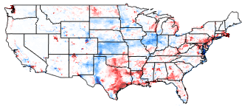
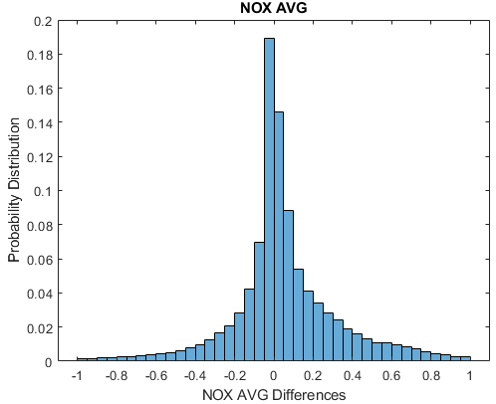
2050 AVG NO_{X}: Effect of meteorology/climate
RCP4.5- RCP8.5
EV BAU Scenario:
Moderate electrified fleet
No automation
No dynamic ride sharing
Stringent Energy Policy
Energy use from EV charging
Winter(Jan)/Summer(July)
[0.03, 109]
[-9.2, 93.6]
[Min, Max]
RCP4.5- RCP8.5
[0.05, 45.0]
[-4.7, 10.8]
Slight increases, with most below 1 ppb
Summer months, less ozone can be seen
Higher ozone ins southeast under recp 45
Midwest: more ozone
Most places below 5 ppbV

Slide 19
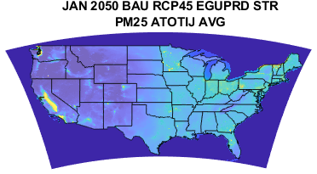
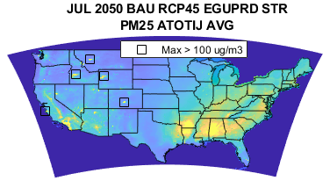
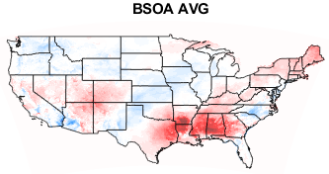
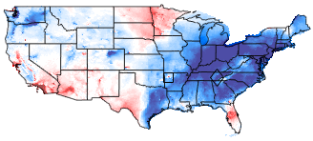
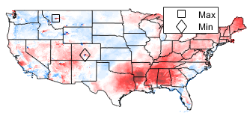
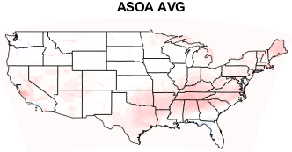
2050 AVG PM_{2.5}: Effect of meteorology/climate
[0.63, 30.2]
[2.12, 194]
RCP4.5 – RCP8.5
RCP4.5 – RCP8.5
[-21, 16]
[-60, 136]
Regional and seasonal variability: Biogenic more than anthropogenic

Slide 20
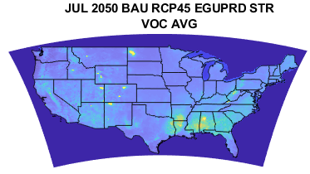
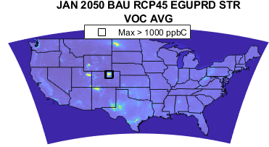
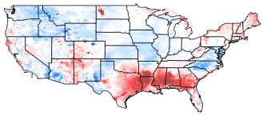
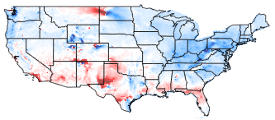
2050 AVG VOC: Effect of meteorology/climate
[5.6, 945]
[10, 1500]
RCP4.5 – RCP8.5
RCP4.5 – RCP8.5
[-268, 586]
[-267, 214]

Slide 21
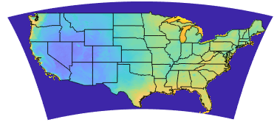
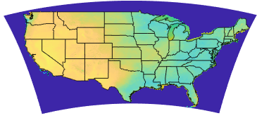
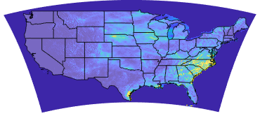
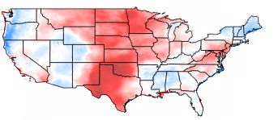
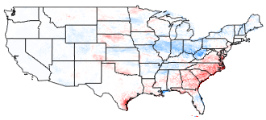
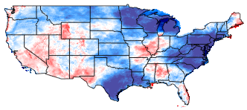
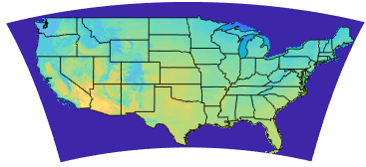
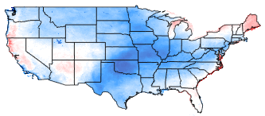
2050 JUL MET: RCP4.5 – RCP8.5
Relative Humidity
Solar Radiation
Precipitation
Temperature

Slide 22
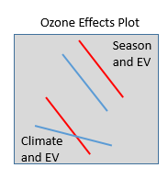
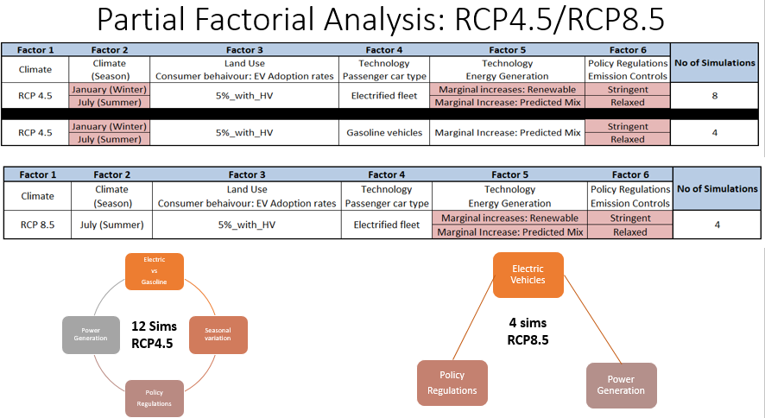
Results II: Automation and EV Adoption Effects

Slide 23
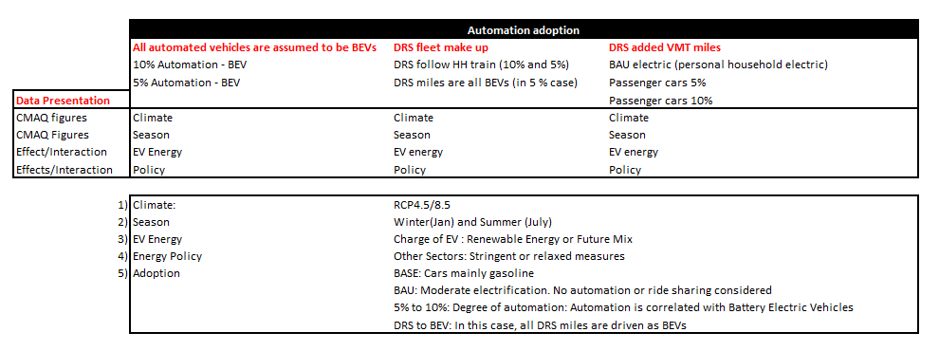
Adoption Scenarios
Price drop allows for automation and BEV
Conversion of DRS car fleet to BEVs
Added effect of DRS miles and more vehicles
Notes:
Additional vehicles are electric vehicles. But the impact of
This assumes all the DRS are Battery operated. Increase the amount of electric cars by how much?

Slide 24
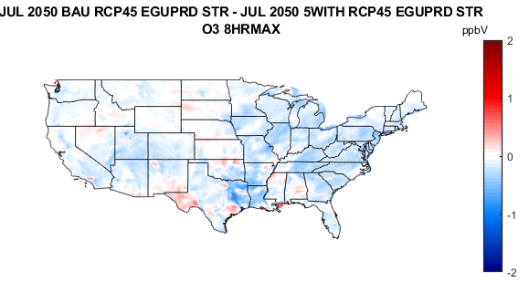
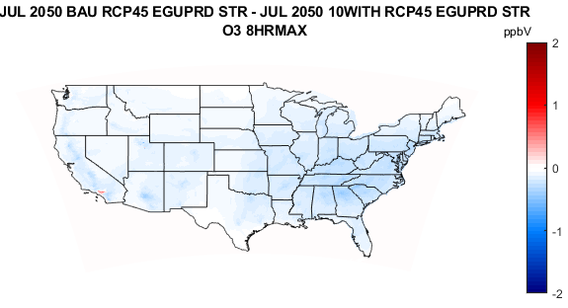
Electrification Vehicle Effect
Considering adding DRS with a moderate electric (BAU) fleet
-
-
[-0.71, 0.97]
[-1.47, 1.26]
BAU: Moderate Electrified fleet
Electrified fleet with DRS VMT Considered
The 5% reflects price drop of automation – conversion to BEVs
BAU: Moderate Electrified fleet
Electrified fleet with DRS VMT Considered
The 10% reflects price drop of automation – conversion to BEVs
Figure 1: Effect of automation and added (DRS) miles and vehicles
More O₃ even though more BEVs
Figure 2: Effect of increasing BEVs due to automation
Increases and decreases in O₃ in some regions
Notes:
Some variables might affect adoption: price point and affordability (economic nexus)
Technology (Charging stations and battery life)
Additional grid use: infrastructure
Life cycle: end use (creating another problem) - sustainability
But the benefits:
Access
Cleaner cities
Lower energy use: charging and use efficiency
Will this solve our problems with environmental pollution

Slide 25
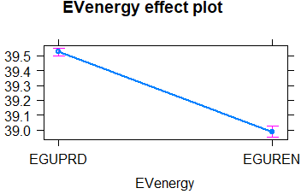
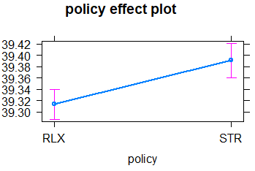
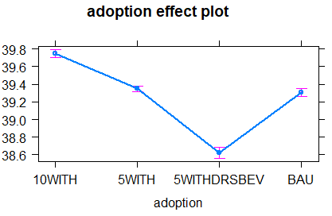
8HR MAX O₃ 2050 Adoption with
Policy: Emission Controls in other Sectors, Energy Production of EVs
EGUREN: Electric Cars charged on renewable energy
EGUPRD: Electric cars use energy mix of future
8HR MAX O₃
STR: Stringent Energy Policy
RLX: Relaxed Energy Policy
JUL
All DRS cars converted to BEVs
Notes:
Additional vehicles are electric vehicles. But the impact of
This assumes all the DRS are Battery operated. Increase the amount of electric cars by how much?

Slide 26
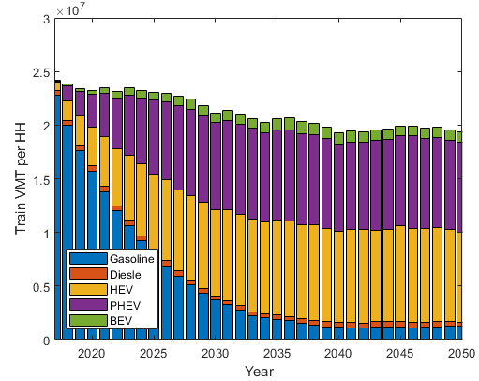
8HR MAX O₃ 2050
Adoption effect of more BEVs
This highlights implications of the electric fleet make up for DRS
Effect of automation and added (DRS) miles and vehicles
More O₃
Effect of increasing BEVs due to automation price drop
Areas with less NOx but more VOC could be explanation
Also energy production could be a factor (i.e. EV charging)
Notes:
Additional vehicles are electric vehicles. But the impact of
This assumes all the DRS are Battery operated. Increase the amount of electric cars by how much?

Slide 27
8HR MAX O₃ 2050
Policy: Emission Controls in other Sectors, Energy Production of EVs
Interaction
- Energy from EV charging appears to have no impact under either policy
- With EV charging energy produced from renewable sources, will have more of an impact under relaxed policy
Notes:
Additional vehicles are electric vehicles. But the impact of
This assumes all the DRS are Battery operated. Increase the amount of electric cars by how much?

Slide 28
PM^{2.5} 2050 Adoption with
Policy: Emission Controls in other Sectors, Energy Production of EVs

Slide 29
Conclusions
Regional effects need to be considered
More ozone and particulate matter under RCP4.5 than RCP8.5
Moving to all BEVs not a combination of hybrid and other cars seems to be important.
Automation will add to pollution, need to consider moving to BEVs to realize additional benefits
Combination of policy and other regulations can be complicated.
Climate also adds to some of the complication – not as linear as expected

Slide 30
Acknowledgment: Collaborators
Special Thanks: Dr. Russell, Dr. Kockelman, Nash Skipper, Dr. Huizhong Shen, Jooyong Lee.
Sustainable Healthy Cities Network

Slide 31
Thank you for listening

