Slide 1
Air Pollution from Agriculture:
an Almanac

Slide 3
Fine Particulate Matter (PM_{2.5})
U.S. EPA, 2022

Slide 4
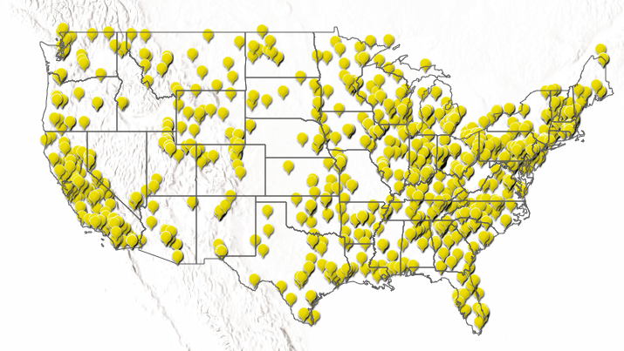
Regional [PM_{2.5}]
Ohio Valley 45%
Southeast -45%
Northeast -43%
U.S. EPA, 2022

Slide 5
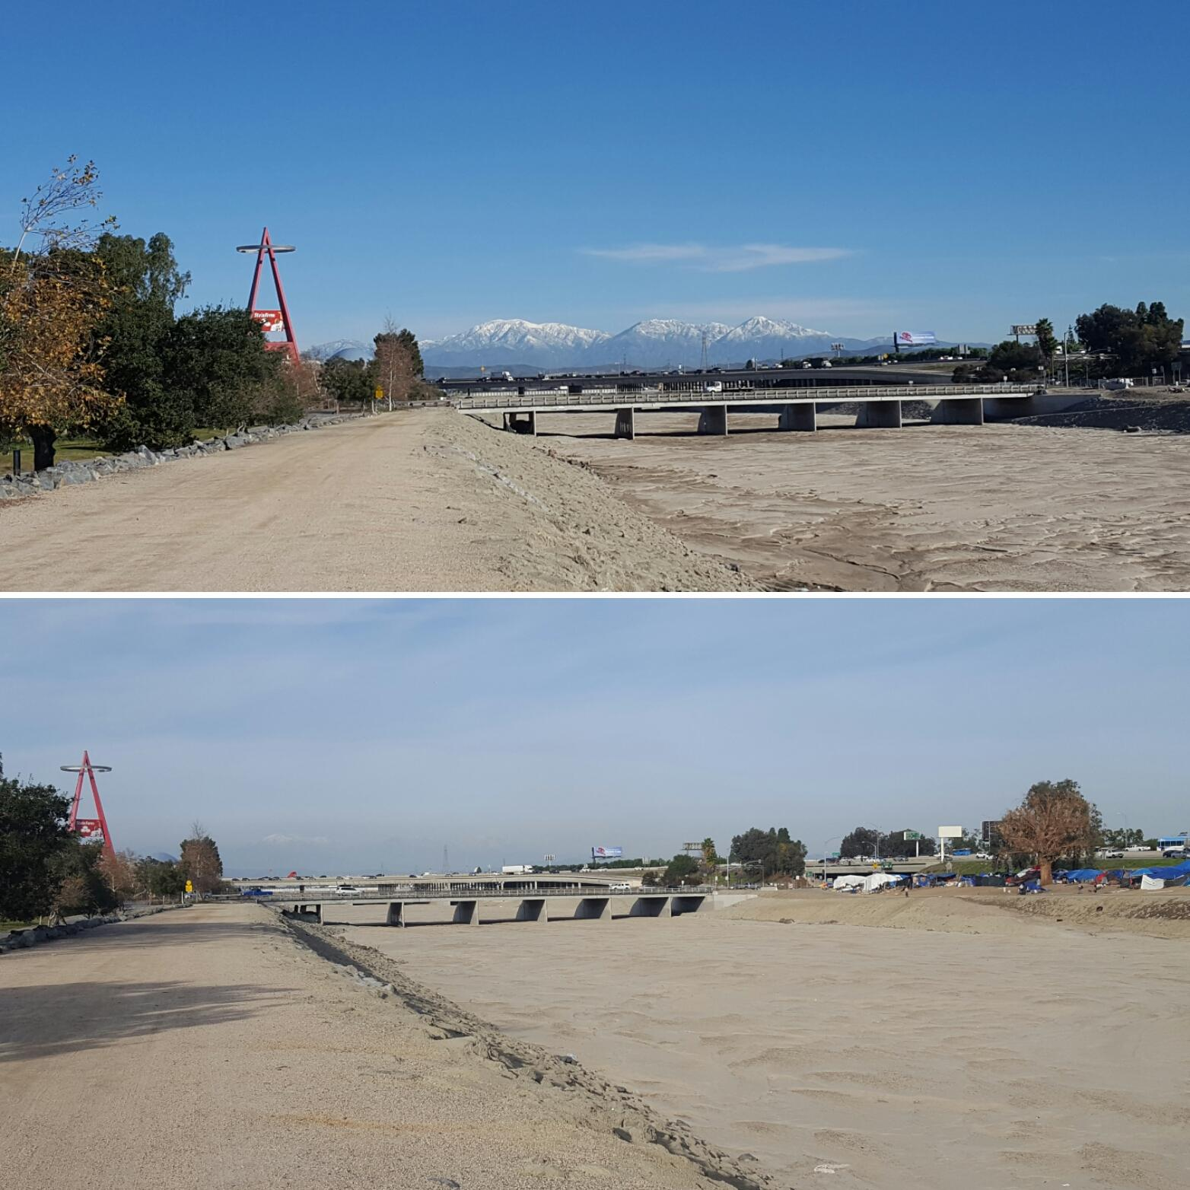
AQ remains a domestic issue

Slide 6
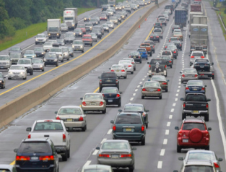
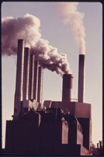
Most PM_{2.5} forms in atmosphere
Sulfate
Nitrate
Organic carbon
Black carbon

Slide 7
NARSTO, 2004

Slide 8
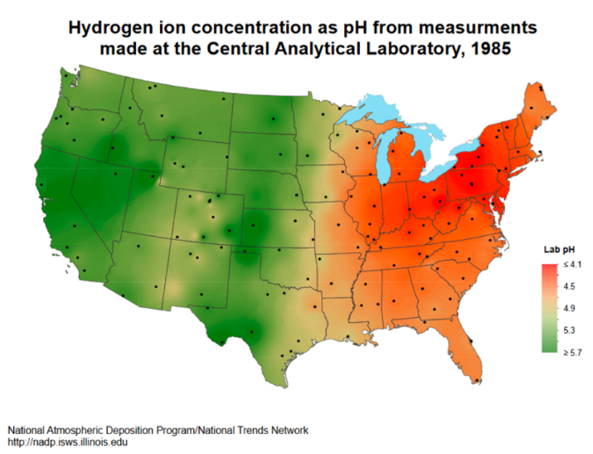
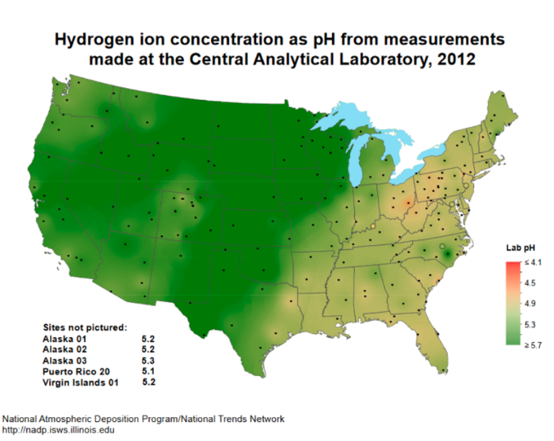
[PM_{2.5}]↓ co-benefit of acid rain rules

Slide 9
PM_{2.5} is salty
chemistry
SO₂
NH₃
(NH₄)₂SO₄
+
NO_{x}
NH₃
(NH₄)NO₃
+

Slide 10
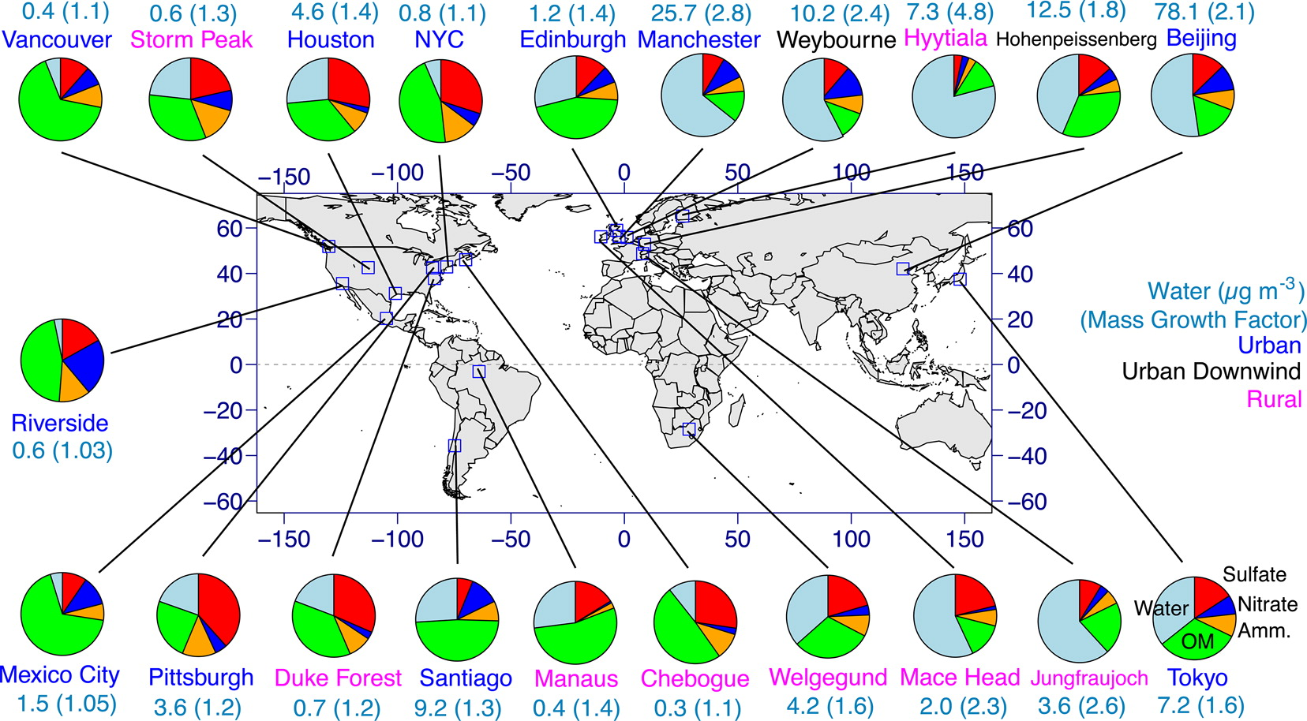
Ammonia critical to PM formation
ammonium also facilitates formation of sulfate, nitrate &
some organic mass (directly and through water uptake)
Nguyen et al., ES&T Letts., 2016

Slide 11
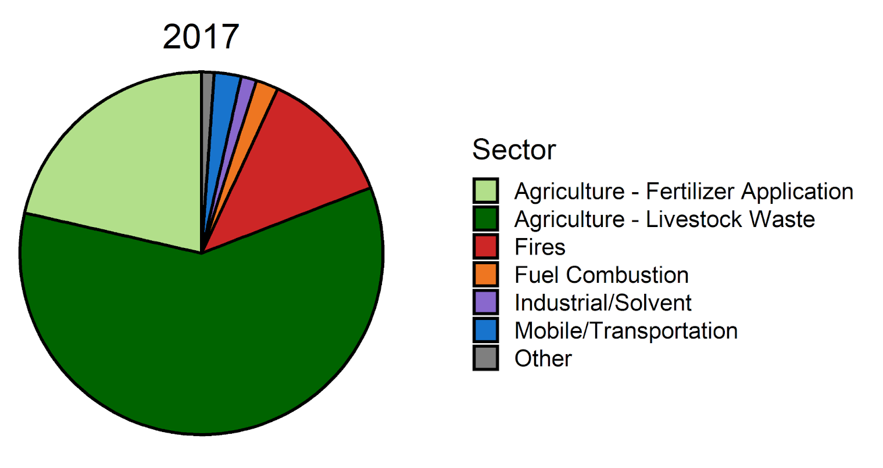
U.S. ammonia sources
EPA’s National Emissions Inventory: NH₃ from livestock 3x all other sources combined, including fertilizer
*estimated from activity data and feed look up tables

Slide 12
AQ policy & regulations for agriculture
EPA regulates NH₃ under CERCLA & EPCRA *except* when on farm
2006: EPA “Final Order” CAFO that paid a nominal penalty to fund a 2-year study to establish Emissions Estimating Methodologies (EEMs) protected from penalty.
EEMs not finalized & Order still in effect; IG urged EPA to end the Order
2008: GAO urged better data for EPA to regulate CAFOs
NEPA exempts agriculture and CAFOs from some requirements, also Agency categorical exemptions
2018: FARM Act exempts farms from any self-reporting requirements for animal waste
2022: riders in the Appropriations Act prohibit use of funds to issue air permits for several pollutants or require GHG reporting from animal manure management

Slide 13
bucolic notions

Slide 14
vertically integrated agribusiness

Slide 15
animal unit density at CAFOs
USDA Census of Agriculture
available every five years from 1997-2017
“large” scale operations: 500⁺ beef cattle, 500⁺ dairy cows, 1000⁺ hogs, 500,000 broiler chickens sold annually or 100,000 egg-laying chickens
largest CAFOs missing
USDA “large” category corresponds to EPA’s “medium” CAFO definition
EPA defines an animal unit as 1000lb of live weight.
individual cattle or cow, 2.5 hogs, and 125 chickens
County level animal numbers from the Census for Agriculture are linked to county-specific land areas from USDA’s Economic Research Service using the Census Service’s unique Geographic Identifier (GeoID) for each county.
Under EPA’s NPDES program, some states report raw numbers of CAFOs

Slide 16
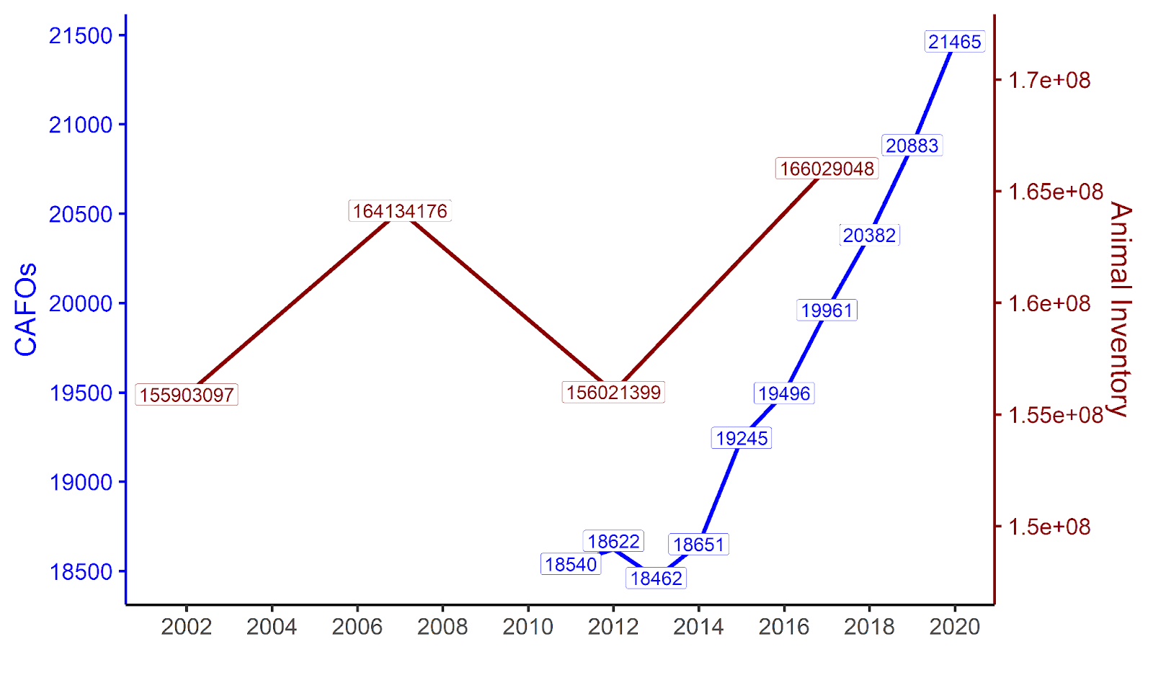
farm animal density & CAFOs
National Pollution Discharge Elimination System (NPDES) reporting indicates shift toward more highly concentrated meat production.

Slide 17
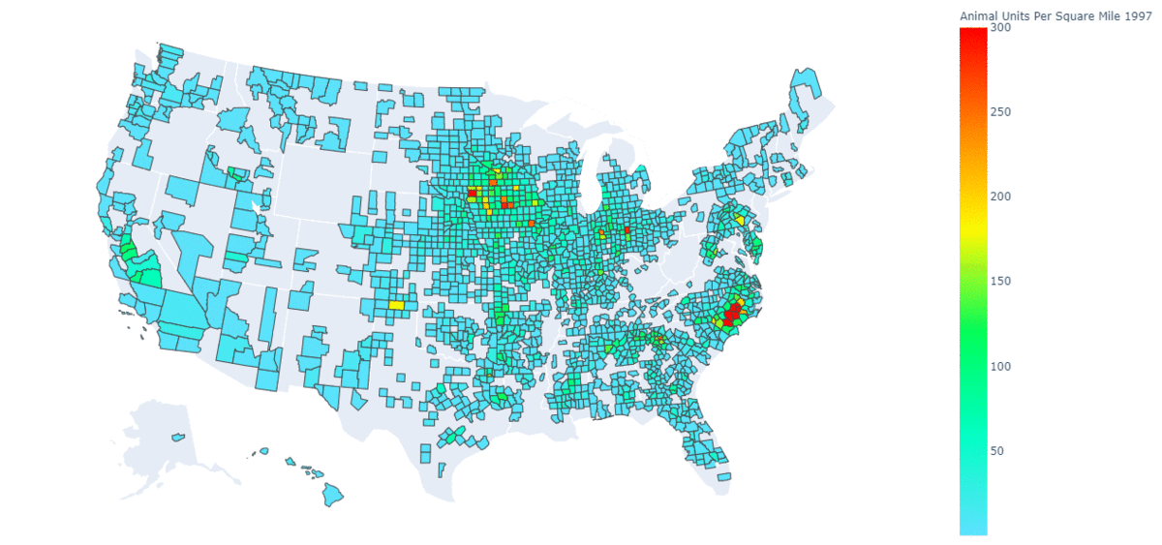
animal units / mi²
300
250
200
150
100
50
animal unit = 1000lb of live weight: individual cattle or cow, 2.5 hogs, and 125 chickens.

Slide 18
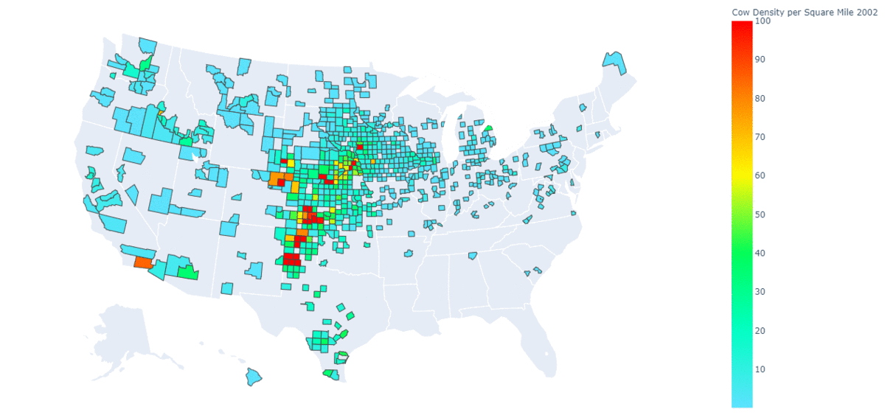
cattle / mi²
90
70
50
30
10

Slide 19
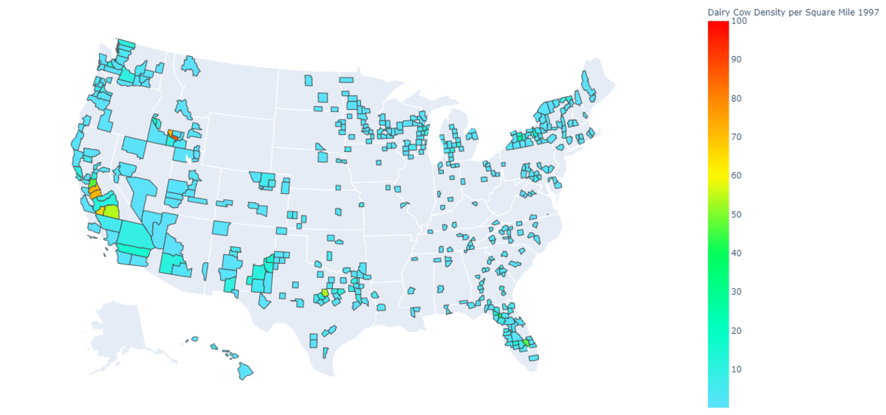
dairy cows / mi²
90
70
50
30
10

Slide 20
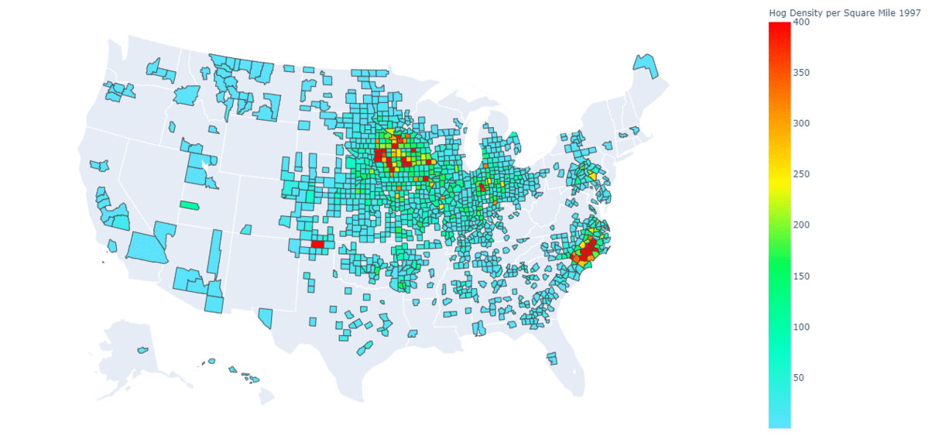
hogs / mi²
400
300
200
100

Slide 21
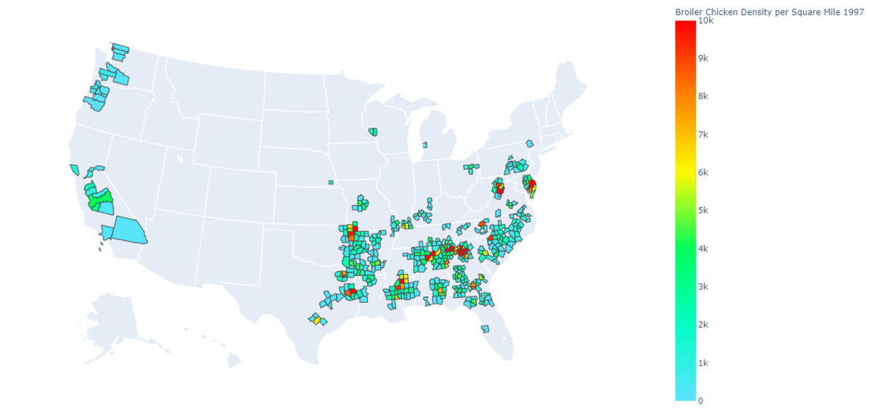
broiler chickens / mi²
10k
8k
6k
4k
2k

Slide 22
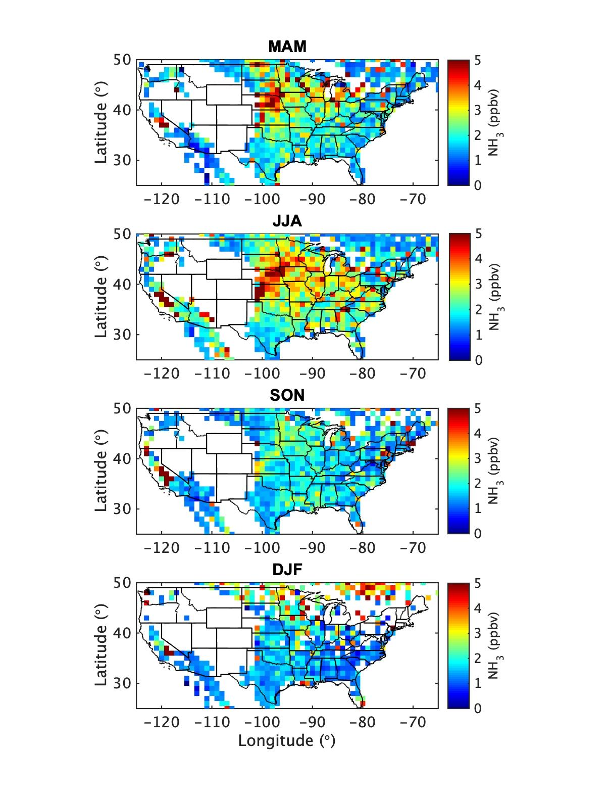
NH₃
Spatial pattern similar to animal unit density
Seasonal pattern consistent with husbandry life cycle
data from NASA’s MERRA product

Slide 23
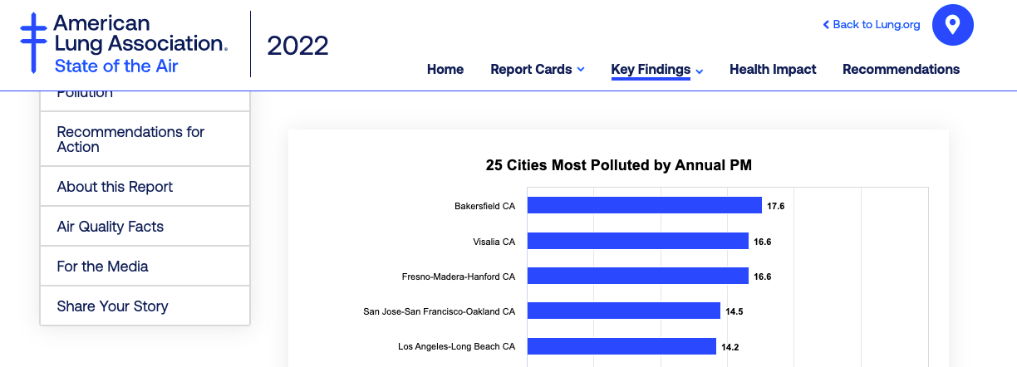
State of the Air
Americans experienced more days of “very unhealthy” & “hazardous” air quality than ever before in the two-decade history of “State of the Air."

Slide 25
State of the Air 2021
Wildfires: higher frequency, greater severity, longer duration, and increasing proximity to populated areas, contributed significantly to the elevated year-round levels in many western cities.

Slide 26
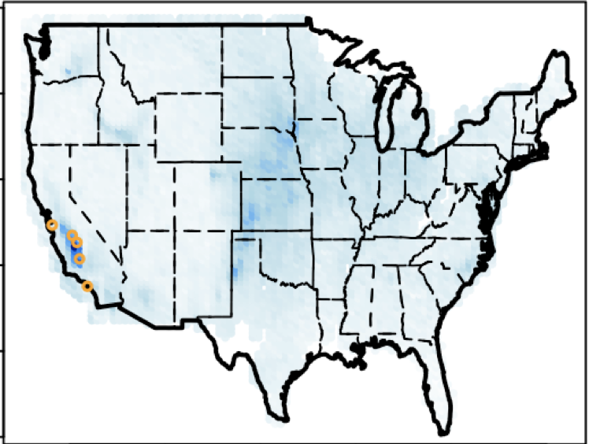
NH₃ & Most Polluted Cites
most polluted cities for year-round PM_{2.5} & ‘serious non-attainment’
NH₃ from IASI

Slide 27
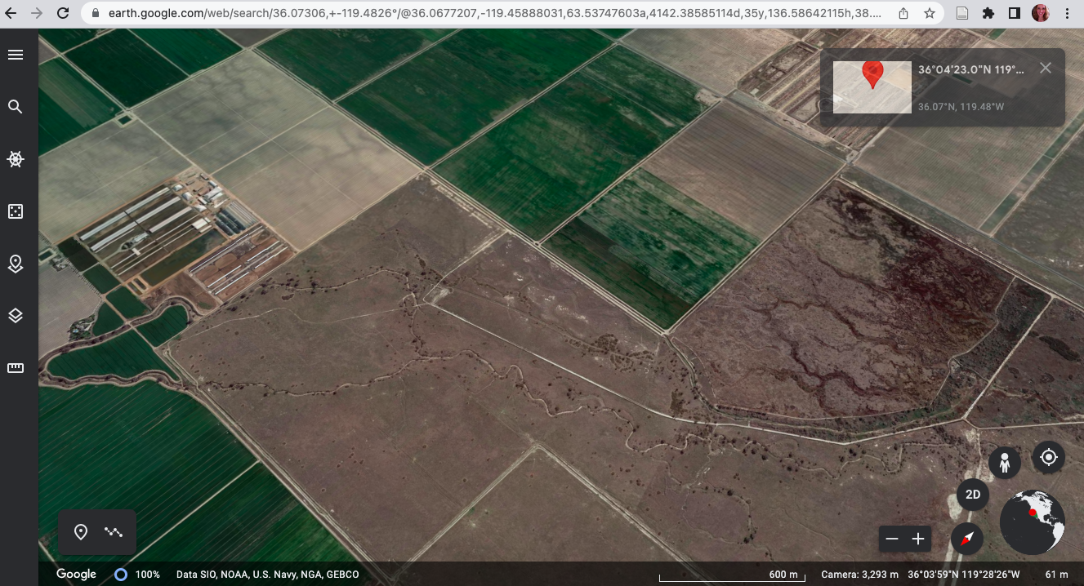
Coordinates with the highest [NH₃] 36º 04’23.0’’N 119º 28’57.4’’W
DAIRY

Slide 28
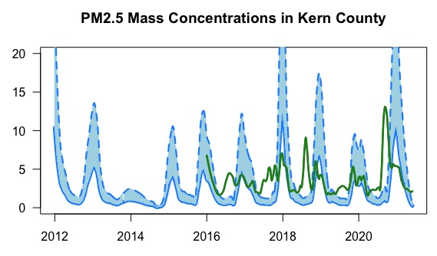
measured nitrate
organic carbon
lower bound estimate for losses
µg m⁻³
Chow et al., “Loss of PM2.5 nitrate from filter samples in Central CA”, JAWMA, 2005
Source: EPA

Slide 29
Ag emissions also affect climate
EPA reports that agriculture is the largest source of 2 GHGs: nitrous oxide (300x CO₂) and methane (80x CO₂)
Methane from agriculture is not regulated & exempt from the Methane Pledge
Nitrous oxide is also the ozone-depleting substance with the fastest rate of growth at the South Pole.
N₂O not covered under the Montreal Protocol or later Agreements, e.g., Kigali

Slide 30
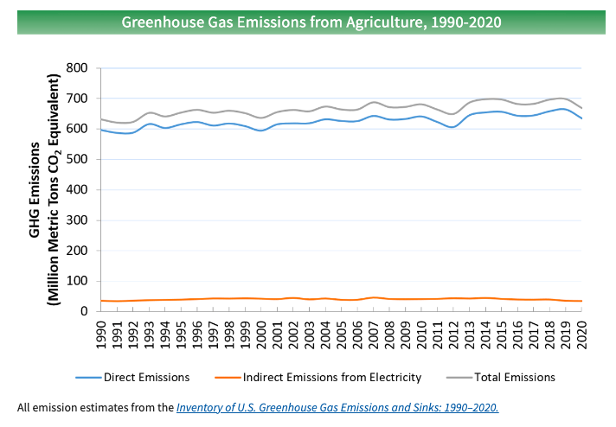
Ag GHG emissions rising
Source: EPA

Slide 31
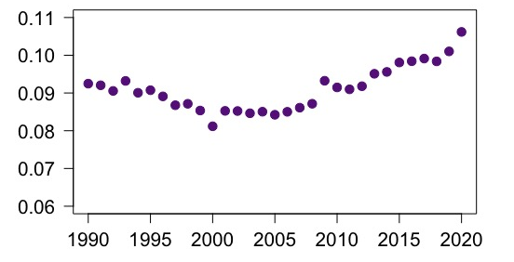
Fraction of US GHG emissions from AG
as MMT CO_{2-equiv}
Source: EPA

Slide 32
Justice 40
farm workers during Covid & epic wildfire
The most ambitious climate plans to decarbonize ‘everything’ will improve AQ in cities but not agricultural regions.
Migrant, seasonal workers are among the most vulnerable in the US & globally

Slide 33
NASA Student Airborne Research Program

Slide 34
Sampling CA’s Central Valley
June 23, 2022, 7-hr NASA DC-8 flight over California’s Central Valley
rain on June 22 scavenged trace species, atmosphere was relatively clean.
CA’s Central Valley:
one of the most productive agricultural regions in the world
large amount of CAFOs, in particular dairies
1000s of oil & gas wells
the Valley is home to the top 3 most polluted cities in the U.S. for year-round PM_{2.5}
CAFOs are a large source of ammonia, a dominant PM_{2.5}-forming species.
CAFOs are more common in high-poverty and majority-nonwhite communities. In CA, the odds of exposure to CAFO pollution increases with increasing percentage of Native Americans, non-Hispanic Black and Hispanic individuals.

Slide 35
Methods
Methane measured with cavity ring-down analyzer (NASA Langley Research Center)
586 methane measurements passed QA/QC & are used in this analysis­
data ranked according to methane content (range: 1.898 - 2.358 ppm)
Coordinates corresponding to the highest & lowest 30 methane measurements (extreme .05 quantiles) are inspected via Google Earth to determine the likely methane source
Additionally, measurements in the lower quantile were further subset for altitudes less than 500 MSL to constrain interpretation of low values for actual low values not for dilution.

Slide 36
Results
½ of top quartile measurements are unambiguously CAFOs
3 top quartile measurements are above > 500 MSL, suggesting values near surface were higher
No measurement in the bottom quantile is associated with a CAFO.

Slide 37
methane
From NOAA: average global methane was 722 ppb in 1750; today it’s 1892ppb
bold indicates CAFO
2.3583
2.2521
2.2172
2.2032
2.1930
2.1900
2.1846
2.1654
2.1508
2.1480
2.1460
2.1425
2.1404
2.1379
2.1345
2.1219
2.1198* 794MSL
2.1154
2.1148
2.1143
2.1111
2.1100
2.1067
2.1062
2.1041
2.1039
2.1028
2.1024
2.1021* 700MSL
2.1019* 524MSL
2.1011
<1.9 ppm
1.9-2.0 ppm
2.0-2.1 ppm
2.1-2.2 ppm
>2.2ppm

Slide 38
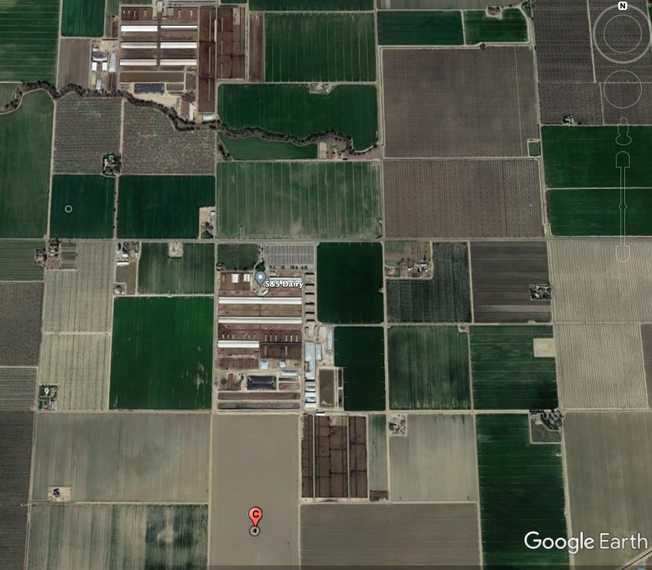
dairies & their lagoons

Slide 39
Conclusions
Air pollution from CAFOs degrades air quality, exacerbates EJ concerns, contributes to the climate crisis
Air pollution from CAFOs is not federally regulated
State and local regulation is hindered by NEPA, EPA’s EEM Consent Order, lack of federal action
Air pollution from CAFOs could be federally regulated
assist with Justice 40 Goals & protect human health

Slide 40
Acknowledgements
Sarav Arunachalam and the CMAS team
Independent Federal Level Science safeguards human health and environment: NASA, EPA, NOAA, WHOSTP
Kira Burkhart, Reese Carlton, Alyssa Burns

Slide 41
NASA SARP
summary(combo.dat$CH4_ppm)
Min. 1st Qu. Median Mean 3rd Qu. Max. NA's
1.898 1.940 1.957 1.978 2.006 2.358 18

Slide 42
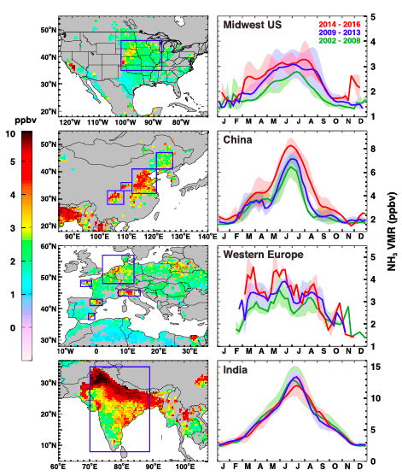

Slide 43
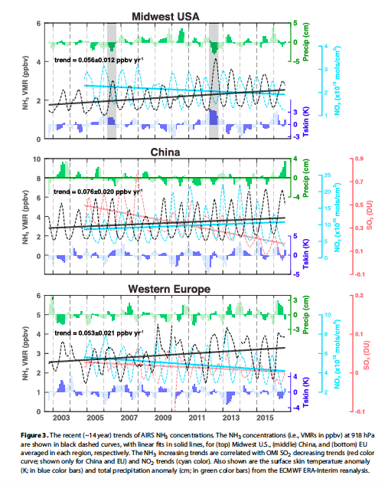
Warner et al., 2017 hypothesize that declining SO₂/SO₄ caused the rise in ammonia

Slide 44
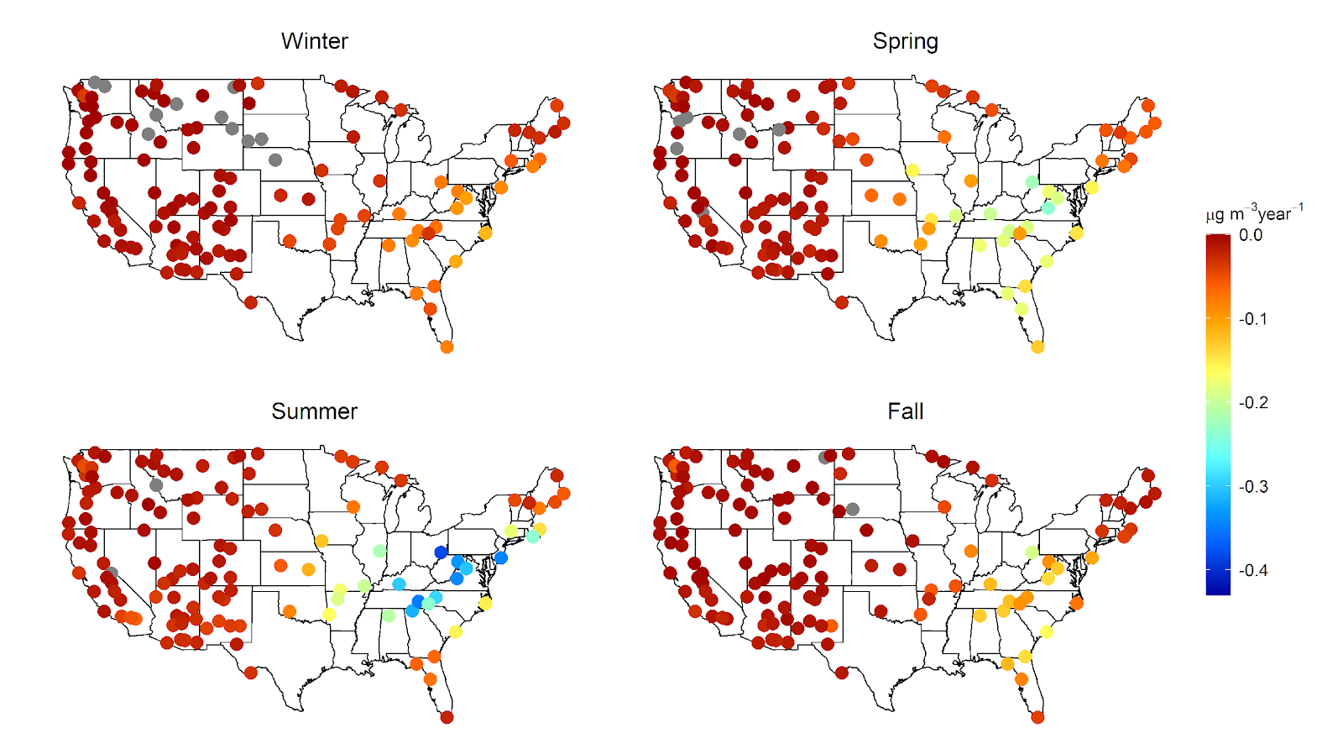
sulfate
Particulate sulfate mass concentrations from 2003-2017 by season
Southeast U.S. Note: Gray dots indicate a slightly positive trend.

Slide 45
Atmospheric aerosol
Atmospheric fine aerosol (PM_{2.5}): associated with adverse health & welfare effects, and can perturb local radiative budgets
Most ambient PM_{2.5} mass forms during transport: consists of inorganic salts, organic species and liquid water
Organic partitioning to concentrated inorganic salt solutions represents an important formation pathway for secondary organic aerosol (SOA), a dominant PM_{2.5} contributor
Salt identity & concentration play a determining role in organic solubility
- 19th century Hofmeister series: repeatable salt pattern that describes the ability of ions to cause proteins (organic molecules) to “salt in” or “salt out”
Burnett et al., 2018; Xie et al., 2016; Attwood et al., 2014; Zhang et al., 2017; Nguyen et al., 2016; Xu et al., 2015; Carlton et al., 2018; Carlton & Turpin, 2013; Pye et al., 2015, 2017; Shrivastava et al., 2017; Zhang et al., 2007; Gurau et al., 2004; Kunz et al., 2004

