Slide 1

World Urban Database
Access Portal Tools
Urban Canopy Parameters for Fit-for Purpose Multi-Scale
Weather, Climate & Air Quality Models
Jason Ching
UNC Institute for the Environment,
Dan Aliaga, Gerald Mills, Valery Masson, Adel Hanna
& many Urban Collaborators from IAUC, PLEA and other urban communities

Slide 2
World Urban Database & Access Portal Tool (WUDAPT)
Why Urban?
What and Why WUDAPT?
>Half of population lives in cities
Cities have major impact on climate and vice versa
Modeling and measurements are challenging.
Characterization of urban land surfaces is major modeling challenge and requirement.
Climate induced risks and exposures are exacerbated in urban areas, thus the need for tools to model for Hazards, Risk, Air Quality and exposures at Urban scales and setting
Interest in urban gaining interest due to influence of urban areas on /climate and vice versa, e.g., WMO’s Urban Services is new mandate and high priority
Provide database and portal infrastructure to support urban Fit-for-Purpose model applications
Database for urban focused meteorological modeling only available for few cities.
Consistency and Characterization of urban land surfaces is major modeling challenge and requirement.
WUDAPT challenge is for world-wide coverage, timely and practical to generate.
WUDAPT Level 0 (LCZ based) is major innovative means for worldwide database for urban modeling
WUDAPT Level 1&2 now underway for wider range “fit for purpose modeling” Pathway is the DSC tool

Slide 3
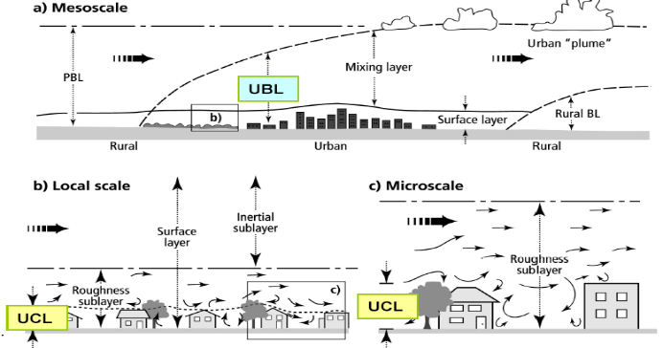
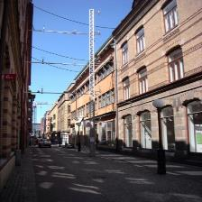
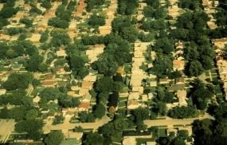
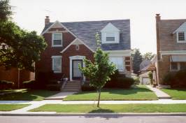
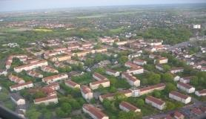
WUDAPT considers variety of Scales and Forms that impacts
Meso-urban boundary layers, weather and climate simulations
Melbourne
Typologies
Scales
Gothenburg
Chicago
Chicago
Scales
Bremen
Notes:
Like all studies in the Atmospheric Sciences, scale is important. In urban areas we typically identify three scales.
Microscale – this is the scale of individual buildings, trees, gardens. Concerned with the urban canopy layer so processes near the roughness elements.
At the local scale or neighborhood scale, we are concerned with areas that have similar characteristics – for example, a residential area with aged vegetation and particular building style; an industrial area – so across a city there are general neighborhoods or local scale units.
The whole city of the mesoscale – here we are looking at the net effect of the city relative to the rural surroundings.
Several local-scale climates

Slide 4

WUDAPT Guiding Principles
Community-Based framework and implementation
Global in scope, results are unrestricted
Based on readily available input data
Methods Protocols provide Global data consistency
Hierarchical implementation approach
Timeliness for urban planning: responsive to Climate change
Supports “Fit-for Purpose” model applications
Pathway based on
DSC, Testebeds and
Building Typologies
Local Climate Zone Paradigm

Slide 5
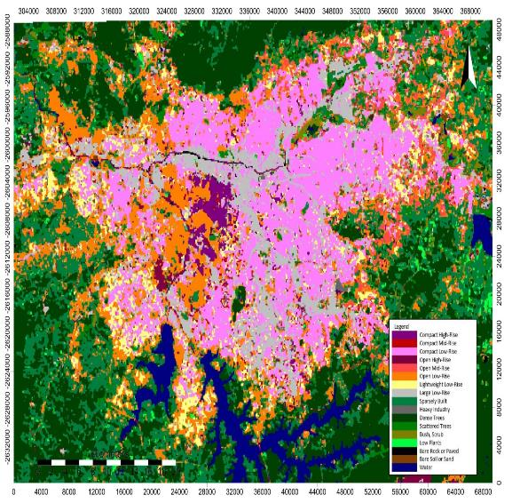
Level 0: Local Climate Zones (LCZ) maps with associated UCP lookup tables for modeling
LCZ map of Sao Paulo

Slide 6
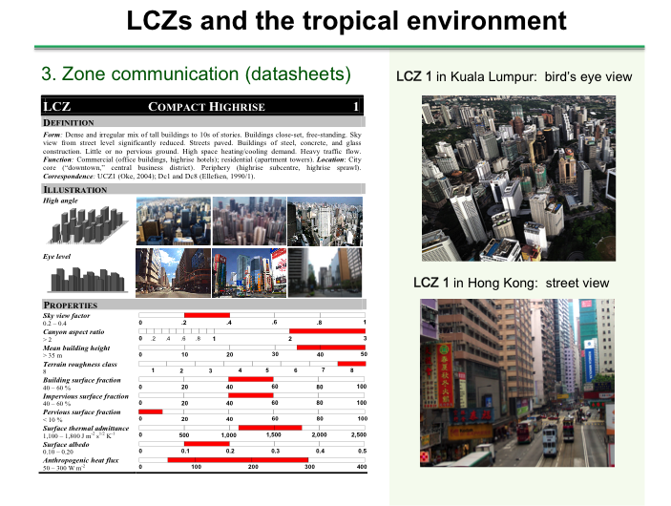
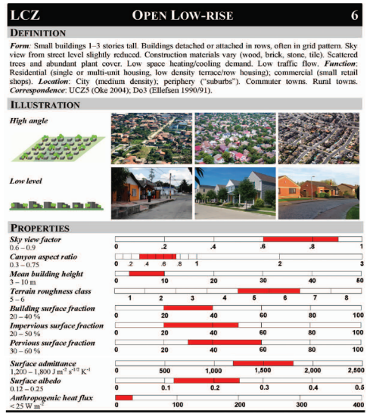
Lookup Tables provide Range of Model Parameters Values associated with Local Climate Zones from WUDAPT Level “0”

Slide 7
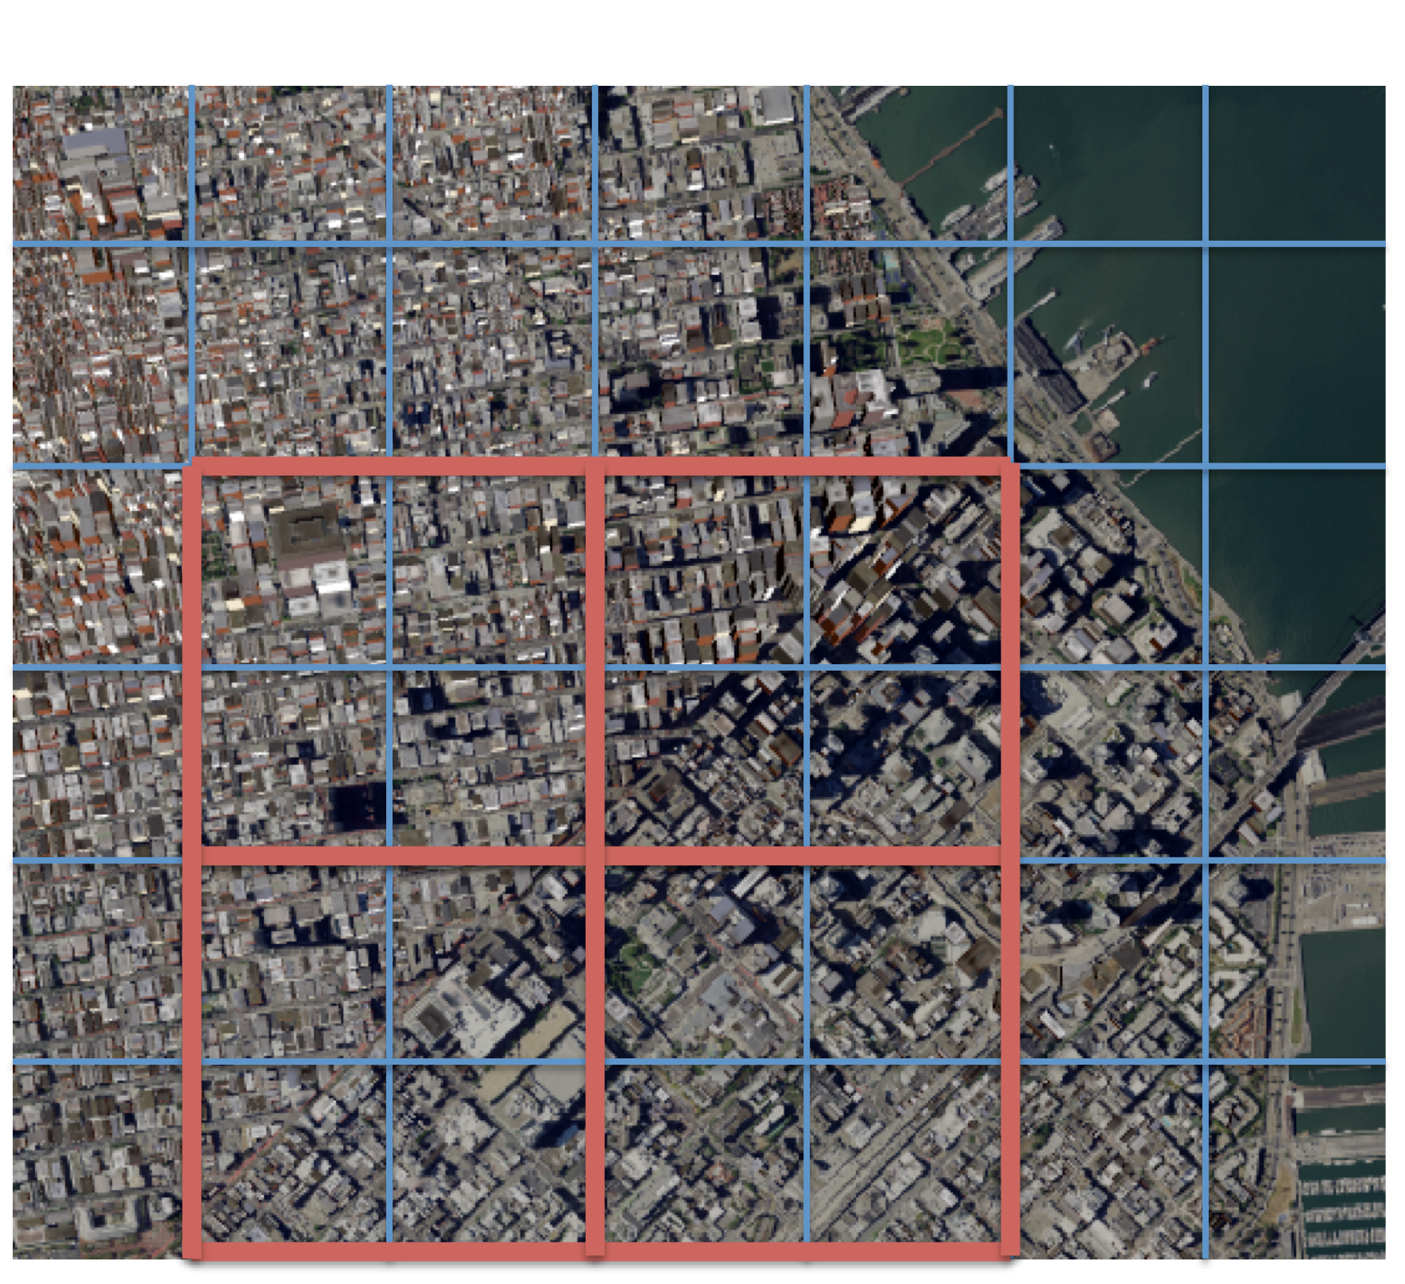
Level 1&2: Computing scale dependent UCPs given digitized
urban morphology from High-Res Google type satellite imagery based on
WUDAPT’s Digital Synthetic City (DSC) tool
DSC can digitize Urban Features
THEREFORE: UCPs
can be generated for each and all Grids
&
Grid size is a User Choice

Slide 8
Digital Synthetic City Pipeline: The DSC workflow.
PM Generation
PROCEDURAL MODEL
GENERATION
Parcel
Generator
Building
Generator
NNs
PARCEL
GENERATOR
BUILDING
GENERATOR
URBAN 3-D
PMMODEL
DSG
S&L Satellite Image
SEGMENTED
SATELLITE
IMAGERY
OSM
OPEN
STREET
MAPS
ELEVATION
Population
POPULATION
PM Optimization
PROCEDURAL
MODEL
OPTIMIZATION

Slide 9
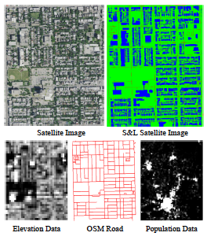
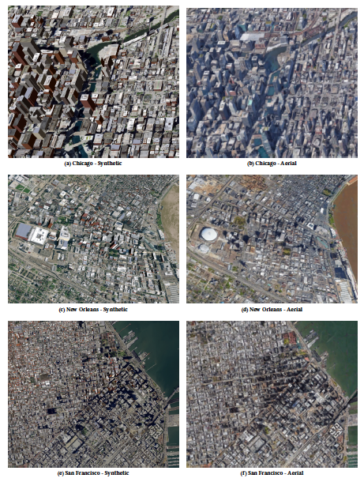
WUDAPT’s Digital Synthetic City Pipeline
DSC
Hi Res Aerial
View from
Afar
Chicago
TechDSC copy
New Orleans
San Francisco
DSC generate entire city in minutes to hours.

Slide 10
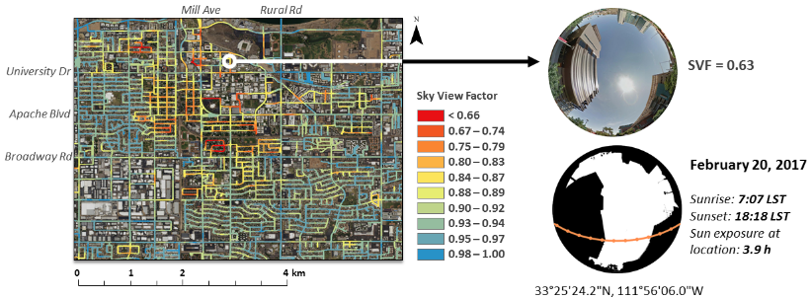
SVF (Sky View Factor)

Slide 11
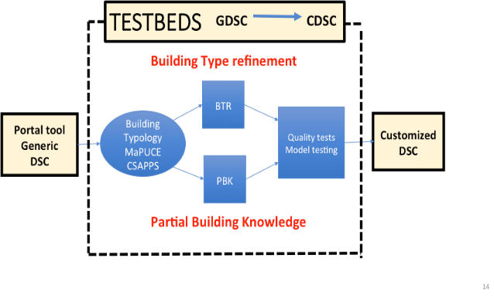
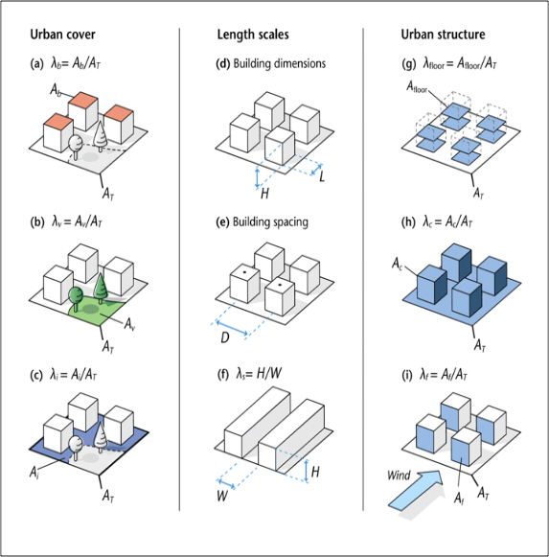
Morphological Parameters
Create, evaluate Form-based Morphological descriptors
1. Generate synthetic city - DSC
2. Evaluate morphometric parameters against ‘truth’ for selected grid size, e.g.:
Building height, wall area, plan area
Street width, H/W ratio
3. Evaluate LCZ types and parameter values

Slide 12
DSC Output Accuracy.
Average building height % error for several test cities DSC procedural output (BLUE). After procedural model optimization (Orange).

Slide 13
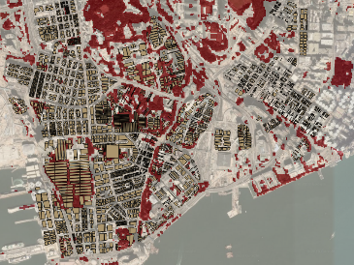
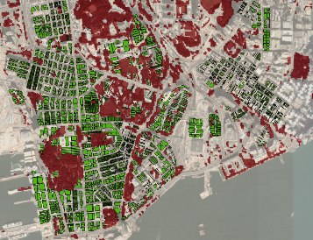
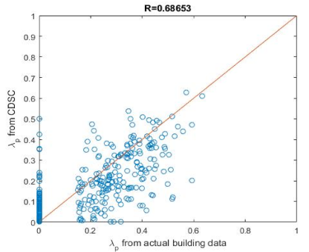
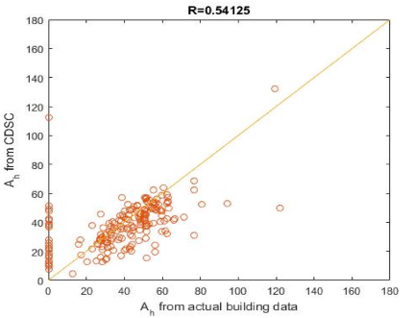
Customizing the DSC; using DSC refinement tool replacing building in areas to tree cover.
Raw DSC product Customized DSC by vegetation
λ _{p} (Hong Kong)
A_{h} (Hong Kong)

Slide 14
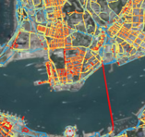
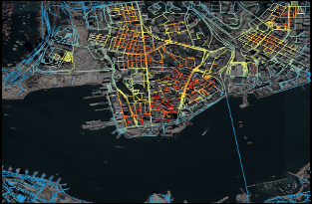
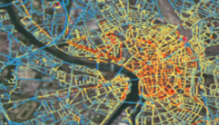
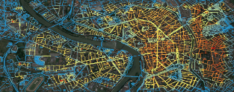
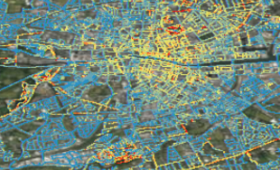
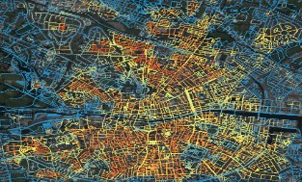

Sky View Factor
Data in WUDAPT Portal
Middel et al 2018
Reference
DSC
Kowloon, Hong Kong
Toulouse, France
Dublin, Ireland

Slide 15
Schematic: Overview of Level 1 and 2
Available High Resolution Data
“Modeling Fit for Purpose”
Applications
WUDAPT PORTAL FOR LEVEL 1 & 2
Digital Synthetic Tool (DSC)
Building Generator
Inverse PM
LCZ + inputs
TESTBEDS
Generic DSC
To
Customized DSC

Slide 16
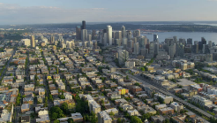
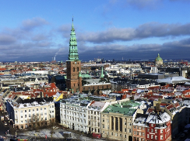
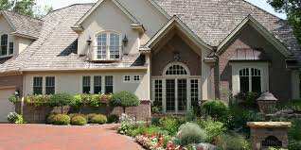
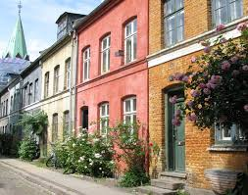
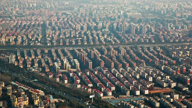
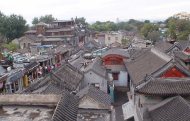
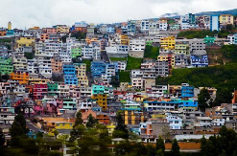
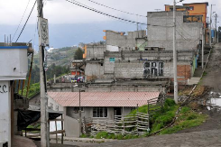
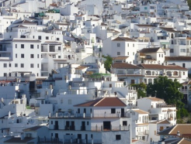
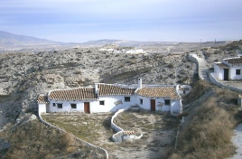
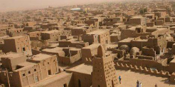
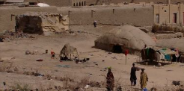
Worldwide variability of building’s architecture
Mid rise buildings
Low Rise buildings and houses
Seattle
Seattle
Copenhagen
Shanghai
Shanghai
Quito
Quito
Andalousia
Andalousia
Tombouctou
Tombouctou

Slide 17
W12 TESTBEDS as Strategic Pathway
Practical & Timely Implementation
Regional coverage:
  20+ TESTBEDS in North and South America, Africa, Euro-India-Asia
  Consideration as WMO Demonstration Cities, Currently China, USA, Europe, South America
Proof of Concept Stage: 2018-2021
Major Activities
  Test and Improve DSC Performance based on available building data
  Customize and Enhance DSC capabilities (Materials and properties) based on Crowdsourcing CSAPP Sampling
  Demonstrate “FIT FOR PURPOSE” Various Model Applications
  Implement DNA Coding protocol
Proposals, Projections:
  Proposed Initial Demonstration at CMAS 2020?
  Proposed WMO Demonstration Cities
  Protocol Rollout in 2021 at IAUC Triennial ICUC-11

Slide 18
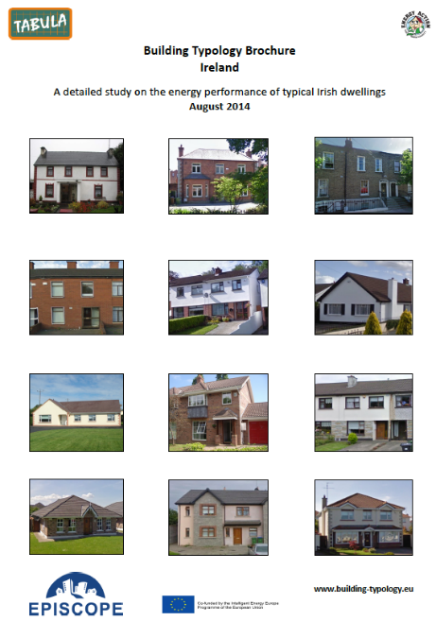
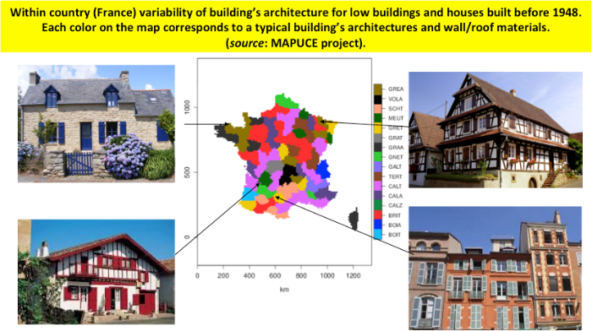
Pathway to W12: Customize DSC
Establish a regional-country Building Typology framework
Incorporate MAPUCE AND TABULA modified paradigms
Generate BT tables/spreadsheets for materials and properties
Utilize Crowdsourcing Sampling and APPS (CSAPPS) approaches

Slide 19
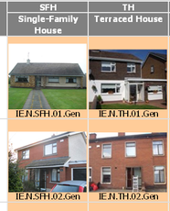
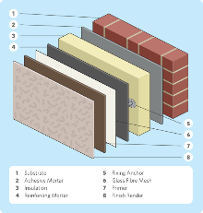
Customizing DSC based on
Building Typology Paradigm
1. Create & Develop associated building typology
Assign thermal/radiative properties to envelope
Assign functional use & likely energy demand to type.
2. Develop procedural model to assign building
types to DSC based on:
Building types representative of city culture/climate and common international types (e.g. residential, warehouses, commercial, etc.) .
Dimensions of building types (floor area, height, roof area, etc.) and dimensions of buildings in DSC.
Local Climate Zone type and probable use.

Slide 20
Specific W-1,2 TESTBED Demonstrations:
Promoting “Fit-for-Purpose” model applications
MESOSCALE (Regional to Urban scale)
  Weather: Extend Current WUDAPT to WRF tool (W2W),
  Air Quality:
    WUDAPT to WRF - Chem
    WUDAPT to WRF - CMAQ
DOWNSCALE TO BUILDING AND STREET SCALE
  WUDAPT to ENVI-met Tool
  WUDAPT to Street Exposure Tool (SinG)
CLIMATE, RISK ASSESSMENT STUDIES
  WUDAPT to UMEP
  WUDAPT TO TEB
  GCP- Global Carbon Project
  WUDAPT TO BUILDING ENERGY- TABULA
WMO URBAN AGENDA:
  Integrated Services “Demonstration Cities”
R&D: Urban Model Physics Studies

Slide 21
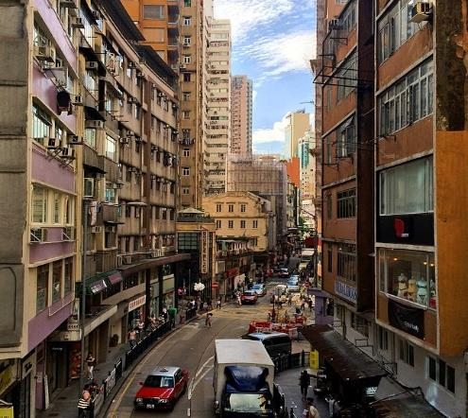
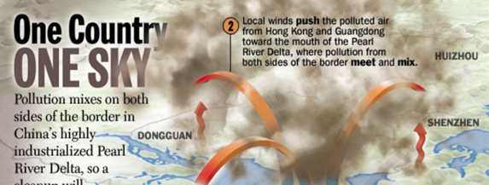
Mesoscale to Street Level
Ground cover, spaces, air flows and inter-connections
≈ 100m x 100m
Notes:
We know that heat stress related mortality is on the increase. The poor, the old and the weak are suffering more.
Moreover, higher urban heat island intensity also increases our energy consumption. A 3 degree UHII will increase our domestic building's energy consumption by 30% This would negate most to our efforts reducing our carbon dioxide emission.
We have calculated that with only 3 degree of urban heat island intensity, our number of hot days will rise from 10 to 96 days. And the number of very hot night will increase from 19 to 127 nights.
In a nutshell, the average Hong Kong people living in the urban environment is now suffering very hot day and very hot night for the entire summer 3 months (June to August).

Slide 22
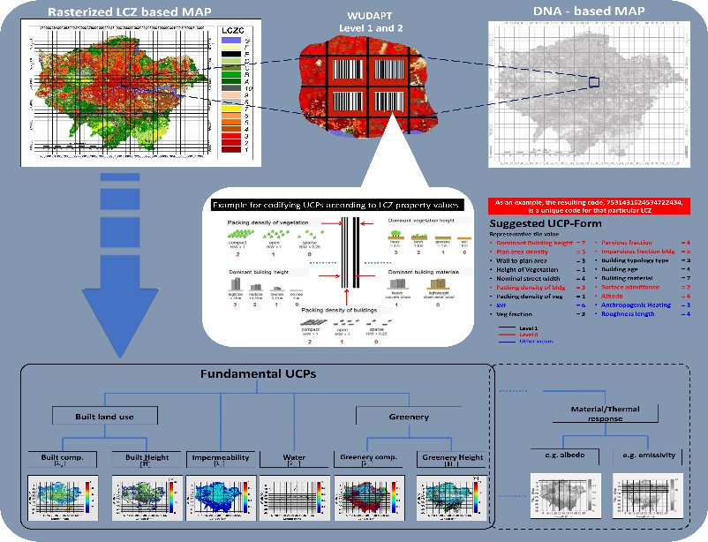
Fig 17. Schematic showing DNA-like coding for UCP from WUDAPT 1&2.

Slide 23
WUDAPT Achievements based primarily on volunteer Collaborations of Urban Communities
Proof of Concept
LCZ Workshop
Level 0 Prototype
Dublin, Ireland
DSC tool introduced
Pathway to W 1@2
Proof of Concept
Establishing Testbeds
Rollout of
Level 1&2
@ ICUC-11
Demonstration
ICUC-9 Toulouse
Proof of Concept
Testbed Testing,
Model
applications
LCZ Concept
Introduced @
ICUC8-Dublin
Rollout of Level 0
Hong Kong
2012 2014 2016 2018 2020 2022

Slide 24
Thanks and STAY TUNED
Question?
Contact: jksching@gmail.com www.WUDAPT.ORG

Slide 25
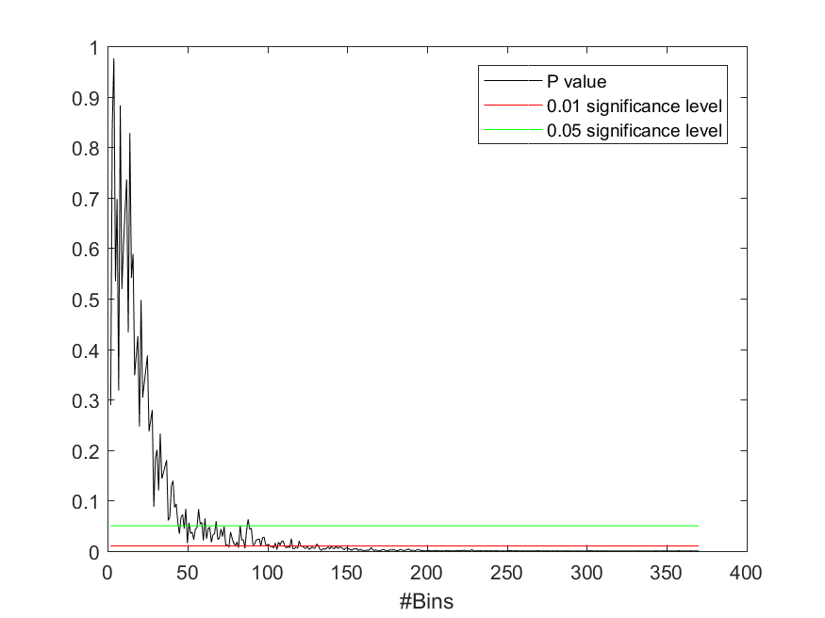
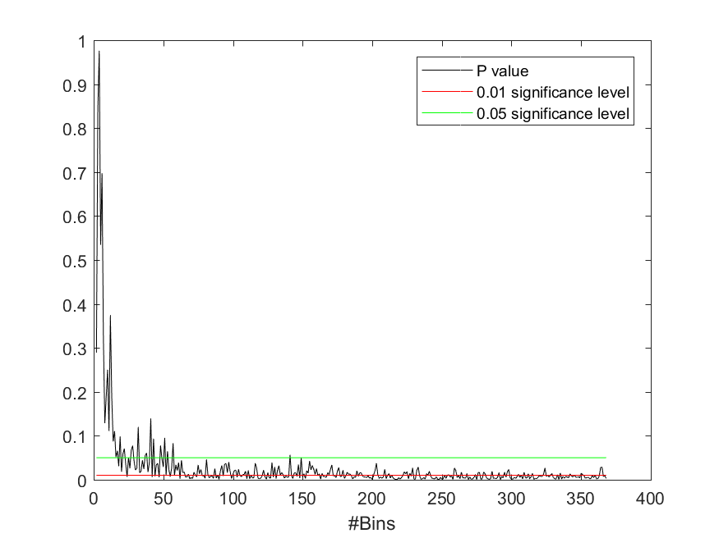
Quantifying DSC Accuracy by Grid Size
Actual Data for Hong Kong
λ _{b}: Building Surface to Plan Area ratio
A_{h}: Area weighted Building Height
P
P
0.05
O.01
0.05
O.01
Grid Size (m)
Grid Size (m)

Slide 26
WUDAPT is International & Community-Based
List of W12 COLLABORATORS is growing, currently
Dan Aliaga
Gerald Mills
Valery Masson,
Linda See
Marina Neophytou
Ariane Middel
Benjamin Bechtel
Chao Ren
Ed Ng
Yuan Huang
Iain Stewart
Jimmy Fung
Michael Wong
Xiaowei Zhang,
Aly Shehata
Alberto Martilli,
Shiguang Miao
Xuemei Wang
Denise Duarte
Luciana Schwander
Weiwen Wang
Yuguo Li
Johan Feddema
Johan Feddema
Yoshiki Yamagata
Adel Hanna
Dev Niyogi
Jorge Gonazales
Julia Hidalgo
Hilge Simon
Michael Bruse
Tim Kropp
Alexander Baklanov
Yoseob Kim
Yelva Ustan
Sue Grimmond

