Slide 1
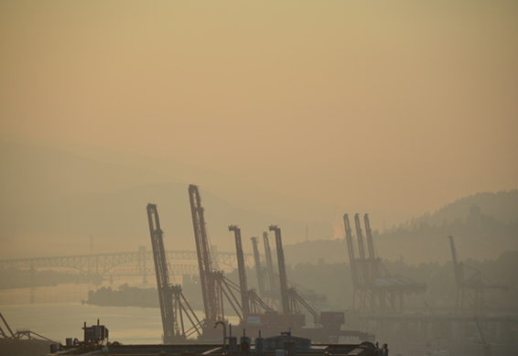
Model Evaluation of ECCC FireWork: Scientific Intrigue in 3 Acts
aka
A Retrospective Analysis for the 2017 British Columbia Wildfire Season
Rita So and Bruce Ainslie
Environment & Climate Change Canada
Vancouver Harbour on July 18, 2017 6:00AM PDT
2018 Community Modeling and Analysis System Conference, Chapel Hill, NC

Slide 2
Programme
Introduction: The setting
Act I: The plot
Act II: The characters
Act III: The drama
Curtain Call

Slide 3
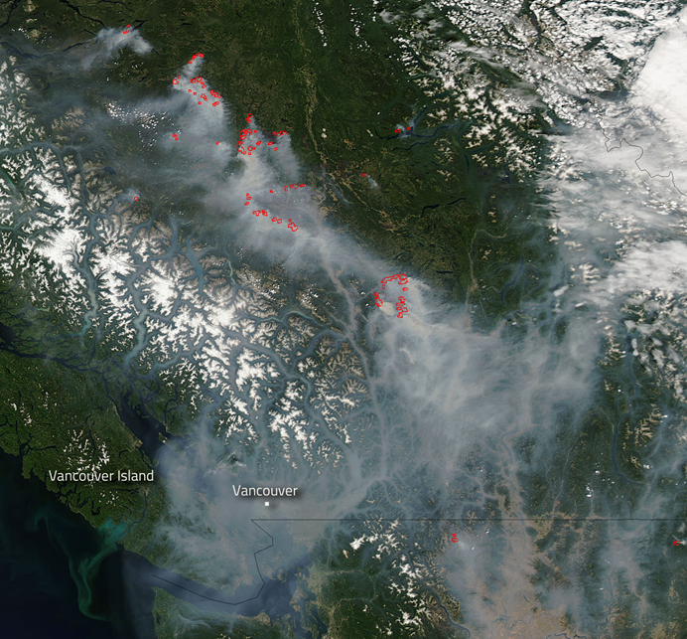
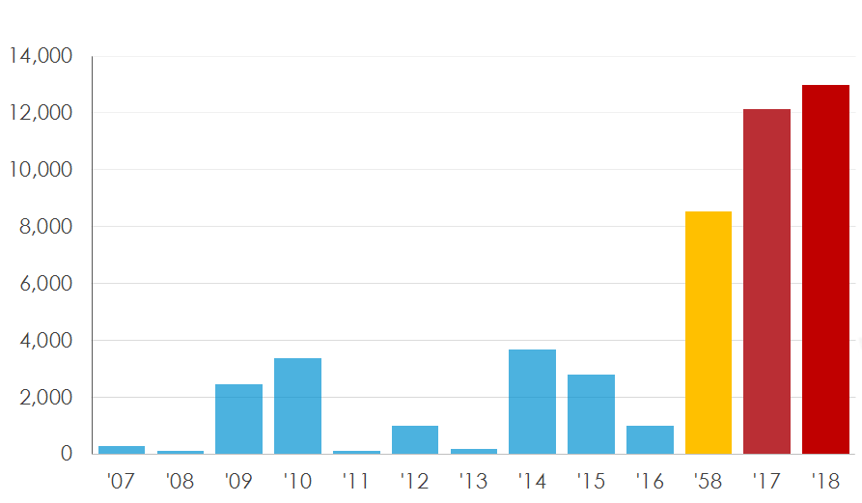
Setting: Time and physical place
2017 Wildfire Season in BC
NASA Aqua MODIS imagery on Aug 1, 2017.
Source: LANCE/EOSDIS MODIS Rapid Response Team
Total Area Burned (km²) by Wildfire per Season (BC Wildfire)
Notes:
- Most severe wildfire season in BC, prev record holder was back in 58
MODIS image on Aug 1st, indicating the fire hotspots in the interior, much of Vancouver and southern BC is smoked out.

Slide 4
Setting: Time and physical place
2017 Wildfire Season in BC
NASA Aqua MODIS imagery on Aug 1, 2017.
Source: LANCE/EOSDIS MODIS Rapid Response Team
Total Area Burned (km²) by Wildfire per Season (BC Wildfire)
Notes:
- Even more severe in 2018

Slide 5
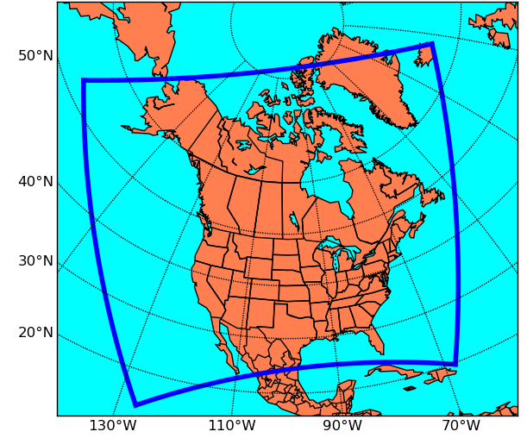
Setting: Digital Place
ECCC’s FireWork forecast model
48hr forecast 2X daily (0z / 12z) from Apr to Oct at 10km horizontal grid spacing
Near-real time fire data from Canadian Wildland Fire Information System
Notes:
During forest fire season
48 hr AQ forecast 2x daily at 10km

Slide 6
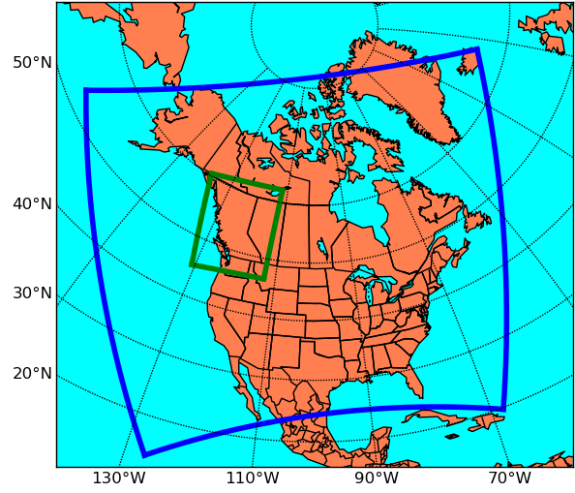
Setting: Digital Place
Re-run 2017 wildfire season (July – mid Sept)on a hi-res 2.5 km domain centered over BC

Slide 7
Plot: How can we improve forecasts?
Test new model configurations with new emissions and higher resolution
Exercise of BC during the 2017 wild fire season
This talk
preliminary experiments: July 5 to August 20, 2017
Evaluate model performance from the users’ point of view
Notes:
To do that we tested various model config with new emissions and high res
-our preliminary experiments were exercised over Jul and Aug
In terms of model perfm we wanted to eval it based on the user’s pov

Slide 8
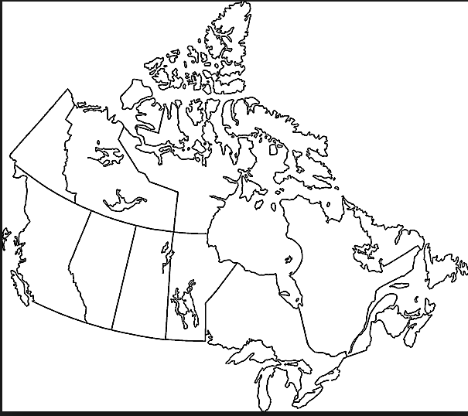
Cast: FireWork User groups
10 Question Survey was sent to AQ forecaster in BC and misc. FireWork users
1 YK
What’s Important?
1 NWT
12 BC
1 MB
How it’s Used?
3 SK
1 ON
4 WA
How to Improve?
1 ID
Notes:
Who? How is it used in their decision making process?
What are looking for in a forecast?
Aprox 25 ppl responded across Canada and some in western US

Slide 9
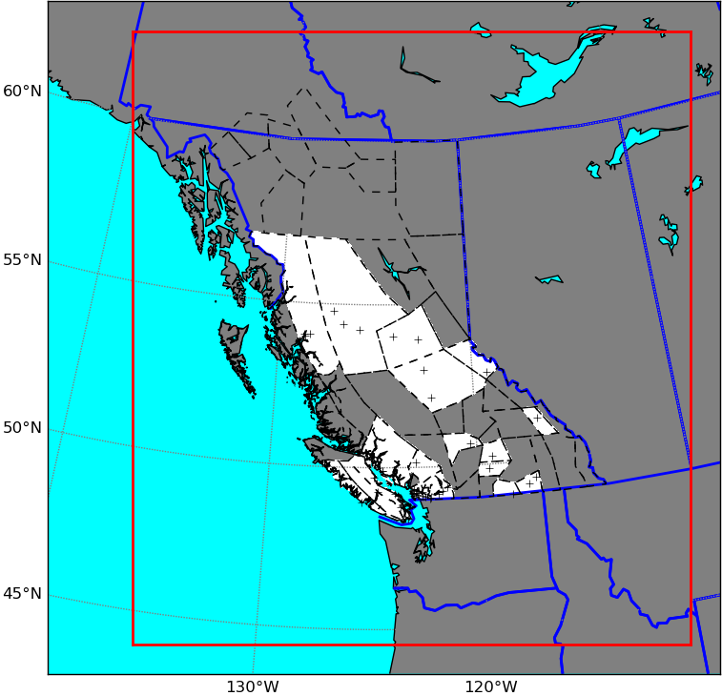
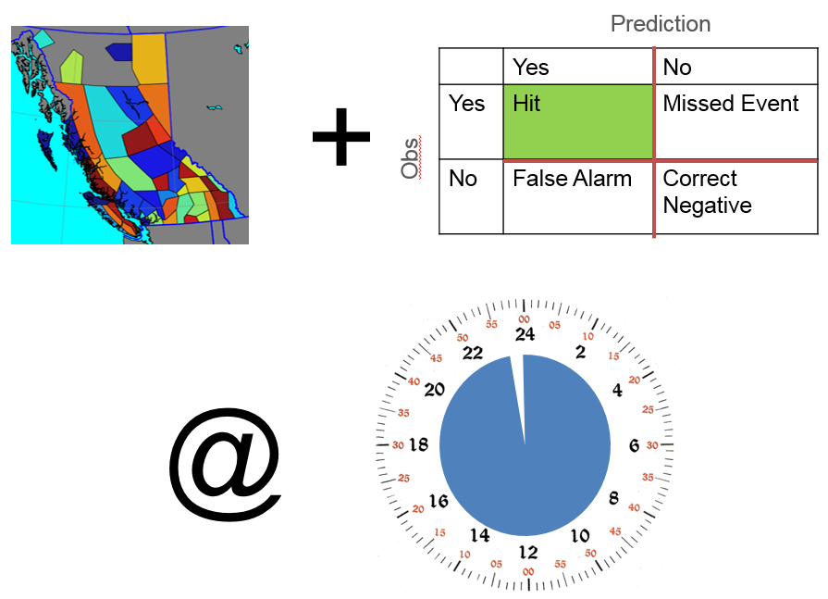
FireWork User Survey
Jurisdiction-based, but never at a monitor…
Timing & Location >> Concentration & Footprint
1st day forecast (0 – 24 hrs) is the MOST IMPORTANT
Notes:
Never entirely consistent; health communities have slightly different
Jurisdiction based set of “obs” to evaluate (which is unfortunate….)
Fcsters want to be forewarn about an exceedance or the anticipated departure of an exceedance….
What’s the worst?? Not issuing a statement for an event that happened?
-> 24 hr cycle of issuing/continuing advisories (preparing communication statements)

Slide 10
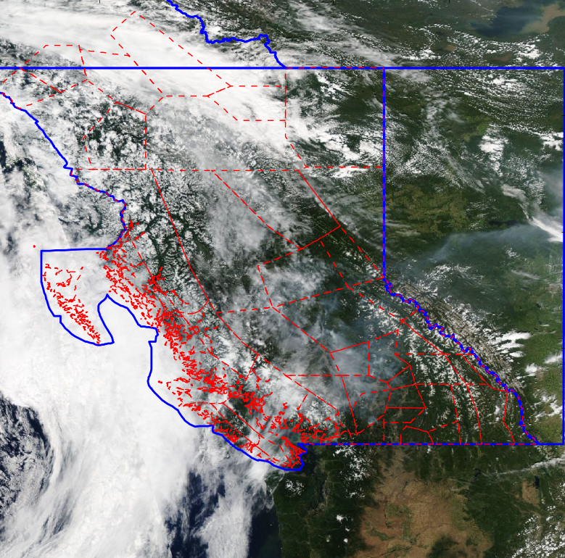
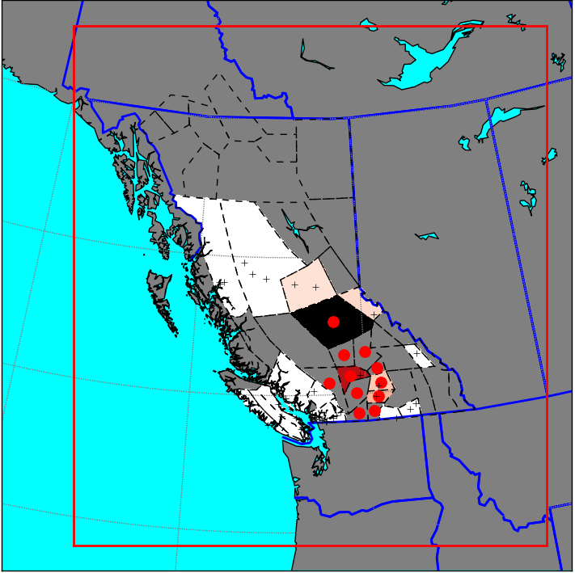
Multiple Linear Regression 2D Product
Jul 8, 2017 MODIS
Obs (monitor)
Daily 24-hr average PM_{2.5} (2008 – 2017)
MLR using:
Aerosol Optical Depth
HMS smoke polygon
Fire Radiative Power
Leave-one-out cross validation (by forecast region & year)
MLR 2D
MLR 2D (Fcst region)
Notes:
In order to try and fill in some of those missing gaps, we developed a statistical model (MLR) that used AOD, HMS, FRP to estimate 24hr average PM2.5.
the forecast regions are shaded based on the obs at monitor locations. The red dots indicate that there was an AQ advisory.
The bottom is our gridded statistical model and then averaged over the forecast regions.

Slide 11
Cast: Model Configurations
Preliminary experiments:
July 5 to Aug 20, 2017
Resolution
 | 10 km | 2.5 km
FEPS
CFFEPS
2-bin
2-bin
Fire Emissions
12-bin
12-bin
2-bin
2-bin
12-bin
12-bin
Check out Mike Moran’s talk, Wed. Oct. 24, 1:20 pm
Notes:
Canadian forest fire emissions prediction system
Config matrix with radiation feedback, improved fire estimates
May look at feedback
Aerosol size representation at 2 bin (fine and coarse) and the 12 bin (in 12 partitions from .01 to 40.96 um)

Slide 12
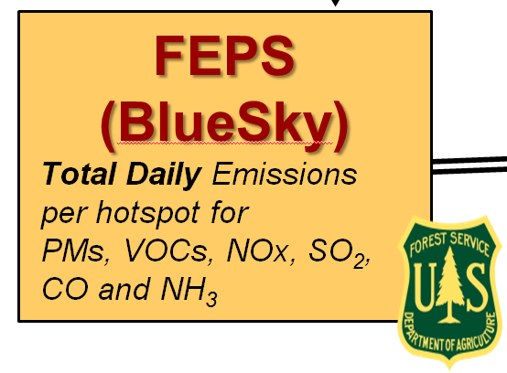
Current Operational System (FEPS + FireWork)
Satellite data
AVHRR / MODIS / VIIRS
Land use data
Fuel types etc
CWFIS
Canadian Wildland Fire Information System
Meteorological Data
observations and forecast
Post-processing
FireWork model

Slide 13
Experimental System (CFFEPS + FireWork)
Satellite data
AVHRR / MODIS / VIIRS
Land use data
Fuel types etc
CWFIS
Canadian Wildland Fire Information System
CFFEPS
Daily total emissions per hotspot
Plus: plume rise, fire energy etc.
Meteorological Data
observations and forecast
Post-processing
FireWork model
More details: see talk by Mike Moran, Wed. Oct. 24, 1:20 pm

Slide 14
Cast: Model & Data
Name | Description | Type | Extent | Purpose
CFFEPS 10km | New fire emissions based on CWIS | Deterministic | Gridded | Evaluation
CFFEPS 2.5km | New fire emissions based on CWIS – high resolution | Deterministic | Gridded | Evaluation
FEPS 10km | Existing operational | Deterministic | Gridded | Benchmark
MLR | Observationally derived PM_{2.5} | Statistical | Gridded | Benchmark (Reference?)
Persistence | Observationally derived PM_{2.5} | Statistical | Point | Benchmark
Observations | 24-hr averaged daily PM_{2.5} | Observations | Point | Reference
Notes:
FEPS benchmark
LT goal -> develop MLR as a reference (but still not happy -> just a benchmark)

Slide 15
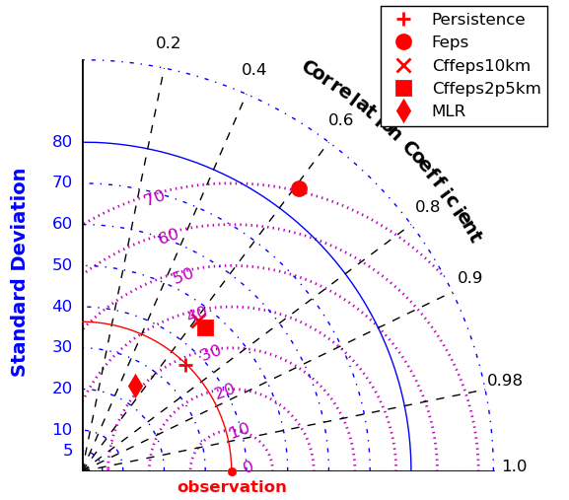
Drama!! Model Evaluation
Traditional:
R, RMSD, SD
Our project:
Arrival of an event
Taylor plot of daily 24-hr average PM_{2.5}
Based on 808 station pairs drawn from 46 locations on smoky* days only
*based on Hazard Mapping System smoke polygons
Notes:
CFFEPS improved over FEPS
2.5 and 10km are very close (surprise that the higher res did not add much value over 10km) → still a limited sample set
At the station level, our Deterministic model do not add value over persistence or the statistical model…

Slide 16
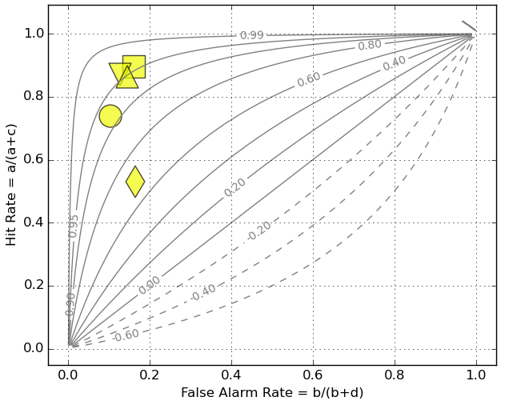
Drama!! Model Evaluation
Traditional:
R, RMSD, SD
Our project:
Arrival of an event
Contingency Plot of daily 24-hr average PM_{2.5} Events
Based on 808 station pairs drawn from 46 locations on smoky* days only
*based on Hazard Mapping System smoke polygons
Notes:
These deterministic models are doing a great job at forecasting for the arrival of an event without too many false alarm
Isopleth: Yule’s Q (fraction of improvement over random change)
Fcst POV – we find that deterministic model outperforms statistical and they are adding value
This is still at the station level… we need to redo this at the forecast region level… but b/c of the poor performance of MLR, not comfortable using it as a ref data set (next work will be focused on)
- if we are just looking at a model’s ability to predict an event, FEPS doesn’t get penalize for its large over prediction and has same skills as the CFFEPS

Slide 17
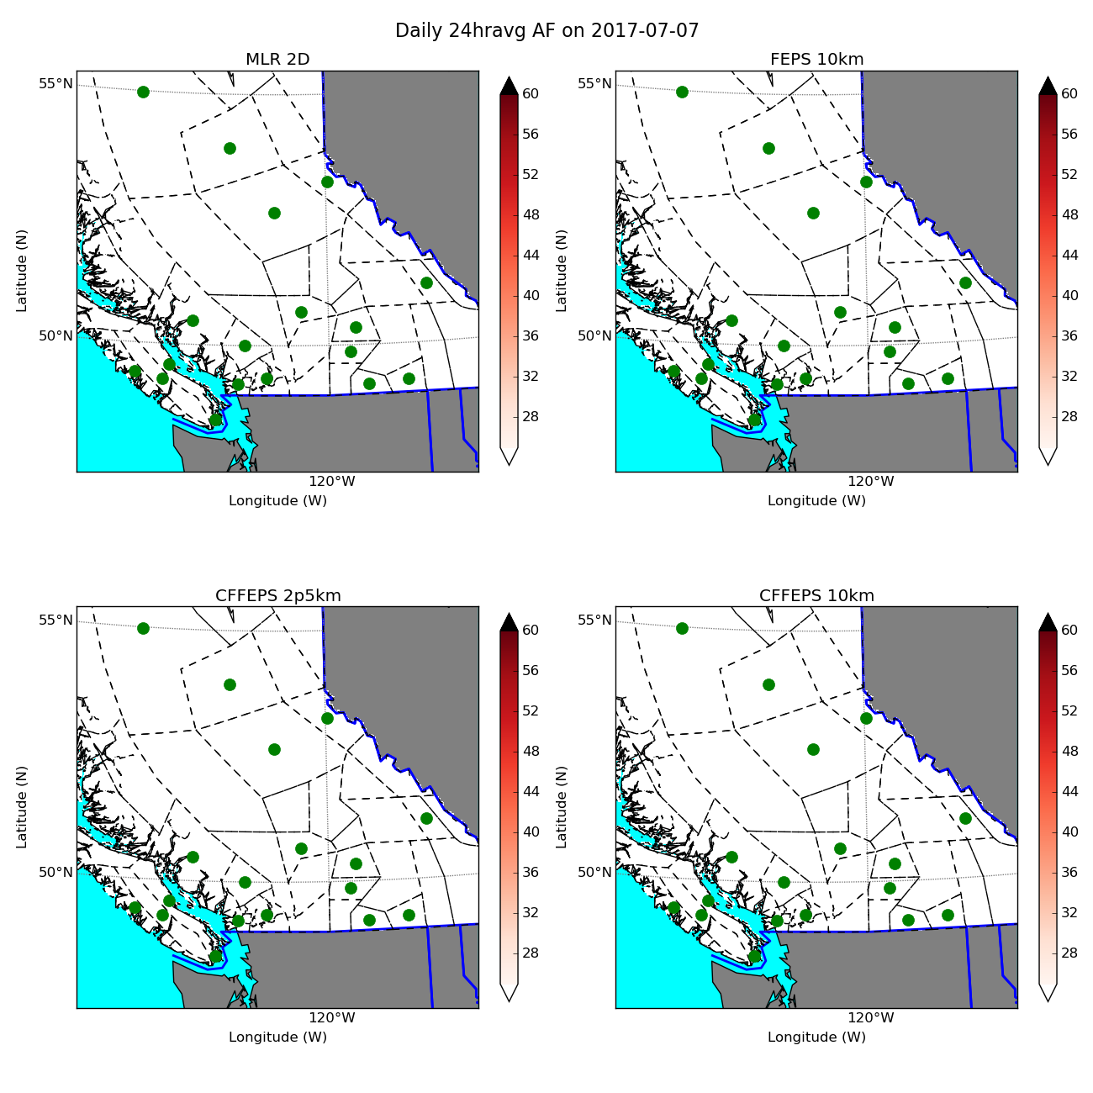
PM_{2.5} Spatial Footprint
176 new wildfires over July 7 – 8
Notes:
Green dots indicate that the stations did not see any exceedance in the fcst region
As do the models since they are all white

Slide 18
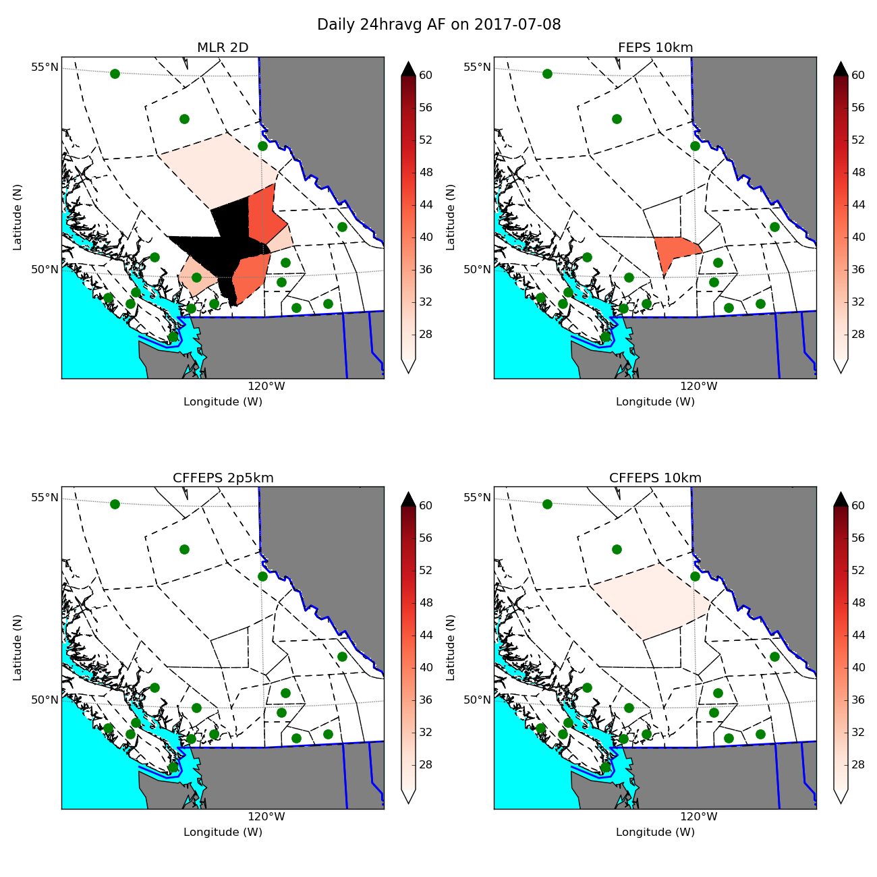
PM_{2.5} Spatial Footprint
176 new wildfires over July 7 – 8
Model | Score
MLR 2D | 2 Hits 1FA
FEPS 10 | 1 Hit 1Miss
CFFEPS 2.5 | 2 Misses
CFFEPS 10 | 1Hit 1 Miss

Slide 19
Curtain Call: Next Steps…
Improving PM_{2.5} 2D Product
Ozone
Consultation on final model configurations
Model Diagnostics
CO soundings (vertical info)
Understanding errors from IC vs Emissions

Slide 20
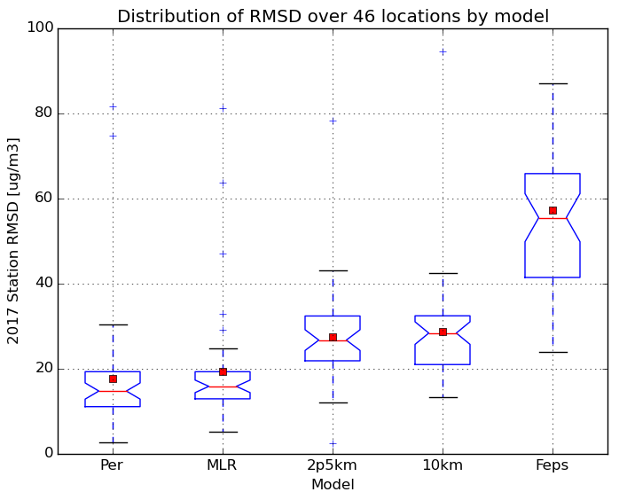
Model Evaluation
Traditional:
R, RMSD, SD
Our project:
Onset & departure of an event
Based on 808 station pairs drawn from 46 locations on smoky days only
Notes:
- Still not beating persistent but greatly improved over FEPS (ops)

