Slide 1
17th annual CMAS conference, Chapel Hill, NC, USA
Year-long Simulation of PM_{2.5} in Pearl River Delta using WRF-SMOKE-CMAQ System
Xuguo ZHANG, Jimmy FUNG, Alexis LAU and Wayne Wei HUANG
Oct 23, 2018

Slide 2
1
Outline
Research Background
Air Quality Modelling System
Refining 2012 emission inventory
Model performance of PM_{2.5}
Summary

Slide 3
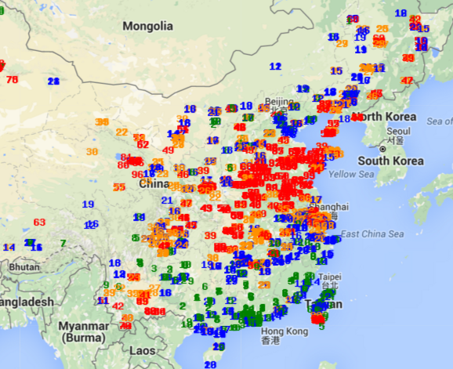
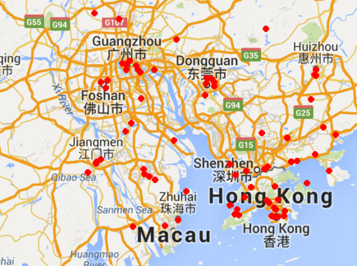
Research Background
2
Complex Air Pollution has become a severe issue throughout the whole China.
Causes: Meteorological Conditions and Emissions (Zhang Q. (2012) Nature; Guo S. (2014) PNAS )
Real time monitoring data have been released since Jan. 2013.
Challenges: Large gradient & Too Sparse & Paucity.
Targeting: What is it? Where does it come from? Where does it go?
Spatial 2D Plot for PM2.5 for the Whole China
(1522 Stations)
Spatial 2D Plot for PM2.5 for PRD
(70 Stations)
PRD

Slide 4
Objectives of this study
3
Assessing 2012 emission inventory to provide a reliable model-ready hourly, gridded emission input.
Total comparison.
Spatial surrogates and temporal profiles.
Scenario analysis to refine the emission inventory.
Year-long simulation to analyze spatial distribution and seasonal variations.
Time series and spatial map for PM_{2.5} performance.
Seasonal changes of PM_{2.5} components.

Slide 5
AIR QUALITY MODELLING SYSTEM
4
Meteorological Model
Create Physical Atmosphere
Solve full set of atmospheric equations for evolution of wind, temperature, pressure and moisture content, etc.
(WRF)
Emissions Model
Anthropogenic, Natural
(SMOKE)
Atmospheric Chemistry Model
Chemical reactions of various chemical species
and solve the advection-diffusion equations
(CAMx, CMAQ)
Analysis Model
Evaluation
Sensitivity
Display

Slide 6
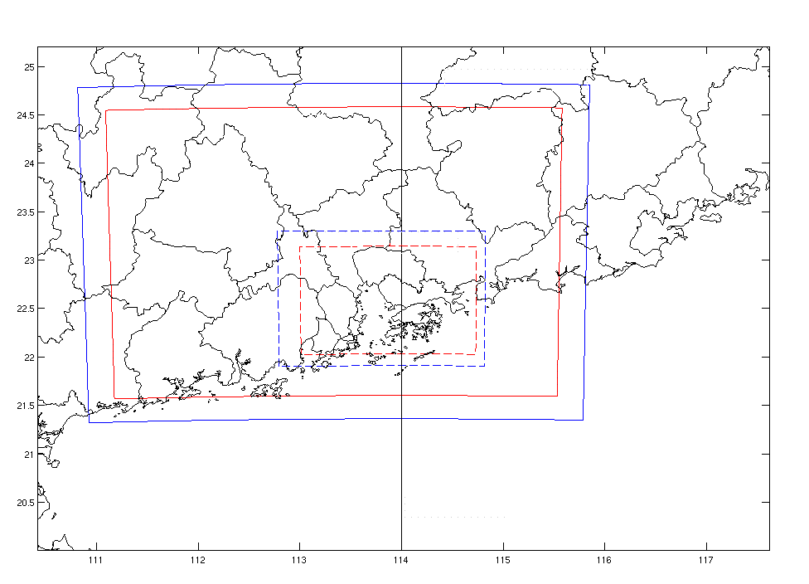
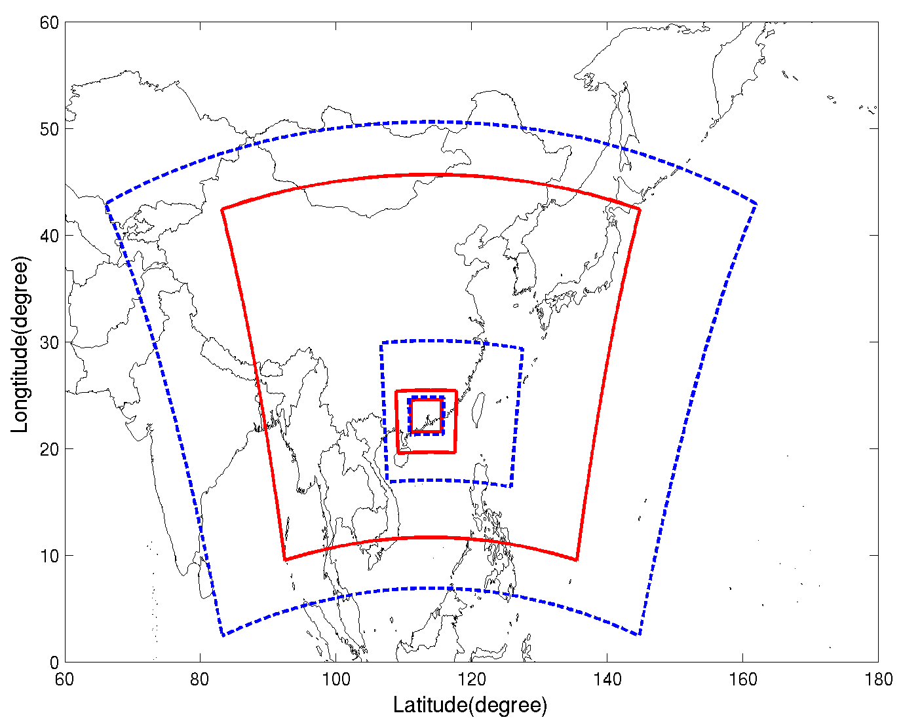
Targeting Domains
5
Larger WRF domain could minimize the boundary effects of meteorological parameters on CMAQ grid.
D3
D1
D4
D2
Parameter | Value
Projection | Lamber-Conformal
Alpha | 250 N
Beta | 40 N
X center | 114 E
Y center | 28.5 N

Slide 7
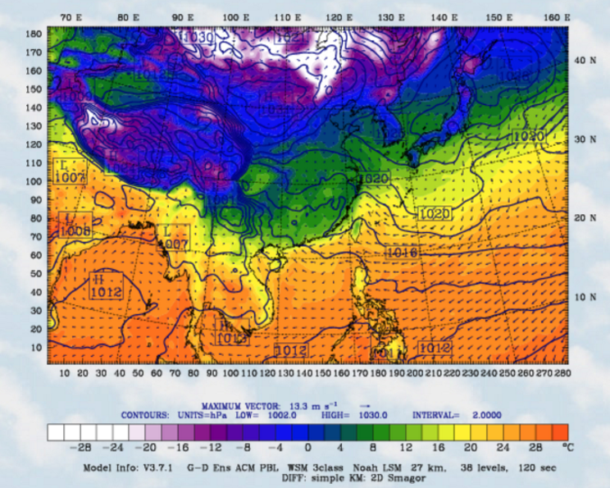
Meteorological Field Validation
6
Spatial distribution of WRF output for parameters: Tem., surface wind vector, sea level pressure.

Slide 8
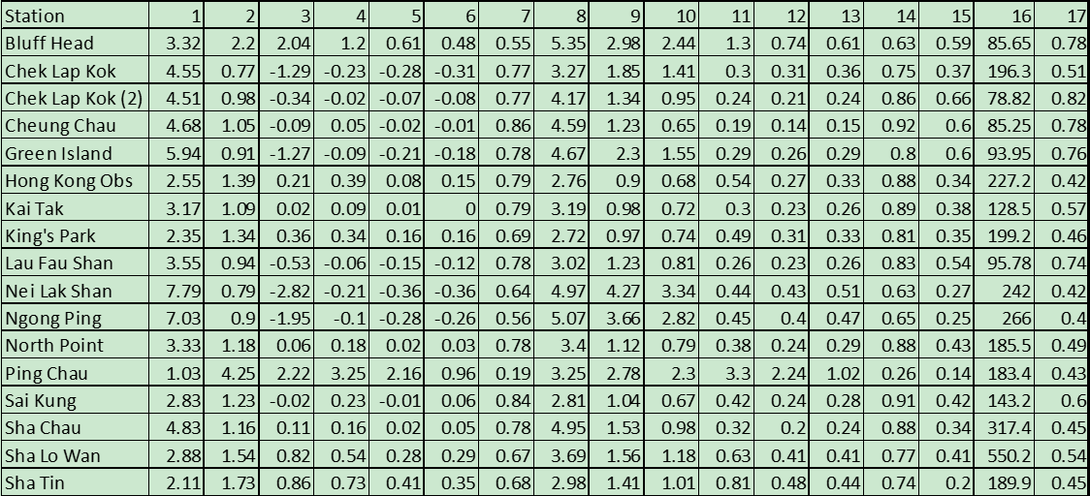
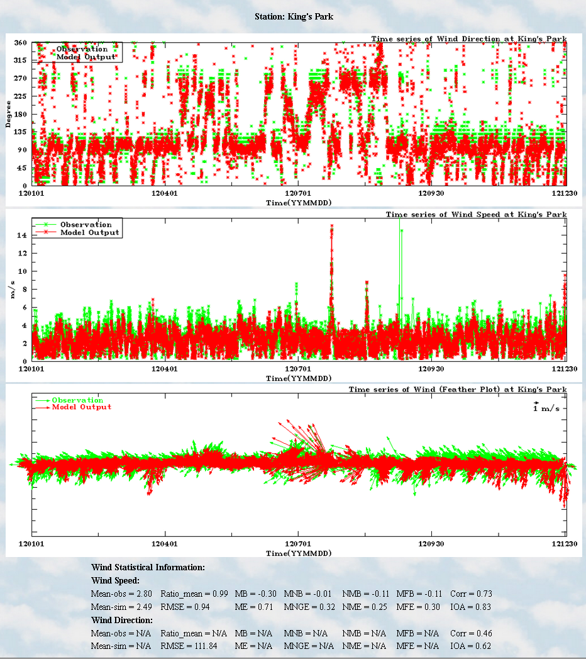
Meteorological Field Validation
7
Performance matrix for WRF field
2012 Wind speed and wind direction
Note (1) Observed Wind; (2) Ratio Mean; (3) Mean Bias; (4) Mean Normalized Bias; (5) Norm Mean Bias; (6) Mean Fractionalized Bias; (7) Coefficient Determination; (8) Simulated Mean; (9) Root Mean Square Error; (10) Mean Absolute Gross Error; (11) Mean Normalized Gross Error; (12) Normalized Mean Err; (13) Mean Fractionalized Bias; (14) Index of Agreement. For wind direction: (15) Corr; (16) RMSE and (17) IOA.

Slide 9
Raw Data Comparison: Total
8
2012PM2.5 47%, due to Fugitive Dust 86%, Mobile 49%, Industry 22%，
But Power Plant 35% .
2012PM10 45%, due to Mobile 55%, Fugitive Dust 39%, Power Plant 39%，
Industry 35% .

Slide 10
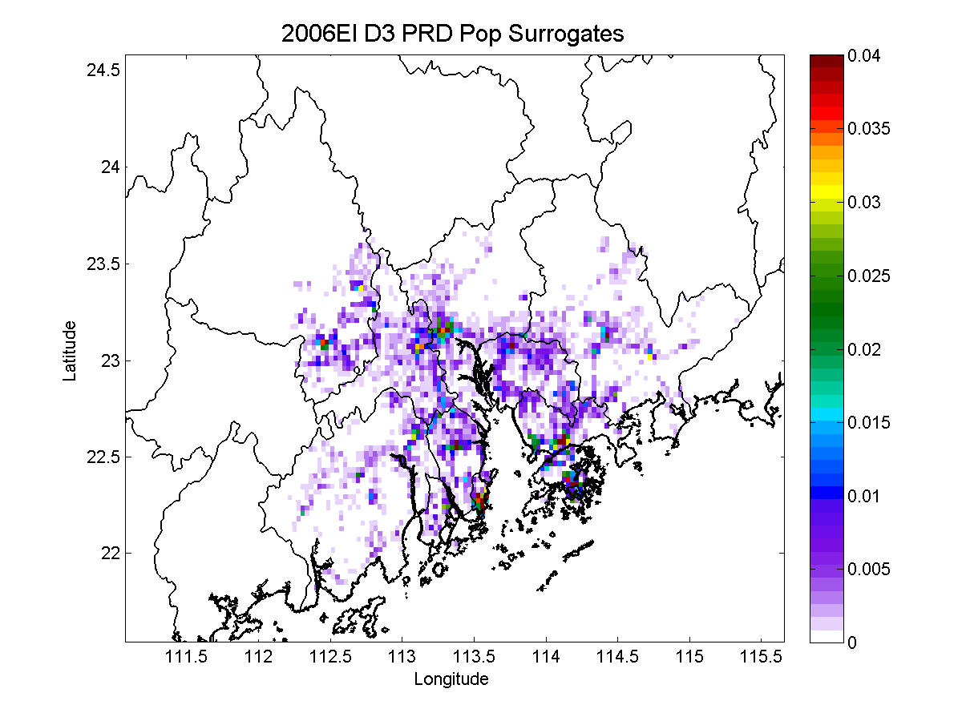
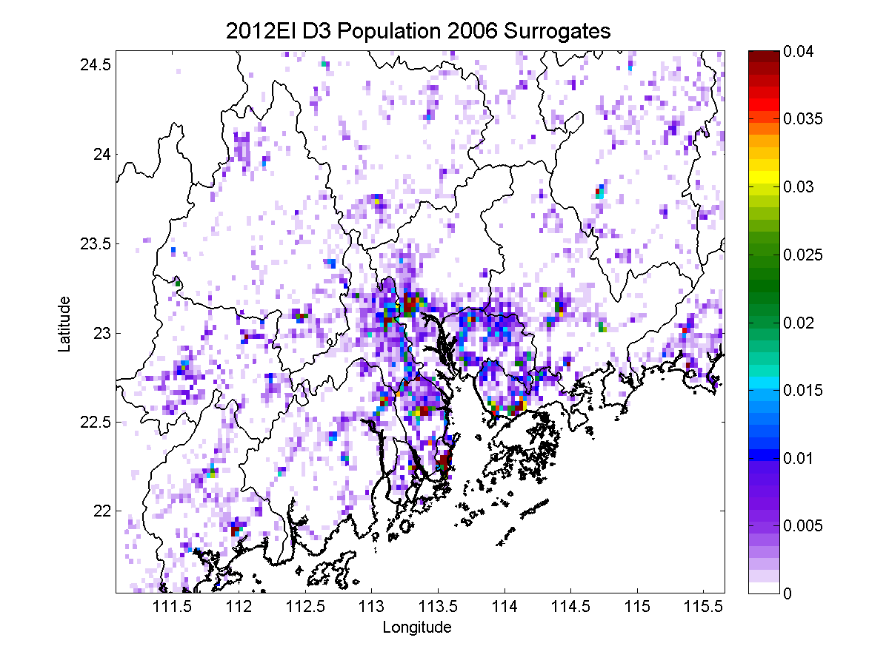
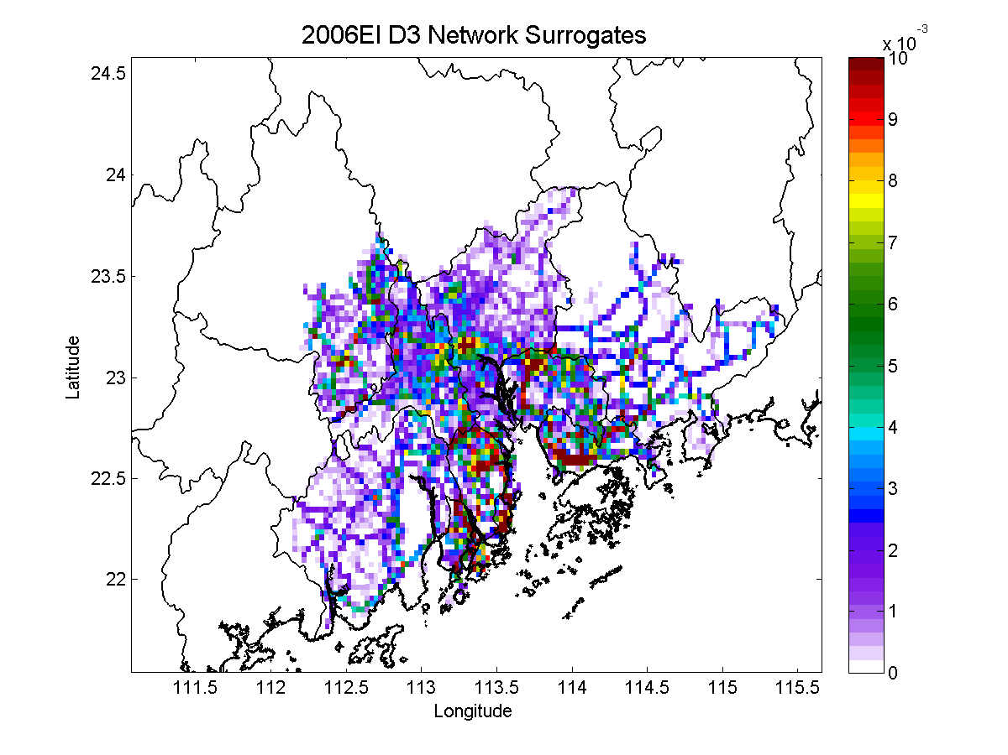
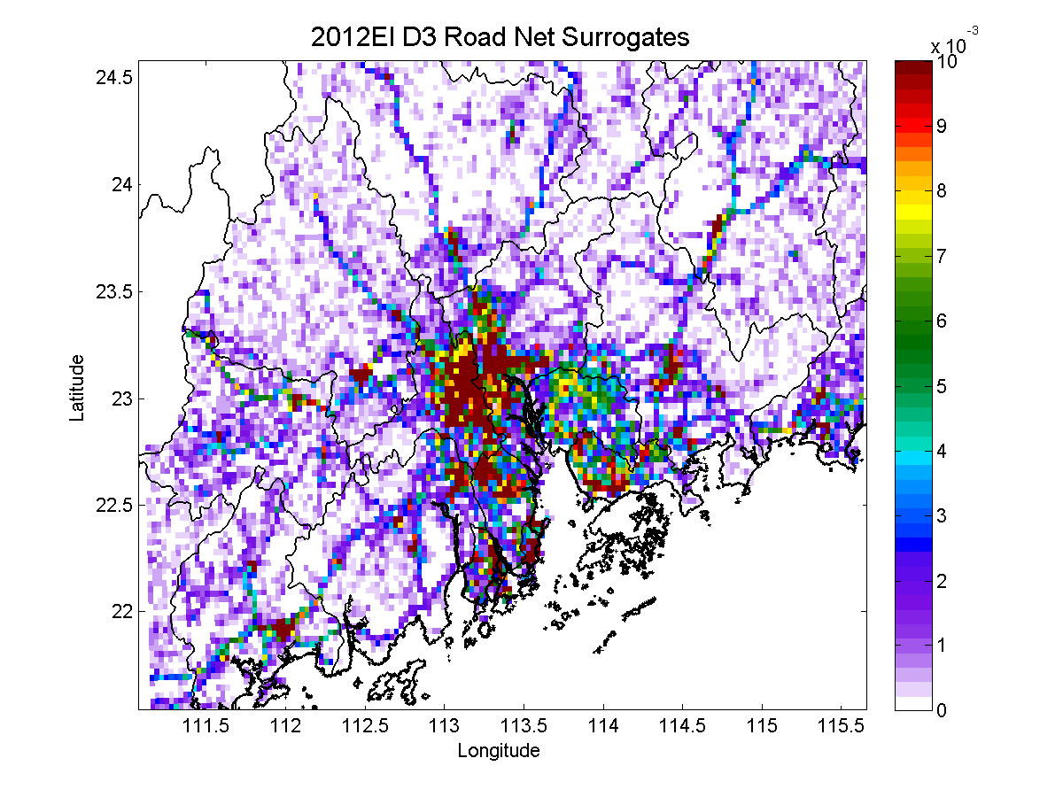
Spatial Surrogates Database
9
D3 (3km)
Year 2006
Year 2012
Population
Road Network

Slide 11
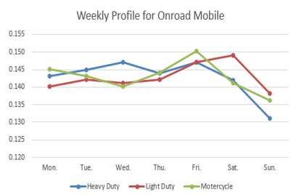
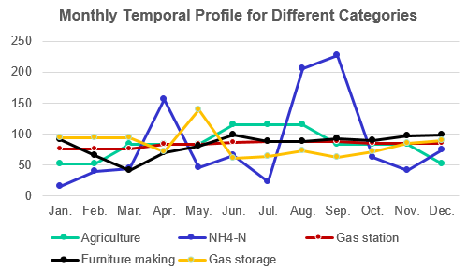
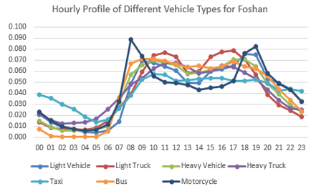
Temporal Profiles Database
10
Monthly Profile
Weekly Profile
Diurnal Profile
Power plant: Continues Emission Monitoring system (CEM) data , monthly fuel consumption and electricity production.
On-road mobile source: traffic flow, vehicle types, vehicle mileage , et al.
None-road mobile source: Automatic Identification System (AIS) data, Port handling capacity
……

Slide 12
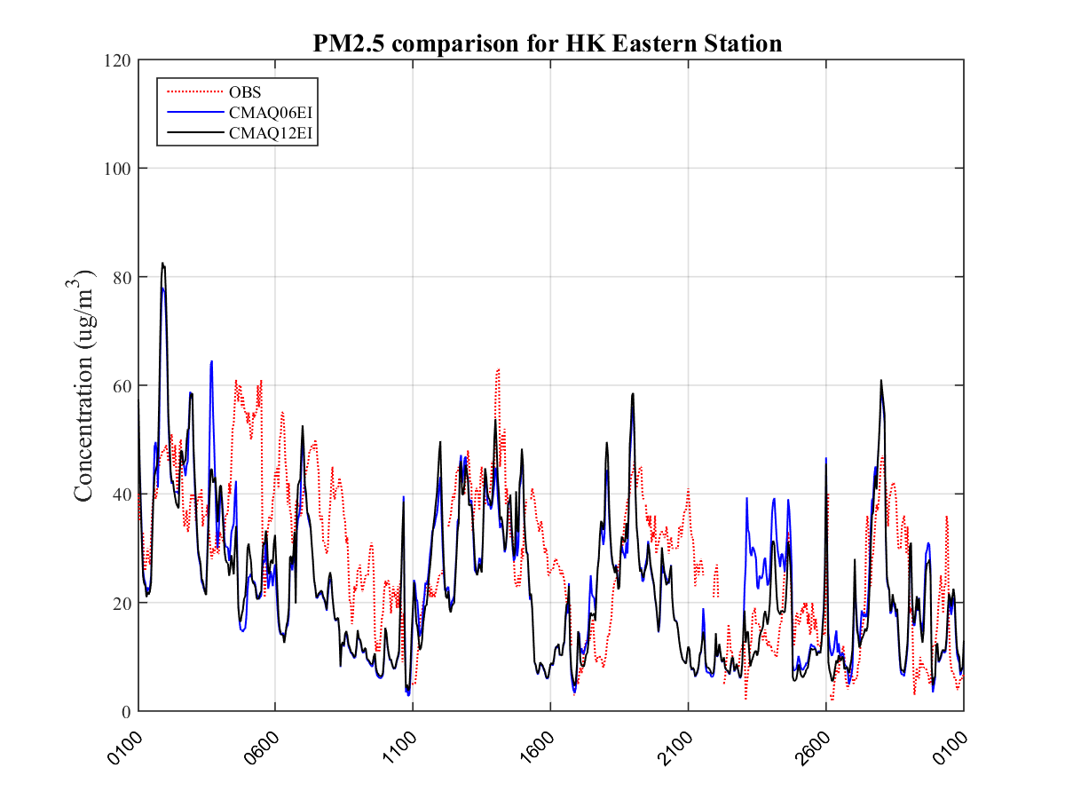
Comparison of the 2006EI and 2012EI
11
With new updated 2012 emission inventory, the overall model performance has been improved.
Peaks or valleys have been well captured in the new updated run.
PM2.5 | Corr | MB | ME | IOA | RMSE
CMAQ06EI | 0.44 | -4.50 | 12.33 | 0.66 | 15.38
CMAQ12EI | 0.50 | -5.08 | 11.83 | 0.70 | 14.94
UTC Time

Slide 13
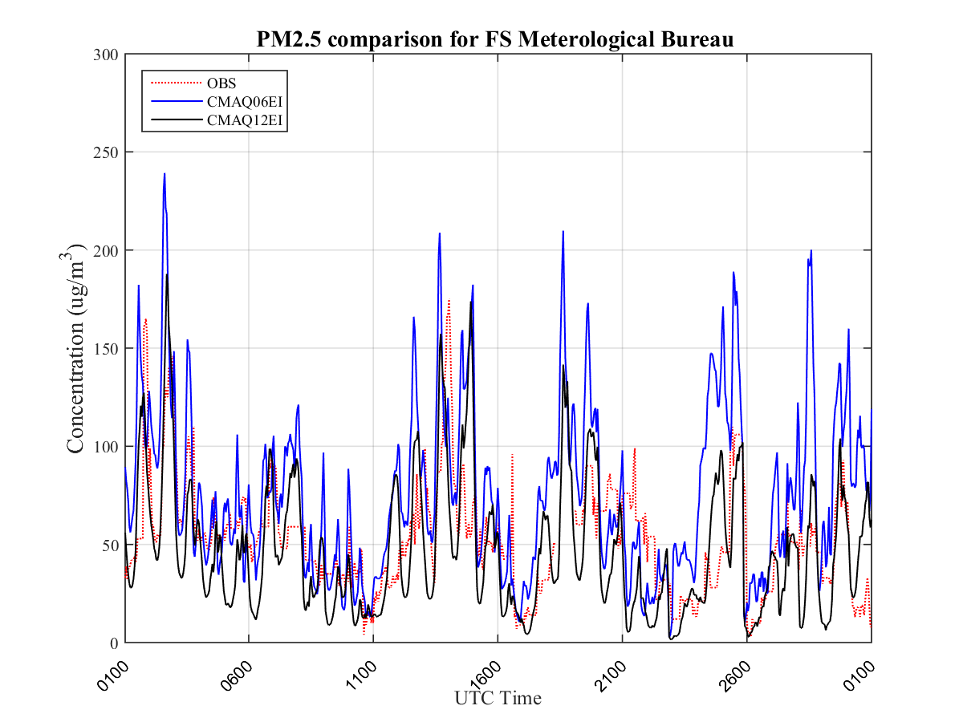
Comparison of the 2006EI and 2012EI
12
With new updated 2012 emission inventory, the overall model performance has been improved by over 10% in IOA.
Peaks or valleys have been well captured in the new updated run.
PM2.5 | Corr | MB | ME | IOA | RMSE
CMAQ06EI | 0.50 | 22.53 | 32.98 | 0.61 | 44.15
CMAQ12EI | 0.59 | -6.16 | 22.39 | 0.75 | 29.30

Slide 14
Comparison of the 2006EI and 2012EI
13
With new updated 2012 emission inventory, the overall model performance has been improved.
The model performance in PRD has been improved larger comparing with that in HK.
 |  | Corr |  | MB |  | IOA |  | RMSE
No. | PM2.5 | New WRF 06EI | New WRF 2012EI | New WRF 06EI | New WRF 2012EI | New WRF 06EI | New WRF 2012EI | New WRF 06EI | New WRF 2012EI
1 | Central | 0.43 | 0.47 | -7.96 | -8.71 | 0.63 | 0.65 | 17.15 | 17.18
2 | Central/Western | 0.48 | 0.52 | -7.78 | -8.67 | 0.66 | 0.68 | 16.71 | 16.79
3 | Eastern | 0.44 | 0.50 | -4.50 | -5.08 | 0.66 | 0.70 | 15.38 | 14.94
4 | Kwai Chung | 0.48 | 0.52 | -7.30 | -8.54 | 0.66 | 0.67 | 17.11 | 17.35
5 | Kwun Tong | 0.45 | 0.49 | -4.15 | -4.78 | 0.67 | 0.69 | 14.93 | 14.74
6 | Sha Tin | 0.51 | 0.54 | -3.88 | -4.73 | 0.71 | 0.72 | 15.13 | 15.25
7 | Sham Shui Po | 0.43 | 0.48 | -1.21 | -2.10 | 0.66 | 0.69 | 15.50 | 15.48
8 | Tai Po | 0.37 | 0.42 | -9.02 | -10.98 | 0.60 | 0.61 | 20.39 | 20.78
9 | Tai Mun | 0.53 | 0.59 | -9.36 | -10.60 | 0.66 | 0.68 | 16.09 | 16.16
10 | Tsuen Wan | 0.44 | 0.47 | -3.06 | -4.24 | 0.66 | 0.67 | 15.99 | 16.26
11 | Ave | 0.46 | 0.50 | -5.82 | -6.84 | 0.66 | 0.68 | 16.44 | 16.49
HK
Average of around 31 monitor stations
 | Corr |  | MB |  | IOA |  | RMSE
PM2.5 | New WRF 06EI | New WRF 2012EI | New WRF 06EI | New WRF 2012EI | New WRF 06EI | New WRF 2012EI | New WRF 06EI | New WRF 2012EI
Ave | 0.42 | 0.47 | 20.74 | -1.52 | 0.56 | 0.66 | 42.99 | 32.27
PRD

Slide 15
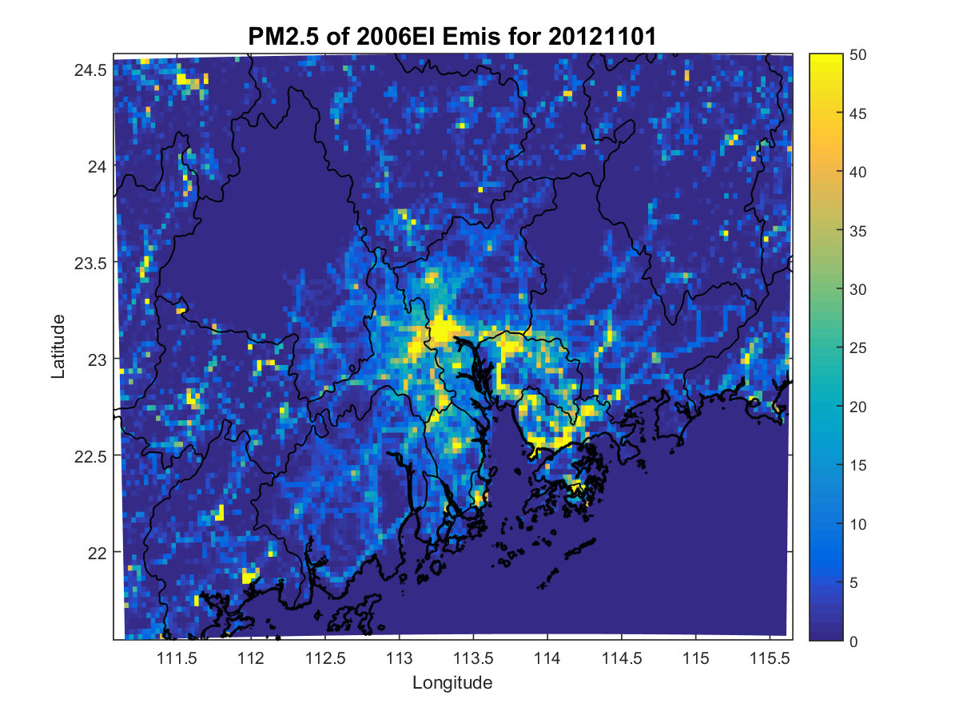
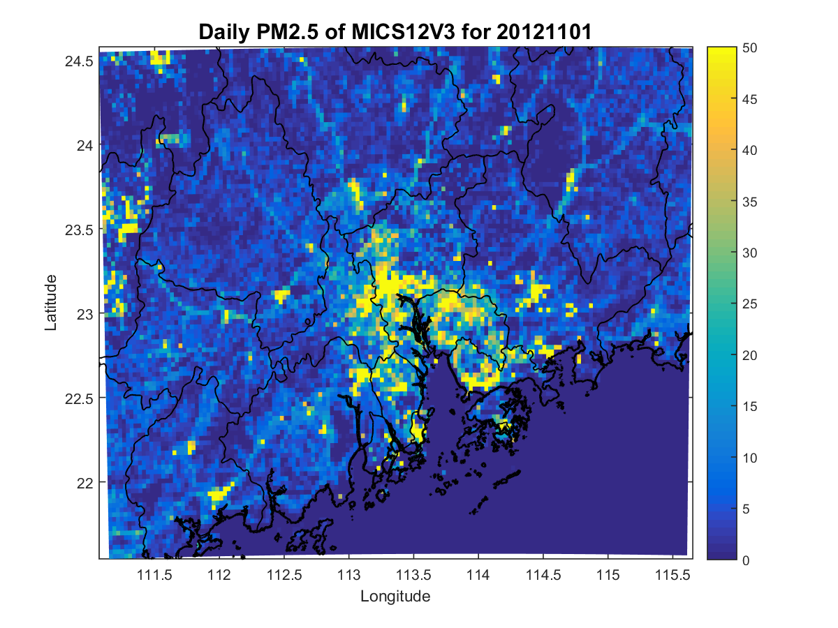
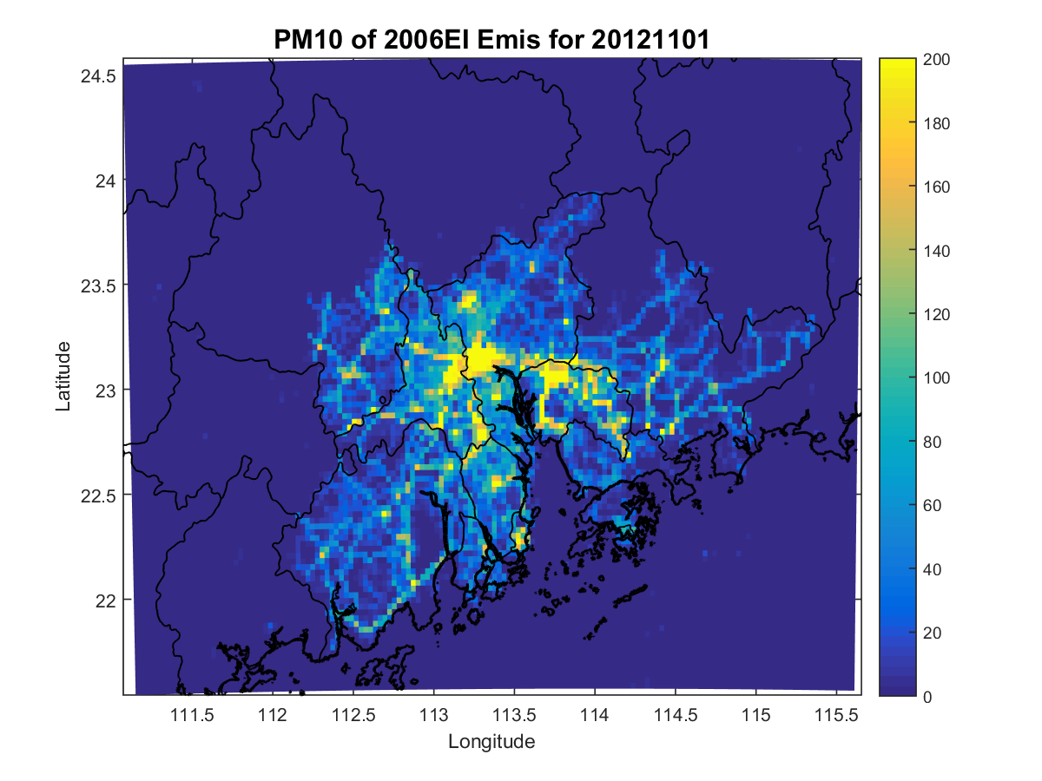
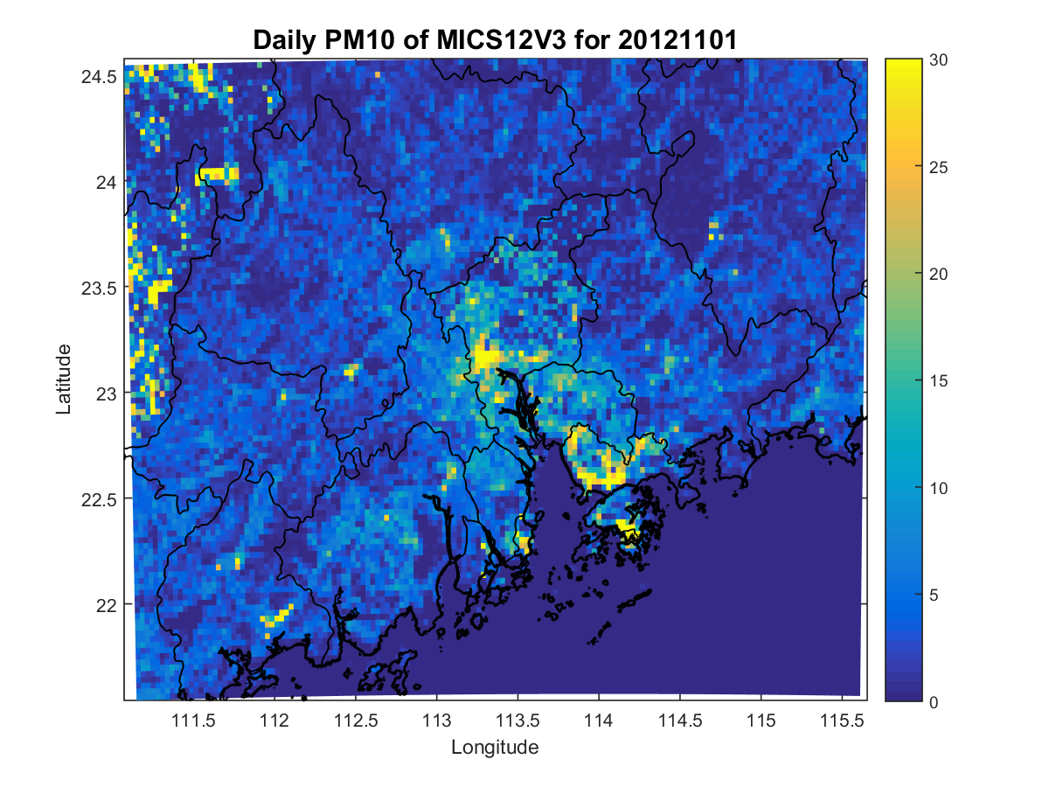
Model ready emission for different species
14
3km
2006EI
2012EI
PM2.5
PM10

Slide 16
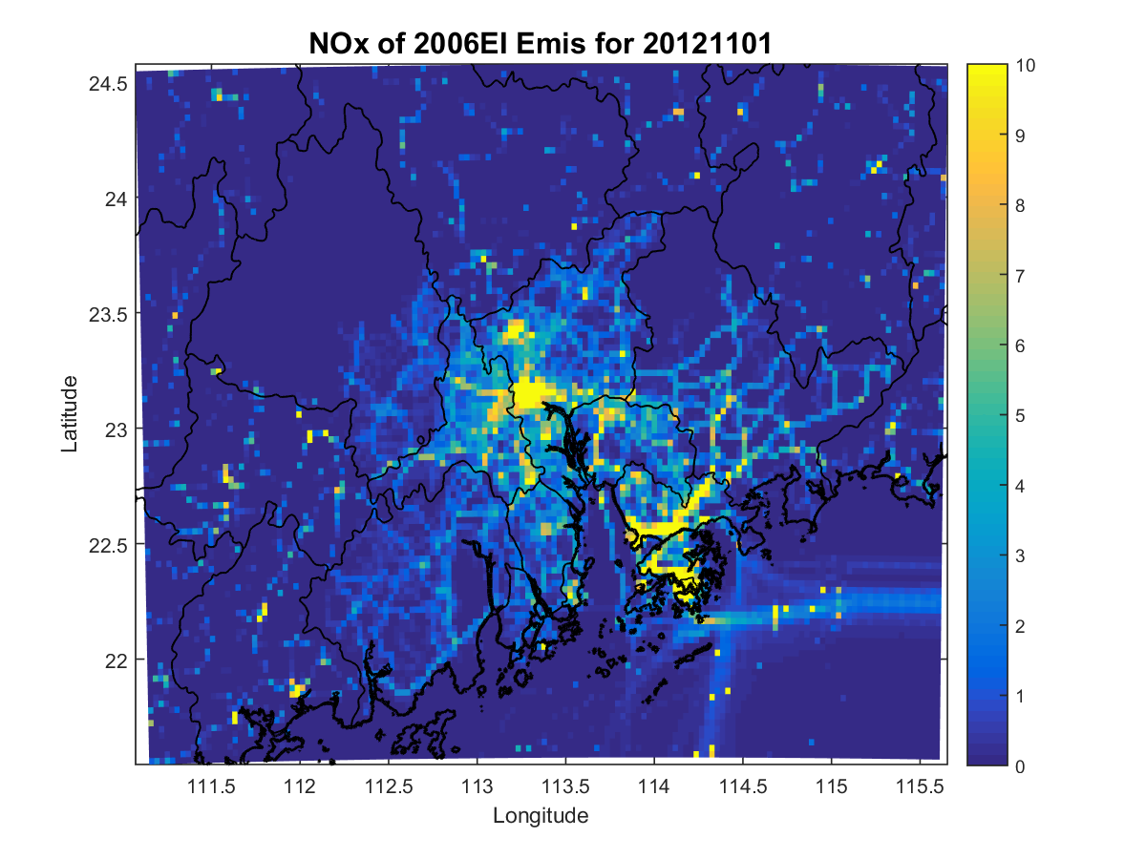
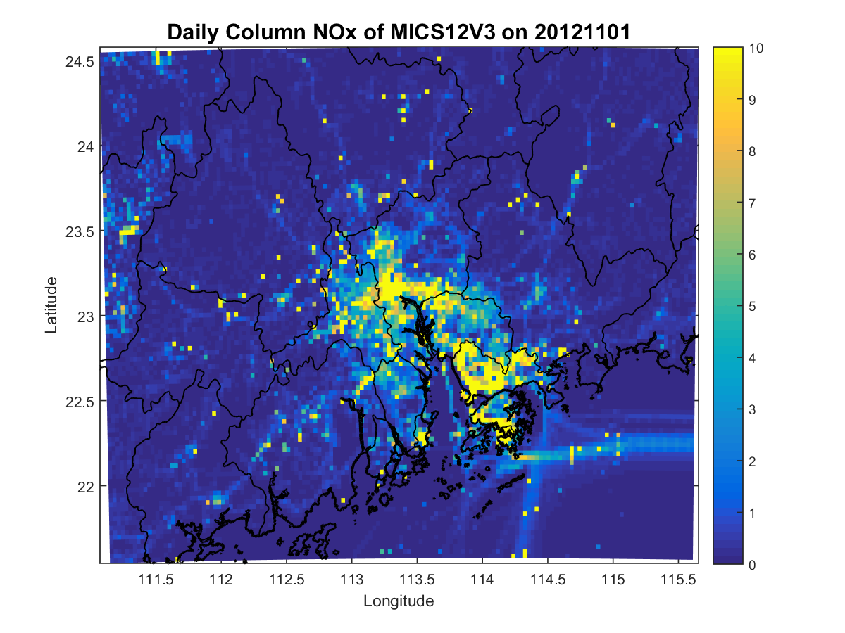
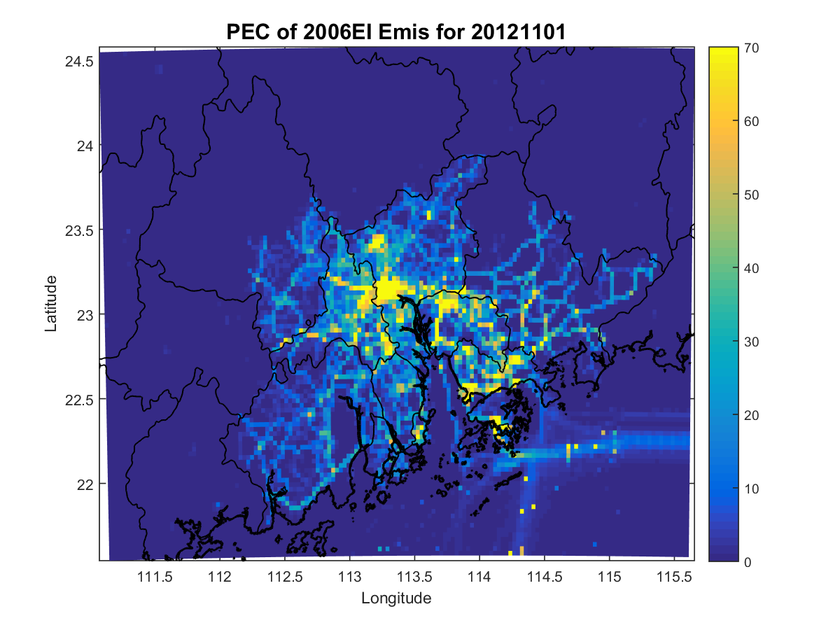
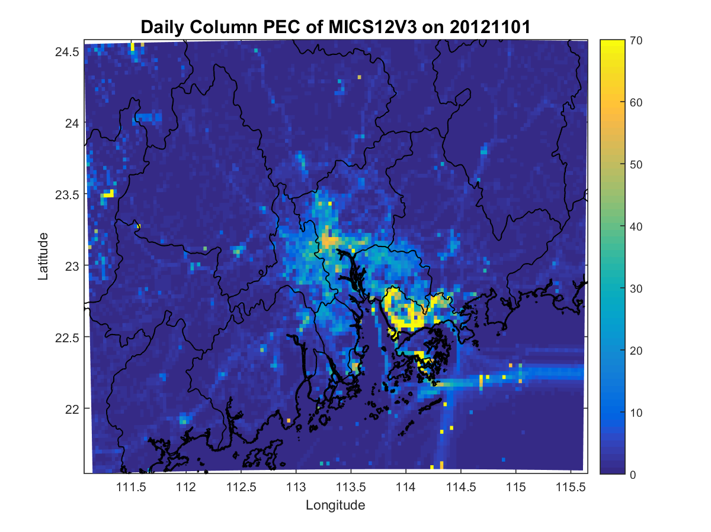
Model ready emission for different species
15
3km
2006EI
2012EI
NOx
PEC

Slide 17
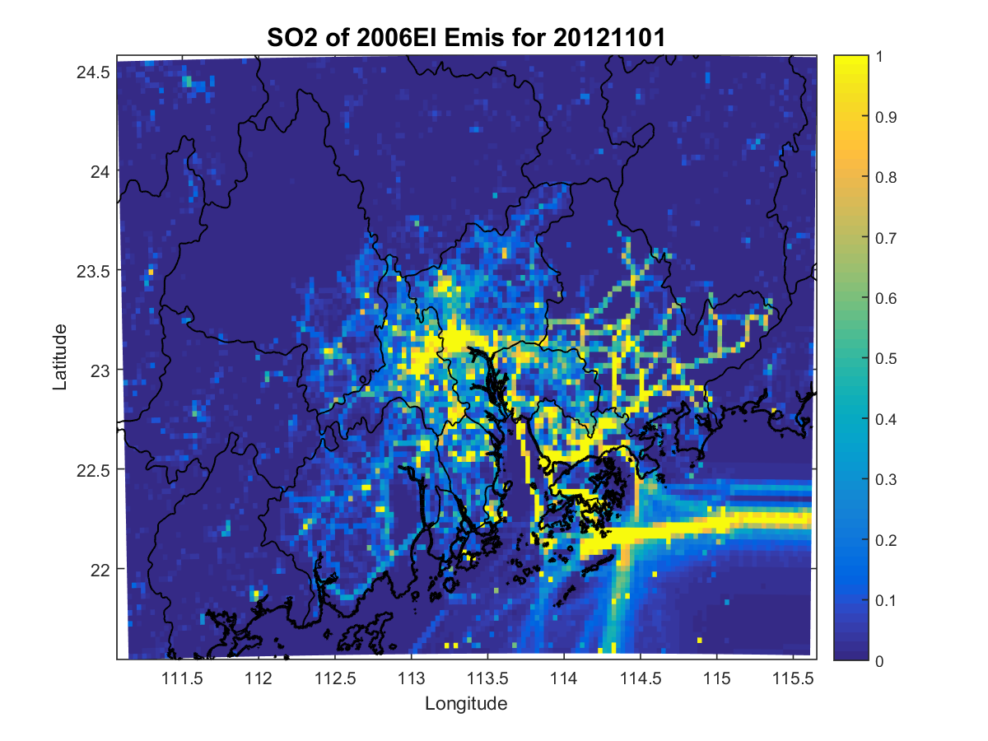
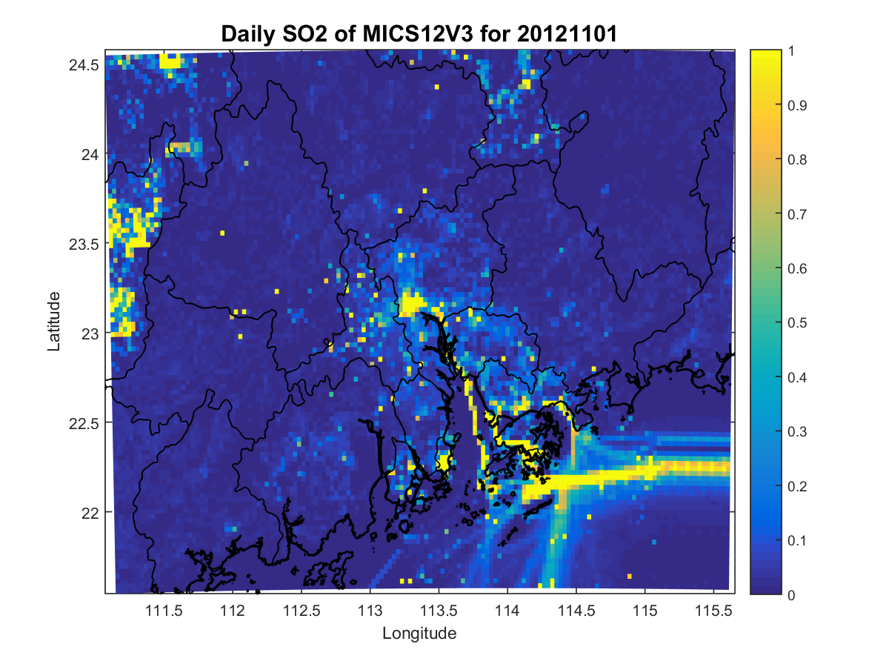
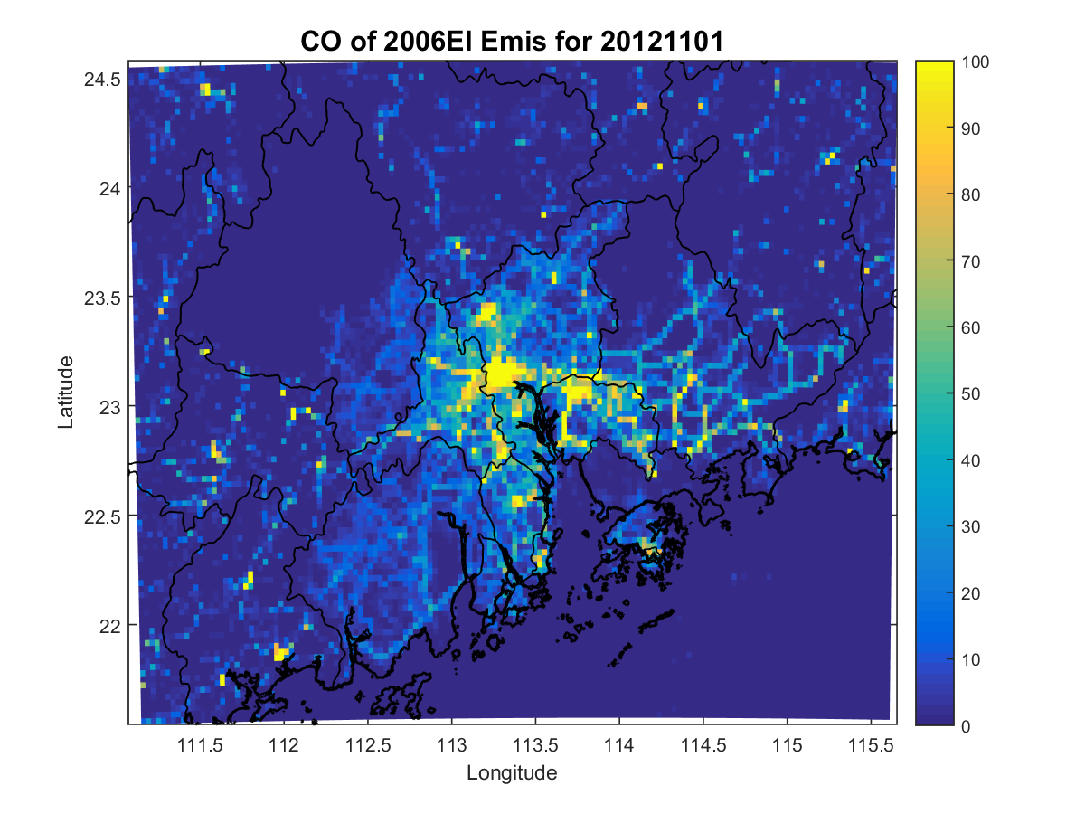
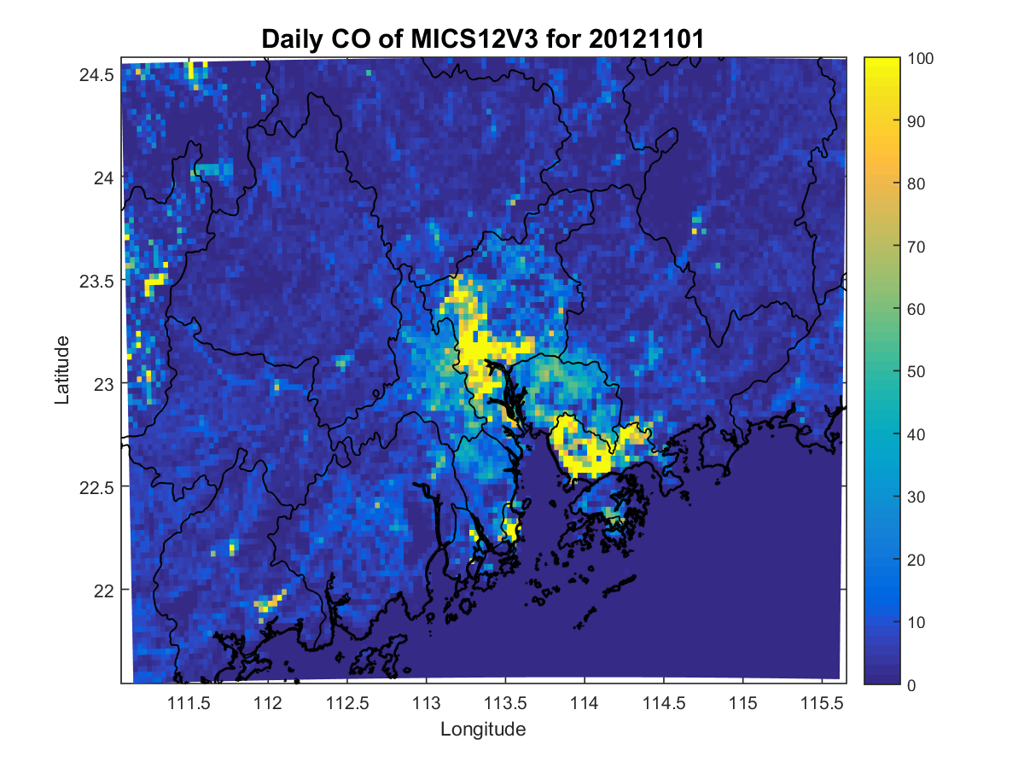
Model ready emission for different species
16
3km
2006EI
2012EI
SO2
CO

Slide 18
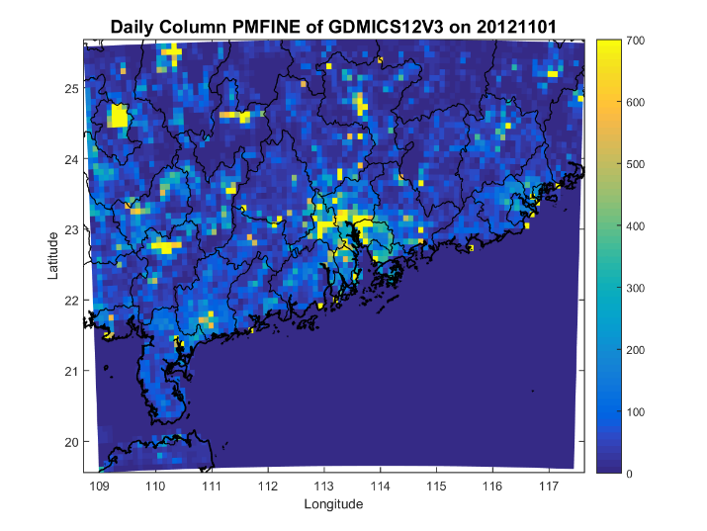
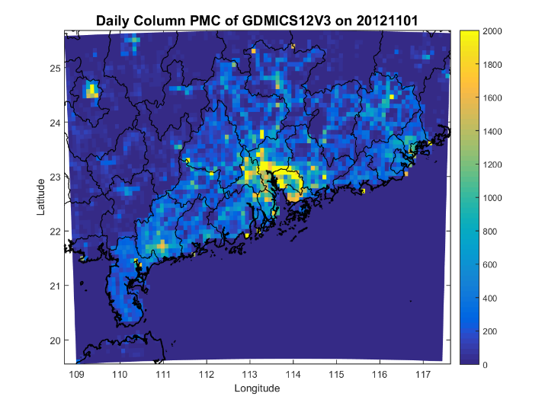
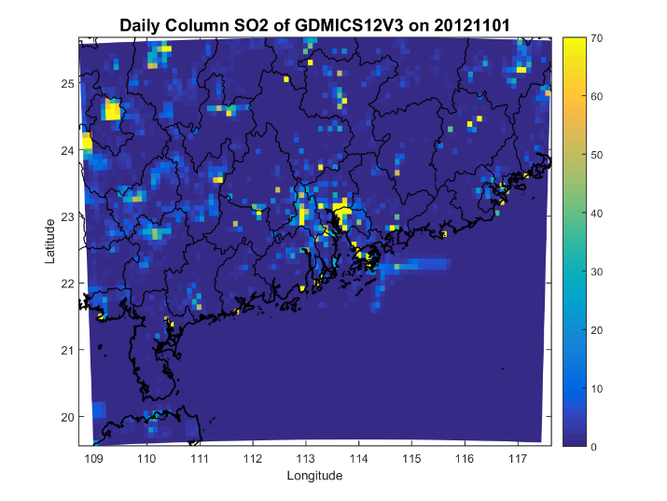
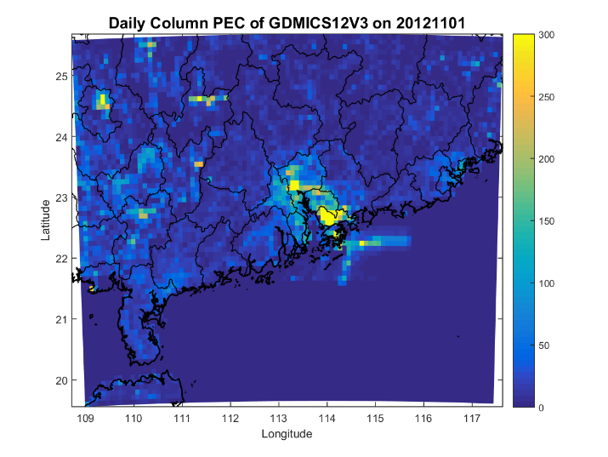
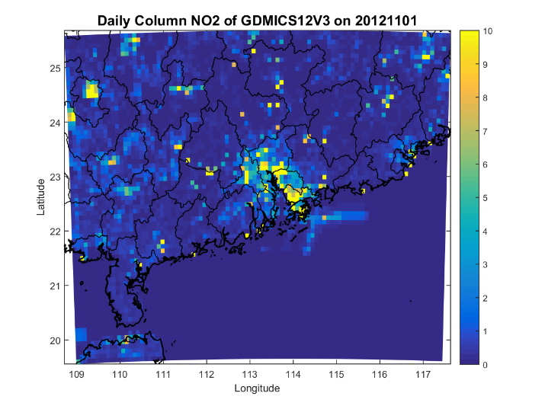
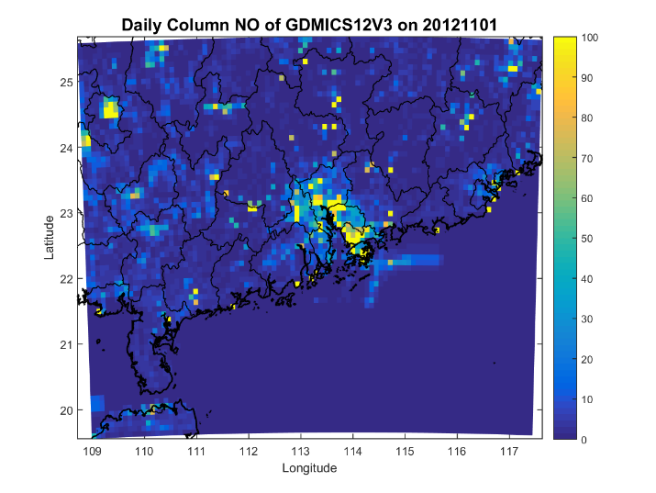
Model ready emission for different species
17
Daily column composite plot for Domain 2 (Resolution: 9km)
The Guang Dong (GD) local information was dealt by SMOKE while outside GD was
adapt from MIX Asia Emission Inventory published by Tsinghua in 2016.
9km
PM2.5
PM10
SO2
Propagate with GD information
PEC
NO2
NO

Slide 19
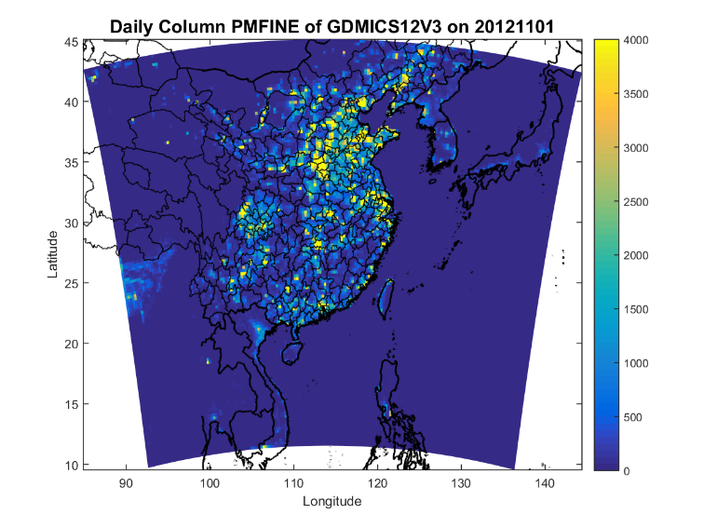
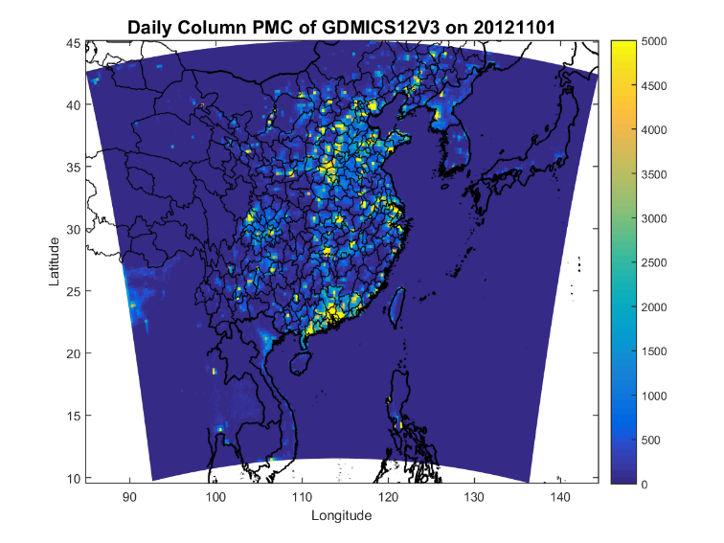
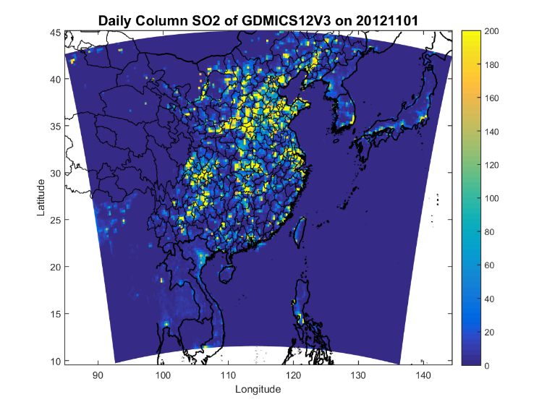
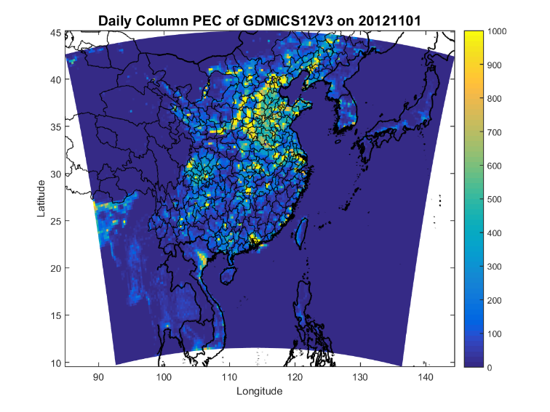
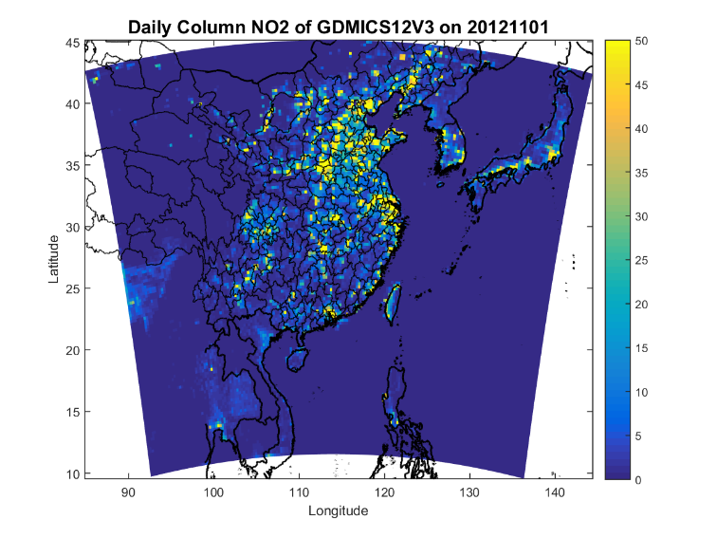
Model ready emission for different species
18
Daily column composite plot for Domain 1 (Resolution: 27km)
The Guang Dong (GD) local information was dealt by SMOKE3.7 while outside GD was adapt from the MIX Asia Emission Inventory published by Tsinghua in 2016.
27km
PM2.5
PM10
SO2
PEC
NO2
NO
Propagate with GD information

Slide 20
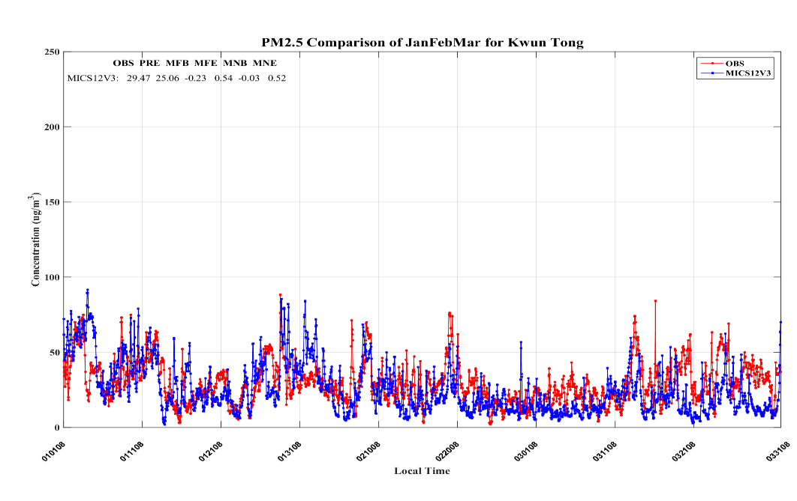
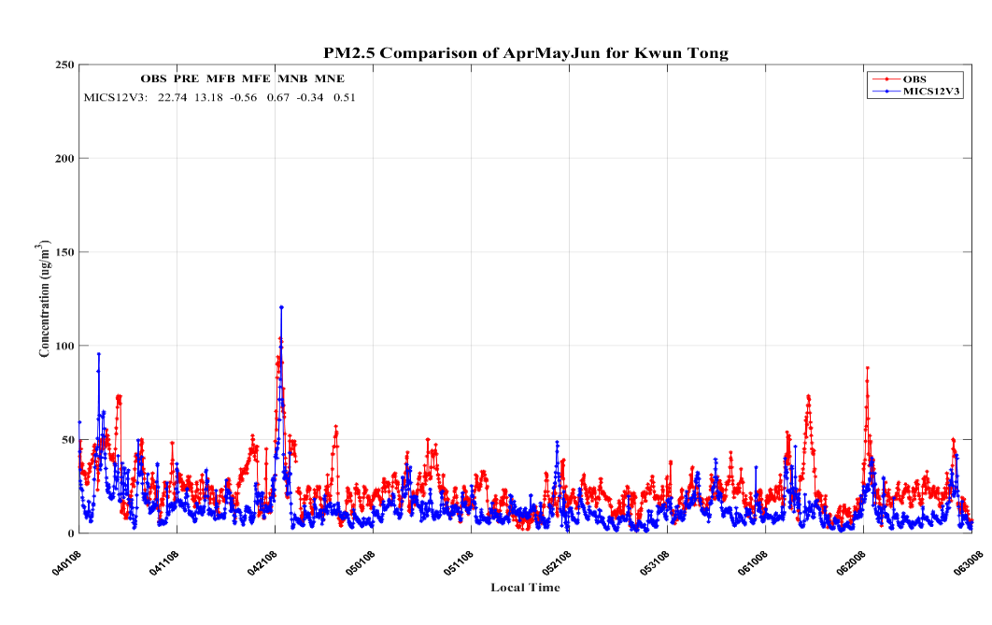
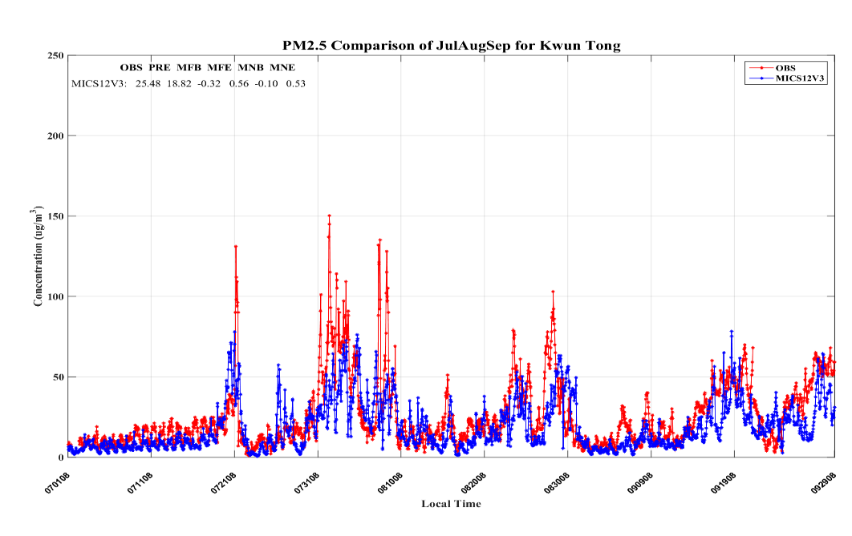
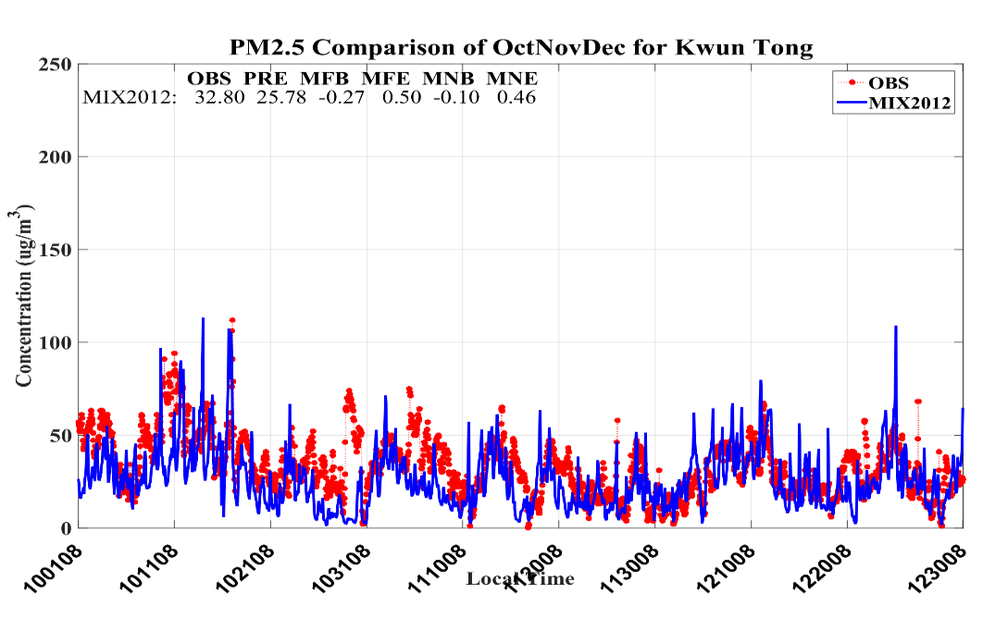
Year-long simulation for HK: Kwun Tong
19
PM2.5
1st Quarter
2nd Quarter
3rd Quarter
4th Quarter

Slide 21
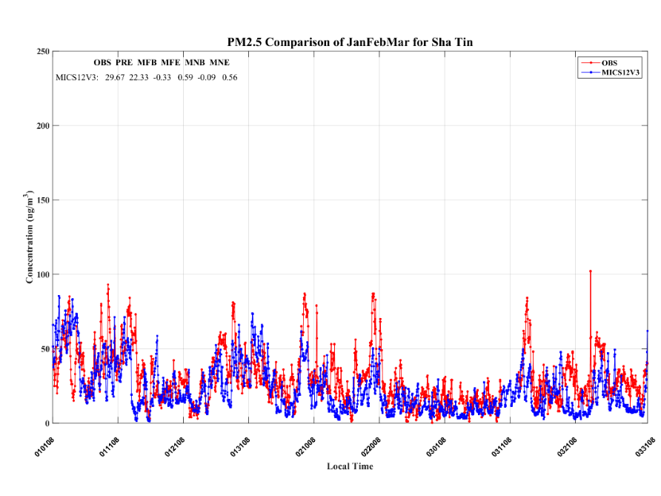
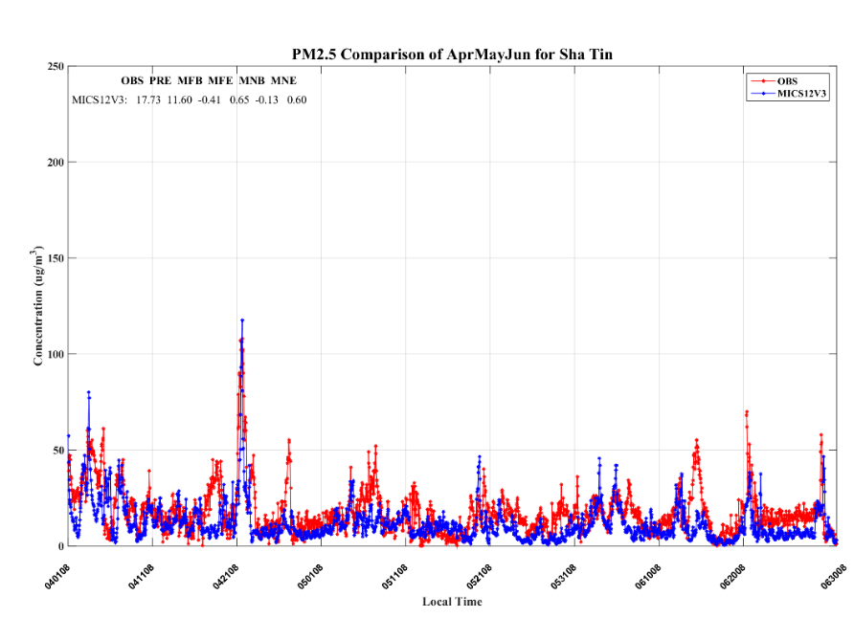
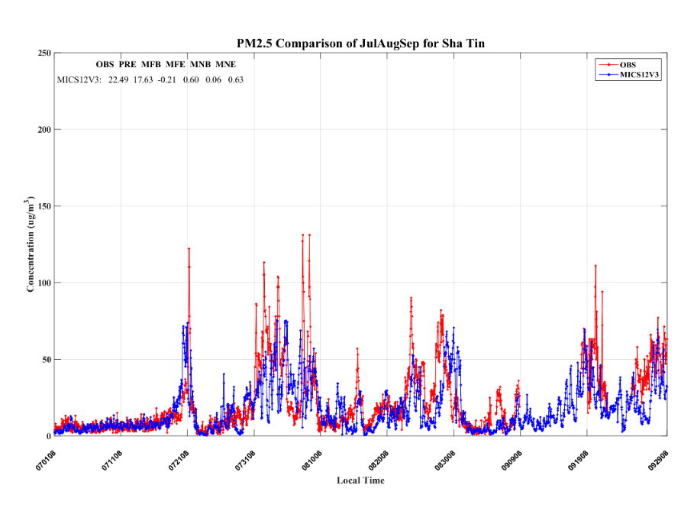
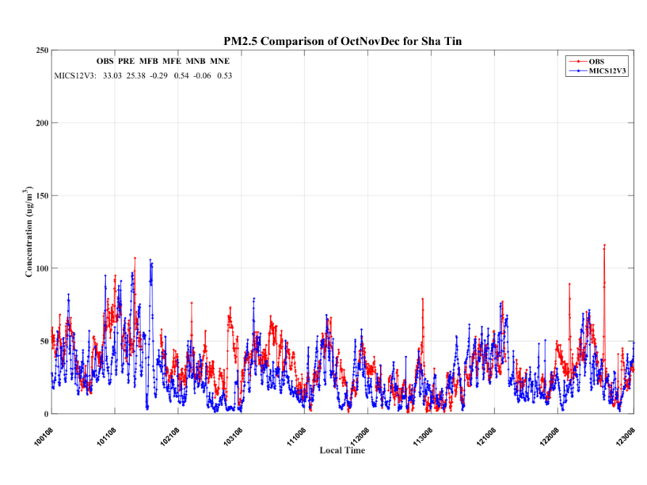
Year-long simulation for HK: Sha Tin
20
PM2.5
1st Quarter
2nd Quarter
3rd Quarter
4th Quarter

Slide 22
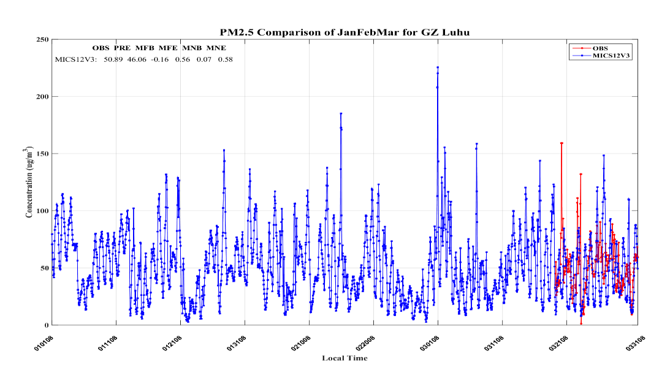
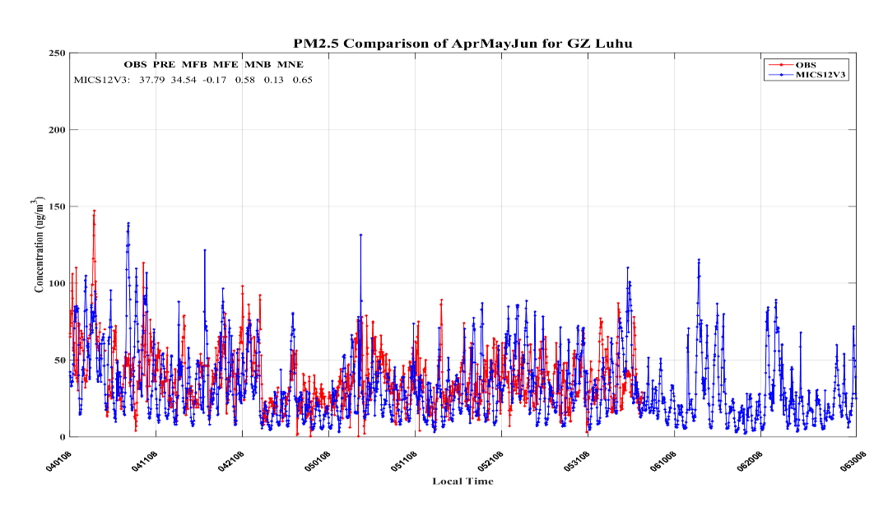
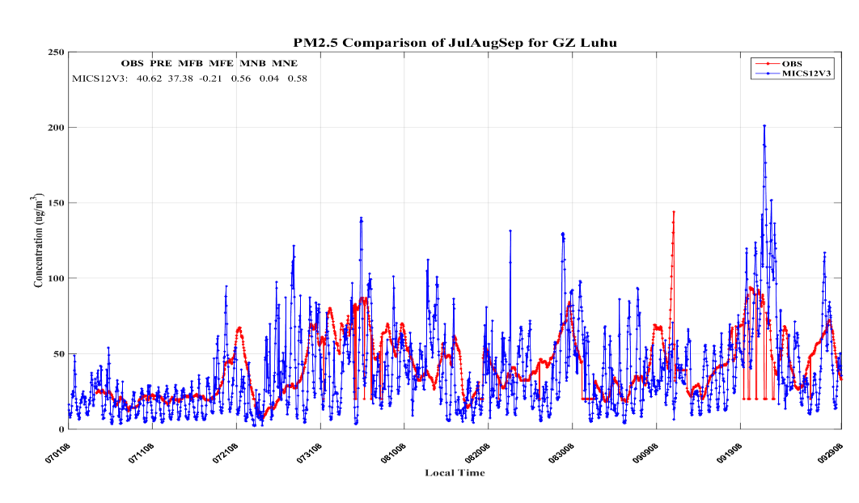
Year-long simulation for PRD: Guangzhou Luhu
21
PM2.5
1st Quarter
2nd Quarter
3rd Quarter
4th Quarter

Slide 23
Year-long simulation for PRD: FS Jinjvzui
22
PM2.5
1st Quarter
2nd Quarter
3rd Quarter
4th Quarter

Slide 24
Performance matrix of model outputs
23
Model performance on PM2.5 for HK and PRD stations in 2012

Slide 25
Spatial distribution of model outputs
24
Dry Season
Wet Season
A: Annual Average
B: 1st Q
C: 2nd Q
Annual and quarterly average spatial map for PM2.5 (A is the annual average while B is for the first quarter, C: 2nd quarter, D: 3rd quarter, E: 4th quarter.)
Wet Season
Dry Season
D: 3nd Q
E: 4th Q

Slide 26
Seasonal variations of PM2.5 components
25
Spring
Summer
Fall
Winter
Nitrate
Ammonium
OC
EC

Slide 27
Summary
26
Research Findings
Successfully reproduce PM_{2.5} concentrations at most cities for most months of the year.
Shows the capability of the system integrating 2012-based emission inventory and MIX Asian emission data to reproduce severe air pollution.
Accurate surrogate database could improve model at a moderate level.
Seasonal variations for the PM_{2.5} components.
Significances
In-depth understanding of the new 2012 emission inventory.
Extensive model validation and sensitivity tests for different emission reduction scenarios.
High resolution concentration map for evidence-based air pollution control policy.

