Slide 1
Future changes in land use-related emissions and their impacts on air/water quality and reactive nitrogen deposition
Yilin Chen, Huizhong Shen, Armistead G. Russell, Talat Odman, Jhih-Shyang Shih, Juha Siikamäki, Dallas Burtraw, Charles Driscoll, Richard Smith, Shuai Shao
Speaker: M. Talat Odman
Community Modeling and Analysis System Conference
Chapel Hill, NC

Slide 2
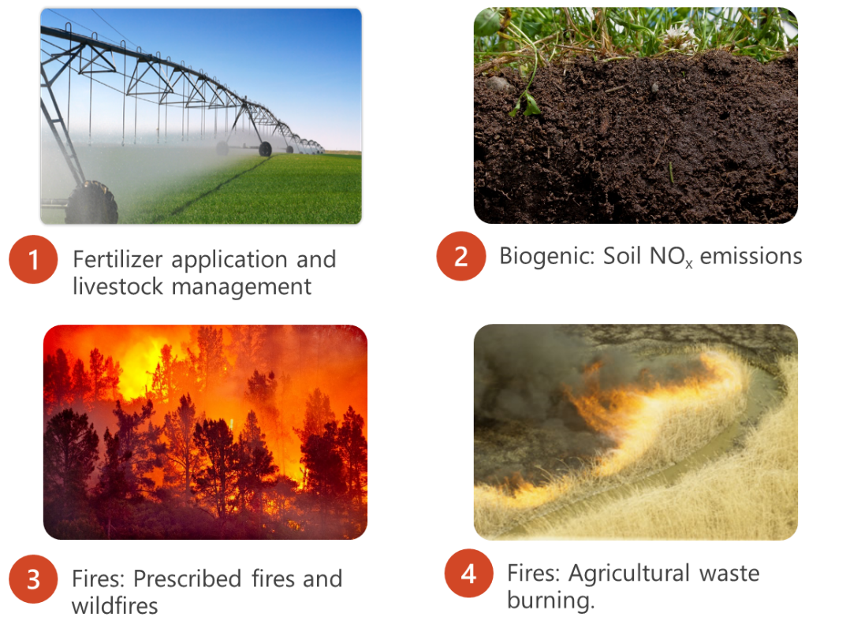
Land Use Change and Air Quality
Why land use change matters to air and water quality:
Emissions/discharge linkages
Increasing component as industrial and mobile sources are reduced
Heating/cooling (e.g., urban heat island)
Directly affected by future global change
Impacts on PM, Ozone, NOx, reactive nitrogen deposition …
Health
Welfare
Often overlooked
Acidic deposition (N&S)
Terrestrial nitrogen
enrichment (NR)

Slide 3
Study Objectives
Identify the future changes in emissions from land use-related source changes and the impacts of global change with a focus on reactive nitrogen (N_{R});
Cropland NH₃ emissions
Forest nitrogen (e.g., fires)
Biogenic emissions
Develop an integrated modeling framework to investigate the potential impacts of land-use and climate-related changes on air pollution, atmospheric deposition and associated impacts on water quality and sensitive ecosystems;
Identified as a need in last NO_{X}-SO_{X} secondary NAAQS review
Identify effective mitigation strategies with benefits in multiple environmental media.

Slide 4
Models applied
CMAQ with FEST-C and BEIS
FEST-C: Fertilizer Emission Scenario Tool for CMAQ, estimates cropland NH₃ emissions;
BEIS: Biogenic Emission Inventory System, estimates biogenic emissions;
CMAQ: air quality modelling, provide deposition fields for SPARROW and PnET-BGC inputs.
SPARROW: USGS SPAtially Referenced Regressions On Watershed attributes
Water quality assessment
Nationwide application, watershed level scale
PnET-BGC: an integrated biogeochemical model to simulate forest and aquatic ecosystems
Two hotspots: Adirondacks and Great Smokey Mountain
Stream chemical composition

Slide 5
Data Preparation
Climate projections
Two sets of meteorological fields under both Representative Concentration Pathway 4.5 (RCP4.5, a scenario with moderate temperature increase) and RCP8.5 (a scenario with intensive temperature increase) scenarios
MCIP: 36km spatial resolution, based on output from the Community Earth System Model (CESM1) downscaled using WRF spectral nudging
MACA (Multivariate Adaptive Constructed Analogs) dataset: major components at a high spatial resolution (6 km) and monthly temporal resolution
Multi-model projections (17 climate models)
Components: temperature (T, Tmax, and Tmin), wind speed, precipitation, humidity, evaporation
MCIP: four periods
RCP4.5
RCP8.5
2008-2012
2028-2032
2048-2052
2098-2099
CMAQ
MACA: 2006-2100, monthly
SPARROW PnET-BGC
2006
2010
2020
2030
2040
2050
2060
2070
2080
2090
2100

Slide 6
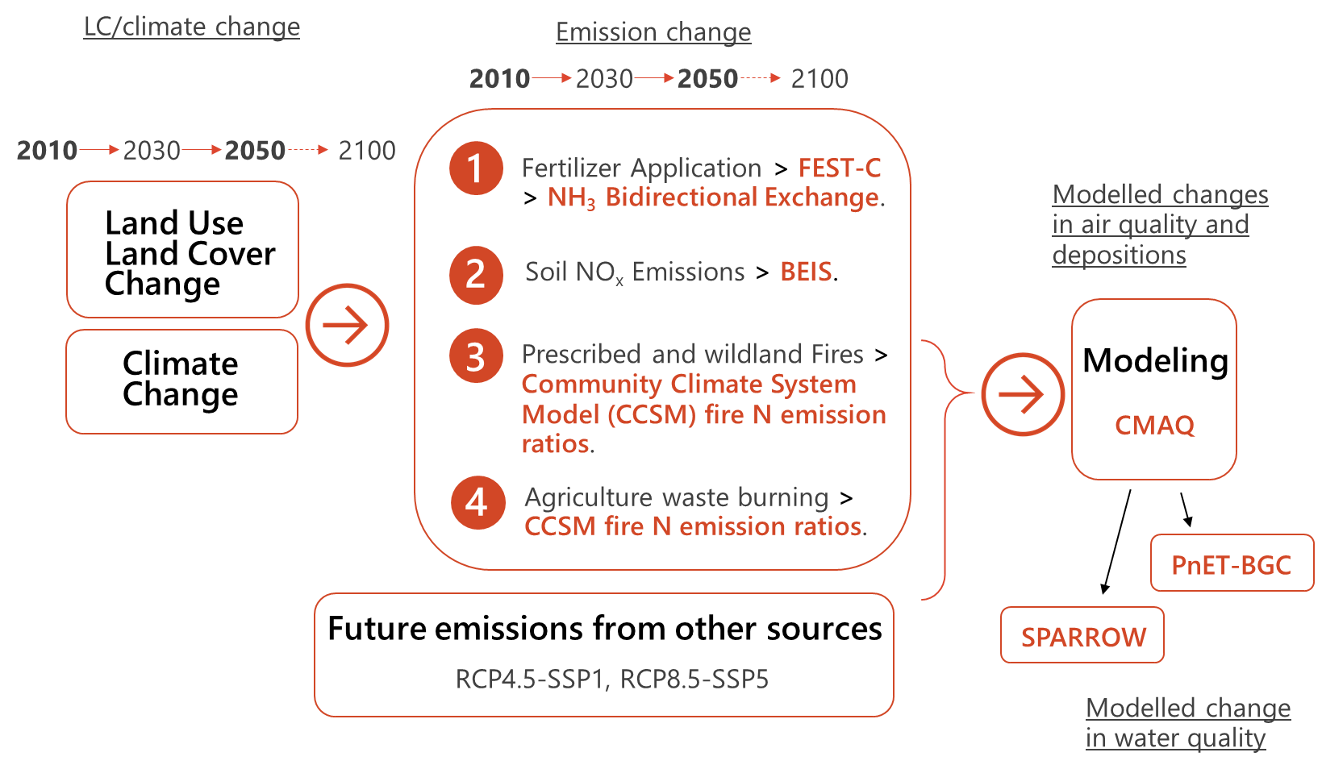
Modeling Framework: Future projection
Note:
CCSM: Community Climate System Model
SSP: Shared Socioeconomic Pathway

Slide 7
Project in progress: Preliminary Results
Primary results shown
Climate change impacts on NH₃ emissions from soil and plants (ESP_{NH3}), mainly over cropland, and implications for crop production and nitrogen deposition.

Slide 8
Model Evaluation and Version Comparison
Model Configurations and Evaluation
CMAQv5.0.2 with FEST-C v1.1
Considering recent updates, will rerun using CMAQv5.3 and FEST-C v1.4.
Both CMAQ with and without NH₃ BIDI exchange were applied, model with the module reduces model bias for the compounds directly related with NH₃.
NMB | Base | BiDi | Observed | CMAQ-BIDI | units
NO₂ CONC | -3% | -2% | 9.1 | 8.9 | ppbV
NH₃ CONC | -52% | -30% | 2.0 | 1.4 | ppbV
HNO₃ DRY DEP | 66% | 65% | 3.4 | 5.6 | kg/ha/yr
NH₄ DRY DEP | -14% | -5% | 0.25 | 0.24 | kg/ha/yr
NO₃ DRY DEP | 499% | 518% | 0.24 | 1.51 | kg/ha/yr
NH₄ WET DEP | -47% | -32% | 2.7 | 1.8 | kg/ha/yr
NO₃ WET DEP | -36% | -36% | 6.9 | 4.4 | kg/ha/yr
Total NO₃ DEP | 10% | 9% | 10 | 11 | kg/ha/yr
Total NH₄ DEP | -41% | -25% | 2.8 | 2.1 | kg/ha/yr

Slide 9
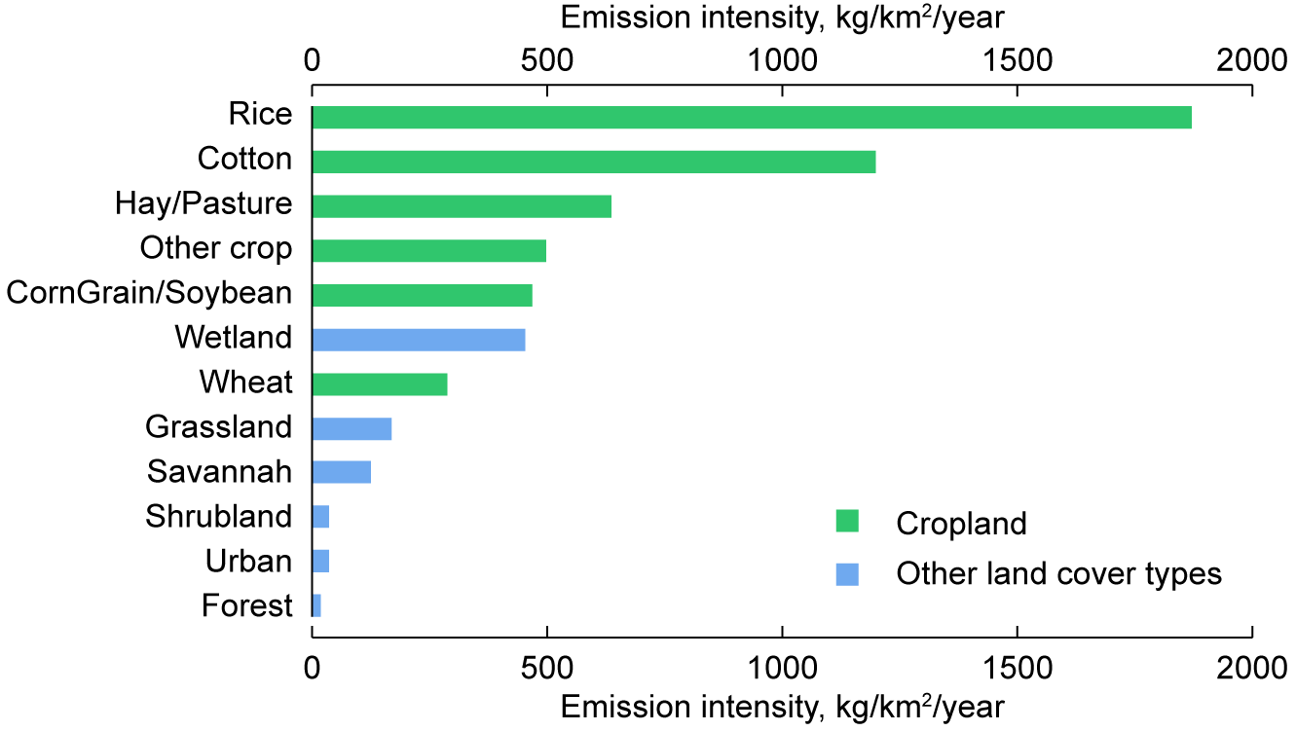
NH₃ emissions from soil and plants (ESP_{NH3}) over different land use types
NH₃ emission intensity in cropland and other land cover types
higher emission intensities over croplands
higher emission-to-temperature sensitivities over other land cover types
NH₃ emission from soil and plants (ESP_{NH3})
Notes:
Cropland shows much higher emission intensities than non-agricultural land (such as forest, grass, urban, etc.) except wetland, which is higher than wheat field. The highest emission intensities are found for rice (1870 kg⋅km⁻²⋅year⁻¹) and cotton fields (1200 kg⋅km⁻²⋅year⁻¹) due to large N fertilizer demand for growth of these two types of crops (Gerik, Oosterhuis et al. 1998, Chauhan, Jabran et al. 2017); The lowest is found over forest (17 kg⋅km⁻²⋅year⁻¹) likely due to mechanisms preventing N loss—substantial plant uptake of nitrogen and leaf absorption of NH₃ as well as low volatilization due to low skin temperature (Finzi, Norby et al. 2007, González-Pedraza and Dezzeo 2014). Overall, cropland contributes to about 80% of the total ESP_{NH3} at the national scale.
We calculate the ratios of the FEST-CMAQ-BIDI-based ESP_{NH3} to the regression model-based ESP_{NH3} and find that the ratios are log-normally distributed with a spatial gradient increasing from the north to the south (Figure SX8). After log-transformation, the ratios are positively correlated with 2-metre temperature (T) (r = 0.76, p ~ 0, Figure SX8), which largely explains the latitudinal gradient—higher ratios in the south due to warmer climates. In addition, the ratios show a positive correlation with near-surface wind speed (W, 10-m wind speed) (r = 0.05, p ~ 0, Figure XX) and a negative correlation with total precipitation (P) (r = -0.21, p ~ 0, Figure XX) mainly because higher wind speeds facilitate volatilization, and higher precipitation enhances NH₃ penetration into deeper soil layers preventing volatilization (Riddick 2012). This warrants including meteorological variables in the regression model. We employ an exponential term (Equation X) as the climate-adjustment factor to account for T, W, and P (Methods) (Sutton, Reis et al. 2013, Riddick, Blackall et al. 2017). The enhanced model (M_{C}, refers to the LC-based model with the climate-adjusted factor) explains 84% of the variance and enables us to reproduce the future ESP_{NH3} changes as projected by FEST-CMAQ-BIDI on a 36km×36km grid level (Figure SX9). By decomposing the effects of LC and the three climate components (T, W, and P), we find the projected increase in T being the dominant driving factor leading to the ESP_{NH3} increase. Under the RCP4.5 scenario, increased T in 2050 leads to a net increase of 11% in ESP_{NH3}, while the projected increases in W and P have opposite and relatively minor impacts (+2.0% and -1.5%, respectively). Cropland has an ESP_{NH3}-T sensitivity (S_{E,T}) of 10.3% K⁻¹ which is lower than other land types such as grassland and forest (?? and ??, respectively) (Table SI). The difference between cropland and non-agricultural lands suggests that agricultural management likely reduces the ESP_{NH3} sensitivity to warming. Overall, the absolute increase in emissions is from croplands (75%) due to the much higher emission intensity.

Slide 10
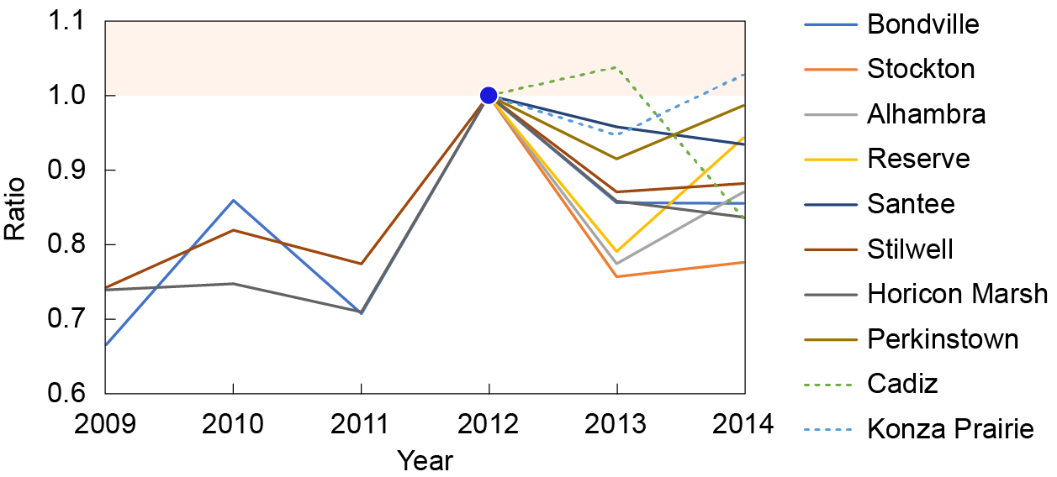
Climate change impacts on NH₃ emissions from soil and plants (ESP_{NH3})
Observed evidence
NH₃ concentration peaked in 2012 in the Midwest United States
likely due to abnormal climate conditions (highest temperature in the last 123 year and dryer-than-normal conditions)
Attributed to multiple factors (emissions, gas-particle partitioning, deposition)
The year-to-2012 ratios of annual mean NH₃ concentrations in the Midwest reported by Ammonia Monitoring Network

Slide 11
Climate change impacts on NH₃ emissions from soil and plants (ESP_{NH3})
Used FEST-C-CMAQ to investigate how climate impacts NH₃ emissions and atmospheric levels and to see how well the model captures the observations
By comparing the model (FEST-C-CMAQ-BIDI) results in 2011 and 2012
sensitivities of NH₃ concentration to temperature (+0.18 ppbK⁻¹ in the Midwest; +0.33 ppbK⁻¹ at the site locations) in line with observations (+0.15 ppbK⁻¹ and +0.34 ppbK⁻¹, respectively)
By replacing ESP_{NH3} in 2012 with that in 2011
cropland NH₃ emissions contributed 40% of the concentration increase.
a. All factors (emissions, gas-particle partitioning, removal processes)
b. Only emissions
Modelled increases in NH₃ concentrations between 2011 and 2012

Slide 12
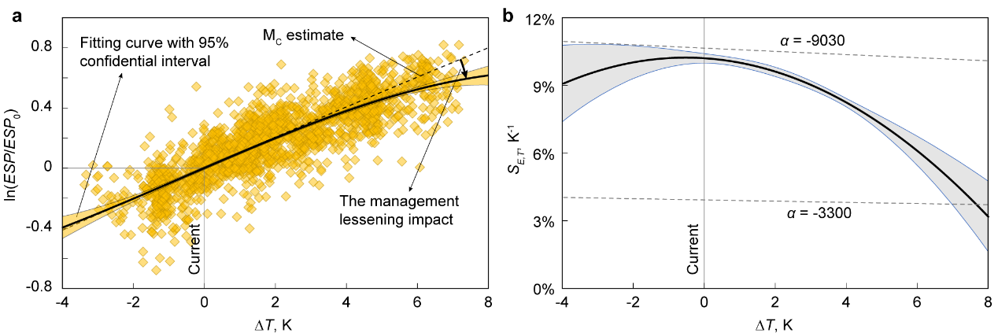
Climate change impacts on NH₃ emissions from soil and plants (ESP_{NH3})
Optimizing agricultural management can reduce emission-to-temperature sensitivity in cropland in warmer conditions
ESP_{NH3}~T function for natural landscapes, often adopted for cropland:
Relationship obtained from natural circumstances
Relationship over cropland considering impacts of agricultural management
ESP_{NH3}~ change in annual mean T
Sensitivity ~ change in annual mean T
Notes:
In most studies as well as in M_{C}, it is assumed that the long-term T-dependency of ESP_{NH3} over cropland follows a similar function as that of natural circumstances (Eq (X), Methods) (Sutton, Reis et al. 2013, Riddick, Blackall et al. 2017). S_{E,T} which is the derivative of the ESP_{NH3}~T function is inversely proportional to T² (S_{E,T} = α / T²), indicating that ESP_{NH3} will become less sensitive to T at higher T levels (Figure X1). M_{C} gives an α value of 8690 K for unirrigated crop, equivalent to a S_{E,T} of 10% K⁻¹ at 18 ℃ and a slightly lower S_{E,T} (9.8% K⁻¹) at 25 ℃. The cropland S_{E,T} directly calculated from FEST-CMAQ-BIDI via a year-by-year comparison (Method) shows a very similar S_{E,T} (10.2% K⁻¹) at 18 ℃ but a much lower S_{E,T} (4.7% K⁻¹) at 25 ℃ (Figure X1). The difference between FEST-CMAQ-BIDI-based and M_{C}-calculated S_{E,T} suggests that M_{C} may be overly sensitive to T changes at higher T levels (Figure X1). For non-agricultural land, on the other hand, the S_{E,T} obtained from M_{C} and FEST-CMAQ-BIDI match each other at a wide T spectrum (for M_{C}, 9.9%—14.8% and 9.5%—14.1% for different LC types at 18 ℃ and 25 ℃, respectively; for FEST-CMAQ-BIDI, 12.0% and 11.4%, respectively). The functional difference at higher T levels between cropland and non-agricultural lands implies heterogeneous responses of ESP_{NH3} to warming and that the true response for cropland could be oversimplified if directly employing the semi-empirical relation. Investigation into the various aspects of the projected agricultural management under RCP8.5 finds a decrease of 5.5% in annual crop yield (expressed as N yield) in 2100 compared with 2010 (Figure X), whereby the uptake of the applied N fertilizer is reduced by 11.9%. An important consequence of such a decrease in applied N fertilizer uptake (specifically NH₃ fertilizer) is a lower soil NH₄⁺ content which ultimately lessens the ESP_{NH3} increase. This provides an important pathway, which is often omitted, of how management, interacting with climate, will factor into ESP_{NH3} under extremely warm conditions―proper management practices in response to climate change can prevent cropland N loss. To confirm the management impact, we reconduct the RCP8.5 2100 simulation but, this time, fix the applied N to the 2010 level. The simulation without the management impact shows the ESP_{NH3} increase being 17.1% higher than the standard simulation, in line with the M_{C} response, and proves the potential of management (more specifically N application in response to climate change) in lessening ESP_{NH3} increase in warm conditions.

Slide 13
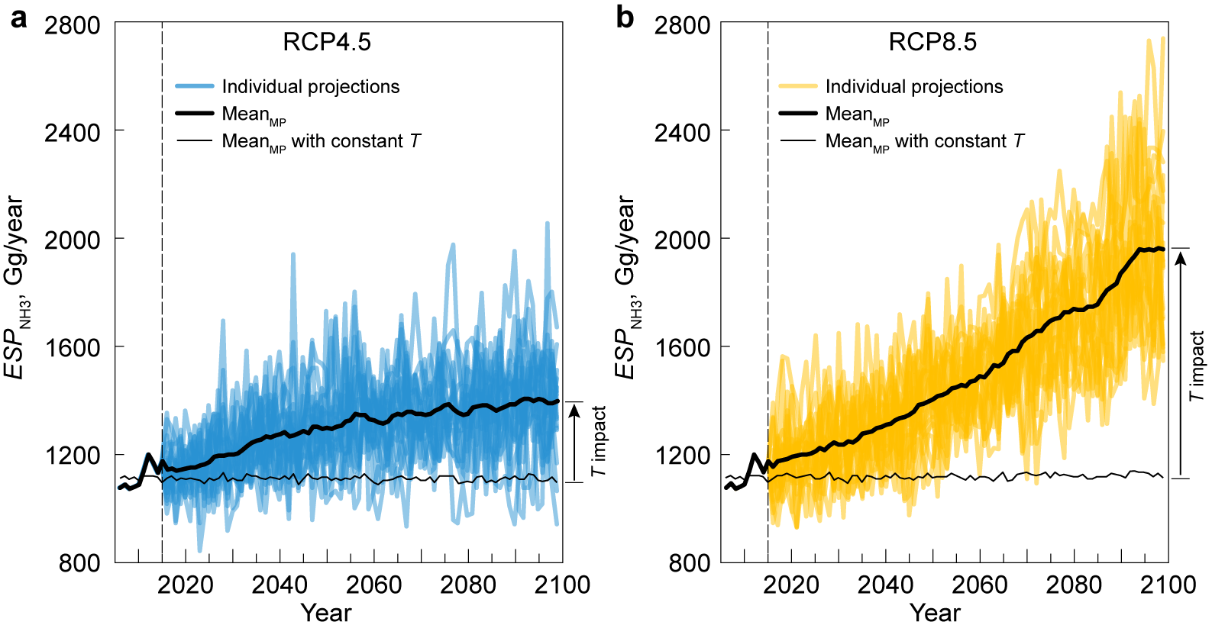
Climate change impacts on NH₃ emissions from soil and plants (ESP_{NH3})
Multi-model projections
Regression models considering land cover types and climate variables (T, wind speed, and precipitation) established based on the integrated model outputs.
Multi-model projections using the outputs of 17 climate models
Notes:
Based on the M_{C} adjusted by the management-induced lessening impact (M_{C-adj}, Method) and climate projections of 18 climate models (Table SX) (Abatzoglou and Brown 2012, Taylor, Stouffer et al. 2012), we evaluate the future trends of multi-projection ESP_{NH3} and isolate the impacts of T, which is expected to provide a broader view of how projected warming will affect ESP_{NH3} (Fig. X2). All ESP_{NH3} projections show increasing trends at the national scale (Fig. X2), with the increased rates by the end of the twenty-first century ranging from +4.3% (based on GFDL-ESM2G) to +58.0% (HadGEM2-CC365) in RCP4.5 and from +36.4% (GFDL-ESM2G) to +120% (HadGEM2-CC365) in RCP8.5 (Fig. X2 and Fig. SXX). Excluding the impacts of T lead to increased rates being close to nil and significantly narrows the variation across projections which largely fall within ±5% (Fig. SXX), indicating the dominant impact of T.

Slide 14
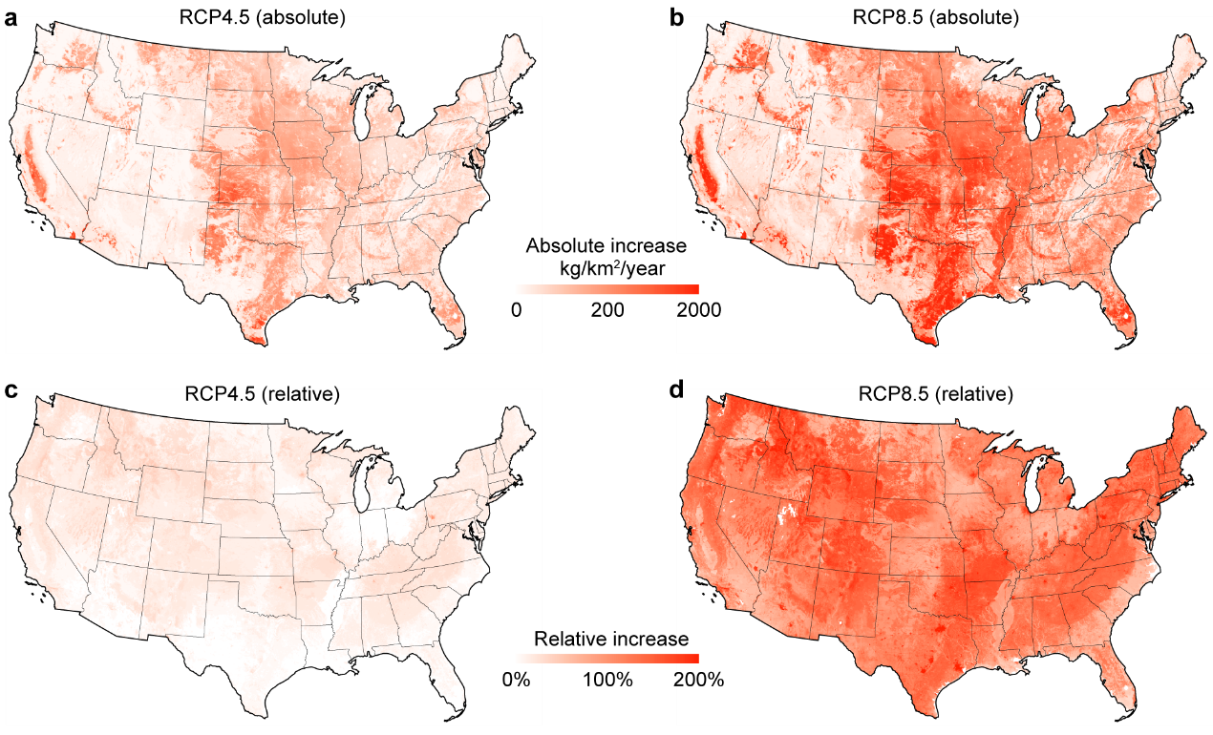
Climate change impacts on NH₃ emissions from soil and plants (ESP_{NH3})
Spatial distributions of ESP_{NH3} changes reflected by the multi-model means
Overall increase in ESP_{NH3} between 2010 and 2100:
30% (26-33% as 95% confidential interval) in RCP4.5;
99% (90%-108%) in RCP8.5.
Spatial changes in ESP_{NH3} by the end of the twenty-first century due to climate change only.
Notes:
16 out of 18 projections show increases of ≥ 50% in at least two thirds of the CONUS land area under RCP8.5 (Fig. X2), but the changes are not spatially consistent because of the disparity in climate projections (Table SX). Means of the multi-projection ensemble derived at the grid level give a tighter spatial estimate, which suggests that, in relative terms, regions with larger fractions of non-agricultural land (e.g. the Mountain States and Appalachia regions) have a tendency towards a higher increase (Fig. X3c,d) due to a higher T sensitivity for natural land, while in absolute terms, the increase is dominated by cropland (e.g. in the Northern and Southern Plains) (Fig. X3a,b). The multi-projection means show higher ESP_{NH3} increases than the estimate driven by a single climate projection of CESM. The ESP_{NH3} under RCP4.5 is estimated to increase by 310±80 Gg/year (as the mean and semi-interquartile range, respectively) by the end of the twenty-first century, while the increase is up to 980±200 Gg/year under RCP8.5, which is 54% higher than the single-projection estimate. Our assessments of the management impact finds that agricultural management practices should further increase the ESP_{NH3} by 16 and 110 Gg in 2100 under RCP4.5 and RCP8.5, respectively. That leads to overall increases of 30% (26%–33% as the 95% confidential interval of the multi-projections meanfor RCP 4.5) and 99% (90%–108%, RCP 8.5) in ESP_{NH3} compared to current levels. In 2010, cropland ESP_{NH3} has an 8% loss of synthetic N fertilizer, which increases to 14% in 2100 (RCP8.5) with current agricultural practices and no further mitigation measures.

Slide 15
Climate change impacts on NH₃ emissions from soil and plants (ESP_{NH3})
Implications
Loss of synthetic N fertilizer: from 8% in 2010 to 14% in 2100 (RCP8.5);
Crop yield loss: 460 Gg N/year;
Atmospheric burden of NH₃/NH⁴⁺: increases by 20%
N deposition over sensitive regions: increases by 10%
Mitigation measures
Replacement of urea with non-urea fertilizers (RU): 500 Gg/year reduction in ESP_{NH3};
Urea application with irrigation (UIR): -180 Gg/year
Application of urea inhibitor (UIN): -280 Gg/year
Deep placement of fertilizers (DP): -700 Gg/year
The most effective strategy combining RU and DP measures with best management practices is estimated to reduce the ESP_{NH3} by ~50% (1020 Gg/year), fully compensating for the negative impacts of warming-induced ESP_{NH3} increase on the atmosphere and ecosystems

Slide 16
Summary
Multiple causes of potential NH₃ (and N_{R}) changes
Land use
Climate
CMAQ-FEST-C appears to capture NH₃ sensitivity to meteorology, Modeled vs Observed:
Midwest: +0.18 ppbK⁻¹ vs +0.15 ppbK⁻¹
Site locations: +0.34 ppbK⁻¹ vs +0.33 ppbK⁻¹
Cropland NH₃ emissions expected to significantly increase in response to
Climate warming,
Land use change
Changes impact
N cycle
Sensitive ecosystems
Threaten food security

Slide 17
Acknowledgement
EPA grant number R835880
Contacts:
Armistead G. Russell: ted.russell@gatech.edu
Yilin Chen: ychen870@gatech.edu
Huizhong Shen: hshen73@gatech.edu
This presentation was made possible in part by USEPA. Its contents are solely the responsibility of the grantee and do not necessarily represent the official views of the funding sources and those sources do not endorse the purchase of any commercial products or services mentioned in the publication.
R835880

