Slide 1
Air Quality Health Co-benefits of CO₂ Reduction in East Asia: an Adjoint Sensitivity Analysis
Marjan Soltanzadeh, Yasar Burak Oztaner, Matthew Russell , Shunliu Zhao, Amir Hakami (Carleton University)
Matt D. Turner, and Daven K. Henze (University of Colorado)
Shannon Capps (Drexel University); Peter B. Percell (University of Houston); Jaroslav Resler (ICS Prague)
Jesse O. Bash, Kathleen Fahey, Sergey L. Napelenok (USEPA)
Rob W. Pinder; Armistead G. Russell and Athanasios Nenes (Georgia Tech)
Jaemeen Baek, Greg R. Carmichael, and Charlie O. Stanier (University of Iowa)
Adrian Sandu (Virginia Tech); Tianfeng Chai (University of Maryland); Daewon Byun (NOAA)
Oct 2018

Slide 2
Introduction
Co-benefits due to reduced emissions of criteria pollutants (or their precursors)
Air pollution impact on human health (PM_{2.5}, O₃, and NO₂)
Not considering the climate feedback on air quality
CO₂ reduction co-benefit or coincident health air pollution damage: dependent on the policy measure
Sectoral
Spatial
Co-benefits due to reduced chronic exposure mortality
Reduced NOX emissions → reduced O₃ health impacts (presented before for US, Canada and Europe)
Reduced primary (e.g., EC, OC) and precursor (SO₂, NH₃, NOX) emissions → reduced PM_{2.5} health impacts

Slide 3
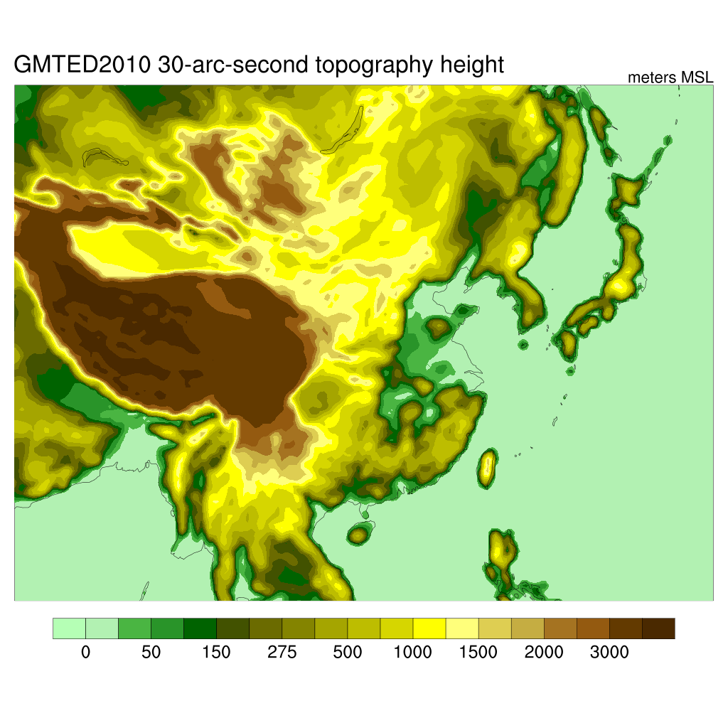
Introduction
East Asia Domain
The rapid increase of CO₂ emissions and growing air pollution crises in most countries of East Asia, particularly China, due to their fast economic and population growth, excessive use of coal and and lack of sufficient and effective emission control policies motivated us to perform a sensitivity analysis to find temporal and spatial distribution of CO₂ reduction co-benefits in this domain.

Slide 4
Methodology
 | East Asia
Resolution | 36 km x 36 km
Episode | 15 days in July 2010 and 13 days in January 2010
IC/BC | Hemispheric CMAQv5.2 with Edgar/HTAPv2
CRF (β) | Cao et al. (2011) for China, 10 μg/m3 increase of PM2.5 was corresponded with 0.90% increment in all cause mortality. β= 0.0009 | Pope et al. (2002) β=0.006
BMR | China Statistical Yearbook (2011), Global Burden of Disease GBD (2010)
VSL | OECD (2010), Viscusi et al.(2017)
Emission | EDGAR v4.3.1

Slide 5
Marginal Benefit
China

Slide 6
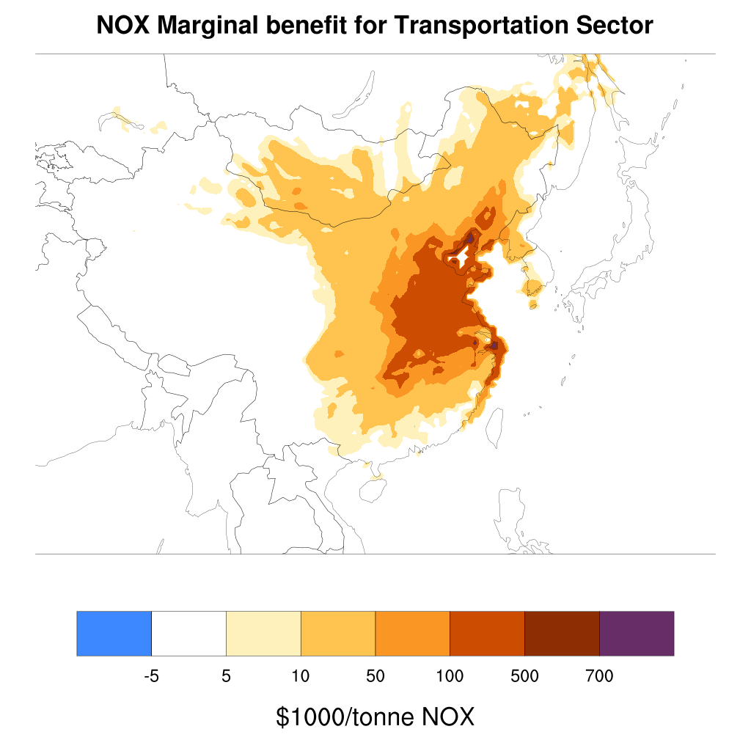
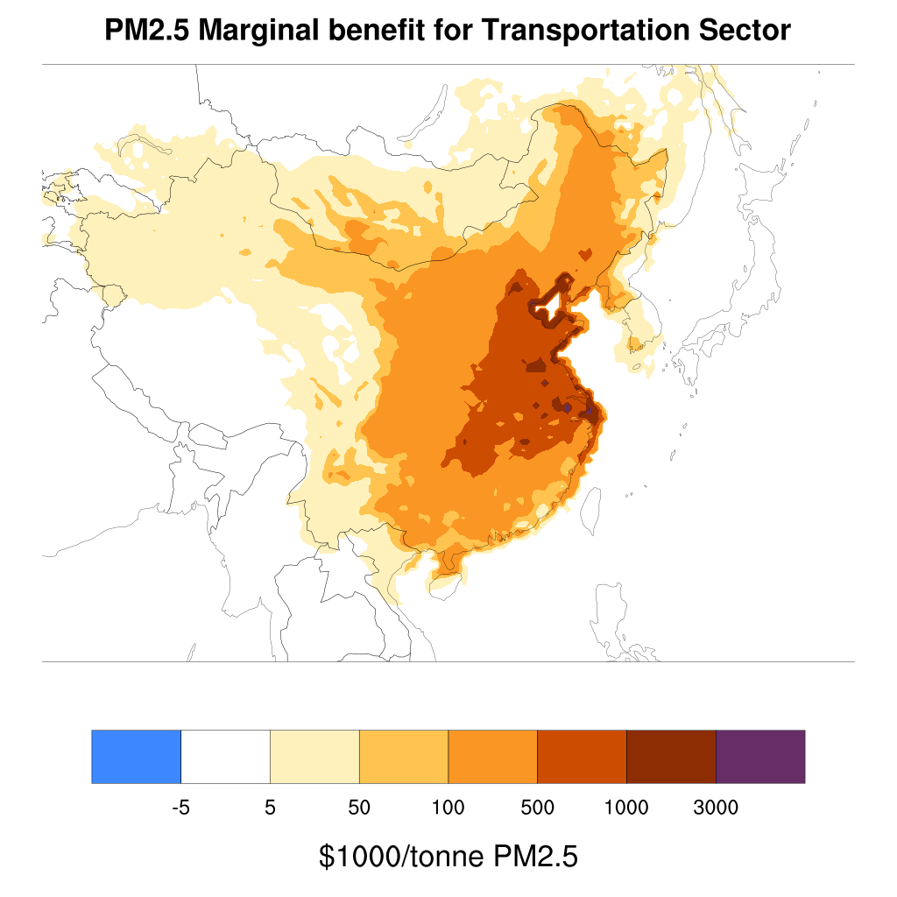
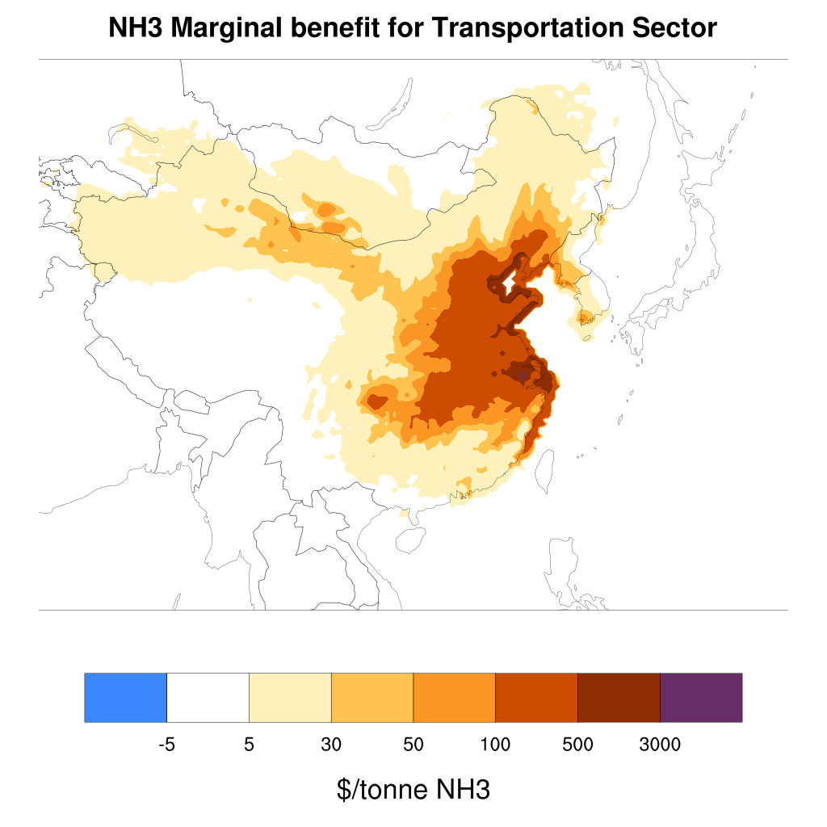
Marginal Benefit for Transportation Sector-China
NOX
PM_{2.5}
NH₃

Slide 7
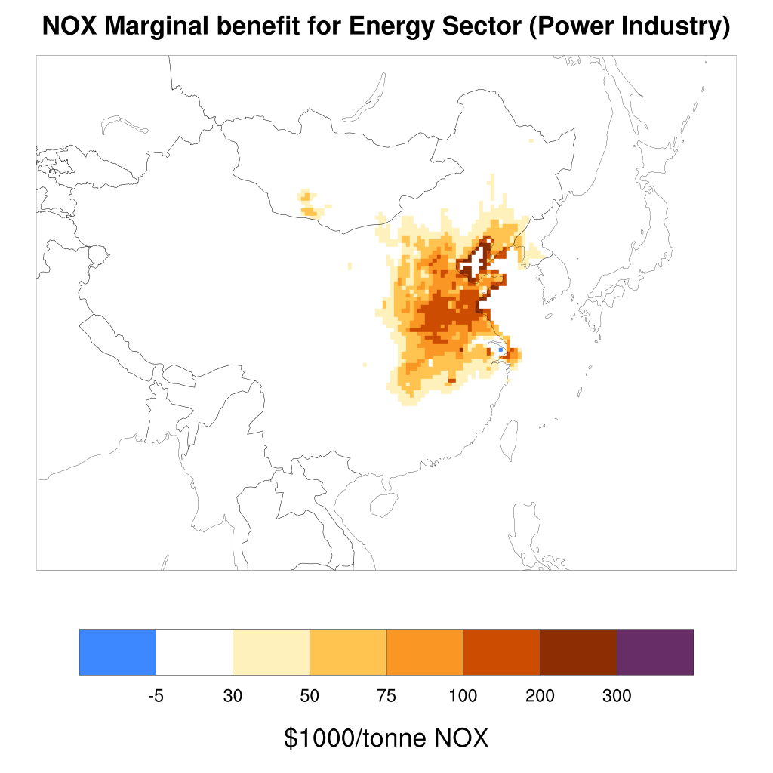
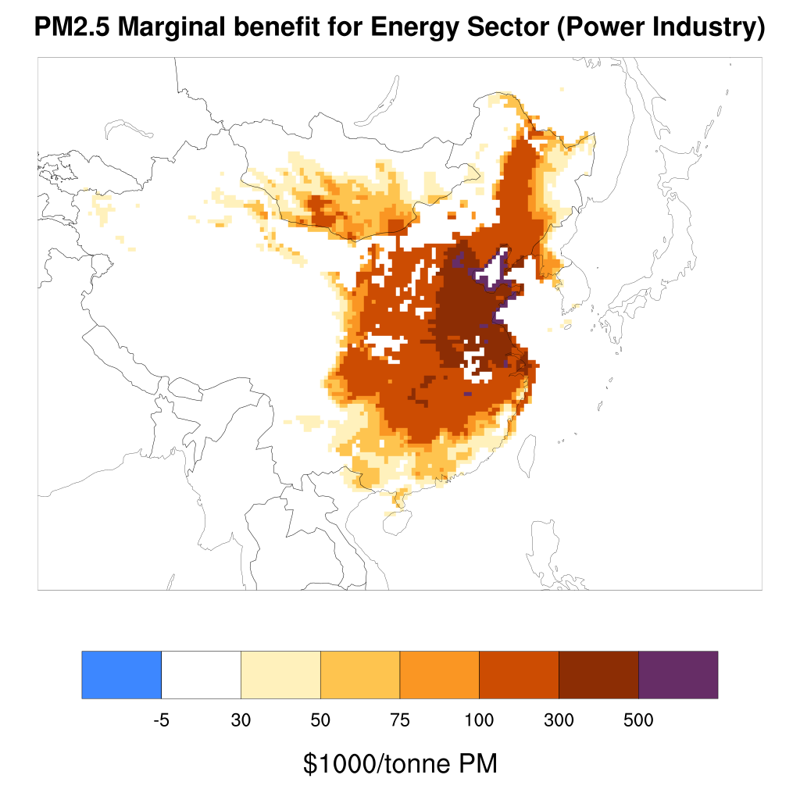
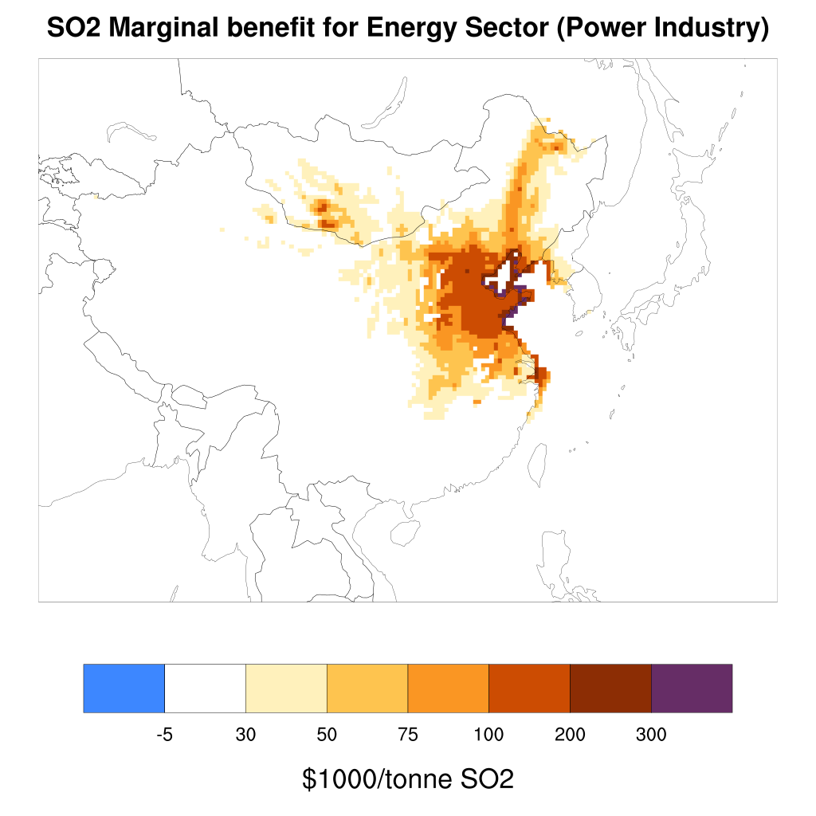
Marginal Benefit for Energy Sector-China
NOX
PM_{2.5}
SO₂

Slide 8
Co-benefit
China,Japan,South Korea

Slide 9
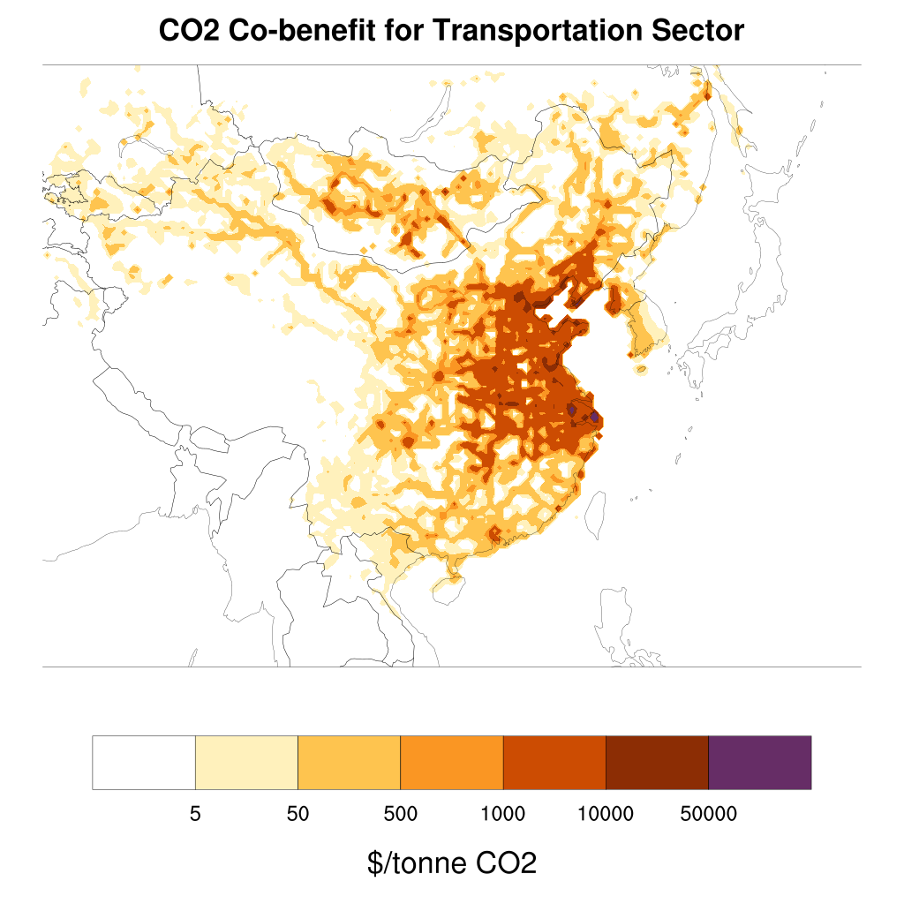
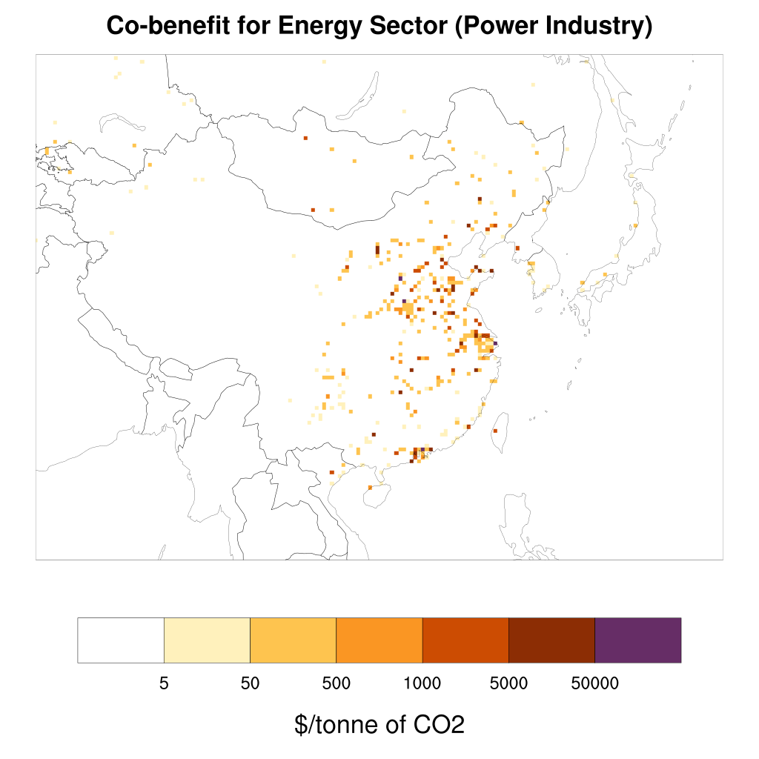
China Co-benefits $/ tonne CO₂
Transportation Sector (Mobile)
Energy Sector (Power Industry)
Total benefit 210 USD billion
Total benefit 730 USD billion

Slide 10
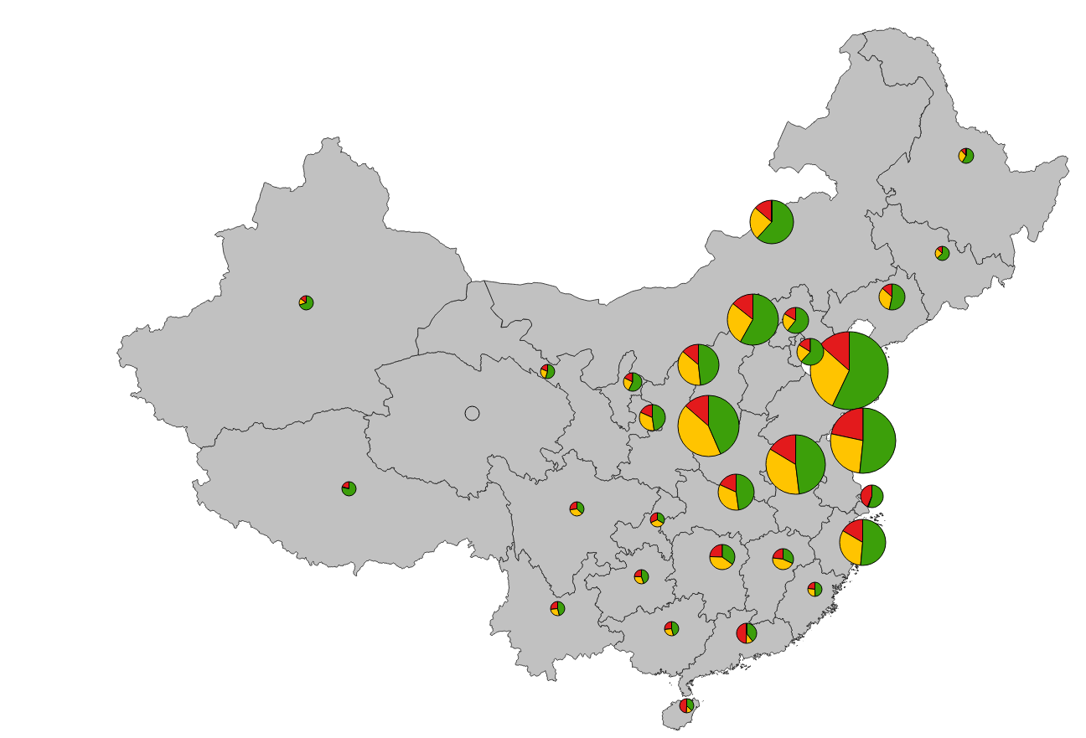
The Contribution of Each Primary Emissions to Total Co-benefit ($) in Energy Sector for 30 China Province
PM_{2.5}
NOX
SO₂
NH₃
~ $0.5 bn
~ $5 bn
~ $100 bn
~$130 bn

Slide 11
The Contribution of Each Primary Emissions to Total Co-benefit ($) in Transportation for 30 China Province
PM_{2.5}
NOX
SO₂
NH₃
~$1 bn
~$5bn
~$15 bn
~$30 bn

Slide 12
Japan Co-benefits $/ tonne CO₂
Transportation Sector (Mobile)
Energy Sector (Power Industry)
Total benefit 86 USD billion
Total benefit 61 USD billion

Slide 13
South Korea Co-benefits $/ tonne CO₂
Transportation Sector (Mobile)
Energy Sector (Power Industry)
Total benefit 35 USD billion
Total benefit 30 USD billion

Slide 14
Top 10 Power Plant Facilities Contributing to the Total Avoided Death(China)
Rank | Power Station | Only-China | Only-Japan | Only-SK
1 | Zhejiang Jiaxing+ Shanghai Caojing | 25,221 | 111 | 56
2 | Anhui Pingwei +Datang Huainan Luohe | 8,235 | 5 | 0.4
3 | Huaneng Yangluo | 7,316 | 0.7 | 0.06
4 | Huaneng Dezhou | 6,566 | 15 | 1.5
5 | Ligang | 5,228 | 50 | 12
6 | Anhui Guodian Tonglin | 5,184 | 1.2 | 0.17
7 | CHD Shandong Zouxian | 3,537 | 3 | 0.2
8 | Taicang Harbor +Huaneng Shanghai Shidongkou+Shanghai Waigaoqiao | 3,044 | 32 | 3
9 | Huaneng Yuhuan | 2,904 | 17 | 88
10 | Suizhong | 1,956 | 1.5 | 0.2

Slide 15
Power Plant’s Total Avoided Deaths
China: 155
Japan: 0.4
SK: 0.1
China: 693
Japan: 18
SK: 3
China: 169
Japan: 3
SK: 0.3
China: 2904
Japan: 17
SK: 88
China: 172
Japan: 2
SK: 5
China: 1677
Japan: 25
SK: 3
China: 25221
Japan: 111
SK: 56
China: 30
Japan: 14
SK: 2

Slide 16
Total Avoided Death (China, Japan, South Korea)
Transportation
Energy Power Plant
Receptor /Source | China | Japan | SK
China | 154,400 | - | 1,230
Japan | 140 | 12,900 | 2,520
South Korea | 580 | 10 | 6,040
Receptor /Source | China | Japan | SK
China | 538,200 | - | 1,160
Japan | 10,400 | 9,150 | 1,380
South Korea | 4,610 | 10 | 5,040
Total
Receptor /Source | China | Japan | South Korea
China | 692,600 | 10 | 2,390
Japan | 10,540 | 22,050 | 3,900
South Korea | 5,190 | 20 | 11,080

Slide 17
Total Co-benefit by Province (billion $)
Shandong Province
Jiangsu Province
Henan Province
Anhui Province
Hebei Province
Jiangsu Province
Henan Province
Shandong Province
Anhui Province
Hebei Province

Slide 18
Key Findings
China’s commitment in Paris Agreement has been to reduce its CO₂ emission intensity to 65% of its value in 2005 ( unfccc.int, 2017). Knowing the estimated health co-benefit influence of different locations can help the decision makers to better achieve this goal by improving China’s air pollution policies.
Estimated co-benefits are larger than the price of carbon or its social cost.(China ~ 6.61 $/tCO₂). Large co-benefit values provide strong justification for integrated climate and air quality policies.
Co-benefit values are comparable to those found previously in scenario-based studies (e.g. Tian, Lin et al. 2017; Li, Mingwei et al. 2018), but significantly larger at specific locations.

Slide 19
Acknowledgment
Funding
NSERC, Health Canada

Slide 20
Thank You! References
Cao, Jie, et al. "Association between long-term exposure to outdoor air pollution and mortality in China: a cohort study." Journal of hazardous materials 186.2-3 (2011): 1594-1600.
China Statistical Yearbook. National Bureau of Statistics of China: http://www.stats.gov.cn/english/statisticaldata/annualdata/
Hakami, A., Henze, D. K., Seinfeld, J. H., Singh, K., Sandu, A., Kim, S., Byun, D., Li, Q. (2007), “The adjoint of CMAQ. ” Environmental Science and Technology, Vol. 41, pp. 7807-7817.
Li, Mingwei, et al. "Air quality co-benefits of carbon pricing in China." Nature Climate Change (2018): 1.
OECD (2014), The Cost of Air Pollution: Health Impacts of Road Transport, OECD Publishing, Paris. http://dx.doi.org/10.1787/9789264210448-en
Pope C A et al 2002 Lung cancer, cardiopulmonary mortality, and long-term exposure to fine particulate air pollution JAMA-J. Am. Med. Assoc
unfccc.int. (2017). The Paris Agreement - main page. [online] Available at: http://unfccc.int/paris_agreement/items/9485.php
Tian, Lin, et al. "Addressing the source contribution of PM2. 5 on mortality: an evaluation study of its impacts on excess mortality in China." Environmental Research Letters 12.10 (2017): 104016.
Viscusi, W. Kip, and Clayton J. Masterman. "Income Elasticities and Global Values of a Statistical Life." Journal of Benefit-Cost Analysis 8.2 (2017): 226-250.
Wang, Haidong, et al. "Global, regional, and national life expectancy, all-cause mortality, and cause-specific mortality for 249 causes of death, 1980–2015: a systematic analysis for the Global Burden of Disease Study 2015." The lancet 388.10053 (2016): 1459-1544.

