Slide 1
Updates on Soil NO_{x} parametrization in CMAQ v 5.1
Quazi Z. Rasool¹, Jesse O. Bash², Rui Zhang¹, Ellen J. Cooter², Benjamin Lash¹, Daniel S. Cohan¹ and Lok N. Lamsal³
¹Department of Civil engineering, Rice University
²Computational Exposure Division, NERL, US Environmental Protection Agency
³NASA Goddard Space Flight Center
15th Annual CMAS Conference, UNC-Chapel Hill
October 25, 2016

Slide 2
Outline: Soil N emissions in CMAQ
Updated parametrized approach to soil NO
Replaces Yienger & Levy scheme in CMAQ
Emissions are function of soil N, biome, and meteorology
Soil N from EPIC agricultural model
Impact of soil NO on ozone and PM_{2.5}
New mechanistic approach
Consistent representation of multiple N species (NO, HONO, N₂O, NH₃)
Accounts for soil processes (nitrification, denitrification)

Slide 3
Soil NO Parameterization
Meteorological model
Land Surface Model
Soil Temperature (T) and moisture (θ)
Canopy reduction factor
Pulsing = f (rain, dry period)
Emission Factor for each biome¹
Available Soil N
Biome
Fertilizer³
Deposition²
Soil NO
¹Stienkamp & Lawrence (2011)
² In-line from CMAQ
³ From Potter et al. (2010) or EPIC agricultural model

Slide 4
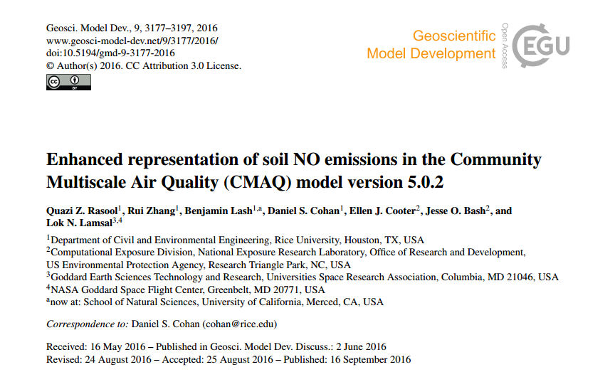
Rasool GMD paper header

Slide 5
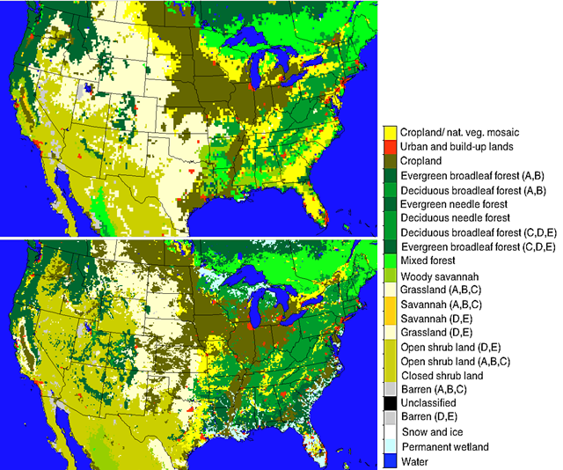
Soil biome/Land Cover Dataset Enhancements
GEOS-Chem (0.25° x 0.25°)
GEOS-Chem
24 MODIS land cover categories
Too coarse for regional modeling
CMAQ
Mapped 40 NLCD categories from Pleim-Xiu to 24 MODIS categories
Köppen-Geiger climate zones
Sub-grid fractionation of biomes
CMAQ (12 km x 12 km)

Slide 6
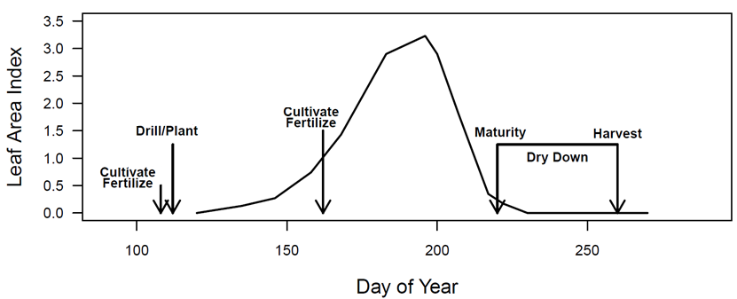
Environmental Policy Integrated Climate (EPIC) agricultural model
Fertilizer quantity: USDA Agricultural Resource Management Survey database, validated with fertilizer sales data
Fertilizer timing: Determined by plant nutrient stress
Can simulate varied agricultural practices (e.g., tillage, fertilizer type)
Fertilizer Emission Scenario Tool for CMAQ (FEST-C) incorporates EPIC simulated soil N into CMAQ runs
[Source: Cooter et al., 2012]
Notes:
HUSC to Schedule Vegetable Plantings, Predict Harvest Dates and Manage Crops
Temperature controls the development of many organisms that don’t have complex thermoregulatory systems. This allows us to predict the development of different organisms by accurately using development or phenology models which are based on the accumulation of heat units (i.e. degree days) during a growing season.

Slide 7
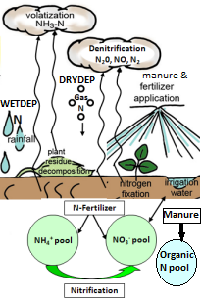
FEST-C integrates EPIC with CMAQ
Biogenic Emissions Land use Database v4 (BELD4)
(Land cover, Crop type fractions per grid)
SMOKE
Other
Emissions
FEST-C*
EPIC agricultural model#
CMAQ with
soil NO parameterization
Soil N
N Deposition
WRF meteorology
Rasool et al., 2016 [GMD]
*modified for CONUS run (based on Bash et al., 2013)
#modified for CONUS run (based on Cooter et al., 2012)

Slide 8
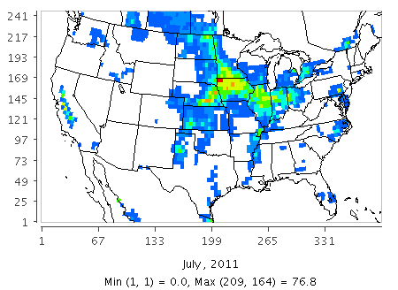
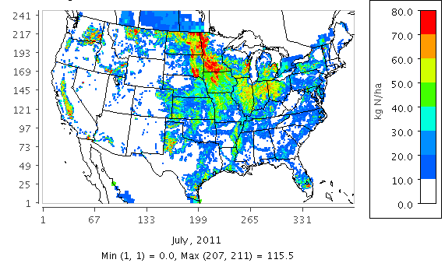
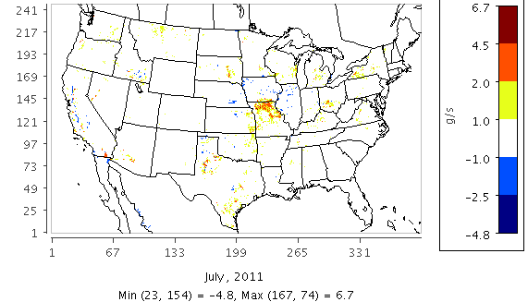
Impact of Potter vs EPIC Fertilizer Data on Soil NO
Potter
EPIC
Fertilizer
Application (kgN/ha)
EPIC - Potter
Difference in
Soil NO (g/s)
*Averaged over July 2011

Slide 9
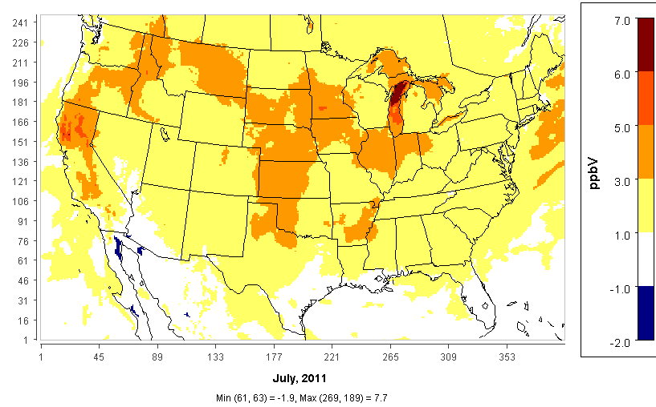
Impact of Soil NO scheme on Ozone
Daily Average 8-hourly max. Ozone (Updated Parametrization – Base CMAQ v5.1)

Slide 10
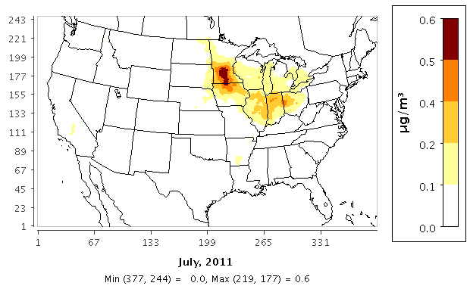
Impact of Soil NO scheme on PM
Daily Average PM_{2.5} (Updated Parametrization – Base CMAQ v5.1)

Slide 11
Parameterized → Mechanistic approach
Parameterization quantifies only soil NO
Not integrated with NH₃ scheme
Neglects other N species (HONO, N₂O)
Need mechanistic approach to represent Soil N biogeochemistry
Nitrification and denitrification processes
Challenge: Scarcity of observational data

Slide 12
Soil-Atmosphere reactive N exchange
NH₃
NH₃
NH₄⁺
NO N₂O
N₂
NO N₂O HONO
NO₃⁻
N₂
N₂O
NO
HNO₃
HNO₃
NO₂⁻
NO₂⁻
Fertilizer, Deposition
NO₂
Atmosphere
Soil
NO
N₂O
NO₂
HNO₂
H⁺
H⁺
Denitrification
Org N
N (-3)
N (+5)
Nitrification
Adapted from Su et al., 2011; Pilegaard, 2013 and Medinets et al., 2015

Slide 13
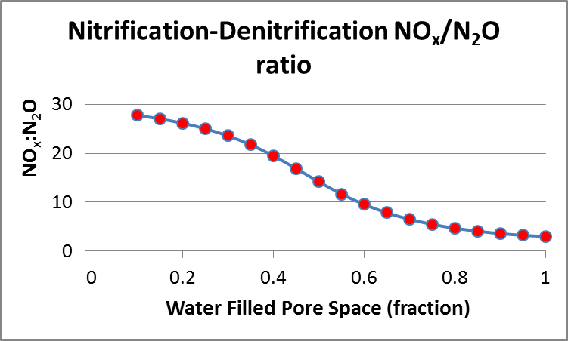
Mechanistic approach including other N species*
Nitrification Rate
Soil NH₄⁺
Water-filled pore space (WFPS)
Soil temperature
Soil texture
(HONO + NO )/ N₂O
vs
WFPS
Optimum HONO
NH₄⁺ / NO₂⁻
Denitrification Rate
Soil NO₃⁻
WFPS
Labile Carbon
Soil texture
HONO
NO
N₂O
*Parton et al., 2001, Del Grosso et al., 2000, Oswald et al., 2013, Su et al., 2011

Slide 14
Conclusions and Next Steps
Enhanced parameterization of soil NO in CMAQ
Significant impact on PM and Ozone compared to base CMAQ
Not consistent with bi-directional NH₃ scheme
Developing mechanistic representation of soil biogeochemistry to model multiple N species consistently
Next steps:
Better represent speciation of deposited N
Bi-directional flux for other N species as for NH₃
Broader goal: Model how soil N emissions and air quality vary with agricultural practices
Potential to mitigate air pollutant and greenhouse gas emissions via best management practices
Choices of tillage, fertilizer timing, biochar, etc

Slide 15
Acknowledgements
NASA AQAST TIGER Soil NOx Project funding
CED, NERL at US EPA for the opportunity as a visiting researcher

Slide 16
References
Bash, J., Cooter, E., Dennis, R., Walker, J., and Pleim, J. (2013). Evaluation of a regional air-quality model with bidirectional NH 3 exchange coupled to an agroecosystem model, Biogeosciences, 10, 1635-1645.
Cooter, E., Bash, J., Benson, V. and Ran, L. (2012). Linking Agricultural Crop Management and Air Quality Models for Regional to National-Scale Nitrogen Assessments. Biogeosciences Discussions, 9: 6095-6127.
CMAS FEST-C 2015: User’s Guide for the Fertilizer Emission Scenario Tool for CMAQ (FEST-C) Version 1.2, Institute of Environment, The University of North Carolina at Chapel Hill, Chapel Hill, NC, available at: https://www.cmascenter.org/fest-c/documentation/1.2/FESTC1_2_userManual.pdf.
Dinnes, D. L., Karlen, D. L., Jaynes, D. B., Kaspar, T. C., Hatfield, J. L., Colvin, T. S., and Cambardella, C. A. (2002). Nitrogen management strategies to reduce nitrate leaching in tile-drained Midwestern soils, Agronomy journal, 94, 153-171.
Hudman, R. C., Moore, N. E., Mebust, A. K., Martin, R. V., Russell, A. R., Valin, L. C., and Cohen, R. C. (2012). Steps towards a mechanistic model of global soil nitric oxide emissions: implementation and space based-constraints, Atmos. Chem. Phys., 12, 7779-7795, doi:10.5194/acp-12-7779-2012.
Medinets, S., Skiba, U., Rennenberg, H., & Butterbach-Bahl, K. (2015). A review of soil NO transformation: Associated processes and possible physiological significance on organisms. Soil Biology and Biochemistry, 80, 92-117.
Pilegaard, K. (2013). Processes regulating nitric oxide emissions from soils. Philisophical Transactions of the Royal Society: Biological Sciences, (368). Retrieved from http://dx.doi.org/10.1098/rstb.2013.0126.
Pleim, J. E. X. A. (1811). Development of a Land Surface Model. Part II: Data Assimilation. Journal of Applied Meteorology. Dec2003, 42(12).
Potter, P., N. Ramankutty, E.M. Bennett, and S.D. Donner. 2010. Characterizing the Spatial Patterns of Global Fertilizer Application and Manure Production. Earth Interactions 14 (2): 1-22. http://dx.doi.org/10.1175/2009EI288.1.
(S&L) Steinkamp, J., & Lawrence, M. G. (2011). Improvement and evaluation of simulated global biogenic soil NO emissions in an AC-GCM. Atmospheric Chemistry and Physics, 11(12), 6063–6082. doi:10.5194/acp-11-6063-2011
Rasool, Q. Z., Zhang, R., Lash, B., Cohan, D. S., Cooter, E. J., Bash, J. O., and Lamsal, L. N.: Enhanced representation of soil NO emissions in the Community Multiscale Air Quality (CMAQ) model version 5.0.2, Geosci. Model Dev., 9, 3177-3197, doi:10.5194/gmd-9-3177-2016, 2016.
Yienger, J. J., & Levy, H. (1995). Empirical-Model Of Global Soil-Biogenic Nox Emissions. Journal of Geophysical Research-Atmospheres, 100(D6), 11447-11464. doi: 10.1029/95jd00370.
Vinken, G. C. M., Boersma, K. F., Maasakkers, J. D., Adon, M., & Martin, R. V. (2014). Worldwide biogenic soil NOx emissions inferred from OMI NO₂ observations. Atmospheric Chemistry and Physics, 14(18), 10363–10381. doi:10.5194/acp-14-10363.

Slide 17
Extra Slides

Slide 18
Inline BDSNP: Three WRF-BEIS-CMAQ simulation cases
YL - EPA standard configuration with YL95 soil NO scheme
BDSNP (Potter with old Biome) – BDSNP soil NO scheme with GEOS-Chem soil biome classification and Potter at al. (2010) fertilizer data
BDSNP (EPIC with new Biome) – BDSNP soil NO scheme with NCLD40 Global soil biome and EPIC fertilizer data

Slide 19
Updated Parametrized approach
Source: Rasool et al., 2016 [GMD]

Slide 20
Mechanistic approach including other N species
Parton et al., 2001, Del Grosso et al., 2000:
NOx to N₂O Nitrification ratio:
$R \left({NO}_{x}:N_{2}O\right) =15.2+\{\frac{35.5∗atan\left[0.68∗π∗\left(10∗D_{r} −1.86\right)\right]}{π}\}$
${Relative gas diffusitivity in soil compared to air , D}_{r}$
$Dr=0.209∗{\left(1−WFPS\right)}^{\frac{4}{3}}$
HONO -> fraction of Nitrification NO+HONO
(Oswald et al., 2013)
Nitrification N₂O flux (Parton et al, 2001 , DayCENT) = K₂ * FNO3 (gNm⁻²d⁻¹)
K₂ = 0.02 (2%) (parton et al., 2001) → fraction of nitrified N lost as N₂O flux

Slide 21
Mechanistic approach (2)
Denitrification N₂ to N₂O ratio:
$R \left(N_{2}:N_{2}O\right)=f({NO_{3}^{−}}/{HR}$) * f (WFPS)
K= soil texture dependent parameter (Del Grosso et al., 2000)
[k controls the max. value of $f({NO_{3}^{−}}/{HR}$)]
Soil heterotrophic respiration (HR) is a proxy for labile C (electron donor) in denitrification

Slide 22
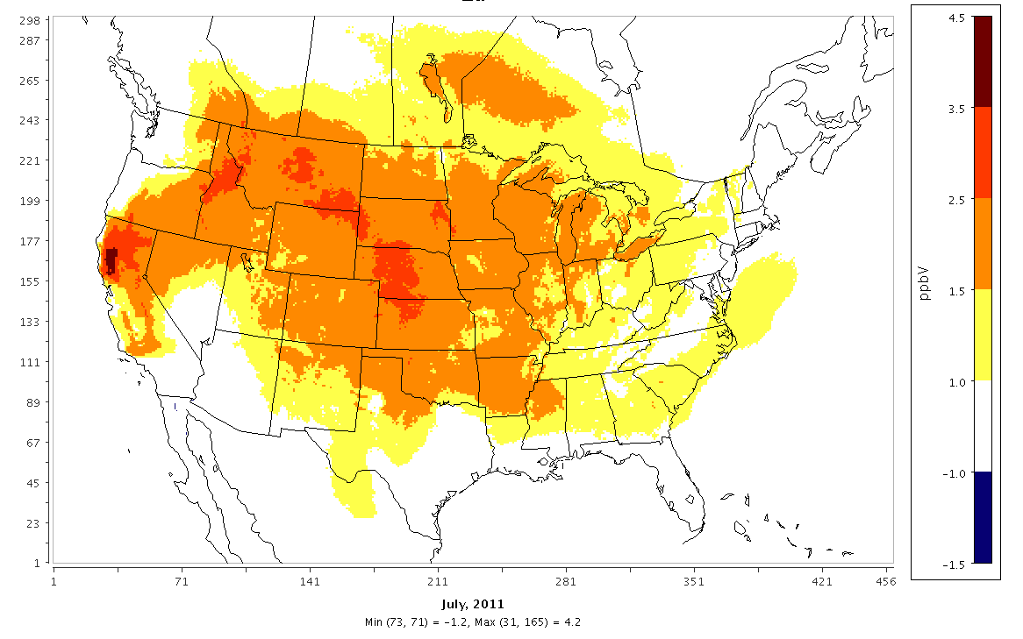

Slide 23
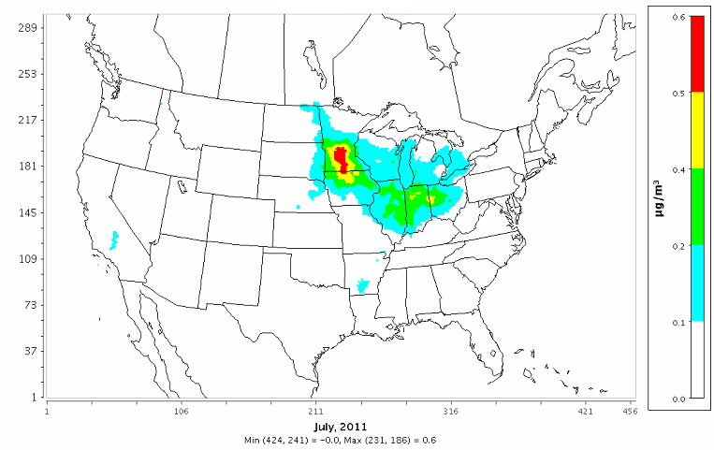
Impact of Soil NO scheme on PM
Daily Average PM_{2.5} (Updated Parametrization – Base CMAQ v5.1)

Slide 24
EPIC-BDSNP-CMAQ interphase
BELD4: Grid Crop Data
(NLCD 40 MODIS 24 types)
Crop usage fraction per grid cell consistent with NLCD40 LU/LC)
Meteorology
WRF
FEST-C*
Bi-directional CMAQ modeling system + BDSNP
EPIC agricultural model#
(25 year spin-up for biogeochemical processes)
(reanalysis)
^{(Inherent EPIC datasets)}
+
Soil data
Grid-wise daily soil N
(Fertilizer + Deposition N)
(classified as separate NH₄⁺-N , NO₃⁻-N , Organic N pools)
N Deposition
Spatial data for CONUS (12 km grid with crop data)
Fertilizer N
Non-Fertilizer NEI (CONUS)
Total daily soil N (= NH₄⁺-N + NO₃⁻-N + Organic N ) for BDSNP
[Weighted sum as per grid –wise crop usage fraction]
*modified for CONUS run (based on Bash et al., 2013)
#modified for CONUS run (based on Cooter et al., 2012)
Source: Rasool et al., 2016 [GMD]

Slide 25
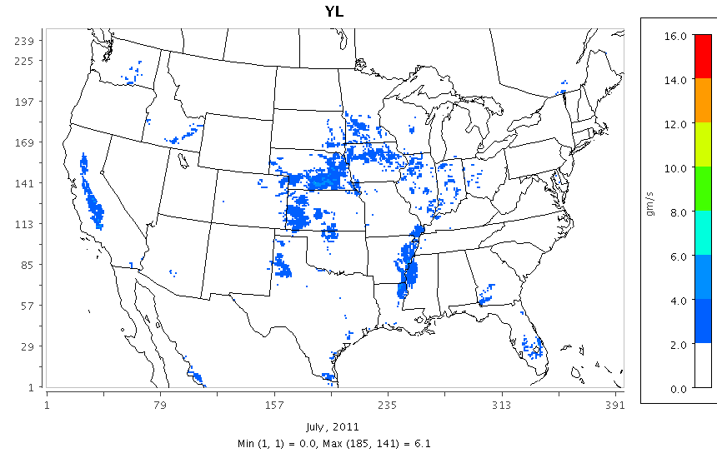
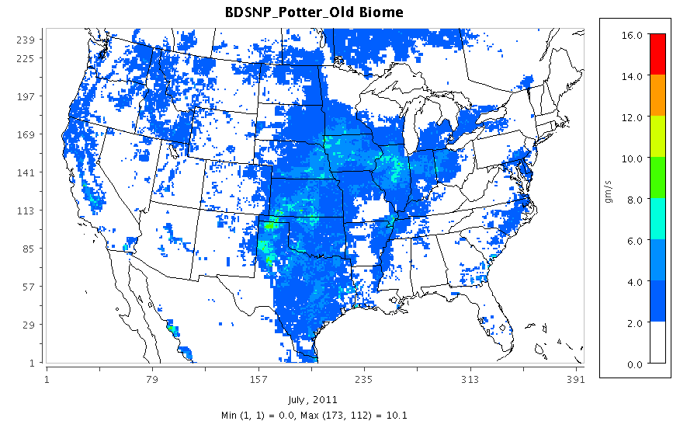
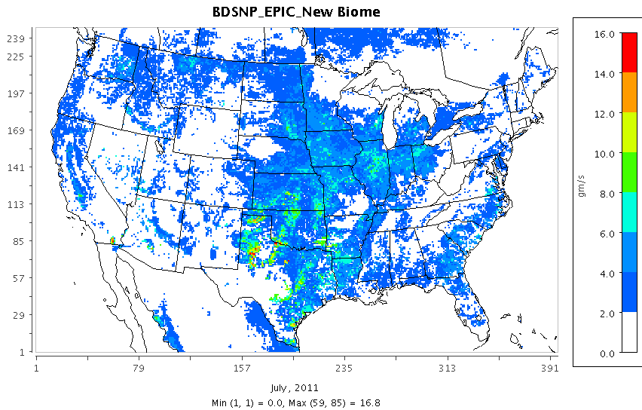
Monthly Mean (July 2011) Soil NO
YL
BDSNP (Potter with Old Biome)
BDSNP (EPIC with New Biome)

Slide 26
Model validation
PM2.5 (Daily) Observed data from IMPROVE sites¹
Ozone Observed data from EPA’s AIRS AQS (Air Quality System) network²
Aggregated performance metrics for sites showing higher sensitivities between 3 cases (including sites exceeding EPA standard in case of Daily max. 8-hr ozone)
¹http://www3.epa.gov/airquality/airdata/
²http://views.cira.colostate.edu/fed/Datasets/Default.aspx

Slide 27
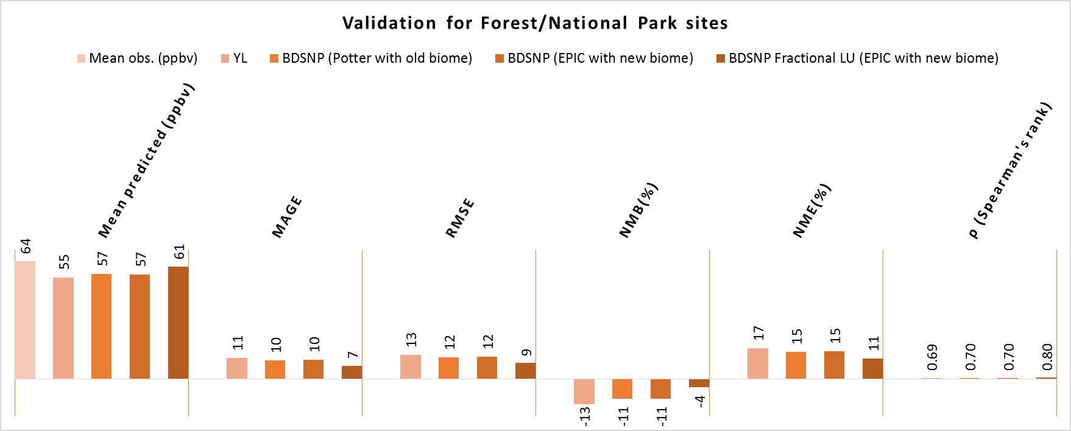
Model performance
For MDA8 Ozone:
F ratio > F_{critical} and P-value << 0.05 from ANOVA analysis
difference between 3 schemes are statistically significant.
For PM2.5 (daily mean):
F-ratio < F_{critical} and p-value > 0.05 in comparisons among the 3 cases
differences are not that statistically significant.
MDA8O₃ modeled vs observed (CASTNET), July 2011

Slide 28
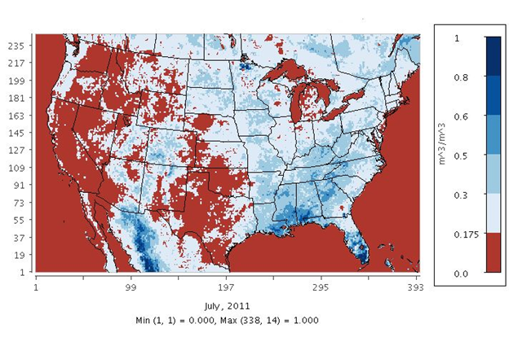
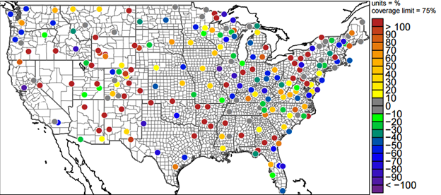
Variability in soil conditions effects modeled N emissions
Soil moisture (vol.) for July 2011 (mean)
Modeled estimates for Dry forest sites
& Wet agricultural/ prairie sites perform differently
Precip. Bias (%) for July 2011 (mean)
-Bias in modeled precipitation not too indicative -Need to include other N species in models

Slide 29
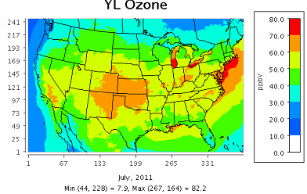
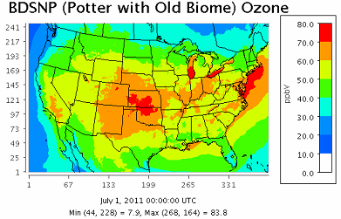
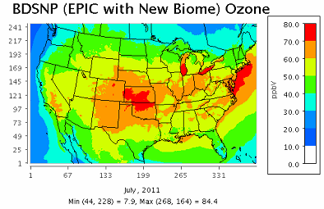
Monthly mean(July 2011) Daily Max. 8 hr. O₃
YL
BDSNP (Potter with Old Biome)
BDSNP (EPIC with New Biome)

Slide 30
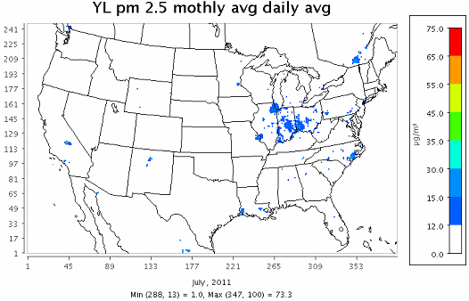
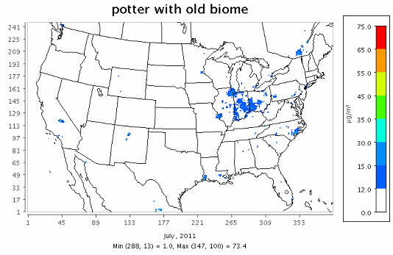
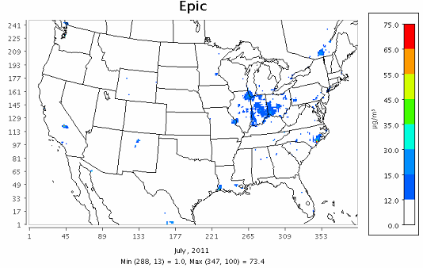
Monthly mean(July 2011) Daily Avg. PM 2.5
YL
BDSNP (Potter with Old Biome)
BDSNP (EPIC with New Biome)

Slide 31
PM2.5 (daily mean) modeled vs observed July 2011

Slide 32
MDA8O3 modeled vs observed July 2011

Slide 33
Model performance (3 cases inline with CMAQ, July 2011 scenario)

Slide 34
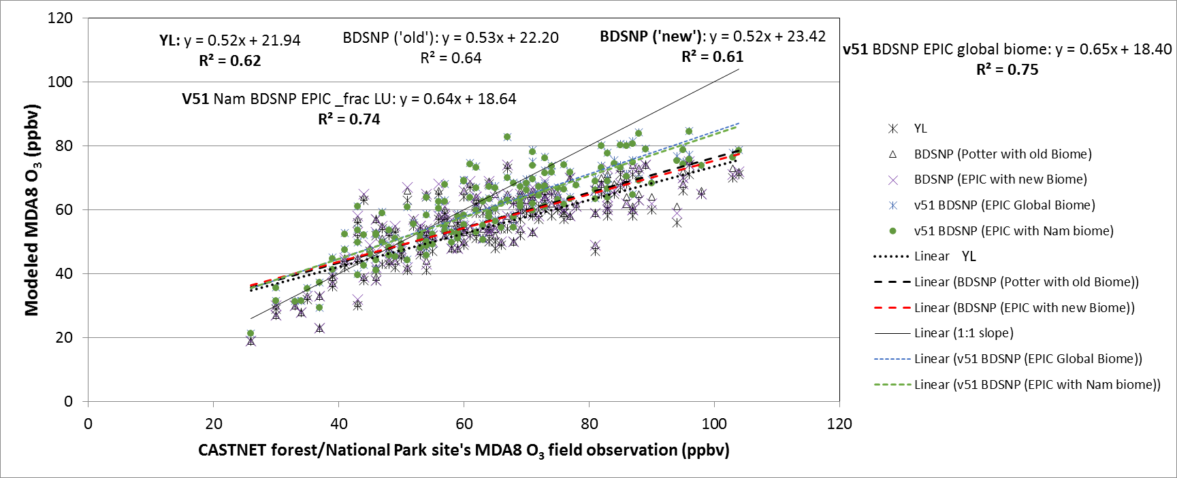
Fractional Land use in BDSNP
Minor enhancement in BDSNP soil biome to improve sub-grid calculation

Slide 35
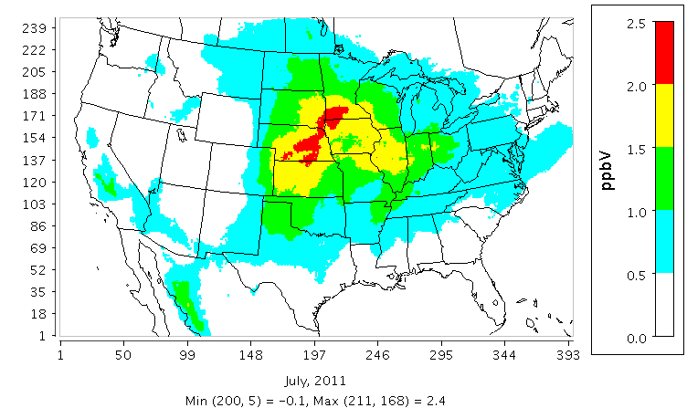
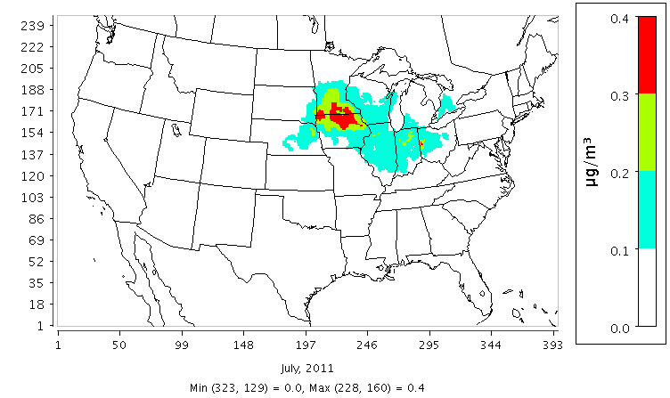
Biochar as N emission amendment
47-67 %reductions in NO emissions (Nelissen et al, 2014) when biochar is applied to agricultural soils

