Slide 1
Single-Source Impacts with SCICHEM and CAMx
Prakash Karamchandani¹, Jaegun Jung¹, Tejas Shah¹, Biswanath Chowdhury², Jeremiah Johnson¹, Maria Zatko³, Greg Yarwood¹, Ralph Morris¹, Eladio Knipping⁴, Naresh Kumar⁵
¹Ramboll Environ, Novato, CA
²Sage-Xator, Princeton, NJ
³Ramboll Environ, Lynnwood, WA
⁴EPRI, Washington, DC
⁵EPRI, Palo Alto, CA
15th Annual CMAS Conference
Chapel Hill, North Carolina, October 24-26, 2016

Slide 2
Background
Appendix W revisions:
Tiered approach to ozone (O₃) and fine particulate (PM_{2.5}) from single sources
Second tier: chemical transport model (CTM)
CTM requirements:
Model formulation includes complex photochemistry leading to O₃ and secondary PM_{2.5} formation
Evaluated against in-plume measurements (e.g., aircraft measurements)
Correctly handle plume chemical interactions with background
Grid models (CMAQ and CAMx) considered resource demanding and complex
Most Lagrangian models lack photochemistry
SCICHEM: Lagrangian puff model with full photochemistry comparable to CMAQ

Slide 3
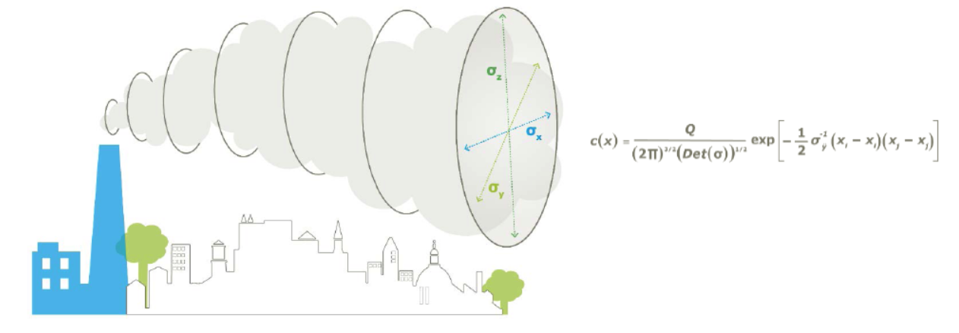
SCICHEM
Plume represented as a succession of 3-D Gaussian puffs
State-of-the-science puff dispersion based on SCIPUFF (Second Order Closure Integrated Puff Model)
Complex photochemistry similar to CMAQ and CAMx
CB05 and CB6r2 gas-phase chemistry
Aerosol and aqueous chemistry modules based on CMAQ
Chemistry on overlapping puffs to correctly account for interaction with background

Slide 4
SCICHEM EVALUATIONs WITH IN-PLUME MEASUREMENTS
Cumberland (TN) power plant plume helicopter measurements
Evaluation with measurements from the 1995 SOS Nashville/Middle Tennessee Ozone Study (Karamchandani et al., 2000, ES&T)
Evaluation with 1998 and 1999 measurements (Chowdhury et al., 2015, Atmos. Env.)
Dolet Hills (LA) power plant plume aircraft measurements (Vijayaraghavan et al., CMAS, 2010; Chowdhury et al., 2015, Atmos. Env.)
Oklaunion (TX) power plant nighttime plume measurements (Karamchandani et al., CMAS, 2011)
Multiple power plant plumes during 2013 NOAA SENEX study in SE U.S. (Knipping et al., AWMA, 2016; Karamchandani et al., 2016, journal article in preparation)
Houston Ship Channel plume during 2013 SEAC⁴RS study (Karamchandani et al., CMAS, 2015; Karamchandani et al., 2016, journal article in preparation)

Slide 5
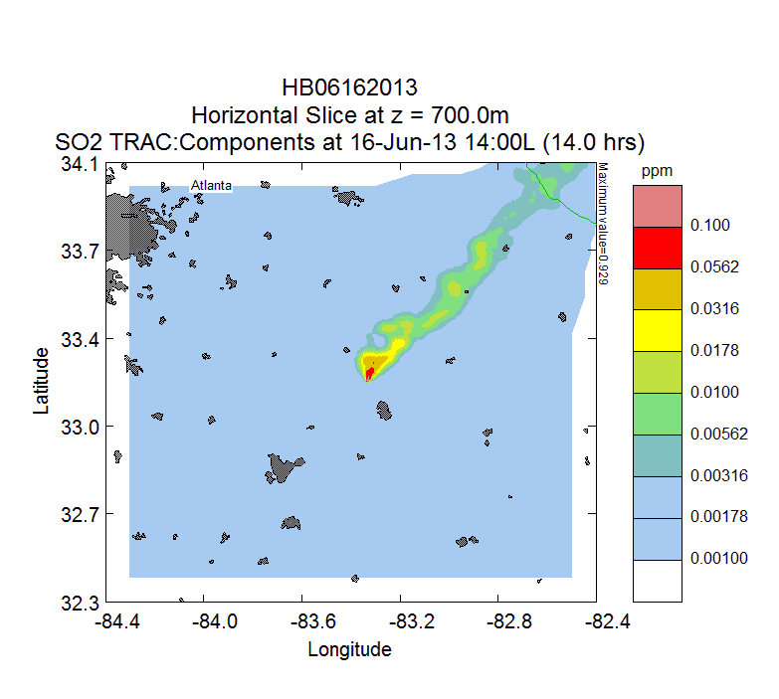
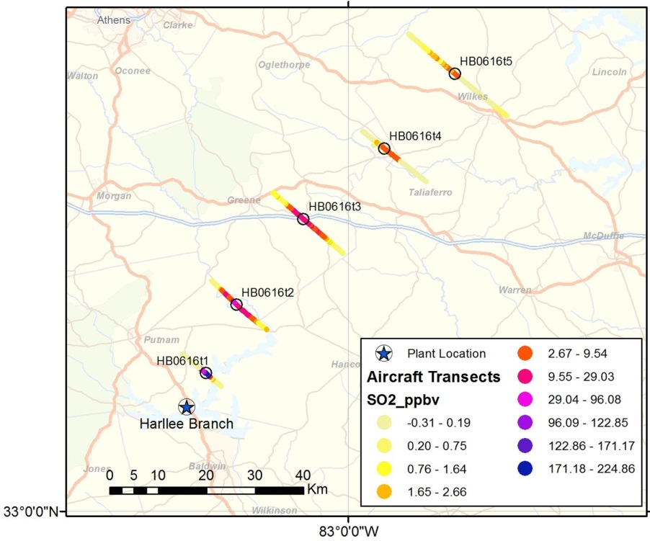
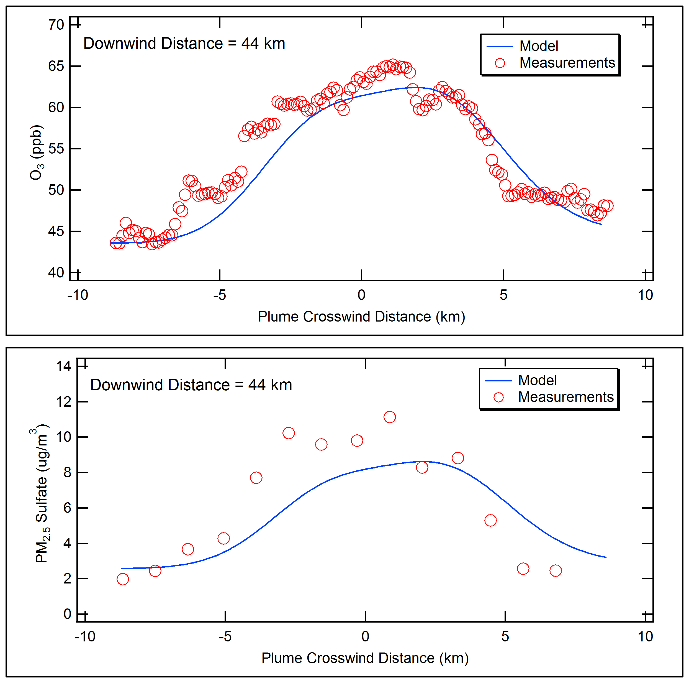
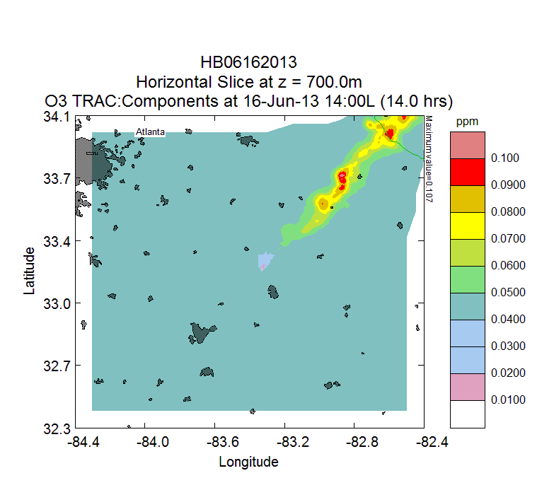
Examples of Model Performance: SENEX
Harllee Branch Power Plant Plume, June 16, 2013
Aircraft Transects
Modeled Plume
Evaluation
Ozone
Sulfate
Aircraft Altitudes: 680 to 800 m (MSL)
Sampling Times: 12:45 pm to 3:45 pm LST

Slide 6
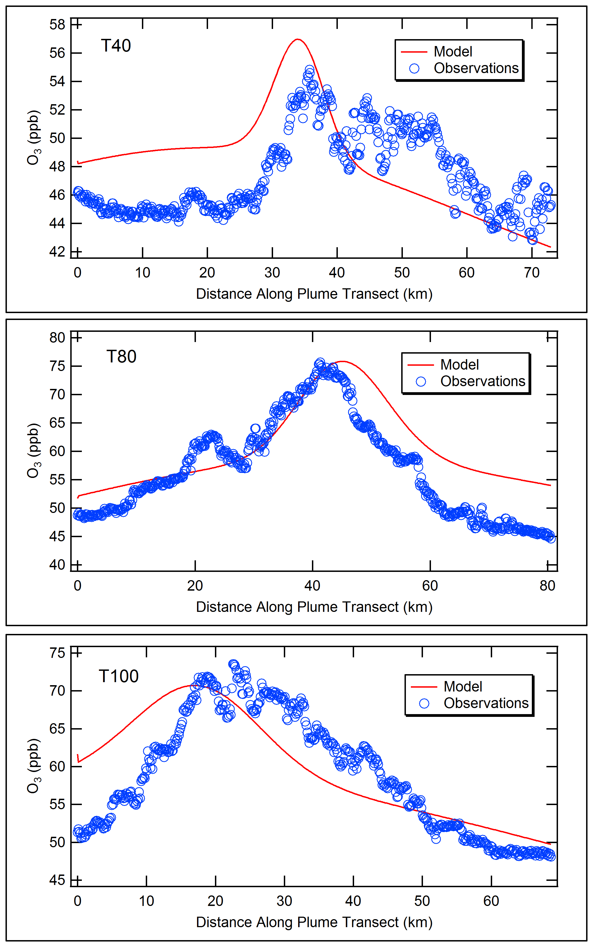
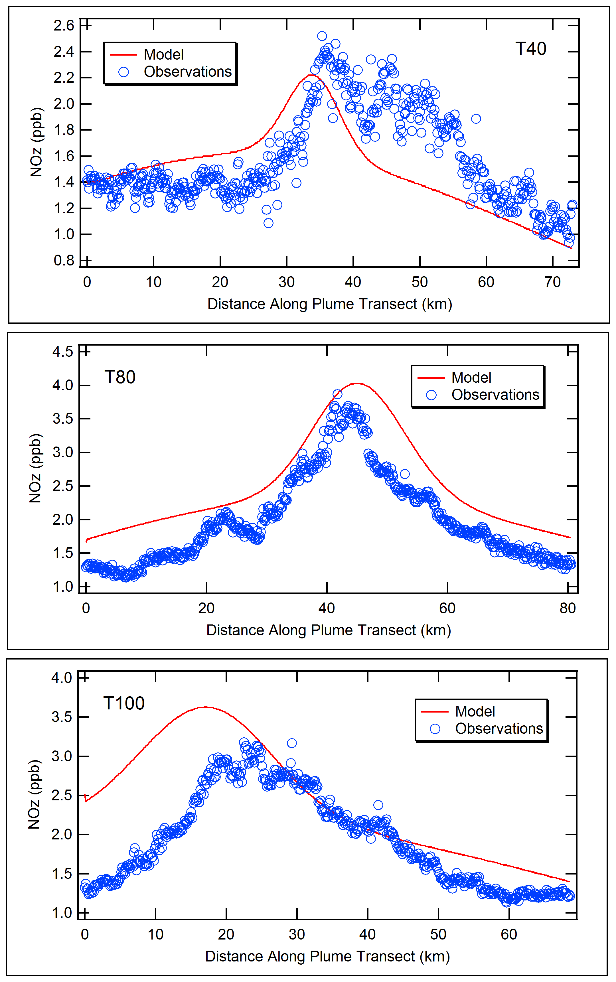
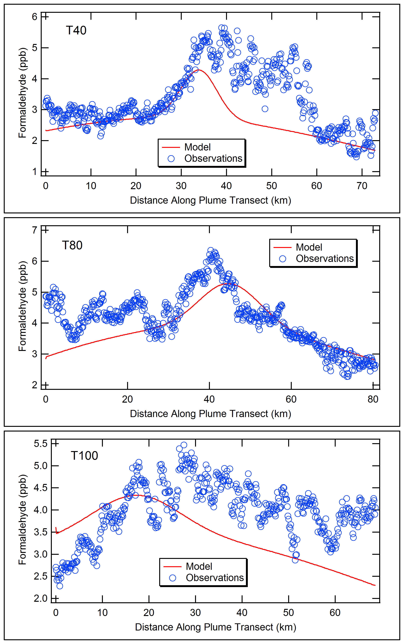
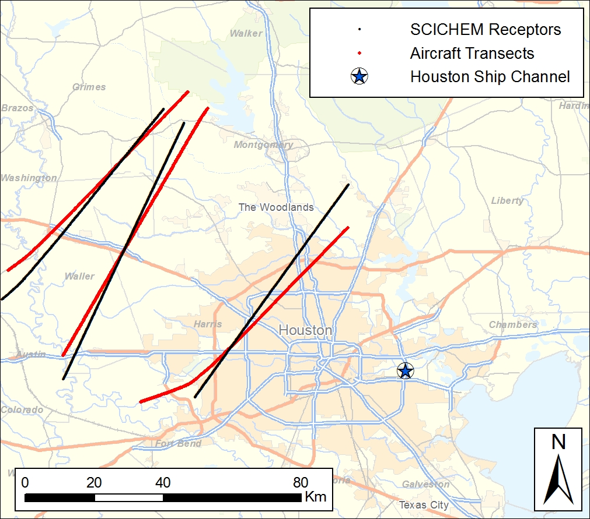
Examples of Model Performance: Houston
Houston Ship Channel Plume, September 18, 2013
Ozone
NOz
HCHO
Aircraft Transects
40 km
T100
T80
80 km
T40
100 km
Aircraft and Model Transects

Slide 7
This Study: SINGLE-SOURCE IMPACTS
Hypothetical EGU (with high NOx emissions) located in 4 different US regions
SO₂ emissions: 12,000 TPY
NOx emissions: 39,000 TPY
SCICHEM inputs
background concentrations from CAMx (EPA 2011 modeling platform)
meteorology from 2011 WRF using MMIF processor
Impacts to Class I area receptors:
Daily maximum 8-hour average ∆O₃
24-hour average secondary PM_{2.5} (sulfate, nitrate) concentrations
24-hour visibility impacts (change in extinction coefficient)
Compare SCICHEM impacts with CAMx zero-out and source apportionment

Slide 8
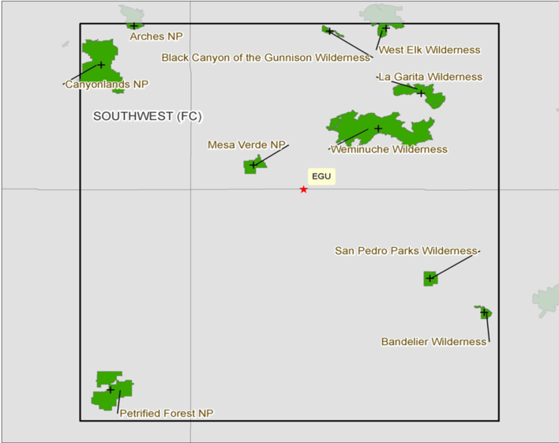
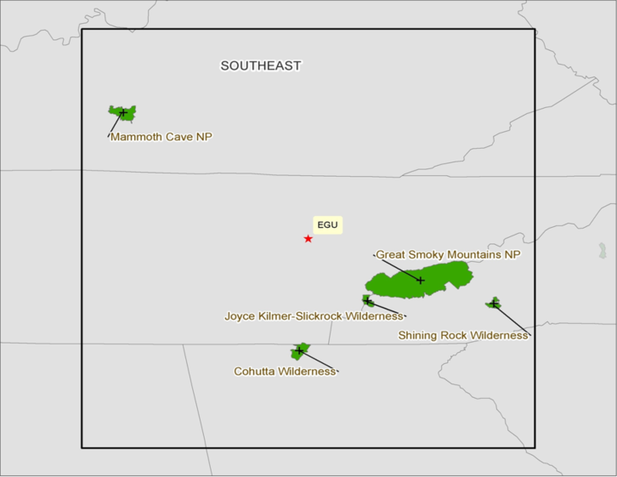
SouthwesT And Southeast US DOMAINS
SCICHEM Runtime for Annual Simulation: 40 to 60 hours on a single-processor per domain
CAMx Runtime for CONUS Annual Simulation: 1 week per quarter on 40 cores (10 MPI x 4 OMP)

Slide 9
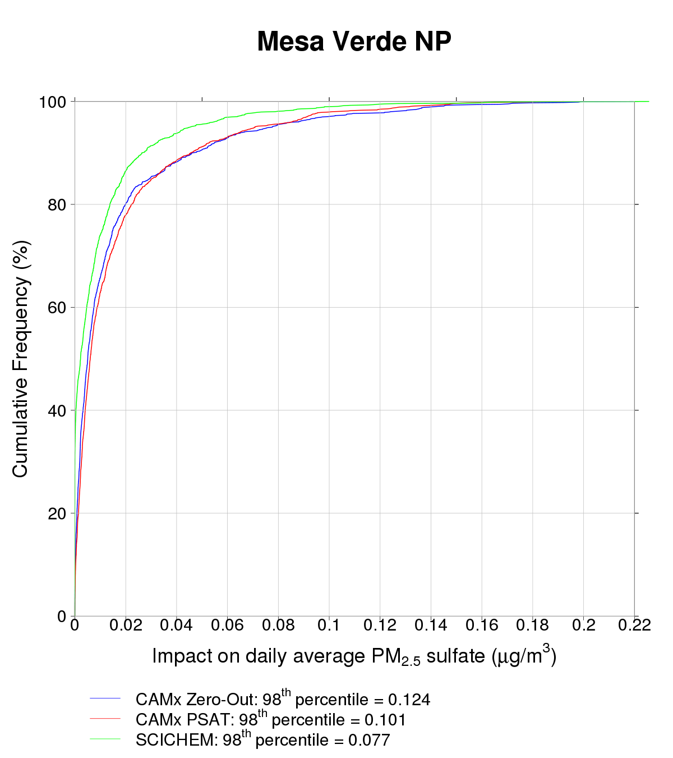
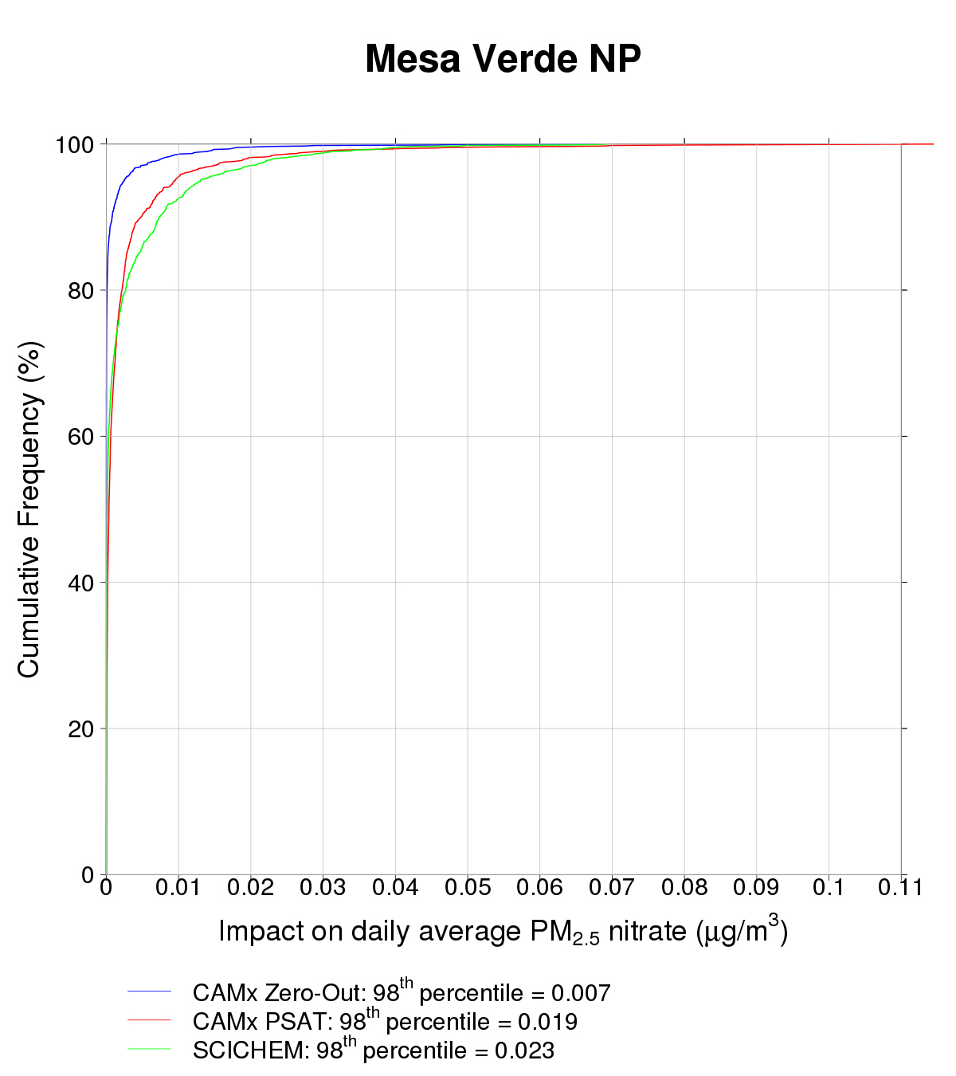
PM_{2.5} IMPACTS: Mesa Verde, Colorado
Distance from source: 50 km
CAMx Zero-Out
CAMx PSAT
SCICHEM
Different dispersion: whether or not plume reaches receptor
Different response of zero-out and PSAT when nitrate is ammonia limited
98th Pctl | SO4 | NO3
CAMx zero-out | 0.124 | 0.007
CAMx PSAT | 0.101 | 0.019
SCICHEM | 0.077 | 0.023
CAMx Zero-Out
CAMx PSAT
SCICHEM
Sulfate
Nitrate

Slide 10
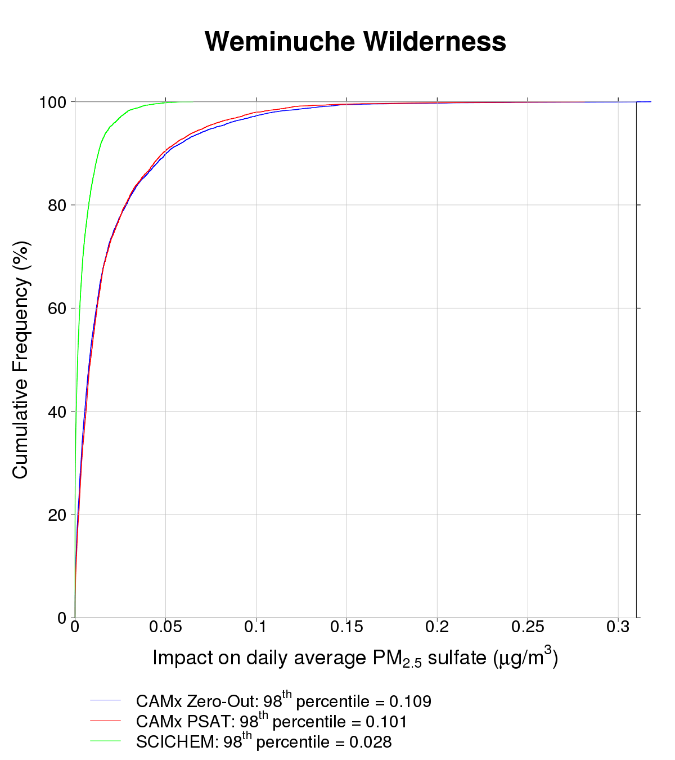
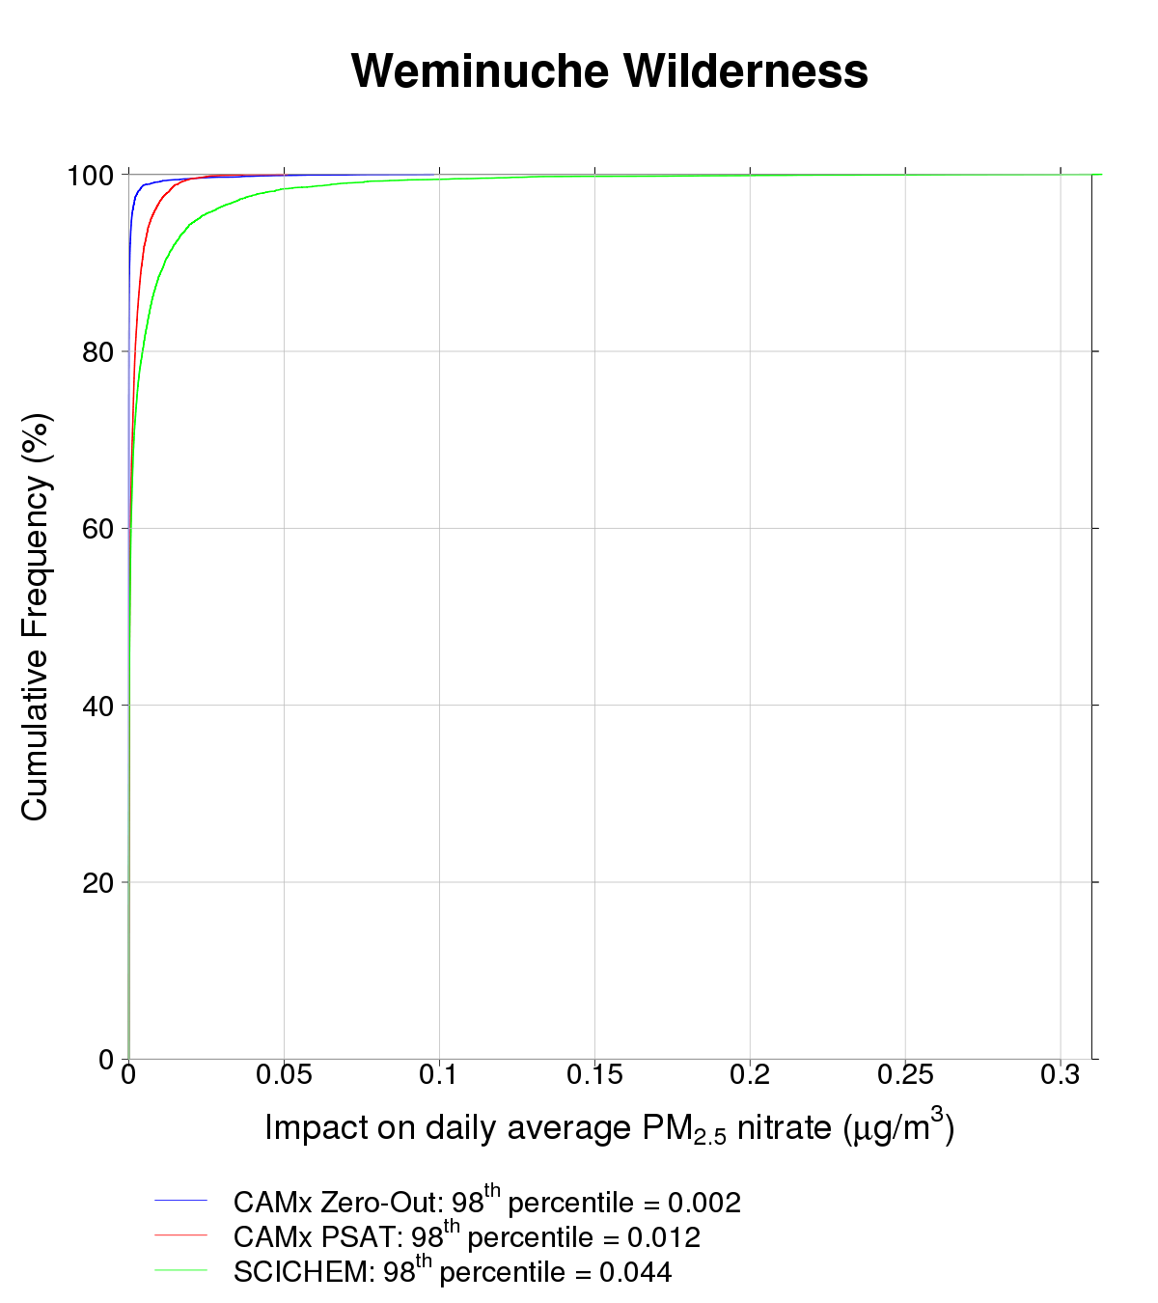
PM_{2.5} IMPACTS: Weminuche, Colorado
Distance from source: 90 km
CAMx Zero-Out
CAMx PSAT
SCICHEM
Different dispersion: whether or not plume reaches receptor
98th Pctl | SO4 | NO3
CAMx zero-out | 0.109 | 0.002
CAMx PSAT | 0.101 | 0.012
SCICHEM | 0.028 | 0.044
CAMx Zero-Out
CAMx PSAT
SCICHEM
Sulfate
Nitrate

Slide 11
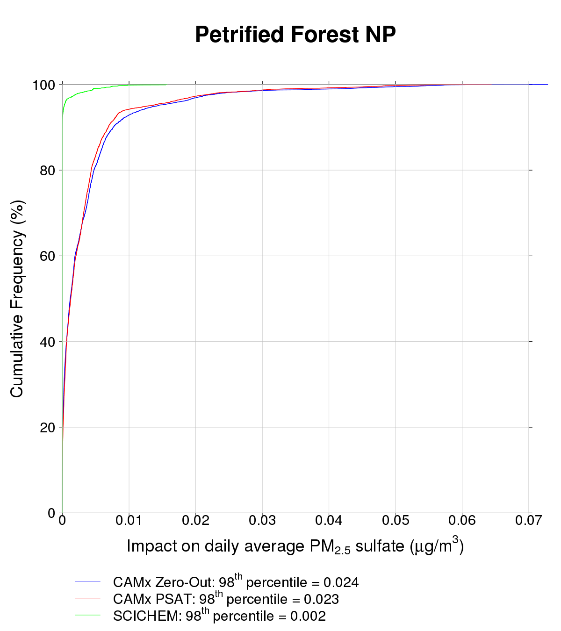
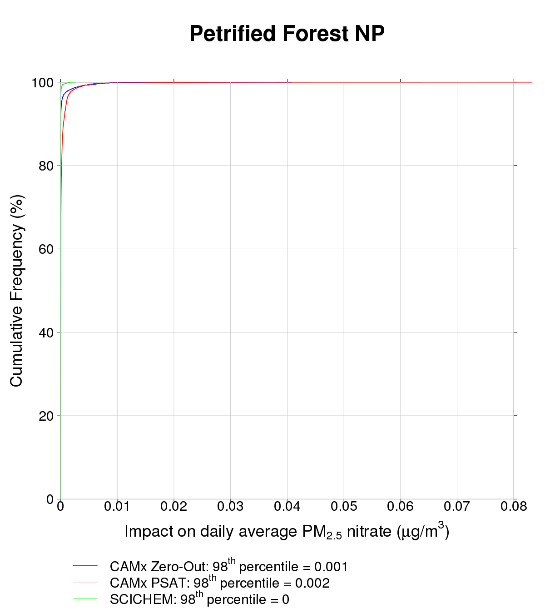
PM_{2.5} IMPACTS: Petrified Forest, Arizona
Distance from source: 275 km
CAMx Zero-Out
CAMx PSAT
SCICHEM
Different dispersion: whether or not plume reaches receptor
98th Pctl | SO4 | NO3
CAMx zero-out | 0.024 | 0.001
CAMx PSAT | 0.023 | 0.002
SCICHEM | 0.002 | 0.0
CAMx Zero-Out
CAMx PSAT
SCICHEM
Sulfate
Nitrate

Slide 12
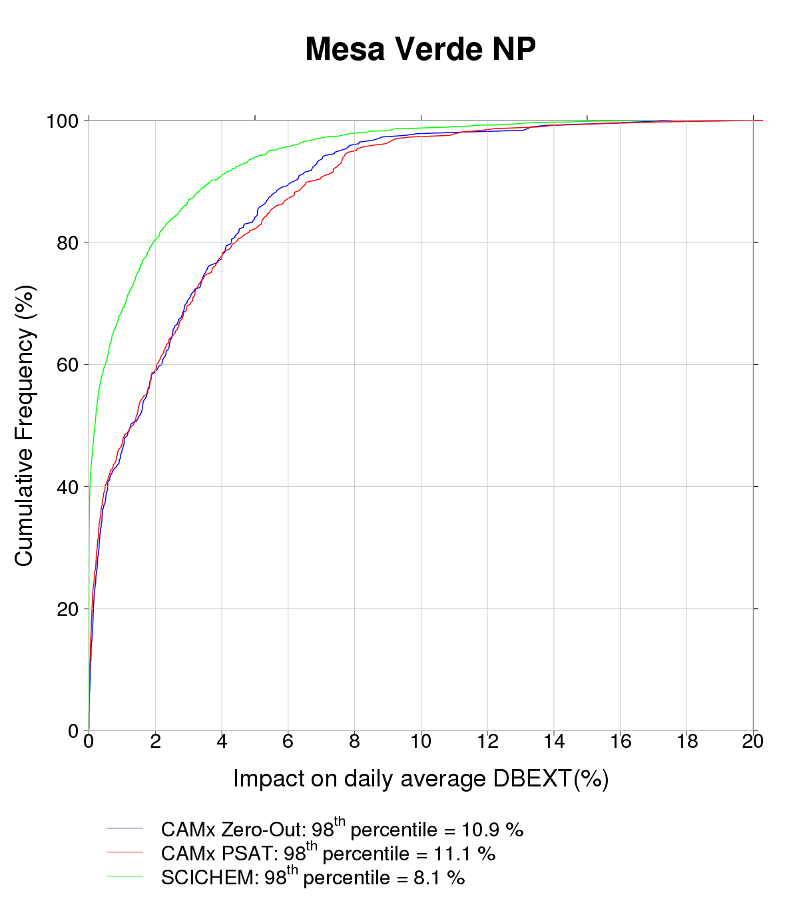
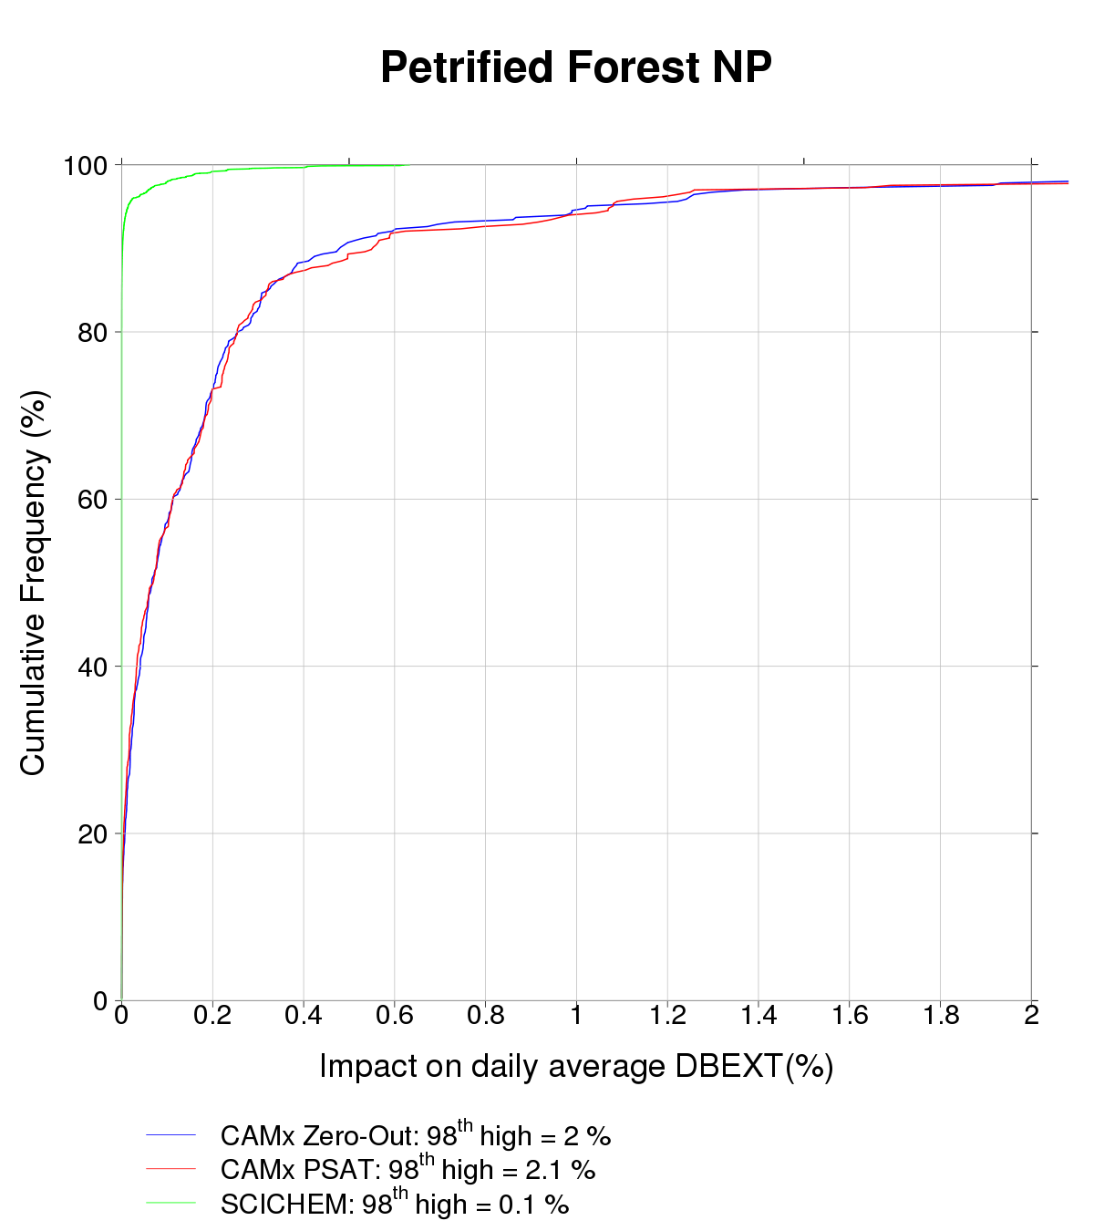
Visibility impacts in the southwest
Distance from source: 50 km
Distance from source: 275 km
CAMx Zero-Out
CAMx PSAT
SCICHEM
CAMx Zero-Out
CAMx PSAT
SCICHEM

Slide 13
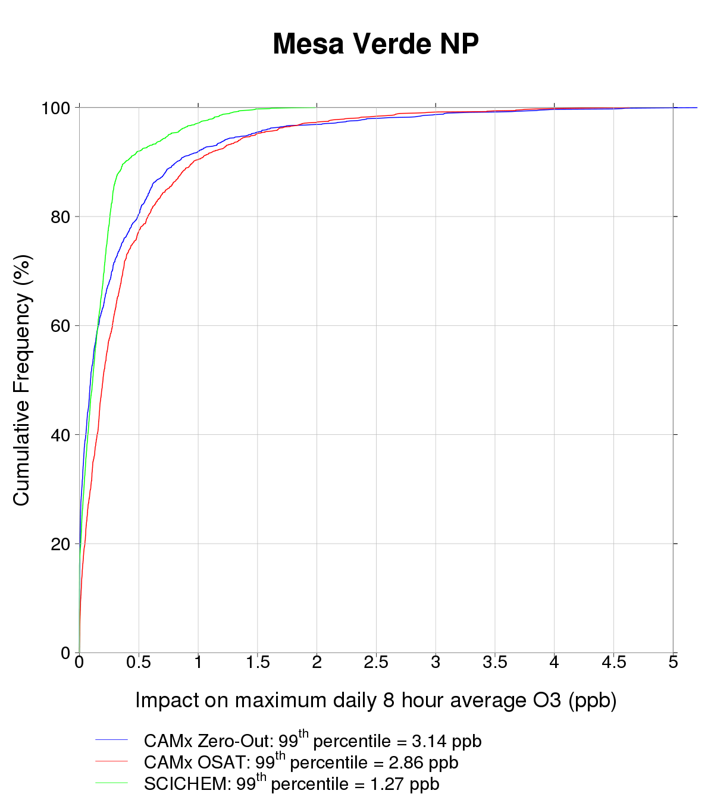
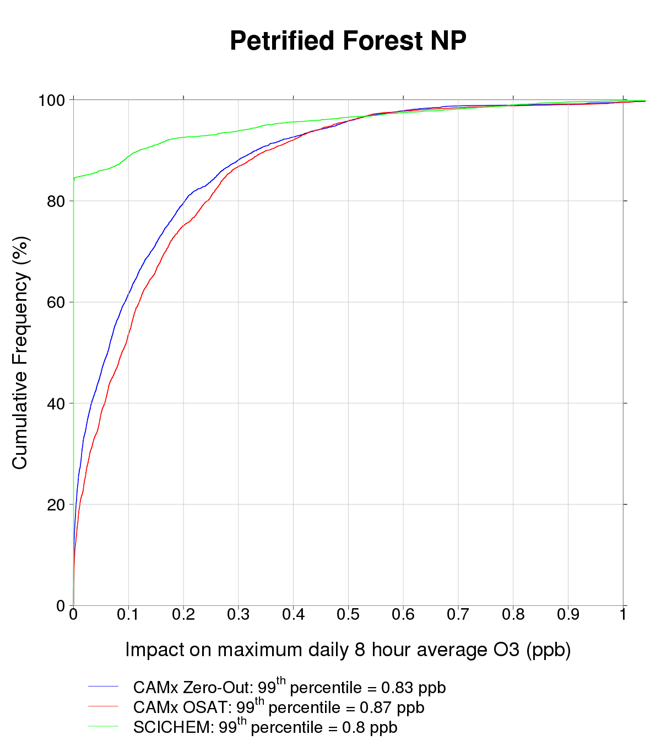
Ozone impacts in the southwest
Distance from source: 50 km
Distance from source: 275 km
CAMx Zero-Out
CAMx OSAT
SCICHEM
CAMx Zero-Out
CAMx OSAT
SCICHEM

Slide 14
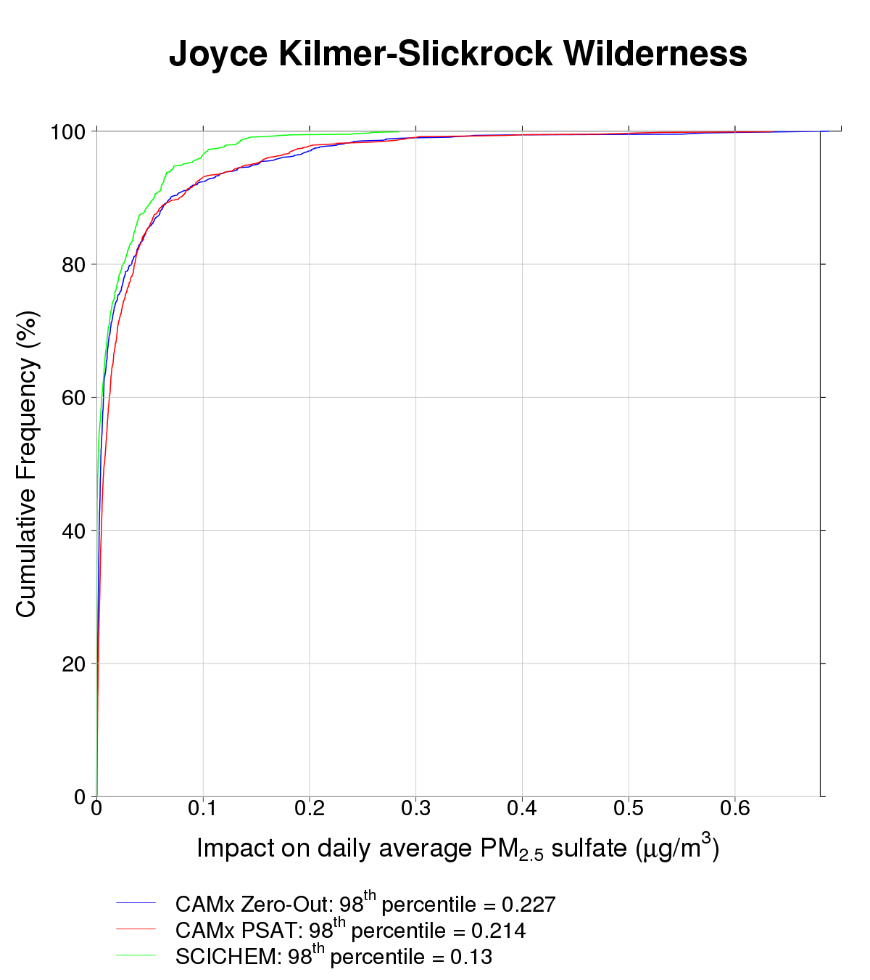
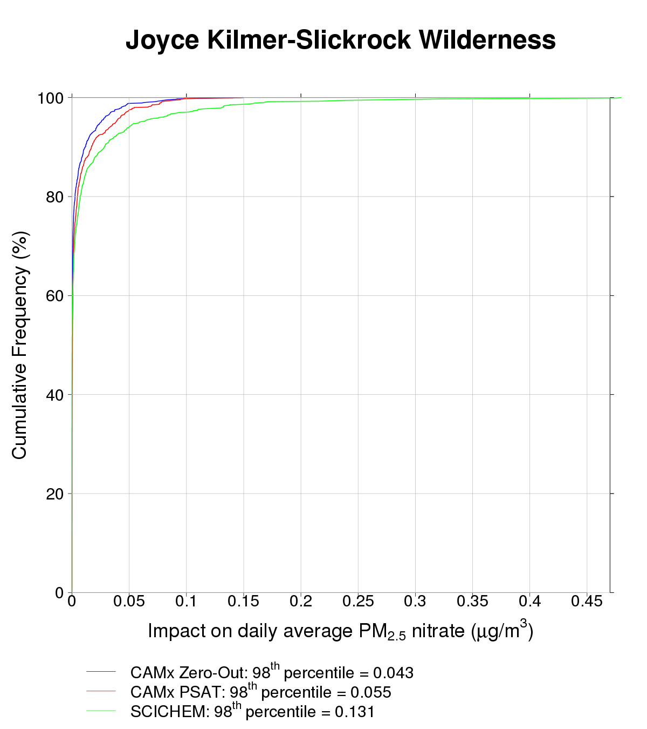
PM_{2.5} IMPACTS: Joyce Kilmer, North Carolina
Distance from source: 80 km
CAMx Zero-Out
CAMx PSAT
SCICHEM
CAMx Zero-Out
CAMx PSAT
SCICHEM
Similar dispersion, some chemistry difference
Similar dispersion, some chemistry difference
98th Pctl | SO4 | NO3
CAMx zero-out | 0.227 | 0.043
CAMx PSAT | 0.214 | 0.055
SCICHEM | 0.130 | 0.131
Sulfate
Nitrate

Slide 15
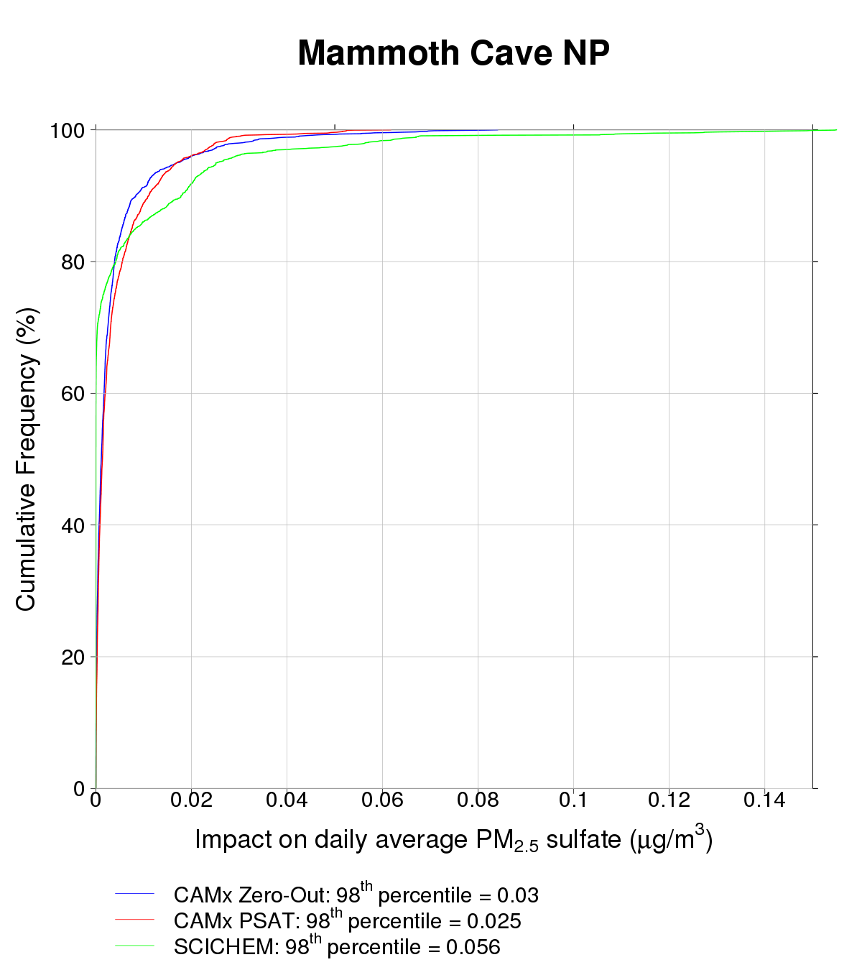
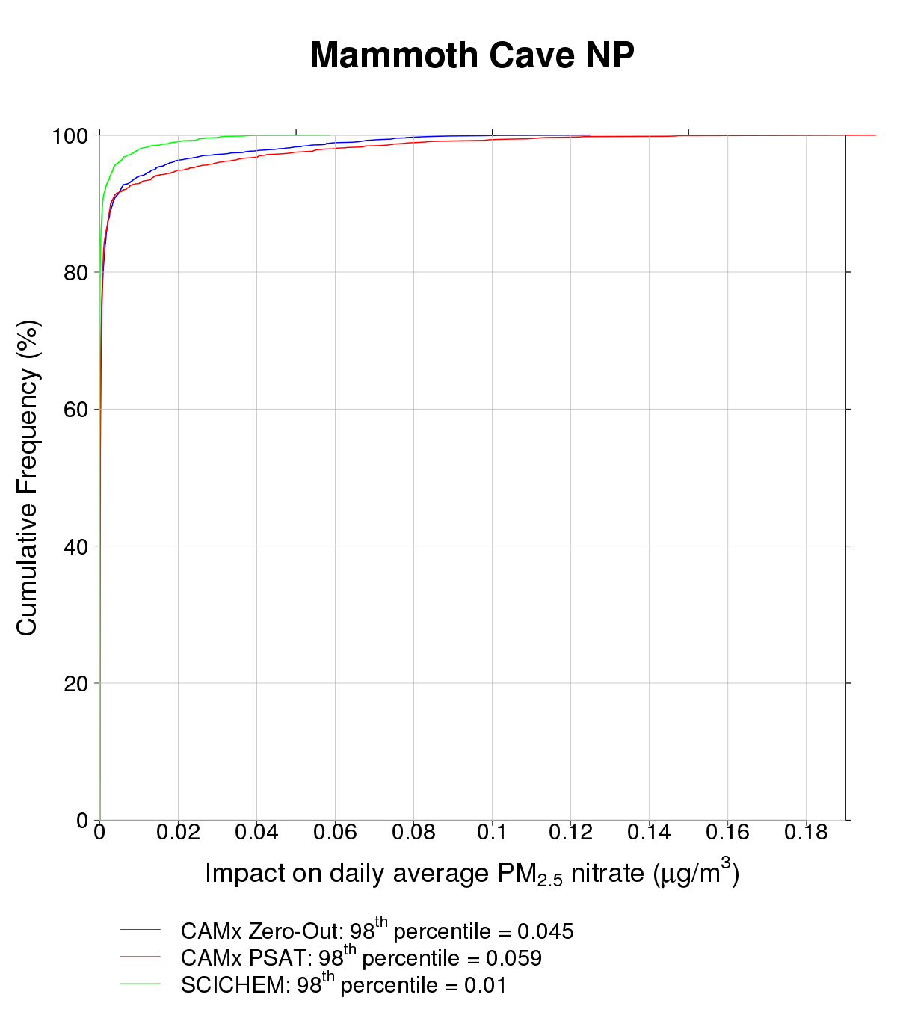
PM_{2.5} IMPACTS: Mammoth Cave, Kentucky
Distance from source: 200 km
CAMx Zero-Out
CAMx PSAT
SCICHEM
CAMx Zero-Out
CAMx PSAT
SCICHEM
Different chemistry
Different dispersion and chemistry
Different dispersion
98th Pctl | SO4 | NO3
CAMx zero-out | 0.030 | 0.045
CAMx PSAT | 0.025 | 0.059
SCICHEM | 0.056 | 0.010
Sulfate
Nitrate

Slide 16
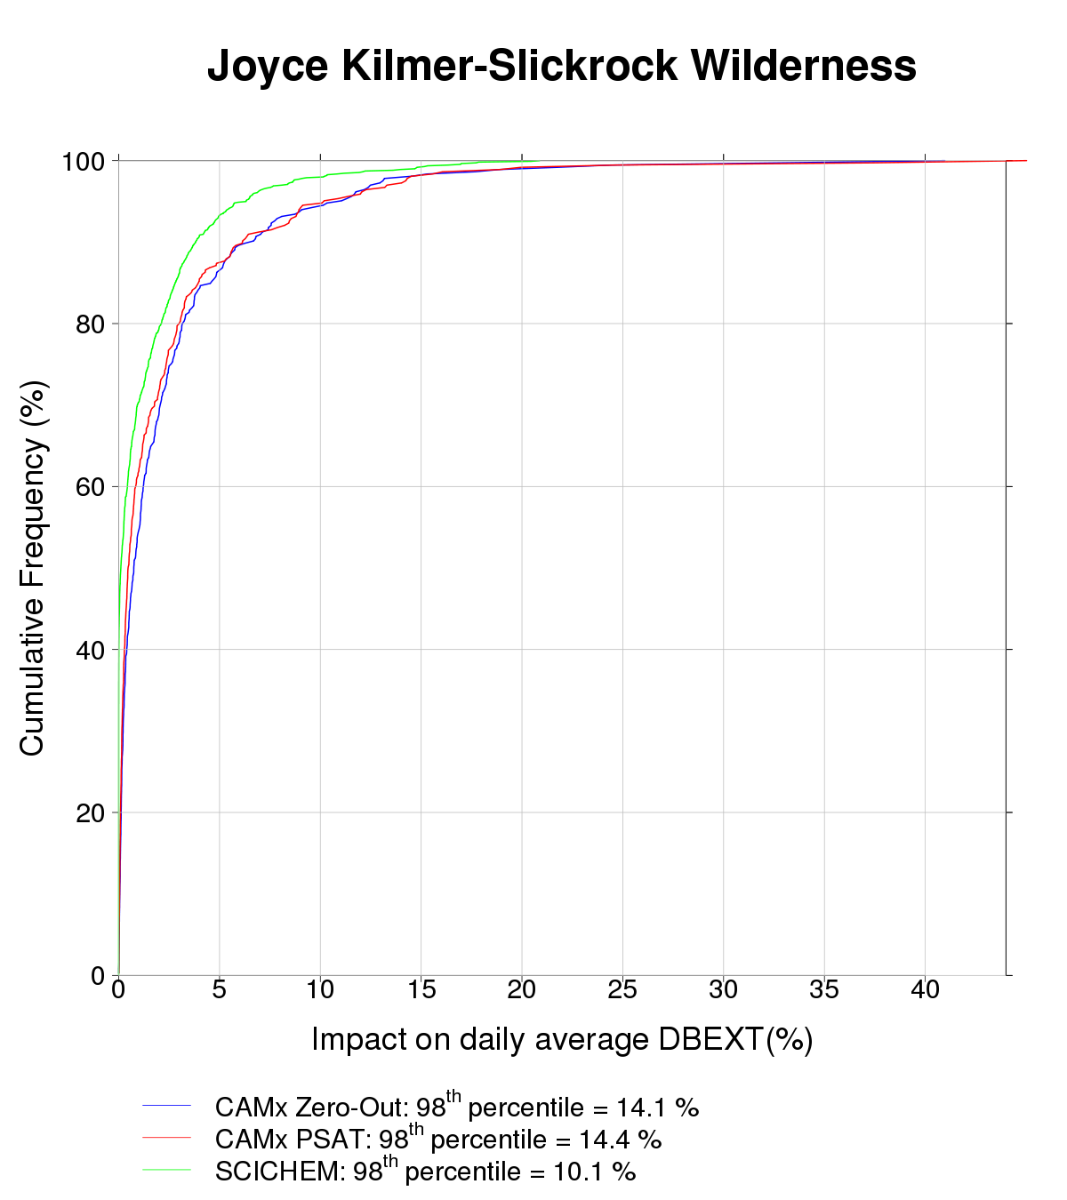
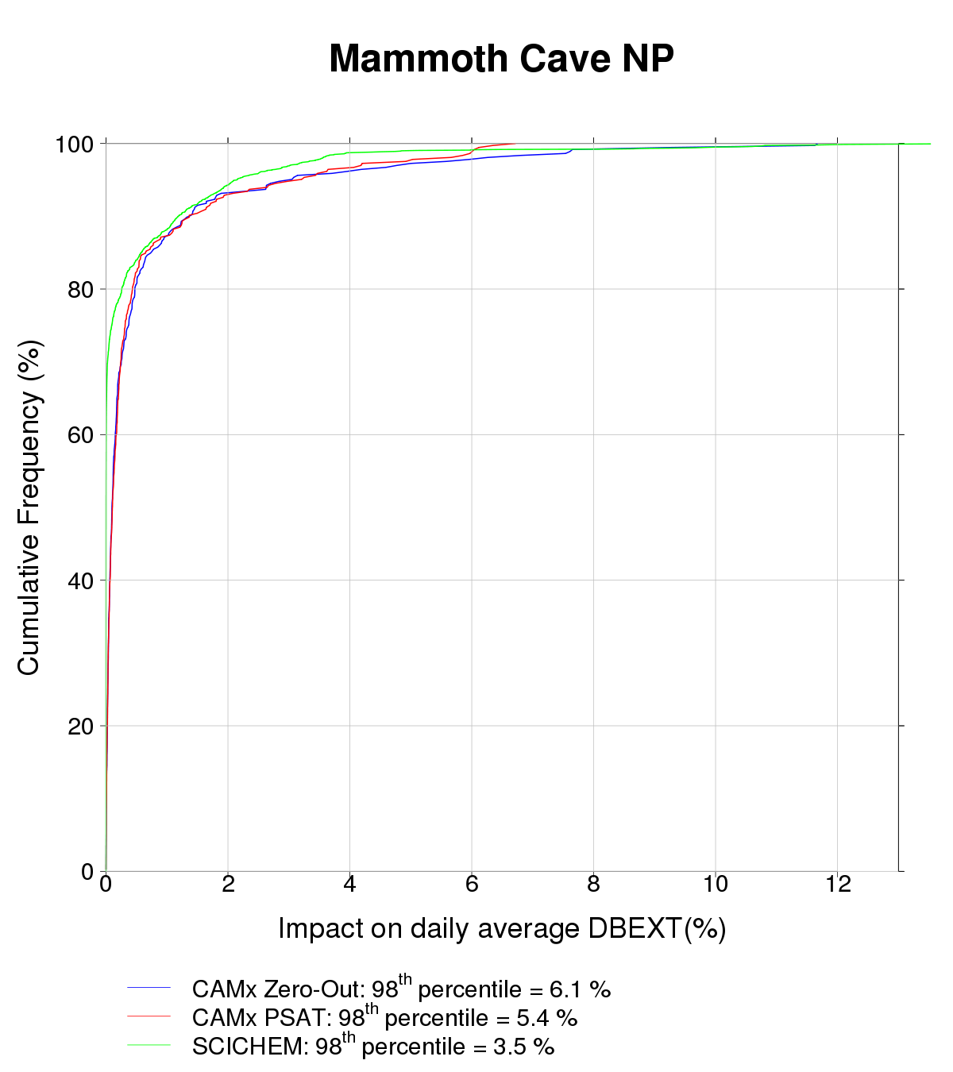
Visibility impacts in the southeast
Distance from source: 80 km
Distance from source: 200 km
CAMx Zero-Out
CAMx PSAT
SCICHEM
CAMx Zero-Out
CAMx PSAT
SCICHEM

Slide 17
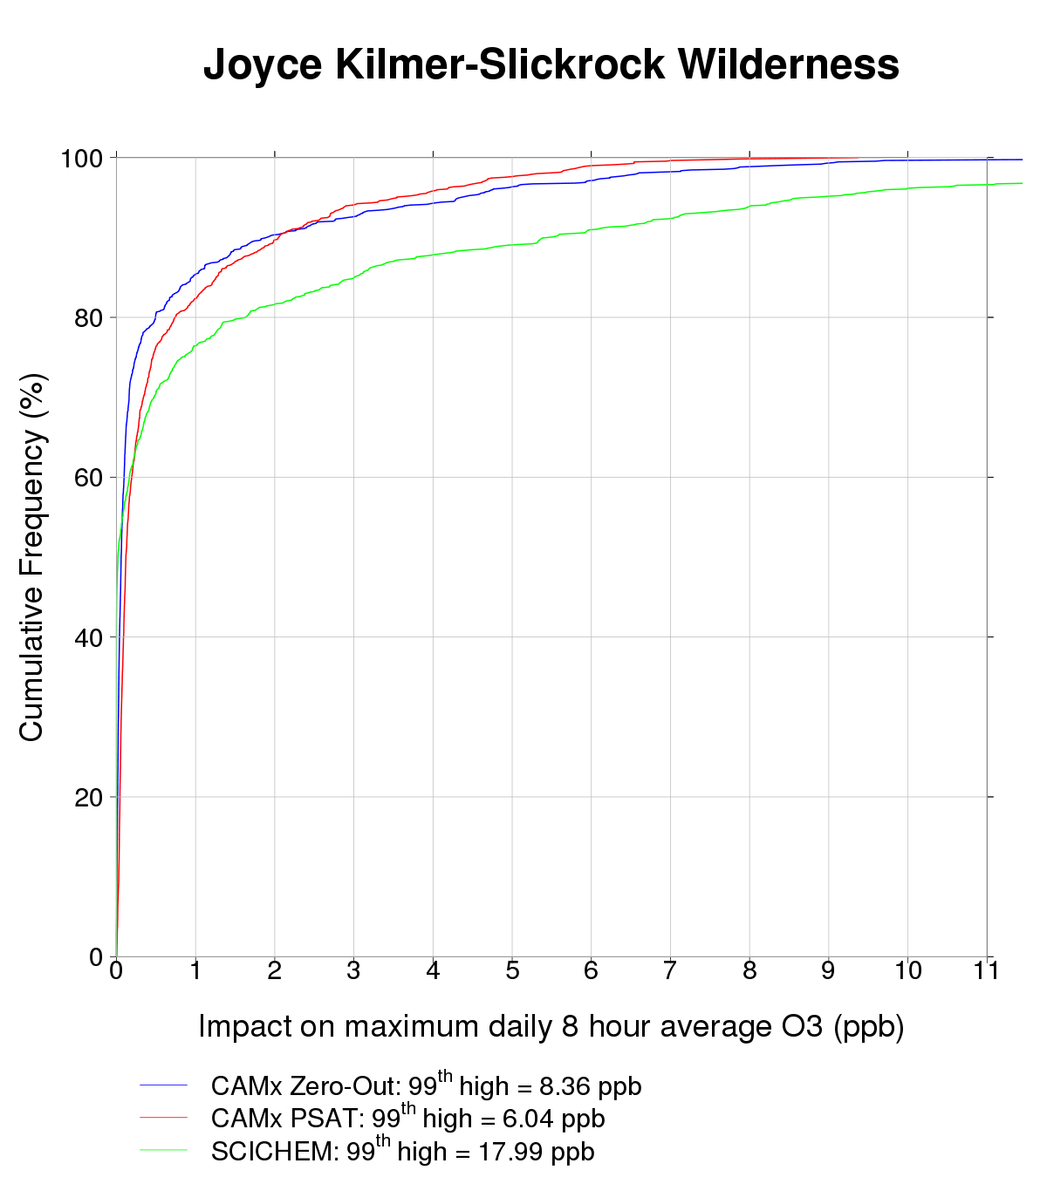
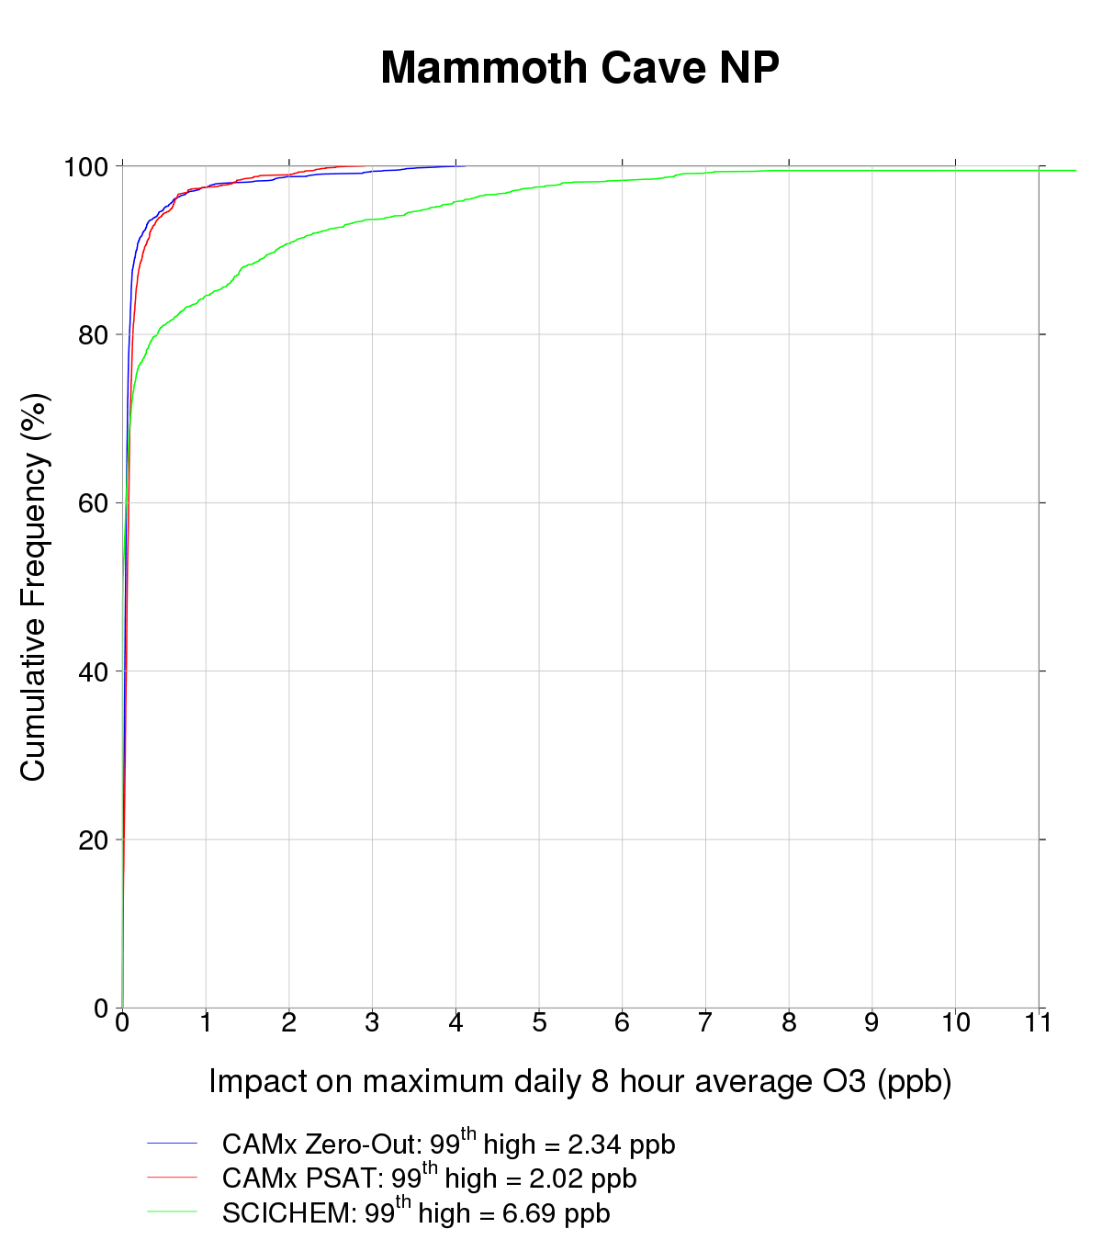
Ozone impacts in the southeast
Distance from source: 80 km
Distance from source: 200 km
CAMx Zero-Out
CAMx OSAT
SCICHEM
CAMx Zero-Out
CAMx OSAT
SCICHEM

Slide 18
SUMMARY & CONCLUSIONS
SCICHEM and CAMx predicted single-source impacts show both similarities and differences
Differences in impacts appear to be primarily due to differences in dispersion and chemistry in puff model vs grid model
Understanding these differences will provide guidance on the use of these tools for single-source impact calculations
SCICHEM offers an inexpensive alternative for calculating single source impacts on secondary pollutants:
Significantly lower runtimes and input requirements
Can be run on a desktop computer

Slide 19
Acknowledgements
This work and SCICHEM development supported by EPRI (Naresh Kumar and Eladio Knipping)
Additional details on SCICHEM evaluation and testing available at
http://download.ramboll-environ.com/environcorp/SCICHEM%20Air%20Quality%20Model.pdf

