Slide 1


Understanding and improving emissions information through atmospheric observations and models
Greg Frost
Chemical Sciences Division, Earth System Research Laboratory
National Oceanic & Atmospheric Administration, Boulder, Colorado, USA
Gregory.J.Frost@noaa.gov, http://www.esrl.noaa.gov/
Acknowledgements: Ravan Ahmadov, Jessica Gilman, Joost de Gouw, Claire Granier, Si-Wan Kim, Brian McDonald, Megan Melamed, Paulette Middleton, Jeff Peischl, Gabrielle Petron, Tom Ryerson, Colm Sweeney, Christine Wiedinmyer

Slide 2
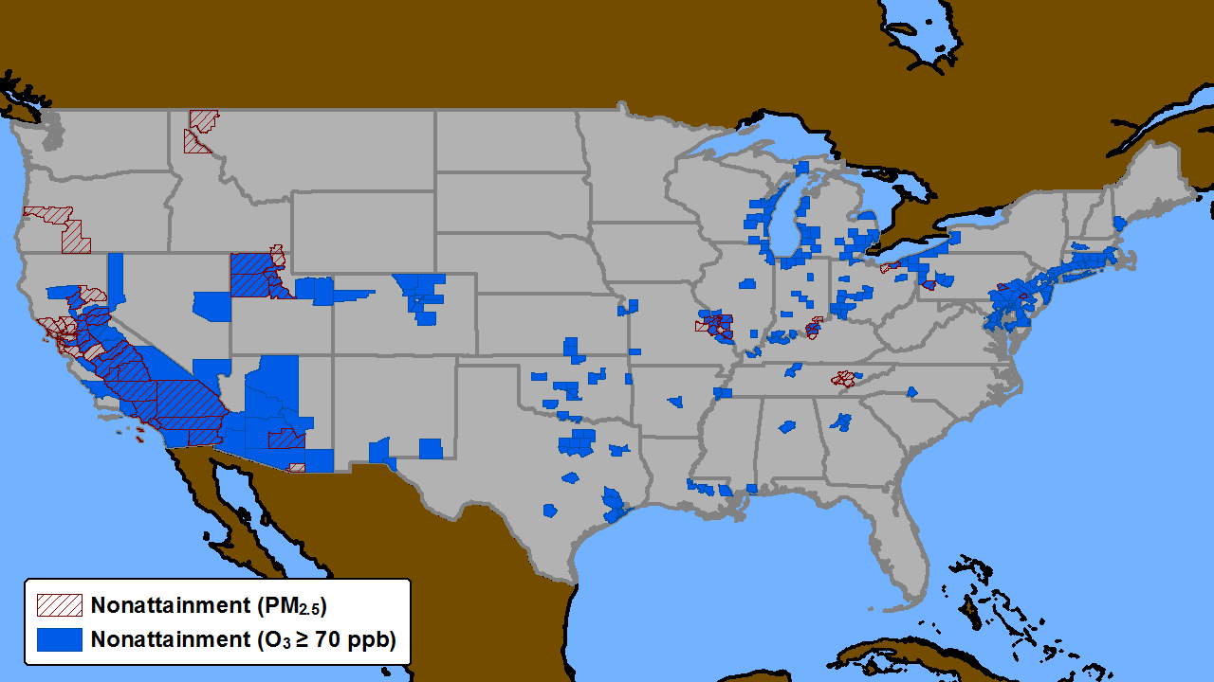
Successes and Challenges of US Clean Air Act
US Clean Air Act and subsequent regulations have reduced emissions of criteria pollutants for decades.
At the same time, population, economy, vehicle use, and energy consumption increased
www3.epa.gov/airtrends/aqtrends.html
1970
1985
1995
1998
1998
2000
2002
2004
2006
2008
2010
2012
2014
Current US Non-Attainment Areas for O₃ and PM
US counties representing a significant fraction of US population remain in non-attainment of O₃ and PM standards
Notes:
FIGURE 2.2 Percent changes from values in 1970 for gross domestic product, vehicle miles traveled,
population, energy consumption, CO2 emissions, and aggregate emissions from the six most widespread
air pollutants (carbon monoxide, ozone, lead, nitrogen dioxide, particulate matter, and sulfur dioxide)
through 2014 nationally over the United States. The graph shows decreasing air pollutant emissions over
time since passage of the Clean Air Act, despite growth in U.S. population, economy, energy use, and
miles driven. SOURCE: https://www3.epa.gov/airtrends/aqtrends.html.

Slide 3
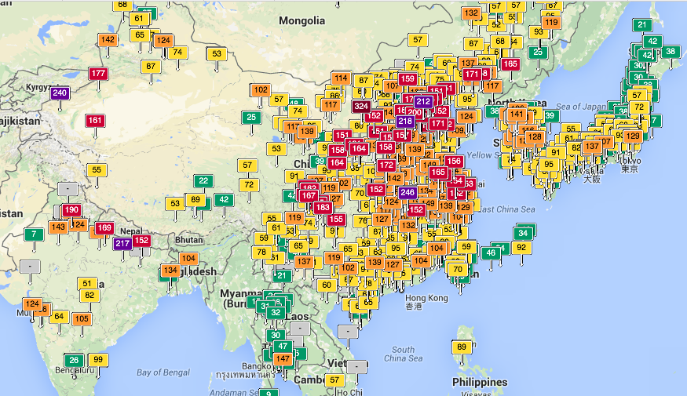

Global impacts of air pollution
Asia
aqicn.org
Green: good Yellow: moderate
Red: unhealthy Brown: hazardous
Bad air quality is still a serious issue in many parts of the world
Air pollution is a leading cause of illness and mortality worldwide
Other nations look to the US for guidance on understanding and solving these problems
www.who.int/phe/health_topics/outdoorair/

Slide 4
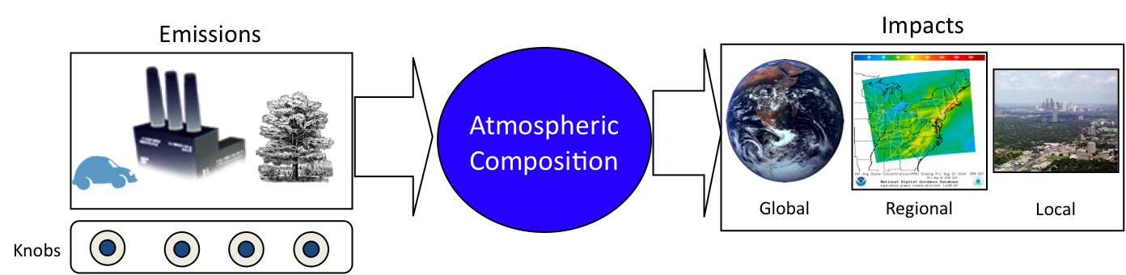




Environmental actions and decisions focus on emissions
Emissions data addresses multiple mandates and has many uses
Research
Analysis
Prediction
Long-range transport
Air quality
Climate change
Regulation
Atmospheric modeling
Human exposure
Permitting & compliance
Standards attainment
Public reporting
Diplomacy
Assessments
Pollution conventions
Data sharing
Economics
Emissions trading
Control implementation

Slide 5
Bottom-Up Inventory Methods
Inventories are simple in structure but complex in application
Total mass of compound X emitted
E_{X} = Σ_{S} [EF_{X,S} • A_{S} • (1 – CE_{X,S})]
Calculated for…
Specific region
Specific time
Also need…
Spatial allocation
Temporal variation
Speciation
Sum up all sources S
Emissions factor = mass of compound X emitted by source S per unit activity
Activity of source S, e.g., amount of fuel burned
Effectiveness of control measures for compound X at source S
Inventories are fundamental
Inventories face challenges
Process-level understanding
High granularity
Comprehensive view
Key model inputs
Quantify changes
Prediction
Connect disciplines
Key decision-making tools
Complexity
Insufficient data
Long costly development cycle
Diverse data sources, traceability
Proprietary data
Inconsistencies
Unknown or missing sources
Super-emitting or sporadic sources
Uncertainties difficult to estimate

Slide 6
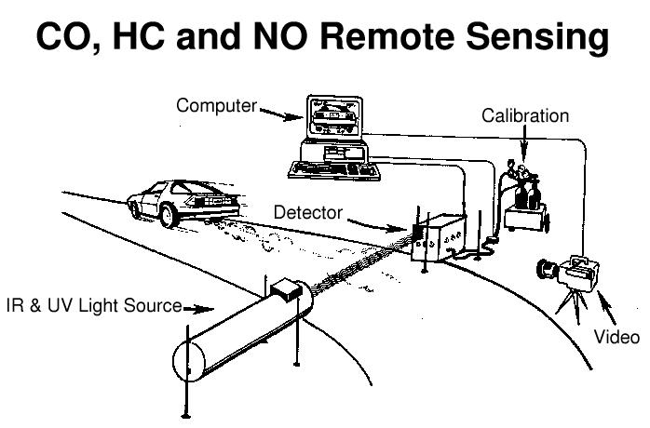

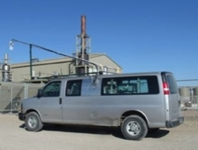



Top-down Emissions Approaches
Rely on high quality atmospheric observations of atmospheric abundance
Use chemical-transport models of varying complexity to convert atmospheric abundance into emissions
Hybrid approach: use atmospheric measurements in bottom-up inventory
Top-down deliverables:
Total emissions
Spatial mapping
Temporal variation
Sector partitioning
Some benefits of top-down methods:
Quantifiable uncertainties
Quantify super-emitting or sporadic sources
Detect cheating
Complementary methods give confidence
Top-down methods complement bottom-up inventories, helping to improve the scientific basis of emissions.
Top-Down Approaches
Reconciliation
Synthesis to Benefit Stakeholders
Bottom-Up Inventories
Improvement
We cannot manage what we can’t measure – John Burrows

Slide 7
Science Priorities
2016 National Academies Report
Recommendations
National Academies of Sciences, Engineering, and Medicine. 2016. The Future of Atmospheric Chemistry Research: Remembering Yesterday, Understanding Today, Anticipating Tomorrow.
Notes:
Priority Science Area 2: Quantify emissions and deposition of gases and particles in a
changing Earth system.
Emission and deposition processes govern concentrations and spatial distributions of
gases and particles in the atmosphere. A predictive capability of these distributions is key for
assessing the impacts of atmospheric processes on human and ecosystem health, weather, and
climate. Research is needed to reduce uncertainties in emissions for known sources and constrain
emissions of poorly understood constituents (e.g., bioparticles), as well as to understand
deposition processes that remove reactive species. Sources of atmospheric constituents change as
humans make new decisions about technology, energy systems, pollution control, agriculture,
and transportation. Natural sources respond to meteorological conditions, changes in land use,
longer-term changes in climate, and biogechemical and ecosystem feedbacks.
Actions needed to address these key scientific gaps include:
A. Better determine emissions from both anthropogenic and natural sources and their spatial
and temporal variations and trends.
B. Identify mechanisms and measure rates by which wet and dry deposition removes aerosol
particles and trace gases from the atmosphere.
C. Determine the role of meteorology, including temperature, precipitation, and extreme
events, on emissions and removal of atmospheric species.
D. Determine the role of global change and societal choices (including changes in climate,
energy choices, and land use) on the emissions and removal of atmospheric species.

Slide 8
Two Examples Today
US motor vehicles
US oil and natural gas basins
Other NOAA examples I won’t have time for:
Power generation
Refineries
US vs European motor vehicles
Well blowouts
Agriculture
Wildfires

Slide 9
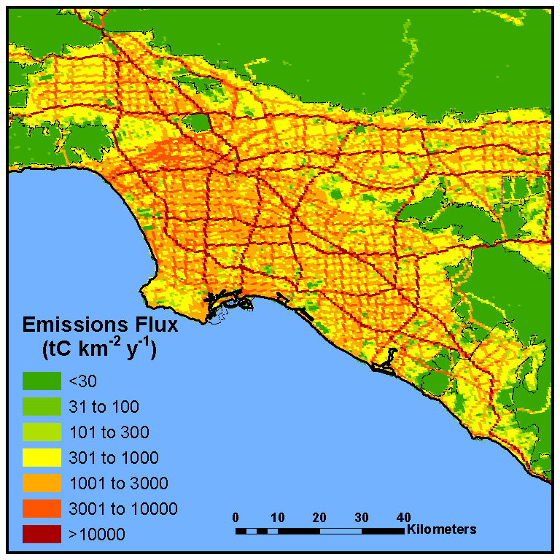
Fuel-Based Inventory of Vehicle Emissions (FIVE)
Emissions = Activity (kg fuel) x Emission Factor (g/kg fuel)
McDonald et al. (J. Geophys. Res. 2014)
Quantify on-road CO₂ emissions
State-level taxable gasoline and diesel fuel sales reports
Public and annual
Map on-road CO₂ emissions
Using traffic count data
Basis for scaling co-emitted combustion byproducts

Slide 10
Use of Roadway Studies for Emission Factors
Emissions = Activity (kg fuel) x Emission Factor (g/kg fuel)
Roadside monitoring data
Measures in-use vehicles
Captures high-emitters
Regulatory models typically rely on chassis dynamometer tests
Figure from Univ. of Denver FEAT System
Brian McDonald

Slide 11
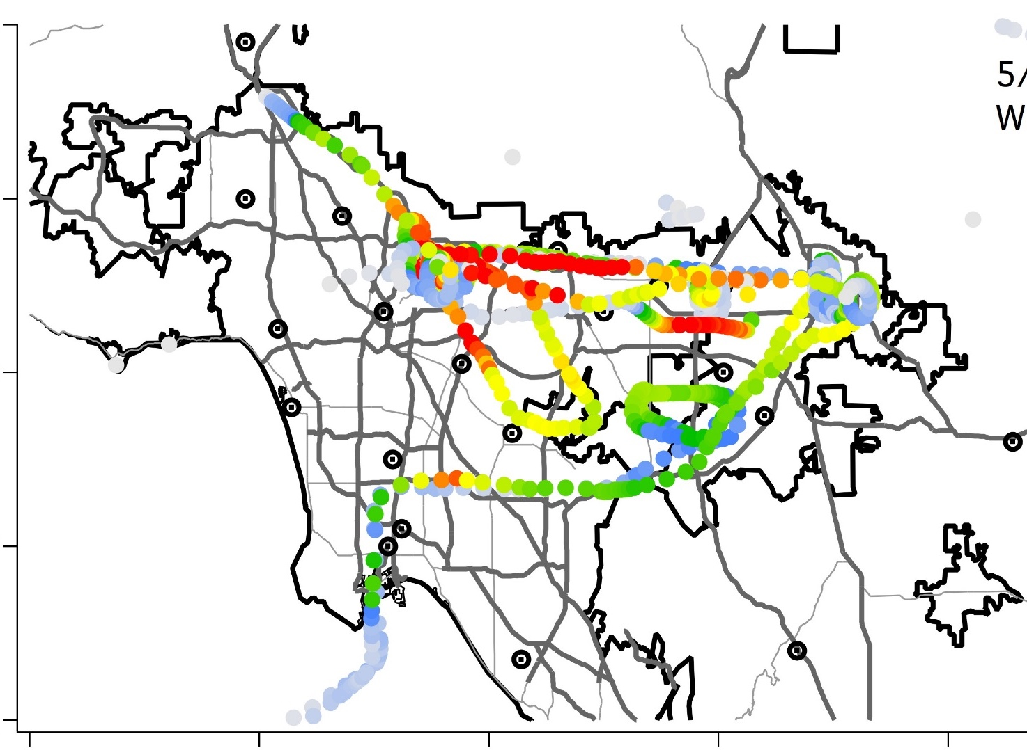

Test of Fuel-Based Emissions Approach
WRF-Chem Model
NOAA P-3 Aircraft
NO₂ (ppb)
0
2
4
6
8
10
12
14
Simulated for California Nexus Study (CalNex) in 2010
Los Angeles is good test case of transportation emissions (~2/3 of NO_{x} budget)
Si-Wan Kim et al. (J. Geophys. Res. 2016)

Slide 12
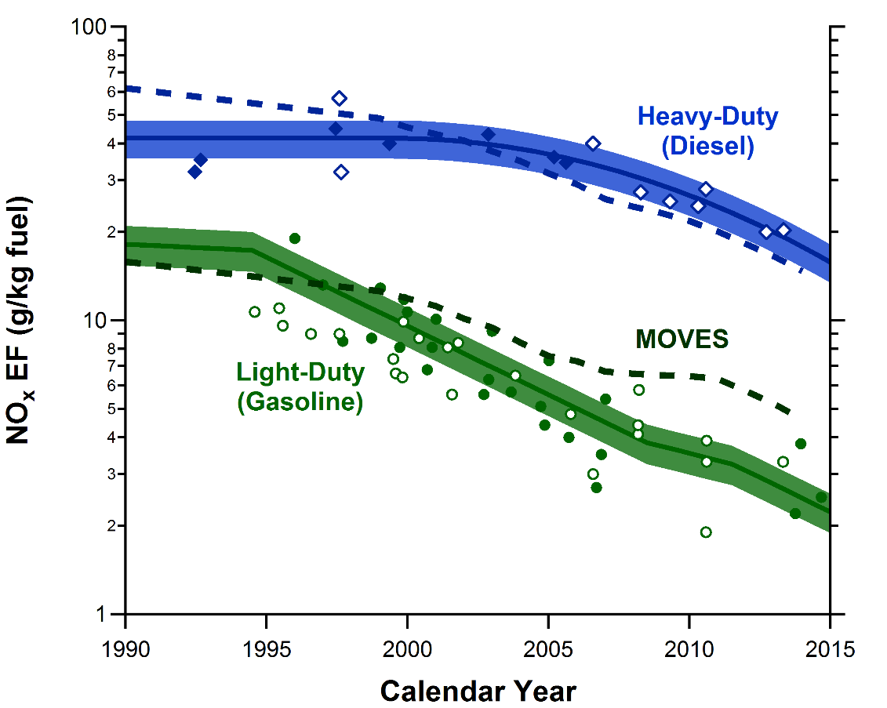
Long-Term Trends in U.S. On-Road NO_{x} Emission Factors
Diesel EF within ~20%
Gasoline EF high by factor of ~2
MOVES = EPA’s Vehicle Emission Model
Figure updated from McDonald et al. (J. Geophys. Res. 2012)

Slide 13
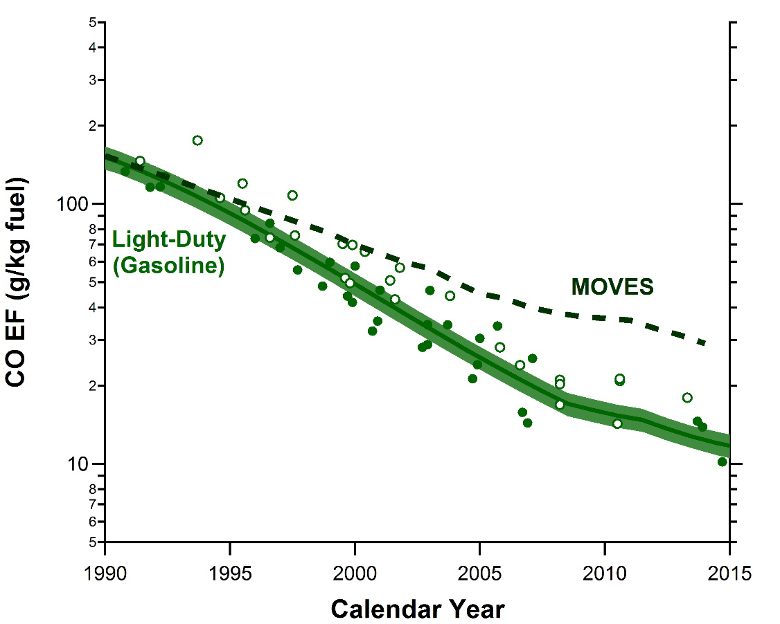
Long-Term Trends in U.S. On-Road CO Emission Factors
Gasoline EF high by factor of ~3
MOVES = EPA’s Vehicle Emission Model
Figure updated from McDonald et al. (Environ. Sci. Technol.. 2013)

Slide 14
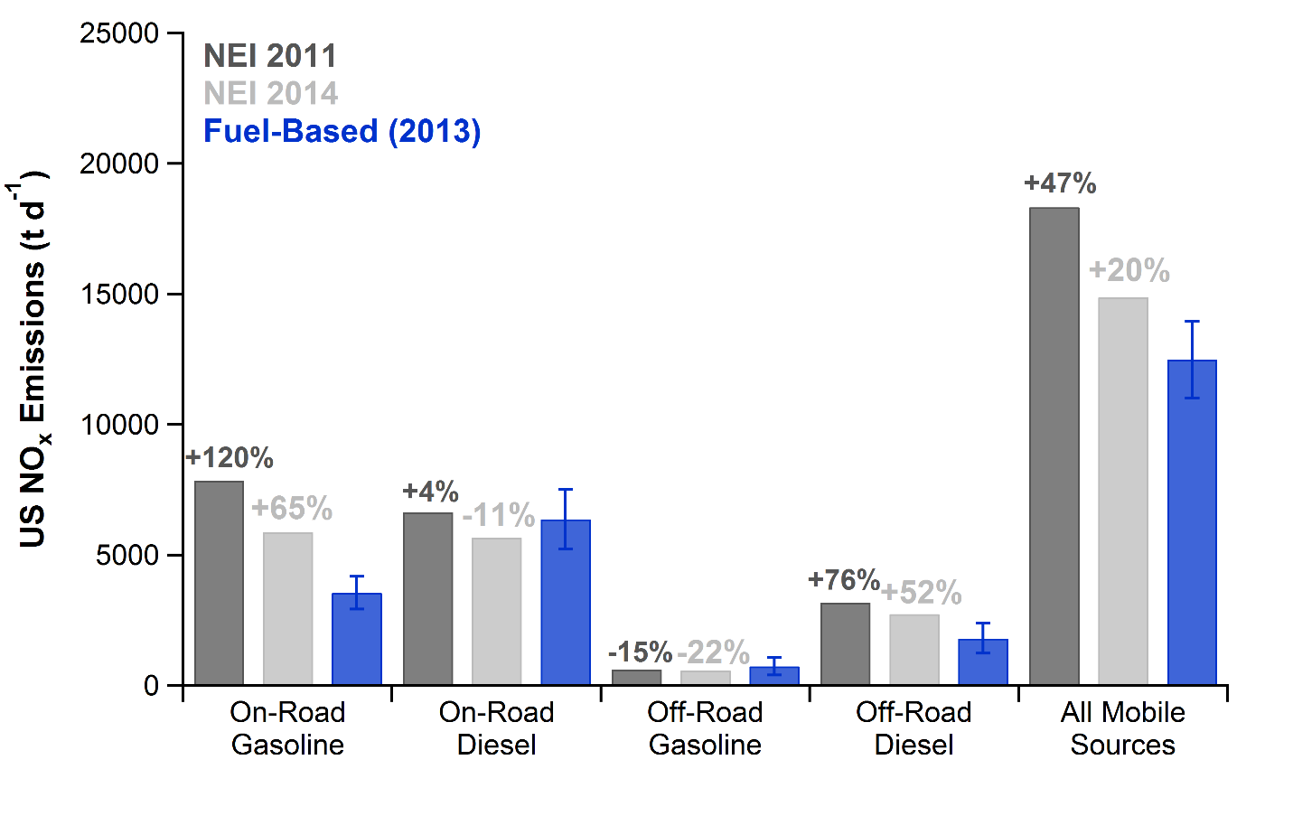
Comparing U.S. Mobile Source NO_{x} Emissions by Sector
McDonald et al. (in preparation)

Slide 15
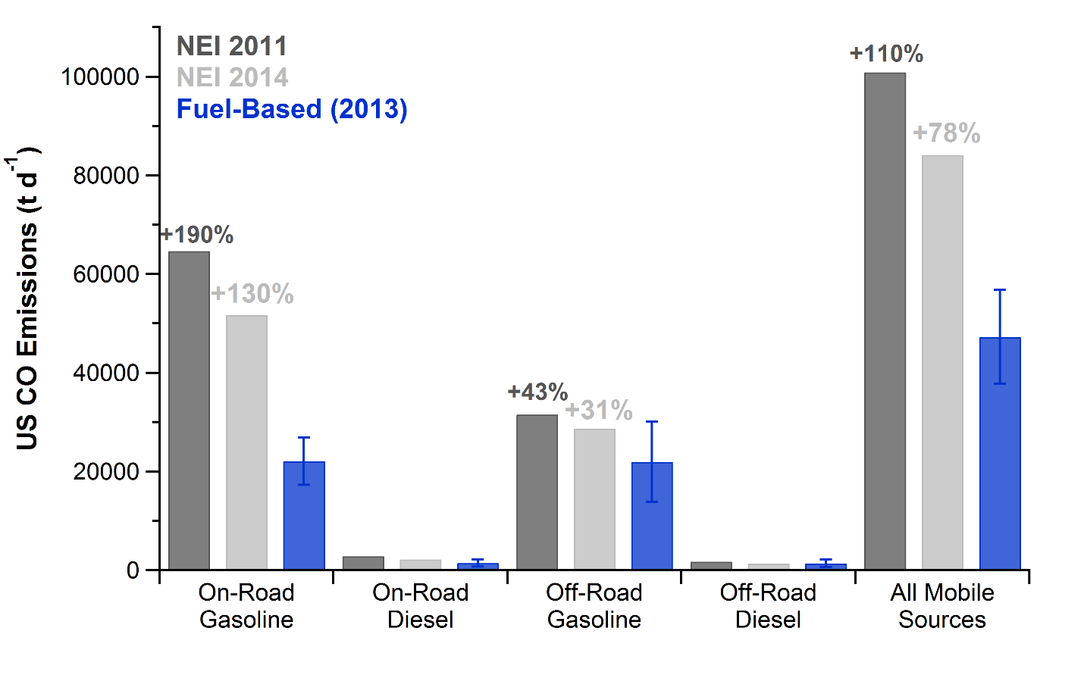
Comparing U.S. Mobile Source CO Emissions by Sector
McDonald et al. (in preparation)

Slide 16
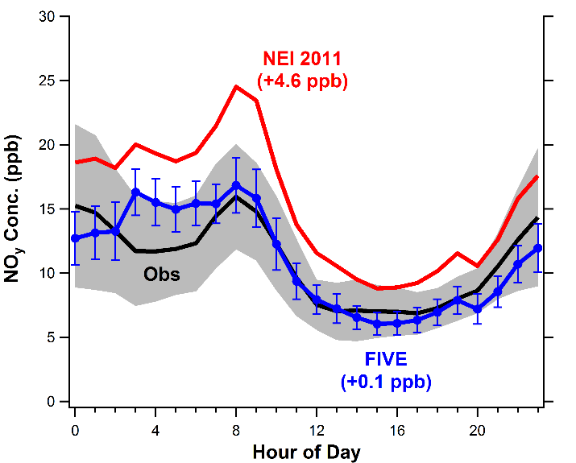
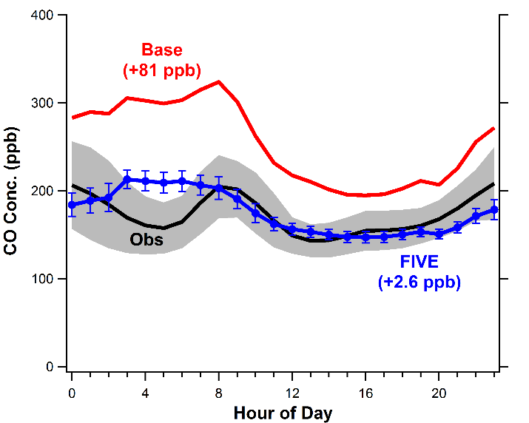
Comparing Fuel-Based & NEI/MOVES in Regional Model
WRF-Chem modeling compared to summer 2013 observations at SEARCH network site in downtown Atlanta
NO_{y}
CO
NEI 2011
Model using fuel-based motor vehicle emissions captures ambient NOy and CO in urban areas better than EPA MOVES
McDonald et al. (in preparation)

Slide 17
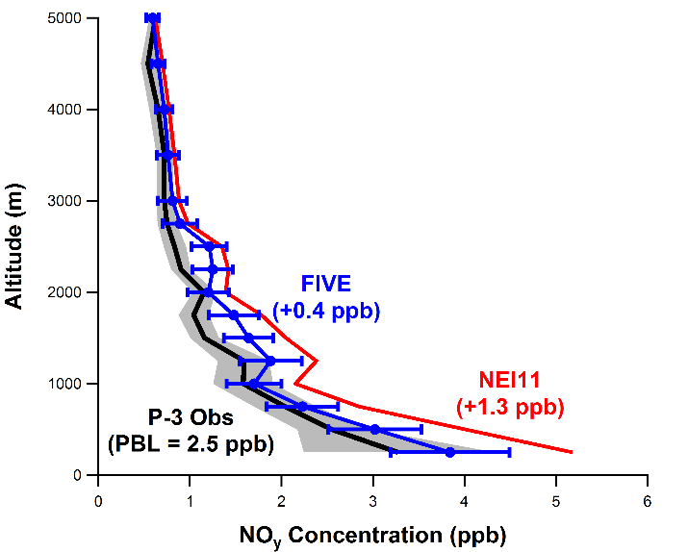
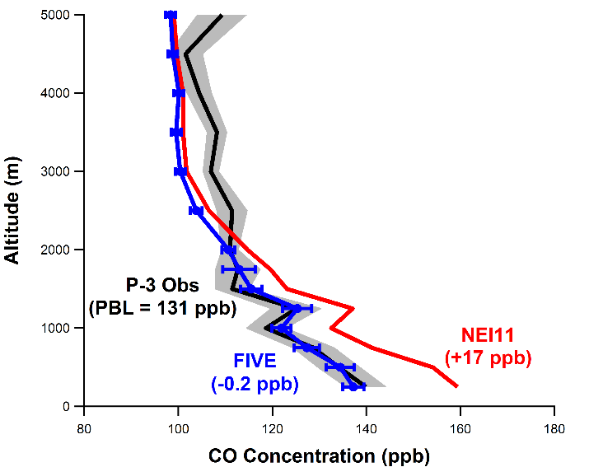
Comparing Fuel-Based & NEI/MOVES in Regional Model
WRF-Chem modeling compared to vertical profile observations collected by the NOAA P-3 aircraft in Nashville in summer 2013
NO_{y}
CO
Model using fuel-based motor vehicle emissions captures ambient NOy and CO in urban areas better than EPA MOVES
McDonald et al. (in preparation)

Slide 18
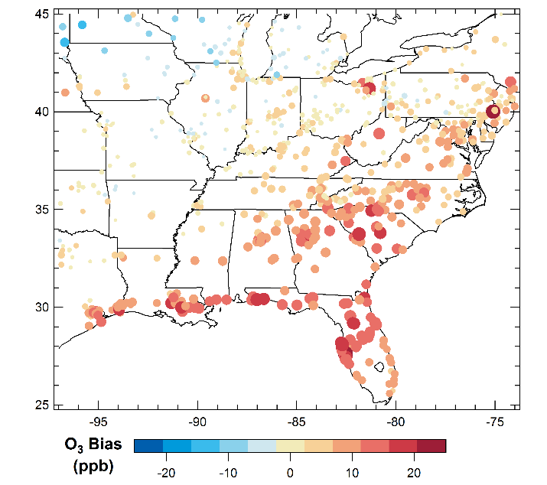
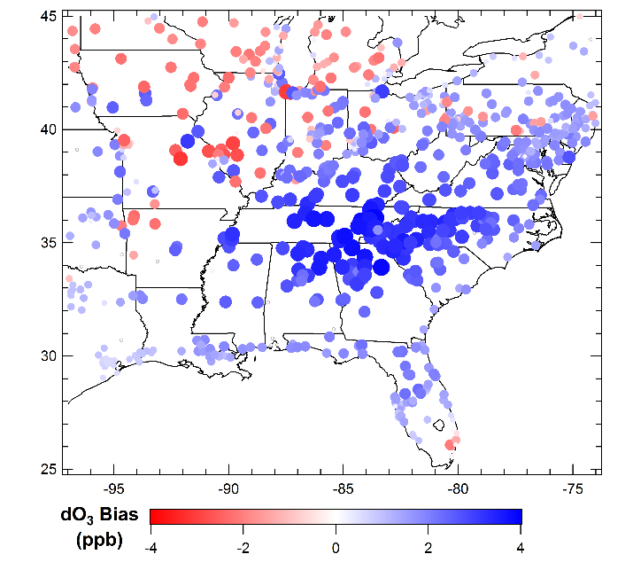
Comparing Fuel-Based & NEI/MOVES in Regional Model
Mean bias (model-obs) in summer 2013 daily 8-hr O₃ max modeled with NEI 2011 vs. AQS data
Change in model-obs bias for daily 8-hr O₃ max
(∆bias = |model(NEI 2011)-obs|-|model(FIVE) – obs|)
← FIVE is worse
FIVE is better →
Model using fuel-based motor vehicle emissions captures regional maximum O₃ levels better than EPA MOVES
McDonald et al. (in preparation)

Slide 19
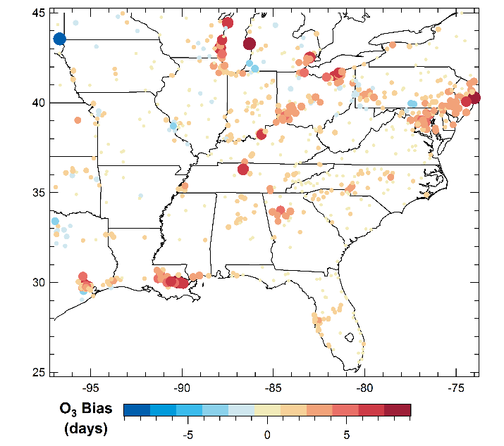
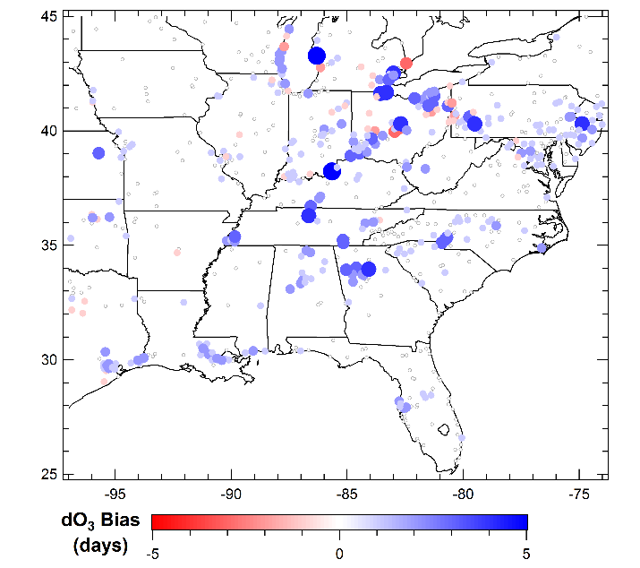
Comparing Fuel-Based & NEI/MOVES in Regional Model
Mean bias (model-obs) in 2013 O₃ exceedance days (>70 ppb) modeled with NEI 2011 vs. AQS data
Change in model-obs bias for O₃ exceedance days
(∆bias = |model(NEI 2011)-obs|-|model(FIVE) – obs|)
← FIVE is worse
FIVE is better →
Model using fuel-based motor vehicle emissions captures regional O₃ exceedance days better than EPA MOVES
McDonald et al. (in preparation)

Slide 20
Quantifying Impacts of Oil and Gas Production
NOAA ESRL research is focused on:
A. Climate
Emissions of radiative forcing agents
(methane, black carbon, CO₂, ozone)
B. Air quality
  Emissions of ozone and PM2.5 precursors
  Understanding ozone formation
  Emissions of air toxics (e.g. benzene)
ESRL research aircraft quantified methane (CH₄) emissions from regions accounting for
  32% of U.S. oil production
  40% of U.S. natural gas production
  70% of U.S. shale gas production
www.esrl.noaa.gov/csd/news/topics/oilandgas.html
Joost de Gouw

Slide 21
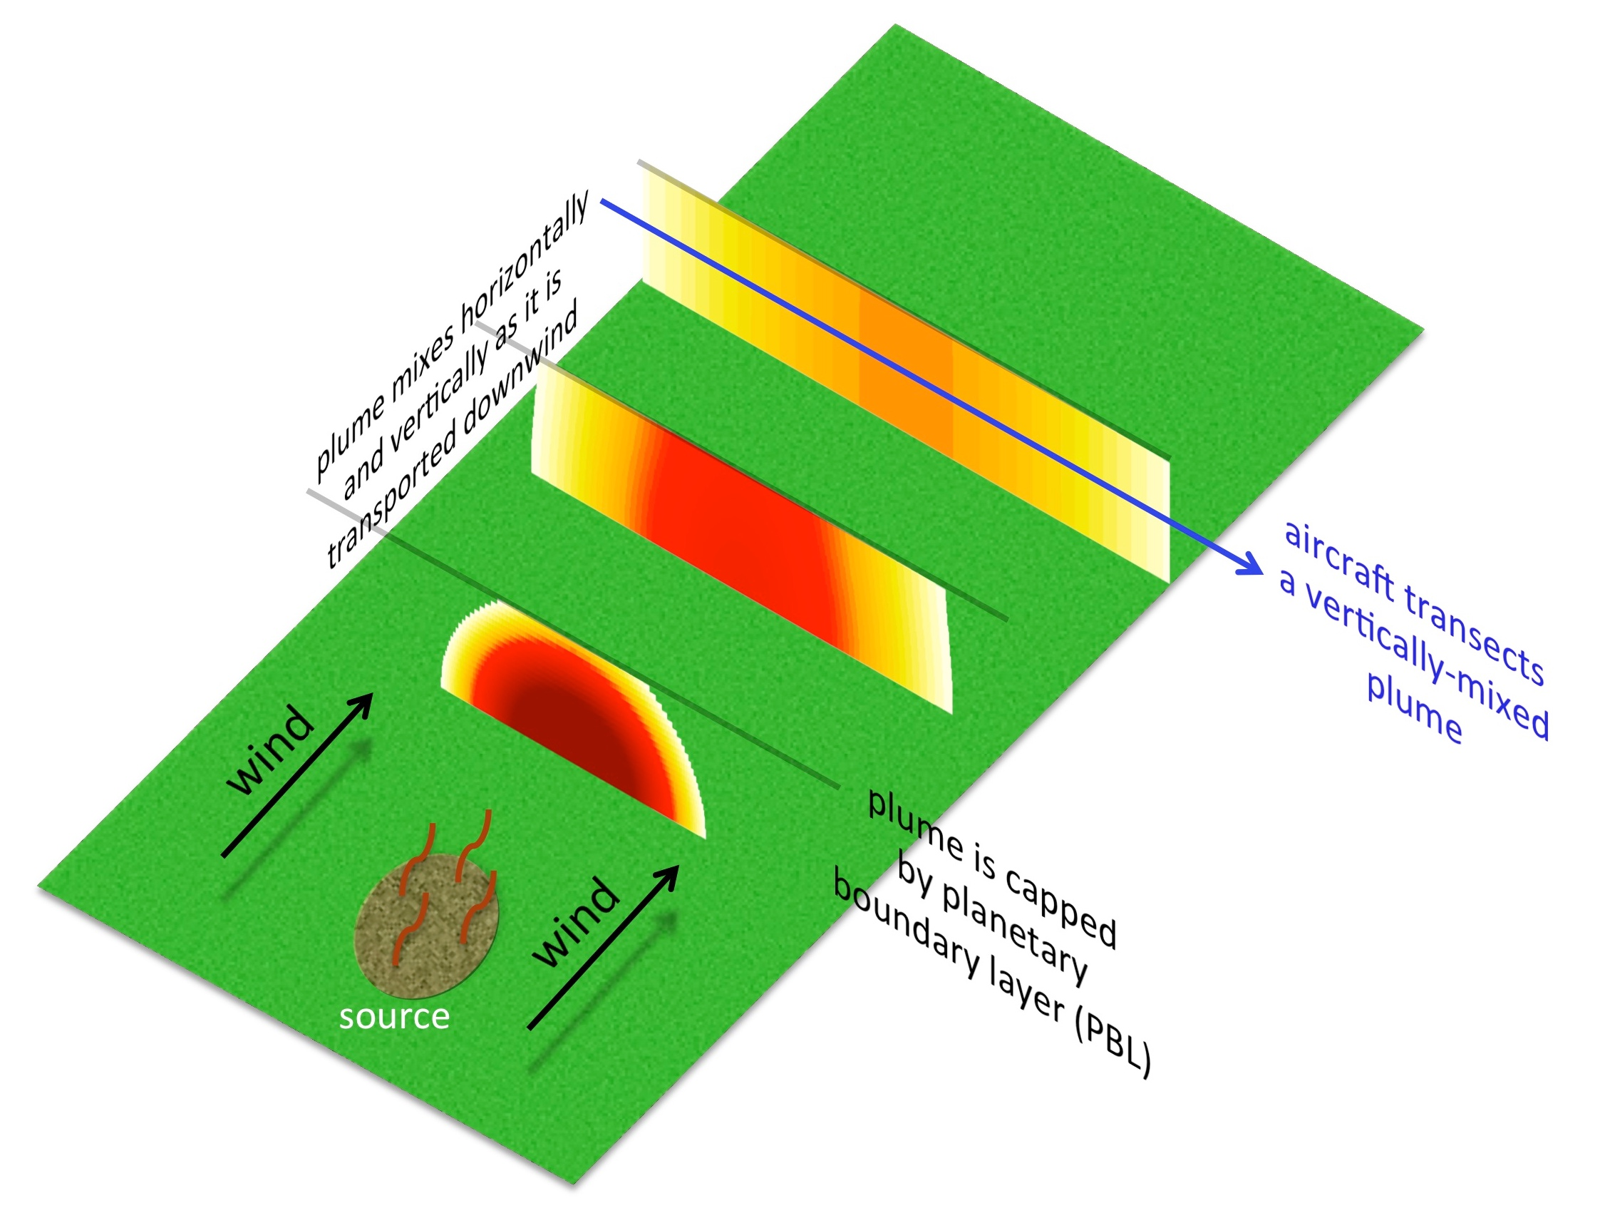
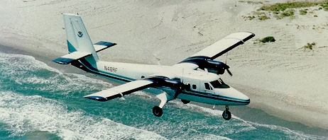


Mass balance flights directly measure CH₄ emissions rate
CH₄ emissions = (wind speed • mixing height • measured plume CH₄ enhancement)
NOAA Twin Otter
Scientific Aviation Mooney
NOAA WP-3D
Jeff Peischl

Slide 22
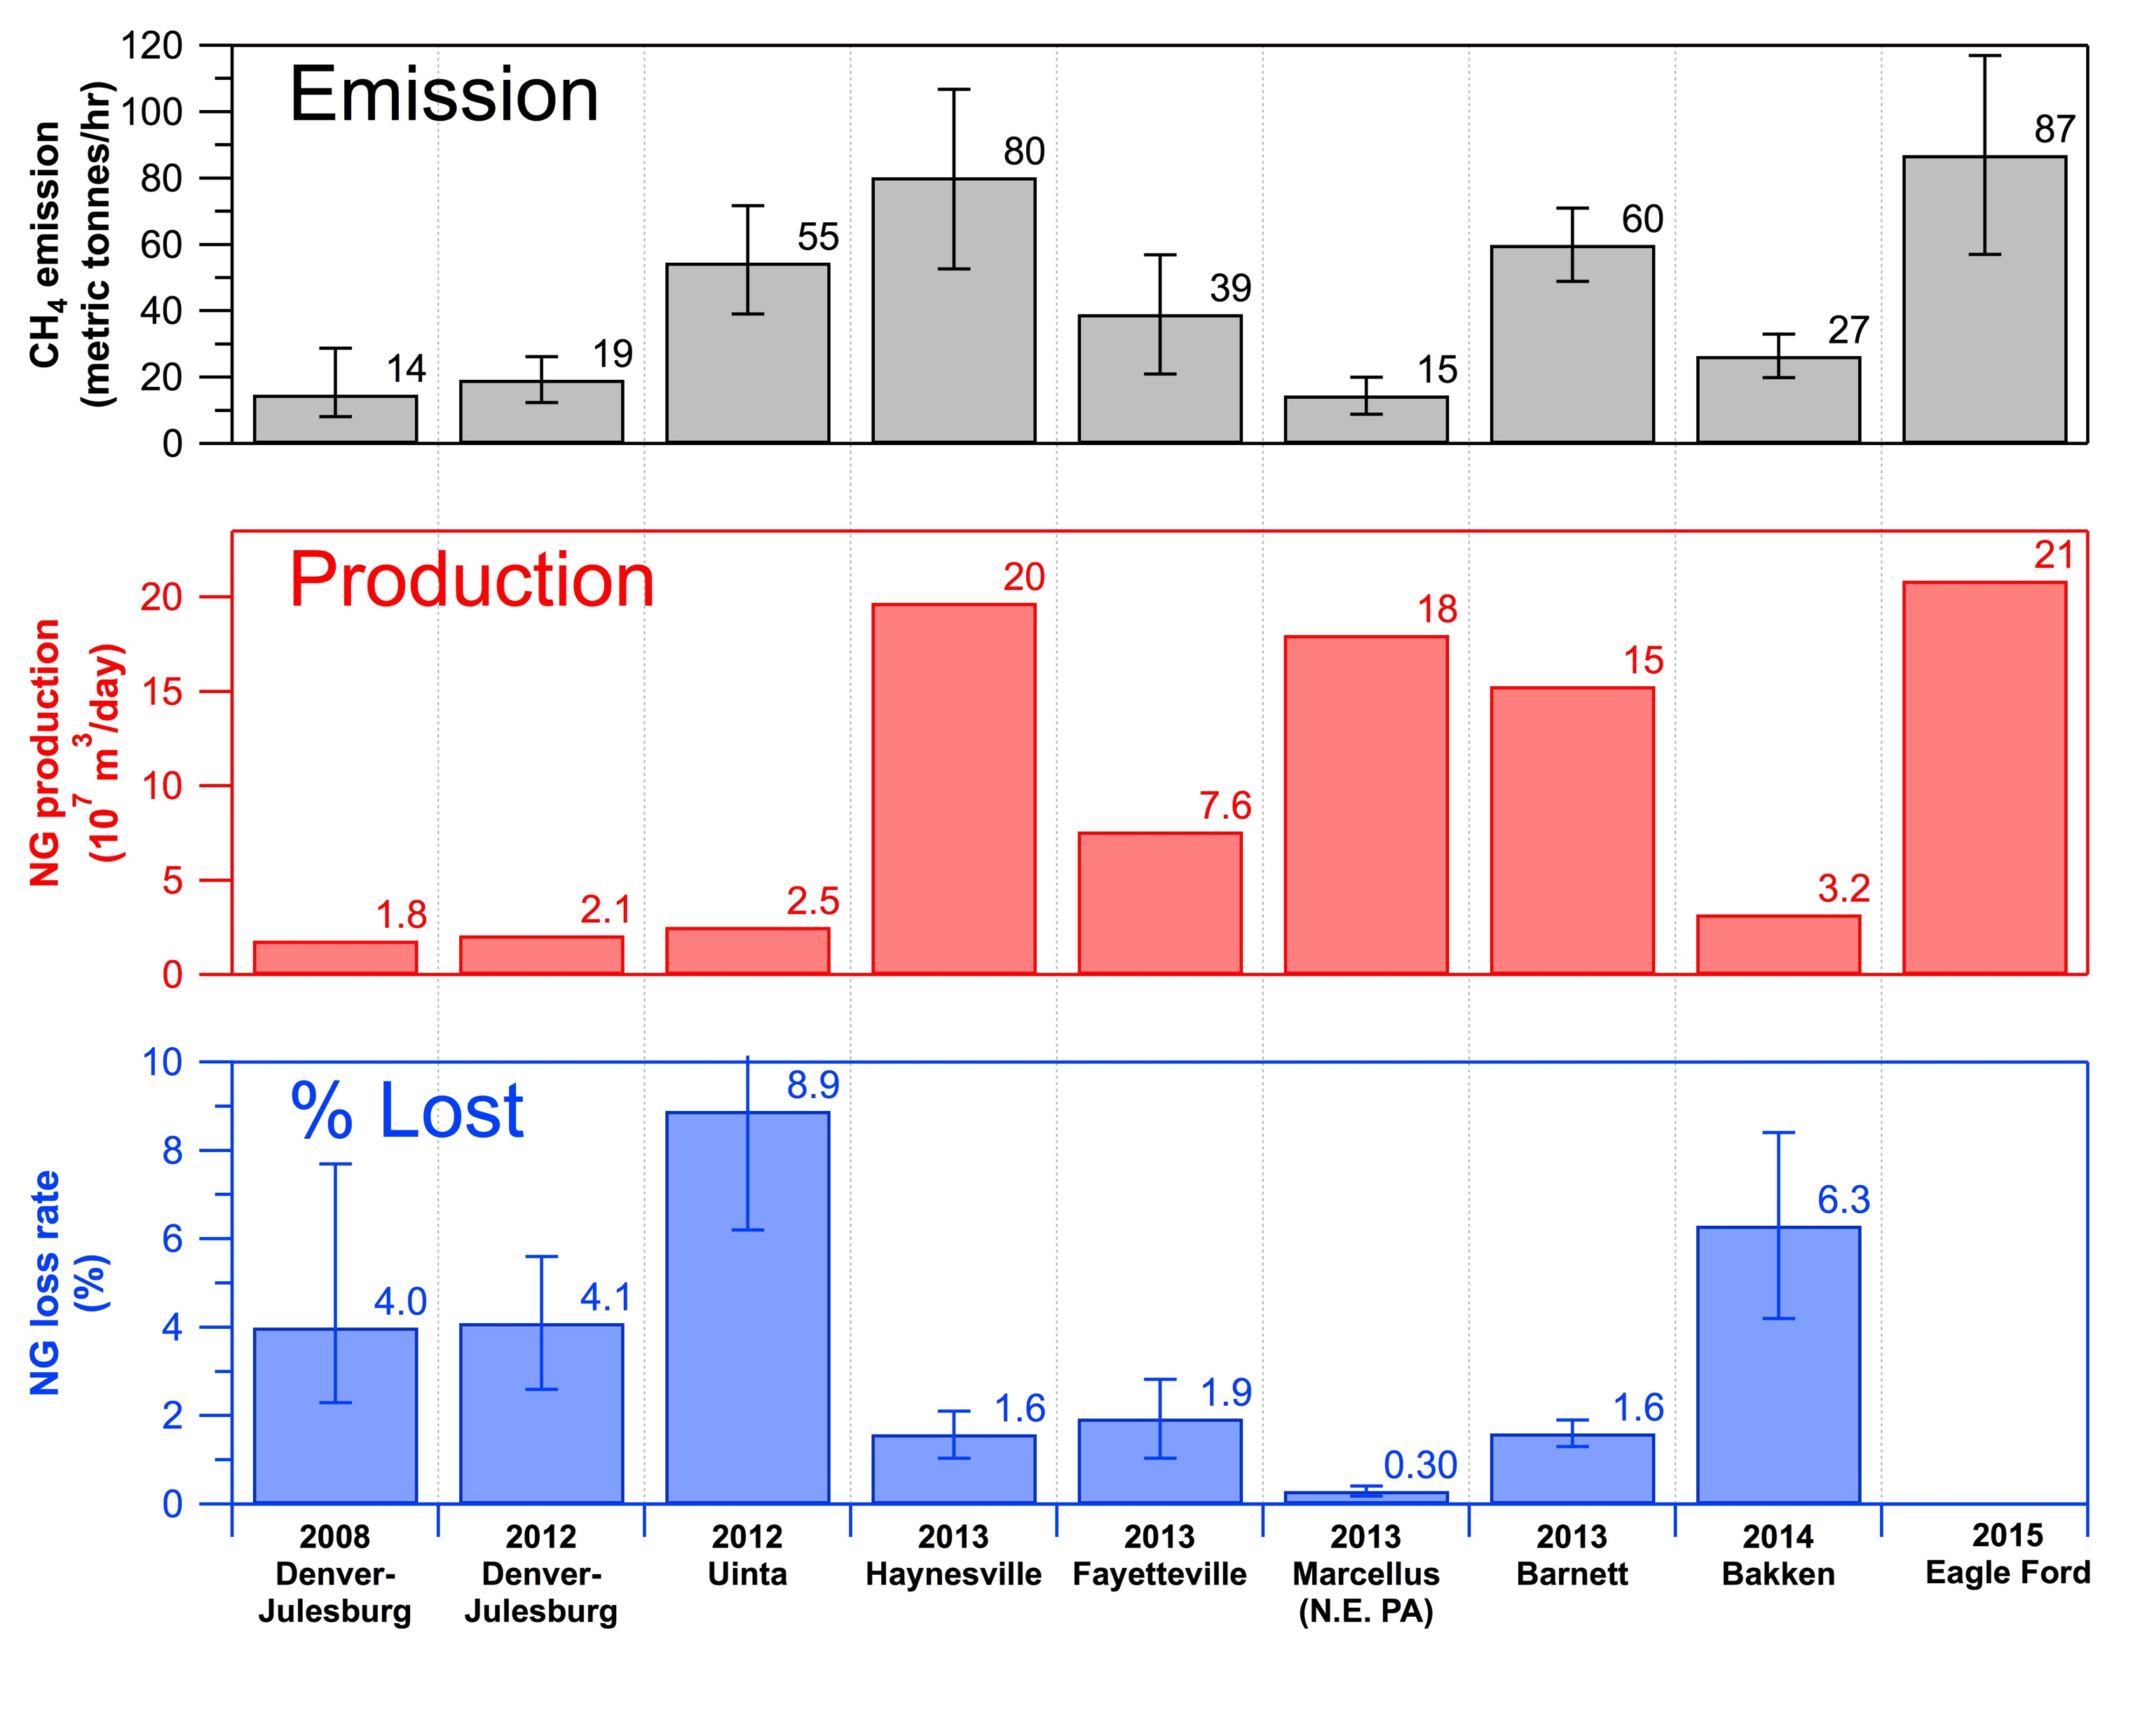
Substantial regional variability in oil/gas CH₄ emissions
Regional emissions variability is high. Drivers include:
dry vs. wet gas formations, production activity, economic and regulatory framework
Interannual emissions variability appears low – at least on basin-wide scales.
Petron et al. JGR 2012; Petron et al. JGR 2014; Karion et al. GRL 2013; Peischl et al. JGR 2015; Peischl in prep

Slide 23
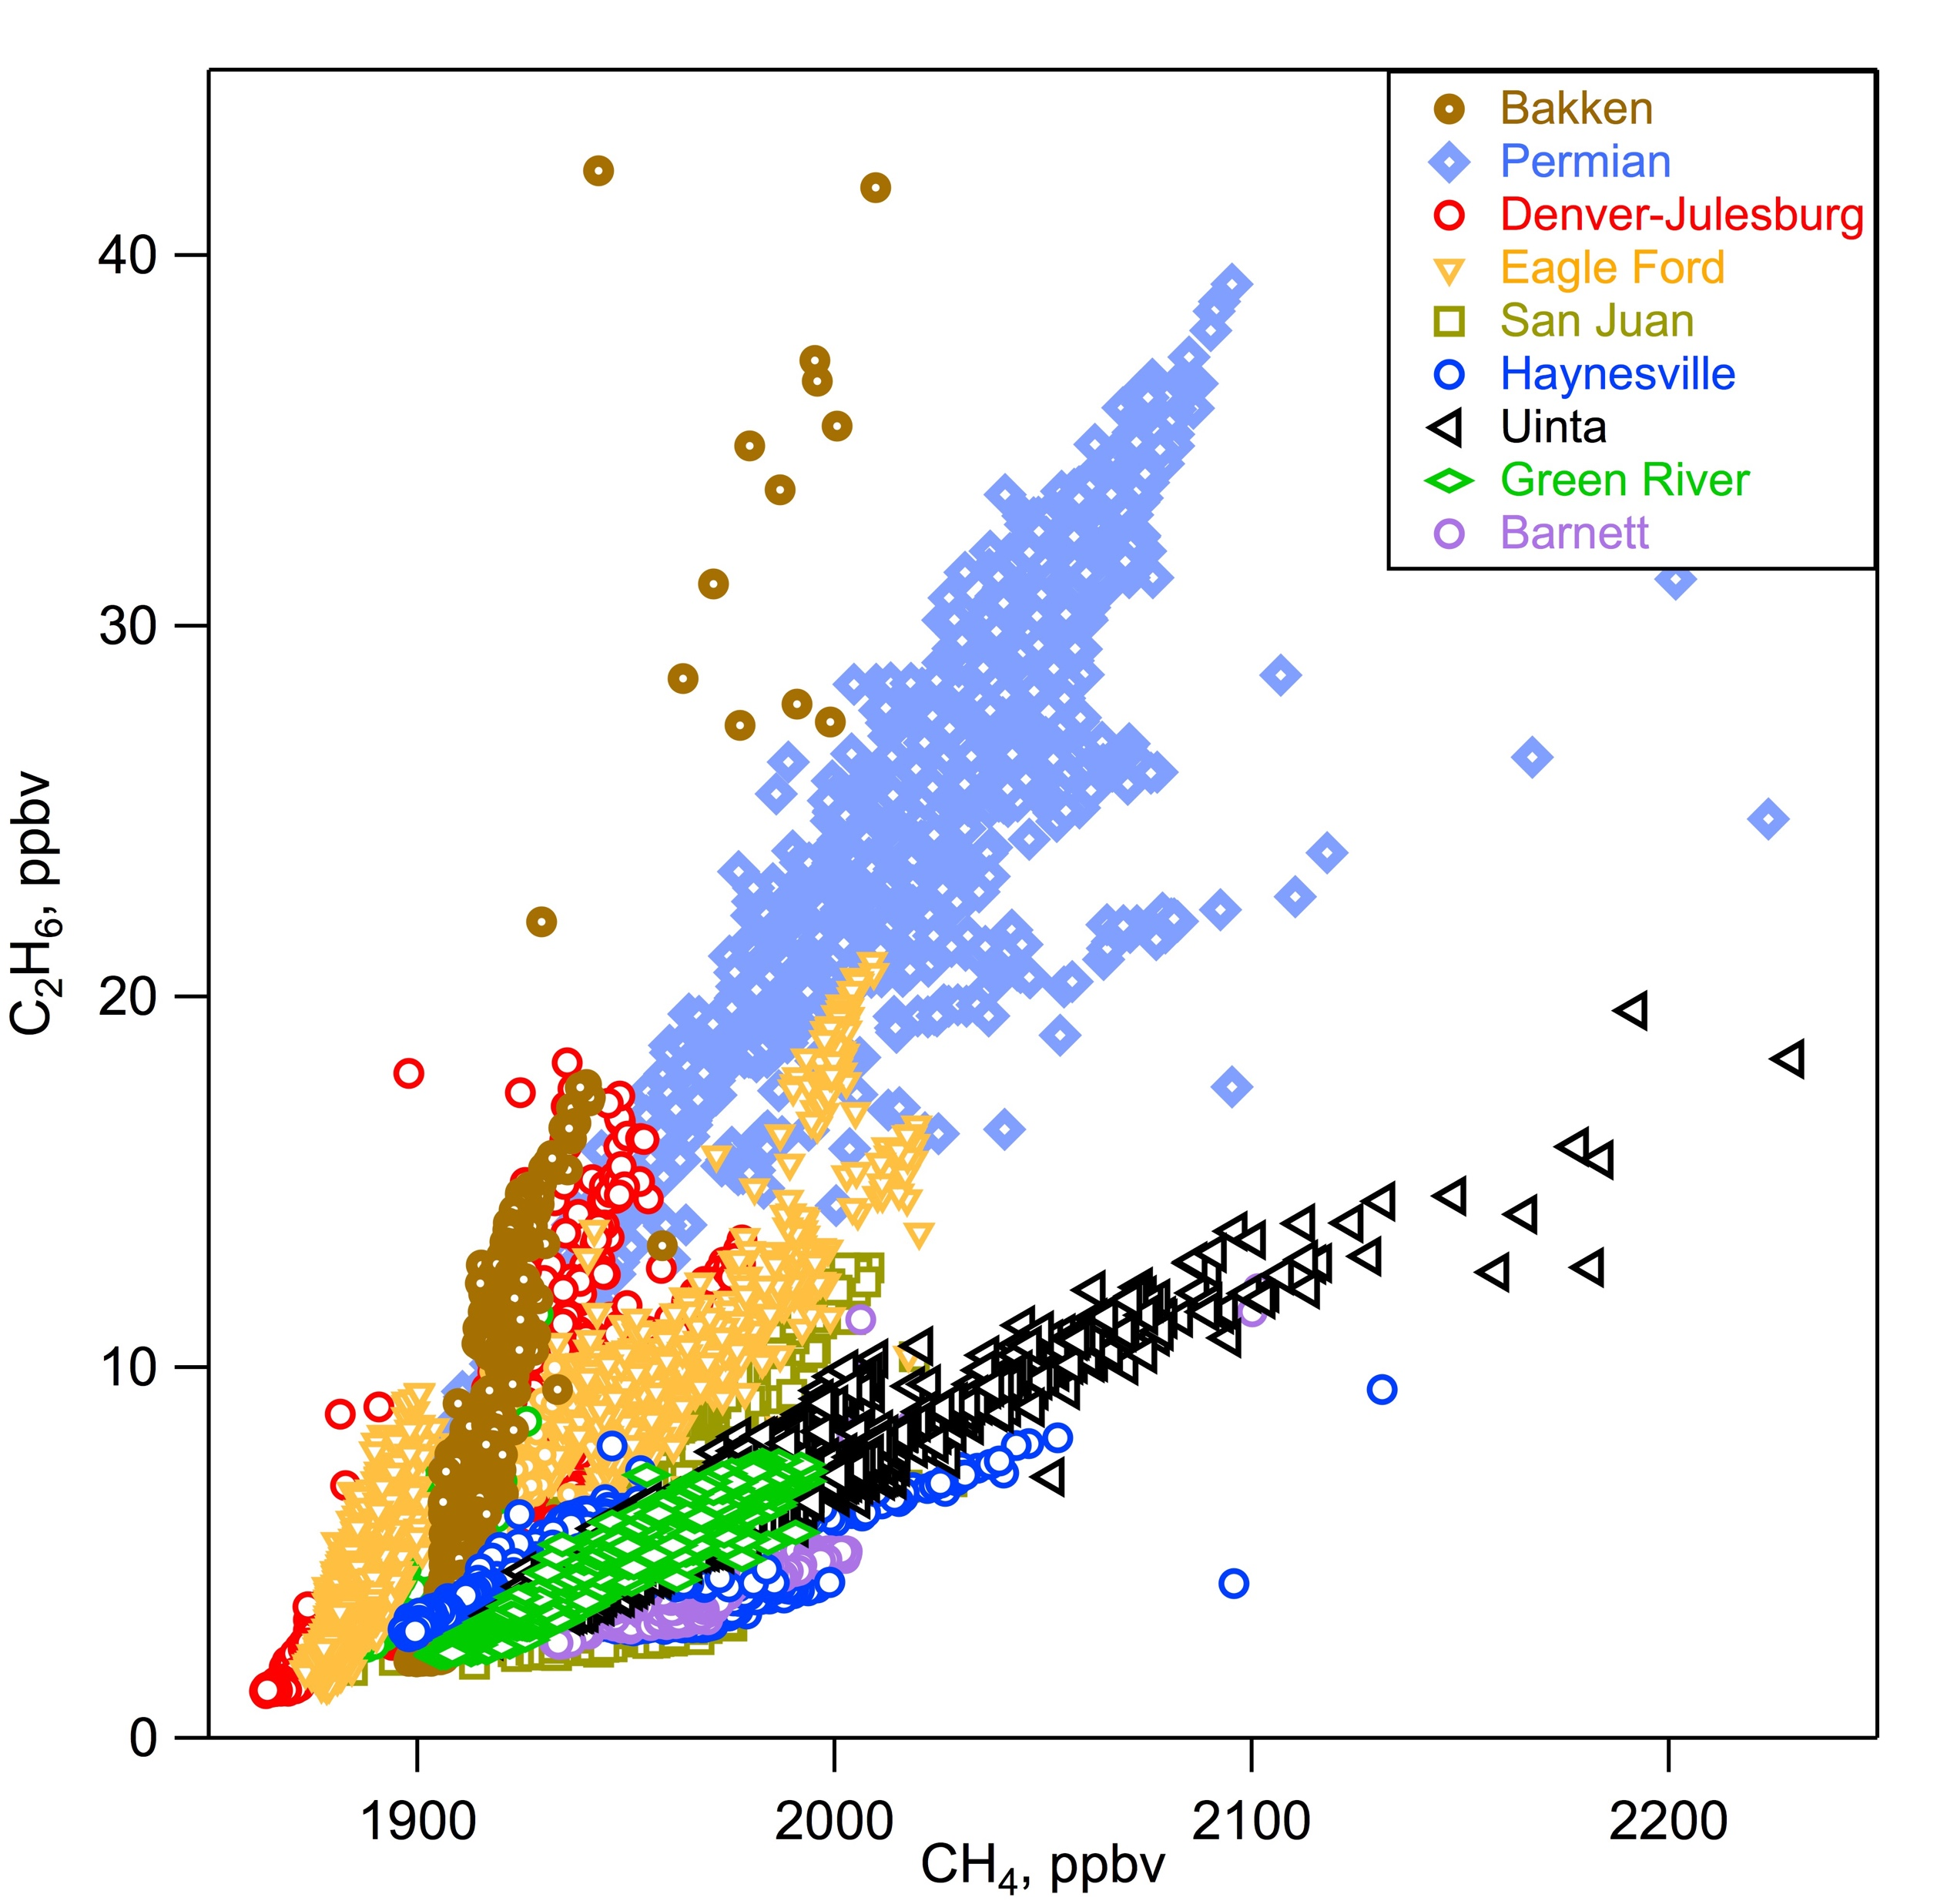
Using VOC/CH₄ Ratios to Quantify VOC Emissions
VOCs and CH₄ are highly correlated with in a basin
VOC/CH₄ enhancement ratios (ERs) provide a chemical fingerprint of oil/gas activity
VOC/CH₄ ERs are basin specific
C₂H₆/CH₄
Flux(VOC) = Flux(CH₄) * ER(VOC/CH₄) * MW(VOC)/MW(CH₄)
Combine CH₄ emissions derived from mass balance with VOC/CH₄ ERs to quantify emissions of different VOC species in a basin
15
VOC | ER_{[VOC]/[CH4}} | r | MW_{VOC}
Ethane | 0.43 ± 0.06 | 0.94 | 30
Propane | 0.38 ± 0.04 | 0.96 | 44
n-Butane | 0.21 ± 0.03 | 0.94 | 58
10
VOC (ppbv)
5
0
1900
1920
1940
Jessica Gilman, in preparation
Methane (ppbv)

Slide 24
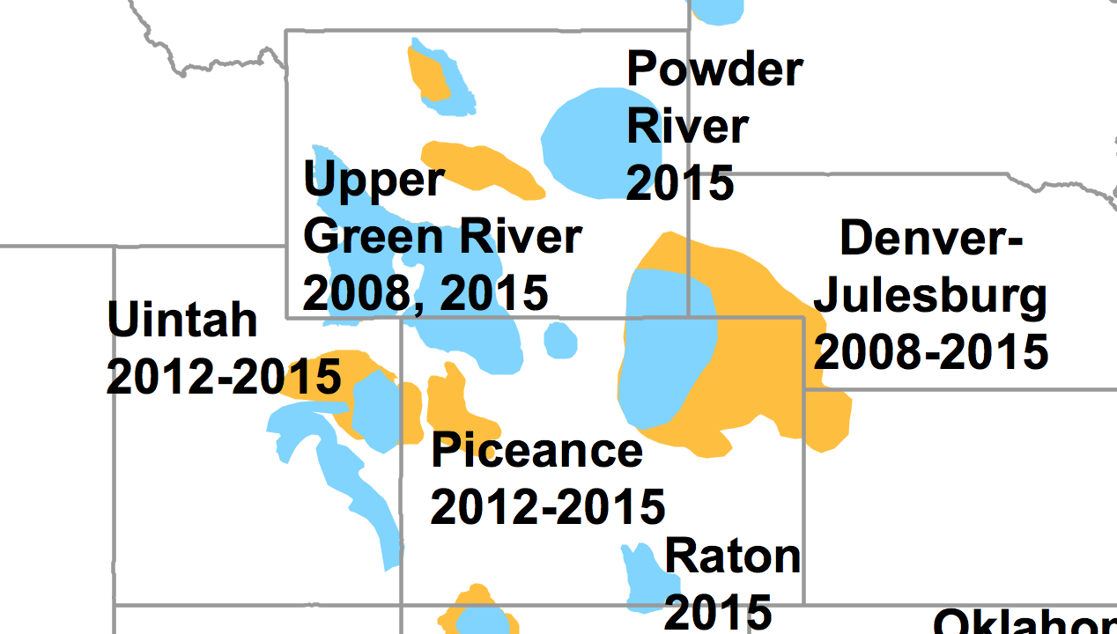
Atmospheric Measurements Improve Oil/Gas Emissions in Uintah Basin
Emission datasets | Source | Methane (tons/year) | Non methane VOCs (tons/year) | NO_{x} (tons/year)
Bottom-up | EPA National Emission Inventory (NEI-2011) | 100,279 | 101,184 | 16,448
Top-down | Based on the measurements | 482,130 | 184,511 | 4,158
Total top-down based methane flux estimate from Karion et al., 2013
Total methane and other VOC emissions in NEI-2011 are lower by a factor of 4.8 and 1.8
than in the top-down estimates, respectively
Conversely, NO_{x} emissions are 4 times higher in the NEI-2011 inventory
Implications for air quality regulations and for climate and air quality impacts
Ahmadov, R., et al. (2015) Atmos. Chem. Phys.

Slide 25

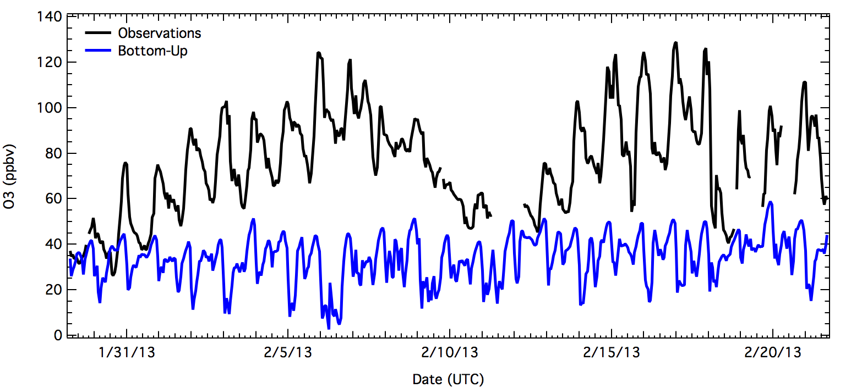
Measurement-Based Emissions Improve WRF-Chem O₃ Predictions in Uintah Basin
Multi-day buildup of surface O₃ during stagnation episodes
Model using official bottom-up emissions inventory can’t reproduce observed high O₃ levels
(NEI-2011)
Ahmadov, R., et al. (2015) Atmos. Chem. Phys.

Slide 26
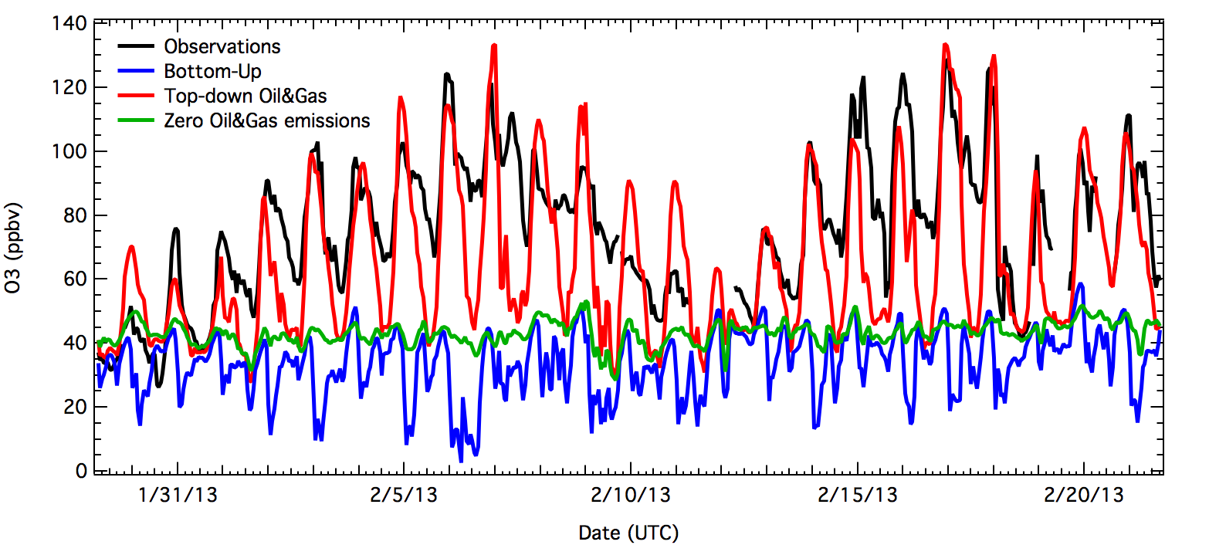
Measurement-Based Emissions Improve WRF-Chem O₃ Predictions in Uintah Basin
Multi-day buildup of surface O₃ during stagnation episodes
Model using official bottom-up emissions inventory can’t reproduce observed high O₃ levels
Measured emissions case explains high O₃ levels
High O₃ in this basin driven mostly by oil/gas emissions
(NEI-2011)
Ahmadov, R., et al. (2015) Atmos. Chem. Phys.

Slide 27
Better Collaboration Can Improve Inventories
Some examples:
NOAA
NASA
AQRS
GEIA

Slide 28


















NOAA’s Emissions Research Benefits Stakeholders
NOAA Stakeholders
A
C
A
D
E
M
I
A
What NOAA provides:
Connect research to models
Inform inventory development
Synthesize information
Nurture community of experts
Forms of outreach:
Journal articles
Conferences
Assessments
Direct outreach

Slide 29
NASA Air Quality Applied Sciences Team
Conveying NASA’s science information to regulatory agencies
aqast.org

Slide 30
Federal Interagency Cooperation on Air Quality
Office of Science and Technology Policy’s National Science and Technology Council
Committee on Environment, Natural Resources, and Sustainability (CENRS)
Air Quality Research Subcommittee (AQRS)
Co-chairs:
Dan Costa National Program Director, ORD’s Air, Climate, and Energy Research Program
John Daniel Deputy Director, Chemical Sciences Division, NOAA Earth System Research Lab
Goals: To enhance the effectiveness and productivity of U.S. air quality research and to improve information exchange on air quality issues, including the scientific knowledge base for air quality standards and compliance assessment.
Ongoing topics of interagency discussion and coordination:
Ozone transport (tropospheric and stratospheric) and the NAAQS
Wildfires: Future field experiments to improve understanding of emissions, chemical transformations, transport, and impacts
Appropriate response to the report by the National Academies of Sciences, Engineering, and Medicine on the future of atmospheric chemistry research

Slide 31

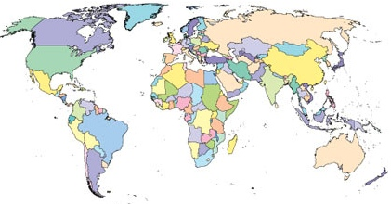


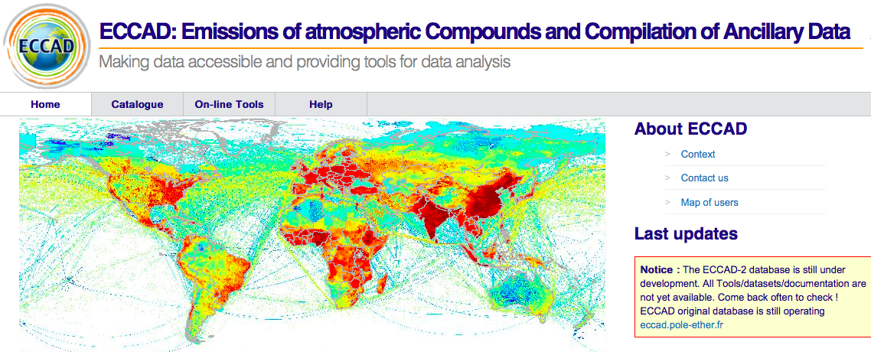

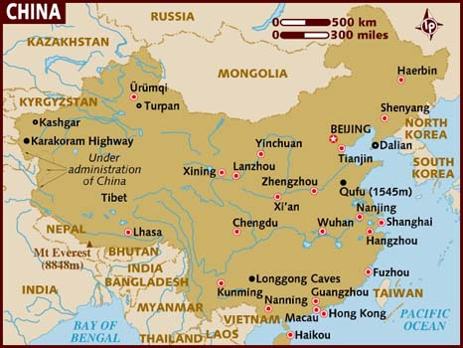
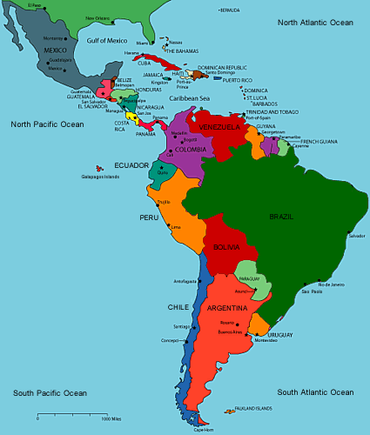
International Emissions Efforts
2000 people worldwide
www.geiacenter.org
Community
Strengthening the emissions community by connecting developers and users
GEIA member(s)
SSC member(s)
Access
Creating easier, more open access to emissions data and information
Community Emissions Data System
www.globalchange.umd.edu/ceds/
Analysis
Identifying priorities, facilitating research, and synthesizing findings to improve the scientific basis of emissions
China Working Group
Latin America/ Caribbean WG
VOC WG
Assessing Emissions Quantification
using
Inverse Modeling
(joint with IGAC)
Notes:
Open information
Freely available
Open to all members of the GEIA community
Strengthening community
GEIA supports network of 1800 people worldwide
GEIA organizes bi-annual conferences
Through IGAC and other sponsors, GEIA provides travel support and encourages participation of early career scientists and scientists from emerging countries
Research priorities, e.g.: Land Use, Fires, Energy Production, Agriculture, Urban Areas, Historical Emissions
GEIA Working Groups, including 2 that focus on building understanding of regional emissions
China WG: Organizing East Asian Emissions Assessment, includes many papers in a multi-year ACP special issue
Latin America/Caribbean WG: Building database of emissions experts in LAC nations. Organizing workshops and other community activities.
VOCs
Urban
GEIA demonstrates approaches for quantifying emissions that can be applied worldwide
GEIA synthesizes and conveys emissions science for the benefit of global emissions stakeholders

Slide 32
Some Final Thoughts
Emissions are critical to decision making
Inventories are fundamental datasets with many challenges
Atmospheric observations and models complement inventories and help inform emissions understanding
Reconciling approaches improves scientific basis
Structures exist to work together nationally and globally
Guiding principles:
  Humility
  Flexibility
  Communication
  Collaboration

