Slide 1

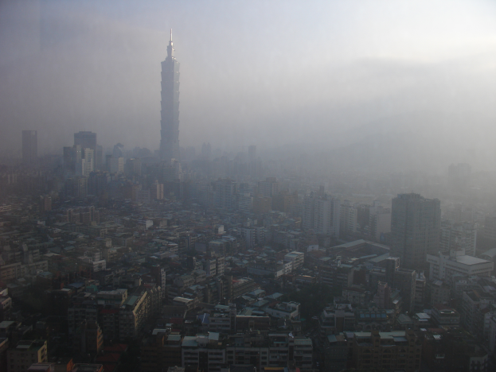
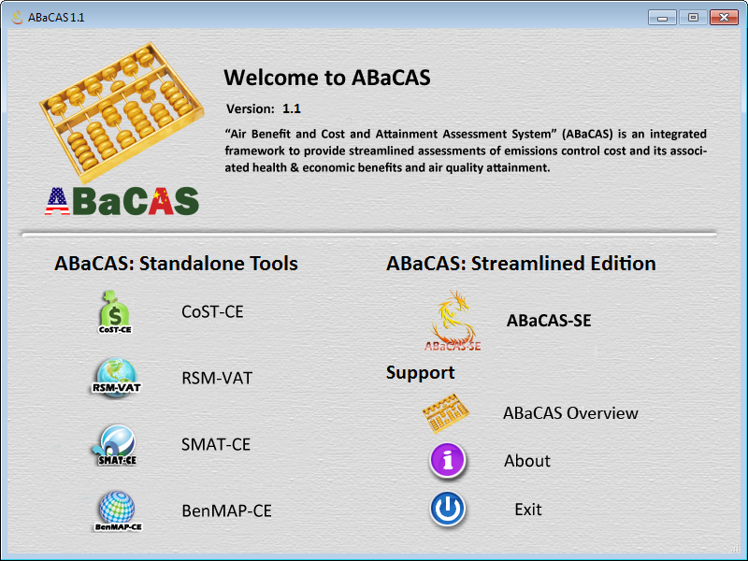


Development of Next-Generation Integrated “Air Benefit and Cost and Attainment Assessment System” (ABaCAS)
Air Pollution
(PM2.5 & O3)
“ABaCAS”
Attainment &
Benefit/Cost
Science
Policy
Actions
Carey Jang, Ph.D.
EPA/OAQPS/AQAD/Air Quality Modeling Group
CMAS Conference, October 5, 2015

Slide 2





Outline
Overview of Air Pollution Control Cost/Benefit and Attainment System
Development of Next-Generation Integrated AQ Decision Support System: “ABaCAS”
  “ABaCAS ”: Air Benefit and Cost and Attainment Assessment System
    Developed Jointly by an Team of U.S. and Chinese Scientists
Recent Development & Future Work Plan (2015/2016):
  Streamlined “ABaCAS-SE” : Policy Analysis
  International Applications
ABaCAS

Slide 3
Effective AQ Management Requires Scientifically Sound Benefit/Cost & Attainment Assessment Tools
Emission
Control
Identify and compare cost of alternative control strategies
CoST-CE
Emission Control & Cost
AQ
Benefit
Assess air quality benefit and attainment of emissions control
RSM/CMAQ & SMAT-CE
Health & Economic
Benefit
AQ
Benefit & Attainment
Health
Benefit
Assess health and Environ.
benefit of emissions control
BenMAP-CE

Slide 4
“ABaCAS”: Air Benefit and Cost & Attainment Assessment System
An integrated AQ Decision Support System
Developed for “Scientists” and “Policy Makers”

Slide 5
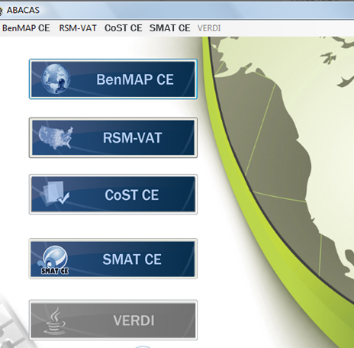
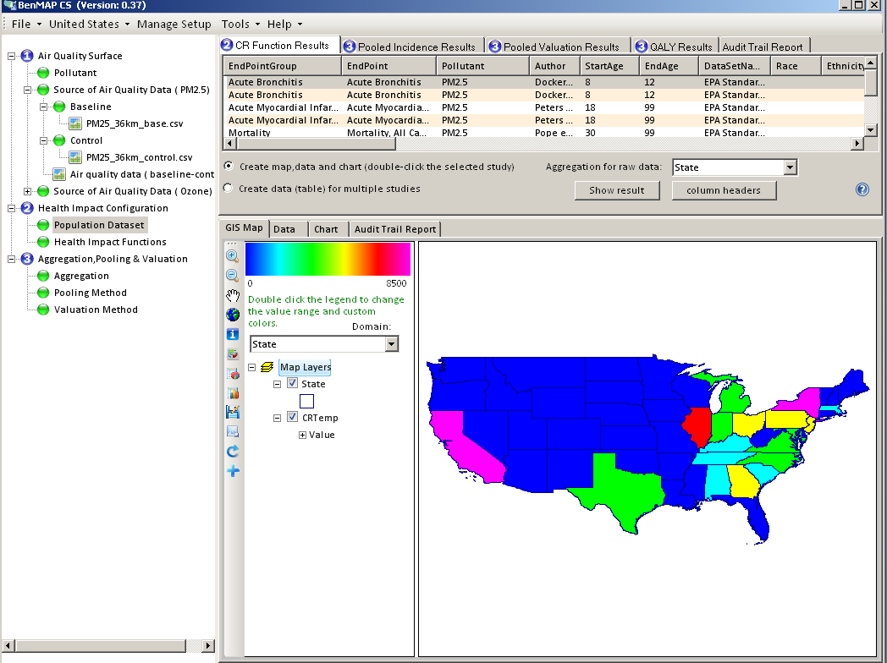
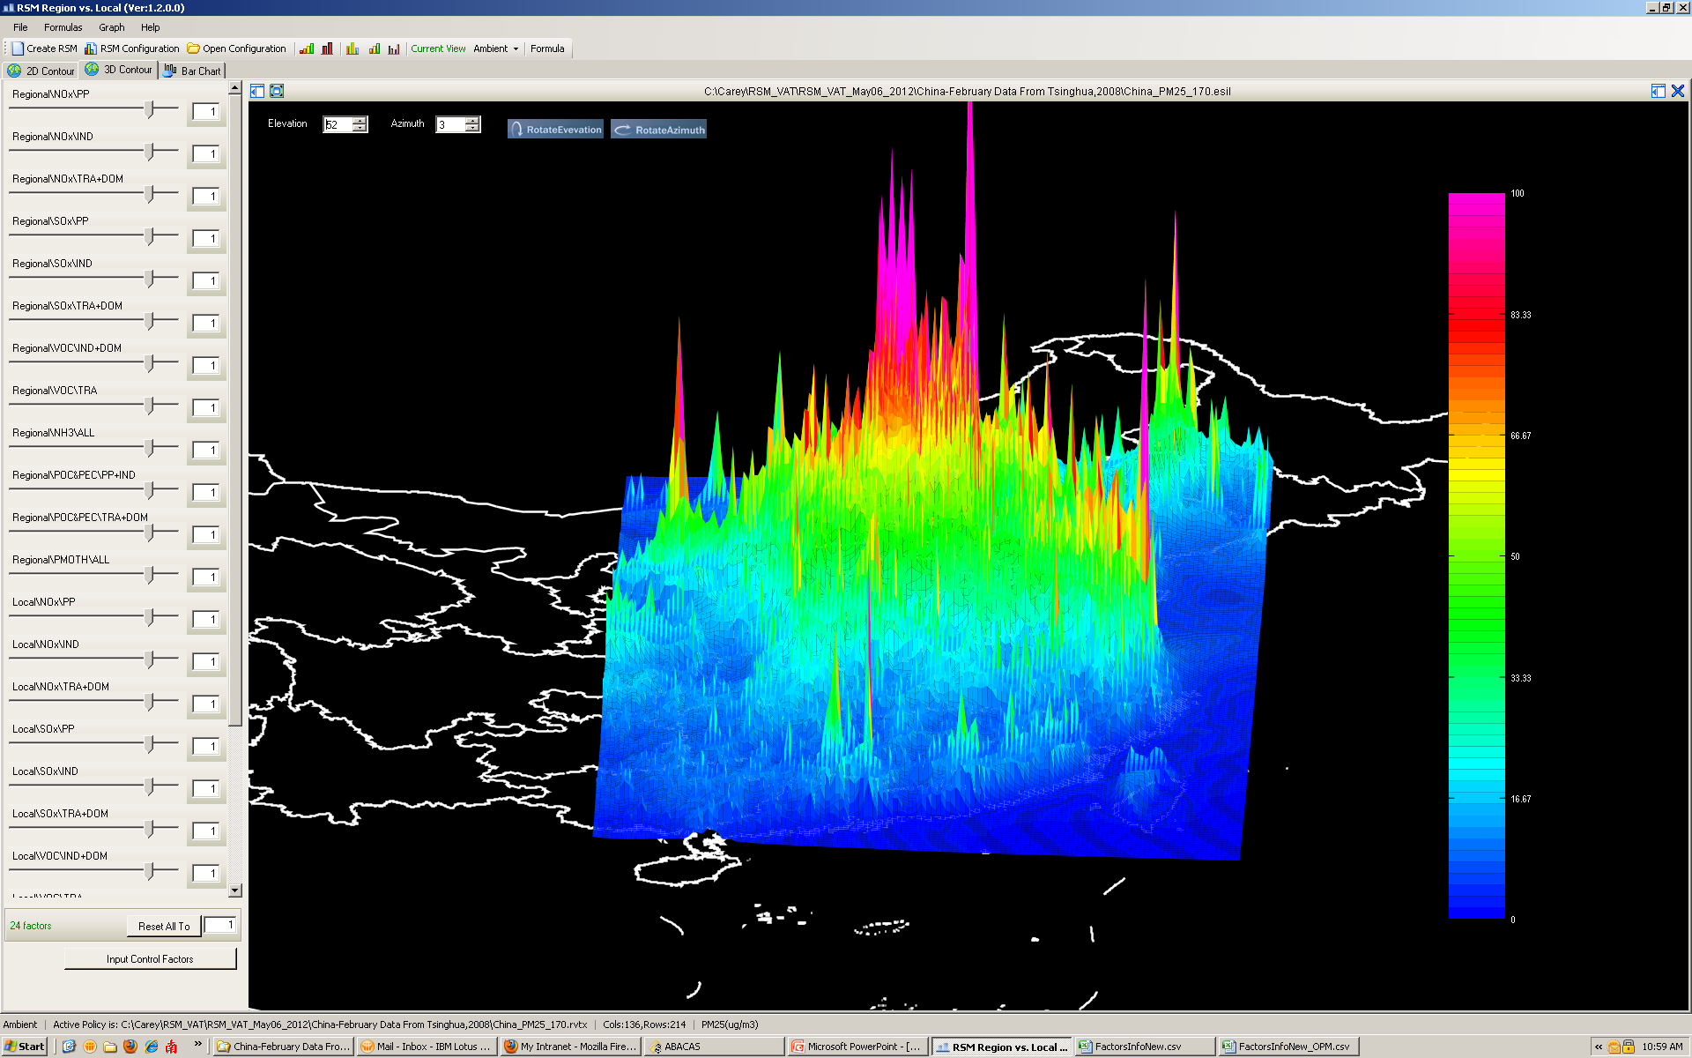
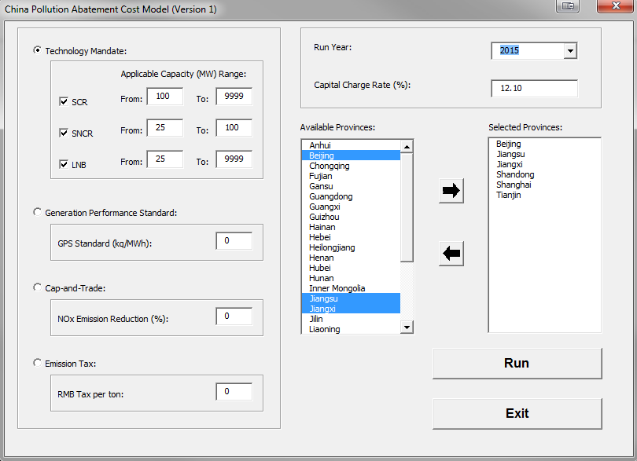
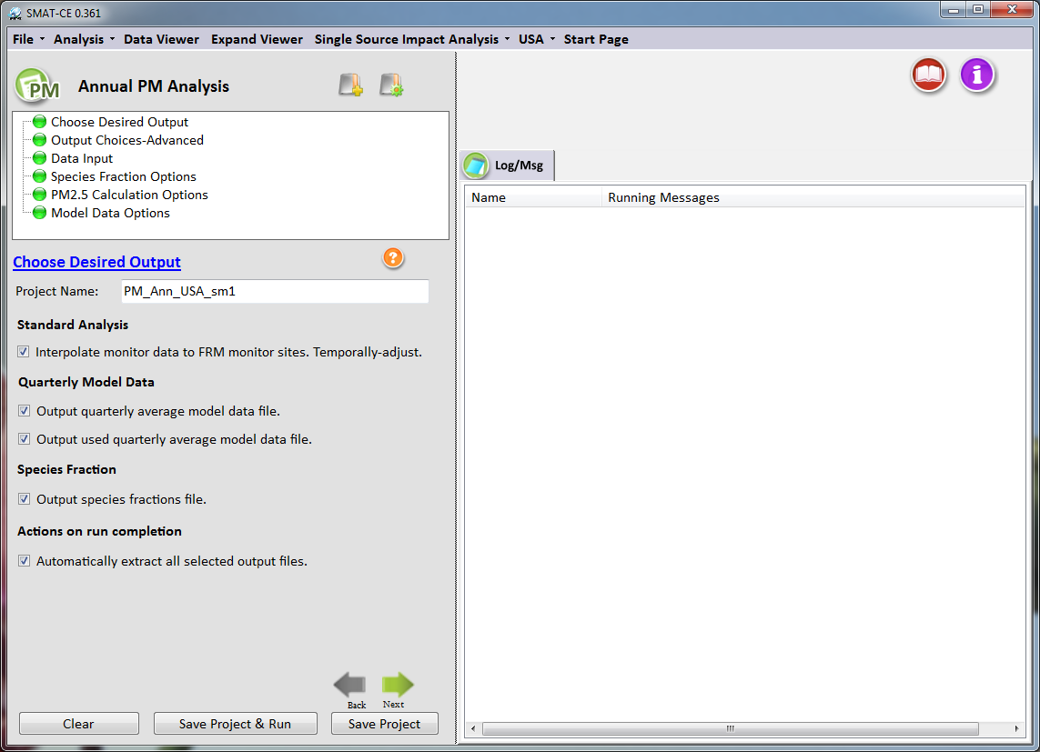
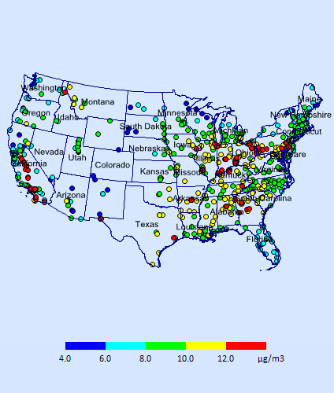
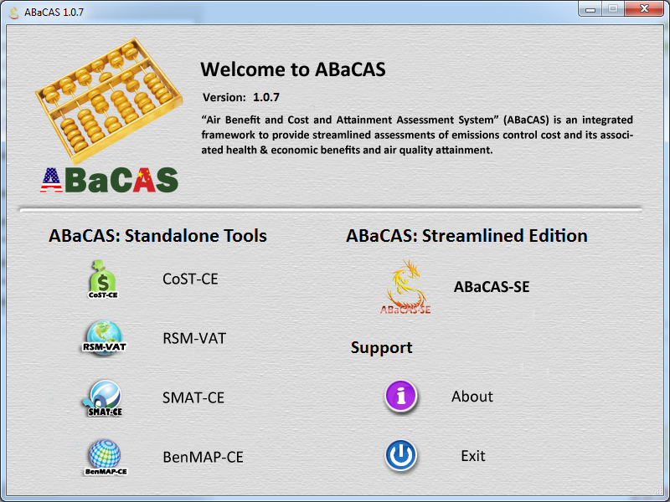
ABaCAS : Air Benefit and Cost & Attainment Assessment System
BenMAP-CE
RSM/CMAQ
Provide Health Impacts and Economic Benefits Estimate
Provide Real-time Air Quality
Response of Emissions Control
Please visit ABaCAS website for more information:
http://www.abacas-dss.com
CoST-CE
SMAT-CE
Provide Emissions Control Cost Analysis and Estimate
Provide Attainment Test/Demo for
PM2.5 & O3 Non-attainment Areas

Slide 6
Air Quality
Benefit
Attainment
Test/Demo
RSM/CMAQ
SMAT-CE
Control Cost
Estimate
Health & Env.
Benefit
ABaCAS
CoST-CE
BenMAP-CE
Cost-effective Control Strategy Development
Cost/Benefit Analysis & Optimization
Health & Air Quality Benefit Assessment
Air Quality Attainment Assessment
An Integrated Air Quality Management and Decision Support System
“www. abacas-dss.com”

Slide 7
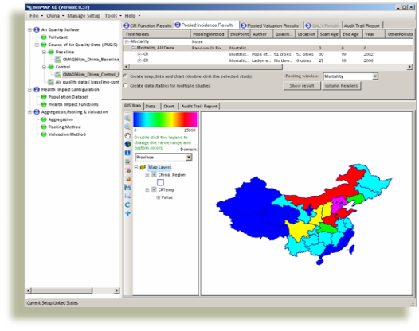
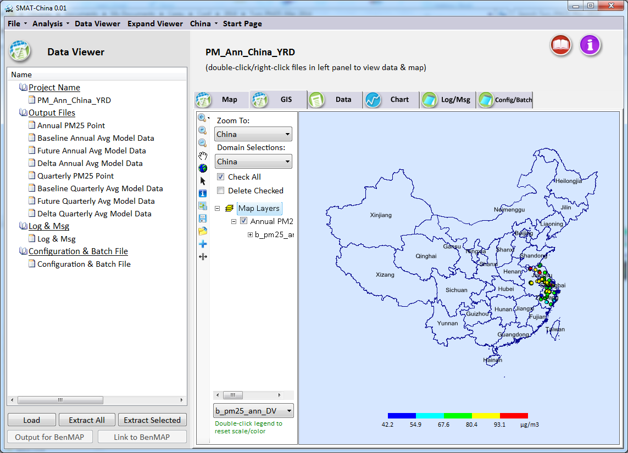
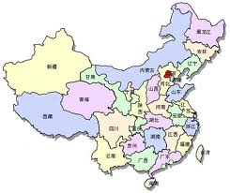
Applications of ABaCAS in China
BenMAP-CE
RSM/CMAQ
Provide Health Impacts and Economic Benefits Estimate
Provide Real-time Air Quality
Response of Emissions Control
Please visit ABaCAS website for more information:
http://www.abacas-dss.com
CoST-CE
SMAT-CE
Provide Emissions Control Cost Analysis and Estimate
Provide Attainment Test/Demo for
PM2.5 & O3 Non-attainment Areas

Slide 8
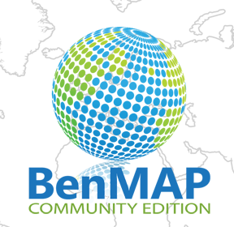
BenMAP-CE: Environmental Benefit Mapping & Analysis (Community Edition)
BenMAP-CE
BenMAP-CE
(2012-2014)
Provide Health Impacts & Economic Benefits Estimate:
Developed by USEPA and International ABaCAS team to estimate health & environmental impacts and economic benefits due to changes in AQ
Notes:
Comment: This is an important slide, but needs to be improved. Consider to use animations to highlight the key features & differences

Slide 9
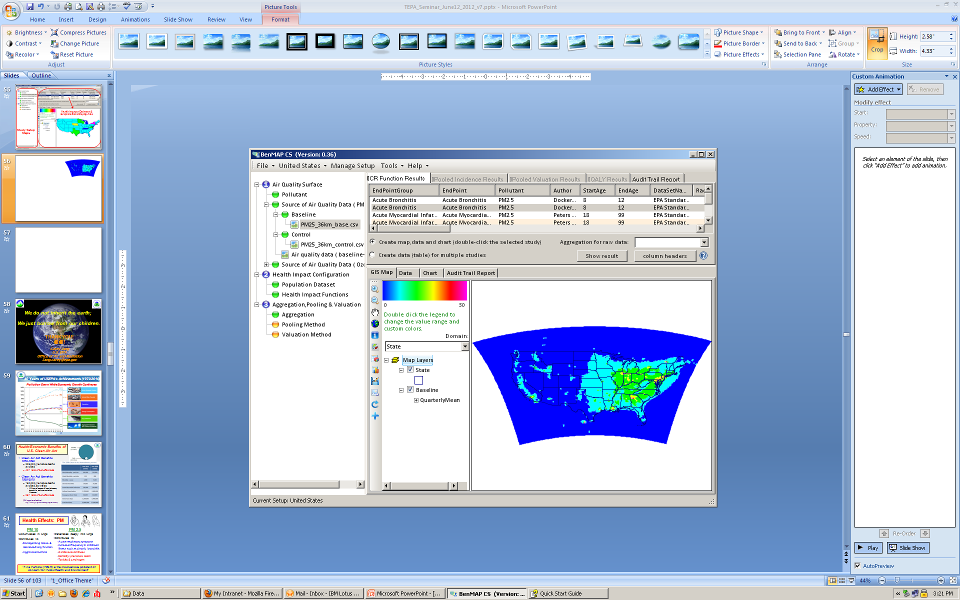
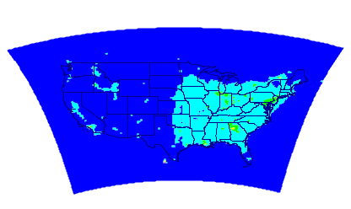
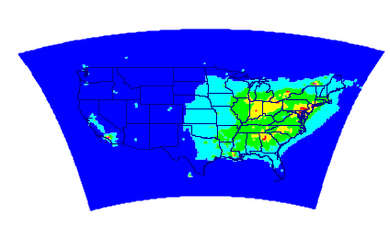
Baseline
Control
1st Step: AQ Data
Setup
AQ Benefit

Slide 10
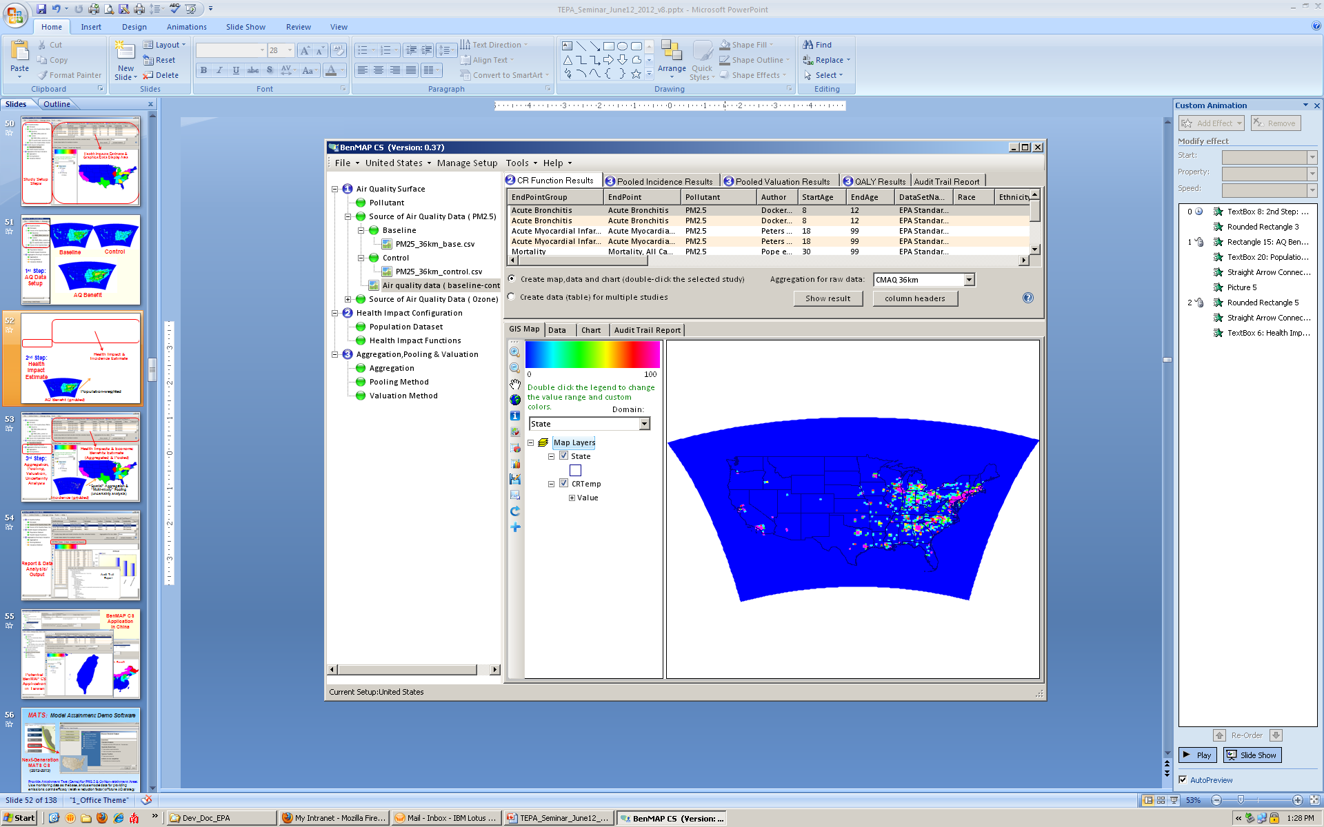
Health Impact &
Incidence Estimate
2nd Step: Health
Impact
Estimate
Population-weighted
AQ Benefit (gridded)

Slide 11
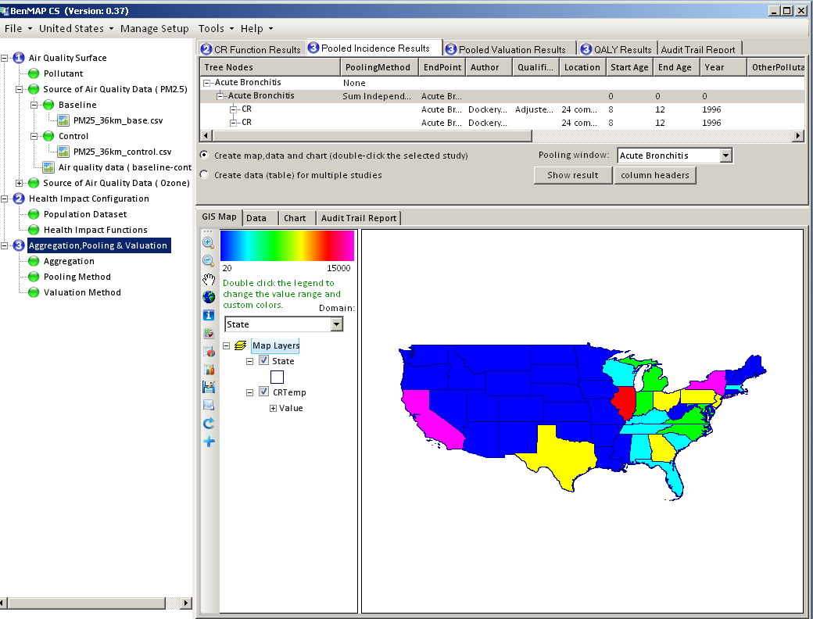
Health & Economic
Benefits Estimate
(Aggregated & Pooled)
3rd Step:
Aggregation, Pooling, Valuation, Uncertainty Analysis
“Spatial” Aggregation &
“Multi-study” Pooling (uncertainly analysis)
Incidence (gridded)

Slide 12
RSM: Response Surface Model
RSM-VAT
RSM/CMAQ
(2011-2015)
Provide Real-time AQ Response of Emissions Control:
Developed by USEPA & international ABaCAS team to provide real-time response of AQ concentrations to changes in emissions
Notes:
Comment: This is an important slide, but needs to be improved. Consider to use animations to highlight the key features & differences

Slide 13
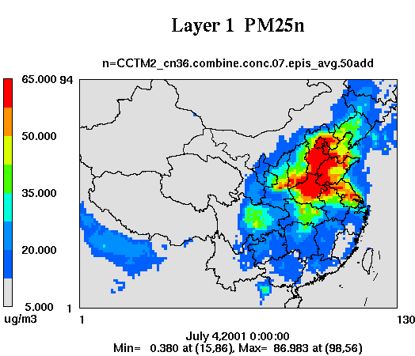
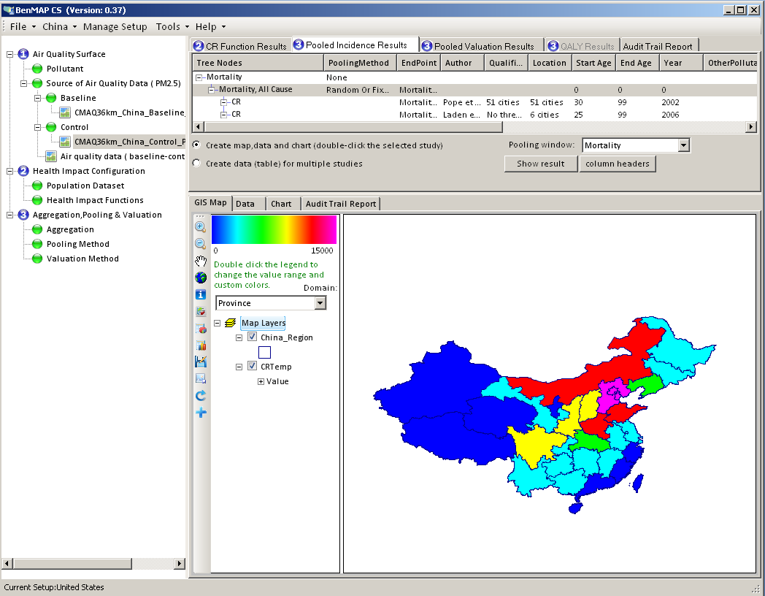
  Air Benefit & Control Assessment (ABaCAS)
Decision-maker/Analyst
Decision Support System
Integrated
Assessment
Policies
Impacts
Modeling Framework
RSM
Response Surface Model
CoST
Cost Analysis Tool
CMAQ
Air Quality Model
BenMAP
Health Benefits Model
Emissions
Air Quality
Air Pollution Abatement Cost Tool
Community Multi-scale Air Quality Model
Benefit Mapping Tool
Cost/Benefit Analysis
Emissions Control
Air Quality Benefit
Health
Benefit

Slide 14
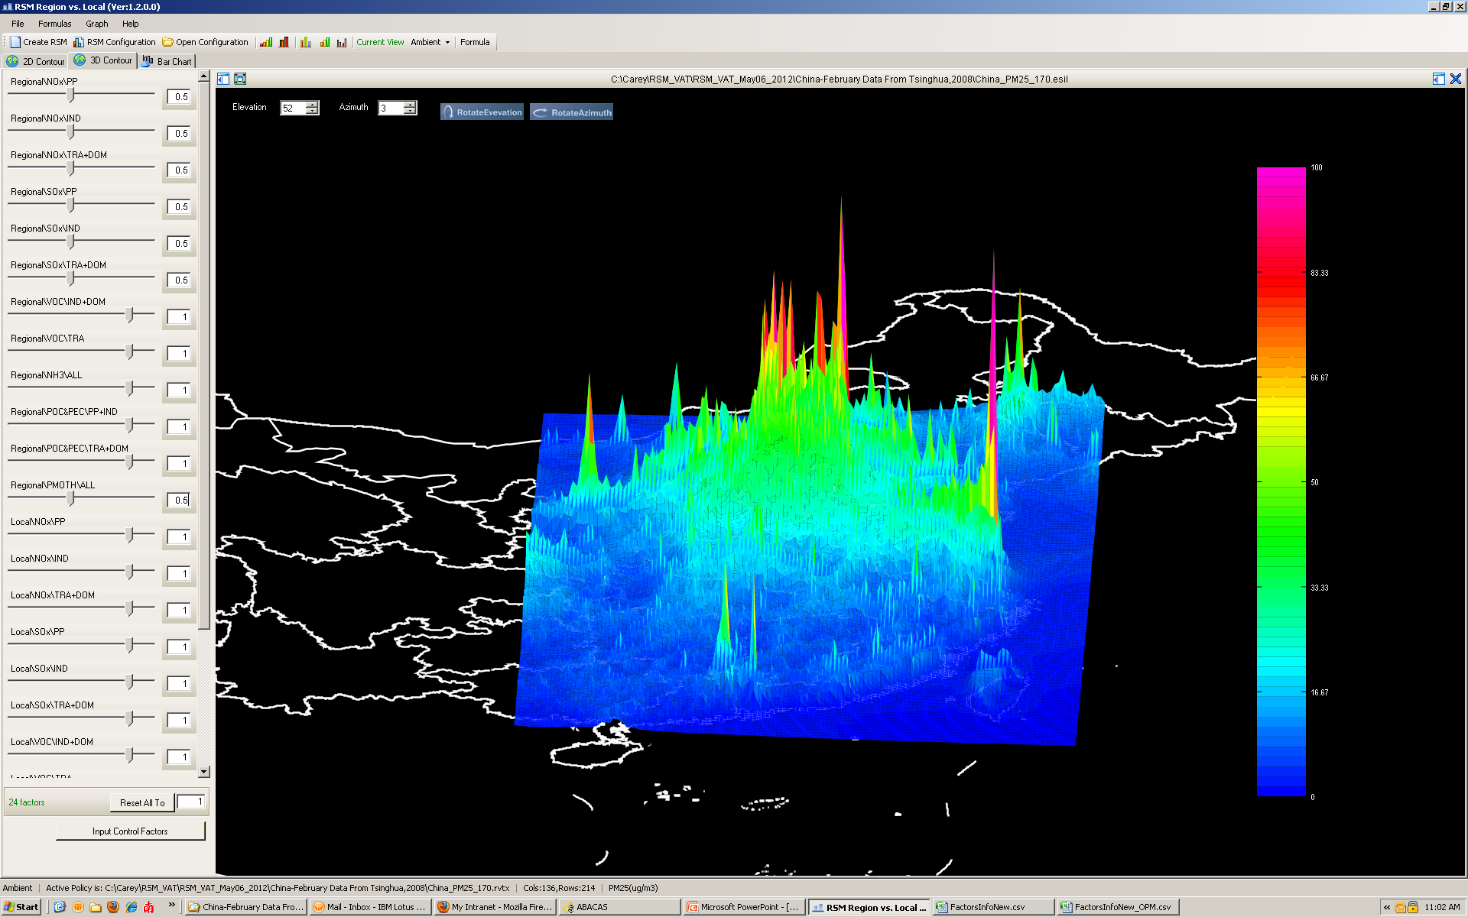
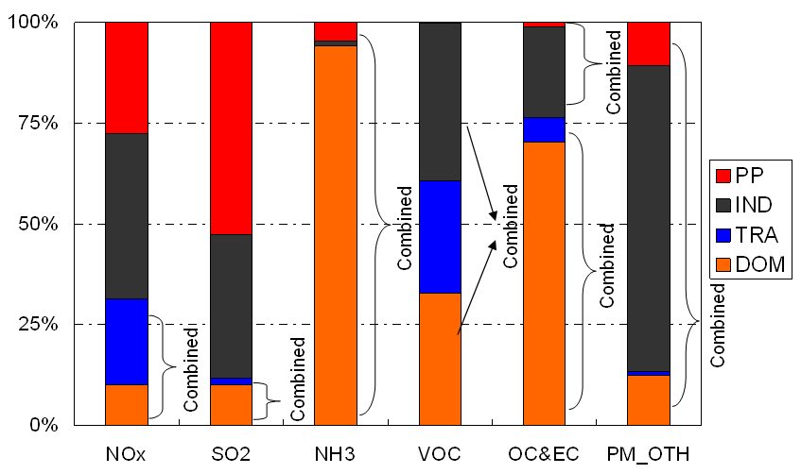
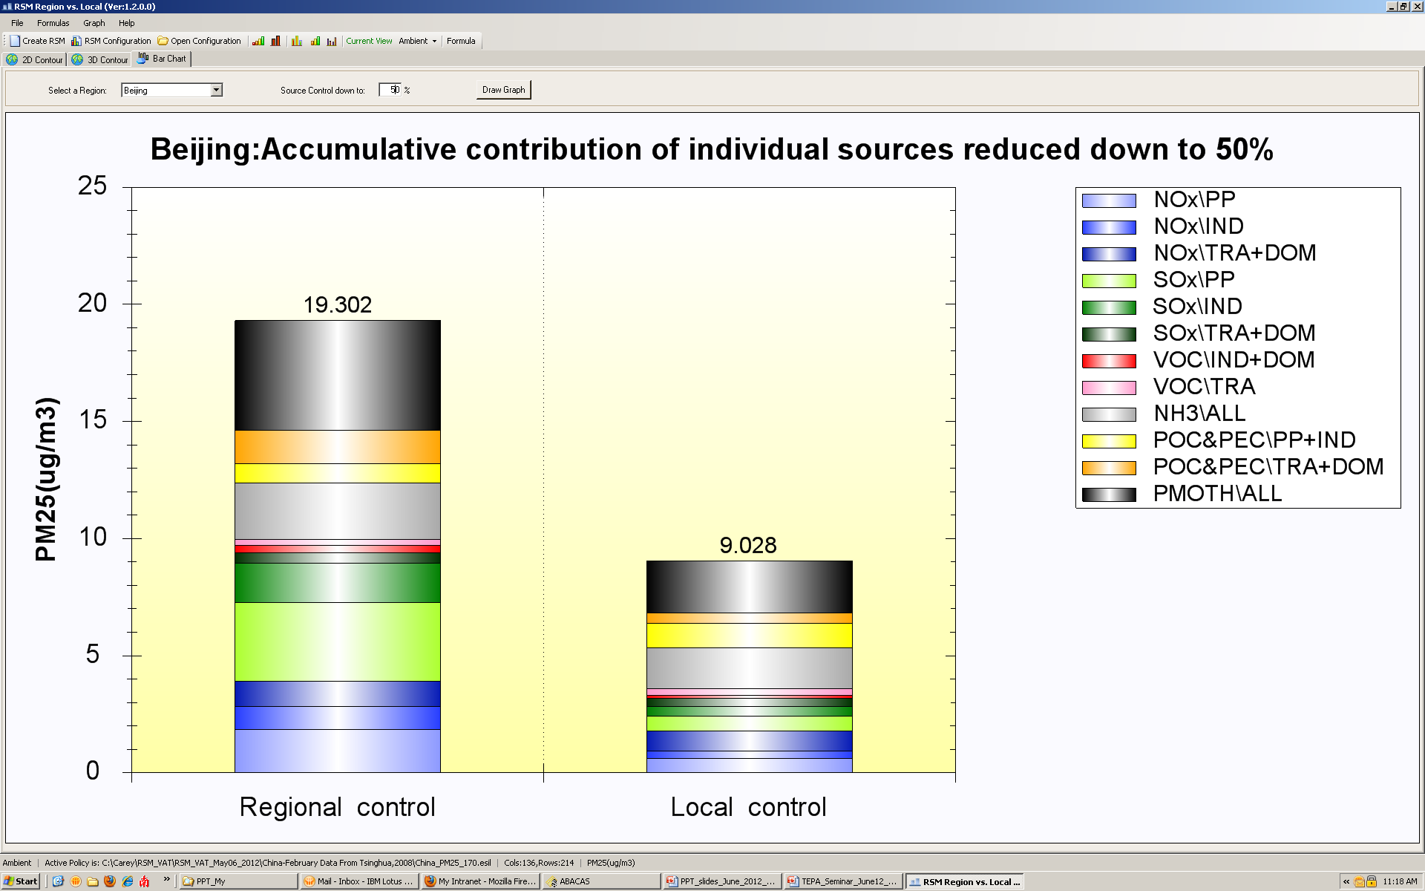
RSM/CMAQ Application in East China
Emission Source groupings
China RSM
Control
Base
Control
Policy
Factor
PP: Power Plant IND: Industry
TRA: Transportation DOM: Domestic
50% reduction of SO2, NOx & PM
Regional control
Regional contribution of PM2.5 can be more important than
local contribution in Beijing
Local control
Beijing
PM2.5
(1) Wang et al., Env. Sci. & Tech., 2011; (2) Xing et al., ACP, 2011; (3) Zhao et al., submitted ES&T., 2014
Notes:
14

Slide 15
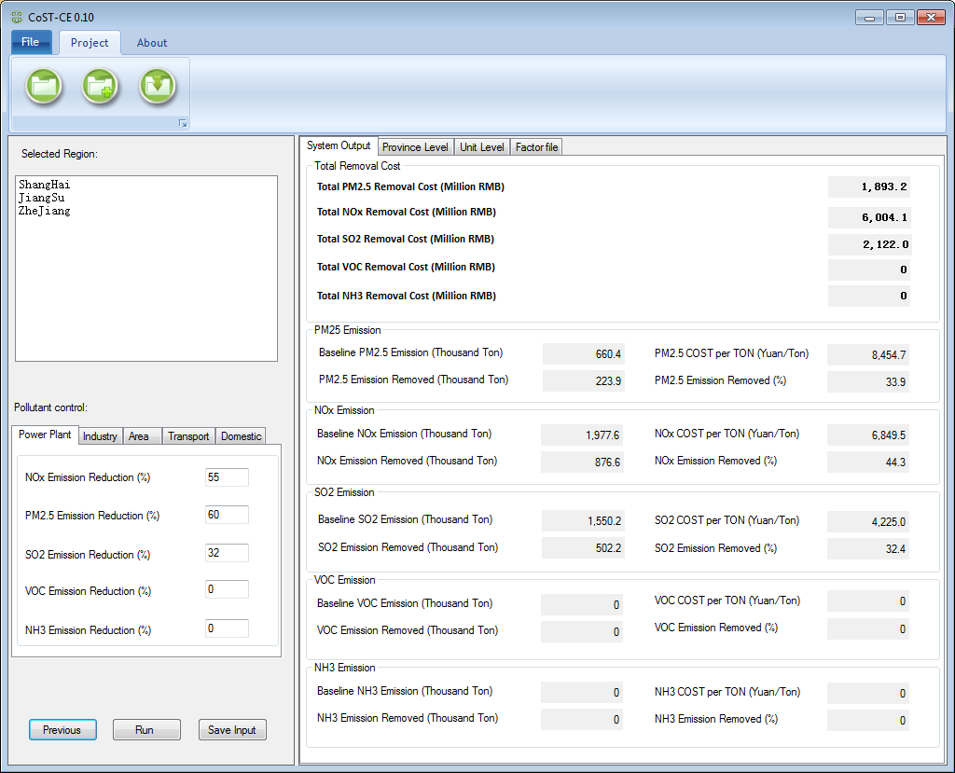
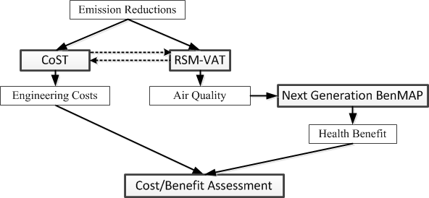
CoST-CE: Control Strategy Tool (Prototype)
China Pollution Abatement Cost Model
CoST-CE
(2014-2015)
Database & Optimization Model
Provide Control Cost Analysis and Estimate : A prototype under development to give an estimate of control cost and link to RSM/CMAQ & BenMAP for cost/benefit assessment
Notes:
Comment: This is an important slide, but needs to be improved. Consider to use animations to highlight the key features & differences

Slide 16
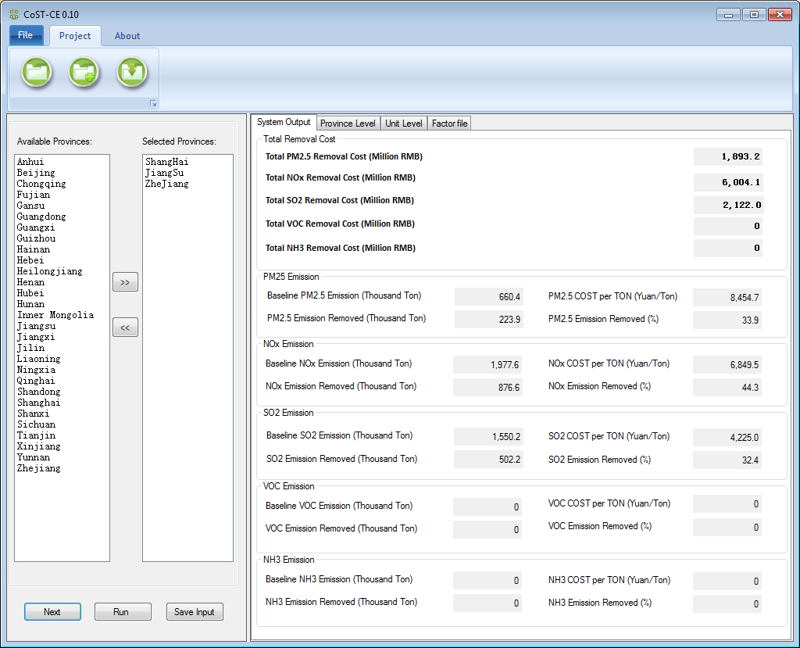
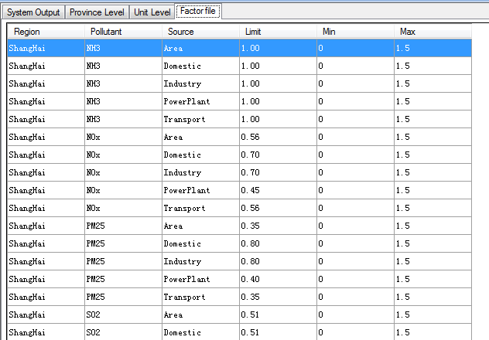
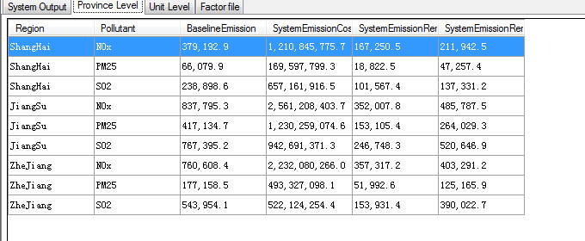
CoST-CE: Prototype
Selections of regions,
pollutants, and technology
Calculations of
control cost & analysis

Slide 17
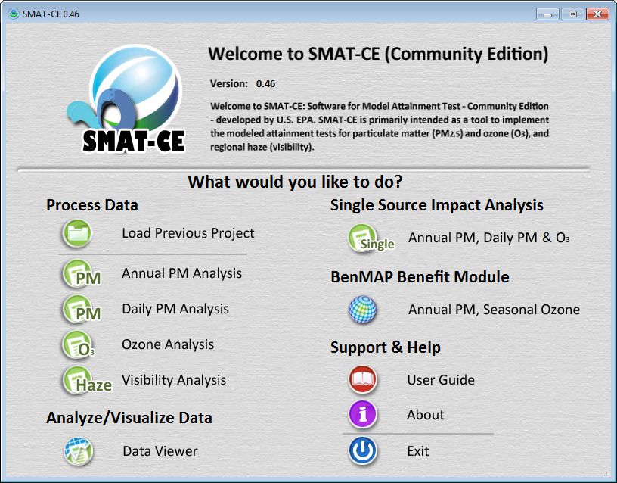
SMAT-CE: Software for Model Attainment Test
SMAT-CE
(Community Edition)
(2013-2015)
Developed by U.S.EPA and international “ABaCAS” team to perform attainment assessment for EPA’s national rules and/or SIPs on PM2.5, O3, and visibility
Notes:
Comment: This is an important slide, but needs to be improved. Consider to use animations to highlight the key features & differences

Slide 18
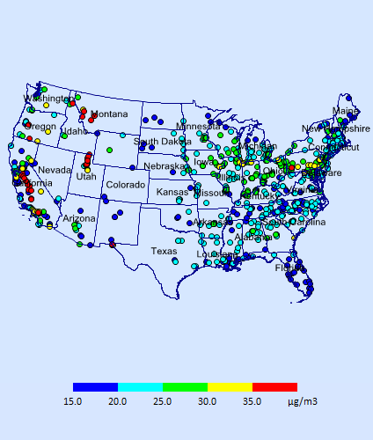
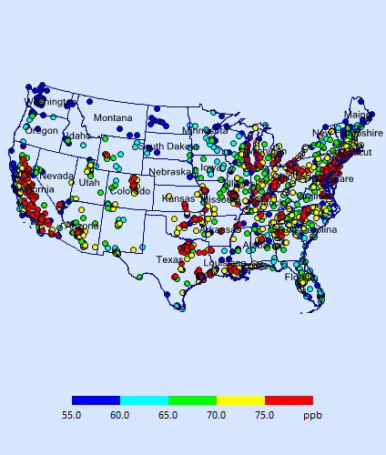
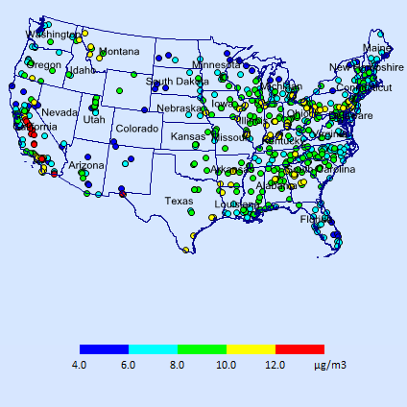
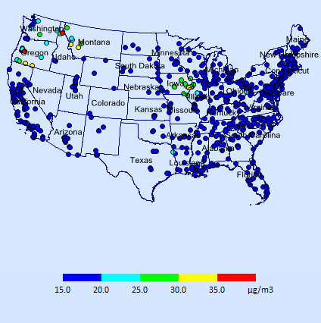
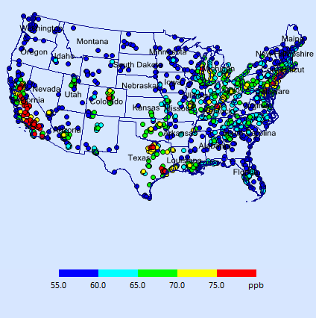
SMAT-CE: Attainment Test (U.S.A)
Annual PM2.5
(12 ug/m³)
Daily PM2.5
(35 ug/m³)
Ozone
(75 ppb, MD8hr)
> 12 ug/m³ (non-attainment)
> 35 ug/m³ (non-attainment)
> 75 ppb (non-attainment)
2011
2011
2011
2018
2018
2018

Slide 19
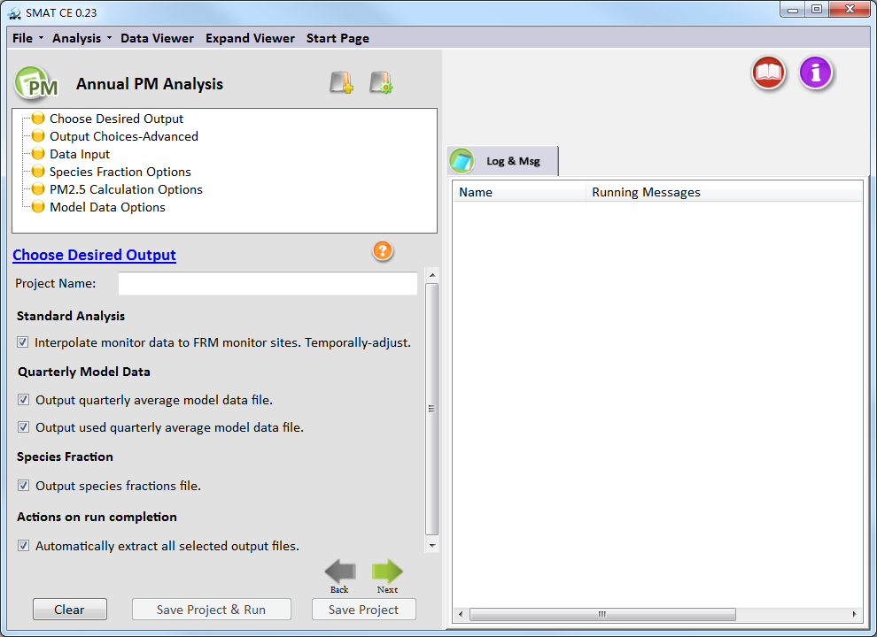

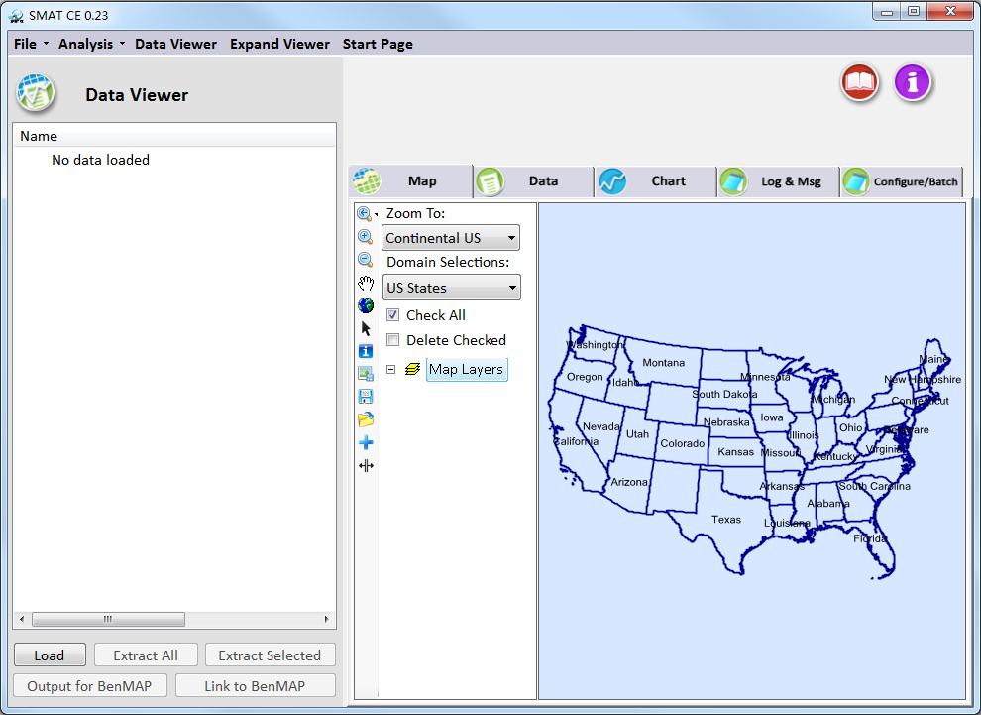

SMAT-CE: Status/Progress
    Software for Model Attainment Test- Community Edition
    Fully functional for annual & daily PM2.5, O3, visibility attainment test
    Open-source program with user-friendly framework & GUI
    Increased computational efficiency by 2~3 times faster than MATS
    Developed “Data Viewer” w/ GIS mapping/data analysis capabilities
    Developed a pilot “SMAT-Asia” module
    Developed (1) “BenMAP” benefit module and (2) “Single Source Impact Analysis” (SSIA) module
User-Friendly GUI framework
Streamlining operations & reports

Slide 20
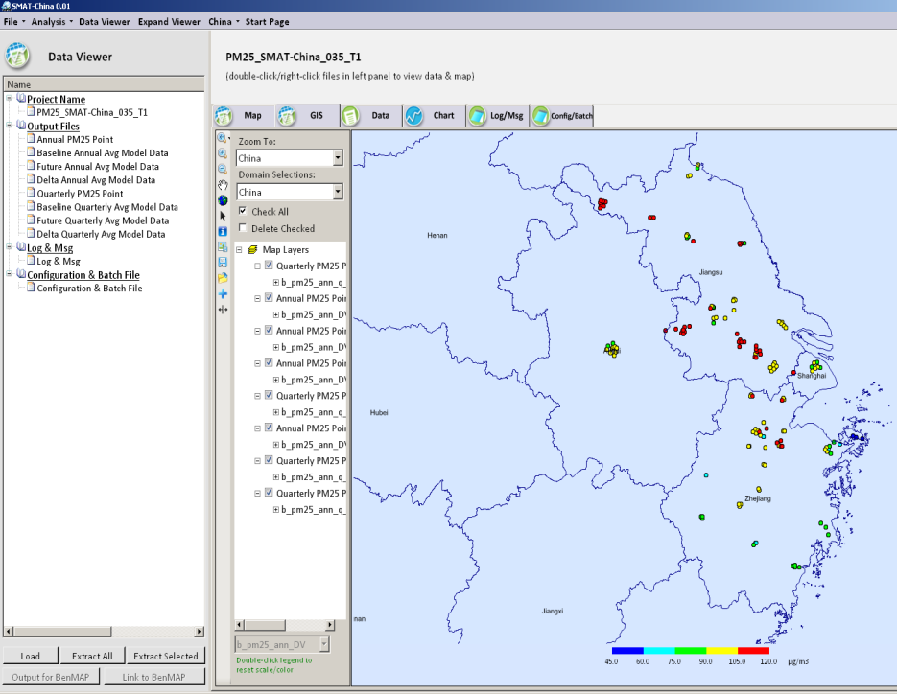
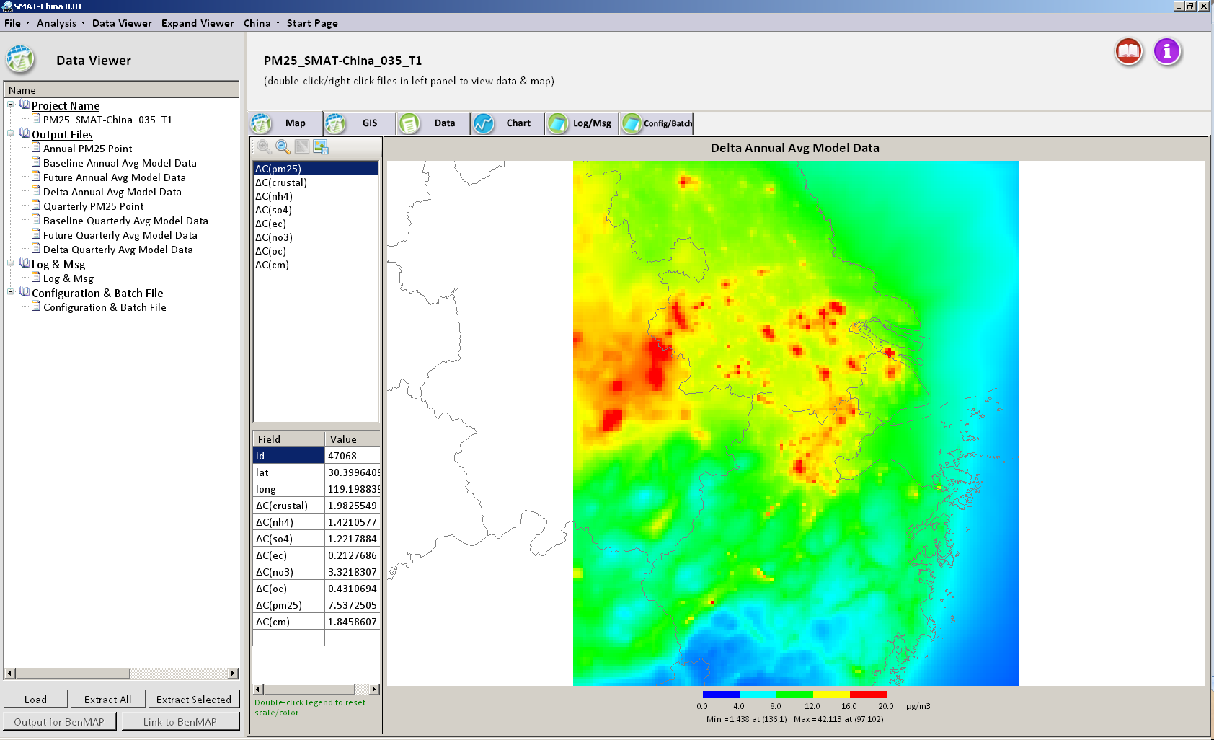
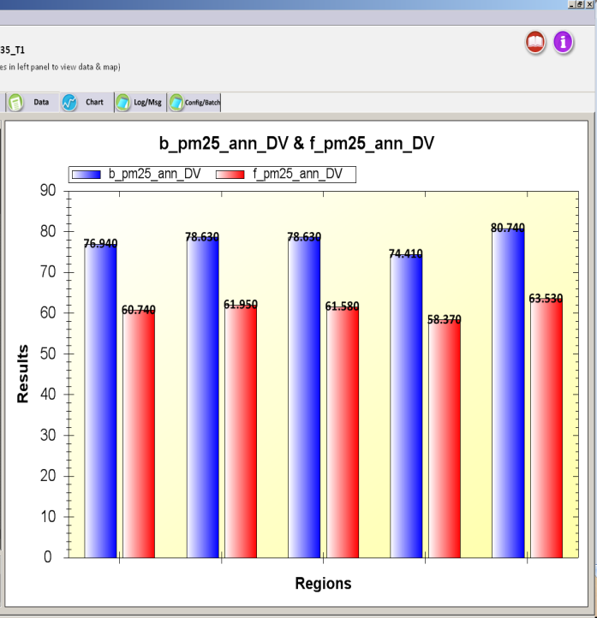
“SMAT-Asia” Prototype Development
“SMAT-Asia”: a customized version for Asia based on “SMAT-CE”
Modified GUI & data inputs/functions to accommodate different monitor data structure & technologies in Asia (e.g., optional PM2.5 species)
USA
|
USA
China
Taiwan
China YRD/Shanghai Pilot Study
Monitor Data
Model Data
Attainment Test
Shanghai
Shanghai

Slide 21
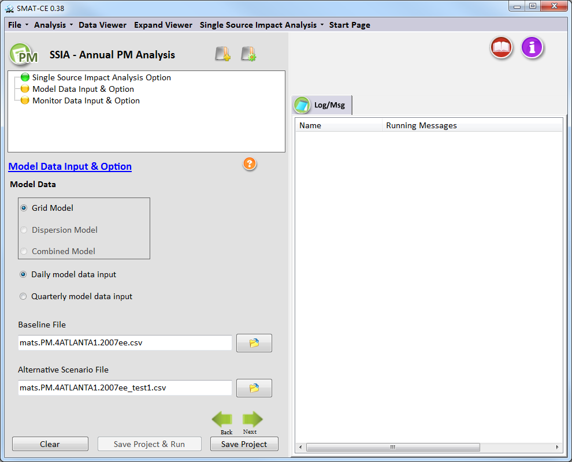
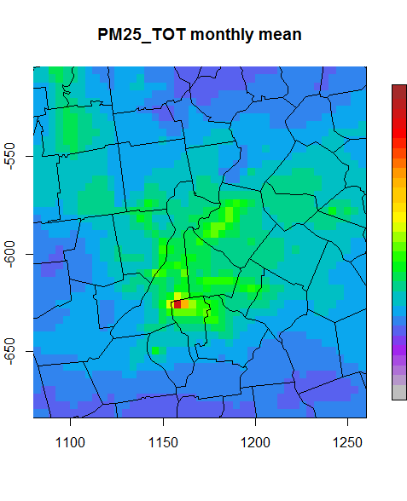
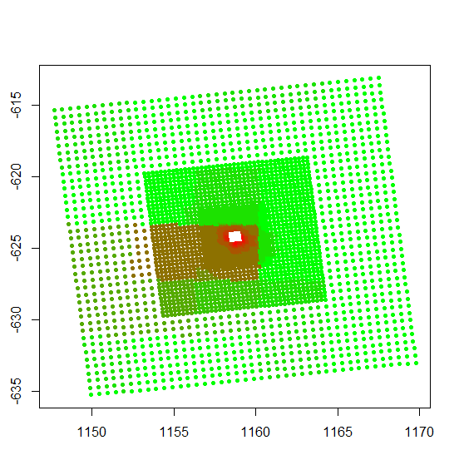
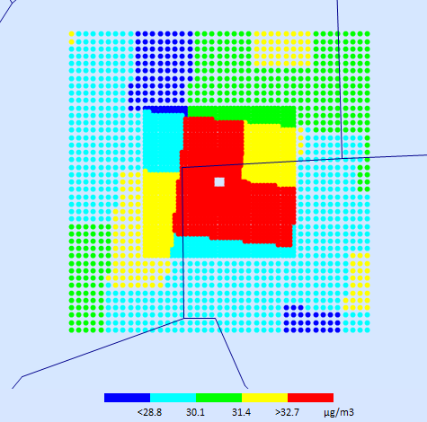
  Single-Source Impact Analysis (SSIA) in SMAT-CE
    Feature:
    Fuse results of “Dispersion” (e.g., AERMOD) & “Grid ” (e.g., CMAQ) model
  1. “Dispersion Model”:
    Provide SSIA of Primary PM2.5
    (local or near-source impact)
  2. “Grid Model”:
    Provide SSIA of Secondary PM2.5
    (regional or downwind impact)
Grid
(CMAQ)
Dispersion (AERMOD)
Fused
Example of fused results of
“Dispersion Model” (AERMOD) and
“Grid Model” (CMAQ)

Slide 22
“ABaCAS”: Air Benefit and Cost & Attainment Assessment System
An Integrated AQ Decision Support & Assessment System
Developed for “Scientists” and “Policy Makers”

Slide 23
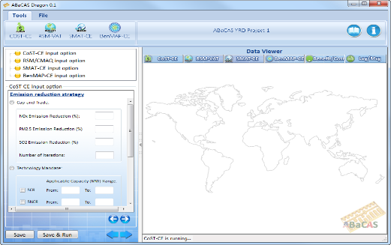

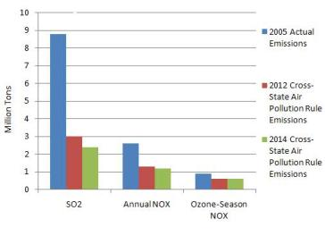

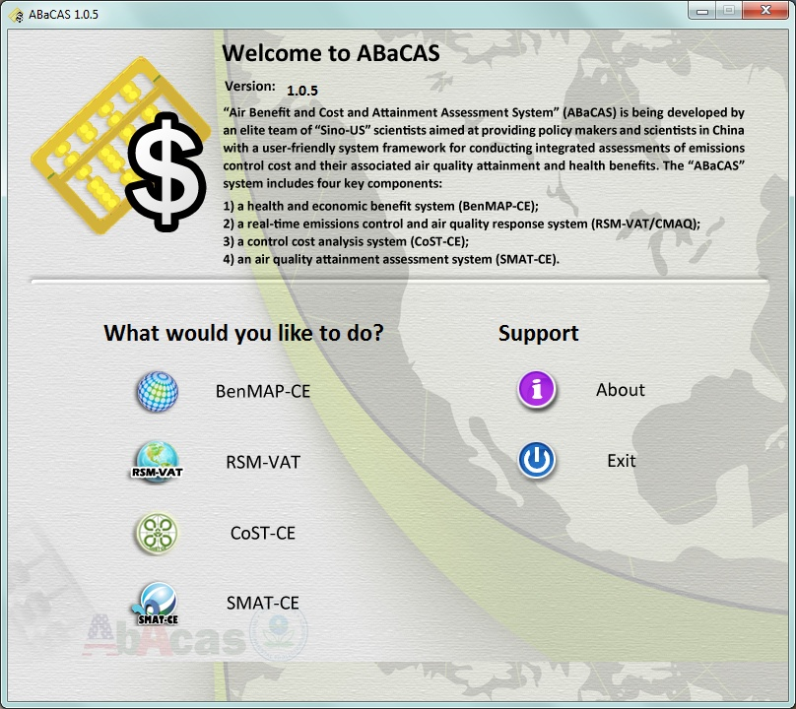


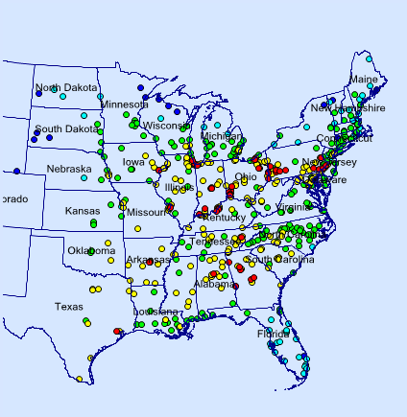

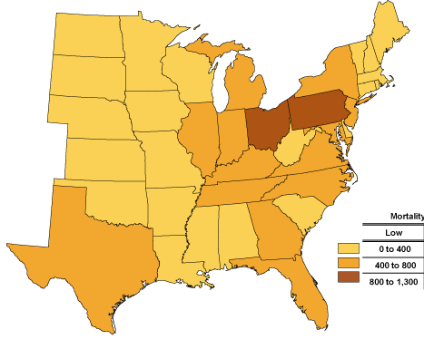
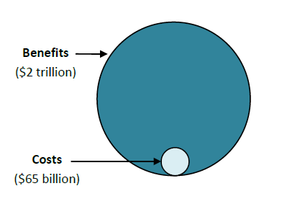
“ABaCAS-SE ” (Streamlined Edition”)
(Prototype: 2014-2015)
Standalone ABaCAS
(Scientists)
Streamlined ABaCAS
(Policy-Makers)
ABaCAS-SE
ABaCAS Master Script
Cost ($$)
CoST-CE
CoST-CE script
AQ Benefit (ug/m³)
RSM-VAT
RSM-VAT script
> 12 ug/m³ (non-attainment)
SMAT-CE
SMAT-CE script
Attainment (DVs)
BenMAP-CE
BenMAP-CE script
BenMAP-CE
Health Benefit ($$)
Benefit ($$)/Cost ($$)
Notes:
spatial field: A Spatial Field refers to air pollution estimates made at the center of each grid cell in a specified modeling domain. For example, MATS might calculate ozone design values for each grid cell in the modeling domain. Several types of Spatial Fields can be calculated for ozone and PM.
利用环境监测数据、模型数据（主要是CMAQ模拟的结果）作为模型输入，并利用优化的数理统计技术对大气复合污染状况进行模拟，实现对环境空气质量标准的达标评估。其中包括point estimate和spatial field estimate。

Slide 24
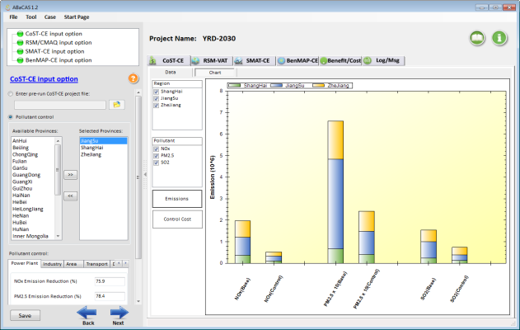


ABaCAS-SE：China YRD Case Study
National AP Control Plan
Region | Annual PM_{2.5}
JJJ/Beijing | 25% ↓
YRD/Shanghai | 20% ↓
PRD/Guangzhou | 15% ↓
Beijing | 60 ug/m³
Other major cities (333 个) | 10% ↓ (PM₁₀)
CoST-CE
Emissions Control & Cost
RSM/CMAQ
AQ Response to Emission Control
AQ Attainment in YRD:
2017: PM2.5 20% ↓
2030: Attain China NAAQS
SMAT-CE
AQ Attainment
BenMAP-CE
Health and Economic Benefits
(PI: Prof. Shuxiao WANG, Tsinghua Univ., 2015)

Slide 25









“ABaCAS-SE” (Streamlined Edition, 2014-2015):: Developed for Policy-Making and Analysis
ABaCAS-SE “YRD 2017 case”:
5~10 minutes to complete a run
ABaCAS-SE

Slide 26

”CoST-CE” in “ABaCAS-SE”
YRD 2017 Case Study

Slide 27


”CoST-CE” in “ABaCAS-SE”: Emissions & Cost
YRD: Base vs. Control (2010 vs. 2017)

Slide 28

”RSM/CMAQ” in “ABaCAS-SE”: PM2.5
YRD: Base vs. Control (2010 vs. 2017)

Slide 29


”RSM/CMAQ” in “ABaCAS-SE”: PM2.5
YRD: Base vs. Control (2010 vs. 2017)

Slide 30

”RSM/CMAQ” in “ABaCAS-SE”
YRD 2017 case: PM2.5 Source Contribution

Slide 31


”SMAT-CE” in “ABaCAS-SE”: PM2.5 Attainment
YRD Base vs. Control (2013 vs. 2017)

Slide 32
”SMAT-CE” in “ABaCAS-SE”: PM2.5 Attainment
YRD Base vs. Control (2013 vs. 2017)

Slide 33


”SMAT-CE” in “ABaCAS-SE”
YRD 2017 case: PM2.5 Attainment (Reduction)

Slide 34


”BenMAP-CE” in “ABaCAS-SE”
YRD 2017 Case: Mortality (Lives Saved)
”BenMAP-CE” in “ABaCAS-SE”
YRD 2017 Case: Valuation ($$ Saved)

Slide 35


”BenMAP-CE” in “ABaCAS-SE”
YRD 2017 Case: Mortality (Lives Saved)
”BenMAP-CE” in “ABaCAS-SE”
YRD 2017 Case: Valuation ($$ Saved)

Slide 36


”Benefit/Cost” in “ABaCAS-SE”
YRD 2017 Case: Benefit/Cost Analysis (Ratio=~11)

Slide 37

YRD 2030 Case Study
(“CoST-CE” in ABaCAS-SE)

Slide 38


YRD 2030 Case Study (ABaCAS-SE)
RSM/CMAQ
(5~10 minutes to run)
SMAT-CE
BenMAP-CE
Benefit/Cost =~ 9

Slide 39



“ABaCAS”
Website
(abacas-dss.com)
“ABaCAS”
System Package
(free download)
“ABaCAS”
System Overview

Slide 40
Next Steps & Work Plan
Continue to upgrade/improve ABaCAS system and sub tools and expand international applications
Develop a pilot “ABaCAS-SE” study in a selected U.S. region
Incorporate “Extended RSM” (ERSM/CMAQ) into RSM-VAT
Develop an international control strategy tool (iCoST) linking to RSM/CMAQ & a “climate co-benefit” module
Develop a “Model-VAT” tool to provide multi-model, multi-scale data visualization and analysis
Develop a standalone “Data Fusion” (DF) tool to fuse monitoring and model data (spatial field)
Initiate ABaCAS pilot projects for PM2.5 & O3 assessment in Asia (Thailand, Philippines, South Korea, Taiwan, etc.)
Plan to provide ABaCAS training workshops in Asia (December 2015 in Bangkok & June 2016 in Shanghai)
PM 2.5
O3
Emission Control
Health & Economic
Benefit
Air Quality Attainment
Notes:
Comment: This is an important slide, but needs to be improved. Consider to use animations to highlight the key features & differences

Slide 41


ABacAS Demo Booth
USEPA/Office of Air Quality Planning & Standards
Univ. of North Carolina – Institute of Environment
Notes:
Because of the limited time, we can not introduce all. Some slides are listed behind as appendix. ///(forward and back)here it is/// Thanks for your attention; and thanks very much for the EPA team’s help again.

Slide 42
Blue Skies for our Children !
THANK YOU! 谢谢!
Carey Jang, U.S. EPA, Jang.carey@epa.gov

Slide 43







ABaCAS Applications in Taiwan
Control Cost & Analysis
S-1 | Control-1 | Cost-1 | Health-1
S-2 | Control-2 | Cost-2 | Health-2
. . . | . . . | . . . | . . .
TECAS
Emissions control cost & strategies
ABaCAS-Taiwan
Emissions scenarios & strategies
Health & Economic benefit
Real-time AQ response to emission changes
Health & economic benefit using local data
AQ
assessment
RSM/CMAQ
BenMAP-CE
PI:
Prof. H.C. Lai,
Chang Jung C. Univ.

Slide 44
ABaCAS-SE
Cost/Benefit
Attainment
CoST
SMAT
BenMAP
Emissions
Control & Cost
RSM/CMAQ
Health/Economic Benefit
AQ Benefit
$$ (cost)
AQ (benefit)
$$ (benefit)
Tons (emis)
Tons (emis)
AQ (benefit)
AQ (benefit)
$$ (benefit)
$$ (cost)
$$ (cost)
“abacas-dss.com”

Slide 45




Slide 46


“ABaCAS” Team
USA:
  EPA: Carey Jang, Dale Evarts, Jeremy Schreifels, Scott Voorhees, Charles Fulcher, Neal Fann, Brian Timin, Kirk Baker, Tyler Fox, etc.
  UNC-IE: Adel Hanna, Limei Ran, etc.
  Univ. of Tennessee: Joshua Fu, Xinyi Dong, Jian Sun, etc.
International:
  Tsinghua Univ.: HAO Jiming, WANG Shuxiao, WU Yue, etc.
  South China Univ. of Technology: YE Daiqi, ZHU Yun, XIE Junping, etc.
  Zhejiang Univ.: CEN Kefa, GAO Xiang, LUO Kun, CHEN Linghong, etc.
  Sponsors/Partners: Energy Foundation, Clean Air Alliance of China, Clean Air Asia, etc.

Slide 47
Summary
Effective AQ management requires scientifically sound assessment tools for supporting and attaining AQ goals
“ABaCAS” can serve as a key decision support community tool for air pollution cost/benefit and attainment assessment in Asia
Need to work closely together with Asian scientists and policy makers to lead to a successful application for AQ attainment in Asia
PM 2.5
O3
Emission Control
Health & Economic.
Benefit
Air Quality Attainment
Notes:
Comment: This is an important slide, but needs to be improved. Consider to use animations to highlight the key features & differences

Slide 48

Work Plan (2015-2016)
New PM2.5 standards and attainment requirements provide a unique opportunity for “ABaCAS-SE” and “SMAT-CE” applications in Asia
Propose to expand pilot projects for “ABaCAS-SE” and “SMAT-CE” applications for PM2.5 (& O3) attainment assessment in Asia (Taiwan, Thailand, South Korea, etc.)
Plan to provide ABaCAS training workshops in Asia (likely mid December 2015 in Bangkok)
PM 2.5
O3
Notes:
Comment: This is an important slide, but needs to be improved. Consider to use animations to highlight the key features & differences

