Slide 1
Co-benefits of energy efficiency for air quality and health effects in China’s cement industry Presenter: Shaohui Zhang, PhD candidate Co-­authors: Ernst Worrell, Wina Graus Copernicus Institute of Sustainable Development, Utrecht University The Netherlands

Slide 2
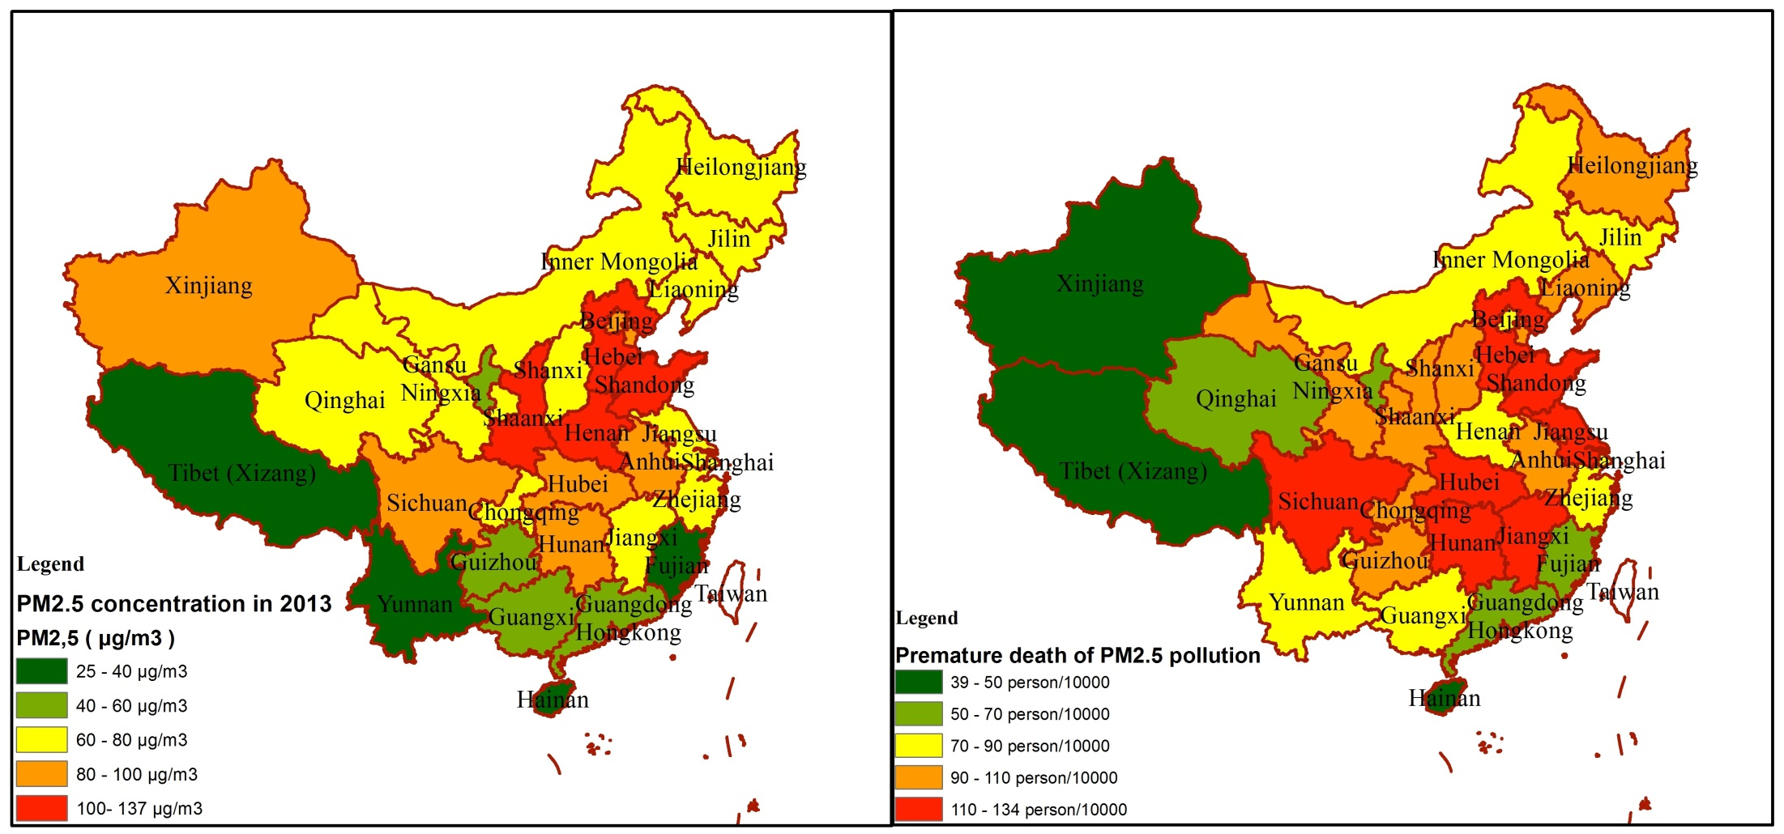
Introduction
In 2013, the China’s population-weighted average exposure to PM2.5 was 52 µg/m³, which led to about 1.6 million people dying per year (0.7-2.2 million death per year at 95% confidence rate) from heart and lung disease, account for 17% of total number of deaths.
Figure 1 China’s PM2.5 concentrations and premature death in 2013
Notes:
Micrograms/cubic meter
In China, the population-weighted average exposure to PM2.5 was 52 µg/m³, which led to about 1.6 million people dying per year (0.7-2.2 million death per year at 95% confidence rate) from heart, lung and stroke problems, account for 17% of total number of deaths in China [6]. In 2013 an estimated 257 thousand premature death in 31 Chinese capital cities could be linked to PM2.5 air pollution, which result in the excess mortality rate increased to 0.9‰.

Slide 3
Introduction
Nationally, the share of PM_{2.5} emissions from China’s cement industry contributed to 14% of the total emissions.
Figure 2 Cement contribution of Total PM2.5 emissions
Notes:
The cement industry contributed to above 40% of total PM_{2.5} emissions were found in three Provinces (Hunan, Guangxi, and Fujian), followed by Qinghai (39%), Chongqing (37%), and Jiangxi (36%), respectively. Cities of Beijing, Tianjin, and Shanghai, have lowest contribution of total emissions, account for 2.25%, 0.62% and 0.03% respectively

Slide 4
Why the China’s cement industry?
Introduction
As the largest cement market in the world, China’s share in cement production amounted to 59% by 2012.
The energy consumption of China’s cement industry accounted for 7% of Chinese total energy consumption.
China’s cement industry, as the second largest CO2 emitter, accounts for 7% of total emissions in China.
As a major emitter of air pollutants, the Chinese cement industry contributed to around 14% of national PM2.5 emission, 4% of SO2 emission, and 10% of NOx emission.
Objective:
assess co-benefits of energy savings and emission mitigation of air pollutants, as well as the environmental and health impacts of pollution arising from China’s cement industry at the provincial level during the period 2011-2030
Notes:
Efforts to quantify co-benefit of energy efficiency measures and emission mitigation have been fewer than those attempted to analyze them separately, while the synergies between policies to address energy efficiency and air pollutant emissions mitigation have been neglected by policy makers

Slide 5
Background
The total production of cement increased rapidly from 210 Mt in 1990 to 2210 Mt in 2012. The cement produced from dry process increased from 6% of total cement production in 1990 to 92% in 2012.
Figure 3 Historical cement production in China between 1990-2012
Notes:
The total production of clinker increased from 157 Mt in 1990 to 1278 Mt in 2012,
The new suspension preheater/precalciner (NSP) kilns has seen rapid developments in the last decade due to fast economic growth and government policy.

Slide 6
Background
The total amount of energy consumption of China’s cement industry increased about 6 times from 1200 PJ to 6961 PJ in 2011, while the air pollution have a fluctuate shape during the period.
Figure 4 Historical energy consumption (top) and air pollution (down) in China’s cement industry
Notes:
The total amount of energy consumption of China’s cement industry increased about 6 times from 1200 PJ to 6961 PJ in 2011, which equals 7% of Chinese total energy consumption
The annual growth rate of energy consumption was 8.7% between 1990 and 2011, lower than the annual growth rate of cement production, which was 11.6% during this period.
the Chinese cement industry contributed to around 15%-27% of national PM emission, 3%-4% of SO₂ emission, and 8%-12% of NOx emission
the PM emission decreased steadily from 8,09 Mt in 2000 to 4,10 Mt in 2010, at an average rate of 6.6% per year;
The PM emission intensities declined from 13.64 in 2000 to 2.20 kg per ton of cement over this period
SO₂ emission remained relatively stable, due to the sharp decline of SO₂ emission intensities (from 1.69 in 2000 to 0.60 kg per ton cement in 2010)
The expansion of the cement industry during the last decades led to a corresponding increase in emissions of NOx from 0.57 Mt in 2000 to 2.27 Mt in 2010.

Slide 7
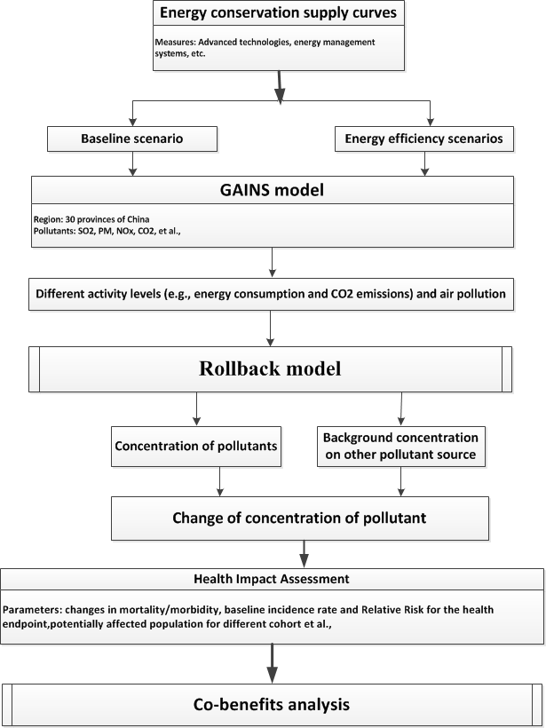
Material and method-framework
Figure 5 The framework of co-benefits assessment in China’s cement industry
Notes:
This figure shows the framework of co-benefits assessment in China’s cement industry.
The time period in this study covers 2010 to 2030, with 2010 as the base year.

Slide 8
Scenario design
Item | Scenario Description
BL | The annual autonomous energy efficiency improvements (AEEI) of each process are 0.2%.
EEPCP | Energy efficiency measures below 0 $/GJ (represents economically feasible opportunities)
EEPTP
 | 37 energy efficiency measures will be implemented.
Figure 6 Key features of different scenarios
Notes:
The EEP1 scenario represents the cost-effective potential for energy efficiency improvement in China’s cement industry. In this scenario, 24 cost-effective energy efficiency measures will be implemented with the projected implementation rates.
For all scenarios, we assume that the discount rate, energy prices, cement and clinker production level and fuel structures are the same.

Slide 9
Material and method-Energy model
Energy conservation supply curves are a standard policy tool to analyse potentials of energy saving by implementing energy efficiency measures
$$CCE=\frac{I×AF+{O \& M}^{Fix}+{O \& M}^{Var}−ESP×PE}{ESP} Equation 1$$
Where:
CCE= Cost of conserved energy ( $/GJ);
I= Investment ($);
AF= Annuity factor;
ESP= Annual energy saving potential (GJ)
${O \& M}^{Fix}$= Annual change in operation and maintenance fixed cost ($);
${O \& M}^{Var}$= Annual change in operation and maintenance variable cost ($);;
PE= Future energy price ($/GJ).
$$AF=\frac{d}{\left(1−{\left(1+d\right)}^{−n}\right)} Equation 2$$
Where:
d= Discount rate (10%);
n= Lifetime of the energy efficiency measures
Notes:
The implementation rate of each energy efficiency measure in the base year was defined based on these studies and potential implementation rates of those measures were defined using a linear deployment approach

Slide 10
Material and method-GAINS
The Greenhouse Gas and Air Pollution Interactions and Synergies (GAINS) model, developed by IIASA, is an integrated assessment model dealing with costs and potentials for air pollution control and greenhouse gas (GHG) mitigation, and assessing interactions. The current GAINS version includes the following emission impacts:
 | PM (BC, OC) |  | SO₂ | NO_{x} | VOC | NH₃ | CO | CO₂ | CH₄ | N₂O | HFCs PFCs SF₆
Health impacts: PM (Loss in life expectancy) | √ | √ |  | √ | √ | √
O₃ (Premature mortality) |  |  |  | √ | √ |  | √ |  | √
Vegetation damage: O₃ (AOT40/fluxes) |  |  |  | √ | √ |  | √ |  | √
Acidification (Excess of critical loads) |  | √ |  | √ |  | √
Eutrophication (Excess of critical loads) |  |  |  | √ |  | √
Climate impacts: Long-term (GWP100) |  |  |  |  |  |  |  | √ | √ | √ | √
Near-term forcing (in Europe and global mean forcing) | √ | √ |  | √ | √ | √ | √
Black carbon deposition to the arctic | √

Slide 11
Material and method-GAINS
The emissions of air pollutants and greenhouse gases are calculated from:
$$E_{p}=\sum_{k}{\sum_{m}{A_{k}{ef}_{k,m,p}x_{k,m,p Equation 3}}}$$
k, m, p= activity type, abatement measure, pollutant, respectively
$E_{p}$= Emissions of pollutant p (for e.g. SO₂, PM2.5, CO₂, PM10, PM_{TSP}, etc.)
$A_{k}$= Energy consumption of each fuel (e.g., coal consumption) in iron and steel industry
${ef}_{k,m,p}$= Emission factor of pollutant p for activity k after application of control measure m
$x_{k,m,p}$= Share of total activity of type k to which a control measure m for pollutant p is applied
The unit cost of end-of-pipe measures (cn) is calculated through the Equation 4:
$$cn={(\frac{I×AF+{OM}^{Fix}}{A}+{OM}^{Var})}/{(ef−{ef}_{m})} Equation 4$$
cn= unit cost of end-of-pipe measures
A= Activity
ef= uncontrolled emission factor
${ef}_{m}$=controlled emission factor under end-of-pipe measures

Slide 12
Material and method-Rollback model
The annual mean concentration of PM2.5 with changes in emissions were calculated based on the rollback model, which represents the relationship between air pollutants emissions and annual PM2.5 concentration that can be extrapolated into the future.
$$∆C_{{PM}_{2.5}}=β∗∆E_{{PM}_{2.5}}$$
Where $∆C_{{PM}_{2.5}}$ is the changes of concentration; $β$ is the rollback coefficient- µg/m3 increase of PM2.5 concentration per ton of emissions
The rollback coefficient were estimated based on GAINS database.

Slide 13
Material and method-Health Impact Assessment
The population with above 30 ages in 2020 and 2030 are calculated by the follow functions:
$$P_{2020}=P_{2010, >30 ages}∗α_{2010, >30 ages}+P_{2010, 20−30 ages}∗α_{2010, 20−30 ages}$$
$$P_{2030}=P_{2020, >30 ages}∗α_{2010, >30 ages}+P_{2010, 10−20 ages}∗α_{2010, 10−20 ages}$$
Where P is Population; $α$ is the mortality rate in 2010 for different cohorts
$$∆Y=α_{2010, >30 ages}∗\left(1−\frac{1}{{HR}^{∆C}}\right)P$$
Where $∆Y$ is the change of mortality/morbidity rate; $α_{2010, >30 ages}$is the mortality/morbidity rate of over 30 years of age cohort at the base year (2010); HR is the Hazard ratio for an increase in PM2.5 concentration of 10 μg/m³;$∆C$ is the changes of PM2.5 concentration under different scenarios; P is the affected population.
Cause of death | Hazard ratio (95% CI) | Baseline rates (‰)
All cause mortality | 1.07 (1.05-1.09) | 5.12
Cardiovascular disease (CVD) | 1.06 (1.12-1,11) | 2.55
Cardiopulmonary Disease | 1.09 (1.03-1.16) | 0.11
Ischemic heart disease (IHD) | 1.06 (0.99-1.14) | 1.09
Lung cancer disease | 1.10 (0.99-1.22) | 0.42

Slide 14
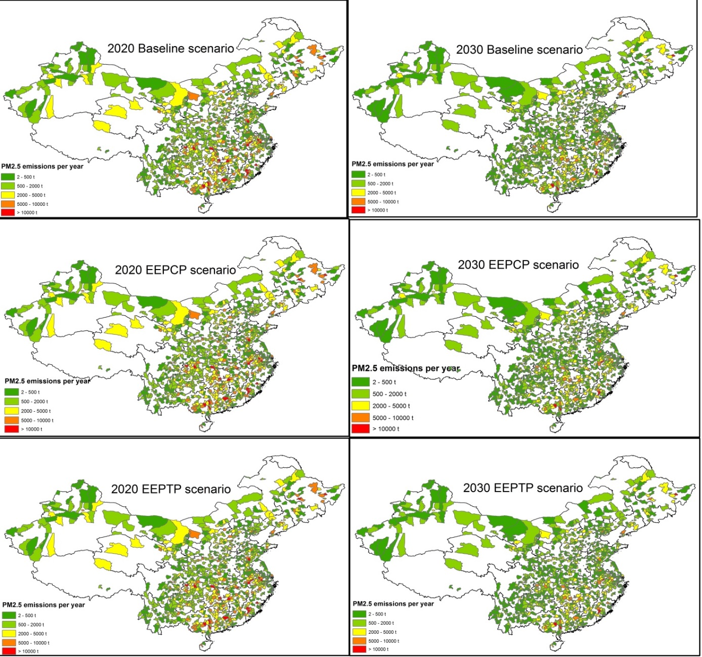
Results-PM2.5 emissions
The ancillary benefits in the EEPCP scenario may decrease 3% PM2.5 emissions, a further decrease of 1% of PM2.5 could be realized in EEPTP scenario.
The spatial distributions of the emissions abatement of PM2.5 are similar.
Four less developed regions contributed to 30% of total emissions.
the abatement of PM2.5 emissions from megacities in 2020 would be higher than that in 2030
Figure 7 PM2.5 emissions for the year 2020 and 2030
Notes:
less developed regions (Jiangsu, Shandong, Hebei, and Sichuan)

Slide 15
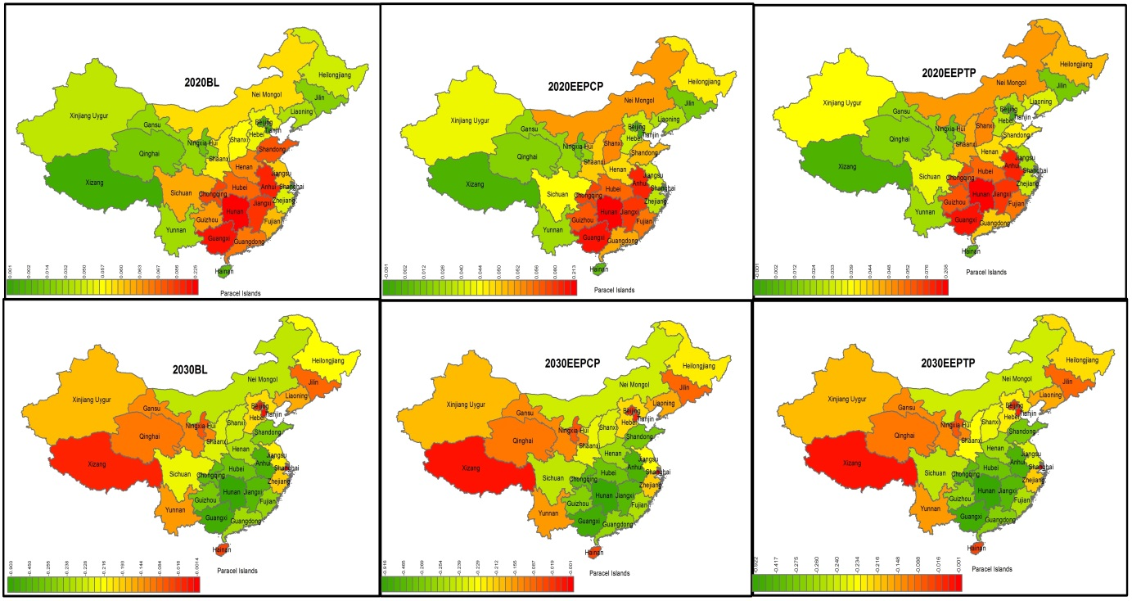
Results-PM2.5 concentrations
In BL scenario, the average annual PM2.5 concentrations across the countries would increase by 0.057 µg/m3 by 2020, and then decrease by 0.216 µg/m3 by 2030.
Figure 8 Changes of PM2.5 concentrations for the year 2020 and 2030, compared to 2010
Notes:
when compared to 2010. In EEPCP and EEPTP scenarios this level would increase by 0.049 and 0.046 µg/m3 by 2020, and then decrease by 0.225 and 0.229 µg/m3 by 2030, respectively.

Slide 16
Results-Health impacts
15% in 2020 and 5% premature deaths in 2030 under EEPCP scenario would be avoided, compared to baseline scenario.
If all energy efficiency measures were implemented, this level would further decrease by 7% by 2020 and 2% by 2030, respectively.
The PM2.5-related mortality increase in 2020 and then decrease in 2030 under all scenarios. 24451 premature deaths could be increased each year in 2020 and then 109431 premature deaths could be delayed each year in 2030.
Figure 9 Comparison of computed (avoided) premature deaths caused by PM2.5 for the year 2020 and 2030, compared to 2010

Slide 17
Results-Health impacts
In BL scenario, the number of morbidity cases increased by 10493 of CD, 693 of CVD, 2822 of LC, and 4485 of IHD, compared to 2010.
in EEPCP scenario, 1604 and 2433 of CVD, 106 and 162 of CD, 431 and 663 of LC, and 686 and 1040 of IHD can be avoided in 2020 and 2030 respectively, compared to the Baseline.
In EEPTP scenario, this level would further decrease by 7% in 2020 and 2% in 2030, respectively.
Figure 10 Comparison of computed health endpoints caused by PM2.5 for the year 2020 and 2030

Slide 18
Conlusions
Most energy efficiency measures are cost-effective even without considering co-benefits in terms of air pollutant emission reduction.
heterogeneity across provinces in terms of potential energy saving as well as emission mitigation of CO2 and air pollution in the next two decades.
Implementation of energy efficiency measures would decrease emissions of PM2.5 from the cement industry by 5%, reducing air quality-related premature deaths by 5.5 thousand cases in 2020 and 7.8 thousand cases in 2030.
Simultaneous planning of energy and air quality policies creates a possibility of increasing efficiency in both policy areas.

Slide 19
Thank You for your attention!
For Further Information contact:
Shaohui Zhang
s.zhang@uu.nl

