Slide 1
Evaluation of CMAQ Driven by Downscaled Historical Meteorological Fields
Karl Seltzer¹, Chris Nolte², Tanya Spero²,
Wyat Appel², Jia Xing²
14th Annual CMAS Conference, Chapel Hill, NC
7 October 2015
1: Nicholas School of the Environment, Duke University, Durham, NC
2: US Environmental Protection Agency, Research Triangle Park, Durham, NC
Notes:
Evaluation of CMAQ driven by downscaled historical meteorological fields

Slide 2
Motivation
EPA Strategic Goal: Addressing Climate Change and Improving Air Quality.
Is there additional bias introduced in air quality projections that are forced by dynamically downscaled meteorology?
Provide a baseline AQ evaluation for this downscaling framework
Determine if the framework is “acceptable” at predicting AQ.
Notes:
We are interested in the effects of global climate change on regional air quality in the U.S.
Our approach is to use the method of dynamical downscaling, in which coarse meteorological fields are used to drive regional-scale model. Ultimately, is additional model bias introduced to AQ simulations using this modeling framework? If so, what level of bias is added and are these levels of bias considered “acceptable”?

Slide 3
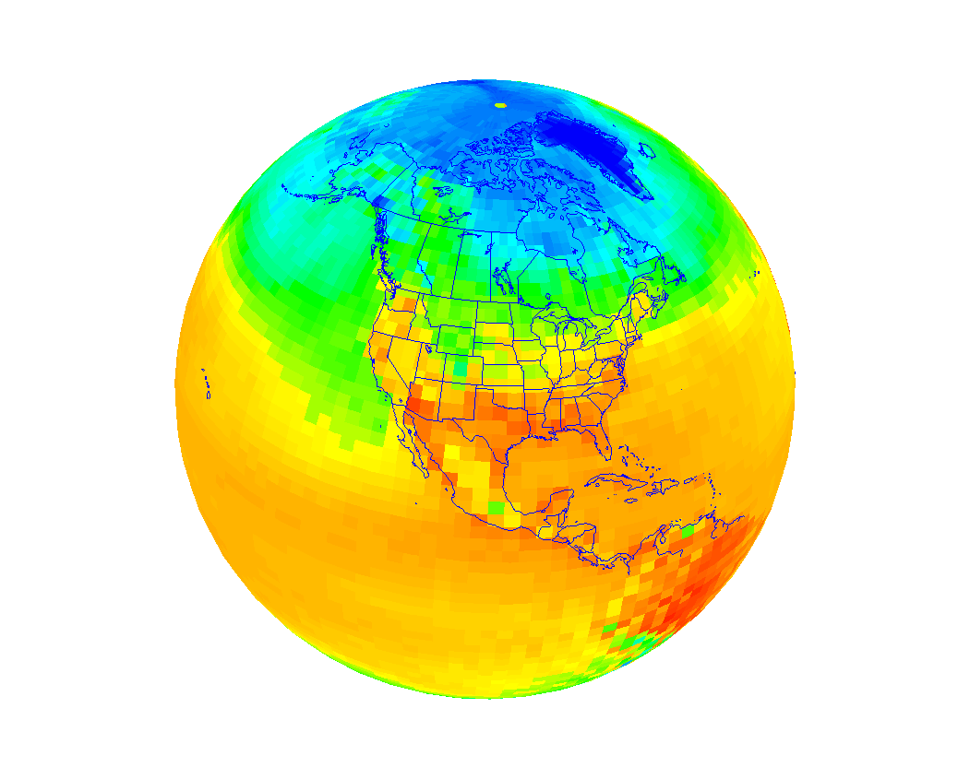
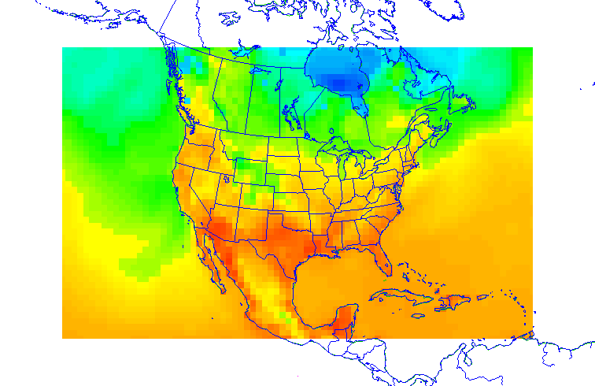
Meteorology Framework
Emulate downscaling for climate change, but use historical data so evaluation can occur.
Large-scale met from NCEP-DOE AMIP II (R2), 2.5° x 2.5°
Dynamical downscaling over CONUS
108-36-km WRF (two-way nested)
FDDA without observations
GCM
RCM
Notes:
It is challenging to evaluate the effect of using meteorology downscaled from a GCM for simulating air quality. This is because downscaling, which is a methodology used in future scenarios, does not have observational data to compare the model against. As such, we emulate downscaling a future climate scenario, but use historical coarse-scale meteorology and emissions so a model evaluation can occur using available observations.
Under this framework, the climate for our simulation period is assumed to be well represented by the GCM, since it is re-analysis data. However, the “weather of the day” features, which are simulated by a regional model, will be determined by dynamical downscaling.
This is done using WRF with a two-way nested domain over the CONUS.
What makes this framework unique from typical historical CMAQ model evaluations is two-fold:
Rather than forcing WRF using relatively fine-scale meteorological input, such as is available from NCEP's NAM, we instead use the (R2) reanalysis. [What is the resolution of NCEP’s NAM? – 40km ]
Secondly, we do not assimilate any additional observations to nudge WRF, because such observations are not available when downscaling a GCM. However, we do nudge toward the driving R2 fields

Slide 4
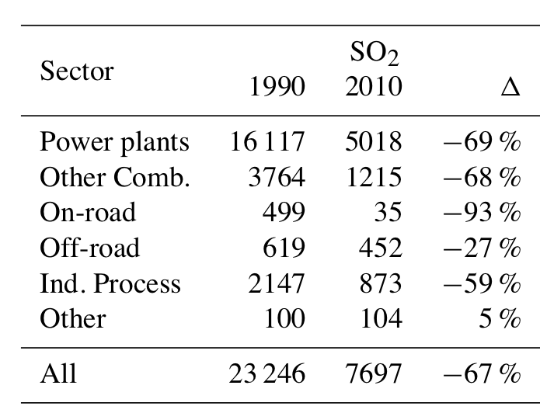
AQ Modeling Framework
AQ simulated using CMAQ v.5.0.2 for 2000–2010.
Xing et al., ACP, 2013
Xing et al., ACP, 2013
CMAQv5.0.2, CB05 Chemistry, AERO6 aerosol module, and online calculation of photolysis rates.
Initial and lateral boundary conditions originated from a 108-km NH CMAQ simulation (Xing et al., ACP, 2015)
Notes:
We use these downscaled regional meteorology with year-specific emissions and the boundary conditions from a CMAQ hemispheric simulation. Both of which were led by Jia Xing (pron- shing).
This emission inventory used activity data derived from the State Energy Data System and emission factors calculated back from NEI and constrained by AP-42 factors. Of notable interest from the modeling temporal period, which was 2000-2010, are the drastic reductions in many precursor emissions for ozone and fine particulate matter. For example, from 1990-2010, SO2 featured an approximate 67% reduction. While these drastic reductions are not a focus for this study, they do show some important characteristics of model response, which will be discussed later.

Slide 5
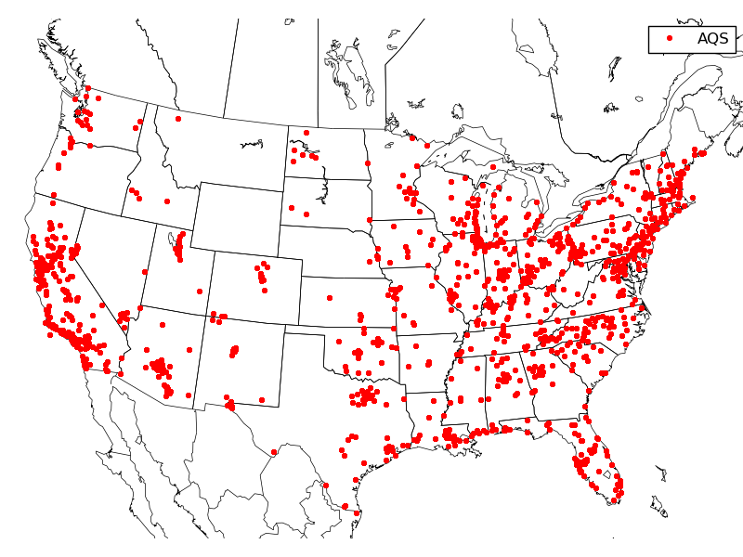
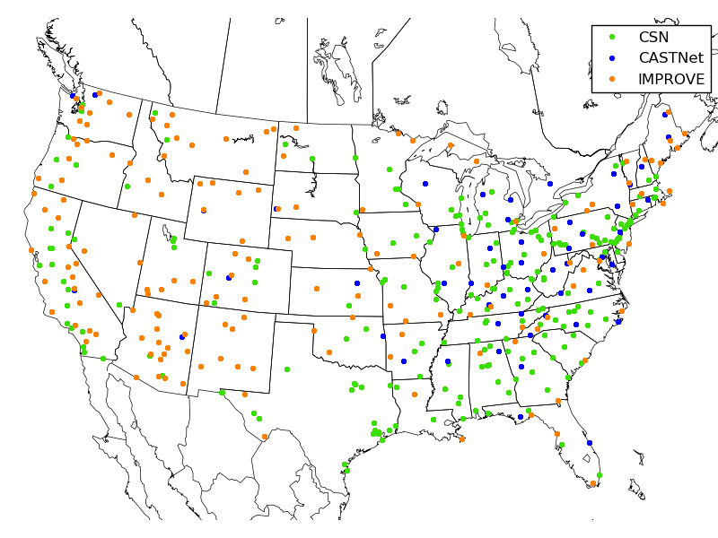
Observation Networks
Ozone
PM_{2.5}
CSN (Urban),
CASTNet (Rural), IMPROVE (Rural)
AQS Network:
National coverage
Notes:
Nation-wide, surface based observation networks were used in this evaluation. For ozone, this consisted of the AQS network and for fine particulate matter, 3 national networks were used. These include the Chemical Speciation Network (CSN), the Clean Air Status and Trends Network (CASTNet), and the Interagency Monitoring of Protected Visual Environments (IMPROVE) network.
One main point I would like to make is regarding the general level of urbanization for the PM2.5 networks. CSN is largely congregated on the coasts and is considered to be predominately in urban locations and the CASTNet and IMPROVE networks are considered to be in predominately rural locations.

Slide 6
O₃: Methods of Evaluation
Using the maximum daily 8-hr metric.
U.S. EPA modeling guidance for O₃: Thresholds.
60 ppb and 75 ppb
High frequency of low ozone concentrations
Greater relevance of higher values for determining NAAQS compliance → New 70 ppb standard!
Evaluation of modeled 8-h O₃ against AQS observations in comparison to results compiled by Simon et al. (AE, 2012).
Notes:
The methods of evaluation for ozone and fine particulate matter that were used were somewhat different. For ozone, this included the use of threshold values, in particular at 60 and 75 ppb. This was based on EPA ozone modeling evaluation guidance, which recommends thresholds to eliminate the high frequency of low ozone concentrations and to target values that are most relevant to NAAQS compliance.
In addition, results from previous studies were utilized to compare our results to. Fortunately, a paper from a few years back, Simon et al., compiled the regional modeling evaluation results from many publications between 2006-2012. As such, we were able to compare our results to the values from a somewhat large dataset.

Slide 7
PM_{2.5}: Methods of Evaluation
Boylan & Russell (2006) proposed a set of performance metrics for model evaluations.
Simon et al., AE, 2012
Boylan and Russell , AE, 2006
Notes:
For fine particulate matter and its components, widely used performance metrics proposed by Boylan and Russell for modeled mean fractional bias and mean fractional error were used. With these metrics, results from a model evaluation can fall within three calculated zones.
If the results in a given population dataset fall within Zone 1 on each of these charts, your model met the modeling goal, which is “is considered to be close to the best a model can be expected to achieve.” If the results fall within Zone 2, your model met the modeling criteria which means the model met “the level of accuracy that is considered to be acceptable for modeling applications.” If your data falls within Zone 3 then you meet neither of these definitions. As seen, each of these zones asymptotically increase as the average observed concentration approaches zero, giving the model more room for error as the values decrease.
As well, another evaluation method utilized the results published by Simon et al.

Slide 8
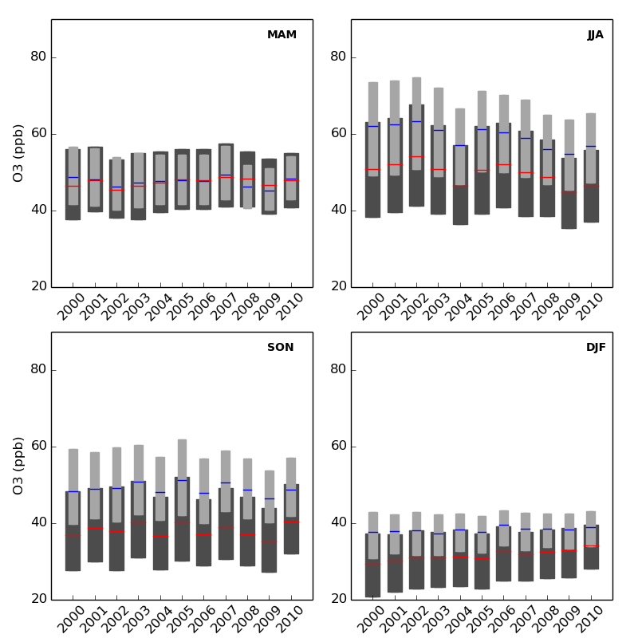
MDA8 O₃: CMAQ vs. AQS
Positive bias during summer and fall.
Captures decreasing 75th percentile during summer and increasing 25th percentile in winter.
Also captures interannual summer variability.
MAM
JJA
SON
DJF
Observed: Dark
Modeled: Light
Notes:
The initial ozone results indicate that the observation and model pairings are seasonal and did experience interannual changes throughout the temporal period. These boxplots are the interquartile range values for the observed (dark bar) and the modeling (light bar) results. Acknowledging that this is a lot of data, I’d like to point out a few things.
(1) Interannual trends are observed and modeled, as a result of the large decreases in precursor emissions. This includes a decrease in the 75th percentile during the summer months and an increase in the 25th percentile in the winter months. Both of these trends have also been reported in other studies.
(2) The magnitude of the different between the modeled and observed 25th percentile, 50th percentile, and 75th percentile values throughout this 11 year period shows very little variability. This long term trend indicates that the model and this framework are able to make consistent predictions of ozone, even in circumstances of vastly changing emissions. Since the modeling framework being targeted by this project is aimed for future settings, this indicates that as emissions continue to decrease, as predicted in the future, it is likely that this modeling framework should carry out stable levels of bias.

Slide 9
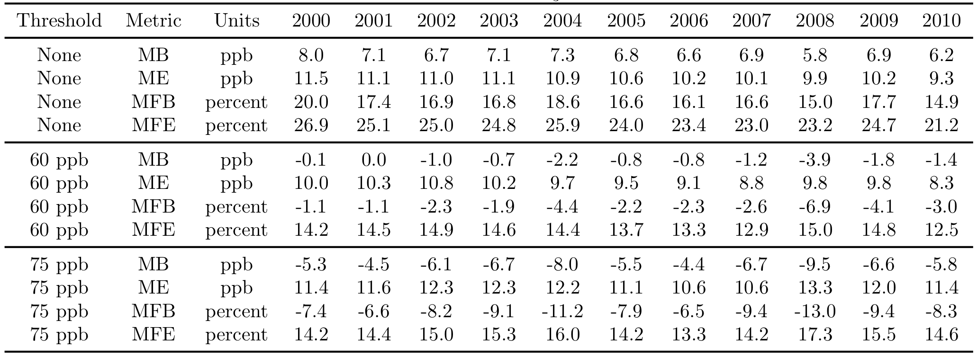
O₃ Evaluation w/ Thresholds
Lower absolute model bias in O₃ predictions after 60 ppb threshold applied.
Due to typically higher overall bias.
Without thresholds:
Simon et al., AE, 2012: IQR of O₃ for NMB and NME was approximately 0–8% and 15–22%, respectively.
This study: Yearly NMB and NME values ranged from 14–17% and 22–25%, respectively.
Notes:
When considering all values, positive bias of 6-8 ppb. Excluding values below 60 ppb, model is nearly unbiased (-1 -- 0 ppb). Excluding values below 75 ppb, negative bias of 5-7 ppb.
When evaluating the results against other published results, a few things are seen.
(1) When the complete dataset of ozone results are compared to other model evaluation results, these values are on the higher end of other results.
(2) However, after applying ozone thresholds, our results are statistically a bit better. For example, in Simon et al., after applying a 60 ppb and a 75 ppb threshold, the model bias drops to approximately -1 – 0 ppb and -5- -7 ppb, respectively. This improvement is due to the coupled fact that overall ozone bias is more positive in this framework that in other studies and that CMAQ tends to overpredict low ozone observations and underpredict high ozone observations.

Slide 10
PM_{2.5}: CMAQ vs. CSN/IMPROVE
JJA
JJA
Captures decreasing 75th percentile during winter at urban and changing trends in summer months.
DJF
DJF
Observed: Dark
Modeled: Light
CSN
IMPROVE
Notes:
The general seasonal and interannual results for total pm2.5 show that the model is typically low biased. This includes strong seasonal variations however, these trends and the interannual variability are well simulated. These interannual trends include capturing the decreasing 75th percentile during winter months at urban locations was captured by the model.
Overall, the observation and modeling values also validate the broad classification of the CSN network as urban and the IMPROVE network as rural; significantly higher observation and modeled concentrations are seen at the more urbanized CSN network.

Slide 11
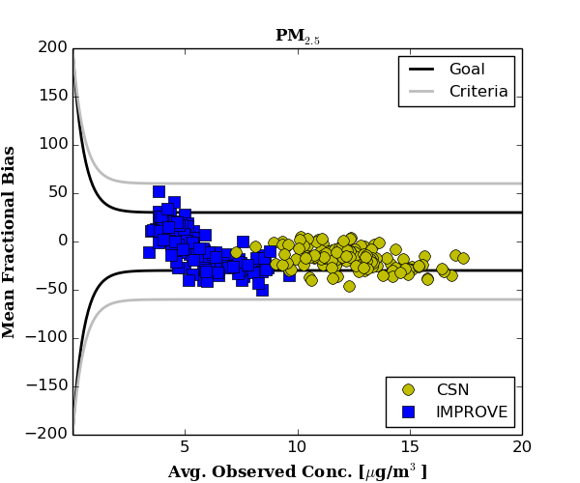
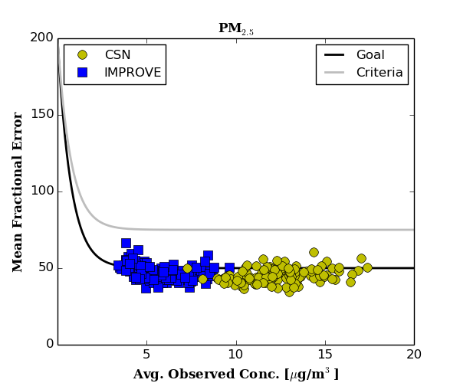
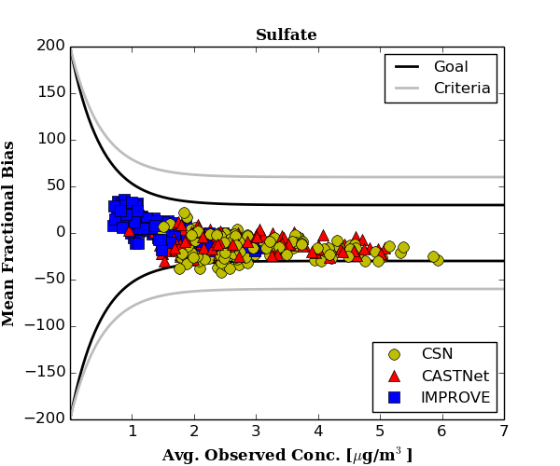
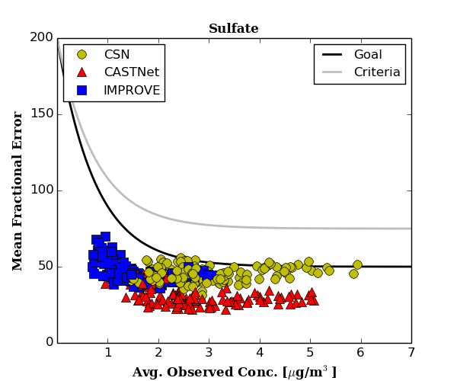
PM_{2.5}
PM_{2.5}
Mean Fraction Bias
Mean Fraction Error
Sulfate
Sulfate
Mean Fraction Bias
Mean Fraction Error
Notes:
The evaluation utilizing the performance metrics of Boylan and Russell expands the analysis to include the speciated components of fine particulate matter. These plots show the mean fractional bias on the left and mean fractional error on the right for PM2.5 on the top and sulfate on the bottom. The curves on these plots represent the values from the Boylan and Russell performance and display the previously discussed Zone 1, 2, and 3. Each data point in these plots are monthly datasets of observation and modeling pairs, and each observation network are uniquely displayed, i.e. CSN as yellow, IMPROVE as blue. As such, there are 11 years * 12 months = 132 data points plotted for each network in each plot. Shown here are the results for total PM2.5 and sulfate, which is a component of total PM2.5. As seen, the results from this project typically met the “performance goals” and met the “performance criteria” when the goal was not achieved. The “Zone 3” wasn’t reached for any of these populations.

Slide 12
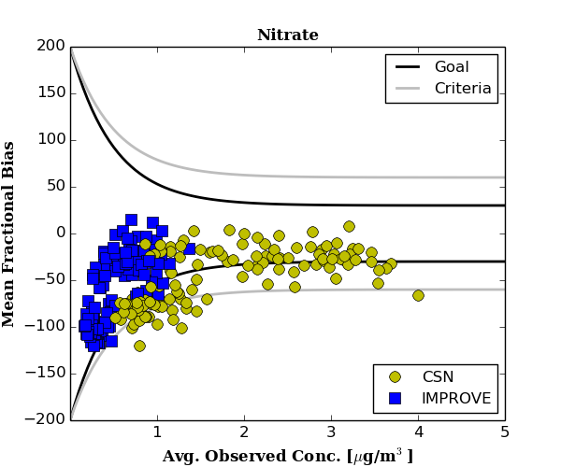
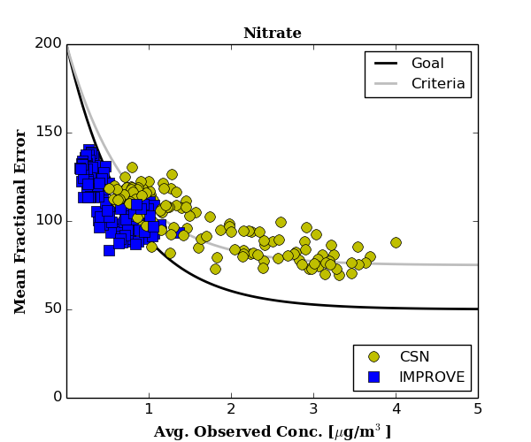
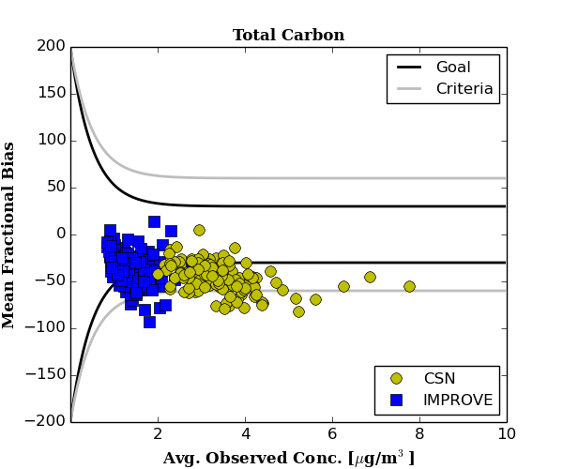
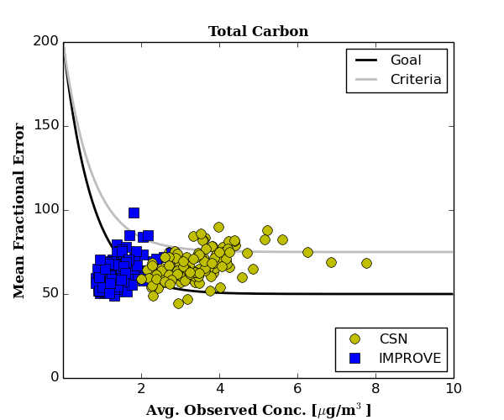
Nitrate
Nitrate
Mean Fraction Bias
Mean Fraction Error
Total Carbon
Total Carbon
Mean Fraction Bias
Mean Fraction Error
Notes:
Results are not quite as good for nitrate and total carbon. For these components, the results fell into all three metric categories defined by Boylan and Russell. This indicates that, sometimes, the model does not meet “the level of accuracy that is considered to be acceptable for modeling applications.” However, a few things should be considered:
(a) What is causing these levels of model bias and
(b) more importantly, is this level of model bias a function of dynamical downscaling?
Well, to answer this, the results from Simon et al were again used.

Slide 13
Comparison to Other Studies Summarized by Simon et al., AE, 2012
Notes:
For brevity, only the components of PM2.5 that did not perform well are shown here. Each of these bars are interquartile range plots. The dark bars are the results from Simon et al and the colored plots are the results from this study.
As seen, for nitrate, the levels of mean fractional bias that were calculated from this study are well within the interquartile range of results in the dataset compiled by Simon et al.
The analysis of total carbon considered both of its components, organic carbon and elemental carbon. The results show that a majority of the total carbon bias comes from the organic components, and in particular, from the urban locations, where it is underpredicted.

Slide 14
Summary
Air quality projections driven by historical downscaled meteorology are:
Typically within defined modeling performance metrics.
Comparable to other published modeling studies using higher-resolution driving meteorology.
Indicates that air quality-climate change projections:
Would not be degraded by driving with downscaled meteorology.
O₃, PM_{2.5}, and speciated PM_{2.5} can be predicted with “acceptable” bias, assuming the coarse scale meteorological fields provided by the GCM well represent the climate of the modeling temporal domain.

Slide 15
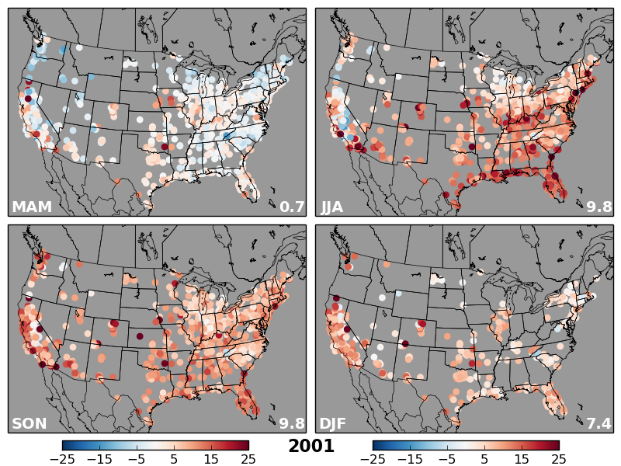
O₃: Spatial Distribution of Results

Slide 16
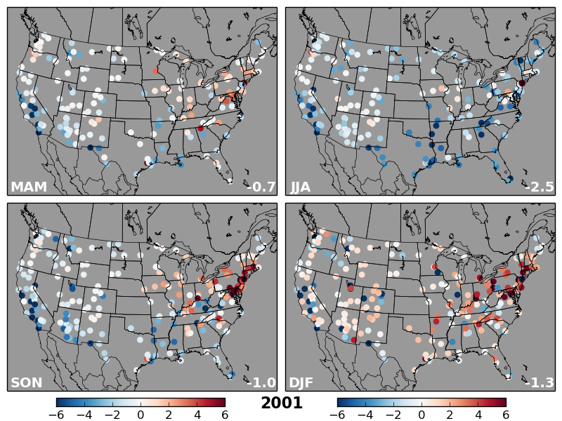
PM_{2.5}: Spatial Distribution of Results

Slide 17
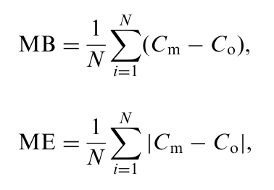
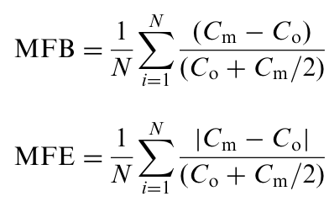
Methods of Evaluation
Statistical Measures:
MB and ME are included due to their prevalence in model evaluations (easy to compare results).
MFB and MFE do not assume that observations are the absolute truth. Their equations normalize to both the modeled and observed values.
Notes:
So, now that we saw the simulated results of PM2.5, how do we go about determining if the results feature bias within “acceptable limits?”
First, we have to calculate statistical measures. Mean bias and mean error are standard statistical measures. Mean fractional bias and mean fractional error are somewhat similar. However, they normalize the bias/error to both the modeled and observed values. This eliminates the assumption that the observations are the absolute truth.

Slide 18
Notes:
This is accomplished by comparing the MFB and MFE from this study to the MFB and MFE dataset reported in Simon et al (2012). This bar chart breaks up each PM2.5 component and adds an additional delineation among networks to enable a comparison of urban vs. rural areas. Also, for brevity, only a select few years are shown. The results in this bar chart are the IQR of the results from this study compared to the compilation in Simon et al.
As seen, the results form this study are generally within the range reported in other model evaluations. An important note is that better MFB results occur when the absolute value approaches zero.
Pay special attention to nitrate and organic carbon. The nitrate results from this study are well within the results in other publications indicating the difficult nature in predicting that component. Total carbon results appear poor due to the low number of reported studies. However, when looking at the organic carbon portion, the poorest results are from the CSN network. This indicates that the model performs better at predicting OC in rural regions as opposed to urban regions.

Slide 19
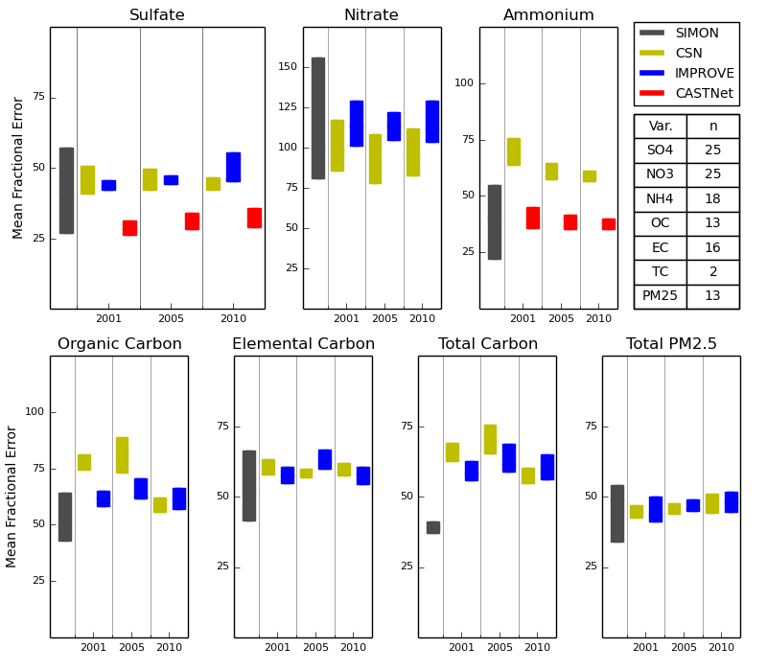
Notes:
- Similar results are shown when comparing the MFE to the results in Simon et al. Namely, nitrate performs within the ranges in other publications and urban OC are the component that performs worse.

