Slide 1
Integrated projections of U.S. air quality benefits from avoided climate change
Fernando Garcia Menendez
Rebecca K. Saari, Erwan Monier, Noelle E. Selin
Joint Program on the Science and Policy of Global Change
Massachusetts Institute of Technology
14th Annual CMAS Conference
October 6, 2015

Slide 2
Impacts of climate change on air quality
Air pollution is now considered the world’s largest environmental health risk
Projected changes in 2100 relative to present ^{[1]}
Air Surface Temperature:
Climate change impacts air quality through many mechanisms:
Atmospheric chemistry
Atmospheric ventilation
Natural emissions
Deposition rates
“Climate penalty” on air quality
Degradation of air quality under climate change in the absence of emission changes
Precipitation:
[1] Monier et al., 2014, Climatic Change

Slide 3
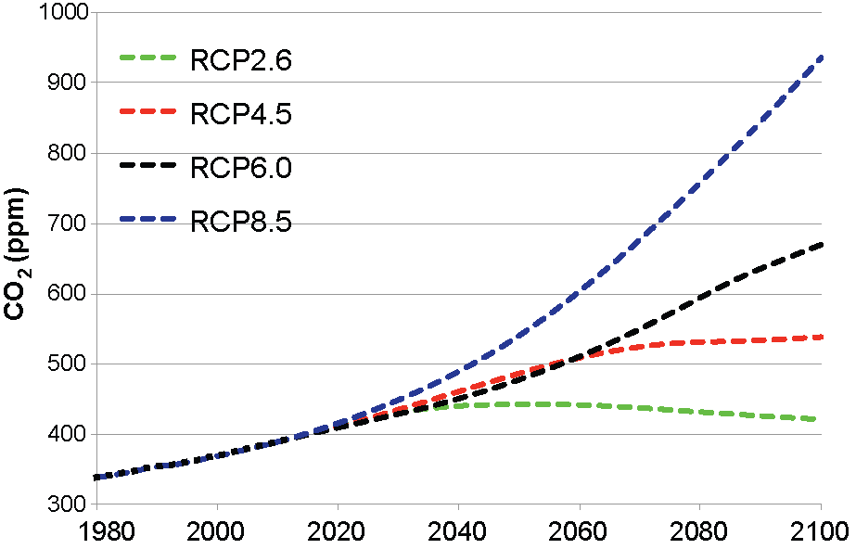
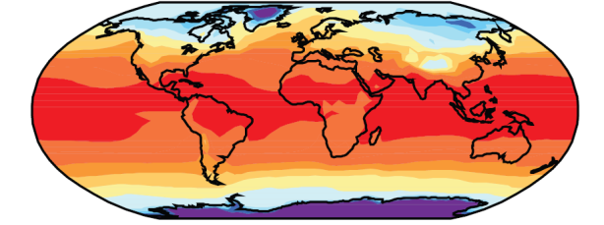
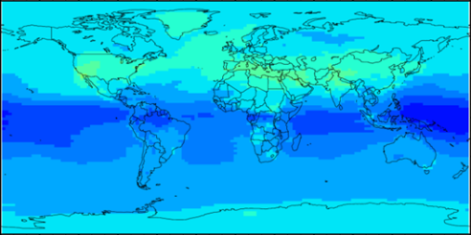
Modeling climate change impacts on air quality
Socioeconomic emissions scenario
General circulation models
Global and regional atmospheric chemistry-transport models
Large uncertainties propagate to air quality projections
Characterizing uncertainty across complete system is important to guide decision-making
Δ Climate + Δ Emissions → Δ Air Quality
“Sensitivity of the U.S. climate penalty to local and global emissions”
Evan Couzo, tomorrow at 3:50pm

Slide 4
Modeling climate change impacts on air quality
Socioeconomic emissions scenario
General circulation models
Global and regional atmospheric chemistry-transport models
MIT IGSM: Policy scenarios and climate projections
CAM-Chem: Global atmospheric chemistry & air quality
BenMAP: Health and economic impacts
Emissions fixed at year-2000 levels in atmospheric chemistry simulations
30-year simulations and 5 initializations used to characterize climate:
1981→2010 2036→2065 2085→2115

Slide 5
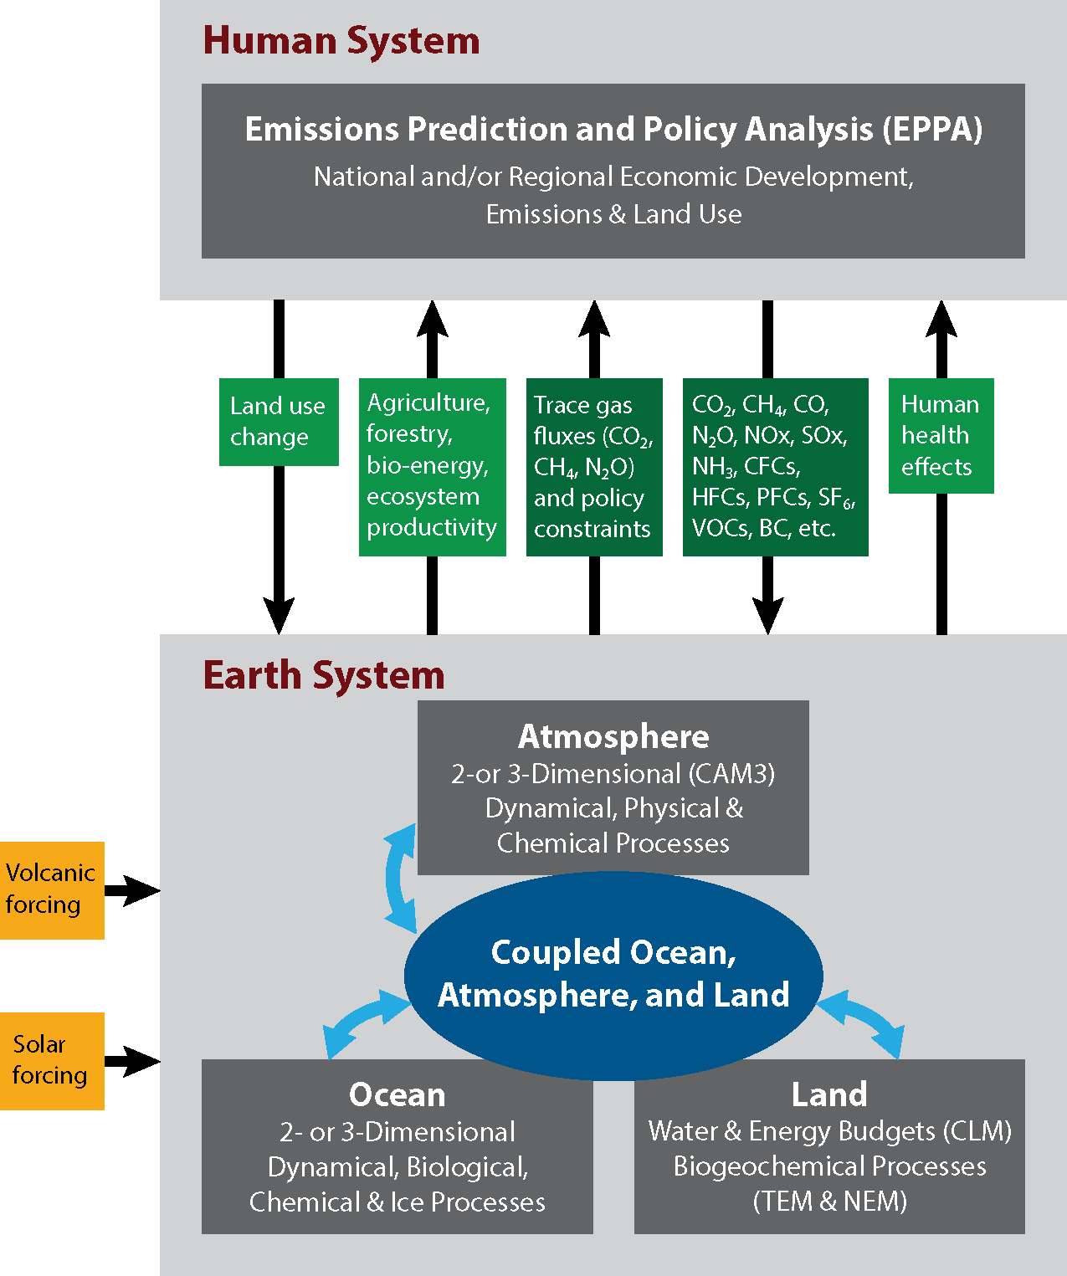
Climate and policy scenarios
MIT Integrated Global System Model:
Two major coupled components:
Economic projection and policy analysis model
Earth system model
Important features:
Single consistent framework for greenhouse gas policy and climate change scenarios
Ability to alter climate system response
Computationally efficient

Slide 6
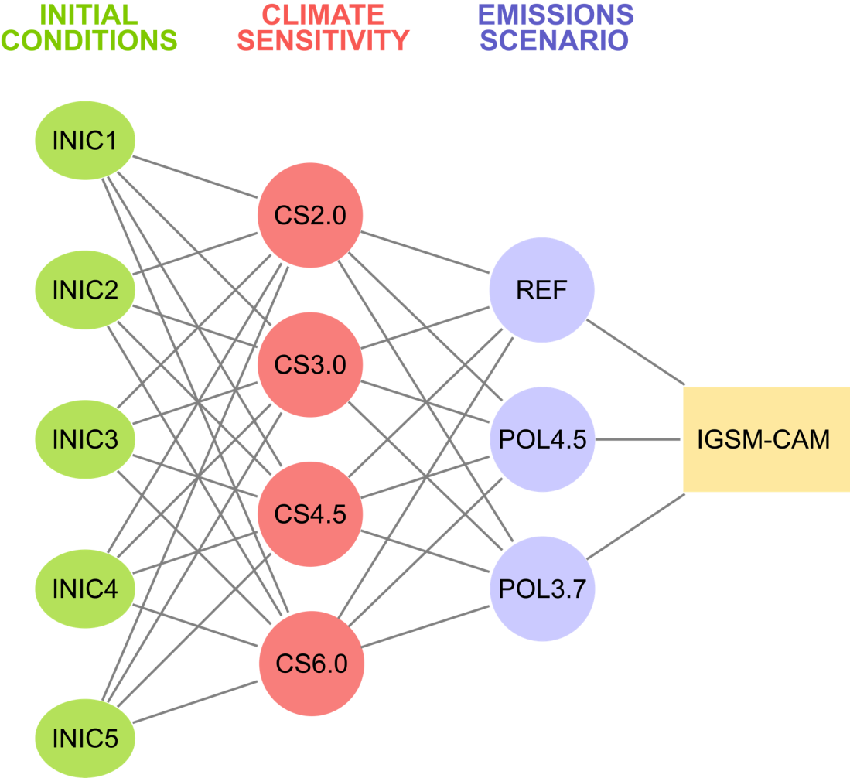
Ensemble simulation of 21st century climate change
Focus on the 3 main sources of uncertainty in climate projections:
Emissions-scenario uncertainty:
Reference: No policy
2100 radiative forcing = 9.7 W/m²
Policy 4.5: Stabilization
2100 radiative forcing = 4.5 W/m²
Policy 3.7: Stringent stabilization
2100 radiative forcing = 3.7 W/m²
Climate model response
Climate sensitivity =
2.0°C, 3.0°C, 4.5°C or 6.0°C
Natural variability
Multidecadal simulations
5 different initializations

Slide 7
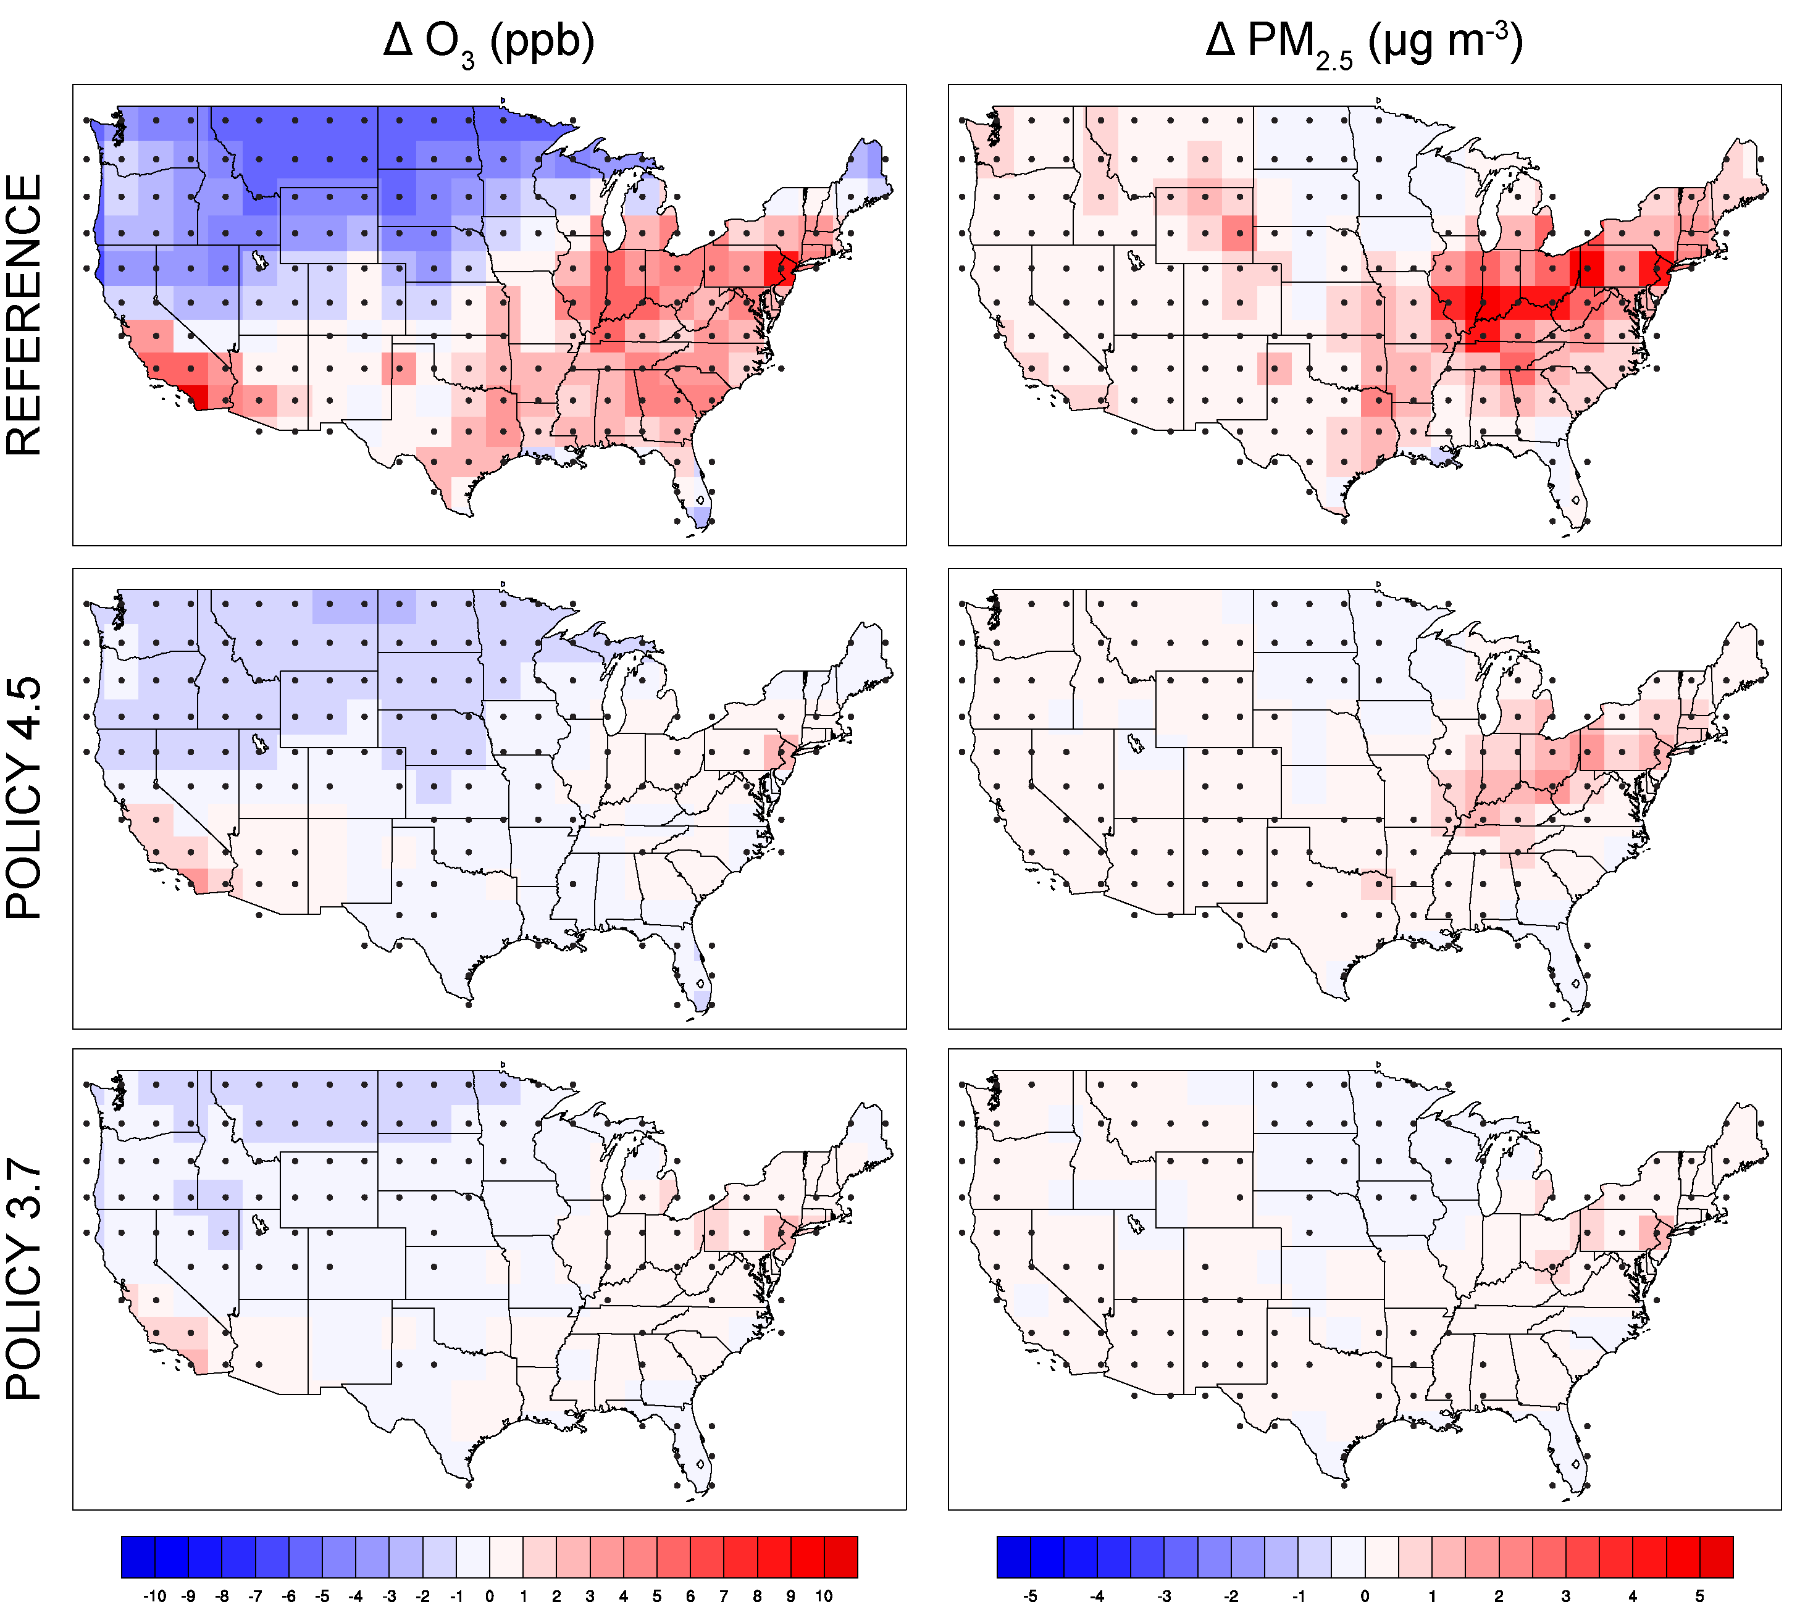
Climate penalty on U.S. air quality in 2100
Δ Annual daily max. 8-hr O₃ (ppb)
Δ Annual PM_{2.5} (µg m⁻³)
Some limitations:
Changes in natural dust, sea salt, and wildfire emissions not modeled
Changes in land cover and land use not modeled
Coarse resolution
Ensemble-mean projections:
O₃ increase over some regions; decrease in background
Larger penalty on O₃ for summer concentrations
Increase in PM (SO₄, BC, OA, NH₄NO₃); largest in East
Important regional differences
Climate policies significantly reduce impacts; most achieved by implementing the 4.5 W/m² stabilization policy
[1] Garcia-Menendez et al., 2015, ES&T

Slide 8
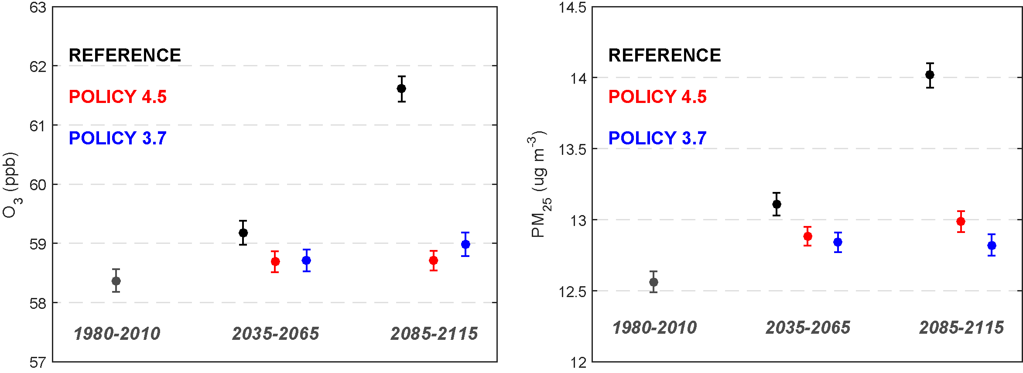
Climate policy benefits for U.S. air quality
US-average population-weighted annual concentrations:
Daily max. 8hr O₃
PM_{2.5}
1.2 ± 0.1
2.9 ± 0.3
1.5 ± 0.1
3.2 ± 0.3
0.8 ± 0.3
0.5 ± 0.1
[1] Garcia-Menendez et al., 2015, ES&T

Slide 9
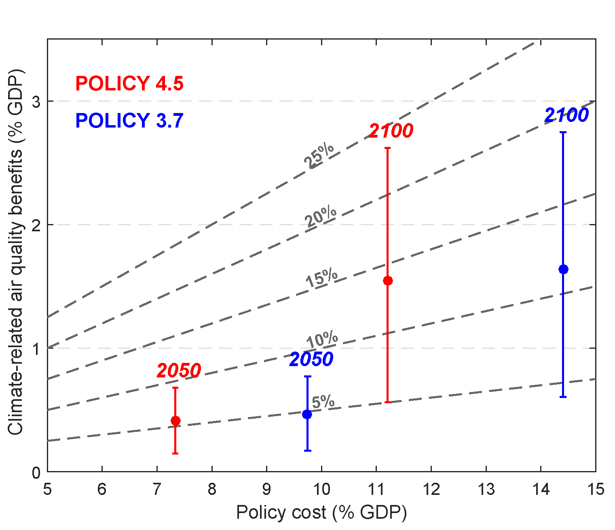
Climate policy health benefits and costs
Policy cost & mortality benefits (VSL-based) as fraction of REF scenario U.S. GDP:
Climate policy relative
to Reference scenario:
Modeled reductions:
(U.S. population-weighted)
> 1 µg m⁻³ and 2.5 ppb by 2100
Avoided U.S. deaths:
2050:
> 10,000 (4,000 - 22,000)
2100:
> 50,000 (19,000 - 95,000)
[1] Garcia-Menendez et al., 2015, ES&T

Slide 10
Uncertainty in climate projections
Emissions-scenario uncertainty
Model-response uncertainty
Natural variability

Slide 11
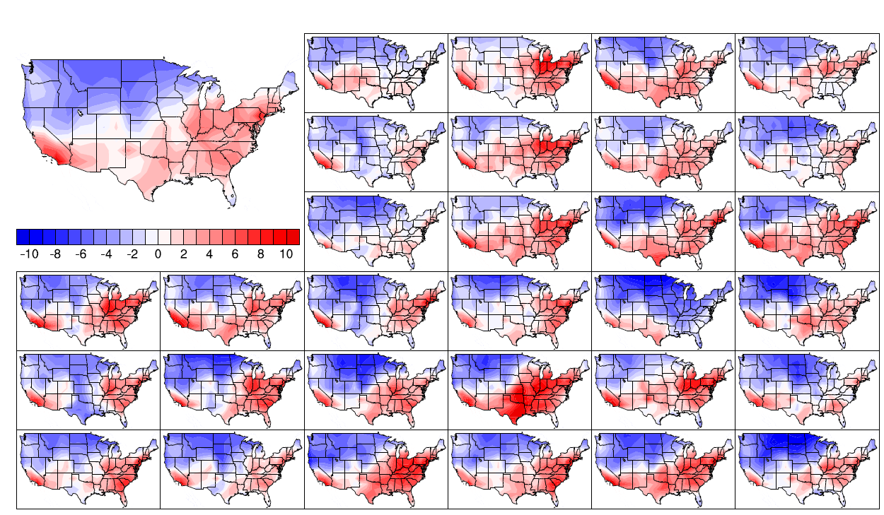
Natural variability
2100 Reference scenario O₃ climate penalty (Δ 8h-max ppb) estimated from
1 model initialization and 1-year simulations:

Slide 12
Natural variability
2100 Reference scenario O₃ climate penalty (Δ 8h-max ppb) estimated from
1 model initialization and 1-year simulations:
O₃ season (May-Sept.):

Slide 13
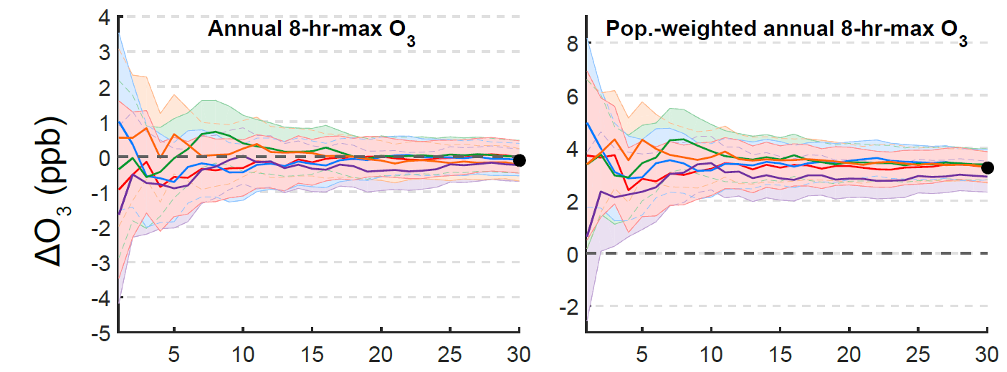
Natural variability
2100 Reference scenario U.S.-average O₃ climate penalty estimated using
5 model initializations:
Averaging period (years)

Slide 14
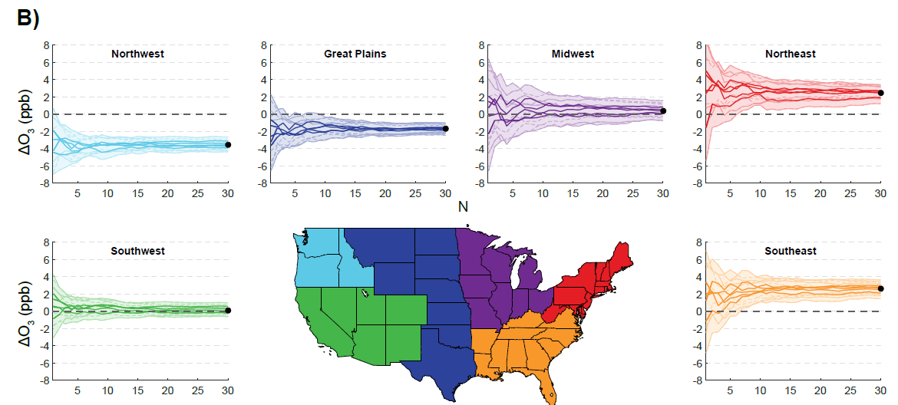
Natural variability
2100 Reference scenario U.S.-average O₃ climate penalty estimated using
5 model initializations:
Averaging period (years)

Slide 15
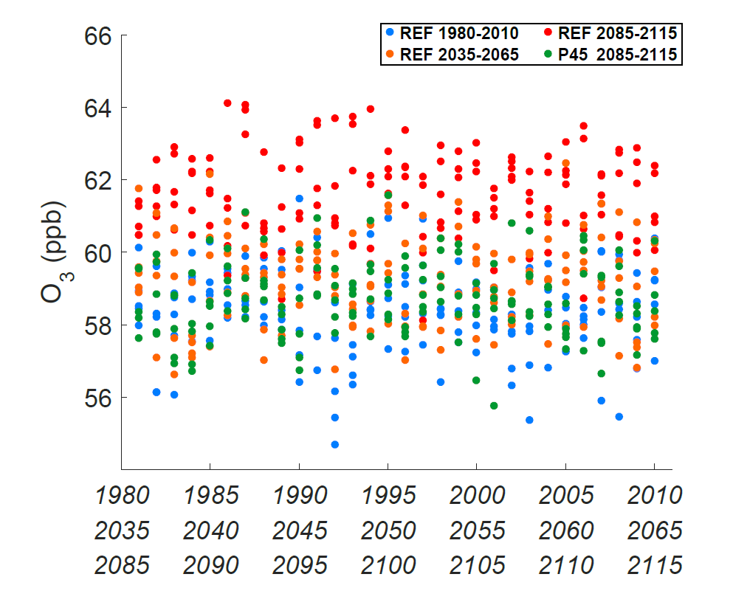
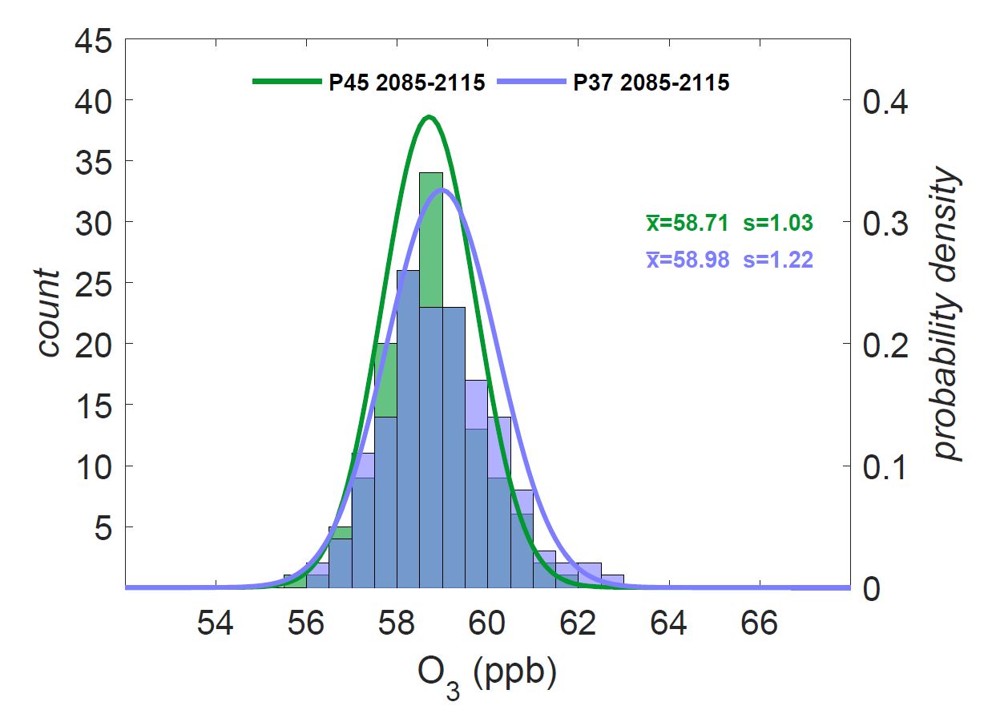
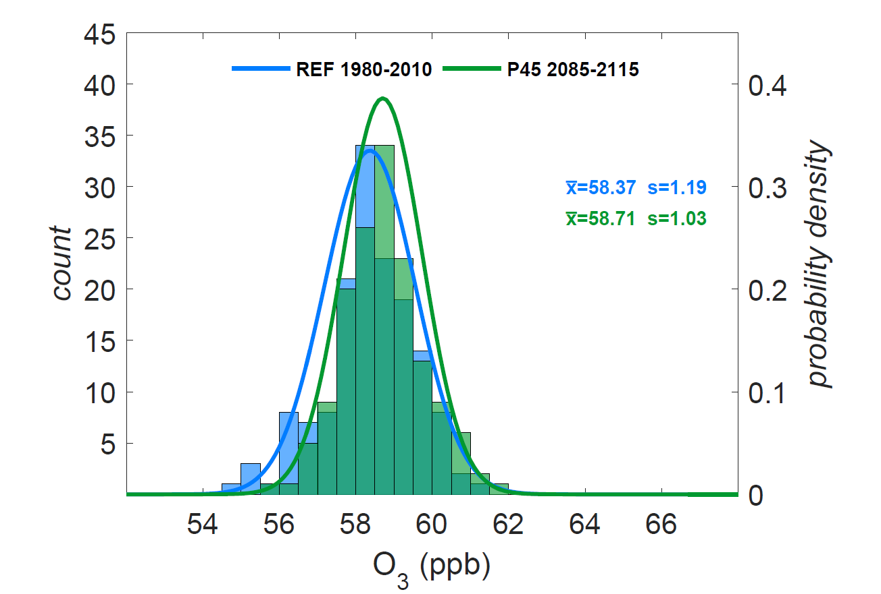
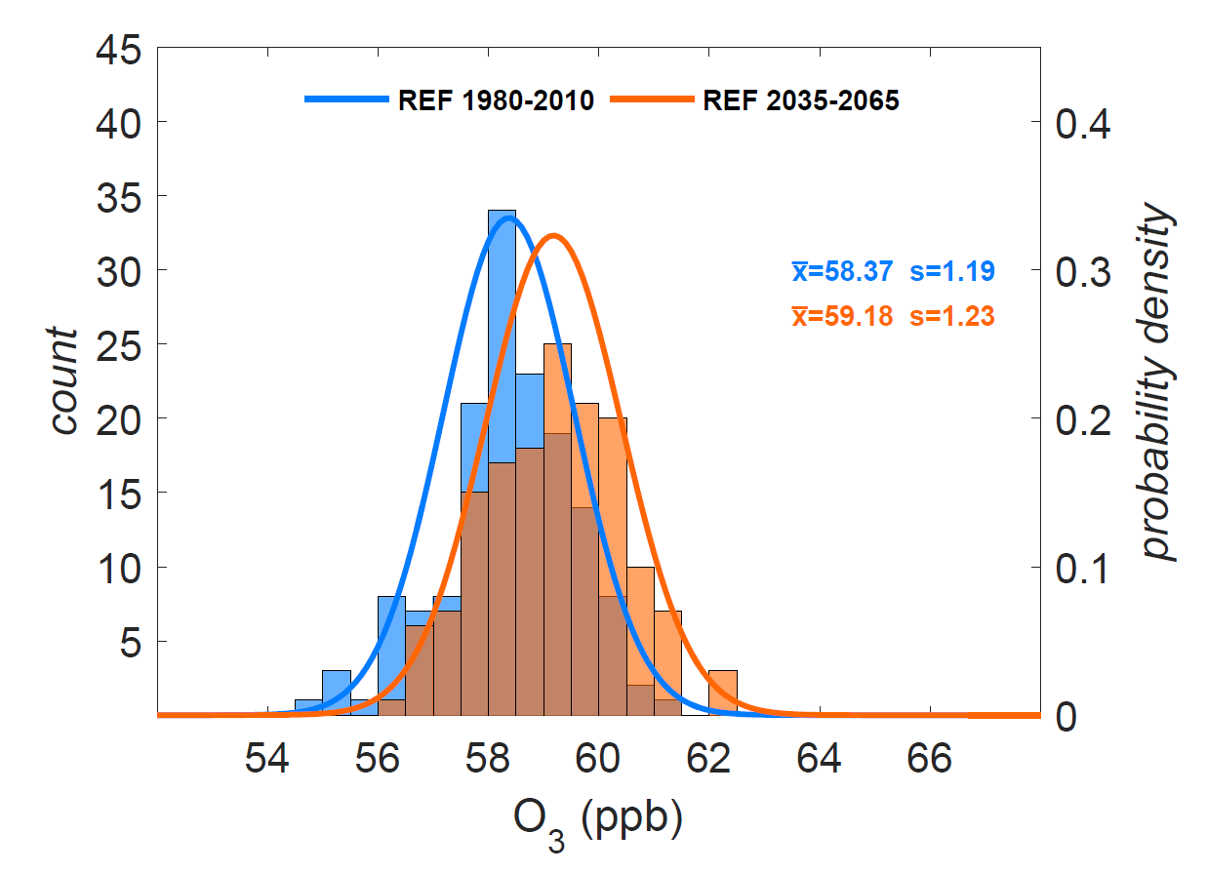
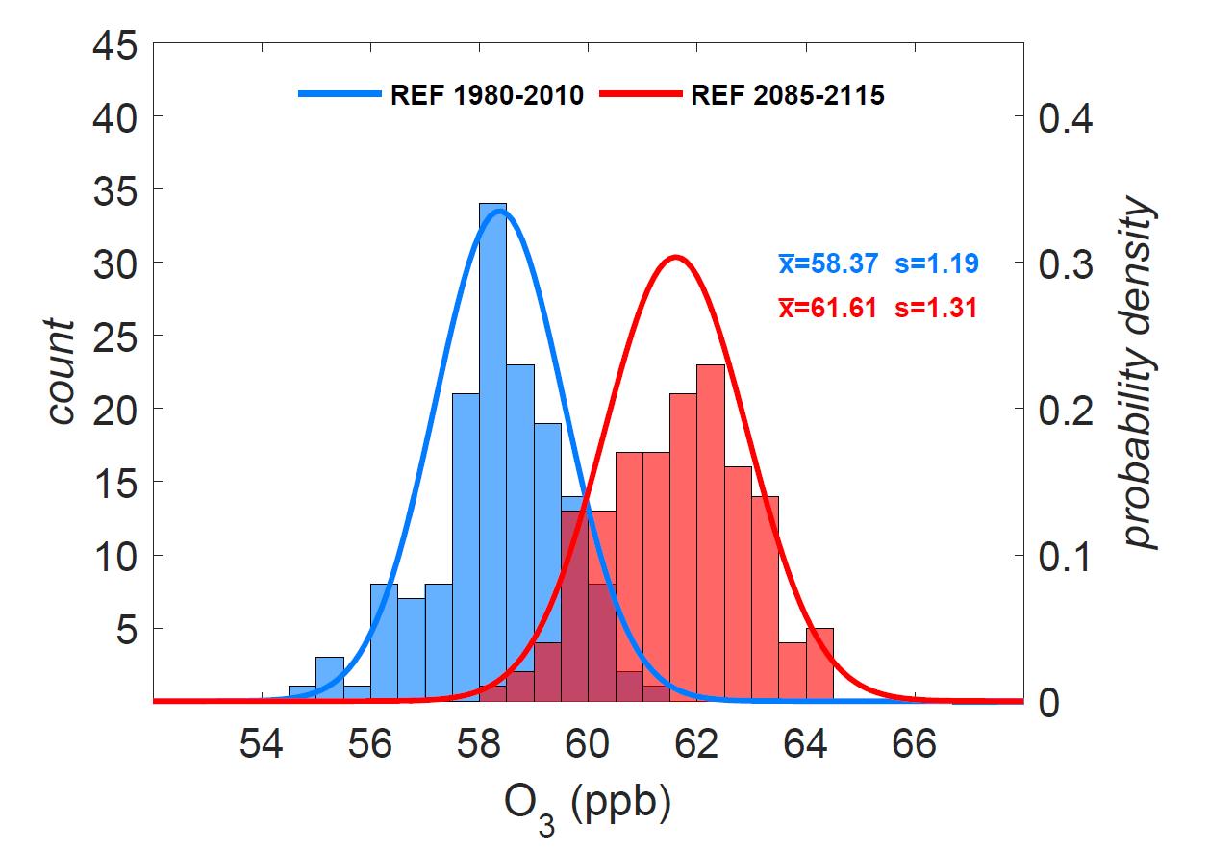
Emissions Scenario
U.S.-average annual population-weighted O ₃ (8-hr max.)

Slide 16
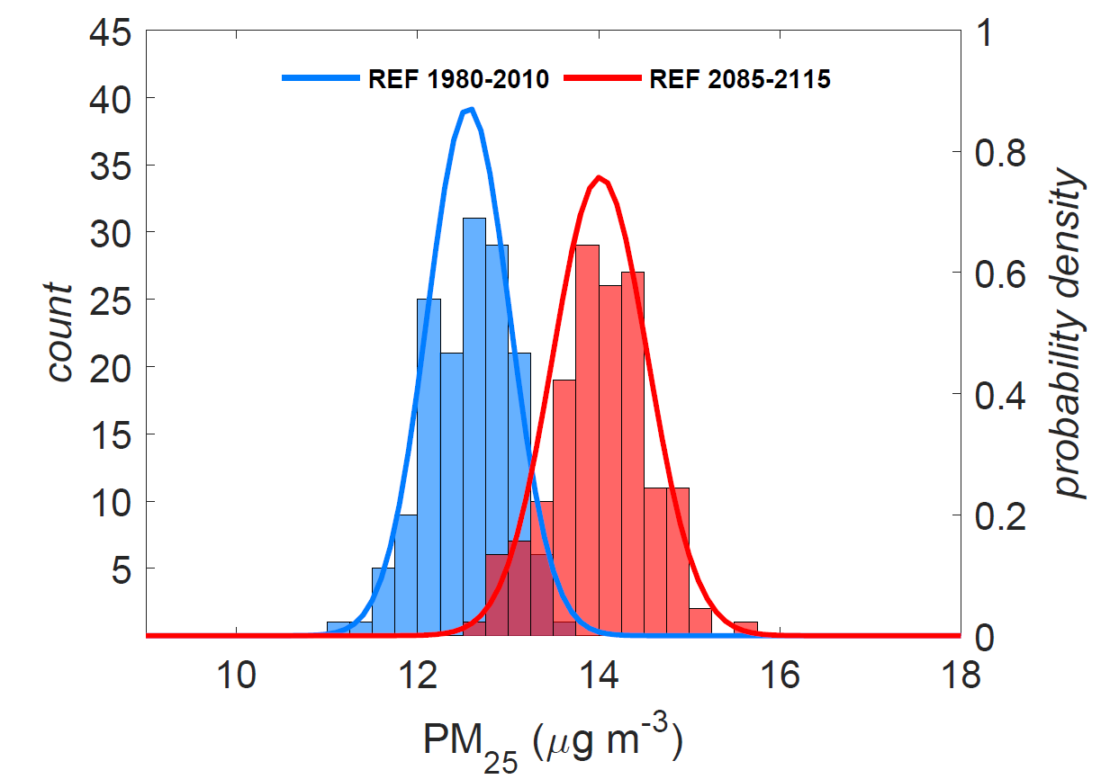
Emissions Scenario
Annual population-weighted O₃
Annual population-weighted PM_{2.5}

Slide 17
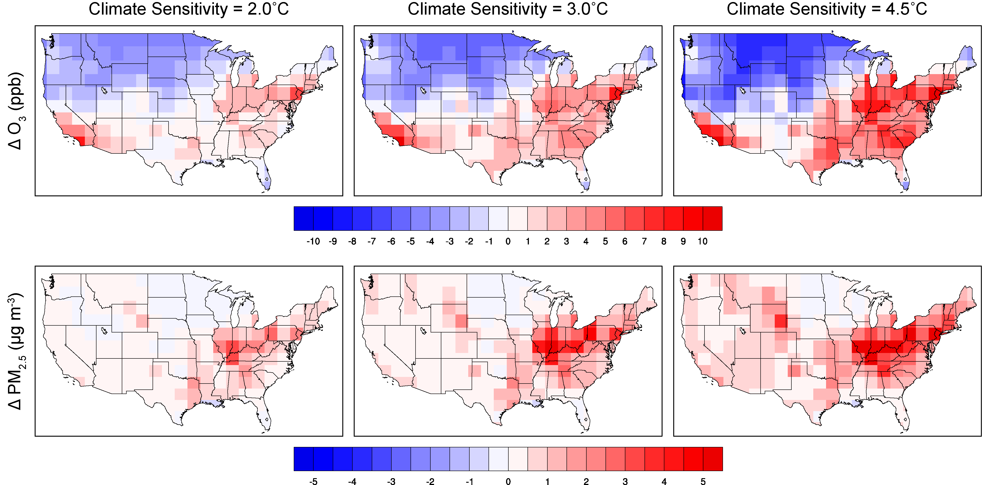
Climate model response
Climate penalty from 2000 to 2100 under REF scenario:

Slide 18
Additional uncertainty in benefits assessments
Health impacts
Benefits valuations

Slide 19
Implications for benefits assessments
Projections suggest climate change may significantly impact O₃ and PM_{2.5} pollution in the U.S.
Greenhouse gas mitigation efforts can largely lessen these impacts by slowing climate change and partially offset policy costs.
Climate-induced air quality benefits of policy increase with time; increasing stringency past a degree may lead to diminishing returns relative to cost.

Slide 20
Implications for benefits assessments
Substantial uncertainties associated with climate projections significantly influence simulations of future air quality.
Beyond emissions scenarios, large uncertainty is associated with natural variability and climate model response.
Climate-specific air quality impacts can contribute to the value of climate change mitigation benefits and should be considered in decisions concerning climate policy.

Slide 21
THANK YOU!
The Joint Program on the Science and Policy of Global Change is funded by a number of federal agencies and a consortium of 40 industrial and foundation sponsors.
http://globalchange.mit.edu/sponsors/all
This work was funded by the U.S. Environmental Protection Agency’s Climate Change Division, under Cooperative Agreement # XA-83600001-0. It has not been subjected to any EPA review and does not necessarily reflect the views of the Agency, and no official endorsement should be inferred.

Slide 22
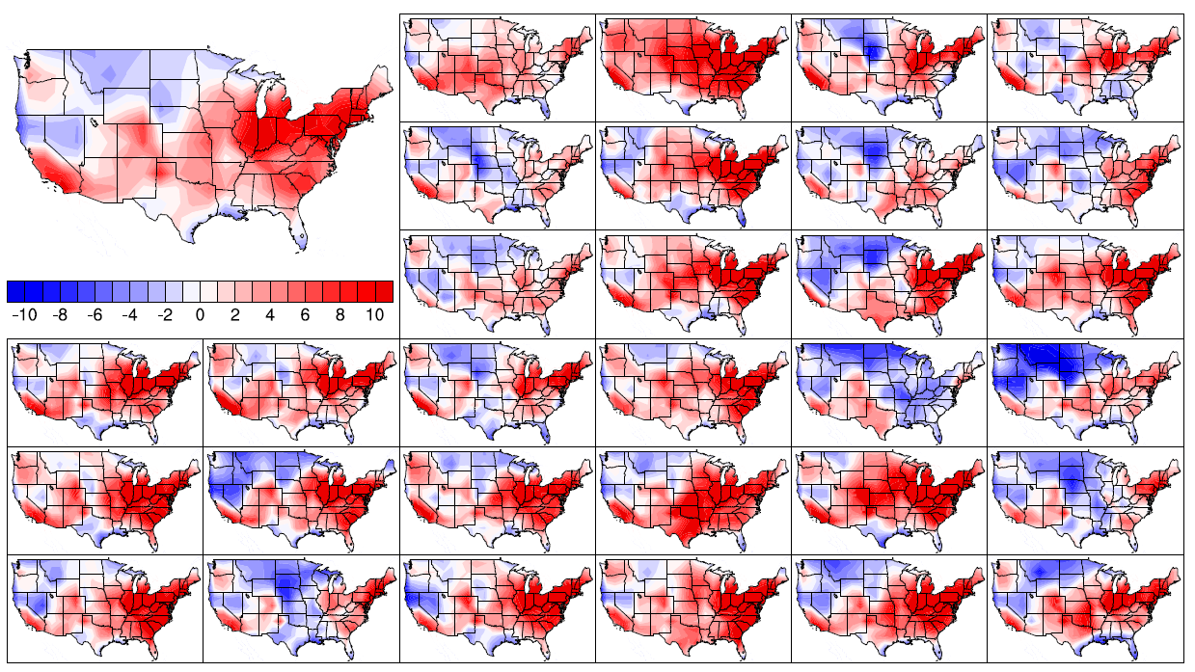
Influence of natural variability
2100 Reference scenario O₃ climate penalty (Δ ppb) estimated from
1 model initialization and 1-year simulations (O₃ season)

Slide 23
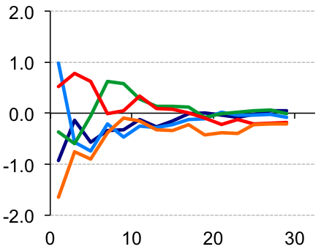
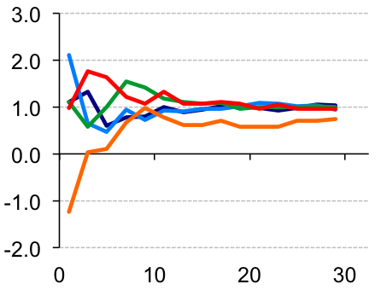
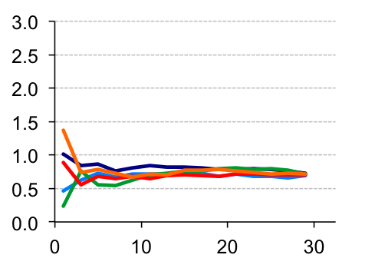
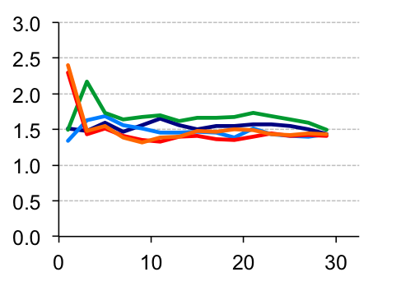
Considering variability in air quality projections
Reference scenario U.S-average climate penalty from 2000 to 2100
Δ Annual daily-maximum 8-hr O₃ (ppb)
Δ Annual population-weighted O₃ (ppb)
Δ Annual PM_{2.5} (µg m⁻³)
Δ Annual population-weighted PM_{2.5} (µg m⁻³)
Averaging period (years)

