Slide 1
Introducing Multi-Scale Kain-Fritsch scheme to the Model for Prediction Across Scales
Allison Michaelis¹
Kiran alapaty²
Valentine Anantharaj³
2015 CMAS Conference
7 October 2015
¹Marine, Earth, and Atmospheric Science, NCSU
²Atmospheric Modeling and Analysis Division, US EPA
³National Center for Computational Sciences, ORNL

Slide 2
Background
Clouds
Ozone/
Aqueous
Chem
Precipitation
Radiation
Balance
Aerosols
Temperature
Regional/Global
Weather/Climate
Notes:
Clouds are a vital part of our earth’s climate system. They have large impacts on the radiation balance and are major drivers of air quality, impacting aerosols and photolysis rates, which in turn affects the creation of stratospheric ozone. Additionally, clouds affect the amount of shortwave radiation reaching the surface, impacting the surface temperature as well as the forcing for convection at the surface, which in turn affects the generation of precipitation. Clouds affect these quantities, and others, on regional and global spatial scales, as well as on weather and climate time scales.

Slide 3
Background
Clouds
Subgrid-scale cloud processes need to be better represented
Ozone/
Aqueous
Chem
Precipitation
Radiation
Balance
Aerosols
Temperature
Regional/Global
Weather/Climate
Notes:
For these reasons, it’s important that cloud processes, in the case of this research, sub-grid scale, or convective cloud processes, are better represented in weather, climate, and air quality models.

Slide 4
Motivation
Most convective parameterization schemes neglect feedback to radiation
Impacts simulations of clouds, surface temperature, etc.
New generation of models include variable resolution grids
Scale-aware physics and chemistry not included
Notes:
However, most convective parameterization schemes in models today don’t account for convective clouds feeding back to the radiation scheme. This can lead to biases in several meteorological parameters, such as clouds and surface temperature. Also, the newest generation of models are incorporated with variable-resolution meshes. However, the physics and chemistry included in these models has not been adapted for scale-awareness.

Slide 5
Motivation
Most convective parameterization schemes neglect feedback to radiation
Impacts simulations of clouds, surface temperature, etc.
New generation of models include variable resolution grids
Scale-aware physics and chemistry not included
Multi-Scale Kain-Fritsch (MSKF) convective parameterization (CP) scheme
Notes:
These are two areas in need of improvement that led to the development of the Multi-Scale Kain Fritsch, or MSKF, convective parameterization scheme.

Slide 6
Multi-Scale Kain-Fritch CP Scheme
Scale aware parameters:
Dynamic adjustment timescale
Scale dependent entrainment effects
Subgrid-scale cloud-radiation interactions
Alapaty et al. (2012), Zheng et al. (2015)
Notes:
Among other updates, the multi-scale KF convective parameterization scheme introduces scale aware parameters, such as a dynamic adjustment timescale and scale dependent entrainment effects. MSKF also updates traditional KF by adding in sub-grid scale interactions between clouds and radiation. For more details on the formulation of MSKF please see Alapaty et al. 2012 and/or Zheng et al. 2015.

Slide 7
Goal of MSKF
Improve model simulations
Streamline activation of convective scheme with changing grid spacings
Ideal for variable resolution grids
Notes:
Overall, the inclusion of scale aware parameters and cloud-radiation interactions aims to improve model simulations across all time/spatial scales. Furthermore, the multi-scale kain-fritsch scheme aims to streamline the activation of the convective scheme with changing grid spacings. This would be especially helpful in the “gray-area” around 2-9km grid lengths where it is debatable on whether or not to run a CP scheme. This adaptability to changing grid lengths in particular makes the MSKF scheme ideal for running simulations with the new generation of models with variable resolution grids.

Slide 8
Research Objective
Test the performance of the MSKF convective parameterization scheme in the Model for Prediction Across Scales (MPAS) atmospheric model
Compare results from MSKF to traditional KF
Notes:
This leads us into our objective for this project. Overall, this research aims to test the performance of the MSKF convective parameterization scheme in the Model for Prediction Across Scales, or MPAS, atmospheric model. To accomplish this, we will be comparing the results of several meteorological parameters to the traditional KF scheme.

Slide 9
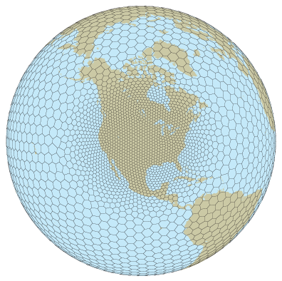
Model for Prediction Across Scales
MPAS-Atmosphere v. 4.0
Variable-resolution horizontal meshes
High resolution
→ 15km
Low
Resolution
→ 60km
http://mpas-dev.github.io/
Notes:
As mentioned, the model used in this study is the MPAS-Atmosphere version 4.0. MPAS-A is a non-hydrostatic, global atmosphere model that makes use of centroid Voronoi tessellations to create variable-resolution horizontal meshes. This technique allows for a gradual expansion from a localized region of mesh refinement to larger grid spacings on the rest of the globe, rather than a harsh discontinuity between domains with different grid lengths.

Slide 10
Model Set-up
15-60km variable-resolution grid
Mesoscale reference suite
WSM6 microphysics scheme
YSU PBL scheme
RRTMG radiation schemes
Convective scheme: KF and MSKF
Notes:
For this project, we used a variable resolution grid with 15km horizontal grid spacing centered over the continental US and expanding out to 60km over the rest of the globe. We used the prescribed mesoscale reference physics package, which includes WSM6 microphysics parameterization scheme, YSU planetary boundary layer scheme, and RRTMG long and short wave radiation schemes. The exception to this package is the convective parameterization scheme. Instead of the default Tiedtke scheme, we used KF and MSKF. We added MSKF in as a separate physics option to MPAS allowing us to easily switch between the two.

Slide 11
Model Set-up
Noah LSM
NCEP Climate Forecast System Reanalysis (CFSR)
Initial conditions, surface update fields
3-month simulation (DOE Titan)
15 May 2006 00Z – 14 August 2006 00Z
Notes:
Additionally, we used the Noah land surface model. The NCEP climate forecast system reanalysis, or CFSR, was used for initial conditions as well as sea-surface temperature and sea ice fields that are updated every 6 hours. Our simulation ran for 3 months, from 00 Z on May 15 2006 to 00Z on August 14 2006, which was completed using DOE’s supercomputer Titan.

Slide 12
Hypotheses
Increase in total cloud cover with MSKF
Decrease in near surface temperature
Decrease in precipitation
Notes:
Because MSKF is including the effects of convective clouds, which is not included in KF, we would naturally expect there to be an increase in total cloud cover with the MSKF simulation. Consequently, we expect to see a decrease in near surface temperature due to less shortwave radiation reaching the surface. We know that KF has a history of a moist bias in the WRF model, especially at high resolutions. So, if this bias also exists in MPAS, we expect MSKF to correct for this bias, thus resulting in a decrease in precipitation.

Slide 13
Results
Daily means
00Z Day 1 – 00Z Day 2
Monthly means
00Z 15th of Month 1 – 00Z 15th of Month 2
Seasonal means
Notes:
Results from here on out will be shown in 3 quantities: daily means, which are calculated from 00Z on day 1 to 00Z on day 2, monthly means, which are calculated from 00Z on the 15 of month 1 to 00Z on the 15 of month 2, and seasonal means, which are averaged over the duration of the simulation.

Slide 14
Surface Shortwave Radiation
Proxy for cloud cover
All-sky – Clear-sky
More negative → More cloud cover
Notes:
I’ll first discuss downward shortwave radiation at the surface, which can be used as a proxy for cloud cover. I have subtracted the “clear sky” downward shortwave radiation from the “all-sky”, which means, in the following figures, the more negative the value, the less radiation reaching the surface (i.e. more clouds)

Slide 15
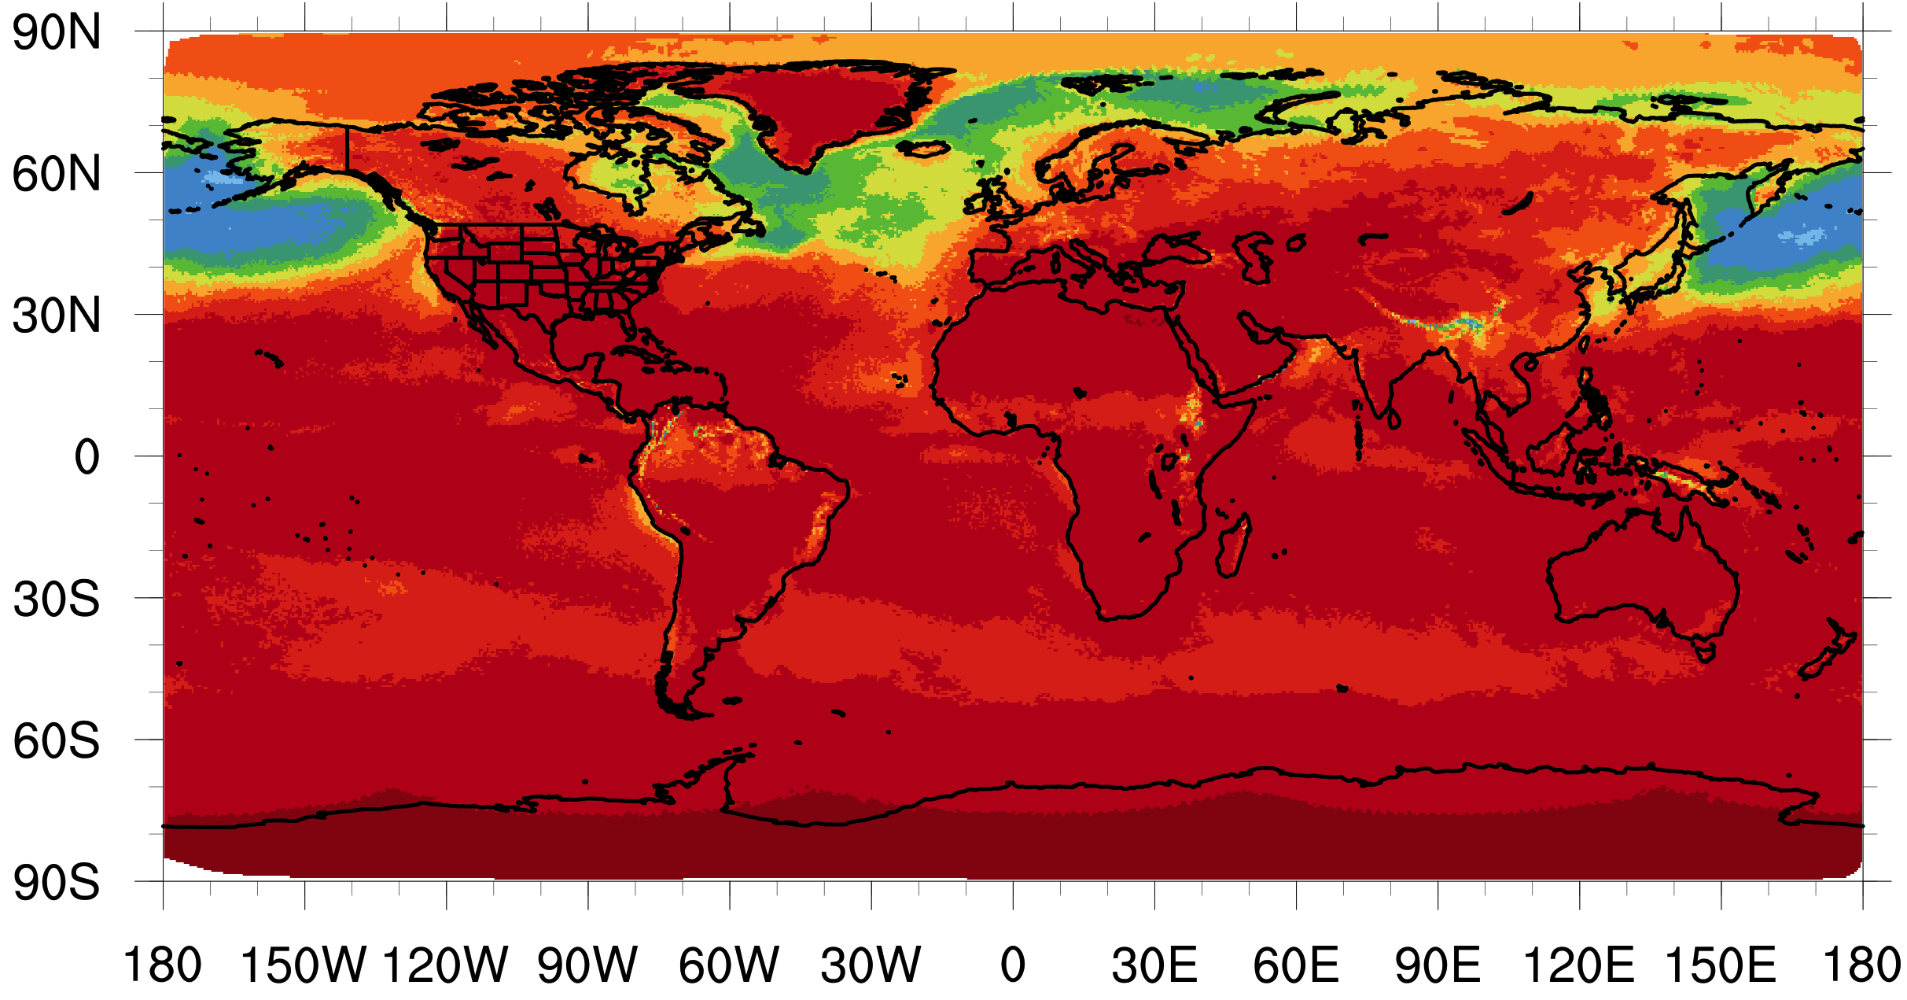
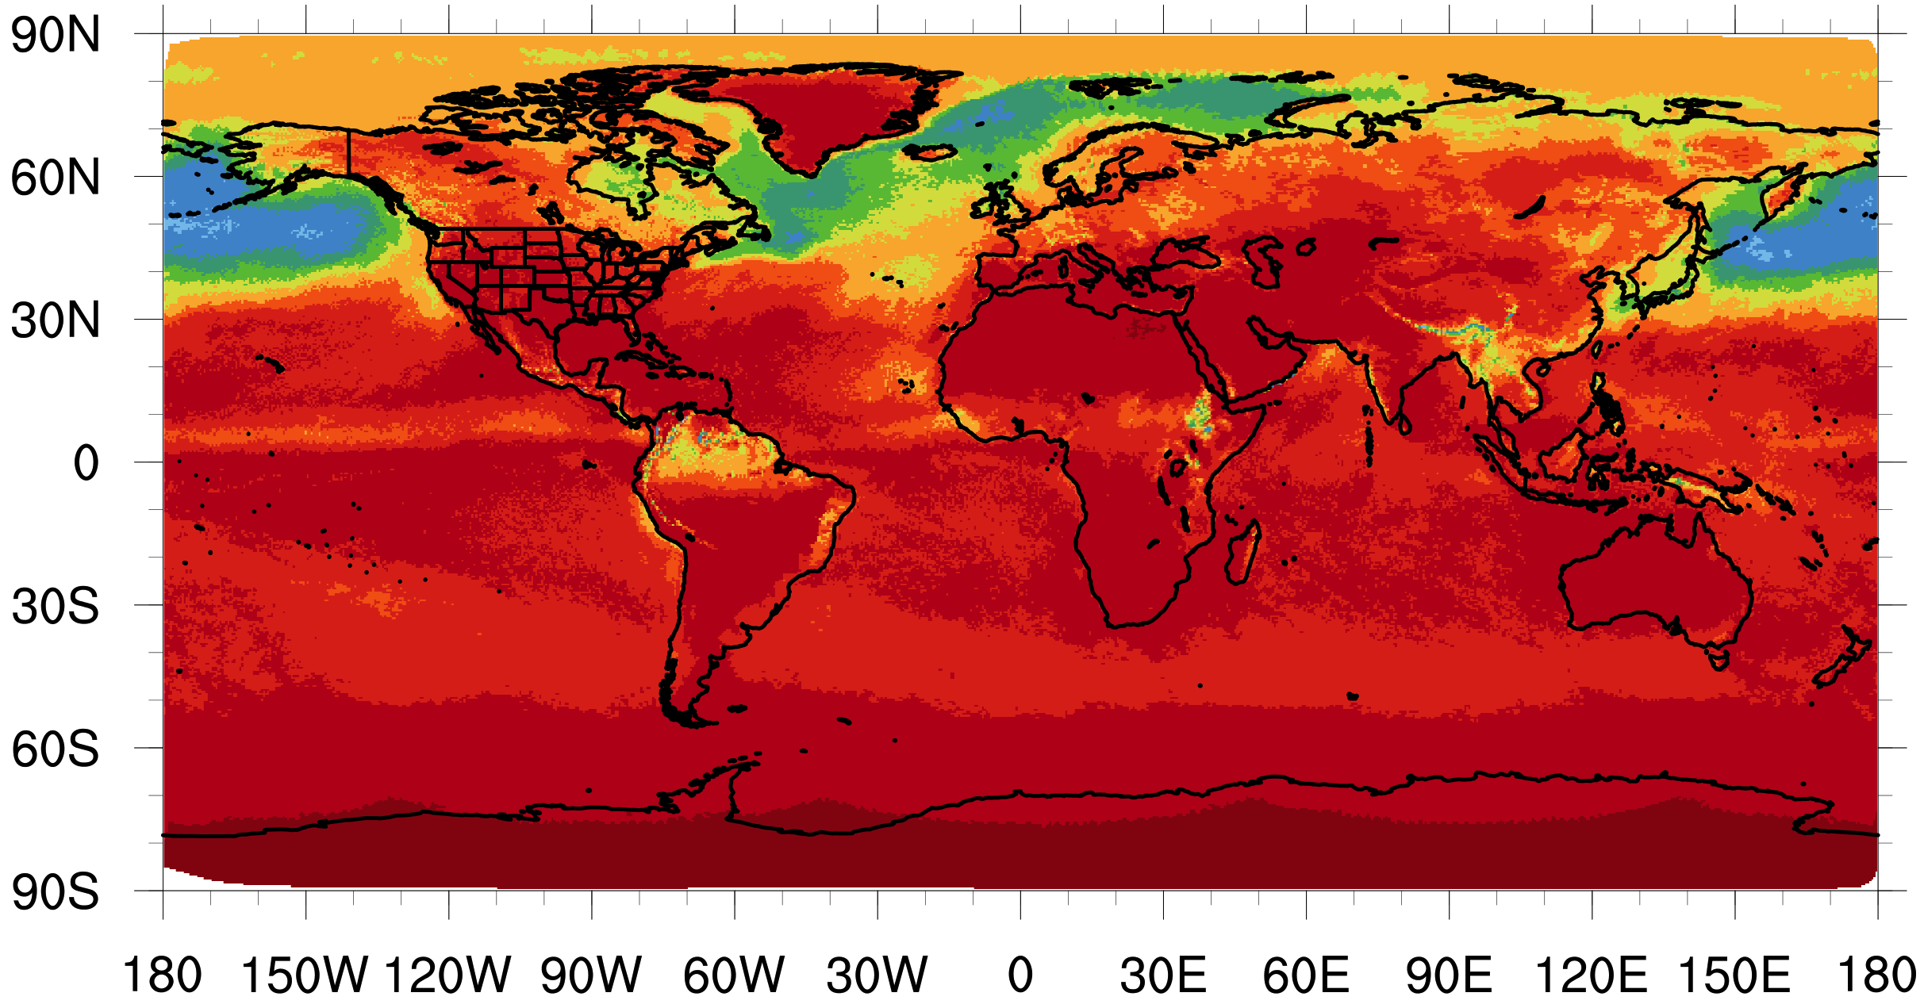
Seasonal
SW Radiation
KF
MSKF
W•m⁻²/day
Notes:
Shown here is the average downward shortwave radiation at the surface per day across the season. By inspection, we can see the ITCZ much more clearly due to less radiation reaching the surface in the MSKF run. There also appears to be more cloud cover throughout Asia.

Slide 16
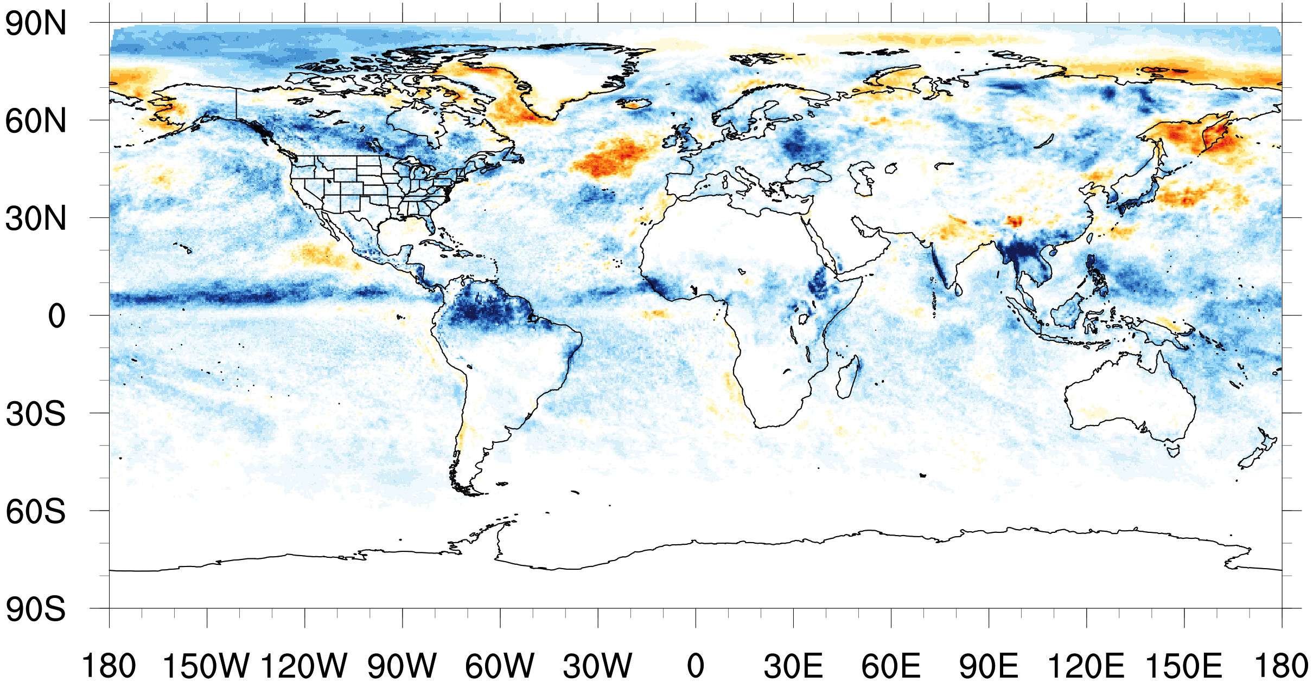
MSKF – KF
W•m⁻²/day
Seasonal SW Radiation
Notes:
Looking at the difference between MSKF and KF, we can see these differences in radiation more clearly. Here, negative values/blue colors indicate more clouds in the MSKF simulation and positive values/red colors indicate less clouds in the MSKF simulation. We can see now that there is clearly more cloud along the ITCZ with MSKF, especially in the eastern Pacific and some in the Atlantic. There’s also a clear increase to the south of China as well as the western coast of India.

Slide 17
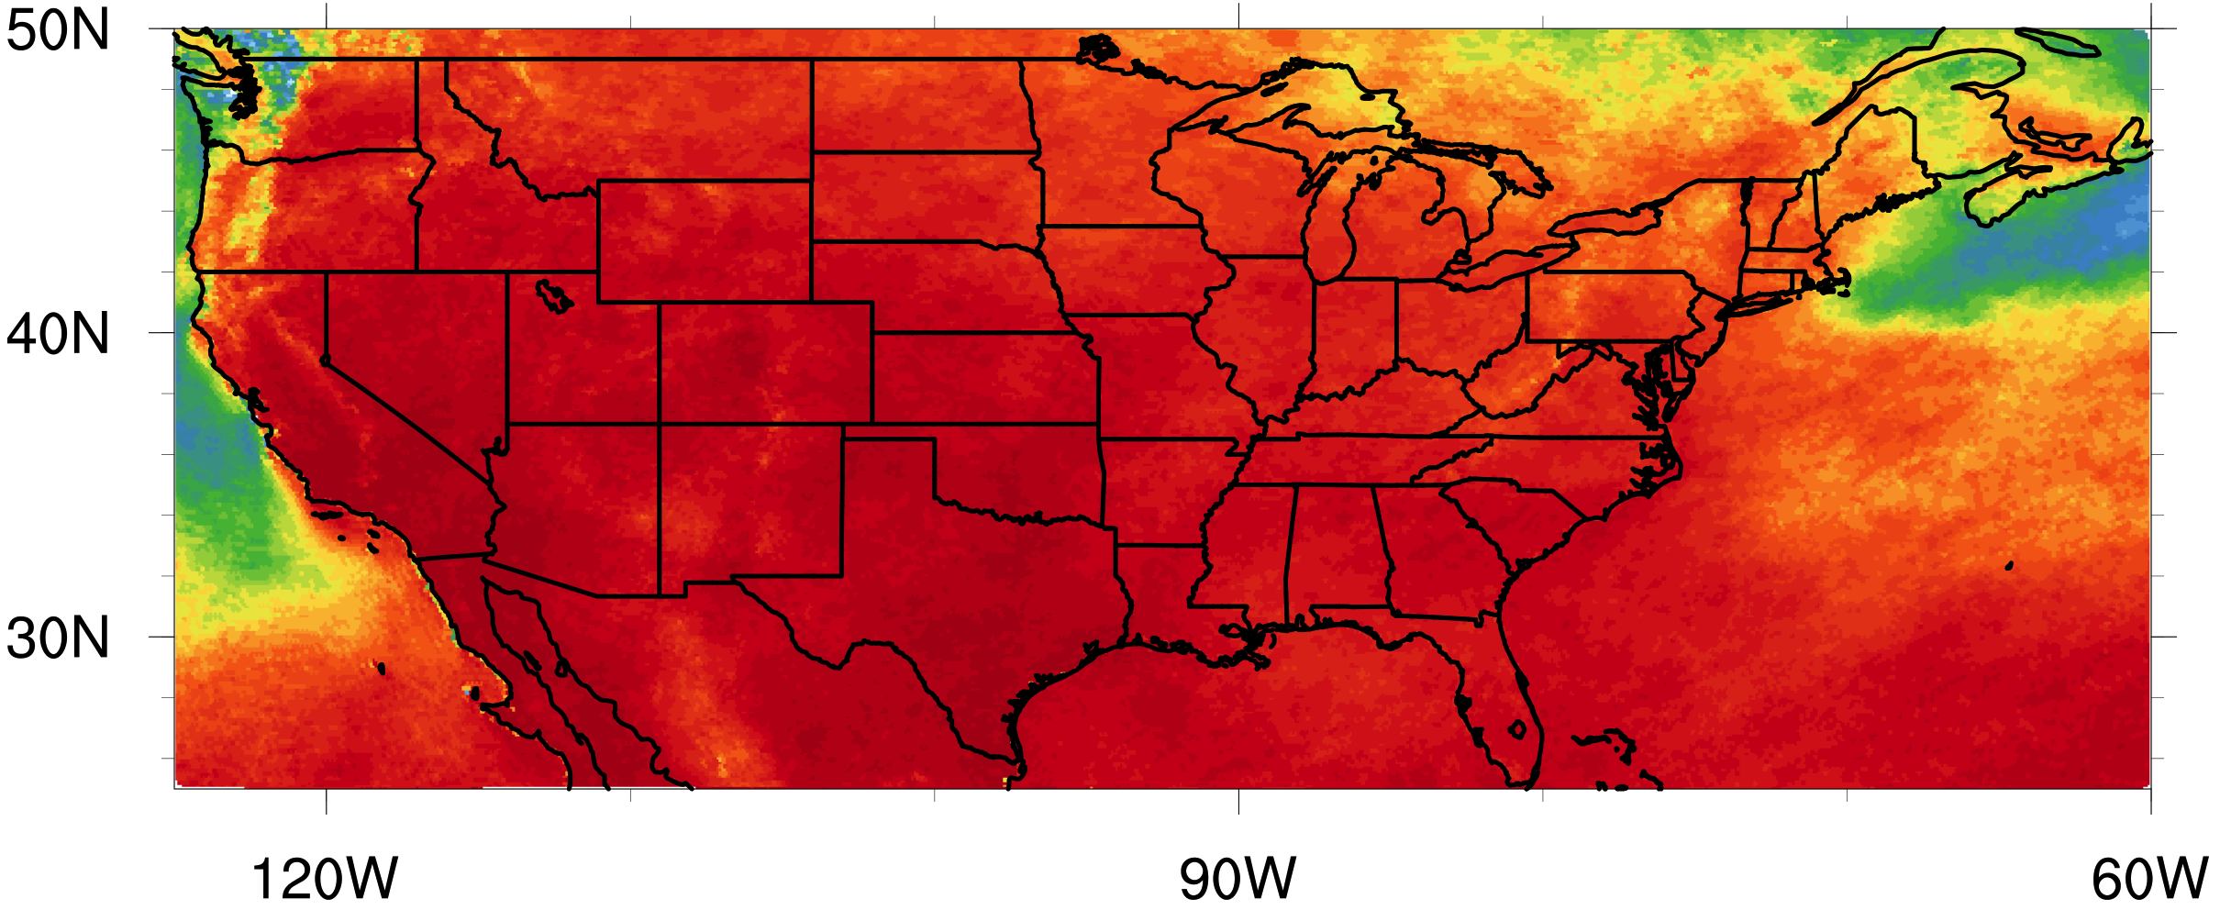
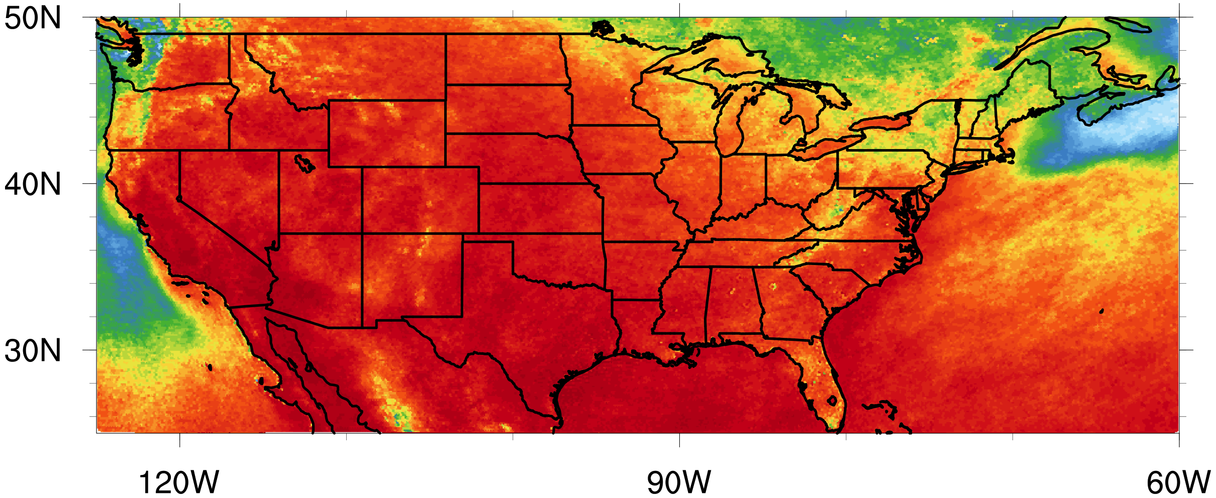
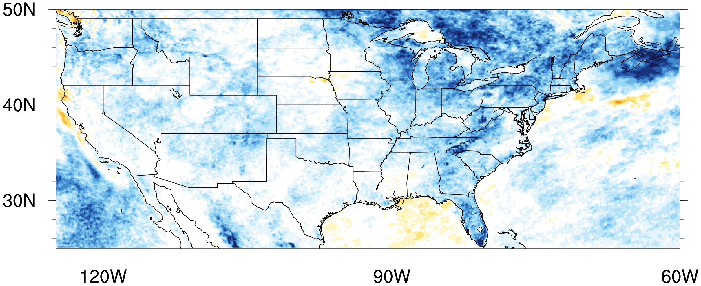
KF
MSKF
MSKF – KF
Seasonal SW Radiation
W•m⁻²/day
Notes:
Shown here is a closer look at the continental US, where the high resolution mesh is centered. With the exception of the Gulf of Mexico and a small area off the coast of Northern California, MSKF shows more clouds across the US, especially in the east/northeast.

Slide 18
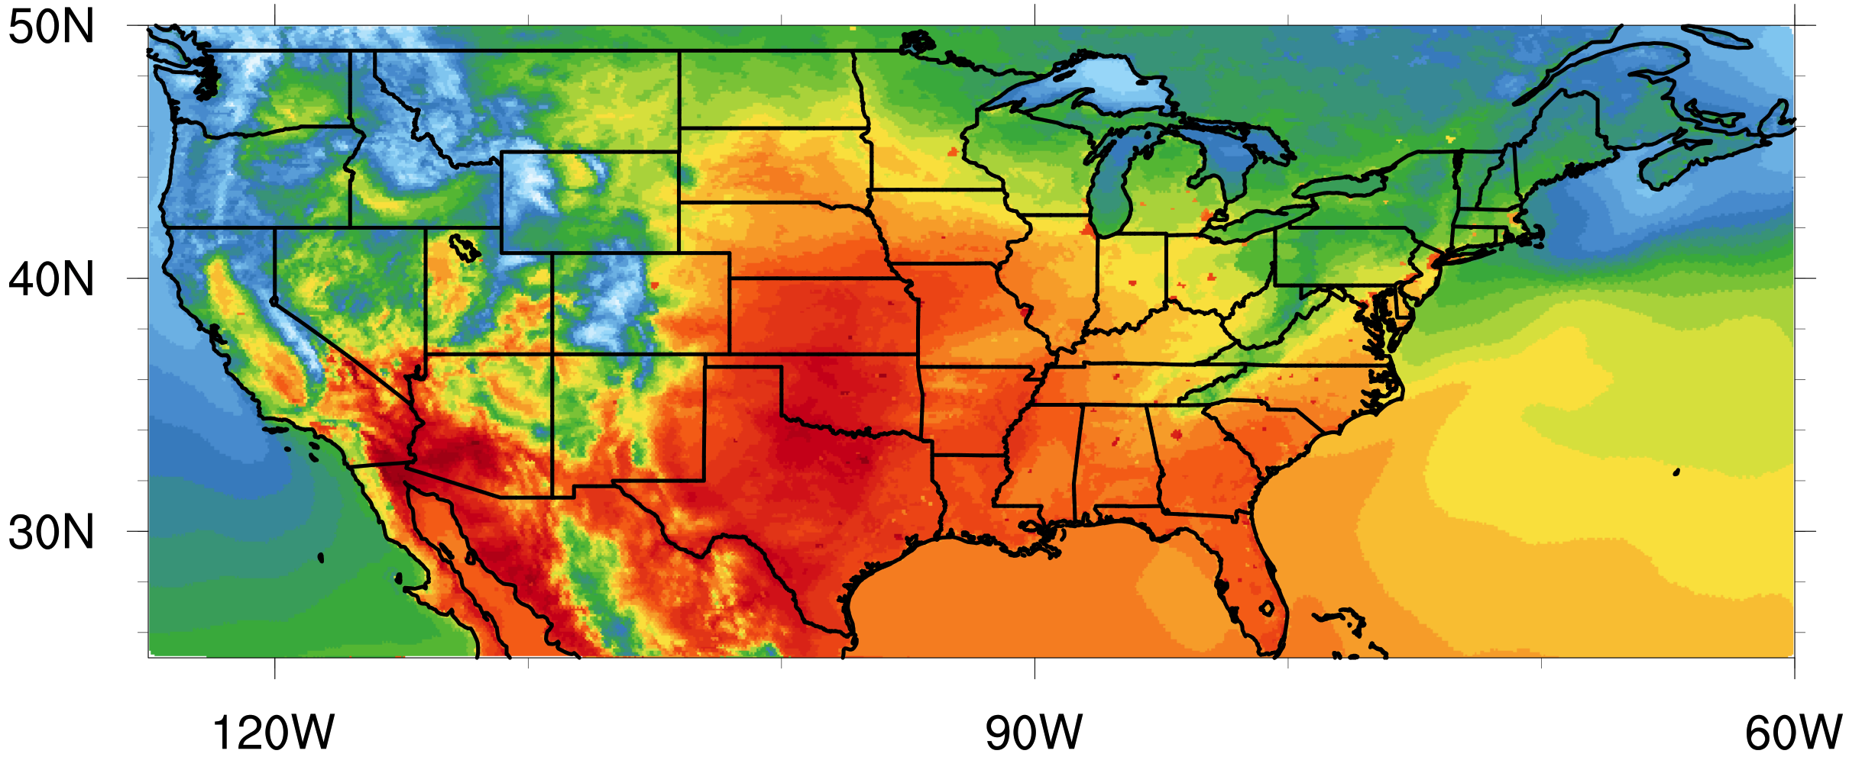
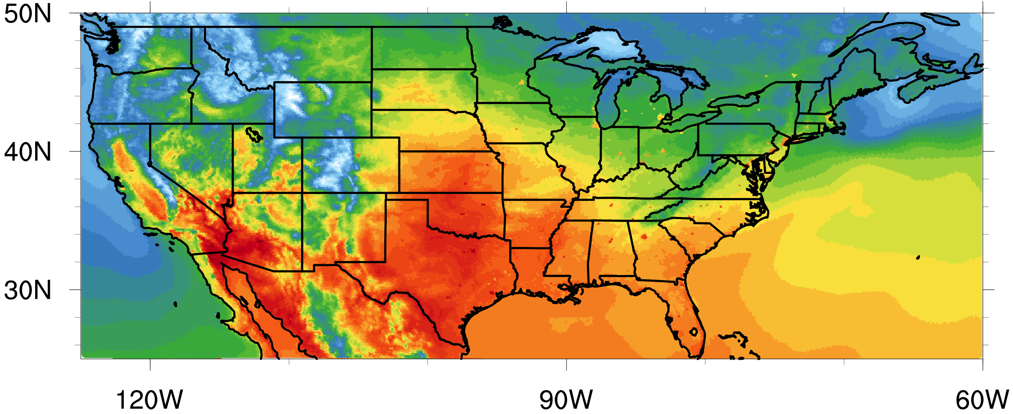
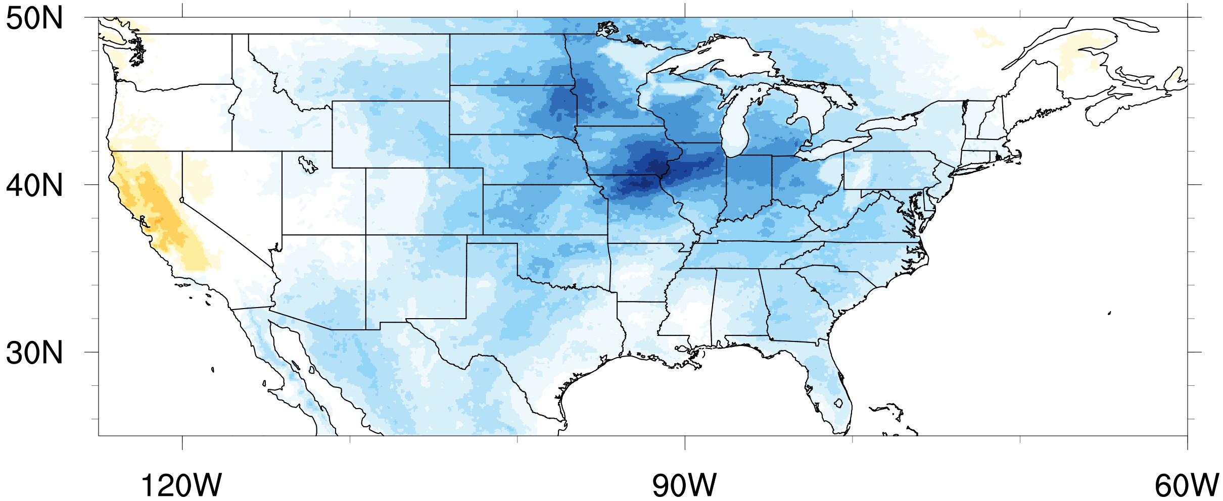
KF
MSKF
MSKF – KF
Seasonal 2m Temperature
K
Notes:
Shown here is 2m temperature for KF in the top left, MSKF in the top right and MSKF-KF at the bottom, where cool colors indicate a decrease in temperature and warm an increase. Looking at the difference in 2-m temperature between the MSKF and KF simulations over the continental US, we see what we expected based in the decrease in downward shortwave radiation at the surface, which is a decrease in 2-m temperature over most of the country. The exception is California, where there is also a decrease in cloud cover.

Slide 19
SW Radiation
W•m⁻²/day
2m Temperature
K
Notes:
It’s also important to note that the areas of maximum decrease in downward shortwave radiation at the surface do not directly correspond with the areas of maximum decrease in 2m temperature. Considering shortwave radiation is only one factor affecting near surface temperature, this is to be expected.

Slide 20
Increase in cloud cover &
decrease in near surface temperature
SW Radiation
W•m⁻²/day
2m Temperature
K
Notes:
But, overall, there is an increase in total cloud cover due to introduction of convective cloud cover to MSKF and decrease in near surface temperatures in the MSKF run, as expected.

Slide 21
Precipitation
Notes:
Alright, let’s move onto precipitation results.

Slide 22
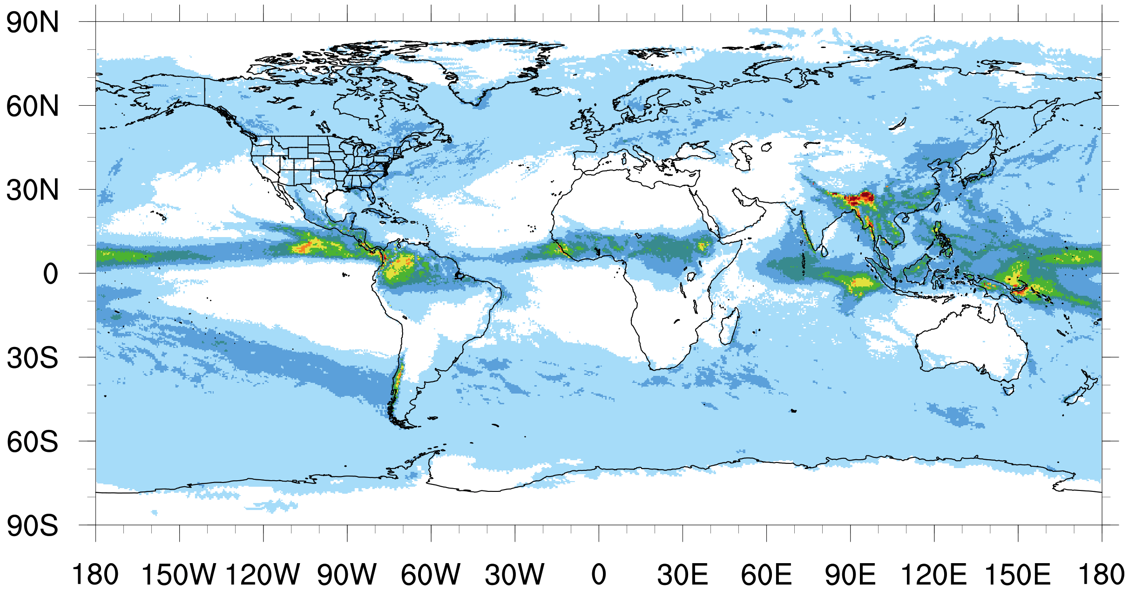
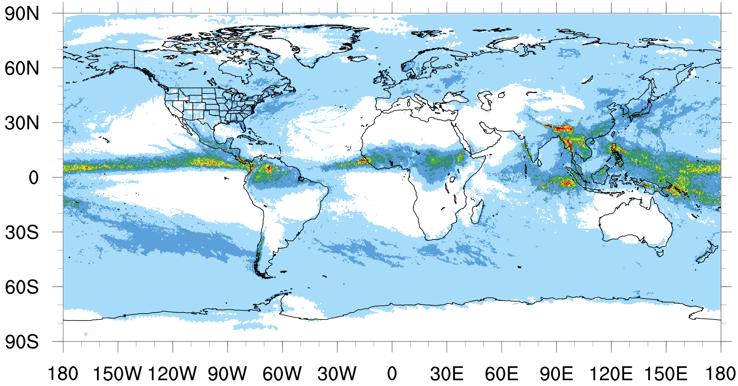
Seasonal
Precipitation
KF
MSKF
mm/day
Notes:
Shown here is average precipitation in mm per day across the season. We can see that both KF and MSKF exhibit realistic precipitation patterns and are comparable to each other, with maximums along the equator and southern Asia and minimums in northern and southern Africa and Australia.

Slide 23
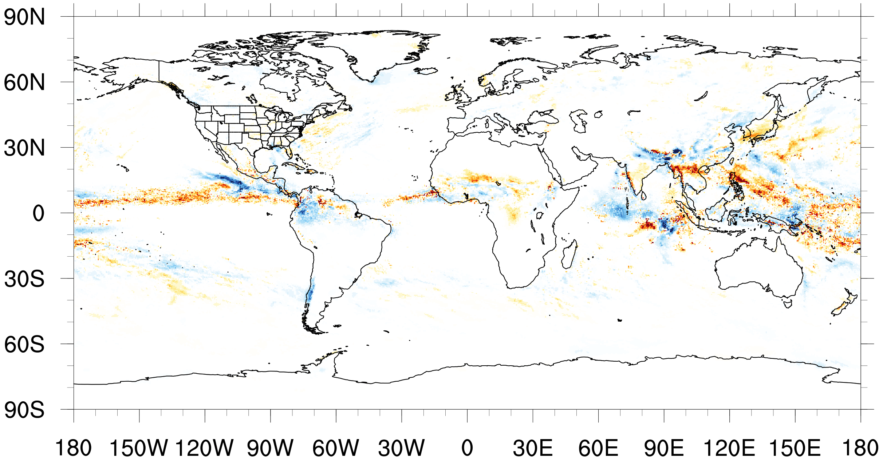
MSKF – KF
mm/day
Seasonal Precipitation
Notes:
Taking a look at the difference in precipitation between MSKF and KF gives us a closer look at the differences in precipitation. Here, warm colors indicate more precipitation associated with the MSKF run and cool colors indicate a decrease. Like the differences in cloud cover, we see an increase in precipitation along the ITCZ. There’s also an increase south of China and along the west coast of India. These changes in both precipitation and cloud cover suggest MSKF may be simulating a stronger Asian monsoon, but we need to look into that more to say for sure.

Slide 24
Seasonal
Precipitation
KF
MSKF
mm/day
Notes:
Another notable difference between these seasonal patterns of precipitation between KF and MSKF is the structure, particularly along the ITCZ. For example, in this area along the equator in the eastern Pacific, the structure in MSKF appears more elongated and banded whereas in the KF run, it’s more localized.

Slide 25
KF
MSKF
TRMM
Seasonal
Precipitation
mm/day
Notes:
Comparing KF and MSKF with the TRMM data, and looking, again, at this area in the eastern Pacific, we that the more elongated, less localized structure associated with the MSKF run more closely resembles observations.

Slide 26
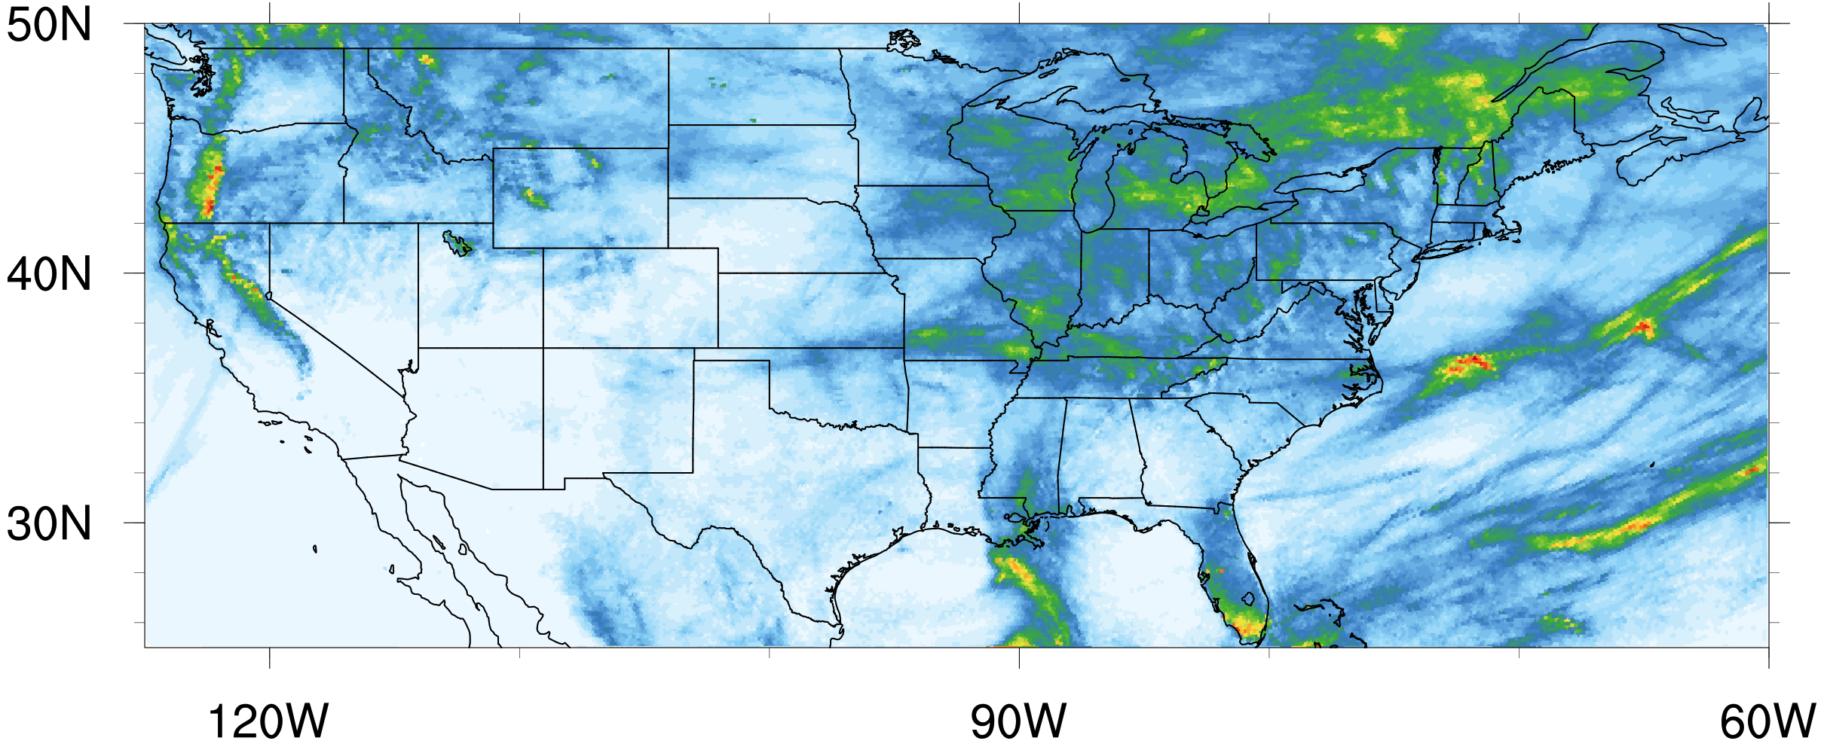
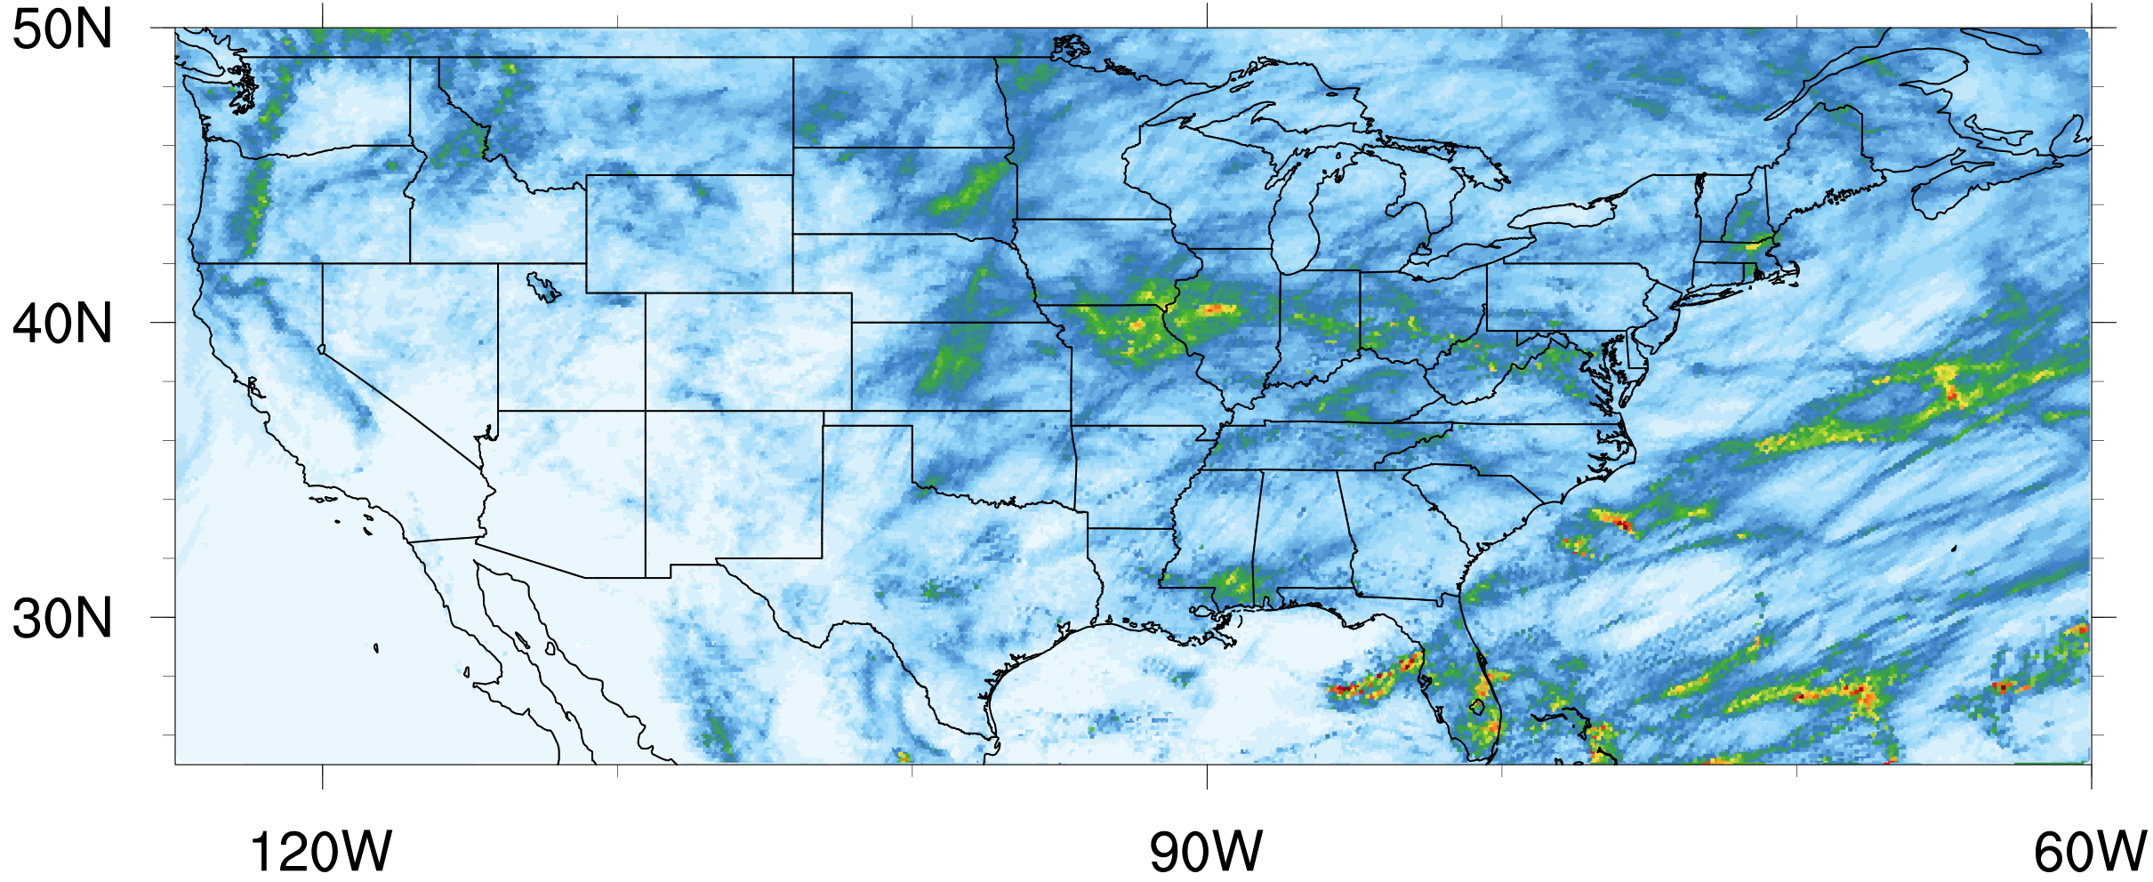
KF
MSKF
May
Monthly Precipitation
mm/day
Notes:
Zooming in on the US, again, where the high-resolution mesh is centered, let’s take a look at monthly mean precipitation, in mm/day. In May, there are some differences between the two runs, but both appear to have similar and realistic patterns over the US.

Slide 27
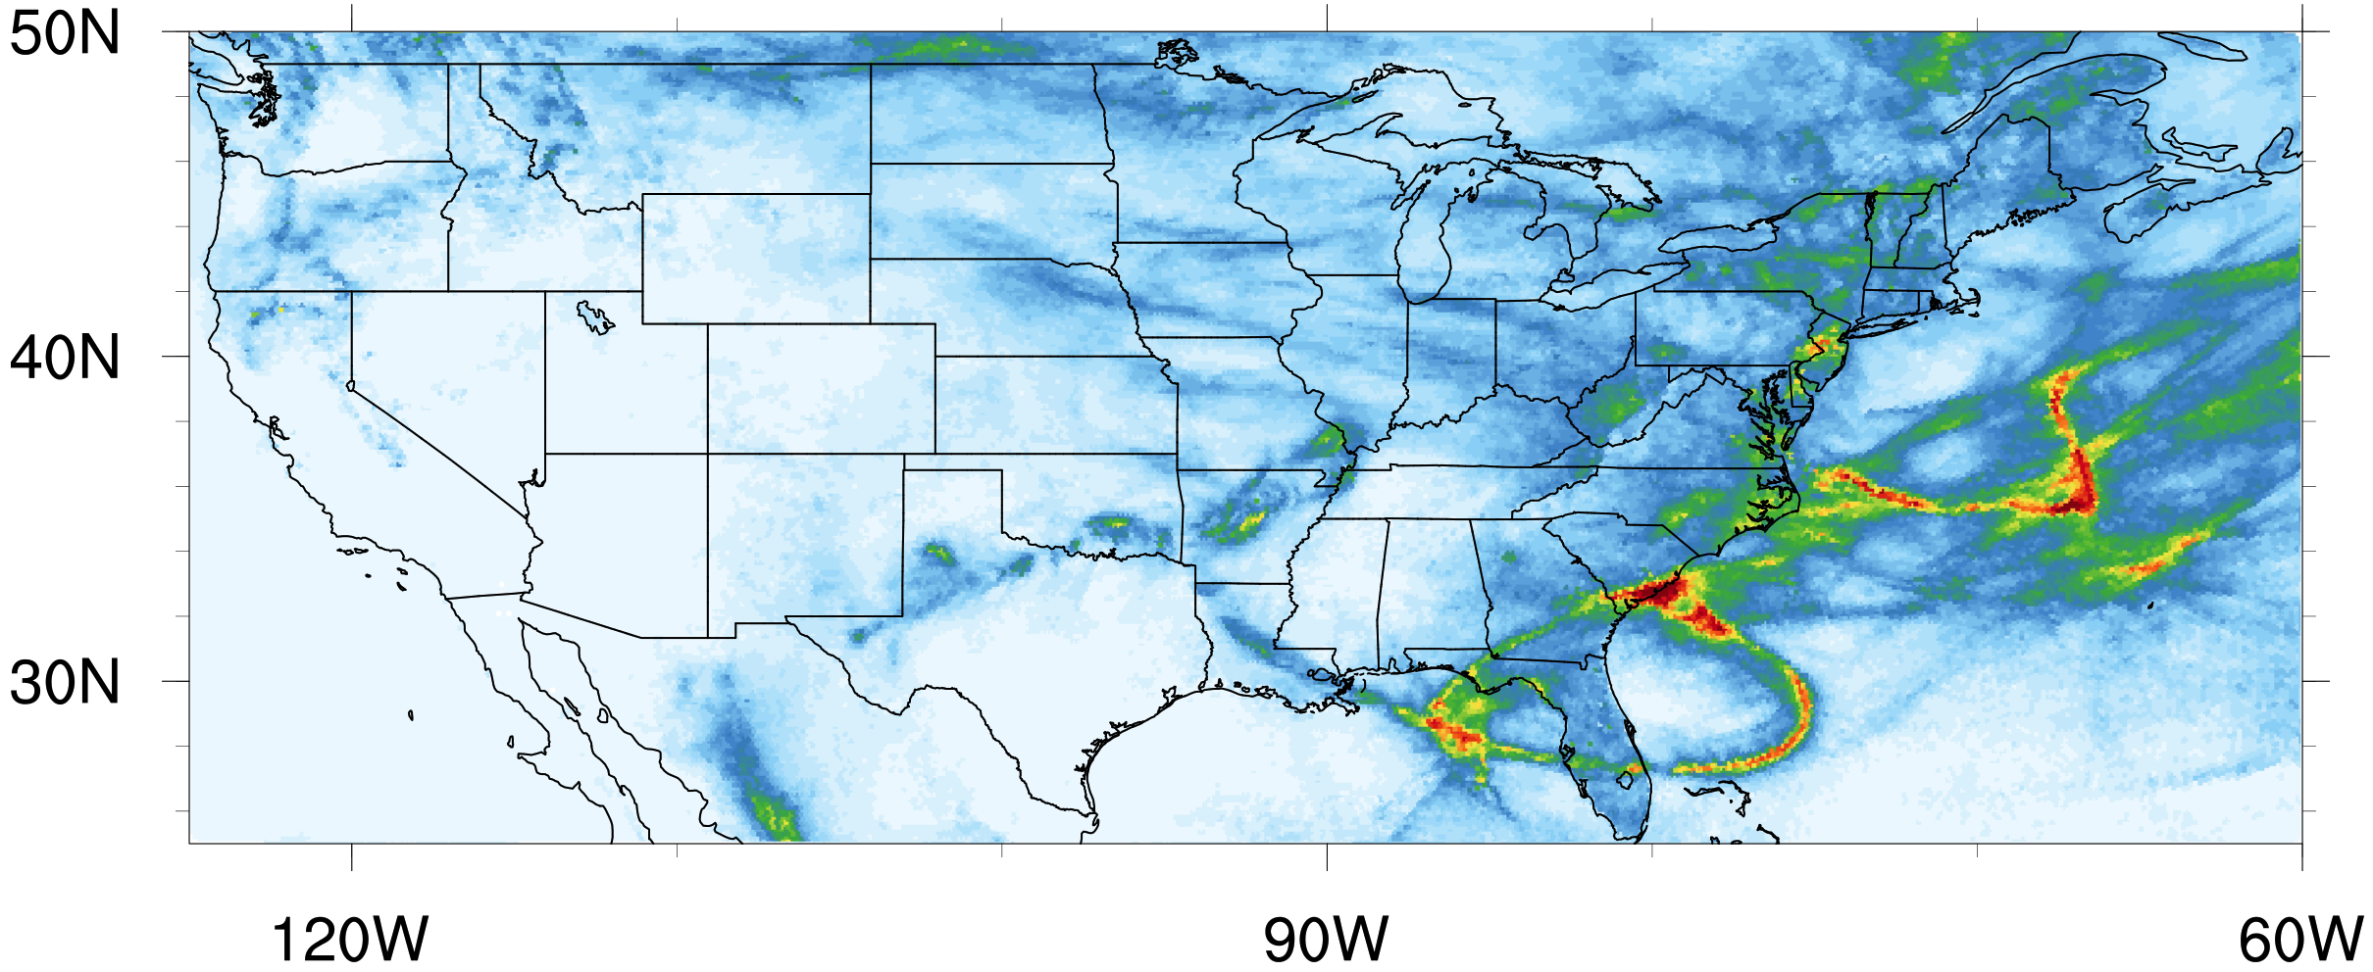
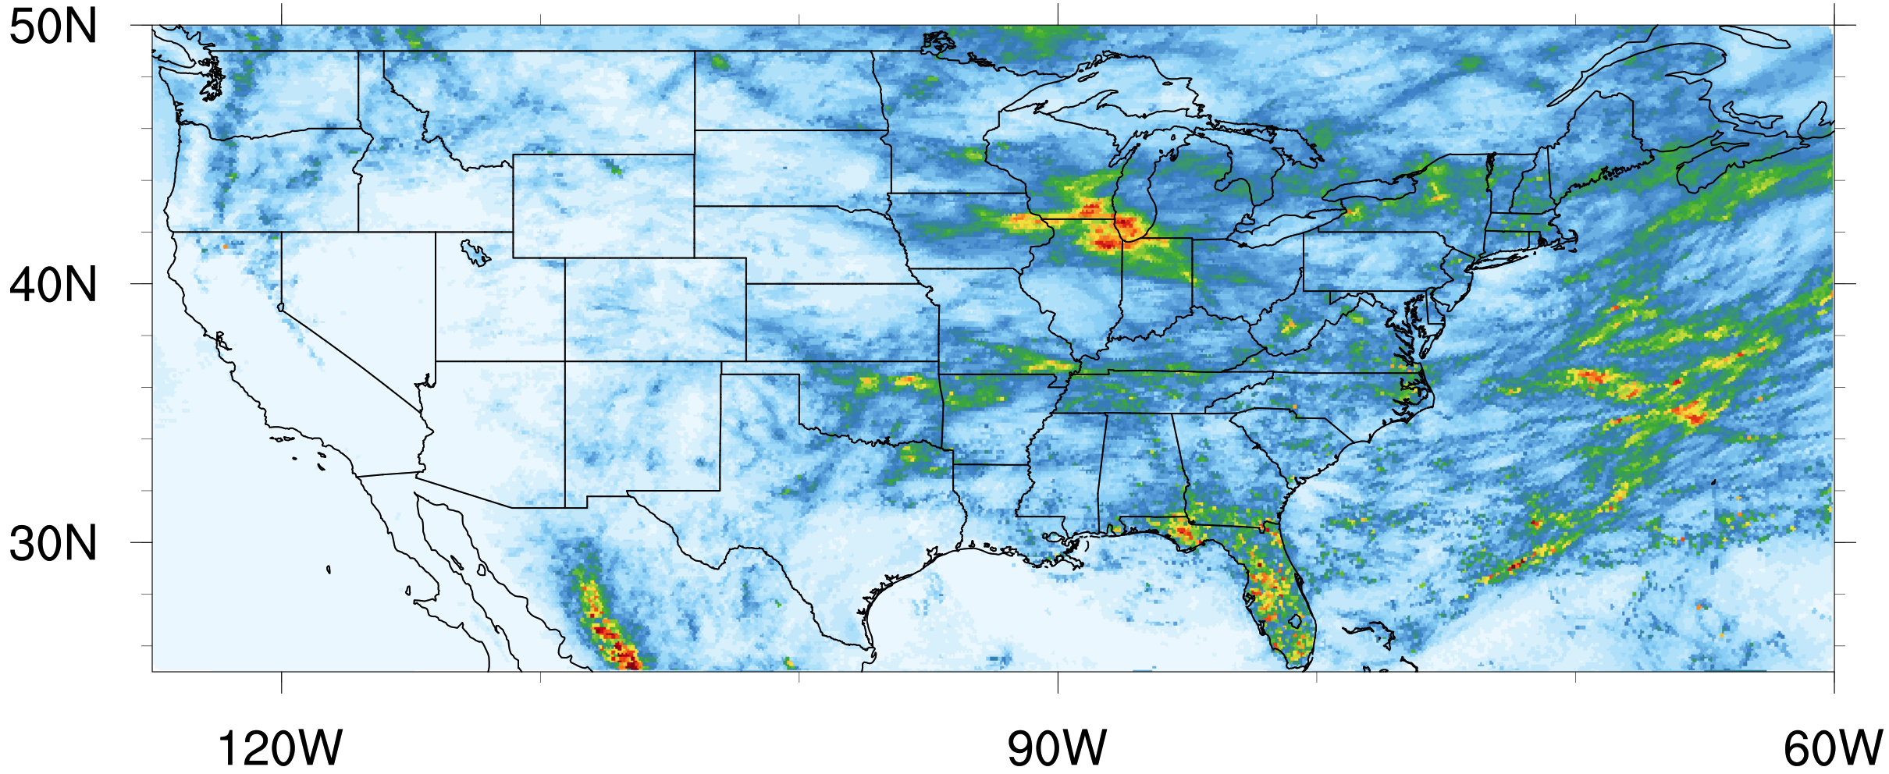
KF
MSKF
May
June
Monthly Precipitation
mm/day
Notes:
Going into June, however, we start to see some notable differences. This area around Florida has an interesting pattern in the KF run, which doesn’t appear in the MSKF run. There’s also this area in the Atlantic where the precipitation is more spread out in the MSKF run. Furthermore, there’s more precipitation evident in the midwest in the MSKF run.

Slide 28
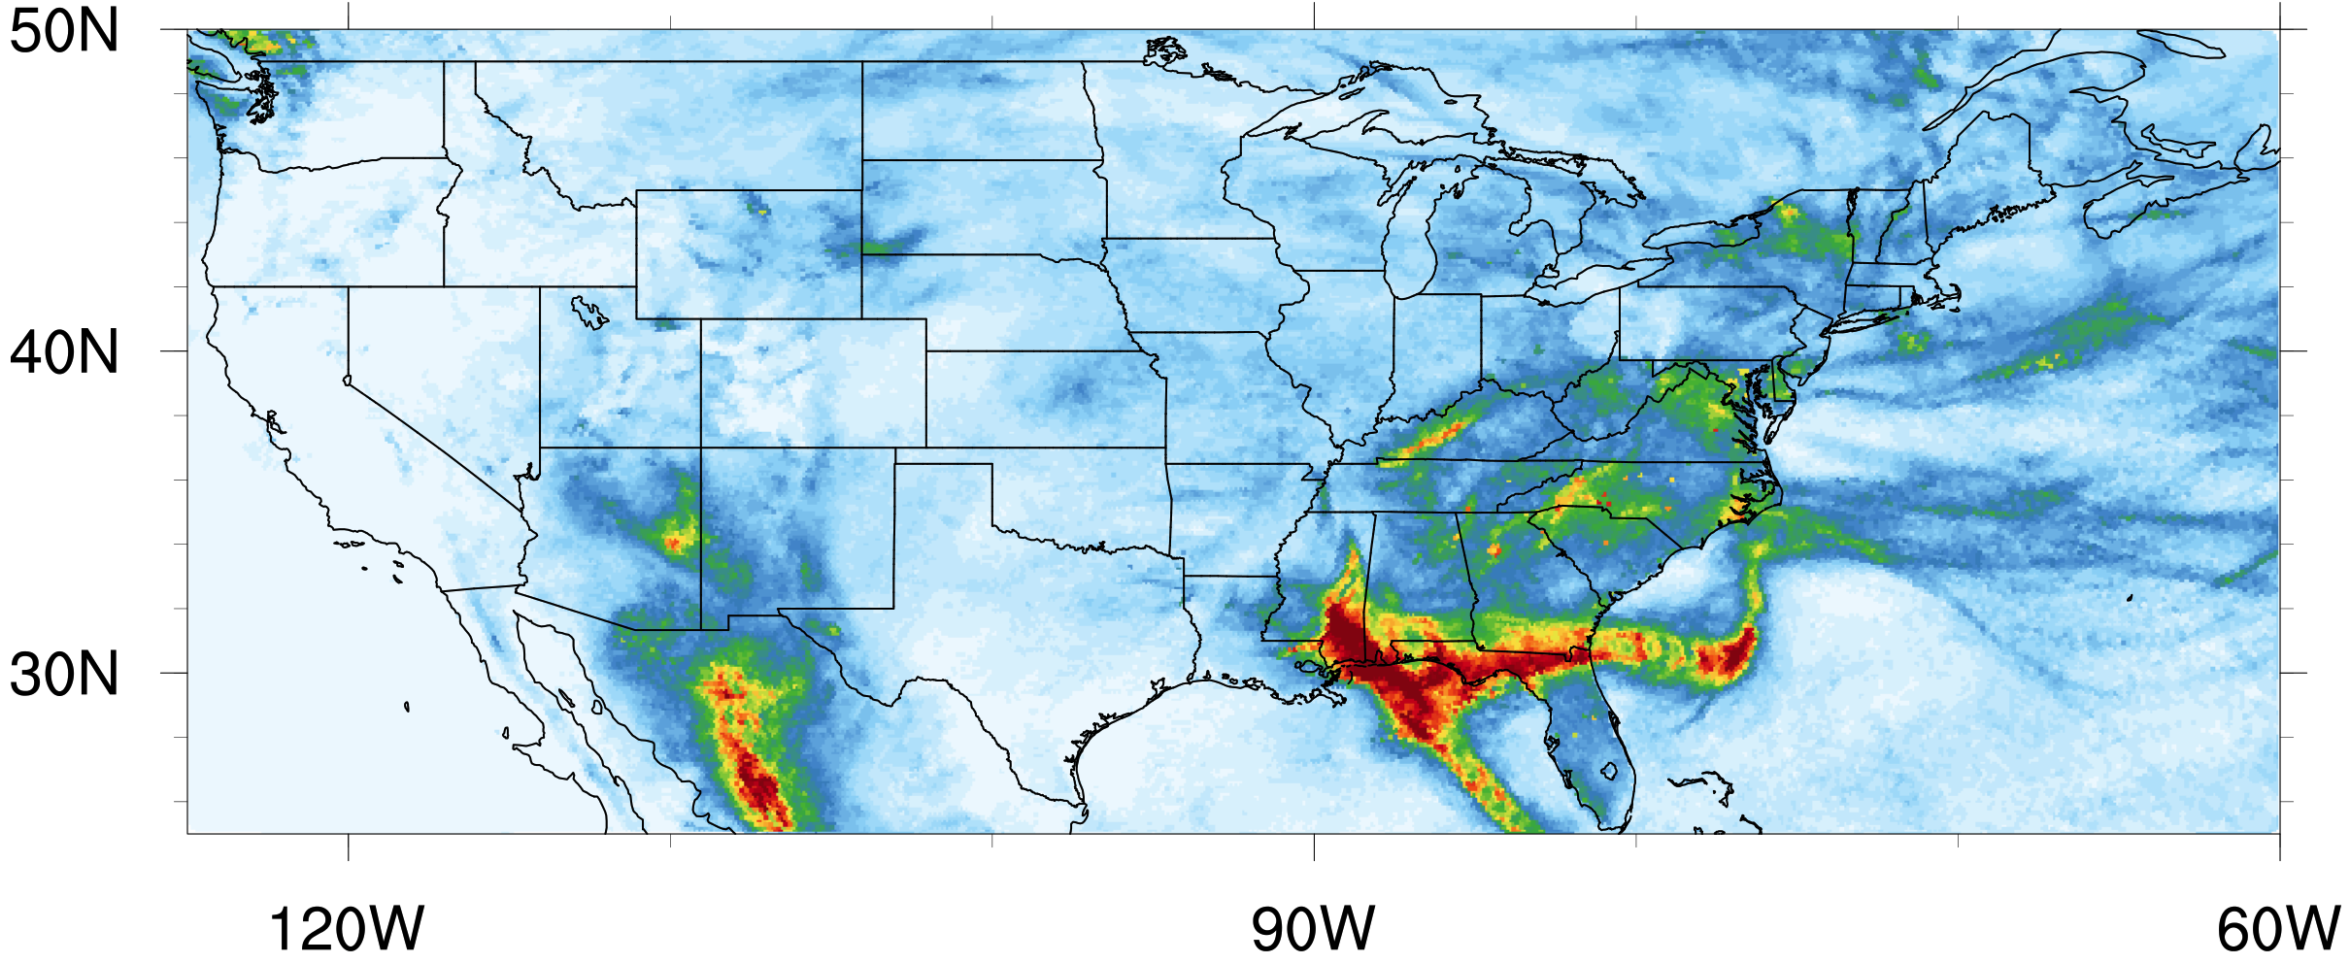
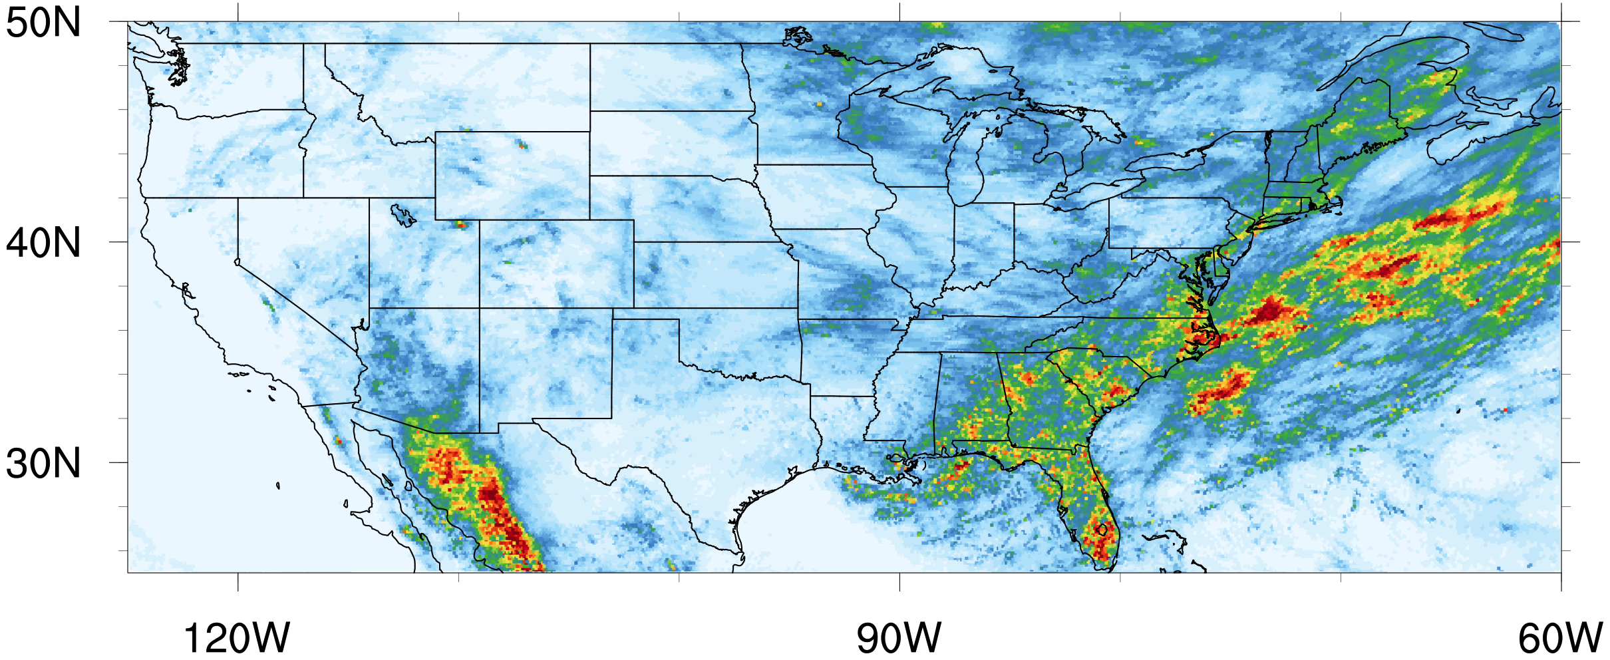
KF
MSKF
May
June
July
Monthly Precipitation
mm/day
Notes:
Looking at July, we can see the largest differences occur off the Gulf Coast and off the Atlantic Coast. The pattern exhibited by MSKF matches the pattern shown by previous runs of this case done with the WRF model. The pattern in the KF run, however, looks unrealistic.

Slide 29
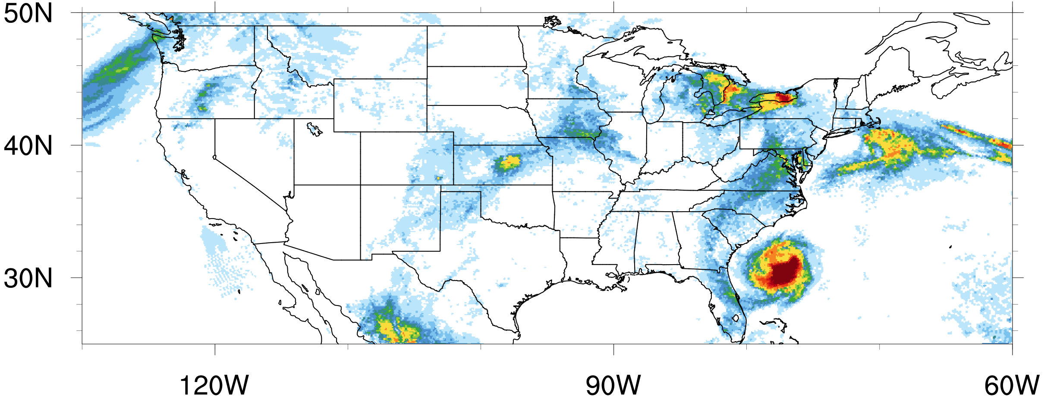
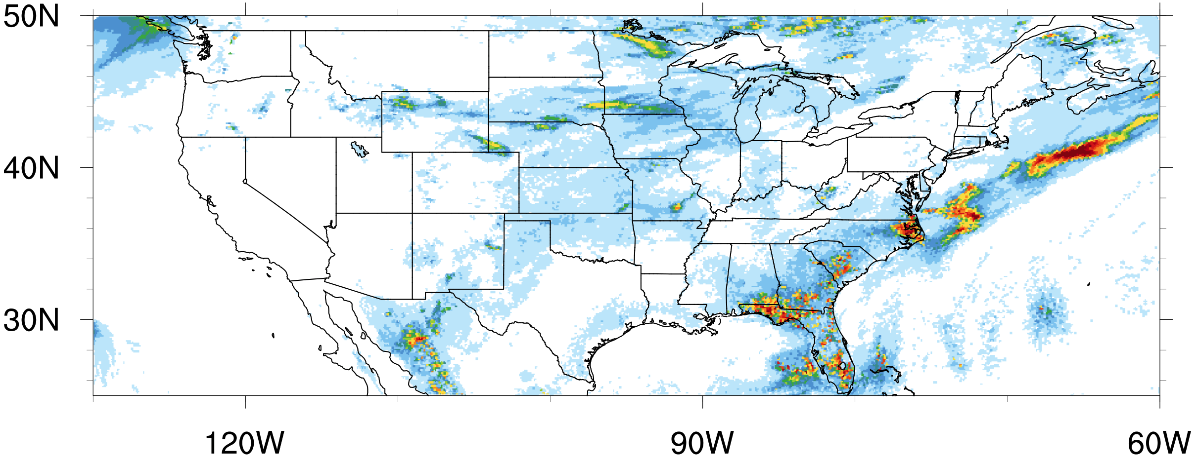
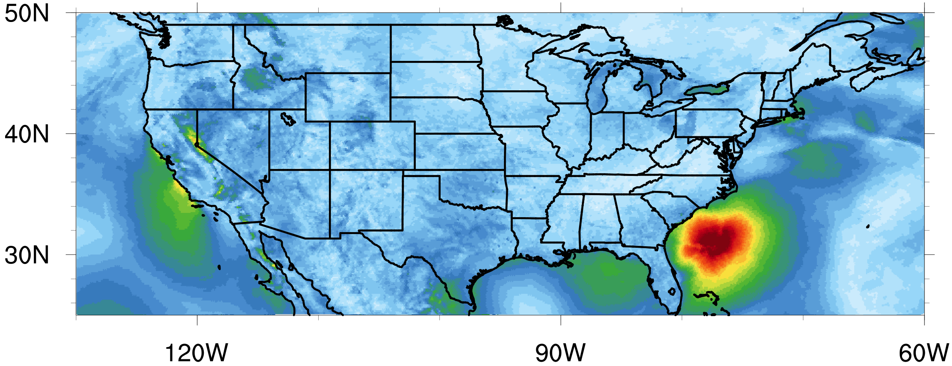
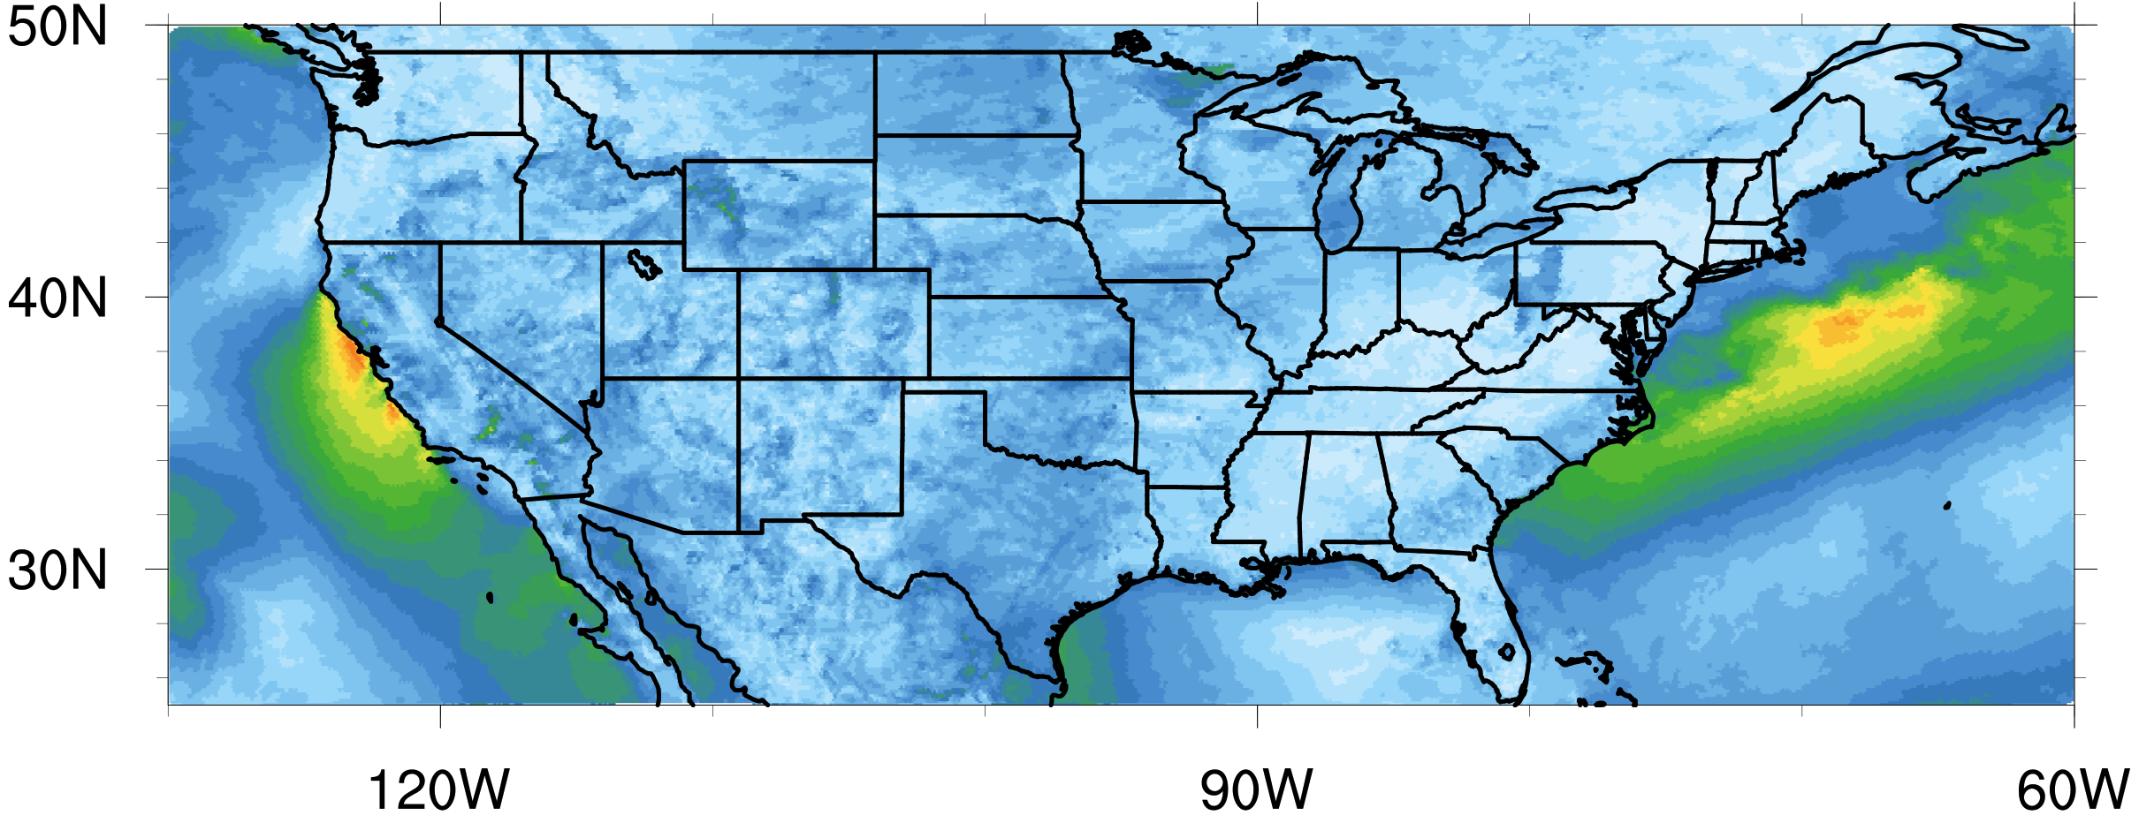
KF
MSKF
Precipitation
mm/day
10m Wind
m/s
21 July 2006
Notes:
To illustrate one potential cause of this discrepancy in precipitation between KF and MSKF, let’s take a look at daily mean precipitation and daily mean wind speed for July 21 2006. We can clearly see that there is some kind of system that has spun up in the KF simulation, that is not in the MSKF run.

Slide 30
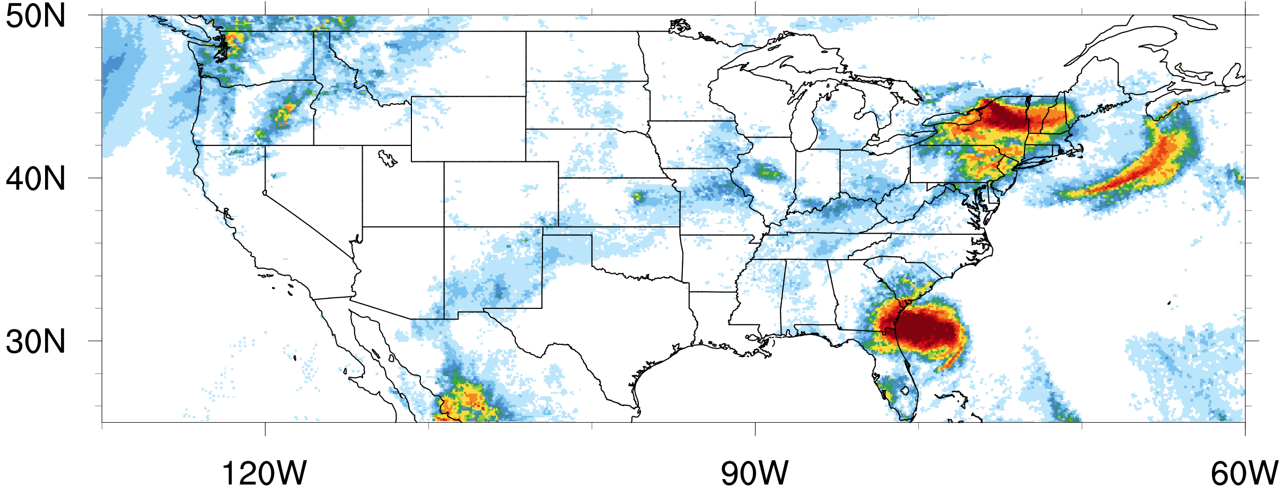
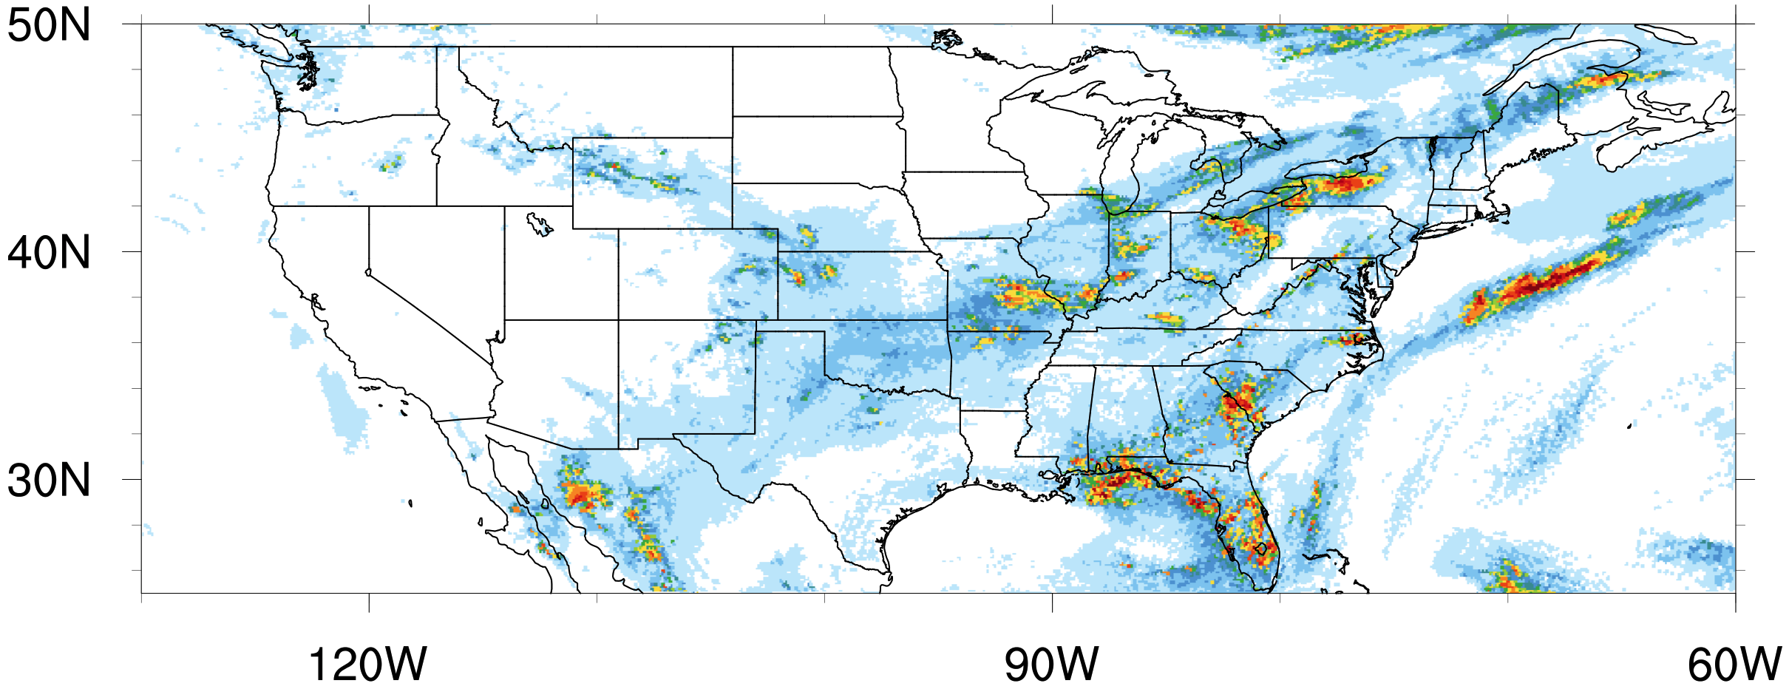
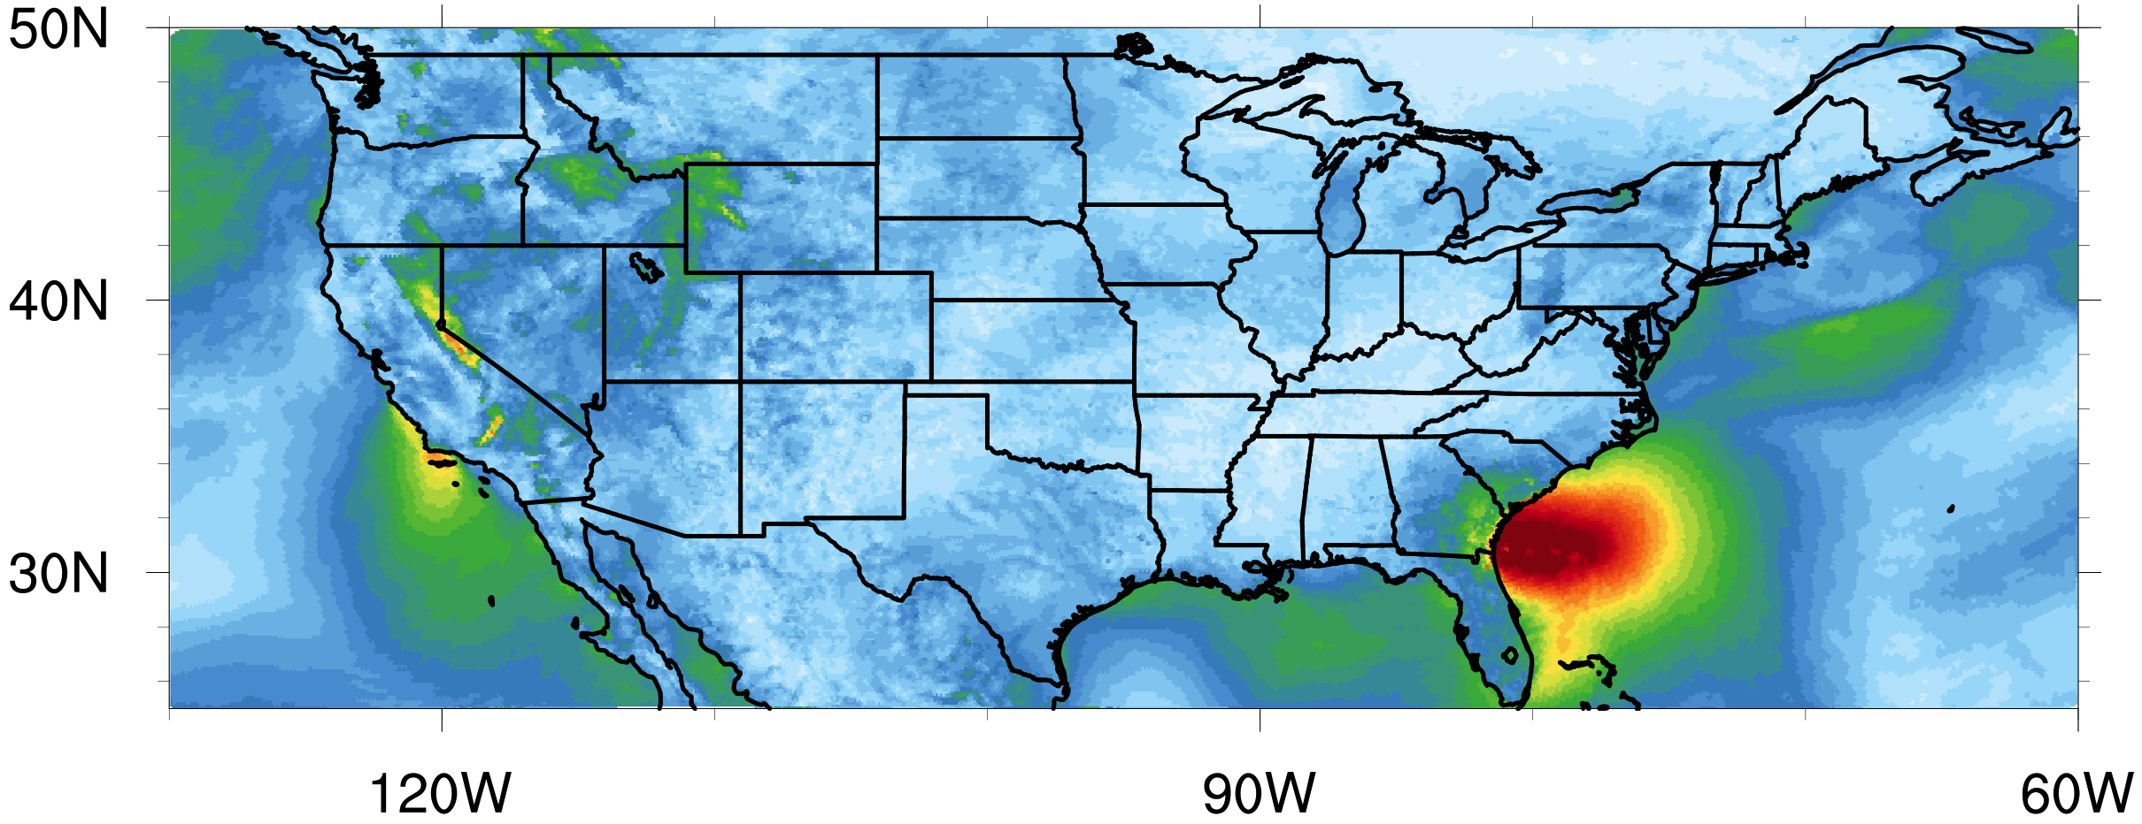
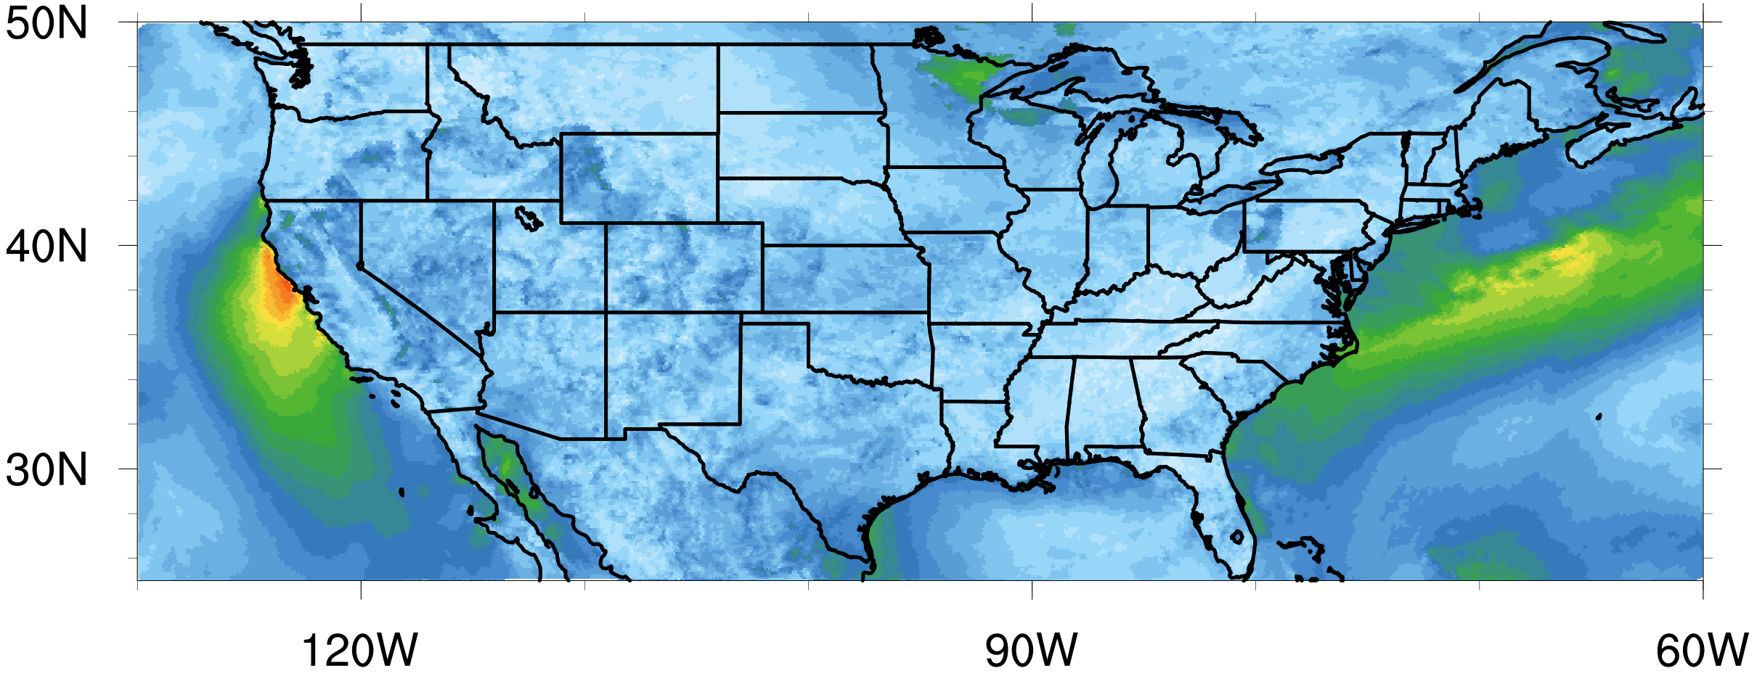
KF
MSKF
Precipitation
mm/day
10m Wind
m/s
22 July 2006
Notes:
As we move through time over the next few days, there is some precipitation activity off northern Florida and the gulf coast of Mississippi and Louisiana with MSKF,

Slide 31
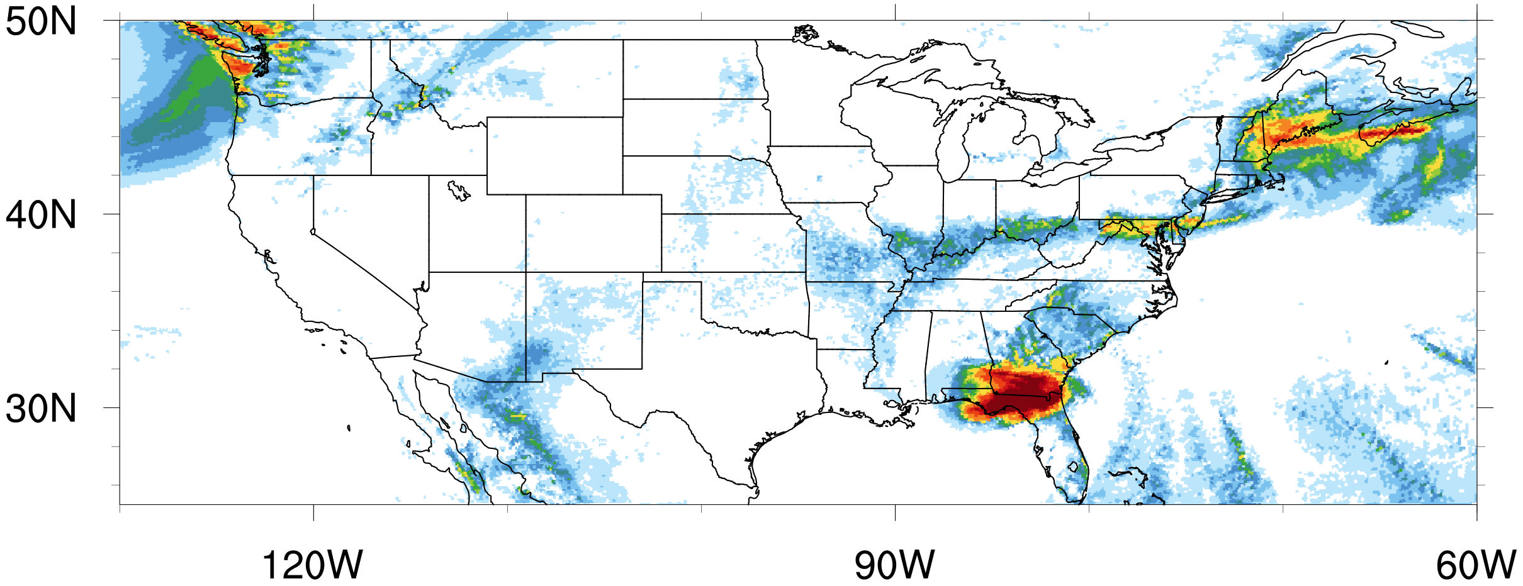
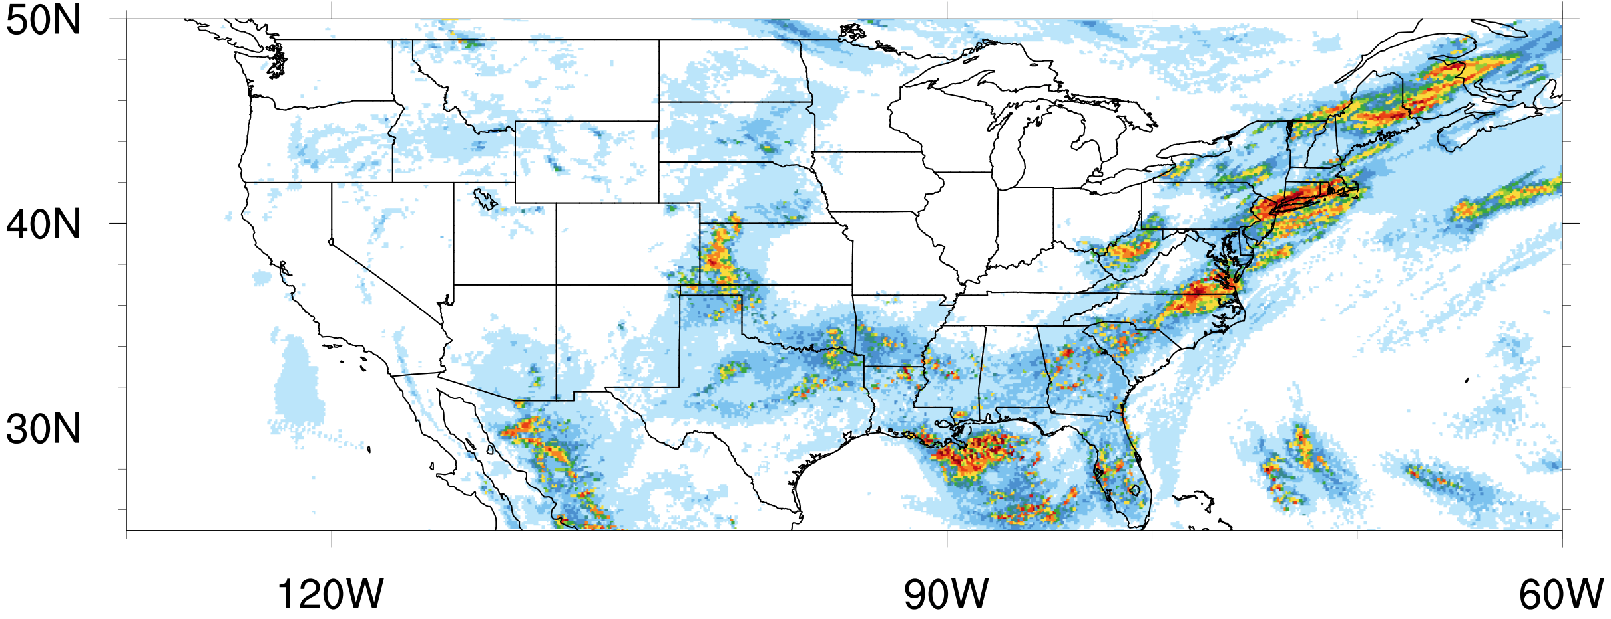
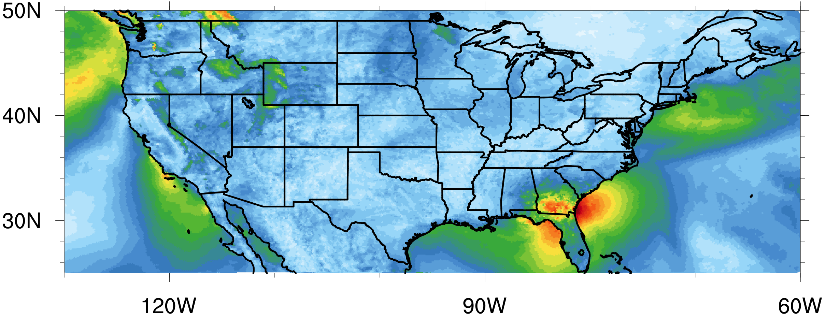
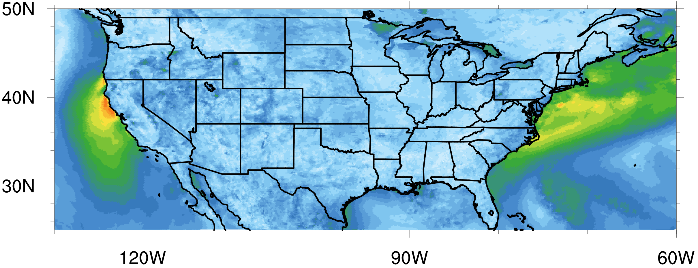
KF
MSKF
Precipitation
mm/day
10m Wind
m/s
23 July 2006
Notes:
but not nearly as concentrated and systematic as in the KF simulation.

Slide 32
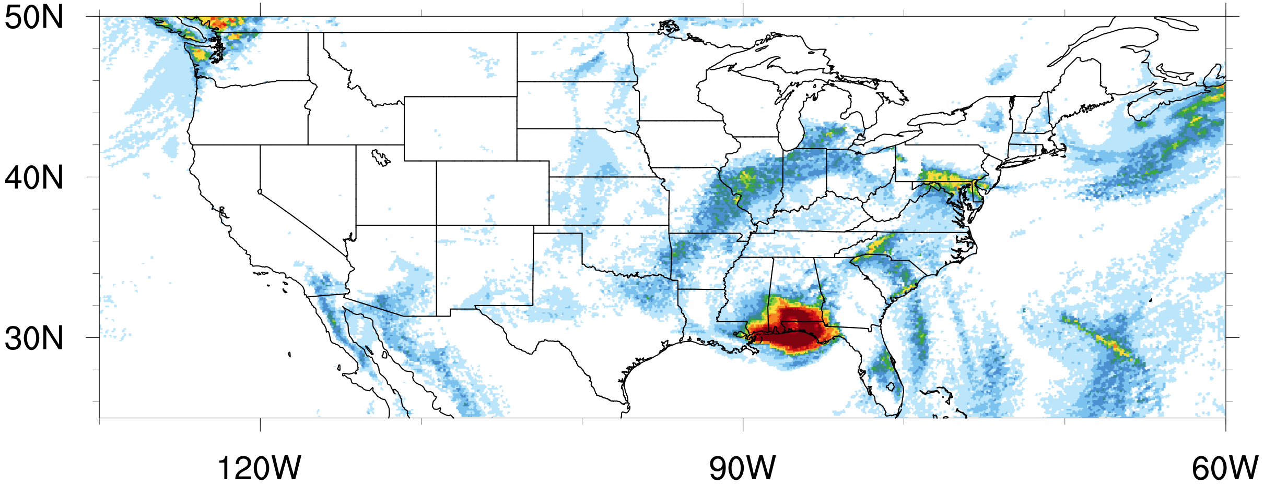
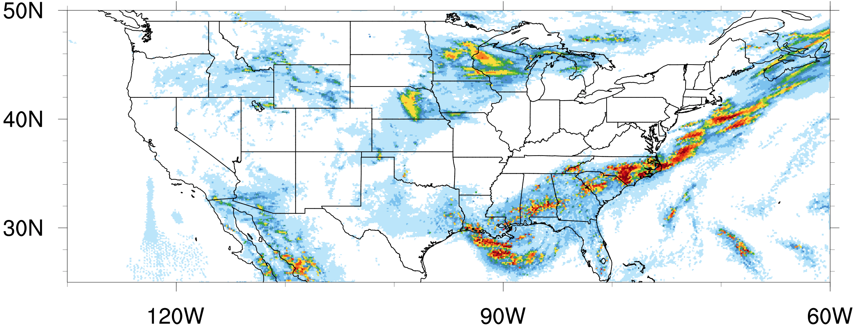
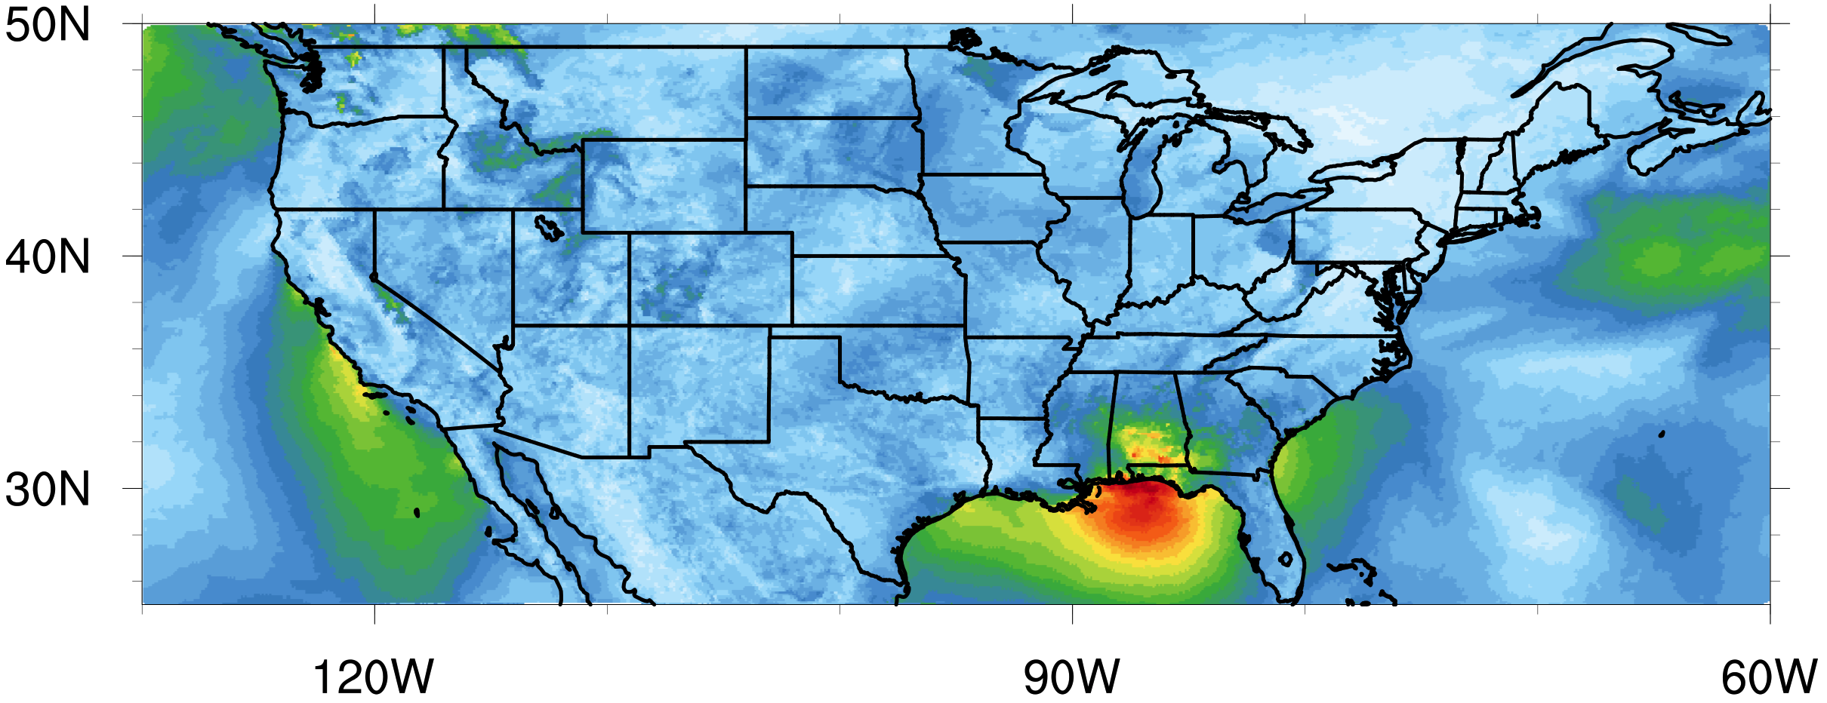
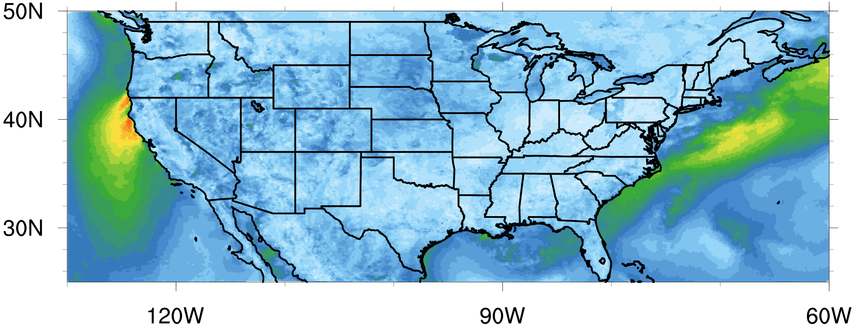
KF
MSKF
Precipitation
mm/day
10m Wind
m/s
24 July 2006
Notes:
You can also see that KF misses a lot of the precipitation occurring over the Atlantic coast. We can see this especially well here on July 24.
We know that the precipitation pattern with MSKF more closely resembles that of previous WRF simulations, but more investigation needs to be done to figure out what’s going on.

Slide 33
Conclusions
Increase in cloud cover with MSKF?
Yes
Along ITCZ, southern Asia, US
Decrease in near surface temperature
Notes:
All in all, was there an increase in cloud cover associated with the MSKF simulation? Yes, most notably along the ITCZ, in southern Asia, and throughout the continental US. As expected, this increase in cloud cover resulted in a decrease in 2m temperature over the US

Slide 34
Conclusions
Decrease in precipitation?
No
Increase along ITCZ, southern Asia
More elongated structure → matches obs
Differences over US unclear
→ potential biases unclear
Notes:
Looking at precipitation, we did not see the decrease we expected, but it’s also not clear if there is a moist bias with KF in MPAS. We saw an increase along the ITCZ and southern Asia. The pattern of precipitation in the MSKF run is also more elongated, which more closely matches observations. Differences over the US, however, should be taken with a grain of salt, given the unrealistic pattern of precipitation in the KF run.

Slide 35
Ongoing/Future Work
Investigate potential issues with KF
Problems with variable grid over long-term
Compare results with observational data
Test MSKF with finer grid
3-9km variable resolution grid
Activate aerosol awareness
Notes:
First things first, it appears the traditional KF scheme performs fine for short term simulations and uniform grid spacings, but is not functional over variable grids over long term simulations, which warrants further investigation. Second, we’ve got several observational data sources to use for evaluation of both schemes. We would also like to test MSKF with a finer grid, with 3km over the continental US expanding out to 9km to really get a feel for how this scheme performs in the “no man’s land” of convective parameterizations. Last, this is being tested out in WRF now, but including variable aerosol arrays and communication between convective and microphysics scheme would be future step.

Slide 36
Acknowledgements
This research was supported in part by the ACE program through the Research Participation Program for the U.S. Environmental Protection Agency, Office of Research and Development, administered by the Oak Ridge Institute for Science and Education through an interagency agreement between the U.S. Department of Energy and EPA.
Bill Skamarock, Laura Fowler, Michael Duda at NCAR
Notes:
I would like to acknowledge ORISE and the EPA for their support of this project over the past few months. I would also like to thank Bill Skamarock, Laura Fowler, and Michael Duda at NCAR for their help in getting MPAS up and running with MSKF. With that, I’ll take any questions.

Slide 37
Questions?

Slide 38
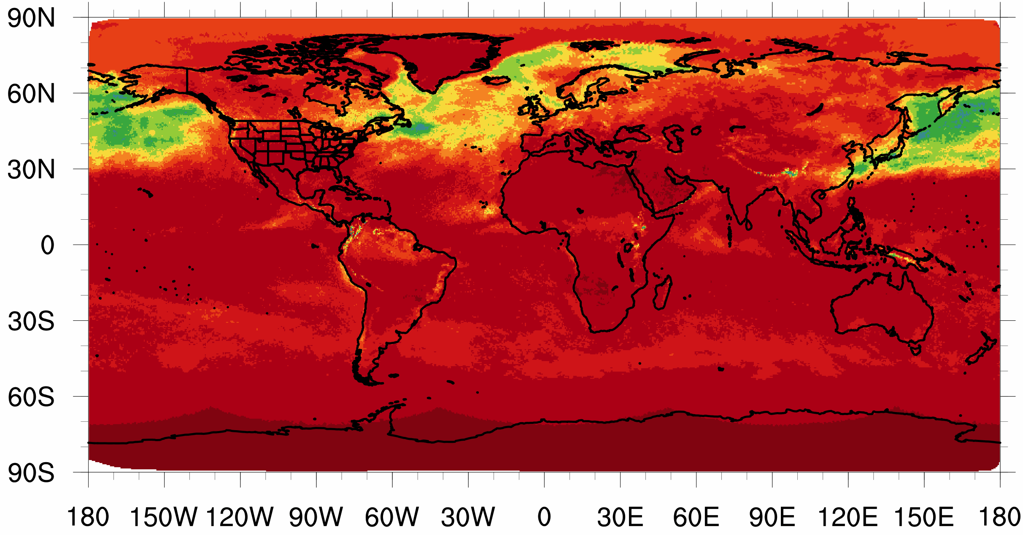
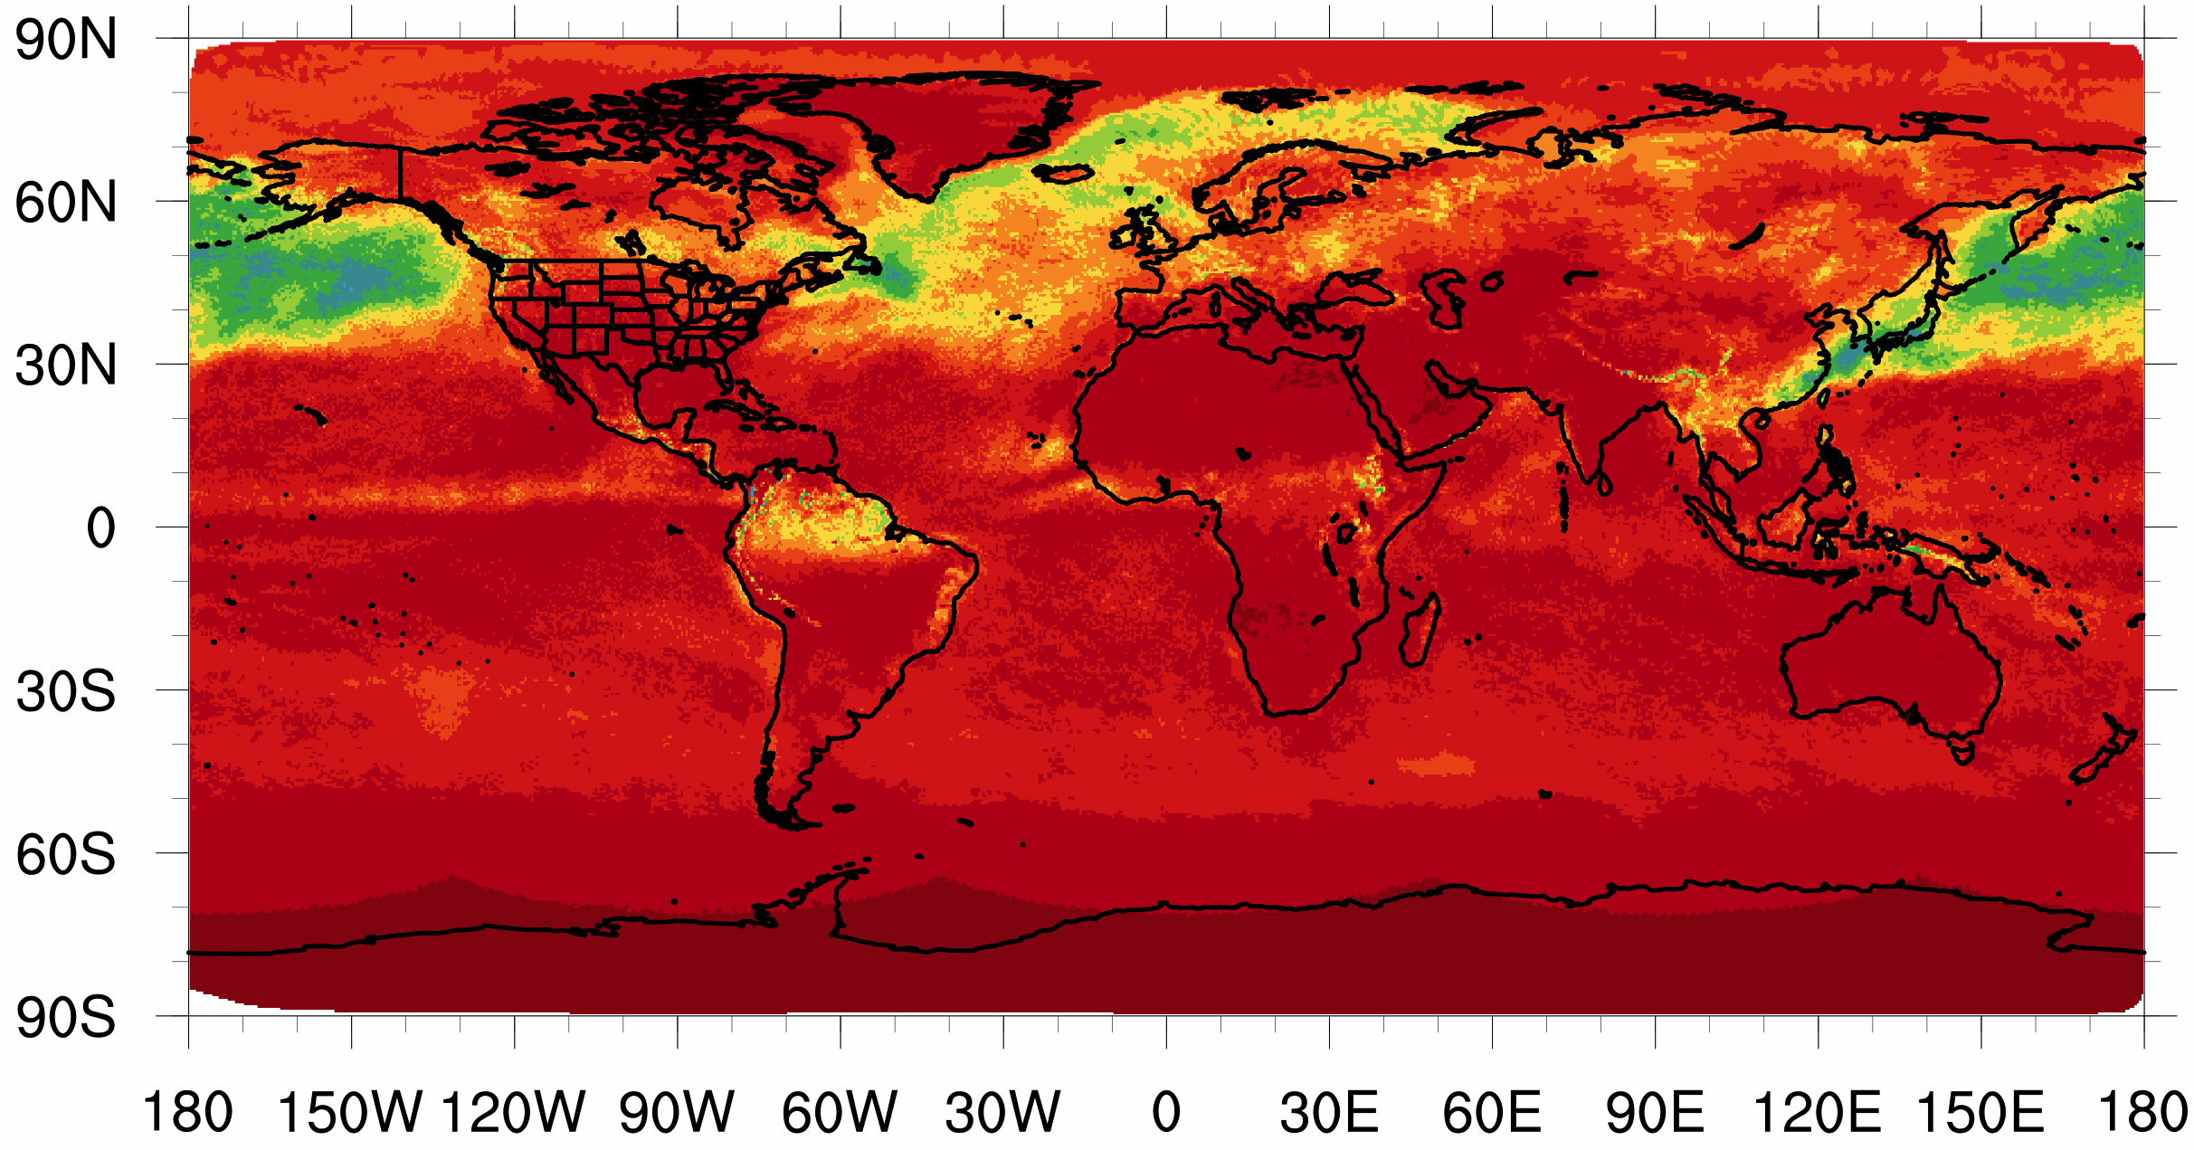
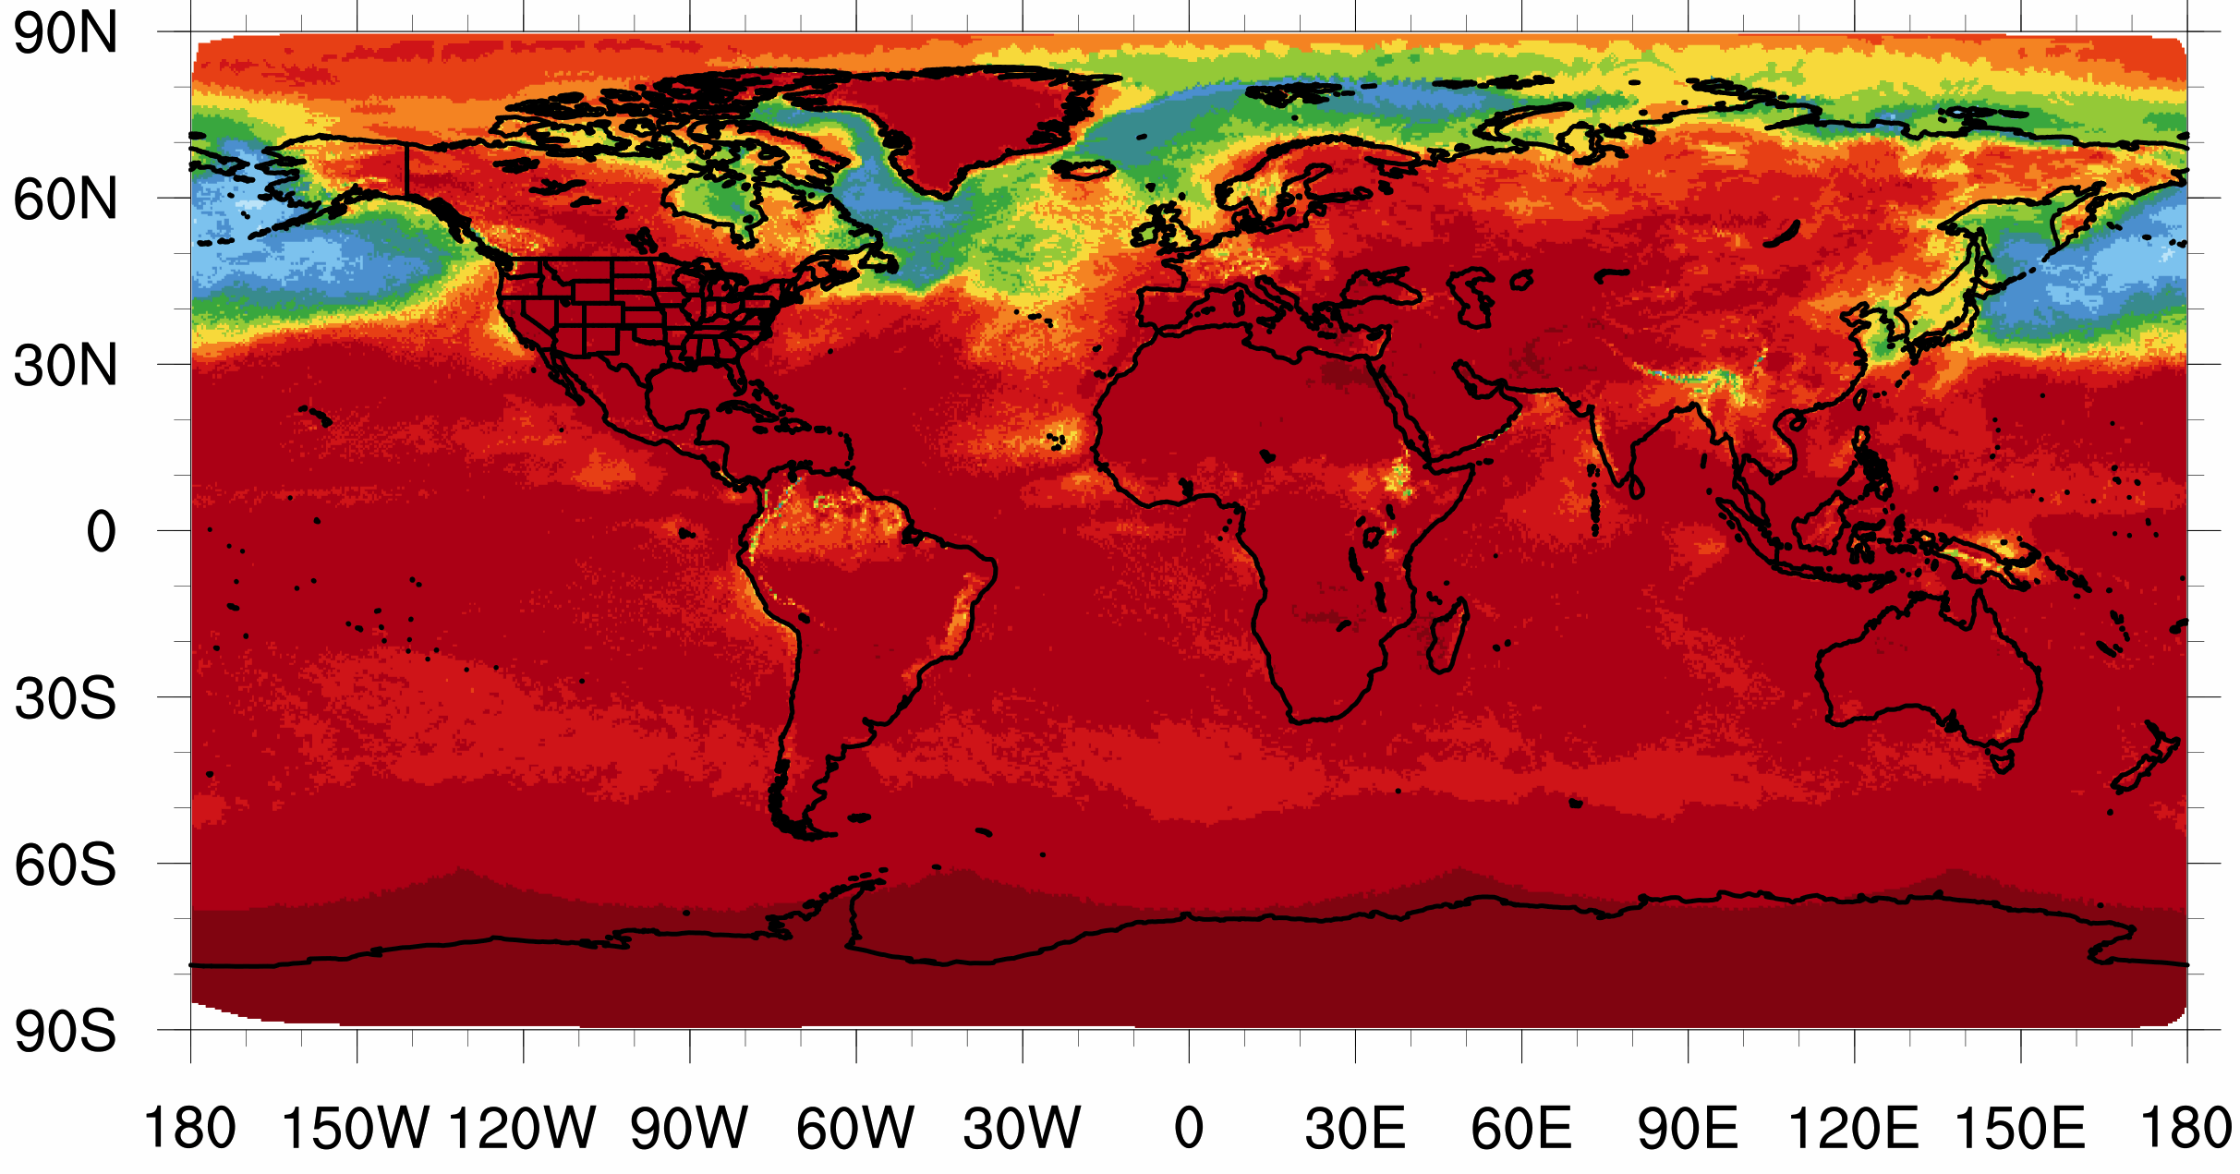
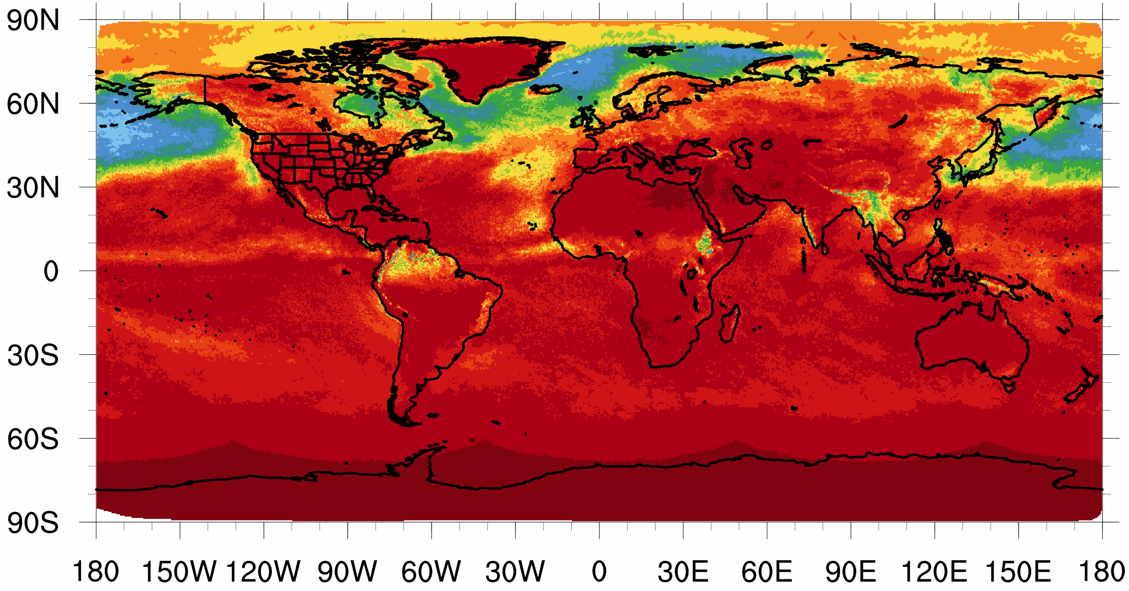
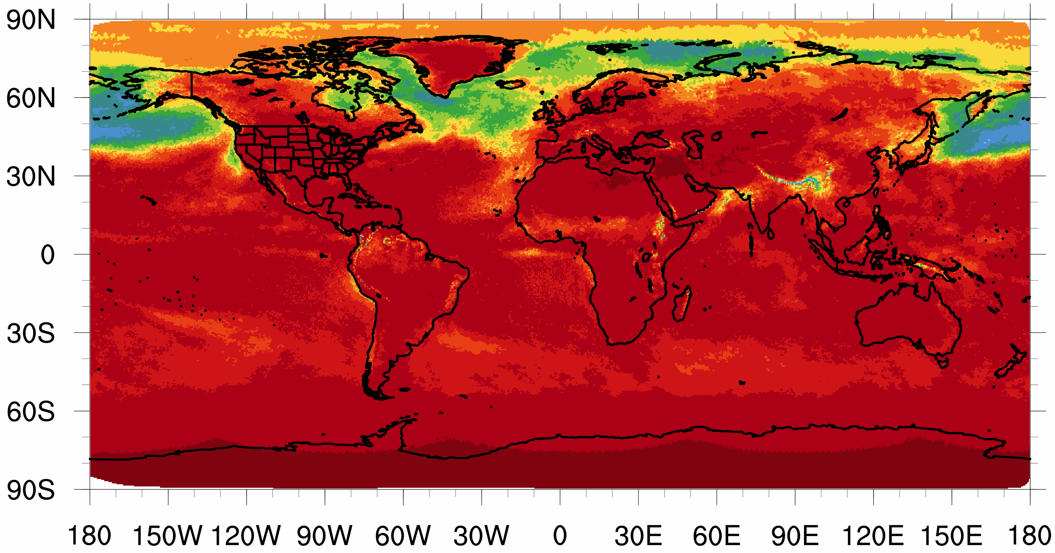
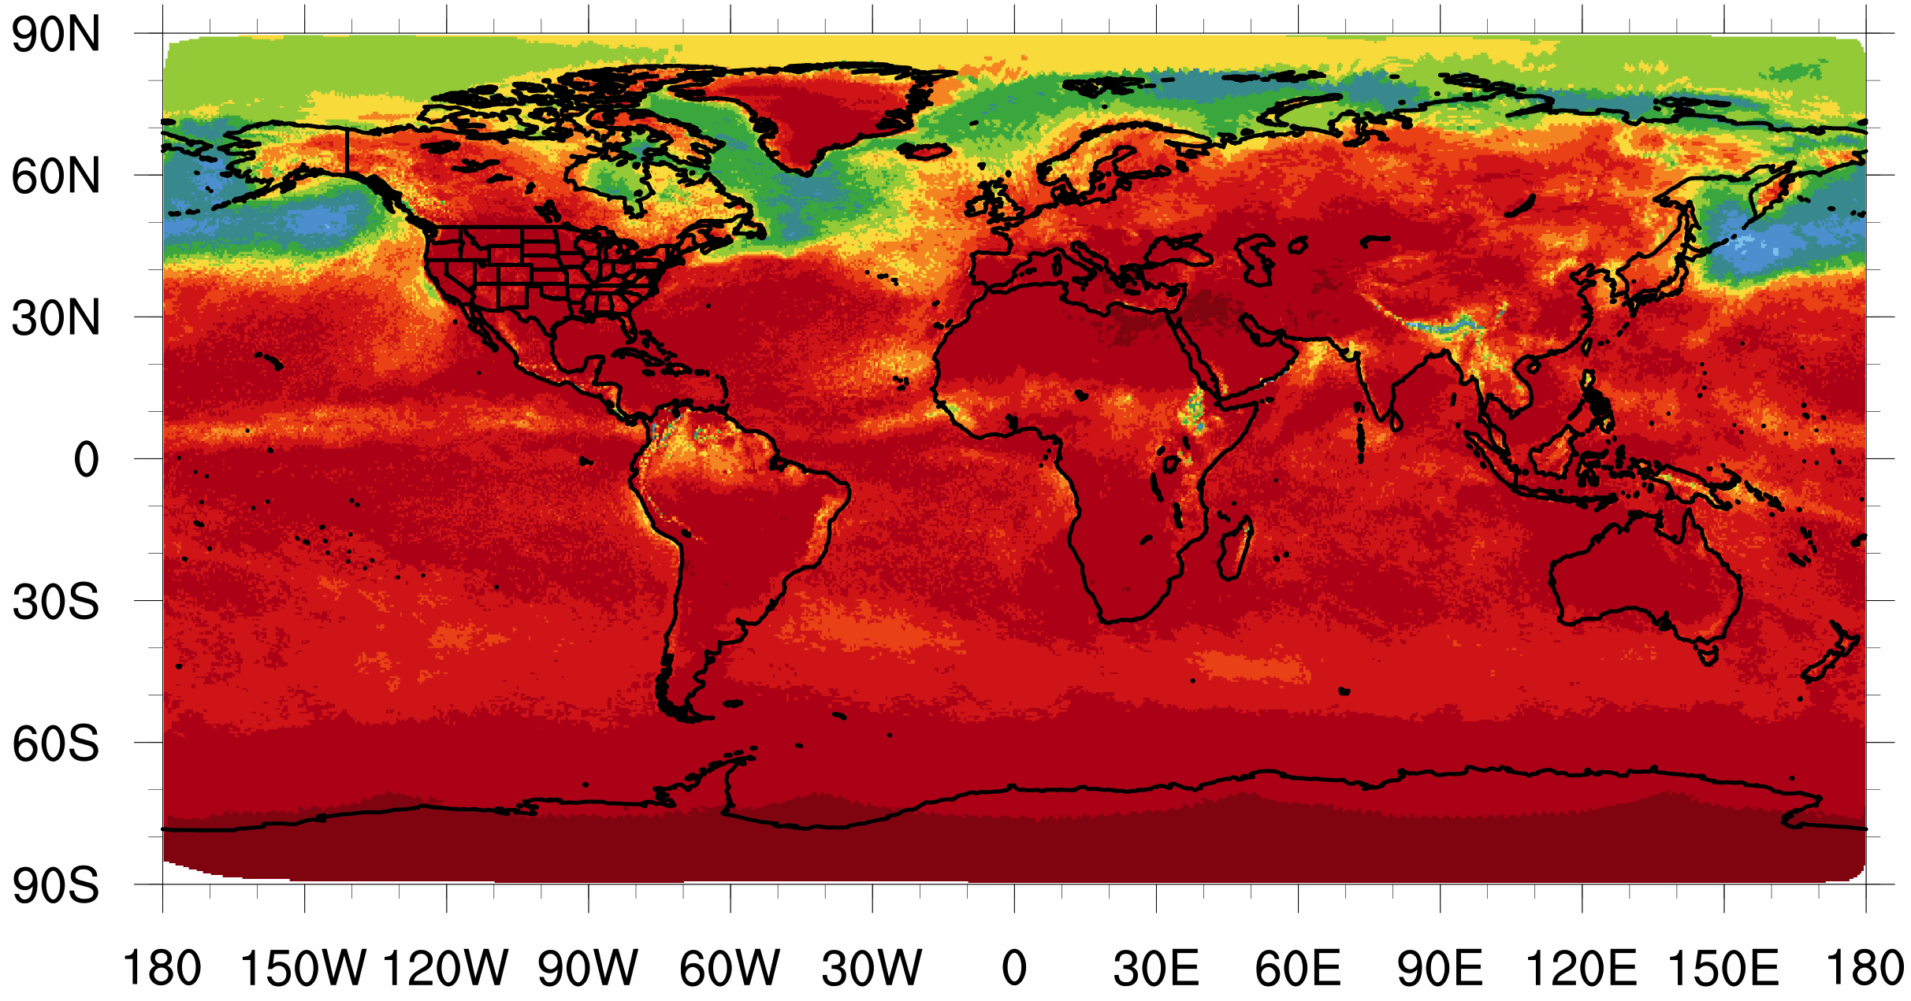
KF
MSKF
May
June
July
W•m⁻²/day

Slide 39
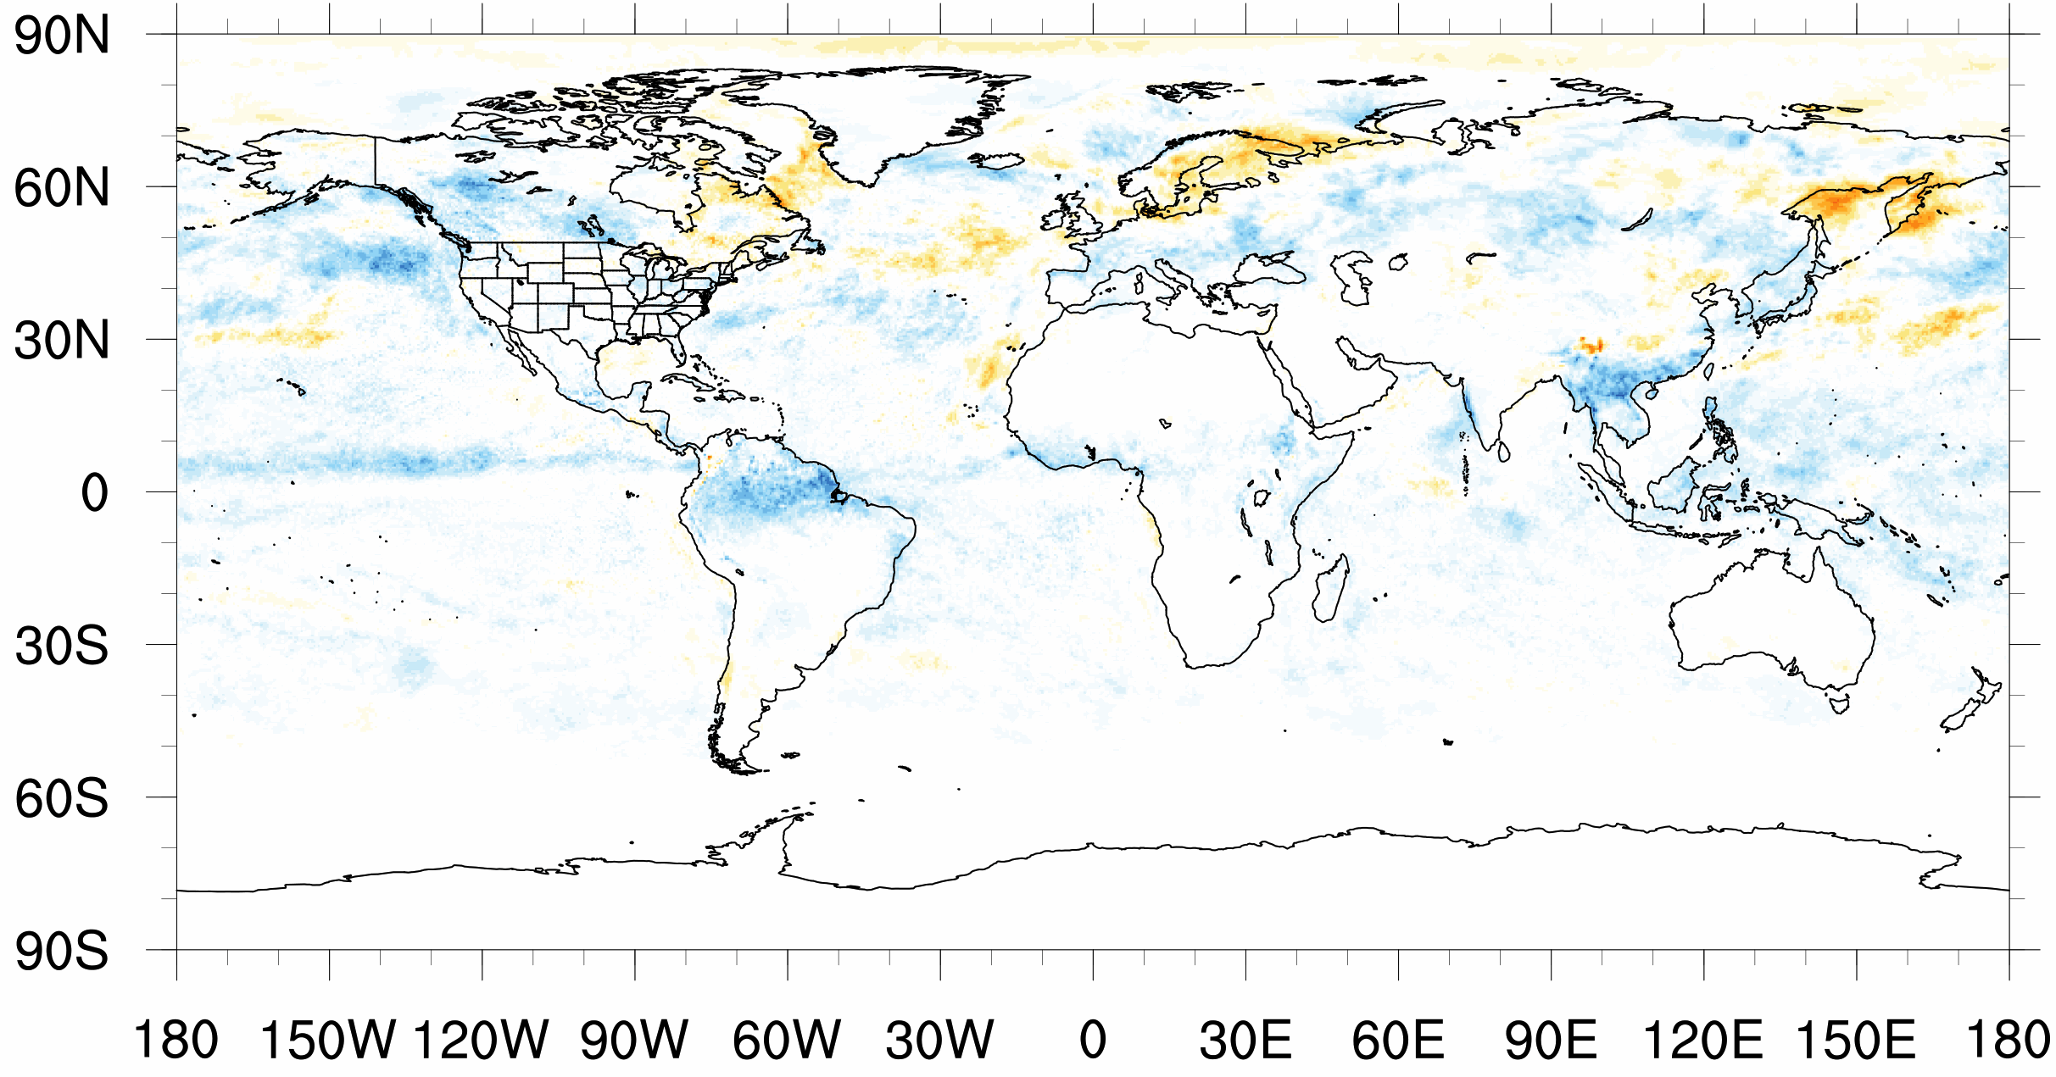
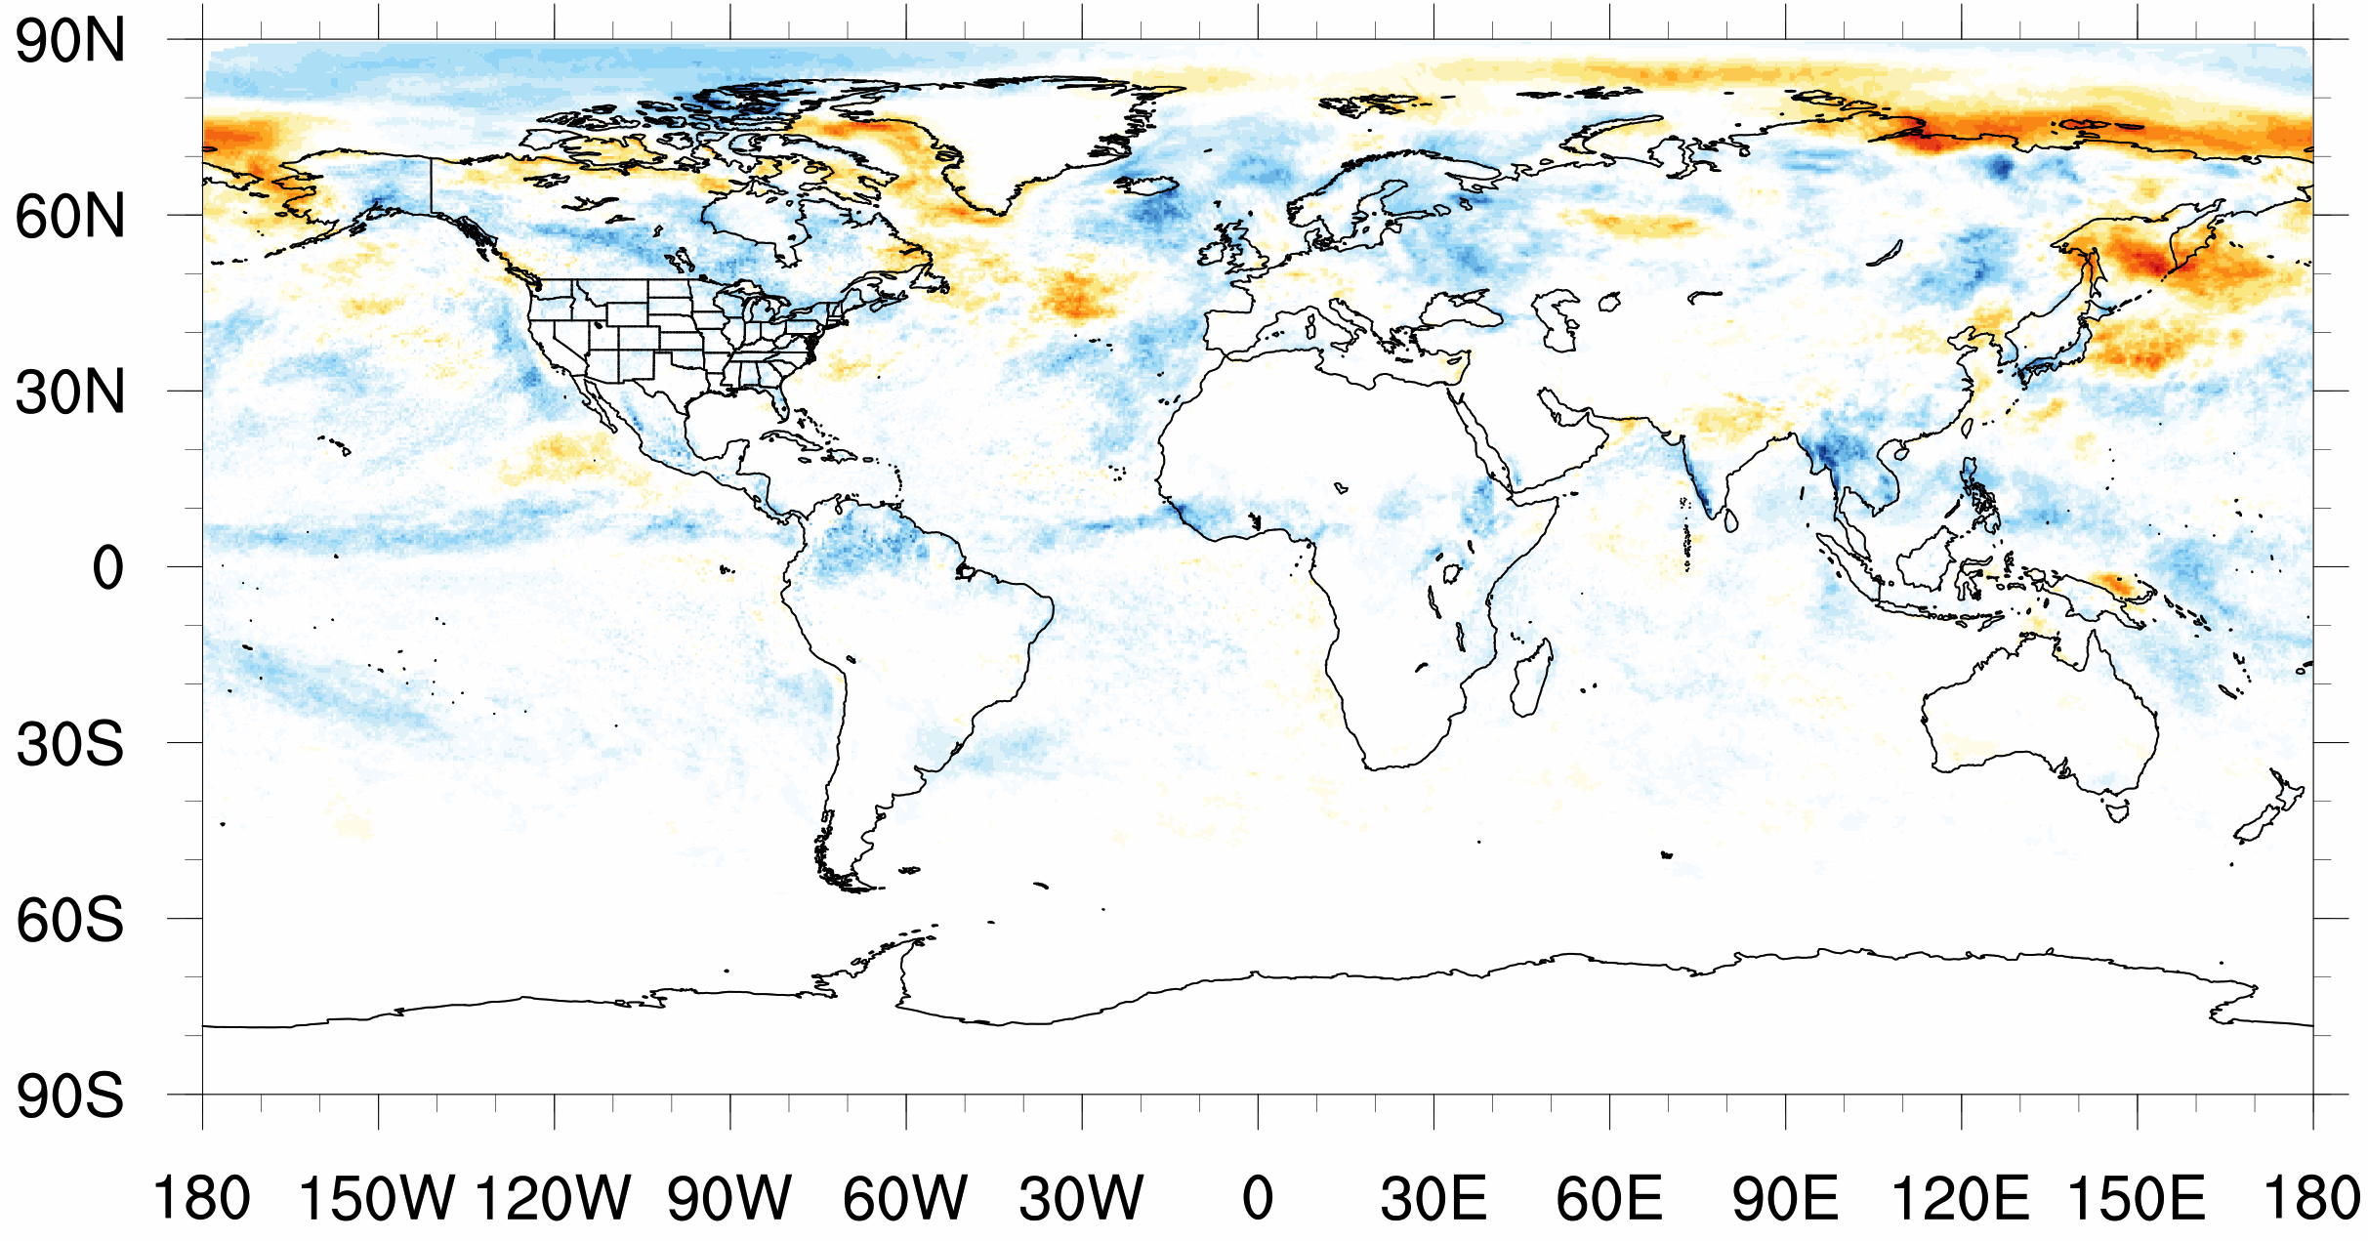
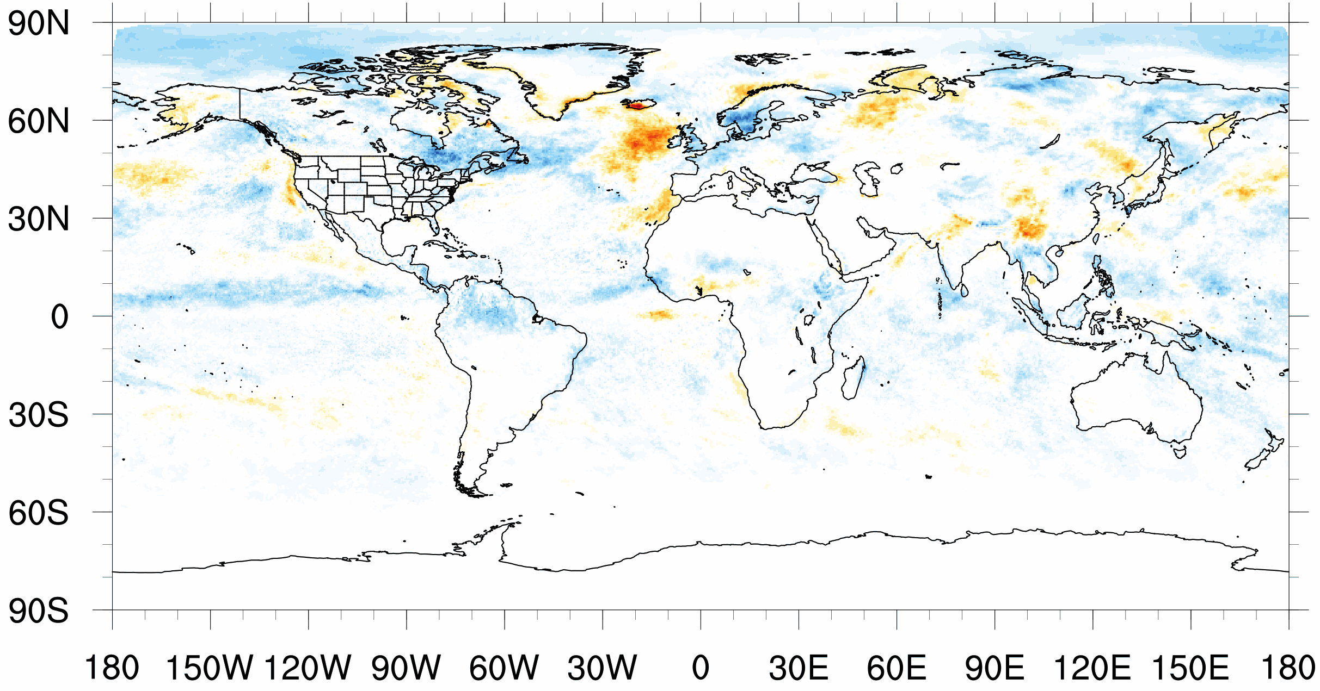
KF
MSKF – KF
MSKF
May
June
July
W•m⁻²/day

Slide 40
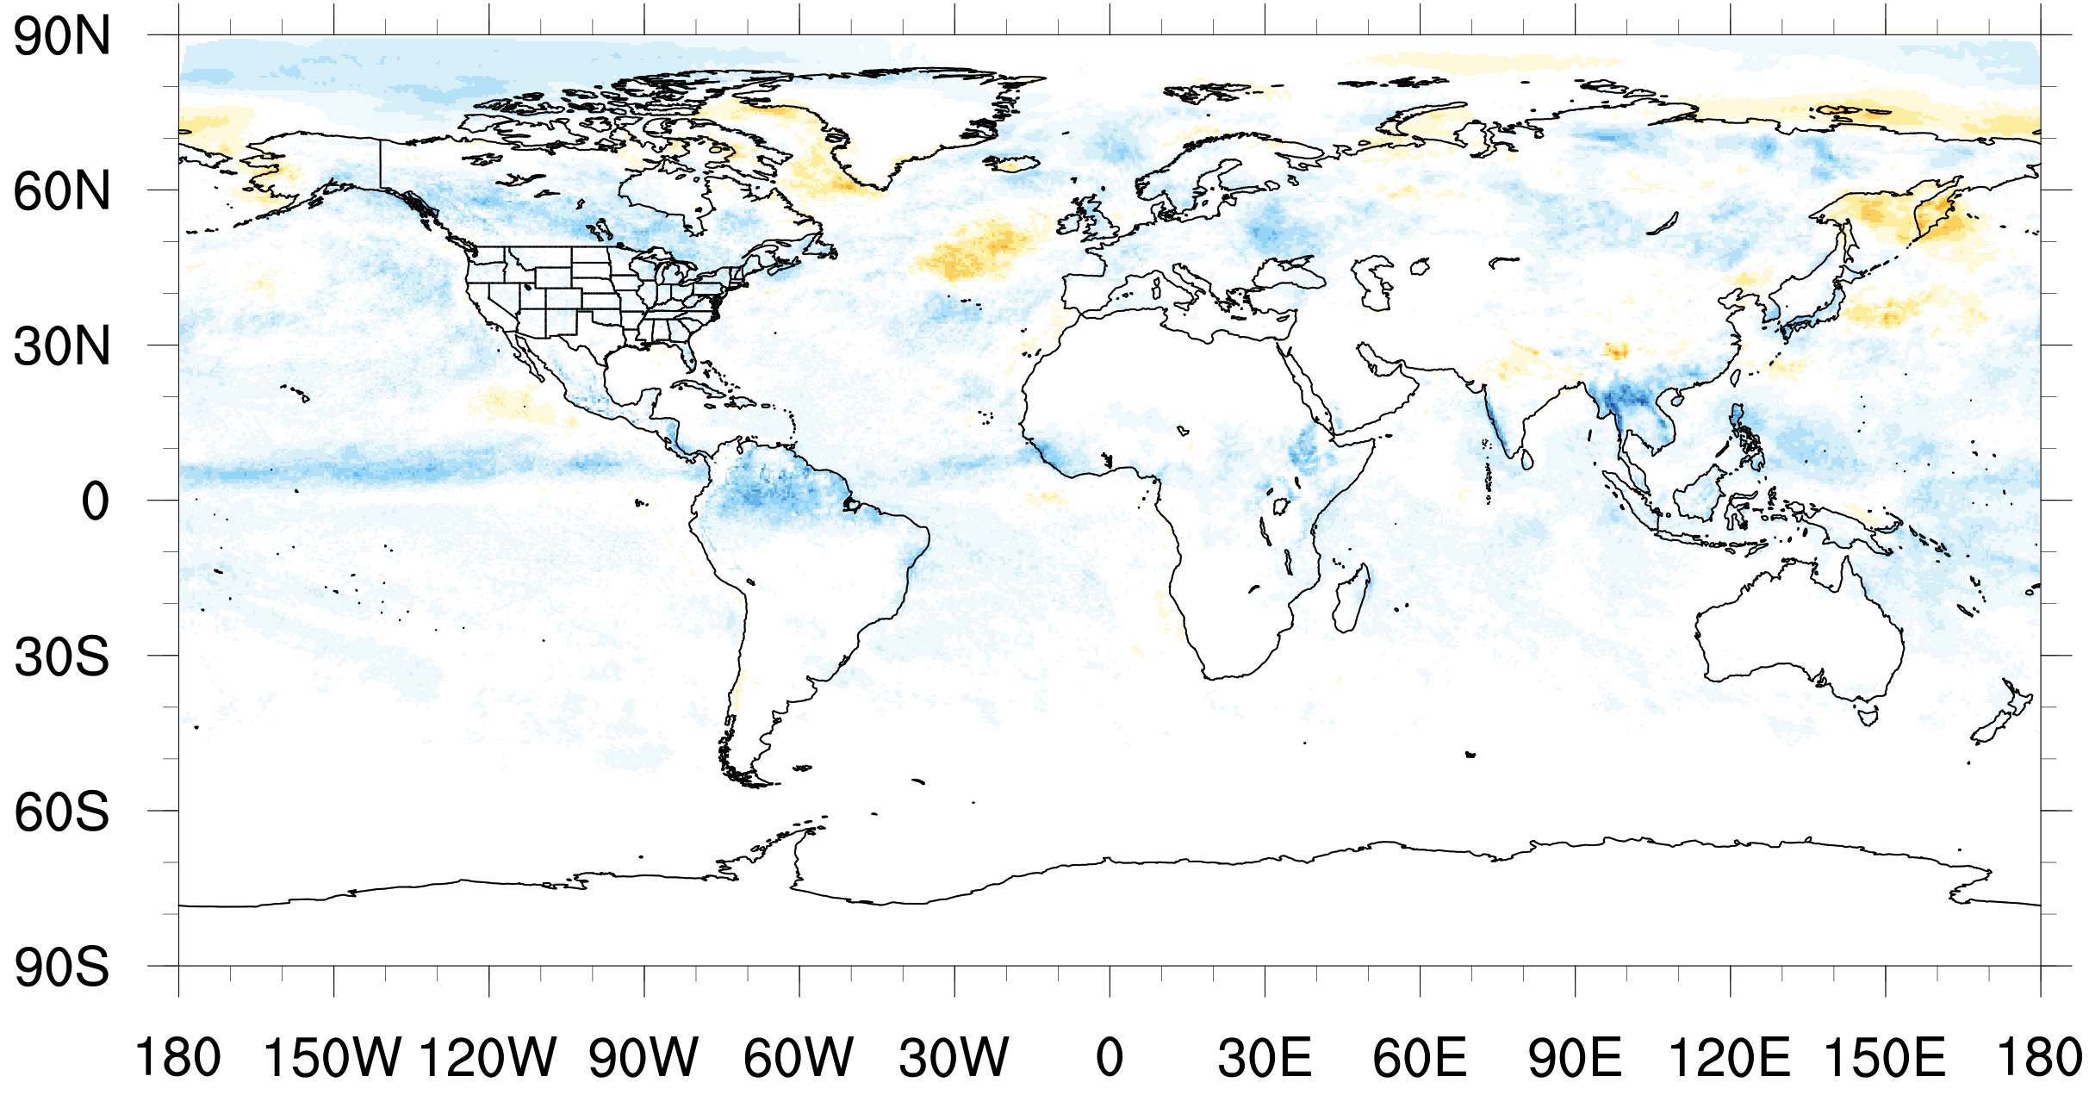
KF
MSKF
MSKF – KF
W•m⁻²/day

Slide 41
KF
MSKF
Increase in cloud cover &
decrease in near surface temperature
MSKF – KF
Seasonal 2m Temperature
K
Notes:
But, overall, there is an increase in total cloud cover due to introduction of convective cloud cover to MSKF and decrease in near surface temperatures in the MSKF run, as expected.

Slide 42
Titan
2512 processors
< 6 hours wait time
~20 days completed in 6 hours runtime
7536 processors
~12 hours wait time
~31 days completed in 6 hours runtime

