Slide 1
A novel approach to model evaluation:
Error diagnostic of AQMEII 3 modelling data
Stefano Galmarini & Efisio Solazzo
EC/Joint Research Center, Italy
AQMEII 3: phase 3 of the Air Quality Model Evaluation International Initiative
Coordinated by EC/JRC and US-EPA
Regional program of the HTAP2 exercise (Hemispheric Trasp. Of Air Pollution)
Dealing with 2010 regional scale modelling over NA and EU
Emissions: MACC and US EPA/Env Canada + Edgar v2 with embedded regional EI
BC: global models participating to hemispheric exercise, ECMWF post used

Slide 2
TR1_MACC_bas | WRF3.5, CMAQ4.7.1 | WRF-CMAQ_1 | 30 km x 30 km, 184 x 156 cells
FI1_HTAP_bas FI1_MACC_bas | ECMWF,SILAMv5.4 | ECMWF-SILAM_H | 0.25x0.25
NL1_MACC_bas | ECMWF/LOTOS-EUROS | ECMWF-L.-EUROS | 0.5x0.25
UK2_HTAP_bas | WRFv3.5.1, CMAQv5.0.2 | WRF-CMAQ_2 | 30 km
IT2_MACC_bas | WRF/Chem, version v3.6 | WRF-WRF/Chem_1 | 23km
IT1_MACC_bas | WRF 3.4.1/CAMx 6.10 | WRF-CAMx | 265x220 grid cells at 23 km
DE1_MACC_bas |  | CCLM-CMAQ_M
DE1_HTAP_bas |  | CCLM-CMAQ_H
ES1_MACC_bas | WRF/Chem (coupled) | WRF-WRF/Chem_2 | 23km
UK3_MACC_bas |  | WRF-CMAQ_3
DK1_HTAP_bas |  | WRF-DEHM | 50 km
FRES1_HTAP_bas |  | ECMWF-Chimere_H
FRES1_MACC_bas |  | ECMWF-Chimere_M
UK1_MACC_bas | WRF3.4.1/CMAQ 5.0.2 | WRF-CMAQ_4 | 15km
DE1_SMOKE_bas |  | CCLM-CMAQ
US3_SMOKE_bas | WRF3.4, CMAQ5.0.2 | WRF-CMAQ_1 | 12 km, 459x299 cells
US1_SMOKE_bas |  | WRF-CAMx | 459x299 cells

Slide 3
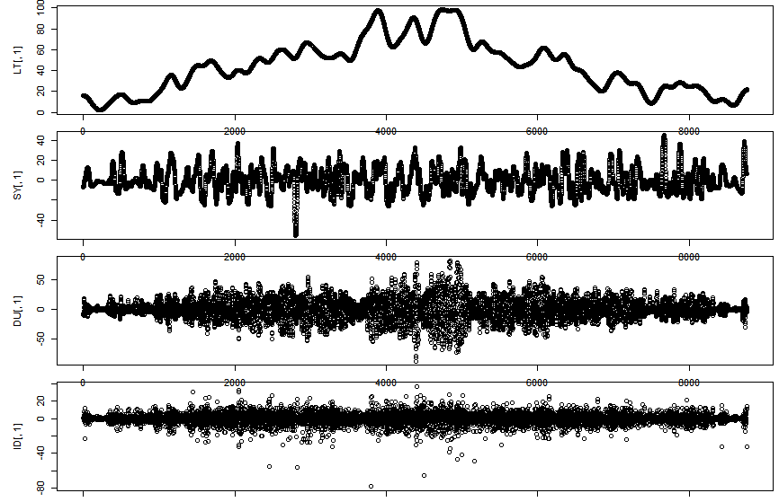
Spectral decomposition
Spectral decomposition of time series of ozone derived from power spectrum analysis
Four components ID, DU, SY, LT
ID : intra-day (fast-acting < 12h)
DU: diurnal (day/night [12h; 2.5d]
SY : Synoptic (weather [2.5d;21d]
LT : Long term (slow processes > 21d)
LT is the base line, the other components are obtained using the filter as band-pass and have zero mean
LT
SY
DU
ID

Slide 5
mMSE: Portion of the variance not explainable by the model: either model too poor (under-fitting) (LT component) or measurements too noisy (DU component), possibly both.

Slide 6
ERROR
LT
SY
DU
ID
bias
variance
mMSE

Slide 7
region3
region1
LAT: (26, 51); LON: (-125, -55)
Availability 75%
Max 360 hour continuous missing
AIRS, CAST, NAPS
No imputation on missing values
No area-type filter
region2
Solazzo & Galmarini, 2015: Comparing apples with apples: Using spatially distributed time series of monitoring data for model evaluation, AE

Slide 8
LON: (-10, 39); LAT: (30, 65)
Availability 75%
Max 360 hour continuous missing
AirBase only
No imputation on missing values
No area-type filter
Region 2
Region 1
Region 3

Slide 9
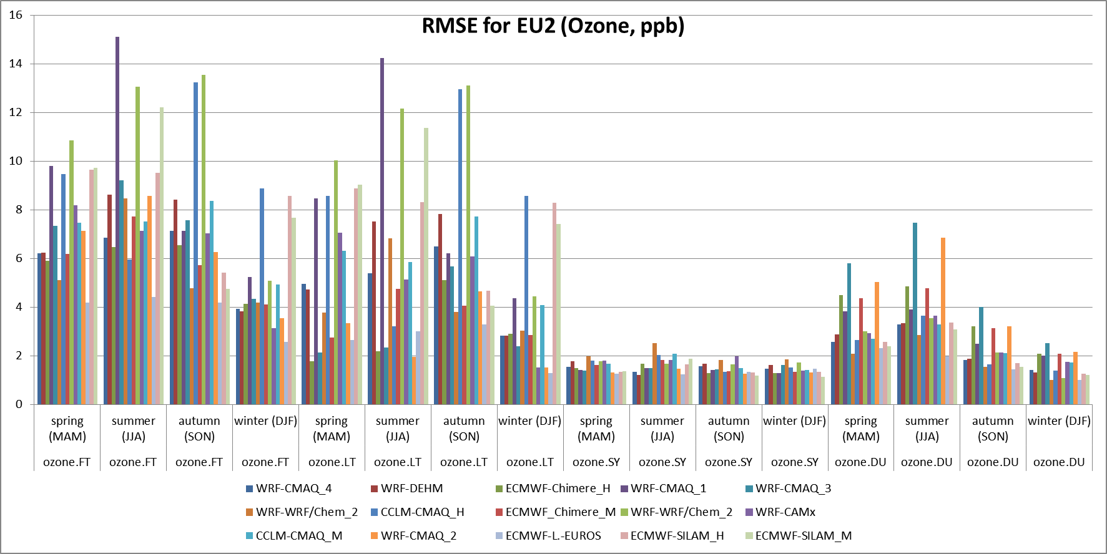
§
FT: Full time series (no filter)
DU: diurnal (day/night [12h; 2.5d]
SY : Synoptic (weather [2.5d;21d]
LT : Long term (slow processes > 21d)

Slide 10
The LT contains all the bias by construction
The signs indicate model underprediction (-) or overprediction (+) of bias and variance.
‘_H’: HTAP
‘_M’: MACC
bias =(<mod>-<obs>)²
var = (σ_{mod}- r σ_{obs})²
mMSE= 2(1-r) σ_{mod} σ_{obs}
(ppb²)

Slide 11
The LT contains all the bias by construction
The signs indicate model underprediction (-) or overprediction (+) of bias and variance.
‘_H’: HTAP
‘_M’: MACC
bias =(<mod>-<obs>)²
var = (σ_{mod}- r σ_{obs})²
mMSE= 2(1-r) σ_{mod} σ_{obs}
(ppb²)

Slide 12
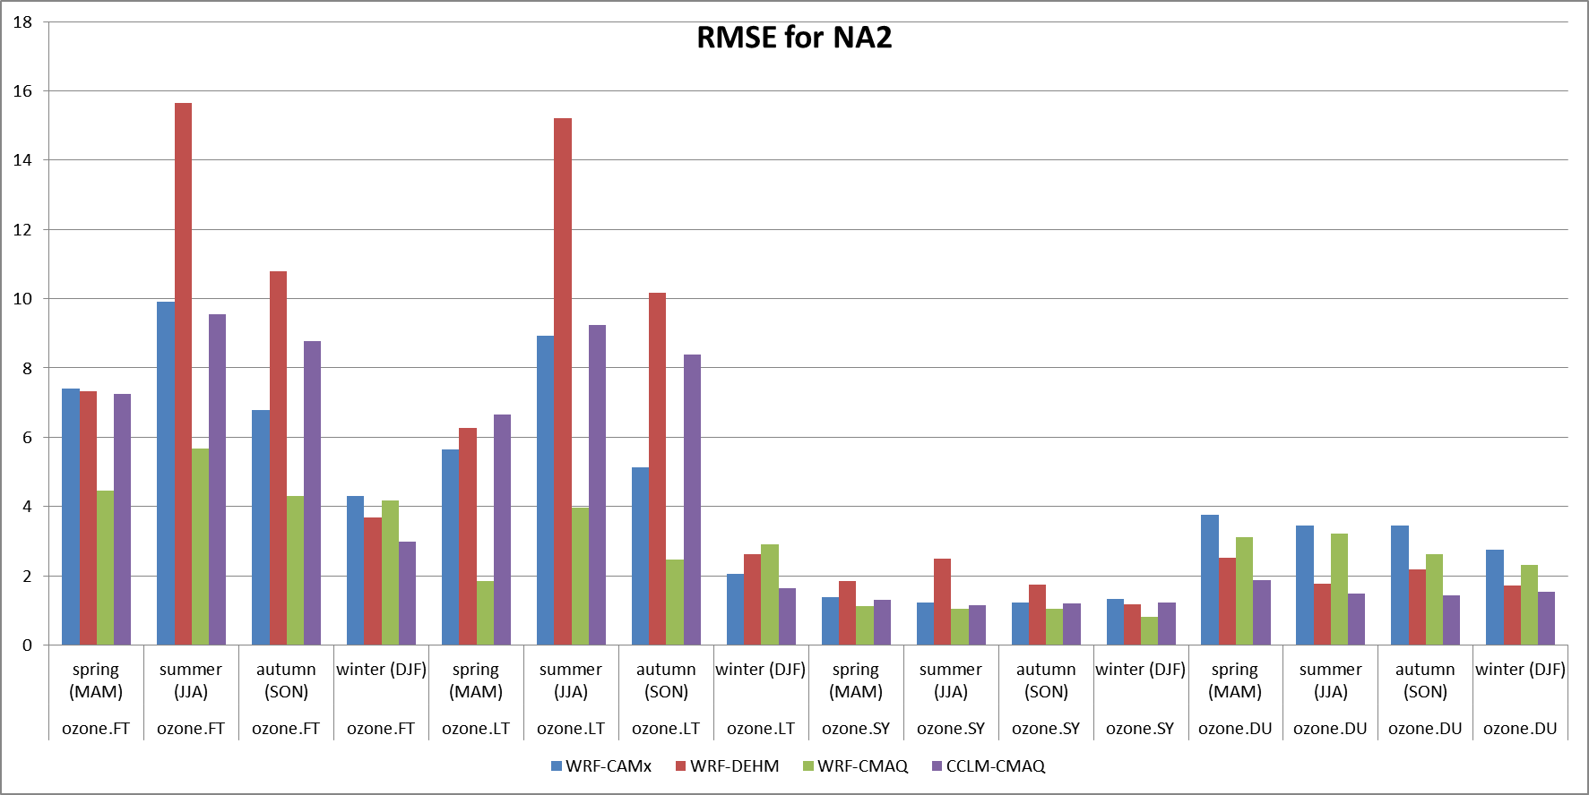
(ozone, ppb)
§
FT: Full time series (no filter)
DU: diurnal (day/night [12h; 2.5d]
SY : Synoptic (weather [2.5d;21d]
LT : Long term (slow processes > 21d)

Slide 13
(ppb²)

Slide 14
(ppb²)

Slide 15
the plots shows the relative magnitude only (all segments are normalised to the longest one)
ID
LT
DU
SY

Slide 16
Spring/summer: error largest in the central-east part, where LT is predominant over DU and SY. Western part is LT/DU dominated but error is smaller than in the other parts
Winter: error largest in the west, where LT is predominant.
Central-east the LT error is comparable to that of the other component and sometime smaller than SY

Slide 17
Spring/summer: the error away from the boundary is small and DU dominated.

Slide 18
PM10 EU REG 2
ID and DU error small in magnitude and due to unexplained error
The error of the SY component is significant , mostly mMSE and low variability (under-predicted variance: transport, deposition?)
The bias accounts for most of the error (one model is un-biased). The mMSE part of the LT error is comparable to the that of SY. The LT variance error is small/negligible.
SY and LT are quite ‘smooth’ thus error due to noise is unlikely. The mMSE error for these two ‘slow’ components underlines at some missing process common to all models?
(ug/m³)²

Slide 19
Summary
A new approach to model evaluation is presented
It could be formally defined as a combination of operational and diagnostic evaluation
The application to the spectral decomposition of mod and obs signal provides a clear identification of the nature of the error, and the components of the signal where it is mainly appearing
The spatial representation allows also to collect indication on the possible sources of the error
Current work is underway ti further decompose the error into process specific components for a clearer identification of the origin

Slide 20
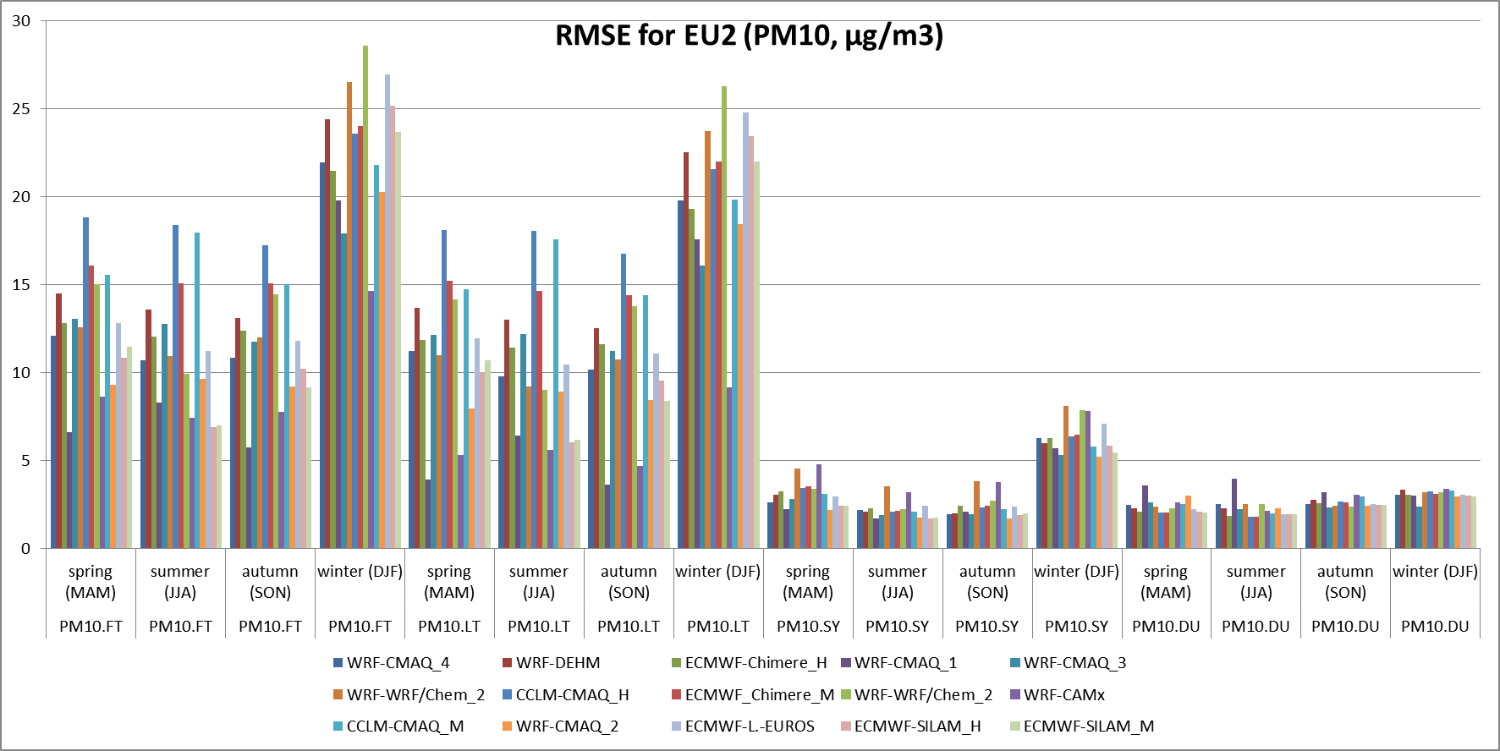
PM10 EU REG 2
§

Slide 21
(ug/m³)²
PM2.5 NA all continent
The total error is mostly due to bias (opposite signs for the two models).
The DEHM model has a negligible/null variance error for all components, while the CMAQ model has an excess of variance and of bias

Slide 22
PM2.5 hourly, NA
DU-dominated
LT- dominated
Excess of DU variance
Too persistent: removal processes
50 days
55 days
0 500 1000 2000 3000
0 500 1000 2000 3000

Slide 23
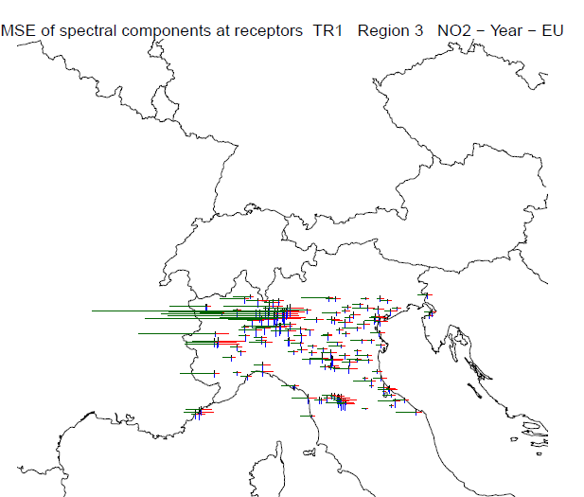
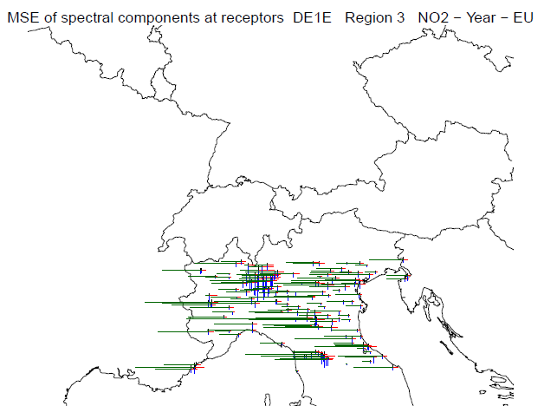
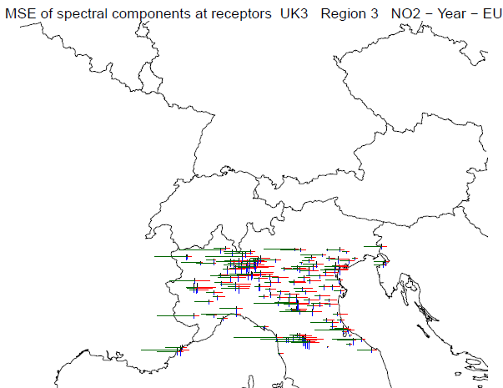
NO₂, EU; receptor analysis
ID
LT
DU
SY

Slide 24
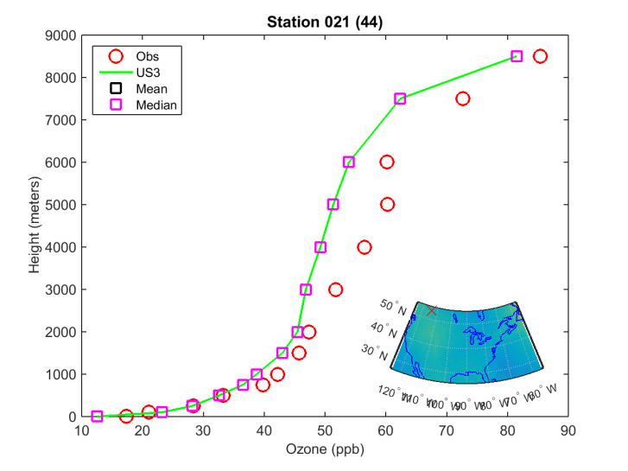
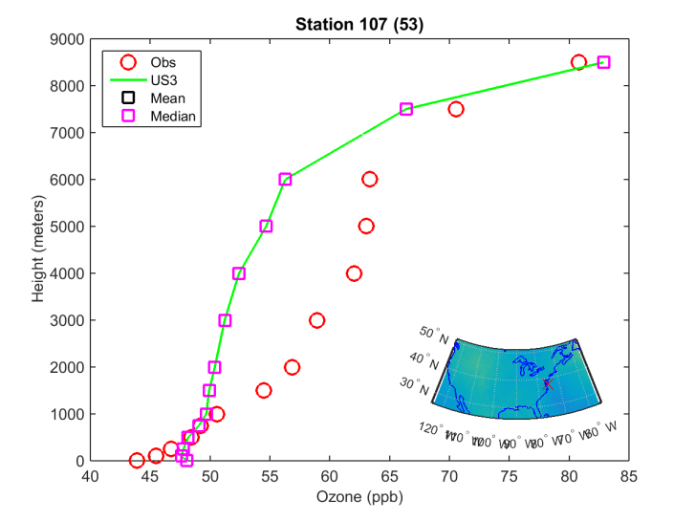
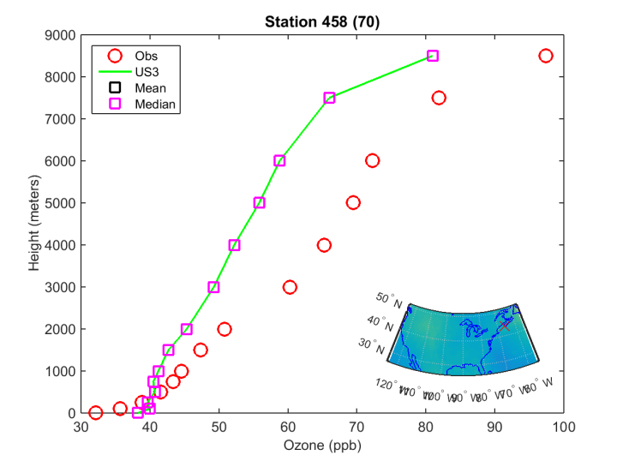
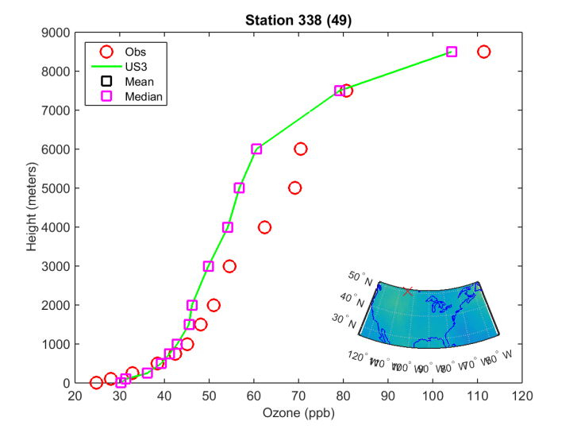
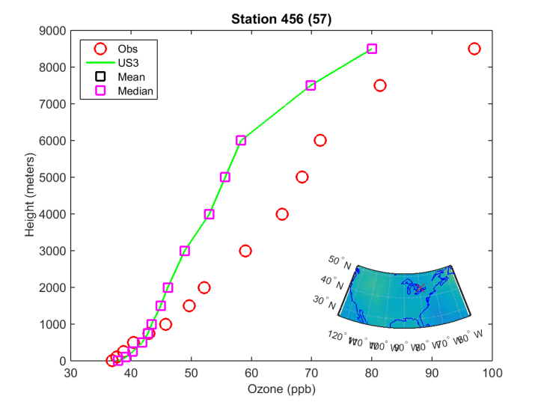
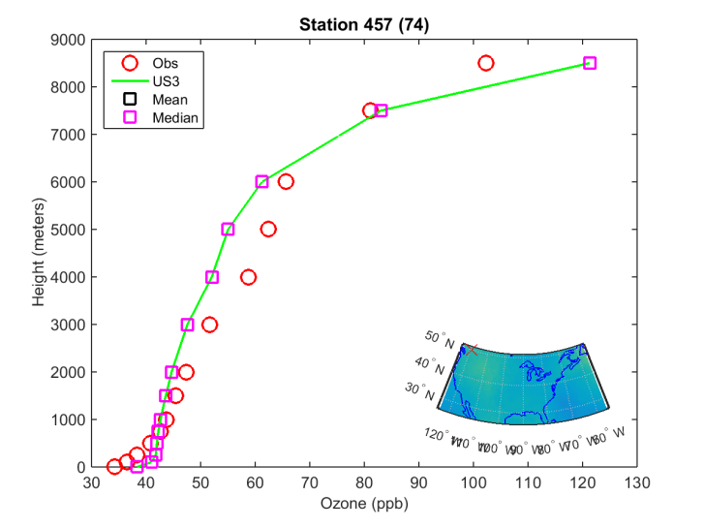
O3, NA; ozonesondes

Slide 25
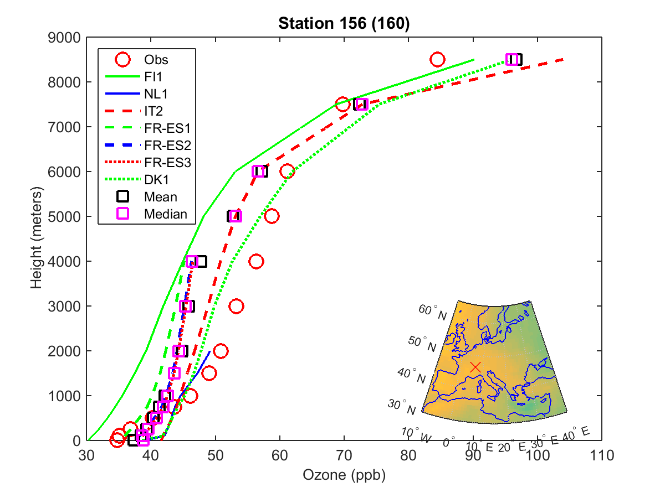
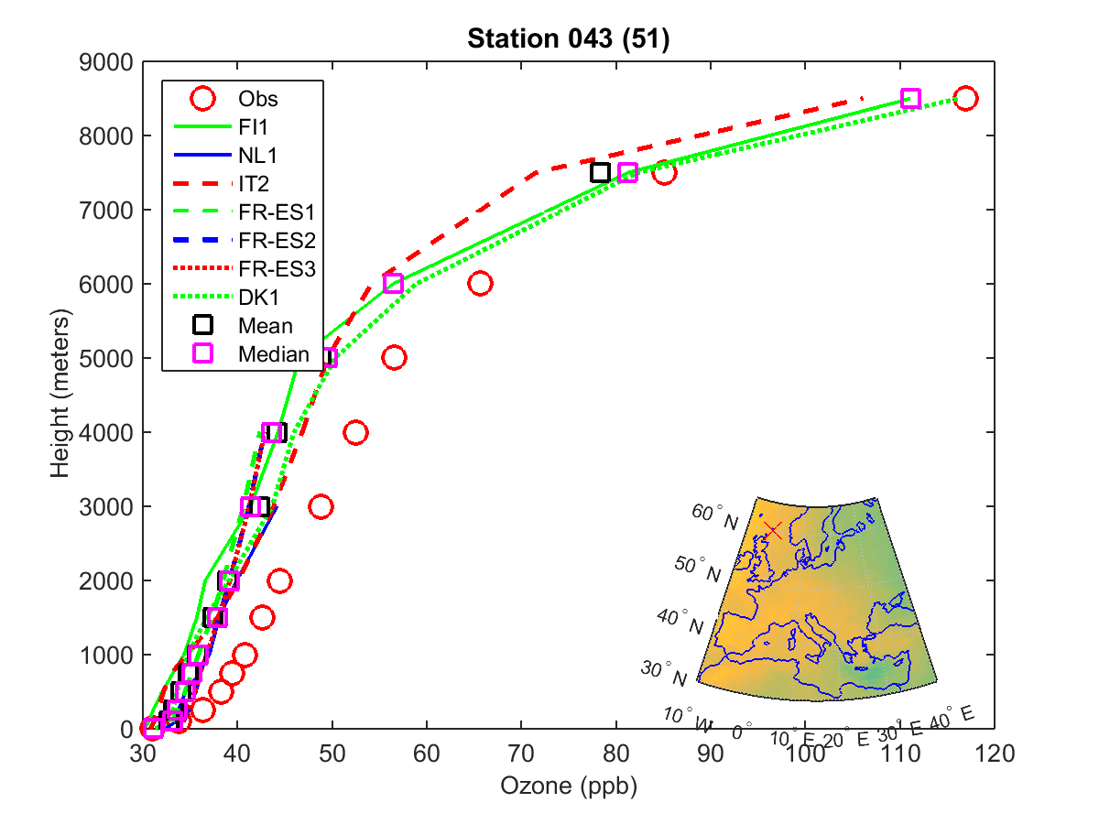
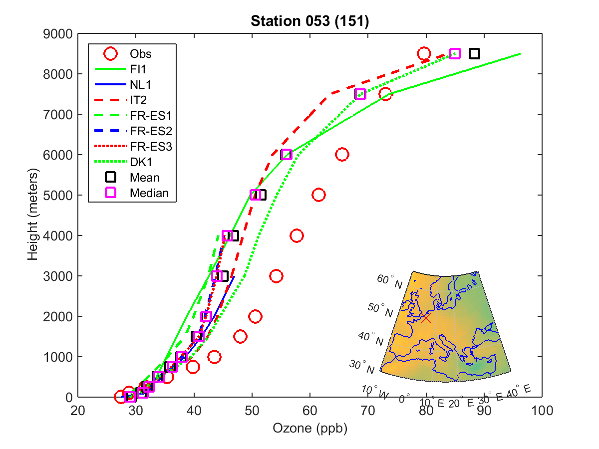
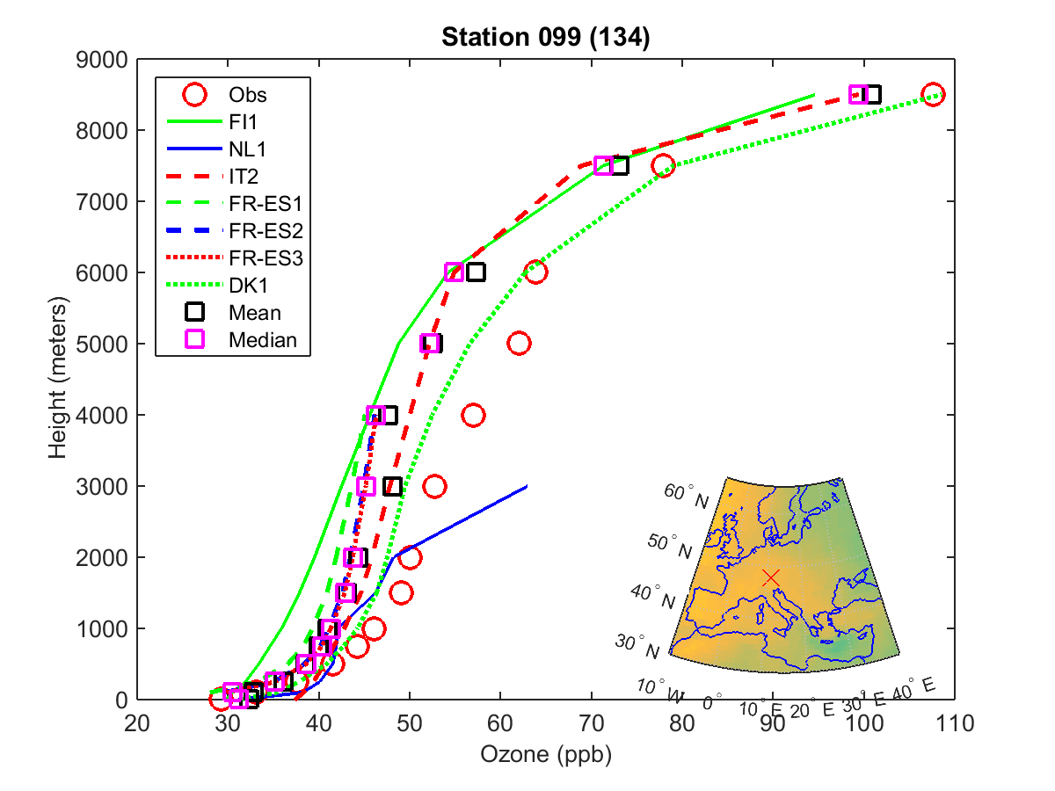
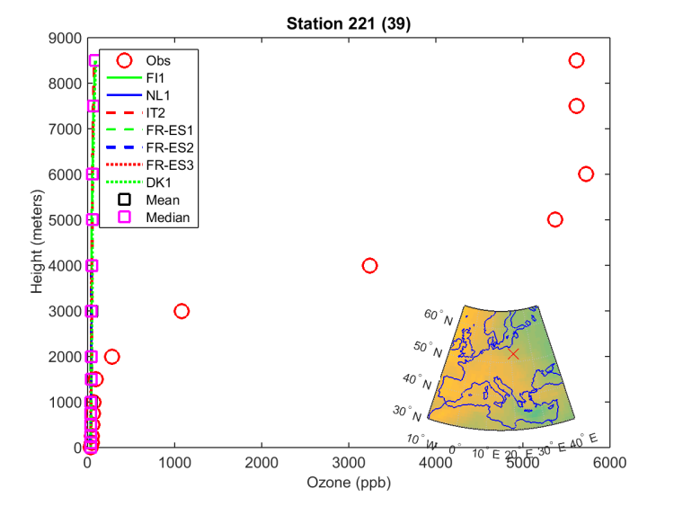
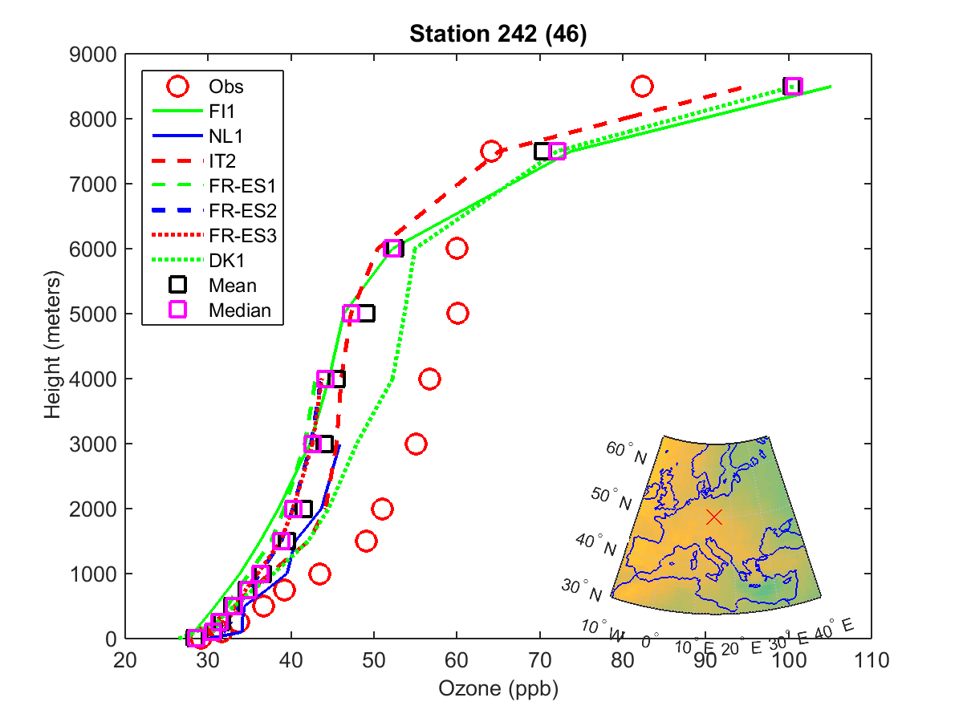
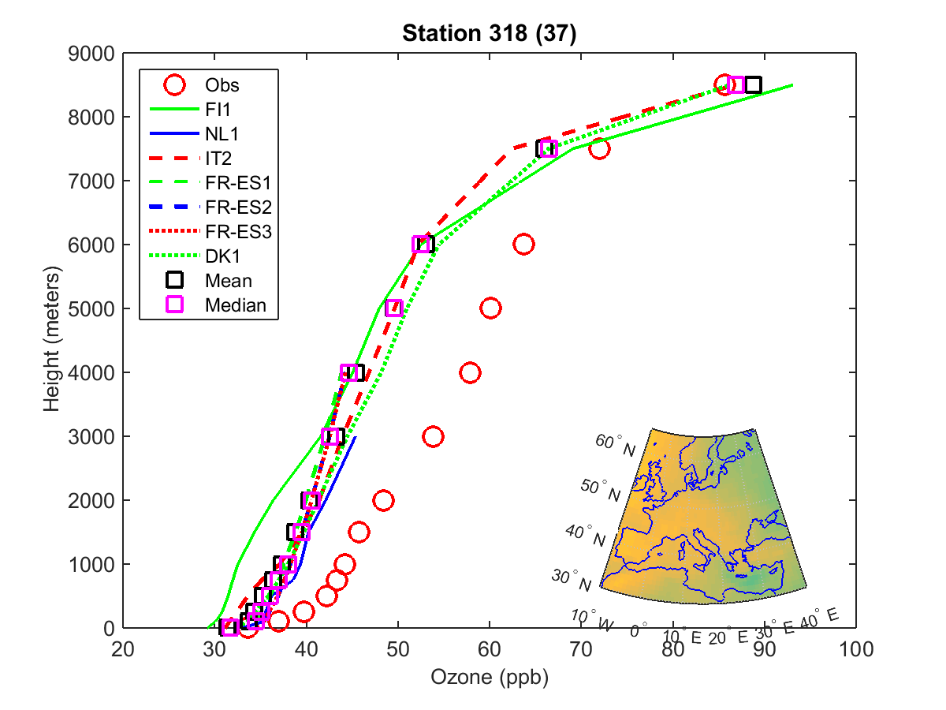
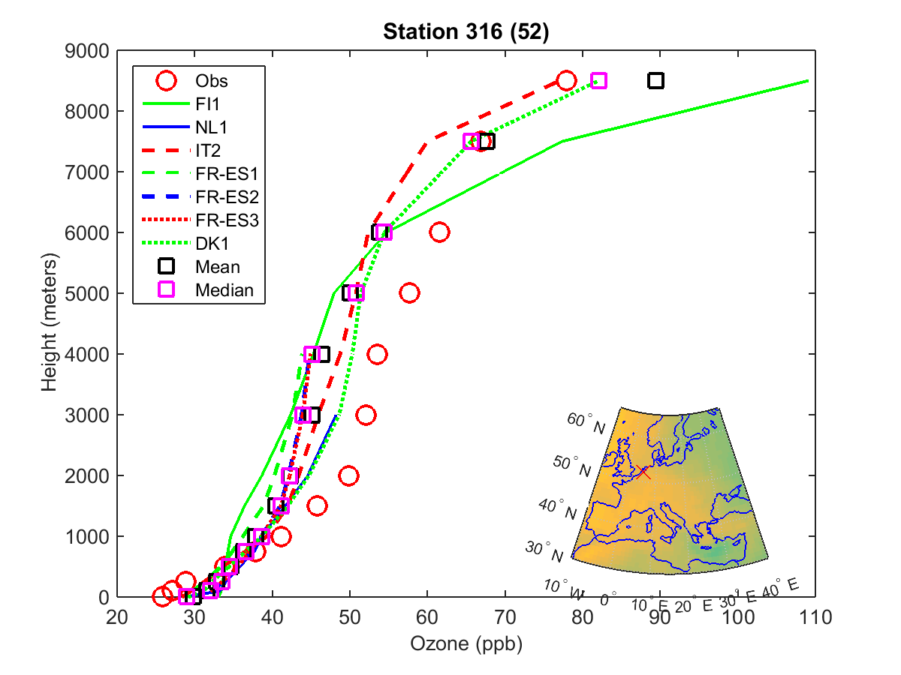
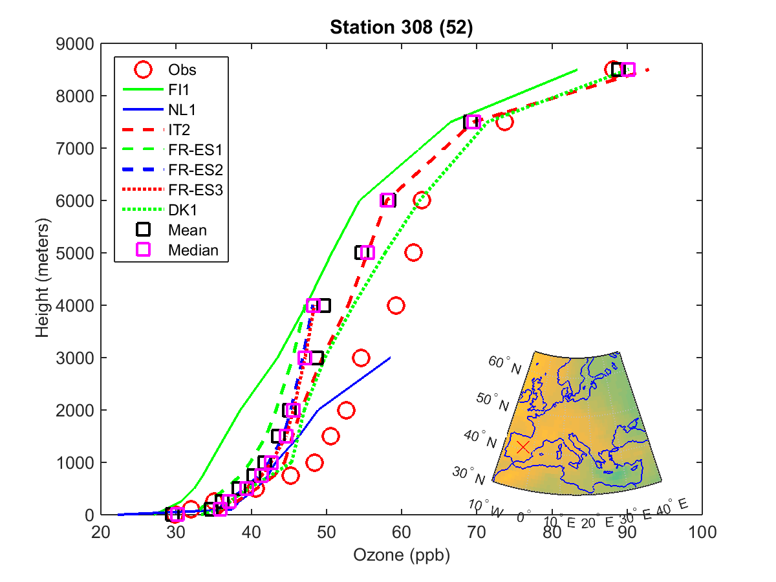
O3, EU; ozonesondes

