Slide 1
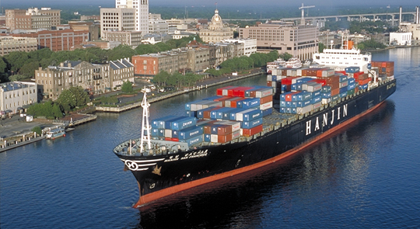


Fine scale modeling to assess the air quality impacts of vessels and port activity: Application to the Port of Savannah’s Garden City Terminal
Yongtao Hu, M. Talat Odman, Michael E. Chang, Armistead G. Russell and Hope Moorer
2015 CMAS Conference
Chapel Hill, NC
October 6, 2015

Slide 2
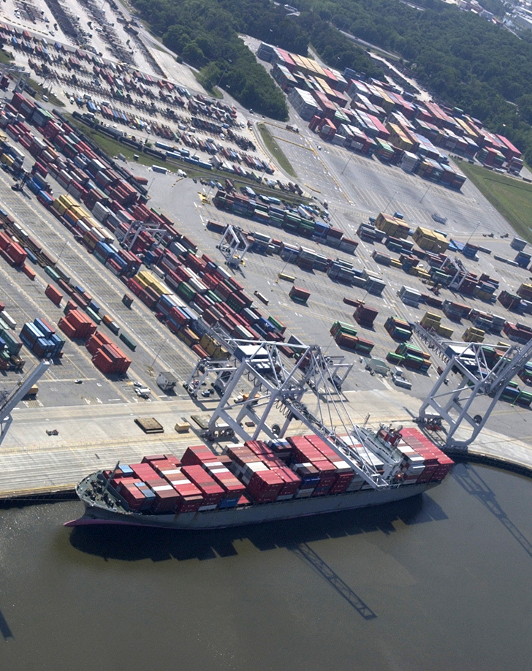
Motivation
What are the air quality impacts from the Port of Savannah?
Approach
Emission Inventory – an account of pollutants released into the atmosphere (important variables: source, type, intensity, context, timing, location)
Air Quality Modeling – a simulation of how pollutants are transported and transformed in the atmosphere (important variables: emissions, meteorology, climate, terrain)
Two typical weeks: July 15-22, 2002 and July 8-15, 2010

Slide 3
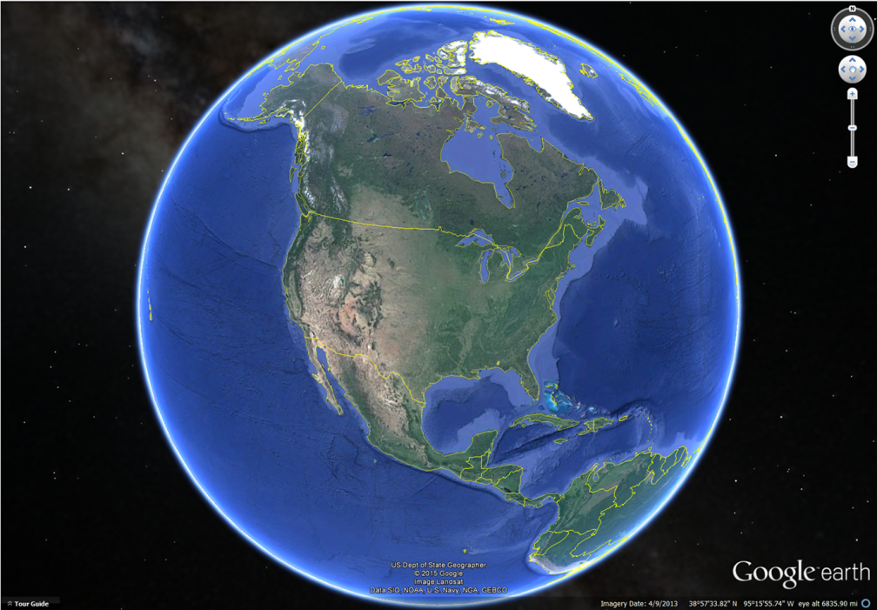
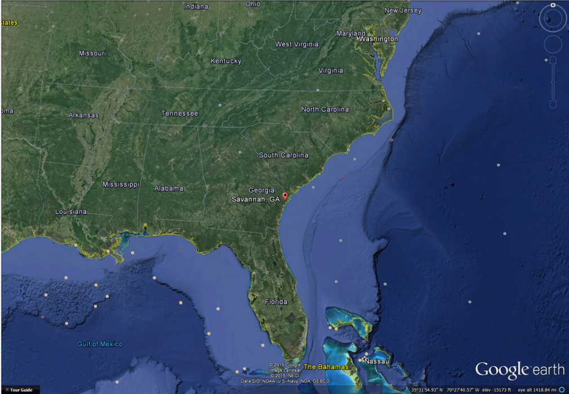
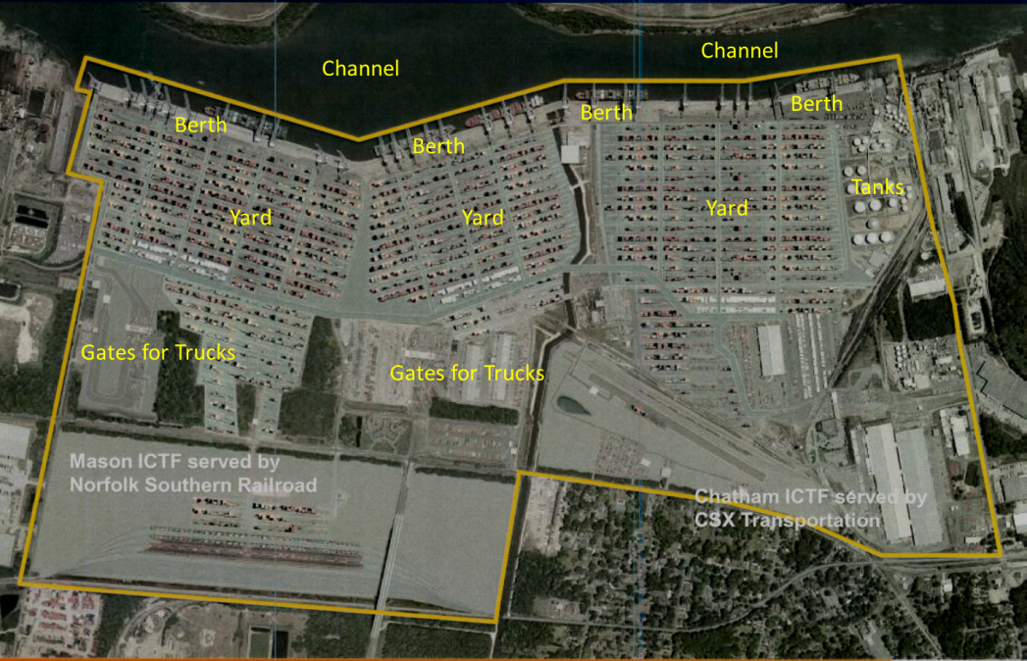
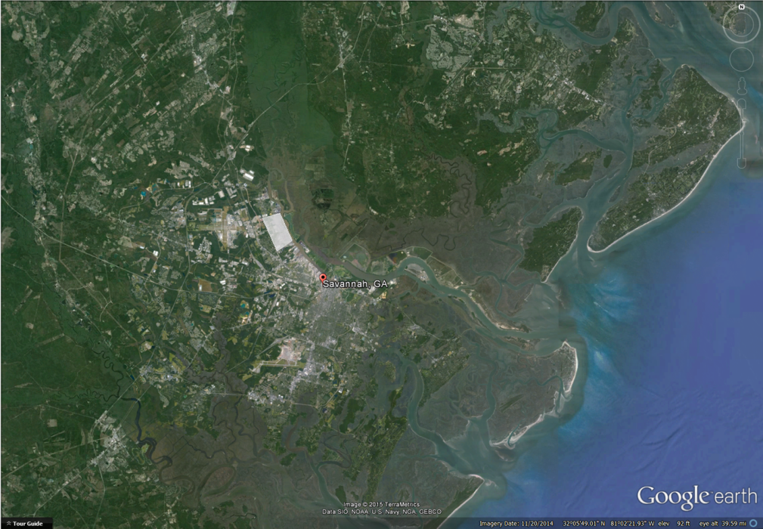
Garden City Terminal (GCT)

Slide 4
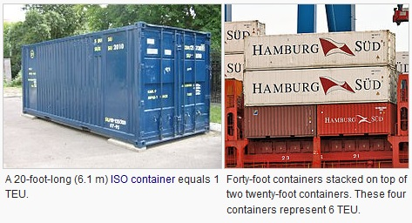
Vessel calls and TEUs almost doubled at GCT from 2002 to 2010.
Fiscal Year (July-June) | Vessel Calls | Total TEU
2002 | 983 | 1,327,926
2010 | 1907 | 2,637,643
TEU = Twenty-foot Equivalent Unit

Slide 5
Regular Port Operations and Air Emissions
    (1) Ocean Going Vessels
    Reduced speed in the channel: main engine vs. ancillary engines, lowered power load
    Tug boats to assist docking and undocking
    Hoteling with ancillary engines
    (2) Cargo Handling
    Ship to shore: Container Cranes (STS)
    Shore to yard: Jockey Trucks
    At yard: Rubber Tired Gantry Cranes (RTG) and Toplift Cranes
    (3) Cargo Ground Transportation
    Heavy Duty Trucks
    Rail Locomotives

Slide 6
Cargo Handling Equipment (CHE)
STS
Jockey Truck
RTG
Toplift

Slide 7
Emission factors decreased from 2002 to 2010 due to increased fuel efficiency at GCT
Average reduction ratios: 2010/2002
(Source: GPA’s 2010 Fuel Efficiency Report)
 | NO₂ | CO | PM₁₀
RTG | 0.10 | 0.09 | 0.52
Jockey Trucks | 0.19 | 0.17 | 0.71
We used PM₁₀ ratios for PM₂₅ and CO ratios for VOCs
Notes:
Fuel Sulfur Content greatly reduced from 2002 to 2010 (15 ppm in 2010 vs. 1139 ppm in 2002). In addition GPA made efforts to increase fuel efficiency.

Slide 8
Vessel call information was used for location and timing of most emissions.
Vessel Name | Berth # | Arrival Time | Departure Time | Duration | Working Times | CHE Numbers
For Location | Tug Hoteling STS |  |  |  | Jockey Truck, RTG and Toplift emiss. allocated near the berth
For Timing |  | Tug docking, Vessel Trip in | Tug undocking, Vessel Trip out | Hoteling | CHE emissions based upon working hours
Also, the number of picks (in TEU) were used to allocate emissions from locomotives, other vehicles, and CHEs that were not exclusively assigned to the vessels.

Slide 9
Gate Truck Moves information was used for timing of truck emissions.
~3 times larger
2002
2010
Move Type | Turn Time | % of Moves
Multiple Moves | 58.3 (min) | 58%
Single Move | 34.6 (min) | 42%
Notes:
Truck emissions factors decreased from 2002 to 2010 due to lower fuel sulfur content

Slide 10
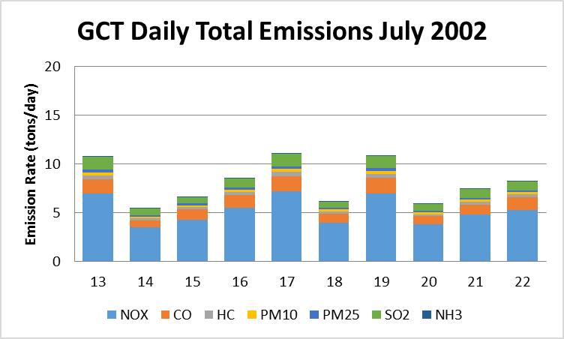
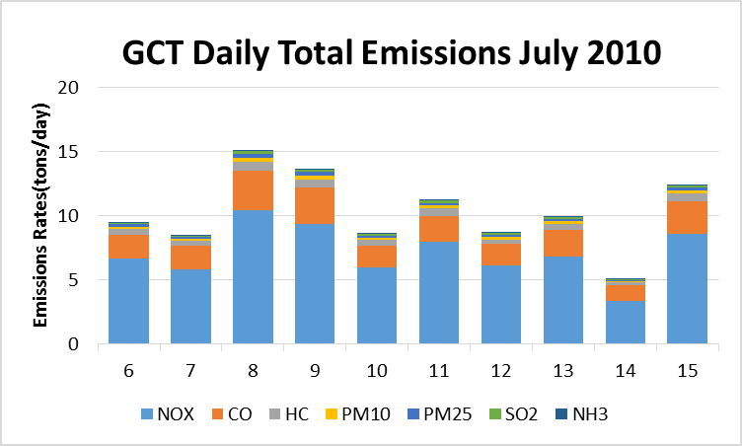
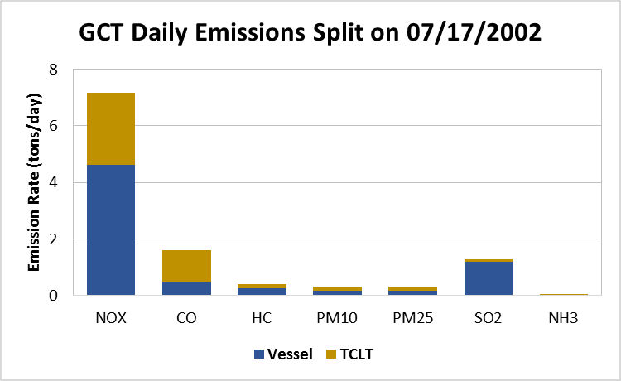
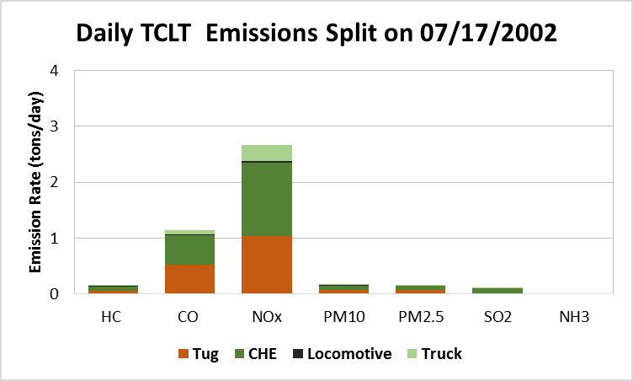
Daily total emissions (2002 vs. 2010)
Emissions by source (July 17, 2002)

Slide 11
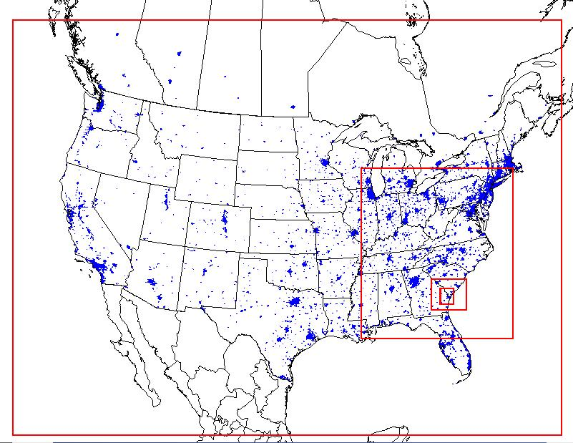
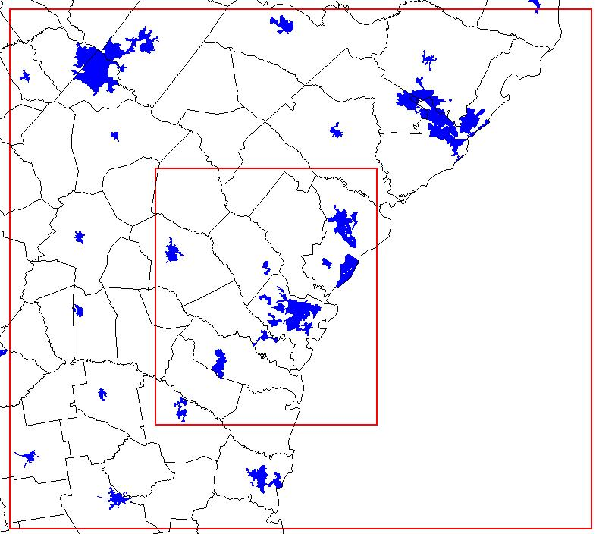
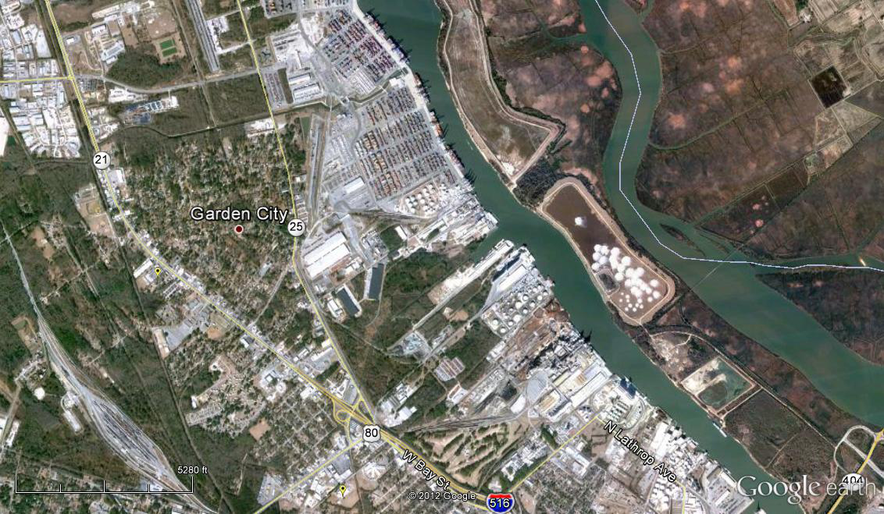
Modeling Grids
12-km (123x138)
1-km (128x148)
36-km (148x112)
4-km (84x75)
Horizontally nesting down to 1-km resolution.
34 vertical layers for both WRF and CMAQ, with the top at 100hp.
1km × 1km

Slide 12
Models Used
WRF 3.6.1 for meteorological fields
  NCEP North American Regional Reanalysis (NARR) 32-km resolution inputs
  NCEP ADP surface and soundings observational data
  Latest MODIS landuse with lakes data for most recent land cover status
  3-D and surface nudging, Noah land-surface model
SMOKE 3.5 for CMAQ ready gridded emissions
  NEI 2002 inventory for 2002, NEI 2011 inventory with 2010 CEM for 2010.
  Estimate detailed emissions inventory for GPA’s Savannah ports
CMAQ 5.0.1 to simulate gas and PM concentrations
  SAPRC99 mechanism, ISORROPIA thermodynamics, Mass conservation
  Updated SOA module
DDM-3D sensitivity tool to identify air quality impacts from GCT sources
  Monitoring sites as receptors
  Specific communities as receptors
CALPUFF 5.8.4 to simulate gas and PM dispersion
  USGS Land Use and Land Cover, Digital Elevation Model terrain
  Same meteorological data
  Same gridded emissions as volume sources

Slide 13
Air Quality and (10×) Impacts from GCT’s
Air Emissions at Monitoring Sites
O₃ at President St.
PM at Lathrop
July
2002
PM₁₀
July
2010
PM_{2.5}

Slide 14
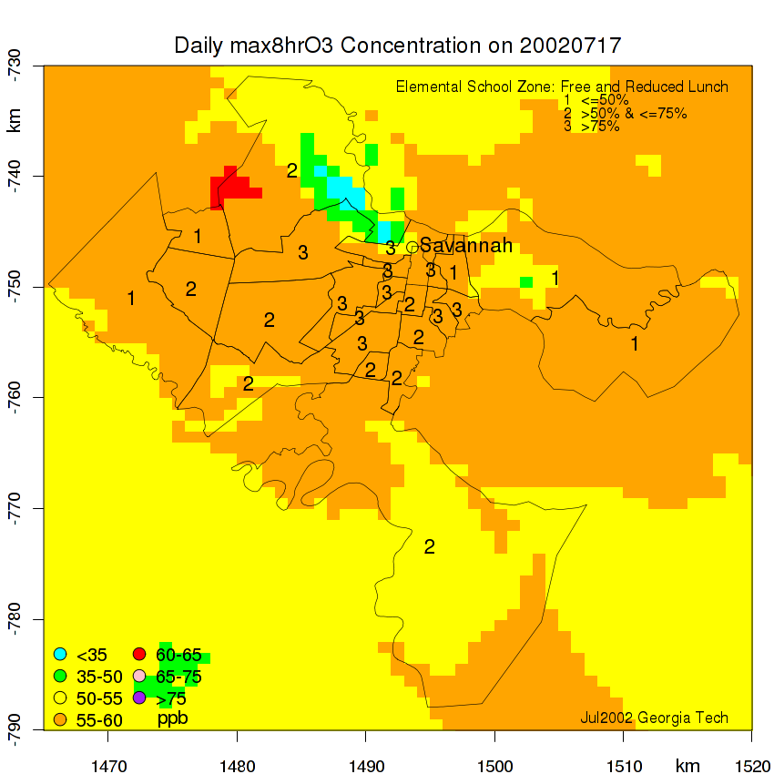
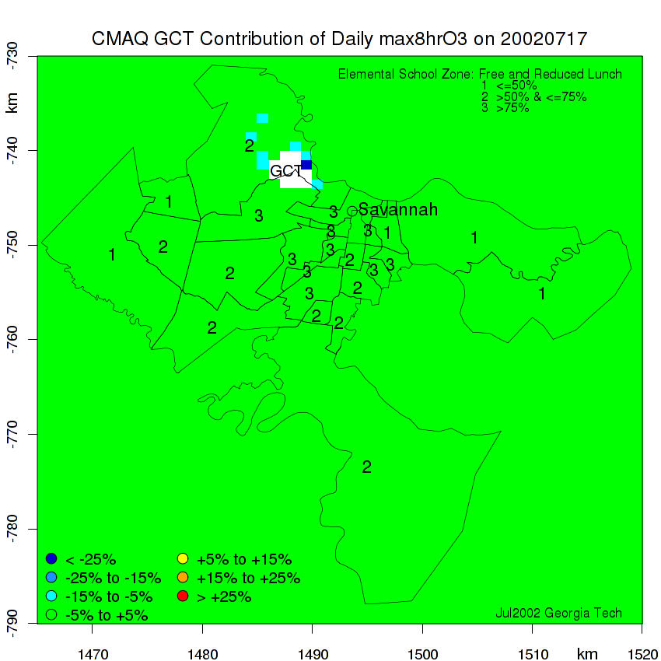
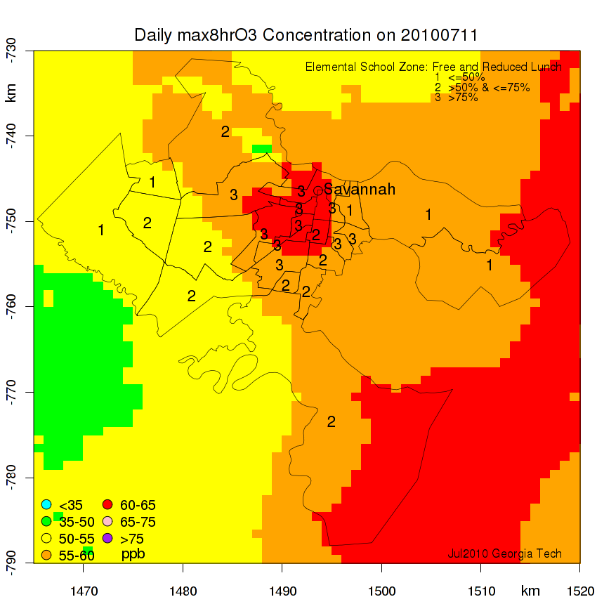
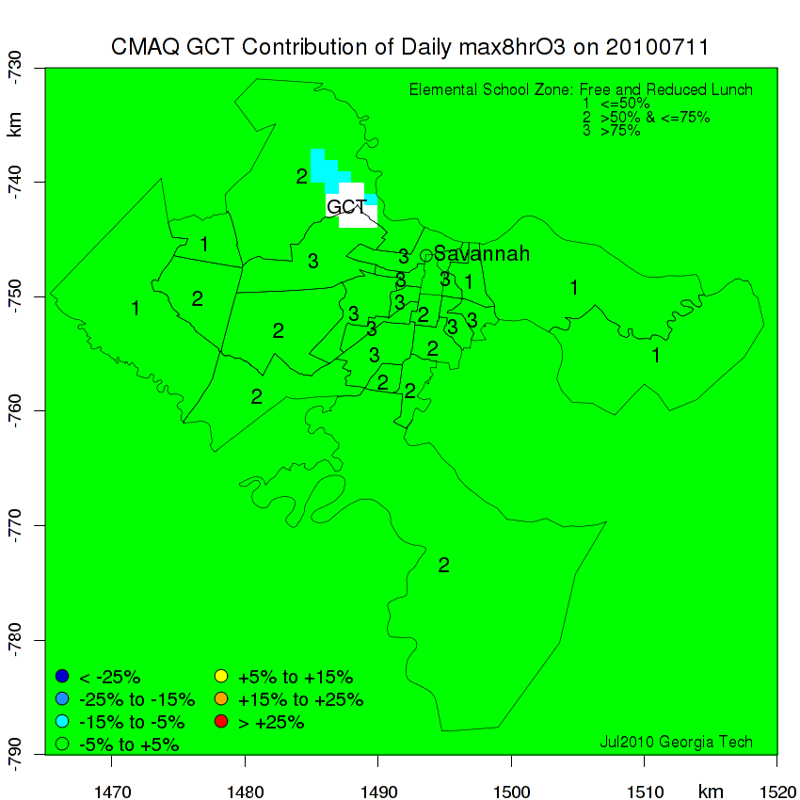
Max. 8hr O₃
GCT’s Impact (%)
17 July
2002
11 July
2010

Slide 15
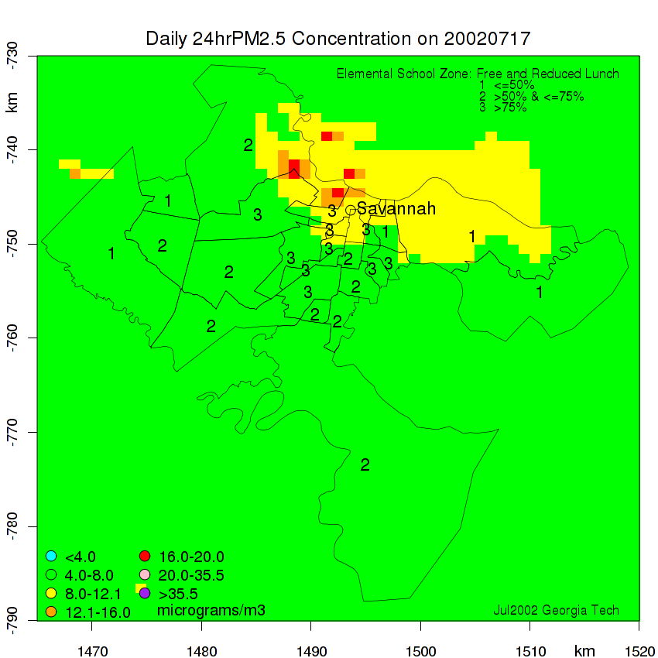
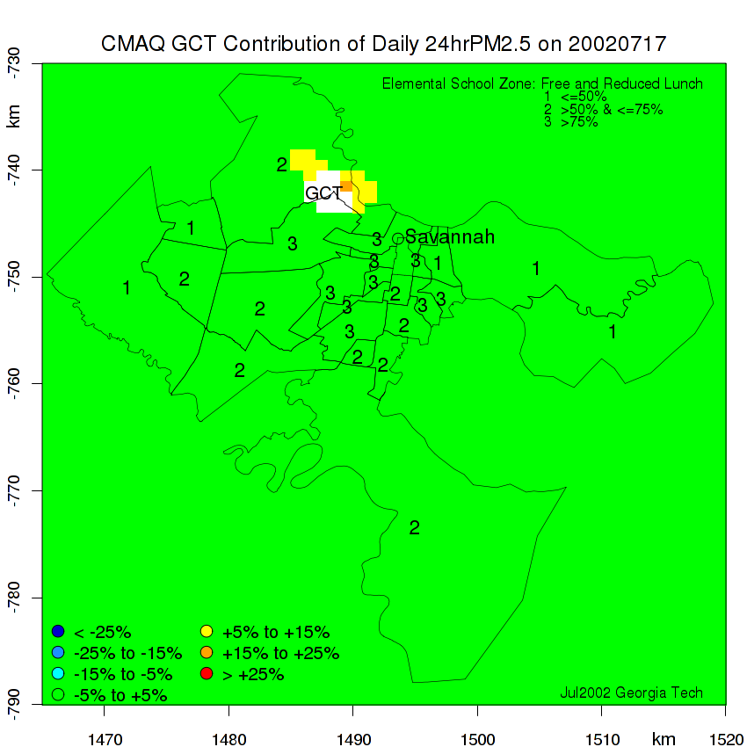
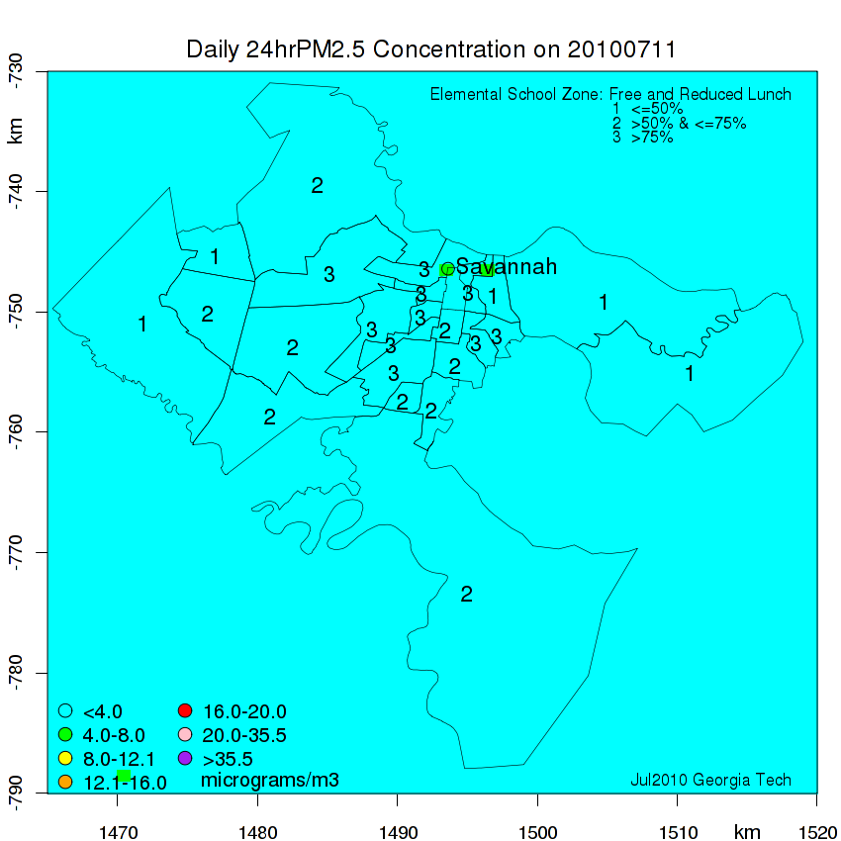
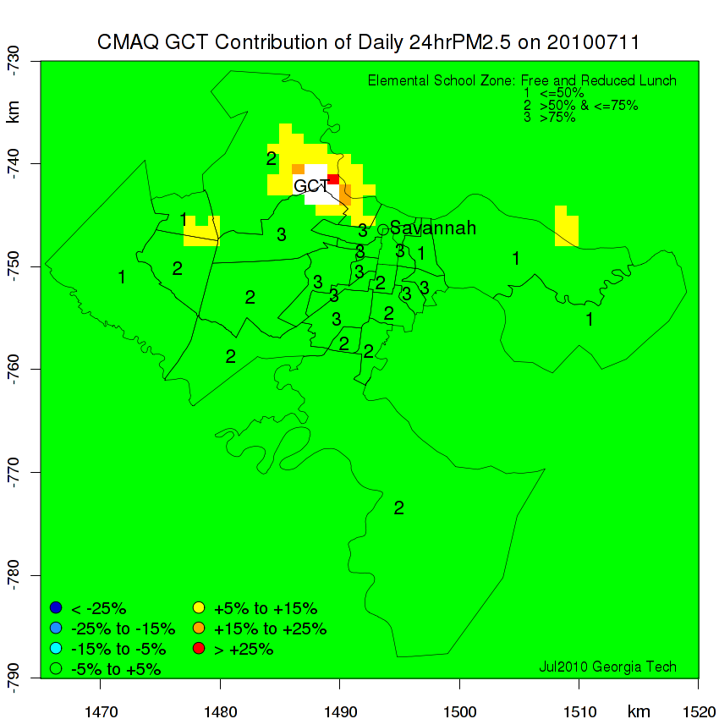
24 hr PM_{2.5}
GCT’s Impact (%)
17 July
2002
11 July
2010

Slide 16
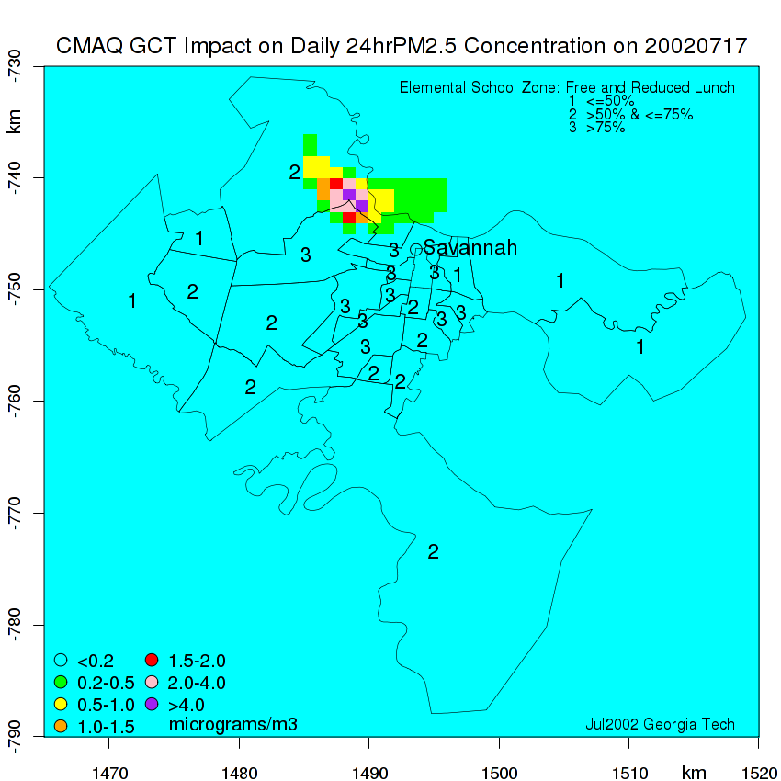
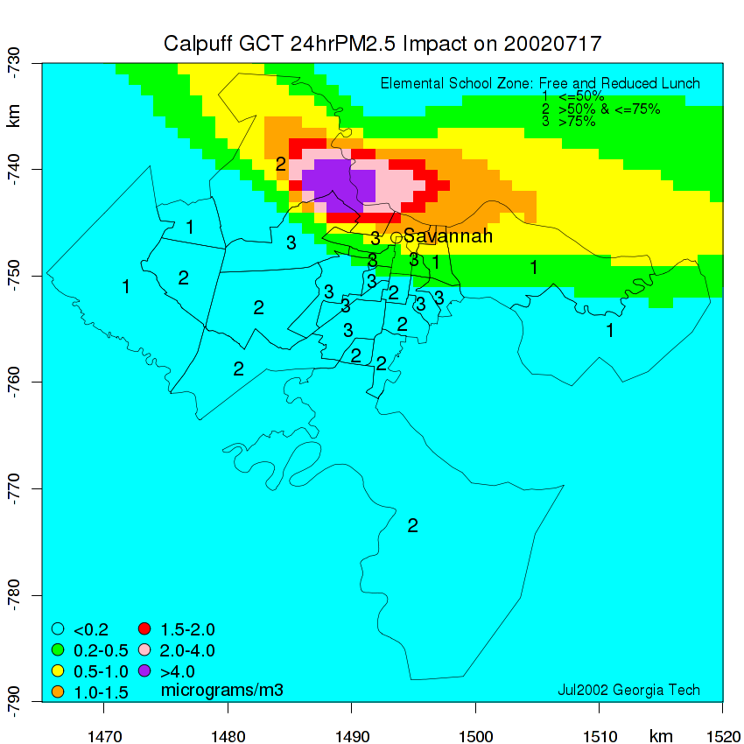
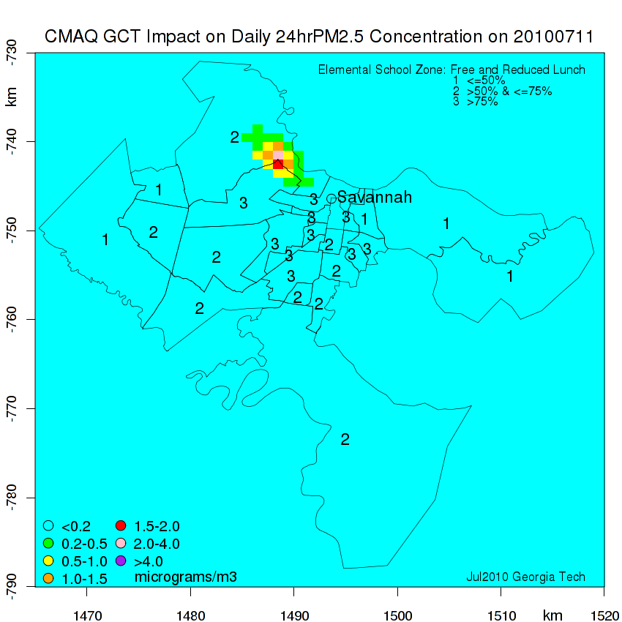
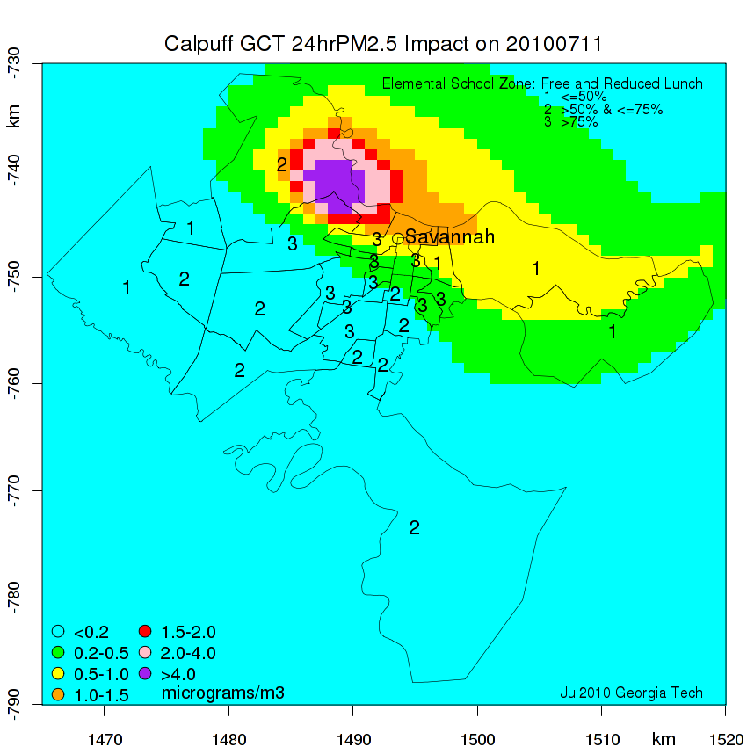
CMAQ PM_{2.5}
CALPUFF PM_{2.5}
17 July
2002
11 July
2010

Slide 17
PM_{2.5} Impacts CALPUFF vs. CMAQ
2002
2010

Slide 18
CALPUFF vs. CMAQ in this study is similar to CALPUFF vs. CAMx in the literature.
2010
C. Trozzi, S. Villa & E. Piscitello
Use of CALPUFF and CAMx models in regional air quality planning: Italy case studies
WIT Transactions on Ecology and the Environment, Vol 123, © 2009 WIT Press, doi:10.2495/AIR090021

Slide 19
Summary and Conclusions
A detailed emissions inventory has been developed for Port of Savannah’s Garden City Terminal (GCT).
Cargo capacity at GCT doubled from 2002 to 2010 but emissions did not increase as much due to increased fuel efficiency.
  NO_{x} and CO₂ emissions increased
  SO₂ emissions decreased
CMAQ-DDM-3D simulated impacts from GCT are less than
  5 ppb for O₃ within a radius of 10 km
  2 μg m⁻³ for PM_{2.5} within a radius of 5 km
CALPUFF simulated PM impacts are about 3 times larger than those simulated by CMAQ.

