Slide 1
CMAQ-Urban: UK FINE SCALE MODELLING FOR DYNAMIC EXPOSURE STUDY Nutthida Kitwiroon, Sean Beevers and colleagues King’s College London 14th Annual CMAS Conference October 5-7, 2015 at Friday Center, UNC-Chapel Hill

Slide 2
Outline
Background
The development and description of the CMAQ-Urban model
for fine spatio-temporal predictions of air pollution and
human exposure at UK national level and policy applications.
CMAQ-Urban results discussion
Application in hybrid exposure model

Slide 3
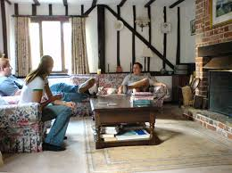
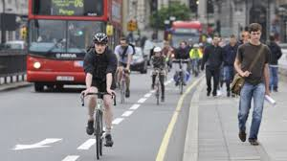
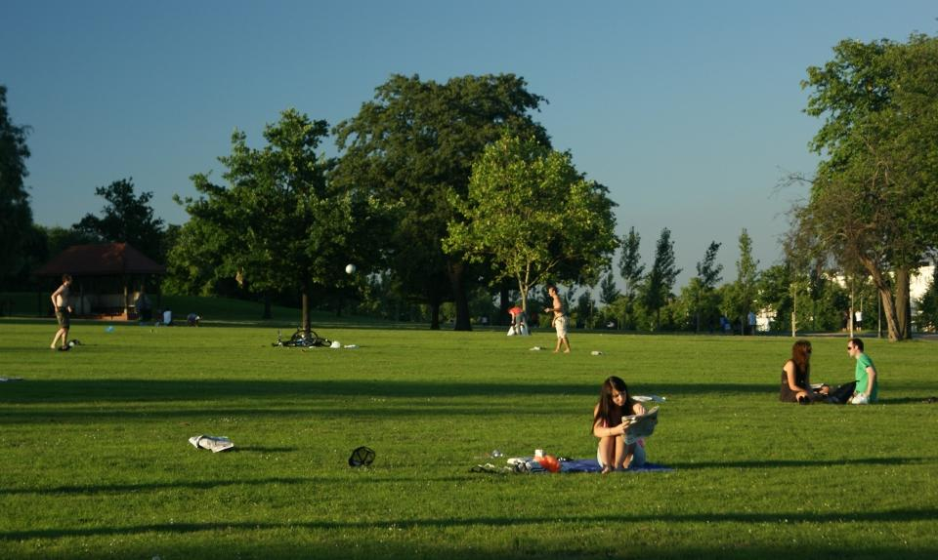
Background (1)
Daily activities and times spent in different microenvironments result in different
levels of individual exposure to air pollution
The time based activities and personal exposure of an individual to air pollution,
is therefore key to determining health risks, and also address of
human exposure misclassification.
at home
travel
at work
in other micro-environments

Slide 4
Background (2)
Traffic related pollutants pose risk to human health, e.g. respiratory and
cardiovascular diseases and with a significant numbers of UK population living
or working near roads.
As part of the NERC traffic and human health project, the CMAQ-Urban was
developed to predict outdoor air pollution at street level by coupling the
CMAQ and ADMS-Road model.
The CMAQ-Urban model was also used as part of the calculation of indoor air
pollution using the mass balance models for, within vehicles, trains, buses and
also for the exposure of cyclists and pedestrians.
To cover the those within the London population who travel beyond the capital,
CMAQ-Urban has been extended to predict hourly concentrations at 20m grid
resolution over the whole of the UK.

Slide 5
CMAQ-Urban modelling system
WRF
(Meteorology)
CMAQ-Urban Interface
(Parallel FORTRAN program)
Output
Mean conc. Maps at 20m grid resolution: NO_{x}, NO₂, O₃, PM₁₀ and PM_{2.5}
Hourly Conc. at selected receptors
ADMS-CMAQ output
archive routine
ADMS-Road
(Dispersion of
unit of emissions)
Online road emissions
module
NO₂-NO_{x}-O₃
chemical module
CMAQ
(Background concentrations)
Output for exposure
estimate routine
(optional)
For UK version, the CMAQ-urban interface has been
parallelised with MPI to reduce model runtime

Slide 6
WRF/CMAQ model domains
50km grid resolution over Europe and downscaled to 10km over the UK,
23 vertical layers with 7 layers under 800m
WRF
Lateral conditions: GFS (ds083.2)
Radiation, Cumulus, Microphysics, Surface, LSM, PBL :RRTM/Dudhia,Kain-Fritsch,
WSM6, P-X, RUC, ACM2
CMAQ
Area emissions for CMAQ:
European Monitoring and Evaluation Programme (EMEP)
National Atmospheric Emissions Inventory (NAEI)
Road traffic emissions from King’s.
Biogenic emissions using BEIS3 in SMOKE2.6
Point sources emissions: European Pollutant Release and Transfer Register (E-PRTR) for EU
and NAEI for UK
Chemical scheme: CB-05 with aerosol and aqueous chemistry
Boundary Conditions: MACC

Slide 7
ADMS-Road v2.3
Input meteorology from WRF: wind speed and direction, temperature,
surface sensible heat flux and planetary boundary layer height.
Output: the dispersion of primary pollutants of unit emissions (1 g km⁻¹ s⁻¹ )
across regular grid spacing of 5m and within 225 m distance from the center of the
roads.
Six road categories are included in the calculation;
Open roads (motorways)
Typical roads (average urban roads surrounded by low rise buildings (~10m),
a road width of 20 m)
Canyon roads (width of 30 m, building height of 25m) and 4 road orientations
are included:
north-south
east-west
southwest-northeast
southeast-northwest

Slide 8
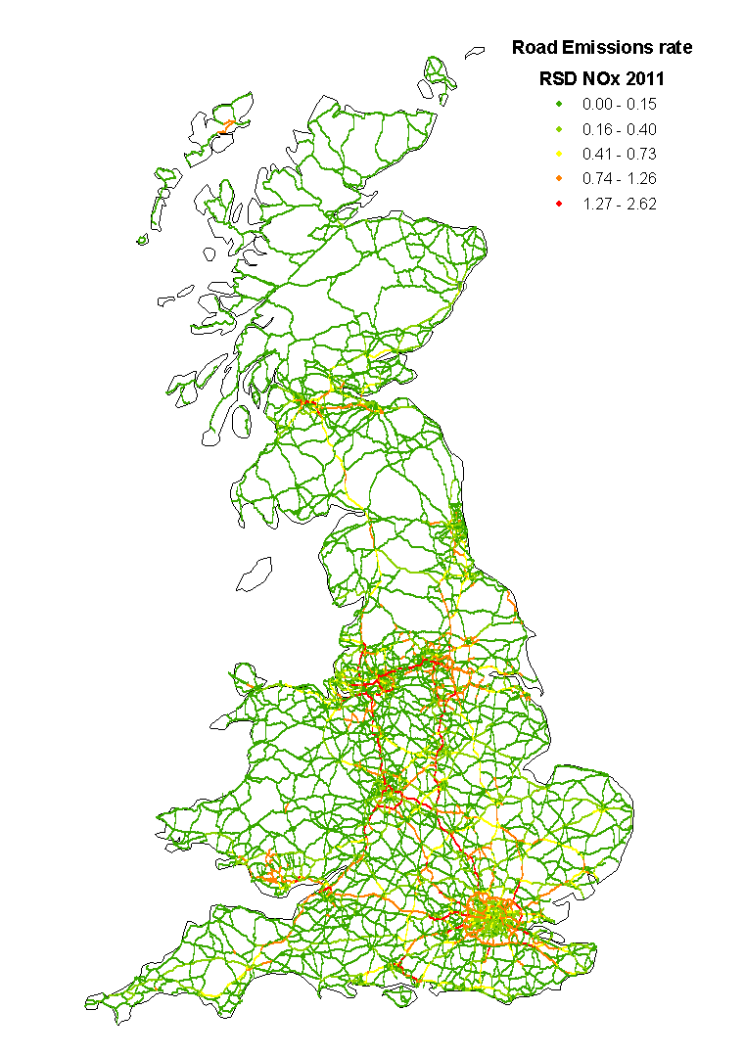
UK road network and emissions used in CMAQ-Urban
Modelled roads include 17,696 major road links
Road emissions are calculated on line
(Beevers, et al. 2012)
Emissions factors are derived from remote
sensing device (RSD) for NO_{x} and the
Department for transport (DFT) for PMs.
Vehicle speeds are based upon road type
(motorways, dual carriage ways and single
carriage ways)
Hourly profile of road traffic is extrapolated and
averaged from 37 automatic traffic count sites in
London

Slide 9
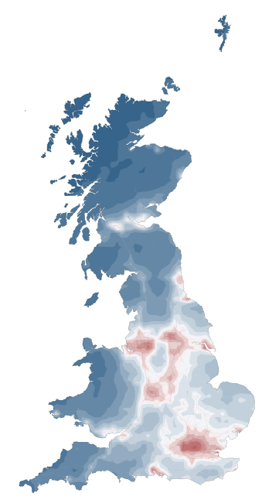
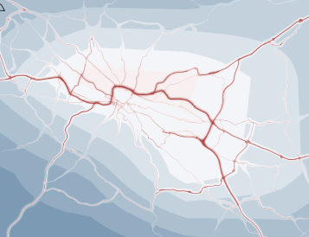
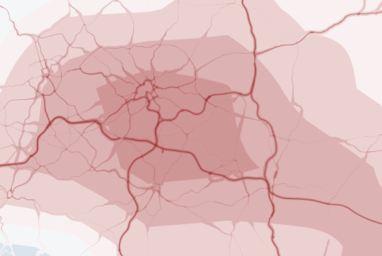
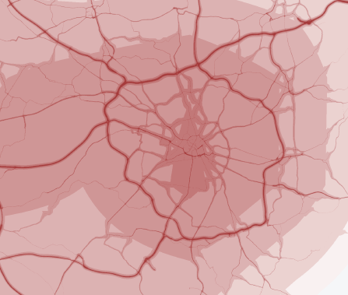
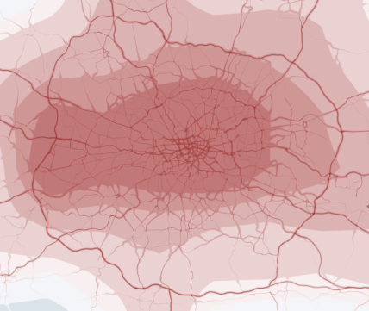
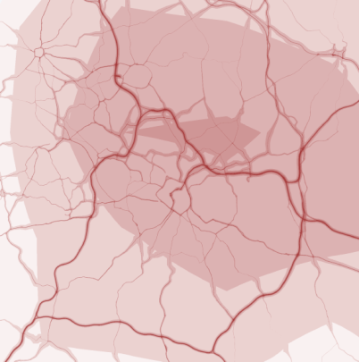
2011 annual mean NO₂ concentrations (10km grid spacing background concentrations)
Glasgow
Leeds
Manchester
London
Birmingham

Slide 10
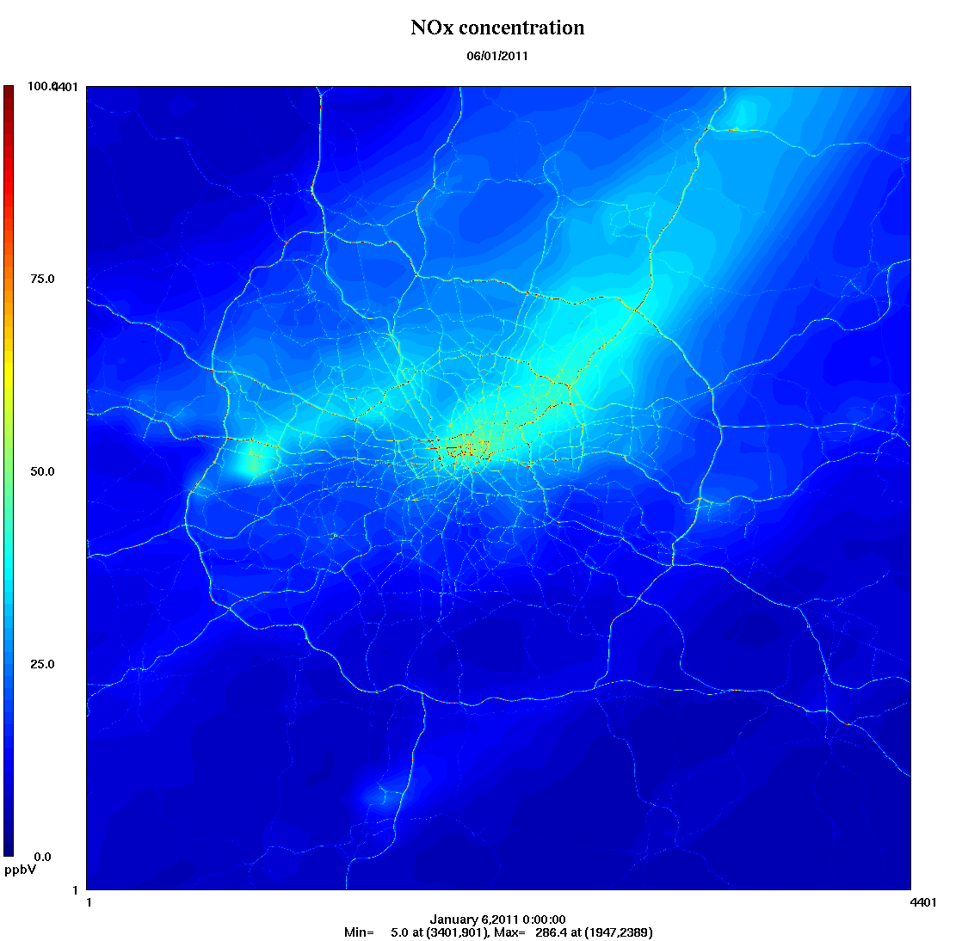
Hourly NO_{x} concentrations: 06/01/2011

Slide 11
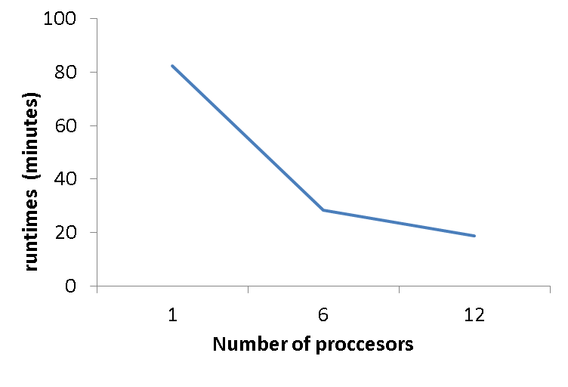
Model runtimes
Model runtimes for UK annual simulations: The CMAQ-Urban runtimes is 8 days on a 4 yrs old Linux cluster with 8 slave node (3GHz CPU and 48 GB RAM on each node each), plus 6 days for WRF/CMAQ simulations (The model runtime can be compromised 3-5 times faster on the UK national supercomputer).
1 day simulation for London on 1 computer
Node (3GHz CPU and 96 GB RAM)

Slide 12
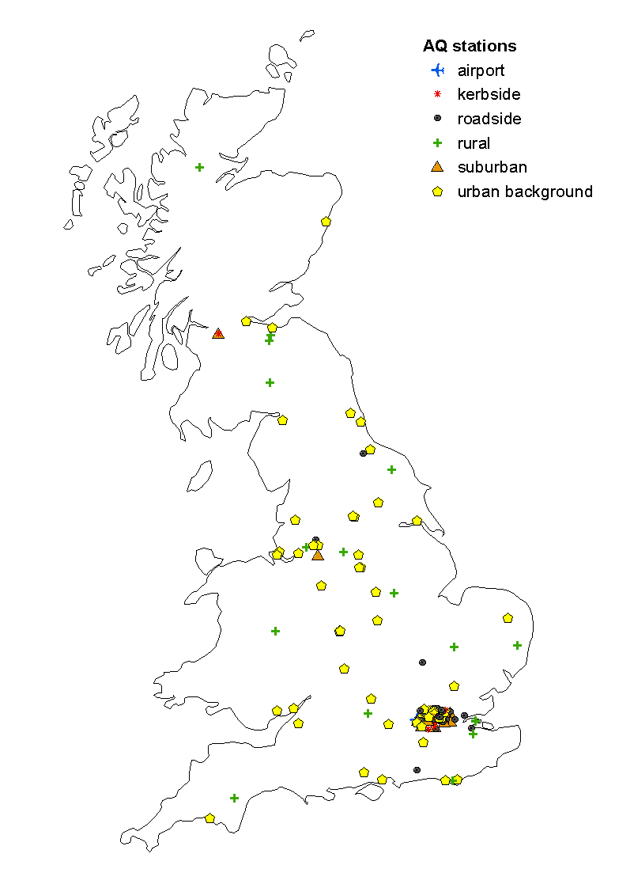
Air quality monitoring stations for model evaluation
144 sites with >75% data captured
Site type | NO₂ | O₃ | PM₁₀ | PM_{2.5}
Rural | 13 | 17 | 7 | 6
Suburban | 7 | 6 | 6 | 6
Urban Background | 28 | 18 | 51 | 48
Roadside | 39 | 10 | 37 | 17
Kerbside | 7 | 0 | 9 | 5
Airport | 1 | 1 | 1 | 1
Pollutant | # of data | Obs mean | Mod mean | FAC2 | MB | NMB | RMSE | r
NO₂ (ppb) | 2681929 | 20.1 | 20.5 | 0.8 | 0.4 | 0.02 | 11.8 | 0.8
O₃ (ppb) | 1605883 | 20.2 | 21.7 | 0.8 | 1.5 | 0.07 | 8.8 | 0.8
PM₁₀ (µg m⁻³)* | 2556574 | 23.4 | 19.7 | 0.8 | -3.7 | -0.16 | 13.0 | 0.7
PM₂₅ (µg m⁻³) * | 1860753 | 14.9 | 13.9 | 0.8 | -1.0 | -0.07 | 9.3 | 0.7
* Background concentrations are adjusted with added SOA (1 µg m⁻³ , a conservative value derived from SOA analysis in the CMAQ-UK project , and biomass burning aerosols (1 µg m⁻³, personal communication with Dr Gary Fuller at King’s)
Fuller GW et al, 2013. Atmospheric Environment 68, 295–296. Fuller GW et al, 2014. Contribution of wood burning to PM₁₀ in London. Atmospheric Environment (accepted, publication pending).

Slide 13
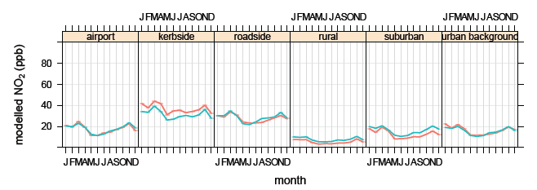
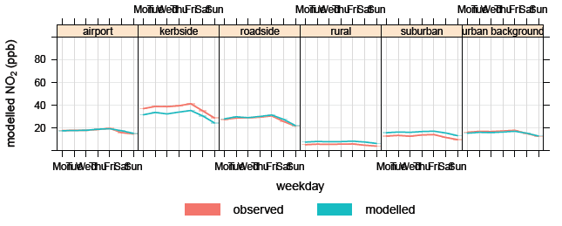
Temporal variations of modelled and observed NO₂ concentrations (2011)
J F M AMJ J AS O N D
M T W Th F S S

Slide 14
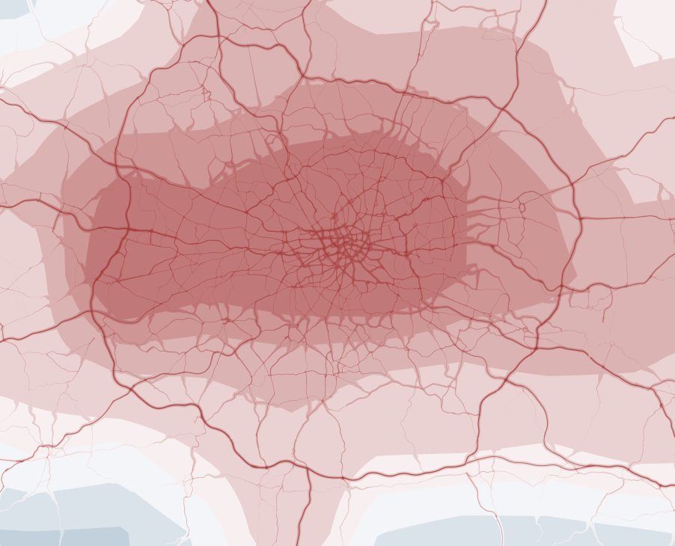
2011 annual mean NO₂ concentrations Improvement with higher resolution of background concentrations
using 10km grid
background concentrations
using 2km grid
background concentrations

Slide 15
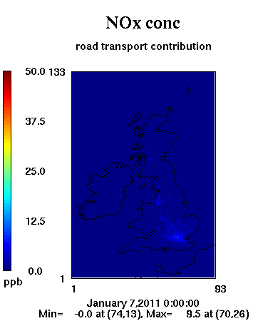
Remove double counting from background concentrations using CMAQ-DDM
Current estimates of double counting using standard CMAQ is < 10%.
CMAQ-DDM can provides the road traffic contribution to background concentrations which can then be used to eliminate the double counting.

Slide 16
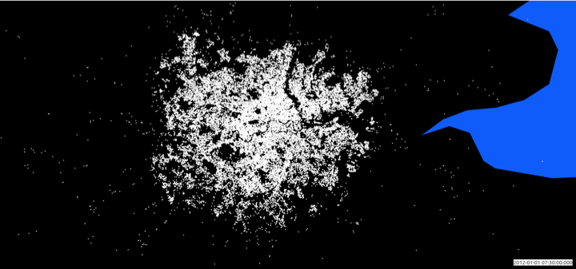
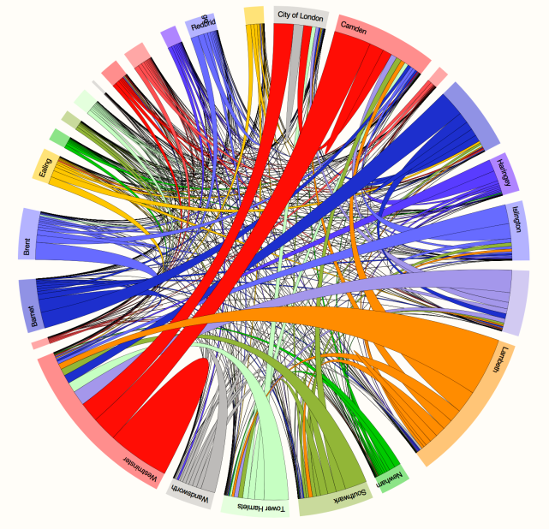
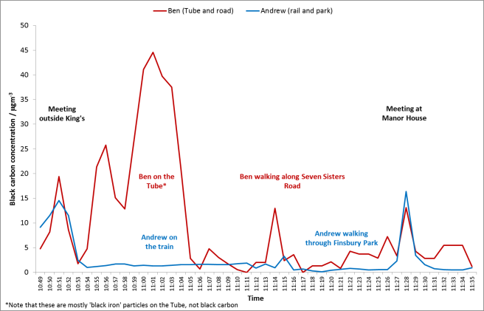
Application in the hybrid exposure model
Micro-environmental modelling: in-vehicle (bus, car, train, tube), cycle, walk, indoors (I/O exchange - J Taylor (UCL))
CMAQ-urban: air quality model
London Travel Demand Survey: Trips by transport mode: Sex, age, gender and socio-economic status
Oyster card data
Detailed human exposure
J Taylor et al., 2014. The modifying effect of the building envelope on population exposure to PM2.5 from outdoor sources. Indoor Air. doi:10.1111/ina.12116

Slide 17
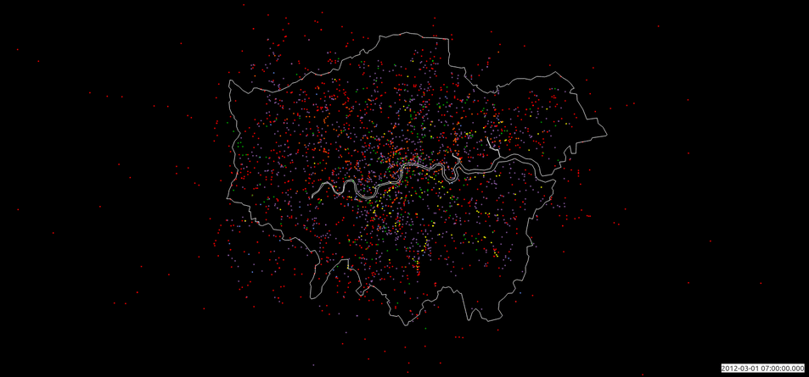
“Thank you for your attention”
London journeys

Slide 18
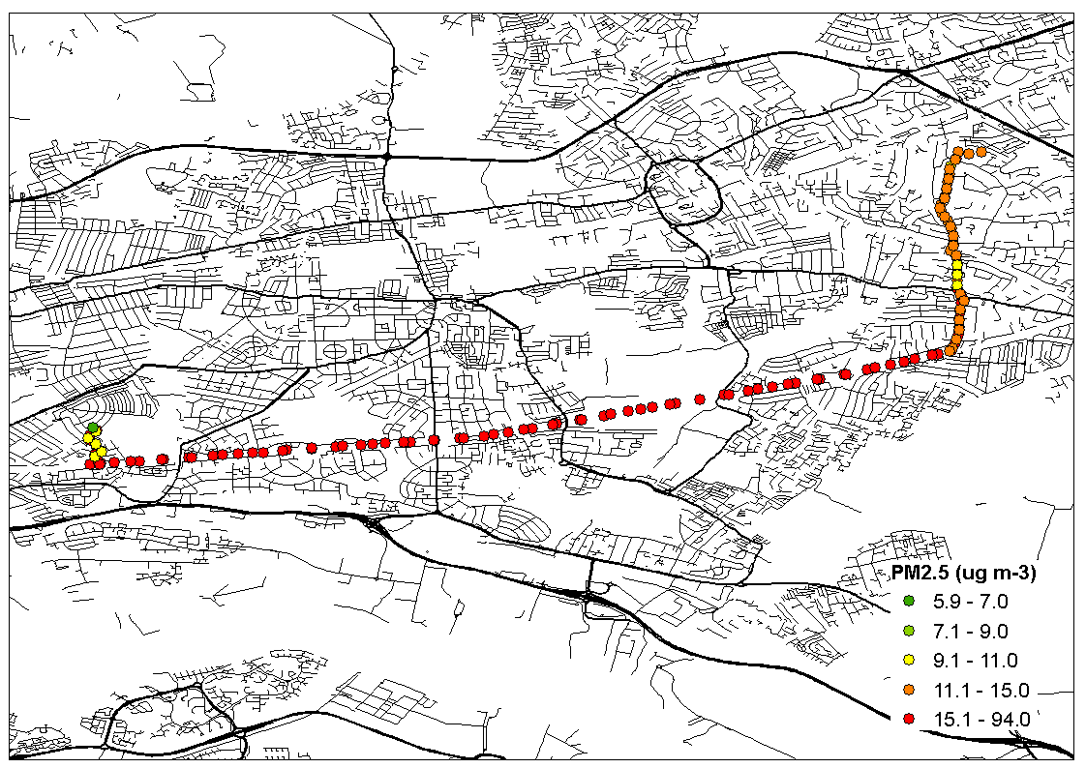
Sample of dynamic human exposure to PM_{2.5}
Walking (9:30am)
Bus (9am)
Indoor (4am, 12:30 pm onward)
Walking (8am, 12:30pm)
Underground (8:30am, 12pm)
Total travel distance of approximately 13 km

Slide 19
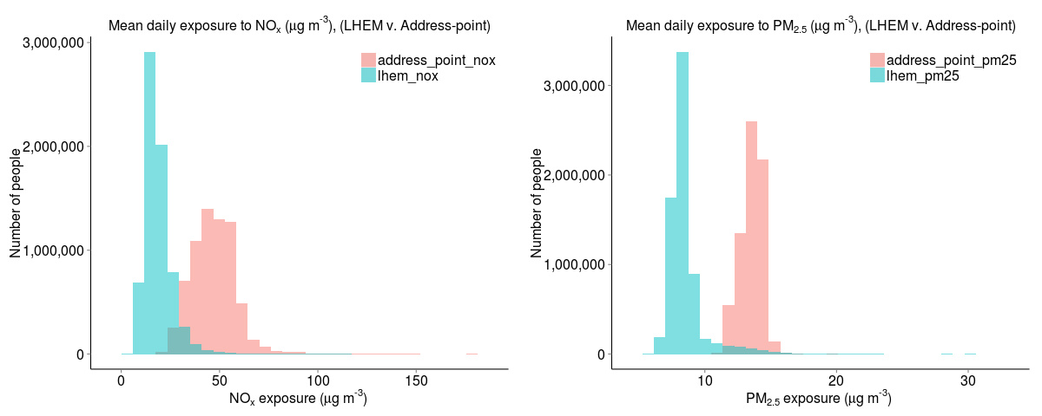
Exposure misclassification
The average exposure for London population is estimated to be 37% lower for PM_{2.5}
and 61% lower for NO_{x}, than at the residential address, due mainly to the
indoor/outdoor ratio of air pollutants and the time spent indoors (90+%).
The range of personal PM_{2.5} exposure estimated by the LHEM is larger than the
equivalent exposure at the residential address: between 6.0 and 32.2 µg m⁻³ (LHEM)
c.f 11.2 and 20.0 µg m⁻³ (residential address).
For NO_{X} the range in exposure is smaller: between 4.9 µg m⁻³ and 136.3 µg m⁻³
(LHEM) c.f. 20.1 µg m⁻³ and 180.5 µg m⁻³ (residential address).
LHEM: London hybrid exposure model (dynamic exposure model)

Slide 20
Summary
CMAQ-Urban has been extended to predict fine spatio-temporal resolution
outdoor air pollution at UK national level for dynamic human exposure study
and other policy applications, e.g., planning for NO₂ reduction.
An annual simulation can be accomplished within an acceptable time frame using
the parallel CMAQ-Urban (an annual simulation can be archived about <=8 days)
The performance analysis show good agreement with the measurements
although with some rooms for improvement, e.g., SOA and biomass burning
aerosols of background concentrations.
Spatial distribution of model output can be improved with finer grid resolution
of background concentrations and this may also reduce the negative bias at
kerbside sites and positive bias at rural sites. Kerbside under prediction is also
likely to be emissions related.
Although a small error of <10%, double counting in CMAQ-Urban can be
eliminated using CMAQ-DDM.

Slide 21
Acknowledgements
“We thank the Natural Environment Research Council, Medical Research Council,
Economic and Social Research Council,
Department of Environment, Food and Rural Affairs and
Department of Health for the funding received for
the Traffic Pollution and Health in London project (NE/I008039/1),
funded through the Environmental Exposures and Health Initiative (EEHI).
The research was also supported by
the National Institute for Health Research (NIHR) Biomedical Research Centre based at
Guy’s and St Thomas’ NHS Foundation Trust and King’s College London.
US EPA for CMAQ model,
NCAR/NCEP for WRF model, EMEP for European emissions,
DEFRA for national emissions inventory,
AQMEII for emissions speciation and temporal profiles,
Gregor Stuart and David Dajnak for UK road traffic emissions,
James Smith and Christina Mitsakou for the dynamic exposure estimates”

Slide 22
“Thank you for your attention”

Slide 23
London journeys
MRC-HPA Centre for Environment and Health
Imperial College
London

