Slide 1
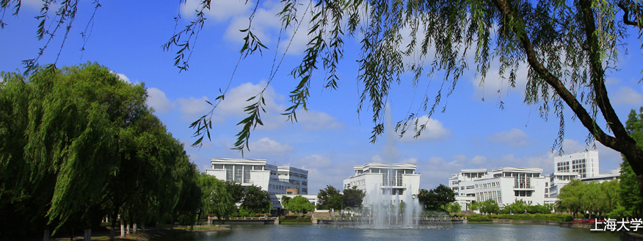
Source apportionment of the Fine Particulate Matter in Beijing during extremely heavy Haze Episodes
Yangjun Wang, Shuxiao Wang, Yongtao Hu, Ted Russell
2015-10-06

Slide 2
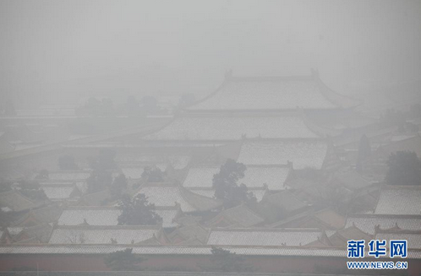
Beijing on Jan. 23, 2013

Slide 3
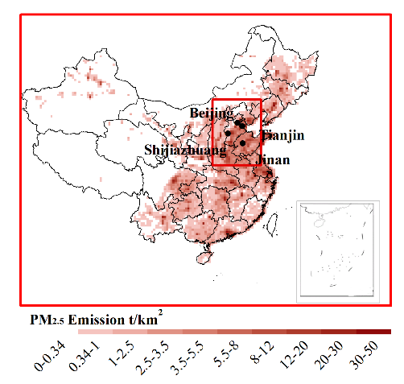
1. Model setup
Simulation System
  WRFV3.4/CAMx5.4
Mechanism
  Land surface mechanism: PL-X
  Radiation mechanism: rrtmg
  Gas-phase/aerosol CB05&AERO5
Modeling domain
  China and Jing-Jin-Ji region
Horizontal Resolution:
  36km×36km
  12km ×12km
Vertical layers
  14 layers
Time Period:
  January 2013
Source Apportionment
  Receptor: urban center of Beijing
  15 emission regions
Species
  PM2.5

Slide 4
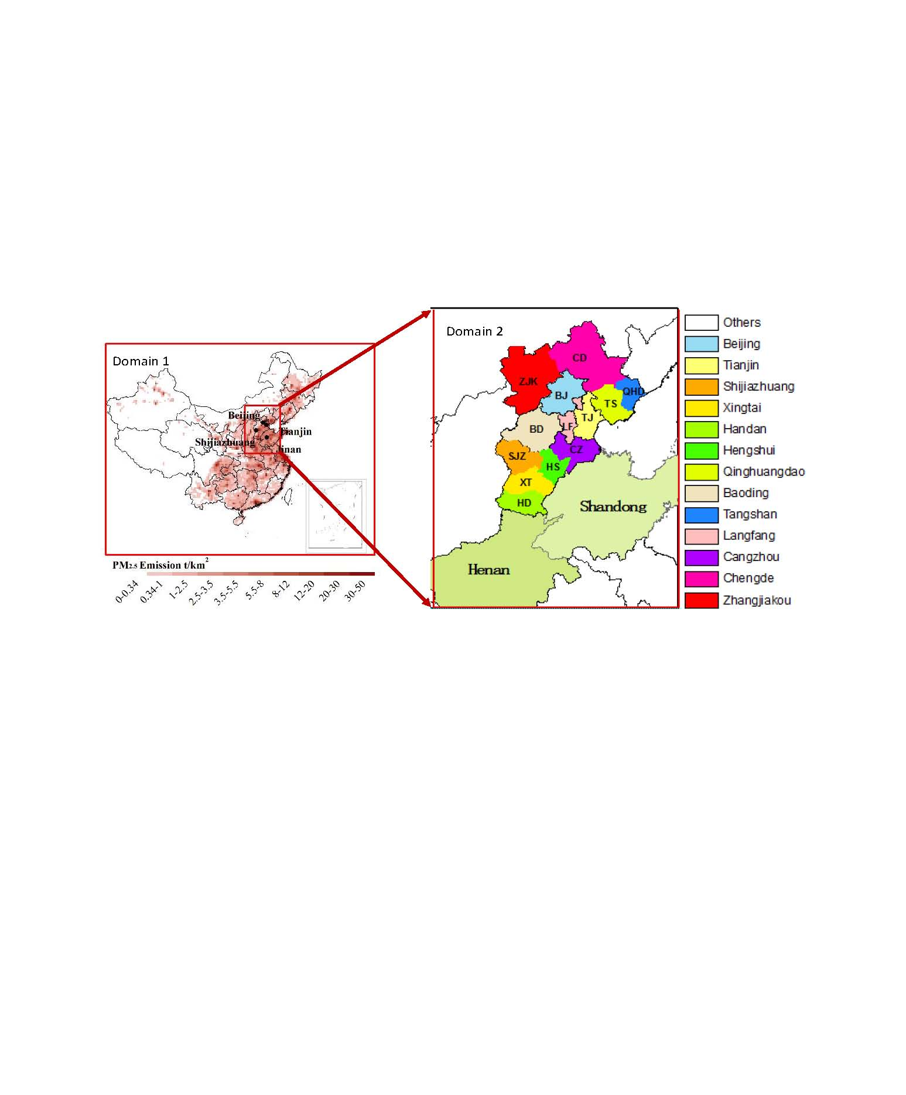

Slide 5
2. Evaluation of Model Performance

Slide 6
Quantitative evaluation of predicted PM_{2.5} concentrations with hourly observations
City | Predicted average (μg/m³) | Measured average (μg/m³) | Number of data pairs | BIAS (μg/m³) | ERROR (μg/m³) | RMSE (μg/m³) | FBIAS | FERROR | IOA
Beijing | 163.68 | 180.32 | 483 | -16.64 | 109.92 | 149.19 | 3.71% | 67.98% | 0.647
Tianjin | 150.56 | 176.05 | 427 | -25.50 | 74.72 | 99.02 | -7.07% | 49.01% | 0.678
Jinan | 174.03 | 252.08 | 418 | -78.05 | 103.46 | 131.56 | -34.55% | 47.15% | 0.526

Slide 7
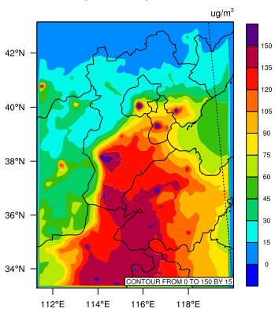
Average modeled ground-level concentrations of PM2.5 in the second domain for January 06-23 2013(LT)
3. Results and discussions
3.1 modeled concentrations of PM2.5

Slide 8
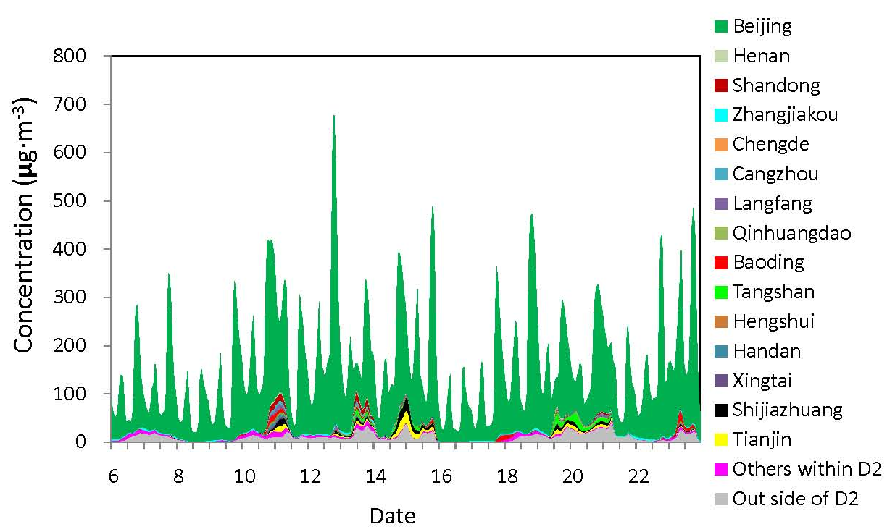
Temporal variation of contributions from different emission regions to PM_{2.5} concentrations at the urban center of Beijing during January 06-23, 2013(LT)
3.2 Temporal variation of source apportionment results

Slide 9
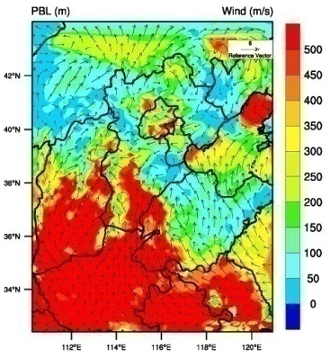
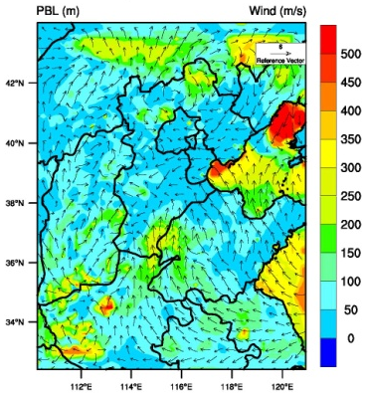
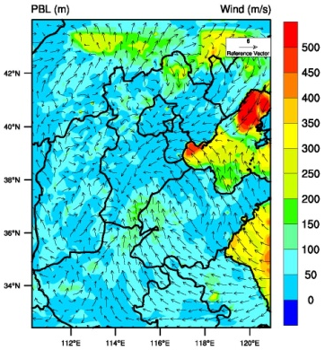
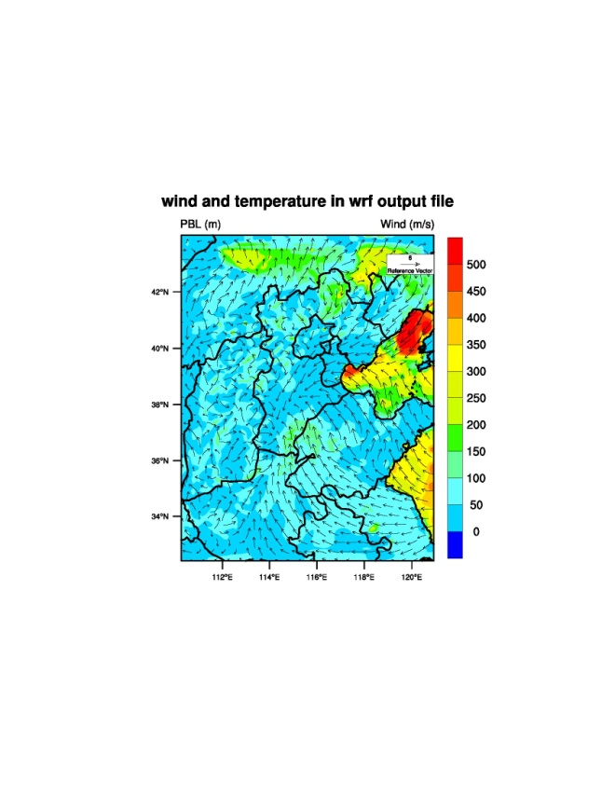
Hourly distribution of velocity field and PBL on January 12, 2013(LT)
(a) 17:00 (b) 18:00 (c) 19:00 (d) 20:00

Slide 10
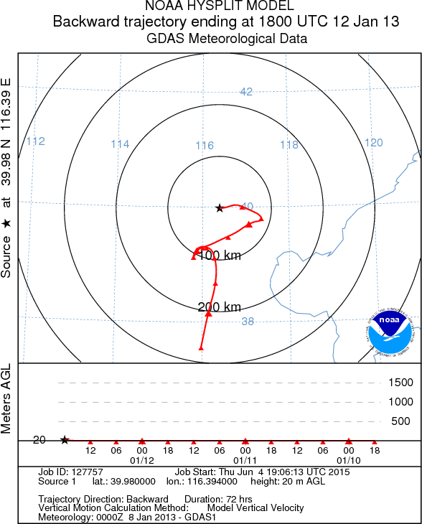
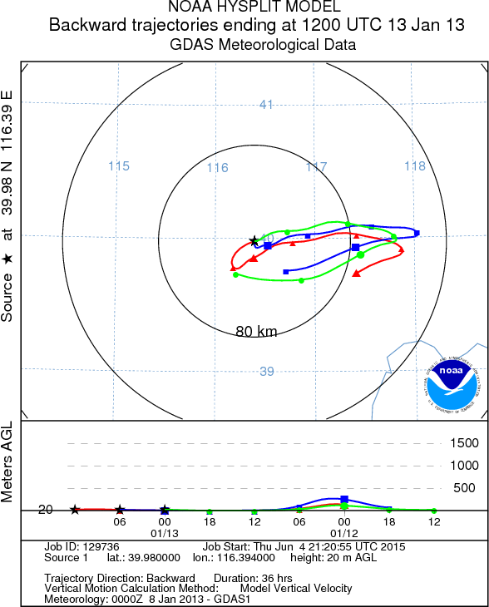
Trajectories analysis

Slide 11
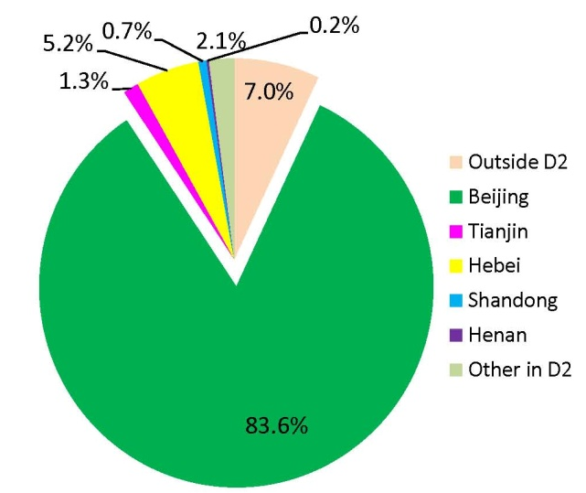
Temporal contribution percentages of emission regions toPM_{2.5} concentrations in central Beijing during January 06-23,2013(LT)
Average contribution percentages of different emission regions to PM_{2.5} concentrations in central Beijing during January 06-23, 2013.

Slide 12
3.3 Contribution evolution during local dominated haze episodes

Slide 13
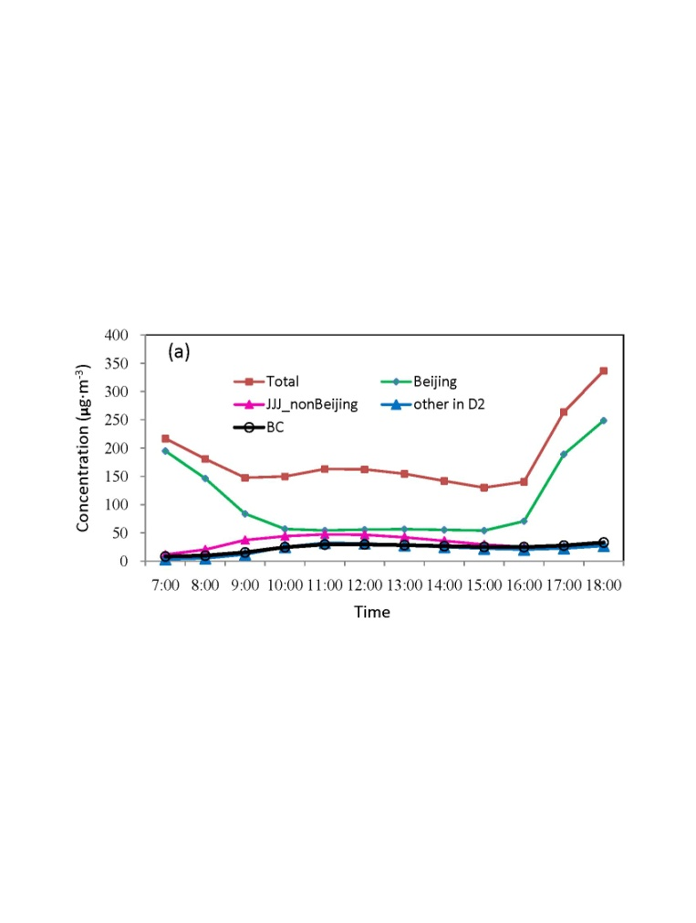
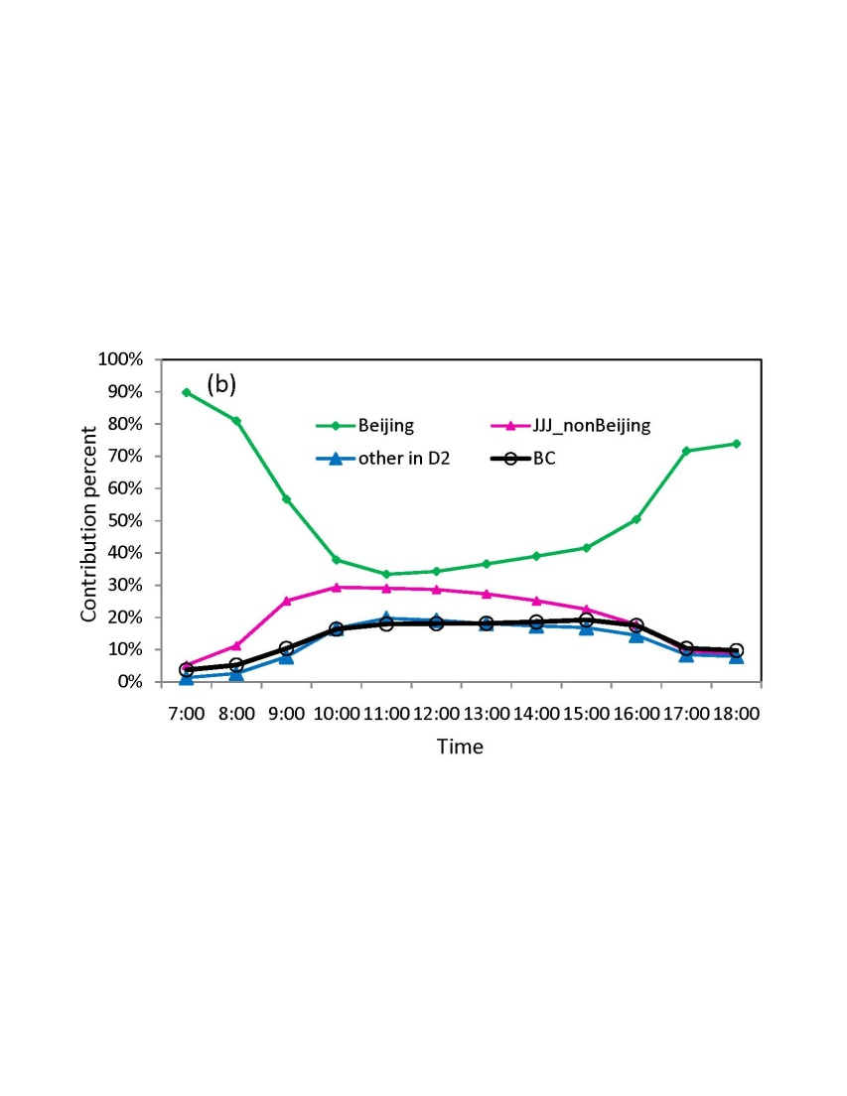
3.4 Contribution analysis in a non-local dominated case (January 13, 2013(LT))

Slide 14
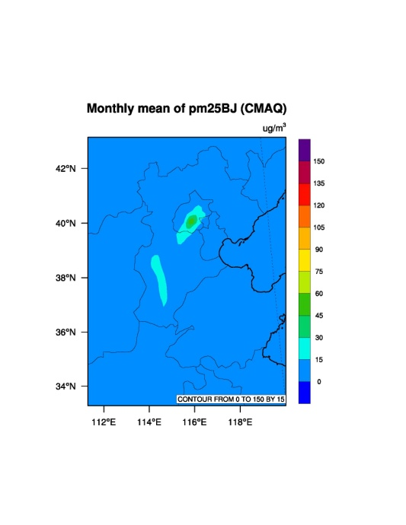
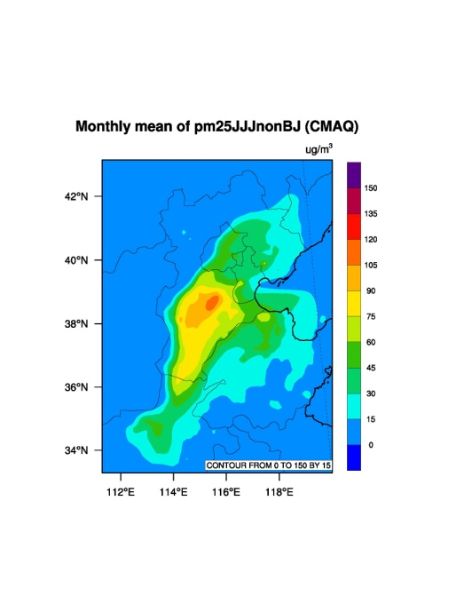
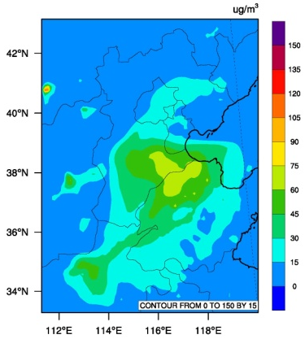
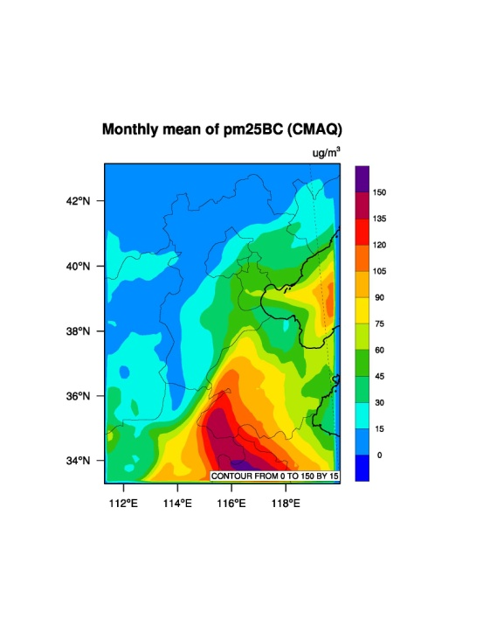
(a) Beijing
(b) JJJ_nonBeijing
(c) other in D2
(d) Boundary Condition

Slide 15
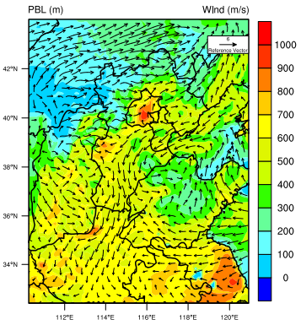
Average wind velocity field and PBL distribution in simulation domain during 10:00 - 15:00 on January 13, 2013

Slide 16
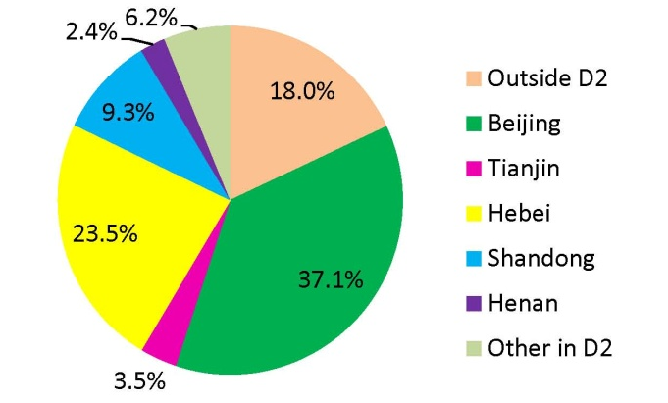
Contribution percentages from regions
on January 13,2013(LT)

Slide 17
4. Conclusions
Controlling local emissions will be the most important step and should be given priority for Beijing government to mitigate the extremely heavy haze pollution.
it is impossible to eliminate the haze episodes in Beijing without controlling emissions in other cities in Jing-Jin-Ji region, even in long-range cities.
The big contributors from outside Beijing are Shandong, Tangshan, Tianjin, Shijiazhuang, Baoding, Cangzhou.
Notes:
Micrograms per cubic meter

Slide 18
Acknowledgments:
Tsinghua University
Georgia Tech
Peking University

Slide 19

Shanghai Municipality is devoted to establishing the city into both an innovation center of science and technology and a professional hub of global innovation. In order to fulfill its role, Shanghai University has been actively recruiting overseas elites and planning its Overseas Job Fair in 2015.

Slide 20
Level | Background Requirement | Job Description | Remuneration
Tier One | Professors with outstanding academic achievements and international reputation | Establish world-class research platforms, undertake national key research projects, carry out high-end international cooperation, apply for being recruited in China’s “1,000-Talent Plan”, the professorship of Yangtze River Scholar, etc | Annual salary: RMB 0.8-1.5 million Housing subsidy: RMB 1.5-2.3 million Research fund: RMB 1-5 million
Tier Two | Associate professors, heads of R&D departments of top multi-national corporations | Lead the related disciplines, undertake national key research projects, carry out high-end international cooperation, apply for being recruited in China’s “1,000-Talent Plan” meant for young researchers,National Science Fund for Distinguished Young Scholars, and Shanghai “1,000-Talent Plan”, etc | Annual salary: RMB 0.5-1 million Housing subsidy: RMB 1.3-1.8 million Research fund: RMB 1-2 million
Tier Three | Assistant professors, post-doctors, PhD holders from prestigious overseas universities | Apply for and undertake national research projects, publish quality research papers, apply for the professorship of Oriental Scholar (including Young Oriental Scholar), etc | Annual salary: RMB 0.2-0.5 million Housing subsidy: RMB 0.2-0.8 million Research fund: RMB 0.3-1.5 million
Please register on http://en.shu.edu.cn/Default.aspx?tabid=23926. You can also send your C.V. to shucareer@oa.shu.edu.cn. They will contact you via your email address.

Slide 21
Thank you !

