Slide 1
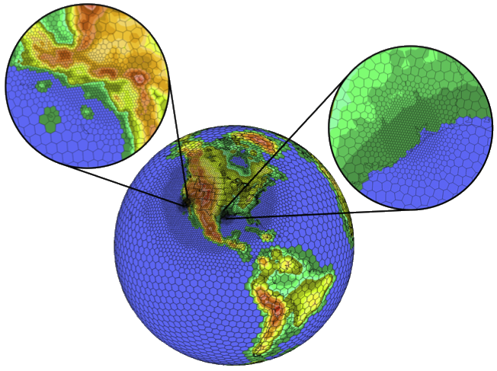
High-Resolution Simulations with CMAQ for Improved Linkages with Exposure Models
Martin Otte
CSC
Christopher Nolte
US EPA
Robert Walko
Univ. Miami

Slide 2
Motivation:
We want to model air pollution from global scales right down to the finest scales necessary for linkages with human exposure models
CMAQ currently does not get anywhere near the resolution necessary for direct input to health risk assessment models
We have to rely on parameterized/non-physically based models to bridge the gap to exposure models
Ideally we would use the physics within CMAQ to characterize exposure
Link global climate, regional air pollution, and small-scale exposure right in the same model

Slide 3
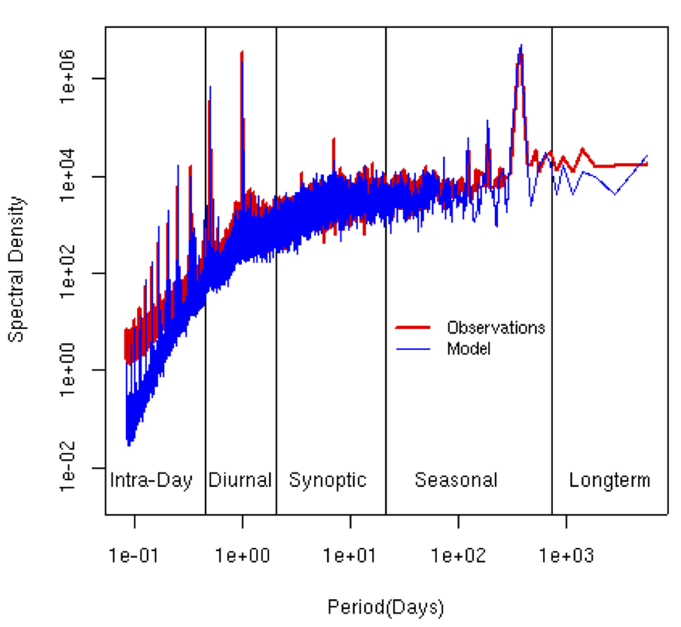
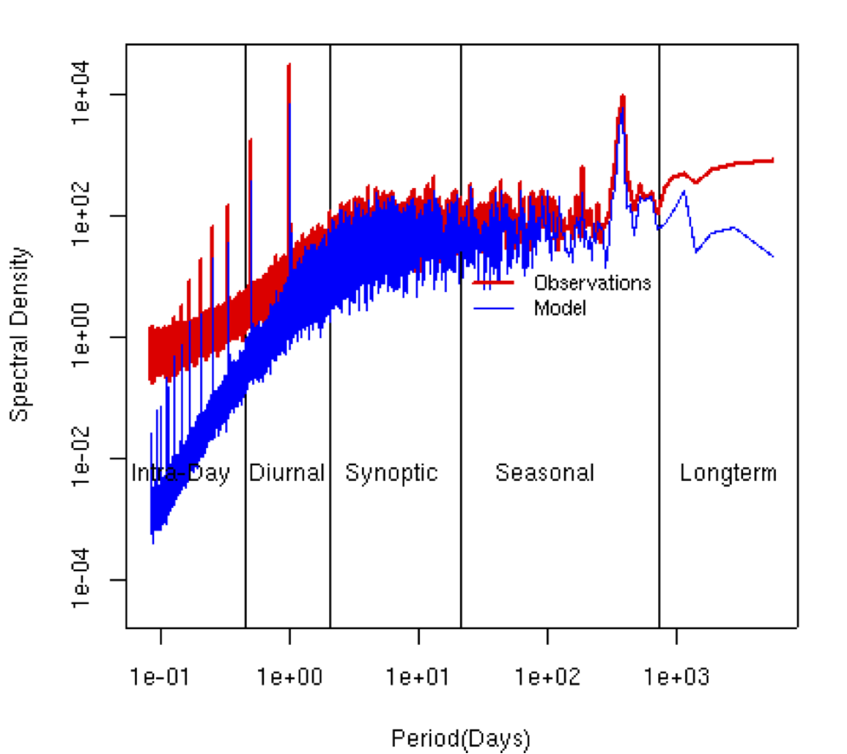
What is the problem with existing CMAQ simulations?
Ozone
Wind Speed
Numerical simulations lack the high frequency variability necessary for exposure models

Slide 4
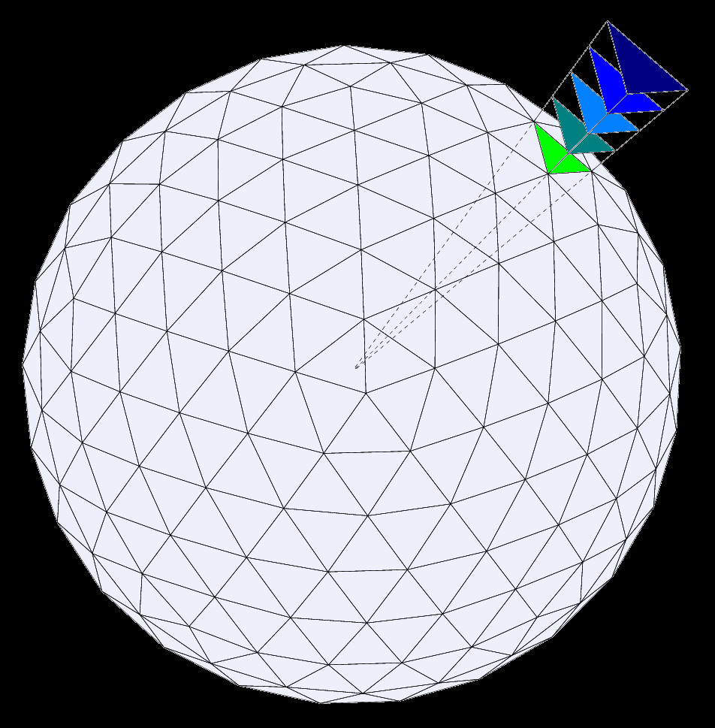
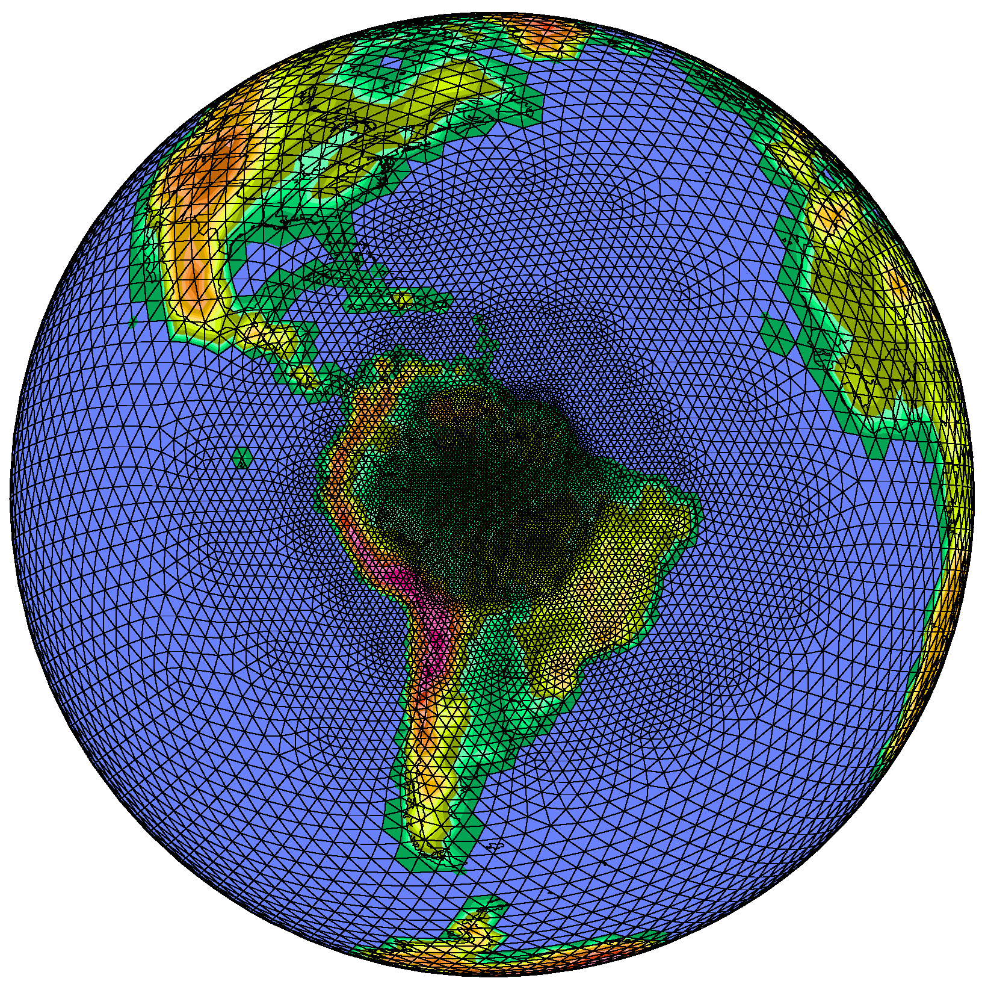
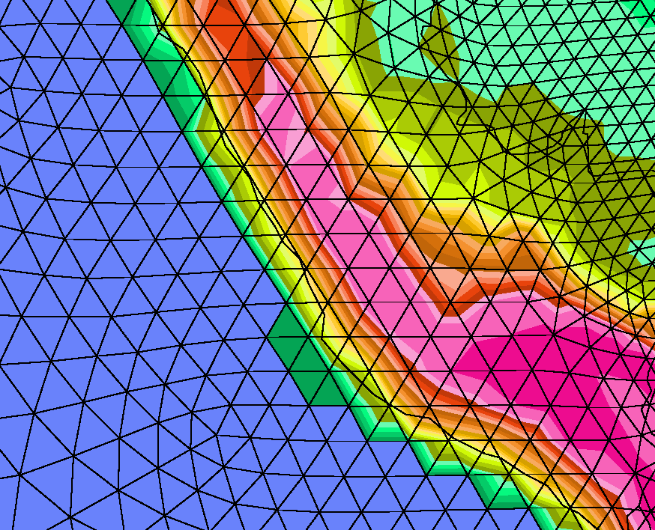
We will rely on next-generation multiresolution models to bridge the gap between global and regional air pollution

Slide 5
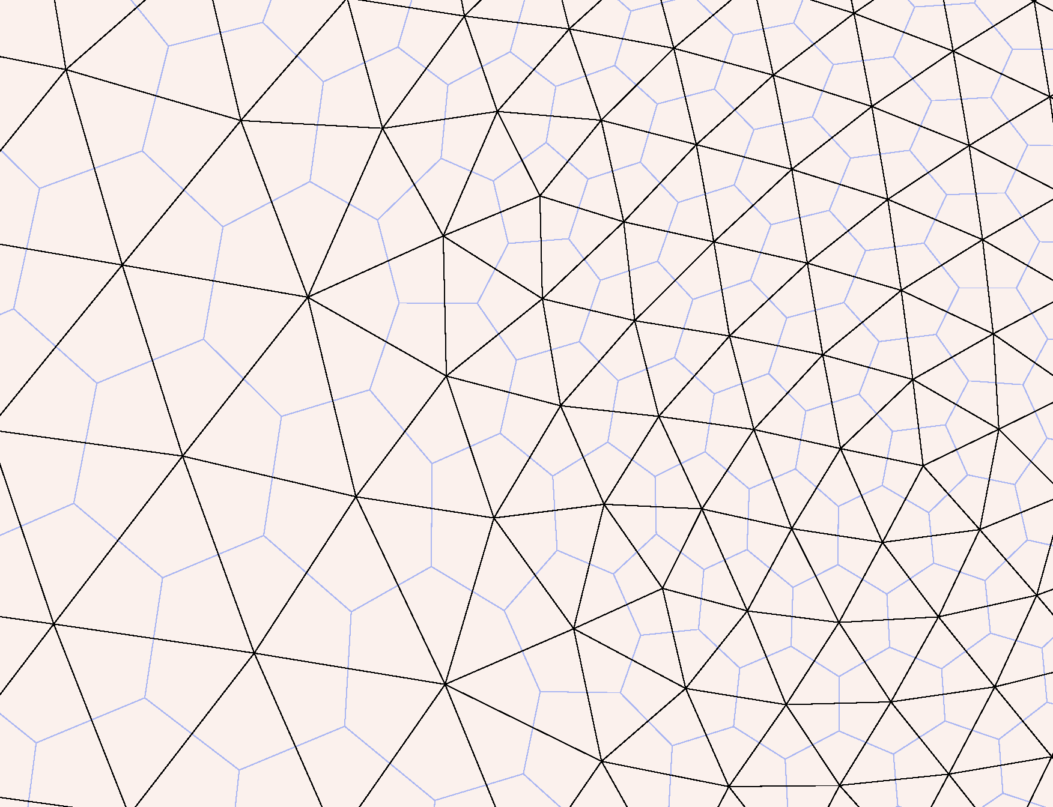
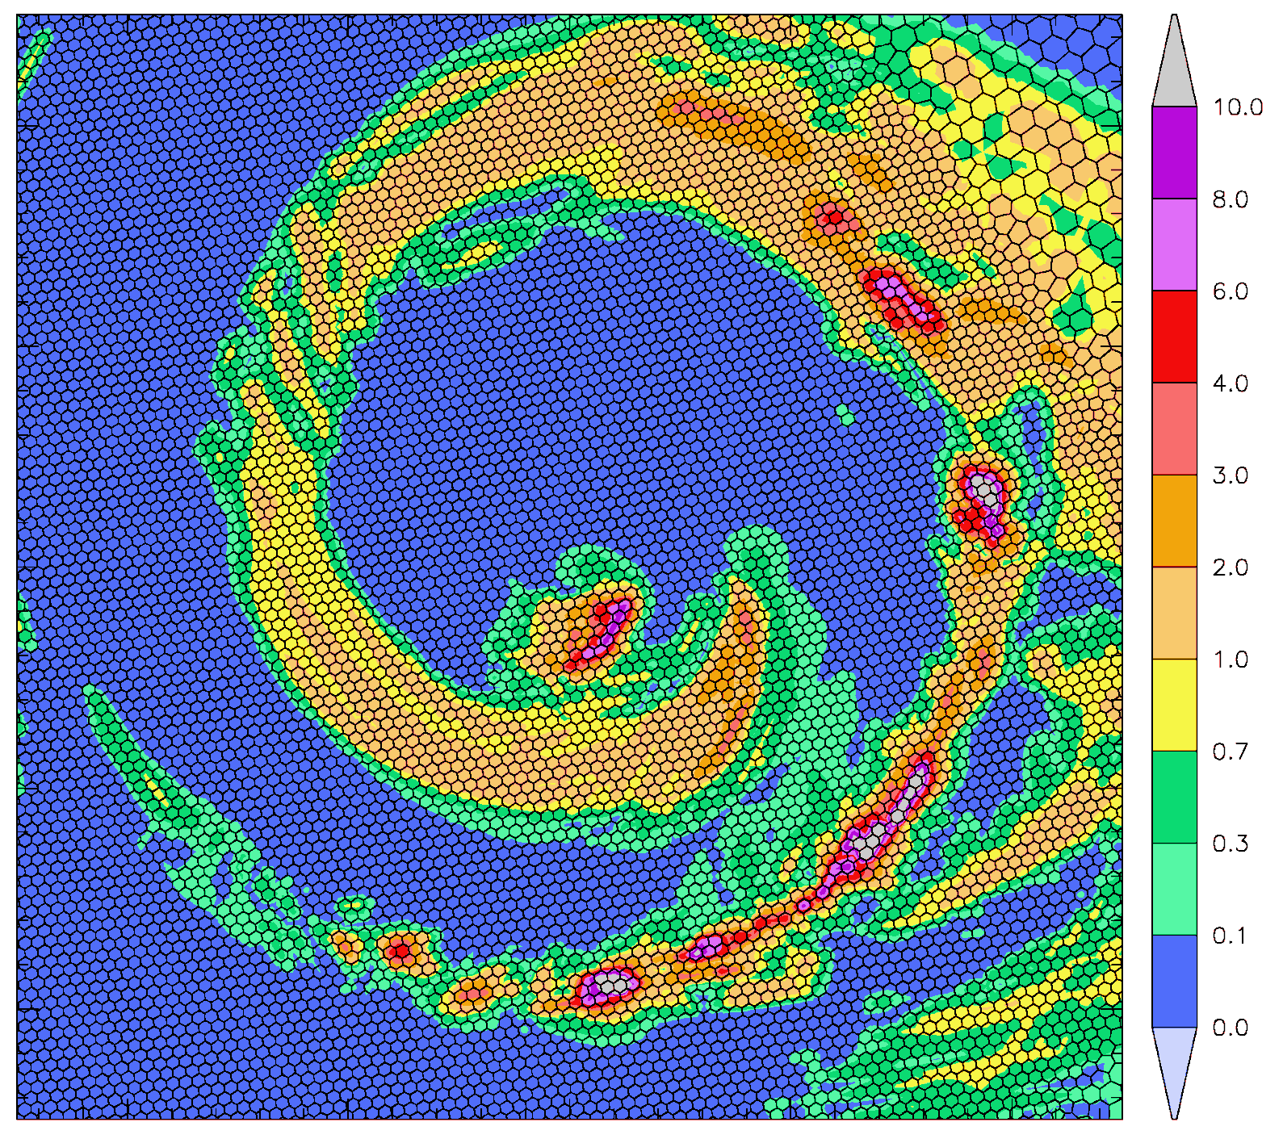
We can rapidly nest down to very high resolution locally

Slide 6
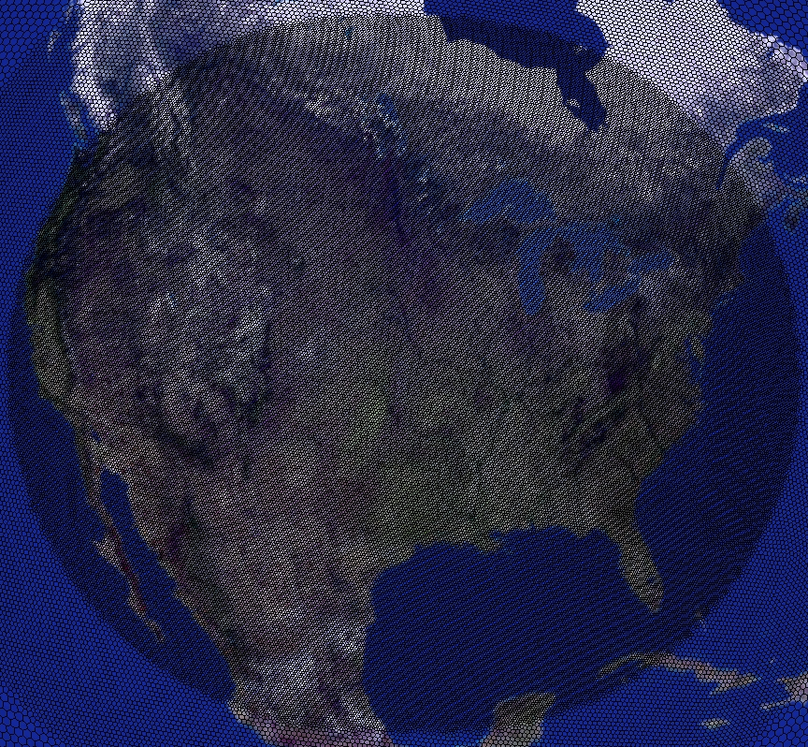
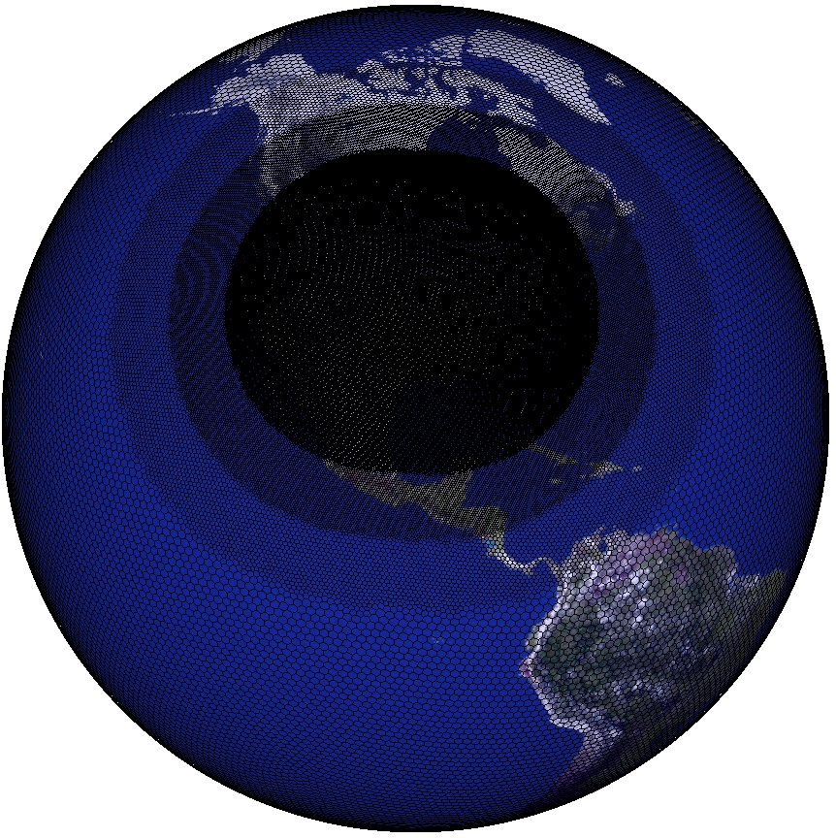
Fully coupled multiresolution simulations with CMAQ
100 km global resolution to 12 km over US
6

Slide 7
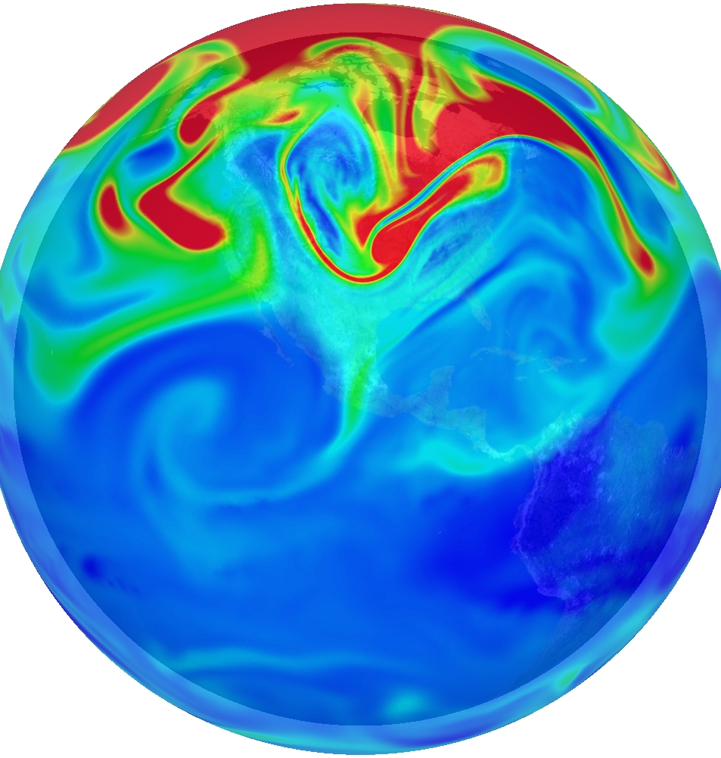
Ozone in Upper Troposphere blue 0 ppmV to red 0.24 ppmV

Slide 8
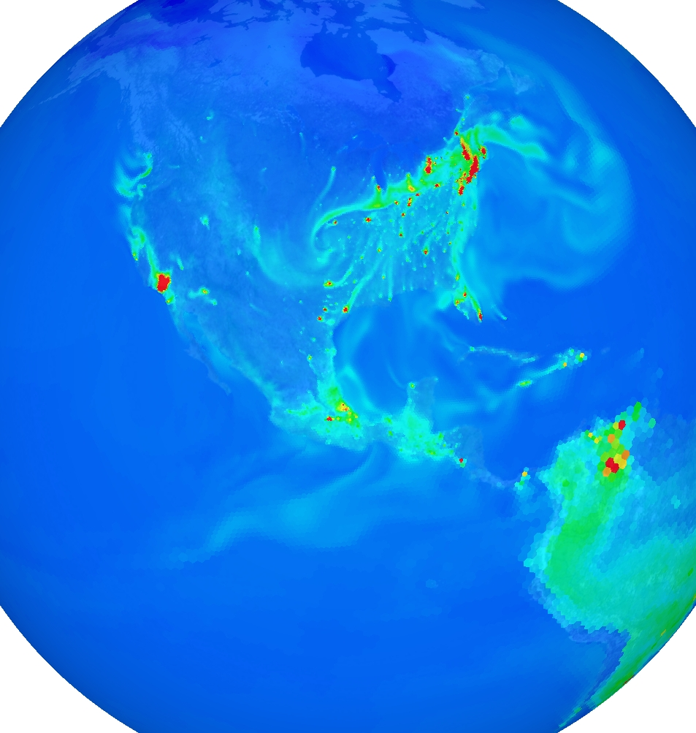
CO at Surface
blue 0 ppmV to red 0.4 ppmV
8

Slide 9
But how do we link with small scale for health and exposure models?
It is not computationally feasible to go from a global grid down to meter scale locally
Even if we could go to meter scale, we would still have the problem that the finer scale variability would be missing
Problems include:
  “grey zone” atmospheric physics
  Need sufficient resolution to represent terrain/land surface/buildings
  Represent the temporal and spatial variability of emissions
  The effective resolution of atmospheric models is 3-5 times the grid size
  We need to represent the turbulent motions responsible for the fine-scale variability
How do we get around these problems? By wisely downscaling!

Slide 10
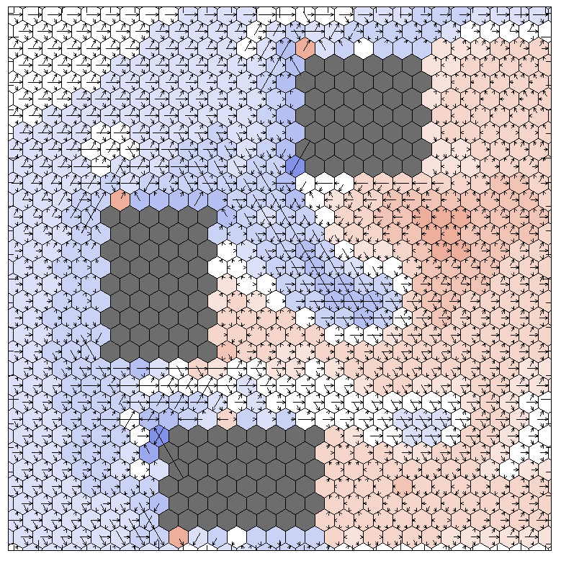
Deterministic Large-Scale CMAQ
Stochastic Small-Scale CMAQ
The large scale run provides the mean conditions and local gradients
The small scale run simulates the emissions variability and the turbulence which generates the fine-scale variability missing in deterministic runs

Slide 11
Stochastic CMAQ details:
Given the large-scale conditions for a particular time (which are held constant), we generate the fine-scale meteorology and chemistry fields
Fine-scale emissions are required though!
As the fine-scale model integrates forward, it generates an ensemble of realizations that represents the variability at each location (time is the ensemble dimension)
By keeping the large scale conditions stationary, we can compute the necessary statistics at each location (variance about the mean, total dosages, time spent above a particular threshold level, etc.)
Downscaling at smaller scales is better justified because the energy transfer at small scales is downscale; at meso and larger scales energy/enstrophy transfer is upscale

Slide 12
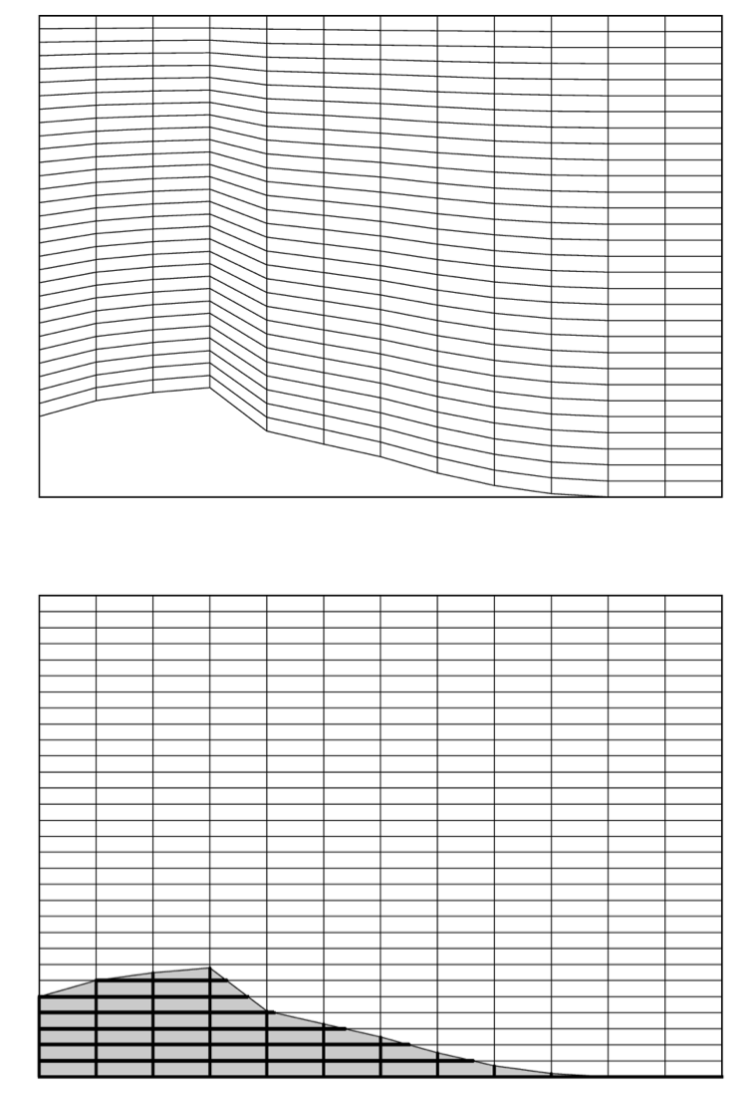
Sigma coordinates are not appropriate high resolution runs
Sigma coordinate representation used
by most atmospheric models
Shaved cell representation used
in the global CMAQ model

Slide 13
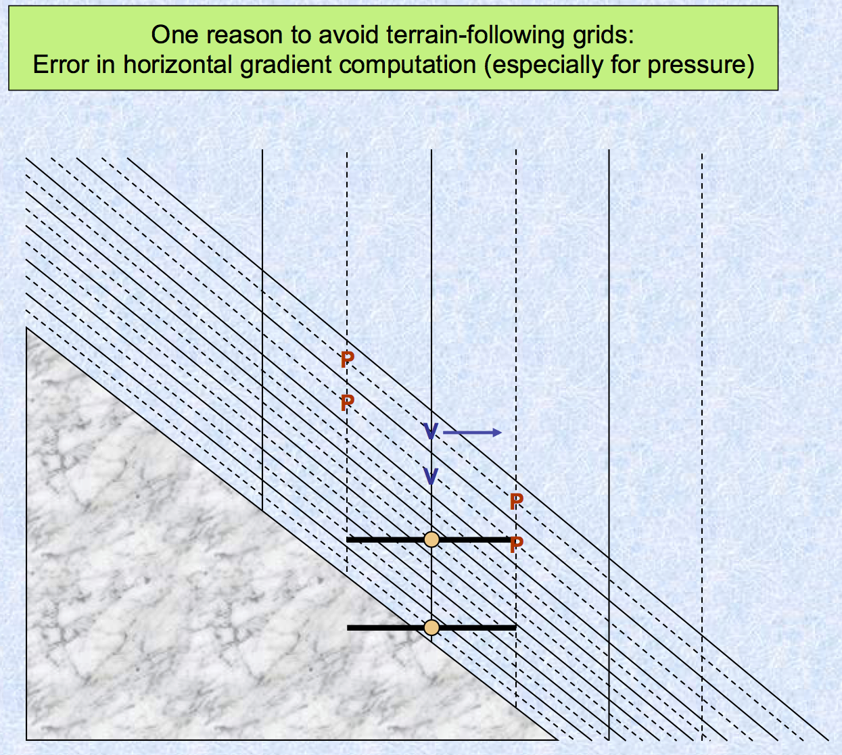

Slide 14
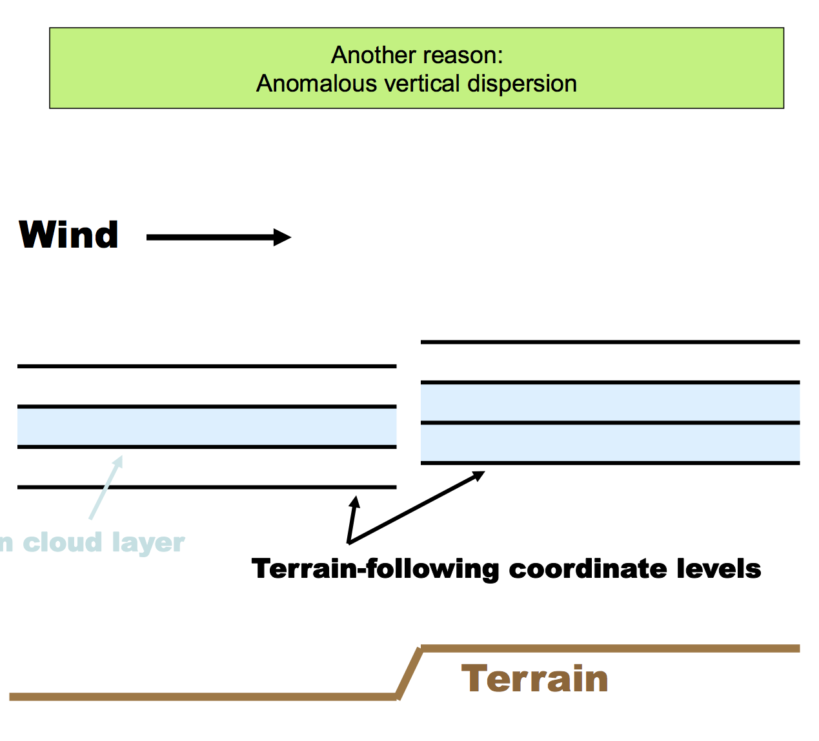

Slide 15
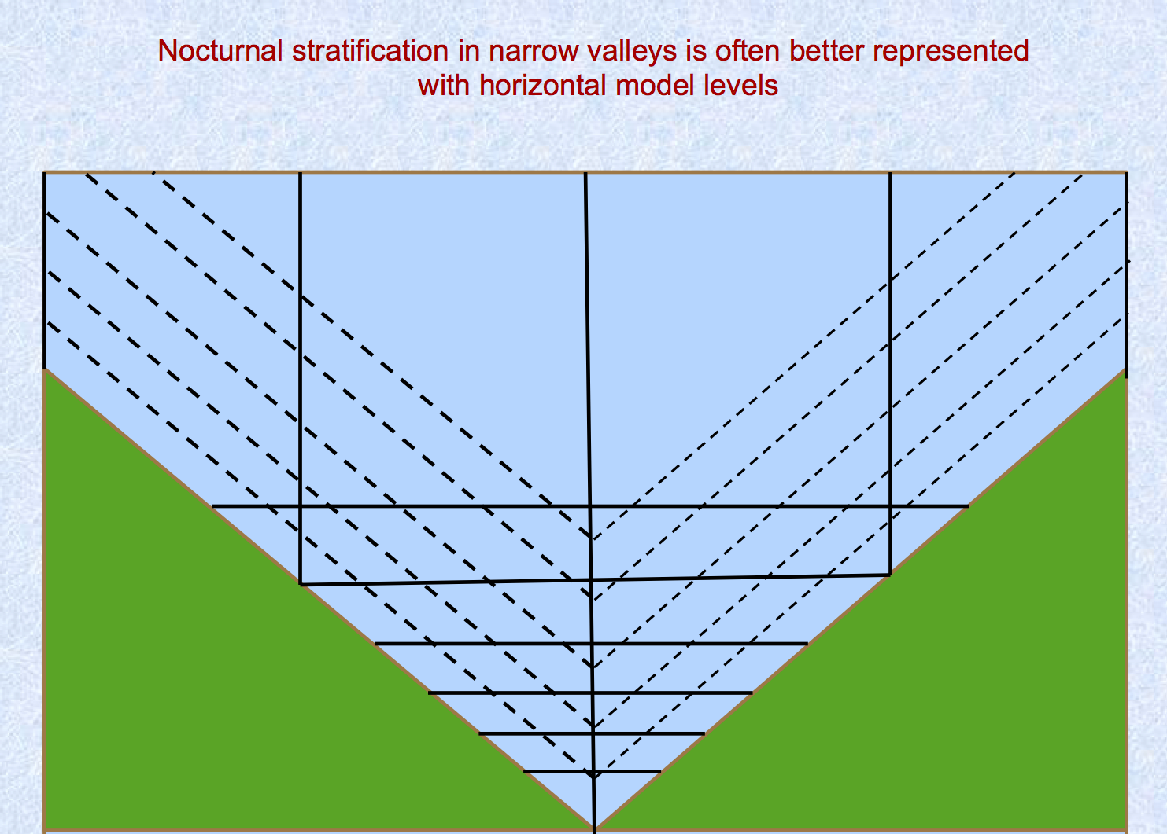

Slide 16
Shaved cell flow over an obstruction:
t10

Slide 17
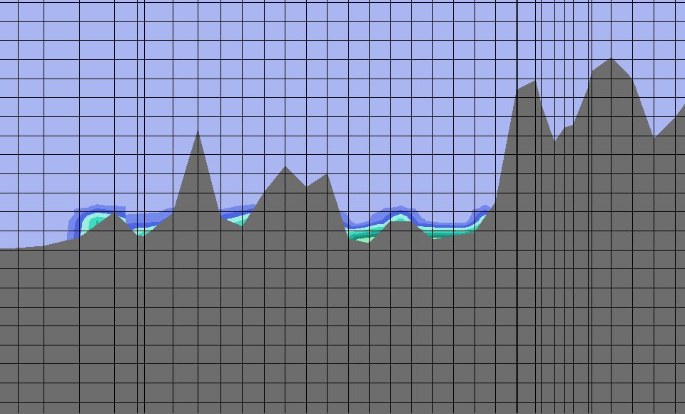
Emitted Tracer in
Wasatch Range near Salt Lake City, UT
Advantages of shaved cells:
  Reduced artificial mixing
  Can represent steep terrain/buildings
Disadvantages:
  Uneven vertical resolution at surface
  Need many vertical levels to have high near-surface resolution at high altitudes

Slide 18
Current / Future Work
Using the physical realism of CMAQ to link with human exposure models would be ideal for air pollution modeling
I am putting together the pieces necessary to accomplish this
Requires a model that does not use sigma coordinates
The model should also behave well for mountain/valley air pollution events

