Slide 1
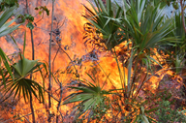



Causes and Consequences of Climate Change: Wildfire Emissions and Their Air Quality Impacts in the Southeastern U.S.
U. Shankar¹,
J. Prestemon², A. Xiu¹, K. Talgo¹, B. H. Baek¹,
M. Omary¹, and
D. Yang¹
¹UNC Institute for the Environment
²USDA Forest Service

Slide 2
Motivation
Land ownership, fuel loads, high fire activity, extensive wildland-urban interface (WUI), rapid forest regrowth and high level of collaboration (among local populations and fire managers) cited as drivers of wild fires in SE US (Source: Southern Fire Exchange)
  42% of significant wildfires, and 52% of national ignitions occurred in the Southeastern U.S. in 2010
Federal managers are mandated to submit ten-year assessment reports under the Forest and Rangeland Renewable Resources Planning Act (RPA) of 1974
  Identify and analyze main drivers of changes in resources: outdoor recreation, fish and wildlife, wilderness, water, range and urban forests
  Provide projections of resource conditions out to 2060
  Climate change likely to have been a major driver of disturbance in wild lands
USFS – UNC Joint Venture Agreement
  Phase 1: estimate annual acres burned (AAB) w/ statistically downscaled climate
  Phase 2: compare dynamical and statistical downscaling approaches
  Phase 3: assess air quality impacts (and feedbacks to climate?)

Slide 3
Fire Activity Projection
Model wildfire with historical county-level data on
  Area burned (Fire Occurrence Database, Rocky Mountain Research Station)
  Meteorological variables
  Land use variables
  Socioeconomic variables
Project county-level AAB with projected met and other inputs
  Same output and predictors
  Predictors from RPA
  Predictors from three PRISM GCMs (Daly et al., 2002) for 3 IPCC scenarios (A2, A1B, B2) each, statistically downscaled to a 12-km AQ modeling grid to project AAB
  Replace statistically downscaled met inputs in selected years with data dynamically downscaled with WRF from the CGCM3 A2 scenario in the NARCCAP to compare effects on AAB
Apply projected AAB to constrain daily fire activity and estimate smoke emissions for input to AQ modeling
Notes:
Remove “simulation” or “modeling” in the last bullet.

Slide 4
Area Burned Models
Models estimated, for 1992-2003, by broad cause and by ecoregion province or their aggregates; validated on 2004-2011 observed fire data.
Ecoregion Provinces | Human Fire Functional Form | Lightning Fire Functional Form
221 | Heckman 3-Stage | Heckman 2-Stage
222 | Heckman 3-Stage | Heckman 3-Stage
231 | Heckman 3-Stage | Heckman 3-Stage
232+234+411 | Heckman 3-Stage | Heckman 3-Stage
All Others | Heckman 2-Stage | Heckman 2-Stage
Model structures based on original work by Mercer and Prestemon (2005) and several other related papers.
Mercer, D.E., and J. P. Prestemon, 2005: Comparing production function models for wildfire risk analysis in the wildland–urban interface, Forest Policy and Economics, 7, 782-795.

Slide 5
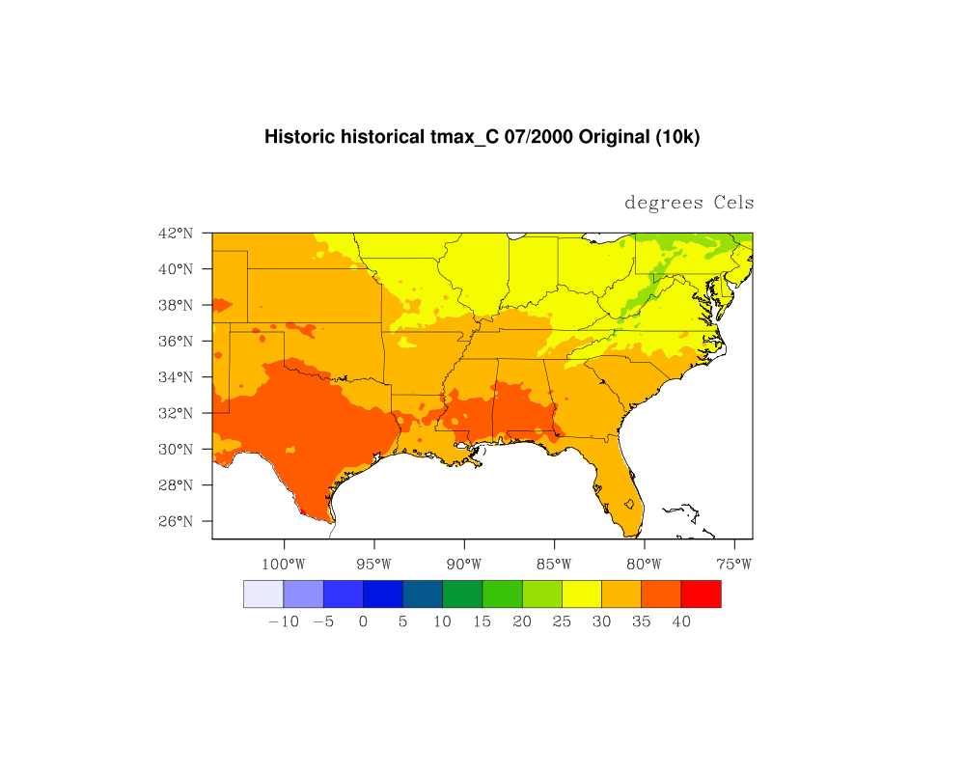
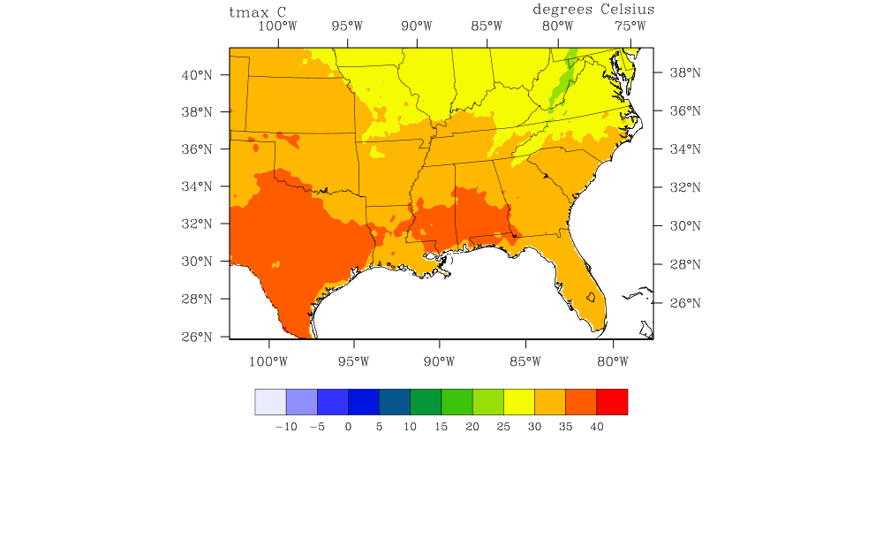
Climate Data Extraction
UNC subsetted data statistically downscaled from the ensemble of GCMs and scenarios, and remapped the data at 5’ resolution (lat-lon) on a Lambert Conformal Conic map projection grid at 12-km resolution to derive AAB “statistical” estimates for the model domain.
Lat/Lon
Lambert
July 2000 Average T_{max}
Replaced data for 2010, 2043, 2048, 2053 and 2058 with WRF output to derive AAB “dynamical” estimates
Notes:
PRISM =Parameter-elevation Regressions on Independent Slopes Model (PRISM) climate mapping system (Daly et al., 2002)

Slide 6
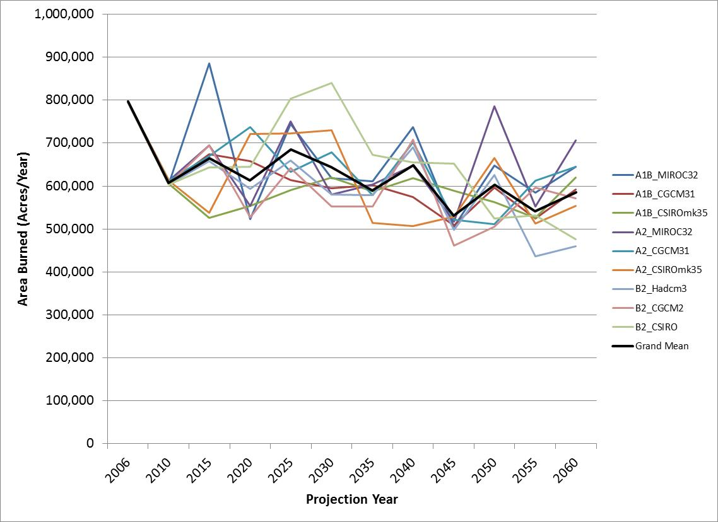
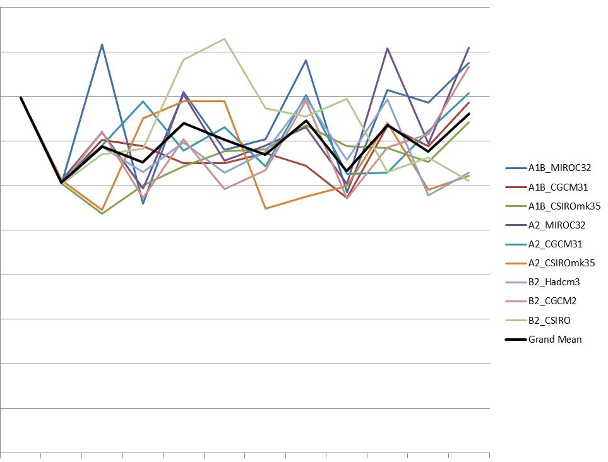
Southwide Annual Acres Burned: Human-caused
Includes Land Use, Income,
and Population Changes
No Land Use, Income,
or Population Changes
  All stages: Precip., PET, max avg daily temperature highly significant
Later stages: Forest area, population and economic growth are very significant
Notes:
Wanted to see the effects of met variable changes alone; when socioeconomics varied, negative trend was seen.

Slide 7
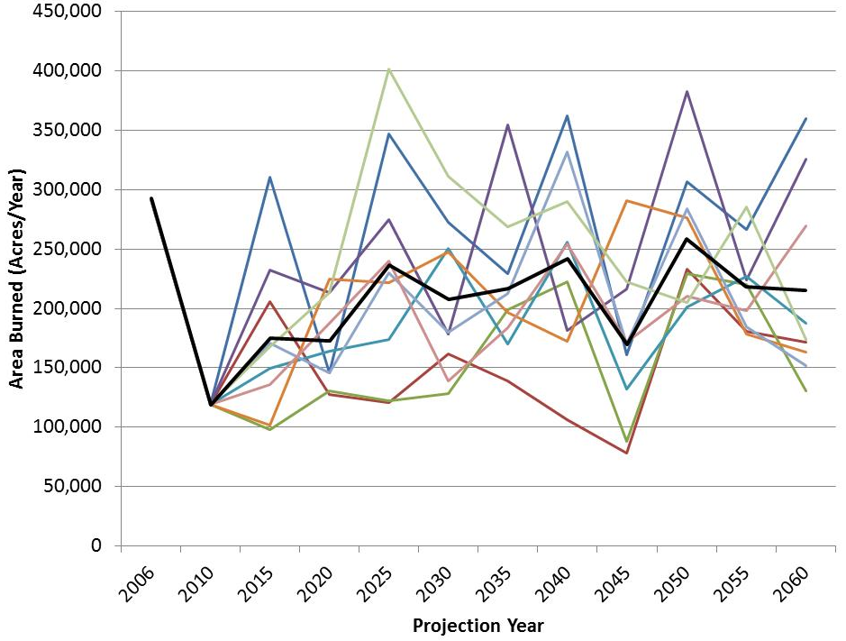
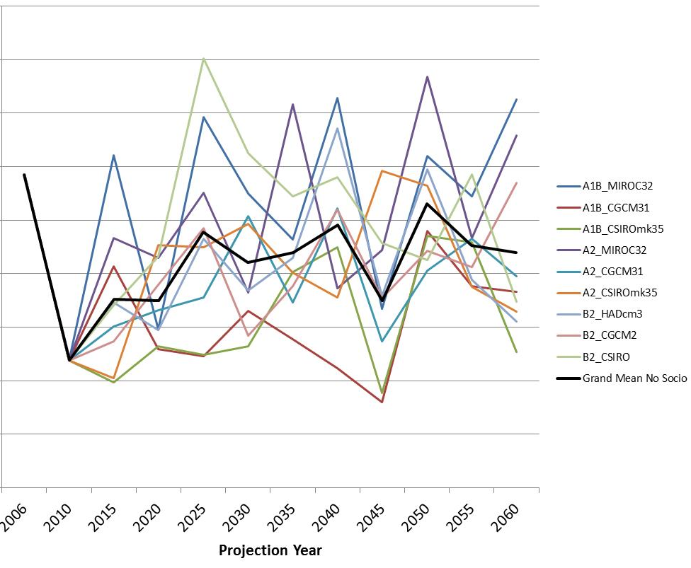
Southwide Annual Acres Burned: Lightning-caused
Including Land Use, Income,
and Population Changes
No Land Use, Income,
or Population Changes
  All stages: Precip., PET, max avg daily temperature highly significant
Later stages: Land area is significant but population and economic growth are rarely significant
Notes:
A1B MIROC shows high peak in 2040; general upward trend consistent with increasing temps and decreasing precip

Slide 8
Daily Acre Burned Estimates:
Fire Scenario Builder
FSB: a stochastic model that estimates daily gridded areas burned needed to calculate daily fire emissions in the fuel consumption model, e.g., CONSUME
  Assumes one fire per grid cell in a given fire season
  Percentile of acres burned on a given day in fire season assumed to match that of the Fire Weather Index on that day
Downscaled met
Designate Bailey ecoprovinces to grid
Gridded AAB
estimates 2010-2060
CFFDRS
Fire season start/end (gridded)
Construct AAB
percentile dist.
(Neg exp +
truncated Pareto)
(Precip ≤ 5mm)
Gridded FWI
percentile
distributions
Select random day
Get AAB with matching percentile
Get FWI percentile
= acres burned on selected day
McKenzie, D., S. M O’Neill, N. K. Larkin, and R. A. Norheim, 2006: Integrating models to predict regional haze from wildland fire, Ecological Modelling, 199, 278-288.
Notes:
May be useful to say that this WRF version has known high bias in precip, and we are examining the effects of an update in the cumulus parametrization (based on Kain – Fritsch, and considering the radiative feebacks of sub-grid clouds) recently available in WRF

Slide 9
AQ Model Simulations
Daily acres burned are used as inputs to the BlueSky smoke emissions model; output is merged with emissions from other sectors to run CMAQ over the Southeastern U.S.
  cb05_tuclae6aq
  BC’s for 2010 extracted from an existing 36-km CONUS simulation for a separate project (source: Dr. S. Arunachalam); used in all years
  2-week spin-up time for base case simulation; sensitivities are initialized from output of base case from previous day
  AQ simulations have been completed for 3 of 5 selected years (2010, 2043, 2058); analysis ongoing for 2043
  2048 and 2053 emissions modeling underway
Compared emissions and AQ impacts of dynamically and statistically estimated AAB vs. base case (NEI fires) for 2010, and current vs. future year AQ
Results are preliminary
Notes:
May be useful to say that this WRF version has known high bias in precip, and we are examining the effects of an update in the cumulus parametrization (based on Kain – Fritsch, and considering the radiative feebacks of sub-grid clouds) recently available in WRF

Slide 10
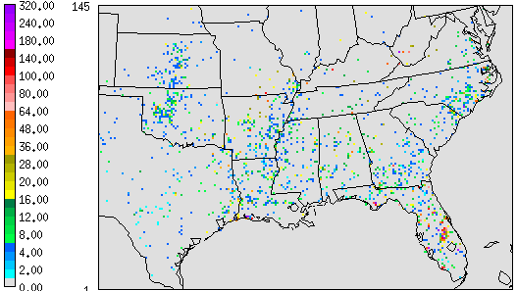
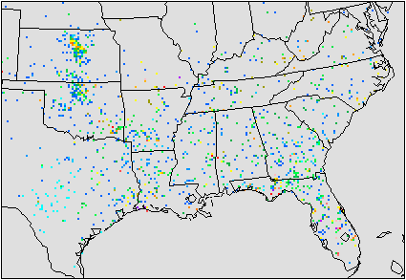
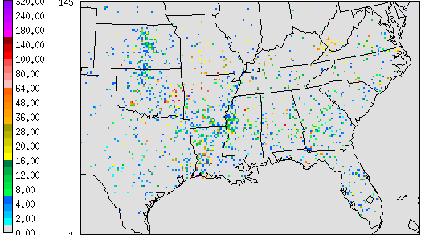
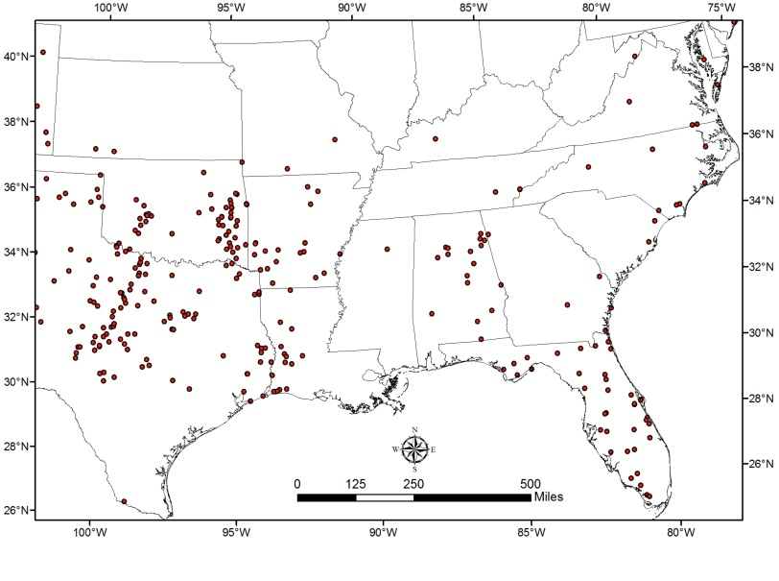
2010 Summer Fire Emissions (NEI Benchmark)
June
July
August
Actual summer fires > 50 acres

Slide 11
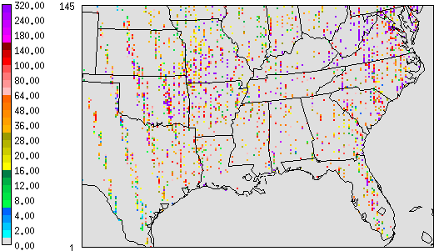
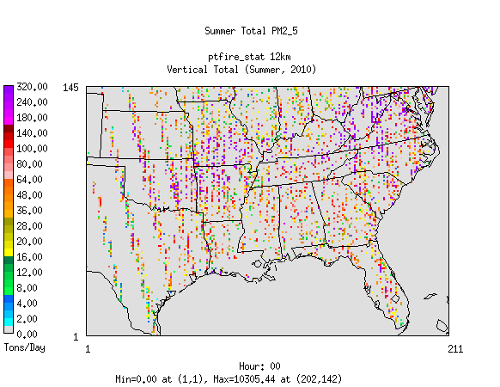
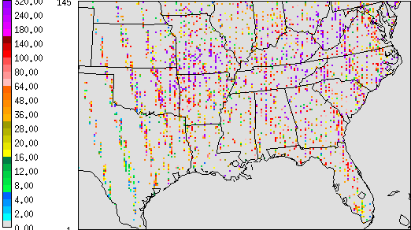
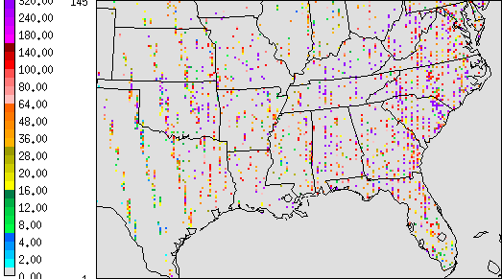
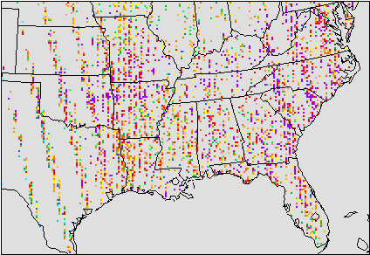
Summer Fire Emissions (This Work)
2010
2043
2058
Dynamic
Statistical

Slide 12
2010 Summer PM_{2.5} Performance
Base
Dynamic
Statistical

Slide 13
2010 Summer EC Performance
Base
Dynamic
Statistical

Slide 14
2010 Summer OC Performance
Base
Dynamic
Statistical

Slide 15
2010 Summer 8-hr O₃ Performance
Base
Dynamic
Statistical

Slide 16
2010 Summer Air Quality:
CMAQ PM_{2.5} Composition vs. IMPROVE
IMPROVE
Base
Dynamical
Statistical

Slide 17
CMAQ PM_{2.5} Composition 2010 vs. 2058
Dynamical
Statistical
2010
2058
2010
2058

Slide 18
Conclusions and Future Work
Human role is critical in Southeastern wildfires
Preliminary finding: AAB spatial distributions appear lower for dynamically derived vs. statistically derived met in future climate regimes – possible effect of precip?
AQ results similar for 2010 from the two methods; slightly better PM performance from the dynamical method vs. statistical
  Higher PM and O₃ than the NEI benchmark; needs investigation
This project provides methods and data for
  dynamic fire emissions estimates to examine fires in future climate regimes
  supporting ongoing work funded by the Bureau of Land Management under its Joint Fire Sciences Program
    considers effects of dynamic vegetation -> fuel loads change 2006-2050
    12-member ensemble of WRF model simulations: current and future modeling periods, high and low fire years, RCP4.5 and RCP8.5 scenarios in future years
Notes:
May be useful to say that this WRF version has known high bias in precip, and we are examining the effects of an update in the cumulus parametrization (based on Kain – Fritsch, and considering the radiative feebacks of sub-grid clouds) recently available in WRF

Slide 19
Acknowledgments
USFS for funding and collaboration
RPA partners: Dave Wear (land use), Linda Joyce (PRISM data), Karen Short (historical FOD) and Greg Dillon for his timely help with 2010 FOD data and plots
Don McKenzie at the PNW Research Station for his guidance on FSB and all things fire
Notes:
May be useful to say that this WRF version has known high bias in precip, and we are examining the effects of an update in the cumulus parametrization (based on Kain – Fritsch, and considering the radiative feebacks of sub-grid clouds) recently available in WRF

Slide 20
Questions
Uma Shankar:
ushankar@unc.edu, 919-966-2102
Jeff Prestemon:
jprestemon@fs.fed.us, 919-549-4033

Slide 21
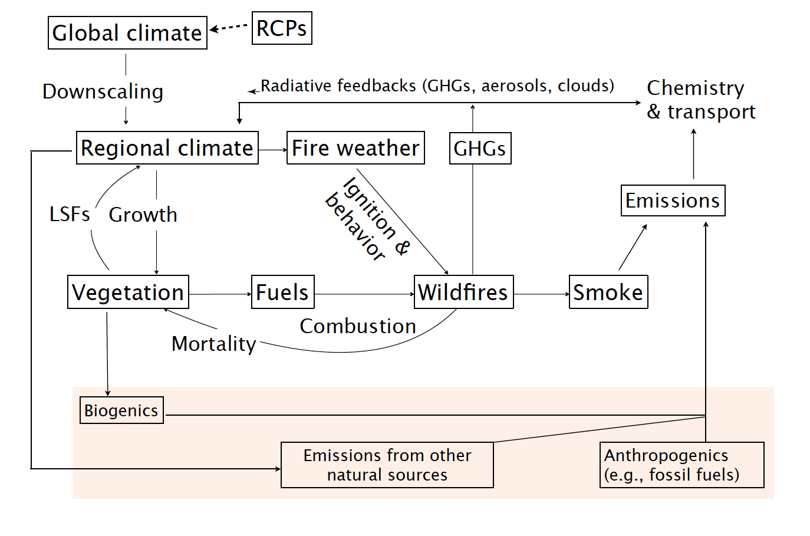
Idealized System of Regional Modeling Components
RCP – Representative Concentration Pathway LSF – Land-surface feedback
GHG – Greenhouse gas
Notes:
Use for background at the end for questions. Emphasize the need for a ONE-ATMOSPHERE system.

Slide 23
Findings to date
Wildfire area burned may be drifting down over time
  Human role is critical
  Trends differ geographically
    TX and FL and maybe OK: higher
    Elsewhere: lower
Precipitation and temperature changes are important
  Precipitation is projected to increase in many places and under certain scenarios
Heckman 3-stage models were needed in most cases
  Validity of wildfire data is related to variables correlated with area burned
  The WRF version used in these projections for selected years (2041, 2043, 2048, 2053, 2058) has a high precip bias
Models also depend on stable connections between area burned and societal variables and land use
Notes:
May be useful to say that this WRF version has known high bias in precip, and we are examining the effects of an update in the cumulus parametrization (based on Kain – Fritsch, and considering the radiative feebacks of sub-grid clouds) recently available in WRF

Slide 24
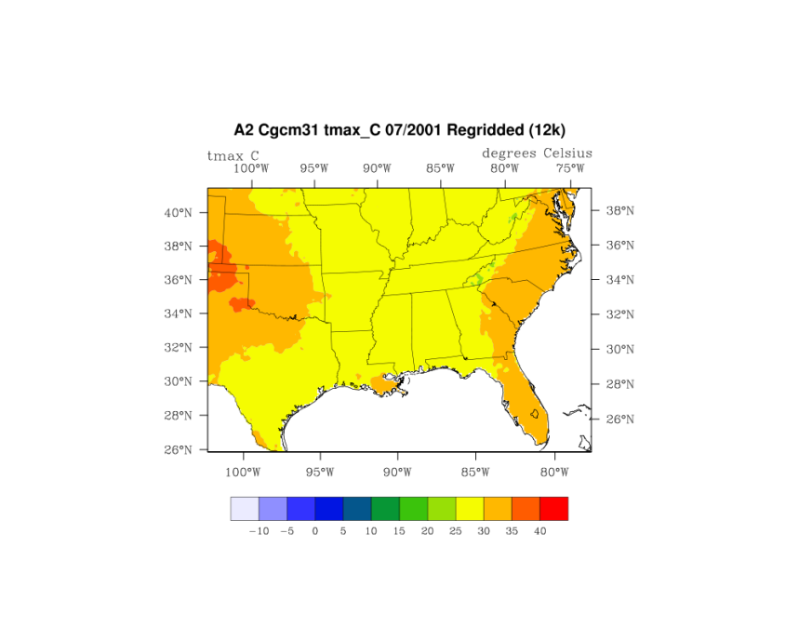
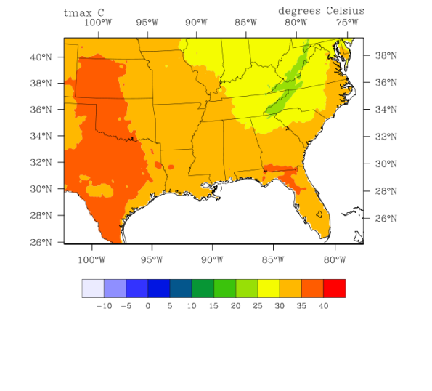
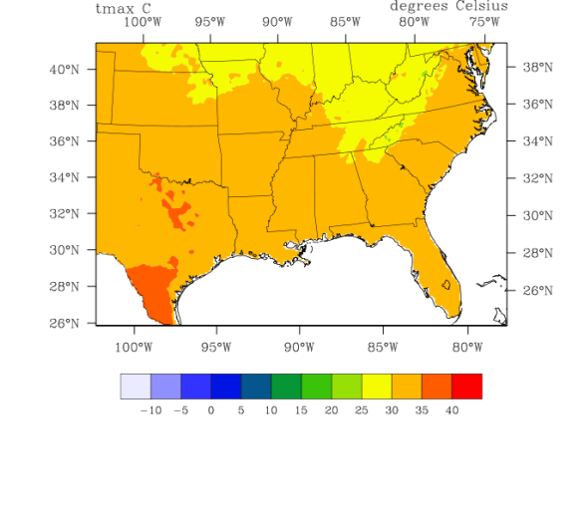
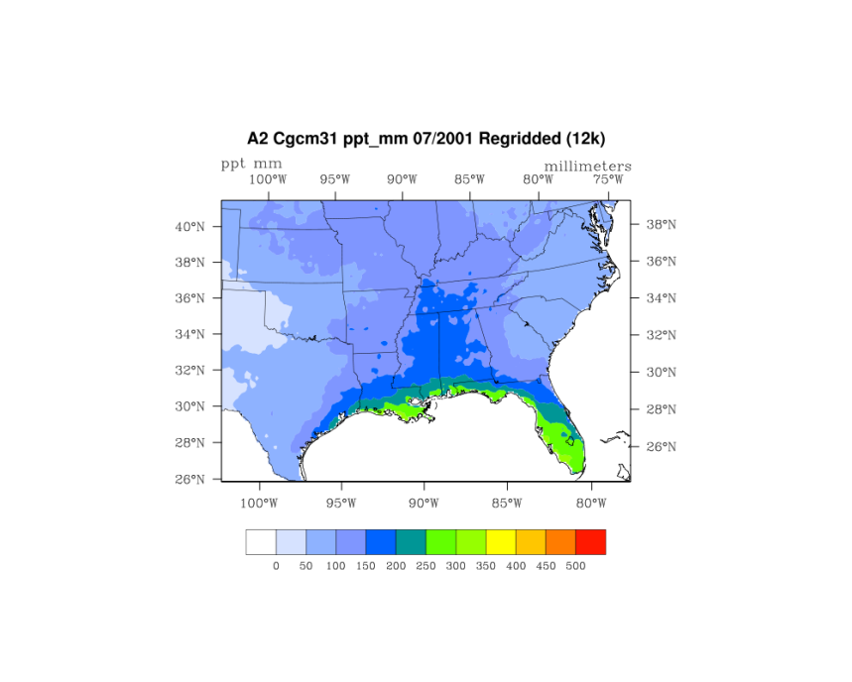
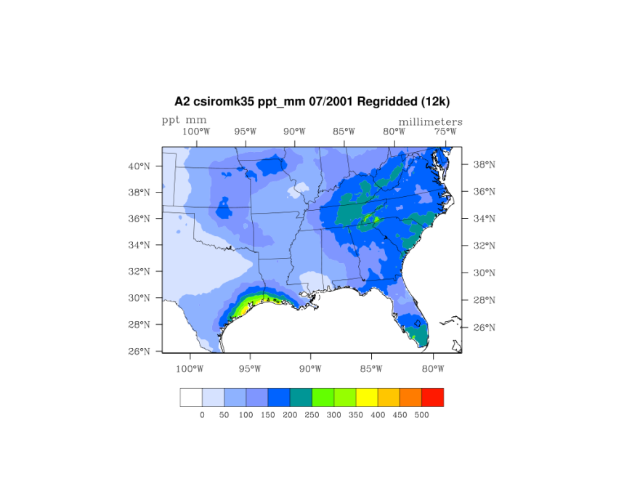
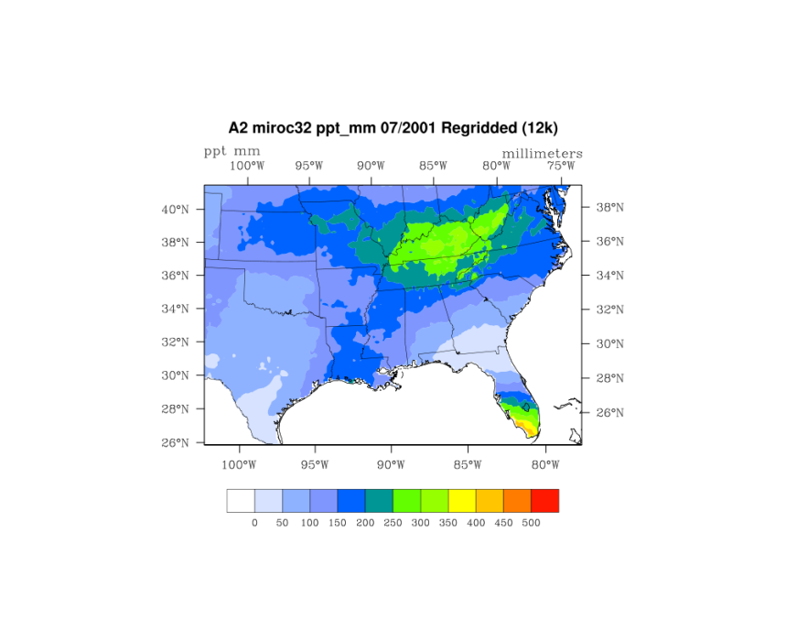
GCM Comparison - A2 - Jul 2001
CGCM
CSIRO
MIROC
Max
Temp
Precip
Notes:
CGCM = Coupled General Circulation Model (CANADA)
CSIRO = Commonwealth Scientific and Industrial Research Organization model (AUSTRALIA)
MIROC = Model for Interdisciplinary Research on Climate (developed by CCSR = Center for Climate System Research, Tokyo, JAPAN)

Slide 25
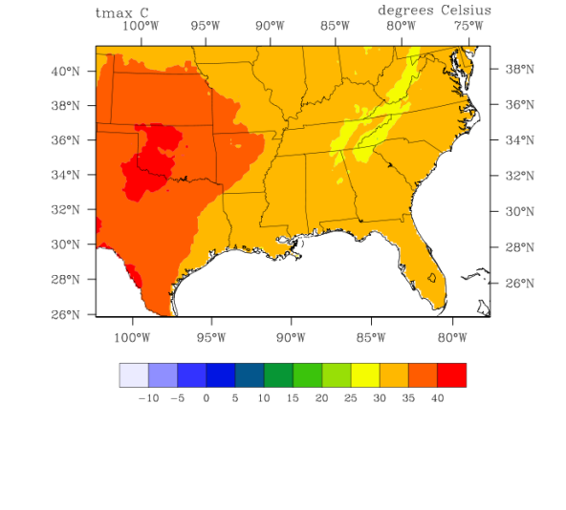
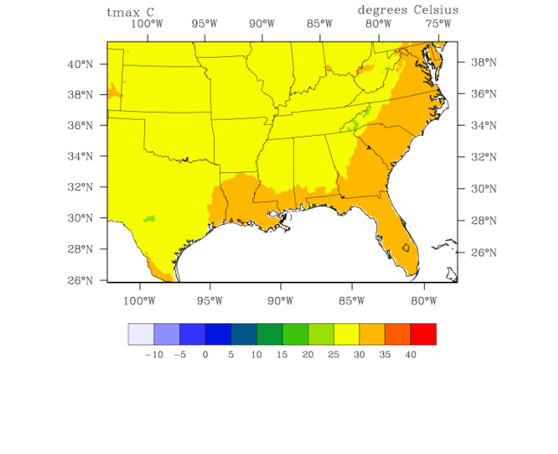
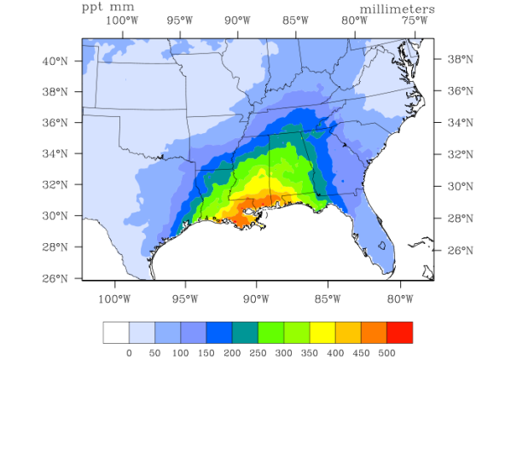
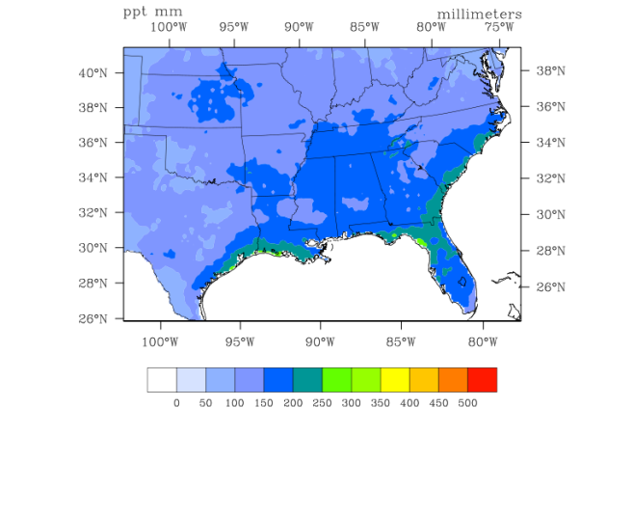
Scenario Comparison – CGCM - Jul 2001
B2
A1B
A2
Max
Temp
Precip

Slide 26
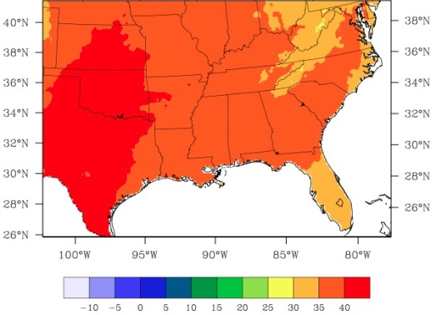
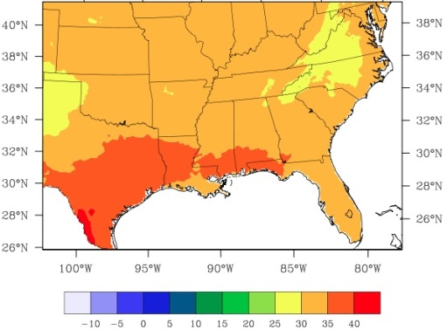
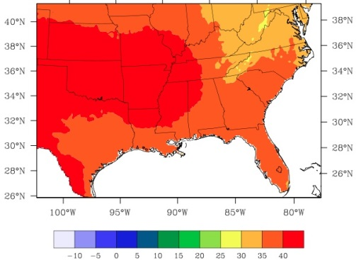
T_{max} Projections July 2001 vs. 2061
Scenario A2*
CGCM
CSIRO
MIROC
July 2001
July 2061
* Only scenario available in NARCAAP for the dynamical downscaling
Notes:
CGCM shows the greatest change in Tmax over time, while MIROC shows highest values as a domain average

Slide 27
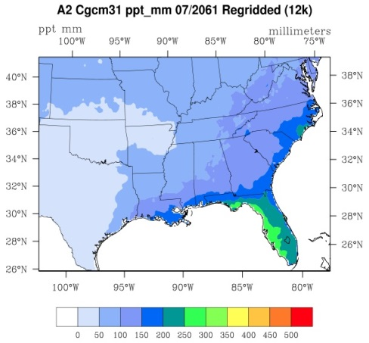
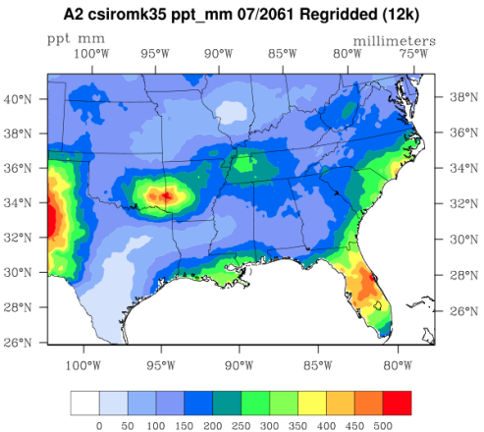
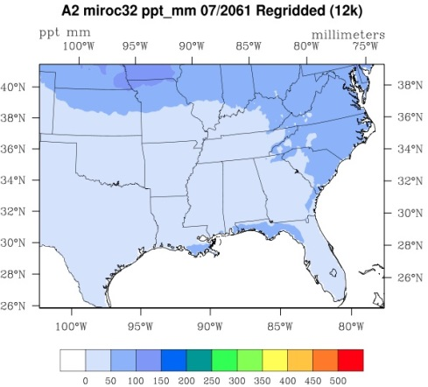
Precip Projections July 2001 vs. 2061 Scenario A2
CGCM
CSIRO
MIROC
July 2001
July 2061
Notes:
Greatest domain-average drying out seen in the MIROC

Slide 28
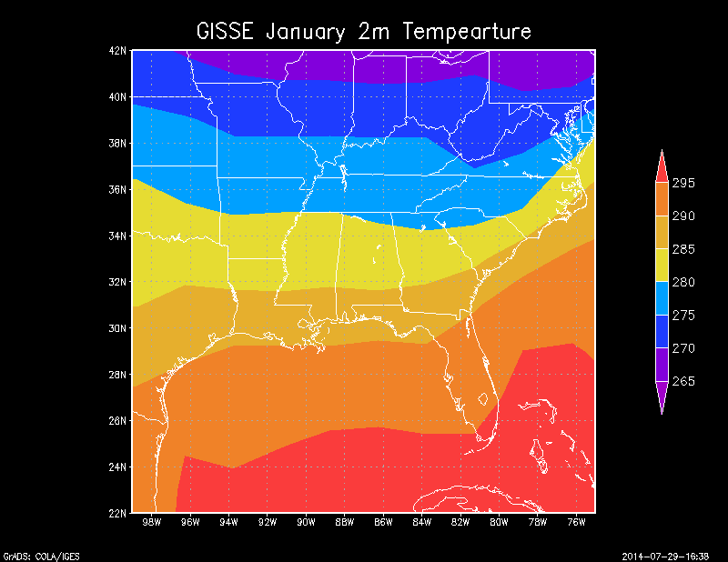
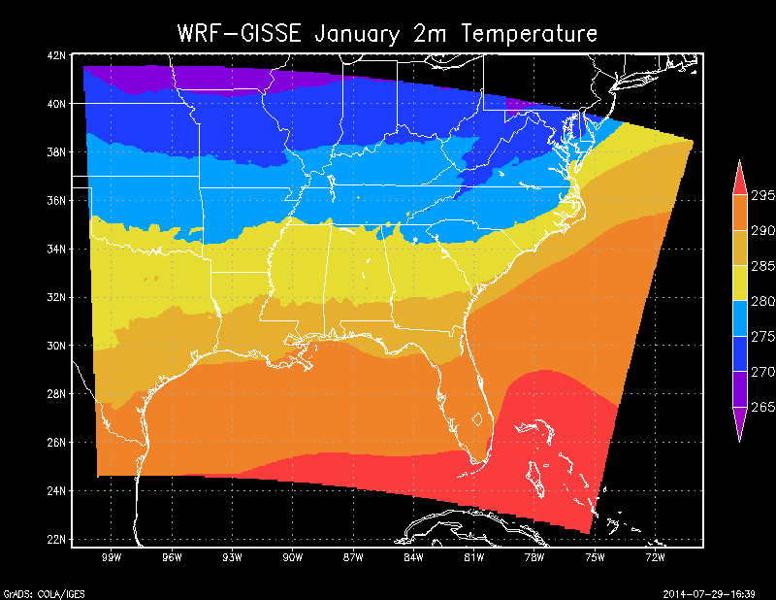
WRF vs. Global Model for SE US
2-m Temperature
Notes:
May be useful to say that this WRF version has known high bias in precip, and we are examining the effects of an update in the cumulus parametrization (based on Kain – Fritsch, and considering the radiative feebacks of sub-grid clouds) recently available in WRF

Slide 29
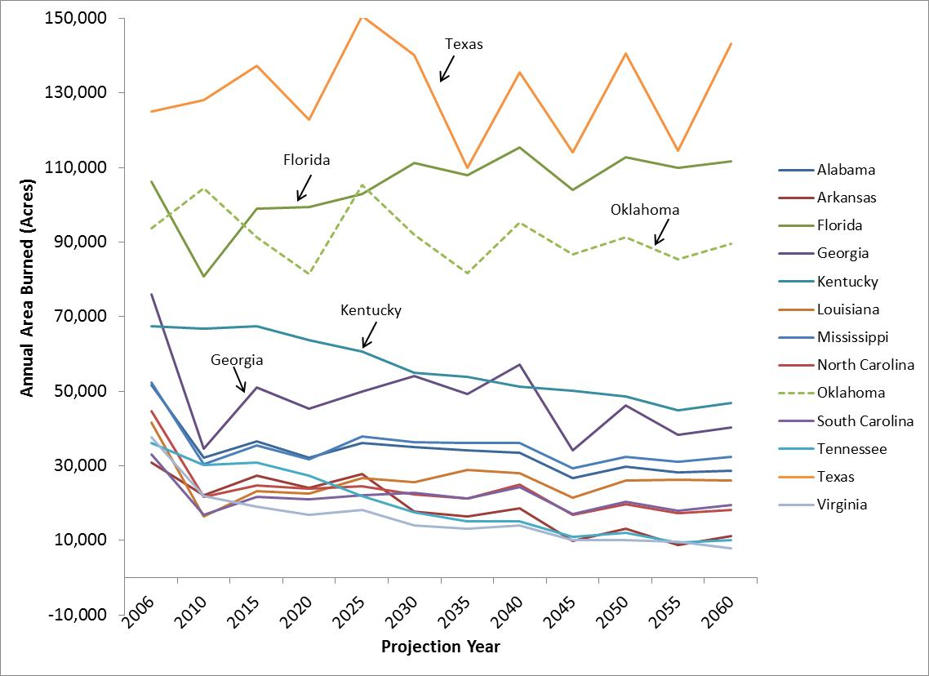
Human Fire Grand Mean By State

Slide 30
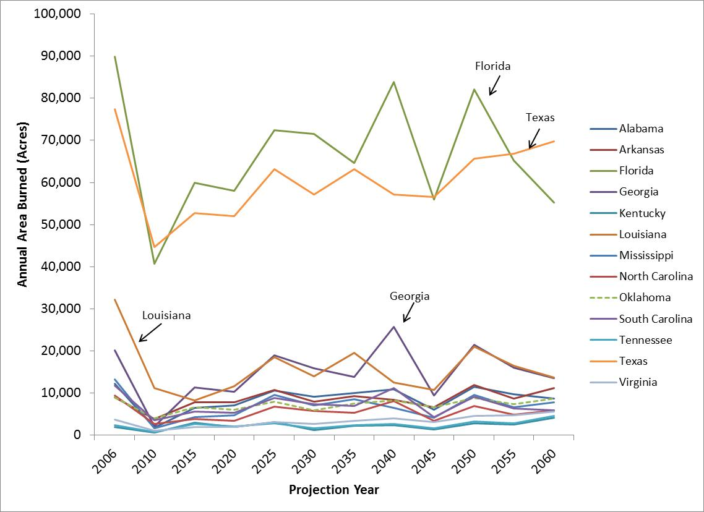
Lightning Fire Grand Mean By State

Slide 31
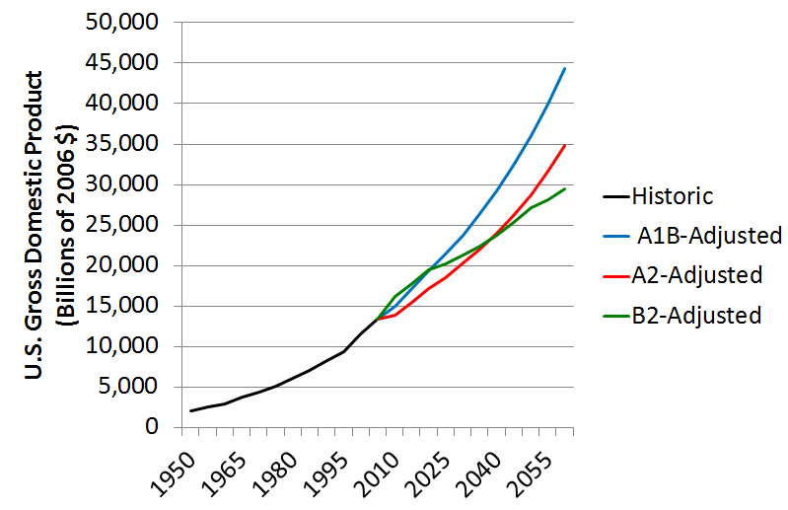
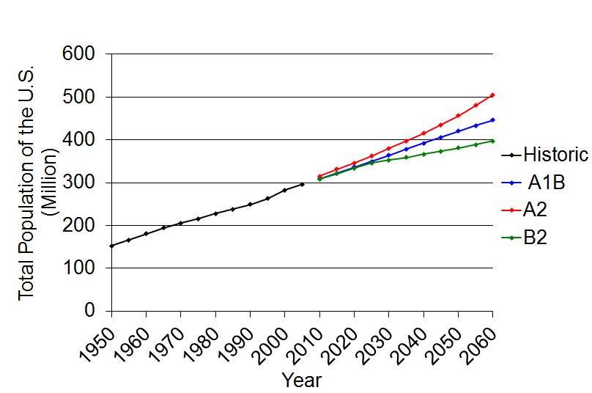
U.S. Economic Output and Population Growth by Scenario
A1B: high economic growth, moderate population growth
A2: moderate economic growth, high population growth
B2: moderate economic growth, low population growth

